Slide 1


The University of Chicago
Crescat scientia; vita excolatur
“Let knowledge grow
from more to more, and
so be human life enriched”
Challenges and Opportunities in Biomedical Imaging
Creating & Growing New Knowledge in
Biomedical Imaging
And So Be Human Life Enriched
Chin-Tu Chen, PhD, Chien-Min Kao, PhD, Heejong Kim, PhD, and UC/FNAL/ANL & Other Colleagues
Workshop on MCP Based Detectors, Argonne, IL, USA, 12/3/2014

Slide 2
EOS Imaging
www.eos-imaging.com
Booth: South - Hall A: 3171
EOS was developed from a NobelPrize-winning technology by a teamof engineers, orthopedic surgeons and radiologists as a complete ultra low dose orthopedic imaging solution. EOS allows full-body imaging of patients at a dose reduction up to 90% compared to CR systems. It enables global assessment of balance and posture as well as a 3D modeling image in a weight-bearing position, and provides automatically over 100 clinical parameters to the orthopedic surgeon for pre- and post-operative surgical planning. EOS is a total solution inorthopedic imaging available in theU.S. since receiving FDA 510(k)clearance.
“Georges Charpak’s Company” - Low Dose X-ray
Notes:
2

Slide 3
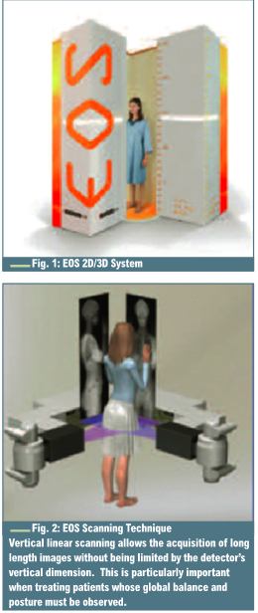

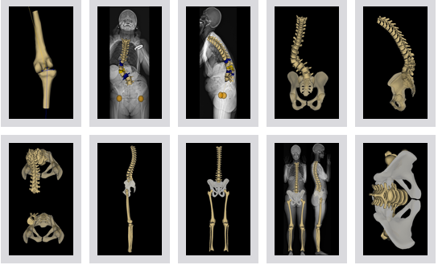
G Charpak’s Company - Low Dose X-ray
Biospace Radiologie
Gas Chambers
Majewski
TIPP2014
Notes:
3

Slide 4
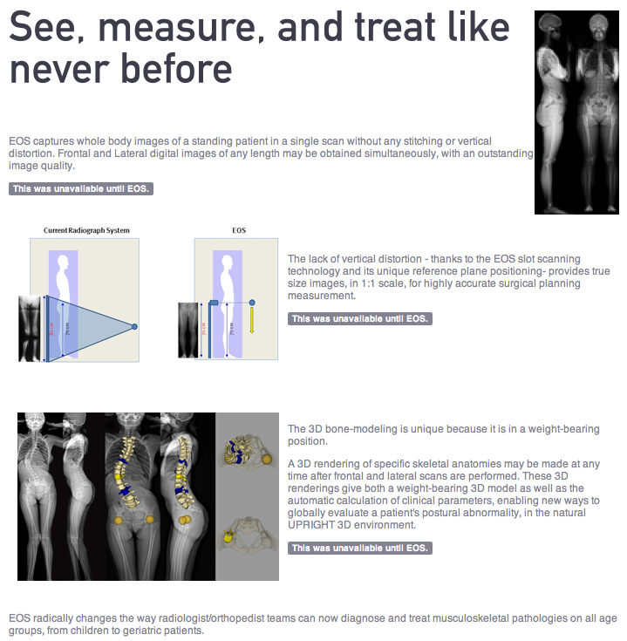
Biospace Radiologie
(EOS)
10 X Lower Dose X-ray
Special Focus:
From Pediatrics
To
Geriatrics
Majewski
TIPP2014
Notes:
4

Slide 5
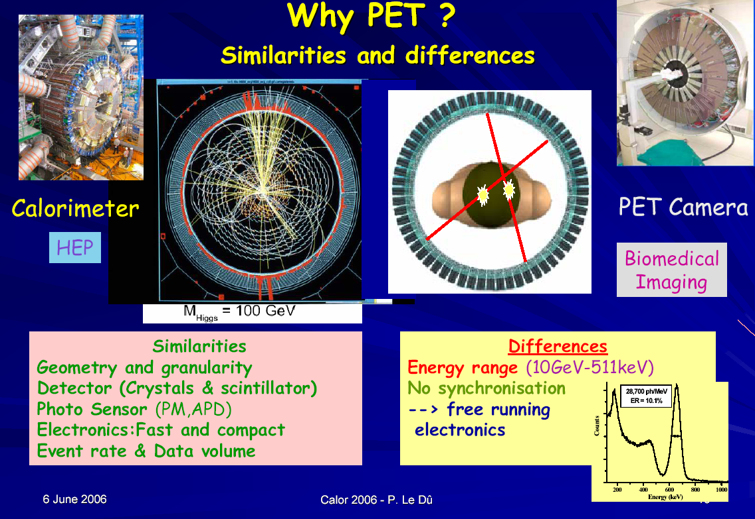

Slide 6
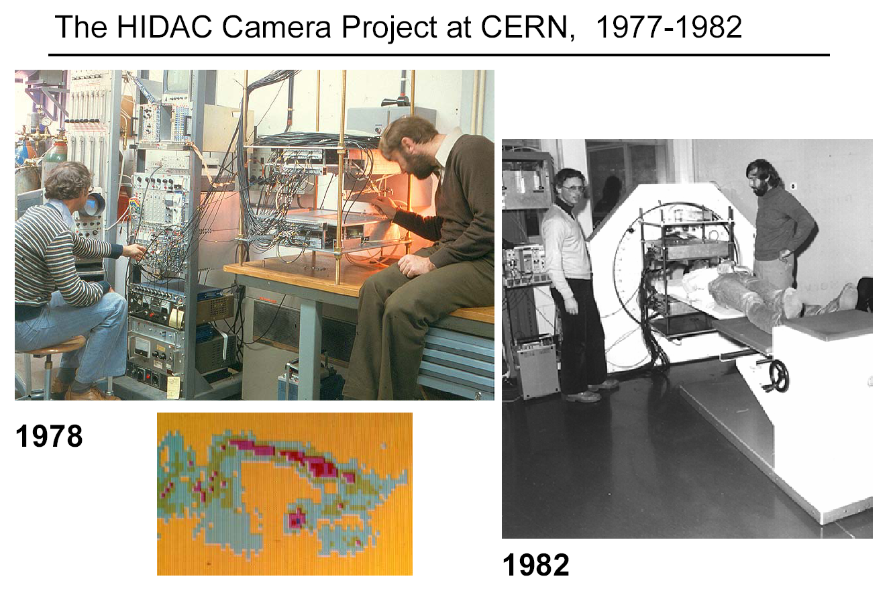
Spin-off from particle physics
Majewski
TIPP2014
David Townsed was affiliated with Georges

Slide 7
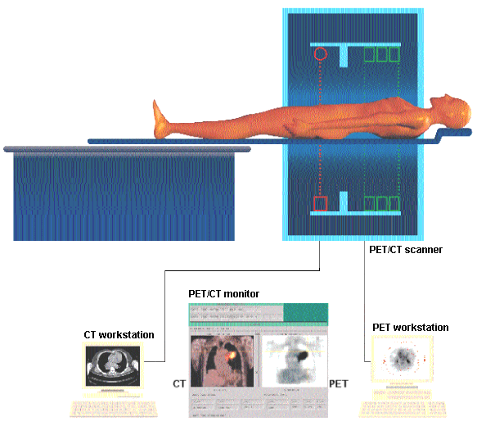
Dual-Modality PET/CT Imaging
PET/CT Dual Modality Imaging
Future “Total-Body” PET Imaging
EXPLORER
> $10M
Townsend et al,
J Nucl Med
45 (2004) 4S–14S
Majewski
TIPP2014
Notes:
L’une des principales préoccupations avec les systèmes TEP/TDM est la durée totale de la séance d’imagerie pour un scan pancorporel.
Un protocole typique pour une étude oncologique comprend:
6 positions du lit ~ 75 cm (commençant sous les yeux jusqu’au pelvis)
Durée du scan TEP: 1-5 min par position du lit, dépendant de la taille du patient (e.g. ~1-2 min/position pour < 60 kg, ~2-3 min/position pour 60-80 kg, ~3-4 min/position pour 80-110 kg, ~4-5 min/position pour >110 kg)
Dose: 0.1-0.2 mCi/kg (3.7-7.4 kBq/kg)
Traceur: FDG, 1 h après injection
Durée du scan TDM: ~70 s (dépendant des ajustements: pas de l’hélice, épaisseur de tranche, collimation)
Durée totale de la séance d’imagerie TEP/TDM: ~16-30 min

Slide 8
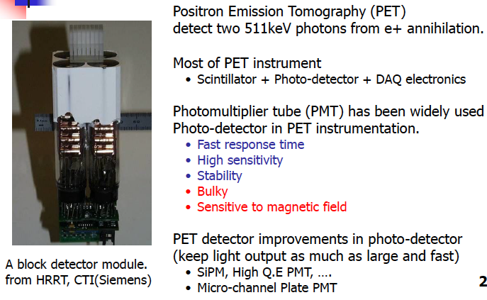
Conventional PET Detector Design

Slide 9
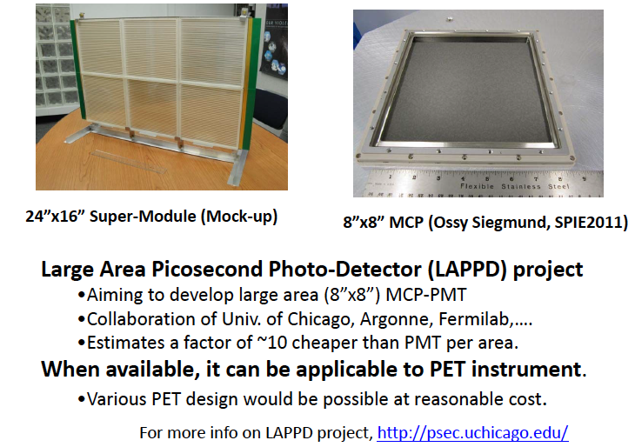
8” X 8” MCP Development from LAPPD

Slide 10
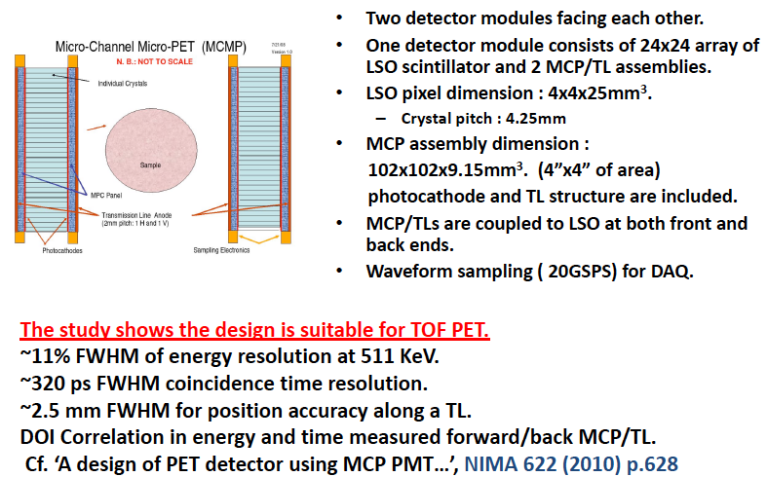
A MCP-PET Detector Design

Slide 11
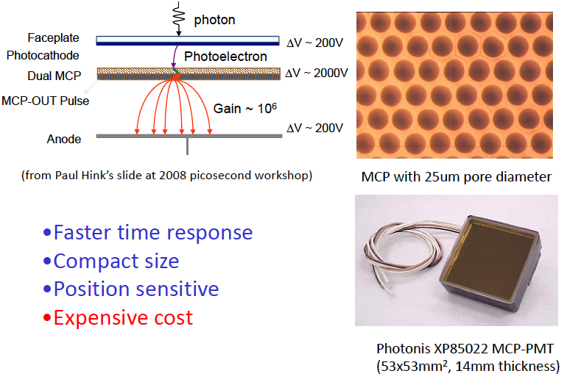
Micro-Channel Plate PMT

Slide 12
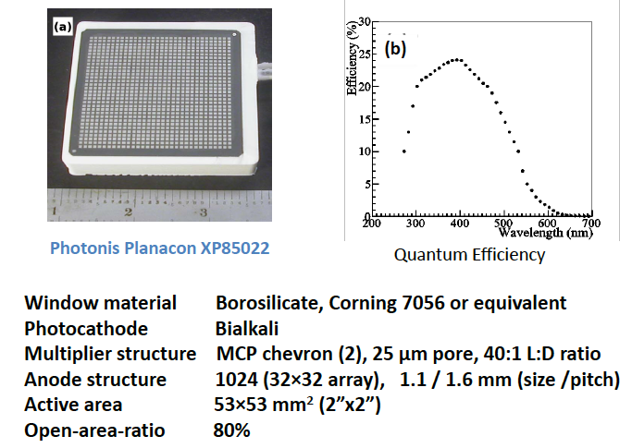
A MCP-PET Detector Design – Sample MCP

Slide 13
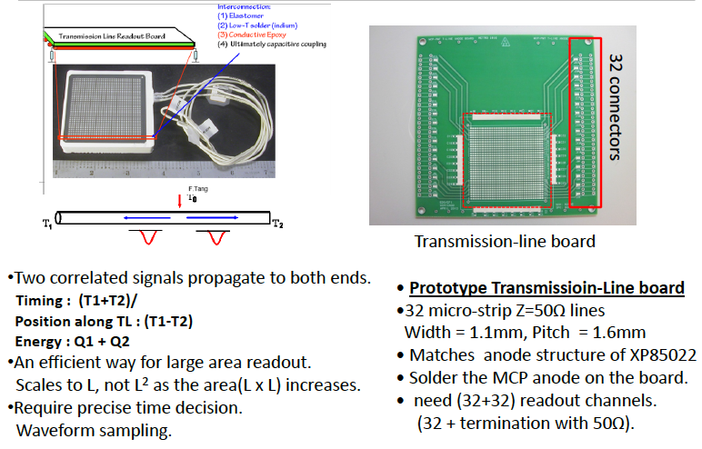
Transmission-Line Readout

Slide 14
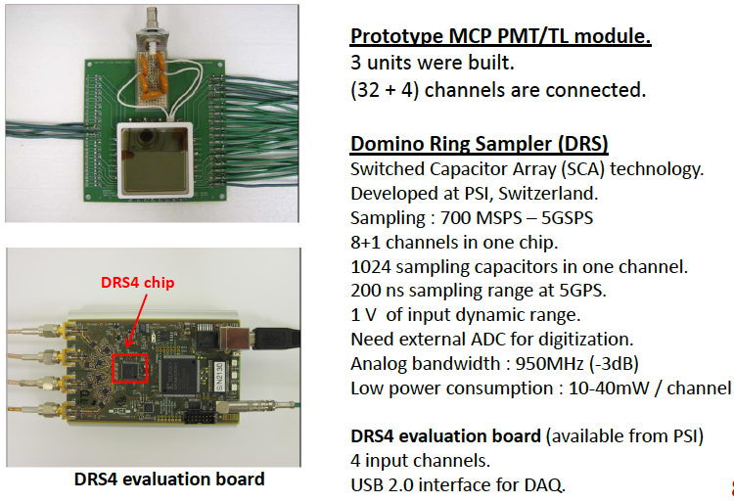
MCP/TL Module + RDS4 Sampling Board

Slide 15
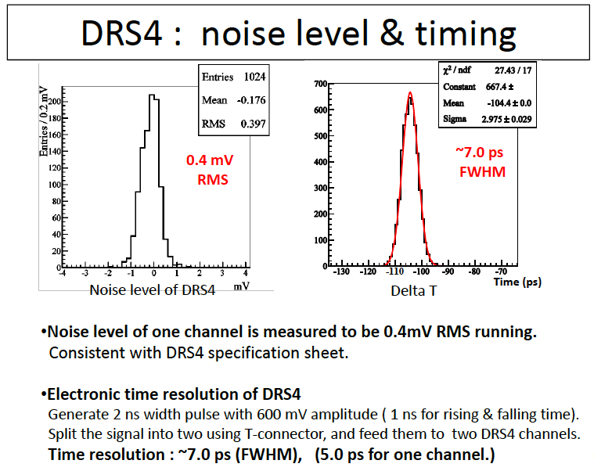
A MCP-PET Detector Design (Simulation)

Slide 16
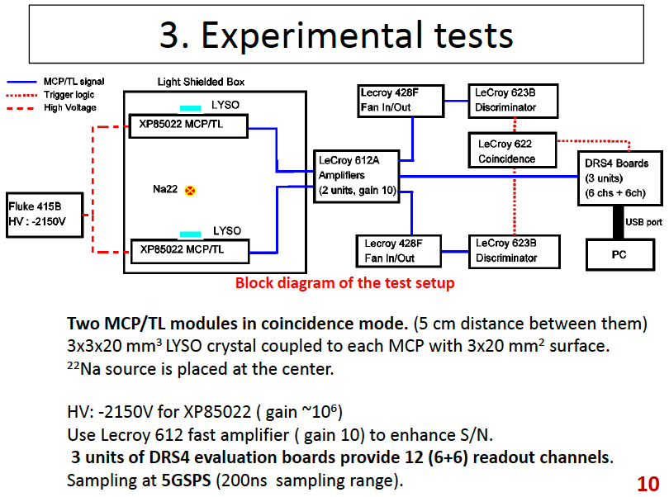
A MCP-PET Detector Design (Simulation)

Slide 17
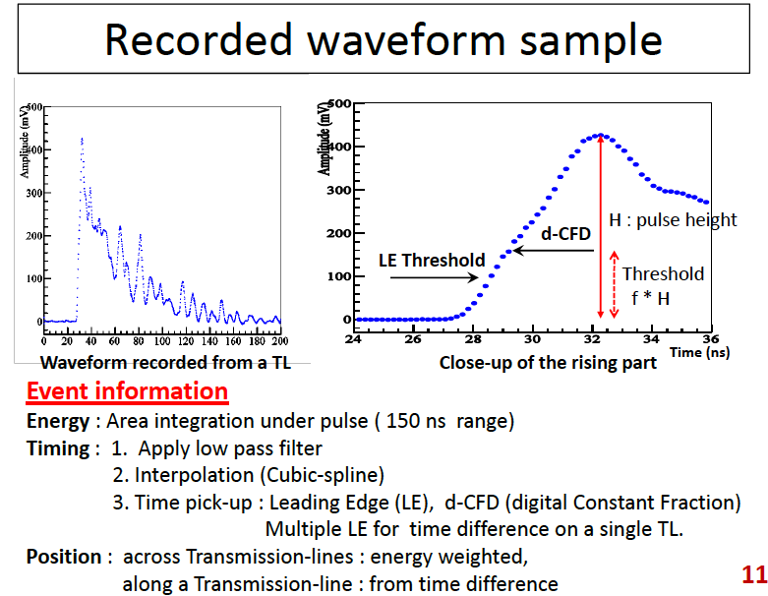
A MCP-PET Detector Design (Simulation)

Slide 18
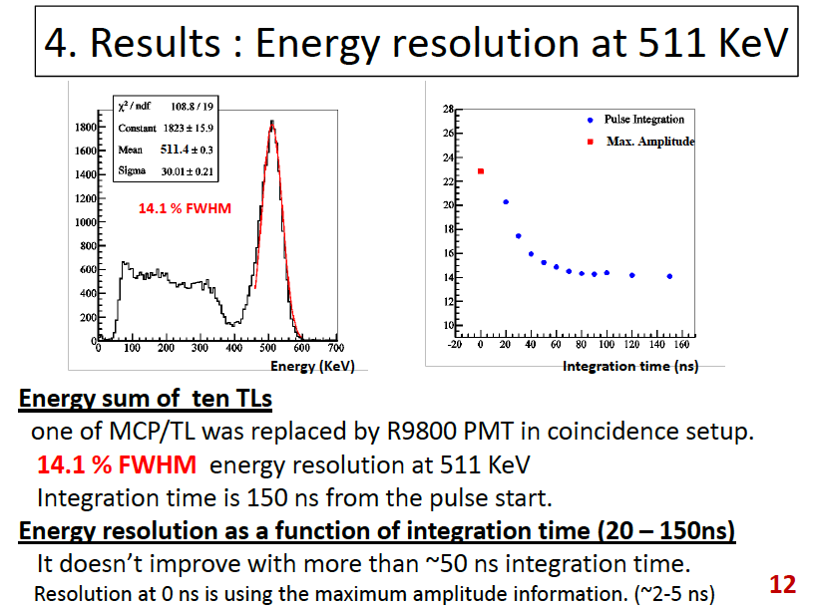
A MCP-PET Detector Design (Simulation)

Slide 19
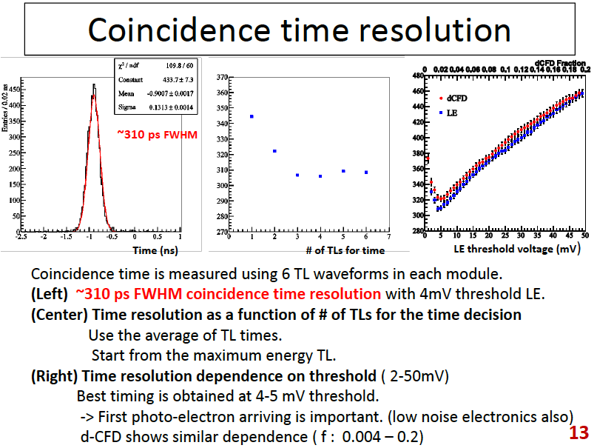
A MCP-PET Detector Design (Simulation)

Slide 20
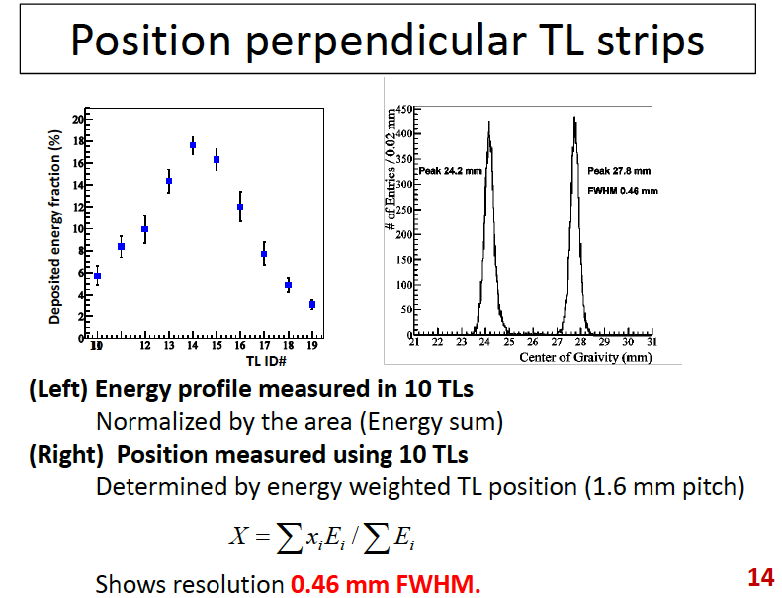
A MCP-PET Detector Design (Simulation)

Slide 21
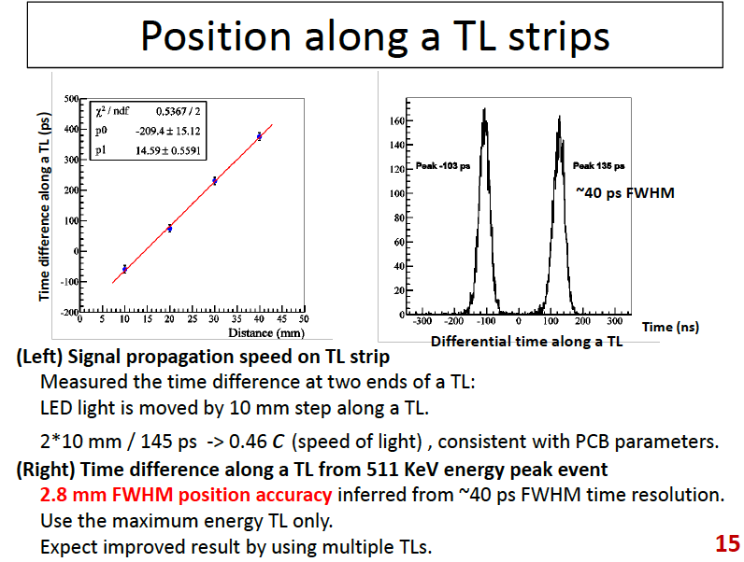
A MCP-PET Detector Design (Simulation)

Slide 22
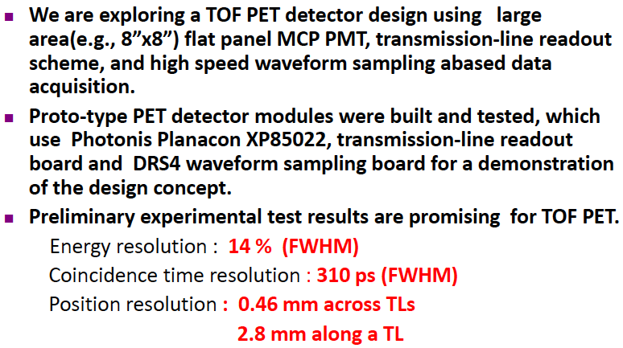
Summary of Preliminary Investigation

Slide 23
21.6 cm
80 cm
60 cm
42.1 cm
40 cm
LAPPD PET
Siemens mCT
Two 80x60 cm² LAPPD detectors, 4x4x20 mm LSO crystals, 40 cm spacing; axial FOV =80 cm
energy res. 15%; perfect time resolution
Count statistics (simulation):
  Zubal phantom (~191 lbs); 2mCi injected; scan starts right away
  450-650 keV energy window, 3.5 ns time window, 210-second scan
  54M trues+scatters, 9.9M randoms; scatter fraction ~32%, random fraction~21.28%
84.2 cm-diameter detector ring, 4x4x20 LSO crystals, 52 rings; axial FOV = 21.6 cm (33% longer than others); 4 bed positions to cover ~80 cm
energy res. <12%; time res ~ 555ps
Count statistics (measurement reported):
  160 lb patient; 16 mCi injected; scan starts 90 min post injection (~9.1 mCi at start of scan)
  350-650 keV energy window, 4.5 ns coincidence window; 210-second scan
  44M trues+scatters, and 67M randoms; scatter fraction ~30%, random fraction ~68%

Slide 24
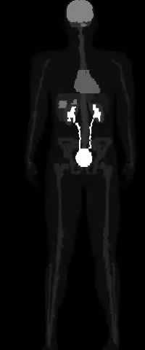
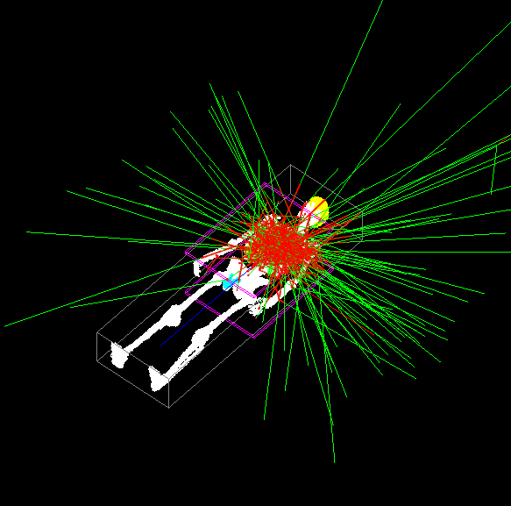
Initial Simulation Results
Whole-body phantom
Have obtained a 6-minute scan (1-minute frame), 7-12 minutes are under way.

Slide 25
Comparison
2mCi with LAPPD PET vs. 9.1mCi with mCT:
  LAPPD PET has more trues+scatters (54M vs 44M, 10M or ~23% more)
  LPPPD PET has much fewer randoms (9.9M vs 67M due to use of lower dose)
  For NECR=T^2/(T+S+R) (a measure of SNR-equivalent count): LAPPD is ~21.0M and mCT is only ~8.54M, ~2.5x gain.
  LAPPD PET uses 22% dose but yields 23% more trues (and scatters) and a SNR gain of ~2.5. This does not consider the effect of TOF measurement.
  TOF: 555 ps with mCT => an additional SNR gain of 1.36, 1.67, or 2.36 due to TOF if the LAPPD PET system has a TOF resolution of 300 ps, 200 ps, or 100 ps.
  An order of magnitude reduction in dose is possible.

Slide 26
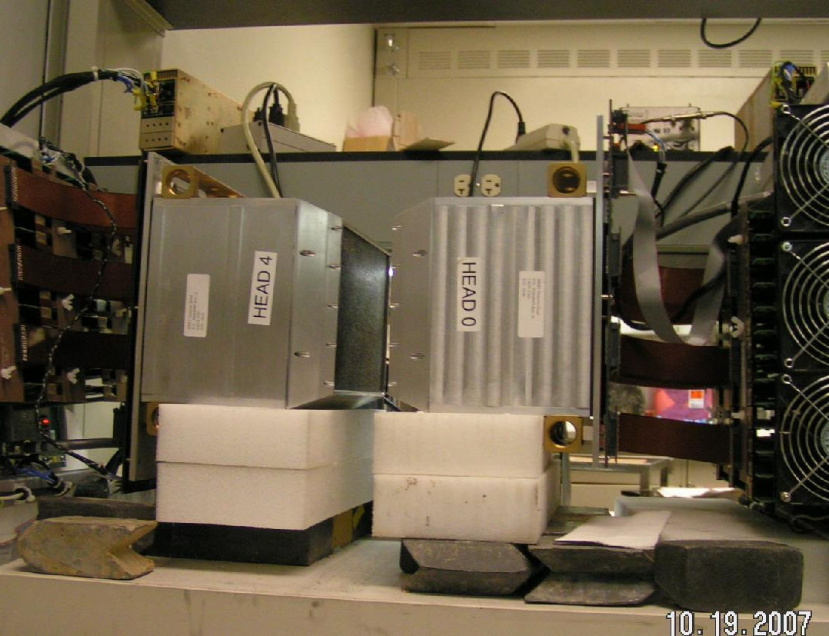
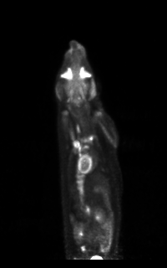
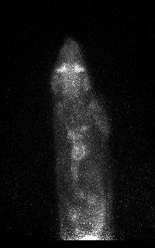
Model-Based Reconstruction ➔ Algorithm Enabled Instrumentation (Physics➔Computing➔Engineering)
1.0
0.75
Key New Perspectives
Modular
Re-Configurable
Application-Specific
2.4 mm
1.35
1.7
2.0
~300 g rat
(MIP 3d rendering)
Integrate detector, system geometry and reconstruction approach to achieve high-resolution, high-sensitivity and large field-of-view imaging.
Utilize novel algorithm enabled novel system designs.
~30 g mouse
(a coronal slice)
Model based
conventional
Kao et al 2007, 2009; Chou et al 2012

Slide 27
Fully Digital PET Instrumentation
Current UChicago effort
Current UChicago effort
Photodetectors (SiPM)
diffusor
γ photon
Multiplexer
Strip line
row/col sum
Sampling
MVT
WS
scintillators
Detector (analog)
Current UChicago effort
Digital Signal Processing (DSP)
CPU
GPU
Reconstruction
visualization
control
DAQ (digital)
Control/Recon/Display
data

Slide 28
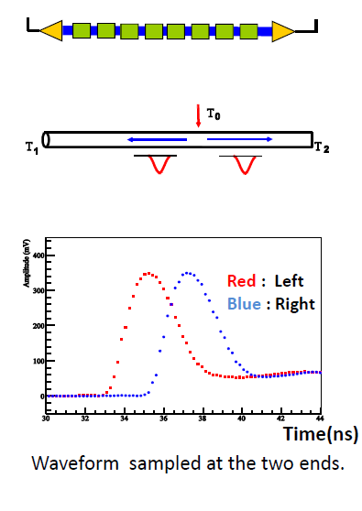
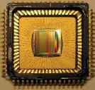
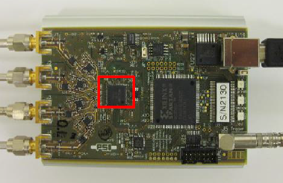
Strip-Line (SL) and Waveform Sampling (WS) DAQ
Domino Ring Sampler
PET signal pulse
SiPMs
preamp
x
Sampling at ~1GHz and above
x
x
x
x
x
x
x
x
DRS4 chip, 0.8-5 GHz sampling, 8 channels
x
~ 2-5 ns
~ 200 ns
DRS4 evaluation board (4 ch)
Switched capacitor array (analog memory)
0.2-2 ns
Inverter “Domino” ring chain
10-100 mW
IN
Waveform
stored
The position of the firing SiPM (or other PD) is determined using the propagation time difference.
Out
Clock
FADC
33 MHz
shift register
Kim et al 2009/10/12/14; Xie et al 2009; Niu et al 2012

Slide 29
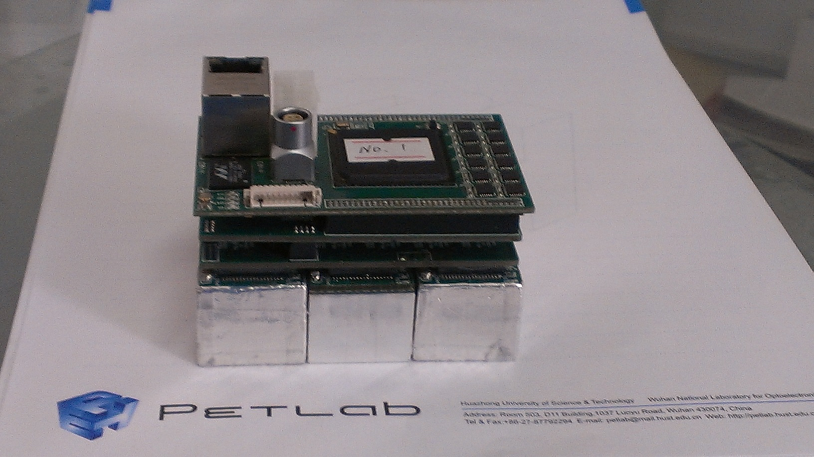
Panel PET detector (w/ HUST)
6x6 LYSO array
3.9x3.9x20mm LYSOs
6x6 SiPM array
SensL FM30035
4x4mm pixels
Ethernet I/O
(3x2 such units)
Readout
Sync clock
FPGA based MVT sampling
strip line
Row sums
MVT sampling Concept
Reference
voltages
PET signal pulse
pulse samples
Column sums
v₄
v₃
v₂
strip line
delay
v₁
FPGA based MVT sampling
Notes:
Top Left: A SiPM based PET detector module. Top Right: The module contains 3x2 units of 6x6 LYSO/SiPM arrays, 1:1 coupling. The SiPM is SensL FM30036, consisting of 4 mm pixels (3 mm active area). The LYSO crystal is 3.9x3.9x20 mm. The pitch between crystal is 4.2 mm. Bottom Right: Readout for each LYSO/SiPM unit is done by using row/column sums followed by strip-line readout, resulting in 4 readout channel for 6x6 SiPMs. The strip lines are read by using MVT sampling (Bottom Left), implemented entirely on FPGA. Due to limited timing resolution of the current FPGA TDC implementation, delays are introduced on strip lines between SiPMs. Preliminary testings successful; no TOF.

Slide 30
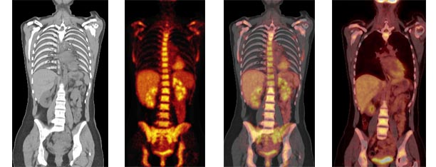
Combine PET & CT
CT Image
PET Image
Fused Image
Post-Therapy
Images courtesy of Stig Larsson, Karolinska Institute
Anatomy from X-Ray CT, Function from PET
Current “Standard of Care”

Slide 31
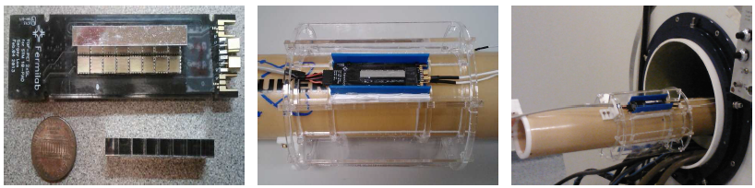
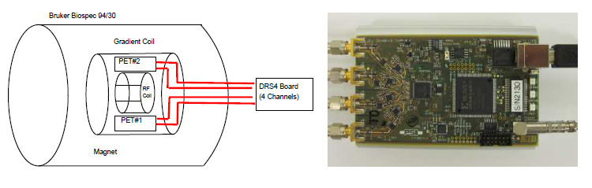
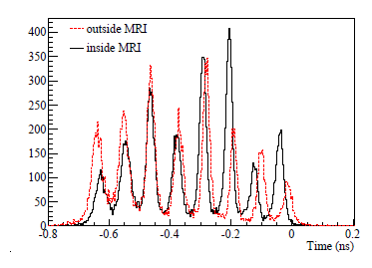
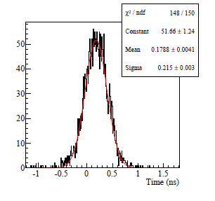
PET/MRI: PET Inserts in 4.7/9.4/14T MRI
8x1 LYSO crystals
SiPMs
8x2 LYSO crystals/SiPMs read by using 2 strip lines
A prototype MRI insert holding 8 modules
Gradient Coil
RF Coil
Insert in a 9.4T Bruker scanner, main DAQ electronics are outside in the control room
Identification of crystals (5.2mm pitch)
Coincidence timing resolution ~500 ps FWHM, in/out MR
Kim et al, 2014 (submitted)

Slide 32
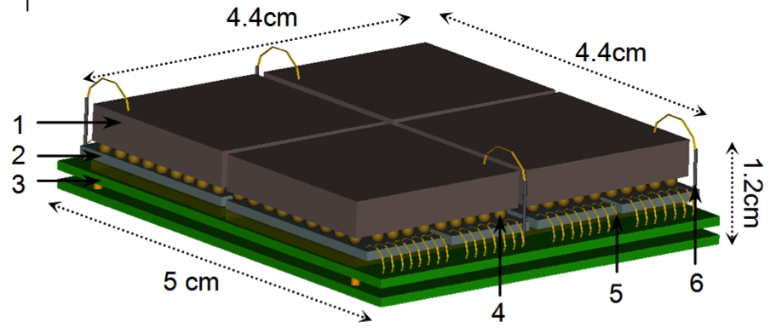
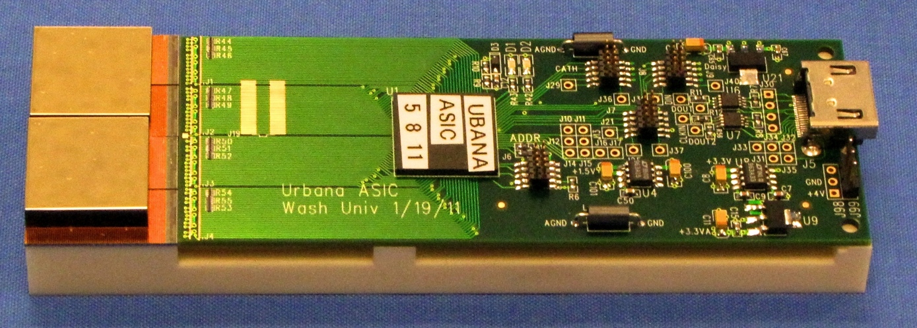
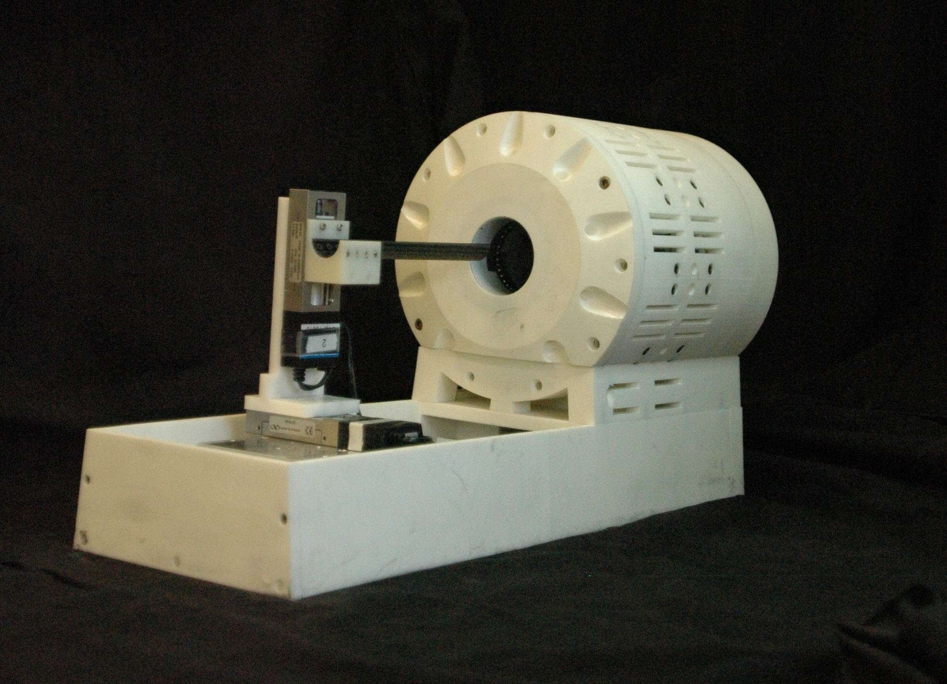
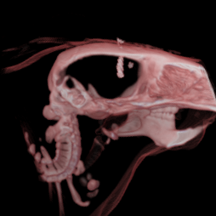
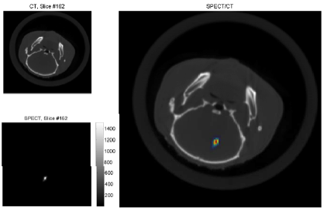
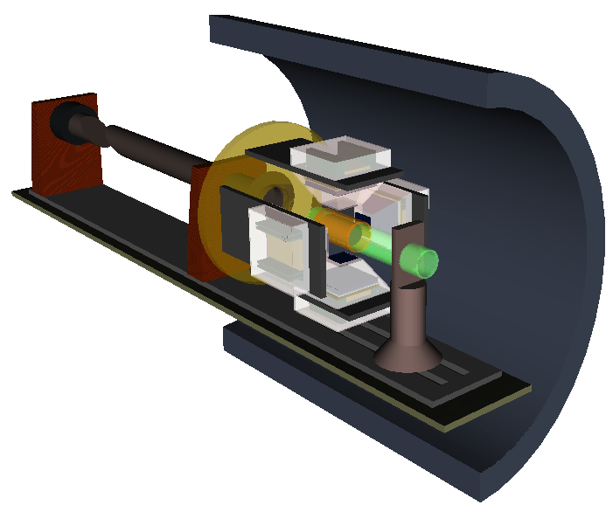
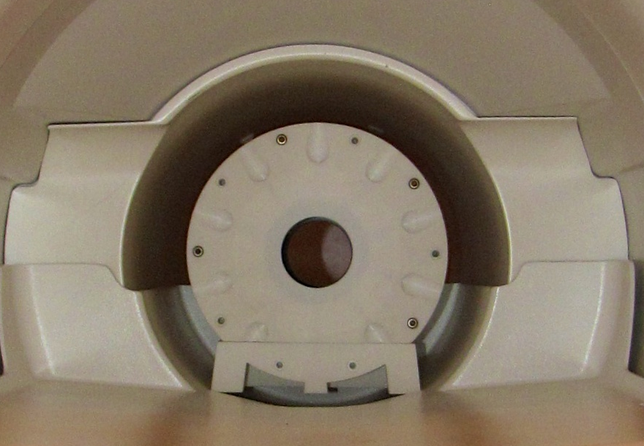
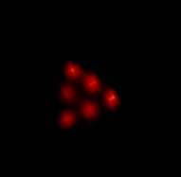
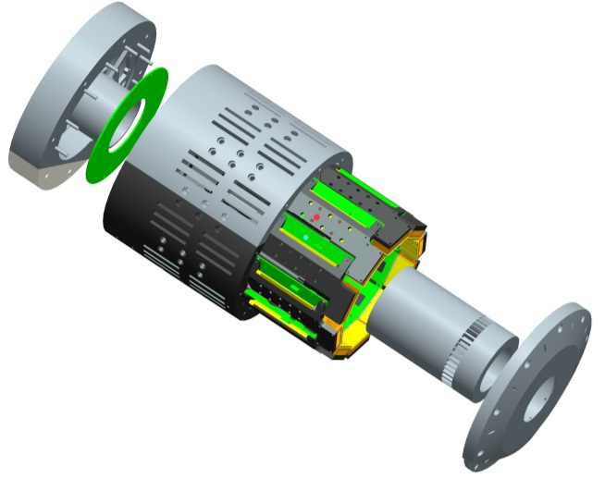
CZT/CdTe – Based SPECT Inserts for
Hybrid SPECT/MRI & SPECT/CT Imaging
Super-Resolution Tracking of T-Cells
The proposed energy-resolved photon-counting (ERPC) detector. (1) CZT crystals of 4.4cm × 4.5 cm × 2-4 mm in size, (2) ERPC ASICs, (3) Readout PCBs, (4) indium bump-bonding between CZT detector to the ASIC, (5) wire-bonds between the ASIC and the PCBs and (6) Cathode signal out.
1.5 m long arm to allow a remotely mounted motor
Images of 6 nCi I-125
in 750 Cells
Rotary motor
SPECT Insert Inside 3T MRI
Readout PCB
RF coil
CdTe Detector
Patient bed
Non-magnetic SPECT system chassis
Spacing = 350µm
Collimator
MRI Scanner Bore
Cai et al, NIMA, 2014
NIH/NIBIB R01 EB011640
Tc-99m
Notes:
Molecular Imaging Instrumentation – SPECT Inserts for SPECT/MRI [Collaboration with University of Illinois – Urbana/Champaign]
We are employing energy-resolved photon-counting (ERPC) solid-state semiconductor detectors such as CZT (or CdTe) to build SPECT inserts that can be incorporated with the existing MRI system to offer hybrid SPECT/MRI imaging
Upper-Left: (1) integrated detector head assembly
Upper-Right: (2) detector heads integrated with readout and signal-processing electronics
Central-Right: (3) [Left]: diagram of the 10-detector ring assembly; [Center]: SPECT assembly with MRI-compatible housing structure/support produced by 3-D printing technology; [Right]: a desk-top stand-alone laboratory SPECT system
Lower-Left: (4) Diagram of a SPECT insert assembly inside a typical MRI scanner;
Lower-Right: (5) the SPECT insert assembly used inside an actual 3T MRI system (can be inserted into a typical 9.4T animal MRI system as well)
Central-Bottom: (6) Image of a test phantom with the use of Tc-99m, the spacing between neighboring hot dots is 350 microns, illustrating the ability to achieve the targeted 200-500 microns resolution

Slide 33
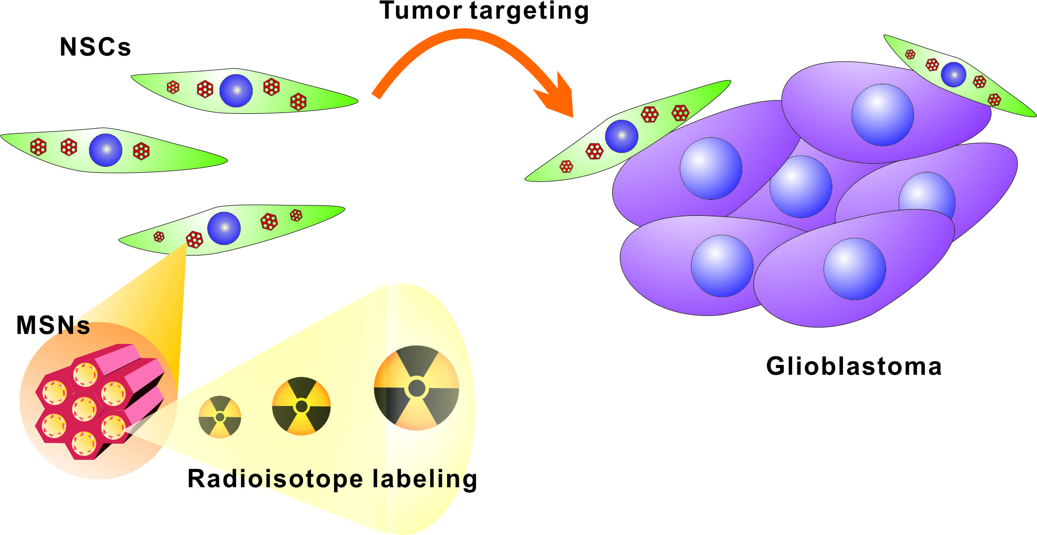
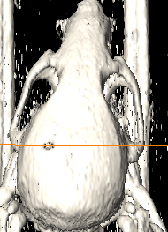
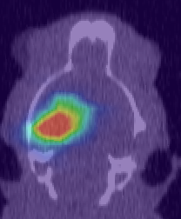
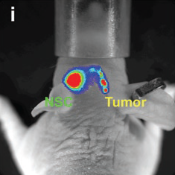
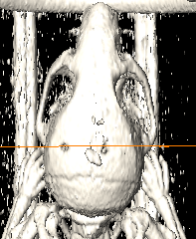
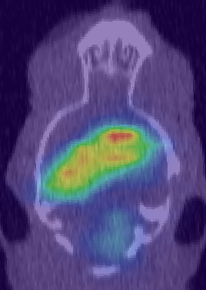
SPECT/CT/MRI/Optical Imaging of Stem Cells in Brain Tumor Targeting
Chen/Lo/Cheng/Roman, Mou (NTU) & Lesniak/Balyasnikova (Surgery)
In vivo delivery vehicle of neural stem cells (NSCs) with pH-sensitive mesoporous silica nanoparticles (MSNs) loaded with doxorubicin (MSN-Dox), promoting programmed self-destruction of NSC carriers after migration to glioma cells
Demonstration of NSCs loaded with MSN-In-111 radiotracer for tracking stem cells migrating toward glioma
In-111
Control
CT
SPECT/CT
Stem cell
Injection (left)
Bioluminescence
24h
Tumor
CT
SPECT/CT
24h
Stem cell
Injection (left)
Tumor
^{Yu, et al,} ^{Small, 2013}
^{NIH/NINDS R01/R21}
tumor cell
Injection (right)
24h
Notes:
Molecular Imaging Chemistry – Nano-Theranostics: [collaboration with UChicago/Department of Surgery, and NTU/Chemistry’s Dr. Chung-Yuan Mou, who is an expert of mesoporous silica nanoparticles (MSNs)]
We are developing multi-modality nano-theranostic platforms for effective delivery of imaging probes as well as therapeutics to brain tumor
Upper & Left – (1) Nano-platforms using neural stem cells (NSCs), conjugated with ph-sensitive mesoporous silica nanoparticles (MSNs), to (2) carry either [Left] therapeutic drug (doxorubin); or [Upper-Right] imaging tracer (in this case, In-111 for SPECT imaging)
Central Upper – (3) electron-microscopic image of the nano-platforms
Molecular Imaging Clinical Application – Targeted delivery of imaging and therapeutic agents for brain tumors
Central Center - (4) Survival curves show improved delivery of therapeutics (Dox) to tumor by MSNs and NSCs
Central Lower – (5) Optical imaging by bioluminescence to illustrate NSC moving toward brain tumor cells
Lower Right – (6) CT and SPECT/CT images demonstrate the nanoplatform of NSC+MSN+In-111 moving toward brain tumor, and the control (no tumor) image shows no such migration
Comments: this nano-platform can carry contrast agents for other modalities such as MRI or PET, and other therapeutic drugs for treating brain tumor, or for other cancers as well

Slide 34



Slide 35


Upgrades and Location of Proposed Shielded Irradiation Cave
⁷⁸Se(p,2n)⁷⁷Br
²⁰⁹Bi(α,2n)²¹¹At
²⁰⁹Bi(⁷Li,5n)²¹¹Rn
Other Medical Radioisotope Production

Slide 36
Addressing the Impracticality of ²¹¹At Short Half Life (7.2 h) & Extremely Limited Supply
Only 4 production sites in the entire USA
For SPECT Imaging, 13.2 h t_{½} ¹²³I is commercially viable and supplied from limited production sites
Benchmark: ²¹¹At would be more attractive if t_{½}≥ ¹²³I
14.6 h
²¹¹Rn
²¹¹At
Generator

Slide 37






Theranostic Use of MIBG in Neuroblastoma
Cohn/Vochenbaum (Pediatrics) &
Appelbaum/Pu/Armato/O’Brien-Penney/Chen (Radiology)
M¹²³IBG whole-body Imaging ➔ Predict and monitor the outcome of treatments
Automated detection &
scoring of lesions ➔ Improved reliability
computer- aided image
analysis
➔ Very challenging
M¹³¹IBG therapy trial ➔ High-risk NB patients
ANL/ATLAS-produced At-211 ➔ MABG therapy

Slide 38





Ultrafast Photonic Switching – Super TOF PET
Souris/Cheng (BSD), Wiederretch (ANL) & Others
Time-of-Flight
PET
Plasmonic
Materials
CNM/ANL
Transient Absorption
Pump/Probe Spectroscopy

Slide 39



Novel X-Ray Imaging La Riviere (BSD) & ANL Colleagues
Elemental Mapping
Color X-Ray Histology
Zebrafish
~350 μm
Optimizing synchrotron micro-CT for
high-throughput phenotyping
56 dpf, 14 mm
Practical Resolution Limit: ~250 nm
Source: http://zfatlas.psu.edu
60 dpf, ~14 mm
Voxel Size:1.43 µm
Source: ANL/APS
100 μm

