Slide 1
Positron Source for Linear Collider
Wanming Liu
2013 DOE Review

Slide 2
Outline
Positron source for LC in general
Our collaboration with other institute on positron source design
Undulator based positron source for ILC
Undulator based positron source for CLIC

Slide 3
Requirements on LC positron source
Be able to produce high intensity positron beam(Yield)
  ILC: 2e10 per bunch (3e10 per bunch with 50% margin)
  CLIC:
    Ecm=3TeV: 3.72e9 per bunch (4.3e9 at injector)
    Ecm=500GeV: 6.8e9 per bunch (7.8e9 at injector)
Polarization
  30% for ILC TDR and >50% for ILC polarization upgrade
  Non-polarized as in CLIC CDR

Slide 4
positron production for LC
Gamma
generation
Conversion
target
Capturing
optics
Acceleration
e- beam
(multi MeV – hundreds of GeV)
Gamma ray
Positrons
Gamma generation schemes
Bremsstrahlung( Conventional scheme)
Channeling radiation
Laser Compton scattering
Helical Wiggler/Undulator

Slide 5
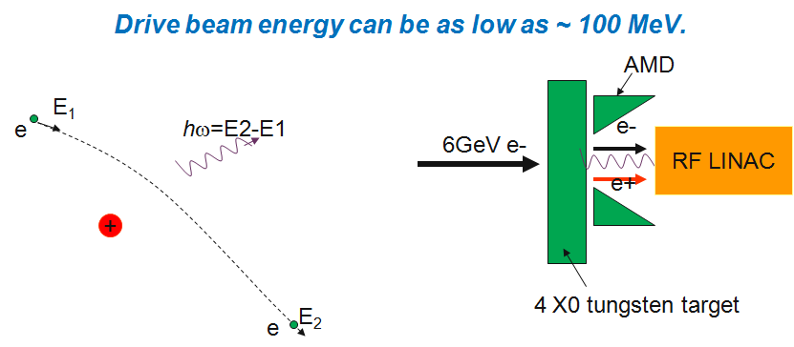
Conventional Scheme
electron beam with energy of ~100MeV to 6 GeV striking on a conversion target made of high Z material, like tungsten, with a thickness up to several radiation length.
γ produced as a result of electrons stopping in matter
No polarization

Slide 6
Channeling radiation
-- Coherent bremsstrahlung (separate γ and e+ production)
Enhancement can be as high as 40 comparing with incoherent bresstrahlung (R. Chehab et al.)
Schematic illustration of channeling
An example of positron source using channeling radiation

Slide 7
Laser Compton Scattering scheme
Circularly polarized YAG Laser or CO2 Laer
Multi GeV e-
Circularly polarized γ
Mr. Omori-San’s favorite drawing
Need stacking ring to build up the intensity of positron beam

Slide 8
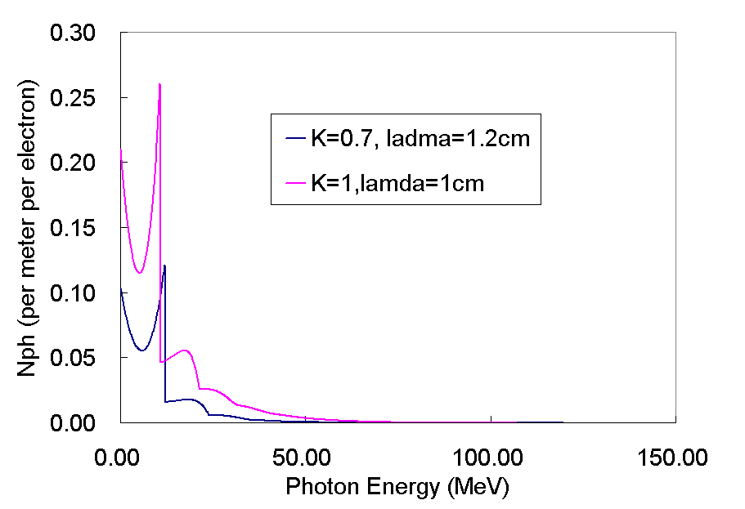
Helical undulator Based Scheme:
i
-i
Supper conducting helix
Requires very high energy drive beam (>100 GeV). Undulator technology is straightforward. (SC or PM)
Can produce circularly polarized photon, good for polarized e+ source.
Drive beam energy: 150GeV
Proposed: A. Mikhailichenko
K. Flottmann, et al

Slide 9
Collaborations
SLAC:
  Conventional source numerical study
  Helical Undulator based positron source start to end simulation
KEK:
  Compton scattering positron source
  Conventional positron source
LLNL:
  Target eddy current issue
  Target energy deposition issue
DESY:
  ILC TDR Beamline lattice design
  ILC TDR positron source parameter table
CERN:
  Undulator based positron source study for CLIC
IHEP:
  Target remote handling/removal

Slide 10
Undulator based positron source for ILC
Start to end modeling
  Undulator
  Target
  Optical matching device
  Positron capture and transport.
Exploring TeV upgrade options
Beam line lattice design
TDR coordination

Slide 11
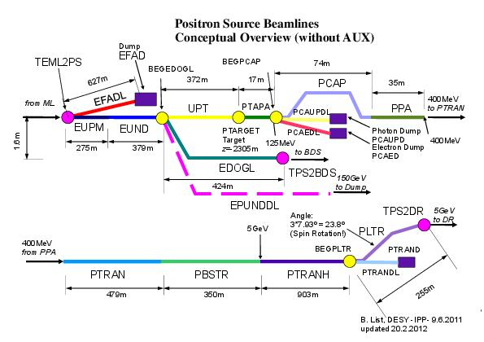
Beamline Lattice
New lattice design has been done to comply with the new layouts as follow.

Slide 12
Our Contributions to ILC positron source
Numerical model of helical undulator photon radiation
Start-to-end simulation of ILC positron source
Undulator parameter comparison
Initial keepalive source numerical studies
OMD comparison
Equivalent circuit model of Flux concentrator
Eddy current study of spinning target in magnetic field
comparison between Ti and W target
Emittance evolution of drive electron beam passing through undulator
Evaluation of end of linac operation
Drive beam energy comparison
Liquid target yield evaluation and heat transfer simulation
Conventional positron source simulation: yield evaluation, heat deposition and transfer simulation
Accumulated energy deposition in target of bunch train
Minimum machine simulation: undulator based and conventional scheme
Post IP scheme
TDR positron source parameter table
TeV upgrade options
ILC beamline lattice design
TDR coordination

Slide 13
Positron source start to end simulation
Positron production: EGSnrc
Undulator radiation: Monte Carlo model
Positron capture: PARMELA
Positron pre-accelerating and booster: elegant

Slide 14
Drive Beam Emittance evolution through undulators
Tool used: Elegant (a well known beam dynamics code includes synchrotron radiation effects);
Bench marked the energy loss results in undulator against the well known analytical formula.
Simulation results show that there is an emittance damping instead of emittance growing when drive beam passing through the undulator.

Slide 15
Optical Matching Device (OMD) comparison
Beam and accelerator phase optimized for each OMD
OMD compared:
  Adiabatic Matching Device (AMD)
  Flux concentrator
  ¼ wave transformer
  Lithium lens
OMD | Capture efficiency
Immersed target, AMD (6T-0.5T in 20 cm) | ~30%
Non-immersed target, flux concentrator (0-3.5T in 2cm, 3.5T-0.5T 14cm) | ~26%
1/4 wave transformer (1T, 2cm) | ~15%
0.5T Back ground solenoid only | ~10%
Lithium lens | ~29%

Slide 16
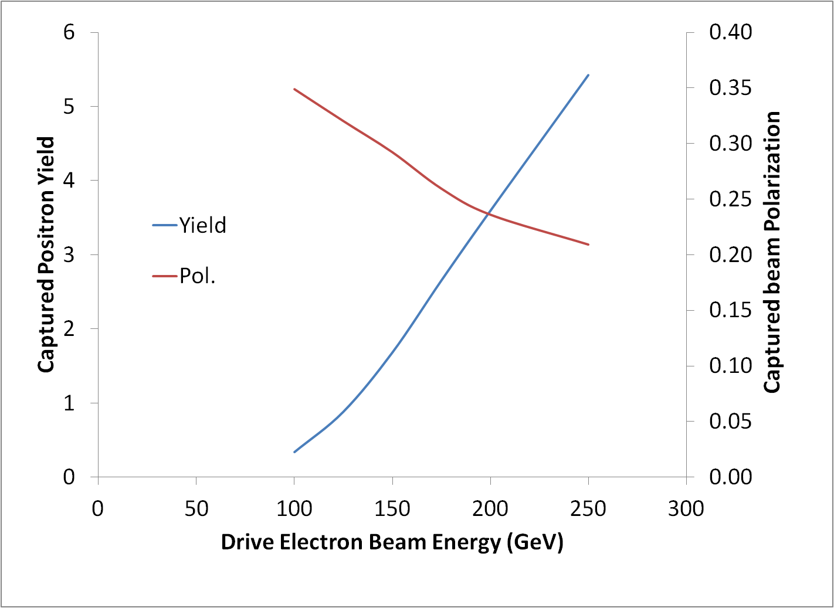
Drive beam energy dependence study (no collimation)

Slide 17
Low energy operation, 100GeV
Short period and high field undualtor:
Simulation results shown that we can bring the positron yield back for lower energy operation by using undulator with short period and high field.
Since undulator technology isn’t ready ready for short period and high field undulator, 10Hz operation mode is chosen for low energy operation in TDR.

Slide 18
High energy operation, 250GeV Drive beam
 | FC, Fixed K | FC, Fixed length
Required effective undulator length | 40 | 137; K=0.45
Average photon power(kW) | 94.1 | 79.3
Photon energy per bunch (J) | 7.17 | 6.04
Energy deposition per bunch (J) | 0.34 | 0.313
Relative energy deposition (%) | 4.9% | 5.2
Peak energy density in target (J/cm^3) | 318.8 | 456.4
Peak energy density in target (J/g) | 70.8 | 84.5
Pol. | 0.23 | 0.30

Slide 19
TeV upgrade
  High drive beam energy, 500GeV which doubles the 250GeV TDR maximum
    photon beam energy increases by factor of 4 results in a larger energy spread and more positrons with unwanted polarization
    Smaller radiation angle results in smaller beam spot on target and thus higher energy deposition density
  Possible Solution
    10Hz operation, challenges exist in transporting two beams with a energy difference more than 100%
    New undulator, challenges exist in finding the parameter set with photon number spectrum similar to RDR undulator with 150GeV drive beam

Slide 20
With Fixed K=1 and different undulator period length
Based on the above plot, λu=4.3 is used for a more detail simulation to evaluate the energy deposition and impact on drive beam

Slide 21
The impact on 500GeV drive beam from the chosen unulator parameters
Code used: elegant
Lattice:
  Quads:
    Effective length 1m
    Strenth:0.09717 and -0.1109 alternating.
    Separation: 12m with space of quad excluded.
  Undulator:
    λu=4.3cm, K=1
    Sections with effective length of ~11.0m between quads
Initial beam parameters:
  ε_{nx}=10e-6 m.rad, ε_{ny}=0.04e-6 m.rad
  βx=46m, βy=9m
  Energy spread: 1GeV or 0.2%
  Average energy: 500GeV
Conclusion
  No significant impact on both emittance and energy spread

Slide 22
ILC positron source TDR efforts
ILC positron source parameter table
Positron source for TeV upgrade
Positron Source cost estimate
ILC TDR positron source chapter writing/coordinating/editing
Positron source technical area group leader (Wei)

Slide 23
CLIC Undulator based Polarized Positron Source

Slide 24
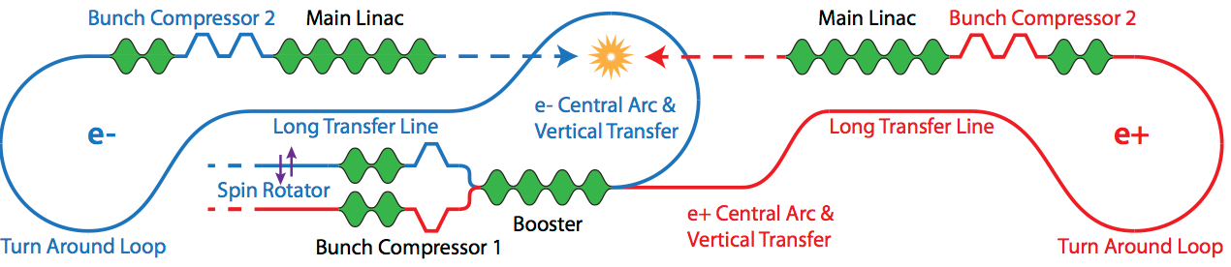
Helical undulator based CLIC positron source for 500GeV Ecm stage
200MeV
349m ILC RDR undulator lattice(effective length 250m)
300m drift
PPA
e-/e+/γ Separation and merging into ERTML tunnel
250m ILC RDR undulator
BDS
Accelerated to 2.86GeV and then inject into damping ring

Slide 25
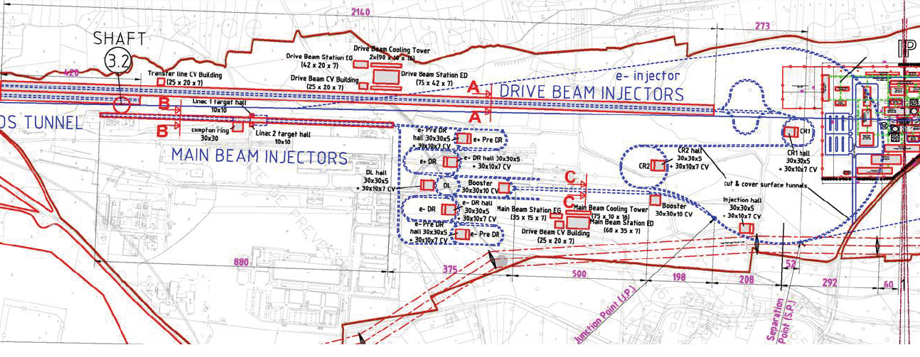
CLIC BDS and Main Beam injector complex layout with undulator based positron source
End of main linac
~2750m to IP
Undulator lattice
~13m
BDS to IP
~100m
~300m
~200m
e- dump
BDS tunnel
Matching section
γ drift
Target
γ dump
Main beam injector complex
200MeV
2.86GeV to damping ring
Common injector linac
Not to scale, more details need to be worked out

Slide 26
Peak energy deposition estimation for CLIC undulator based positron source
Timing and charge density comparison between ILC and CLIC
 | ILC | CLIC 500GeV | CLIC 3TeV
Positron per bunch at IP (Ne+) | 2x10¹⁰ | 6.8x10⁹ | 3.72x10⁹
Bunches per pulse (Nb) | 1312 | 312 | 312
Bunch spacing (ns) | 554 | 0.5 | 0.5
Rep. Rate (Hz) | 5 | 50 | 50
Since bunch separation of CLIC is only 0.5ns, for 1st order approximation, one can consider all the bunches are striking at the same spot. And thus the peak energy deposition of undulator based positron source for CLIC can be estimated using the existing data for ILC undulator based positron source scaled by the charge density and sum by the number of bunch: 1.9(J/cm^3)*312*6.8/20=~202J/cm^3 or ~45J/g which is lower than ILC’s 67.5J/g for 250GeV drive beam energy
As the charge has been lowered down to 3.72x10⁹ for the 3TeV machine, the energy deposition will be even less.

Slide 27
Advantage:
Undulator located at end of e- main linac makes it essentially the same as ILC TDR positron source and thus most of our results regarding undulator based positron source for ILC can be applied with some minor adjustments. (CLIC injector linacs are running at 2GHz while ILC is 1.3GHz all the way; and CLIC has a different timing structure)
Polarized e+ beam -> higher effective luminocity

Slide 28
Summary
We have made contributions to all aspects of ILC positron source design.
We have been collaborating with other institutes around the world on other LC positron source schemes.

Slide 29
Thanks

Slide 30
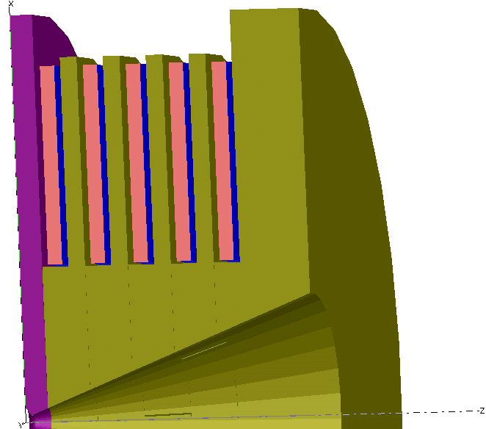
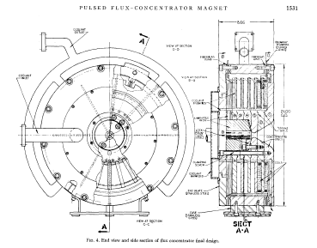
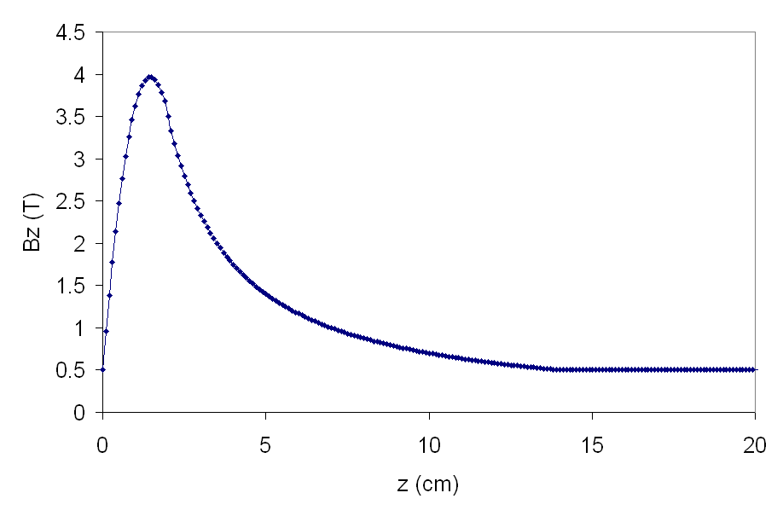
Flux concentrator
Pulsing the exterior coil enhances the magnetic field in the center.
  Needs ~ 1ms pulse width flattop
  Similar device built 40 years ago. Cryogenic nitrogen cooling of the concentrator plates.
  ANL and LLNL did initial rough electromagnetic simulations. Not impossible but an engineering challenge.
  No real engineering done so far.
Target will be rotating in an pulsed 0.5T B field
30

Slide 31
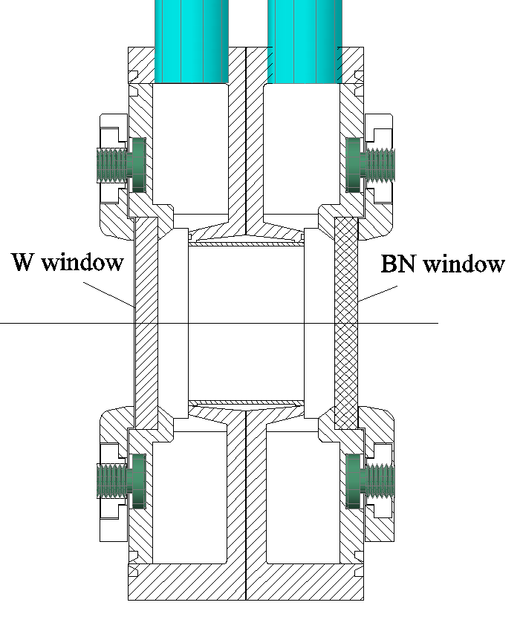
THE CONCEPT
~2mm
The gamma beam is coming from the left. By arrows it is shown the liquid Lithium flow.
31

Slide 32
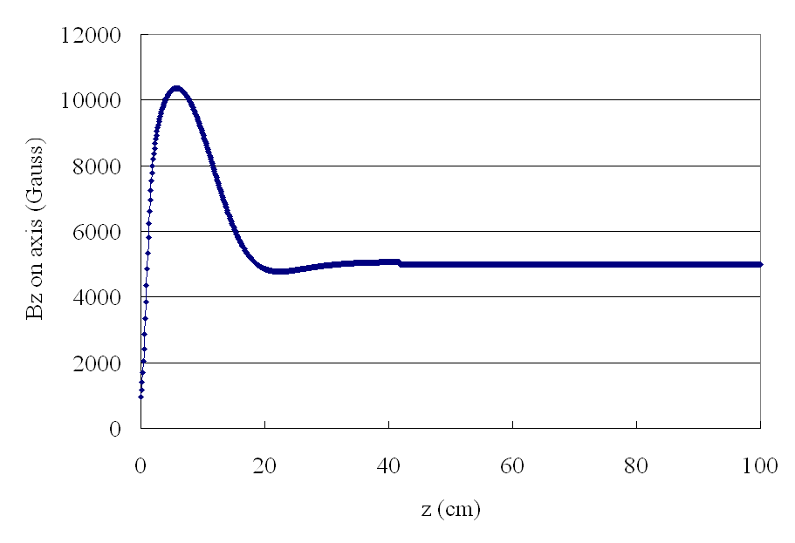
¼ wave solenoid
Low field, 1 Tesla on axis, tapers down to 1/2 T.
Capture efficiency is only 25% less than flux concentrator
Low field at the target reduces eddy currents
This is probably easier to engineer than flux concentrator
SC, NC or pulsed NC?
ANL ¼ wave solenoid simulations
W. Liu
The target will be rotating in a B field of about 0.2T
32

Slide 33

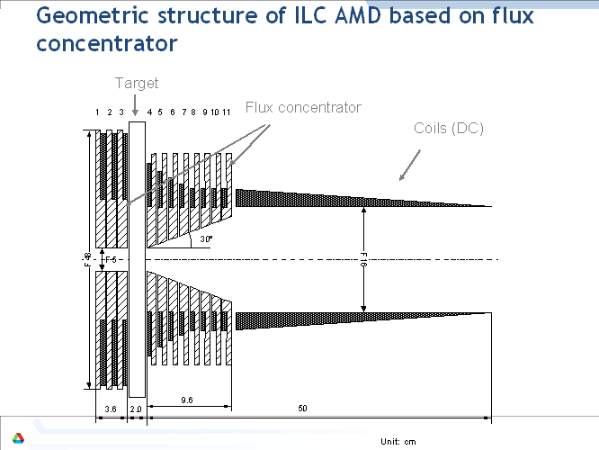
AMD
On axis B field profile given as:
Using paraxial approximation to obtain the rest field information.
A sample AMD field:5T-0.25T in 50cm
33

