Slide 1



Euclid Techlabs/AWA Collaboration Efforts on the Wakefield Accelerator Development
A.Kanareykin for Euclid/AWA Collaboration
Euclid TechLabs LLC, Gaithersburg, MD
DOE Visit 2013

Slide 2
Euclid Techlabs LLC
Euclid TechLabs LLC, founded in 1999 is a company specializing in the development of advanced designs and new dielectric materials for particle accelerator and other microwave applications. Additional areas of expertise include theoretical electromagnetics; dielectric structure based accelerator development; superconducting accelerating structure design; "smart" materials technology and applications; and software development.
Euclid and the Argonne Wakefield Accelerator group at ANL have a long history of successful collaboration in engineering development and experimental demonstra-tion of high gradient acceleration using a number of different dielectric structures and electron beam configurations.
2013: 12 people research staff; 4 full time researcher (2 more soon) working at ANL/AWA site in close cooperation with ANL/AWA.
www.euclidtechlabs.com

Slide 3
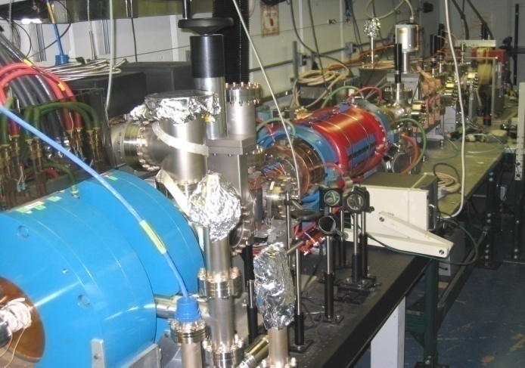
ANL/AWA & Euclid Techlabs LLC Collaboration
AWA of Argonne Nat. Lab, Chicago:
Manoel Conde, John Power, Scott Doran, Wanming Liu and Wei Gai
Euclid Techlabs LLC:
at AWA site: Chunguang Jing, Sergey Antipov, Sergey Baryshev and Richard Konecny,
Jiaqi Qiu, Stanley Zuo (soon).
Alexei Kanareykin (visiting)
Paul Schoessow (online, visiting)
at FNAL site, Technical Division: Yi Xie, P. Avrakhov, Y. Eidelman and R.Kostin (student)

Slide 4
Dielectric Based Accelerator
What is needed ? High gradient (~300-600 MV/m)
High Power MW and THz Sources (100s MW - GW power)
Beam Breakup (BBU) mitigation and control
  Why dielectrics ? Short MW or THz pulses with no breakdown. Bandwidth is high. Increased energy transfer efficiency. Structure can be made tunable.
Dielectric based accelerator advantages:
GHz,THz structures at ~ 0.5-1.0 GV/m gradient
design simplicity: no tight tolerances;
maximal field magnitude at the vacuum channel of the structure;
enables tuning;
reduced sensitivity to the beam break-up (BBU) instability;
thermal conductivity – even better than metal (if diamond)

Slide 5
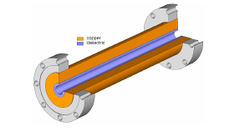
Ceramic Materials for the Dielectric-Based Accelerator
Low-loss ceramic microwave ceramic for the DLA
Diamond, ε~ 5.7, tanδ<10⁻⁴
Quartz, ε~ 3.75, tanδ~10⁻⁴
Linear MW/THz ceramic materials
Nonlinear MW/THz ceramic materials
BST+Mg based oxides, ε~ 50–100, tan<10⁻³

Slide 6
Dielectrics Tested as DWA Loading
THz experiments at FFTB and ATF

Slide 7
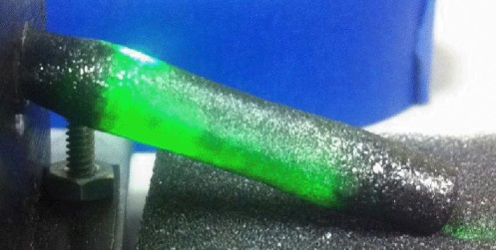
Field of Experimental Activity
High power high frequency MW and THz generation
Two beam acceleration
Collinear wakefield acceleration
Beam manipulation and diagnostics
Beam wakefield acceleration, beam manipulation and diagnostics were well presented in Dr. C.Jing’s talk.
Some recent results on MW and THz high power generation will be presented later in this pesentation.

Slide 8
Euclid Efforts in the WF experiments (2010~2012)@ AWA
Experimental Demonstration of the tunable DLA. Phase II completed.
  Developed the tunable DLA structure and finished bench test. It has been beam tested in the fall 2010. Results have been published , PRL 2011. Patented.
Beam tests of the diamond structure 2011-2012. Phase II completed.
  Electronic quality cylindrical diamond structures have been fabricated. Planar structure has been fabricated and tested at AWA, 300 MV/m field demonstrated. J. of Physics 2010, AAC 12, PAC11, IPAC’12. Patent pending.
Experiment of transformer ratio enhancement. Phase II completed.
  Successfully enhanced the transformer ratio to 3.4 by using ramped bunch train technique (2 bunches). Published, PRL (2007). Double triangle bunch experiment PR-STAB (2011).
Experiment of 26GHz dielectric wakefield power extractor. Phase II completed.
  16ns,1MW & 6ns, 20MW 26GHz rf pulse were measured. BBU was observed. NIM-A (2011), AAC’10’12.
Beam Breakup Instability in Dielectric Structures. DE-FG02-07ER84823
  Software developed to be used by various DLA groups. Verified with AWA wakefield beam experiments. Published AAC, PAC publications – to be published PR-STAB.
New RF Design of Externally Powered Dielectric-Based Accelerating Structures ; DE-FG02-06ER84463
  High Power Tested at NRL. Published IEEE Plasma Science (2011), AAC, PAC .

Slide 9
Frequency Ranges

Slide 10
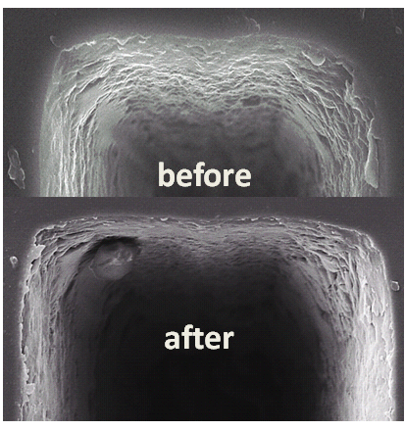
Diamond High Gradient Test
At AWA we introduced fields of ~ 300 MV/m with 35 ns pulse length in the diamond groove
SEM analysis before and after the experiment does not reveal breakdown damage
This year we tested a 250 GHz diamond structure at BNL and mapped the wakefield via two-beam acceleration mechanism.
S. Antipov et al. Appl. Phys. Lett. 100, 132910 (2012)

Slide 11
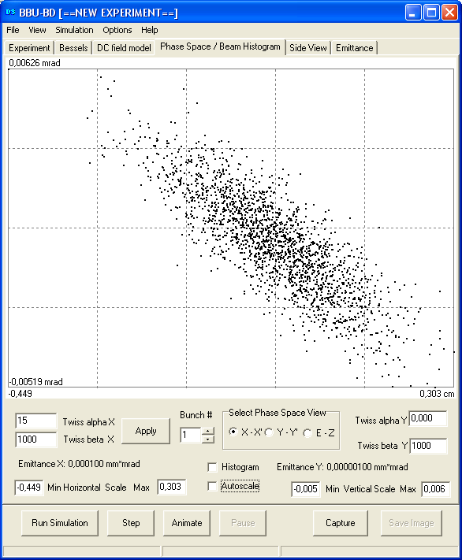
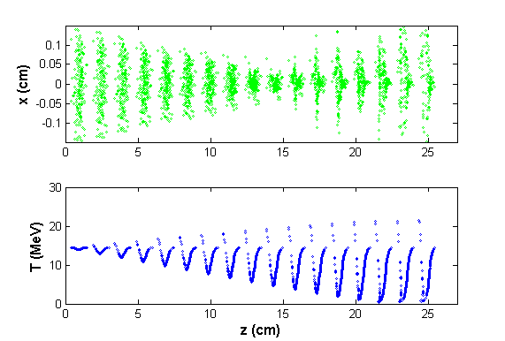
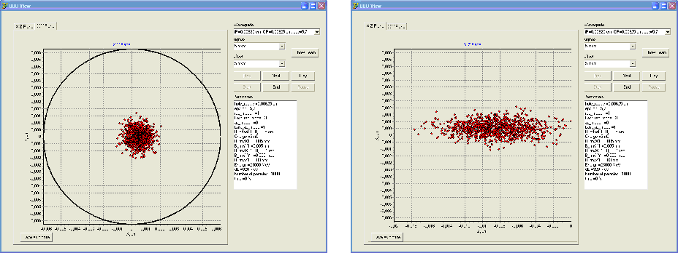
Self-Wakefields and BBU Control

Slide 12
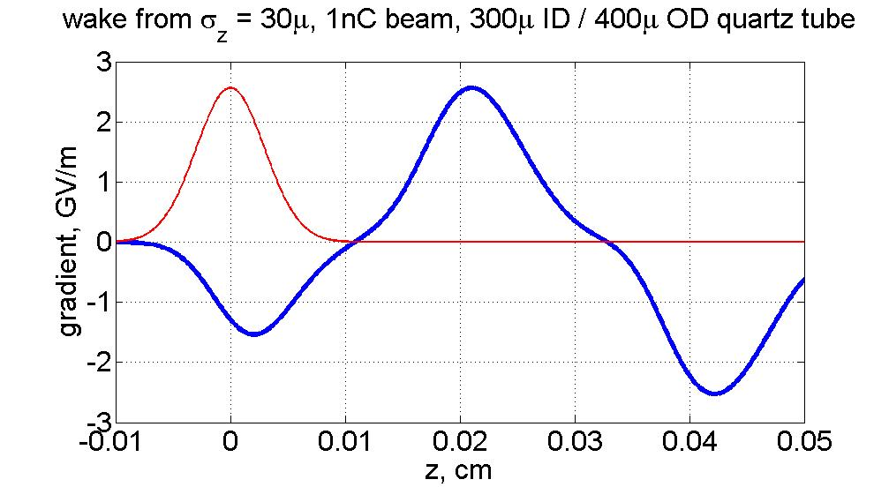
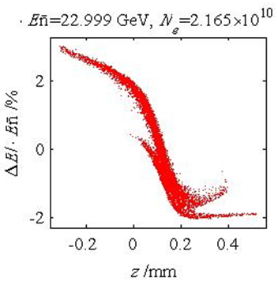
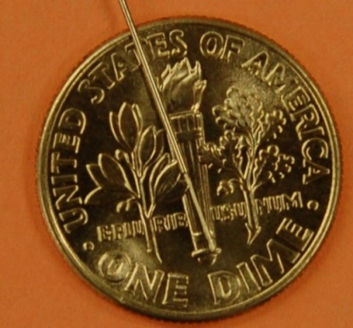
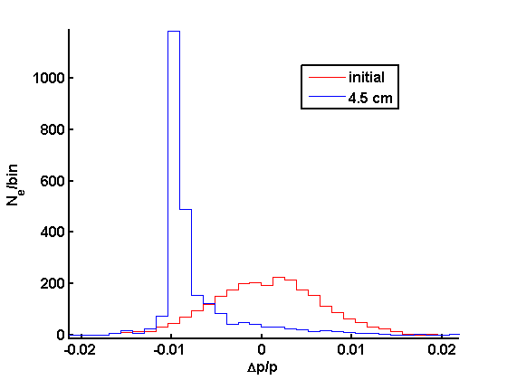
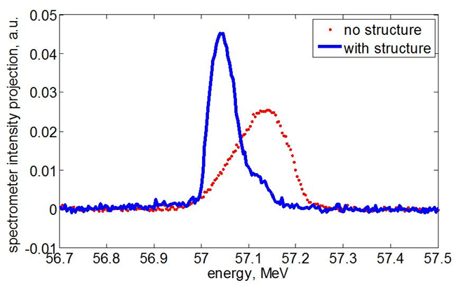
Wakefield Silencer
Energy chirp correction example

Slide 13
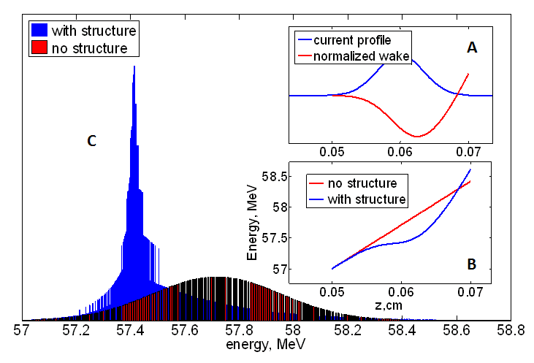
Planar Tunable DLA

Slide 14
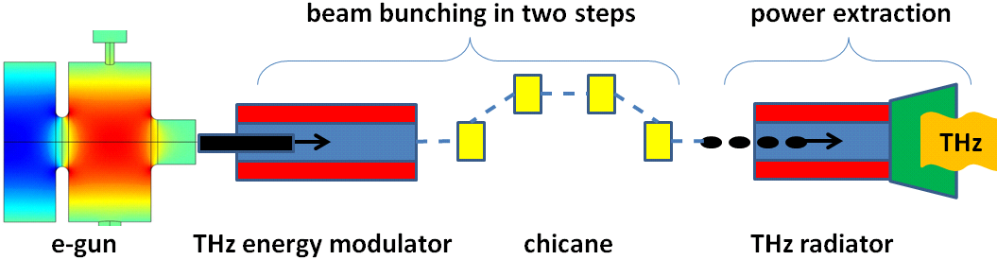
Beam based THz source

Slide 15
Euclid Efforts in the WF experiments (2012~2013)@ AWA
2012 Phase II. CHIRPED ELECTRON BUNCH ENERGY COMPENSATION FOR AN X-RAY LIGHT SOURCE
  Developed the structure and demonstrated Energy Chirp correction. The tunable structure is being currently tested. Results published PRL 2012, APL 2012, to be published in PR-STAB 2013.
  Patent pending
2012 Phase II. HIGH GRADIENT TEST OF A STANDING WAVE DIELECTRIC LOADED ACCELERATING.
  . AAC’12, PAC’11, IPAC’12
2011 Phase II DEVELOPMENT OF A 12 GHz DIELECTRIC-BASED WAKEFIELD POWER EXTRACTOR FOR POTENTIAL CLIC APPLICATIONS.
  AAC’12, PAC’11, IPAC’12
2011 Phase II. DEVELOPEMENT OF A DIELECTRIC-BASED SHORT RF PULSE TWO BEAM ACCELERATOR PROTOTYPE MODULE.
  Published Plasma Physics (2013), AAC’12, PAC’11, IPAC’12

Slide 16
Euclid Phase II, I 2013 @ AWA
Phase II 2013@ AWA:
2013 Phase II. COMPLETE MULTIPACTOR SUPPRESSION IN DIELECTRIC LOADED ACCELERATORS USING A SOLENOID FIELD.
  to be published , PR STAB, AAC’12, IPAC’12, PAC’11.
2013 Phase II. FERROELECTRIC BASED HIGH POWER COMPONENTS FOR L-BAND ACCELERATOR APPLICATIONS. Patent pending.
  published , PR STAB’11,APL 2009 , AAC’08,10,12, IPAC’10’12, PAC’09’11 etc.
  Phase I 2013@AWA:
2013 Phase I HIGH POWER HIGH FREQUENCY RF GENERATION
  to be published
2013 Phase I. METAL PLASMONIC NANOSTRUCTURES FOR ROBUST HIGH-QUANTUM-EFFICIENCY ULTRAFAST PHOTOCATHODES.
  to be published .
2013 Phase I. HIGH POWER TUNABLE AND NARROWBAND THZ SOURCE FOR THZ PUMP – X-RAY PROBE EXPERIMENTS. Patent pending.
  Published PRL 2012, APL 2012

Slide 17
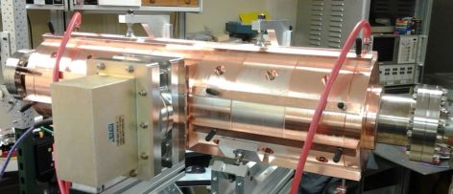
Commercialization
Euclid has completed an extension of the agreement with a major international corporation (S&P 500 Company). Currently it is 2nd year of the project on industrial X-band accelerator development.
Euclid was invited to prepare a quotation for photoinjector for the John Adams Institute at Oxford University in the UK. The quotation was submitted and we are awaiting the award.
Euclid is in the process of completing the sales of diamond capillary intended for the laser-plasma acceleration experiments of the John Adams Institute at Oxford University, UK.
The SC cavity E/M software package SLANS with completed sales to the following major institutions and companies:
  Raja Ramanna Centre for Advanced Technology –India;
  Helmholtz-Zentrum-Berlin – Germany;
  Niowave, Inc – USA,
  Deutsches Elektronen Synchrotron – Germany.
Euclid is also introducing its BPPM board, a new low cost measurement system for beam charge and phase.

Slide 18
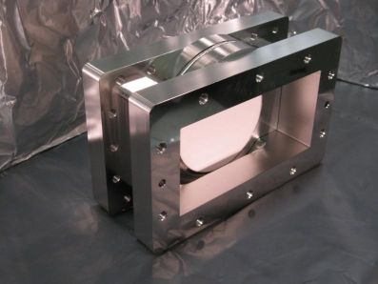
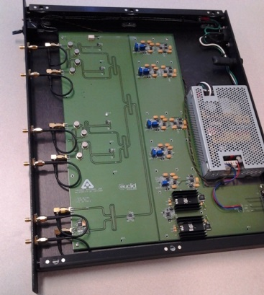
Commercialization (II)
Euclid has developed an L-band RF window using a streamlined manufacturing process, sales to Lawrence Berkeley Laboratory.
Euclid has completed sales of ferroelectric materials in excess of $50,000 to a major US company and has contracts for ~$200,000 total for the next two years; (Phase II 2008-2010, DE-FG02-07ER84822, Development of a Tunable Dielectric Loaded Accelerating Structure; Phase II 2005-2007, DE-FG02-04ER83946, Low Loss Ferroelectric Material Development for Accelerator Applications);
Euclid designed and laser driven table top THz device for Northern Illinois University. Euclid provided the diamond slabs necessary for construction of the device.
Euclid has designed a X-band high power rf load and power detector for Los Alamos Laboratory.

Slide 19
Summary
Euclid strongly collaborates with ANL/ AWA in high gradient (~300-600 MV/m) structures development; high power MW and THz Sources (100s MW - GW power) design; material development; beam breakup (BBU) mitigation and control.
Materials for Dielectric Loaded Accelerator - sustaining highest gradient - thermal conductivity – diamond is the best (tested at 300 MV/m)
Short pulse is critical. Short pulse scheme is under consideration.
Tunable dielectric based accelerator demonstrated at X-band.
Beam Breakup software has been developed
THz DLA structures have been developed and experimentally demonstrated. New field of applications: DLA for light sources development.

