Slide 1
Updates and status on the next generation of Superconducting RF cavities
7th of March 2013
Argonne National Laboratory
DOE Review 2013
Speaker: Thomas Proslier
DOE Review 2013

Slide 2
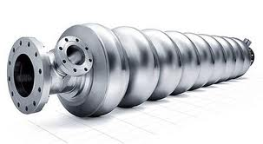
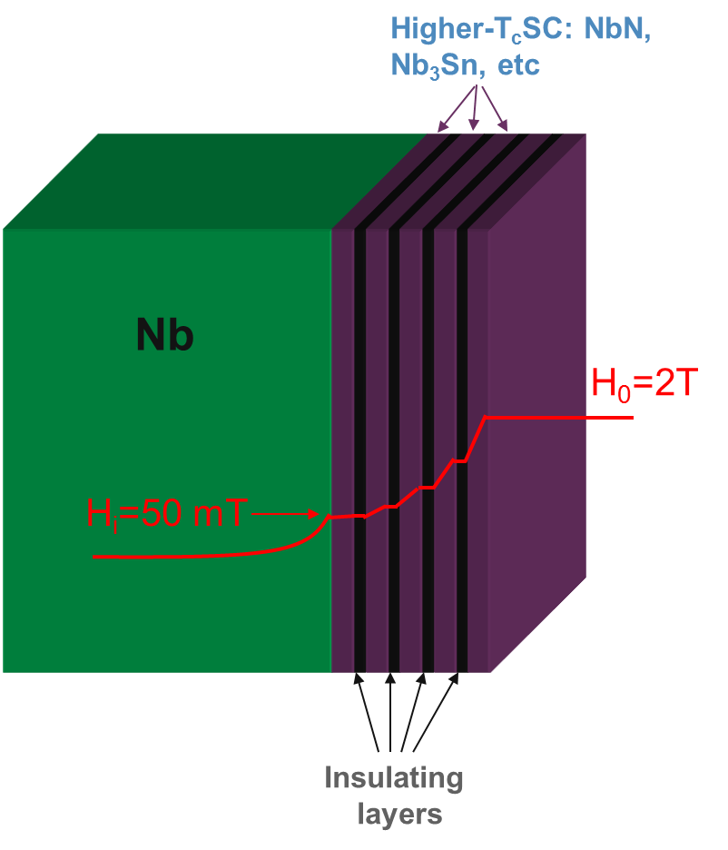
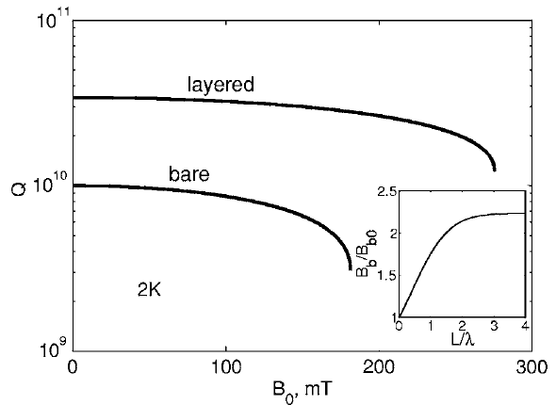
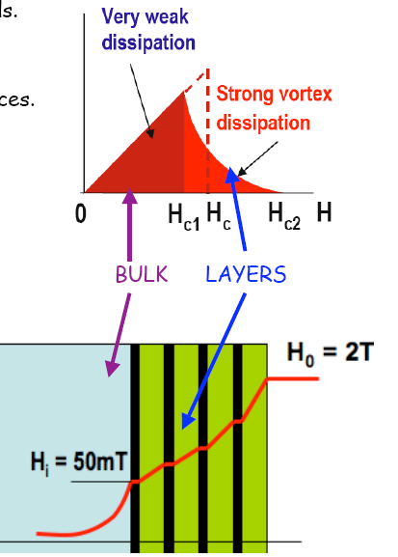
solutions
Here we aim at transformative technology changes in SRF technology
by developing a predictive understanding of the materials
physics issues currently limiting SRF technology and by applying
this understanding to significantly improve cavity performance.
DOE Review 2013
A. Gurevich, APL 88, 012511

Slide 3
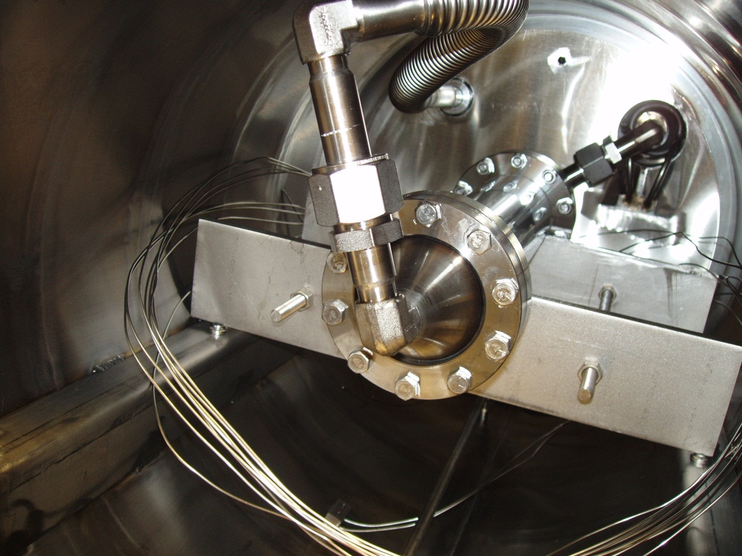
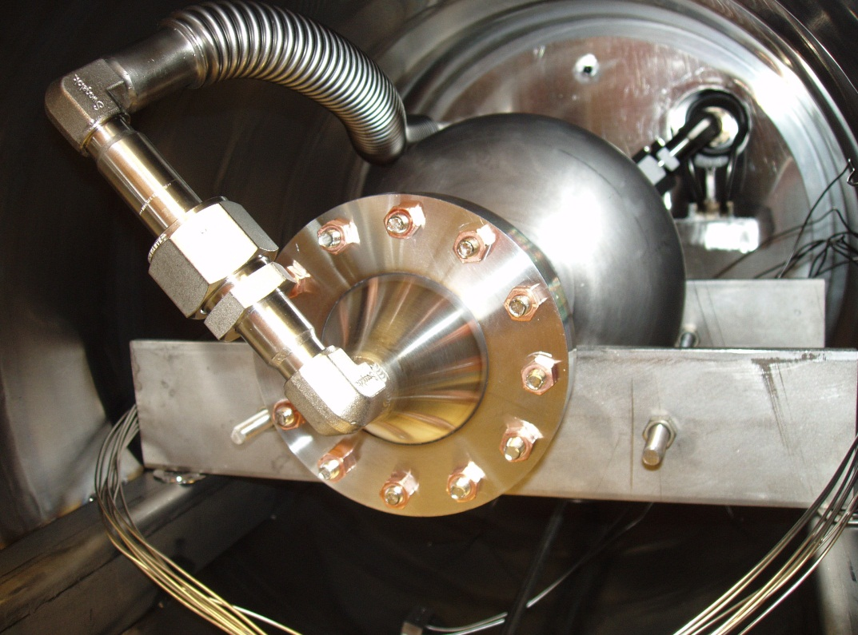
Test chamber-coupons growth
Cavity ALD growth
Gas in
Gas Out
Max size coupons: 2.5” OD-12” long
ILC shape single cell: ~15” long
DOE Review 2013

Slide 4
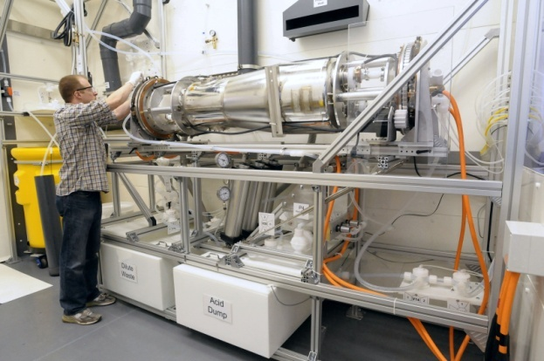
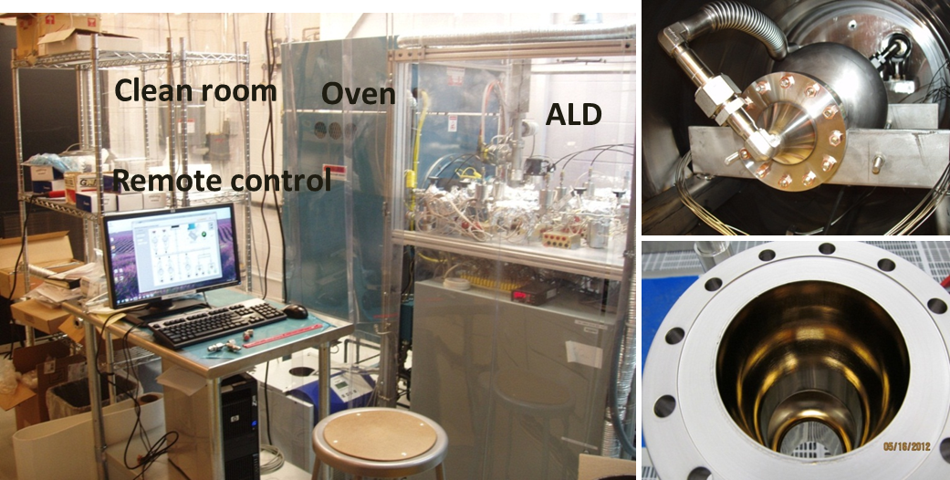
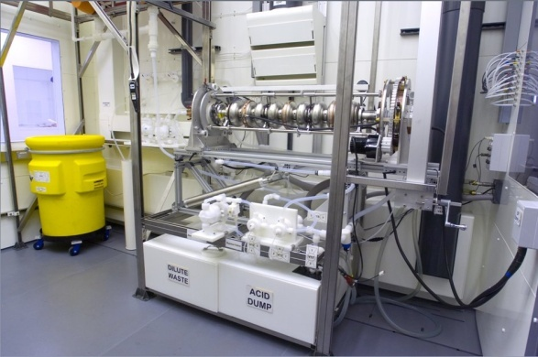
Synergy onsite
FNAL
Single Cell Nb Cavities
PHYS/APS/HEP
MSD/HEP
Material science
fundamentals
Surface treatments
RF testing
DOE Review 2013

Slide 5
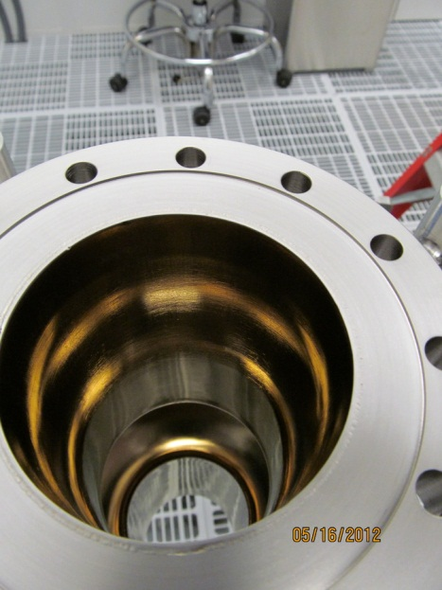
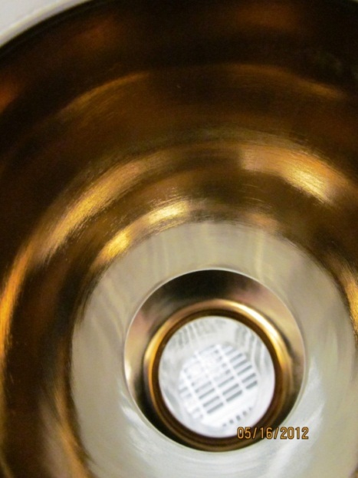
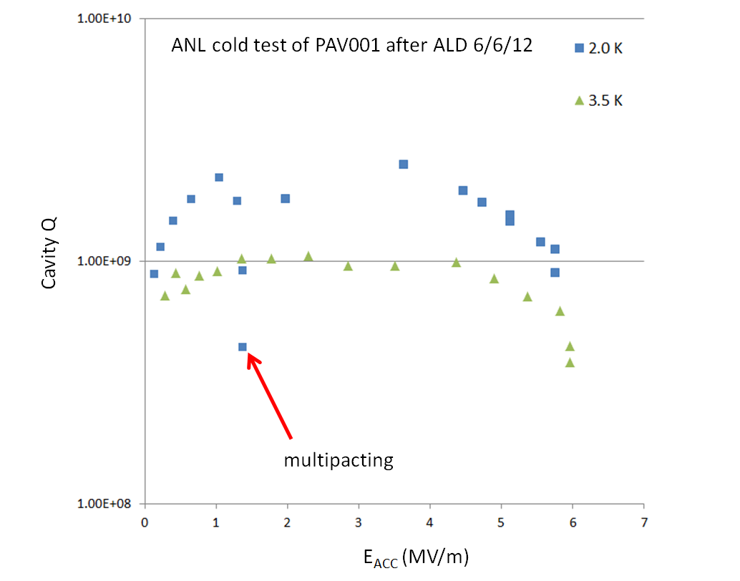
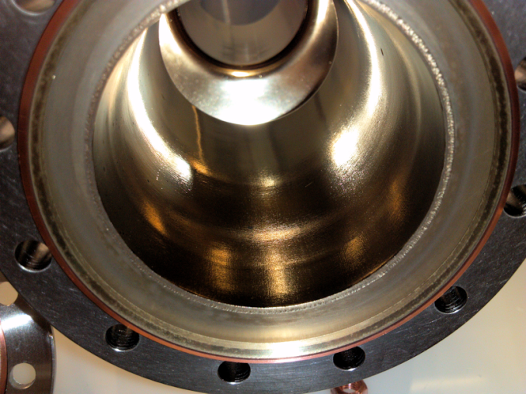
First cavity test
But:
Program stopped during deposition
Resist HPR and sonicator
BCP does not work -> tumbling @ Fermi (in line)
DOE Review 2013

Slide 6
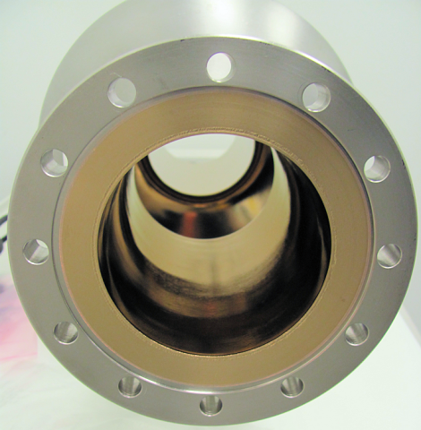
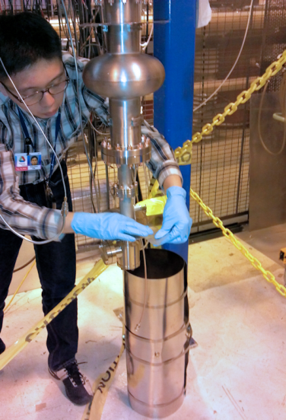
Blind Baseline test ANL
PAV002 uncoated: Fermi Baseline Q~ 10¹⁰
ANL Baseline Q ~ 10⁹
Improper Magnetic shielding.
Valve leaking
New shielding
New valves
Re-test: Q~ 10¹⁰ , Good calibration Accelerating field.
Coated PAV002 cavity with NbTiN/AlN/Nb
RF test on March 07
Coat Jlab ILC cavity with AlN/MoN/AlN/Nb
  Coating 13th March
DOE Review 2013

Slide 7
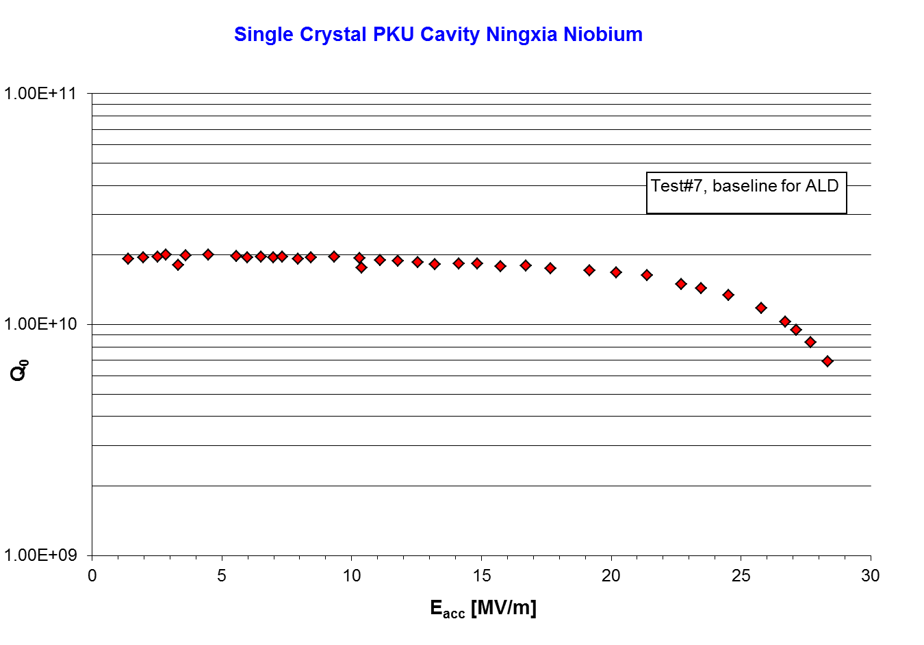
Scares Nb cavities / bottleneck of iterations (Jlab/FNAL …)
RF coupons testing as preliminary measure
DOE Review 2013

Slide 8
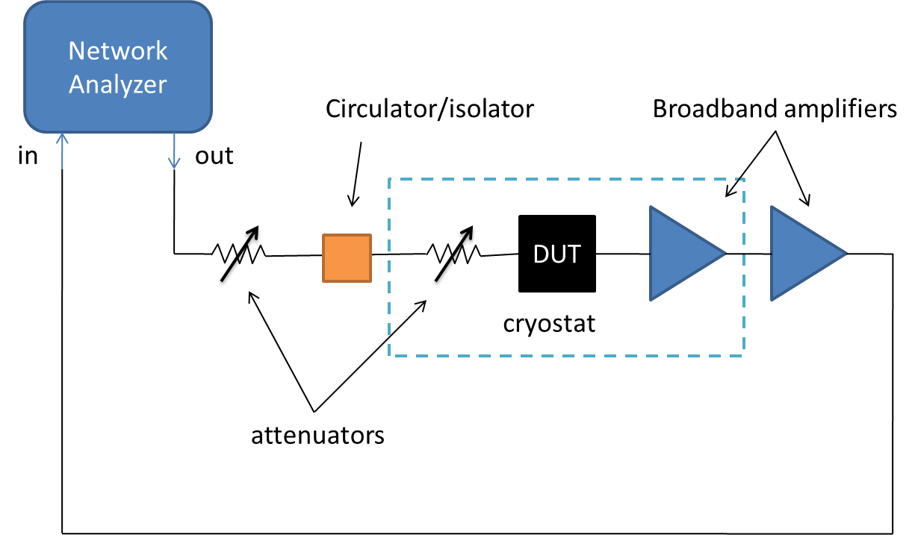


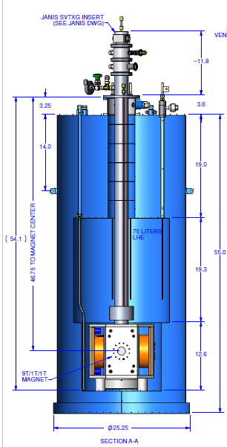
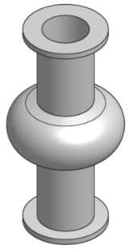
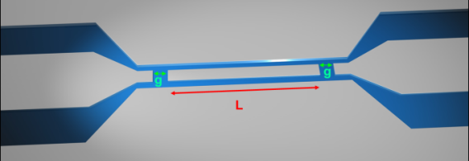
RF testing station for coupons
out
Network
Analyzer
in
Available for this project:
cryostat with 3-axis magnet (9T||z, 1 T ||x,y)
VTI (1.5 K – RT), 2.5”
Accommodates:
4”
18.7 Ghz <-> 3.4 mm
resonators patterned from new materials;
custom mounts
1.9”
small-scale cavities
DOE Review 2013

Slide 9
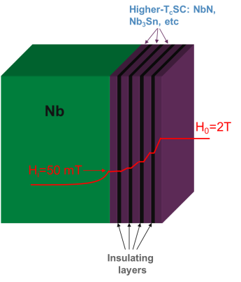
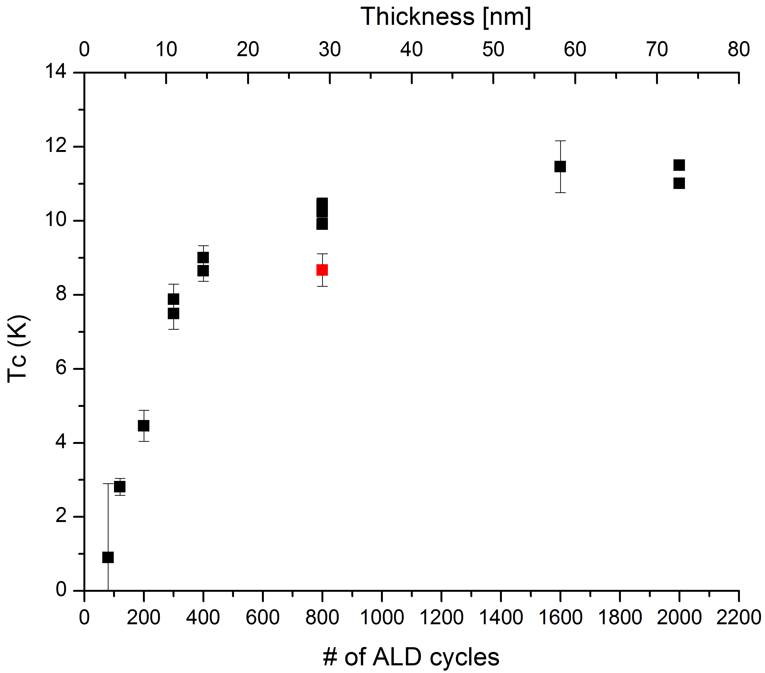
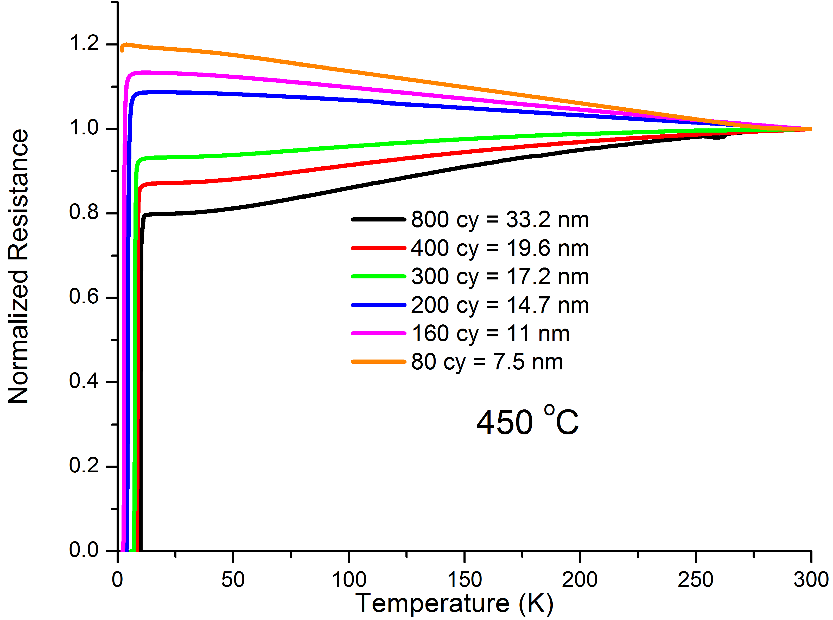
Superconductors by ALD (thin films)
MoN
condition ξ< d << λ
DOE Review 2013

Slide 10
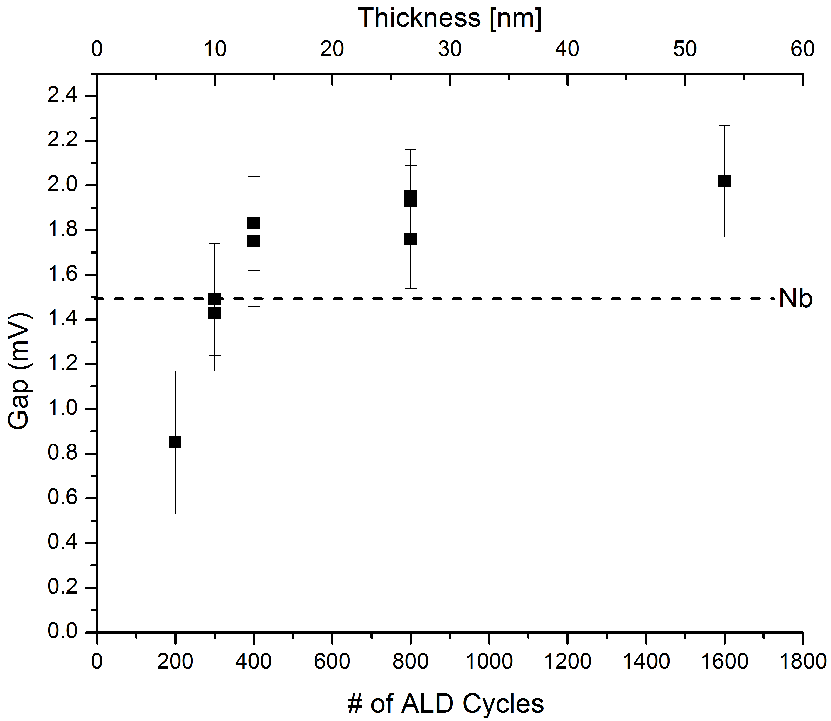
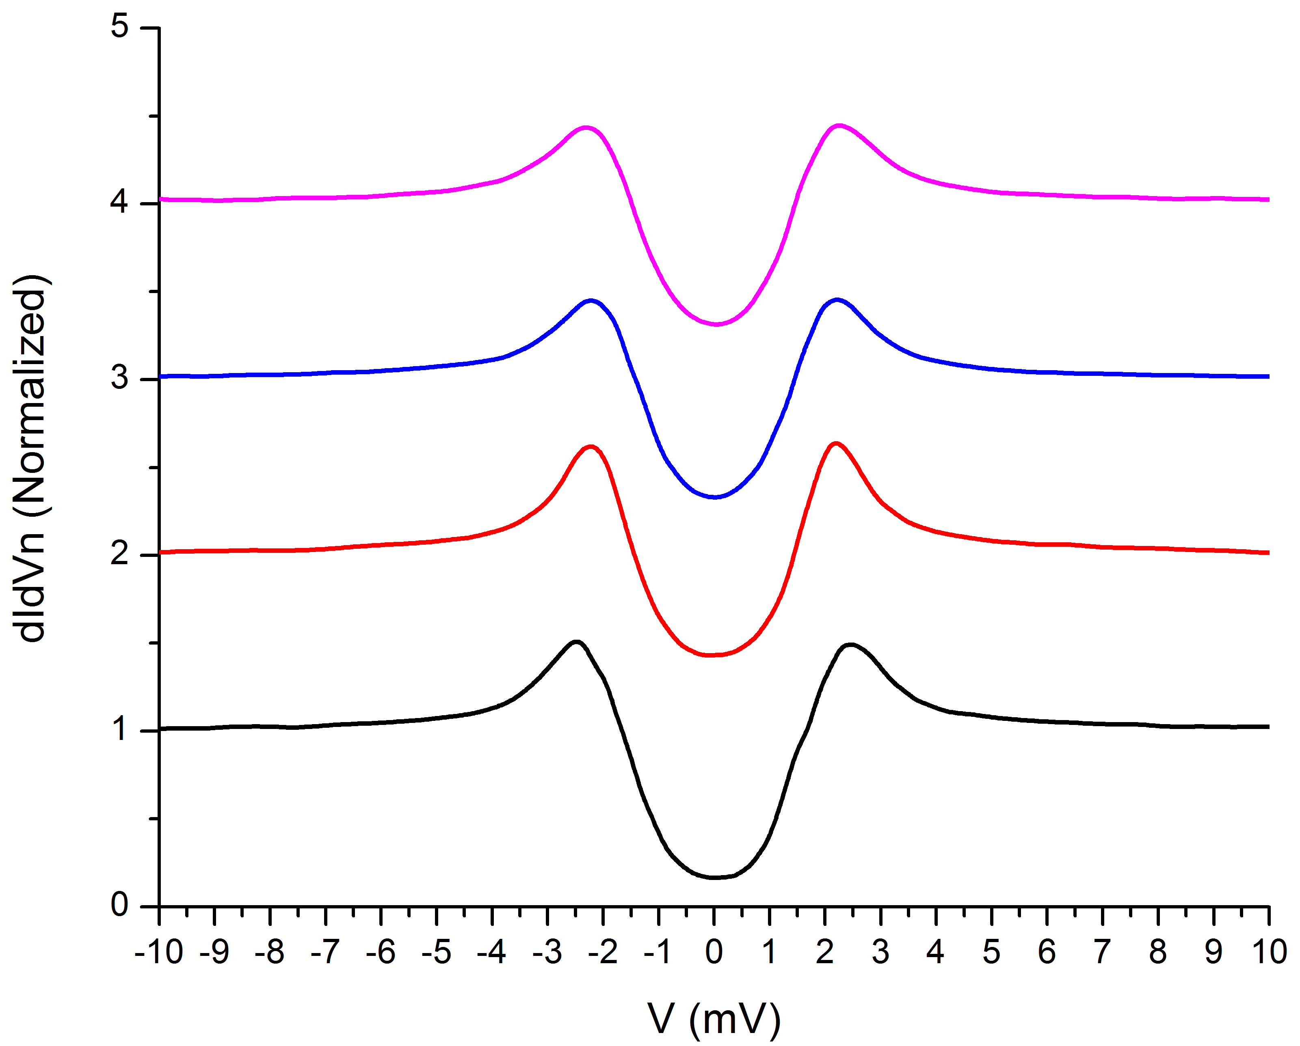
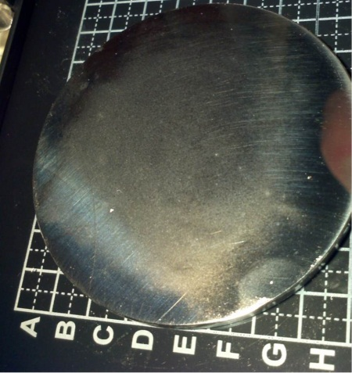
MoN by ALD: Gap
1600 cy = 60 nm
Δ = 2 meV
HPR on Si coupons -> didn’t change
Cu coupons -> changed
AlN/MoN/AlN
TiN/MoN/TiN
-> no change
DOE Review 2013

Slide 11
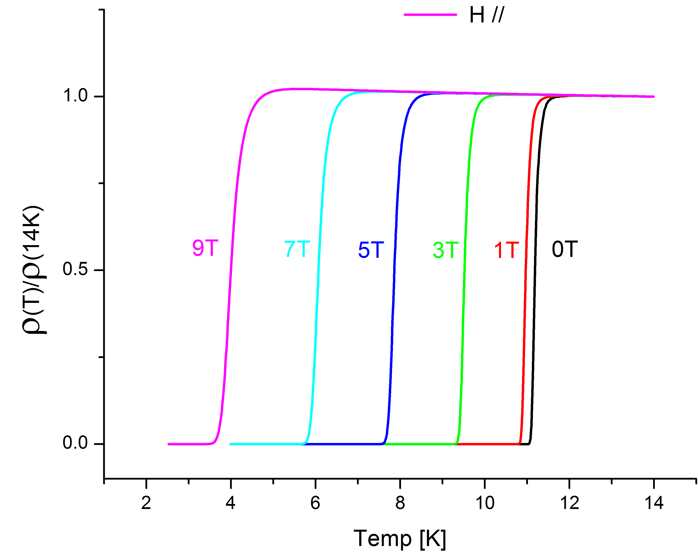
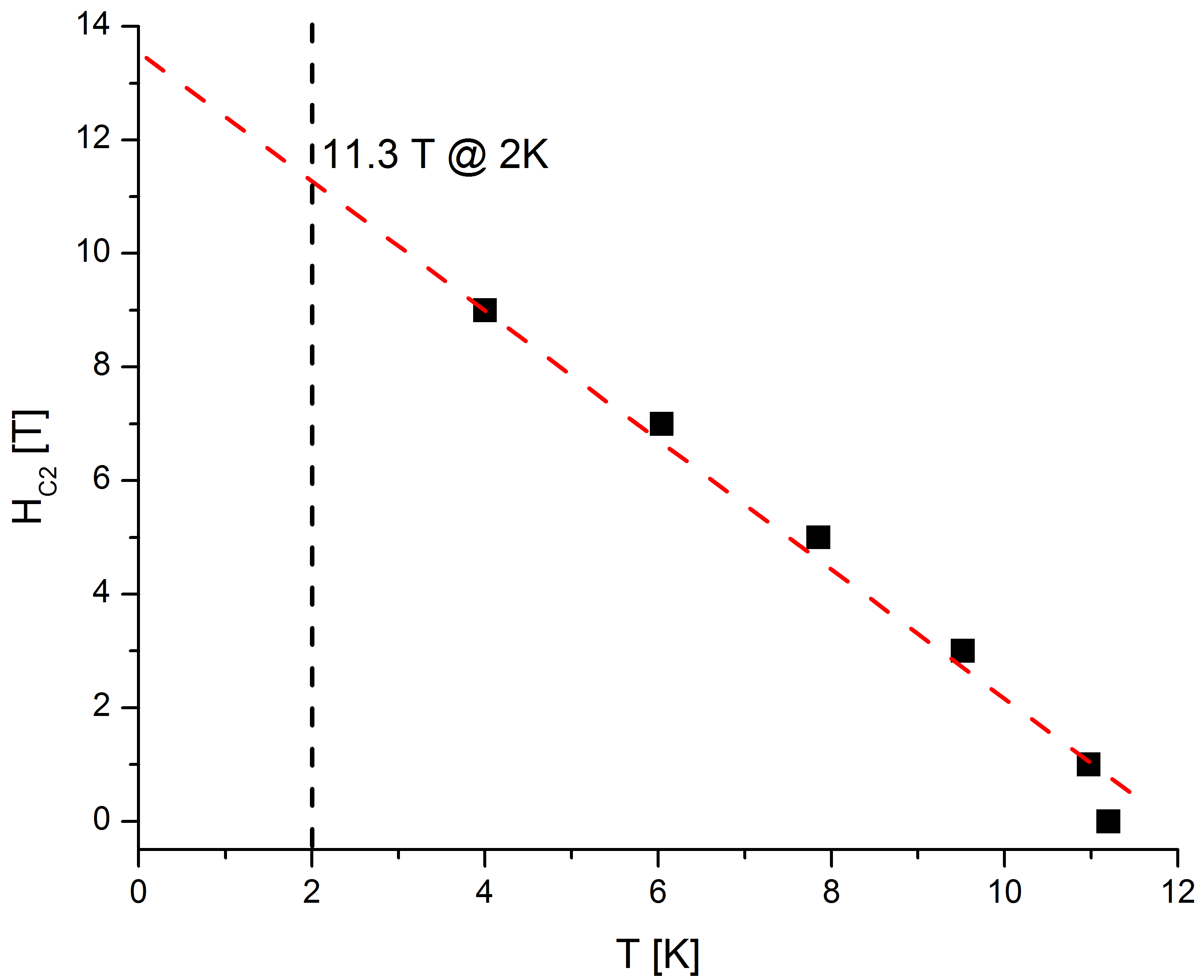


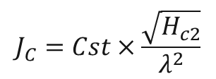
MoN in Magnetic filed
H
MoN
60 nm
H_{C2} [0K] = 13.5T
ξ [0K] ~ 6 nm
ξ [2K] ~ 6.6 nm
$$J_{C}=Cst×\frac{\sqrt{H_{c2}}}{λ^{2}}$$
$$J_{C}=3.3 {10}^{8} A/{cm}^{2}$$
At least 10 x higher than NbTi
Assume
$$λ \sim 100 nm$$
MoN 60 nm on 0.6 mm Cu wire
I_{MAX} ~ 1 Amp
Measure by Tunnel diode

Slide 12
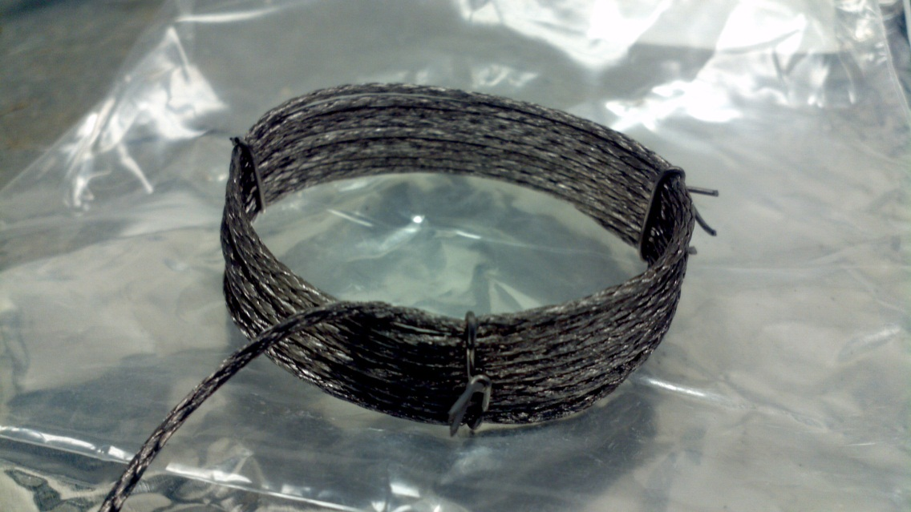
MoN superconducting wires
260 wires/ 50 μm diameter
I_{MAX} = 8000 Amps
Cu Stranded wires Coil
2”
80 nm

Slide 13
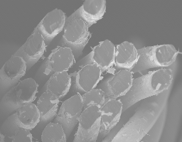
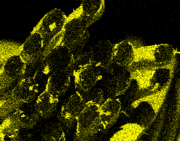
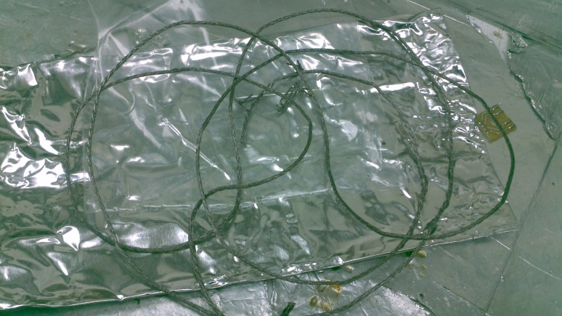
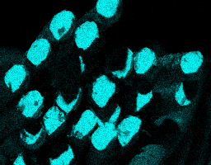
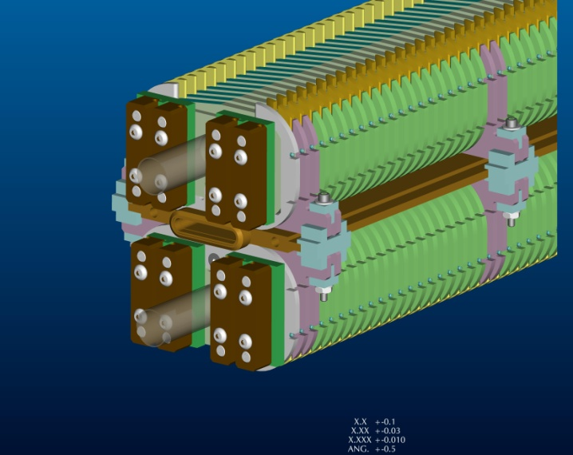
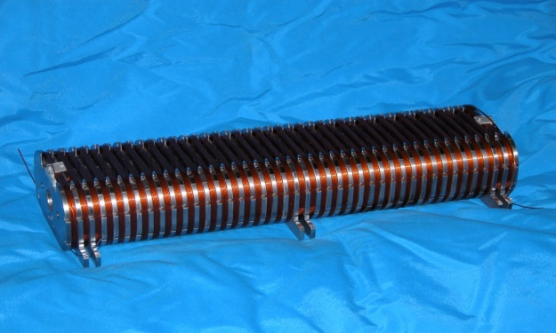
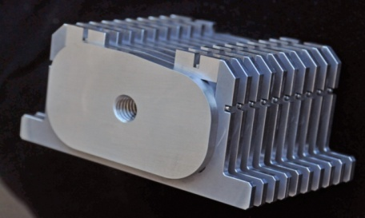
Superconducting undulator
SE
Mo
Cu
Testing/collab with Y. Yvanyushenkov
Cooling tube
Beam chamber
NbTi: 700 Amps

Slide 14
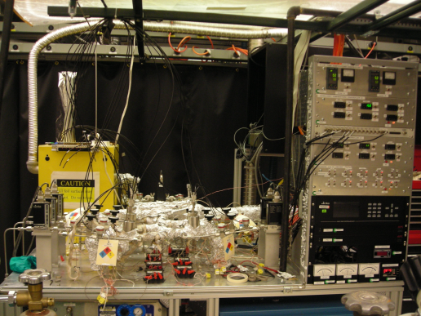
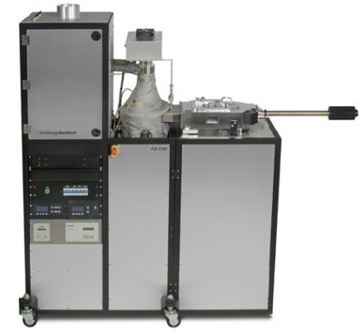
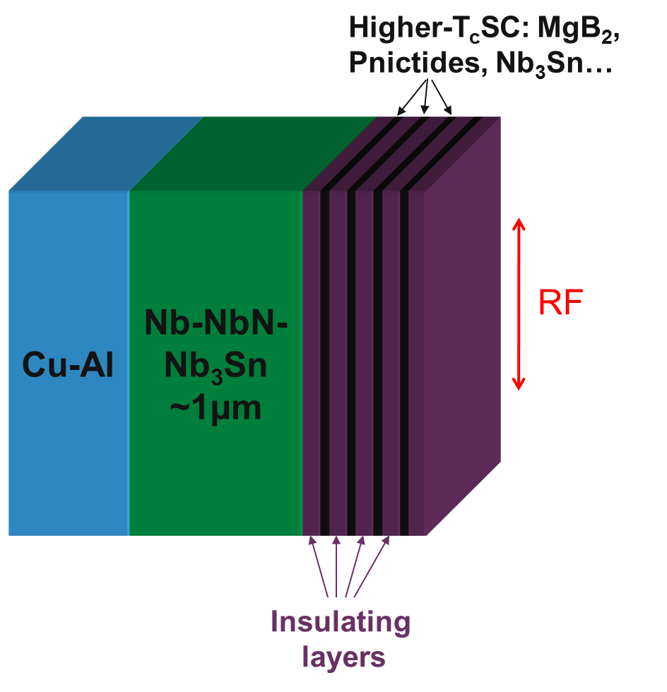
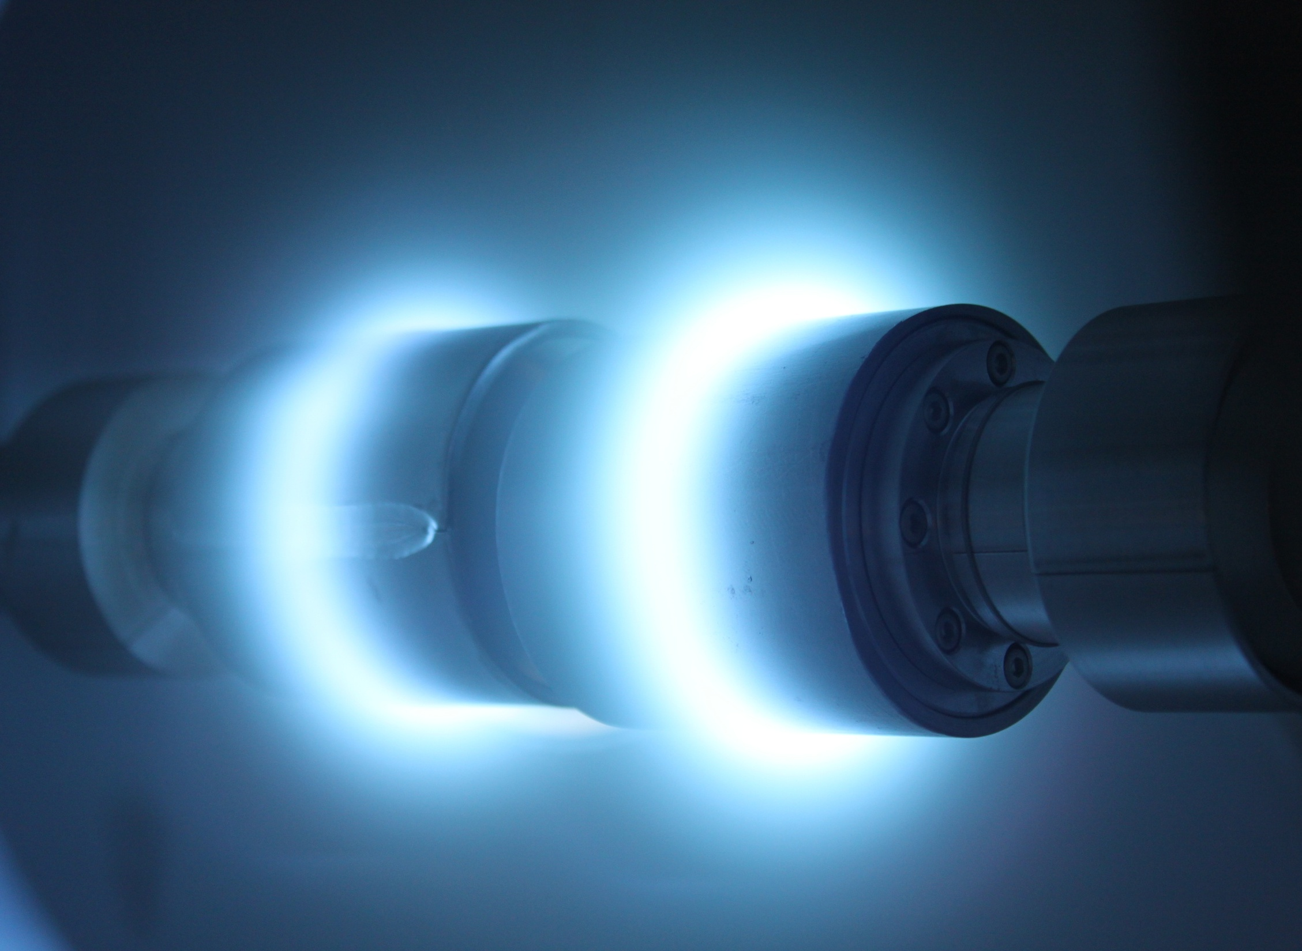
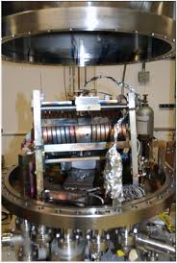
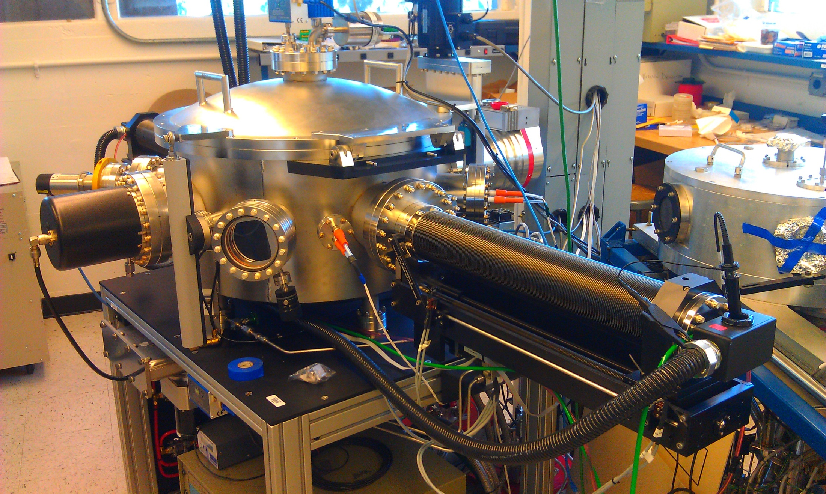
Synergy deposition techniques: Nb onto Cu
ALD/ANL
HIPIMS/Berkeley
ECD/Jlab & Alameda
Early career award
DOE Review 2013

Slide 15
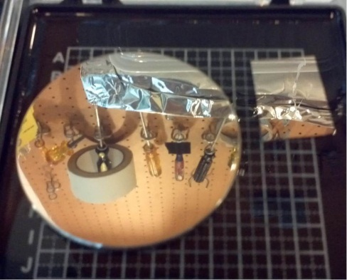
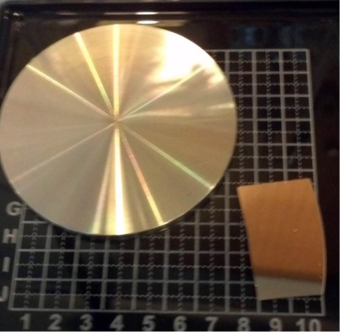
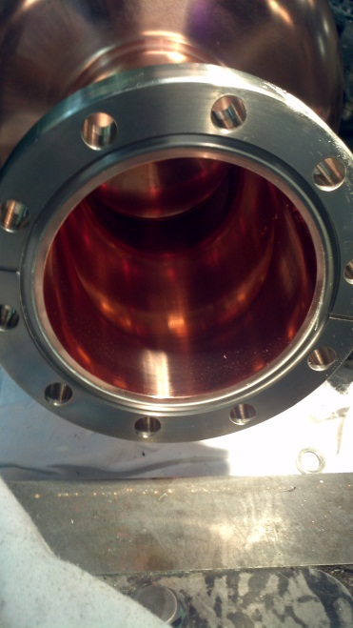
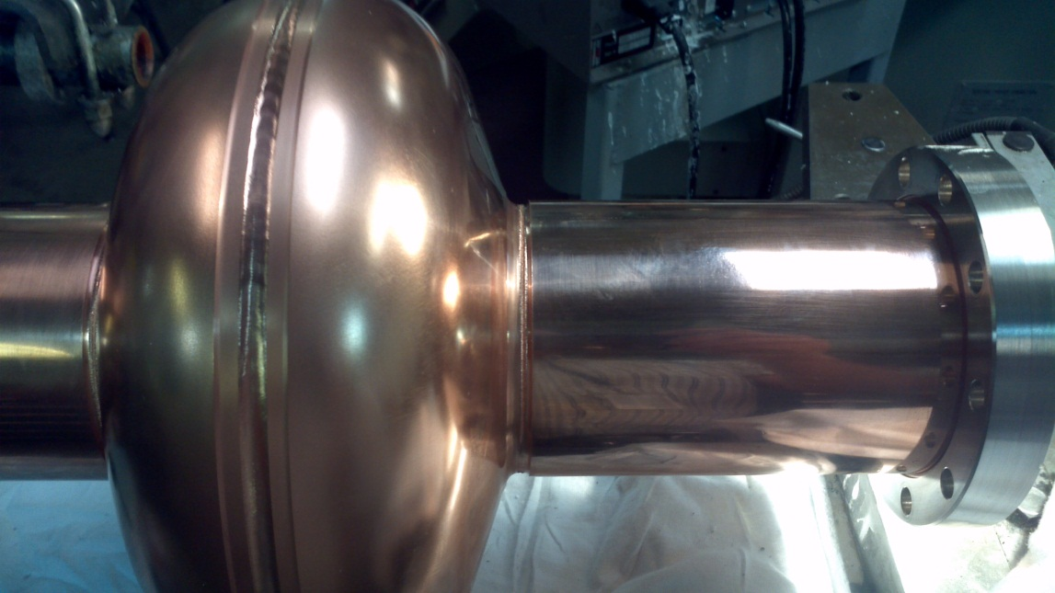
Initial surface roughness?
Cu surface: Surface roughness, Sticking onto Cu
μm Sup films <-> roughness
4/HPR, All
3/EP (Able Electro)
2/Mechanical polish
(mirror-intermediate(5μm))
1/Machining
~1μm
>30μm
10 coupons
AlN/MoN
intermediate(5μm)
1 Cu cavity EP
1 Cu cavity Pol + EP
Nb/ Cu cavity
from Jlab
APS optic shop
600nm
DOE Review 2013

Slide 16
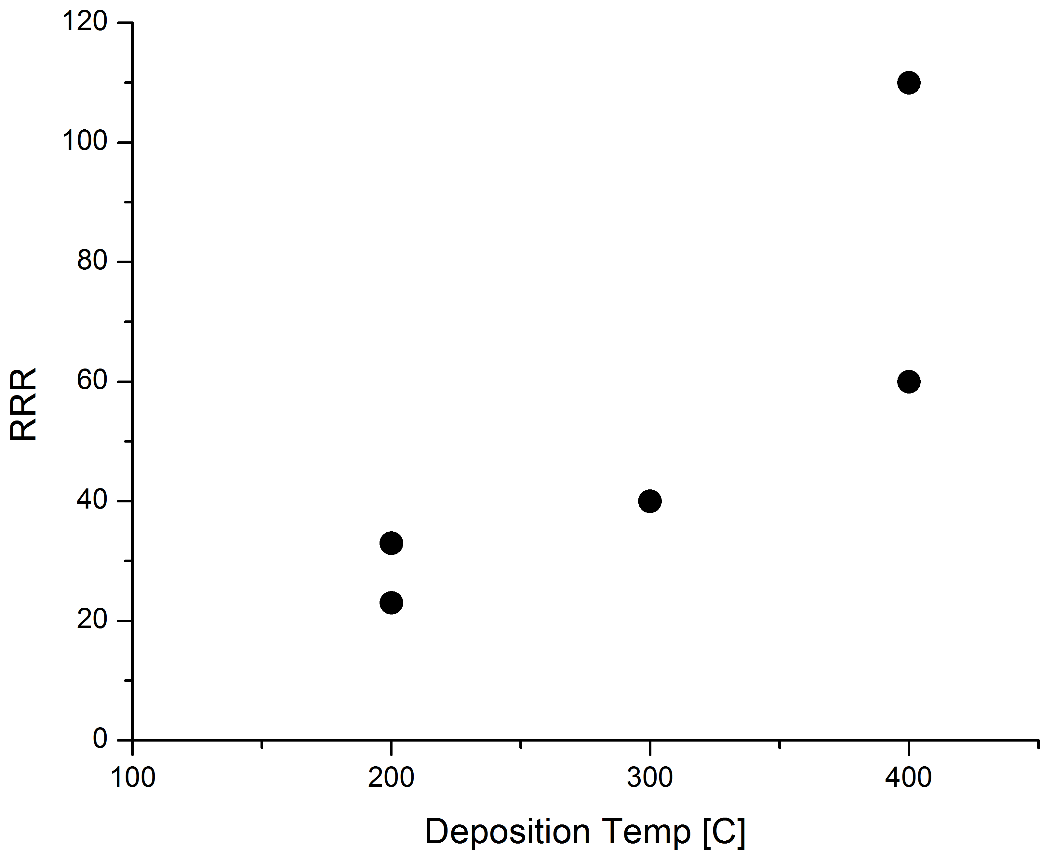
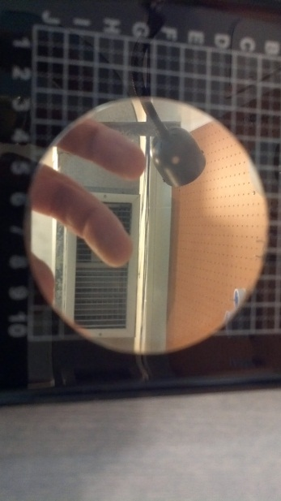
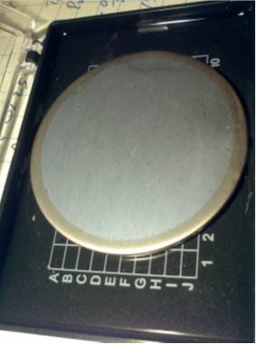


Sticking/diffusion barrier
High RRR for T >~ 400 C
BUT! delamination occurs
Solution: seed layer/diffusion barrier
ALD can Help:
Nitrides
Nb on Cu
AlN/NbTiN
AlN/MoN/AlN
900 nm
HPR 2000 psi
HPR 2000 psi
Send coupons to HIPIMS/Alameda/Jlab
RF tested @ Jlab (end of March)
Send EP Cu Cavity to Alameda (20 march)
Dep of Nb @ 450C and above.
600 nm
Nb sputt @ ANL @ 450C in 10⁻⁷ Torr
TiN, AlN, MoN/TiN coating works
DOE Review 2013

Slide 17


HIPIMS (High Impulse Magnetron Sputtering)
DOE Review 2013

Slide 18


HIPIMS of Nb/Cu or Al: Superconductivity @ ANL
Mix Nb-Cu
High Quality Nb/Cu or Al
⬄ bulk Nb
Resist HPR test
DOE Review 2013

Slide 19




Cavities test ⬄ Uniformity
Test Cavity-coupons Jlab (Kneisel)
Uniform cavity heating in HIPIMS chamber
Fast heating + UHV compatible: IR solution (Heraeus)
2” OD magnetron do not ignite (e mfp interrupted)
1” OD -> ignite inside the cavity tube/ small I
Varying the speed of the magnetron arm
-> control on uniformity
DOE Review 2013

Slide 20



Point contact
1/ ANNEALING IN N₂ (FERMI)
Very low gap -> proximity effect?
X-ray on coupons at IIT -> Nb₂N phase (no NbN)
DOE Review 2013

Slide 21



Point contact
2/ ANNEALING of Nb IN UHV (JLAB)
Correlation with Cavity results:
1400 C heat treatment homogenized gap
To bulk Nb.
Ongoing temp for higher temp treatment
DOE Review 2013

Slide 22








PHYS-APS
Testing
HEP
support-funding
M. Kelly
Th. Proslier
Collab
Berkeley, FNAL, JLAB
MSD
ALD-PCT-characterization
A-M. Valente, Kneisel, Giovati
J. Klug, N. Groll,
N. Becker, C. Cao
A. Anders, R. Mendelsberg
DOE Review 2013

Slide 23
Conclusion
Opportunities Coils
Cu Cavity/Nb cavity coating tests
    Multilayers
    Seed layers
    Not enough Nb cavity!
DOE Review 2013

Slide 24


PCT Spectrum Dependence on Junction Resistance
High Z junction
Low Z junction
Au Tip
Nb₂O₅
NbO₂
NbO
Nb
Depairing region

Slide 25


Γ collapses for Z < 1.5
Au tip scraping through surface oxide removes depairing

Slide 26



Fermi lab cold spot
Significantly lower Γ values

Slide 27





28nm Nb_{0.8}Ti_{0.2}N (without AlN layer)
T_{c}= 8.3K
by SQUID
Δ(meV)
Γ(meV)

