Slide 1
AWA Experiments
Chunguang Jing (Euclid Techlabs & AWA)

Slide 2
Core Experiments: 2009-2014
Goal | Key technologies | Experiments: 2009-2012 | Scheduled Experiments: 2013-2014
Advanced (dielectric based) short rf pulse Two-Beam Accelerator | High charge bunch train generation | High QE cathode test: 2011 | 19MeV 32*40nC bunch train characterization: 2013 spring 75MeV 32*40nC bunch train characterization: 2013 summer
 | High freq. high power short pulse rf generation | 26GHz high power rf generation:2009. High power rf test of Dielectric PETS: 2012 | GW level X-band rf generation: 2013 winter Multi-hundreds MW K-band rf generation: 2013 fall.
 | High grad. short pulse accelerating structure | Tests of external Powered DLA s: 2009-2012 Multipactor suppression using solenoid: 2012 | Test of K-band short pulse high gradient accelerator: 2014 spring Two beam acceleration: 2014 spring

Slide 3
Complementary Experiments: 2009-2014
Goal | Key technologies | Experiments: 2009-2012 | Scheduled Experiments: 2013-2014
Advanced (dielectric-based) high gradient collinear wakefield accelerator | Bunch shaping | Demonstration of transformer ratio of 3.4 using ramped bunch train: 2010 LPS measurement using half exchanger: 2011 | Triangular bunch generation: 2013 summer Transform ratio enhancement through a shaped bunch : 2014 summer
 | High gradient wakefield structure | Demonstration of the 1st tunable DWA: 2011 300MV/m diamond DWA test: 2012 | Collinear wakefield acceleration: 2014 fall

Slide 4
Collaborators: 2009-2014
Experiments: 2009-2012 | Scheduled Experiments: 2013-2014
Dipole modes characterization of PBG structure (AWA/Euclid/Tsinghua): 2009 Demonstration of the 1st two channel DWA (Omega-P/AWA): 2010 Alpha BBO crystal based micro bunching generation (AWA/NIU): 2011 Fundamental metal surface emission study(AWA/ Tsinghua Uni. ): 2011 THz wakefield mapping (Euclid/AWA/ATF): 2011 Wakefield based energy chirp compensation (Euclid/AWA/APS/ATF): 2011 High power THz generation using wakefield modulation (Euclid/AWA/ATF): 2011-2012 Ring beam generation (AWA/Omega-P): 2012 DWA at FACET (UCLA/Euclid/AWA): 2012 Standing Wave DLA test (Euclid/NRL/AWA) : 2012 | Wakefield characterization of CLIC choke mode cavities (Tsinghua/AWA/CLIC): 2013 spring High power rf test of Muon high pressure cavity (Muon Inc./AWA): 2013 spring Coaxial wakefield accelerator (Omega-P/AWA): 2013 summer PBG power extractor (LNAL/AWA): 2014 spring Dielectric multipactor study (Euclid/NRL/AWA): 2013-2014 DWA at FACET (UCLA/Euclid/AWA): 2013-2014 Fundamental rf breakdown studies (Euclid/AWA/SLAC): 2013-2014

Slide 5
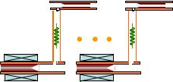
Two Beam Acceleration at AWA
Short, Ultrahigh Power RF pulse→~25ns, 1.3GW
High Gradient → >300MV/m
Broad band TW accelerator →fast rf rise time.
Large (~10%c) Vg → less filling time.
high frequency and optimal beam loading → higher rf-to-beam efficiency.
e.g. rf-to-beam efficiency of a 26GHz Short Pulse Accelerator:
T_{rf}=28ns
3ns
Competitive rf-beam efficiency for the short pulse TBA
3ns
6.5A
267MV/m
0.3m
16ns
T_{f}=9ns
T_{beam}=16ns
1.264GW
25ns

Slide 6
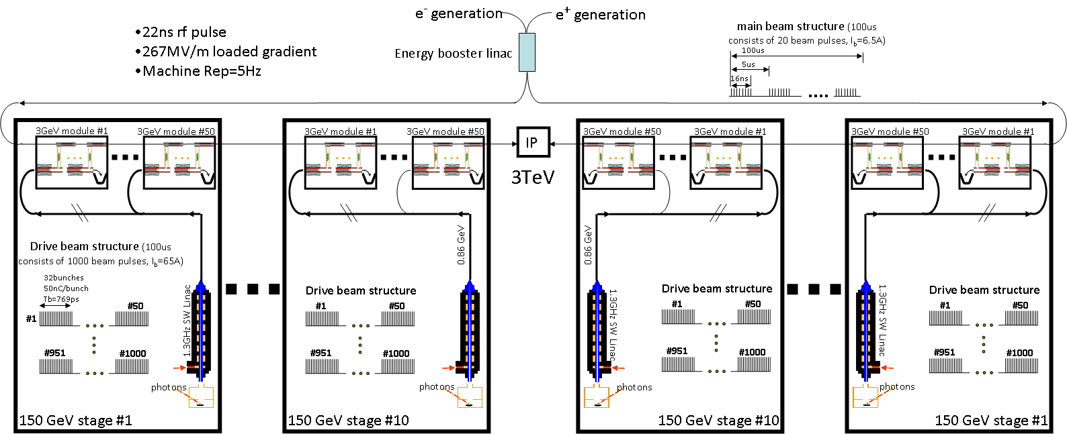
3TeV Argonne Flexible Linear Collider
18km
7.5km linac
7.5km linac

Slide 7
High Power RF Generation @AWA

Slide 8
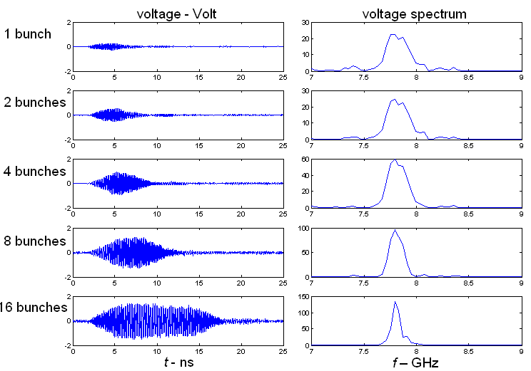
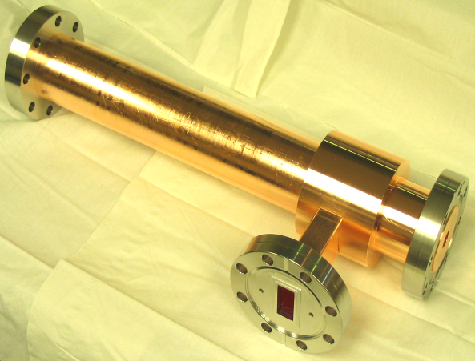
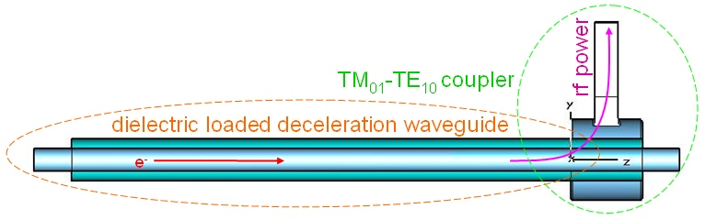
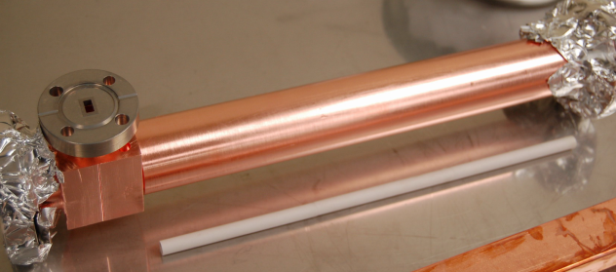
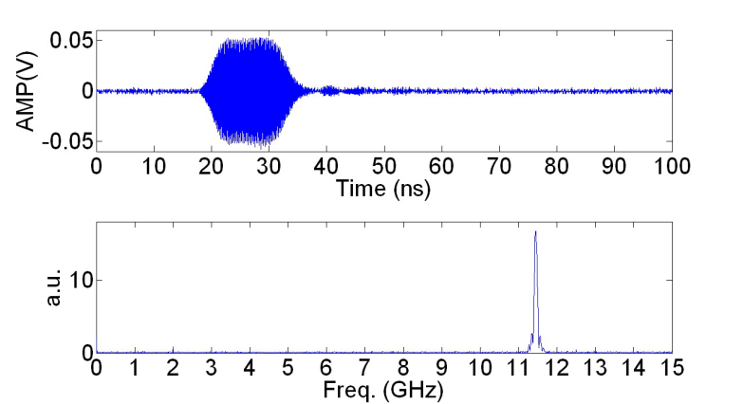
Development of Dielectric-Based Wakefield Power Extractors
C-Band Wakefield Power extractor
Dielectric-Loaded deceleration waveguide
30ns,1MW & 10ns, 40MW 7.8GHz rf pulse produced
TM₀₁-TE₁₀ coupler
rf output port
K-Band Wakefield Power extractor
16ns,1MW & 10ns, 20MW 26GHz rf pulse produced
Downconverted signal
11.44+14.576=26.016 GHz

Slide 9
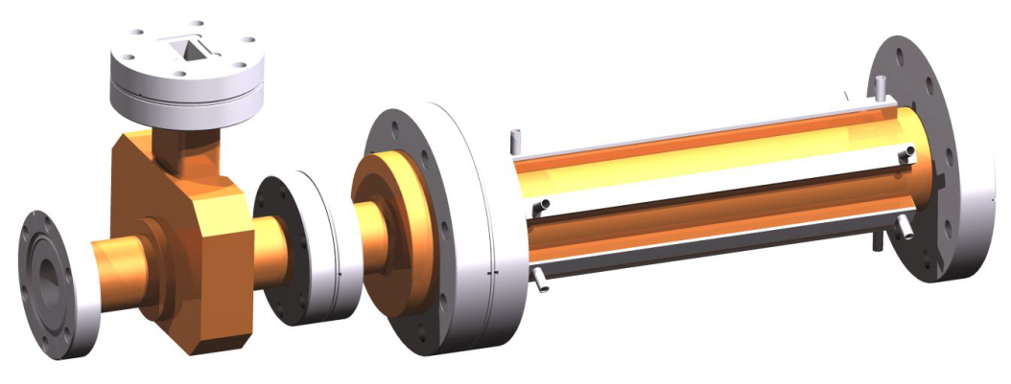
Dielectric PETS (CLIC Power Extraction and Transfer Structure)
Using CLIC Beam: σz=1mm, Q=8.4nC, Tb=83ps
Freq | 11.994GHz
Effective Length | 23cm
Beam channel | 23mm
Dielectric wall thickness | 2.582mm
Dielectric const. | 3.75(Quartz)
Q | 7318
R/Q | 2.171kΩ/m
Vg | 0.4846c
Peak surface Gradient | E_{ll}=12.65MV/m; E⊥=18.28MV/m
Steady Power | 142MW

Slide 10
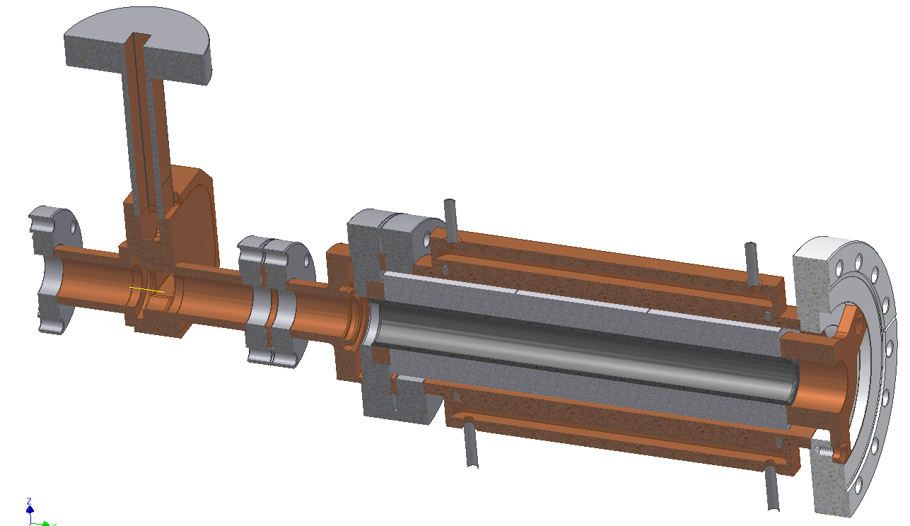
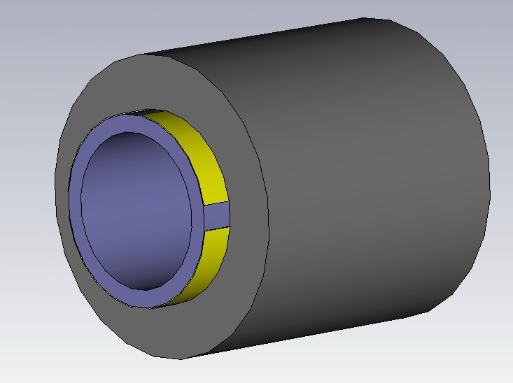
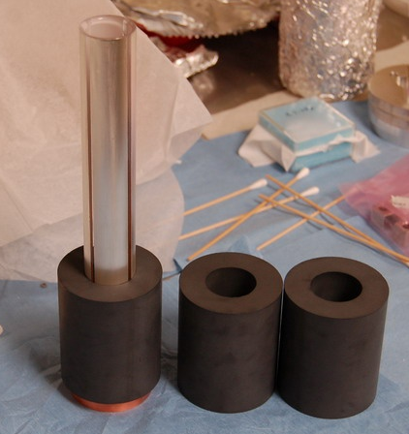
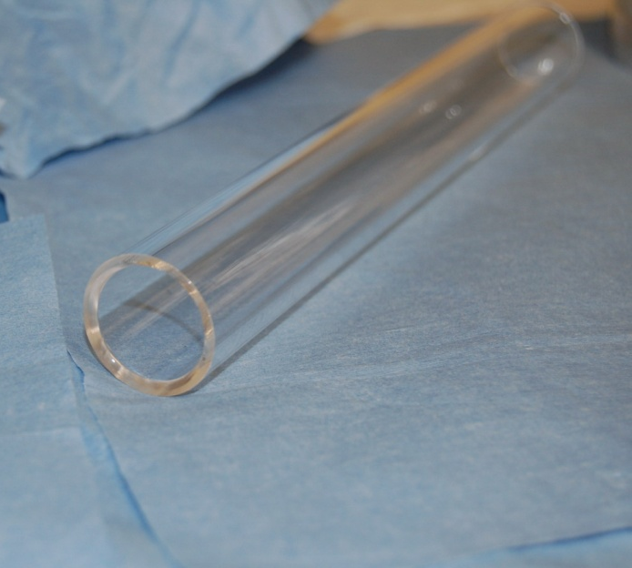
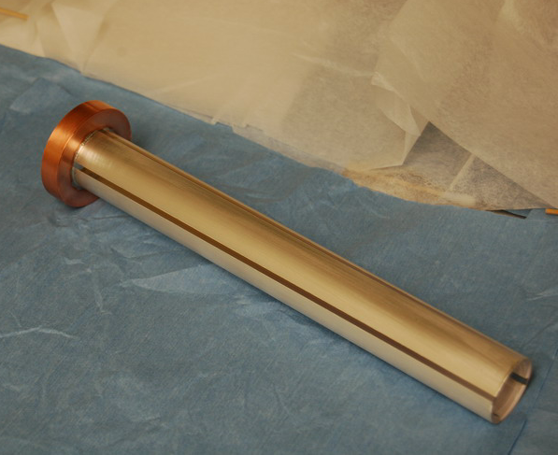
Construction
Dielectric loaded waveguide
RF output coupler
Impedance matching section
Transverse mode damping
Quartz tube
SiC tube
metalization
3 section of damper
Brazed copper ring
Quartz tube

Slide 11
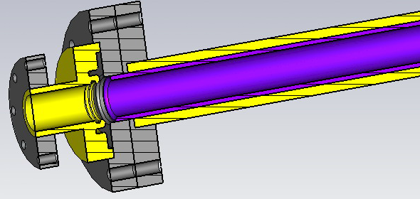
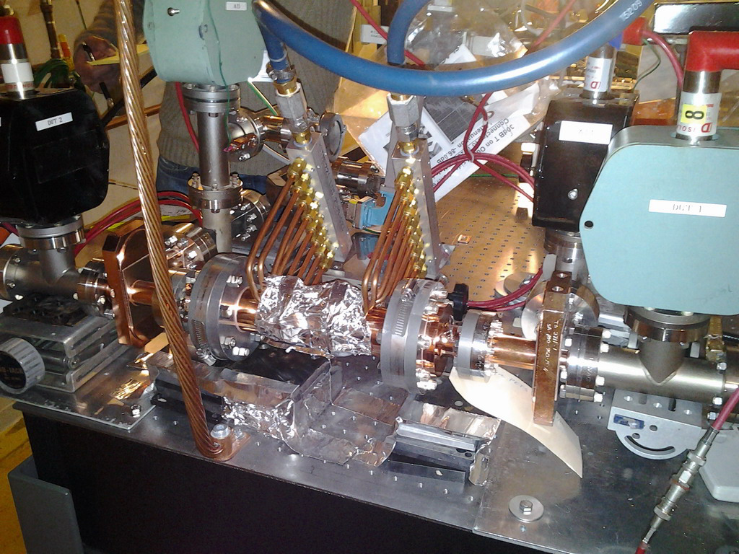
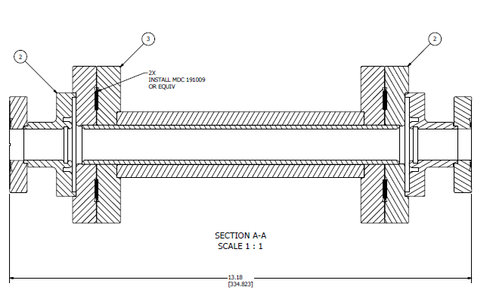
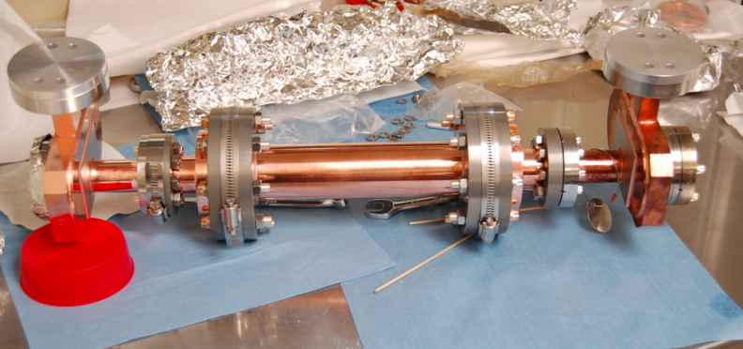
11.4GHz version Dielectric PETS under high power rf test @ SLAC
Setup at SLAC ASTA facility
11

Slide 12
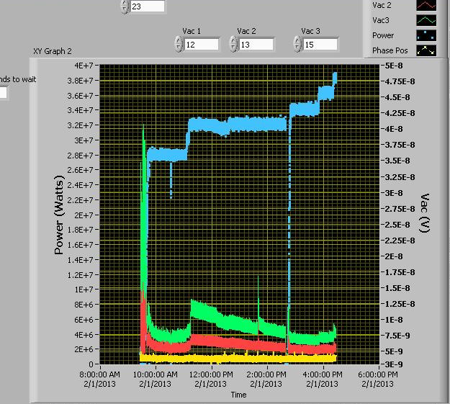
Testing data on 2/1/2013 (100ns flat pulse)
Test continues at SLAC.
Input Power: 39MW
May cut the cost of CLIC PETS by 2/3!
Torr
3 ion pumps attached to the structure.
Vacuum stay below 1e-8 torr.

Slide 13
Short rf Pulse Dielectric Accelerator @AWA

Slide 14
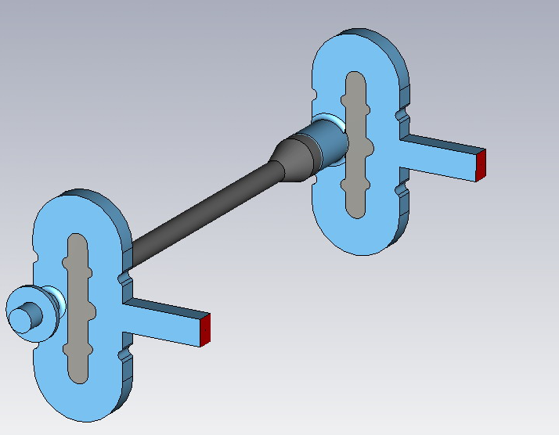
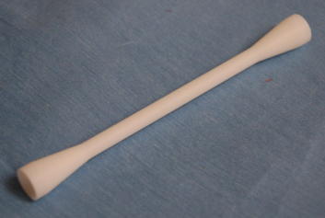
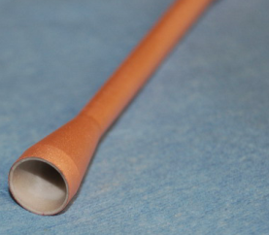
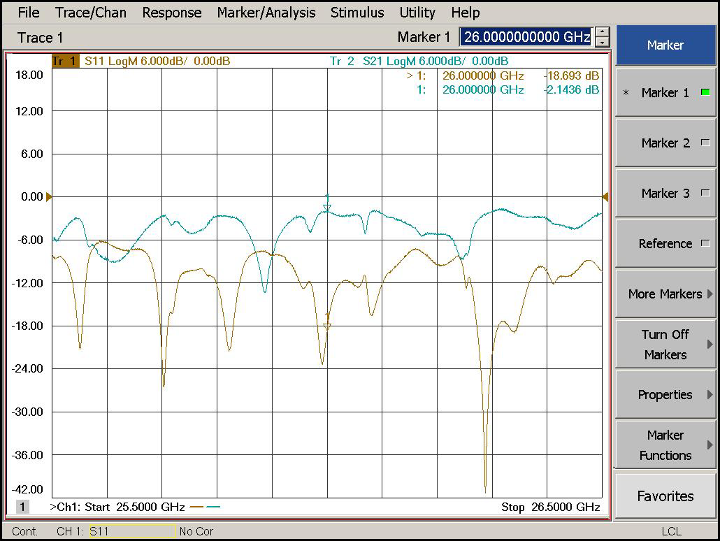
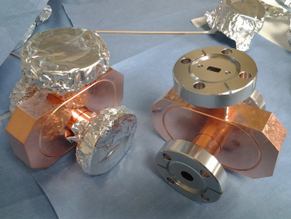
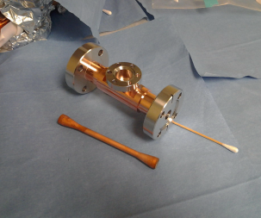
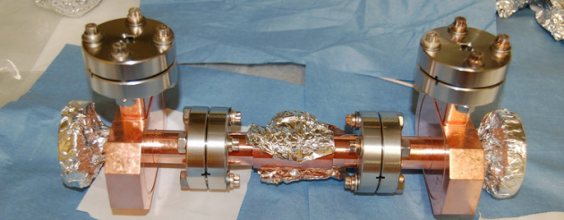
Fabricated 26GHz short pulse DLA Structure
parameters | value
ID / OD of dielectric tube | 3 mm /5.025 mm
Dielectric constant | 9.7
Length of dielectric tubes | 105 mm
Vg | 11.13%c
R/Q | 21.98 kΩ/m
Q (loss tan=10^-4) | 2295
Shunt impedance | 50.44 MΩ/m
E_{acc} for 316MW input | 158 MV/m
S21=-2.1dB S11=-18.9dB@26GHz

Slide 15


Planned Two beam acceleration experiment @AWA
26GHz Stage I DWPE
a=3.5mm; b=4.53mm;
eps=6.64; L=30cm
75MeV drive beam
16 bunches x 60nC/per bunch
σz=2mm
65MeV drive beam
(10MeV loss)
RF Power Generation
767MW x15ns
26GHz rf
26GHz Stage II DLA
a=3mm; b=5.03mm;
eps=9.7; Vg=11%c; L=30cm
witness (10 MeV)
Q=1nC, σz=1mm, ε=1.5 um
witness (85 MeV)
Ez = 250MV/m
15

Slide 16
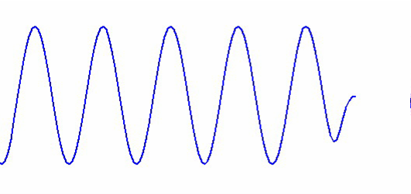
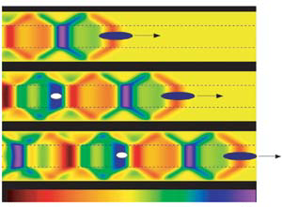
Dielectric Collinear Wakefield Acceleration
q (gain energy)
Q (lose energy)
Accel. Voltage:
Wake function: structure related;
Drive bunch current;
Bunch shaping

Slide 17
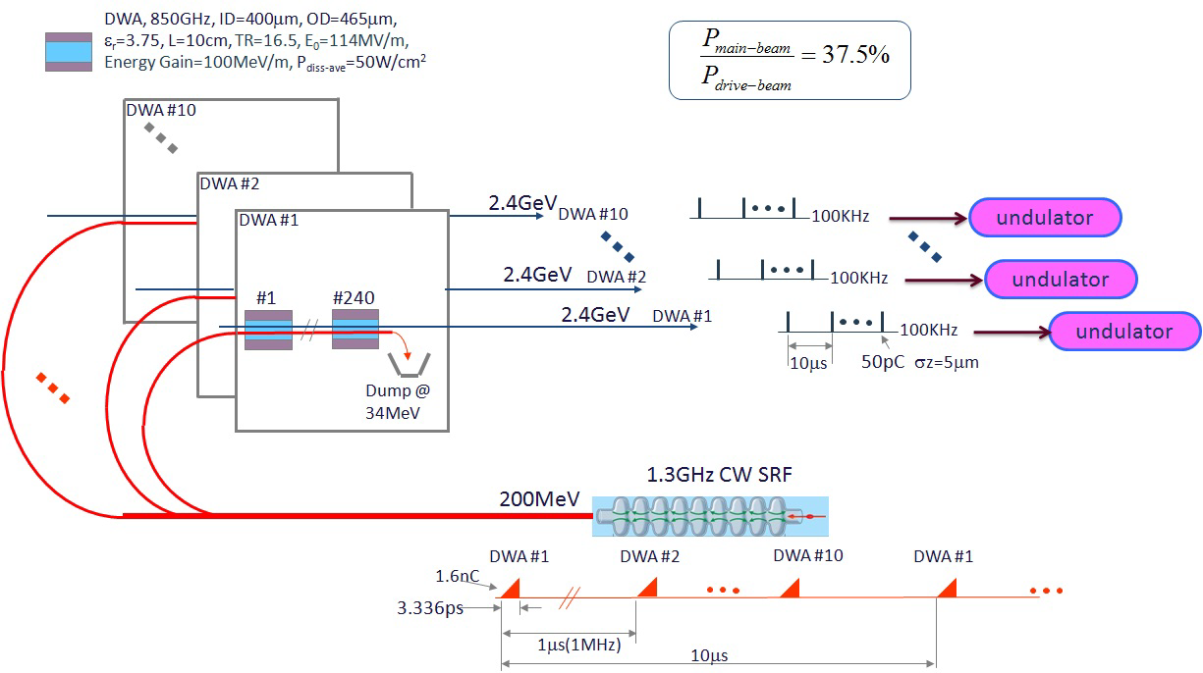
Technology for HEP machine also have great impact in other applications: e.g. Dielectric wakefield accelerator to drive future FEL (100MeV/m, 100kHz Rep.)

Slide 18
High Efficiency Wakefield Acceleration
W
+
ρ
(z)
Ramped Bunch Train
z
W
-
d
d
d
Ramped Bunch
(Trailing bunch)
Transformer Ratio:
(driving bunch)
Directly related to efficiency;
>>2 is preferred;
temporal shape of the bunch determined;
favors ramped charge profile and its variations;

Slide 19
Demonstrated Transformer Ratio Enhancement @ AWA

Slide 20
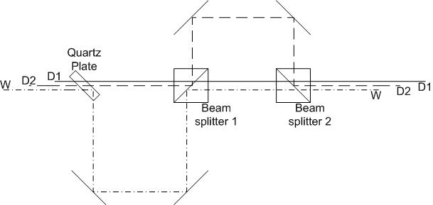
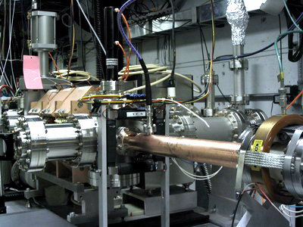

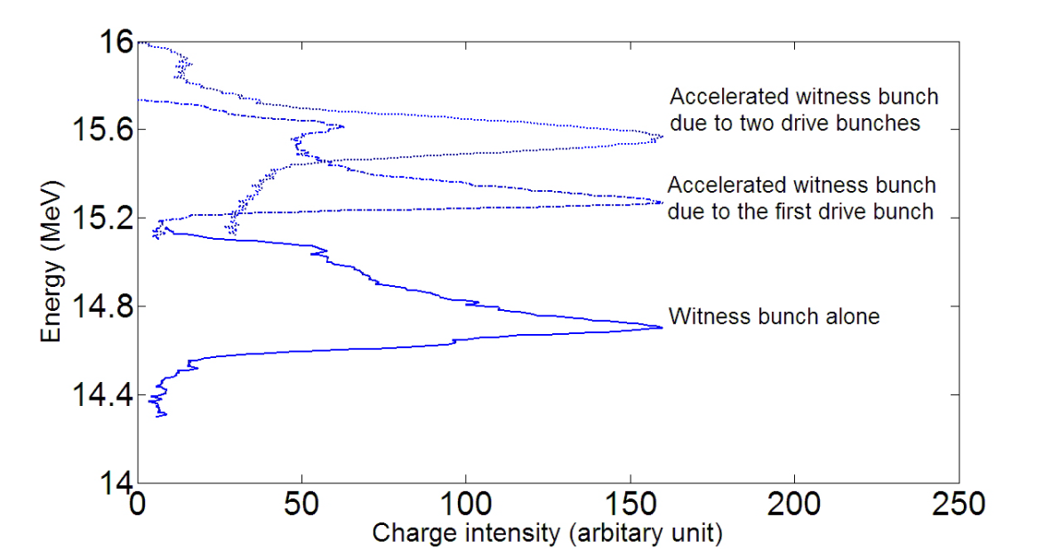
Two Transformer Ratio Enhancement Experiments at AWA
Bunch train generation
~770ps
~770ps
W
D2
D1
13.625GHz DLA structure
Transform Ratio R was first demonstrated over the limit of 2 in 2006. Results were reported on PRL 98, 144801, 2007.
With improved experiment conditions, we achieved record high R of 3.4 in the 2nd experiment in 2010. Results were published in PR ST-AB, 14, 021302, 2011.
Measured bunch energy distribution

Slide 21
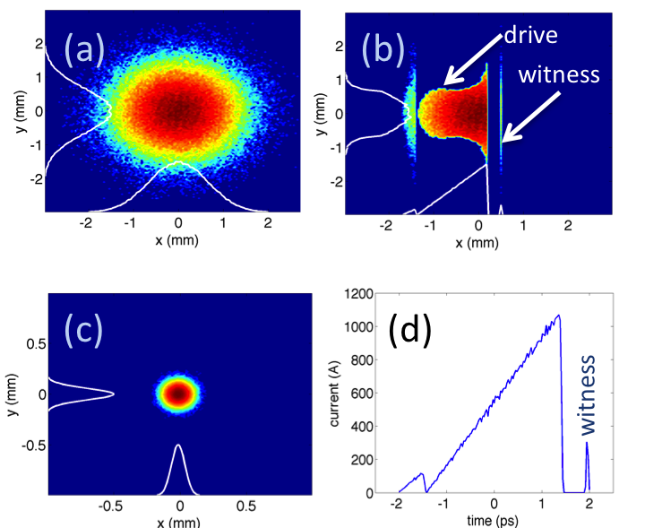
Bunch shaping for high transformer ratio
y
Mask
Dipole
Beam
Deflecting cavity
(b)
I
(a)
x
witness
drive
Emittance Exchanger
(c) (d)
t
Works well for a few nC charge after mask;
flexible with mask shape
witness bunch can be produced with the same mask to avoid the timing jitter;
Simulation by P. Piot (NIU)

Slide 22
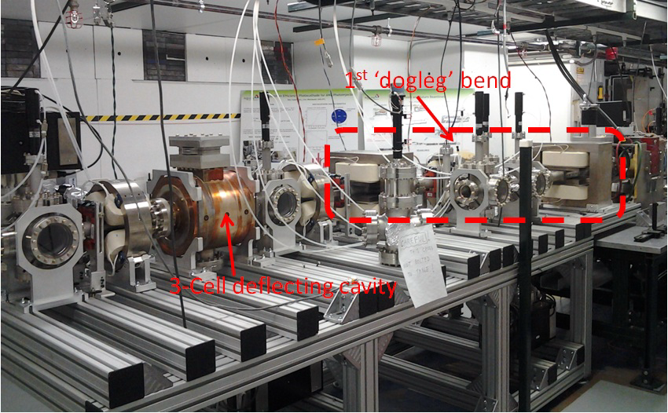
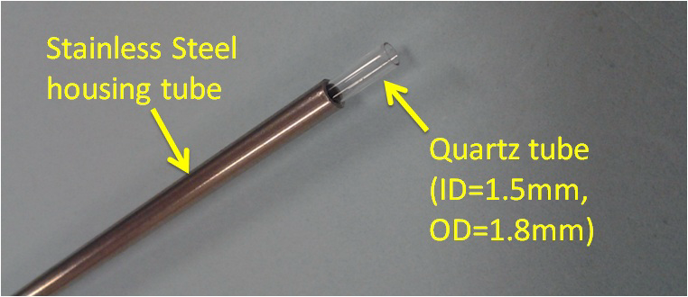
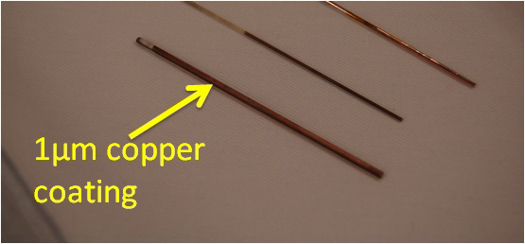
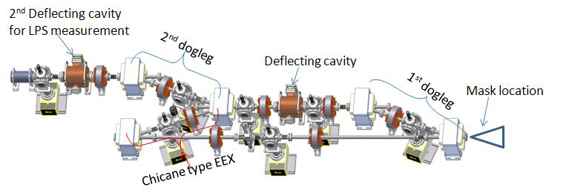
Experiment in 2 years
EEX beamline at AWA in 2011
200GHz DWA construction
EEX beamline at AWA in 2013

Slide 23
High Gradient Collinear Wakefield Experiments @ AWA

Slide 24
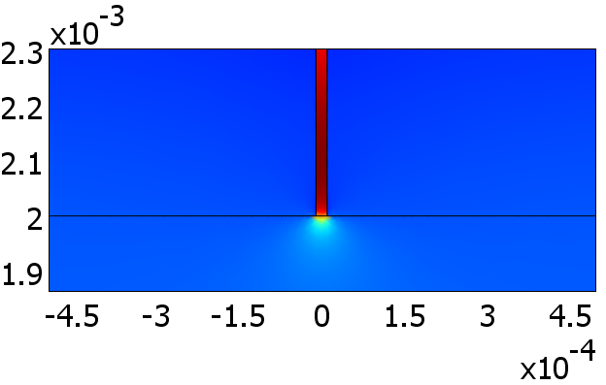
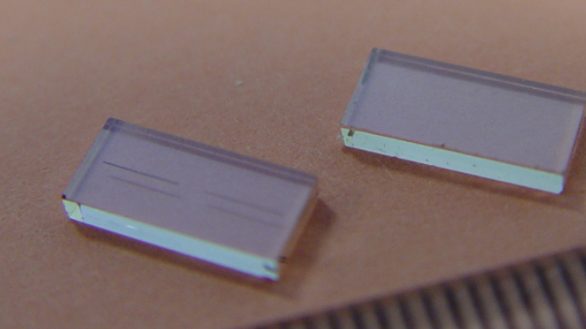
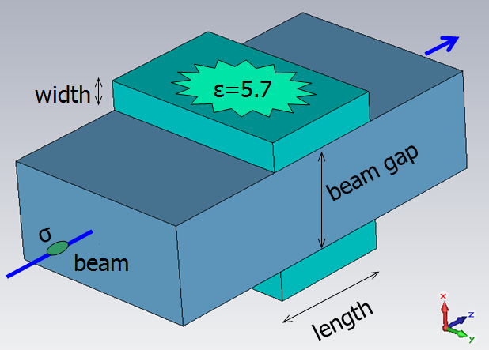
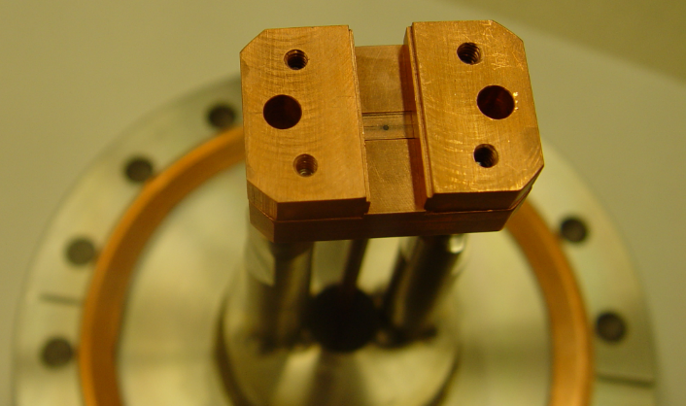
High Grad. Breakdown Study of A Diamond Slab Structure @ AWA (2012)
E/Ea = 5 in the groove
Our goal is to perform first WF experiment with Diamond-based DLA, test for breakdown
Laser cut groove
Post-experiment SEM
Beam gap | 4.0 mm
D thickness | 1.2 mm
width | 8 mm
length | 5.0 mm
Grad. by 50nC (σ_{z}=2.3mm) | 50MV/m
72nC went through which is eqv. to ~300 MV/m gradient inside the groove for (decay time~35ns).
Post-Exp examination shows No evidence of breakdowns.

Slide 25
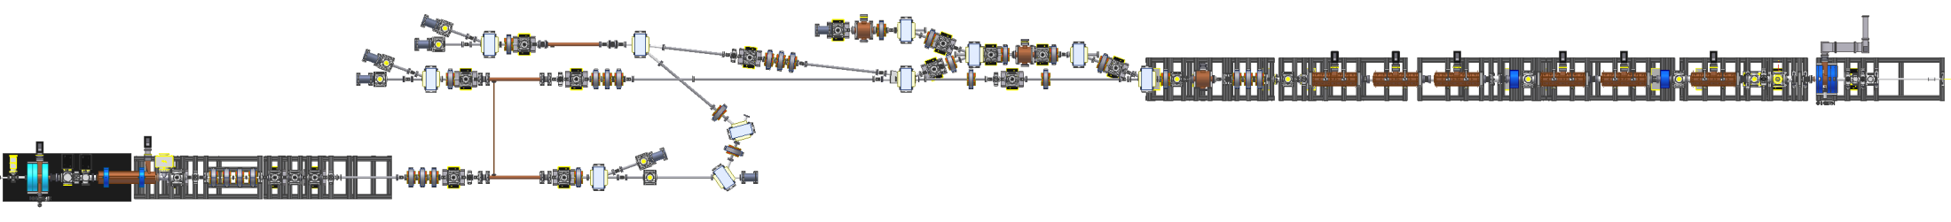
Planned Collinear wakefield acceleration Experiment @AWA
drive z-direction
witness z-direction
Beam Parameters
Structure Parameters
Estimated Gradient
75MeV beam
8 bunches
40nC/per bunch
σz=2mm
Beam hole=3mm
Quartz tube
Freq.=29.9GHz
~500MV/m on axis
25

Slide 26
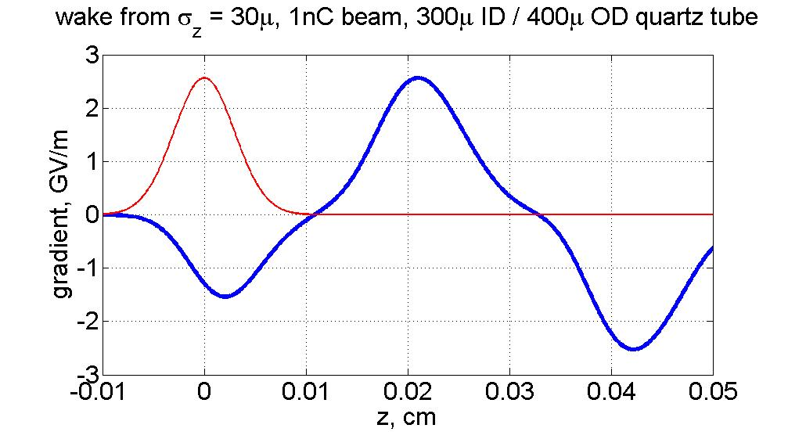
Novel Wakefield Applications (Euclid/AWA/APS/ATF)
Energy spread compensation
Energy modulation

Slide 27
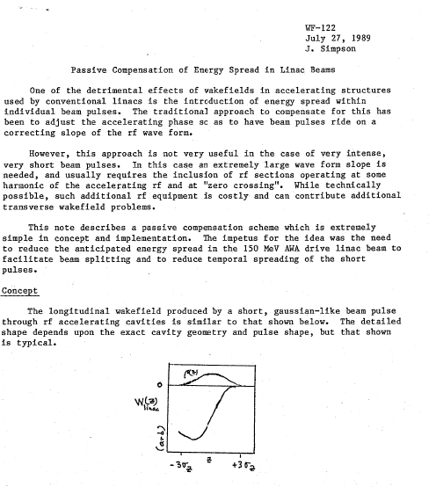
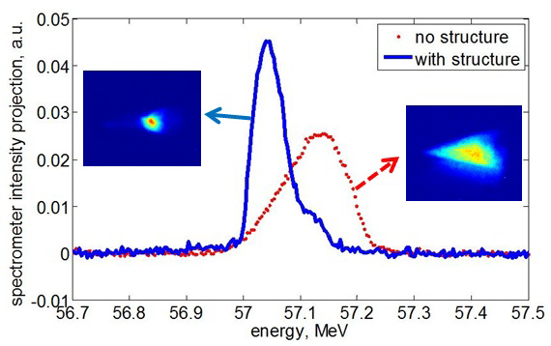
Wakefield Silencer was originated at AWA in 1989. We demonstrated it in 2011.

Slide 28
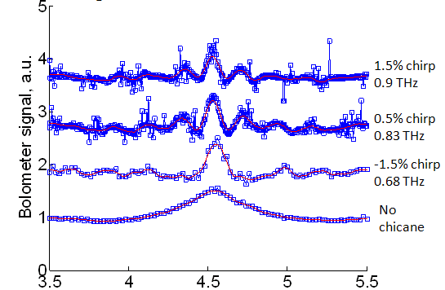
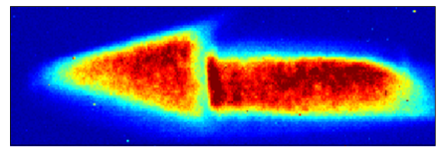
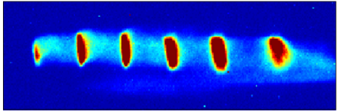
High power beam-based THz source
AWA (10nC / 6.3mm) 0.5 GW peak, 0.3THz, 320ps pulse, 1%BW, 155mJ pulse
Stage I Stage II Stage III
S. Antipov, C. Jing et. al. Phys. Rev. Lett. 108, 144801 (2012)
S. Antipov, et al. to be published
Energy modulation via self-wakefield
Chicane energy modulation conversion to bunch train
THz radiation wakefield structure
THz
Tunable 100% source: Range: 0.3-1.5 THz
Pulse bandwidth: 1%
Energy in pulse: ~ mJ
Measured beam spectrum
Energy chirped rectangular beam
Measured beam spectrum
Energy modulated rectangular beam
Sub ps bunch train
Flexible: each step has a tuning range

Slide 29
SUMMARY
Developing and demonstrating the key technologies for Future Accelerators. Applications of Argonne’s wakefield technology range from large facilities, such as Linear Colliders and future light sources, to applications in need of compact accelerators.
In the recent past, the effort in the group has been balanced between the major upgrade of the AWA facility and maintaining an active AARD program with the existing 15MeV beam line with excellent progress on both fronts.
As the AWA upgrade is approaching the finish line, the AARD program will soon extend its reach to higher wakefield accelerating gradients (200~500 MV/m) and the generation of higher RF power levels (1~3 GW). The Argonne technology may open up a path to new accelerator applications reliant on compact and efficient acceleration schemes.

