Slide 1
Upgraded AWA Drive Beamline →CONFIGURATION →SIMULATIONS →DIAGNOSTICS
75 MeV
Direction of beam propagation
drive gun
John Power
AARD DOE Review
March 07, 2013

Slide 2
The AWA Upgrade drive beamline
75 MeV
Direction of beam propagation
drive gun
Upgrade Goals
Original Drive Beam (Achievements)
Upgraded Drive Beam (Targets)
Single bunch operation
15 MeV
Q = 0.1-100 nC (world record!)
@ 100 nC
σz = 3 mm
High Current: ~11 kA
emittance < 200 um
Bunch train operation
4 bunches x 20 nC
16 bunches x 5 nC
Train Length = 10 - 25 ns
Single bunch operation
75 MeV
Q = 0.1-100 nC
@ 100 nC
σz = 2 mm
High Current: ~16 kA
emittance < 200 um
Bunch train operation
10 bunches x 100 nC
32 bunches x 30 nC
Train Length = 10 - 50 ns

Slide 3
Outline
Beamline configuration and installation of the beamline components
Beam Dynamics Simulations
Beam Commissioning Plan

Slide 4
1. beamline configuration AND INSTALLATION
Building up the beamline …

Slide 5
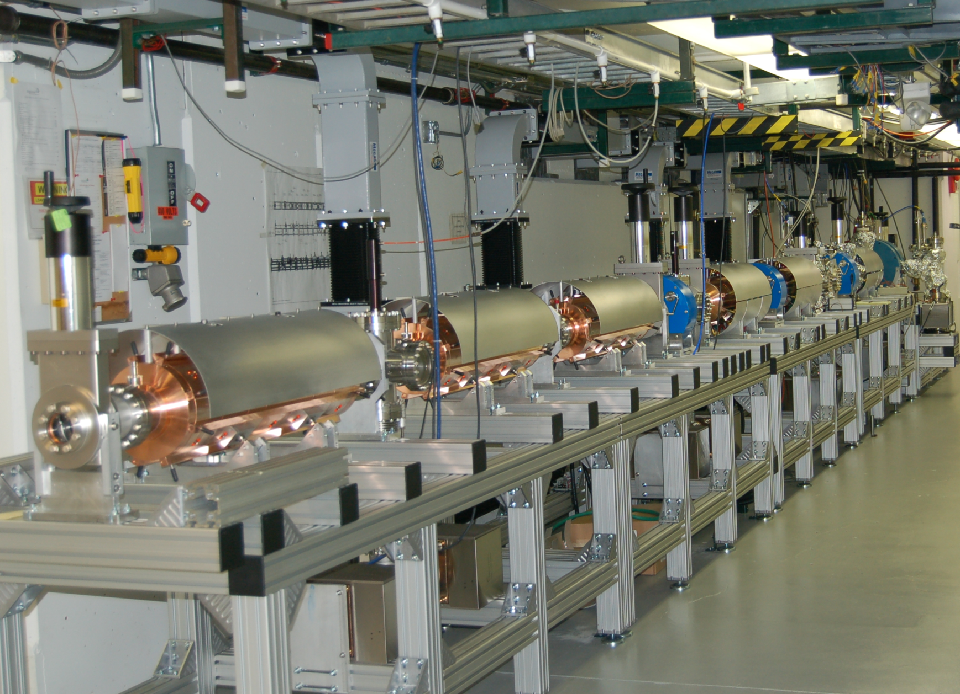
Installation of beamline components (PROGRESS)
ONGOING
COMPLETED
RF Gun
*Conditioned to Full power
(Spring ‘11)
Waveguides
*installed Winter 2013
Solenoids
*arrived Summer 2012
*installed Winter 2013
DIAGNOSTIC
BEAMLINE
6 New RF cavities
*tuned & balanced Fall ‘12
*installed Winter ’13
+Spectrometer
+Quads
+Def Cavity
+etc.

Slide 6
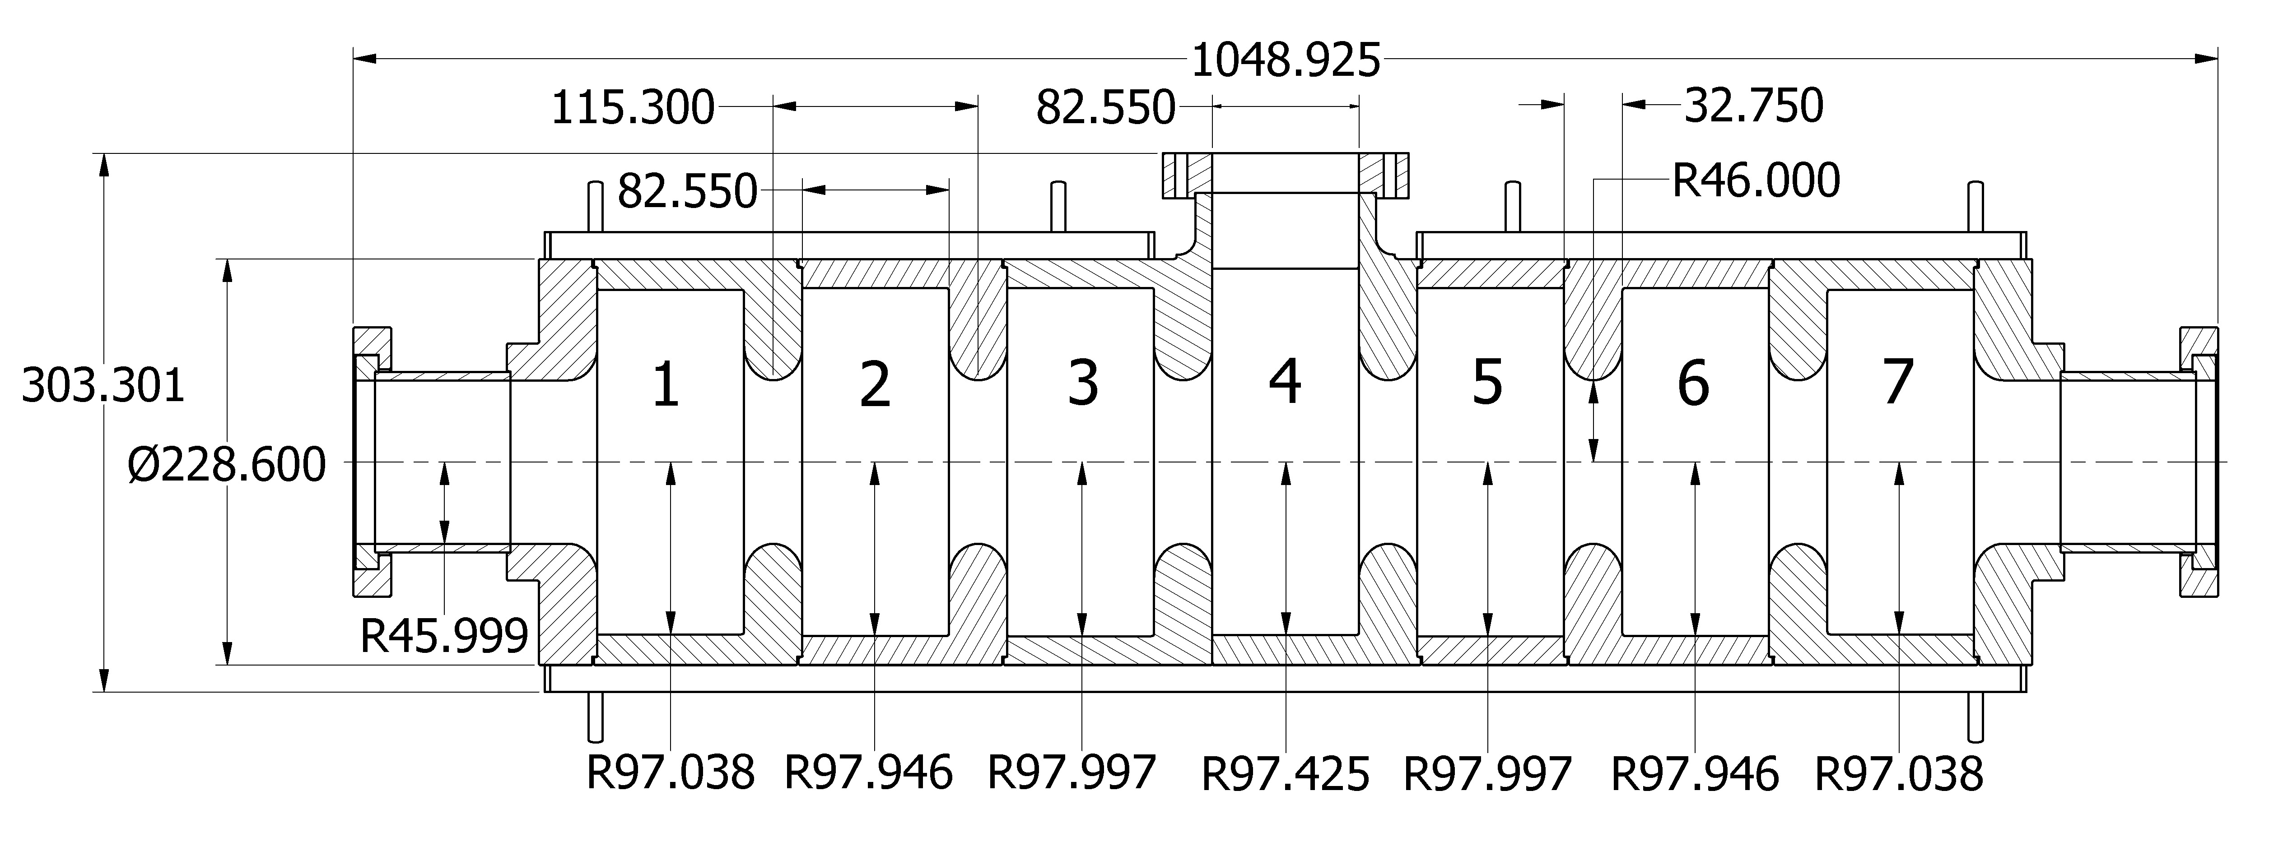
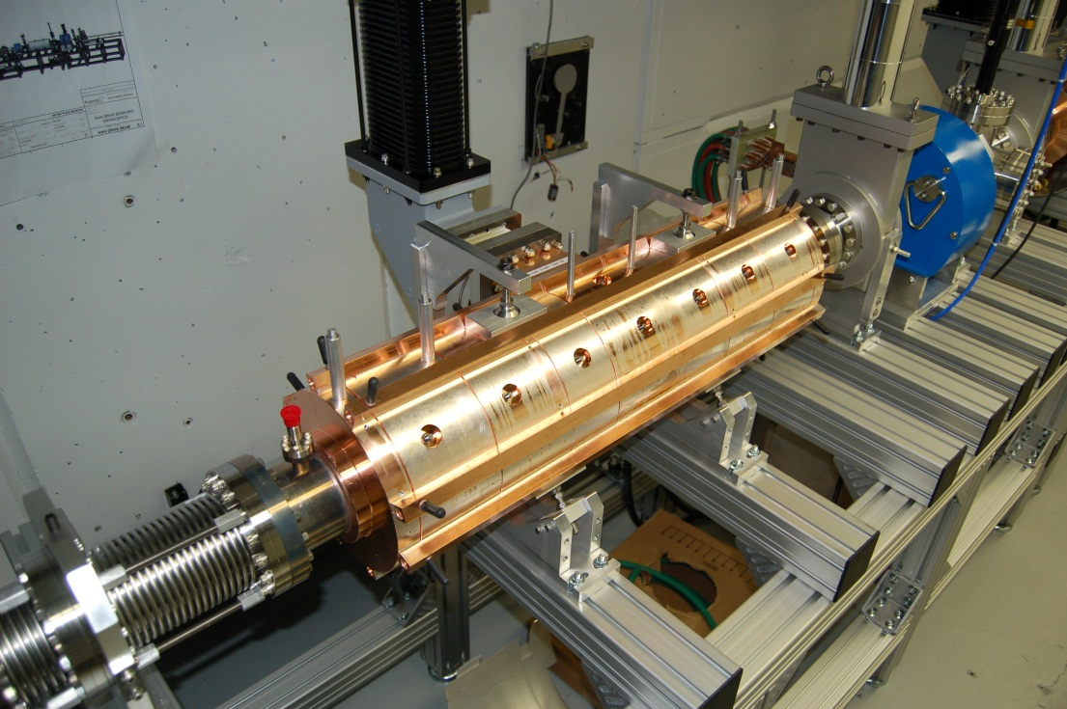
1300 MHz rf cavity
Parameter (unit) | Value
unloaded voltage gain, V (MV) | 11.8
ε = U_{b}/U₀ @ 1 μC (%) | 43.15
energy droop along beam¹ (%) | 27
σ = rms energy spread due to wakes¹ (keV) | 159
μ = mean energy loss due to wakes¹ (keV) | 394
E_{surf} (MV/m) | 33.5
H_{surf} (kA/m) | 58.8
pulsed heat temp. rise (ºC) | 1.5
Q₀ | 25147
U₀ (J) | 27.49
coupling parameter, β | 1.28
mode separation (MHz) | 14.7
power flow phase shift (º) | 0.17
from design …
…to installed in beamline
waveguide
RF window
Installed RF cavity
¹for P_{in} = 10 MW and Q_{b} = 100 nC, σ_{z} = 2 mm.
RF conditioning next

Slide 7
2. beamline simulation
Expected beam performance

Slide 8
RF power distribution
Total Power Budget = 96 MW
75 MeV
DG
DL6
DL5
DL4
DL3
DL2
DL1
11 MW
11 MW
11 MW
11 MW
13 MW
14 MW
14 MW
φ
φ
φ
K4
25MW
K3
K2
30MW
K1
PWR
25MW
28 MW
Klystron Maximum Operated
Power Power (90%)
φ
K1 (Orig.) 28 MW 25 MW
K2 (Litton) 30 MW 27 MW
K3 (Thales) 25 MW 22 MW
K4 (Thales) 25 MW 22 MW
Total 110 MW 96 MW
φ
6 MW
5 MW
+
10 MeV
WL1
WG

Slide 9
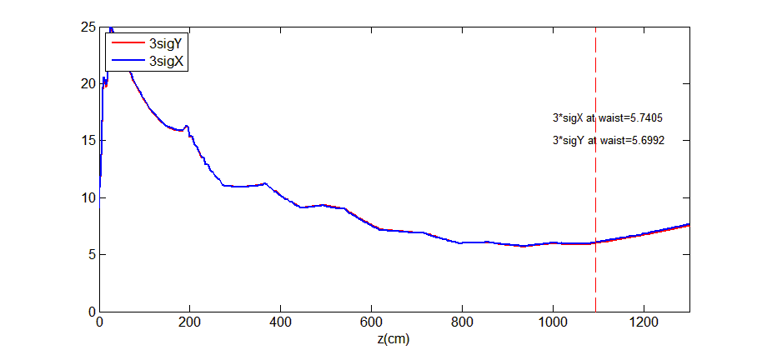
Start-to-end simulations (Parmela/Impact-T)
Simulations performed
Single bunch
Bunch train (beam loading and its mitigation)
Combined effects
GUN
DL1
DL2
DL3
DL4
DL5
DL6
Full Width (3σ) Beam Envelope (mm)
z= 1093 cm
Example: 100 nC beam through the linac

Slide 10
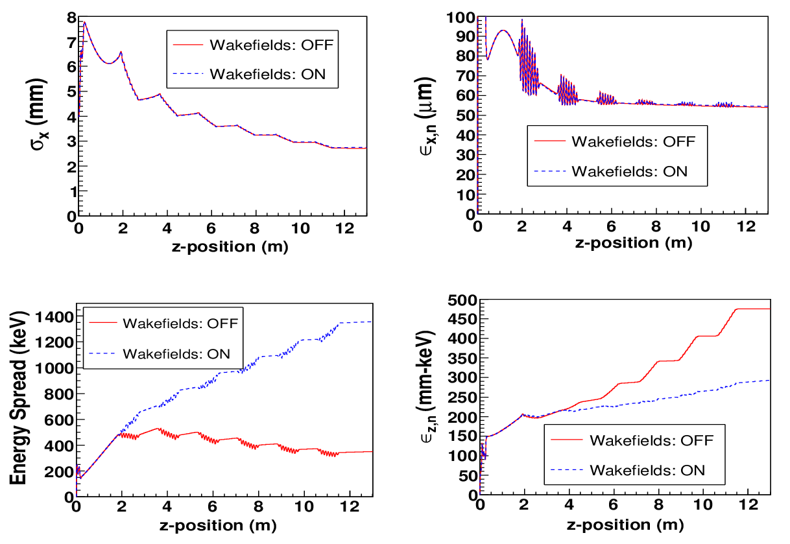
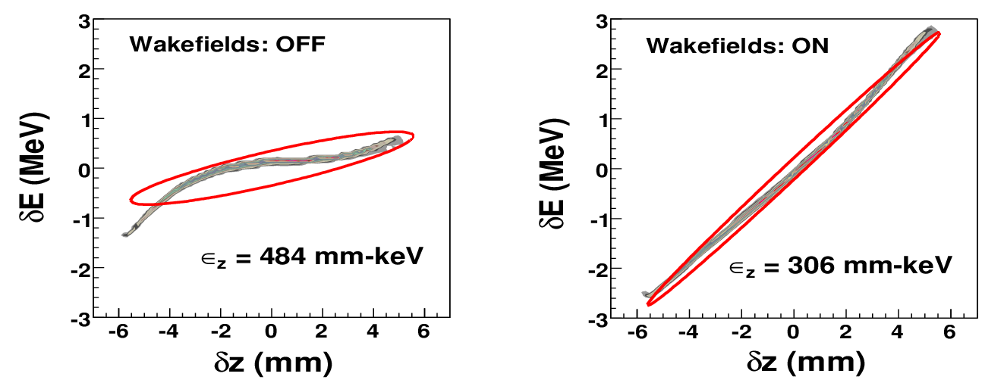
1. Single bunch start-to-end simulations
Beam parameters: Q = 100 nC, R (at cathode) = 8.0 mm, σ_{z} = 3.40 ps
Single Bunch Wakefields*:
negligible effect on transverse phase-space
increased correlated energy spread.
decreased longitudinal emittance.
*Impact-T implementation of the wakefields based on, K. L. F. Bane, SLAC-PUB-9663, 2003 and benchmarked to ABCI.

Slide 11
2. Bunch Train start-to-end simulations
initial stored energy
BUNCH TRAIN
U₀
U₀- ΔU
U_{b}=N*ΔU
U₀-N*ΔU
Goal: minimize droop → U_{b}/U₀ @ Q_{b}=1μC
Solution:
large stored energy (U₀) → rf cavity design
vary launch phase → during operation

Slide 12
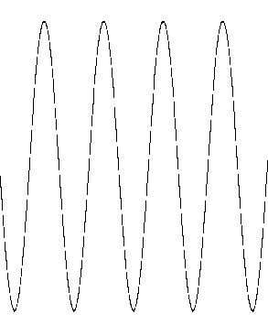
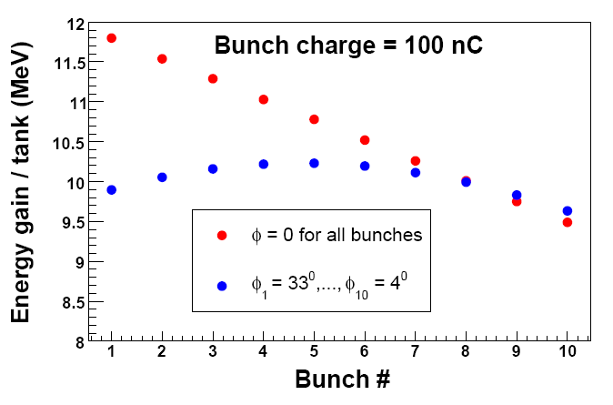
2. Bunch Train start-to-end simulations
10 bunches on crest
Bunches at different phases
Multibunch wakefield effects and its mitigation
T
T+Δt

Slide 13
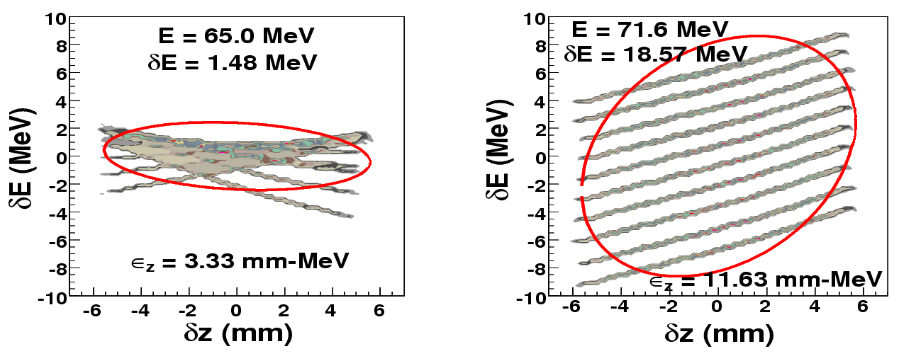
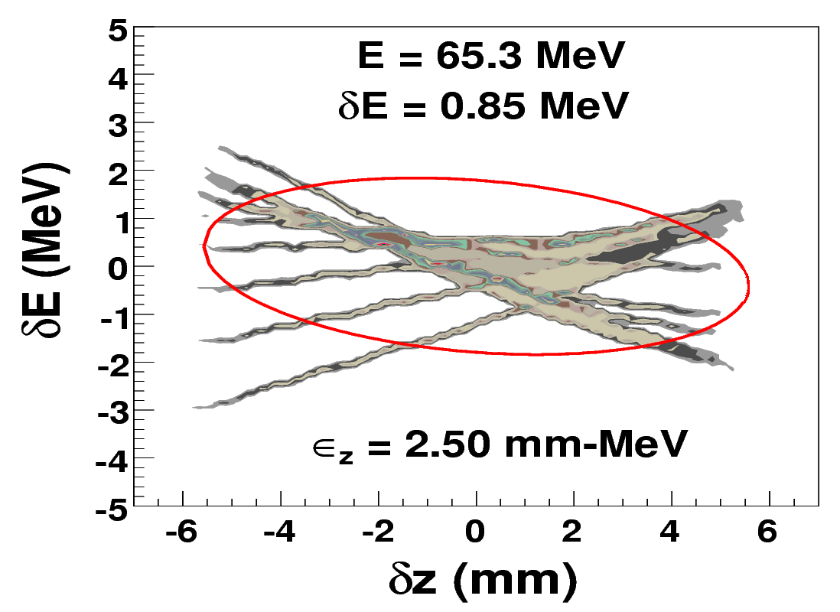
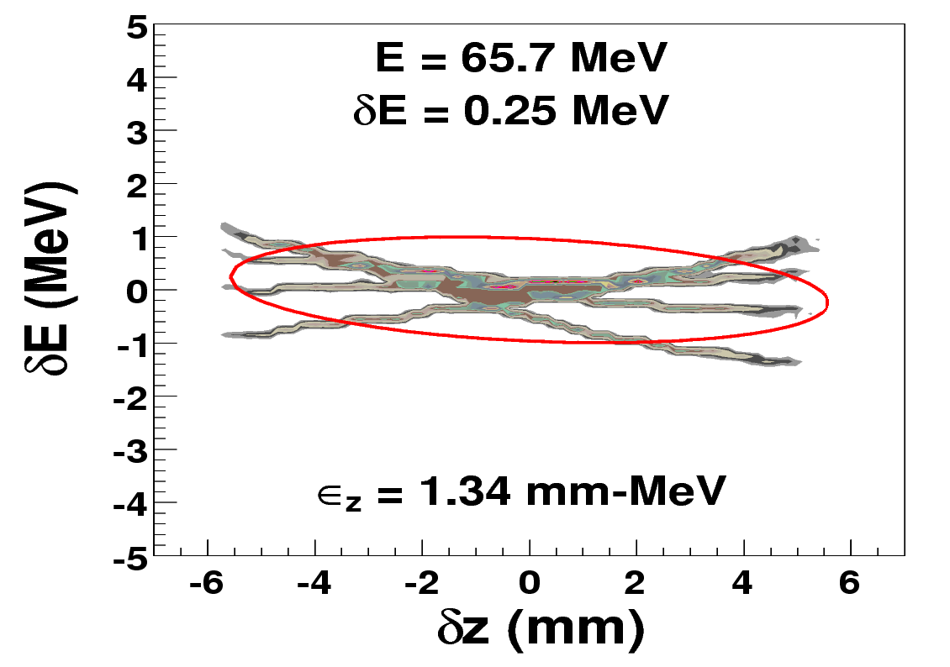
3. Bunch Train start-to-end simulations
Vary phase (ΔE/E = 2.3%)
On crest (ΔE/E = 26%)
Vary phase (ΔE/E = 1.3%)
5 bunches x 100 nC
Notes:
Equal time separation vs unequal time sep

Slide 14
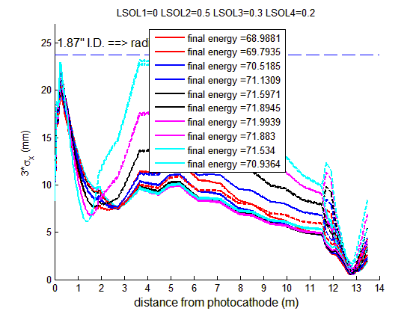
Example: 40 nC x 10 bunch train
quad
triplet
GUN
Solenoid
Solenoid
DL1
DL2
DL3
DL4
DL5
DL6
DLA
L=0.5 m
radius = 2.5 mm
Notes:
High Gradient, hundred of MV/m

Slide 15
3. beamline commissioning
Diagnostics

Slide 16
Drive Beam Commissioning
Challenges for Diagnostics
Front-end diagnostics
σx,y
σx,y
Q
wide dynamic range
charge: (100 pC < Q < 100 nC)
emittance: (1 μm < εN < 200 μm)
fast pulse trains
pulse train: single microbunch to bunch trains of up to 32 bunches spaced by 769 ps.
Q
Drive beamline front-end (19 MeV )
<x>, <y>
<x>, <y>
σx,y
Q
Main Diagnostic Beamline
σx,y
σx,y
σx,y
Transverse: sigX/Y, emittanceY
Longitudinal: E, DE/E, sigZ
75 MeV Drive Beamline

Slide 17
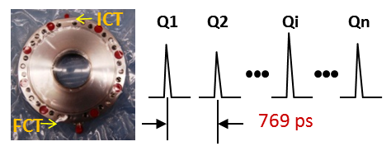
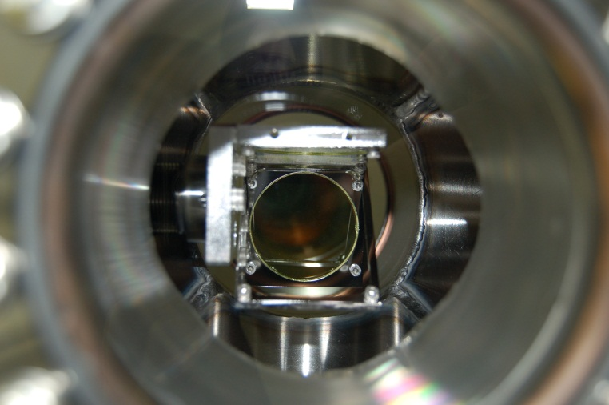
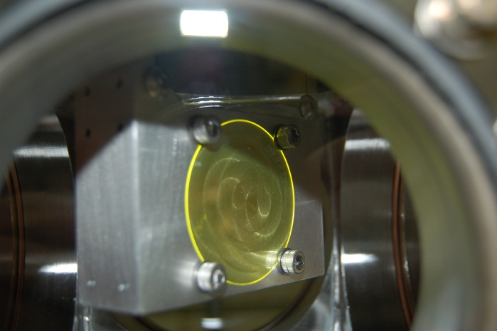
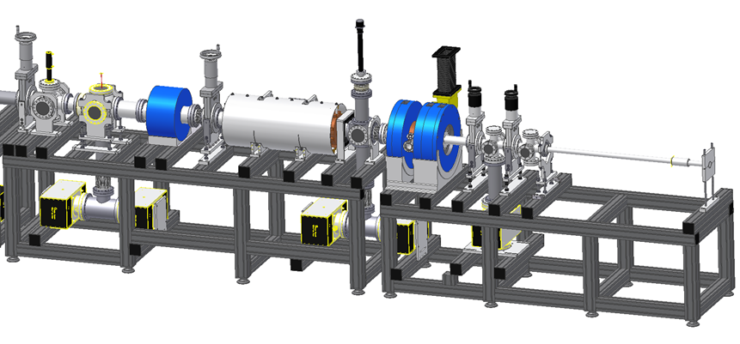
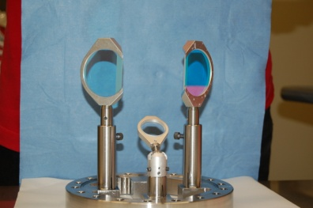
Front-end diagnostics Installed Winter 2012-13
In-flange FCT-ICT from Bergoz
FCT: rise time ~175ps → resolve bunches inside the bunch train
ICT: calibrated measurement of total charge in train
Normal incidence YAG screen
50mm x 100 μm
45º incidence YAG screen
50mm x 100 μm
Diagnostic Cross #2
<x>, <y>
Diagnostic Cross #1
Faraday cup
YAG
mirror
66mm
RF cavity
Gun
Laser Input
Solenoid
Trim
Drive beamline front-end (19 MeV )

Slide 18
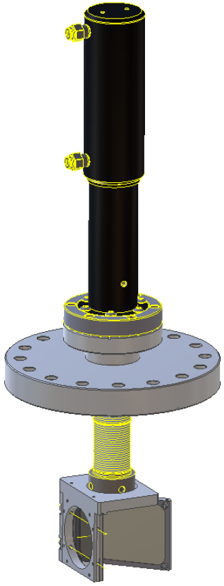
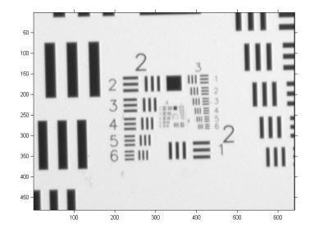
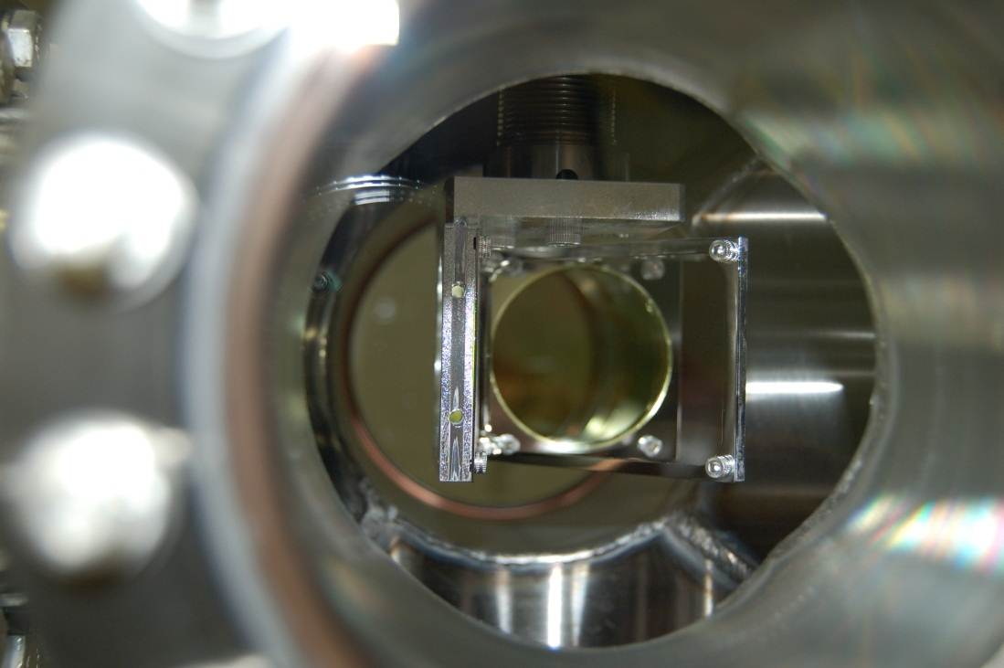
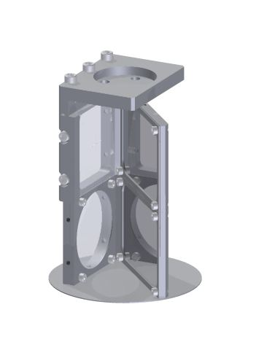
Imaging Station:(inside vacuum)
installed Winter 2013 (ongoing)
Resolution
target
Normal incidence YAG screen
50mm x 100 μm
camera
Dual YAG-alignment screen
YAG:Ce Screen
reduced depth of focus (normal incidence )
High resolution (100 μm thickness)
45º Si-wafer, double-side mirror
300 μm: very little energy deposited,
very flat: good for laser alignment
can be used for OTR at other locations (if YAG screen is removed)

Slide 19
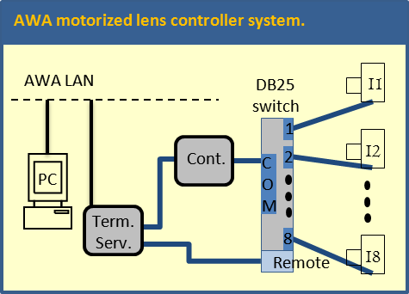
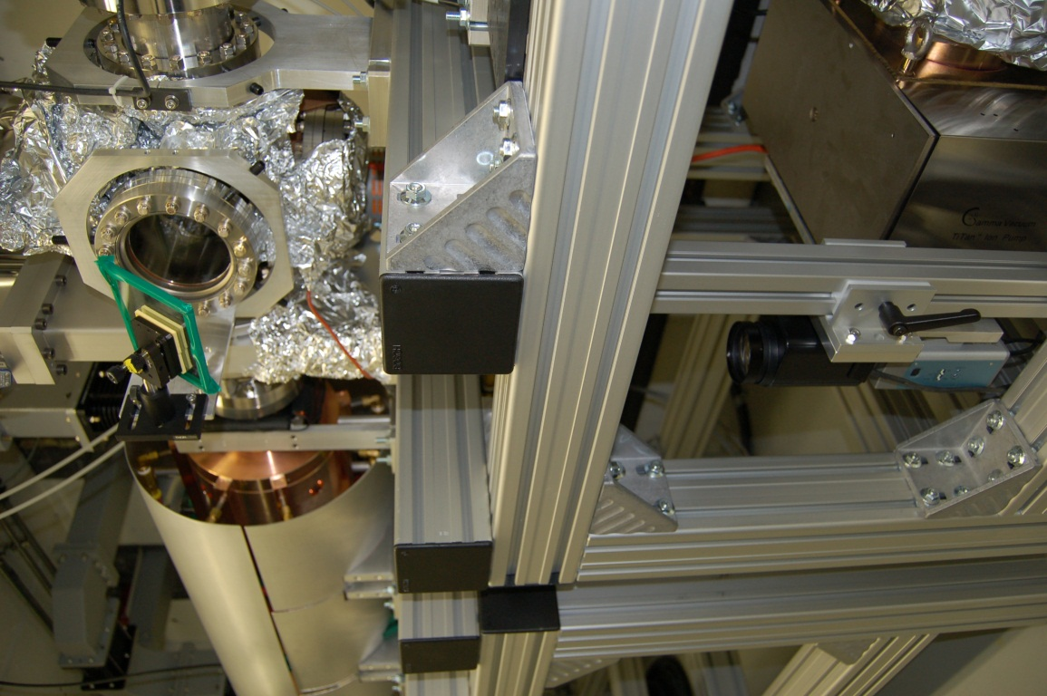
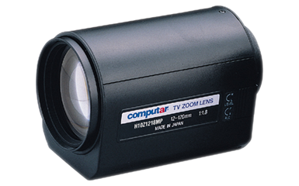
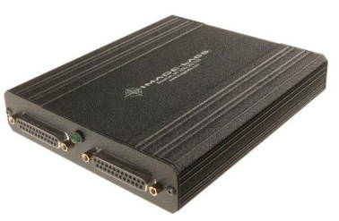
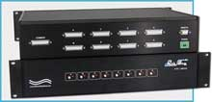
Imaging Station (outside vacuum) To be Installed Spring ‘13
To be installed Spring 2013
Remote: Zoom, Focus, and Iris
10X Motorized Zoom Focal Length =
12.0 - 120.0 (mm)
Motorized Lens Controller
Zoom, Focus, and Iris
The cameras are mounted:
below table
inside of the legs
8-to-1 DB25 Switch

Slide 20
Main Diagnostic Beamline
To be installed Spring 2013
TEST
AREA
75 MeV
Longitudinal: Δp, p [MeV]
dump
DIAGX8
1m
0.762m
0.762m
End of linac
DIAGX7
0.4 m
1.5 m
1.0 m
1.0 m
A
1m
A
15 deg
A
Cav 6
A
dump
2m
DIAGX5
1m
Def Cav
DIAGX3
DIAGX2
DIAGX6
DIAGX4
DIAGX1
Longitudinal: σ_{z} [mm]
Transverse: ε_{y,rms,normalized} [μm]
Q[nC]
Transverse: σ_{x,y}[mm]
A
USAF
target
Slit
Trim
YAG+
mirror
OTR
BPM
ICT
Quad
DIAGNOSTIC
CROSS

Slide 21
Transverse: ε_{y,normalized} [μm]
USAF
TARGET
A
NORMAL
INCIDENT
YAG:Ce
TUNGSTEN
SLIT
OTR
SCREEN
dump
1m
TRIM
COIL
A
1m
15 deg
A
A
dump
2m
1m
A
Transverse: Emittance measurement
Multiple slits: 50um, 100um, 300um
Centered slit: quick estimate
Motorized slit: accurate measurement
Multiple drifts: ~70cm, ~1.7m, ~2.7m
0.5mm tungsten → θ=64 mrad

Slide 22
Longitudinal: σ_{z} [μm]
1m
0.762m
dump
A
1m
15 deg
A
A
dump
2m
1m
A
Longitudinal: σ_{z} [mm]
Longitudinal: Bunch length
RF Deflecting Cavity
OTR mirror + Streak camera

Slide 23
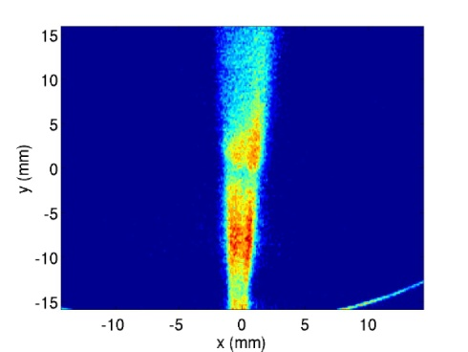
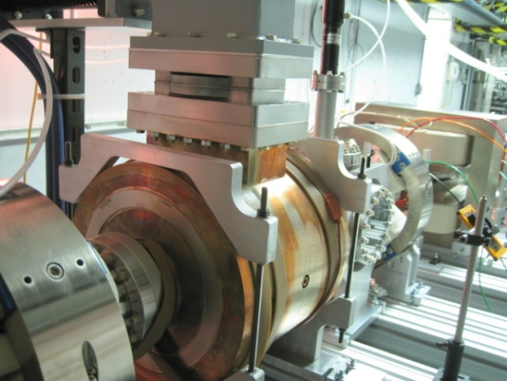
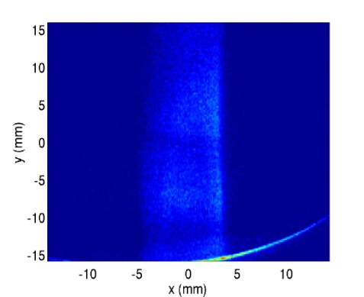
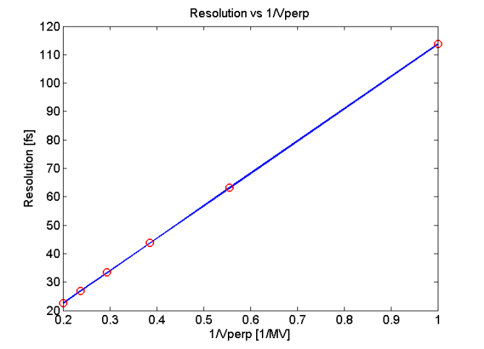
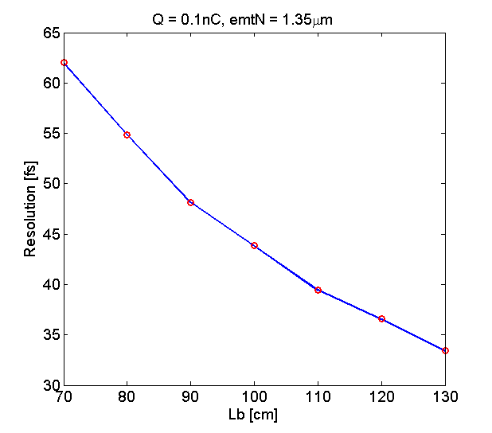
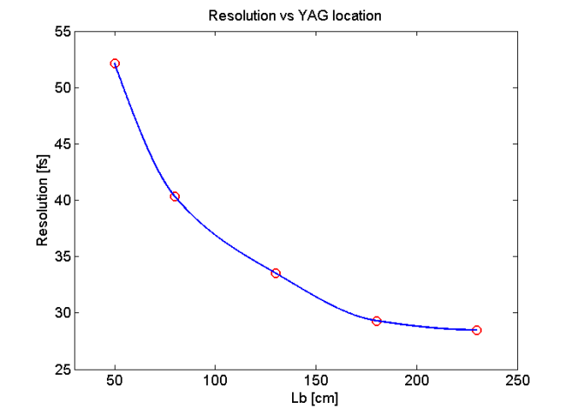
Longitudinal: σ_{z} [μm]
OFF
Deflecting cavity first results
3.4 MV @ 4.2 MW (1300 MHz)
bunch length measurements
longitudinal phase space
Resolution study
ON
La
Lb
Q=0.1 nC & E=14 MeV
Vperp
200 cm
1/Vperp
Lb
Lb
Resolution ~ 35 fs @ 0.1 nC → 1 ps @ 100 nC @14 MeV

Slide 24
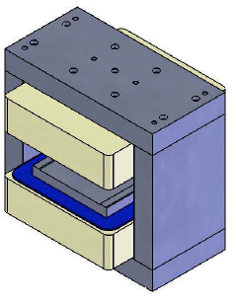
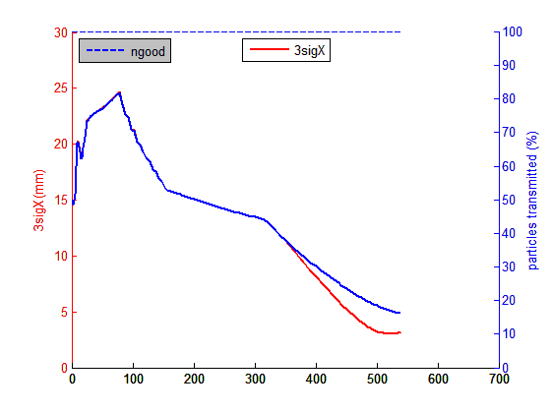
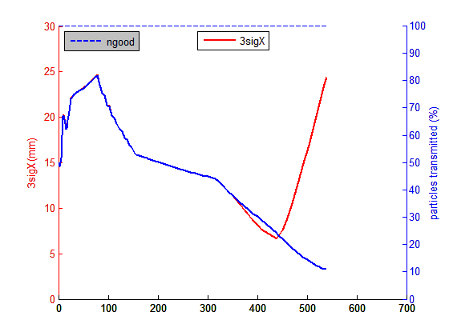
Longitudinal: {E, ΔE/E}
Spectrometer based on existing 15º dipole
DIAGX4
dump
A
DIAGT4
BEND
DIAGQ1
A
DIAGT3
DIAGX2
DIAGT2
dump
DIAGX3
(100 mm)
(50 mm)
QUAD
BEND
SCREEN
QUAD
BEND
SCREEN
BEND
LSOL
DRIFT
LSOL
24

Slide 25
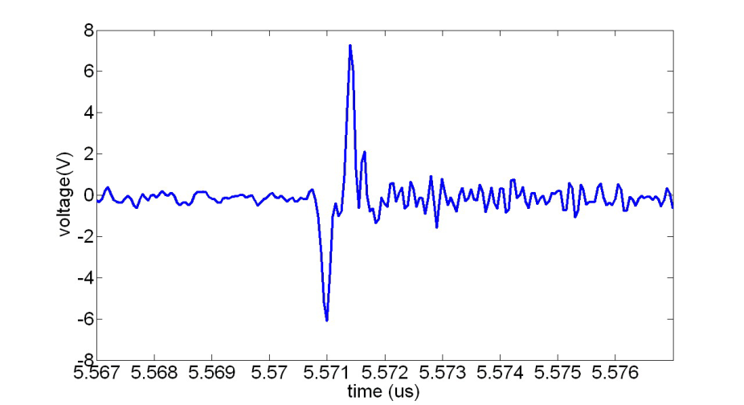
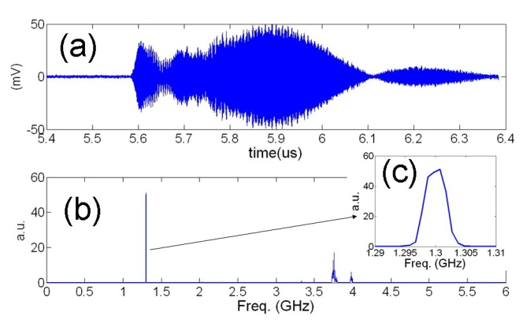
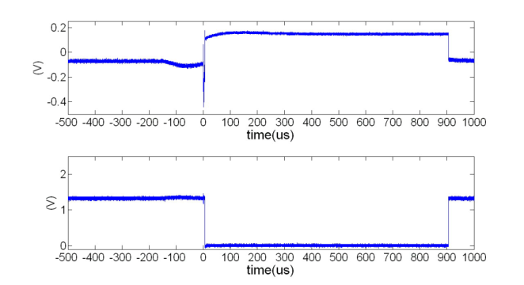
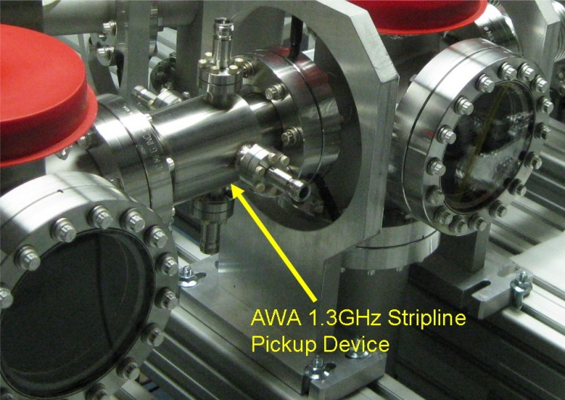
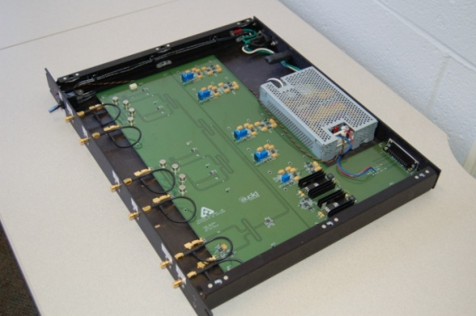
Transverse: centroid {BPM system}
Stripline BPM (recently commissioned front end)
lock beam phase to LLRF (new effort at AWA)
slow orbit feedback system (new effort at AWA)
~400ps
1.3 GHz BP filter
(commercial)
BPPM circuit board
(Euclid-ANL; in house)
1.3 GHz Stripline BPM (in house)

Slide 26
Summary
Beam dynamics simulations for the 75 MeV beamline - Complete
Front-end (<19 MeV) beamline – Spring 2013
Install beamline (1st cavity and diagnostics) - Complete
Condition 1st RF cavity to full power
Generate and characterize single bunches and trains
75 MeV beamline – Spring/Summer 2013
Install remainder of beamline (cavities and diagnostics) - Complete
Layout of 75 MeV diagnostic beamline - Complete
Condition RF cavities 2-6
Install diagnostic beamline
Begin full beam commissioning at 75 MeV
First wakefield experiments – Fall 2013

