Slide 1
Advanced Accelerator R & D Activities at ANL-HEP
Wei Gai
(for the AWA group)

Slide 2
Outline
Mission
Major areas of research
The group and collaborators
The AWA facility & upgrade (M. Conde & J. Power)
Recent research activities (C. Jing)
Planned research activities
Timeline

Slide 3
Mission
  Studying the Physics and Developing the Technologies for Future HEP Accelerators (and possibly other applications).
Reasons for the mission (Challenges for Future HEP Linear Colliders):
High gradient (~hundreds MV/m) and High Impedance (high R/Q)
  Requires new or alternative accelerating structures.
High Power RF Sources (~ GW Scale)
  Requires new type sources.
Higher order mode damping
  Requires beam breakup control.
Positron acceleration
Find pathway to LC / Higgs factory

Slide 4
Highlights Achievements of the Accelerator R & D group in the past
  Pioneered the direct wakefield measurement technique.
    First demonstration of collinear Wakefield Acceleration:
      Dielectric Structures, Metallic Structures, and Plasmas
    First Ever plasma wakefield acceleration in underdense regime (non-linear) (with UCLA).
  First Ever 100 nC RF photocathode gun and Linac.
    First Ever dielectric based two beam acceleration experiment.
    First Ever high power testing of dielectric traveling wave accelerator.
    First Ever observed Schottky enabled photoelectron emission in RF gun.
  Discovered new multipactoring regime in dielectric structure.
  ……..

Slide 5
Wakefields in Dielectric Structures (a short Gaussian beam)
ε
2b
2a
Q
Cu
Keys to the success:
  Drive beam, drive beam and drive beam!
    Energy ↑
    Charge ↑
    Bunch length ↓
    Emittance ↓
But, it is difficult to have high charges pass
through small holes! 10 nC@20 MeV a<0.5 mm
Notes:
The idea here is to make an accelerator by using the wakefields of the electron bunch. Large wakefield=large acceleration gradient.

Slide 6
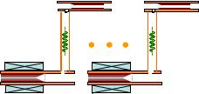
Two Beam Acceleration at AWA
Short, Ultrahigh Power RF pulse→~25ns, 1.3GW
High Gradient → >300MV/m
Broad band TW accelerator →fast rf rise time.
Large (~10%c) Vg → less filling time.
high frequency and optimal beam loading → higher rf-to-beam efficiency.
e.g. rf-to-beam efficiency of a 26GHz Short Pulse Accelerator:
T_{rf}=28ns
3ns
Competitive rf-beam efficiency for the short pulse TBA
3ns
6.5A
267MV/m
0.3m
16ns
T_{f}=9ns
T_{beam}=16ns
1.264GW
25ns

Slide 7
Significant Experimental Achievements in last year:
(Detail’s in Jing’s talk)
Development and high power testing of dielectric PETS for CLIC,
  Prototype made and tested. Significant cost savings. (70%)
  Achieved 40 MW (require 120 MW) and 100 ns (require 200 ns).
  Ongoing testing at SLAC to push higher power to 150 MW.
First ever demonstration of energy spread reduction in a subpico second relativistic electron beam using a passive wakefield devices.
  Also the energy modulation of the shaped beam.
High surface field excitation (300 MV/m) by high charge beam in diamond structure

Slide 8
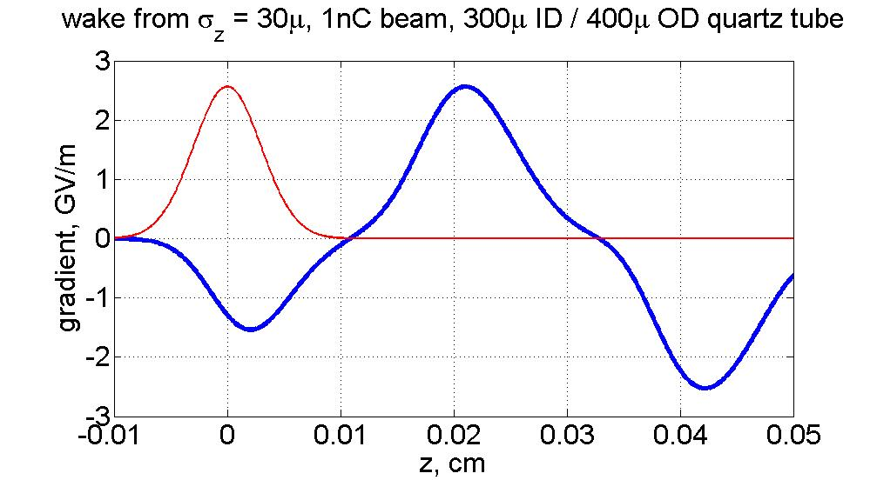
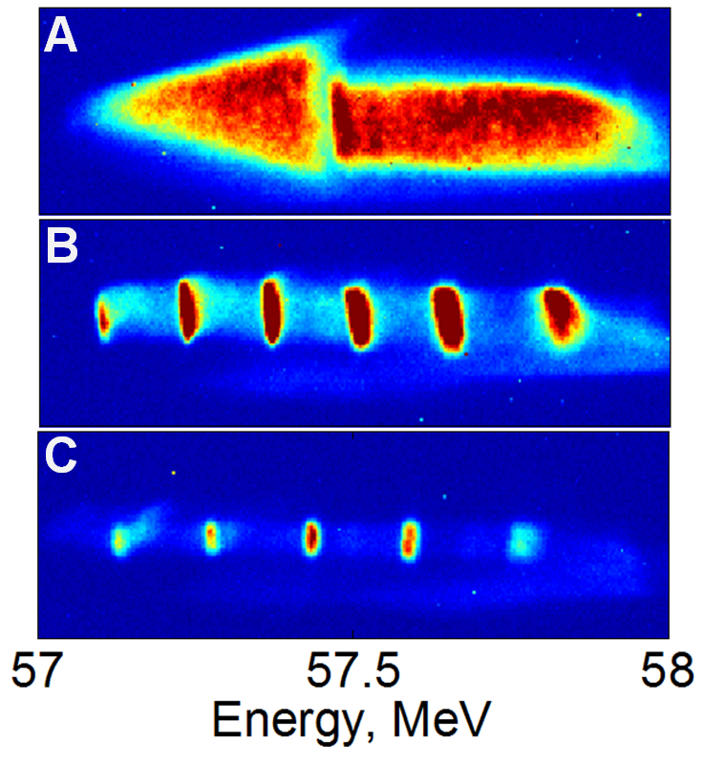
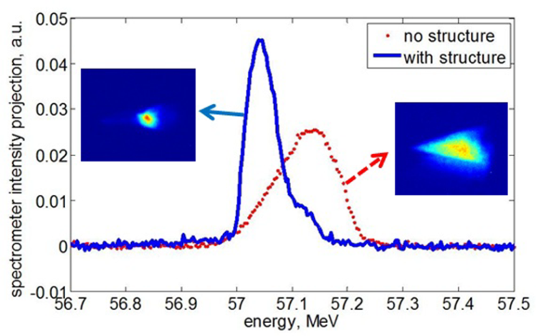
Wakefield Application (Euclid/AWA/APS/ATF)
Chirp correction
Energy modulation

Slide 9
The AWA Approach: a Realistic Path to a Future HEP Machine
Use short RF pulses
  It is well established that shorter RF pulses are less likely to cause breakdown. The energy efficiency and structure bandwidth can be made appropriately high.
Use advanced structures (e.g. dielectrics)
  Dielectric materials are likely to withstand higher electric fields than metals, without arcing.
Use structures that can accelerate electrons and also positrons
  Since colliders are assumed to need electron beams and positron beams, it is sensible to develop accelerating structures that can operate with either.
Use schemes that allow for staging
  The need for precise control of the RF phase of multiple stages, advises against processes that rely on the growth of instabilities.

Slide 10
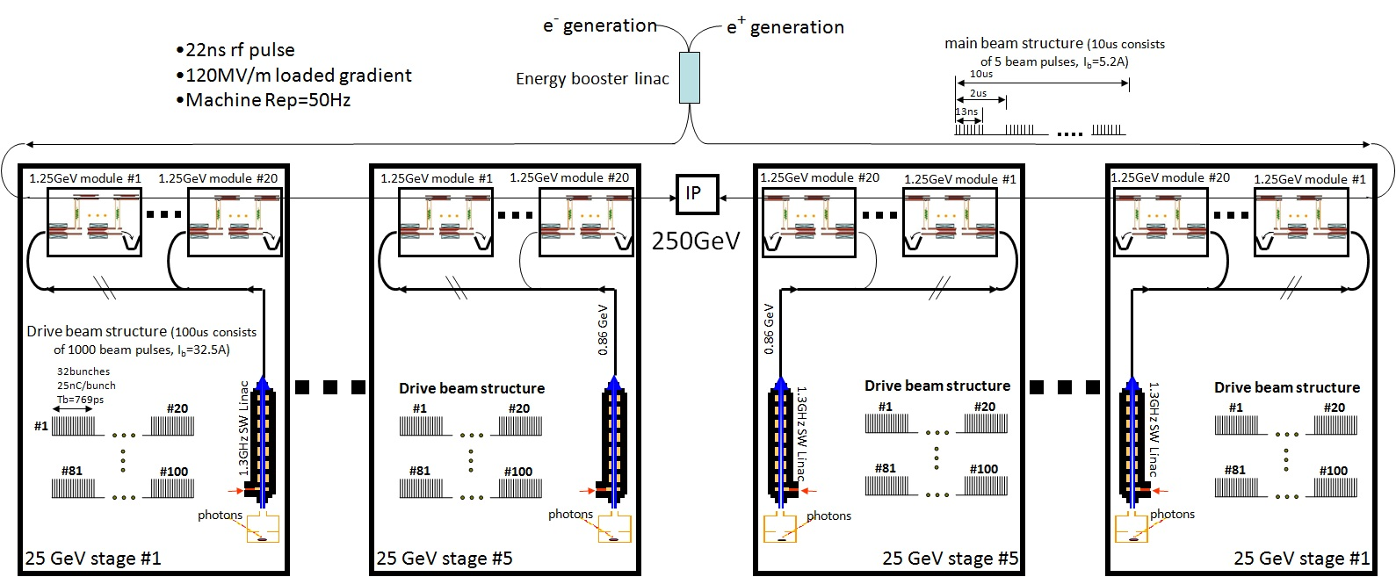
ANL Flexible Linear Collider
Core of Concept:
Short rf pulse: tens of nanosecond
Modular TBA scheme: energy scalable easily
Flexible drive beam structure

Slide 11
Major HEP Accelerator Research Areas at ANL
Linear Collider Technologies:
  Developed TeV LC scheme based on short RF pulse scheme (Argonne Flexible Linear Collider).
  Component developments and breakdown physics studies for CLIC.
  Comprehensive positron source studies for the ILC and CLIC.
Advanced accelerators:
  Wakefield Accelerators Structures:
    dielectrics, photonic band gap, tunable dielectric and left-handed meta-materials.
  Wakefield Acceleration Schemes:
      High Transformer Ratio Ramped bunch (Euclid)
      Rectangular Two Channels (Omega-P/Yale), Annular Beam Co-Axial (Omega-P)
Beam Physics:
  High-Power/High-Brightness Electron Beams generation, acceleration and propagation.
  Beam phase space manipulation and application to Wakefield Acceleration.
We are operating the AWA facility to experimentally demonstrate the science and technologies listed above. And possibly other accelerator technologies for BES.

Slide 12
The AWA Group
Scientists / Engineers:
  Wei Gai (group leader), Manoel Conde (Facility Manager), Scott Doran, Wanming Liu and John Power.
  Personnel changes: R. Konencny (retired), Z. Yusof (left), and P. Malhotra (left)
Euclid Resident Scientists:
Sergey Antipov, Sergey Baryshev, Chunguang Jing,Jiaqi Qiu (soon), Richard Konecny (part-time), .
Euclid Non-Resident Scientists: Alexey Kanareykin, Paul Schoessow.
Technical Support:
  Charles Whiteford , Marvin Lien.
  HEP safety coordinator: Leon Reed.
Current Students:
  Eric Wiesniewski (IIT), Chen Li (Tsinghua Univ.), Hao Zha (Tsinghua), Gwang-hi Hwa(Joint APS/HEP support). A few more visitors here soon.
Six Ph.D. theses completed in the last 10 years.

Slide 13
External Users (collaborators):
Due to the unique and flexible capabilities of the AWA facility and the group’s expertise, we have attracted many external collaborators:
  Euclid Techlabs
  Yale/Omega-P/Columbia
  Muons Inc.
  IIT (Illinois Inst. Tech.) (Linda Spentzouris)
  Tsinghua Univ.
  NIU (Northern Illinois Univ.) (Philippe Piot et al.)
  U.Md. (Ralph Fiorito et al.)
  SLAC (Tantawi et al.)
  NRL (Steve Gold)
  Fartech: RF cavity BPM
  Los Alamos (Eugenia Simakov): PBG structures, dielectric WF for FEL
  FACET (UCLA): dielectric wakefield structures
  CERN/DESY/ILCGDE: Linear collider sources design.
Adv. Accelerator Concepts
Beam Physics and diagnostics
externally powered HG structures

Slide 14
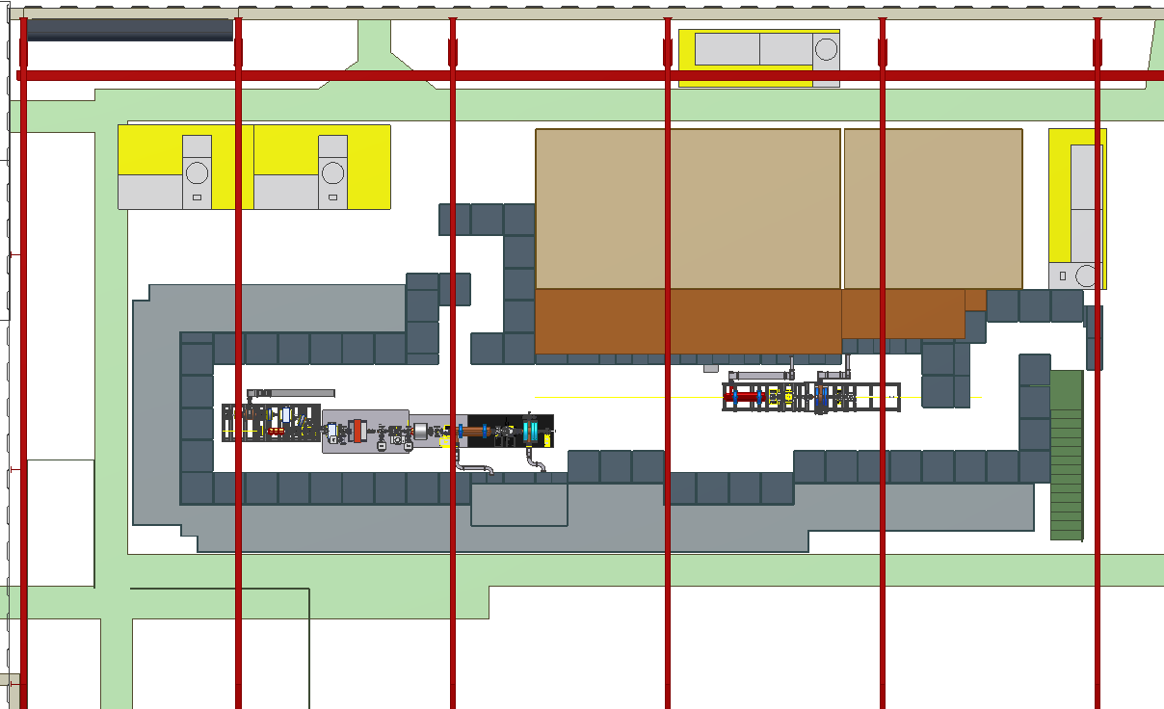
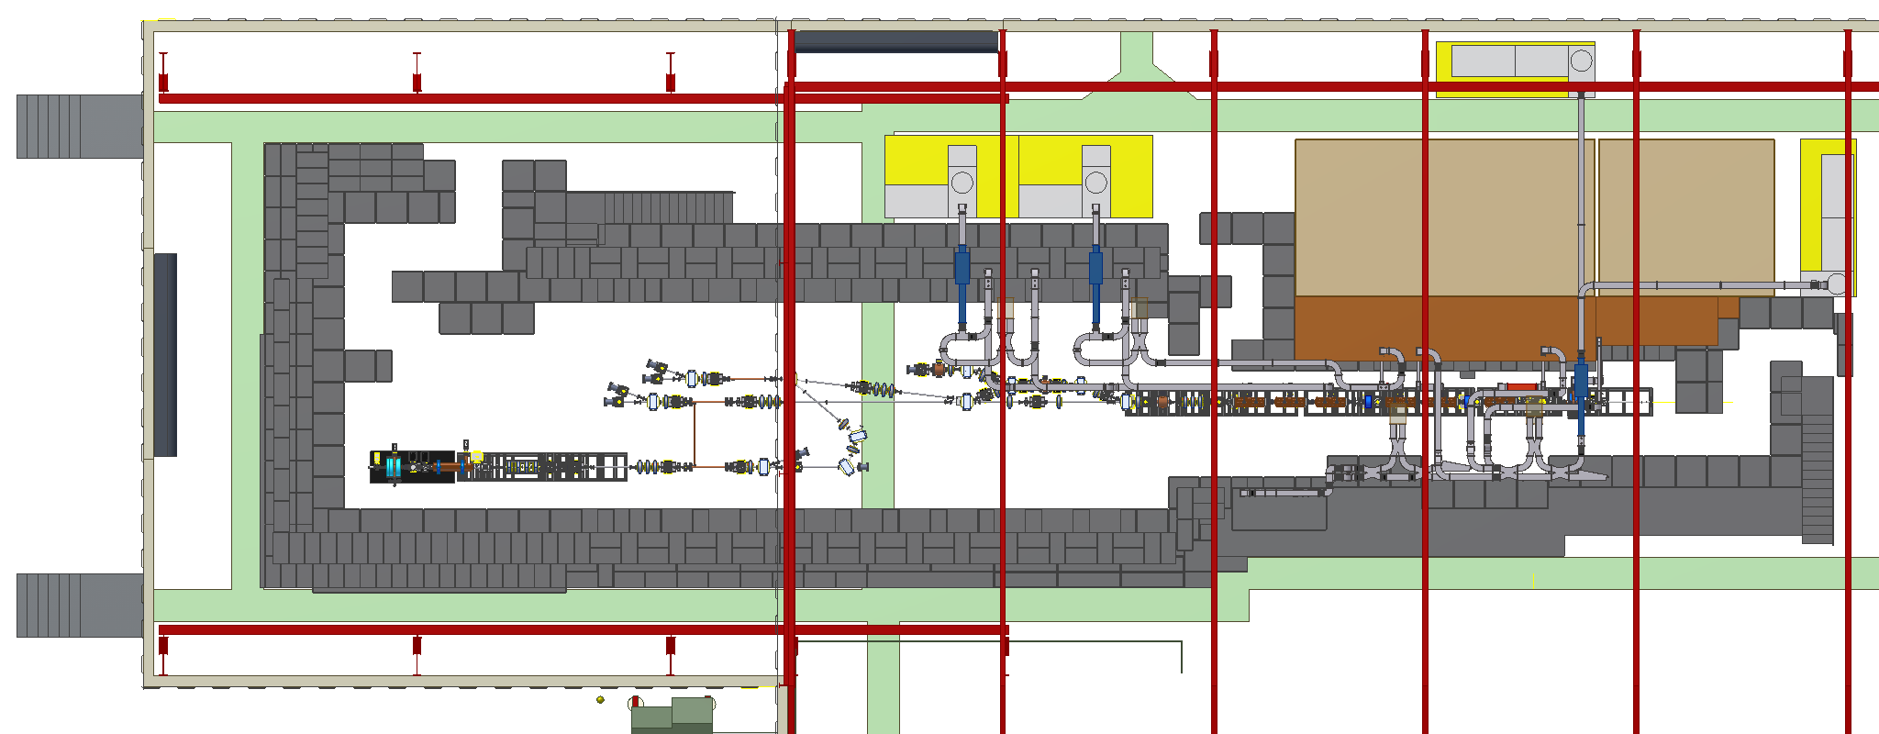
AWA Facility Undergoing Major Upgrade
Before…
15 MeV beam:
RF gun with Mg photocathode
& one linac tank
new RF gun with
Cs₂Te photocathode
After…
15 MeV beam moved & turned around
new 75 MeV drive beam: RF gun &
six linac tanks
new beamline switchyard

Slide 15
Motivation for AWA Upgrades
Restore two beam accelerator capability:
  Have two parallel beamlines, allowing drive bunches to excite wakefields and accelerate witness bunch.
Use the demonstrated high gradients to accelerate beam:
  The high quality drive beam has excited high gradient accelerating fields (100 MV/m) in dielectric loaded structures. Now these high gradients will be used to accelerate a witness bunch.
Higher drive beam energy is critical for high gradient and sustained acceleration:
  Propagation of drive beam through smaller diameter structures, resulting in even higher accelerating gradients.
  More energy available in drive bunches, allowing extraction of higher energy RF pulses.
  Construction of longer structures will demonstrate higher energy gain.
Need beamline switchyard for added flexibility:
  Beamline switchyard will greatly facilitate the implementation of distinct experimental setups: collinear wakefield acceleration, two-beam-acceleration, phase space manipulation and, further into the future, staging.

Slide 16
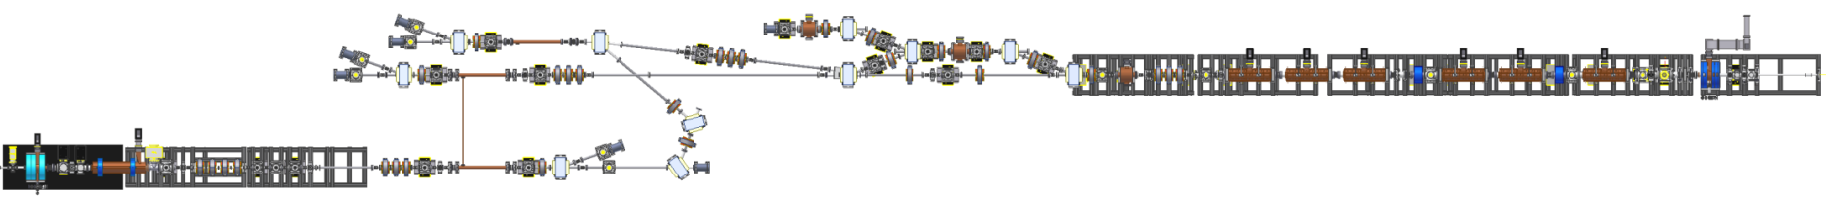
Overview of AWA Beamlines
experimental area
collinear & TBA
EEX & bunch compression
witness beam U-turn
75 MeV drive beam
15 MeV witness beam

Slide 17
Undulator based positron source for ILC/CLIC
Start to end modeling
  Undulator
  Target
  Optical matching device
  Positron capture and transport.
Exploring TeV upgrade options
Beam line lattice design
TDR coordination (Wei Gai: Technical Area Group Leader)
See details at Liu’s presentation
17

Slide 18
Planned Main Experiments at AWA in next 2~3 years
(mostly relevant to LC development, see details from C.Jing) Jing))
Experiment Group | Experiment List | Experimental Goal
High Power High Frequency rf generation | 1) High charge bunch train generation and characterization | Demonstrate the high current drive beam in the new AWA drive beamline
 | 2) 26GHz dielectric wakefield power extractor w/ BBU control | Demonstrate multi-hundreds MW short pulse rf generation
 | 3) 11.7GHz metallic wakefield power extractor | Demonstrate multi-hundreds MW short pulse rf generation
Two Beam Acceleration | 4) 26GHz TBA experiment | Demonstrate short pulse high gradient TBA scheme
Collinear wakefield acceleration | 5) Ring beam and coaxial two channel structure 2nd run | Demonstrate high transformer ratio
 | 6) Shaped bunch generation | Demonstrate the triangular bunch using EEX technique
 | 7) High transformer ratio w/ shaped bunch | Demonstrate high transformer ratio w/ a shaped bunch
Beam diagnostics | 8) Emittance measurement | New diagnostic method
Wakefield | 9) Wakefield measurement of CLIC choke mode structure | Characterize a new CLIC wakefield damping structure

Slide 19
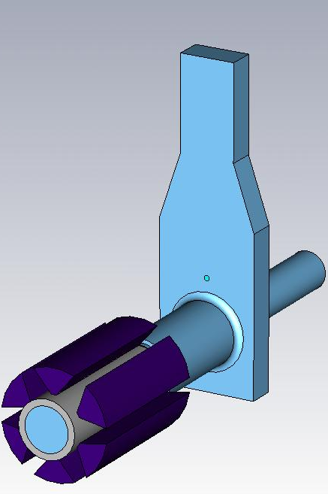
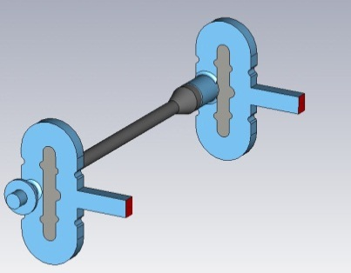
Objectives to be Achieved with Upgrades
Higher gradient excitation: ~ 0.5 GV/m in long structures.
Acceleration of witness beam: ~ 100 MeV
Higher RF power extraction: ~ GW level
Example of 26 GHz dielectric loaded structures for two-beam-acceleration experiment:
Decelerating structure | Accelerating structure
ID / OD / length (mm) | ID / OD / length (mm)
7.0 / 9.068 / 300 | 3.0 / 5.025 / 300
Dielectric constant 6.64 | Dielectric constant 9.70
Group velocity 0.254 c | Group velocity 0.111 c
R/Q 9.79 kΩ/m | R/Q 21.98 kΩ/m
RF power (50 nC) 1.33 GW | Shunt impedance 50.44 MΩ/m
Peak gradient 167 MV/m | E_{acc} (1.26 GW) 316 MV/m
Energy loss 20.5 MeV | E_{loaded} (1.26 GW) 267 MV/m

Slide 20
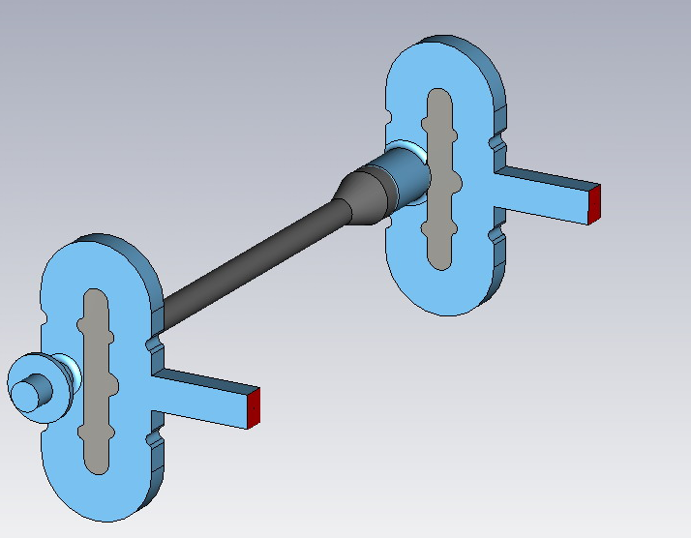
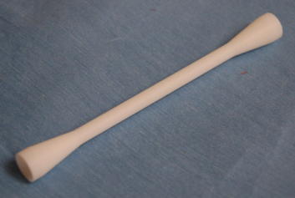
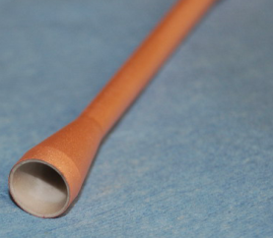
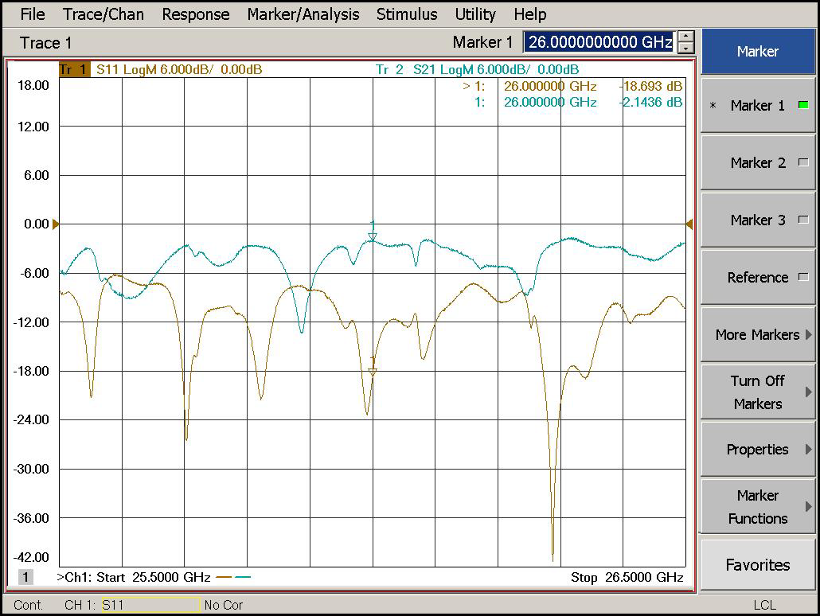
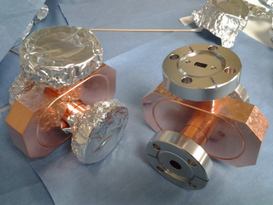
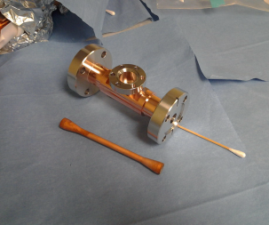
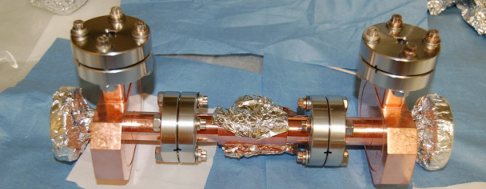
Development of 26GHz short pulse DLA structure (Euclid SBIR project)
parameters | value
ID / OD of dielectric tube | 3 mm /5.025 mm
Dielectric constant | 9.7
Length of dielectric tubes | 105 mm
Vg | 11.13%c
R/Q | 21.98 kΩ/m
Q (loss tan=10^-4) | 2295
Shunt impedance | 50.44 MΩ/m
E_{acc} for 316MW input | 158 MV/m

Slide 21
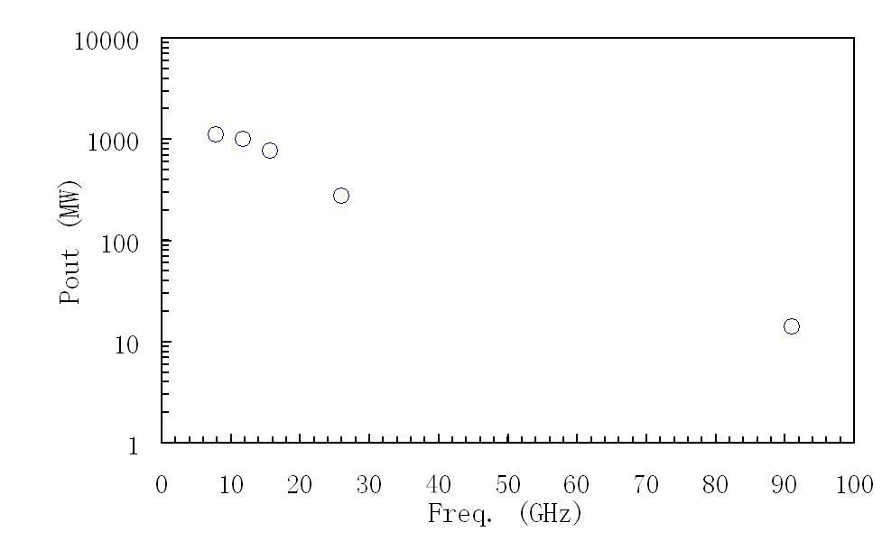
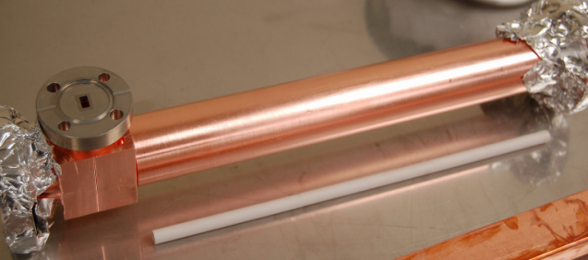
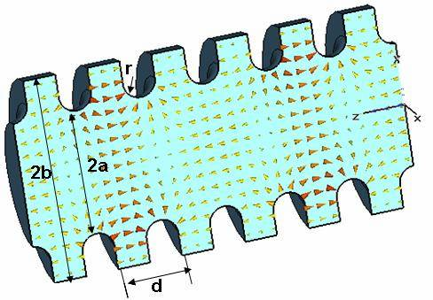
RF Power Generation by the AWA 75MeV Drive beam
26GHz power extractor
Dielectric
11.7GHz metallic power extractor is under development
Metallic (2pi/3 mode)

Slide 22
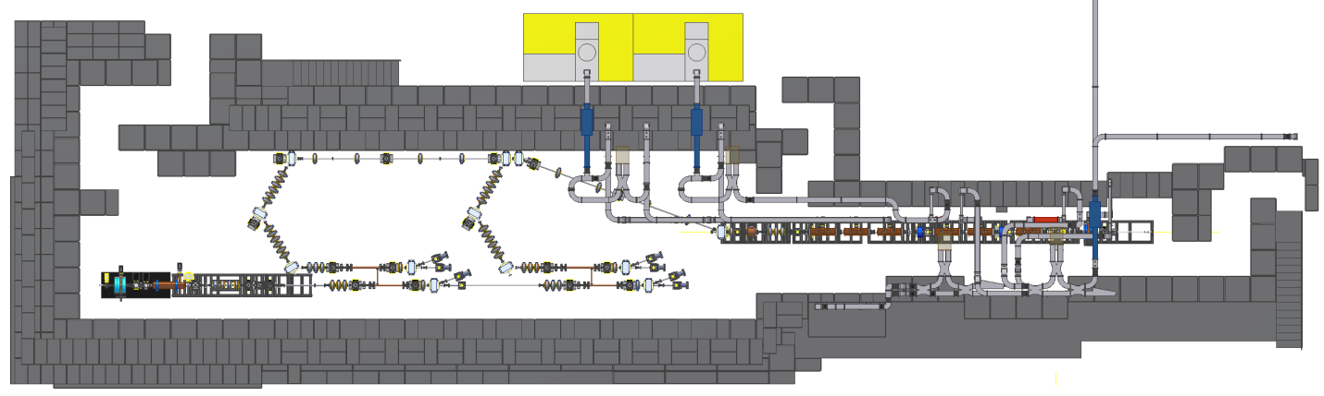
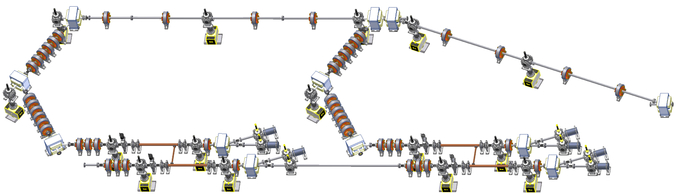
Longer Term Goal: Staging
stage I
stage II
Drive Beam
Witness Beam

Slide 23
Timeline for Upgrades and Initial Experiments
civil construction, electrical, etc
run experiments using witness beam
move and flip witness gun
commission first new linac tank & generate high charge bunch trains with new gun
start experiments with new drive beam
Jul
2012
Oct
2012
Jan
2013
Apr
2013
Jul
2013
Oct
2013
Jan
2014
install & commission more linac tanks
install & commission beamline switchyard
New linac tanks delivered
75 MeV beam

