Slide 1
A compact soft x-ray Free-Electron Laser facility based on a Dielectric Wakefield Accelerator
C.Jing, P. Schoessow, A. Kanareykin, Euclid Techlabs LLC, Solon, OH-4413
J. G. Power, HEP Division, Argonne National Laboratory, Argonne, IL-60439 R. Lindberg, A. Zholents, APS, Argonne National Laboratory, Argonne, IL-60439 P. Piot, Northern Illinois University, Department of Physics, DeKalb, IL 60115, USA
Assessment of opportunities
ANL HEP review, March 7, 2013
Notes:
A fair amount of good ideas and excellent work in the past and today has been directed to the idea of using beams of particles (primarily electrons) to accelerate other beams of particles.
(I do not feel myself being enough competent to provide references here without risking of non-advertent omission of important ones. )
Obviously, the attraction point of this research is a very possibility for a fast acceleration and a hope that it will materialize with a reduction of the cost of the machine.
On the other side, the anticipated cost reductions should be compared to other costs to build the facility either for science or for industry and these other costs could also be quite extensive.
Then the question is what is the right balance and in my view the method of a dielectric wake field accelerator is on a right track to hit a target.

Slide 2
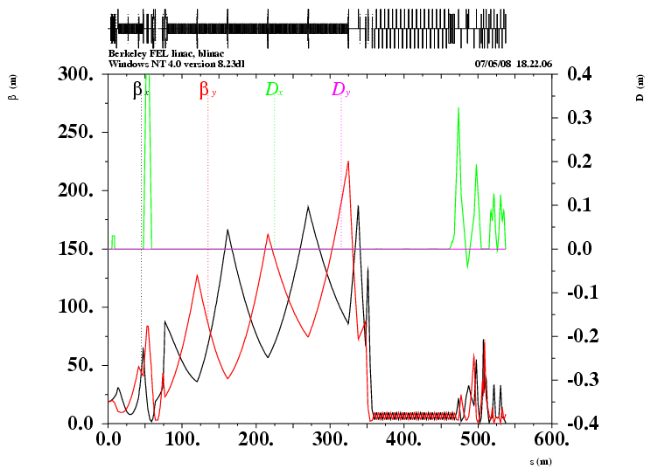
Multi-user soft x-ray FEL facility based on SRF linac (talk by J. Corlett)
~ 250 m
~ 100 m
~ 50 m
~ 350 m
40 MeV
Bunch compressor
Spreader
2.4 GeV
~ 50 m
Energy gain 13 MeV/m

Slide 3
Motivation for DWA
Reduce construction and operation costs of a high bunch rep. rate FEL facility:
  accelerating gradient > 100 MV/m,
  peak current > 1KA,
  bunch rep. rate of the order of 1MHz,
  electron beam energy of a few GeV

Slide 4
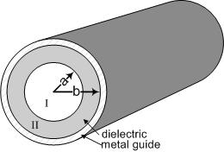
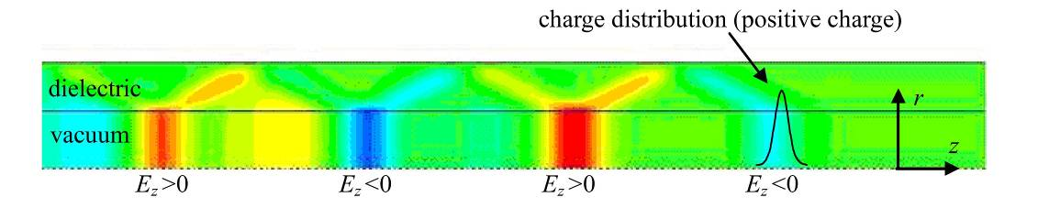
Dielectric Wakefield Accelerator
Simple geometry
Capable to high gradients
Easy dipole mode damping
Tunable
Non expensive
Recent impressive results (obtained along development of a Linear Collider):
- 1000 MV/m level in the THz domain (UCLA/SLAC group)
- 100 MV/m level in the MHz domain (AWA/ANL group)

Slide 5
Wake field in dielectric tube induced by a short Gaussian beam
ε
Q
2b
2a
Cu
a=240 um; Q=1 nC; bunch length=0.5 ps (FWHM), f=650 GHz

Slide 6
Road map to a high energy gain acceleration
Increase Transformer Ratio, i.e., a ratio of the maximum energy gain experienced by witness bunch to maximum energy loss experienced by drive bunch or train of bunches
Beam based → Ramped Bunch, or Ramped Bunch Train
Structure based → Two Beam Accelerator
Ramped Bunch
Reference: Bane et. al., IEEE Trans. Nucl. Sci. NS-32, 3524 (1985)
W
+
ρ
(z)
Ramped Bunch Train
-
z
W
d
d
d
Reference: Schutt et. al., Nor Ambred, Armenia, (1989)

Slide 7
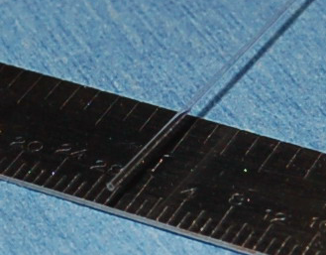
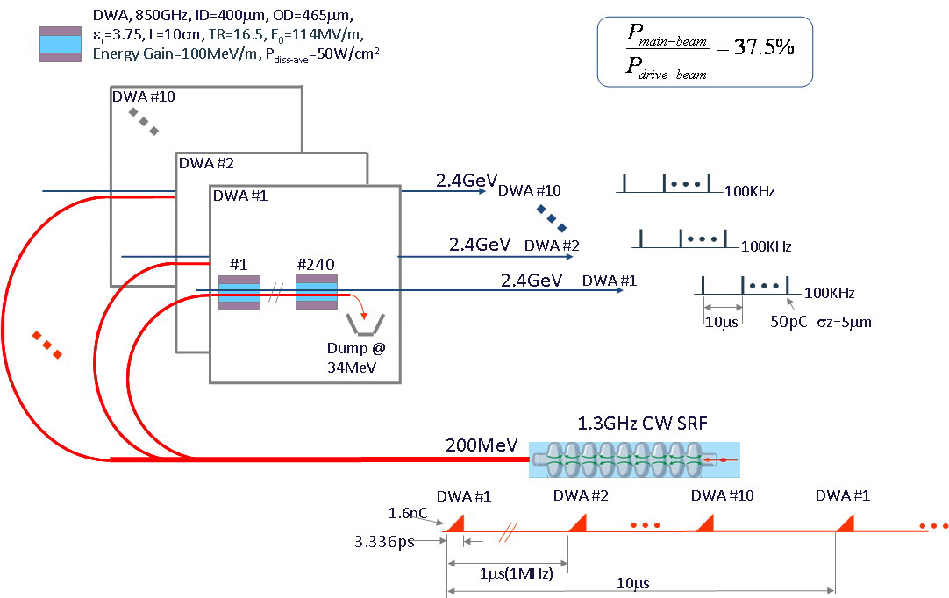
Euclid Quartz DWA (before metalization) ID=400 um
A schematic of a x-ray FEL user facility based on a 2.4 GeV DWA
FEL10
FEL2
FEL1
1 MHz,
P=320 kW

Slide 8
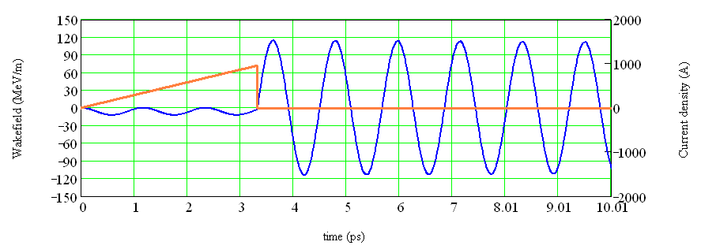
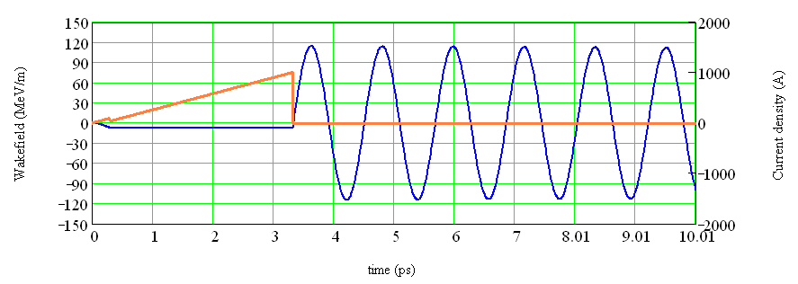
Key technology: bunch shaping enhances transformer ratio
Triangular bunch
TR~10
Double triangular bunch
TR~17

Slide 9
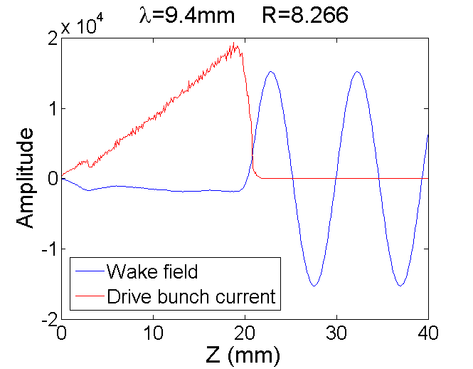
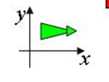


Double EEX technique:
a convenient tool for bunch shaping
Emittance exchange
FODO
Emittance exchange
-I
-I
T
-I
-I
B
B
QD
QD
QF
B
QF
B
QF
B
QD
QF
QF
B
QD
QF
QD
QD
QF
QD
QF
QD
B
B
TM₀₁₀
TM₁₁₀
TM₀₁₀
Deflecting cavity
z →x emit. exch.
x → z emit. exch.
Bunch shaping manipulations
Mask
Low charge witness (main) bunch can also be made out of drive bunch at the same time

Slide 10
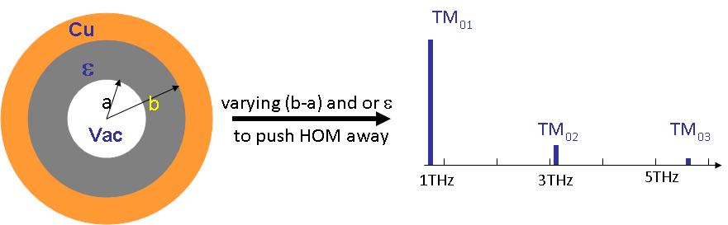
Key technology: DWA structure design
ID, OD, Length | 400 μm, 464.7 μm, 10 cm
ε, tanδ | 3.75, 0.6x10⁻⁴
Freq. of TM₀₁, TM₀₂, TM₀₃ | 850 GHz, 3092 GHz, 5749 GHz
Q of TM₀₁, TM₀₂, TM₀₃ | 1260, 3173,4401
r/Q of TM₀₁, TM₀₂, TM₀₃ | 94.1 kΩ/m, 3.2 kΩ/m, 0.5 kΩ/m
ν_{g} of TM₀₁, TM₀₂, TM₀₃ | 0.592c, 0.794c, 0.813c

Slide 11
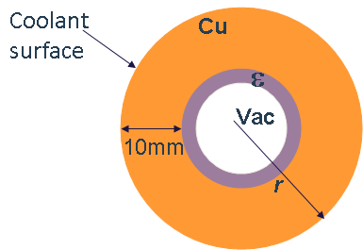
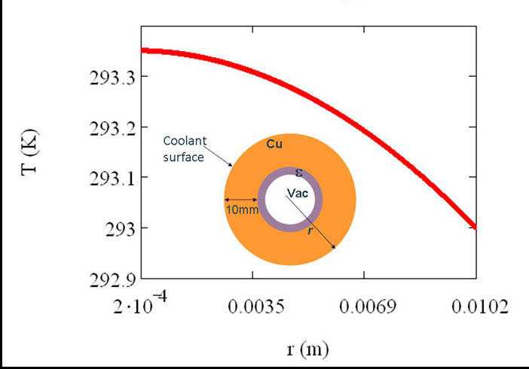
Thermal load and cooling
The structure overheating problem is much less severe in the DWA comparing to S-band Cu linac because of a small amount of energy used to excite the wake fields and a short period of time that the wake field remains inside of the structure.
Average power load 50 W/cm² at a 100 kHz rep. rate;
mostly dissipates in Cu
The pulse temperature rise from the wake field pulse is estimated to be only ~ 20 ºC

Slide 12
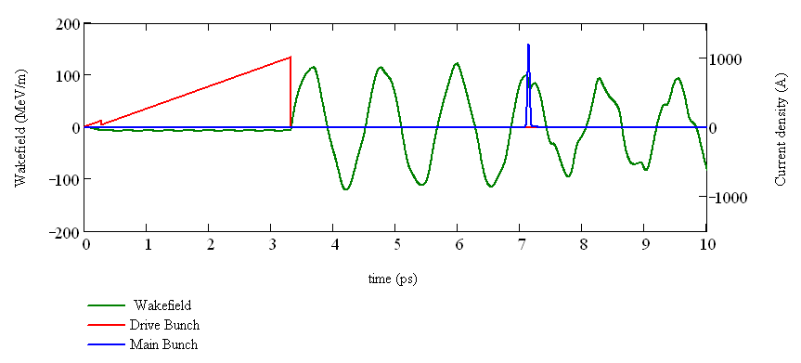
Beam loading
10 MeV in 10 cm
150 KeV (~1.5%)

Slide 13
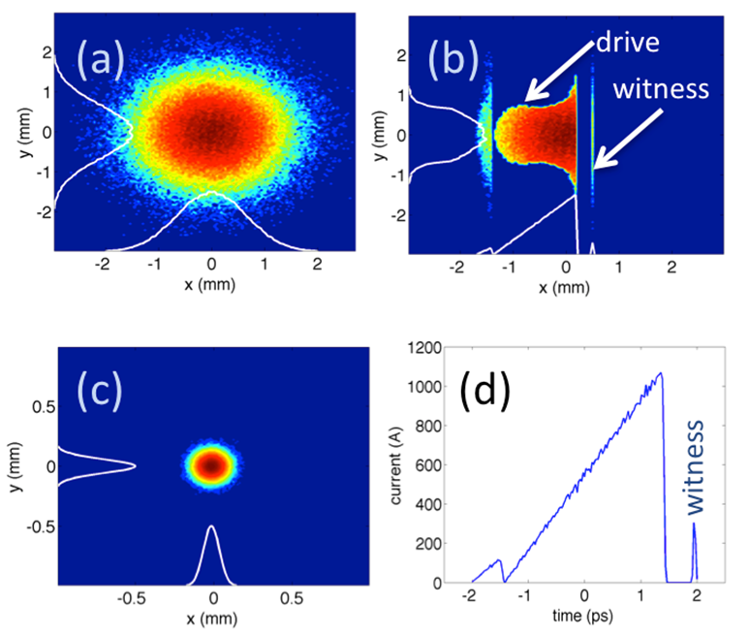
Before mask
After mask
At emittance exchange exit
Peak current
Double-triangular bunch generation using an EEX-based bunch shaper, where the transverse mask is tailored to generate a double-triangular bunch
(positive time corresponds to the tail of the bunch).

Slide 14
Electron bunch is strongly chirped in energy
Accelerated current
Wakefield

Slide 15
Strongly chirped beams for FEL applications: preliminary results
For short beams (<10 um rms) the energy chirp is approximately linear in time
Accelerated beam is strongly chirped (little FEL gain)
Using the chirp to compress the beam does not seem to be useful for radiation (although it is at the limit of various typical FEL approximations)
Tapering of undulator strength or period can counteract large energy chirp and maintain gain
For example, chirping the undulator strength K we have
Power evolution of DWA beam + undulator taper
Power profile near saturation z/L_{G} = 20
Chirped SASE spectrum near saturation z/L_{G} = 20
Nonlinear regime
Linear gain
Some applications favors wide bandwidth

Slide 16
Summary
Several DWAs driven by a single SRF linac can be located in the same tunnel and serve several FEL undulator lines, each at a 100 kHz rep. rate.
Energy chirped electron bunch coming from DWA will produce a powerful broad band x-ray light.
A proposed facility is energy efficient and may have a relatively low operational cost.
More studies are needed to prove the feasibility of DWA and to solicit new ideas.

Slide 17
Backup slides

Slide 18
Magnetic Bunch Compression
Courtesy P. Emma
ΔΕ/Ε
ΔΕ/Ε
ΔΕ/Ε
under-compression
σ_{z0}
‘chirp’
z
z
z
σ_{E}/E
σ_{z}
RF
Chicane
V = V₀sin(ωτ)
Δz = R₅₆ΔΕ/Ε
RF Accelerating
Voltage
Path Length-Energy
Dependent Beamline

Slide 19
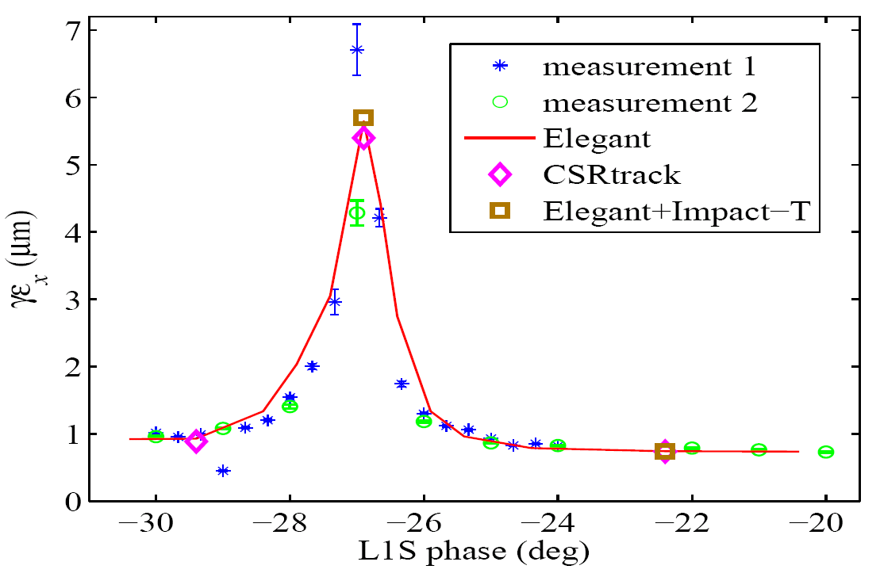
Some issues
ΔΕ/Ε
Needs:
de-chirping
De-chirping is
typically done by using wake fields and/or off-crest acceleration
under-compression
z
σ_{z}
Full compression is not good because of emittance growth due to CSR
LCLS
ΔΕ/Ε
Full compression
under-compression
K. Bane et al., PRST AB, 12, 030704 (2009)
z
σ_{z}

Slide 20
First beam experiment:
Passive “de-chirper” using dielectric wall waveguide
Cu
ε=4.4
0.1 mm
Q=300pC
2 mm
σ_{z}=100 μm
10 mm
15.4 MeV/mm/m
Notes:
Dielectric material: corderite, epsilon=4.4

Slide 21
Resistive wall wake field by design

Slide 22
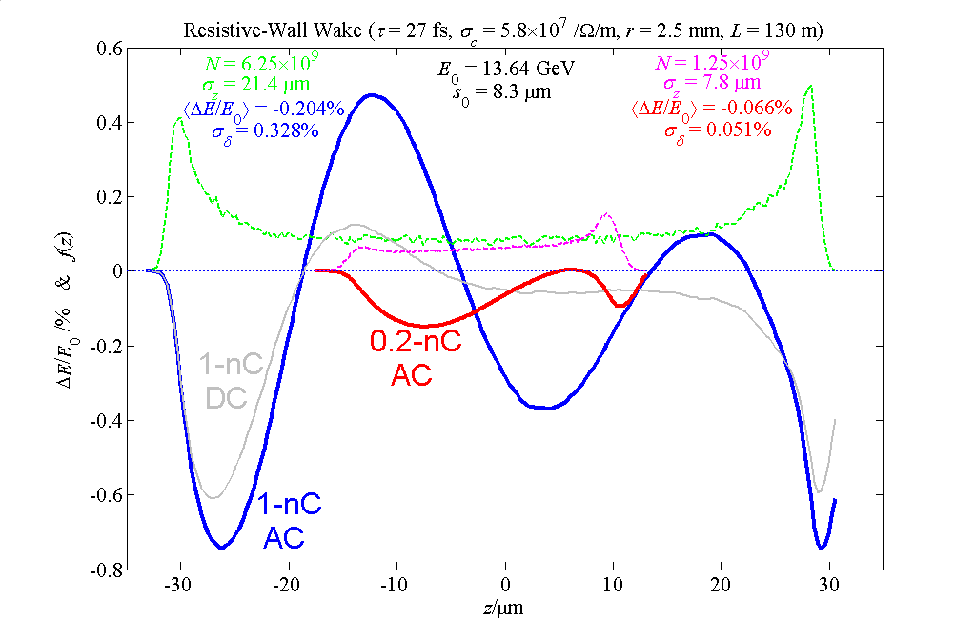
Resistive-wall wakefield effect in a narrow gap undulator
AC conductivity in metals
0.2 nC
1 nC
Cylindrical, Copper, r = 2.5 mm
Bane/Stupakov AC-wake model

