Slide 1
PREP Modernization Plan
A vision for bringing the equipment pool into the FPGA era
Lorenzo Uplegger
Scientific Computing Division
PREP Manager

Slide 2
PREP pool status
Most of the electronics that are in the PREP pool are more than 3-4 decades old.
PREP is still being used by many experimenters because:
It is easy to use
The experimenters are familiar with PREP electronics
It is free of charge
The equipment is temporarily loaned so there is no need to buy
PREP should modernize the equipment because it is a valuable resource for HEP experiments, especially the small ones and those just starting out.
Many small experiments, for example at the test beam or universities, only last for a short amount of time and they prefer to borrow equipment rather than buy it.

Slide 3
Why we should modernize PREP
No electronic piece of equipment in anyone’s household is 3-4 decades old and laboratories that claim to be at the forefront of research must also be at the forefront of technology, not only because it is “cool” but also because technology enables us to increase our performance and productivity.
Remote debugging and remote configuration are currently missing features.
Experts (those that know the application specific wiring/setup) must be present to resolve issues.
Our grad students and post-docs should be introduced to modern DAQ components, instead of learning how to use obsolete equipment.
The skills they learn will be valuable to the next generation of experiments
And more transferrable to industry

Slide 4
Modernizing the equipment – Power supplies
PREP has two main equipment’s categories:
Power supplies (PS)
Data Acquisition Components
Power Supplies:
Fermilab has limited capability for repairing High Voltage and also Low Voltage power supplies. So PREP would benefit from Argonne’s expertise.
The PS are dying and pretty soon we’ll be running short. Furthermore a failing PS might be a hazard to instrumentation and experimenters.
National laboratories shouldn’t design power supplies – so to modernize this category we need to start acquiring new commercial power supplies (several approaches to this).

Slide 5
Modernizing the equipment – DAQ Components
PREP has two main equipment categories:
Power supplies
Data Acquisition Components
DAQ components:
We would like to propose a very different approach that can be the backbone of general purpose DAQ in HEP in the US for the next two decades…

Slide 6
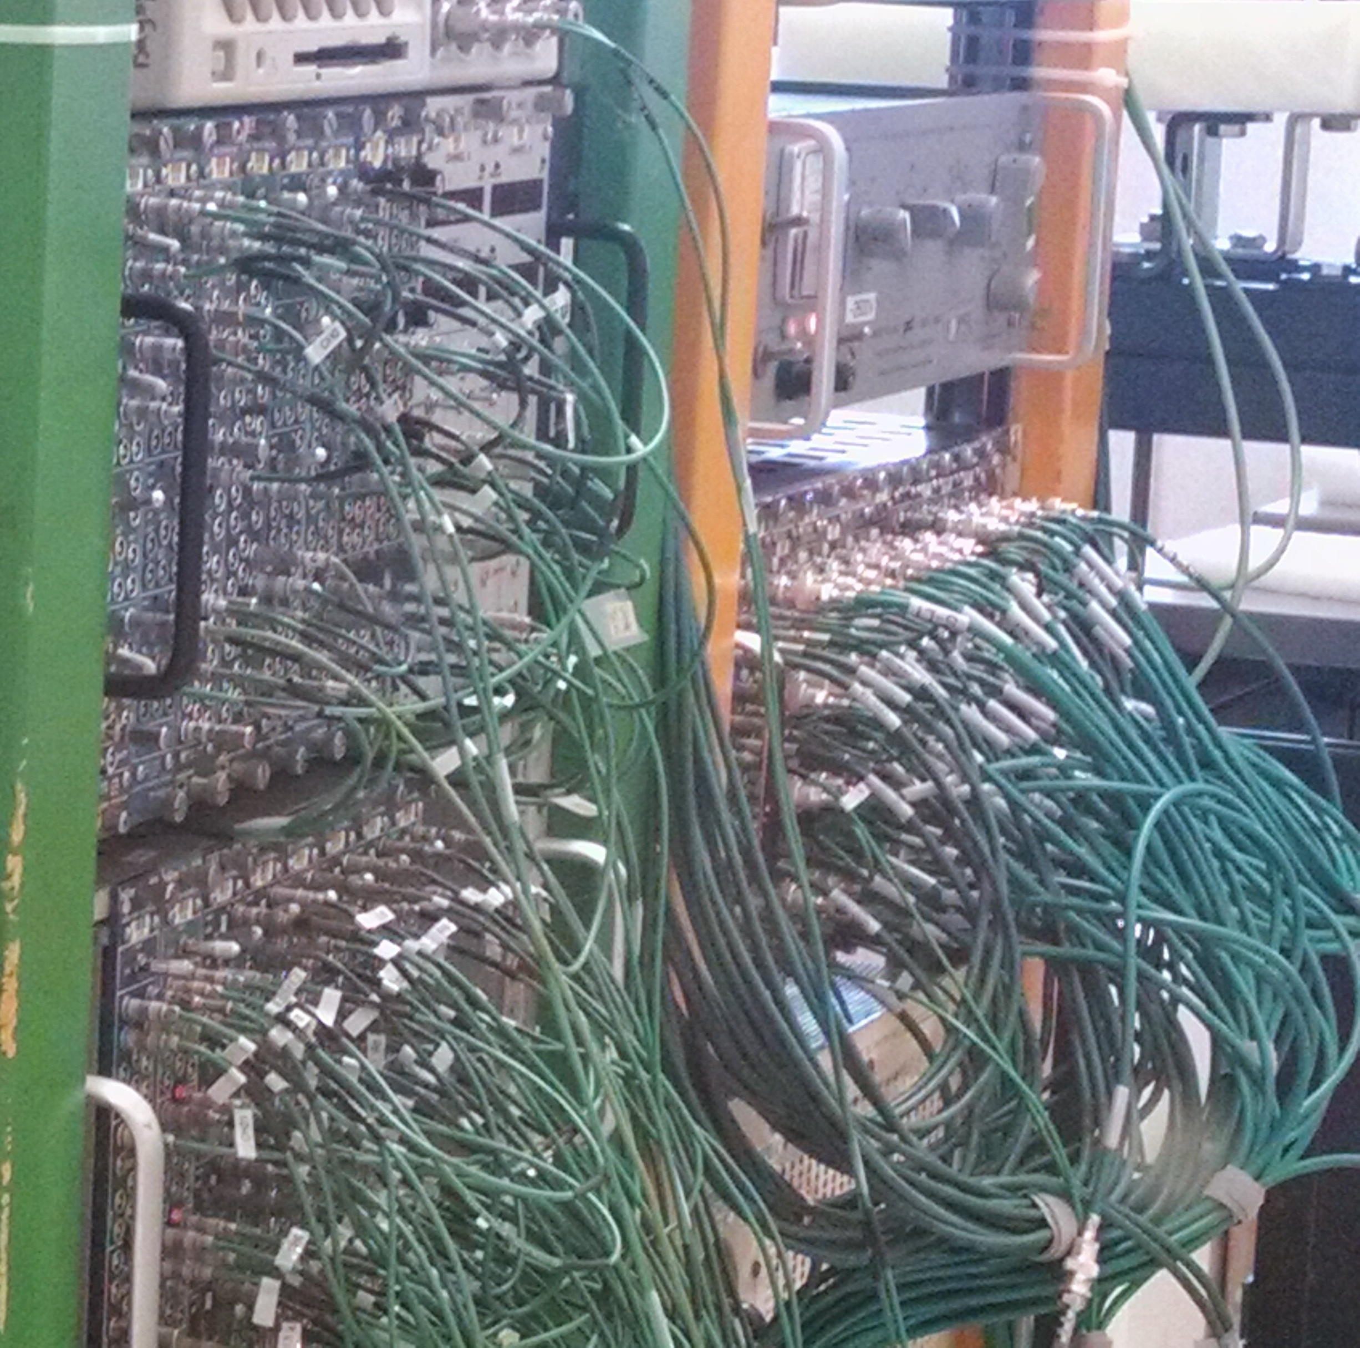
What would it look like…
FPGA

Slide 7
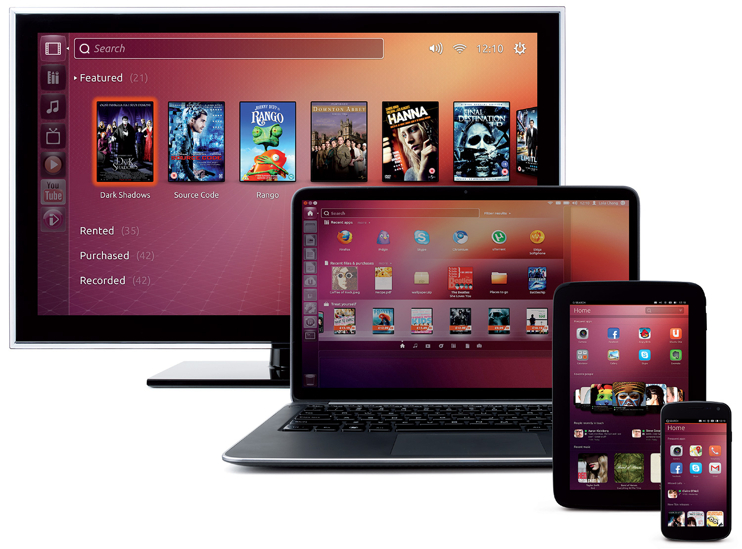
General Architecture
Web server (optional PC middle-man)
INTERNET
FPGA motherboard
with VHDL code
User Interface through web browser

Slide 8
General Architecture
Ethernet Switch
Gbps Ethernet Links
Wall Power
FPGA
LEMO connectors
Rack Mountable

Slide 9
Modernizing the equipment – DAQ Components
DAQ components proposal:
We want to propose DAQ “as a service”
Software/Firmware development will be 90% of the effort, and the key to making the user experience familiar and simple.

Slide 10
Why we are uniquely positioned
We want to do it!
We have identified the resources with the experience, ability, and desire.
The electronics departments in SCD and PPD agree that this is valuable and interesting work. (We in fact are already driving towards efforts that overlap this proposal. What does this means to PREP: “more for less”)
The two departments have considered NI, and other commercial options.
A dedicated system can better achieve the needs of HEP unlike commercial equipment that has to fit a multitude of possible users.
PREP experience
We are familiar with user needs.
We can get high channel density at low cost since we know what signals to expect, i.e. phototubes and wire chambers.

Slide 11
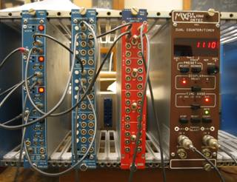
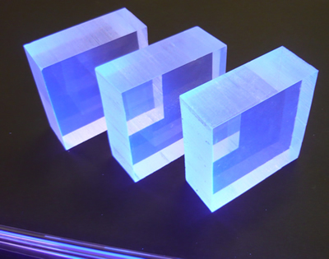
A simple example
Lemo cables
Beam
Coincidence counter at 0
NO
COINCIDENCE!!!

Slide 12
A simple example
Adjusting the length of the lemo cables
Beam
Coincidence counter at 1
COINCIDENCE!!!

Slide 13
A simple example
A custom designed simple daughter board that converts scintillation signals to single ended.
Lemo cables
Beam
SIGNALS ARE DELAYED IN THE FPGA TO FORM THE
COINCIDENCE!!!

Slide 14
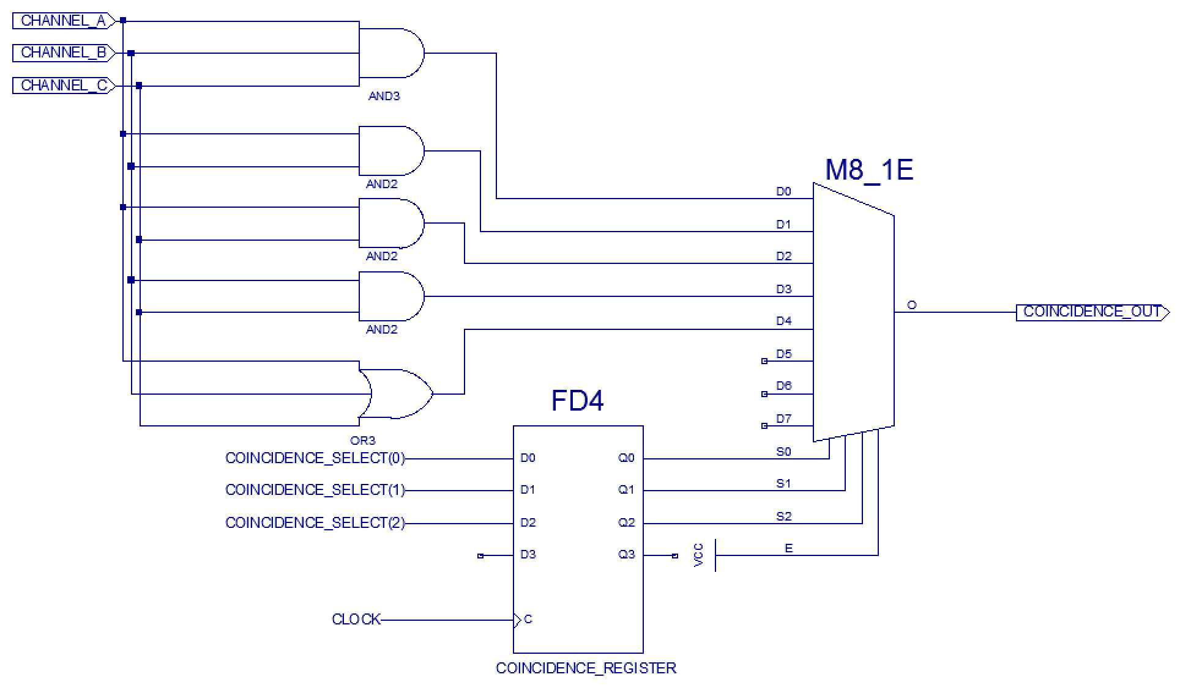
Inside the FPGA

Slide 15
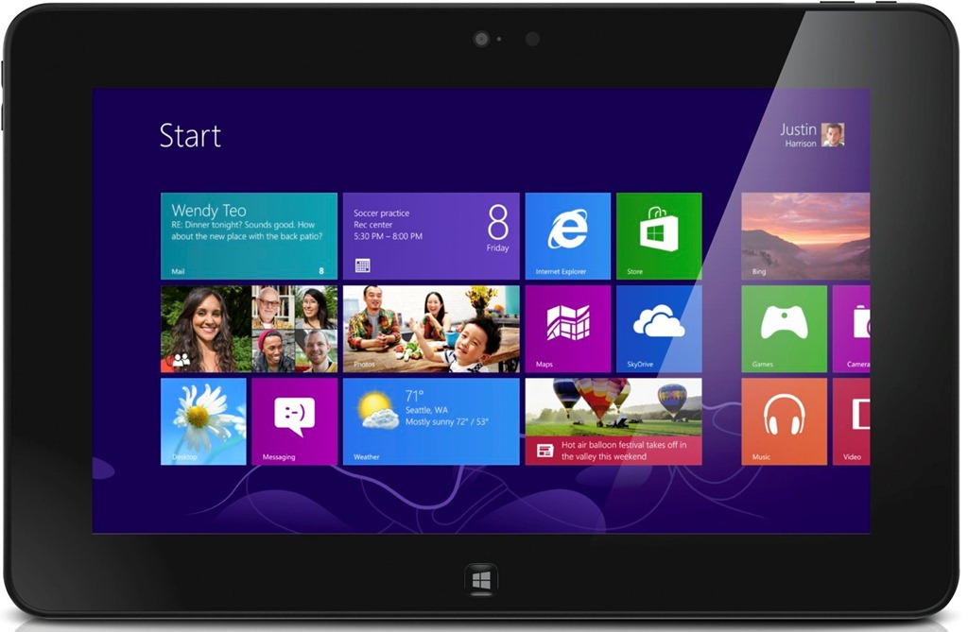
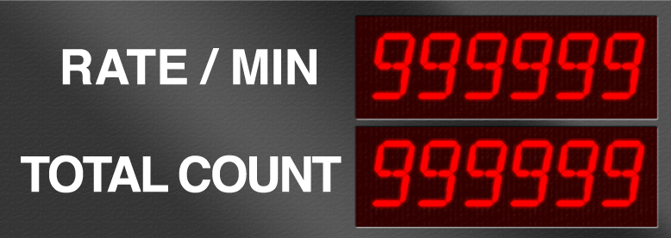
User Experience (e.g. on a tablet)
Coincidence
Level 1
Level 2
Level 3
Enable
Channel A:
Channel B:
Channel C:
Delay (in ns)
Channel A: 50
Channel B: 26
Channel C: 0
Threshold (in mV)
Channel A: -60
Channel B: -55
Channel C: -80
Counters
Channel A
Channel B
Channel C
Coincidences
Mean Delay From
First Signal (in ns)
Channel A: 0.5
Channel B: 26.2
Channel C: 49.4
Veto (in ns): 100,000
Load Configuration
Save Configuration

Slide 16
To make it happen labor
We think the DAQ modernizing effort breaks down into 15% hardware, 15% firmware and 70% software.
We would need about 2 FTEs for 3 years for the core software development of the system, mostly developed by SCD/RSE leveraging on the experience in data acquisition systems.
We would need about 1 FTE spread over 3 years for electronics to work out the details for a few core hardware implementations and develop daughter cards, leveraging on the experience from PPD/EED in designing analog electronics, that can replace the most common applications right now based on NIM and CAMAC.
Annual Effort Breakdown:
Year 1: 2 FTEs software + 1 FTEs hardware/firmware + 0.2 FTEs mechanics
Year 2: 2 FTEs software + 1 FTEs hardware/firmware + 0.2 FTEs mechanics
Year 3: 1.5 FTEs software + 0.5 FTEs hardware/firmware + 0.1 FTEs mechanics
After year 3: 1 FTE for support and continued updates.

Slide 17
To make it happen milestones
Annual Milestones:
Year 1: Demonstration of an analog discriminator module and a gate generator module with software framework.
Year 2: Add daughter cards and streamline user experience. Start replacing modules in the test beam. Start advocating for community contribution to open source development.
Year 3: Start replacing old modules in targeted experiments and supporting new modules.
After year 3: Support new modules. Maintain software. Grow user/developer community.

Slide 18
To make it happen M&S
Annual M&S Breakdown:
Year 1: A first prototyping run in year 1 of 5 motherboards and 10 daughter cards to use for debugging and software/firmware development and early deployment at the test beam (15K $).
Year 1: Mechanical prototypes (5K $)
Year 2: A first production of about 25 motherboards and ~100 daughter cards, of various types, for test stands and small experiments (~150K $)
Year 2: Mechanical production (20K $)

Slide 19
Thanks.

Slide 20
Backup Slides

Slide 21
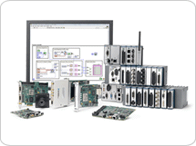
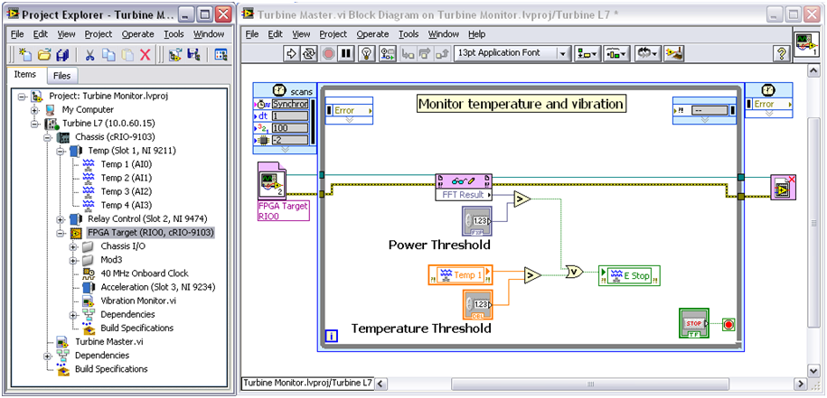
National Instruments
We have thought about this option but we always hit the same issues:
Many of the applications are mostly for HEP, like scintillators detectors, so many times we need specific instrumentation that is not easy to find in the industry
License Management
If we buy FPGA cards from NI there are two major issues:
They are costly, even when the FPGAs are already old
We just get the hardware but THE USER then have to write the software using LabVIEW
You are forced to use LabVIEW FPGA (http://www.ni.com/labview/fpga/) to program the FPGA while everybody else is using VHDL/Verilog
National Instrument has been around for 40 years already and, although is used at the Lab, it has never been as widespread like the NIM and CAMAC modules.

Slide 22
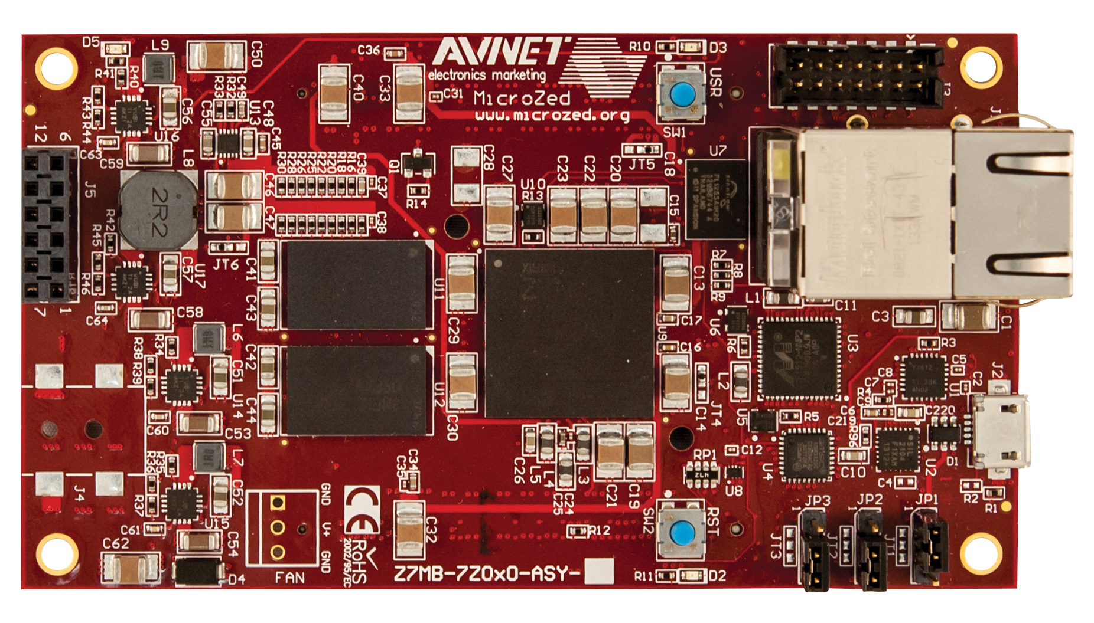
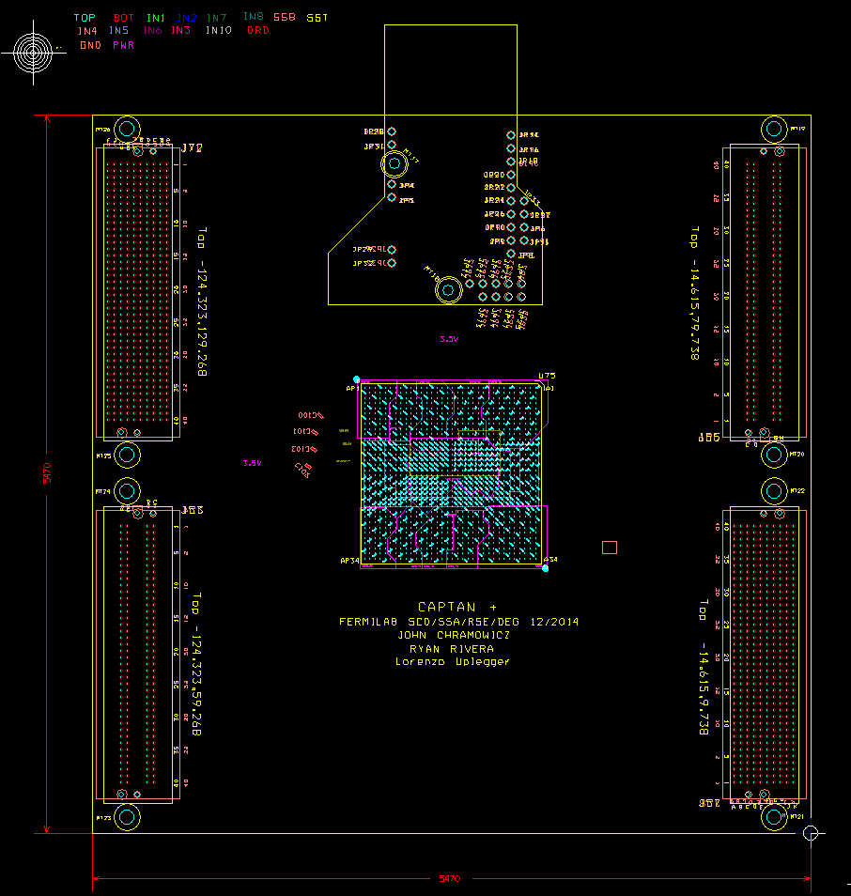
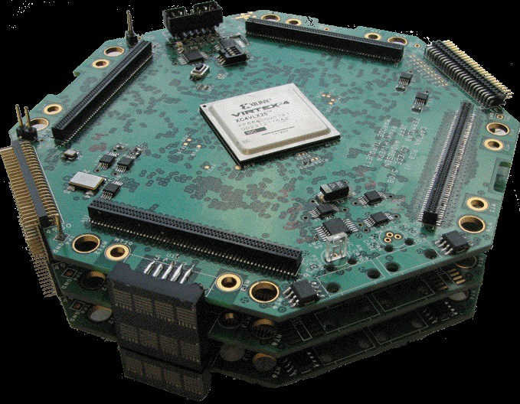
FPGA cards
microzed FPGA card from Avnet
(http://zedboard.org/product/microzed)
CAPTAN+ (Fermilab
FMC carrier card for microzed

Slide 23
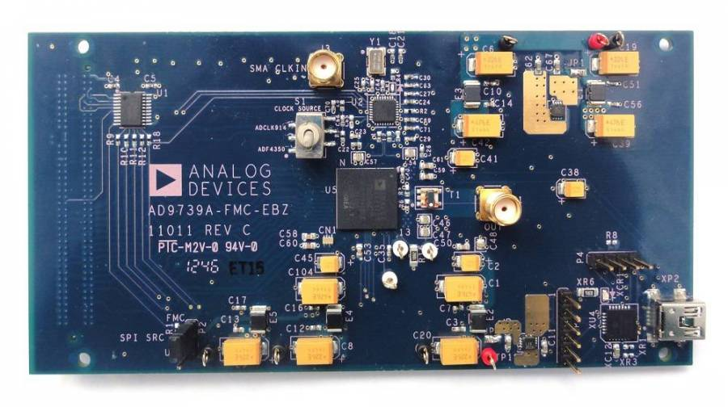
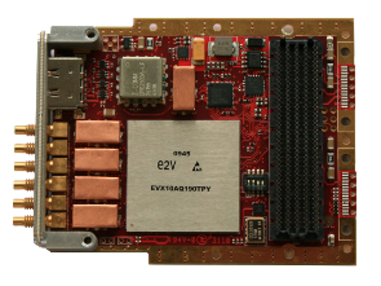
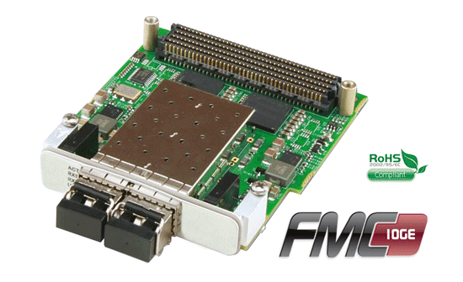
FMC cards examples
FMC-HPC Analog-to-Digital Converter Board
Multi-Channel Multi-Mode 10-bit ADC
1.25 Gsps / 2.5 Gsps / 5.0 Gsps
FMC VITA 57.1 Compliant
From: http://www.4dsp.com
ADC Card from Analog Devices:
14 bits 2.5GSPS
Two independent 10GBASE-T interfaces
with SR-IOV support

