Slide 1
Technology Requirements for Large-Angular-Scale CMB Science
Science Goal: Measure (or set stringent limits on) the polarization signal in the CMB caused by remnant gravity waves (tensor fluctuations) from Inflation.
This signal is characterized by a single number, r, which is the ratio of the fluctuation power in tensor and scalar modes.
Current best limit: r < 0.1 from Bicep2/Planck.
Target CMB-S4 sensitivity: r = 0.001 at 5-sigma
John Ruhl (Case Western)
Brad Benson (Fermilab / U. Chicago)
CPAD, 10/5/2015

Slide 2
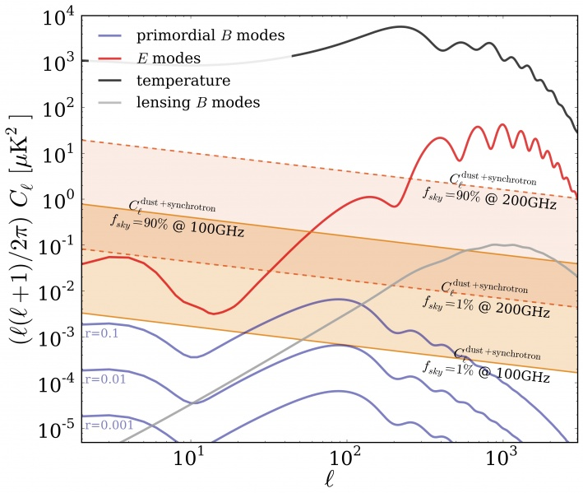
CMB Power Spectrum
Temperature
Polarization
E-modes
“Recombination”
Bump
B-modes:
Inflation signal is beneath galactic foregrounds.
“Reionization”
Bump
CMB-S4 target
Errard, Feeny, Peiris, and Jaffe, arXiv:1509.06770
Notes:
Point out reionization bump, which is another possible target.
Go over foreground bands briefly; dust + synchrotron everywhere higher than the target, requires foreground subtraction.

Slide 3
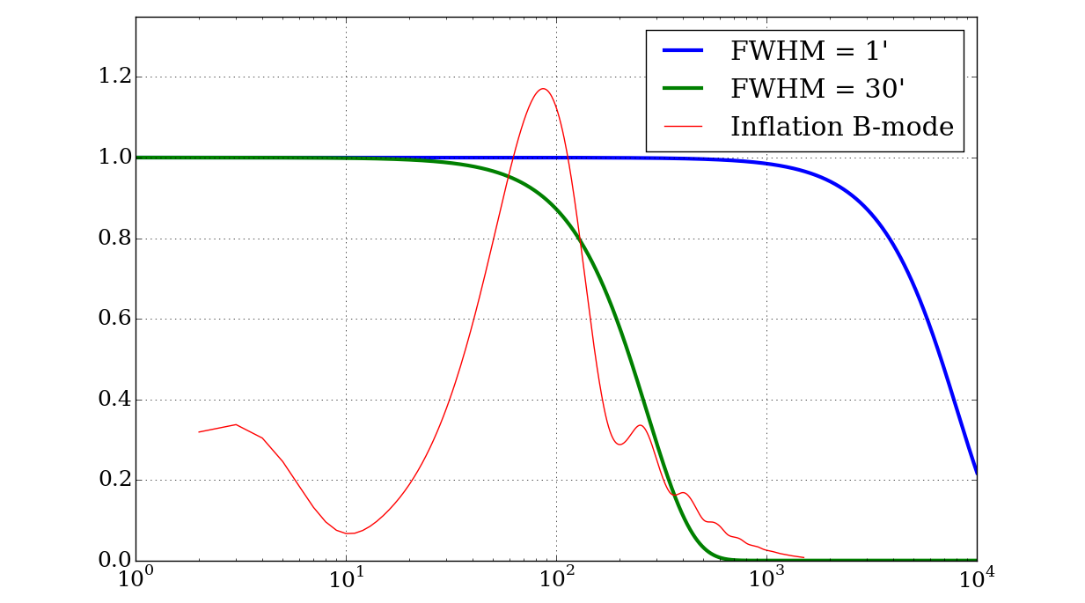

Telescope Design: Beam size filters
small angular scale (high l) information
“Recombination”
Bump
SPT/ACT-like
“Reionization”
Bump
Spider/Keck/Bicep-like
Notes:
What instrument do we need to get at the ell=80 bump? Small telescopes are fine for that, though if we build a large telescope it should be able to probe the ell =100 range too if used properly.
Note: the red curve here is arbitrarily scaled… it looks funny because the y-axis is linear, and we’re used to seeing it on a log scale.

Slide 4
Survey Design: Area of sky scanned limits
largest angular scales (lowest l) information
For a circular patch X>1, but historically X is at least a few, maybe even 10, due to filtering.
“Recombination”
Bump
X = 2;
f_{sky} =
50%
1%
“Reionization”
Bump
Notes:
What survey size do we need? 1% is (theoretically) okay, though really you’d want a few times more. Even more than that is good if you want to check for isotropy to convince yourself that any signal isn’t foregrounds. Once you get to 50% you can start characterizing the reionization bump.
Note: the red curve here is arbitrarily scaled… it looks funny because the y-axis is linear, and we’re used to seeing it on a log scale.

Slide 5
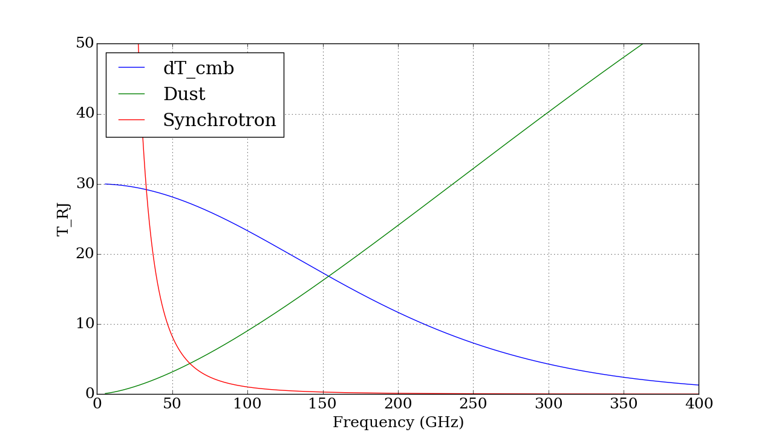
Frequency Coverage: Need to separate
CMB from foregrounds
Dust:
20K greybody with a power law emissivity
Antenna Temperature (K)
Synchrotron power law
CMB
N foregrounds may require ~ (3N + 2) bands
Dust is equal to r=0.1 signal at 150GHz at l~80. (Bicep2/Planck)
Foreground minimum is somewhere near 70GHz-ish
Notes:
Foregrounds are strong relative to the signal so we need to characterize them.
Note:
The blue curve here is dT_rj/dT_cmb and so gives the signal strength of a cmb signal. Synchroton and dust are very roughly (by hand) normalized for 150GHz, ell=80 bump, small sky patch where we know that the dust gives about r=0.1, and such that the foreground minimum is near 70GHz. So in this plot you can take the CMB line as r=0.1, then the dust line is about right for Bicep’s patch… and the synchrotron is too if the 70GHz minimum rule holds up for small patches.

Slide 6
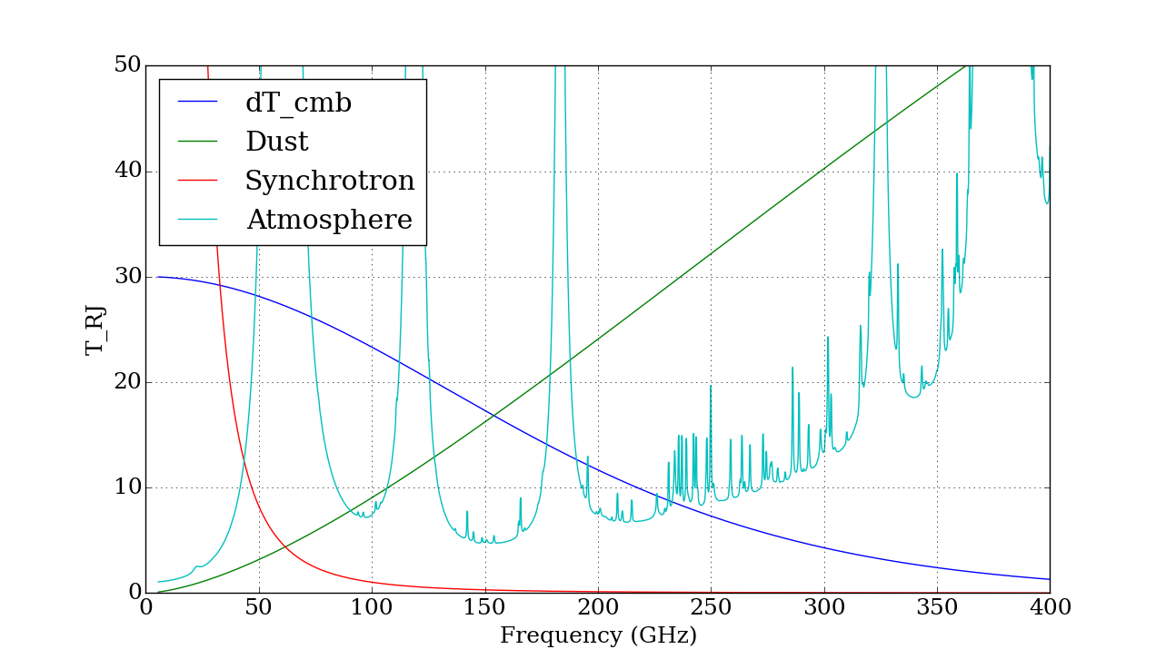
Observe in Atmospheric Windows:
Target CMB-S4 range is 30-300 GHz, but will be refined with future modeling
Antenna Temperature (K)
N foregrounds may require up to (3N + 2) bands (< 8 bands for 2 foregrounds)
>300 GHz difficult from ground; potential help from balloons/satellites
Notes:
Atmosphere shown is for pole, zenith, 0.26mm pwv, winter. But that’s not the point… just that the spectrum rises but <300GHz doesn’t look crazy… and that to get 3N+2 bands we’ll have to split windows.
Another point is that the 60GHz water line means that the next band you’re going to use (down low, below 90) is going to be 40GHz where hemts work great though we’d need to look at $.

Slide 7
Science Goals Drives Sensitivity Requirements
RMS in
bin
10uK
1uK
100nK
10nK
Aim to detect signals at < 10 nK RMS
Errard, Feeny, Peiris, and Jaffe, arXiv:1509.06770
Notes:
Now that we’ve made the point that we need lots of bands to deal with foregrounds, make the point that we’re going after ridiculously small signals. So we need enormous sensitivity.

Slide 8
CMB Experimental Stages
CMB-S4 needs to be ~200x faster than operating Stage-2 experiments
Primary technical challenge for CMB-S4 will be scaling up current detector technology
Snowmass: CF5 Neutrinos (arXiv: 1309.5383)

Slide 9

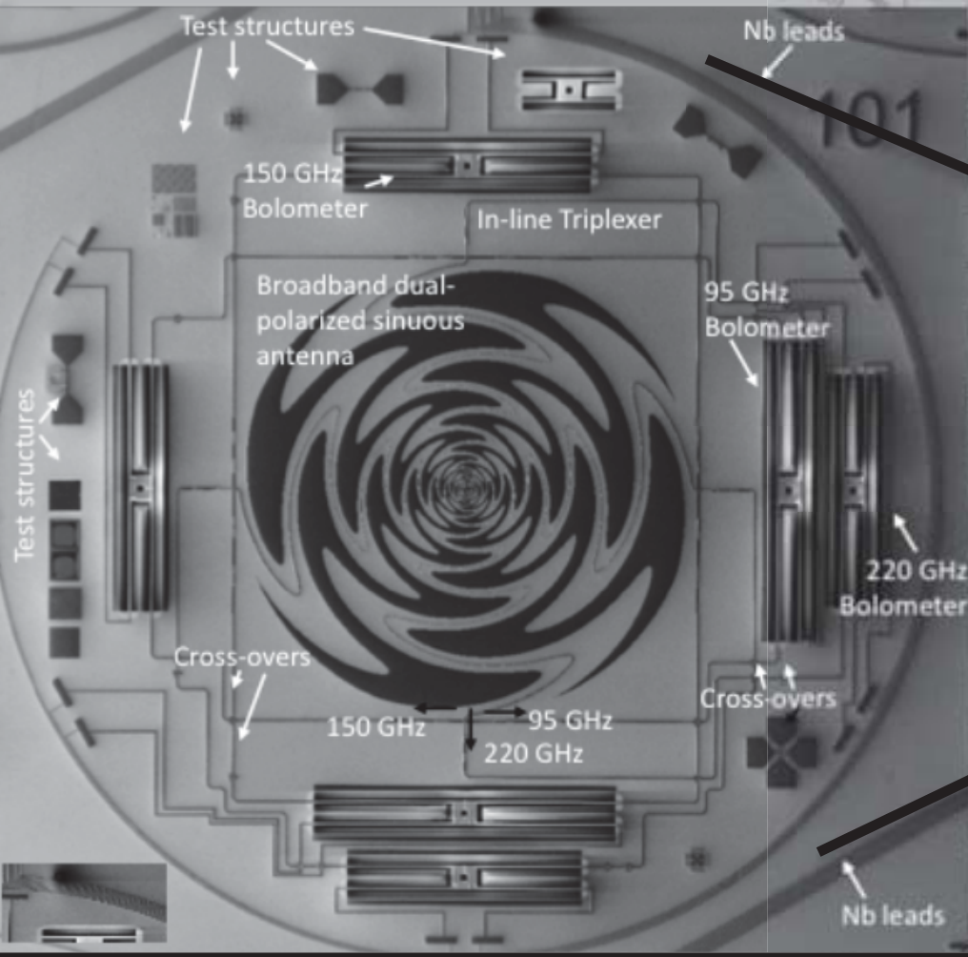
Current (“Stage-3”) Detector Technology:
TES bolometers, 80-250 GHz
2 polarizations in each of
3 freq. bands
=> 6 detectors /pixel
Photons couple via polarized antenna/feed to microstrip, with power deposited onto a bolometer.
Each pixel has detectors sensitive to each linear polarization, and in 1 to 3 frequency bands.
(There are several architectures for this in use, which use a variety of beam forming/coupling optics.)
Notes:
Bolos currently in use from ground are almost all 90-150GHz, with 220GHz starting.
They all work roughly the same way; feeds differ.
Npolarizations*Ncolors = Ndetectors in pixel.

Slide 10
Improving Instrument Sensitivity
Single-detector sensitivity is typically (near) photon-noise limited.
Limited room for improvement:
  Optical efficiency (more photons => more sensitive)
  Optical loading (fewer non-CMB photons => more sensitive)
At best (very optimistic) maybe a factor of sqrt(2) improvement is possible.
Need: a) more sensitivity, b) many bands to deal with foregrounds.
=> deploy a suite of instruments with ~500,000 detectors.
Notes:
We’re not perfect yet (at least in SPT… Act?) But we’re close enough that just working on sensitivity alone, which isn’t easy either, won’t get us where we need to be.

Slide 11
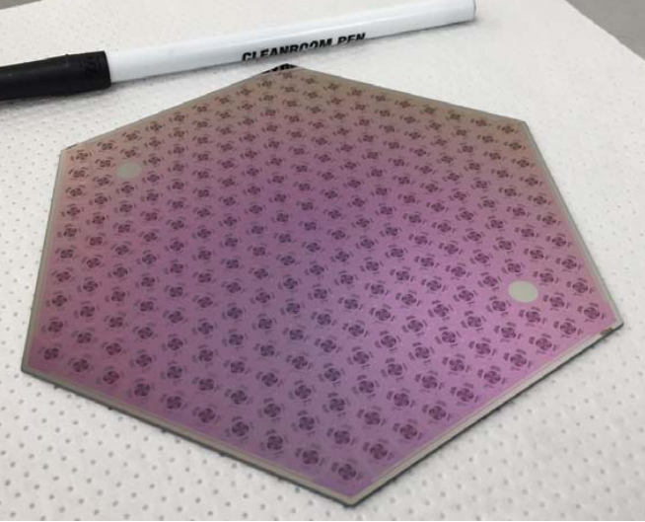
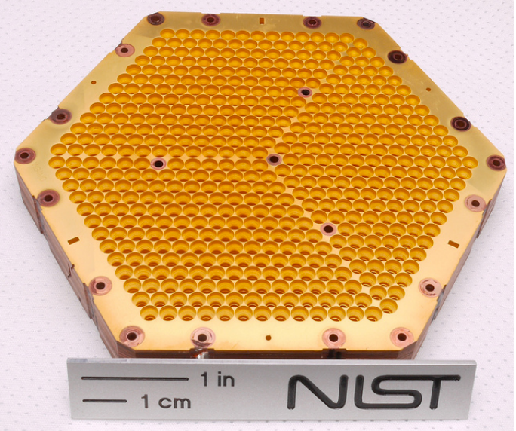
“Stage-3” Detector Technology:
Order(1,000) detectors on one 6” wafer
Order(10,000) detectors in instrument
SPT-3G wafer
Advanced ACT array
(Could show other examples from eg JPL, UC Berkeley…)
Issues:
Scaling up to 100K’s of detectors. (100’s of good wafers!)
Cost per pixel including readout (< ~$10/detector)
Demonstrating on-sky performance at freq > 200GHz, or < 60GHz.
Notes:
We’re at about the ultimate scale for pixels per wafer. We may not be at the ultimate scale for bands/pixel, though, so detector count on a 6” wafer may still rise. But we’re going to need many many many of these. That’s the biggest change in S4’s focal planes, as all else could be evolutionaary.

Slide 12
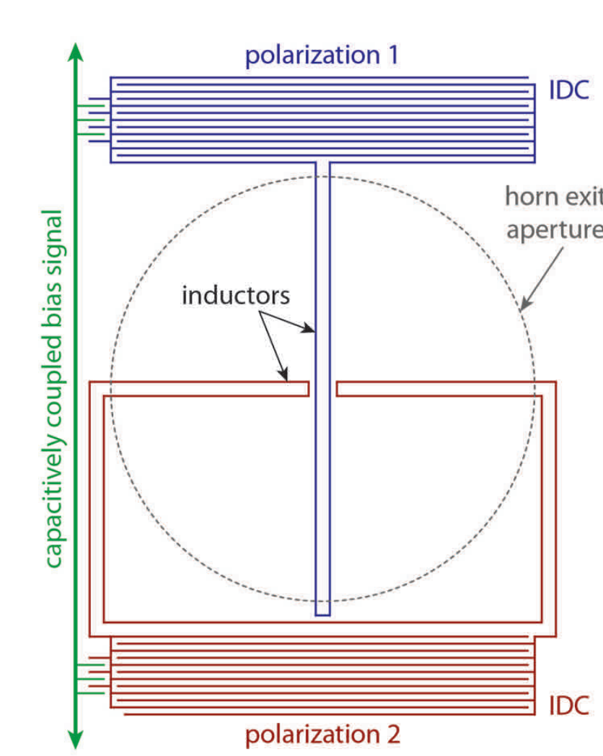
Kinetic Inductance Detectors (KIDs):
A simpler cost saving detector?
Photons are coupled into a superconducting resonant circuit. They change its kinetic inductance, which changes resonance properties (Q or freq or phase)
Advantages: potentially easier fab, easier (highly multiplexed) readout, lower cost.
Disadvantages: not CMB field tested, and CMB-likely designs (dual polarization, multichroic) are still in very early stages
Notes:
Readout is a real cost. KIDs can simplify the readout a lot. And may be simpler to fabricate. They’re not more sensitive, so there’s no benefit in that direction.

Slide 13
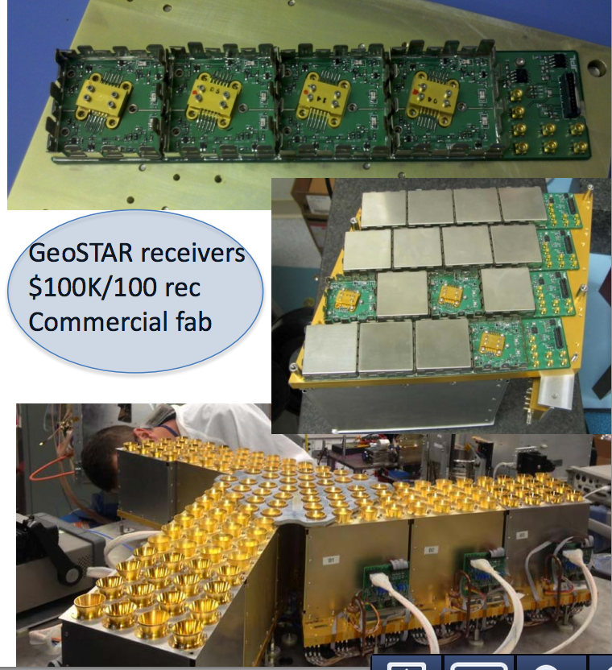
HEMT Amplifiers:
Frequencies lower than 60GHz
Bolometers haven’t been demonstrated at < 60 GHz … could/should work (e.g., CLASS experiment)
HEMT amplifiers have a strong history, but are expensive per pixel (~$1 K). Worth looking at costs… some progress there but still expensive.
Notes:
Below 90GHz (and I say 60 here to get fully below the 90GHz band) there’s a real question about what to use. HEMTs work great but cost a lot. Bolometers should work there but haven’t been developed/deployed.

Slide 14
Optics
Need telescopes that can fit the desired number of detectors.
Warm reflectors followed by cryogenic broad-band lenses (e.g., ACT, Polarbear, SPT) Requires cutting edge developments in cryogenic millimeter-wave lens and anti-reflection coating technology. Current state of the art is Order(5K) pixels, times two to three bands.
Small cryogenic refractors (e.g., Bicep/Keck, Spider). Cheap enough that multiple receivers can be deployed. State of the art is ~2500 90GHz detectors in one telescope in Bicep3.
New designs, e.g., wide-field cross-Dragone (next slide). All-reflector optics make many-color focal planes more likely.
Notes:
The optics are challenging, with an important goal being to minimize overall project cost while meeting other specs. Desire wide-field optics, and multichroic especially for the precious large-aperture telescopes.

Slide 15
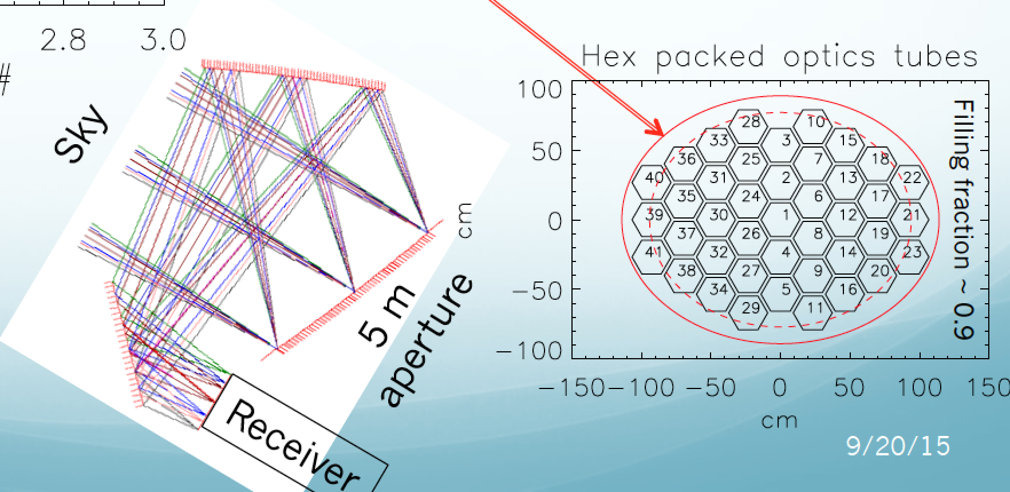
Cross-Dragone telescopes can illuminate
more than 100K multichroic detectors
(# scales with diameter : this is for 5m, > 100K detectors, but smaller telescopes can still be impressive)
M. Niemack
Notes:
An example of an audacious new design that accomodates an enormous number of detectors. Worth further study.

Slide 16
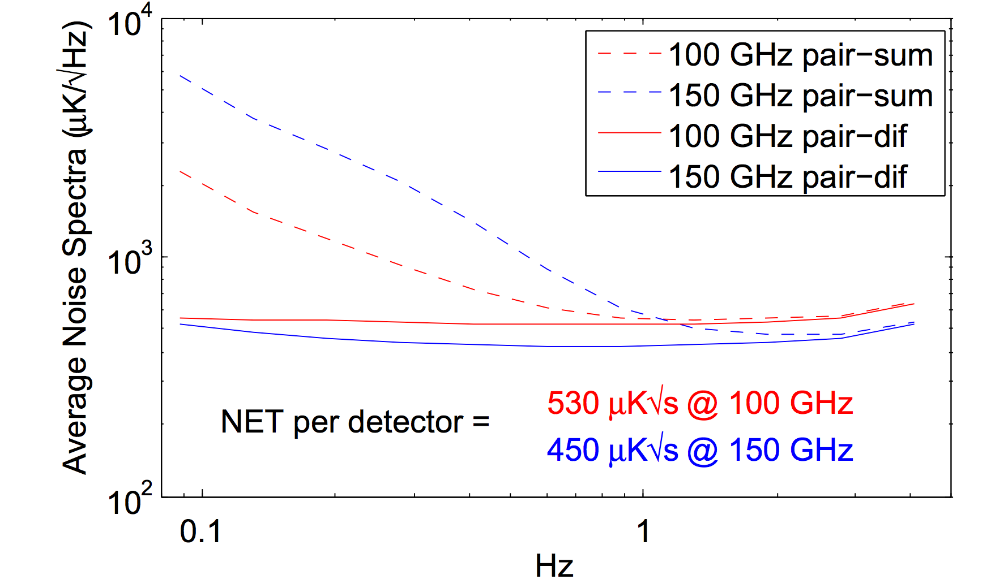
Measuring Large Angular Scales
Atmosphere fluctuates on large-scales, but is un-polarized.
Differencing polarized detector pairs removes atmosphere to < ~0.1 Hz (ell < ~ 50) for BICEP2/KECK.
Higher focal-plane sensitivity and larger scales will require improved detector gain matching..
Bicep: Takahashi etal, arXiv:0906.4069

Slide 17
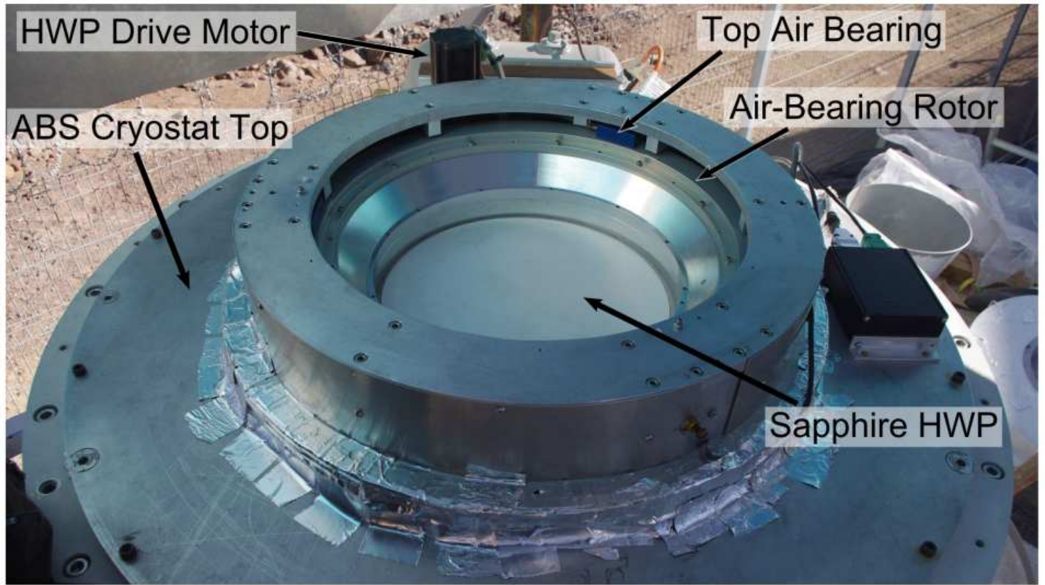
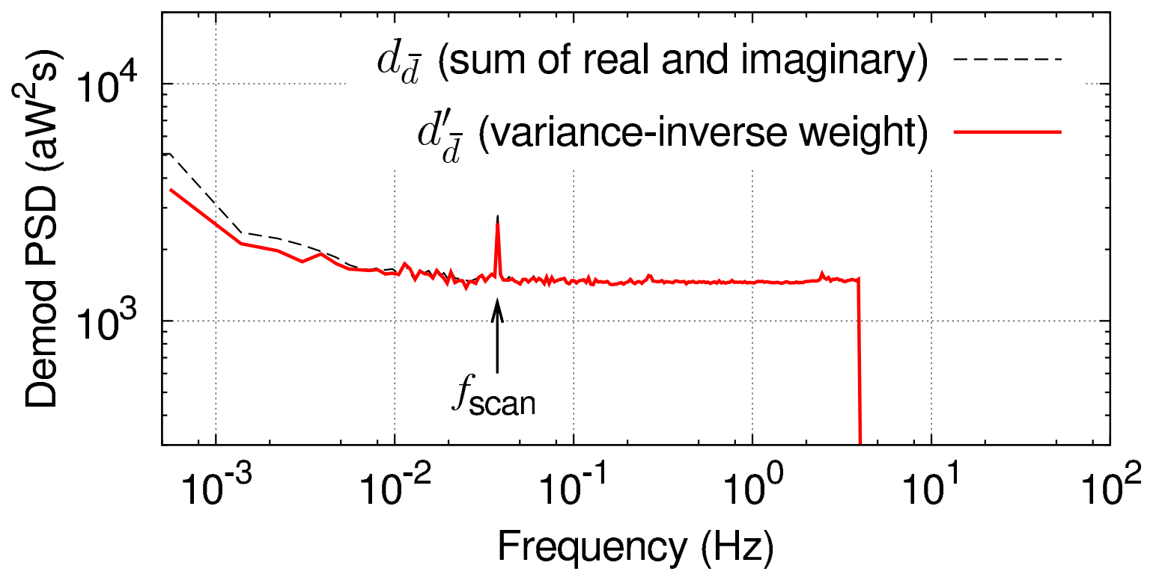
Polarization Modulators
Rapid polarization modulators could be useful/necessary for higher frequencies (where atmospheric emission is worse) and larger angular scales.
Candidates being explored by various groups:
Rotating half-wave plates (ABS, EBEX, ACT, Polarbear)
Variable-delay polarization modulators (CLASS)
(See Suzanne Staggs’ talk (next) for more details)

Slide 18
Summary
Motivation for large-angular scale measurements driven by Inflationary science goals, to measure the tensor-to-scalar ratio, r
CMB-S4 goal is to measure r=0.001 at 5-sigma.
Primary technical challenge is scaling of detector technology to achieve requisite sensitivity, which will require ~500,000 detectors
Removing foreground emission will require multiple frequency bands (as many as 8) from 30-300 GHz, might require multiple detector technologies.
The recovery of large angular scales will be an important systematic consideration, current generation experiments are demonstrating several techniques. Science drivers will set required ell-min.

Slide 19
END

Slide 20
Primordial B Modes, Inflation, Foregrounds, Frequency Bands, and maybe optics methods to deal with the need for lots of frequencies (ie, either broadband components and many frequency channels per pixel, or separate optics for less broadband chains)
This makes it easy for you to use SPIDER & SPT for comparisons, and to work in the balloons are complementary for foregrounds theme
1) first speaker (sounds like me) should give an overview of "how do we actually measure cmb polarization" after talking about the bands needed, giving nod to hemts at low frequency as well as bolos.
2) One of us should talk about detector technologies that are relevant for future DOE involvement; the spt3g/ANL stuff is probably the poster child for this audience, but we should probably mention HEMTS and MKIDs. Maybe this is all part and parcel with #1?

Slide 21
Outline:
D_ell plot, signal levels (rms on sky) TT, EE, BB, foregrounds, r goal of 0.001.
  Three ell ranges, angular scales. CMBS4 certainly ell 50 to 5000, think about lower.
  How many bands over what range to deal with them. Atmospheric windows. Need realistic sims to guide band placement.
  Telescope beam size drives l_max
  Scan region (and 1/f noise, etc) drives l_min
  Slides:
    1) D_ell plot. Spectra + foregrounds.
      Overlay B_ell
      Overlay l_min from scan region
      Overlay data
    2) Atmospheric windows
    3) Sky coverage from Chile and South Pole
Measuring CMB polarization
  TES bolometers + scanning… detector differencing
  Sensitivity on D_ell plot. Planck, Spider, SPT3g, vs… CMBS4.
  Challenges:
    Sensitivity (loading, optical efficiency, photon/phonon noise, 500K detector count),
    atmospheric 1/f
    Sufficiency of bands (to get at foregrounds)
    cost
  Modern focal planes
    Pbear/Spt3g design, 3 band/pixel
    Actpol design, feeds, 2 band/pixel
    Spider (1 band/pixel or telescope)
  Future focal planes
    TES – increase size, and/or colors/pixel (split atmospheric bands)
    MKIDs
    HEMTs if <60GHz needed.
Optical designs
  Small aperture, limited bandwidth, can replicate (spider, keck). Limited l_max.
  Larger aperture, can’t replicate, drives demand for large bandwidth (ACT, spt)
  Modulators
  Broadband makes refractive optics more complicated (Case study: SPT3g vs Spider)
  Possibility of cross-dragone designs (all reflector) – large bandwidth.

