Slide 1
Dark Matter: A Continuing Saga
Bhaskar Dutta
Texas A&M University

Slide 2
Outline
Probing DM
Understanding the DM Content
Indirect Detection
Direct Detection
Collider
Examples of Complimentarity
Conclusion

Slide 3
Probing Dark Matter
Coll
Collider Production
Dark Energy
68%
DM
SM
Dark Matter
27%
Scattering
Atoms
5%
SM
DM
SM
Annihilation
Annihilation: Indirect detection/DM content
Scattering: Direct/Indirect detection

Slide 4
Probing Dark Matter
Collider experiments
Dark Energy
68%
+
Dark Matter
27%
Indirect detection
Direct Detection
Atoms
5%
SM
Overlapping region
DM content (CMB) + overlapping region:
Thermal history, particle physics models, astrophysics,
backgrounds…

Slide 5
Probing DM
M_{p}
DM content in models depends on thermal history of
the universe:
Thermal history prior to BBN is unconstrained
→ DM: thermal/non-thermal DM
➔ <σv>=3x10⁻²⁶ cm³/sec to produce 27% is
model dependent
Direct and Indirect Detection:
particle models, astrophysics
Collider: particle models
Inflation
TeV
GeV
MeV(BBN)
We need to combine all of them

Slide 6
Dark Matter content: Thermal
Production of thermal non-relativistic DM:
Y
Universe cools
Boltzmann equation
Freeze-Out: Hubble expansion
dominates over the interaction rate
m/T
Dark Matter content:
freeze out ➔

Slide 7
Thermal Dark Matter
M_{p}
Inflation
Dark Matter content:
freeze out ➔
Dark Energy
68%
Dark Matter
27%
➔
TeV
WIMP
Atoms
5%
GeV
~ WIMP freeze-out
Weak scale physics :
MeV➔BBN
α_{χ}~O(10⁻²) with m_{χ} ~ O(100) GeV
leads to the correct relic abundance

Slide 8
Dark Matter: Thermal
Suitable DM Candidate:
Weakly Interacting Massive Particle (WIMP)
Typical in Physics beyond the SM (LSP, LKP, …)
Most Common: Neutralino (SUSY Models)
Neutralino: Mixture of Wino, Higgsino and Bino
smaller annihilation
cross-section
Larger annihilation
cross-section
Larger/Smaller Annihilation ➔ Problem for thermal scenario

Slide 9
Status of Thermal DM
Non-standard thermal history at is generic in some explicit UV
completions of the SM.
Thermal equilibrium above is an assumption.
Acharya, Kumar, Bobkov, Kane, Shao’08
Acharya, Kane, Watson, Kumar’09
Allahverdi, Cicoli, Dutta, Sinha,’13
DM content will be different in non-standard thermal histories (i.e., if there is entropy production at ).
Barrow’82, Kamionkowski, Turner’90
DM will be a strong probe of the thermal history after it is discovered and a model is established.

Slide 10
Non-Thermal DM
Dark Matter from Moduli decay:
Moduli are heavy scalar fields that acquire mass after SUSY
breaking and are gravitationally coupled to matter
Inflation
The moduli decay width:
Radiation
domination
start oscillating when H < m_{τ}
dominate the Universe before decaying
and reheating it
moduli
domination
Decay of moduli
radiation
domination
For T_{r}<T_{f}: Non-thermal dark matter
.
.
.
Abundance of decay products
e.g., Moroi, Randall’99; Acharya, Kane, Watson’08,Randall; Kitano, Murayama, Ratz’08;
Dutta, Leblond, Sinha’09; Allahverdi, Cicoli, Dutta, Sinha,’13

Slide 11
Non-thermal DM
Decays dilutes any previous relics
Thermal DM gets diluted if T_{r} < T_{f} ~ m_{DM}/20 ~ O(10) GeV
Axionic DM gets diluted if T_{r} < Λ_{QCD} ~ 200 MeV
(f_{a}~10¹⁴ GeV is allowed for T_{r} ≥ T_{BBN}) [Fox,Pierce,Thomas’04]
Baryon asymmetry gets diluted if produced before φ decay
Non-thermal DM Production from φ decay
Annihilation scenario for T_{r} close to T_{f}
DM production with large cross-section: Wino/Higgsino
Branching scenario for smaller T_{r}
(annihilation cross-section does not matter)
Baryon asymmetry from φ decay ⇒ Cladogenesis of DM and
Baryogenesis [Allaverdi, Dutta, Sinha’11]

Slide 12
Low mass DM /Baryon Abundance
“Branching scenario” solves the coincidence problem
BR_{φ→B} ~ 10⁻¹-10⁻³
ε (1 loop factor) ~ 10⁻¹-10⁻²
[Y_{φ} depends on T_{r} and m_{φ}]
Baryon abundance :
Y_{φ}~ 10⁻⁷- 10⁻⁹
DM abundance:
Ω=ρ/ρ_{c}; ρ=mn
For m_{DM} ~ 5 m_{B}, ε BR_{φ→B} ~ BR_{φ→DM} ➔ n_{B} ~ n_{DM}
The DM abundance and Baryon asymmetry are mostly
saturated by Y_{φ}, Brs contribute the remaining ➔
not much particle physics uncertainty
Low m_{DM} is well motivated

Slide 13
Low mass DM /Baryon Abundance
Asymmetric dark matter: dark matter particle ≠ anti‐particle
If the dark matter asymmetry is related to the baryon asymmetry, then the number densities should be related
if the particle mass is also related (O(GeV)),
right relic abundance remains at late times by requiring suppressed annihilation
S. Nussinov’85; Gelmini, Hall, Lin’87
Barr’91, Kaplan’91

Slide 14
DM Content: Summary
M_{p}
Large ➔
multicomponent/non-thermal;
Small➔ Non-thermal
Probe directly at Indirect and
Collider experiments
M_{p}
Inflation
Inflation
TeV
TeV
Non-thermal DM
GeV
~ WIMP freeze-out
GeV
MeV➔BBN
MeV➔BBN

Slide 15
Indirect Detection
Calculating γ-ray flux
Particle side:
Annihilation Cross-section: σv, Dark matter mass m_{DM}, Photon spectrum per annihilation dN_{γ}(E_{γ}) /dE_{γ}
Astro side: Calculation involves
Depends on density Profile (NFW, Einasto etc.)
Mixed dark matter also impact:

Slide 16
Dark Matter Pair Annihilation
Dark matter annihilation cross-section:
<σv>= a + b v²
a, b are constants
If S wave is suppressed then the cross-section is
dominated by P wave ➔ b v²>>a
⎝ <σv> is much smaller today compared to the freeze-out time
Thermal Relic Density:
At freeze-out, <σv> =3x10⁻²⁶cm³/s
High b/a lowers the cross-section at small v (Present Epoch)
For S wave domination, cross-section remains same (constant)
Annihilation cross-section can be larger today compared to the
Freeze-out time due to Sommerfeld enhancement

Slide 17
Indirect Detection: Fermi
Experimental constraints:
Large
Cross-section
is constrained
Gamma-rays constraints:
Dwarf spheroidals, Galactic center
Thermal DM ➔ 27%
: smaller than the thermal value
Fermi Collaboration: arXiv:1503.02641

Slide 18
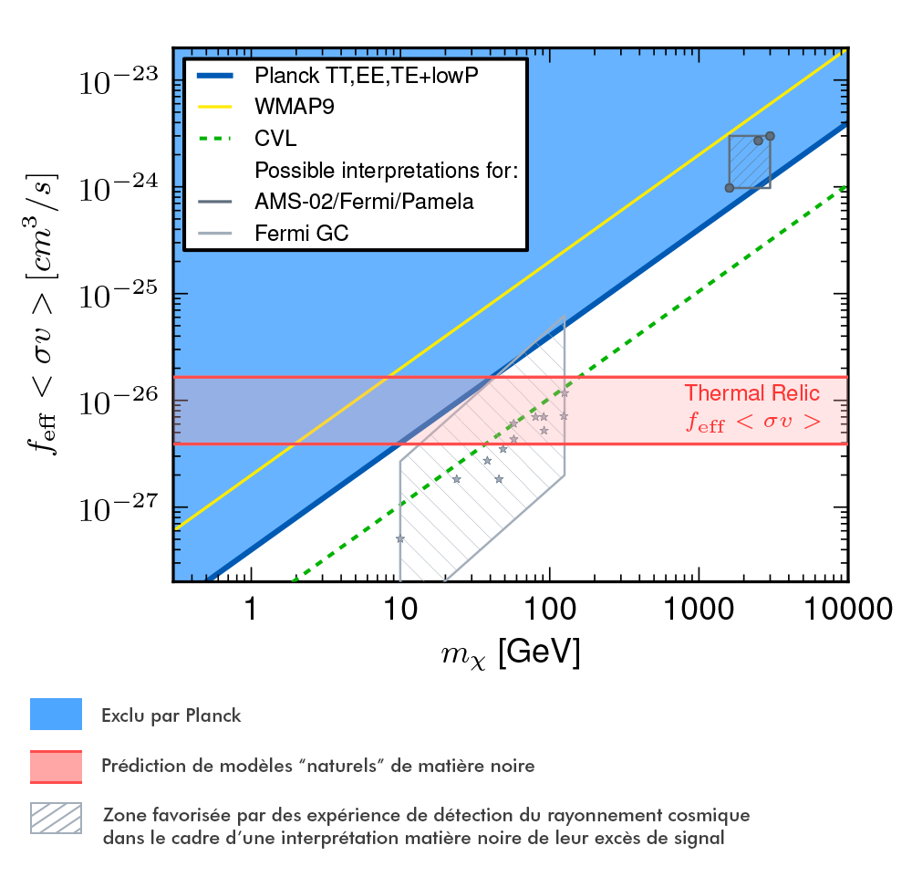
Latest Result from Planck
http://public.planck.fr/images/resultats/2014-matiere-noire/plot_constraints_planck2014.jpg

Slide 19
Direct Detection
DM
DM
DM
DM
q
q
q
q
Typical momentum exchanged: O(100(MeV))
The differential recoil rate:
Astrophysics input
For actual detectors: Energy resolution, detector’s efficiency

Slide 20
Direct Detection
In a general framework:
Arising from:
particle x nuclear responses
Particle responses can be written in terms of:
exchanged momentum q/m_{N}, relative velocities ,
DM spin (S_{χ}) , Nucleon spin (S_{N})
Fitzpatrick, Haxton, Katz, Lubbers, and Y. Xu’12
Anand, Fitzpatrick, and Haxton,’13

Slide 21
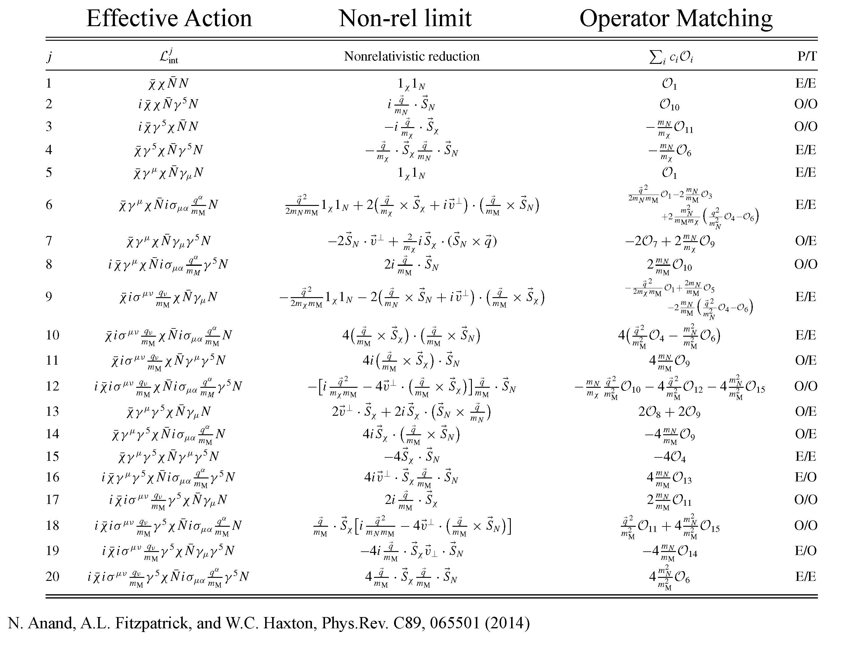
Direct Detection
15 O’s and 6 nuclear responses ( )

Slide 22
Direct Detection
Within this framework
• Include general dark matter particle types
• Include general mediator particle types
• Explore possible operator degeneracies
• Determine the dominant operators
• Determine distinguishability at detectors
Dent, Krauss, Newstead, and Sabharwal ‘15
Gluscevic, Gresham, McDermott, Peter, Zurek,’15

Slide 23
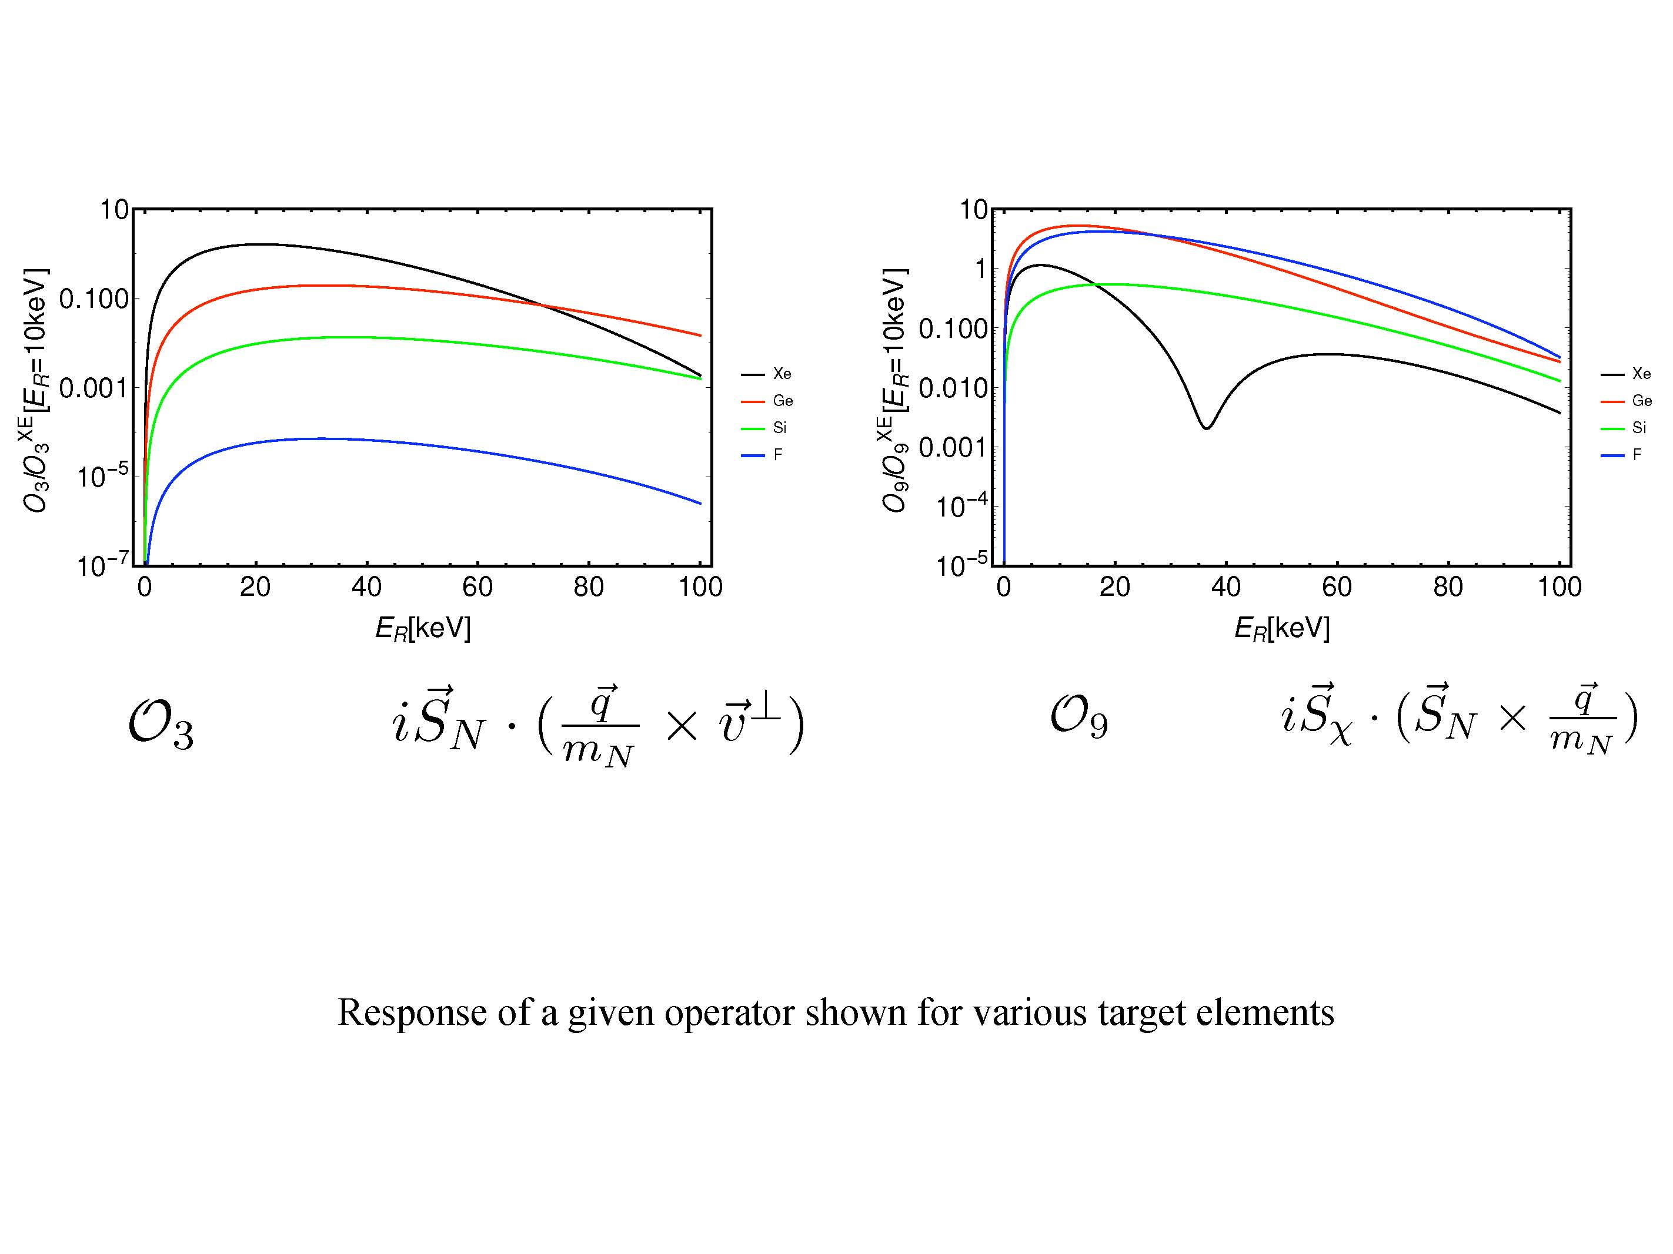
Direct Detection
A complementary choice of nuclear
targets can provide important discriminating information
Dent, Krauss, Newstead, and Sabharwal ‘15

Slide 24
Direct Detection
Gluscevic, Gresham, McDermott, Peter, Zurek,’15

Slide 25
Direct Detection
Gluscevic, Gresham, McDermott, Peter, Zurek,’15

Slide 26
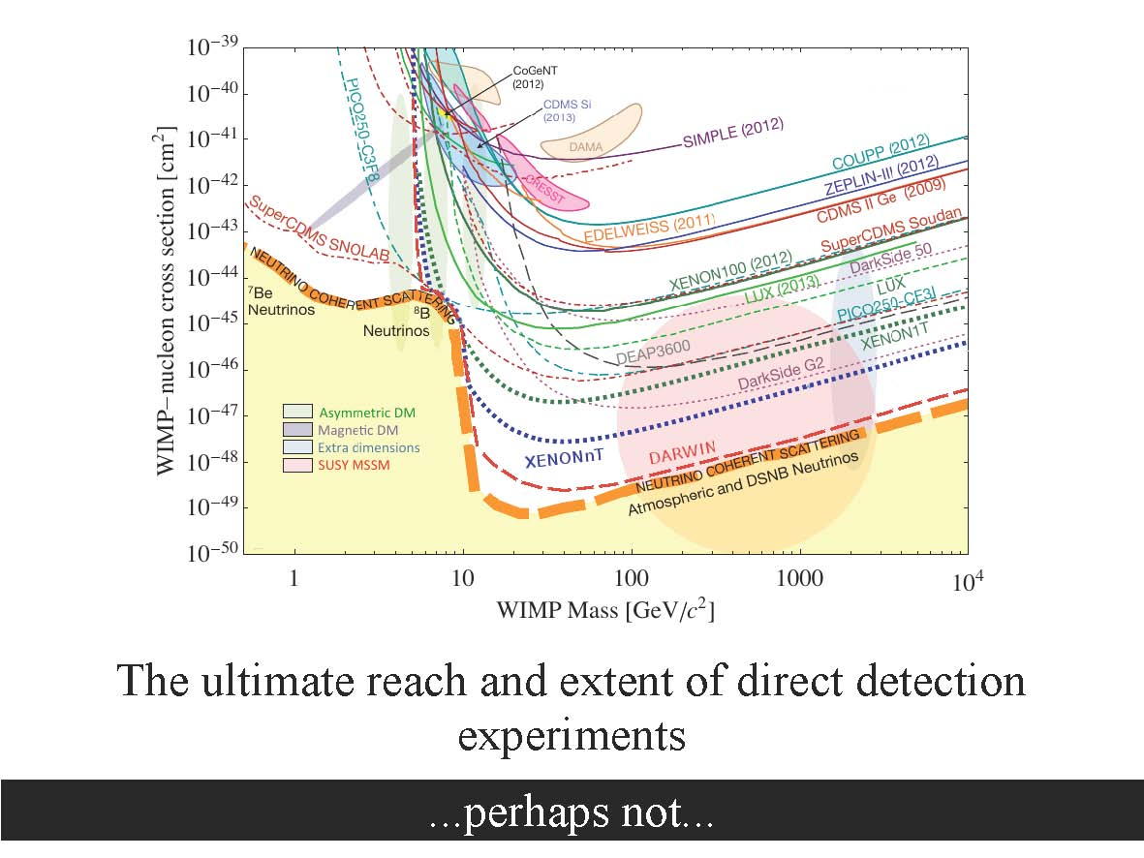
Direct Detection: Neutrino problem
Billard, Strigari, Figueroa-Feliciano ‘14
However,…

Slide 27
Direct Detection
Dent, Dutta, Newstead, and Strigari to appear

Slide 28
Direct Detection
Read’14
DM distribution in the solar neighborhood mostly smooth in simulation. Resolution of simulations O(100 pc) >> O(0.1 m pc) scales probed by direct detection experiments
➔Is the local DM distribution really smooth?
However, once a signal is observed it is possible to perform a halo independent analysis [Fox, Liu ,Weiner’10; Nobile, Gelmini, Gondolo, Hu’13]

Slide 29
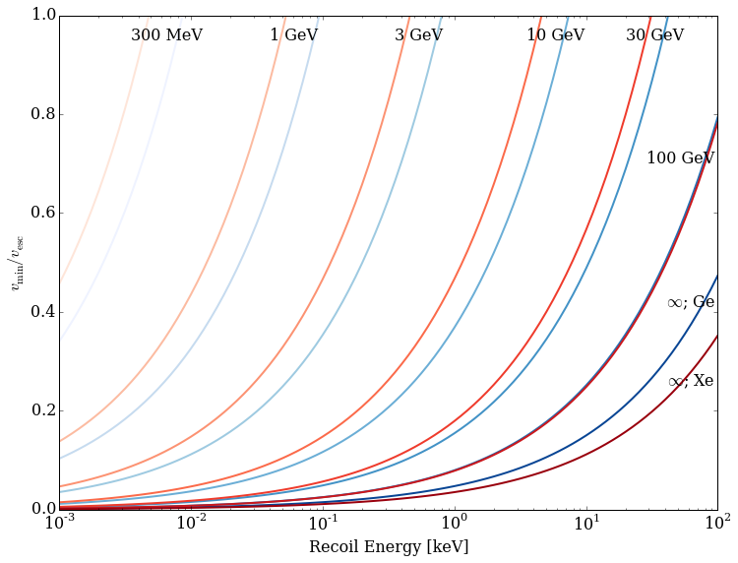
Direct Detection
Y axis is independent of f(v)

Slide 30
Probing DM at the LHC
Probing DM: mostly non-colored particles and colored particles with
small mass gaps
➔ LHC reach is not very good for them:
excluded between 110 and 280 GeV for a mass-less or for
a mass difference >100 GeV, small ΔM is associated with small
missing energy
➔ masses between 100 and 600 GeV are excluded
for mass-less for or for the mass difference >50 GeV
decaying into e/μ

Slide 31
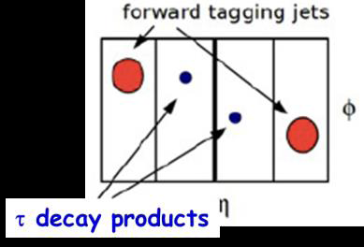
LHC
Non-colored sector: Direct production via Drell-Yan and VBF
VBF topology: Tagging VBF jets➔ helpful for both
non-colored sector and colored particles with small mass gaps
Refs (For example):
A. Datta, P. Konar, and B. Mukhopadhyaya, 02.
G. Giudice, T. Han, K. Wang, and L.T. Wang, 13
A.G. Delannoy, B. Dutta, A. Gurrola, W. Johns, T. Kamon, E. Luiggi, A. Melo,
P. Sheldon, K. Sinha, K. Wang, S. Wu, ‘13
Helpful for coannihilation,
Stop-neutralino,
sbottom-neutralino etc
Dutta, Gurrola, Kamon, John, Sinha, Shledon; ‘13

Slide 32
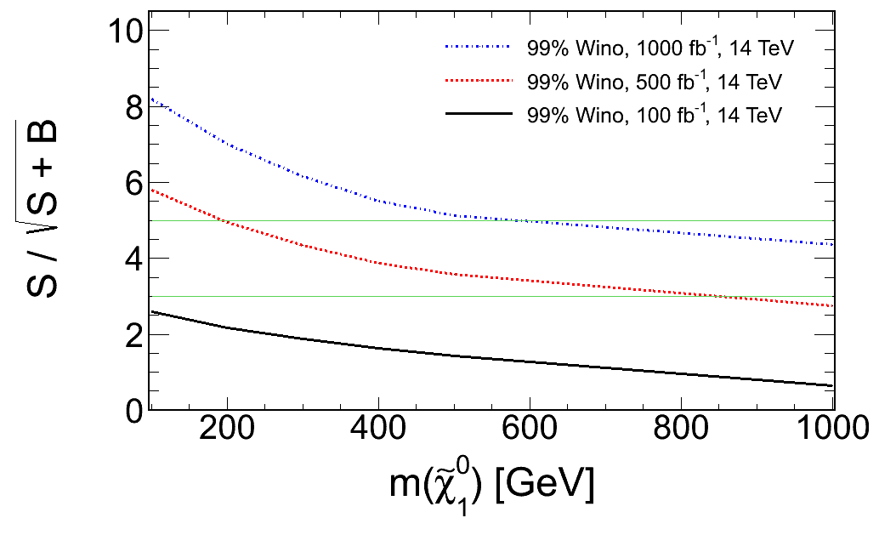
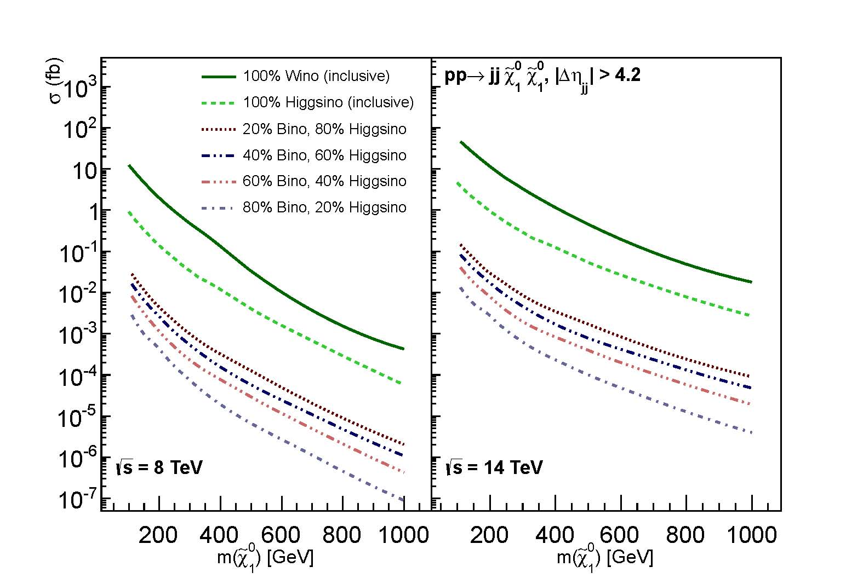
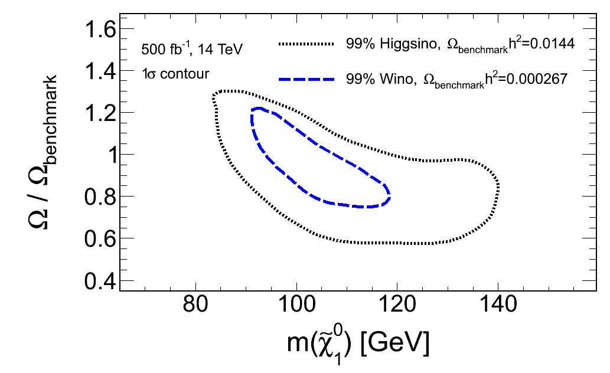
DM@LHC
Cross Sections via VBF
Probe the DM sector directly:
Delannoy, Dutta, Gurrola, Kamon, Sinha et al’13
32

Slide 33
LHC, Direct, Indirect, DM content
Wino Higgsino Bino Higgsino-Bino
Indirect good good ok good/ok
LHC good good poor ok
DM Content NT/mixed NT/mixed T/NT T/NT
Direct poor good(SD) poor good(SI)
NT: Non-thermal, T: Thermal

Slide 34
LHC, Direct, Indirect, DM content
Thermal
Direct
Indirect
Red points:
thermally allowed:
Bino-Higgsino
Green points:
Mixed DM
Baer, Barger, Mustafayev,’12
Direct and Indirect detection: Good
LHC: up to 300 GeV for pure Higgsino
using soft leptons+jets+messing E_{T}, VBF+soft leptons, monojet etc
Baer, Mustafayev, Tata’15; Han, Kobakhidze, Liu, A. Saavedra, L. Wu, Yang,14,
Delannoy, Dutta, Gurrola, Johns, Kamon, Luiggi, Melo, Sheldon’13

Slide 35
Non-thermal Scenarios in CMSSM
Various T_{r}
Large cross-section
for smaller T_{r}➔
More Higgsino
domination
Apparicio, Cicoli,
Dutta, Kippendorf,
Maharana, Muia,
Quevedo,’15

Slide 36
Conclusion
The origin of DM content is a big puzzle
DM can be thermal/non-thermal/mixed: since the history prior to
BBN is not constrained
LHC, Indirect, direct results are needed to break degeneracies and
establish a new model
LHC: non-colored particles and particles with small mass gaps
need to be probed
Direct detection: different kinds of detectors, low thresholds help to probe models

