Slide 1
Challenges for Instrument Technologies for Indirect Dark Matter Searches
Eric Charles
on behalf of the Fermi-LAT Collaboration
CPAD Workshop
Arlington TX
Oct. 5-7 2015

Slide 2
Outline
Dark matter & dark matter candidates
Types of dark matter searches and complementarity
Indirect searches for weakly-interacting massive particles (WIMPs)
Astrophysical backgrounds
Types of limiting factors for search sensitivity
Current & planned instruments
Selected WIMP search targets
Summary of search sensitivity and limiting factors
Summary & Conclusions

Slide 3
Dark Matter and Dark Matter Candidates

Slide 4
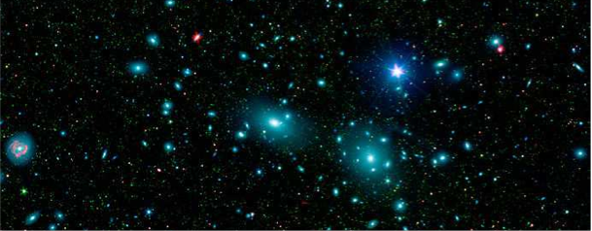
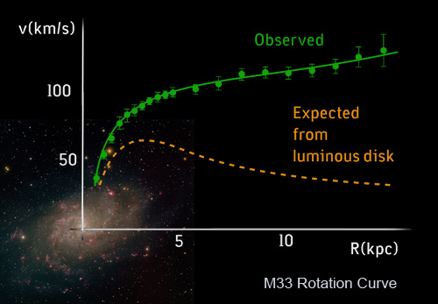
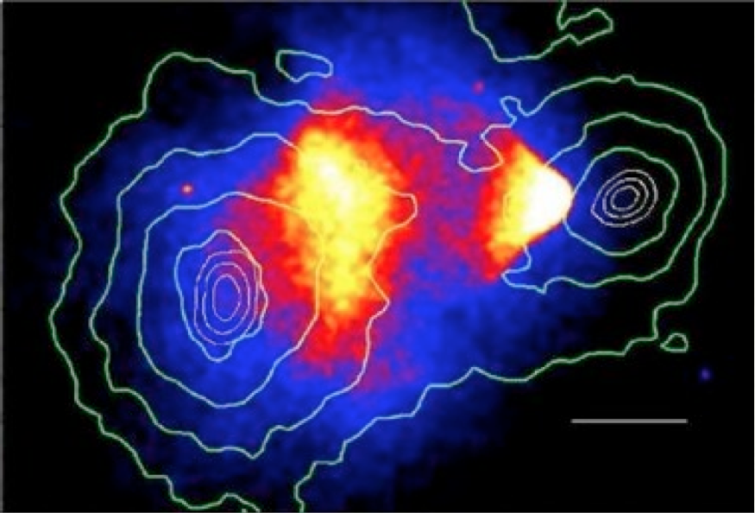
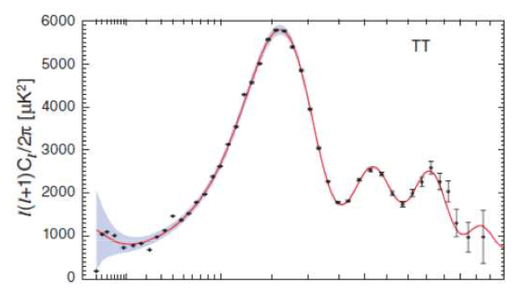
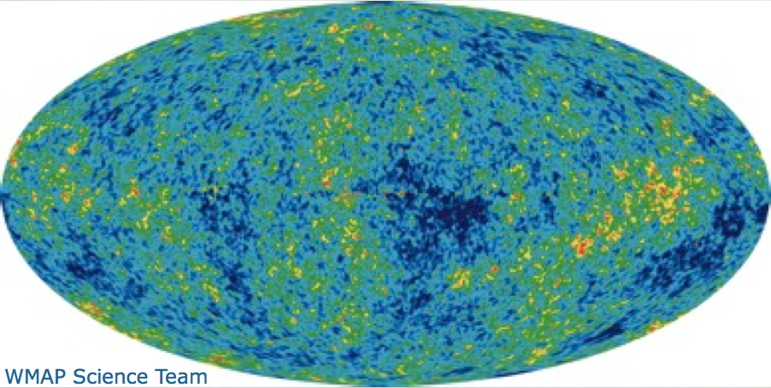
Evidence for / Salient Features of Dark Matter
Comprises majority of mass in Galaxies
Missing mass on Galaxy Cluster scale
Zwicky (1937)
Large halos around Galaxies
Rotation Curves
Rubin+(1980)
Almost collisionless
Bullet Cluster
Clowe+(2006)
Non-Baryonic
CMB Acoustic Oscillations
WMAP(2010)

Slide 5
Evidence for / Salient Features of Dark Matter
All of the evidence for dark
matter is astrophysical!
Comprises majority of mass in Galaxies
Missing mass on Galaxy Cluster scale
Zwicky (1937)
Large halos around Galaxies
Rotation Curves
Rubin+(1980)
Almost collisionless
Bullet Cluster
Clowe+(2006)
Non-Baryonic
CMB Acoustic Oscillations
WMAP(2010)

Slide 6
Cosmological Constraints on Dark Matter
Λ−CDM Concordance Fits
DM Candidates by Mass & Cross Section
No Standard Model particle matches the known properties of dark matter
Many candidate particles have been proposed:
In this talk I will focus on WIMPs
Current instruments also sensitive to axion-like particles, primordial black holes, Q-balls

Slide 7
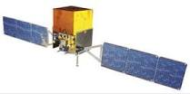
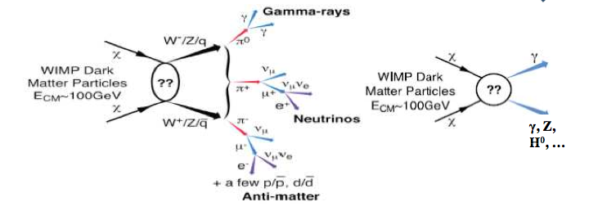
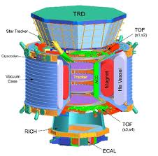
Indirect Detection of WIMPs
What we observe are stable final-state annihilation products
Charged particles (e⁺,e⁻,p,anti-p) diffuse in the Galactic magnetic field
Neutral particles (γ, ν) travel directly to us

Slide 8
WIMP Dark Matter as a Thermal Relic
Small cross-section:
freeze out too early,
too many WIMPs
Freeze out
Large cross-section:
freeze out too late,
too few WIMPs
The calculation of the thermally averaged cross-section <σv> needed to obtain the relic density is robust and gives <σv> ~ 3 10⁻²⁶ cm³s⁻¹
At that cross-section limits start to put constraints on model space

Slide 9
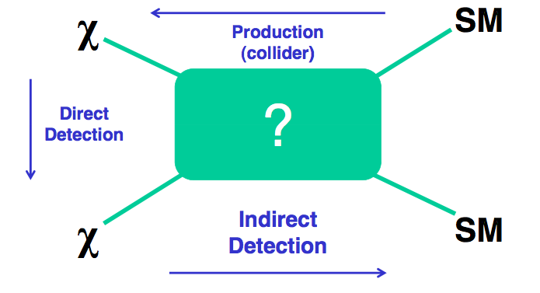
Role of Indirect Detection Dark Matter Searches
Compared to collider searches: indirect detection is sensitive to high mass scales (particles already exist, stable final state particle spectrum peaks at ~10% of m_{χ})
Compared to direct detection: indirect detection is sensitive to annihilation rather than scattering off of nuclei (i.e., more sensitive when χ couples more to heavy quarks and vector bosons than to light quarks and gluons)

Slide 10
Indirect Searches for Weakly-Interacting Massive Particles

Slide 11
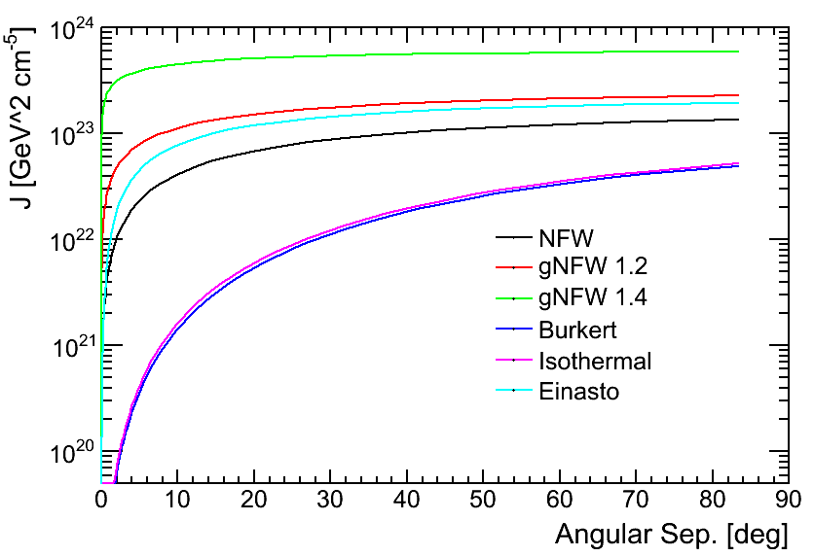
The Key Formula for WIMP Searches
Particle Physics
Astrophysics (J-Factor)
dN/dE for 200 GeV DM
J-factor for the Galactic Center
Note: J-factor includes distance, i.e., J-factor would decrease by four if a point-like source were twice as far away
Note: the key factor of 1/m_{χ}² is b/c we express the J-factor as a function of mass density (which we can measure), not number density

Slide 12
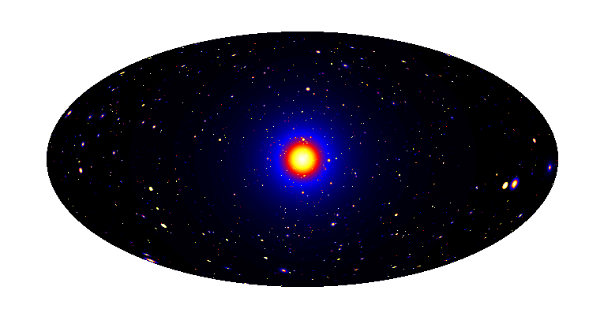
Dark Matter Search Strategies
Satellites
Low background and good
source id, but low statistics
Galactic Center
Good statistics, but source
confusion/diffuse background
Milky Way Halo
Large statistics, but diffuse
background
Spectral Lines
Little or no astrophysical uncertainties, good
source id, but low sensitivity because of
expected small branching ratio
Isotropic contributions
Large statistics, but astrophysics, galactic diffuse background
Galaxy Clusters
Low background, but low statistics
Dark Matter simulation:
Pieri+(2009) arXiv:0908.0195

Slide 13
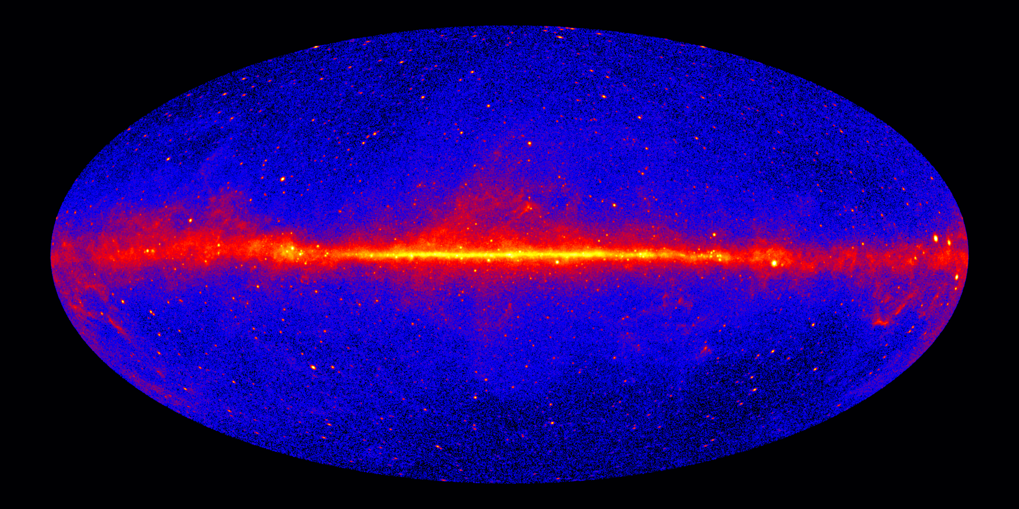
Search Strategies (against the γ-ray Sky)
Satellites
Low background and good
source id, but low statistics
Galactic Center
Good statistics, but source
confusion/diffuse background
Milky Way Halo
Large statistics, but diffuse
background
Spectral Lines
Little or no astrophysical uncertainties, good
source id, but low sensitivity because of
expected small branching ratio
Isotropic contributions
Large statistics, but astrophysics, galactic diffuse background
Galaxy Clusters
Low background, but low statistics
LAT 7 Years Sky > 1 GeV

Slide 14
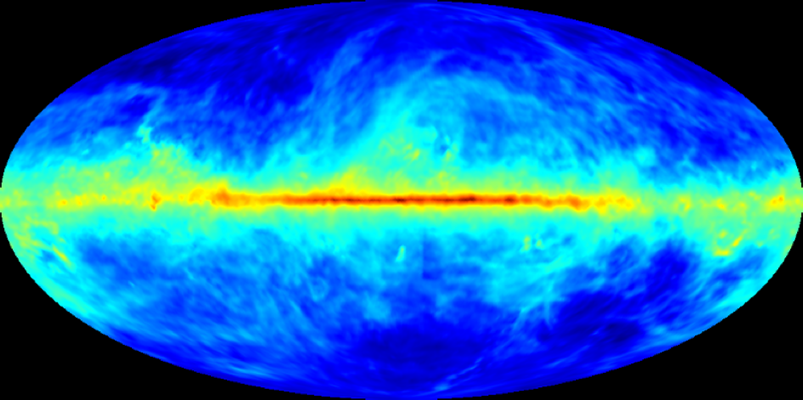
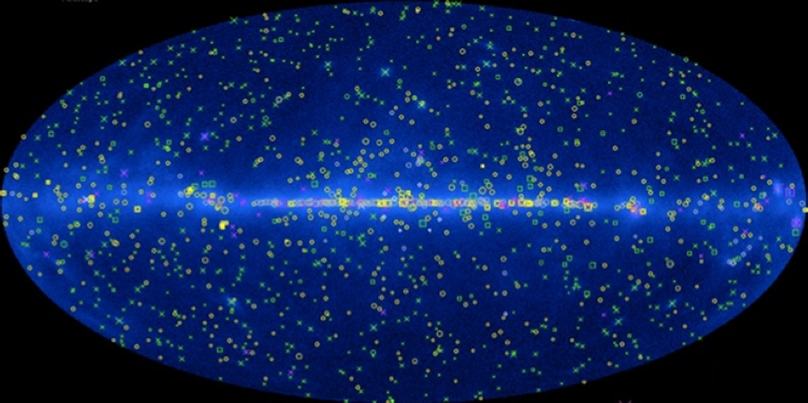
Astrophysical Backgrounds (GeV)
Diffuse Backgrounds:
Cosmic-ray interactions with dust, gas and radiation fields
Source Backgrounds:
Blazars and Active Galactic Nuclei
Pulsars
Supernova Remnants
Galaxies (starburst galaxies)
Unresolved Sources

Slide 15
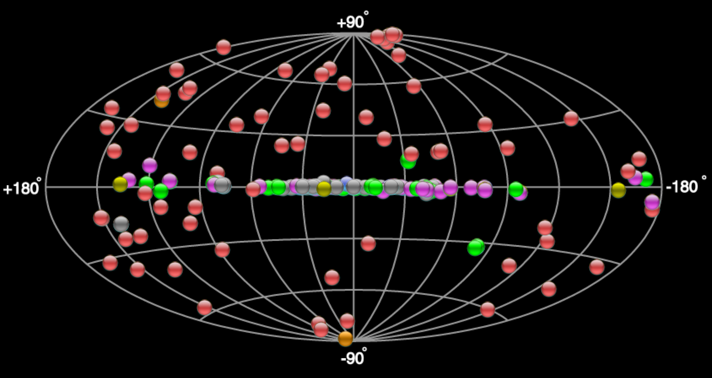
Astrophysical Backgrounds (TeV)
TeV sources from TeVCAT: http://tevcat.uchicago.edu/
Diffuse Backgrounds:
Cosmic-ray interactions with dust, gas and radiation fields
Diffuse spectra softer than typical source spectra
Source Backgrounds:
Blazars and Active Galactic Nuclei ( z < ~0.5 )
Pulsars
Supernova Remnants
Galaxies (starburst galaxies)
Unresolved Sources

Slide 16
Some Published Results from Indirect DM Searches
Thermal Relic
χχ -> bb channel

Slide 17
Aside: Limiting Factors for Search Sensitivity
Systematics-limited: limited by uncertainties of modeling either the background or the dark matter target. Additional data will help to the extent that it improves the modeling uncertainties.
Background-limited: limited by the noise-fluctuations of the background. Additional data will improve sensitivity as sqrt(N)
Signal-limited: limited by the magnitude of the expected signal. Additional data will improve sensitivity linearly

Slide 18
Limiting Factors Feed into Instrument Design
For systematics-limited and background-limited searches we probably want to focus first on the background
Reduce background:
Better particle type identification (e.g., reduce cosmic-ray contamination of gamma-ray data)
Improve point-spread function, reducing area of sky within the signal target
Improve understanding / modeling of background
Reduce modeling uncertainties, constrain intensity of background
For signal-limited searches we want more data:
Increase size, efficiency, duty cycle of detector, find more search targets

Slide 19
Current & Next Generation Instrumentation

Slide 20
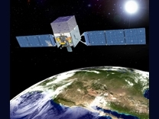
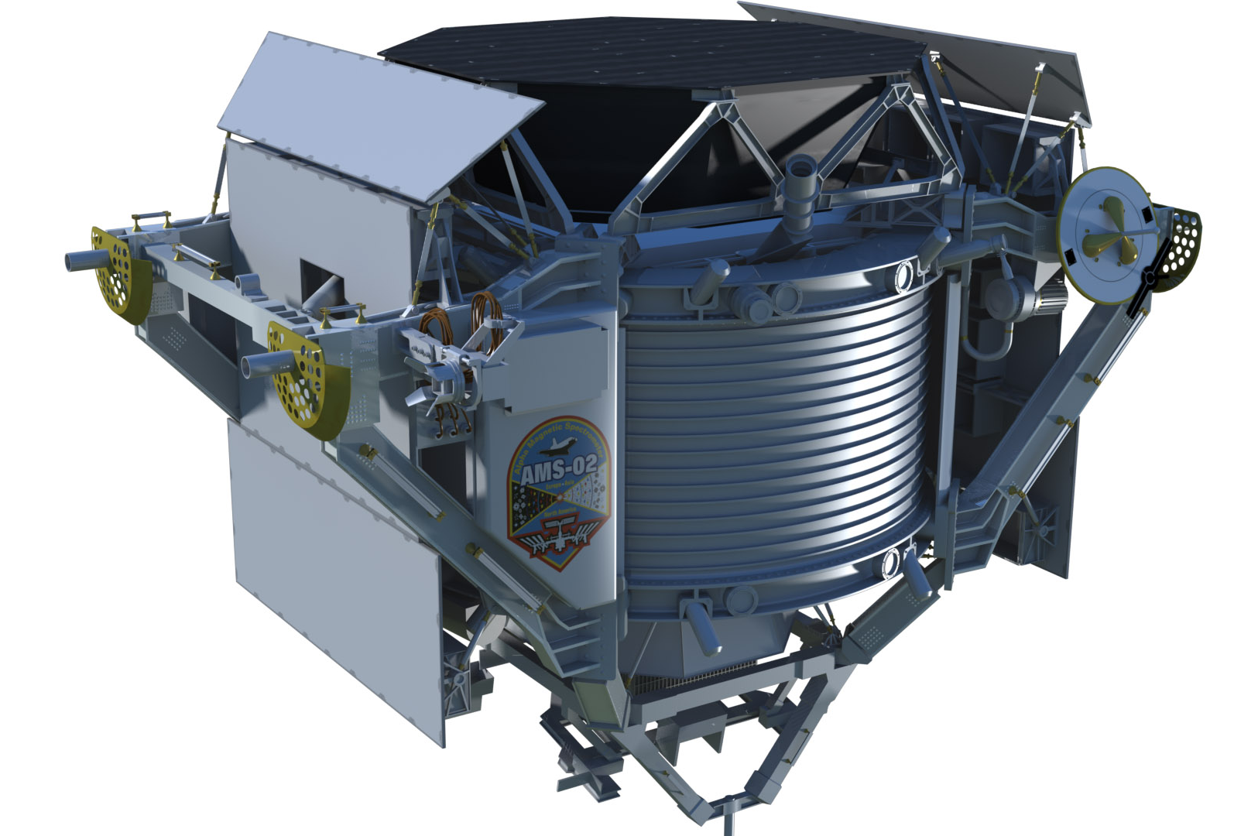
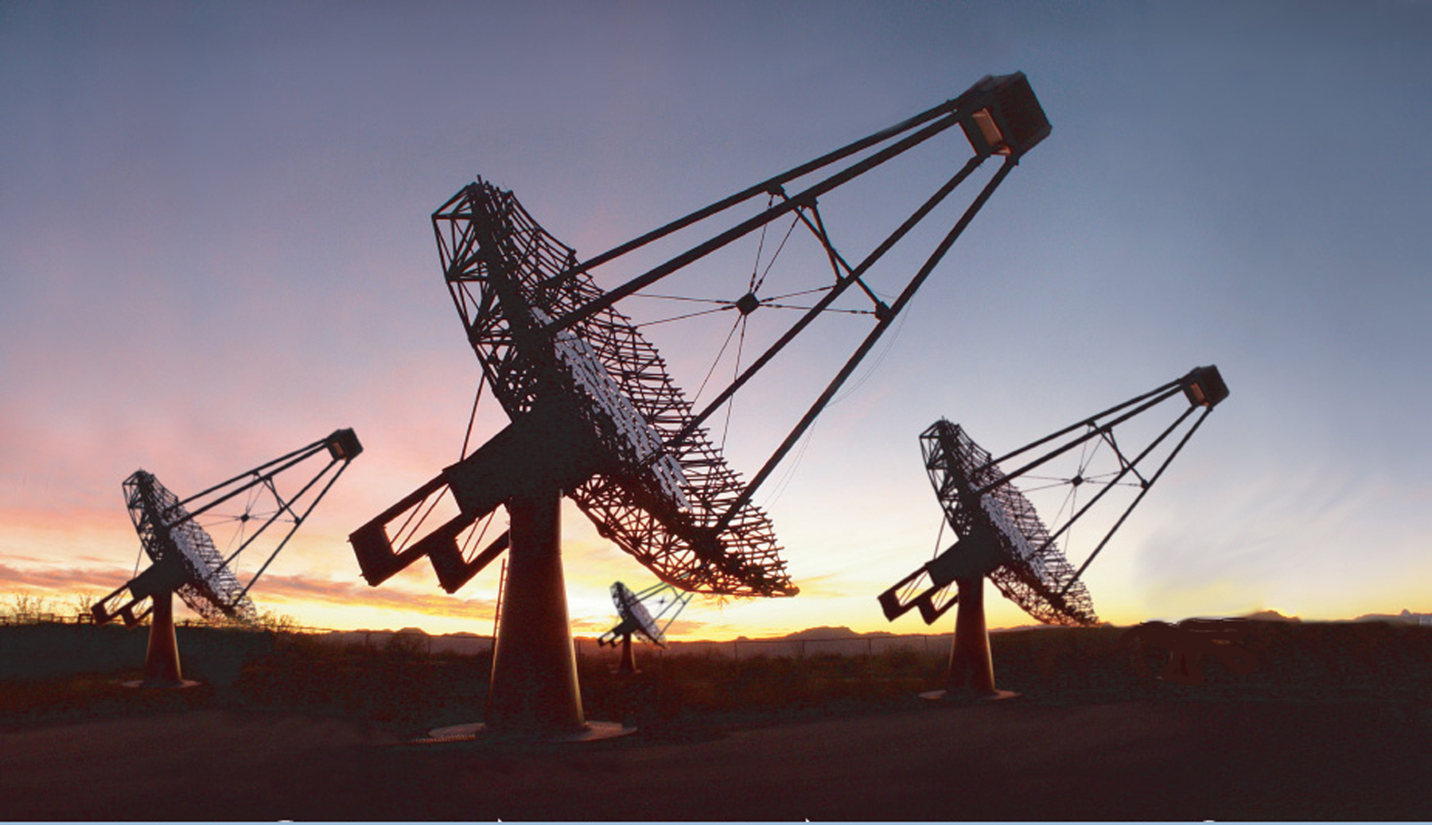
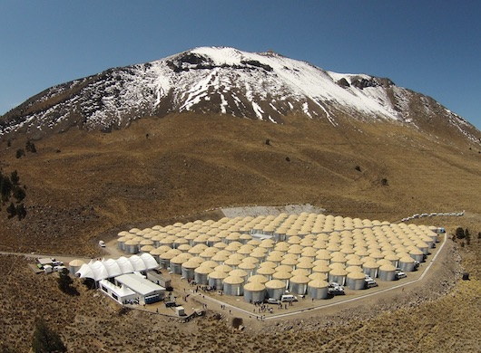
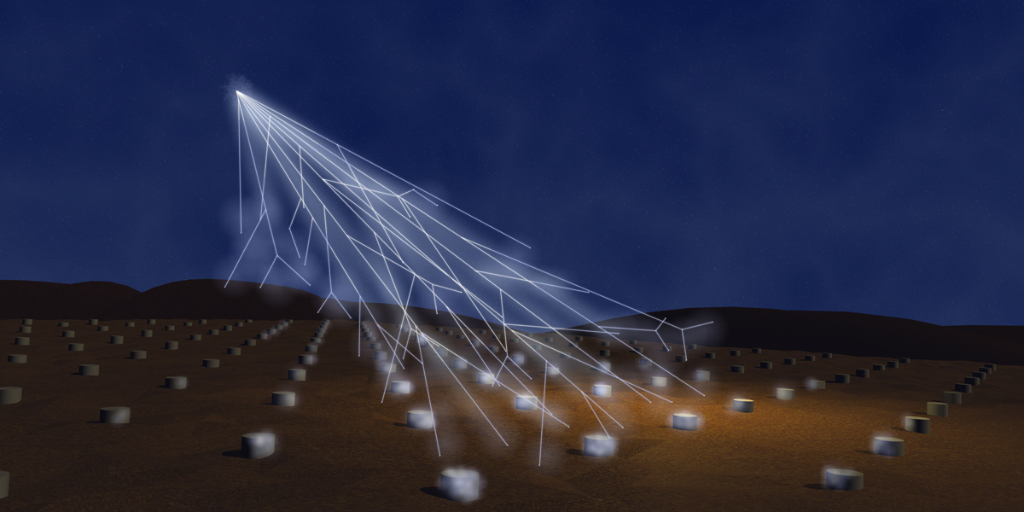
High Energy Astrophysics Instruments
Pair-conversion telescopes:
Fermi, AGILE, DAMPE,
Gamma-400
Cosmic-ray detectors:
PAMELA, AMS-02, HERD
Imaging Atmospheric Cherenkov Telescopes:
HESS, MAGIC, VERITAS,
CTA
Hybrid cosmic-ray detectors:
Auger
Water Cherenkov Telescopes:
HAWC, ICE-Cube

Slide 21
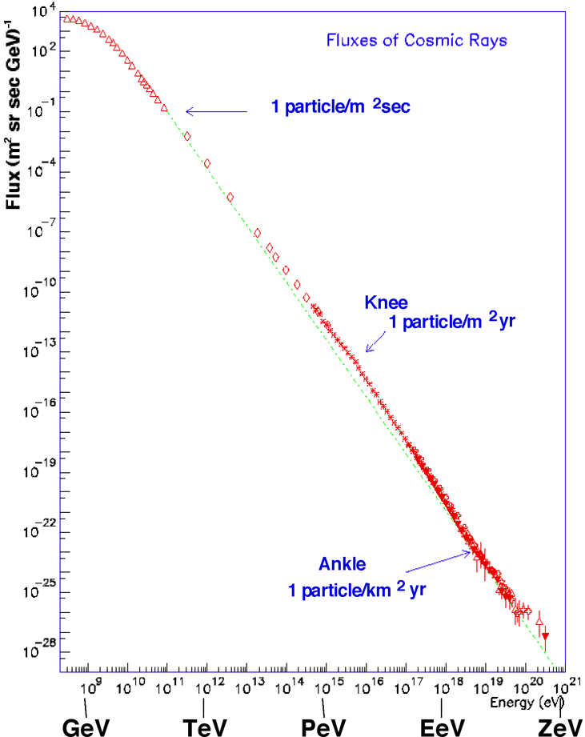
Sensitivity to Cosmic Rays (and γ Rays) Depends on Instrument Area
Fluxes fall like power laws, typically by three orders of magnitude per decade in energy, 87% p, 9% He, few % heavy ions, even fewer e± and γ
Acceptance in m²sr determines energy reach

Slide 22
Driving Factors in Instrument Development
Space-based: performance constrained by mass (~< 10000 kg), power budget (~< 3kW), bandwidth (~< 10 MHz averaged). Must survive launch (vibrational / acoustic noise), space radiation environment.
Ground-based: performance constrained by light collection area, array size and in-fill factor, (air-showers arrays: night-sky brightness)
In both cases we are pushed toward modifying well-established technology to meet the instrument design challenges & optimize scientific return.

Slide 23
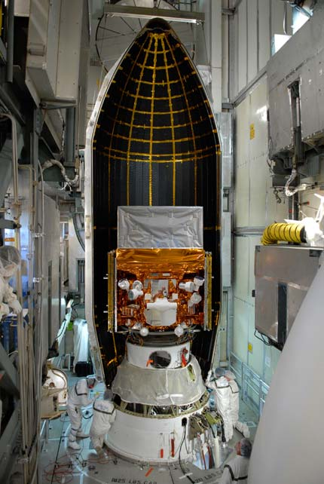
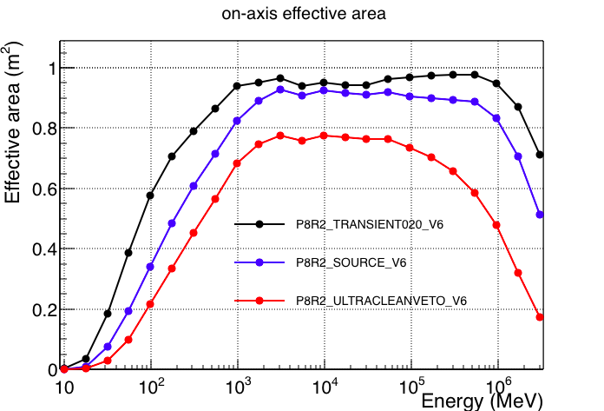
Key LAT Performance Limitation: Size
The on-axis cross-sectional area of the LAT is ~2.25 m²
The tracker is 1.4 X₀ deep: roughly 2/3 of on-axis γ rays convert in the tracker, giving a maximum effective area of ~ 1.5 m²
Actual effective area is ~1m²

Slide 24
Optimizing Pair-Conversion Telescopes
TKR
Radiation length sets scale for both scattering and pair conversion
CAL
TKR
Small Layer Spacing:
Poor Resolution,
Good FoV
TKR
Low density:
Good PSF,
Poor A_{eff}
TKR / CAL
CAL
TKR
Is there a technology
that allows monolithic design for > 2π field of view?
Large Layer
Spacing:
Good Resolution,
Poor FoV
High density:
Poor PSF,
Good A_{eff}

Slide 25
Optimizing Ground-based Telescopes
CTA sensitivity (in units of the Crab flux)
CTA design extends energy band-pass by using different types of telescopes to cover different energy ranges
Low-energy, need more sensitivity to detect Cerenkov light -> few large telescopes
High-energy, need more area to compensate for falling rate -> lots of small telescopes

Slide 26
Optimizing Cosmic-Ray Detectors
Large cosmic-ray fluxes, key is particle identification
Design multiple sub-systems to provide redundant information about particle charge, momentum, energy

Slide 27
Optimizing PSF (Resolution) v. A_{eff} (Efficiency)
Celestial background γ rays above a given energy inside the PSF
Syst-limited
Galactic plane
Bkg-limited
High Galactic
latitudes
Sig-limited
Once we are signal limited, efficiency becomes more important than background rejection
Signal limited: expect < 1 background γ ray inside the PSF
Background limited: lots of background photons
we should favor spatial resolution over detection area to allow us to disentangle complex regions like the Galactic center

Slide 28
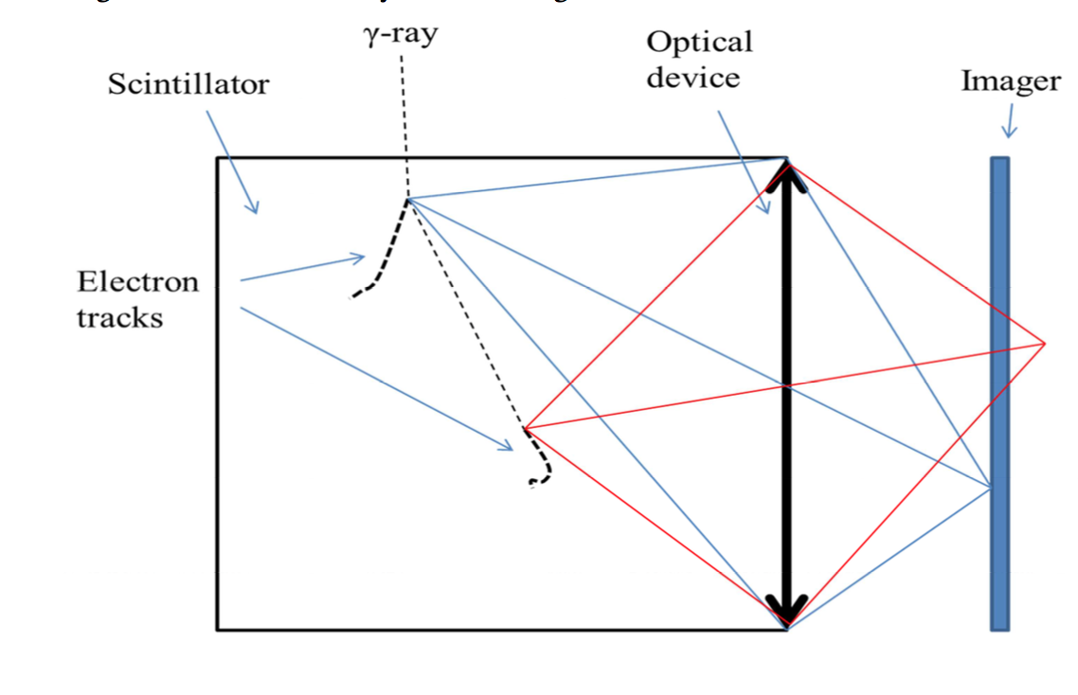
Alternate Technologies for Pair-conversion Telescopes
Gamma Cube design concept
3D tracking: use gas drift chambers or noble liquid TPCs: increase the density of spatial measurement; e.g., LaRGO, AdEPT.
Tracking Calorimeters: highly segmented scintillator, e.g., HERD.
Fiber Tracker: scintillating fibers as sensor material, e.g., APT
Active masks / collimators: like coded mask, but rather than try to shield the sensors against γ rays, use an active veto
Solid State Bubble Chamber: imaging the scintillation light from a solid plastic scintillator, e.g., Gamma Cube

Slide 29
Aside: NASA Instrument development
Technology
adopted from
Other HEP
applications comes in here
NASA has a well-defined R&D program designed to adapt suitable technologies for space missions
NASA accepts proposals for technologies at all TRLs
What is missing is LDRD-type funding to survey existing technologies and prepare competitive NASA R&D proposals.

Slide 30
WIMP Searches Targeting the Galactic Center

Slide 31
Observing the Galactic Center
LAT Counts: 4 years, 1-100 GeV
Observations of the Galactic center include strong astrophysical foreground and backgrounds along the line-of-sight
In the 1-100 GeV energy band these account ~85% of the γ-rays in a 15°x15° box around the Galactic center

Slide 32
Estimating the astrophysical modeling uncertainties
Spectral Excesses w.r.t. diffuse emission model in as a function of Galactic longitude
Calore+(2015)
arXiv:1409.0042
Excess emission w.r.t. standard diffuse emission models peaking around a few GeV near the Galactic center is well-established
The interpretation of the excess is not-clear (similar size excesses attributed to local sources of cosmic rays are present elsewhere)

Slide 33
DM Search targeting GC is systematics-limited
Expected ULs on DM from the GC assuming different levels of systematic uncertainties (LAT: 6 years)
χχ -> bb channel
Express the expected uncertainties as a function of the “effective background”, i.e., the background that overlaps with the dark matter profile
Testing current signal claims require understanding the background at the few percent level (studies of control regions suggest we are at the ~10-20% level)

Slide 34
WIMP Searches Targeting Dwarf Galaxies

Slide 35
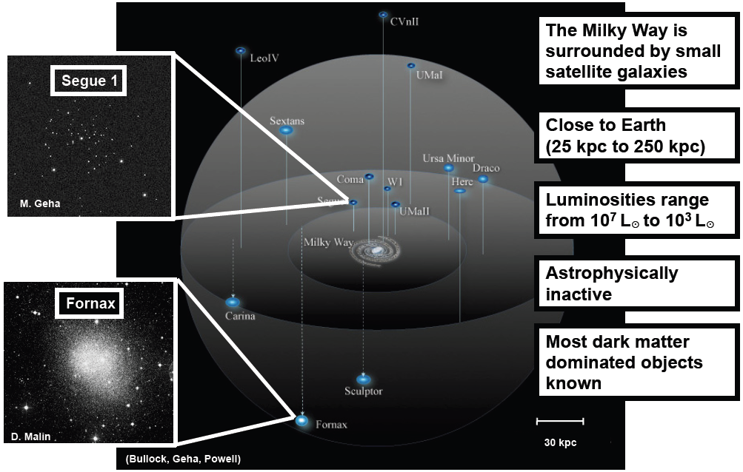
Dark Matter Searches in MW Dwarf Galaxies

Slide 36
Limits from Dwarf Galaxy DM Searches
Published upper limits on DM from searches targeting dwarf galaxies (and CTA projection)
Thermal Relic
χχ -> bb channel
Limits are dominated by LAT up to a few TeV
LAT limits are background-limited up to ~100 GeV, signal-limited above

Slide 37
Rapidly Growing Dwarf Galaxy Population
DES Year 2 Data:
Drlica-Wagner+,
arXiv:1508.03622
DES Year 1 Data:
Bechtol+:
arXiv:1503.02584
Koposov+:
arXiv:1503.02079
Advent of survey era in optical astronomy has lead to the discovery of numerous new Milky Way-satellite dwarf galaxies
LSST & other surveys will continue to find new dwarf galaxies after Fermi is decomissioned (more on this later)

Slide 38
WIMP Searches Targeting Unresolved Dark Matter Structures

Slide 39
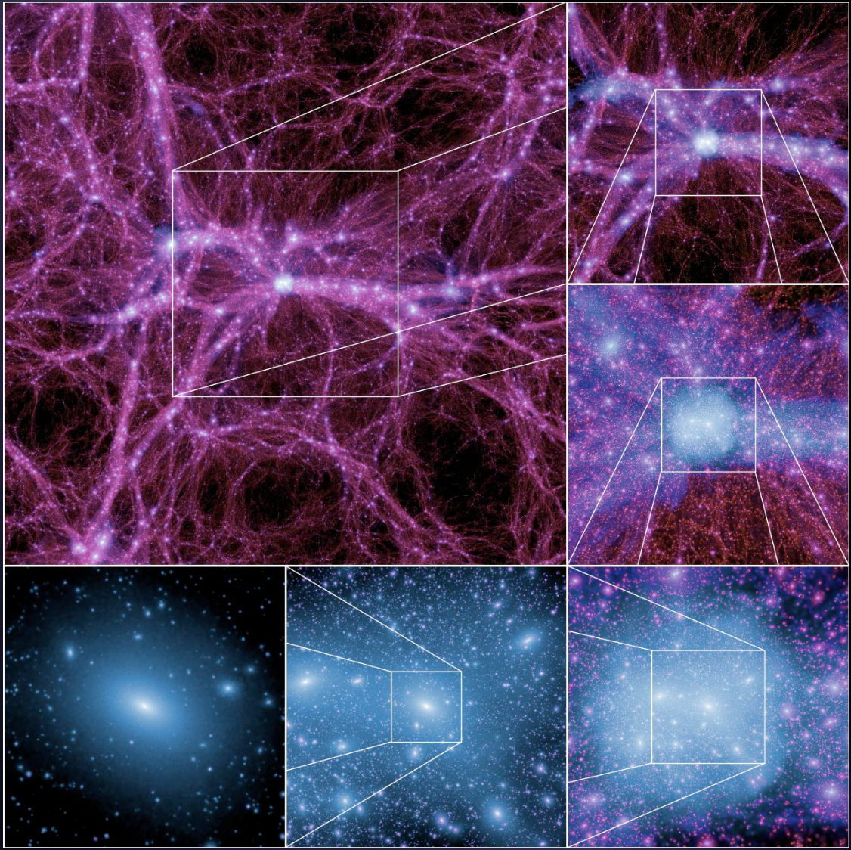
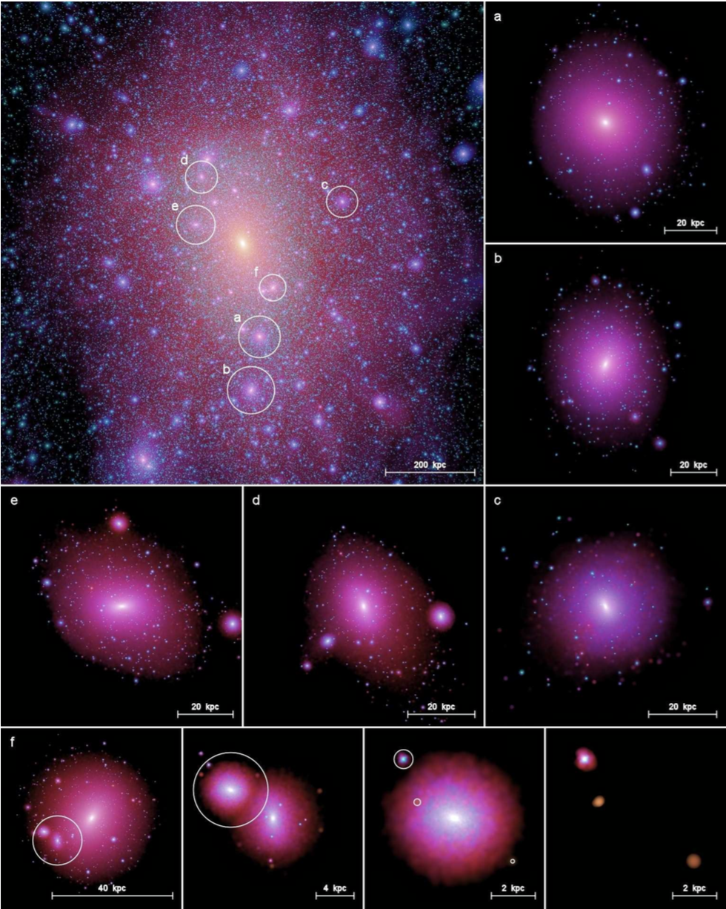
DM Structures are Present on Many Scales
Zoom sequence of DM structure on Cosmo. Scales
Milky Way like halo and several sub-halos
We can probe DM by looking for signal contributions from halos:
On cosmological scales (left)
In the Milky Way virial radius (~300 kpc, right)

Slide 40
hic sunt dracones
Results are schematic only

Slide 41
Dark Matter Contributions to the Extragalactic Background
Comparison of extragalactic gamma-ray background to contributions from sources
Ajello+,
arXiv:1501.05301
Estimating the contribution from unresolved sources requires fitting the cumulative luminosity function N(Flux > Threshold) as a function of the threshold (log N – log S in astronomy parlance)
Good knowledge of the log N –log S can also constrain the DM emission from local DM halos

Slide 42
Published Limits from Cosmological Halos & Local Sub-Halos
Thermal Relic
χχ -> bb channel
These methods only work for sky-survey instruments (i.e., Fermi and HAWC)
Sensitivity is set by the point-source detection threshold

Slide 43
WIMP Searches Targeting Cosmic Rays

Slide 44
DM constraints from anti-matter fluxes
AMS-02 electron and positron fluxes
AMS-02 and PAMELA anti-proton fraction
Geisen+
arXiv:1504.04276
Extracting constraints on DM cross section from anti-particle fluxes requires detailed modeling (see sources of uncertainty on right figure).

Slide 45
Published Limits from anti-proton Spectra
Thermal Relic
χχ -> bb channel
All of these limit curves were derived from the same anti-proton spectrum (and similar cosmic-ray propagation models)
Large variation in the limits suggests large systematic uncertainties from input source and propagation modeling

Slide 46
Summary of WIMP Searches

Slide 47
Projected Limits from Best Targets

Slide 48
Summary of Best Projected DM Limits
It is likely that the DM sensitivity from the current crop of instruments and CTA will largely be set by two types of searches
Fermi-LAT searches targeting dwarf galaxies
This search is background-limited at lower energies (m_{χ} < 100 GeV) and signal-limited at higher energies
Searches targeting halos both on cosmological scales and Galactic scales are competitive with dwarfs and are limited by the LAT point-source sensitivity
CTA searches targeting the Galactic center
This search is systematics limited, possibly by both instrumental systematics and uncertainties of the TeV diffuse Galactic emission

Slide 49
Room for Improvement
Main room for improvement for pair-conversion telescopes:
More collecting area (bigger)
Larger field-of-view (monolithic technologies?)
More target dwarf galaxies (LSST…)
Reasonable target for next generation-telescope:
10x LAT = 25 m²sr acceptance
Main room for improvement for IACTs:
Better γ-hadron separation (more telescopes, greater infill)

Slide 50
Searches for Non-WIMP Dark Matter

Slide 51
Searches for Primordial Black Holes and Axions
Spectra over remaining lifetime of PBH
Spectrum from Blazar PKS1424+240
PBH Evaporation: best limits come from considering the total contributions to the isotropic emission over the entire lifetime of the PBH
The “burst” at the end of the PBH life is dramatic, but for every dying PBH there are millions that are emitting MeV γ rays
Axion-like particles: search for TeV gamma-rays that reach us from distant Blazars where the optical depth from attenuation from interactions with extra-galactic background light is large (τ >> 1)
Other search methods consider spectral distortions of nearby Blazars

Slide 52
Summary

Slide 53
Summary
The sensitivity of indirect DM searches from current instruments and CTA will likely be set by:
LAT searches targeting dwarf galaxies (below~ 500 GeV to 1TeV)
These will probe the thermal relic cross section up to ~400 GeV
Improving on these will require larger area ( or more targets )
CTA searches targeting the Galactic center
Depending on control of systematic uncertainties these may probe the thermal relic up to 10 TeV
Keys to reducing systematic uncertainties are to improve hadron rejection and understanding of TeV galactic diffuse emission
Design of next-generation instruments for indirect DM searches will focus on scalability issues such as:
Building a pair-telescope with 25 m²sr acceptance
Infilling CTA to better image the entire air-shower

Slide 54
Comments for the CPAD Panelists
Indirect DM detection is poorly represented in DOE portfolio
Little or no presence post Fermi, few or no ongoing R&D projects
Instrumental R&D for indirect DM detection will likely focus primarily on scaling existing technologies for use in future instruments
Cost per channel, data volume and rate, and instrument infrastructure will be key factors
Space-based instruments have the additional constraints (in particular power budget)
Exceptions do exist; e.g., Gamma cube concept is extremely novel
Adapting existing technologies for scalable, low-cost, applications takes time, effort and resources
NASA has a well established R & D program to adapt technologies for space missions
Missing LDRD-type funding to survey existing technologies and prepare competitive NASA R&D proposals (i.e., ~$100k grants)
Missing LDRD-type funding identify how to scale up existing technologies to mutli-km² scales for air shower arrays

Slide 55
Extra Slides

Slide 56
Radiation Length
The radiation length is the distance over which:
Electrons lose 1/e of their energy to Bremsstrahlung.
54% of high-energy γ rays will pair convert.
An average 1 GeV particle will change direction by 1.1° due to multiple Coulomb scattering.
X₀ / ρ values:
Si: 9.5 cm
Ge: 2.4 cm
CsI: 1.7 cm
W: 0.4 cm

Slide 57
Multiple Coulomb Scattering
For 100 MeV e±: 0.006 X₀ => 1° of MCS
For 20 MeV e±: 0.006 X₀ => 5° of MCS
Key design question:
How much information ( positional accuracy * lever-arm * sqrt(N) ) can we extract from the instrument before the particles are MCS dominated?

Slide 58
Electromagnetic Shower Development
Key longitudinal parameter, shower maximum:
Energy resolution improves markedly if the shower maximum
is contained in the detector.
Key transverse parameter, Moliere Radius:
> 99% of EM shower energy is < 3 R_{m} from shower axis.

Slide 59
Drift chamber-based concepts
These designs optimize the amount of active to passive sensor material in the detector fiducial volume by using drift chamber technologies
LArGO: Liquid Argon. AdEPT: gas, HARPO: high-pressure gas
Expect excellent performance for polarization
Challenges arise for operation in space, must reject large induced backgrounds from pressure vessel
AdEPT approved for balloon flight for prototype

Slide 60
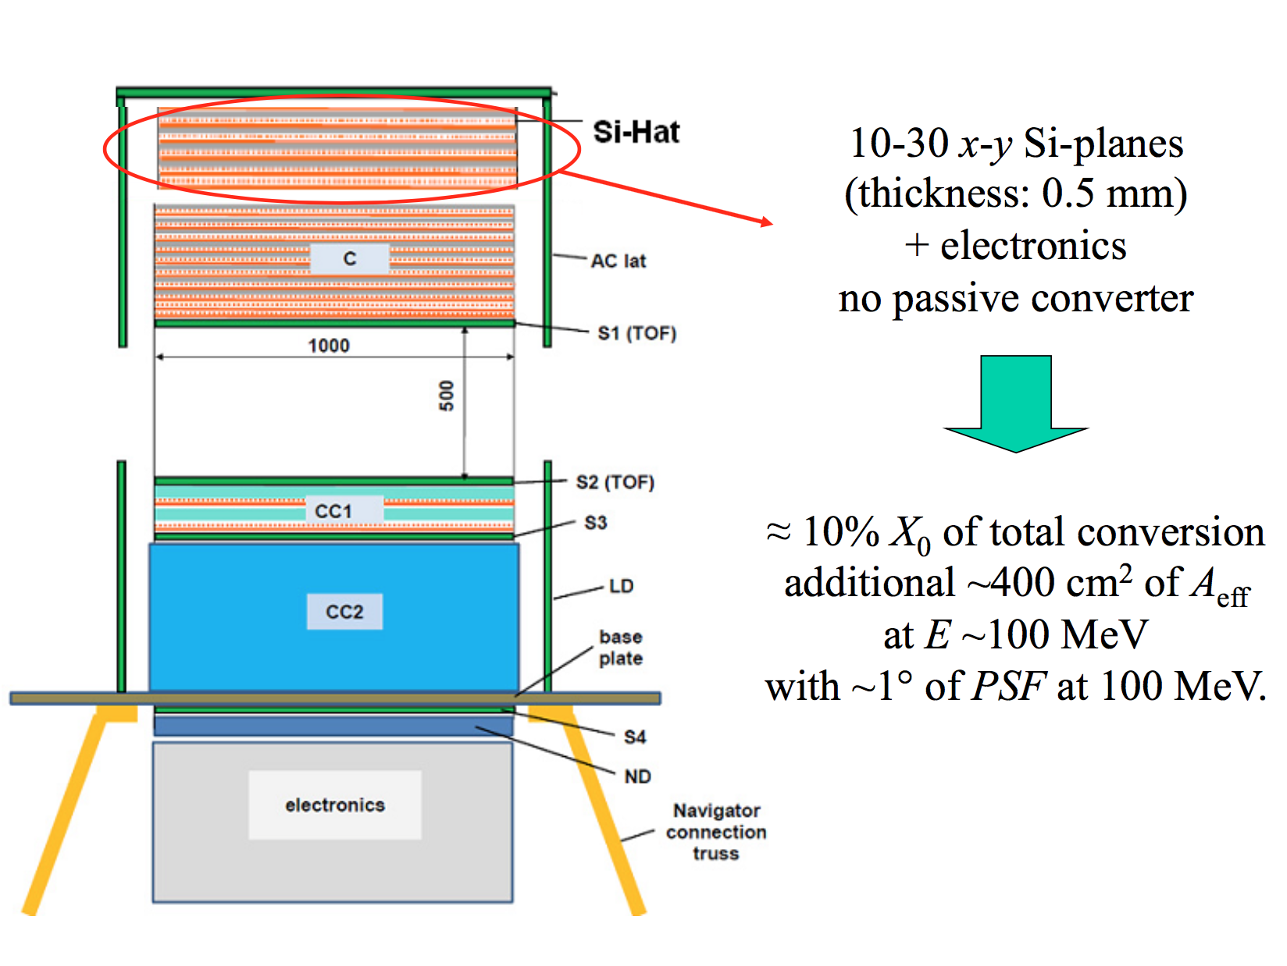
“Fermi-Lite” concepts
Gamma 400
These concepts are similar to Fermi with the Tungsten convertors removed
Good PSF at 100 MeV
not quite as good as AdEPT, but larger A_{eff}, and simpler design
Proposals to European Space Agency, also PANGU (China)

Slide 61
Compton / Pair-production concept (ComPair)
Sensitivity to both Compton scattering and pair-conversions
CZT strips surrounding Si Tracker to achieve full absorption of Compton scattered photon
Approved for balloon-flight prototype development

Slide 62
Advanced pair telescope concept
Optimized for Fermi-LAT energy range, trades energy resolution for larger tracking volume and improved spatial resolution
Aims for > 10x sensitivity improvement in GeV energy range

Slide 63
Segmented Calorimeter instrument concept

