Slide 1
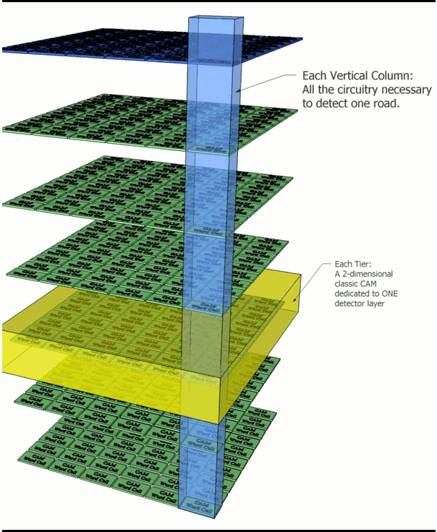
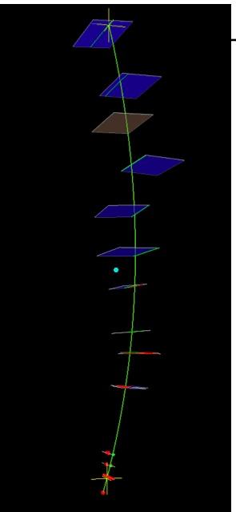
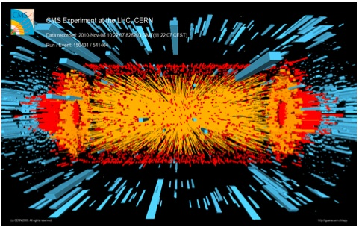
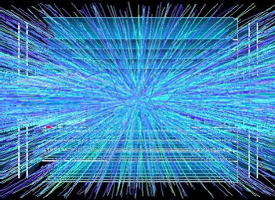
AM based approach for future Tracking Trigger applications
Ted Liu (Fermilab)
CPAD meeting at Arlington
Oct 6th, 2015

Slide 2
Guideline of the talks
“Please remind speakers, should there be any doubt, that we are not looking for them to deliver review talks but instead to focus on the key technological limitations to address the P5 science drivers. Speakers should indicate areas where there is a potential for high return on investment. This emphasis will be repeated in our introduction to the workshop”.
Will try to follow this guideline, not easy.
Will not cover extensive simulation work already done (>50% work has been simulation)
Will not cover any tracking trigger demonstration details (on going work)
Still have many slides, will skip some.

Slide 3
~ 30+ years ago …
The workshop focused on the problems posed by high luminosity at hadron colliders, … from 10²⁹ to 10³⁴ cm⁻² s⁻¹ …1 TeV and 20 TeV energy….
Some of the old worries became a reality
at Tevatron Run II 20+ years later ! …

Slide 4
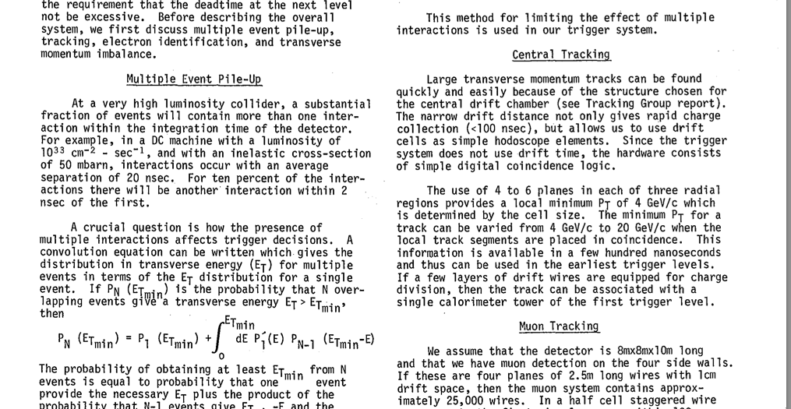
Trigger Working Group Report (1983, DPF workshop)
Some of the old worries became a reality
at Tevatron Run II 20+ years later ! …

Slide 5
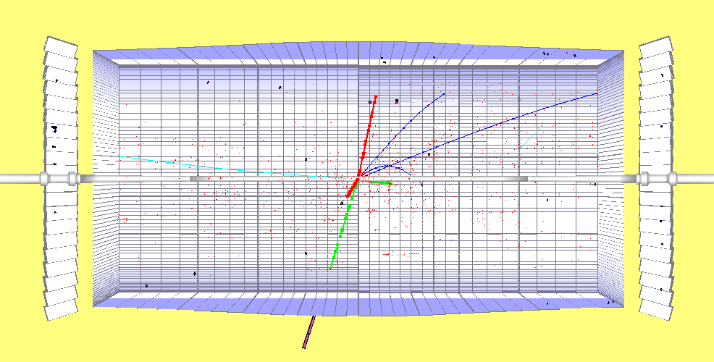
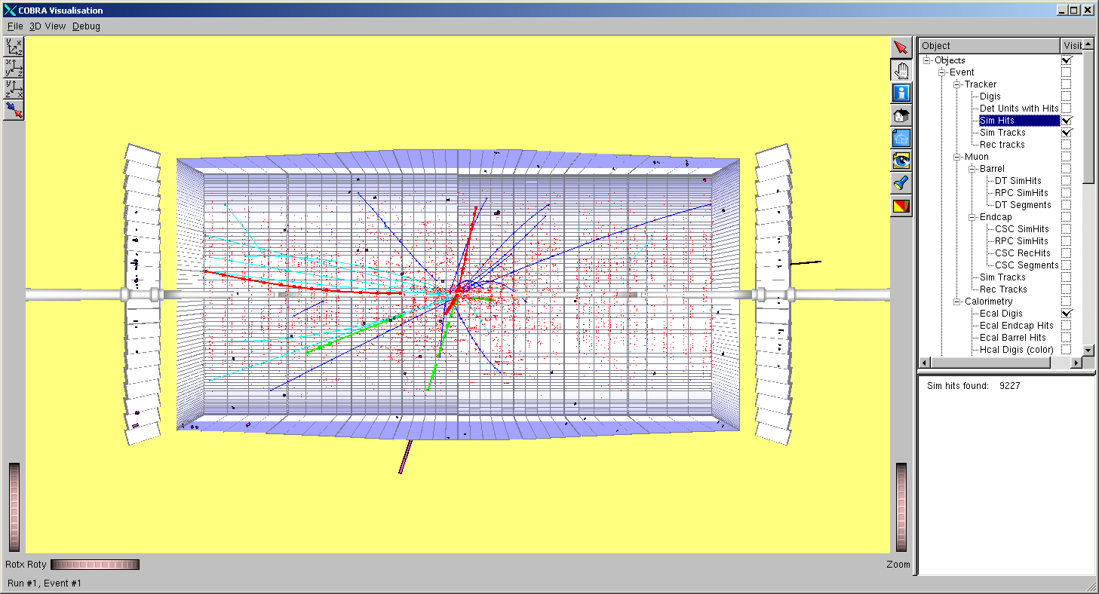
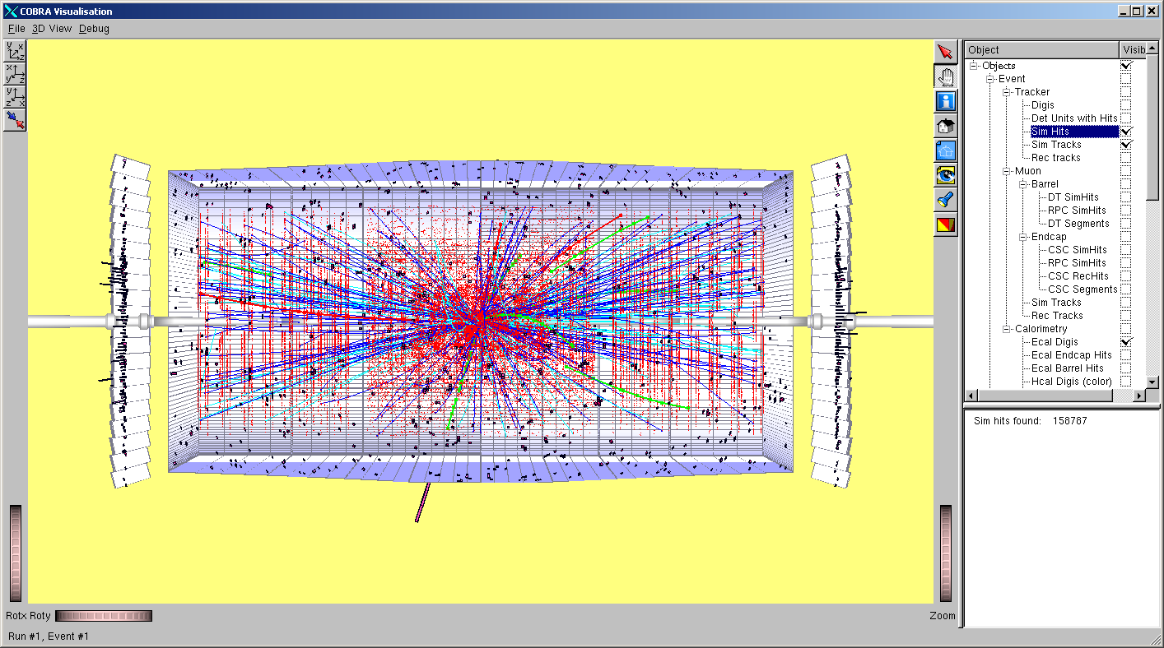
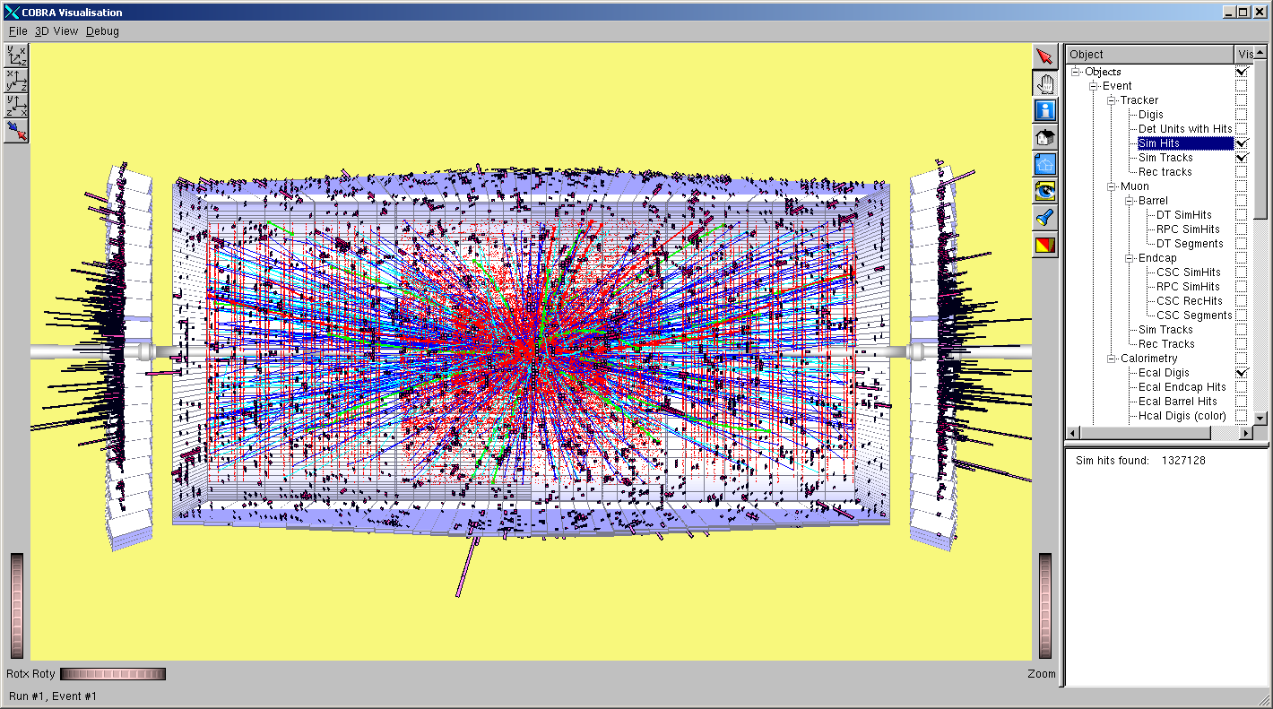
And the old worries continue in the coming decade & beyond …
H→ZZ → μμee, M_{H}= 300 GeV for different luminosities in CMS
10³² cm⁻²s⁻¹
10³³ cm⁻²s⁻¹
10³⁴ cm⁻²s⁻¹
10³⁵ cm⁻²s⁻¹
Raw information from silicon detector/tracker reaches ~ Pb/s at Phase II luminosity

Slide 6
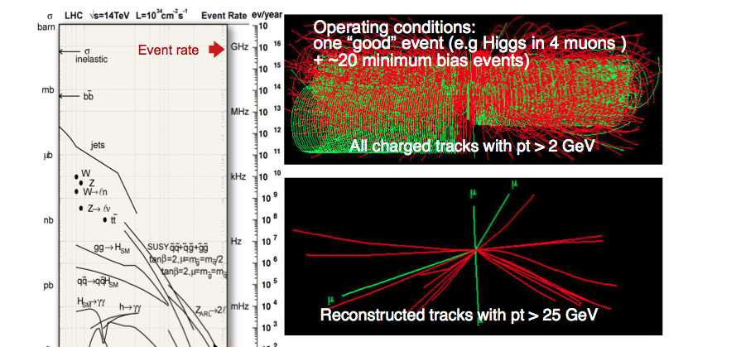
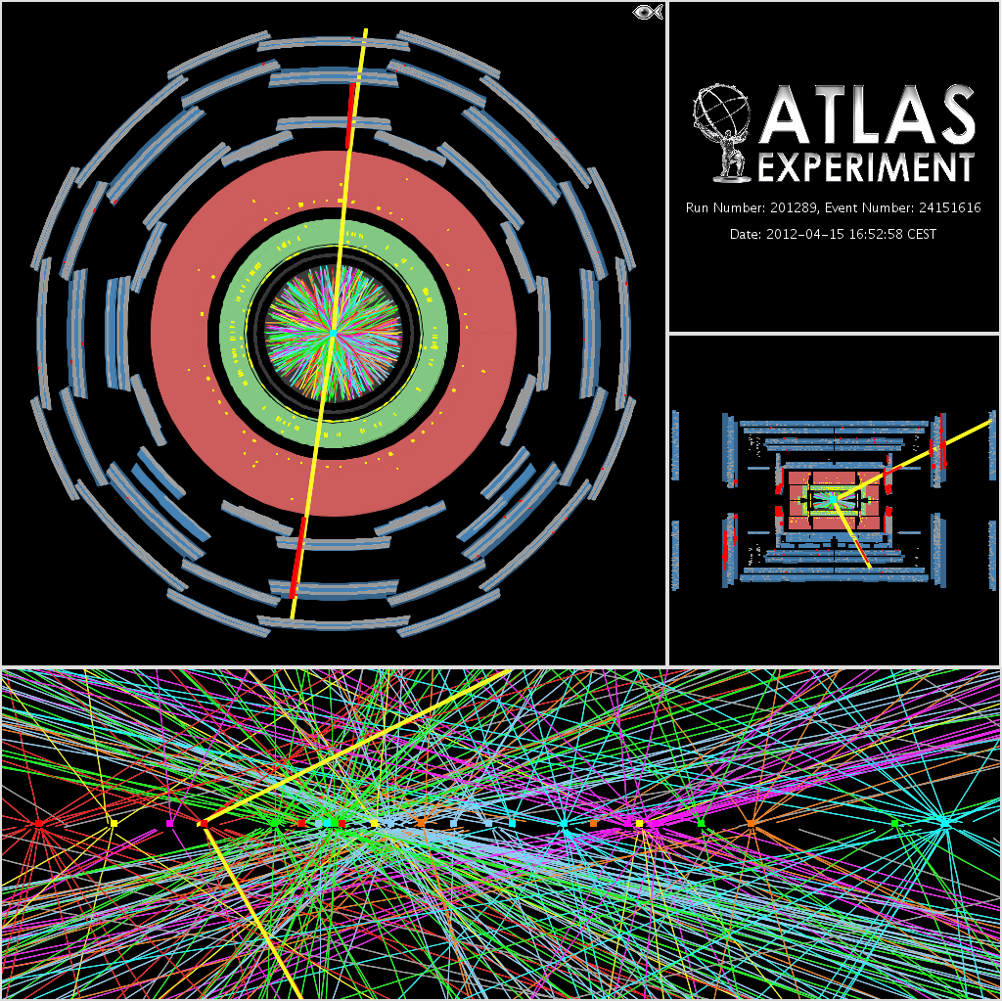
Silicon based tracking trigger at L1 will be crucial for trigger objects reconstruction at
higher luminosity:
Electron
Photon
Muon
Tau
Jets
b-jets
missing ET
….
Essential for establishing
nature of EWSB,
new physics …
See Ulrich Heintz’s CMS Higgs talk yesterday and Darin’s talk earlier on CMS
Phase 2 upgrade.
Pileup at HL-HC: > ~ 140 (only 20 shown here)
With tracking information
Actual event

Slide 7
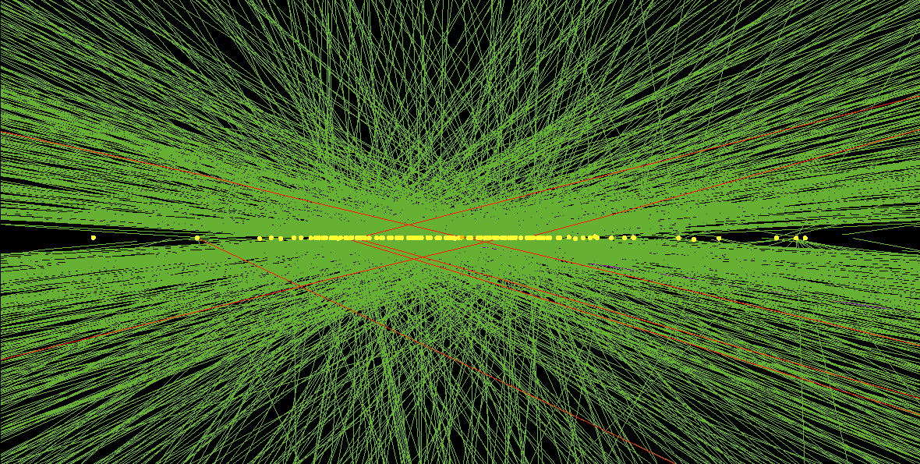
CMS L1 Tracking Trigger:
Will need to reconstruct charged particle trajectories “on-the-fly” for every beam crossing (25 ns, or 40 Million beam crossings per second), from an ocean of input data (bandwidth required to transfer data ~ 100Tb/s)
This requires extremely
fast high bandwidth data communication as well as massive pattern recognition and track fitting power,
with near zero latency (~ few μs total)
This is challenging!
Pileup at HL-HC: ~ 140 (only 20 shown here)
With tracking information
Simulation with 140 PU

Slide 8
High Performance Computing
→ from US “Report to the President and Congress” by President’s
Council of Advisors on Science and Technology, Dec. 2010 (page 65)
Compute-intensive
  massively parallel computation involving very large number of processing elements;
Communication-intensive
  high-speed transfer of data among processing elements;
Data-intensive
  high-speed manipulation of very large quantities of data
HL-LHC L1 Tracking Trigger is High Performance Computing
(Non-von Neumann approach)
but with very Low Latency and in Real Time
HL-LHC requires the most advanced Real Time processing technology

Slide 9
Use HL-LHC as an example
Frontier physics at LHC in the future:
Go to Higher Energy: needs more aggressive R&D in Magnet
OR
Go to Higher Luminosity: needs aggressive Tracking Trigger R&D
It has become clear that track based trigger capability will be crucial to the frontier physics reach at LHC in the future, as luminosity increases.
The current technology using fiber data transfer, FPGAs, custom chips and modern PCs cannot be scaled in a simple manner to accommodate all the tracking trigger demands.
Significant improvements, or breakthroughs, will be needed. In other words, aggressive R&D efforts will be required.
➔ How to take advantages of modern (new/emerging) technologies

Slide 10
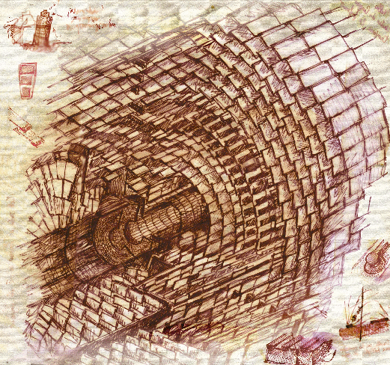
Detector design for triggering
L1 Tracking Trigger challenges at HL-LHC
Partition detector into
trigger towers/sectors
Data transfer
Pick your favorite method
Data formatting
Challenging issues
(1) Data Reduction at detector/sensor stage
(2) Data Transfer (rad hard, high bandwidth, low power link)
(3) Data Formatting
(4) Pattern Recognition
(5) Track Fitting …
Pattern Recognition
Finer pattern recognition
Track
Fitting

Slide 11
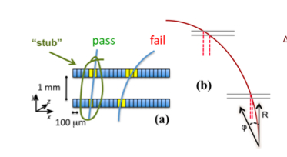
Detector design for triggering
L1 Tracking Trigger challenges at HL-LHC
Partition detector into
trigger towers/sectors
Data transfer
Pick your favorite method
Data formatting
Challenging issues
(1) Data Reduction at detector/sensor stage
(2) Data Transfer (rad hard, high bandwidth, low power link)
(3) Data Formatting
(4) Pattern Recognition
(5) Track Fitting …
Pattern Recognition
Finer pattern recognition
Track
Fitting
CMS new Tracker Design:
Pt stub finding reduce the
data volume by ~ 10-20.

Slide 12
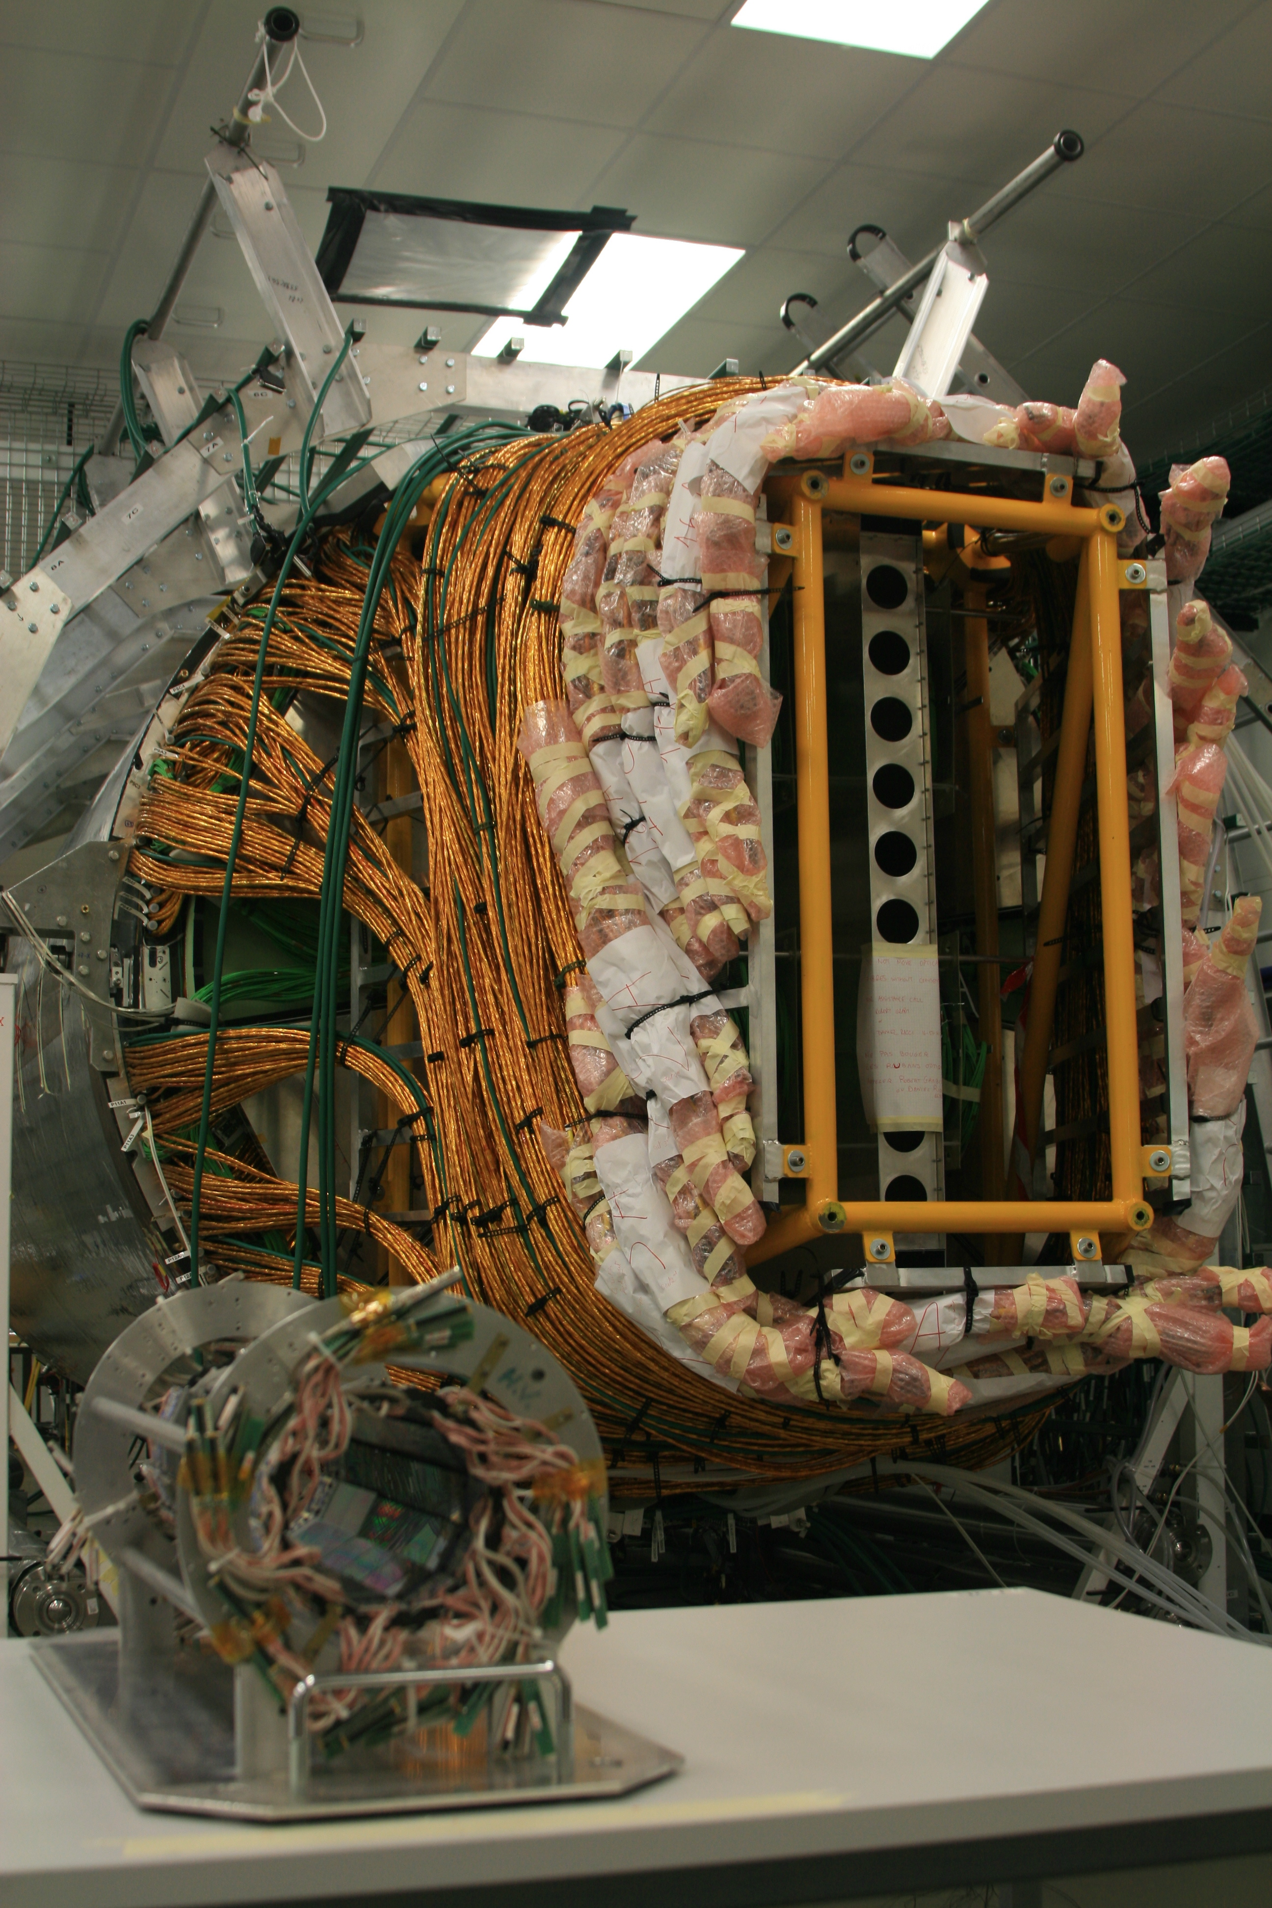
Detector design for triggering
L1 Tracking Trigger challenges at HL-LHC
Partition detector into
trigger towers/sectors
Data transfer
Pick your favorite method:
Data formatting
Challenging issues
(1) Data Reduction at detector/sensor stage
(2) Data Transfer (rad hard, high bandwidth, low power link)
(3) Data Formatting
(4) Pattern Recognition
(5) Track Fitting …
Pattern Recognition
Finer pattern recognition
Track
Fitting
Very challenging

Slide 13
Detector design for triggering
L1 Tracking Trigger challenges at HL-LHC
Partition detector into
trigger towers/sectors
Data transfer
Pick your favorite method
Data formatting
Challenging issues
(1) Data Reduction at detector/sensor stage
(2) Data Transfer (rad hard, high bandwidth, low power link)
(3) Data Formatting
(4) Pattern Recognition
(5) Track Fitting …
Pattern Recognition
Finer pattern recognition
Track
Fitting
Need massive parallelism: divide and conquer (100Tb/s)
regional multiplexing as well as time multiplexing.
Requires high bandwidth, low latency, and flexible real time communication.

Slide 14
Detector design for triggering
L1 Tracking Trigger challenges at HL-LHC
Partition detector into
trigger towers/sectors
Data transfer
Pick your favorite method:
Associative Memory Approach
Hough Transformation
Tracklet-based
Adaptive Pattern Recognition
Biology Inspired …
your choice here… (any new ideas?)
Data formatting
Challenging issues
(1) Data Reduction at detector/sensor stage
(2) Data Transfer (rad hard, high bandwidth, low power link)
(3) Data Formatting
(4) Pattern Recognition
(5) Track Fitting …
Pattern Recognition
Finer pattern recognition
Track
Fitting
Here we should be able to take advantage of
commercial technology development, but will need to develop
new ways to implement known HEP techniques or develop new techniques.

Slide 15
Detector design for triggering
L1 Tracking Trigger challenges at HL-LHC
Partition detector into
trigger towers/sectors
Data transfer
Pick your favorite method:
Associative Memory Approach
Hough Transformation
Tracklet-based
Adaptive Pattern Recognition
Biology Inspired …
your choice here… (any new ideas?)
Data formatting
Challenging issues
(1) Data Reduction at detector/sensor stage
(2) Data Transfer (rad hard, high bandwidth, low power link)
(3) Data Formatting
(4) Pattern Recognition (using AM as a filter)
(5) Track Fitting … (track fitting is done in FPGA)
Pattern Recognition
Finer pattern recognition
Track
Fitting
Associative Memory approach is a known HEP technique for silicon based tracking trigger for hadron collider.
The challenge in the future is pattern density and performance …

Slide 16
Detector design for triggering
AM + FPGA based Tracking Trigger
Partition detector into
trigger towers/sectors
Data transfer
Associative Memory Approach
Data formatting
Challenging issues
(1) Data Reduction at detector/sensor stage
(2) Data Transfer (rad hard, high bandwidth, low power link)
(3) Data Formatting
(4) Pattern Recognition
(5) Track Fitting …
Core R&D for AM + FPGA approach:
High performance Data Formatting/Delivery
High performance Associative Memory (ASIC)
Will use CMS L1 Tracking Trigger as an example next
Pattern Recognition
Finer pattern recognition
Track
Fitting
Tracking Trigger

Slide 17
Overview of the R&D
Top down
System architectural design (2012-2013) for CMS L1
  System Architecture fully studied/established in 2013
  Concept of demonstrator developed in 2013
System level performance simulation (2013-
  Preliminary results on system requirements:
  AM patterns ~ 2M patterns/Tower, or ~200K/chip
  Linearized Track Fitting details worked out for all regions
High performance ATCA board R&D (2011 - )
  The Pulsar2 project goal: ~ 1Tbps ATCA board with large mezzanines for AM chips
  This goal has been achieved in 2014 with Pulsar 2b design
  High performance pattern recognition mezzanine card design in 2015 (done)
High performance Associative Memory (2010 – )
  The VIPRAM project (Vertically Integrated Pattern Recognition Associative Memory)
  Goal: few x 100K patterns/cm^2 @ few x100MHz speed
  First 2D protoVIPRAM00 chip successfully tested in 2014 and works as designed
  The first 3D protoVIPRAM01 chip design in 2015 (to be submitted)
  The first 2-tier protoVIPRAM02 dedicated for L1CMS in 2015 (to be submitted)
  The first FPGA implementation of L1CMS ASIC working
Bottom up
Technical board to system level demonstration work started …

Slide 18
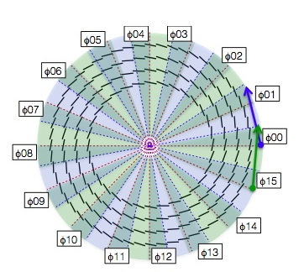
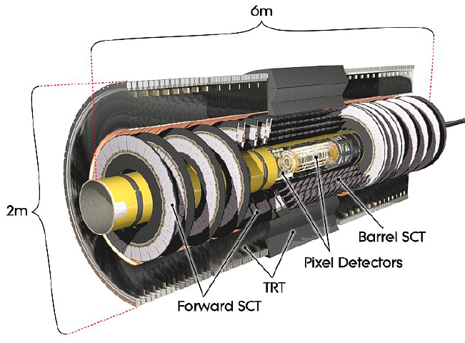
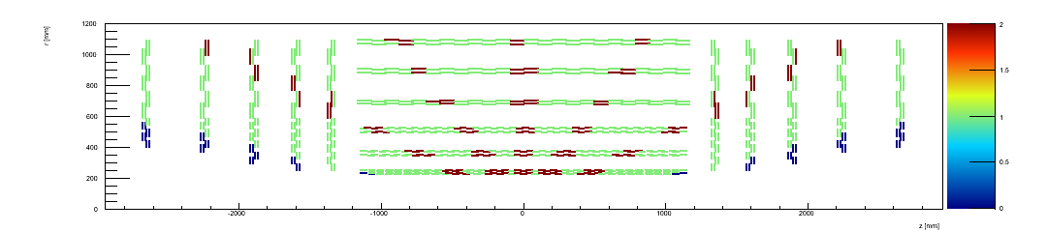
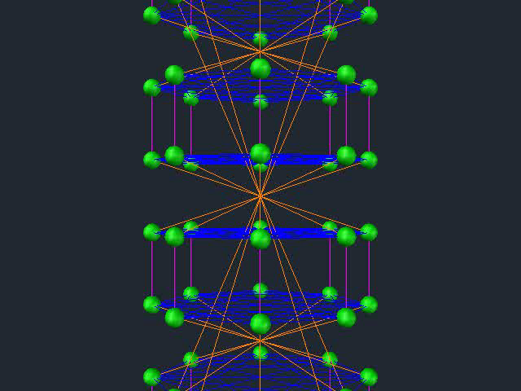
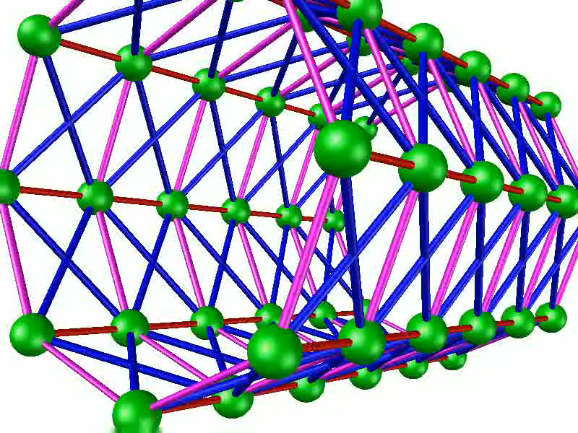
Comparison: ATLAS L2 FTK and CMS L1 Track Trigger
Existing
Tracker/cabling
not designed for
Tracking Trigger
New
Tracker/Cabling
to be designed for
Tracking Trigger
for HL-LHC
4 η x 16 φ = 64 trigger towers
6 η x 8 φ = 48 trigger towers
This leads to new Architecture….

Slide 19
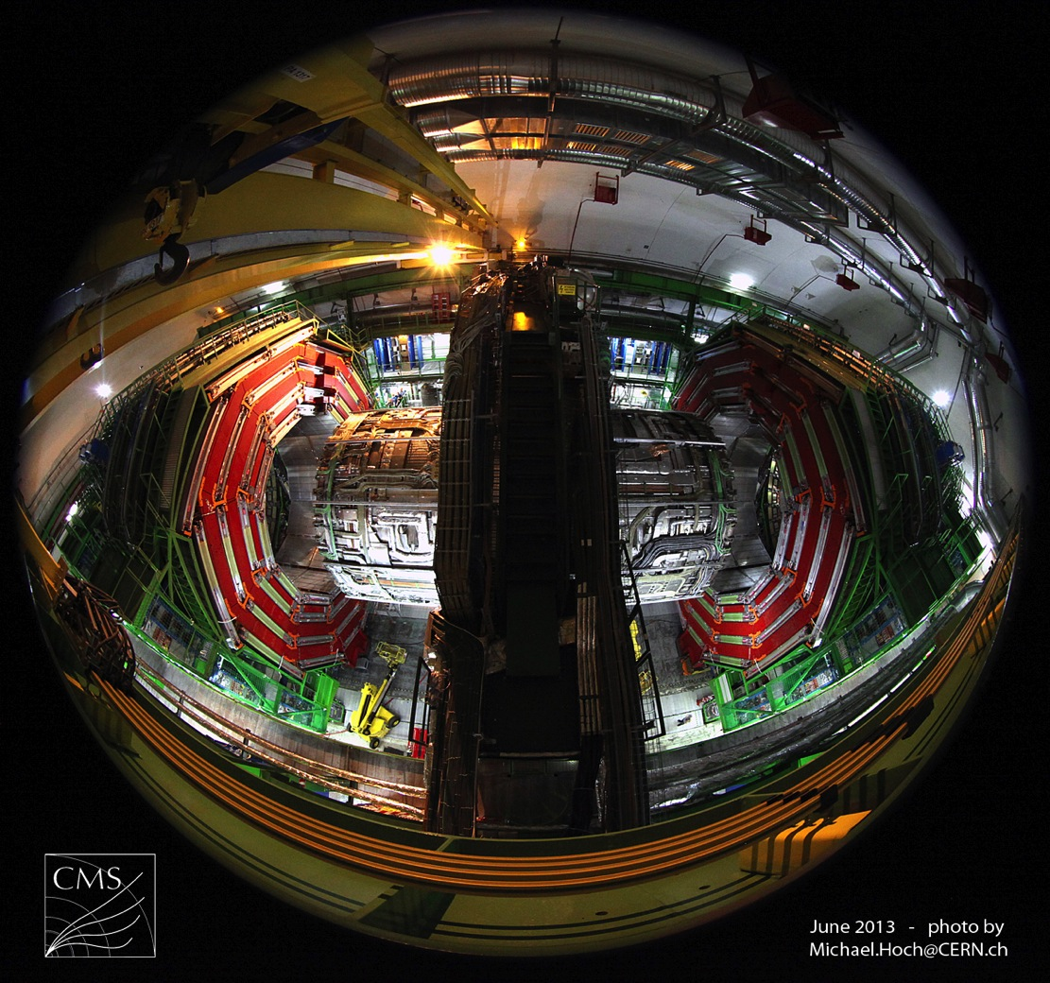
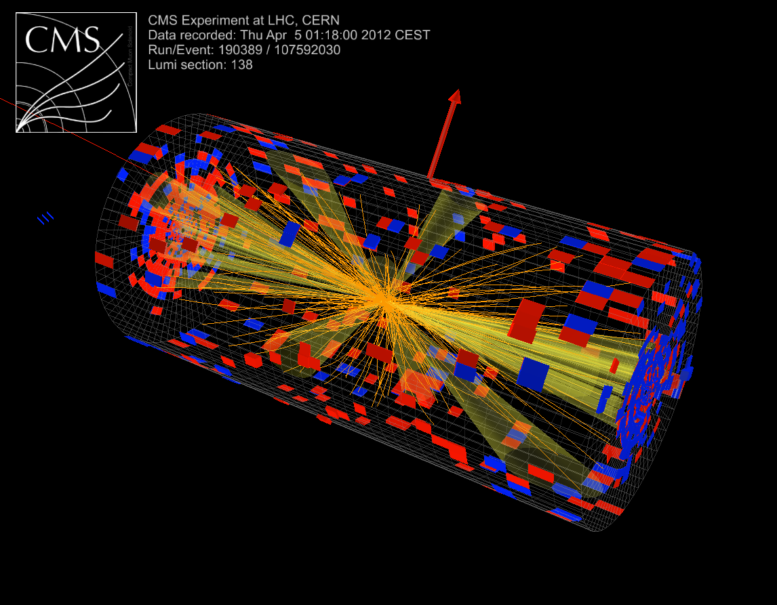
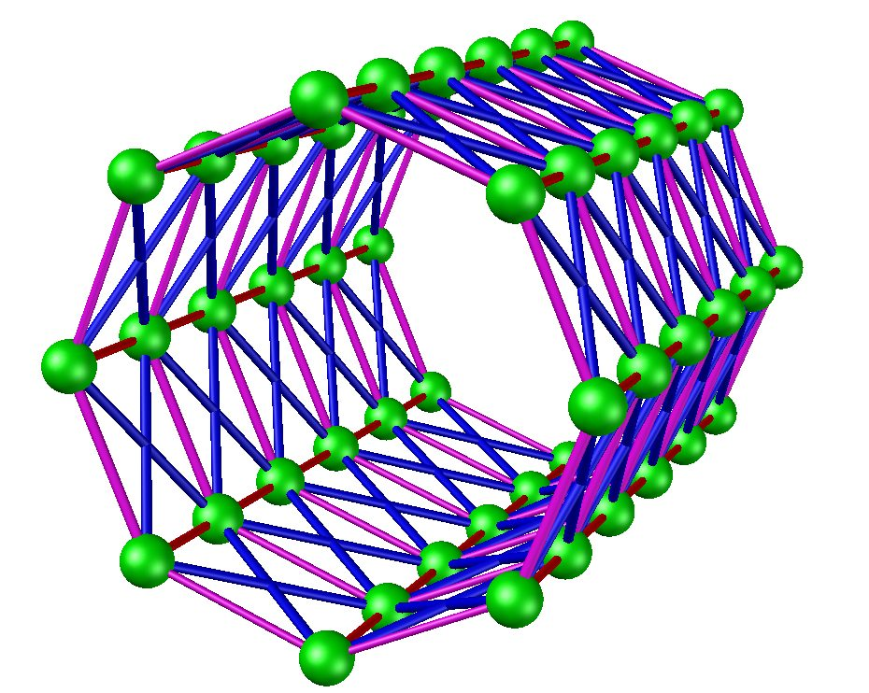
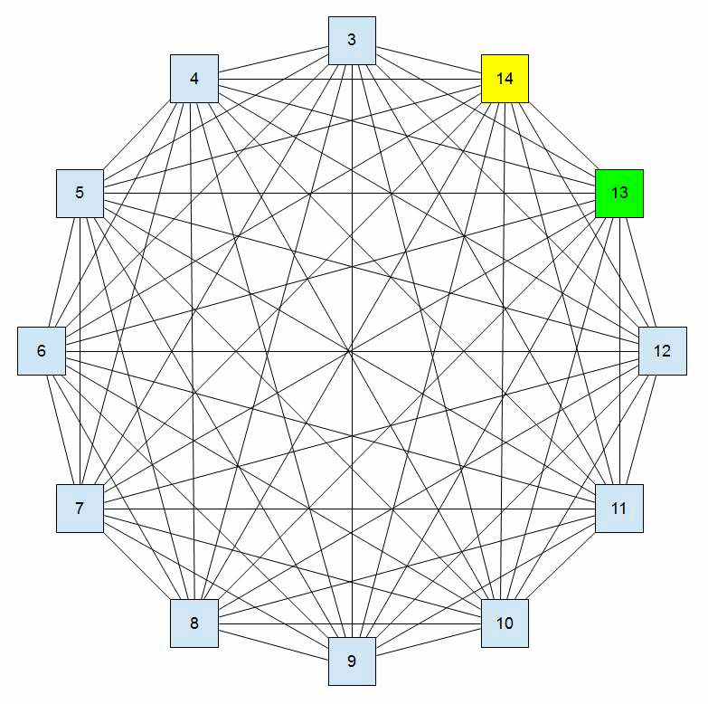
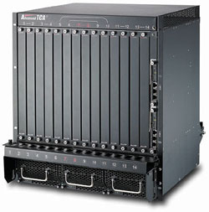
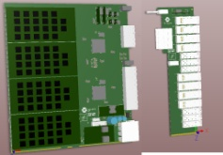
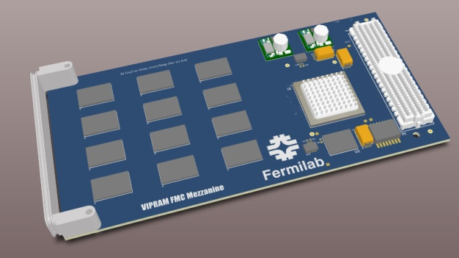
CMS
Tracking Trigger Towers
AM or other track finding approaches implemented on mezzanine (PR engine)
ATCA

Slide 20
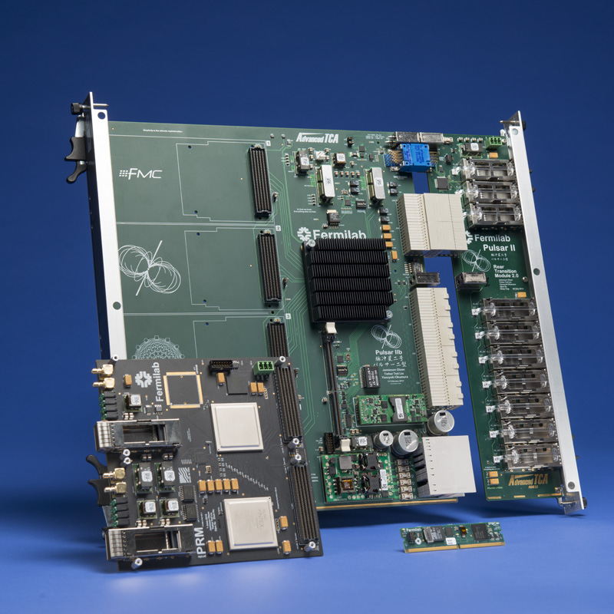
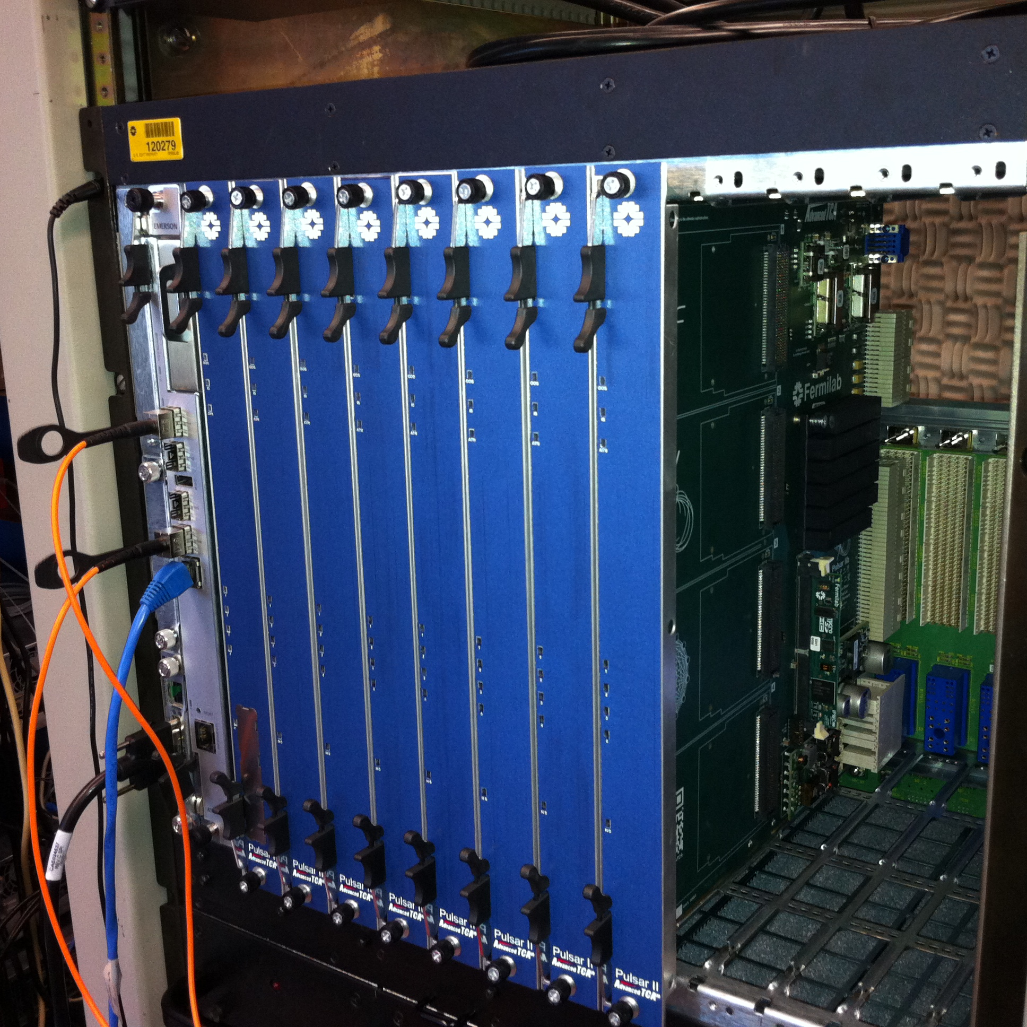
Pulsar II Web page: http://www-ppd.fnal.gov/EEDOffice-w/Projects/ATCA/
User information: https://twiki.cern.ch/twiki/bin/view/Main/PulsariibTesting
Data IO capability ~ 1 Tbps

Slide 21
Pulsar II Web page: http://www-ppd.fnal.gov/EEDOffice-w/Projects/ATCA/
User information: https://twiki.cern.ch/twiki/bin/view/Main/PulsariibTesting
Demonstrated Interconnection Bandwidth:
Pulsar IIb FPGA to full mesh backplane channels 10Gbps/lane
Pulsar IIb FPGA to FMC Mezzanine (GTH) 10Gbps/lane
Pulsar IIb FPGA to FMC Mezzanine (parallel LVDS) 800 Mbps/pair
Pulsar IIb FPGA to Rear Transition Module QSFP+ over fiber 10 Gbps/lane
ProtoPRM FPGA to QSFP+ over fiber 10 Gbps/lane
ProtoPRM Master-Slave UltraScale FPGA interconnections 15.6 Gbps/lane

Slide 22
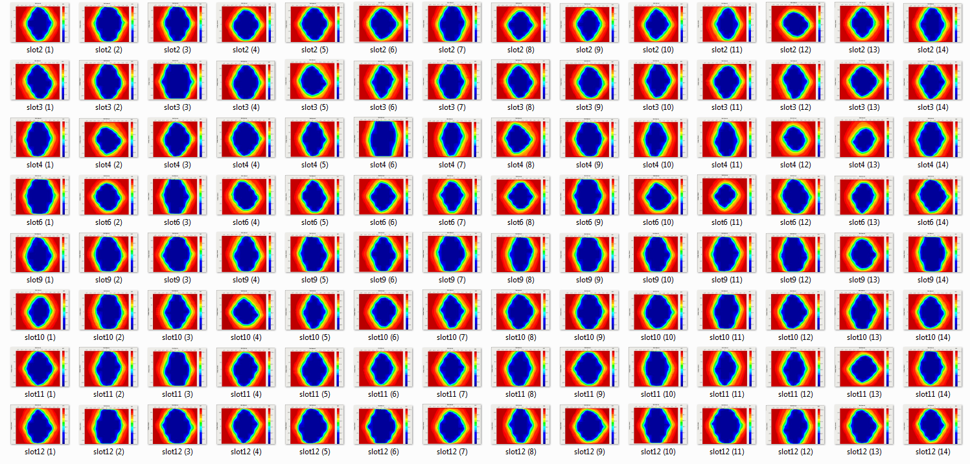
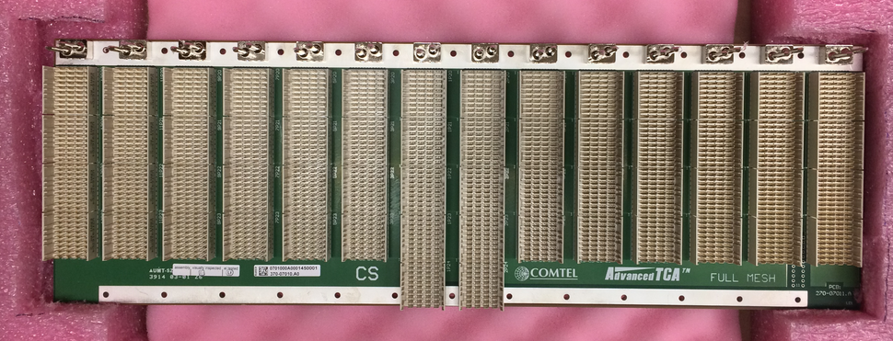
Pulsar IIb FPGA to Full Mesh ATCA Backplane
The latest COMTEL “AirPlane” 100G full mesh ATCA backplane. This new backplane has to date yielded the most consistent link performance with all eight Pulsar IIb boards running all GTH transceivers simultaneously (56 lanes) at 10 Gbps.
COMTEL new full mesh

Slide 23
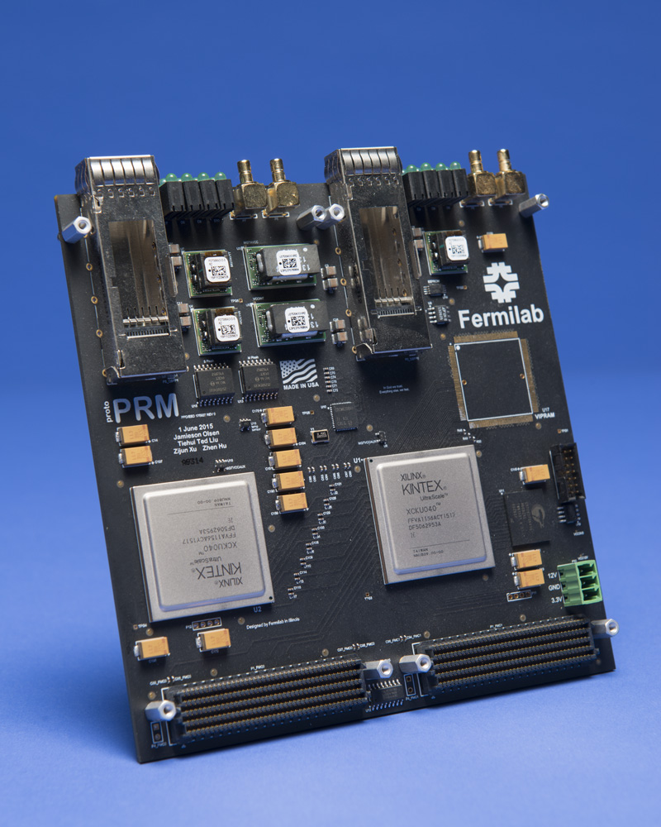
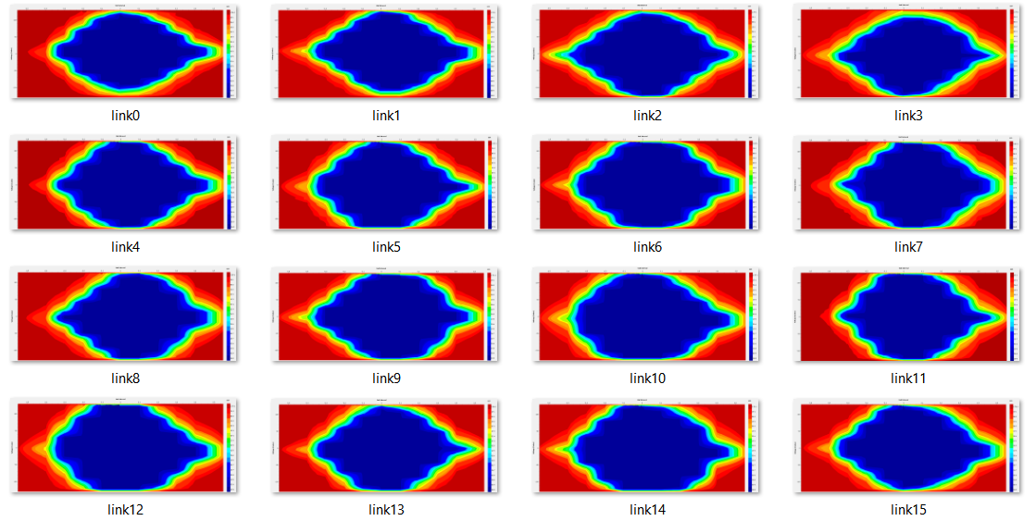
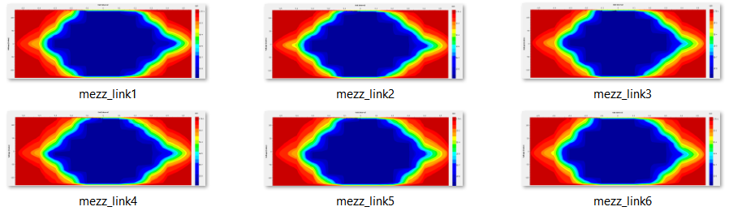
10Gbps
15.6Gbps between UltraScale FPGAs

Slide 24
Pulsar 2b achieved performance
→ data delivery capability demonstrates
24 crates system is feasible
One crate with 10 Pulsar 2b
Data sink capacity:
10 x 400Gbps/RTM = 4Tbps/crate
24 crates x 4Tbps ~ 100 Tbps

Slide 25
Detector design for triggering
AM + FPGA based Tracking Trigger
Partition detector into
trigger towers/sectors
Data transfer
Associative Memory Approach
Data formatting
Challenging issues
(1) Data Reduction at detector/sensor stage
(2) Data Transfer (rad hard, high bandwidth, low power link)
(3) Data Formatting
(4) Pattern Recognition
(5) Track Fitting …
Core R&D for AM + FPGA approach:
High performance Data Formatting/Delivery
High performance Associative Memory (ASIC)
Pattern Recognition
Finer pattern recognition
Track
Fitting
Tracking Trigger

Slide 26
The AM approach
Pattern Recognition Associative Memory (for HEP)
  Based on CAM cells to match and majority logic to associate hits in different detector layers to a set of pre-determined hit patterns (simple working unit, yet massively parallel)
  Pattern Recognition finishes right after all hits arrive
  A PR engine naturally handles a given detector region: divide & conquer
Road!
Animation by Jim Hoff (FNAL engineer)
CAMs
Millions of
Patterns
compared
at the same
time
Layer 1
Address 4
Layer 1
Address 4
Match
Match
Match
Match
Match
Match
Match
Match
Match
Match
Match
Match
Match
Match
Match
Match
Match
Layer 2
Address 1
Layer 2
Address 1
Layer 2
Address 4
Layer 2
Address 4
Match
Match
Match
Match
Match
Match
Match
Match
Match
Match
Match
Match
Match
Match
Match
Match
Match
Match
Match
Match
…….
Layer 3
Address 7
Layer 3
Address 7
Layer 3
Address 9
Layer 3
Address 9
Match
Match
Match
Match
Match
Match
Match
Match
Match
Match
Match
Match
Match
Match
Match
Match
Match
Match
Match
Match
Match
Match
Match
Match
Match
Match
Match
Match
Match
Match
Match
Match
Match
Match
Match
Match
Layer 4
Address 4
Layer 4
Address 4
Match
Match
Match
Match
Match
Match
Match
Match
Match
Match
Match
Match
Match
Match
Match
Linearized track fitting can follow each road found (FPGA implementation)

Slide 27
Pattern Recognition
Associative Memory approach
Roads
Pattern Recognition using Associative Memory (AM):
  Massive parallel processing to tackle the intrinsically complex
  combinatorics of track finding algorithms, avoiding the typical power
  law dependance of execution time on occupancy
  solving the pattern recognition in times roughly proportional to the number of hits, making the downstream task much easier
  Usually requires custom ASIC
The Track Fitting stage (in FPGA) after AM:
  Examples: linearized track fitting … etc
  The more powerful the AM stage, the less demand on TF/FPGA
  The more powerful the TF/FPGA, the less demand on AM

Slide 28
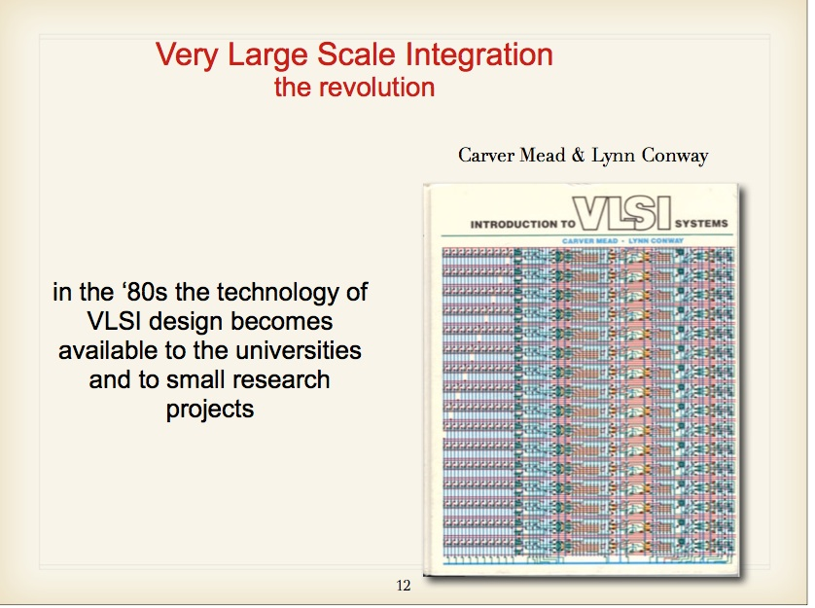
The first Amchip for CDF/SVT was implemented in the 90s, 128 patterns/chip
A slide from Luciano Ristori
at TIPP 2011 conference
Back then:
Crucial emerging technology for
CDF silicon detector and silicon vertex trigger….
(top quark discovery, rich b/c physics program …)

Slide 29
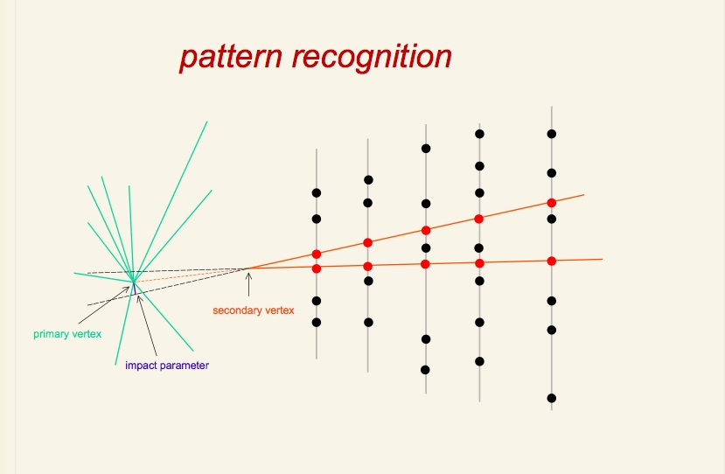
The AM approach was successfully used at CDF for secondary vertex trigger (SVT) in Run 2
Found roads
  Massive parallel processing to tackle the intrinsically complex
  combinatorics of track finding algorithms, avoiding the typical power law dependance of execution time on occupancy

Slide 30
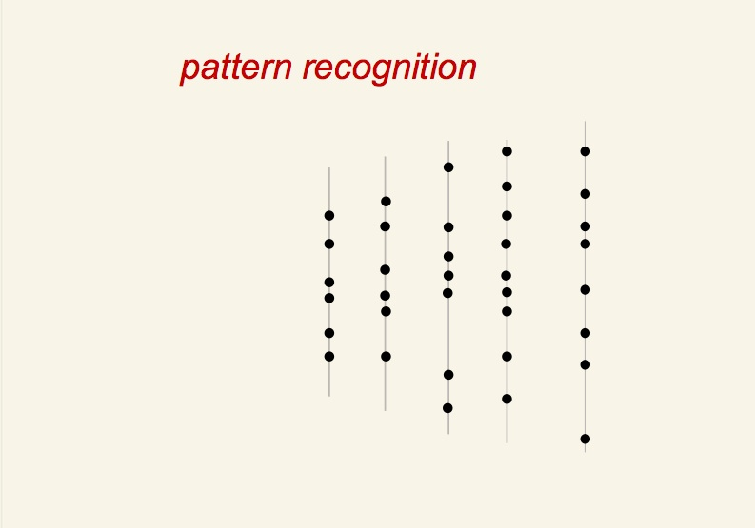
  avoiding the typical power law dependance of execution time on occupancy (large combinatorics …)

Slide 31
Occupancy or combinatorics will be much worse at HL-LHC
H→ZZ → μμee, M_{H}= 300 GeV for different luminosities in CMS
10³² cm⁻²s⁻¹
10³³ cm⁻²s⁻¹
10³⁴ cm⁻²s⁻¹
10³⁵ cm⁻²s⁻¹

Slide 32
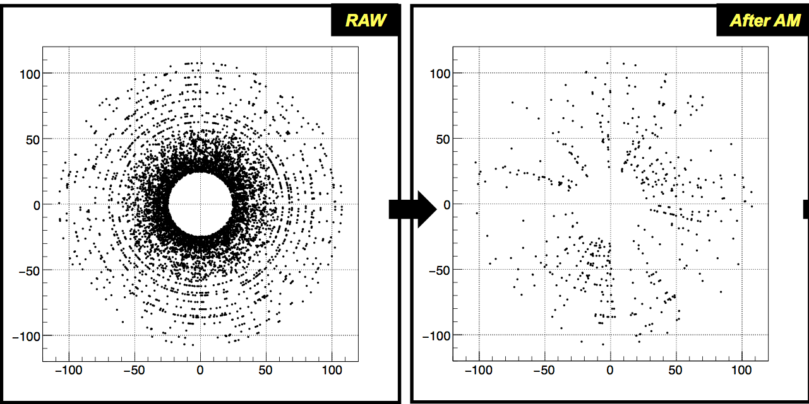
Before and after AM stage:
Associative Memory for CMS case at HL-LHC
~100M patterns, or ~2M pattern per trigger tower, or few x 100K per chip
PU200+4Top event simulation
(endcap)
Roads found
A factor of > 10 reduction of occupancy, and more importantly,
stubs/hits are organized in roads (“hits of interest”),
making the track fitting task inside FPGA much easier.

Slide 33
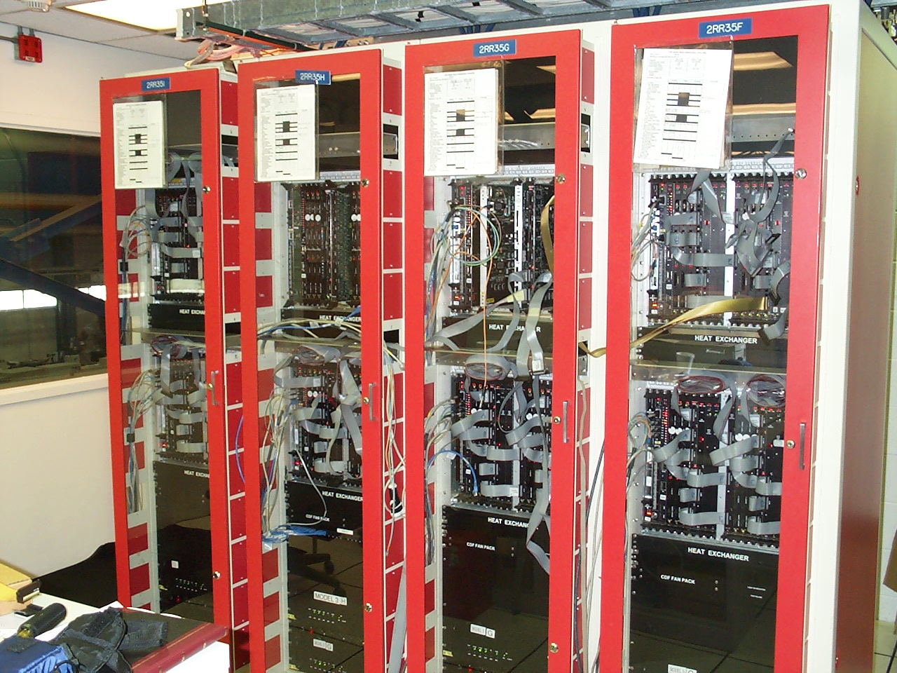
CDF original SVT system had ~400K patterns total …
128 patterns per AMchip -- commissioned around ~2001
(initial concept started in 1980s)
0,1
fan-out
fan-in
10,11
2 meters
2,3
4,5
6,7
8,9
Question: can one integrate all these into one chip for HL-LHC?

Slide 34
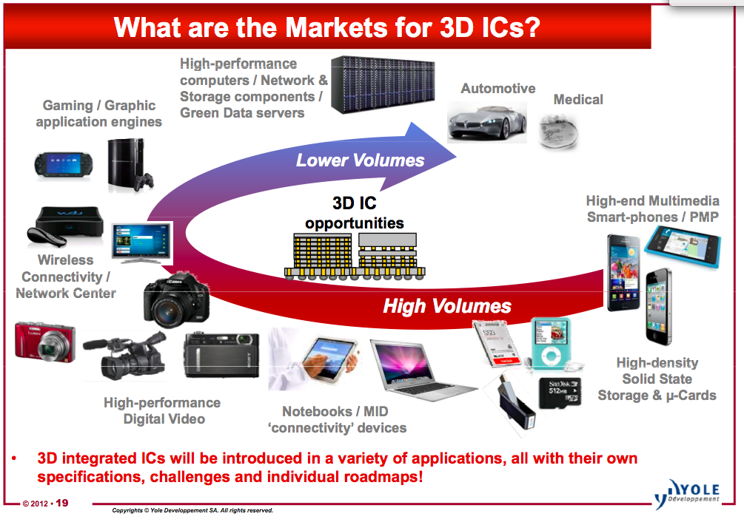

Slide 35
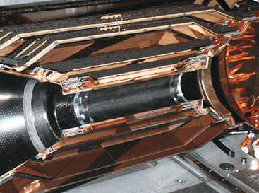
“A New Concept of Vertically Integrated Pattern Recognition Associative Memory”
TIPP 2011 Proceedings http://www.sciencedirect.com/science/article/pii/S1875389212019165
fired road
Pattern recognition for tracking
is naturally a task in 3D
track

Slide 36
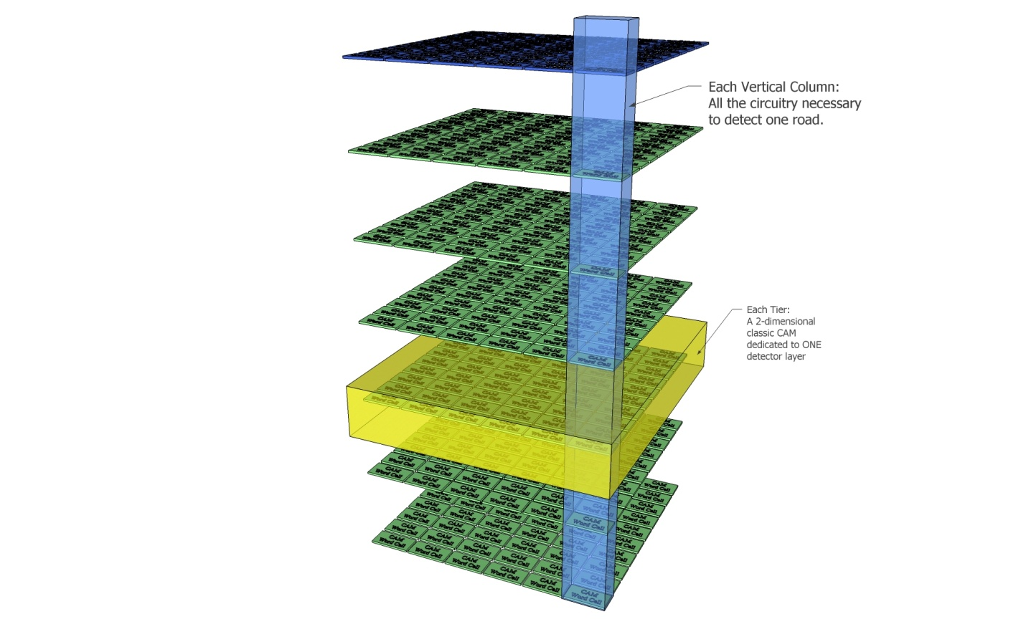
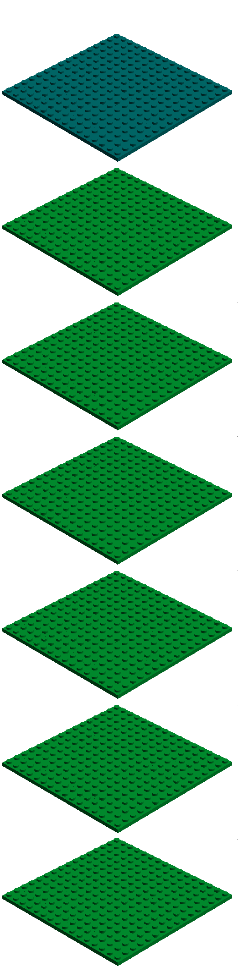
The 3D stack is very thin ( < ~ 10 um per tier)
Directly shortens the longest of the driving lines in the
pattern recognition cell (address match lines).
→ reduced power density or increased speed

Slide 37
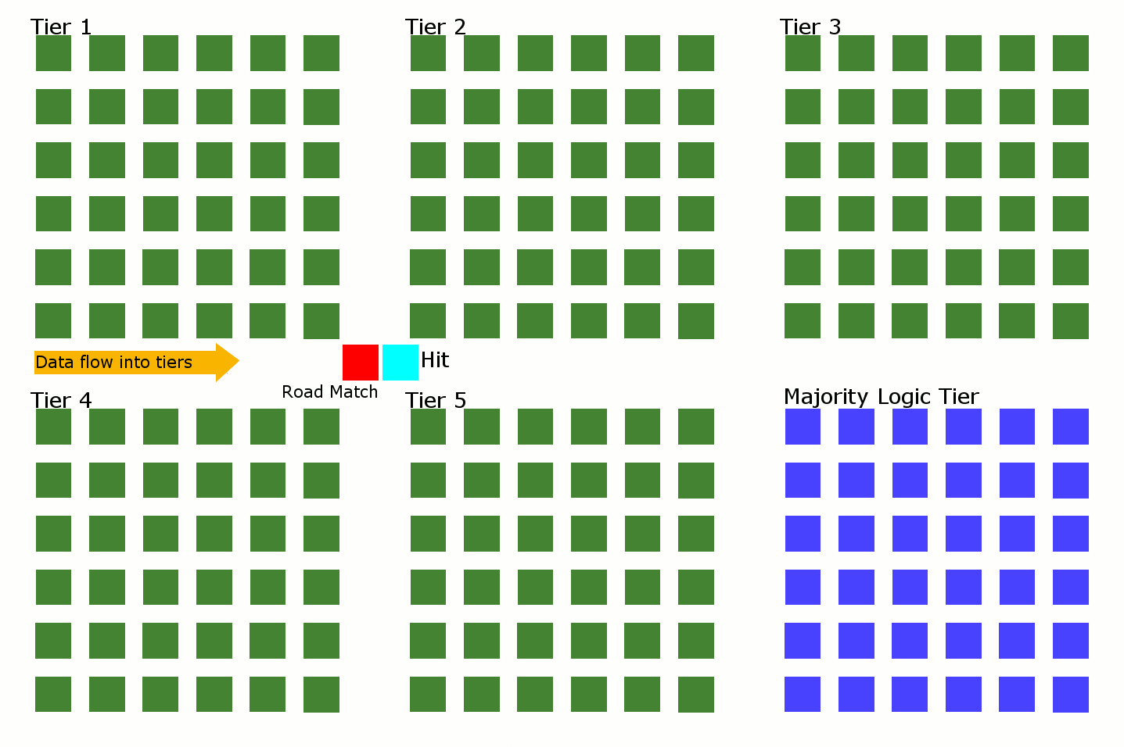
Connecting the Dots “in slow motion”

Slide 38
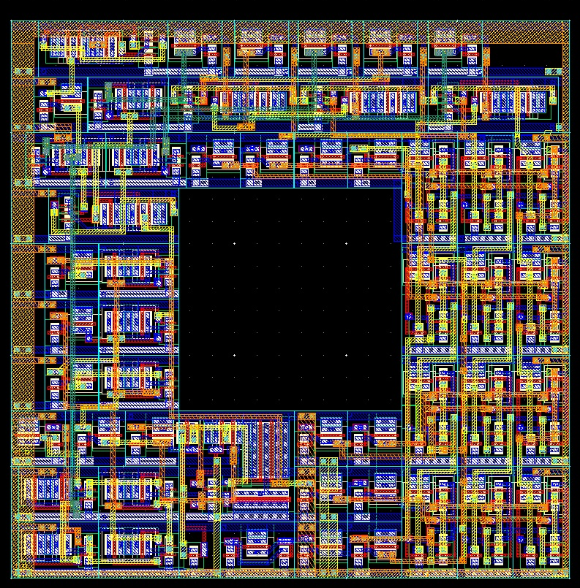
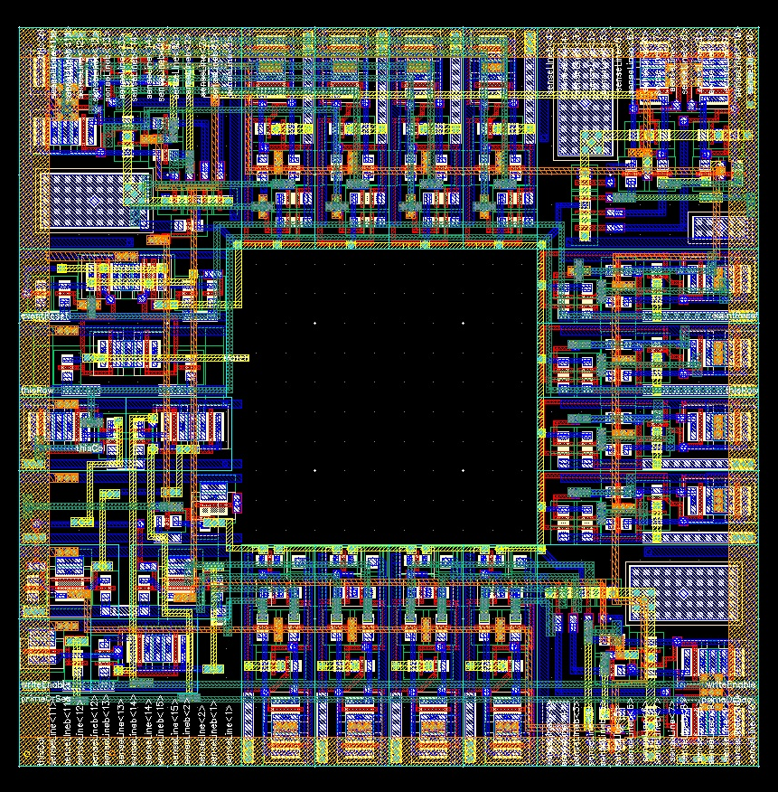
Design involved
In 130nm
Control/interface
Majority Logic
Cell design
CAM cell design
25μm
Initial R&D goal:
Proof-of-principle demonstration

Slide 39
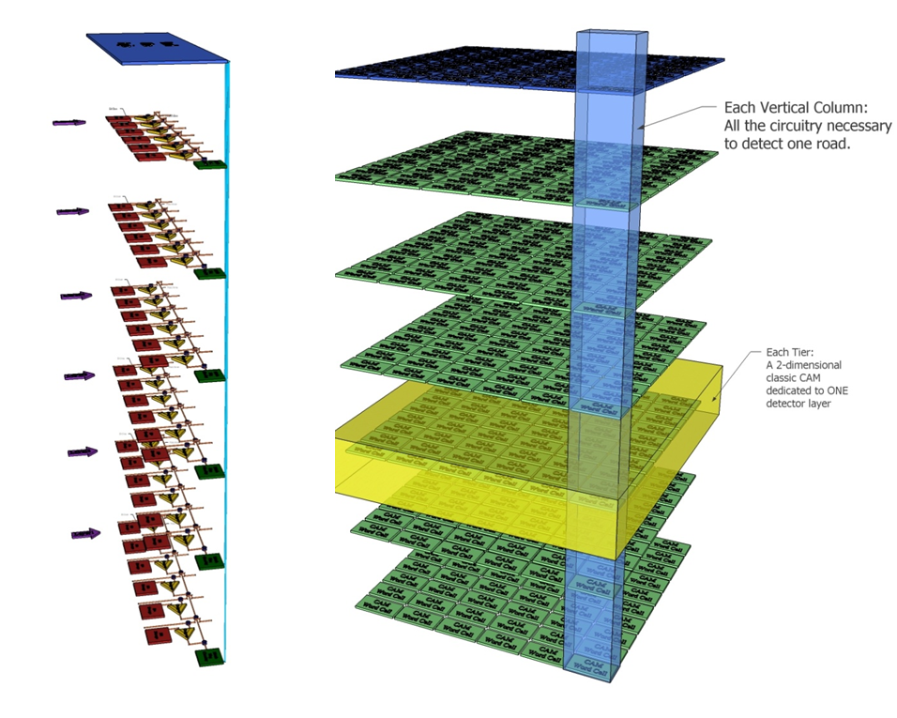
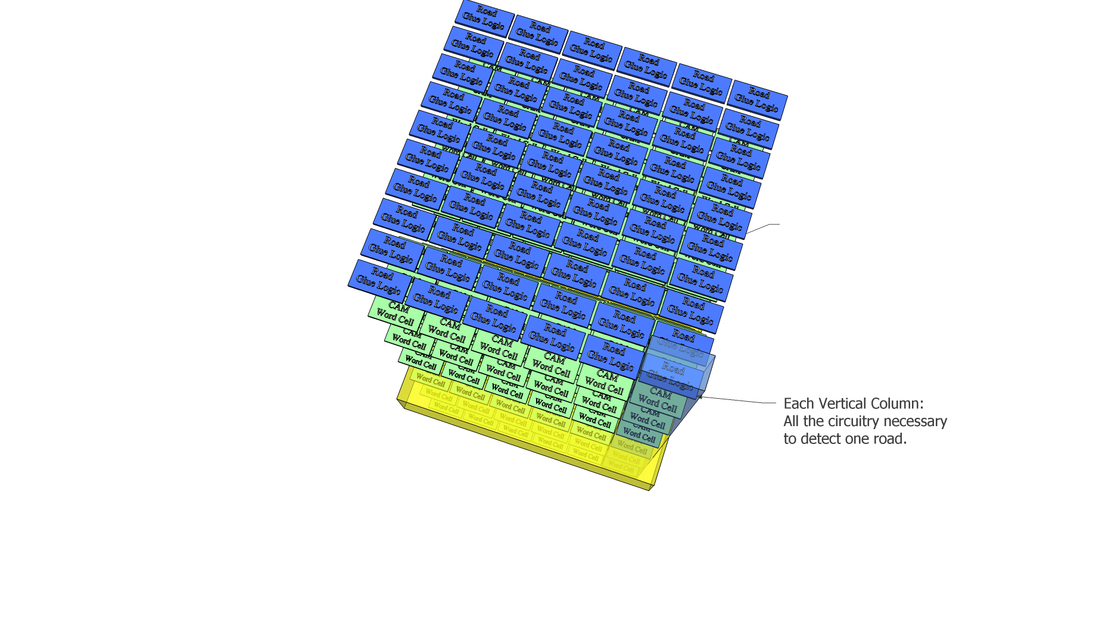
3D Architecture intrinsically open/flexible:
“CAM cell” doesn’t have to be CAM
e.g. simple algorithm or even NN …
platform to implement more advanced/fast
pattern recognition algorithm…
possible area for breakthrough
VIPRAM concept
In 3D, with 130 nm, VIRPAM ~160K AM patterns/cm^2
CDF AMchip03: 180 nm, standard cell, 5K AM patterns/chip
Fig. 4 - A 3D PRAM

Slide 40
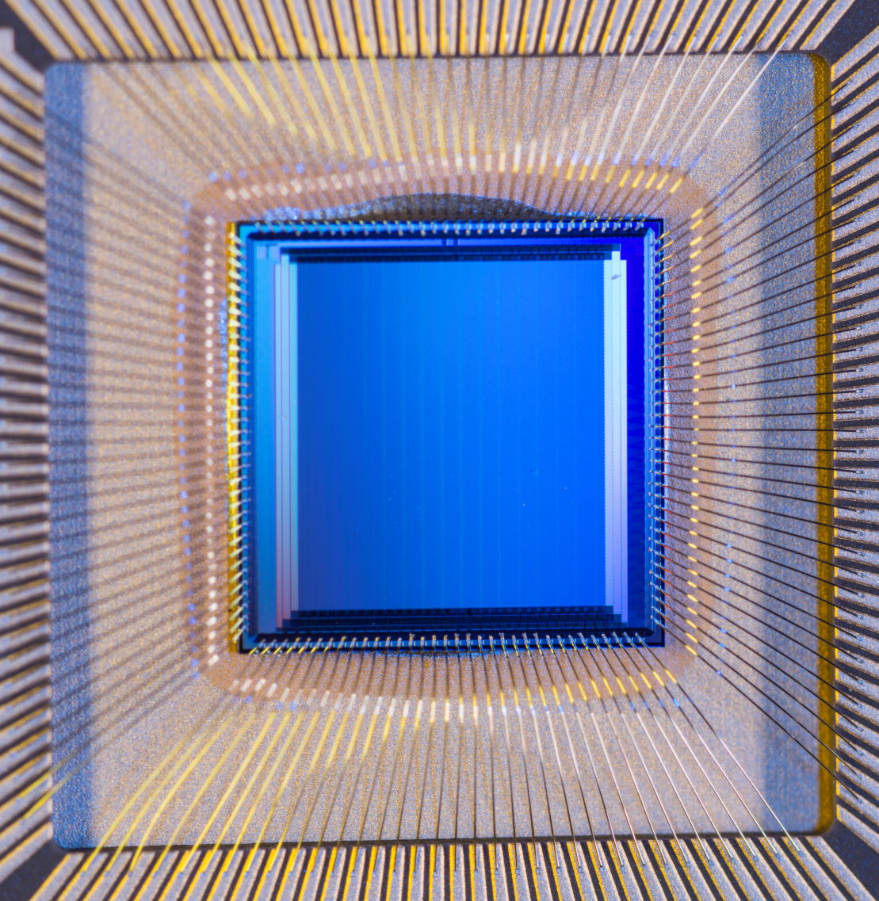
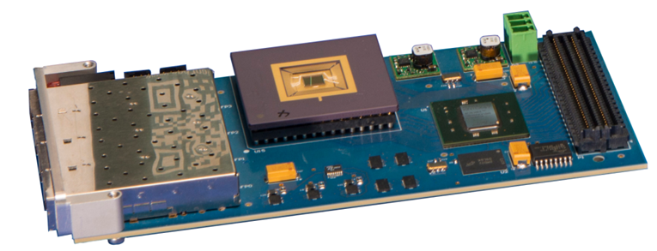
VIPRAM Project Status Summary
The past: with steady progress
Initial Idea: ~2010
VIPRAM concept paper: 2011
CDRD award: 2012
First 2D Design submission: 2013
First ProtoVIPRAM00 chip successfully tested: 2014
→ Design building blocks are ready for 3D stacking
2D design fully compatible with 3D stacking
CAM cell size: 25 um x 25 um, @ 130nm GF CMOS
On going work (2015)
The 3D multi-tier design (protoVIPRAM01) ready
A 2-tier design for CMS L1 tracking trigger (protoVIPRAM02) at final stage
both designs ready for submission later this year (2015)

Slide 41


Extensive simulation and optimization work done at different levels
→ much of the work done by engineering students
CAM cell
Majority Logic cell
Single Pattern
Power delivery
Signal timing …
Full-chip
Pattern core

Slide 42



The project has attracted
engineering school students.
Few engineering school thesis,
work done at Fermilab as intern
or URA fellowship.
Second URA fellowship for
VIPRAM project:
Northwestern EE school
Ph.D student:
Dawei Li (June 2014 – June 2015)

Slide 43

People involved from Fermilab (highly coherent team)
Engineers: G. Deptuch, J. Hoff, S. Joshi, J. Olsen, M. Trimpl,
Physicists: S. Jindariani, T. Liu, N. Tran
Power/thermal analysis by
W. Xia, P. Gui ( SMU EE)
D. Li, S. Memik (NWU EE)
First ProtoVIPRAM00 Chip
Chip delivered Jan 2014:
Found patterns the day after
the chips were wire bonded.
Successfully/extensively tested in 2014, no problem found.
Collaboration with Tezzaron company

Slide 44

Test Mezzanine Card
4 SFP+ Transceivers
Up to 6.6 Gbps
Voltage regulators
protoVIPRAM
FMC (LPC)
Connector
Config Flash
DDR3
Kintex 7 FPGA (XC7K160T-1)
protoVIPRAM Voltage and Current Readback
protoVIPRAM voltage regulators (programmable)
CMC/PMC size
74 mm x 149mm

Slide 45
Chip Testing and Performance Study
Use data and patterns from 140 Pile Up CMS AM simulation for HL-LHC to study the chip performance in close to “battle field” conditions
layer | <Nstubs>
1 | ~90
2 | ~60
3 | ~50
4 | ~40
5 | ~40
6 | ~40
protoVIPRAM00 shows 100% performance around ~111 MHz,
design target was 100 MHz
Power consumption ~ 300mW,
as expected
Extensive stress test performed to study chip performance in extreme conditions.
stub
inputs
Fired
patterns

Slide 46
Moving forward: 3D stacking (protoVIPRAM01)
1st step
There are minimal modifications to that existing 2D protoVIPRAM00 design. In fact, only those changes that are consequences of 3D are being permitted
This would allow an apples-to-apples comparison of our design in 2D and its 3D cousin, using the exact same test setup.
We will learn the effect of 3D on speed, power consumption, thermal dissipation etc this way.
The design is finished and ready for submission …
More stacking
Using the same test setup
for apple-to-apple comparison
TWEPP 2014 Aix-en-Provence

Slide 47


Moving Forward: VIPRAM for L1CMS
This will be a Two Tier design: protoVIPRAM02
IOtier: handles the System Interface of the chip with the goal to bring it to maturity.
CAMtier: Complete PRAM pattern structure on one tier with 8 CAM Cells/1 Control Cell
One pattern for 8 detector layers
70 x70 um
at 130 nm
Focus on speed

Slide 48


Moving Forward: protoVIPRAM02 for L1 CMS
Focus on the System Interface
2 Tiers
  ioTier – handles all data input and output. Hits received on the ioTier are passed immediately to the PRAMtier. Road flags are read out through the ioTier
  PRAM or CAMtier – handles all pattern recognition
Pipelined
  On command, all road flags raised by the CAMtier are captured into the ioTier, and then the PRAMtier is free to start digesting the next event.
Strategic Planning
3D is an emerging technology. What if it is not ready in coming year(s)?
  This design can be realized with existing bump bond technology.
70 x70 um
per pattern
TWEPP 2014 Aix-en-Provence

Slide 49
Pattern Recognition Mezzanine
VIPRAM
IO Tier
Roads
Track Stubs
VIPRAM multi-tier pipelined operation
PRAM Tier(s)

Slide 50


The L1CMS “CAM Tier and I/O Tier ” Schematic and Layout
Layout is done,
At final design verification stage

Slide 51

The technology of B-TSVs
This year, success from
B-TSV test wafers from
Tezzaron (done at FNAL)
With 111,360 TSVs chains
working
Single TSV vs double TSVs
B-TSV measurements:
resistance ~ 0.3 Ohm
capacitance ~ 8 fF
as expected
Results rather promising …
B-TSV test 8” wafer on probe station during measurements

Slide 52

3D MPW Run
Internal FNAL 3D-IC run - GF130 nm CMOS process and Tezzaron/Novati (Naperville, IL) 3D IC technology with B-TSV (Via-Last) – for VIPIC-L and VIPRAM
VIPIC-L
VIPRAM
> for 1 Megapixel Detector for X-ray Correlation Spectroscopy
Generic detector R&D and US-CMS
the most significant 3D efforts in int’l scientific community, to provide science ready camera for XCS experiments and proof of principle of AM-based track-triggering
reticle map, single mask for 3D assemblies
A slide from Gregory Deputch

Slide 53
Implementing VIPRAM functionality in FPGA
4K patterns (64x64) in KU40
Event N
Event N-1
FPGA
AM

Slide 54


4K patterns in UltraScale FPGA KU40 @250MHz
Will be used for initial demo and
performance optimization
Very cost effective way to guide the ASIC design …
VIPRAM
Main
FPGA
FPGA-AM
Track fitting
in main FPGA

Slide 55
Pattern Recognition Engine flow
Δt2
Δt3
Main FPGA
Roads
with all
associated
stubs
stubs
Pt
Check
for each
comb
Track
fitting
stage
Clean
up
tracks
Stubs library
Stubs library
Stubs library or
Data Organizer
Stubs from
Pulsar for a given BX and Trigger Tower
Super Strip ID
of each stub
~ few x100
unique Roads fired
AM
with N patterns
stored
No time to show
Track fitting details
here

Slide 56
Before and after AM stage:
Associative Memory for CMS case at HL-LHC
~100M patterns, or ~2M pattern per trigger tower, or few x 100K per chip
(PU200 + 4Top) simulation (endcap)
Roads found
A factor of >~10 reduction of occupancy, and more importantly,
stubs/hits are organized in roads (“hits of interest”),
making the track fitting task inside FPGA much easier.

Slide 57

Fired
road
Relationship among different algorithms (one way to look at it)
Linearized Track Fitting (PCA) (default for AM)
Tracklet-like (being explored)
Hough Transform (being explored)
Retina (being explored)
AM
AM’s role is to make things much easier for the FPGA, whatever algorithm runs inside

Slide 58
High Performance AM chip development
Future AM chip from INFN:
from 65nm down to 28nm, pure 2D
Jointed effort
in the future
Future chip from FNAL for CMS L1:
Simple 2-tier design, scale from current 130nm to 40 nm
to reach ~200K patterns/chip
More cost effective and feasible
Three
approaches
being
explored
FNAL generic R&D exploring multi-tier VIPRAM @ 130nm.

Slide 59

animation
After all, the main
purpose of
L1 tracker info
is to confirm
L1 muon
and electron
candidates
Associative memory
||
Confirmation memory
Potentially possible to directly
identify/confirm lepton objects at L1,
many advantages this way…
potential for lepton isolation on chip…
(Food for thoughts for future colliders)

Slide 60
Experiment on chip
Lepton isolation in a chip?
High Pt lepton
High Pt lepton takes much less patterns
Isolation veto doesn’t require high eff for low Pt tracks →much less patterns
Number of fired roads MUCH less (track fitting stage MUCH simpler/faster)

Slide 61


What if one could implement
much more patterns with 3D?
Triggering Taus at L1?
Need detailed studies
tau

Slide 62



Initial Board Level demo (2015- early 2016)
One board emulating
~40 modules worth of data
10 x QSFP+ (40 x 10Gbps)
Data Source Board(s)
Pattern Recognition
Mezzanine
Pattern Recognition Board

Slide 63

One Trigger Tower can be fully demonstrated with two ATCA shelves (2016 - 2017)
Sourcing ~ 400 modules/fibers worth of data
from one full Trigger Tower
Data Source
with 10 Pulsar2b
All 10 Pulsars take turn to process events
10 Pulsar2b
and Pattern
Recognition
Mezzanine
with 3 unique towers, 1,2,3
1 2 3

Slide 64

AM based Tracking Trigger Demonstration 2015 - 2017
Data Sourcing
Emulate tracker output using
HL-LHC simulation data
Partition detector into trigger towers
Data transfer
AM approach as example
Processing
Latency Δ t
Data formatting /delivery
Goal: ~4 μs
Δt1
Finer pattern recognition
Pattern Recognition (PR)
Δt2
Track
Fitting
system level demonstration:
Study processing latency vs performance vs cost
Demonstrate the feasibility of tracking trigger
Identify bottlenecks and guide future R&D
Δt3
Tracks out
  People currently involved within CMS:
  USCMS: Florida/FNAL/Northwestern/TAMU
  Non-US: Brazil/Lyon/INFN/KIT/PKU/CERN/ …

Slide 65




AM-based Tracking Trigger R&D for HL-LHC
Detector design for triggering
VIPRAM in 3D (DOE CDRD)
Custom
ASIC
Data transfer
L1 Track Trigger
architecture
Data formatting
VIPRAM:
Vertically Integrated Pattern
Recognition Associative Memory
Pattern Recognition
ATCA
Track
Fitting
Pulsar II
Extensive
simulation
work
Pattern Recognition Mezzanine (PRM)

Slide 66

HL-LHC tracking trigger challenges
& new/emerging technologies
& R&D
Detector design for triggering
CDF SVXII
Beam spot
Data transfer:
Data formatting
Telecommunication technology natural fit
3D technology may allow
major breakthrough here
Module design:
modern packaging
technologies
Pattern Recognition
Frontier Physics reach at
high luminosity LHC require the most advanced
Real Time processing technology.
LHC developments in this respect are also a “playground”
for developing and experiencing novel Real Time field.
FPGA technology
Track
Fitting
tracks

Slide 67
backup

Slide 68


Slide 69


Slide 70


Slide 71
Outlook:
Tracking Trigger & Future Hadron Colliders
Generally speaking, the ultimate physics reach of any higher energy hadron collider (given a center-of-mass energy) will be governed by its luminosity.
Given the huge cost associated with any future higher energy hadron collider, it is crucial to push for higher luminosity (similar to HL-LHC or beyond). This is to maximize the new physics reach of the huge investment already made, before a new higher energy collider can be proposed or built.
Because tracking information is the most effective means for high pile-up mitigation, a high performance, real time tracking trigger will be mandatory.
On going Tracking Trigger R&D projects: not only will they be important for the success of physics program in the HL-LHC era, they also lay some of the technological foundations for the future of the field…

Slide 72
General comment on demonstration
Data Sourcing
Emulate tracker output using
HL-LHC simulation data
Processing
Latency Δ t
Data formatting /delivery
Goal: ~4 μs
Δt1
Pattern Recognition (PR)
Δt2
performance
Track
Fitting
Δt3
cost
Tracks out
(system/board/chip)
design optimization
latency

