Slide 1
CMS Phase-2 Trigger Upgrade Plans and R&D
Darin Acosta
University of Florida

Slide 2
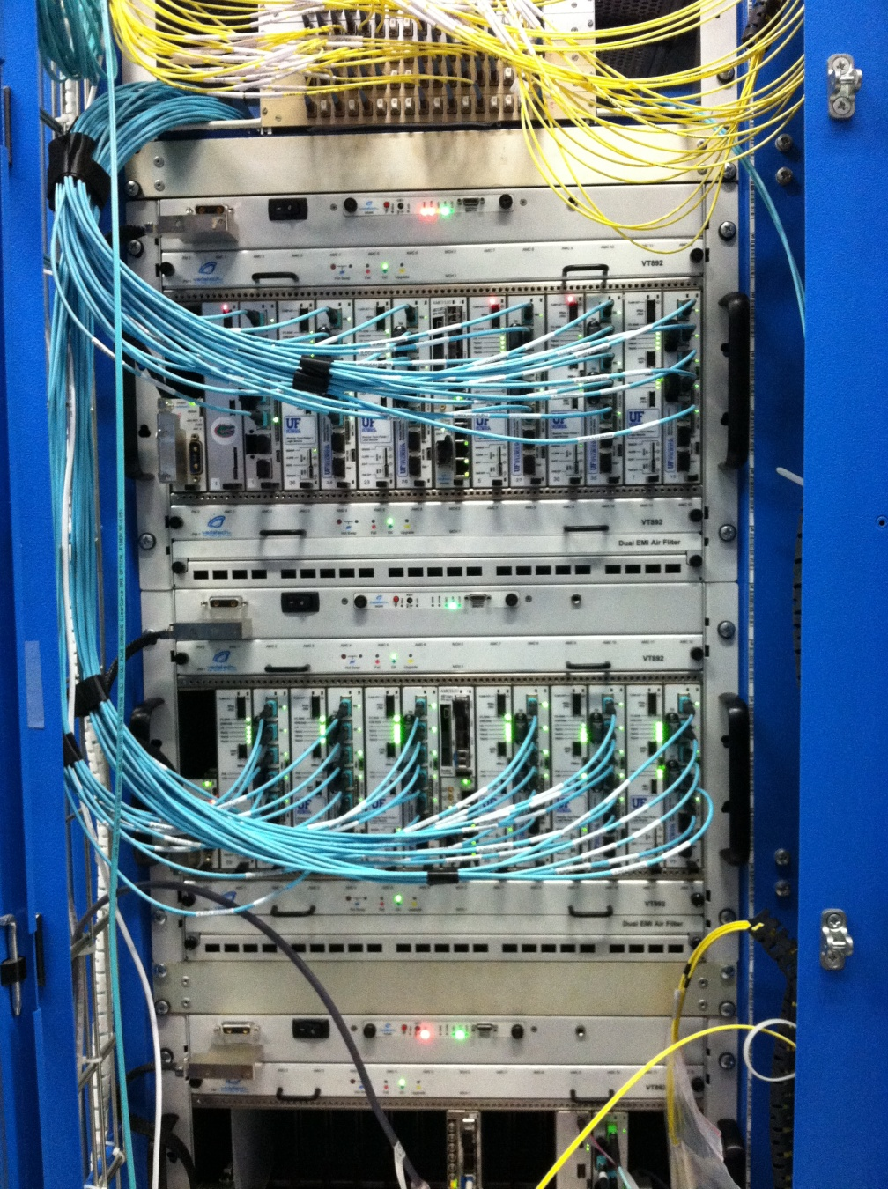
First: Phase-1 Level-1 Trigger Upgrade
To address the rate and pile-up challenges of LHC Runs 2 and 3, upgrade to improve:
e/γ and τ cluster footprints and isolation
Muon pT resolution and muon isolation
Jets and Energy sums with pile-up subtraction
Menu sophistication (#lines, complexity)
A complete replacement of the Run 1 system
Increase system flexibility with high bandwidth optical links and large FPGAs
Further standardization across systems using μTCA telecomm platform
Build and commission upgrade in parallel with current trigger in 2015, deploy in 2016
Designed to achieve ultimate performance without:
Silicon tracking at Level-1
Crystal granularity for electromagnetic calorimetry
Raising the read-out rate ceiling for FE electronics
Increasing the trigger latency
CERN-LHCC-2013-011
Endcap muon

Slide 3
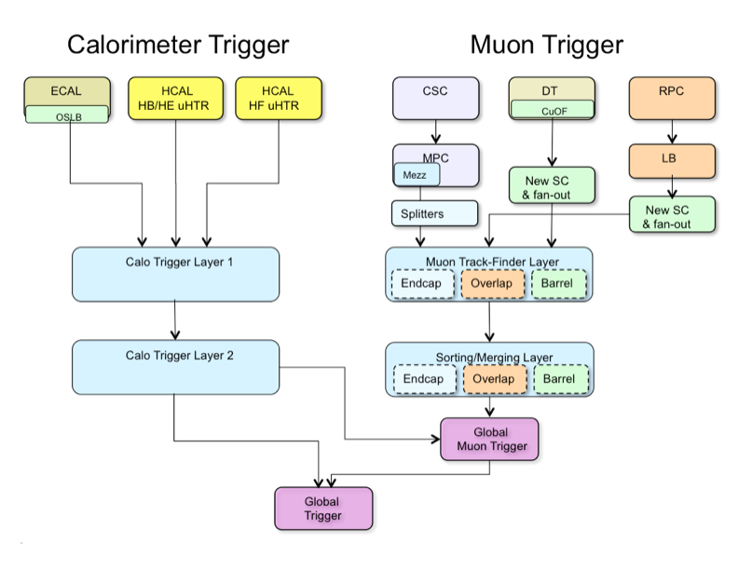
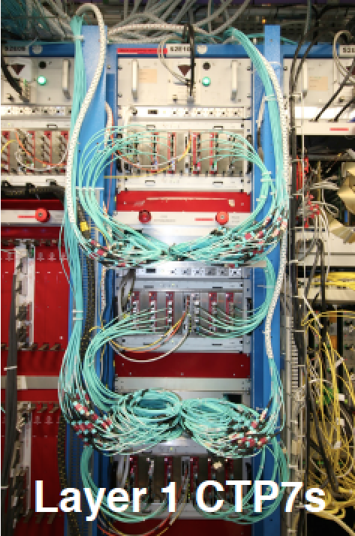
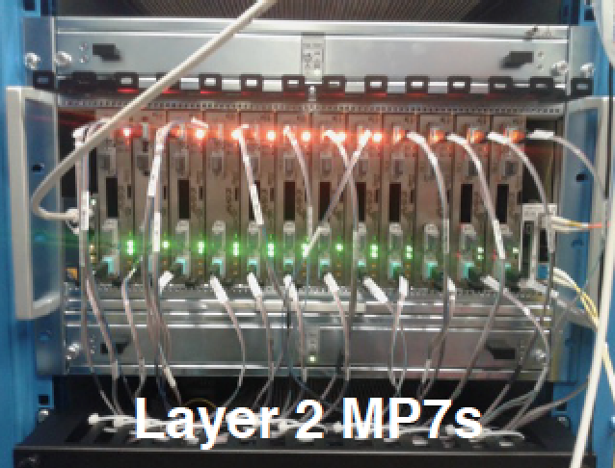
Phase-1 Trigger Architecture
~6 Tbps
~3 Tbps
Global Decision

Slide 4
Challenges of High Luminosity LHC
Integrated luminosity of 3000 fb⁻¹ beyond LHC Run 3
Fully explore the electroweak sector (Higgs couplings) and reach ultimate sensitivity for TeV scale physics
Luminosity leveled to 5×10³⁴ Hz/cm² (pile-up ~140), possibly as high as 7.5×10³⁴ Hz/cm² (pile-up ~200)
Compare to Runs 2+3: L<2×10³⁴ Hz/cm² (pile-up ~50)
Increased rate and pile-up effects:
Muon thresholds pushed into the flat region of rate curve because of limited P_{T} resolution
Very high e/gamma trigger rates
Degradation of the utility of calorimeter-based isolation due to high pile-up
Blow-up in rate of energy sum and multi-jet triggers due to high pile-up
Nevertheless need thresholds efficient for precision electroweak scale measurements (Higgs) and TeV scale

Slide 5
CMS Phase-2 Upgrade for the HL-LHC
CMS Technical proposal:
CERN-LHCC-2015-010
https://cds.cern.ch/record/2020886
Detector upgrades:
Silicon strip Outer Tracker
Pixel Tracker
Forward calorimetry
Forward muons
Bream radiation protection and luminosity
Trigger /DAQ

Slide 6
Phase-2 Level-1 Trigger & Readout Design Specifications
Incorporation of tracking at Level-1 from the silicon tracker
Major missing ingredient!
Correlation of tracks with other Level-1 objects
Better charged lepton ID, refine (muon) momentum, assign jet vertex, determine primary vertex, provide track-based isolation …
Introduction of crystal granularity at Level-1 for ECAL barrel
ΔϕΔη = 0.0175 × 0.0175 vs. 0.0875 × 0.0875
Better spike rejection and EM shower identification
Incorporation of Phase-2 forward muon detectors into muon Track-Finder trigger (GEM, iRPC)
Increased redundancy, more bending angles
Trigger rates up to 750 kHz @ Level-1, 7.5 kHz @ HLT
Compare to today: 100 kHz and ~1 kHz
Alleviate a Level-1 bottleneck and allow HLT to do more
Level-1 trigger latency of 12.5 μs (500 BX * 25ns/BX)
Compare to today: 4.0 μs
Allow time for additional processing (Track Trigger, Correlation)

Slide 7
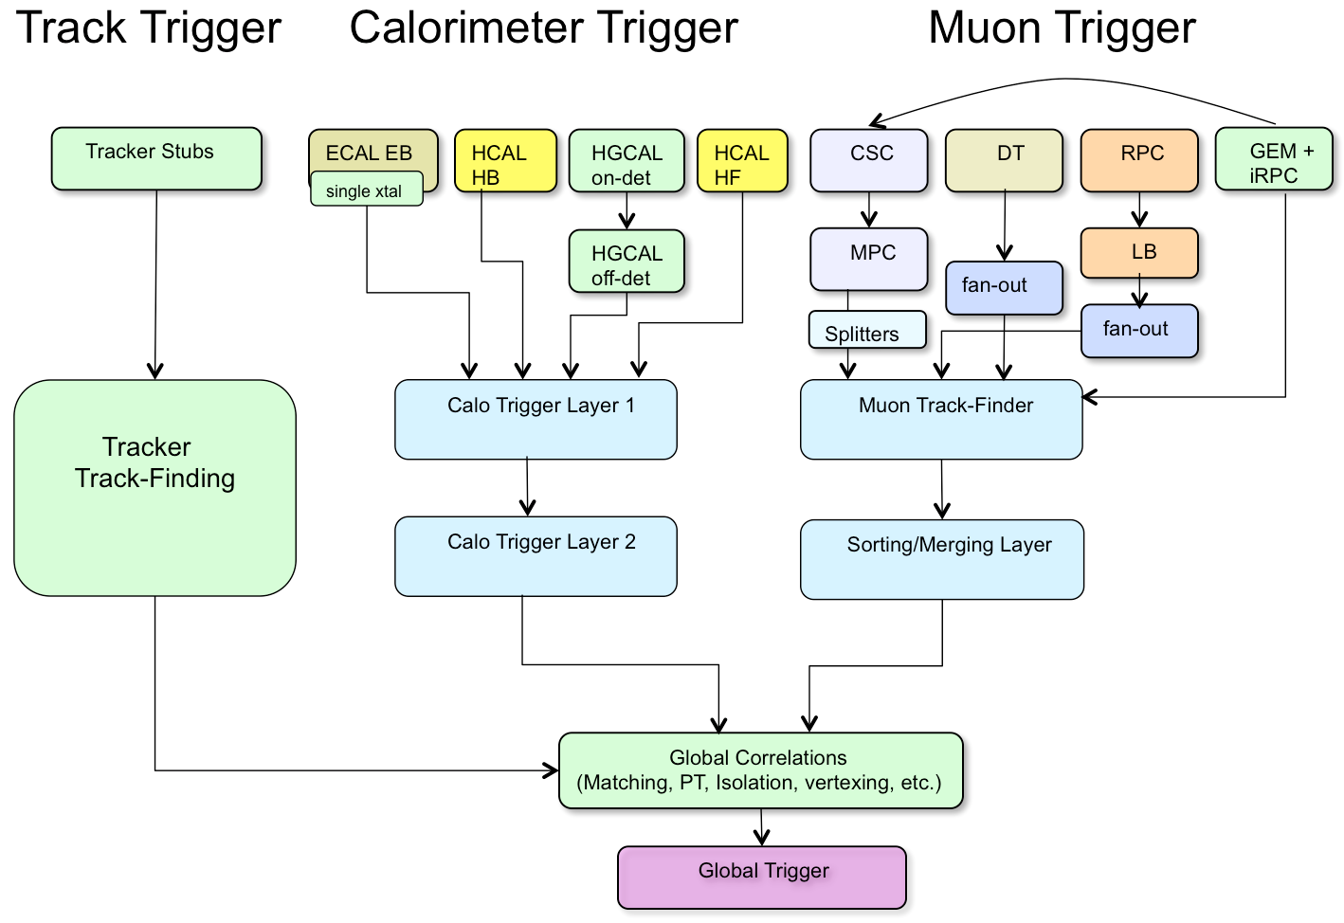
A Possible Level-1 Trigger Architecture
New
New
New
New
~50 Tbps
~50 Tbps
~25 Tbps
But need to develop details of a design to understand layer structure and segmentation
New
~4 Tbps
New
Modeled after Phase 1 design

Slide 8
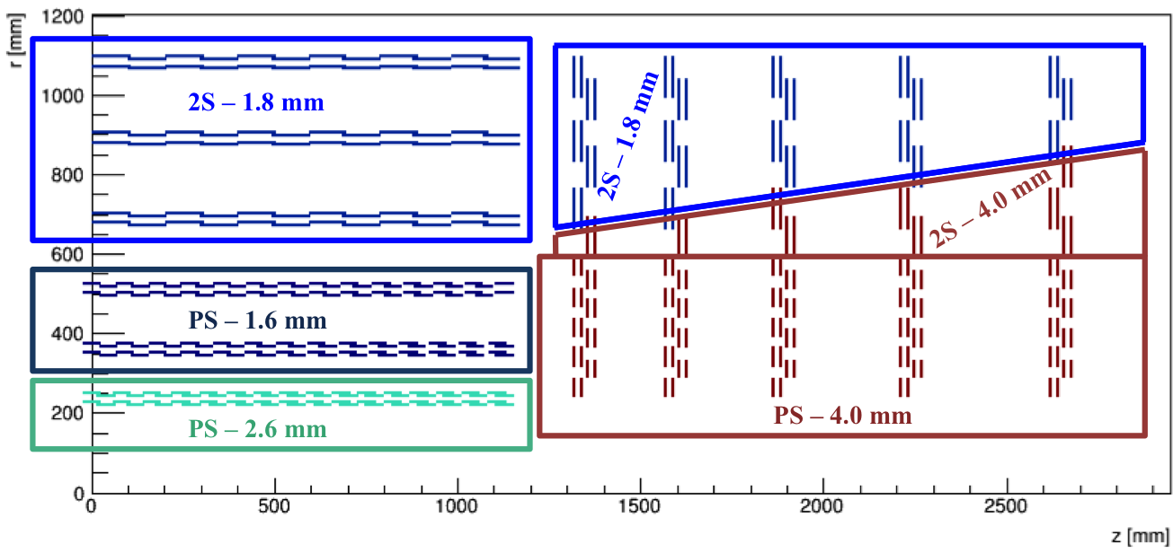
Phase-2 Outer Tracker Design
Baseline design has 6 barrel layers and 5 endcap disks
10 and 11 layers, respectively, in current Tracker
220 m² area
Two sensor modules in all layers for triggering (stubs)
2S: 2.5cm strips, 90μm pitch
PS: Long Pixel (1.5mm) in 3 inner layers for z-coordinate, and 5cm strips, 100μm pitch
50M strips
220M macropixels
Sensor spacing optimized to obtain 2 GeV p_{T} threshold
Inner pixels not shown →

Slide 9
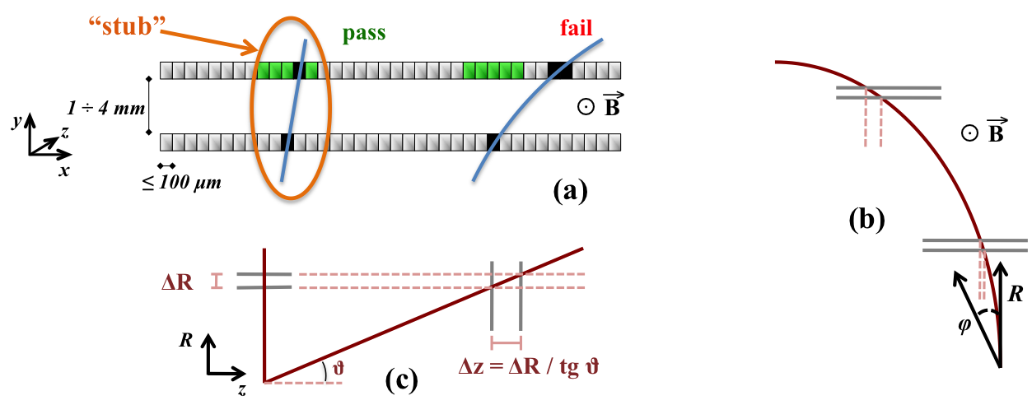
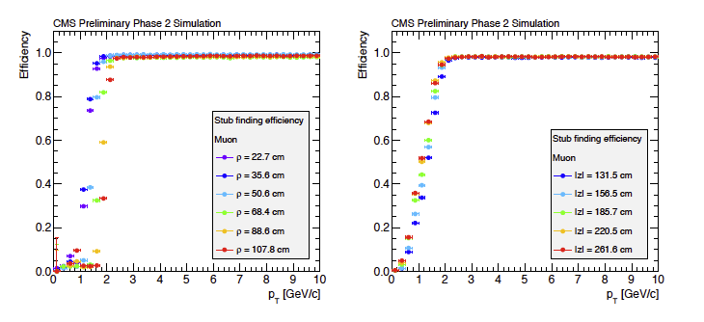
Track Stub Finding
Double layers help reduce data bandwidth.
Require a coincidence within a road, limits P_{T} > 2 GeV
< 3% of tracks
“Push” design: all stubs forwarded
3-4 stubs/module/BX for Barrel layer 1
~10K stubs/BX
O(50) Tbps
Barrel
Endcap
Stub efficiency vs. P_{T} for various layers and disks →
1 BX = 25ns

Slide 10
Track-Finding
More in T.Liu’s and A.Ryd’s reports
Again a “push” design, not region of interest
Input: Expect ~10K stubs/BX @ PU~140, of which 5-10% belong to tracks with P_{T}>2 GeV
Output: ~100 bits/track → several Tbps to track correlators
Latency: ~5 μs allocated
Multiple approaches under consideration to find tracks:
Pattern-based: Track patterns stored in Associative Memory chips
Target implementation in custom ASICs to store large number of patterns (~100M overall)
Hough transform: transformation of track patterns to clusters in transformed space
Target implementation in FPGAs
“Tracklet” approach: Track building from stubs with pair-wise layer extrapolations
Target implementation in FPGAs
Generally implemented with time-multiplexing of the input data (round-robin of event data to processors)
All followed by a track-fitting stage to extract track parameters

Slide 11
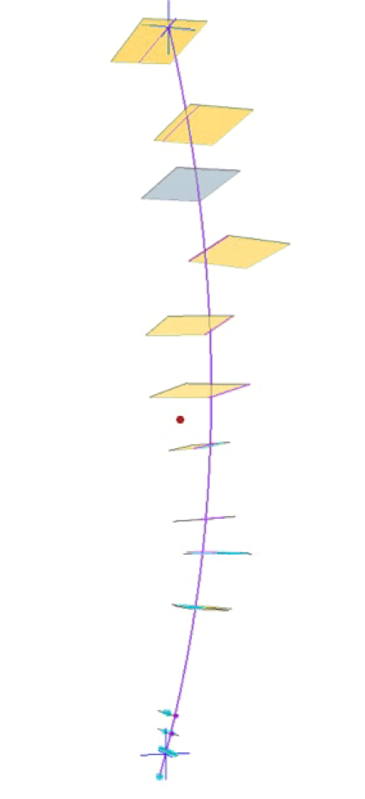
Pattern Recognition with AM Approach
Identify track patterns from hits across different detector layers
Content addressable memory cells with provision for majority logic in pattern
Generally does well for high occupancy environments
Massively parallel approach
CMS AM Track-Trigger Concept
Partition geometry into 48 towers (6 in η × 8 in φ)
Target:
1 ATCA crate per tower, with 40 Gbps full mesh backplane (Time MUX)
~2M patterns per tower
~200K patterns/AM chip
Ultrascale FPGA for current prototype
Develop ASIC prototypes in 2D (~2018) and 3D (~2021)

Slide 12
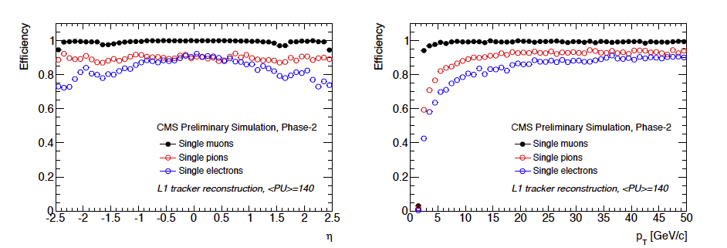
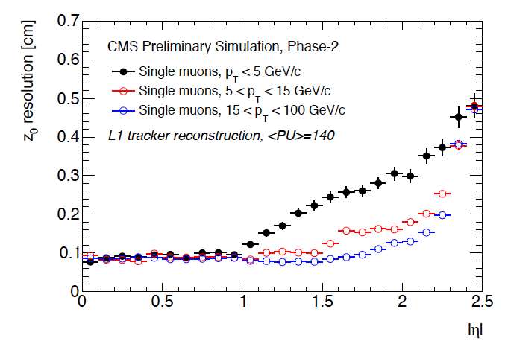
Track-Finding Performance
Efficiency curves vs. eta and PT for PU=140:
Z0 resolution:
Tracklet approach
1mm

Slide 13
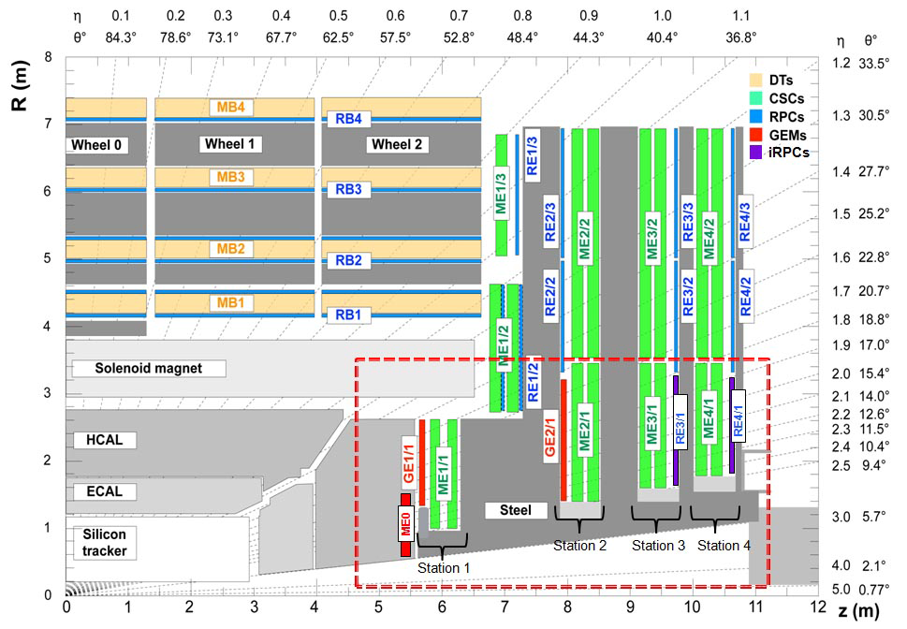
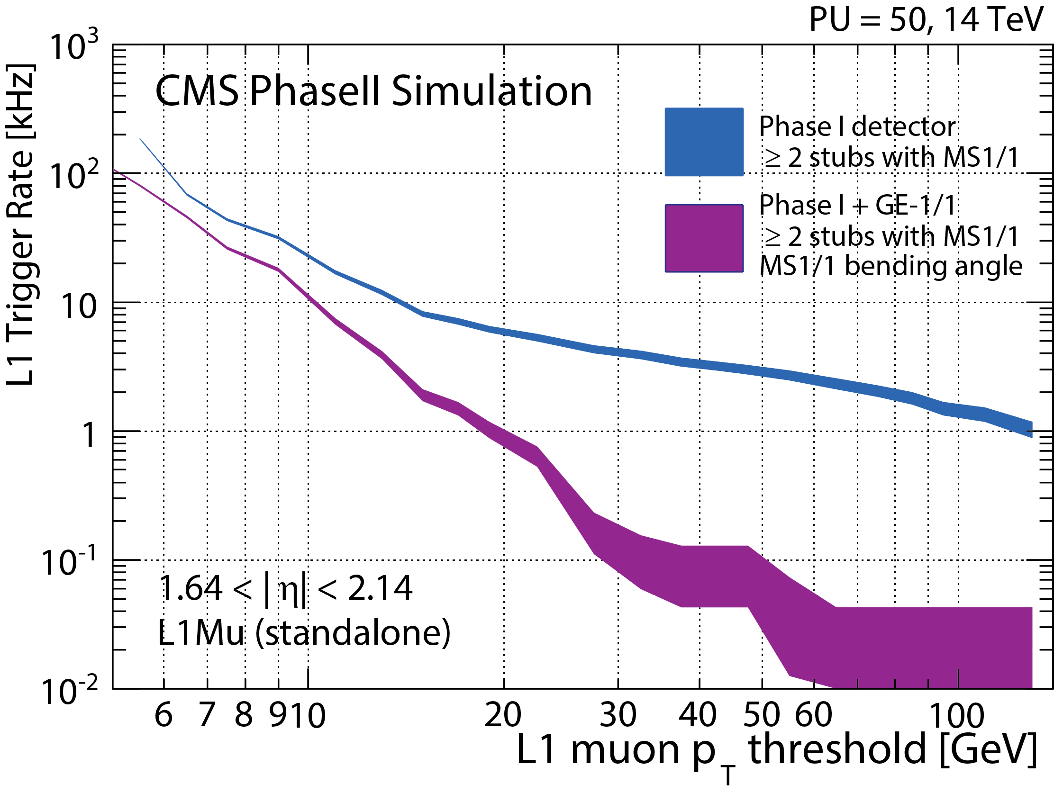
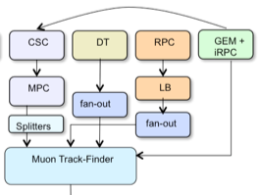
Standalone Muon Trigger
New detectors in forward region to add redundancy and enhance trigger
GEM in first 2 layers
Improved RPC in outer layers
Additional inputs and improved angular information (bend angle) for track-finding for better efficiency and rate rejection
Rate just in GE1/1 region

Slide 14
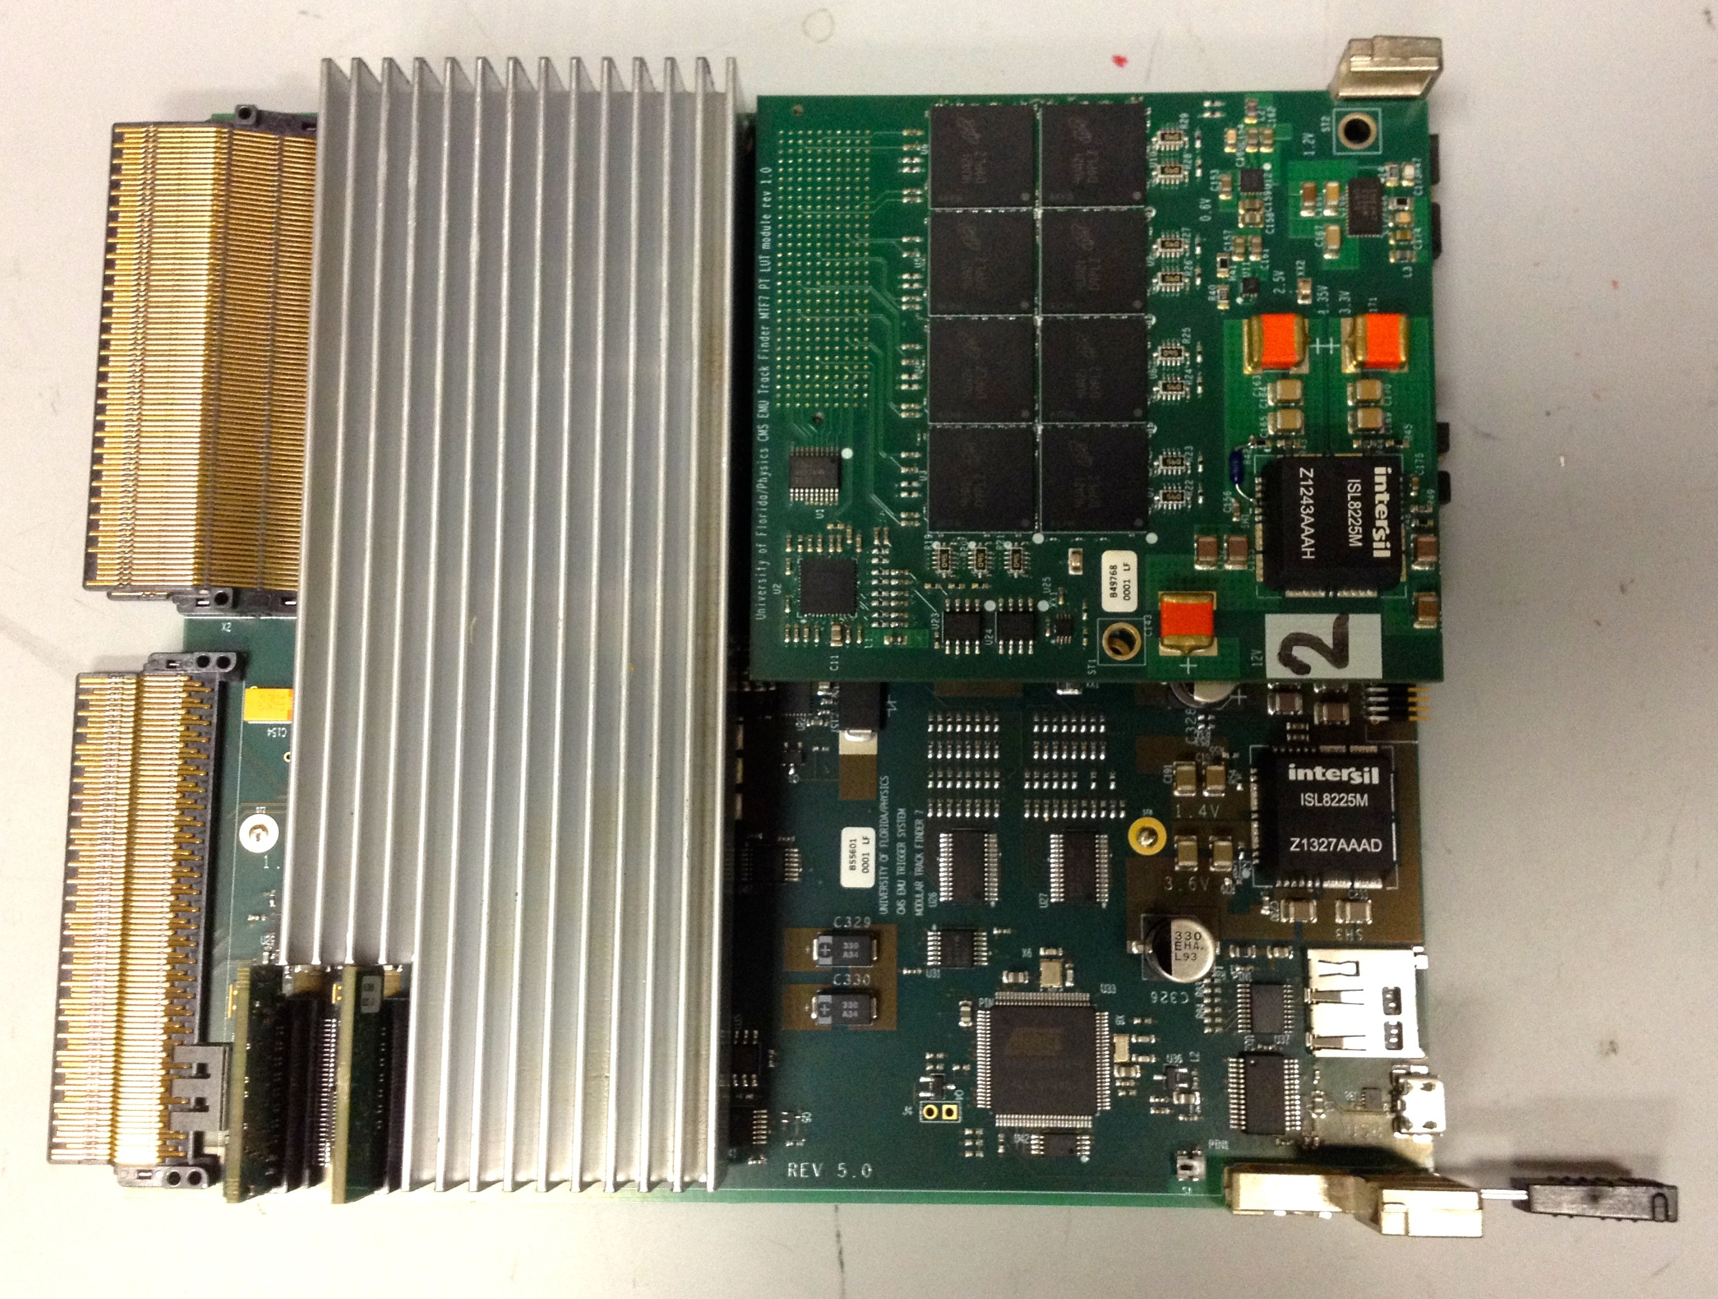
Example from Phase 1 Upgrade
Muon rate reduction comes from improved P_{T} resolution
Large look-up table has been very successful for the muon PT assignment at Level-1 in CMS forward region
Non-uniform B-Field
Ability to use multiple deflection angles in φ and η within and between measurement layers
Phase-1 making use of Boosted Decision Trees for calculation
4MB (legacy) → 1 GB for Phase 1 upgrade LUT
Memory type: Micron RLDRAM3
Total size: 1G x 9 bits, 30 address bits
Upgradeable in future
Clock frequency: 200 MHz
Random address read operations: 5/25ns
Latency: 2 LHC clocks
Memory array is split into 32M banks, 32 words each
Notes:
Firmware logic ensures restriction that that random address reading not done from same bank on 2 consecutive clocks

Slide 15
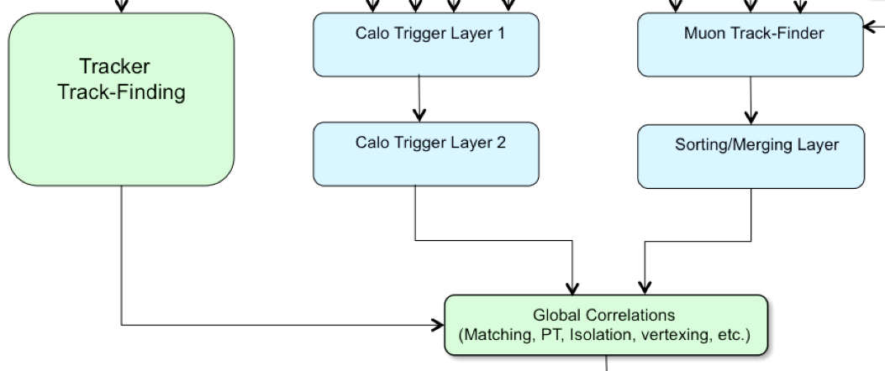
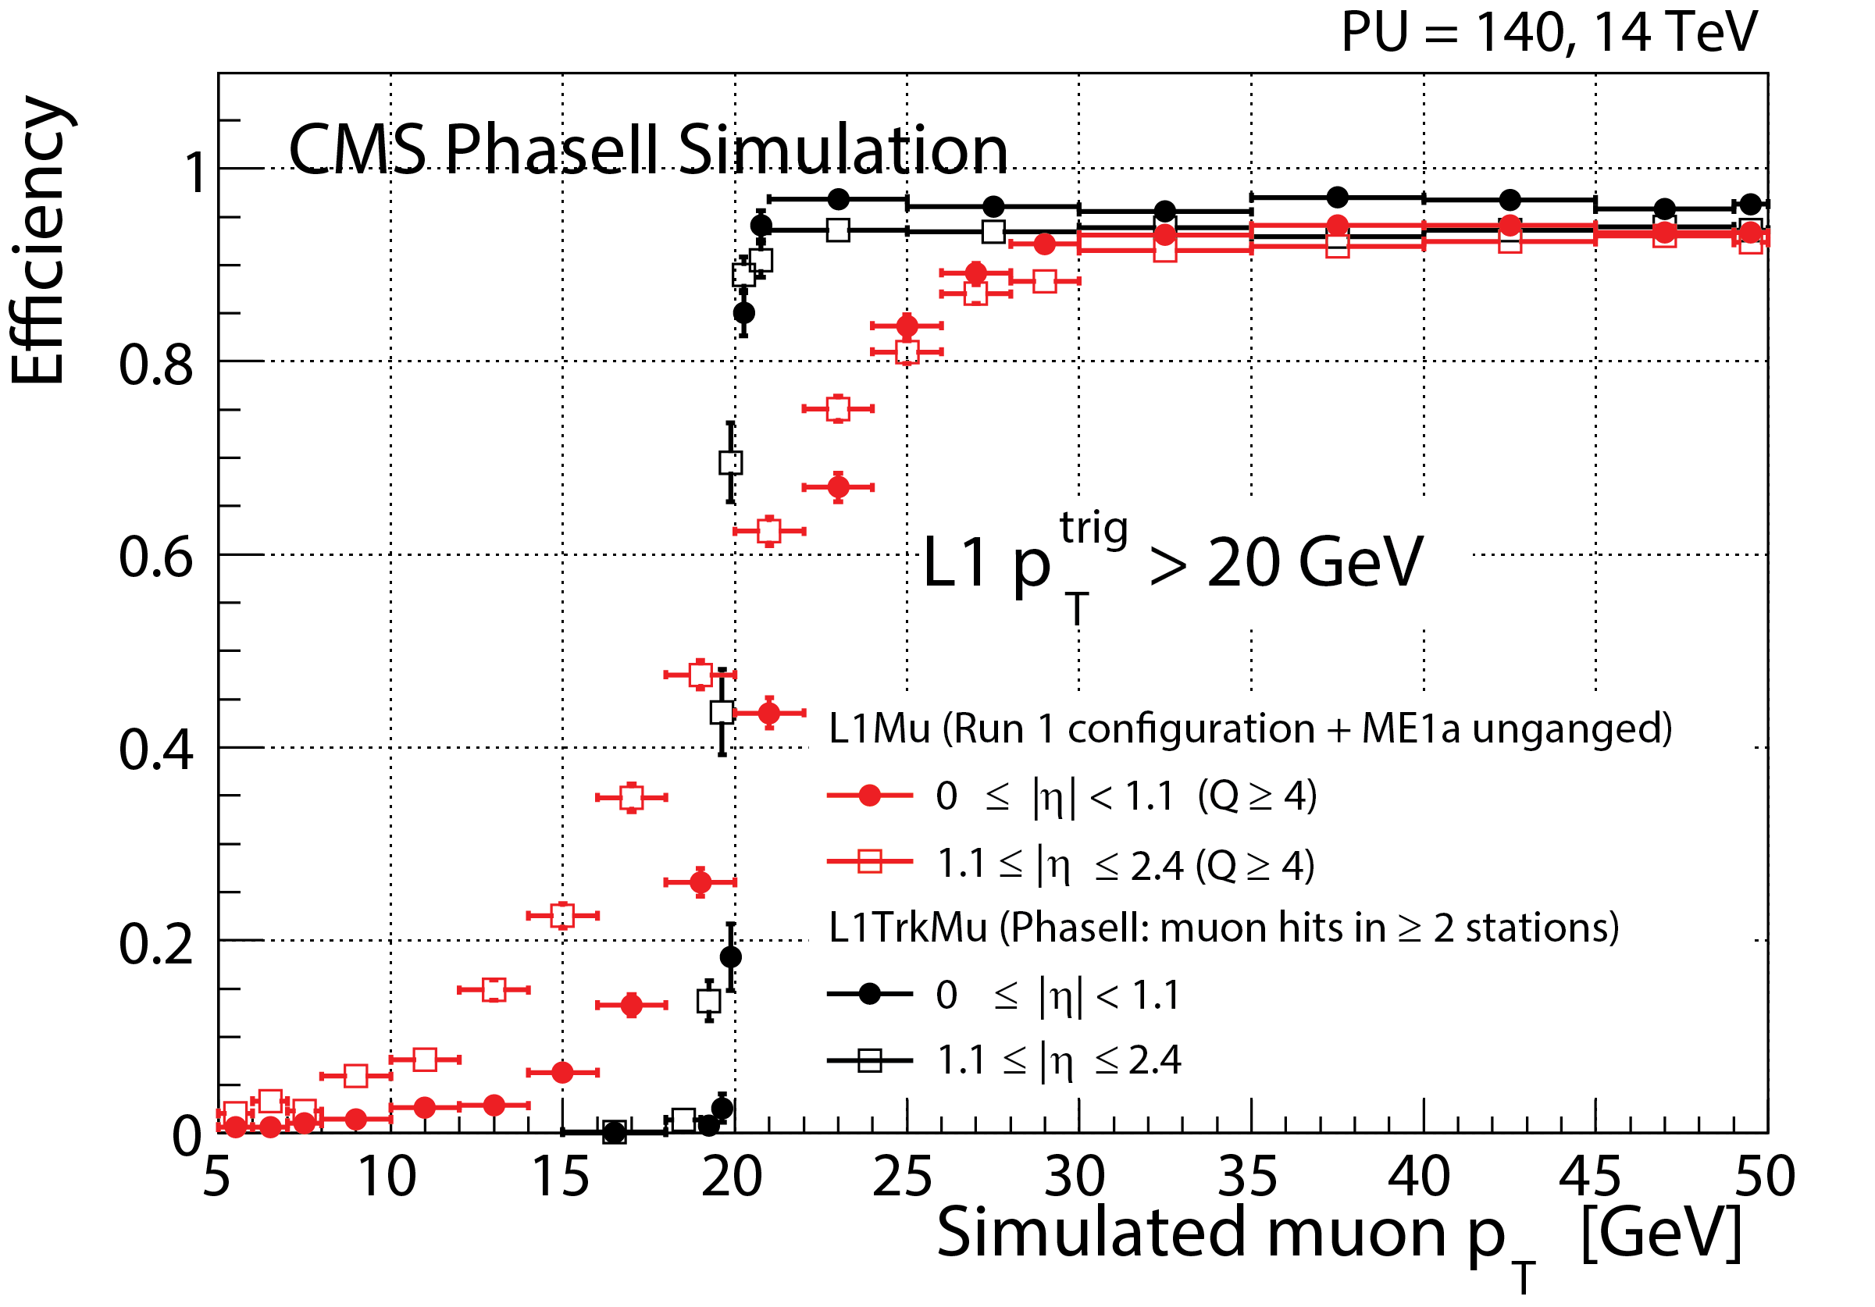
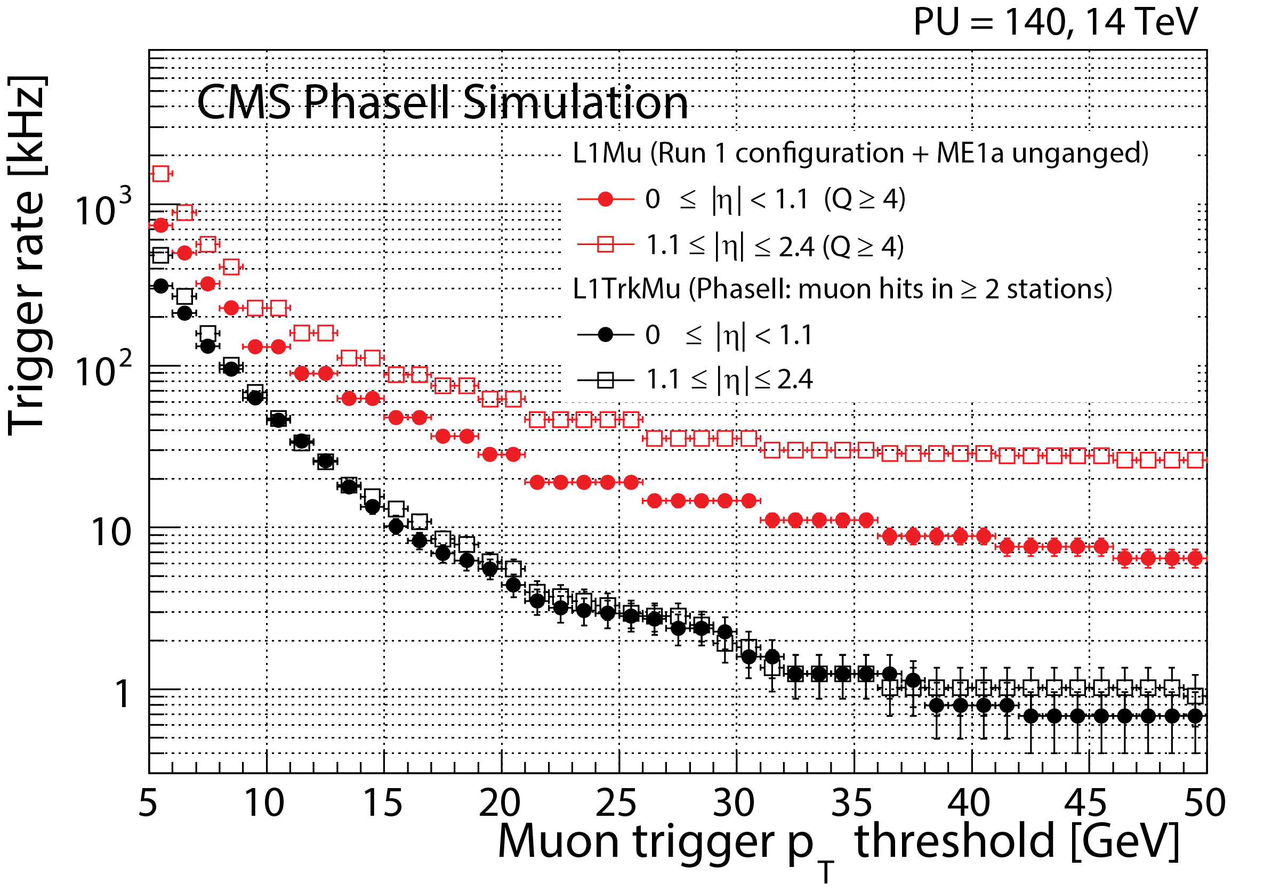
Muon-Track Correlation
Match standalone muons to tracker tracks, take measurements from track
P_{T} resolution improves from O(20%) to 1-2%
Sharpens turn-on efficiency
Drops rate ~10X from current 2015 muon trigger
However, closer to ~5X rate reduction after 2016 Phase 1 muon upgrade
L=5E34

Slide 16
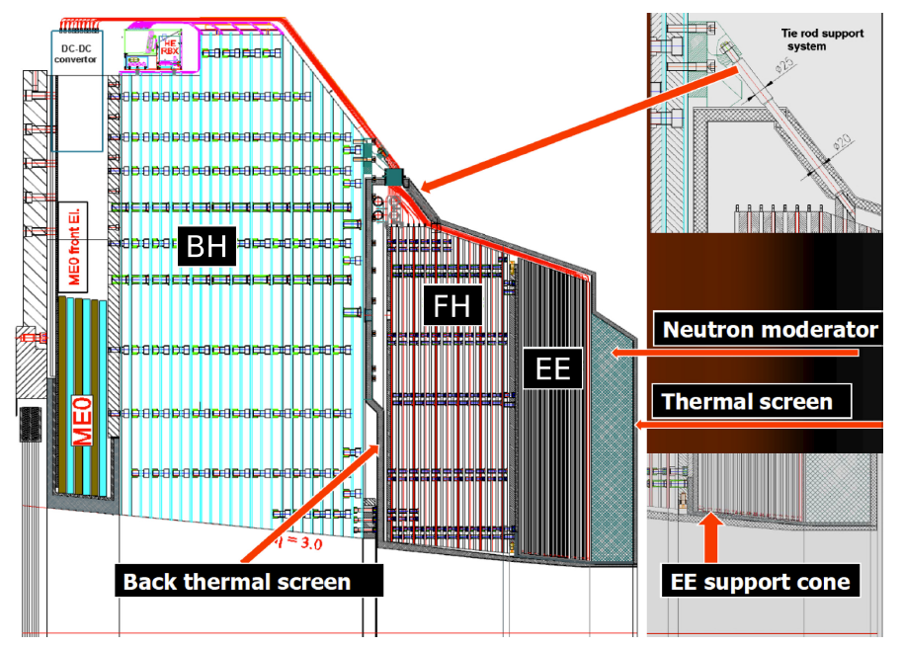
High Granularity Calorimeter (HGC)
New endcap calorimeter with high granularity to survive radiation does and high pile-up environment of HL LHC (inspired by ILC detector design)
Electromagnetic (EE): 28 layers of silicon/tungsten
Front Hadronic (FH): 12 layers of silicon/brass
Back Hadronic (BH): 12 layers of scintillator/brass
Trigger primitives:
850K sums for EE+FH @ 40 MHz transferred off detector
2x2 sensor pads, alternate active planes, each 2 x 10 Gbps links → O(50) Tbps transferred
Comparable to tracker output
Form longitudinal clusters and projective towers in off-detector electronics
589 m²
6.1M ch.

Slide 17
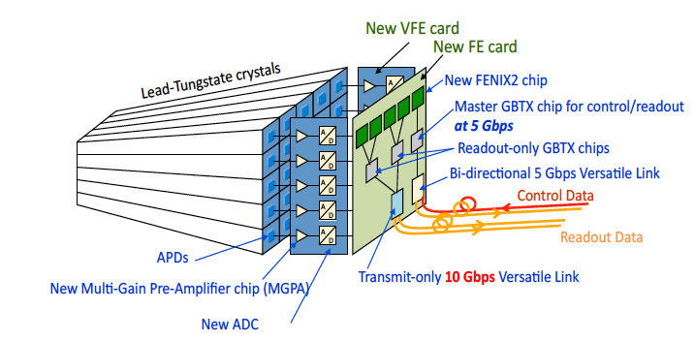
ECAL Barrel Trigger Primitives
In order to meet the requirements for an L1 rate of 750 kHz and a latency of 12.5 μs requires a redesign of the ECAL barrel front-end electronics
Take opportunity also to deliver trigger information at crystal granularity (vs. 5x5 currently)
Utilize newer rad tolerant link technology for O(10) Gbps/ch.
Improves spike rejection in single APD channel from hadron interaction in APD (energy comparison to 4 neighbors)
ΔϕΔη = 0.0175 × 0.0175 (vs. 0.0875 × 0.0875) better granularity to match to tracks
O(25) Tbps transferred off detector!
Comparable to Tracker output

Slide 18
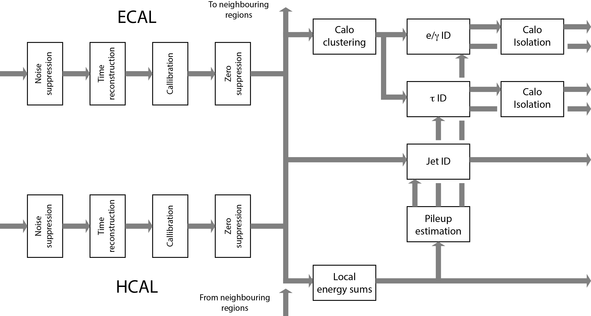
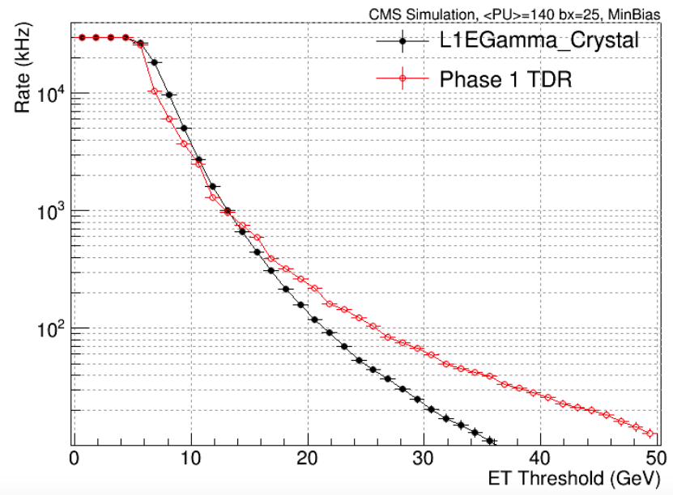
Calorimeter Trigger
Cluster energies into electron/photons, taus, jets, and form energy sums (H_{T}, E_{T}^{miss}, total E_{T})
← Processing workflow
Barrel e/γ rate vs. ET for single xtal resolution vs. 5x5 →
2 – 3X rate reduction

Slide 19
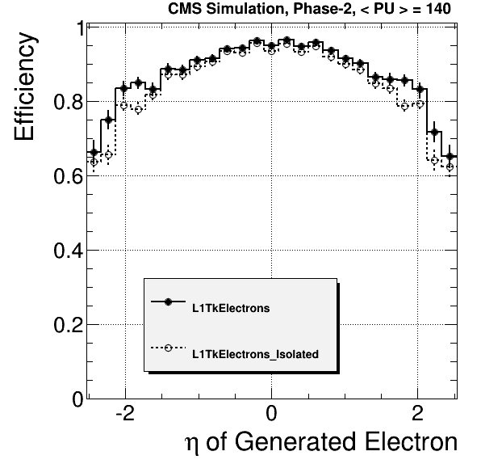
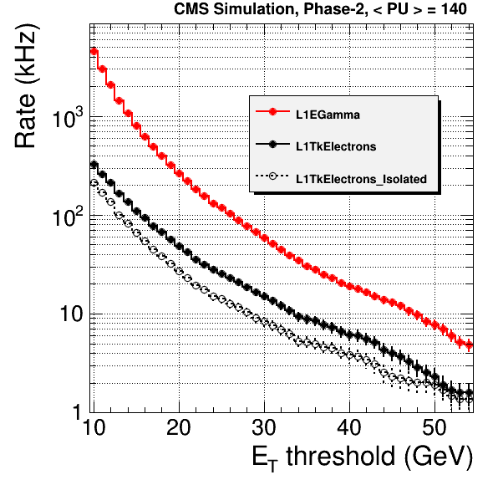
Electron-Track Correlation
Match EG objects to tracker tracks
Reduced track efficiency compared to muons from material interaction
Drops rate ~5X for E_{T} >20
~2X after single xtal improvement
Track isolation
Tracks in cone about lepton with consistent z0
Cut on relative isol: ΣP_{T}^{trk} / P_{t}^{e}
Rate reduction ~2X

Slide 20
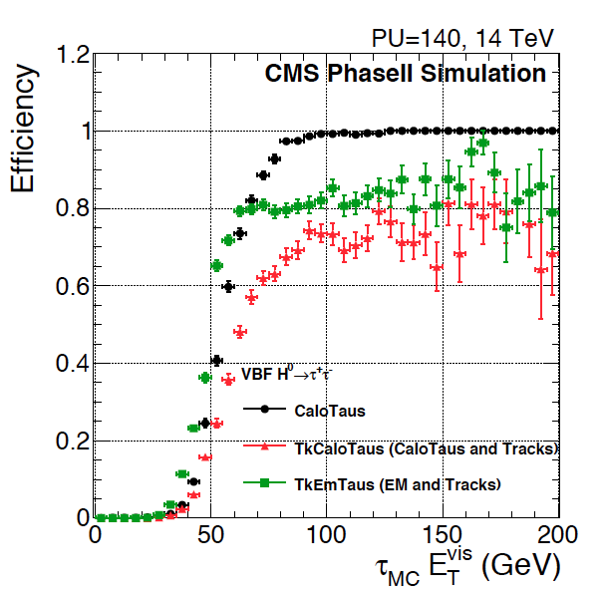
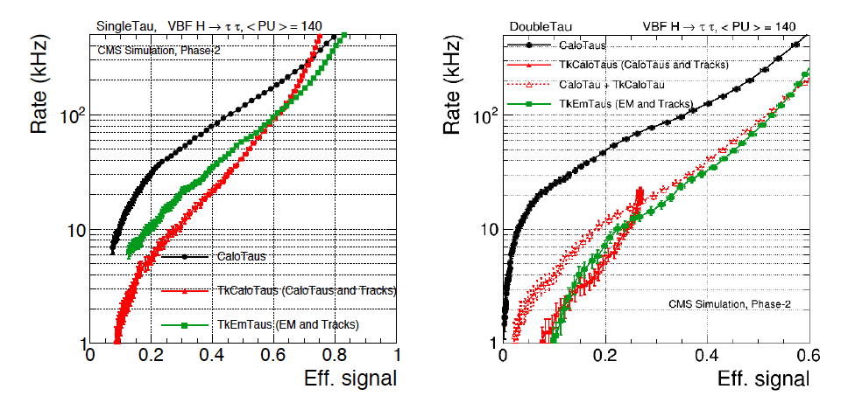
Tau Track Triggers
Two approaches studied:
Matching calo tau objects with track
High quality track in narrow cone with P_{T}>15 and no other tracks in isolation cone
Matching tracks to e/γ clusters
Combine high quality tracks with consistent z0 and e/γ clusters with E_{T}>5 with inv. mass < m_{t}
Rate vs. VBF H→ττ effic. for single (left) and double (right) tau triggers
Rate reduction ~2X with tracking (~50 kHz @ 50%)

Slide 21
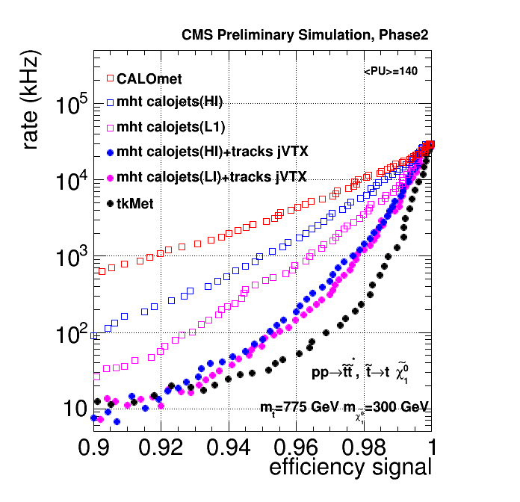
Energy Flow with Tracks
Event vertex
Resolution ~5mm for tracks with P_{T}>2
Jet-vertex matching
Energy sums such as H_{T} and H_{T}^{miss} purely based on calorimeter quantities are very sensitive to pile-up
Requiring consistency with a vertex greatly improves multijet and jet sum triggers
Track-based MET
Reconstruct missing transverse momentum from tracks associated to primary vertex
Less affected by pile-up
Tracking
Impact of several triggers with and without tracking for a SUSY scenario

Slide 22
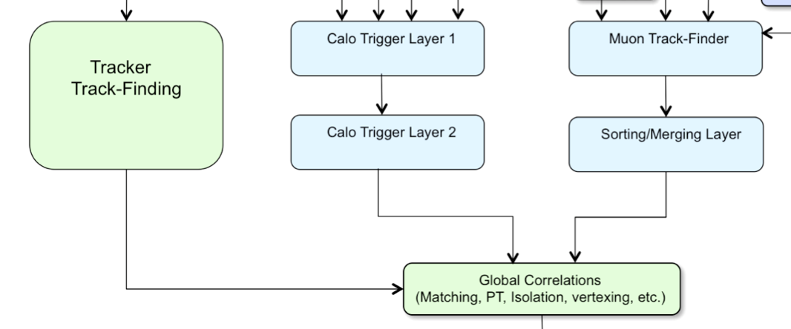
Particle Flow at Level-1?
Full exploitation of tracking at Level-1
Requires matching all calorimeter clusters to all tracks, removing clusters not attached to the primary vertex, and replacing cluster energy with track parameters for rest
Significantly improves the jet and hadronic energy flow measurements at CMS. Also reduces pile-up dependence.
Very successful in offline reconstruction and at HLT
Likely very ambitious for Level-1…

Slide 23
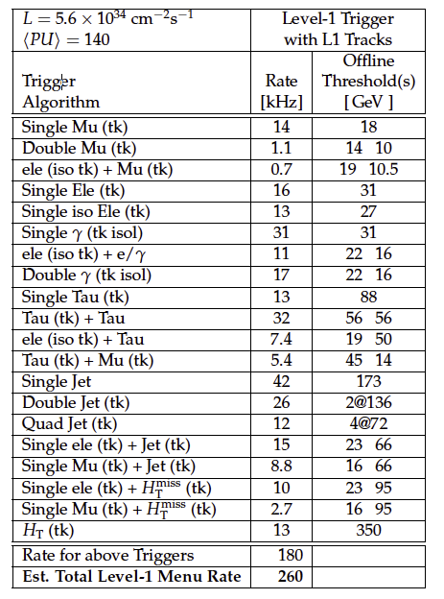
Simplified Example Level-1 Trigger Menu
Target L = 5.6E34, PU=140
Main track-based triggers
Thresholds are comparable to Phase 1 as intended
Estimate 30% of rate missing to all other cross triggers
260 kHz @ PU=140
Scales to 500 kHz @ PU=200
Then add safety factor of 1.5 → design for 750 kHz ultimate rate from Level-1

Slide 24
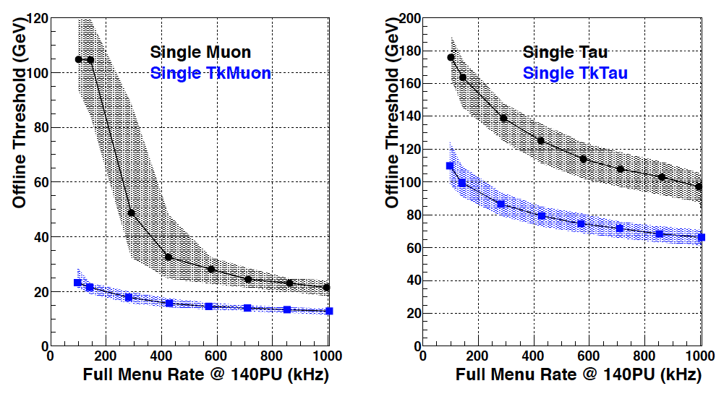
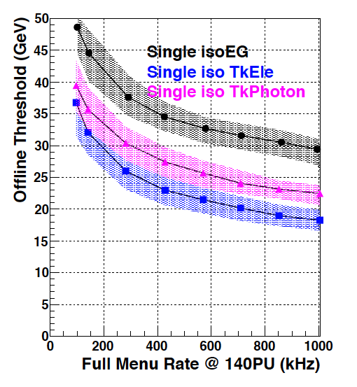
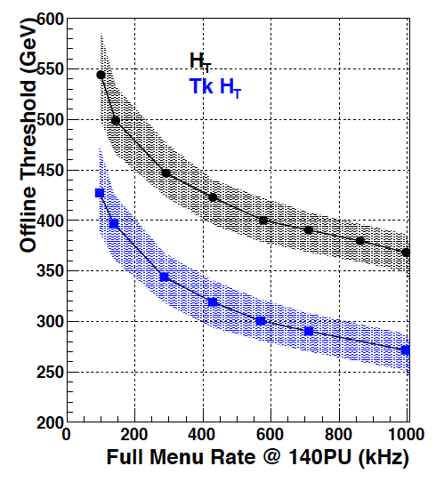
Dependence of Trigger Threshold vs. Total L1 Bandwidth
Illustrates benefit of tracking
Thresholds obviously can be reduced with more L1 bandwidth
Note current bandwidth limit is 100 kHz
Diminishing returns beyond 750 kHz
Bandwidth assumed for previous menu

Slide 25
HLT
More on DAQ in R.Mommsen report
If we have full tracking at Level-1, what is left for HLT to achieve another factor 100 reduction in rate?
Tracking
Has access to pixel hits in addition to strips → b-tagging
HLT so far has not had the resources to perform global tracking for the entire Level-1 bandwidth
But with the Track-Trigger, the full collection of tracks can be accessed by HLT for every event and used even if Level-1 did not need to for all triggers to achieve rate reduction
Like FTK for ATLAS trigger
Particle Flow
As mentioned, maximally combining tracking with calorimetry greatly improves performance of jet and energy sum triggers
Likely that HLT would be much closer to offline performance than what could be possibly achieved at Level-1

Slide 26
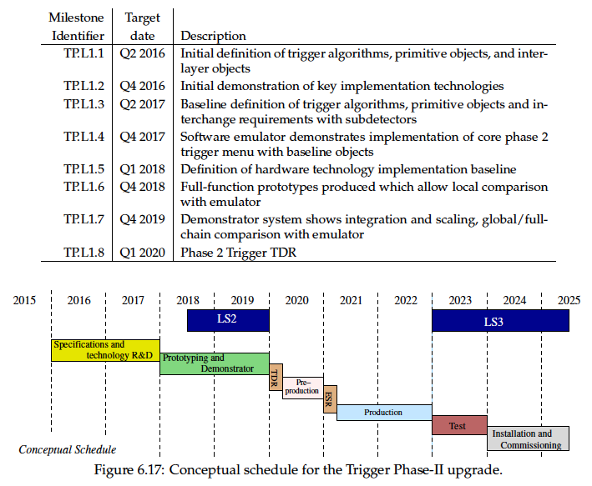
Milestones for Phase-2 Trigger
Demonstrators in 4 years

Slide 27
Trigger Electronics R&D Directions, 1
I/O bandwidth and system/PCB design
Electronic systems designed to handle O(50) Tbps input
High bandwidth optical data links at O(25) Gbps
High bandwidth backplane communication
Logic implementation
Ultrascale FPGAs
And associated high-level synthesis tools to improve productivity
Associative Memory ASIC, 3D technology for high density
Large, fast memory access
Access to >GB memory near logic resources for quick, complex calculations via large lookup table (P_{T} assignment in tracking triggers)

Slide 28
Trigger Electronics R&D Directions, 2
Electronic controls
Clock and trigger control signal distribution to systems
On-board processors (e.g. Xilinx ZYNC) for board control and monitoring
Platform technologies
Evaluate platforms for backplane bandwidth, card real estate, power density …
xTCA? (Telecommunications Architecture)
CMS Phase-1 upgrade electronics are based on μTCA standard
Advanced TCA for some Phase 2 implementations?
Note: important to maintain ties with industry as well as ECE colleagues at universities on technology and tool developments

Slide 29
Summary
CMS has an ambitious but achievable program to upgrade its detectors and the Level-1 Trigger electronics for HL-LHC
For the Level-1 (HLT) Trigger, the goal is to maintain sensitivity for electroweak and TeV scale physics with rate < 750 (7.5) kHz and 12.5 μs latency
Bring more of what was done at HLT to the Level-1 Trigger
Initial algorithms demonstrate meeting goal, but much more R&D required for implemented algorithms and system design
Likely performance can improve further (e.g. particle flow at Leve-1)
Many Level-1 trigger subsystems will absorb many tens of Tbps data input
Order of magnitude higher than current Phase-1 upgrade
Trigger logic similarly expands by a large factor
e.g. tracking logic for the silicon detector trigger
Need to achieve this during the next decade within roughly the same budget and overall system size as for the current Level-1 trigger system

