Slide 1
Ultra-Fast Silicon Detectors
Hartmut F.-W. Sadrozinski
SCIPP, Univ. of California Santa Cruz, CA 95064, USA
for the
UFSD Group
UCSC – Torino – CNM Barcelona – IJS Ljubljana- LPNHE
Applications
Principle of UFSD
Time resolution
Segmented UFSD

Slide 2
Ultra-Fast Silicon Detectors (UFSD)
Since 2012, we have been developing a new type of sensor and its associated readout electronics, called an ultra-fast silicon detector (UFSD), allowing detection of charged particles over large areas, with very high data rates, and very high spatial precision and time resolution.
The sensor is based on a silicon detector (Low-gain avalanche detector = LGAD) with a new implantation scheme during the sensor fabrication to achieve internal gain without electrical breakdown. It allows an improvement of the time measurement for large area detector arrays by about a factor of 1000 from ~ 10 nano-seconds to ~ 10 pico-seconds.
We expect profound impact in many fields where the timing of charged particles is important.
To name a few:
Tracking: Reduction of random coincidences, by adding a 4th dimension (time).
Vertex Locator: Forward physics in AFP2, HGTD (ATLAS), CT-PPS (CMS)
Time of Flight (ToF): Mass Spectroscopy, Particle ID, Remote Vision
Particle counting: Dose in hadron beams
Energy of low-energy protons: Proton CT (pCT) and Interaction Vertex Imaging (IVI) in hadron therapy
Hartmut Sadrozinski, “Exploring charge multiplication for fast timing with silicon sensors”, 20th RD50 Workshop,
https://indico.cern.ch/getFile.py/access?contribId=18&sessionId=8&resId=1&materialId=slides&confId=175330

Slide 3
Applications of UFSD in HEP
Several potential applications for UFSD are proposed for instrumentation at particle colliders.
Time-of-Flight (ToF)
ToF will measure the flight path for relativistic particles of a known start time to a few millimeters along the flight direction, in systems with fine granularity in the two perpendicular directions. This offers a significant new capability for large detectors where measurements of the flight path have typically been too coarse to be useful.
Alternatively, for a known path length, the timing measurement can be used to very accurately measure the particle velocity, a classic method to identify the particle mass when combined with a momentum measurement (“Particle ID”).
Advantage: thin ToF sensor.
Coincidence timing to suppress accidental coincidence
For groups of particles hitting an UFSD array, the timing can be used to combine particles with near simultaneous arrival times to distinguish signals from out-of-time backgrounds. In the past this has been used on the level of 10’s of ns to identify the beam crossing, while UFSD will enable us to look into the substructure of an event and associate particles coming from the same z- vertex.

Slide 4
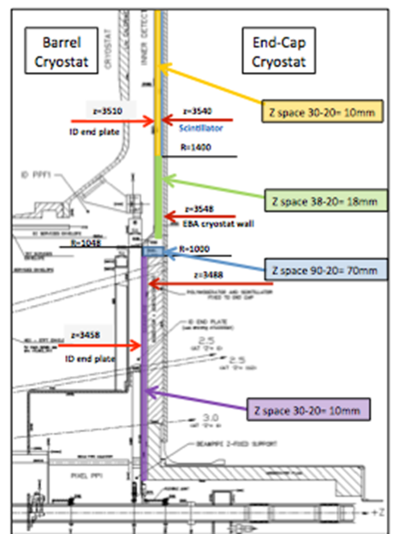
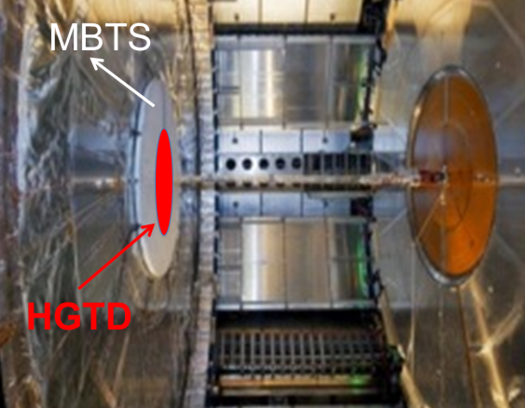
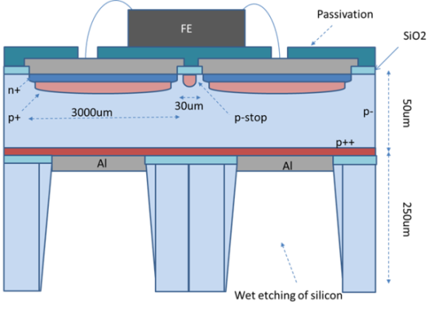
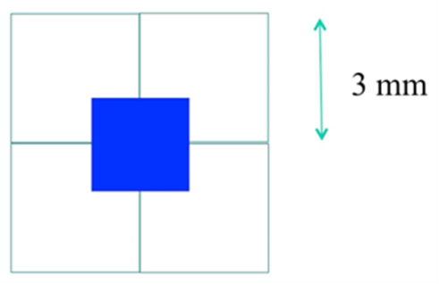
Identification of the Longitudinal Vertex
ATLAS High-Granularity Timing Detector HGTD
4 active layers per side (~10 m² in total) in front of FCAL
HGTD baseline dimensions:
Z =[3475, 3545] mm ; ΔZ=70mm
Rmin ~ 90 mm (ηmax≃4.3), Rmax ~ 600 mm (ηmin≃2.4)
Possible to extend η=5.0 (Rmin ~ 50mm)
Required timing resolution: 50 – 100 ps
There are several (6?) technologies being considered.
Radiation Levels: (scaled to 3000 fb⁻¹):
- (1-3)x10¹⁵ n/cm2
- (0.3-2.4)x10¹⁵ hadrons/cm2 (>20MeV) ~100 Mrad
A challenging project for the radiation resistance of UFSD.
CNM started to work on the UFSD Implementation
2x2 array with 1 ASIC
Thinned 50 µm SoI

Slide 5
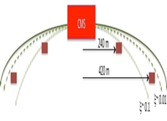
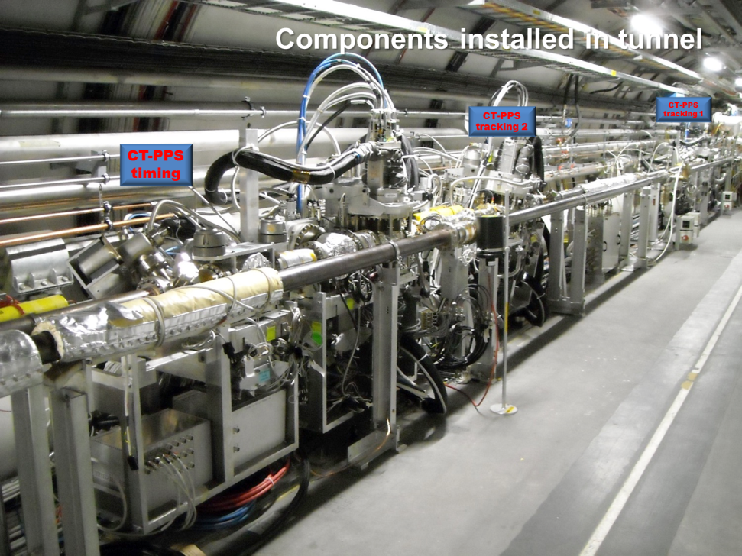
PPS by CMS & TOTEM = CT-PPS
A Totem-CMS combined spectrometer to detect
high momentum – high rapidity protons.
RP – 200 m
CMS ip5
RP + 200 m
Timing
Tracking
Tracking
Timing
Tracking and timing
detectors positioned
inside Roman-pots.

Slide 6
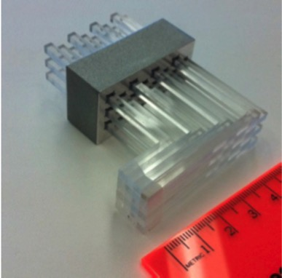
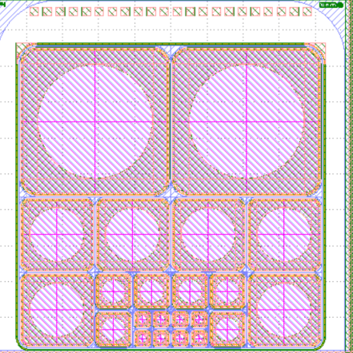
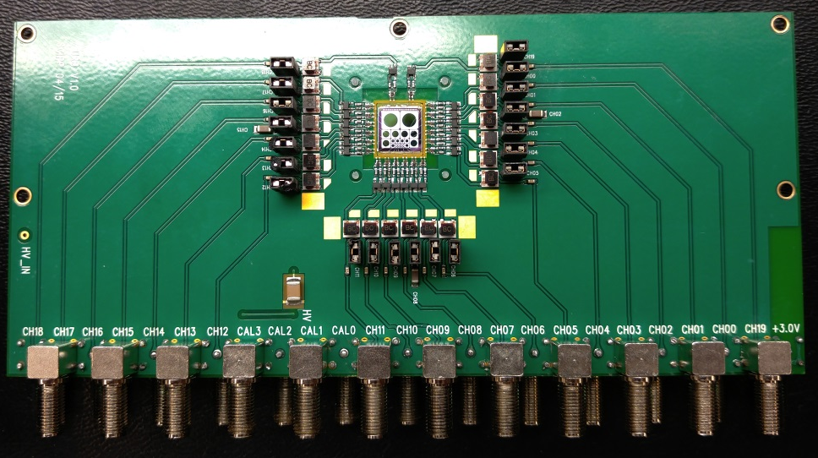
CT-PPS Basic Design: Timing
Vertex z-by-timing: ~ 2 mm:
Time resolution ~10 ps
Segmentation: 1 - 3 mm
Edgeless, active to ~ 200 micron from edge
Radiation hard:
Lifetime > ~ 1 year at LHC at 10³⁴ (~5*10¹⁵ p/cm²)
Rate: 25 ns sensitivity
        Current solution: quartz bars
        Upgrade solution: UFSD
Segmented LGAD,
with pad/pixel size
varying with distance
from the beam.
LGAD and readout
ready for beam test.

Slide 7
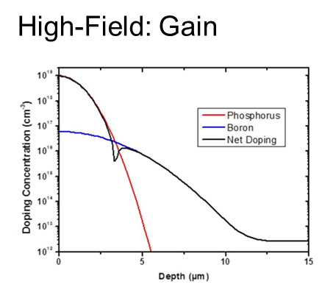
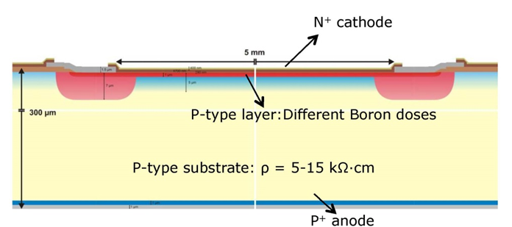
Low-Gain Avalanche Detectors (LGAD)
Low-Gain Avalanche Detectors (LGAD) are based on the principle of SiPM or APD, but with moderate internal gain (10 – 20) and analog response.
Adding a thin p-layer to a n-on-p silicon sensor to increase the E-field and deep n-implants at the edges generate moderate charge multiplication without breakdown.
The technology is being developed as a RD50 Common Project.
After 7+ manufacturing cycles at CNM (Barcelona) addressing general issues like gain variations, bias voltage reach, leakage current reduction, segmented sensors etc. we now have submissions targeting specific applications mentioned previously.
A second supplier, FBK (Trento), is starting fabrication with mainly INFN funding.
G. Pellegrini, et al., Nucl. Instrum. Meth. A765 (2014) 12.

Slide 8
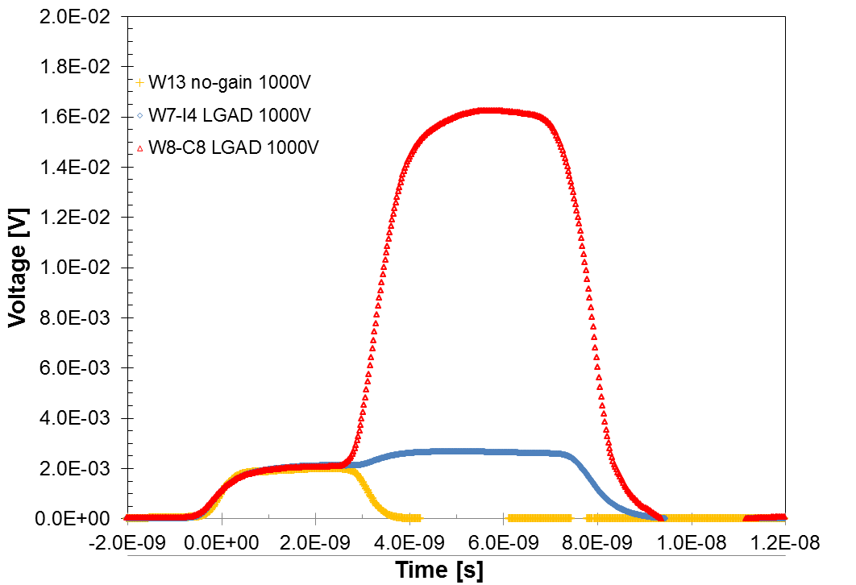
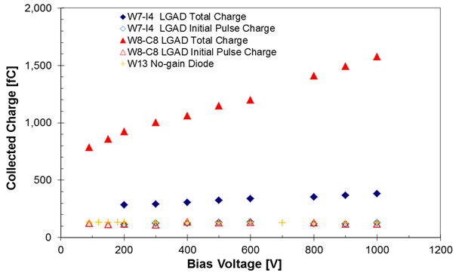
Gain Calibration with α’s from Am(241)
α’s
“Electron injection” with α’s from Am(241) or with red laser illuminating the back side, range ~ few um’s, electron signal drifts and is then amplified in high field, holes drift back.
Colin Parker, M.S. Thesis UCSC
Large bias voltages reach.
Gain of 15, can be tuned within factor 2x with bias voltage.
Pulse shapes for high-gain (red), low-gain (blue) LGAD and no-gain sensor (yellow)
e- & h+ from multiplication
2x
Initial e-

Slide 9
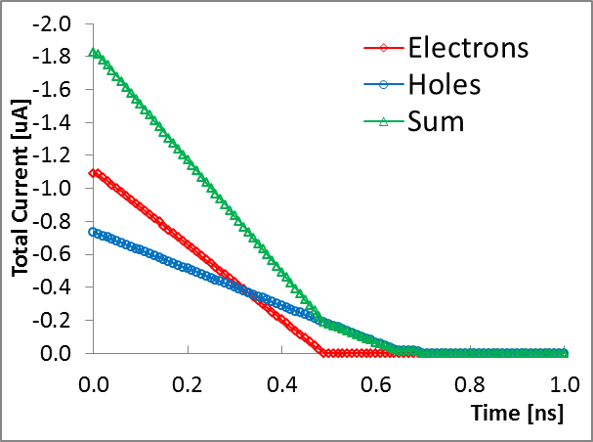
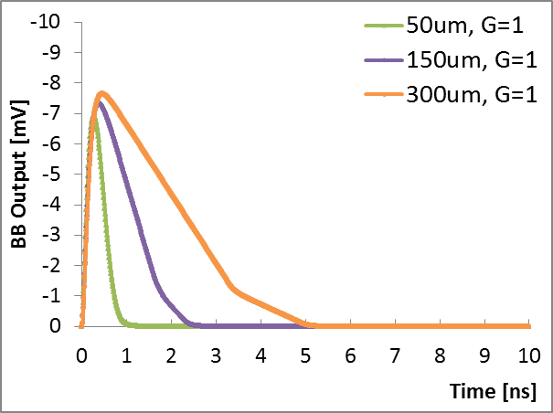
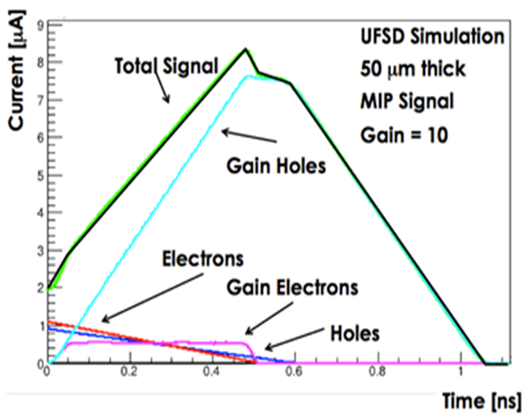
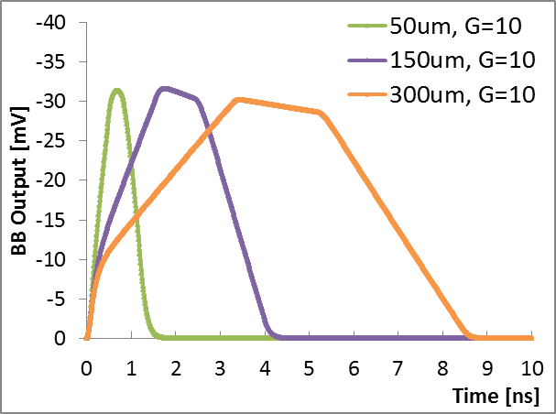
Signal Characteristics vs. UFSD Thickness & Gain
Pulse duration scales with thickness due to saturated drift velocity in high fields
No-gain sensors:
rise time and pulse height independent
of thickness
50 µm
Gain = 1
Gain = 1
LGAD:
pulse height independent of thickness
thickness determines peaking time (~ electron collection time) and slew-rate
Gain = 10
Weightfield 2
(WF2)
Simulations
F. Cenna, et al., Nucl. Instrum. Meth. A796 (2015) 149

Slide 10
Time Resolution and Slew Rate
The time resolution σ_{t} depends on the rise time τ_{r} i.e. the collection time (~ detector thickness) and signal amplitude S. It has 3 terms:
time walk due to amplitude variation, time jitter due to noise N, and binning resolution:
introducing the slew-rate signal/rise time S/τ_{r} = dV/dt.
For constant noise N, to minimize the time resolution, we need to maximize the slew-rate dV/dt of the signal. Need both large and fast signals.
Dependence of the slew-rate dV/dt on the LGAD thickness and gain
Large slew rate, good time resolution
50 micron:
~ 3x improvement with gain = 10
WF2 Simulations
Significant improvements in time
resolution require thin and small sensors

Slide 11
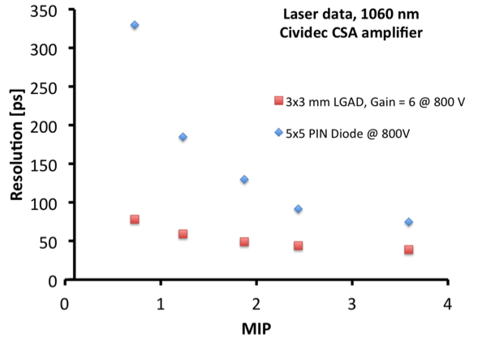
Measured Time Resolution of UFSD: IR Laser
IR Laser irradiating 300 µm sensors to measures the intrinsic time jitter, of both LGAD and no-gain diode (PIN).
(7859 W1E10-3)
Hartmut F.-W. Sadrozinski, Ultra-Fast Silicon Detectors. CPAD
For 1 MIP, an UFSD with gain ~ 6 shows a factor of 3 better time resolution than PIN diodes: 70 ps vs 200 ps
For many MIPS the difference is decreasing (important for timing calorimeter)
11

Slide 12
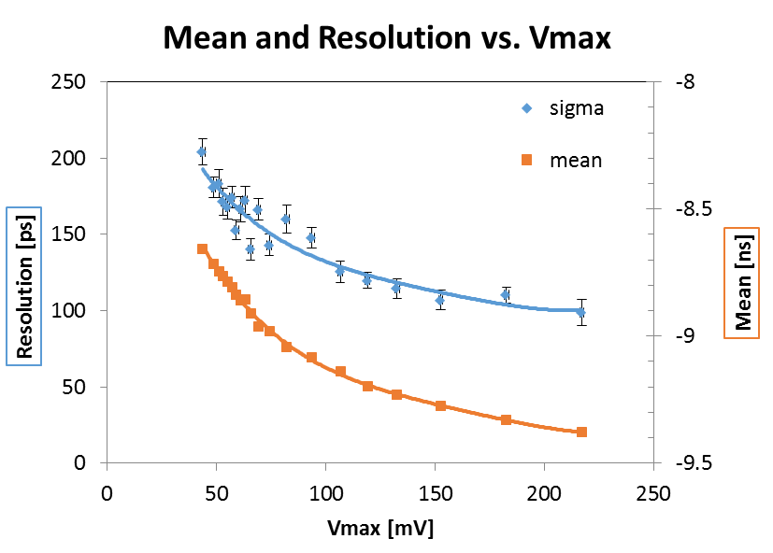
BT Timing Resolution I (Fixed Threshold)
Beam tests (BT) data aid in the development of the readout electronics.
Record signal waveforms with 50 ps sampling and analyze off-line.
CERN 2014 Beam Test of FZ LGAD 300 µm, C = 12 pF, G=10, BB
Bias 1000V, fixed threshold = 10 mV, filtered with 20 bins
Time walk is large
~ 400ps for MIPs
Resolution:
150 – 200 ps
Precise time walk correction looks non-trivial to incorporate into an ASIC.
1 MIP
Analysis: Chi Wing Ng (Tom) & Sze Ning Mak (Hazel)

Slide 13
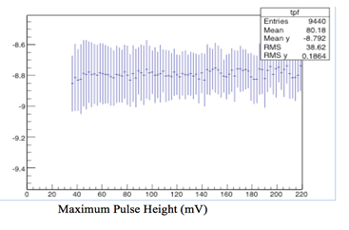
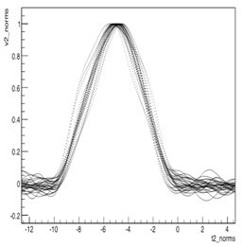
BT Timing Resolution II (Constant Fraction Disc.)
Abe’s unified pulse shape indicates uniformity of pulse shapes.
A low CDF has best resolution.
CDF = 20% has no time walk
CFD =20% Time
Timing resolution vs. CFD threshold for varying BW cut-off. Optimize the filter (i.e. shaping time) for each CFD threshold
Best time resolution (160 ps)
at low CFD threshold
CFD is easily incorporated
into an ASIC.
Analysis: Abe Seiden, Natasha Woods, Ben Gruey

Slide 14
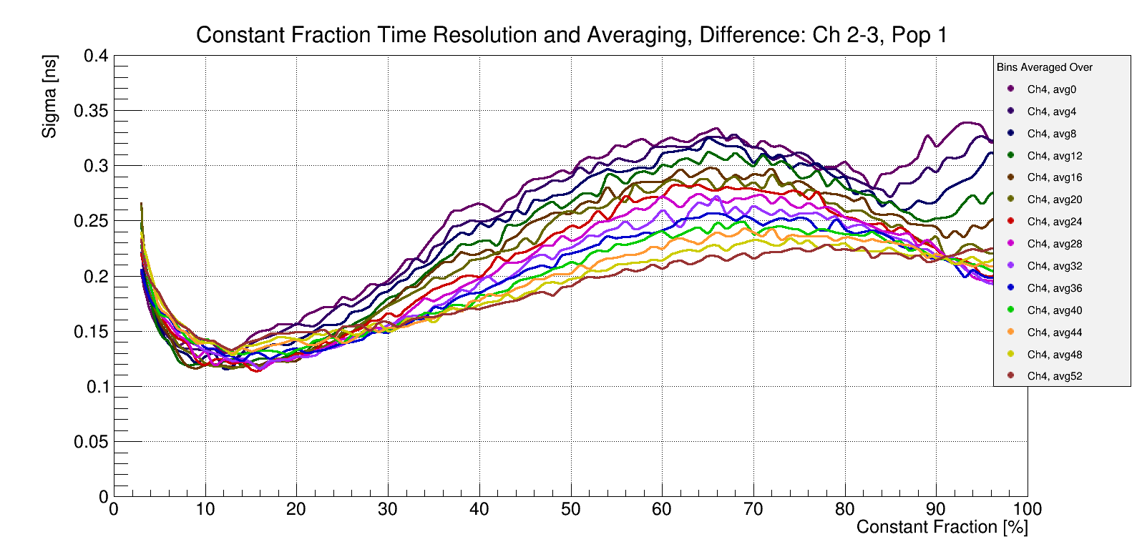
BT Timing Resolution III (Lower Capacitance)
July 2015 beam test, 2 FZ LGAD 300 µm, C = 4 pF (instead of 12 pF before), G=10 & 6, BB
Bias: 900V, CFD: 0->100%, filtered with variable BW.
Resolution: Time difference between two channels divided by sqrt(2).
Best resolution 120 ps with CFD @ 8 -15% with BW cutoff ≈ 0.8 GHz
(c.f. 100 MHz for 3.5 ns rise time)
The two LGADs used have different gain. It's difficult to assign correctly the two time resolutions, but using simply the inverse of the gain G, we get:
σ(G = 6) =140 ps, σ(G = 10) = 80 ps
Analysis: Abe Seiden, Natasha Woods, Ben Gruey

Slide 15
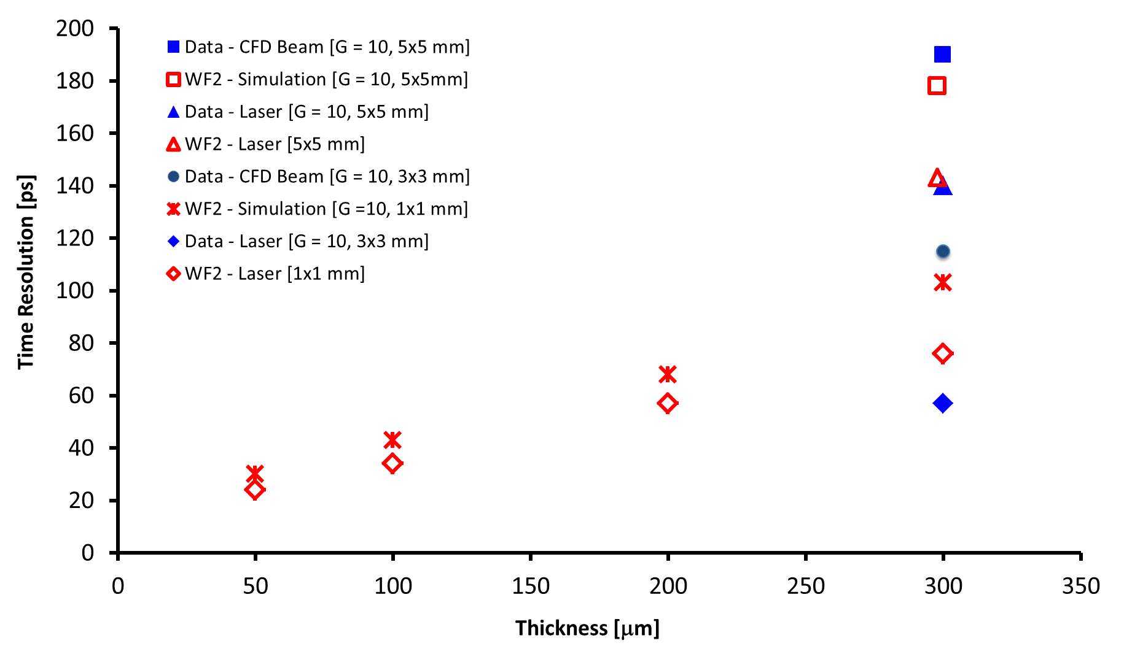
Timing Resolution of UFSD (Laser, BT, WF2)
Up to now the only MIP data available are for 300 µm LGAD.
Good agreement between data (beam test & laser) and simulations (WF2).
Laser data have no time walk.
Improvements are due to reduction of capacitance which increases the pulse height and reduces the noise.
Prediction: resolution of 30 ps for 50 µm LGAD with gain of 10, needs ASIC
No
time walk
Reduction
of capacitance
Reduction
of noise

Slide 16
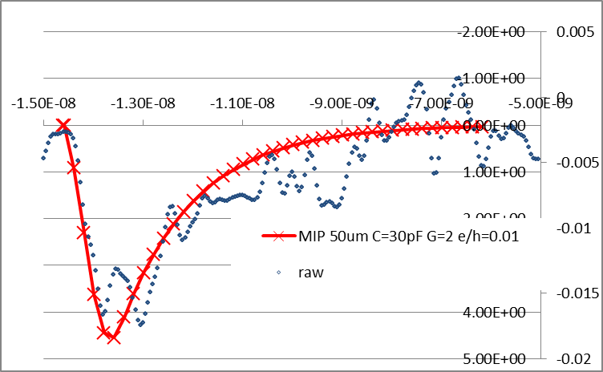
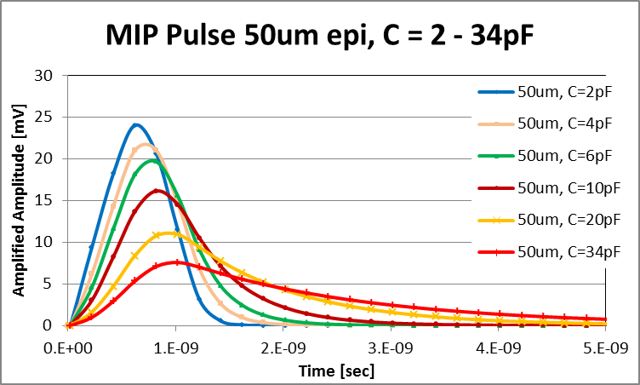
Thin LGAD
MIP’s Pulse shape C = 34 pF, Gain = 3
Simulation of pulse shape (gain = 10)
Predicted improvement with reduced capacitance (50Ω input, Cividec Amp))
Capacitance C [pF] | Rise time [ps] | Amplitude [mV] | dV/dt (relative) | Noise [mV]
34 | 710 | 7 | 1 | 3
2 | 390 | 24 | 5.2 | ALARA
Beam test data provide reality checks for 10 ps electronics development.
We are starting to investigate options for the electronics chain for UFSD including the front-end parameters (shaping time, noise, architecture) on-chip data reduction, data transmission, ASIC technology, power consumption, etc.
We hope to organize a mini-workshop for these topics before the end of the year.

Slide 17
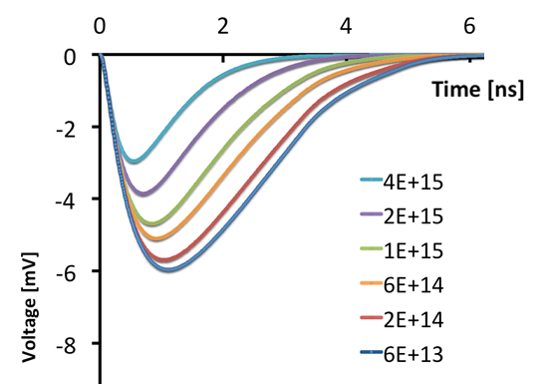
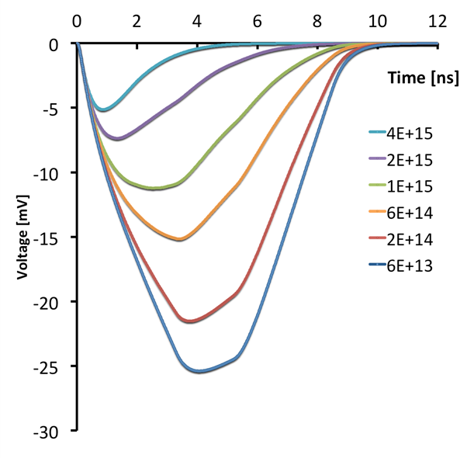
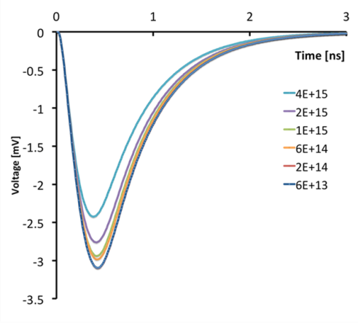
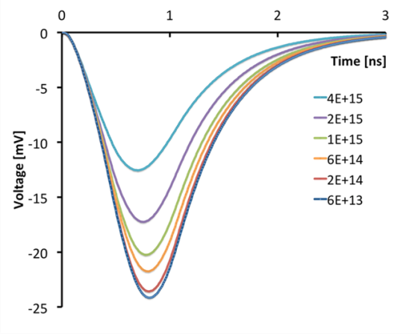
WF2 Simulation: Radiation Damage (Trapping)
Effect of trapping in thick and thin detectors at large fluences is different since the trapping distance is ~ 50 µm.
300µm,
NO Gain
300µm,
Gain=10
The radiation induced change of the peaking time of thick (300µm) sensors bodes ill for timing.
50µm,
NO Gain
50µm,
Gain=10
The peaking time (and CFD time) of thin sensors is reasonably stable with radiation.
The rising edge of thin sensors is insensitive to trapping.
Weightfield 2 (WF2) Implementation and Simulation: Bianca Baldassari

Slide 18
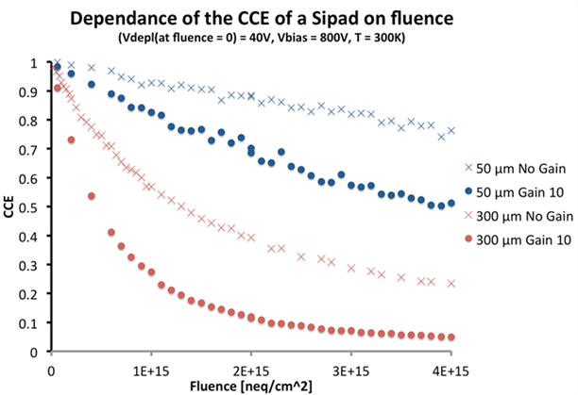
Radiation Damage in UFSD
Measurements of collected charge (CCE) with MIP’s done on 300 µm LGAD have confirmed the larger CCE degradation wrt no-gain diodes, as expected since the gain signal is in large part due to late drifting holes which have large trapping effects.
Simulation of trapping:
overlap up to 2*10¹⁵ neq/cm² with measurements and agree for low-gain LGAD.
At a fluence of 4*10¹⁵ neq/cm²
the 50 µm LGAD is predicted to
yield > 50% of the initial charge.
An additional effect resulting in a decrease in gain beyond trapping has been reported in 300 µm LGADs and needs investigation. The fact that this is observed mainly in high-gain LGAD and is leveling off at higher fluence is hard to explain in terms of “Acceptor Removal”.
An interpretation of the data in terms of modification of the field by trapped holes (“Double Junction”) impacts much less the collected charge in thin detectors since both the number of holes and the trapping are much smaller there.
Important to measure the gain (with electron injection by red laser) of thin LGAD with different gains (include no-gain diodes) as a function of fluence, temperature and laser intensity.
Investigate restoring gain loss after irradiation with increasing the bias voltage.
Pursue program to improve radiation tolerance by replacing Boron with Gallium.

Slide 19
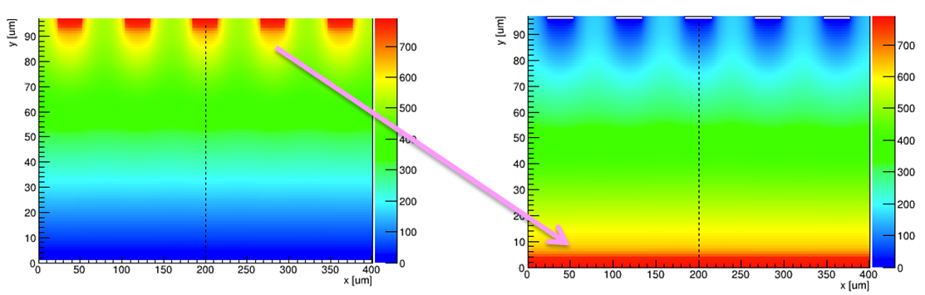
Segmented LGAD I: Pixels/Strips
Electrode segmentation makes the E field very non uniform, and therefore ruins the gain and timing properties of the sensor
Non uniform E field
and Weighting field
We need to find a design that produces very uniform E field, while allowing electrode segmentation.
Reversed–LGAD design:
the gain is on the opposite
side of the read-out
Separation Timing and segmentation leads to p-on-p LGAD
Un-segmented gain layer (resistive sheet) with AC coupling
G.-F. Dalla Betta, et al., Nucl. Instrum. Meth. A796 (2015) 154

Slide 20
Segmented LGAD II: Separate Functions
Reading from both sides gives the best of both environments:
      Position determination:
    finely pixelated electrodes, opposite to the gain layer.
    It can use present chips, for example PSI46, FEI4
      Time determination:
larger pads, near the gain layer
much fewer channels (~1/10)
Gain layer
Large pads for time measurements
Small pixels for position determination

Slide 21
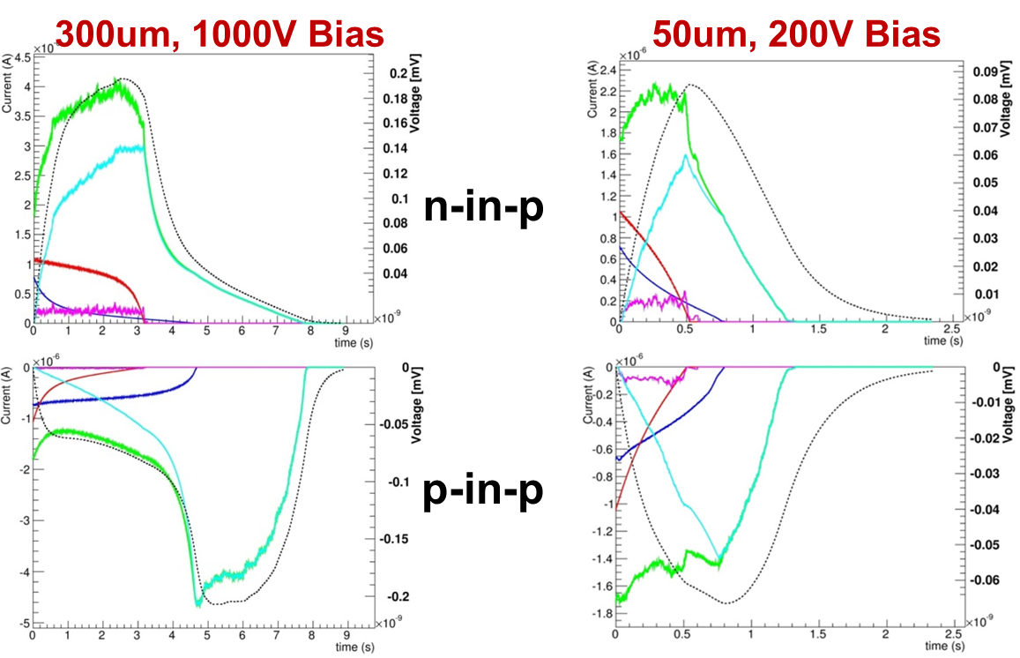
Segmented LGAD III: p-on-p
Will p-on-p work since holes are collected which are slower?
Thick p-type LGAD relies
on late hole collection:
p-in-p not viable.
Thin p-in-p LGAD has a
very fast slew rate, comparable to n-in-p
Yes, for thin LGAD!

Slide 22
Resistive Sheet with AC-coupled Pixels
AC coupling
n++ electrode
In the n-in-p design, the resistivity of the sheet is hard to control, as the doping of the n++ and p+ layers determine the gain, so the values cannot be chosen as we like.
gain layer p+
p++ electrode
AC coupling
p++ electrode
Gain layer p+
In the p-in-p design, the resistivity of the p++ sheet is easier to control
n++ electrode

Slide 23
Conclusions
Ultra-Fast Silicon Detectors promise excellent position and time resolution
Present proposals for their use deal mainly with the suppression of accidental background from different z-vertices in the same LHC event.
We made progress in understanding the principle and the expected performance of UFSD. Manufacturing is approaching maturity.
Simulations with Weightfield 2 (WF2) confirm timing resolutions extracted from beam and laser tests for 300 µm thick LGAD. WF2 is ready to be used to extrapolate to thin sensors.
Thin sensors are predicted to have many advantages. We expect results from UFSD with thickness down to 50µm later this year.
Need to start on frontend electronics and readout system for the first applications of LGAD at the LHC.
Part of this work was carried out in the framework of RD50 Common Projects and was funded by the US Dept. of Energy, the Spanish Ministry of Education and Science and INFN Italy.

Slide 24
Author List
A. Anker, V. Fadeyev, P. Freeman, Z. Galloway, B. Gruey, H. Grabas, Z. Liang, S. N. Mak, C. W. Ng, Hartmut F.-W. Sadrozinski, A. Seiden, N. Woods, A. Zatserklyaniy
SCIPP, Univ. of California Santa Cruz, CA 95064, USA
B. Baldassarri, N. Cartiglia, F. Cenna, M. Ferrero
Univ. of Torino and INFN, Torino, Italy
G. Pellegrini, S. Hidalgo, M. Baselga, M. Carulla,
P. Fernandez-Martinez, D. Flores, A. Merlos, D. Quirion
Centro Nacional de Microelectrónica (CNM-CSIC), Barcelona, Spain
M. Mikuž, G.Kramberger, V. Cindro, I. Mandić, M. Zavrtanik
IJS Ljubljana, Slovenia

Slide 25
UFSD for Low-Energy Protons
Ultra-fast silicon detectors (UFSD) afford very good time resolution for low-energy proton (or ions) since they have very high slew-rare.
The large slew rate due to the high specific energy loss of low-energy protons is enhanced by a factor 3 when a UFSD with gain = 10 is used. Timing resolution of < 10 ps for protons with E < 200 MeV are predicted.
The fact that UFSDs have their best timing capability when the sensor is thin (< 50 um) goes hand-in-hand with the fact that tracking of low-energy protons need thin sensors to reduce MCS (Multiple coulomb scattering).
Smaller UFSD with 200um thickness and 50um thickness are being produced at CNM.

Slide 26

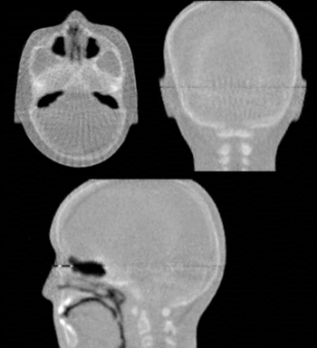
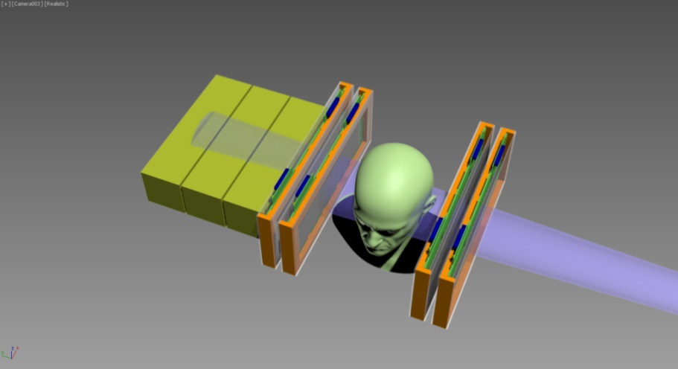
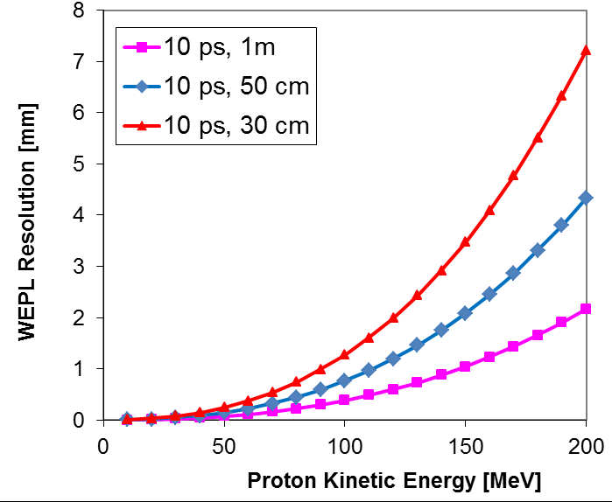
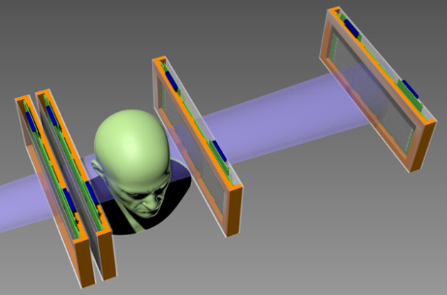
4-D Ultra-Fast Si Detectors in pCT
In support of Hadron Therapy, the relative stopping power (RSP) is being reconstructed in 3D.
The UCSC-LLU pCT scanner uses Si strip sensors to locate the proton and heavy scintillator stages to measure its energy loss (WEPL).
Protons of 200 MeV have a range of ~ 30 cm in plastic scintillator. The resulting straggling limits the WEPL resolution.
Replace calorimeter/range counter by UFSD:
Combine tracking with WEPL measurement where the ToF of the proton measures the residual energy., with comparable or better resolution than the scintillator.
Range straggling limit for 200 MeV p
Light-weight,
all silicon
construction
ideal for
installation
Into the gantry

Slide 27
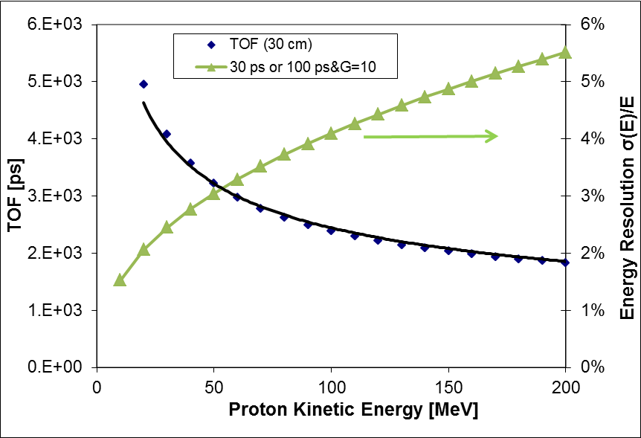
Interaction Vertex Imaging (IVI) with UFSD
Direction and energy of (low-energy!) secondaries are measured in telescopes of UFSD and projected back to identify the beam location.
D = 30 cm
UFSD: 50 um thin, pixels 300um x 300 um,
Time resolution of 30 ps,
i.e. (“100ps & Gain = 10”)
allows energy measurement by TOF
Energy resolution on secondaries:
100 MeV pions: 16%
100 MeV protons : 4%
UFSD can operate at 10+ MHz rate and provide real-time beam diagnostics.
Hadron beam
Head phantom
Longitudinal distribution of energy deposition
(Bragg peak) and number of secondaries
Protons

Slide 28
Resistive sheet with AC-coupled Pixels
The signal is “frozen” on the resistive sheet, and it is AC coupled to the electronics
➔ E and E_{w} fields are very regular
➔Segmentation is achieved via AC coupling
AC coupling
n++ electrode
gain layer
p++ electrode
The AC read-out sees only a small part of the sensor:
small capacitance and small leakage current.

Slide 29
Resistive sheet with AC-coupled Pixels
Details of AC coupling - I
Additional Rise time
R_{Ampl} * C_{detector} ~ 100 Ω ∗ 1pF ~ 100 ps
R_{Ampl}
C _{AC}
R_{Sheet}
Detector
Detector
Detector
Detector
Detector
Detector
Freezing time
R_{Sheet} * C_{AC} ~ 1kΩ ∗ 100pF ~ 100 ns
Only a small part of the detector is involved

