Slide 1
Picosecond Timing
Anatoly Ronzhin
October 5 - 7, 2015 - University of Texas at Arlington

Slide 2
Outline
Timing system application.
Fast timing detectors and photodetectors.
Readout.
Time Of Flight (TOF), particle ID.
Calorimeters and shower max (SM).
PET-TOF.
Fermilab timing results.

Slide 3
Physics needs
The high luminosity upgrade of the Large Hadron Collider (HL-LHC) at CERN is expected to provide instantaneous luminosities of 5x10to34/cm2s. This emphasize the need in detectors with very high counting rate. The size of the detector is ~few meters.
One of the goal is to associate calorimeter measurements with primary vertex location. Needs in time resolution (TR) of ~few tens ps in association with the measured energy of the photon, the goal is to suppress pileup in collisions. 30 ps corresponds to 1cm in z of collision vertex and approximately corresponds to reduction in pileup from 200 → 20. Objective is to achieve time of flight (TOF) measurement resolution of ~30ps using EM calorimeter.
The association of the time measurement to the energy measurement is crucial, leading to a design that calls for the time and energy measurements to be performed in the same active detector element.
One of the possible option for CMS calorimetry upgrade is to use single sensitive layer inside of the calorimeter (like SM) with very high TR. The possible single layer could be MCP, SiPMs or Si. We focus our timing measurements on these possible options. Working together with Caltech and ANL on it.
Possible medical applications include PET-TOF, brain scanners, pcT. We working on it.
Improvement of tools for time measurements and analysis (like DRS4, PSEC, fast scops) continues.
.

Slide 4
Photodetector’s timing parameters
Photodetectors timing properties almost totally could be characterized by three parameters:
Single Photoelectron (SP) output pulse shape (we name it “SP response function”, should be as short as possible, (~1 ns for MCP-PMT).
SP time resolution (SPTR), (~30 ps, sigma, MCP-PMT)
“Electronics time resolution and noise (~2.5 ps obtained, ~0.3 mV/50 Ohm)”. “Electronic” time resolution is the time jitter for two signals applied as “start” and “stop” (from the same source) to electronics, measuring the time jitter of the time interval between them. The “electronic” time resolution is the one of the main parameters of such a systems and should be much smaller that time jitter of used detectors. We achieved ~2.5 ps “electronic” time resolution for our timing systems. New method to calibrate readout proposed and tested. We use Pilas laser as light source (17 ps, sigma light pulse) with 405 nm (blue) and 635 nm (red) light in our photodetectors bench test. Fermilab test beam Facility (FTBF) used for the detectors test.
4 Anatoly Ronzhin, Fermilab, Picosecond timing, Arlington, Oct. 5-7, 2015

Slide 5
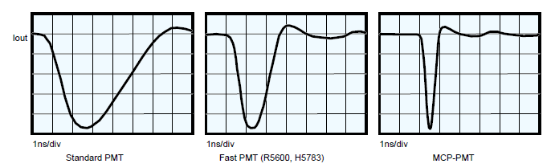
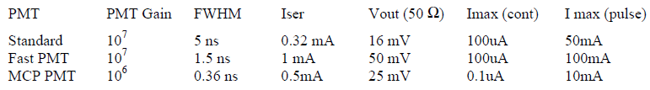
Fast phototubes: PMTs, MCP-PMTs
5 Anatoly Ronzhin, Fermilab, PhotoDet for PET, December 2015

Slide 6
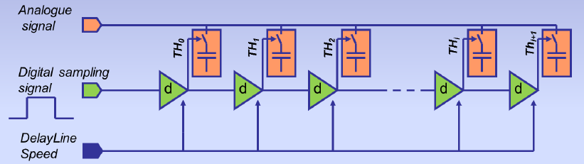
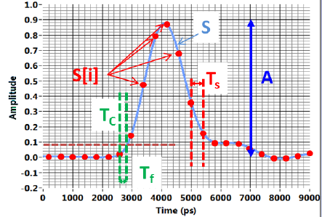
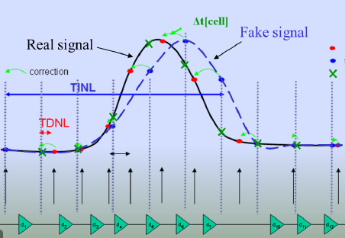
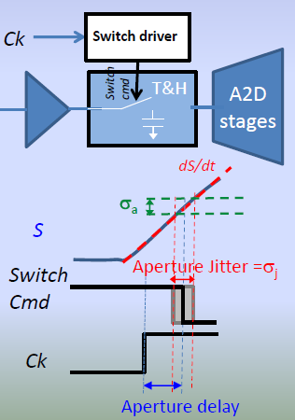
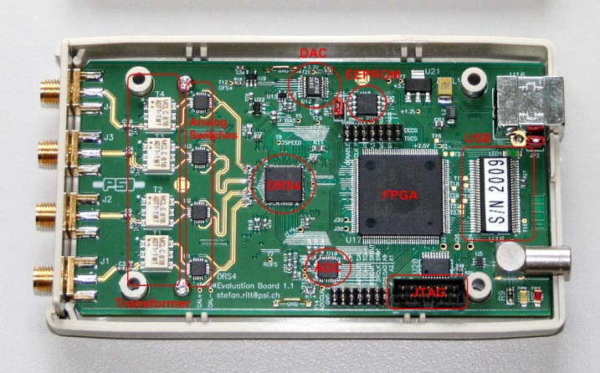
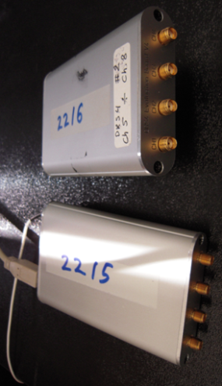
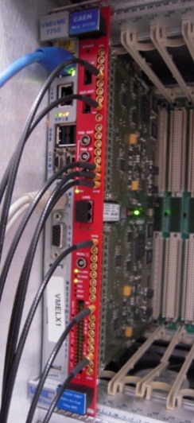
DRS4, (Domino Ring Sampler), introduced by Stefan Ritt, PSI
Principle: Sample & Store an incoming signal in an array of capacitors, waiting for (selective) readout and digitization= bank of Track & Holds. DRS4 can replace old classic TDC, ADC traditional readout. PH and TR measured by the same unit. Used one is capable to digitize 4 input channels at sampling rates 5 Giga-samples per second (GSPS, 200ps/cell). Individual channel depth of 1024 bins and effective range of 12 bits. BW is up to 850 MHz. DRS4 is based on Switch Capacitor Array (SCA). “Aperture” and “random” time jitter. Correction of “aperture” jitter. Noise floor ~1 mV/50 Ohm (Slides below taken from Stefan Ritt (DRS4) and Eric Delagnes (LAPPD).
Switch Capacitor Array (SCA).
Signal sampling
Correction of “aperture” jitter
Key parameters of DRS4
DRS4 unit open, (old) version
DRS4, last version
CAEN V1742

Slide 7
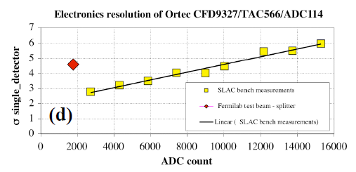
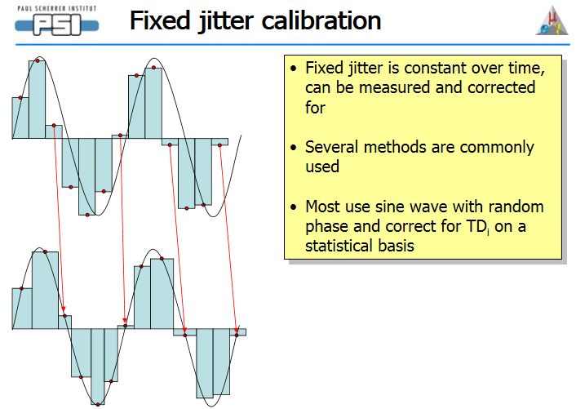
Electronics TR (ETR), noise, cables length influence, bench and beam ETR time difference. When working with less of 10 ps TR detectors the ETR is does matter, even SMA cables length, change of temperature etc…Our target to have ~1ps ETR. We have ~2.5 ps so far with DRS4
Our new method of the DRS timing calib, TR~2.5 ps
The scops with 20 ps sampling allow to suppress the aperture time jitter.
7 Anatoly Ronzhin, Fermilab, PhotoDet for PET, December 2015

Slide 8
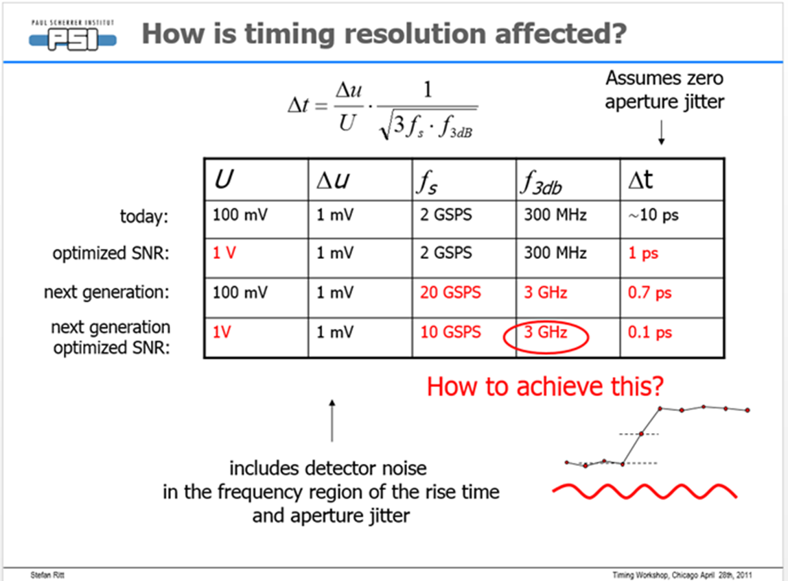
Stefan Ritt made estimation of achievable time resolution with the DRS
.

Slide 9
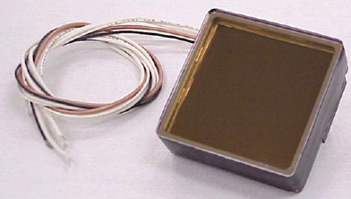
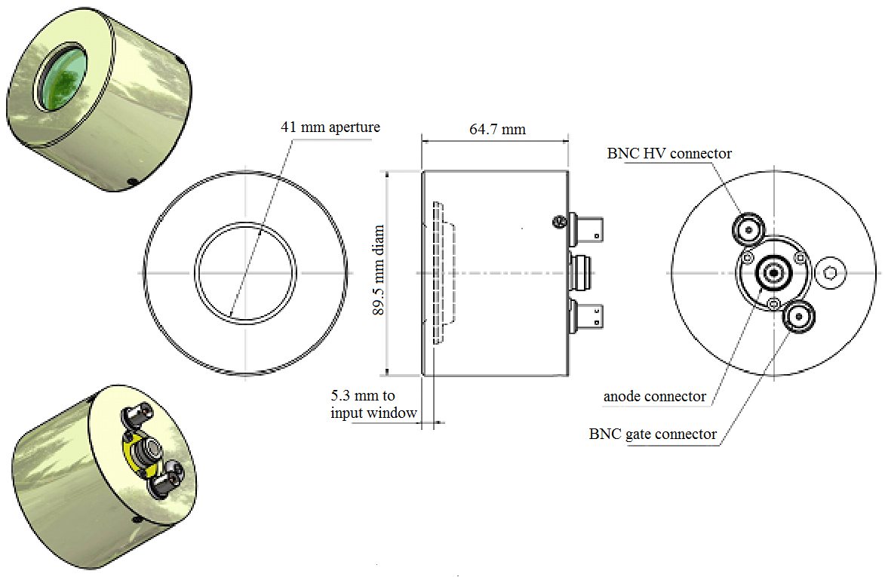
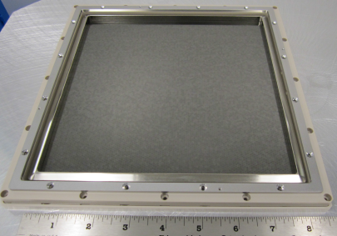
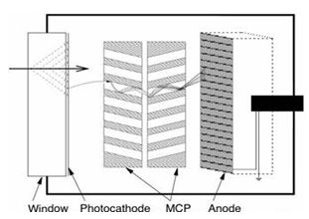
Photek 240, Photonis MCP-PMT and LAPPD, (8”x8” transverse size).
Photonis XP85012
LAPPD MCP
200mm x 200mm
Could be single layer
for SM, thickness 10mm
SPTR of MCP-PMT and MCP
~ 10-20 ps
Noise less
of 1 uA, or
Less of few
counts/mm2
A micro-channel plate (MCP) is a slab made from highly resistive material of typically 2 mm thickness with a regular array of tiny tubes (micro channels) leading from one face to the opposite, densely distributed over the whole surface. MCP is sensitive to MIP with less of 100% efficiency.

Slide 10
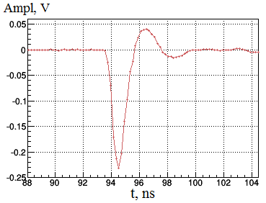
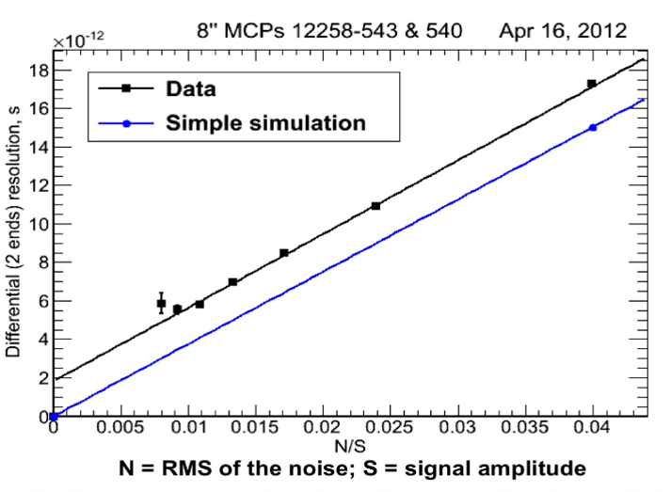
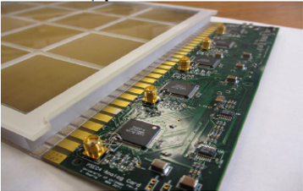
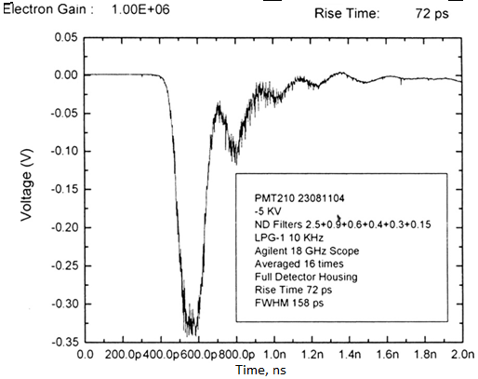
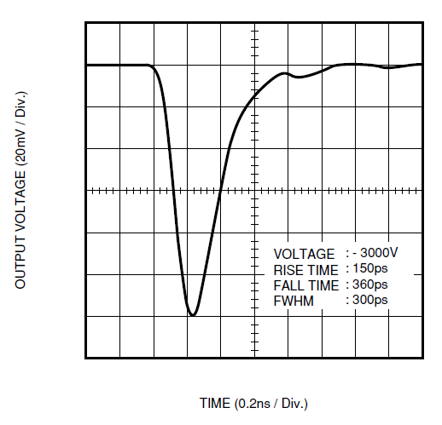
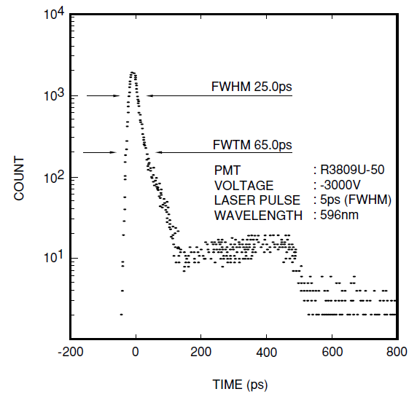
MCP-PMTs: Photek, Hamamatsu, LAPPD
1`0 Anatoly Ronzhin, Fermilab, PhotoDet for PET, December 2015

Slide 11
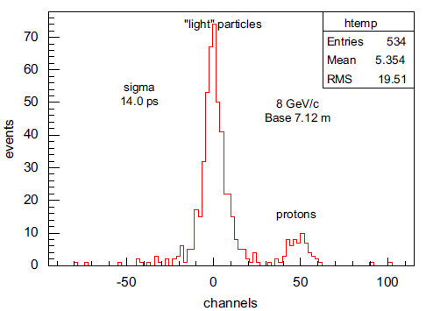
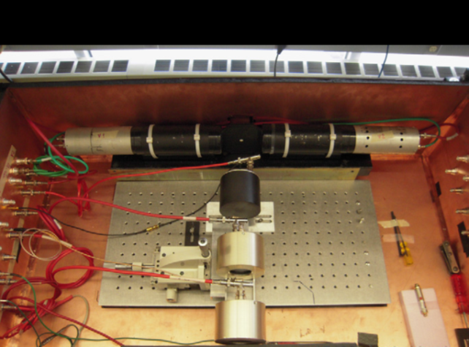
TOF system at FTBF based on Photek 240, 14 ps time resolution (8.7 ps last tb result). 120 GeV protons.
.
The TOF sensitive area is 41 mm of diameter

Slide 12
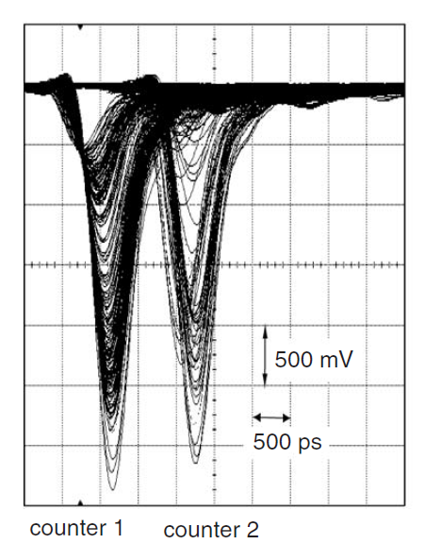
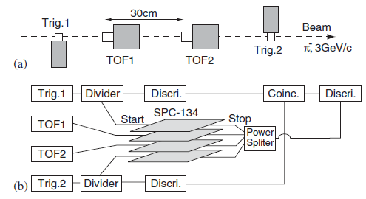
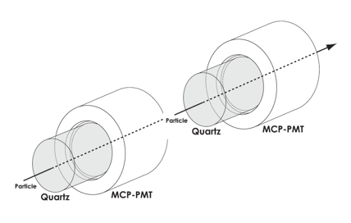
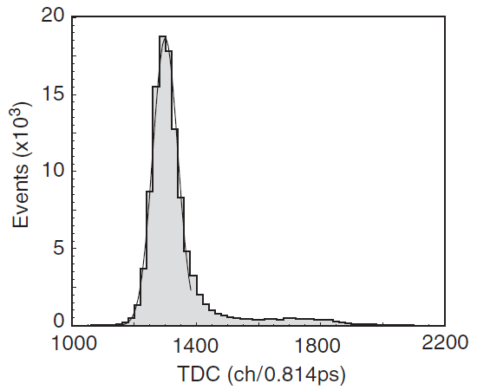
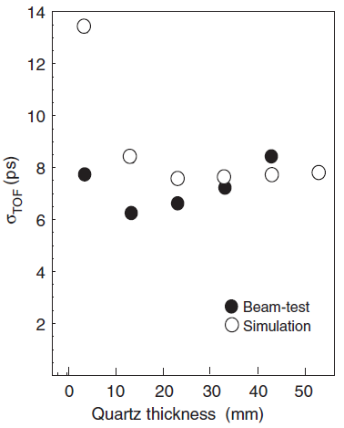
Others best TOF TR in the world with MCP-PMT
A 5 ps TOF-counter with an MCP–PMT K. Inami, N. Kishimoto, Y. Enari, M. Nagamine, T. Ohshima, NIM A 560 (2000), 303-306
The TOF
sensitive
area is 10 mm diam.

Slide 13
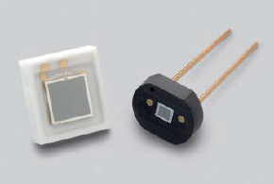
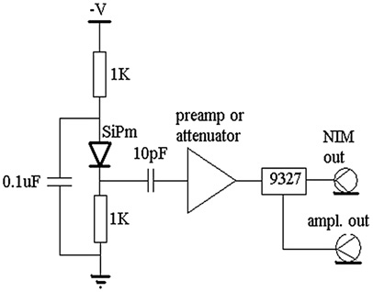
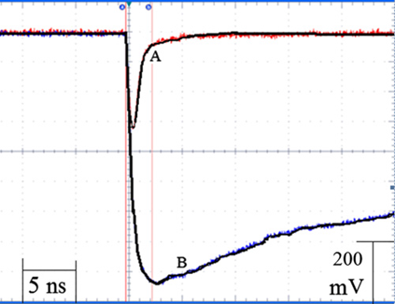
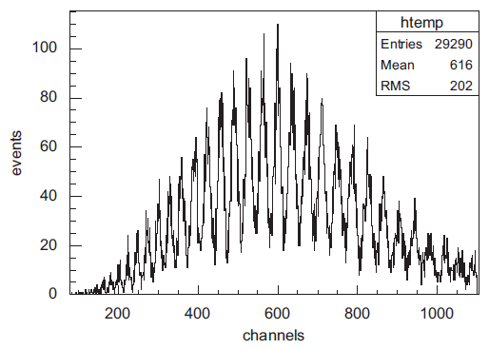
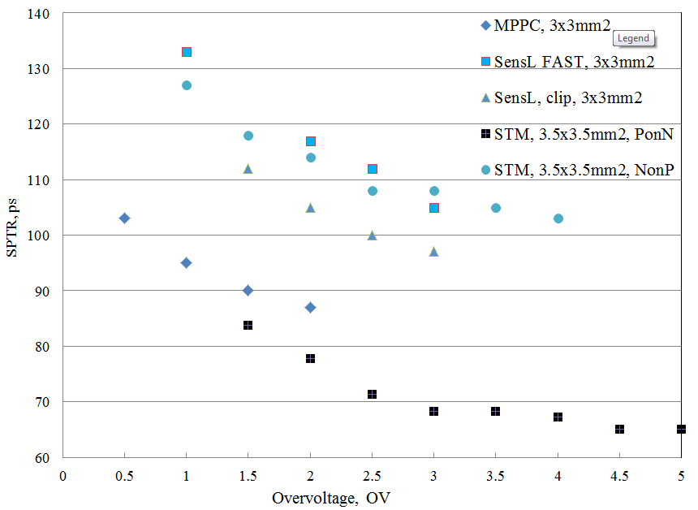

Silicon Photomultiplier or avalanche Geiger mode photodiode
.
10pF CAP
NO CAP
SiPM PH spectrum
TR on OV

Slide 14
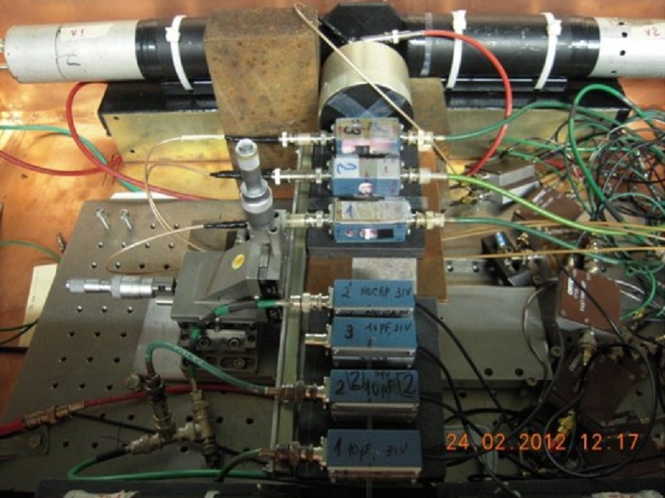
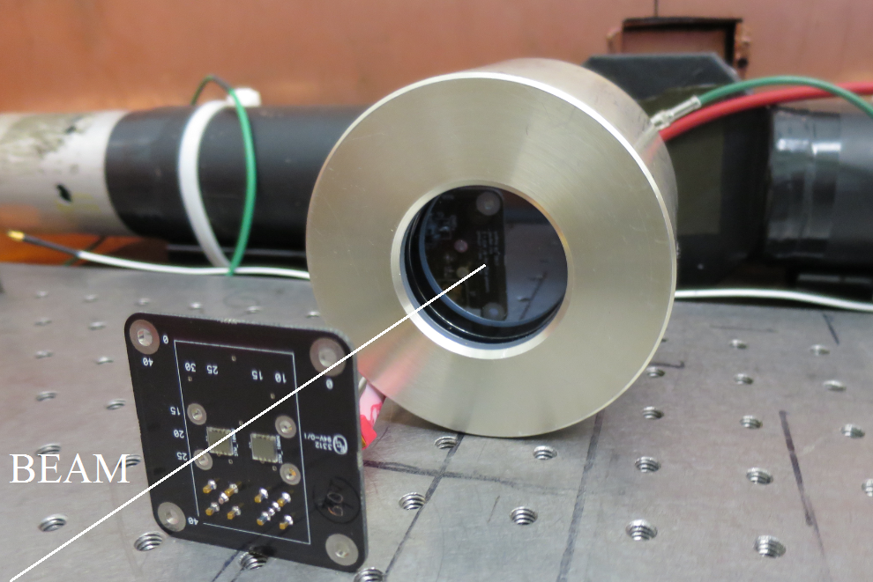
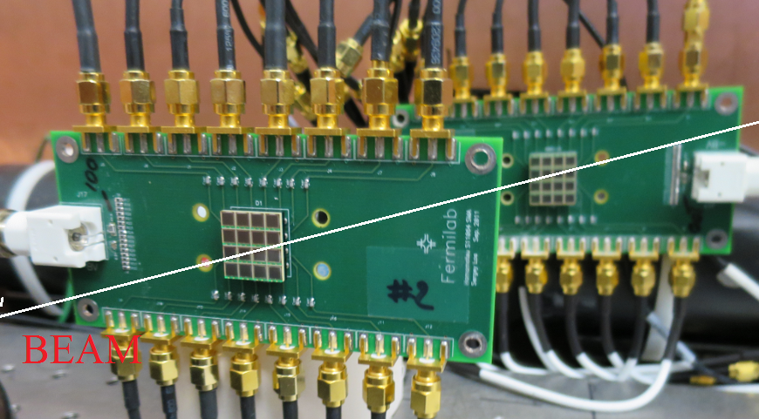
Normal 120 GeV proton incidence, TR, IT IS NO radiators, 3x3 mm2 transverse size
.
It is possible to suppress influence of the transverse size of photodetector on TR with SiPM matrix

Slide 15
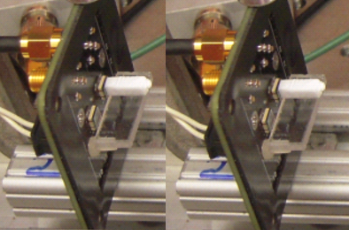
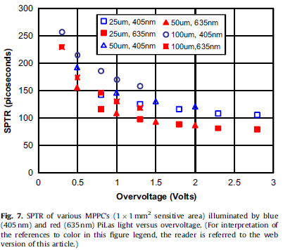
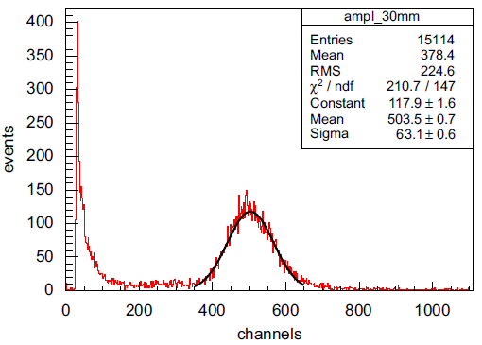
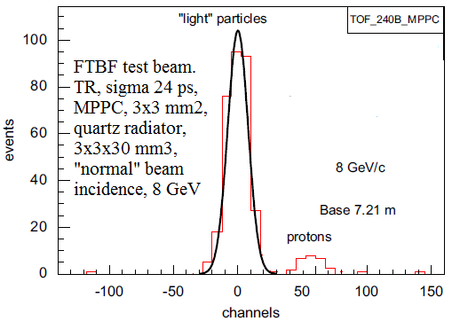
TR ~ 15 ps with MPPC, Hamamatsu, Fermilab test beam
.
FTBF test beam, 8 GeV/c. MPPC with 3x3x30mm3 quartz radiator, normal particle’s incidence. 20 photoelectrons/10 mm

Slide 16
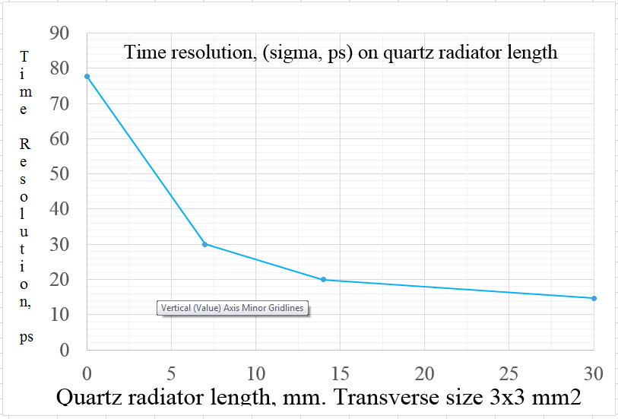
MPPC TR dependence on radiator thickness, ~77ps without radiator, 120 GeV protons
.
The MPPC transverse size is 3x3mm2. For the MPPC without radiator the TR is less of 80 ps and the efficiency is less of 30% (so far), 120 GeV protons.

Slide 17
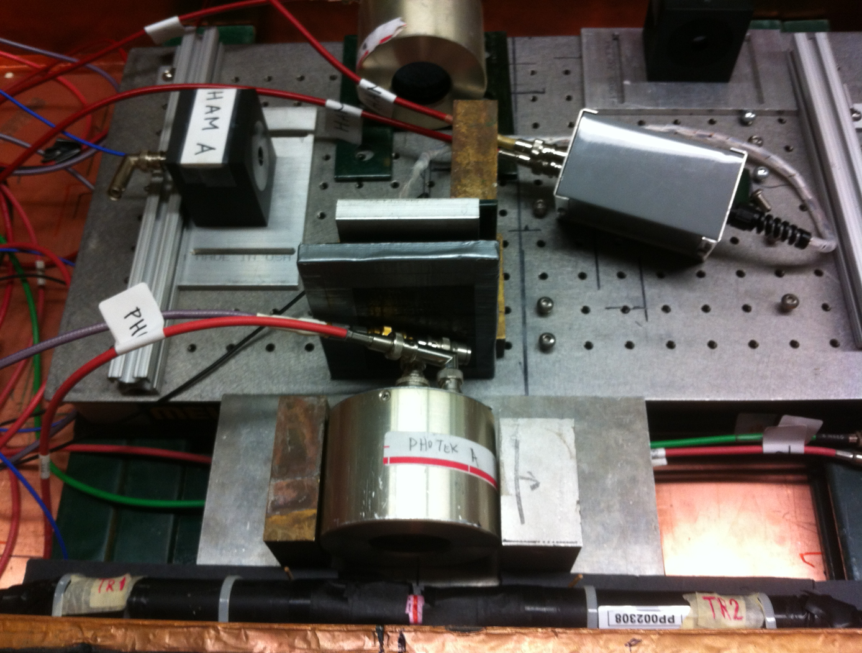

Development of a New Fast Shower Maximum Detector based on MCP-PMT as an active element
Photek 240
Photek 240
Photonis
Photonis

Slide 18
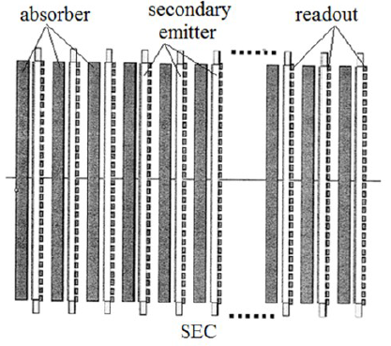
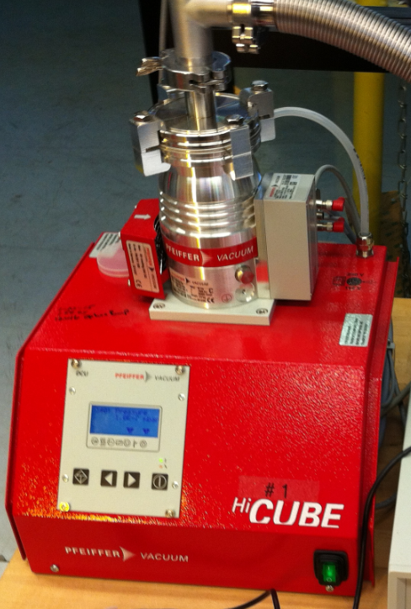
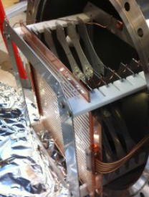
PLANS. OUR SECOND SEC VERSION, T1058, FTBF
SEC: W absorber, ~30 layers, 6x6x0.35 cm3. SE: active layers: MCP, 6x6 cm2, SiPMs, or Silicon.

Slide 19
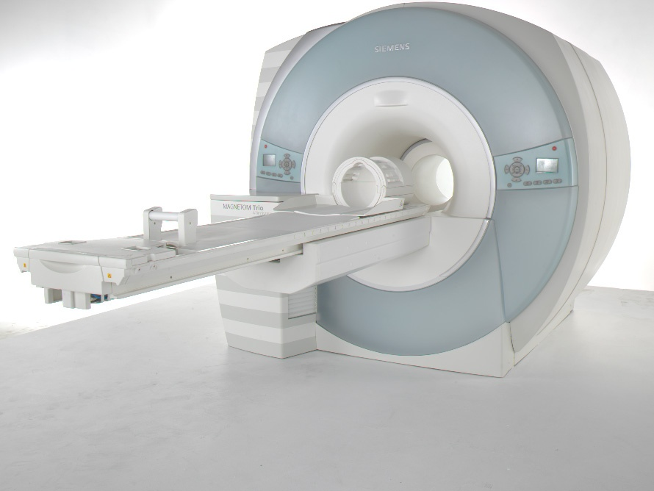
“Dream”detectors for future integrated MR/CT/PET-TOF; SiPMs, DRS4
Illustration
19 Anatoly Ronzhin, Fermilab, Picosecond timing, Arlington, Oct. 5-7, 2015

Slide 20
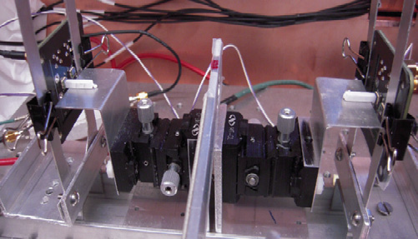
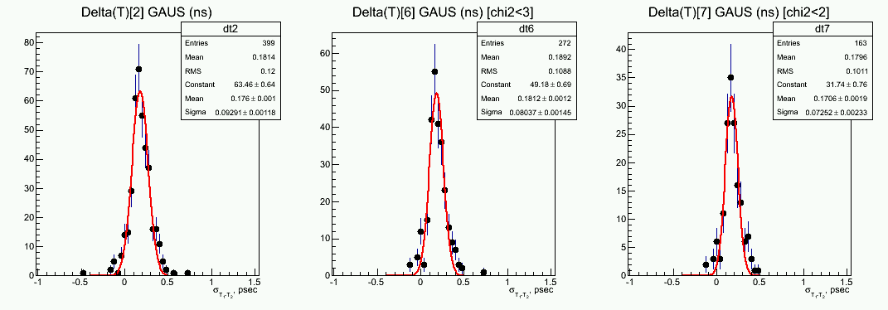
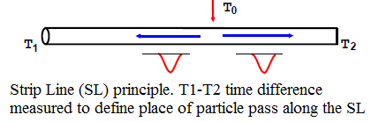


PET-TOF, R&D phase. “Helmet brain scanner”. Strip Line (SL) readout.
.
We have performed a study of silicon photomultipliers (STM and MPPC) with 3x3x15 mm3 LYSO crystals for TOF-PET applications. We obtained CTR 75 ps, sigma, best result in the world with the size and type of the crystal. Two main readout options of the “final helmet”: SiPMs matrix or Strip lines (SL) readout. Why to improve the CTR? The less CTR the better quality and contrast PET-TOF image and shorter scanning time.
.

Slide 21

A feasibility study of a PET/MRI insert detector using strip-line and waveforms sampling data acquisition. H. Kim et al., NIM, A784 (2015) 557–564.
.
Preliminary experimental results show that the effect of interference on the MRI image due to the PET-TOF detector is negligible and that PET-TOF detector performance is comparable with the results
measured outside the MRI scanner. Magnetic field ~9.4 T,
Time resolution ~10 ps along strip line, or ~1 mm. The signals appearing on the two ends of the strip-line are
digitized by the DRS4 waveform sampling electronics Strip line length ~50 mm, LYSO crystals 5x5x10 mm3, 8 crystals settled along the strip line. Na22 source used.

Slide 22


Slide 23



We propose to use SiPMs (may be with thin LYSO or other cryst upstream) as an active layer for FAST SM
Secondaries from EM shower can produce large signal in Si or in SiPM (SiPM may be with thin cryst (LYSO)

Slide 24




We also will try silicon as an active layer for FAST shower maximum (SM) detector
.

Slide 25
Summary
We obtained 13 ps of the time resolution (TR) for the SM based on MCP-PMT. We see almost NO DEPENDENCE of the TR on absorber thickness and tungsten or lead as absorber material.
We continue study the TR and PH resolution of SMs with MCPs (without PC), SiPms with different absorber materials and different readout. We made detailed measurements with MCP-PMT as SM active element. The time and space resolution obtained are ~13ps and 0.3 mm.
We propose to use SiPMs as active layers for EM shower maximum (SM) detectors.
The TOF time resolution (TR) 8.3 ps obtained with MCP-PMT (aperture is 41 mm diameter). With 120 GeV protons. We got TR ~14.3 ps with SiPMs (new STMs, new readout, DRS4, FTBF). Different algorithms to get best signal’s timing tested. Leading edge, CF, MF are among them. 9 ps TR along Strip Line (SL) readout is obtained on FTBF beam.
The transverse and longitudinal radiator’s size influence on the TR of the photodetectors investigated with “normal” particle’s incidence. TR of the PD WITHOUT radiator measured.
PET-TOF. Our current results, ~80 ps TR and 10% of PH (FWHM with MPPCs and 3x3x15 mm3 LYSO crystals) resolution are among the best with this type and size of the crystals.
Setup for new SiPm study with DRS4 readout arranged at SiDet. We have studied timing properties (Single Photoelectron Time Resolution (SPTR), signal shape dependence on SiPm structure, noise floor of several SiPms producers (STM, MPPC, IRST FBK, SensL, Kotura, MePhy, CPTA, etc.). Now we working together with Caltech team on timing study of new SiPM. The TOF based on SiPms used in FTBF (FNAL), PET-TOF, HPS (CERN) and in small projects. We provide tested SiPMs for the small projects.

Slide 26
Picosecond Timing, Caltech, CERN, Fermilab
1. Direct tests of micro channel plates as the active element of a new shower maximum detector, A. Ronzhin, S. Los, E. Ramberg, A. Apresyan, S. Xie, M. Spiropulu, H. Kim. NIM, A795 (2015), 52-57.
2. Study of the timing performance of micro channel plate photomultiplier for use as an active layer in a shower maximum detector. A. Ronzhin, S. Los, E. Ramberg, A. Apresyan, S. Xie, M. Spiropulu, H. Kim, NIM, A795 (2015), 288-292.
3. A feasibility study of a PET/MRI insert detector using strip-line and waveform sampling data acquisition, H. Kim, C.-T. Chen, N. Eclov, A. Ronzhin, P. Murat, E. Ramberg, S. Los, Alice M Wyrwicz, Limin Li, C.-M. Kao, NIM, A784 (2015), 557-564.
4. On Timing Properties of LYSO-based Calorimeters, D. Anderson, A. Apresyan, A. Bornheim, J. Duarte, C. Pena, A.
Ronzhin, M. Spiropulu, J. Trevor, S. Xie, NIM, A794 (2015), 7–14.
5. Precision timing measurements for high energy photons, Dustin Anderson, Artur Apreysan, Adi Bornheim, Javier Duarte,
Harvey Newman, Cristian Pena, Anatoly Ronzhin, Maria Spiropulu, Jason Trevor, Si Xie, Ren-Yuan Zhu, NIM, A787 (2015) 94.
6. Development of a new fast shower maximum detector based on micro channel plates photomultipliers (MCP-PMT) as an active element. A. Ronzhin, S. Los, E. Ramberg, M. Spiropulu, A. Apresyan, S. Xie, H. Kim, A. Zatserklyaniy. NIM, A759 (2014) pp. 65–73.
A New Time Calibration Method for Switched-capacitor-array-based Waveform Samplers, H. Kim, C.-T. Chen, N. Eclov, A. Ronzhin, P. Murat, E. Ramberg, S. Los, W. Moses, W.-S. Choong, C.-M. Kao, NIM, A767, (2014), 67-74.
7. A SiPM - based TOF - PET detector with high speed digital DRS4 readout. A. Ronzhin, M. Albrow, S. Los, M. Martens, P. Murat, E. Ramberg, H. Kim, C.-T. Chen, C.- M.Kao, K. Niessen, A. Zatserklyaniy, M. Mazzillo, B. Carbone, G. Condorelli, G. Fallica, A. Piana, D. Sanfilippo, G. Valvo, S. Ritt. NIM, A703 (2013) pp. 109–113.
8. Waveform digitization for high resolution timing detectors with silicon photomultipliers.
A. Ronzhin, M.G. Albrow, S. Los, E. Ramberg, Y. Guo, H. Kim, A. Zatserklyaniy, M. Mazzillo,B. Carbone, G. Condorelli, P. Fallica, A. Piana, D. Sanfilippo, G. Valvo, S. Ritt. NIM, A 668 (2012) pp. 94-97.
9. Electro-Optical Performances of p-on-n and n-on-p Silicon Photomultipliers. Massimo Mazzillo, Anatoly Ronzhin, Sergey Los, Salvatore Abbisso, Delfo Sanfilippo, Giusy Valvo, Beatrice Carbone, Angelo Piana, Giorgio Fallica and Erik Ramberg. IEEE Trans. On Electr. Dev, 2012, V.59, No 2, p.3419
10. Waveform analysis of SiPM signals with DRS4 board. Erik Ramberg, Anatoly Ronzhin, Andriy Zatserklyaniy. NIM, Physics Procedia, 37 (2012) pp. 800 – 802
11. Observation of a new boson at a mass of 125 GeV with the CMS experiment at the LHC, CMS Collaboration, Physics Letters, B 716 (2012) 30–61.

Slide 27

.
27 Anatoly Ronzhin, Picosecond Timing, October 5-7, Arlington, Texas 2015

