Slide 1
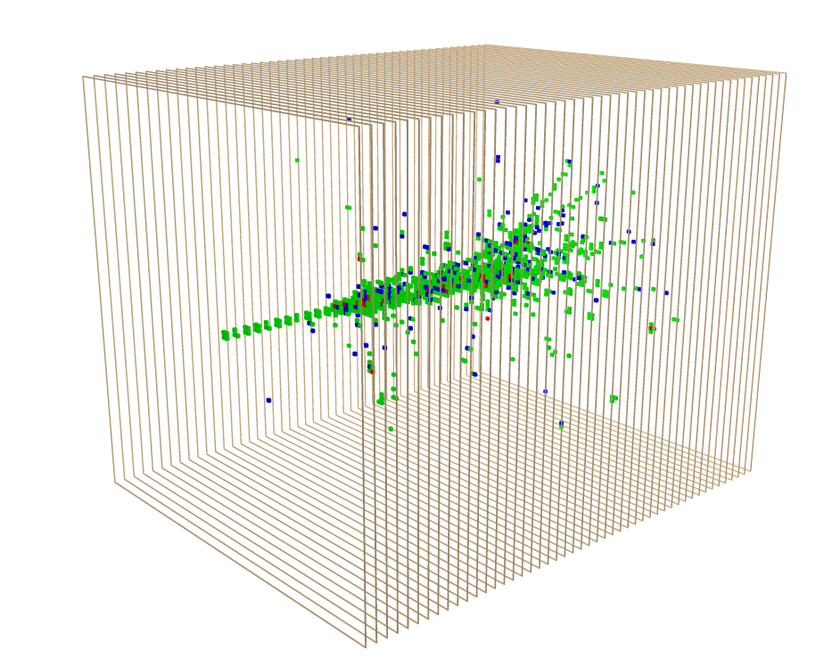
Imaging Calorimetry
José Repond
Argonne National Laboratory
New Technologies for Discovery
University of Texas in Arlington, Arlington, TX
October 5 -7, 2015

Slide 2
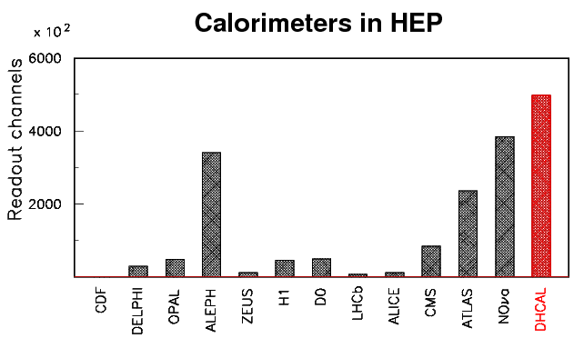
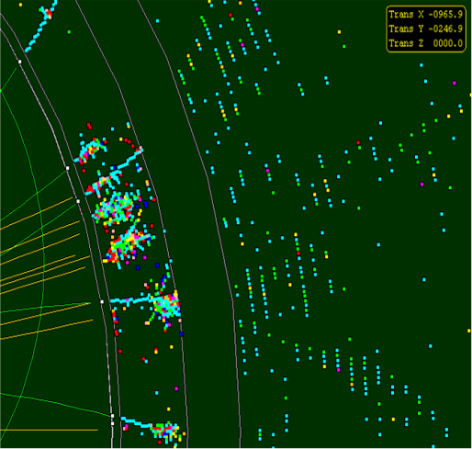
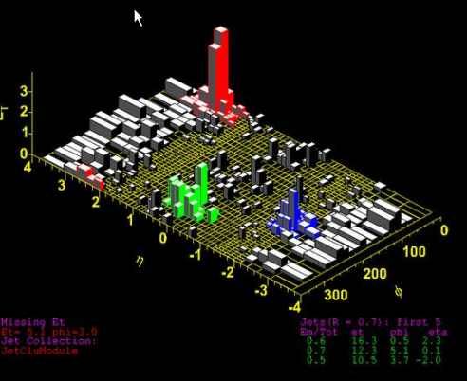
Trend in Calorimetry
Tower geometry
Energy is integrated over
large calorimeter volumes
into single channels
Readout typically with
high resolution
(> 10 bits/channel)
Individual particles in a
hadronic jet not resolved
Imaging calorimetry
Large number of calorimeter
readout channels (~10⁷)
Option to minimize
resolution on individual
channels (1, 2… bits/channel)
Particles in a jet are
measured individually
E_{T}

Slide 3
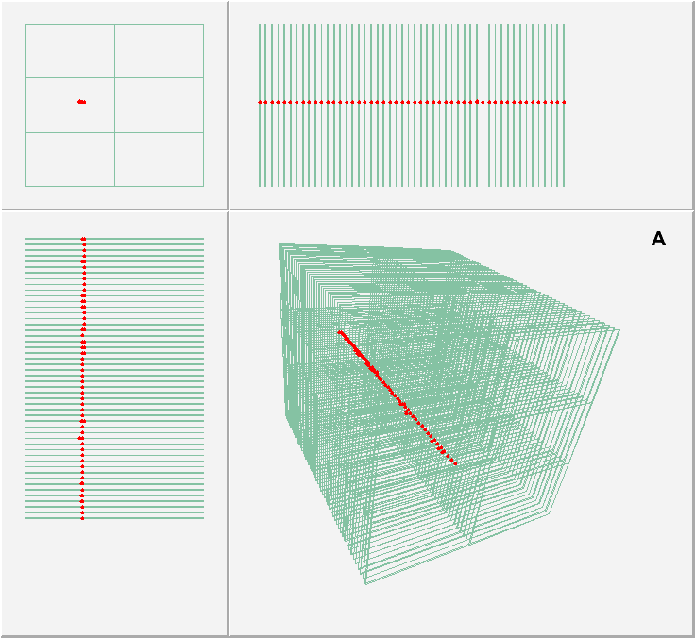
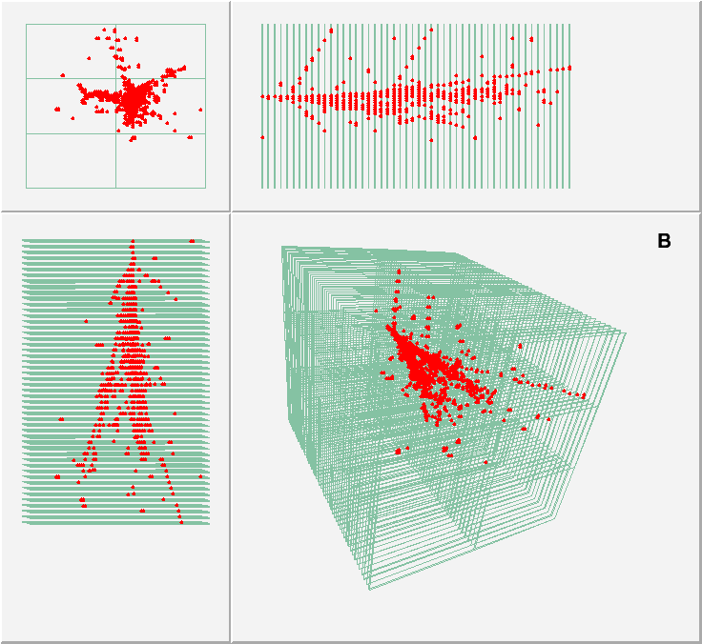
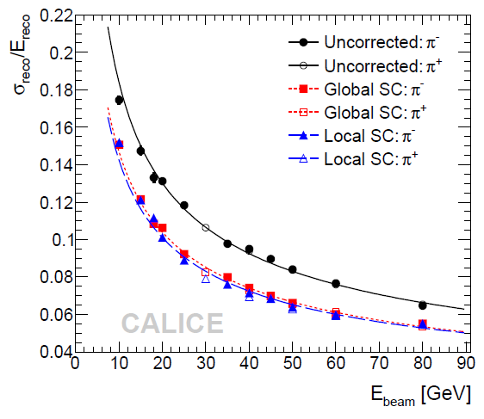
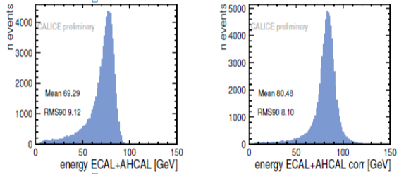
Advantages of Imaging Calorimetry
Particle ID
Electrons, muons, hadrons → (almost) trivial
Software compensation
Typical calorimeters have e/h ≠ 1
Weighting of individual sub-showers possible
→ significant improvement in σ_{E}^{had}
Leakage corrections
Use longitudinal shower information to compensate for leakage
→ significant improvement in σ_{E}^{had}
Measure momentum of charged particles exiting calorimeter
Application of Particle Flow Algorithms (PFAs)
Use PFAs to reconstruct the energy of hadronic jets

Slide 4
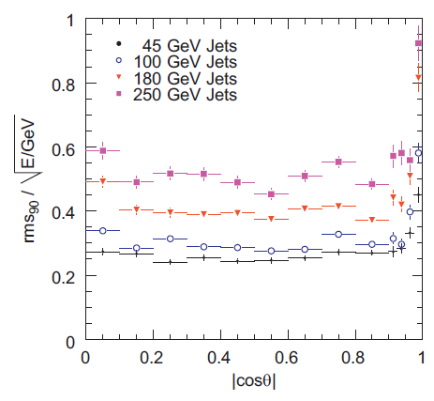
Particle Flow Algorithms
K_{L}
HCAL
Attempt to measure the energy/momentum of each particle in a
hadronic jet individually with the detector subsystem providing
the best resolution
ECAL
γ
π⁺
Particles in jets | Fraction of energy | Measured with | Resolution [σ²]
Charged | 65 % | Tracker | Negligible
Photons | 25 % | ECAL with 15%/√E | 0.07² E_{jet}
Neutral Hadrons | 10 % | ECAL + HCAL with 50%/√E | 0.16² E_{jet}
Confusion | If goal is to achieve a resolution of 30%/√E → |  | ≤ 0.24² E_{jet}
PANDORA PFA based on
ILD detector concept
Factor ~2 better jet energy resolution than previously achieved

Slide 5
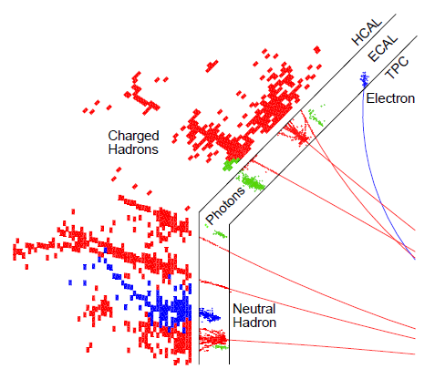
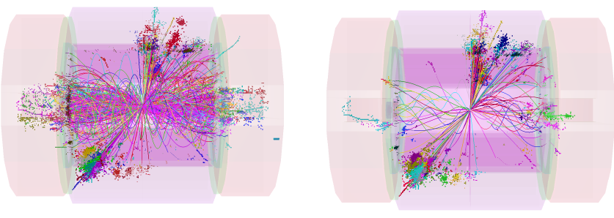
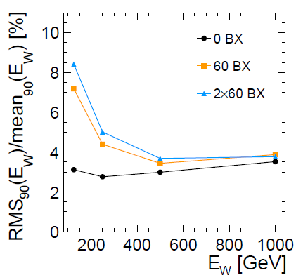
Particle Flow Algorithms at Higher Energies
Nucl.Instrum.Meth. A700 (2013) 153
At CLIC
E.g. at √s = 3 TeV
2 – background becomes significant → 1.2 TeV (per train)
Additional timing cut reduces it to 100 GeV
Excellent jet energy preserved up to E_{W} = 1 TeV
Imaging capability helps identifying backgrounds/pile-up

Slide 6
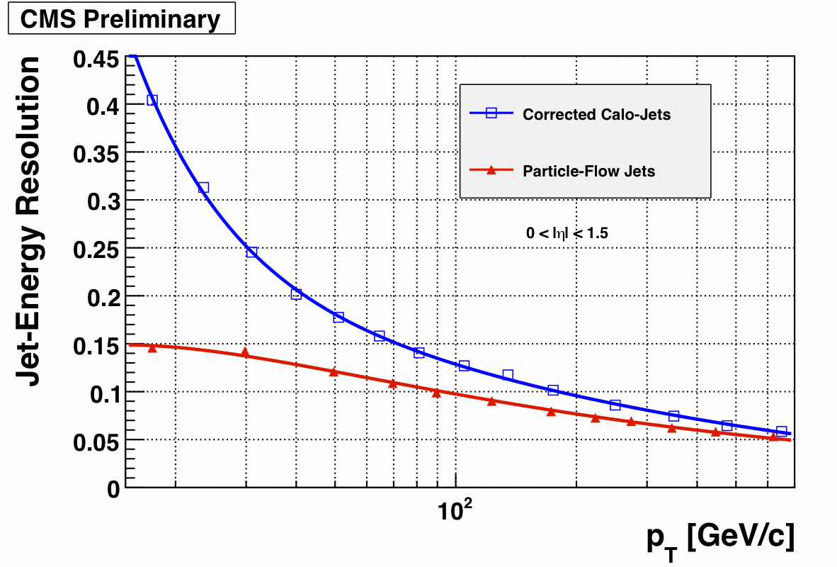
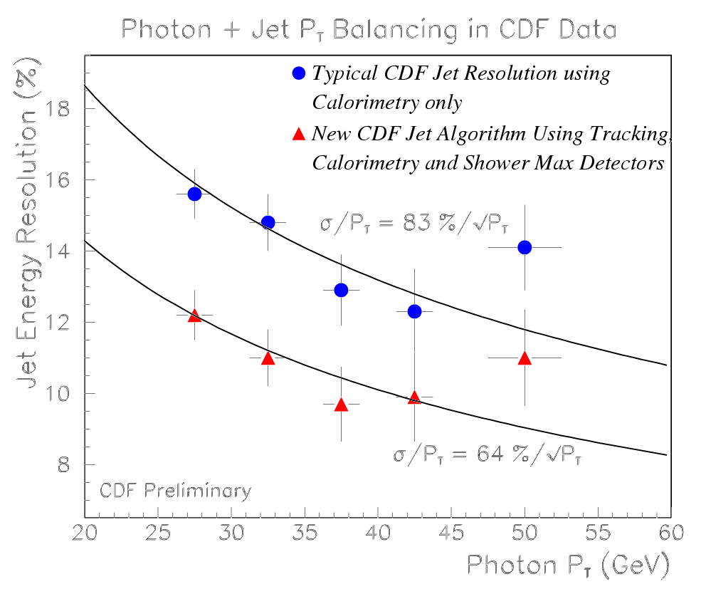
Application of PFAs
Past
Pioneered by
ALEPH
Used by
ZEUS, CDF…
Future
ILC/CLIC detectors
LHC Upgrades
Any new colliding
beam detector
Detectors optimized for PFAs
Present
CMS

Slide 7
Implications from PFAs for Calorimetry
● A calorimeter optimized for photons: separation into ECAL + HCAL
● Place the calorimeters inside the coil (to preserve resolution)
● Minimize the lateral size of showers, in particular a small R_{Molière}
● The highest possible segmentation of the readout
● Minimize the thickness of the active layer or the depth of the E+HCAL (cost)
● Embed the front-end readout electronics into the calorimeter
(implications for reliability!)
The role of the HCAL reduced to measure the part of showers from neutral hadrons
leaking from the ECAL
Two performance measures of a calorimeter optimized for PFAs
Energy resolution for Identification of energy deposits
single neutral particles (minimize confusion)

Slide 8

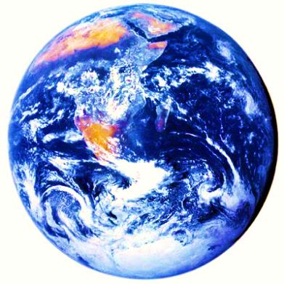
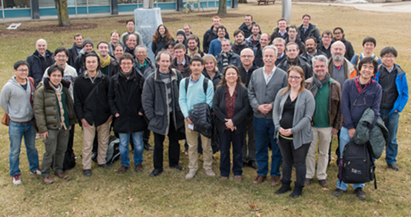
Collaboration
2nd largest R&D
collaboration in HEP
Goal
Development and study of finely segmented/imaging calorimeters
Initially focused on the ILC/CLIC needs
Now widening to include the developments of all imaging calorimeter
Large prototypes built and tested to date
Silicon-W ECAL, Scintillator-W ECAL, Scintillator-Fe/W HCAL,
RPC-Fe/W HCAL, RPC-Fe HCAL
4 continents
20 countries
60 institutes
364 physicists/
engineers

Slide 9
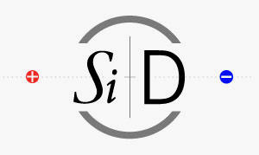

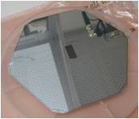
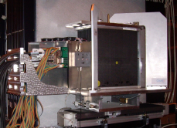
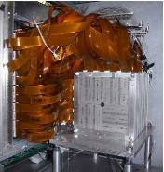
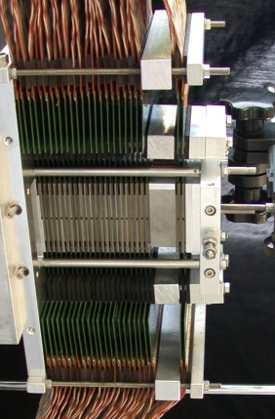
Development of Imaging Electromagnetic Calorimeters
Silicon pads
Silicon pads
Scintillator tiles
MAPS
W
R_{Molière} ~ 9.4 mm
W
W
W
Recent
addition
to CALICE

Slide 10


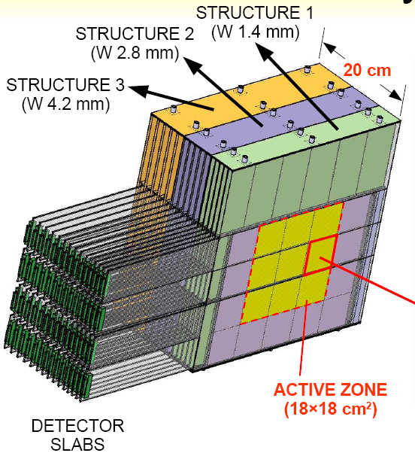
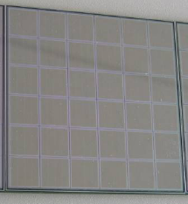
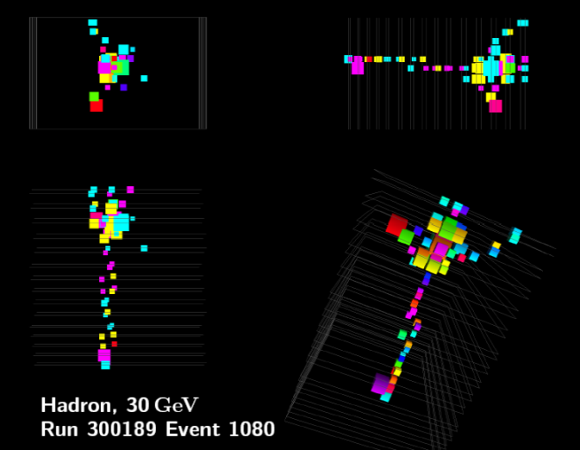
Silicon – Tungsten ECAL
Physics prototype
3 structures with different W thicknesses
30 layers; 1 x 1 cm² pads
18 x 18 cm² instrumented
→ 9720 readout channels
Tests at DESY/CERN/FNAL
Electrons 1 – 45 GeV
Pions 1 – 180 GeV
X₀^{W} = 3.5 mm
1 X₀(W) = 3.5 mm
Electronic Readout
Front-end boards located outside of module
Digitization with VME – based system (off detector)

Slide 11
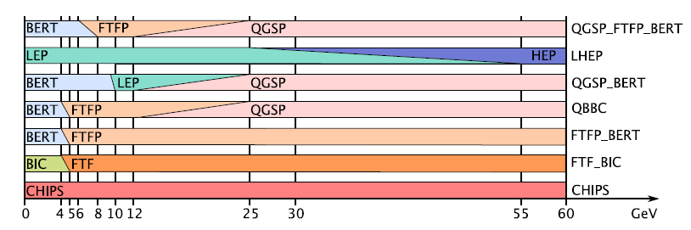
Monte Carlo Simulations: GEANT4
Adequate simulations are a
prerequisite for understanding
the physics of a new technology
Electromagnetic shower simulation
Reproduces results at the < 1 % level
Multiple scattering still challenging
Thin layers also still challenging
Excellent tool to validate our understanding of the detector
Hadronic shower simulation
Greatly improved in the last few years
Precision better than 10% (shapes < 20%)
Choice of different models combined into various Physics lists

Slide 12

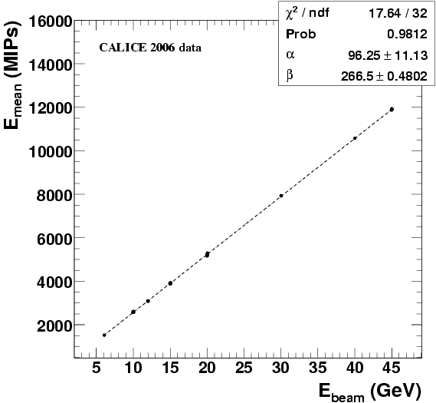
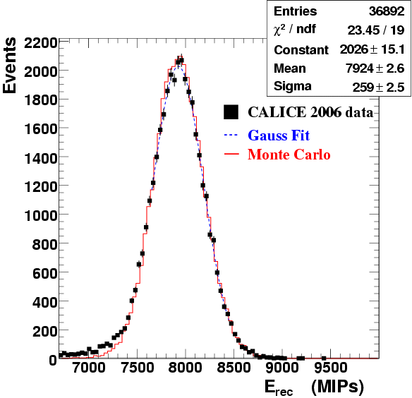
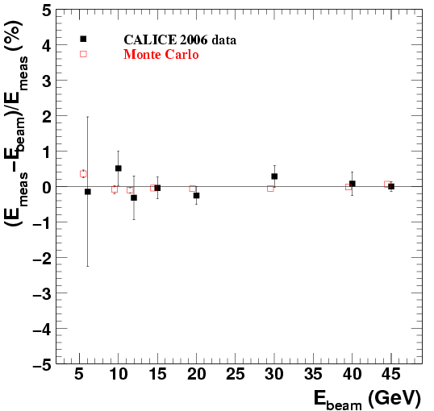
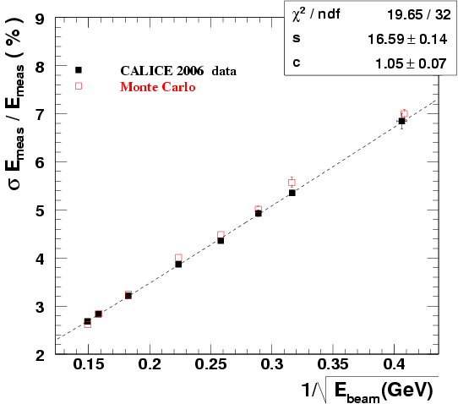
Si-W ECAL: electron response and resolution
Response
Linear between 6 and 45 GeV
Residuals < ±1%
Excellent agreement with simulation
Resolution
As expected
Sufficient for PFAs
(not dominant contribution)
Good agreement with simulation

Slide 13
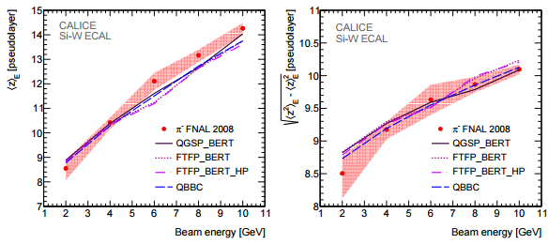
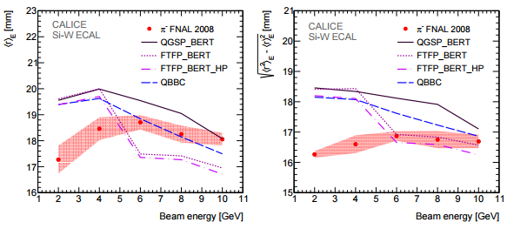
Si-W ECAL: measurements with pions
Dispersion
Longitudinal shape
Slightly longer shower in data
Comparison with simulation OK
Radial shape
High precision measurement
Simulation significantly off
Transition between hadronic
shower models visible
Nucl.Instrum.Meth. A794 (2015) 240-254

Slide 14
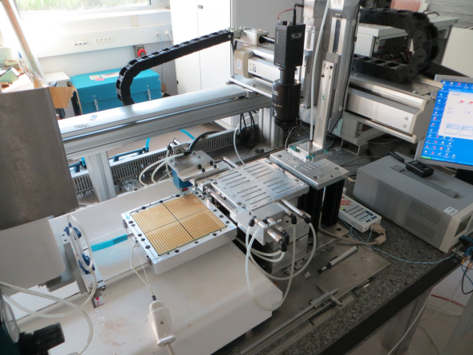

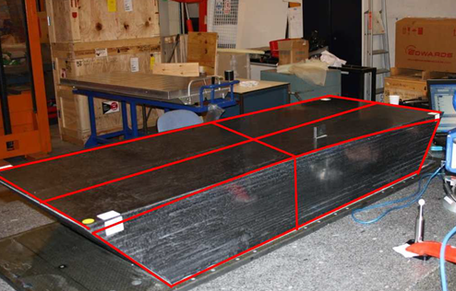
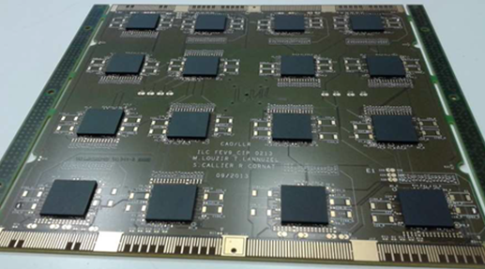
Silicon – Tungsten ECAL
Technical prototype
0.5 x 0.5 cm² pads
Wedge –shaped mechanical structure
New generation readout system (embedded front-end, power pulsing)
Automated assemblies
Studies
Test beam, on the bench…

Slide 15
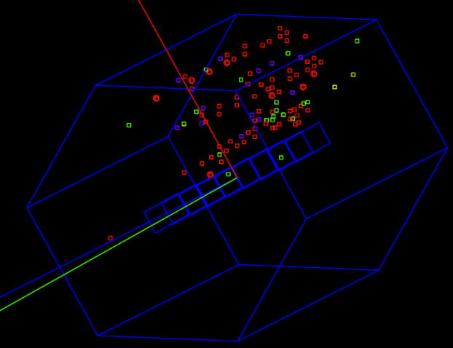
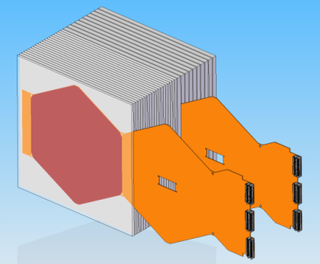
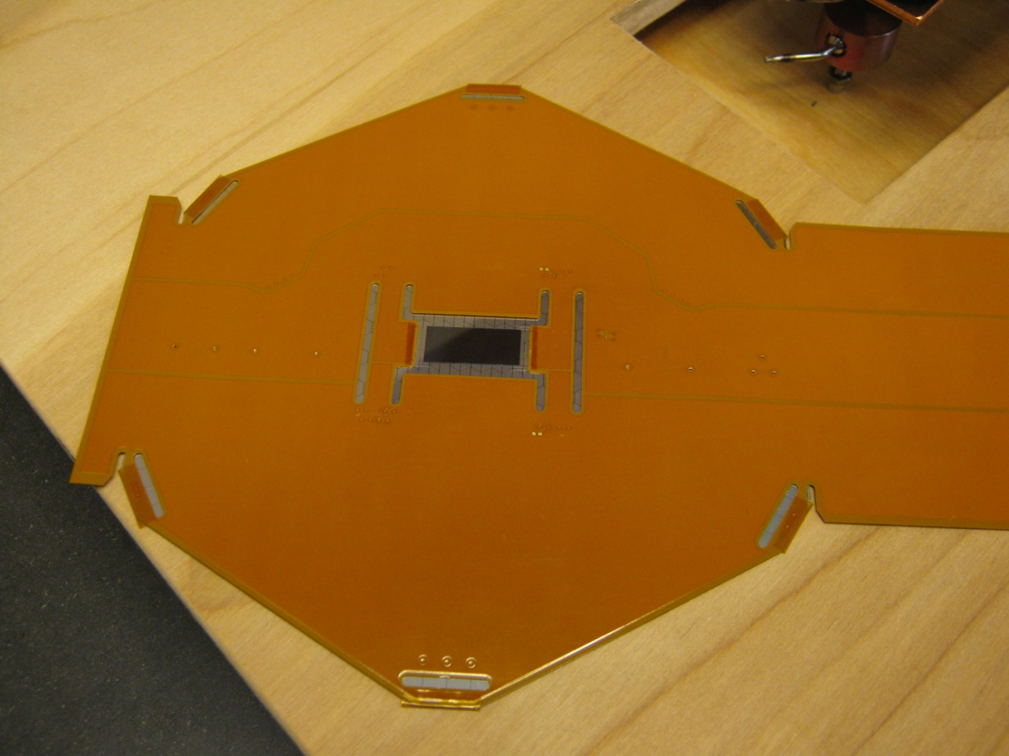
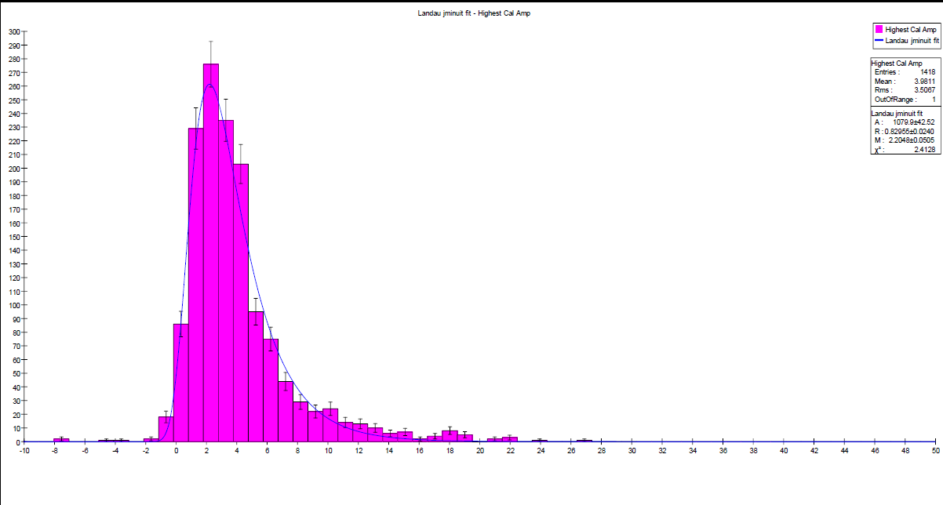
SiD Si-W ECAL
Prototype
20 layers with 2.5 mm W (5/7 X₀)
10 layers with 5.0 mm W (10/7 X₀)
30 gaps (each 1.25 mm) with Si Pixel sensors
Effective Moliere radius = 13 mm
Sensors
6” Silicon wafer
1024 pixels, each 0.13 cm²
Readout
KPiX ASIC
Bump bonded to wafer
1024 readout channels
17 bit dynamic range
Power pulsing (O(x100) reduction)
Status
Measured response to cosmic rays
Prototype assembled
First tests in particle beams

Slide 16

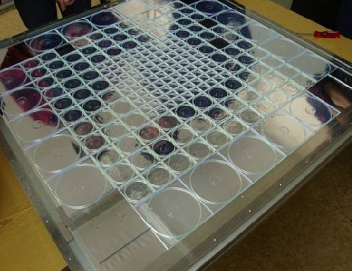
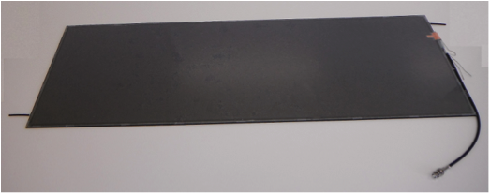
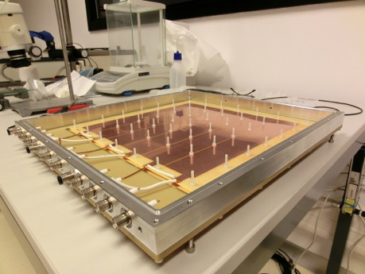
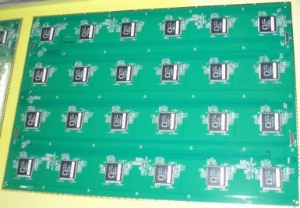
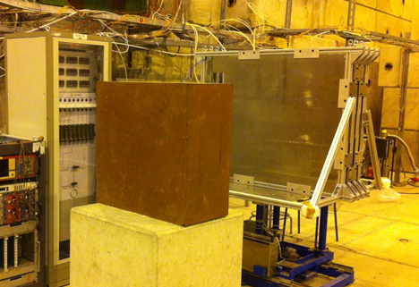
R&D for Imaging Hadronic Calorimeters
16-bit
1-bit
2-bit
Scintillator tiles
RPC
GEM
RPC
μMegas
Fe
W
Fe
W
Fe
Fe

Slide 17

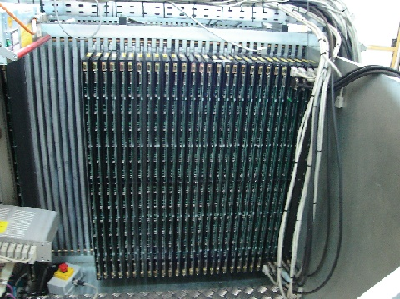
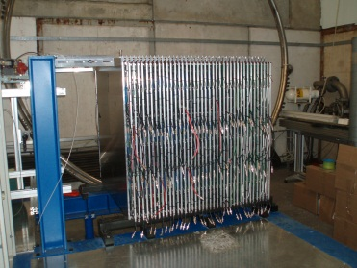
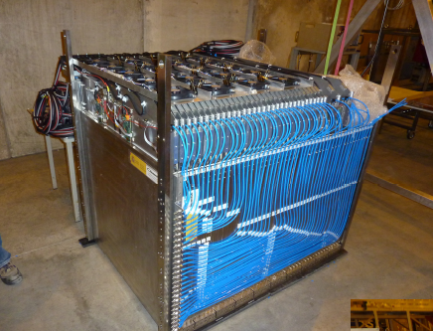
The Large HCAL Prototypes
The AHCAL
Scintillator – (Steel, Tungsten)
3 x 3 cm² -> 12 x 12 cm² scintillator tiles
First use of SiPM in HEP
16 bits per channel (analog readout)
~8,000 readout channels
B) The DHCAL
RPC – (Steel, Tungsten)
1 x 1 cm² readout pads
First time embedded front-end readout
1 bit per channel (digital readout)
~500,000 readout channels
C) The SDHCAL
RPC – Steel
1 x 1 cm² readout pads
Use of power pulsing
2 bits per channel (semi-digital readout)
~500,000 readout channels

Slide 18
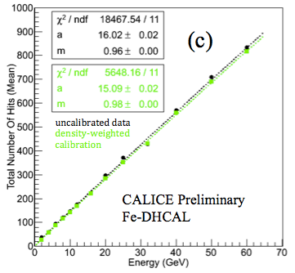
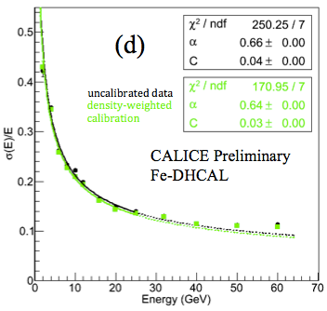
The DHCAL: Some Results
First `real’ digital hadron calorimeter
π⁺
π⁺ resolution
As expected
At higher energies: saturation
π⁺ response
Linear up to 60 GeV
(due to wide hadronic showers)

Slide 19
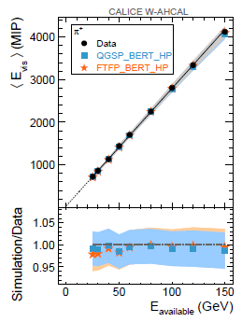
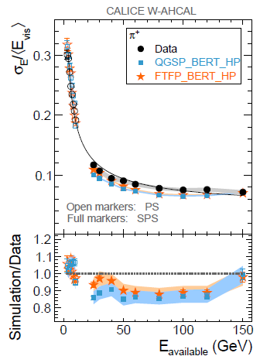


W-AHCAL: Recent Results
38 layers interleaved by 1 cm thick Tungsten plates (2.9 X₀ or 0.13 λ_{I}) + Tail catcher
π⁺ response
Linear and well simulated
π⁺ resolution
(3-15)% better in simulation
arXiv:1509.00617
Longitudinal shower shape
Measured from shower start
Simulated within ±12%
Radial shower shape
Simulation too narrow: π⁰ production???

Slide 20






The Scintillator – Steel/Tungsten HCAL
Technical prototype
3.0 x 3.0 cm² tiles
Wedge –shaped mechanical structure
New generation readout system
→ embedded front-end, power pulsing, scalable
Automated assemblies
Studies
Megatiles with dimples
Tests on the bench
Test beams at DESY and CERN …
μ peak in CERN
testbeam

Slide 21



GEMs, Micromegas & RPCs
Studies to reduce spark rate and increase rate capability
Resistive Thick GEMs
Study of different designs
Measurement of gain vs rate
JINST 9 (2014) P04011
RPCs with semi-conductive glass
Conductance 2 orders of magnitude larger
Measurement of efficiency vs rate
arXiv:1507.06968

Slide 22
While waiting for the ILC/CLIC
broadened its scope
Involvement in LHC upgrades
Additional challenges at the LHC
Radiation hardness (both sensor and embedded FE-electronics)
High rates
Pile-up
Cooling (no power pulsing, maintain small R_{Molière} )
Triggering

Slide 23


ALICE (@ LHC) Forward Calorimeter
Proposal for the ‘ultimate’ digital calorimeter
→ for the high-luminosity upgrade
Using MAPS (Monolithic Active Pixel Sensor)
19.2 mm
MIMOSA 23
640 x 640 pixels
30 micron pitch
MAPS
CMOS integrated circuit
On sensor digitization
→ 1 bit per pixel
→ minimizes dead area

Slide 24


Now, new world record channel count in calorimetry
First prototype
96 sensors → 39 Million readout channels
Interleaved with 1 X₀ Tungsten plates
Tests in DESY and PS/SPS test beams
Beam
Test beam results
Linear response to
electrons
→ No sign of saturation
Very detailed measurements
of shower shapes
→ Looking forward to
comparison with
simulation
2 mm
2 mm

Slide 25


The CMS (@LHC) Endcap Calorimeter Upgrade
Radiation damage
Energy resolution for existing
endcap greatly reduced after
500 fb⁻¹
Segmentation marginal
For increased pile-up rate
Conceptual design of upgrade
EE: Silicon/Tungsten ECAL
28 sampling layers – 25 X₀
FH: Silicon/Brass
12 sampling layers – 3.5 λ_{I}
BH: Scintillator/Brass
12 sampling layers – 5.5 λ_{I}

Slide 26


The CMS HGCAL and Timing
Studies in Testbeam (INFN)
Molière Radius
R_{molière} (Tungsten) = 9.4 mm
R_{molière} (EE) = 27.8 mm
Timing information
Time over threshold (ToT) provides a ~ 50 ps measurement at cell level
Estimated timing resolution for showers ~ 20 ps → Vertex determination ~ 5 mm
Full potential of timing information still to be established…

Slide 27

CMS HGCAL: Cell Structure and Radiation
Radiation levels
Neutrons expected to dominate with
fluences of up to 1.6 x 10¹⁶ n/cm²
Charged hadron fluences in the range
of 2 x 10¹⁴ to 1 x 10¹⁶ 1 MeV neq/cm²
to contribute to readout
electronics, testbeam…
Much more on this in next talk by Roger Rusack…

Slide 28


ATLAS @ LHC: High Granularity Timing Detector
Project just initiated, not many details yet
Silicon-W Calorimeter with timing information (based on ) )
To be located in front of the Liquid Argon Endcap Calorimeter
ATLAS Phase II Scoping Document: http://cds.cern.ch/record/2055248/files/LHCC-G-166.pdf?

Slide 29

LHCb @ LHC: High Resolution ECAL
Current ECAL
Shashlik design with cell sizes from 16 cm² → 144 cm²
Improvements
Reduced shower overlap
Better position resolution
Better timing resolution (to determine parent pp interaction)
Better angular resolution
Possible upgrade for >2023
Silicon – Tungsten sandwich à la
Very small segmentation of 1 x 1 mm² (?)
Timing resolution of 30 ps conceivable with Silicon
Dedicated TOF layer possible with O(1 ps) timing resolution
2,400 m² of Silicon needed (Solar cells?)
More details in Sheldon Stone’s talk

Slide 30

Conclusions
Trend towards imaging calorimeters for future applications
leading the development of such devices
> Technologies for imaging calorimeters have been validated <
Further R&D remains to be done
→ Sensors, integration, LV/HV distribution, gas recycling…
4/4 LHC experiments have adopted or are considering adopting
technologies for their calorimeter upgrades
→ Additional challenges radiation hardness, trigger, cooling…

