Slide 1
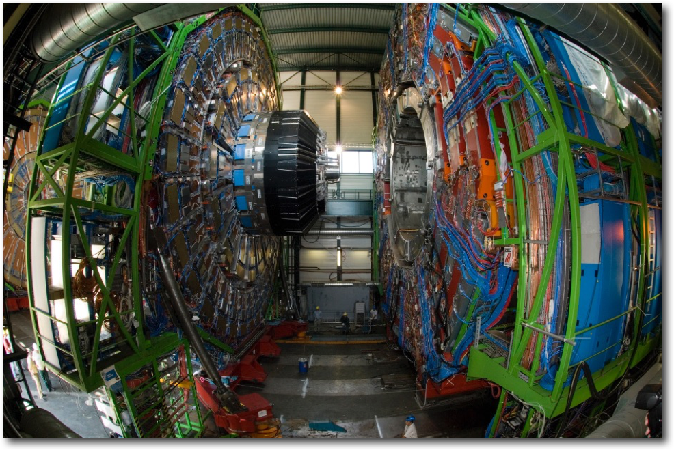
The challenges of CMS Calorimetry
Roger Rusack
The University of Minnesota

Slide 2
Outline
Brief outline of calorimetry in CMS
Our plans for the short and long term upgrades.
Ideas explored for the Phase 2 Upgrade.
Lessons learnt.
R&D for the future.

Slide 3

CMS Calorimeters
ECAL – lead tungstate crystal calorimeter
Brass scintillator hadron calorimeter
Quartz fiber calorimeter.

Slide 4
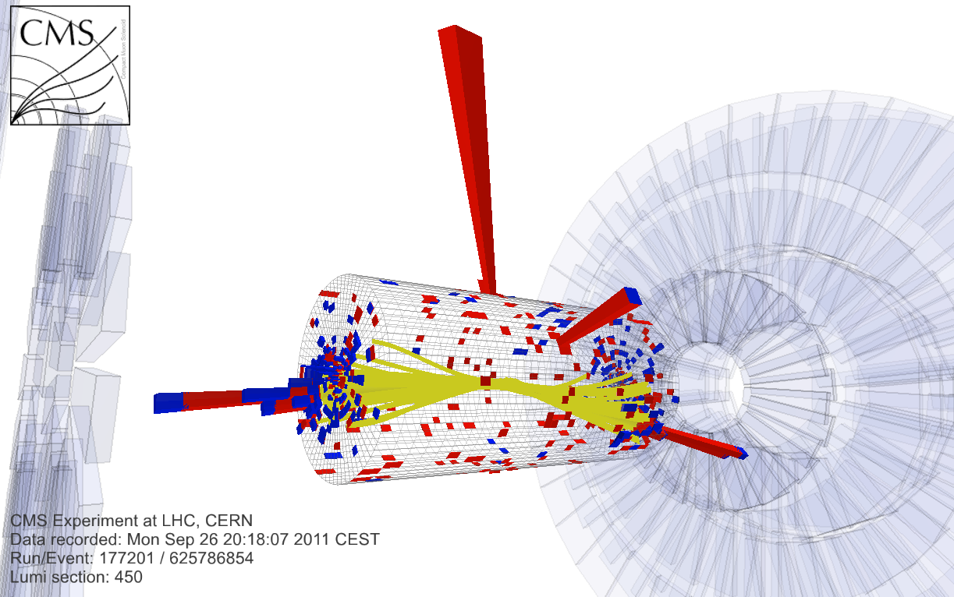

Slide 5
What we have now
Electromagnetic calorimeter.
  Lead tungstate crystals readout with larger area APDs.
Hadronic Calorimeter:
  Brass – scintillator sampling calorimeter readout with HPDs now to be replaced by SiPMs in LS2.

Slide 6
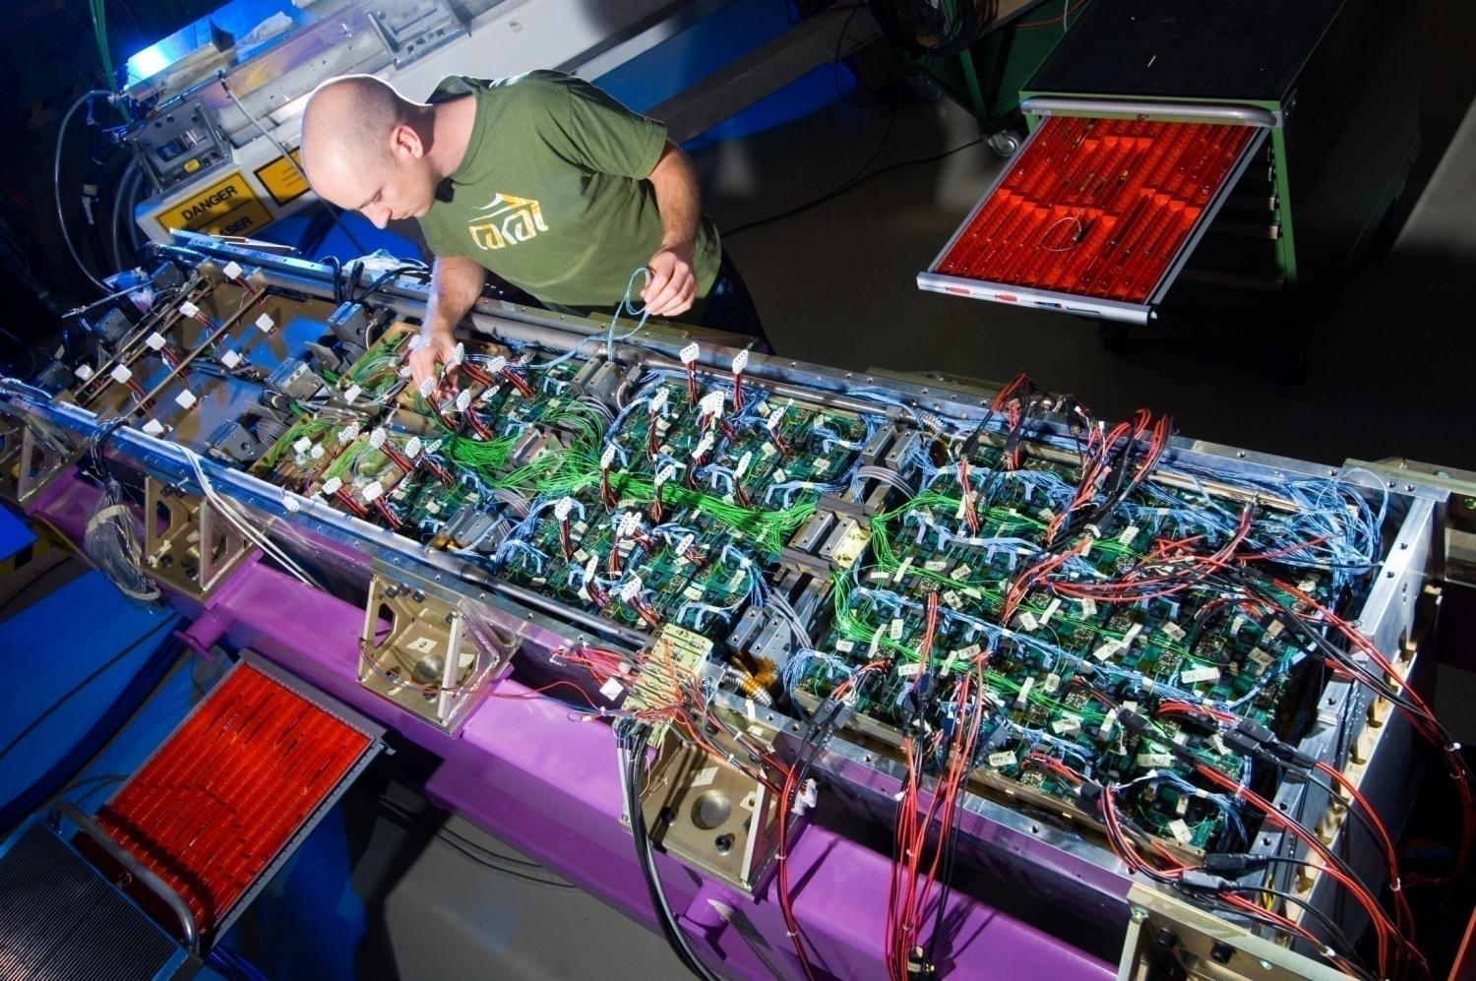
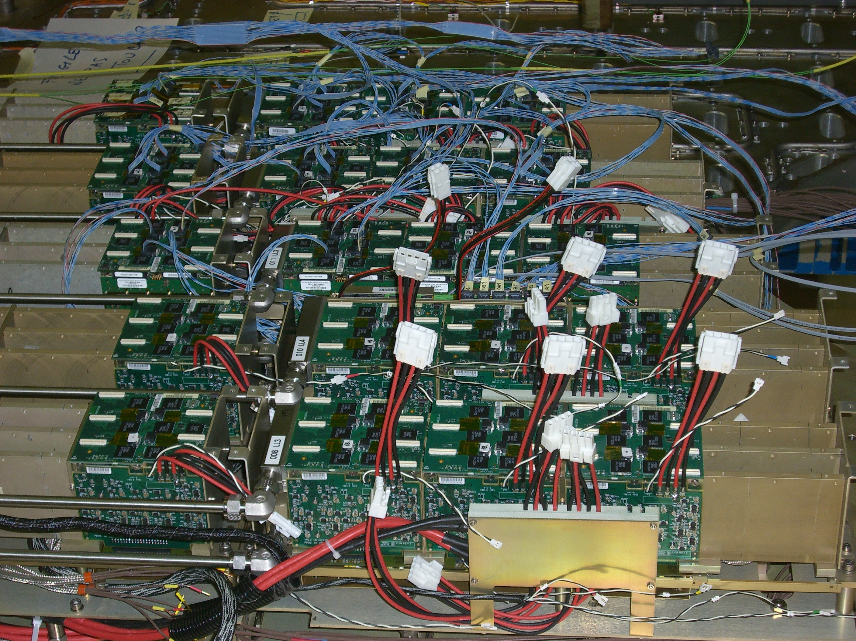
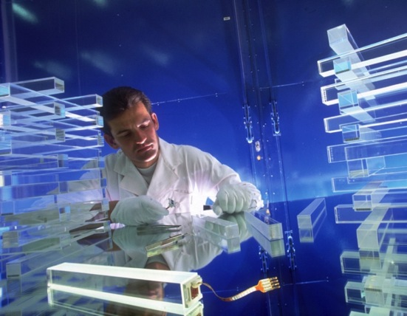
Crystal Calorimeter
Lead tungstate crystals readout with avalanche photodiodes in linear mode.
72,000 crystals 23 and 25/23 X₀. Two 25 mm² APDs per crystal.
Ground-breaking technology at the time.

Slide 7
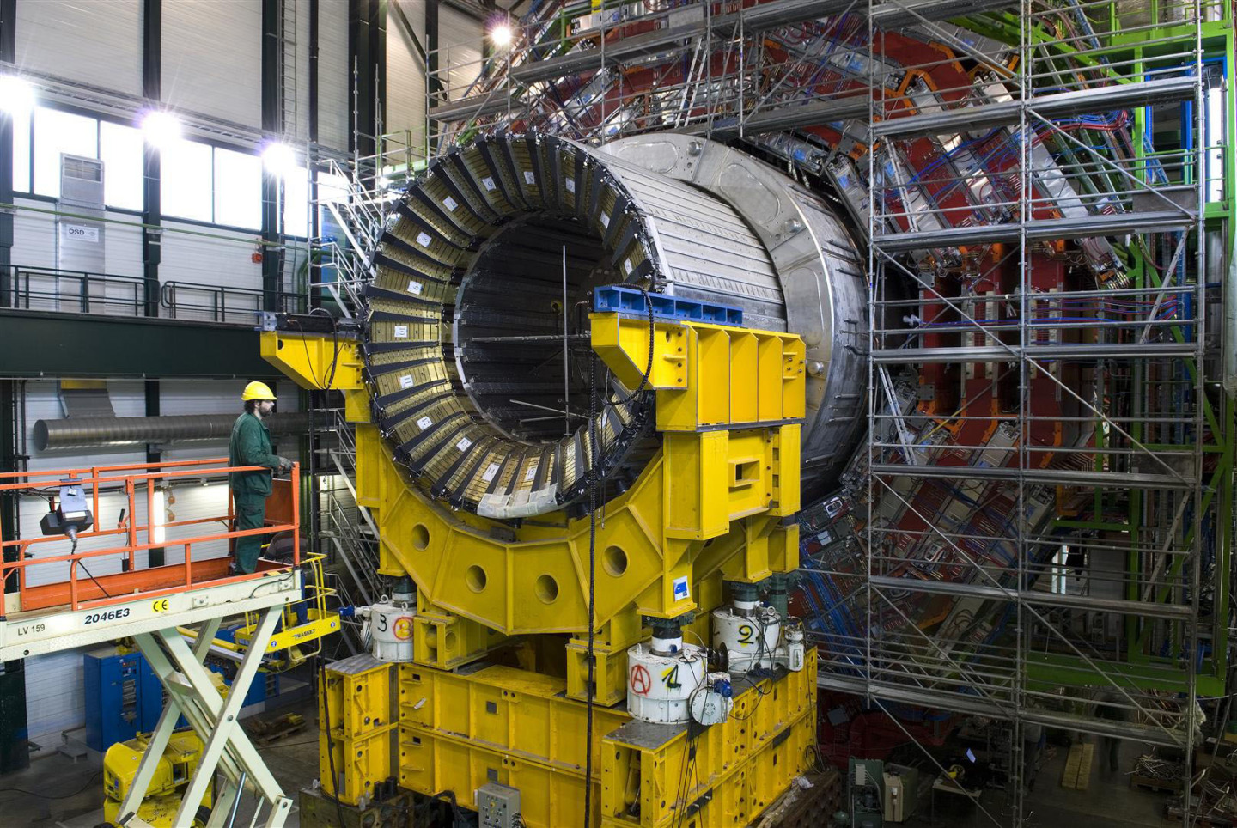
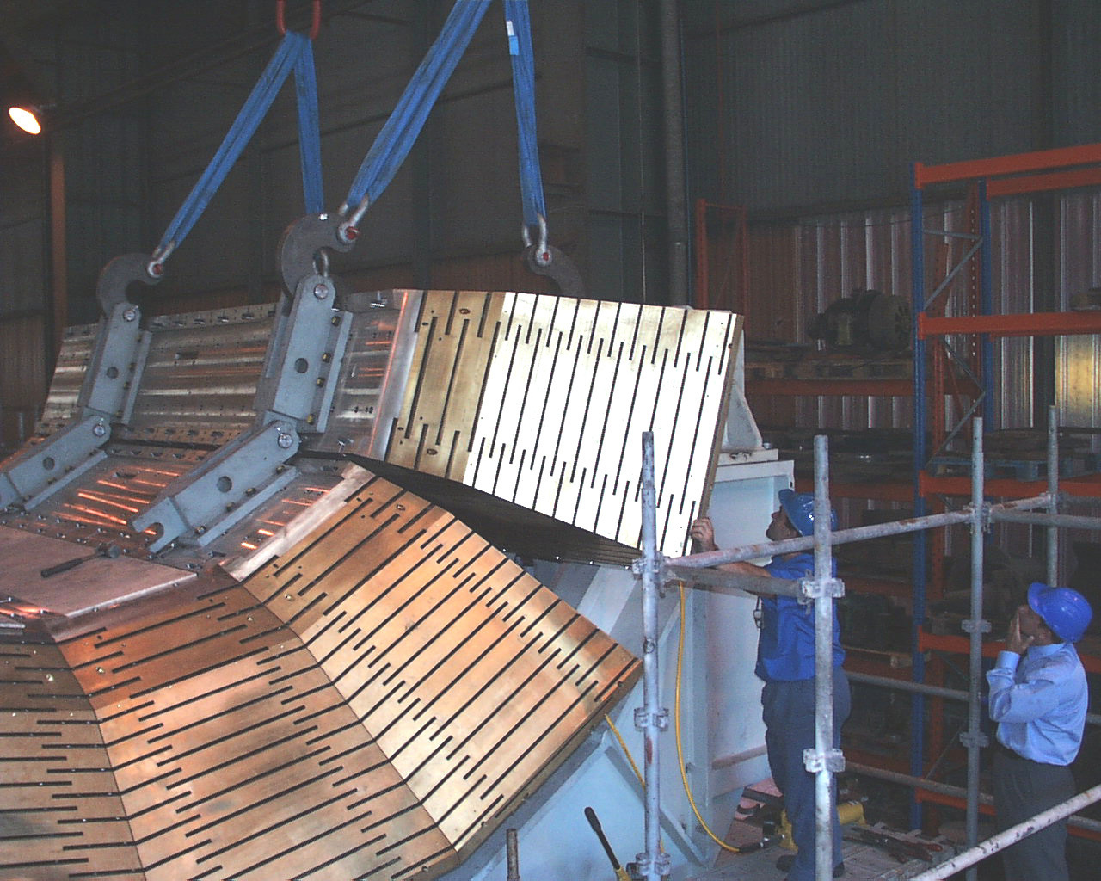
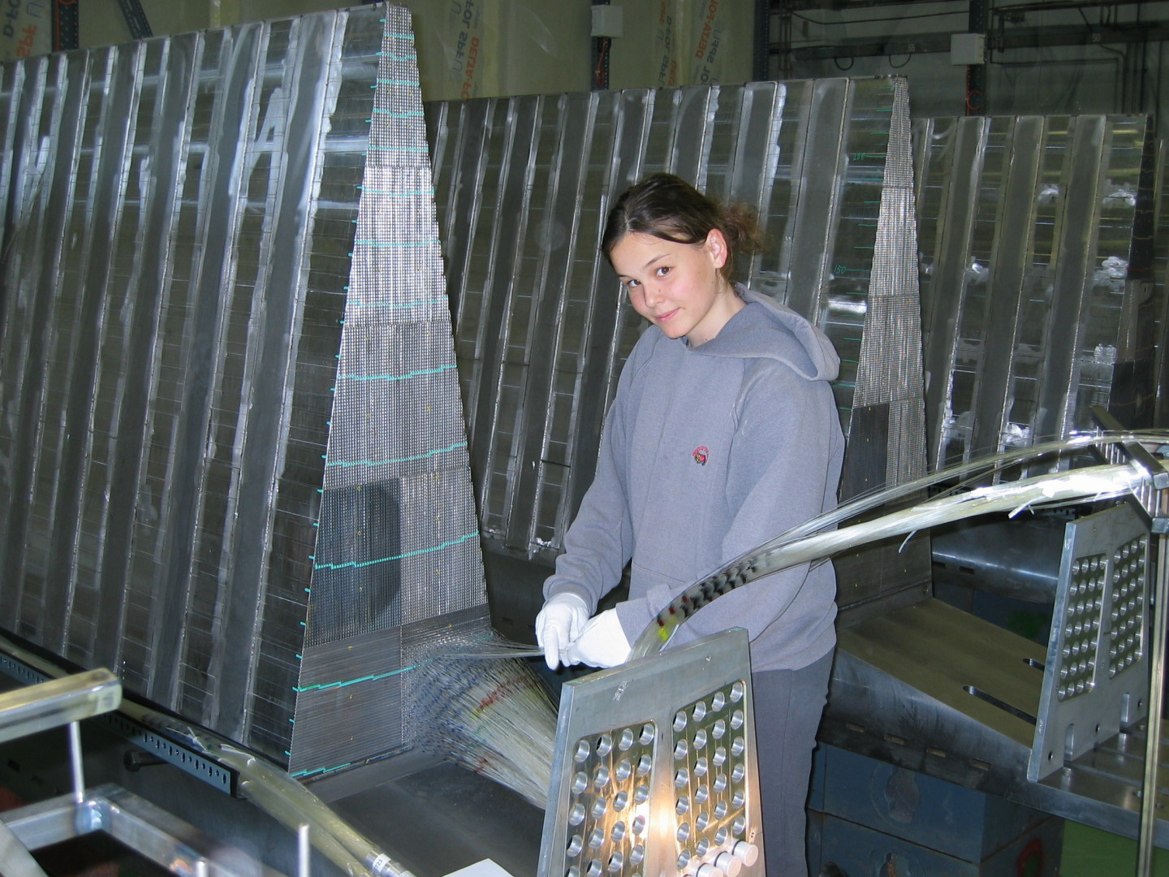
Hadron Calorimeter
Scintillator tiles readout with WLS fibers coupled to quartz fibers.
Optical readout is Hybrid photodiodes – changing to SiPMs to improve signal-to-noise.

Slide 8
The Upgrade for HL-LHC
The problem we are trying to solve with this upgrade:
  High pileup – we are assuming 200 events per 25 ns.
  High radiation η~ 2.5 we are expecting doses of order 1 MSv and integrated neutron fluxes of around 10¹⁶ neutrons/cm².
Approach adopted by CMS
  Upgrade readout of electromagnetic calorimeter.
  Refurbish the scintillator of front part of the our barrel hadron calorimeter
  Replace endcap calorimeters with a new silicon based sampling calorimeter.
  Keep the quartz fiber calorimeter at the highest η region.
Challenges:
  Many detector and engineering challenges to be solved for this program.

Slide 9
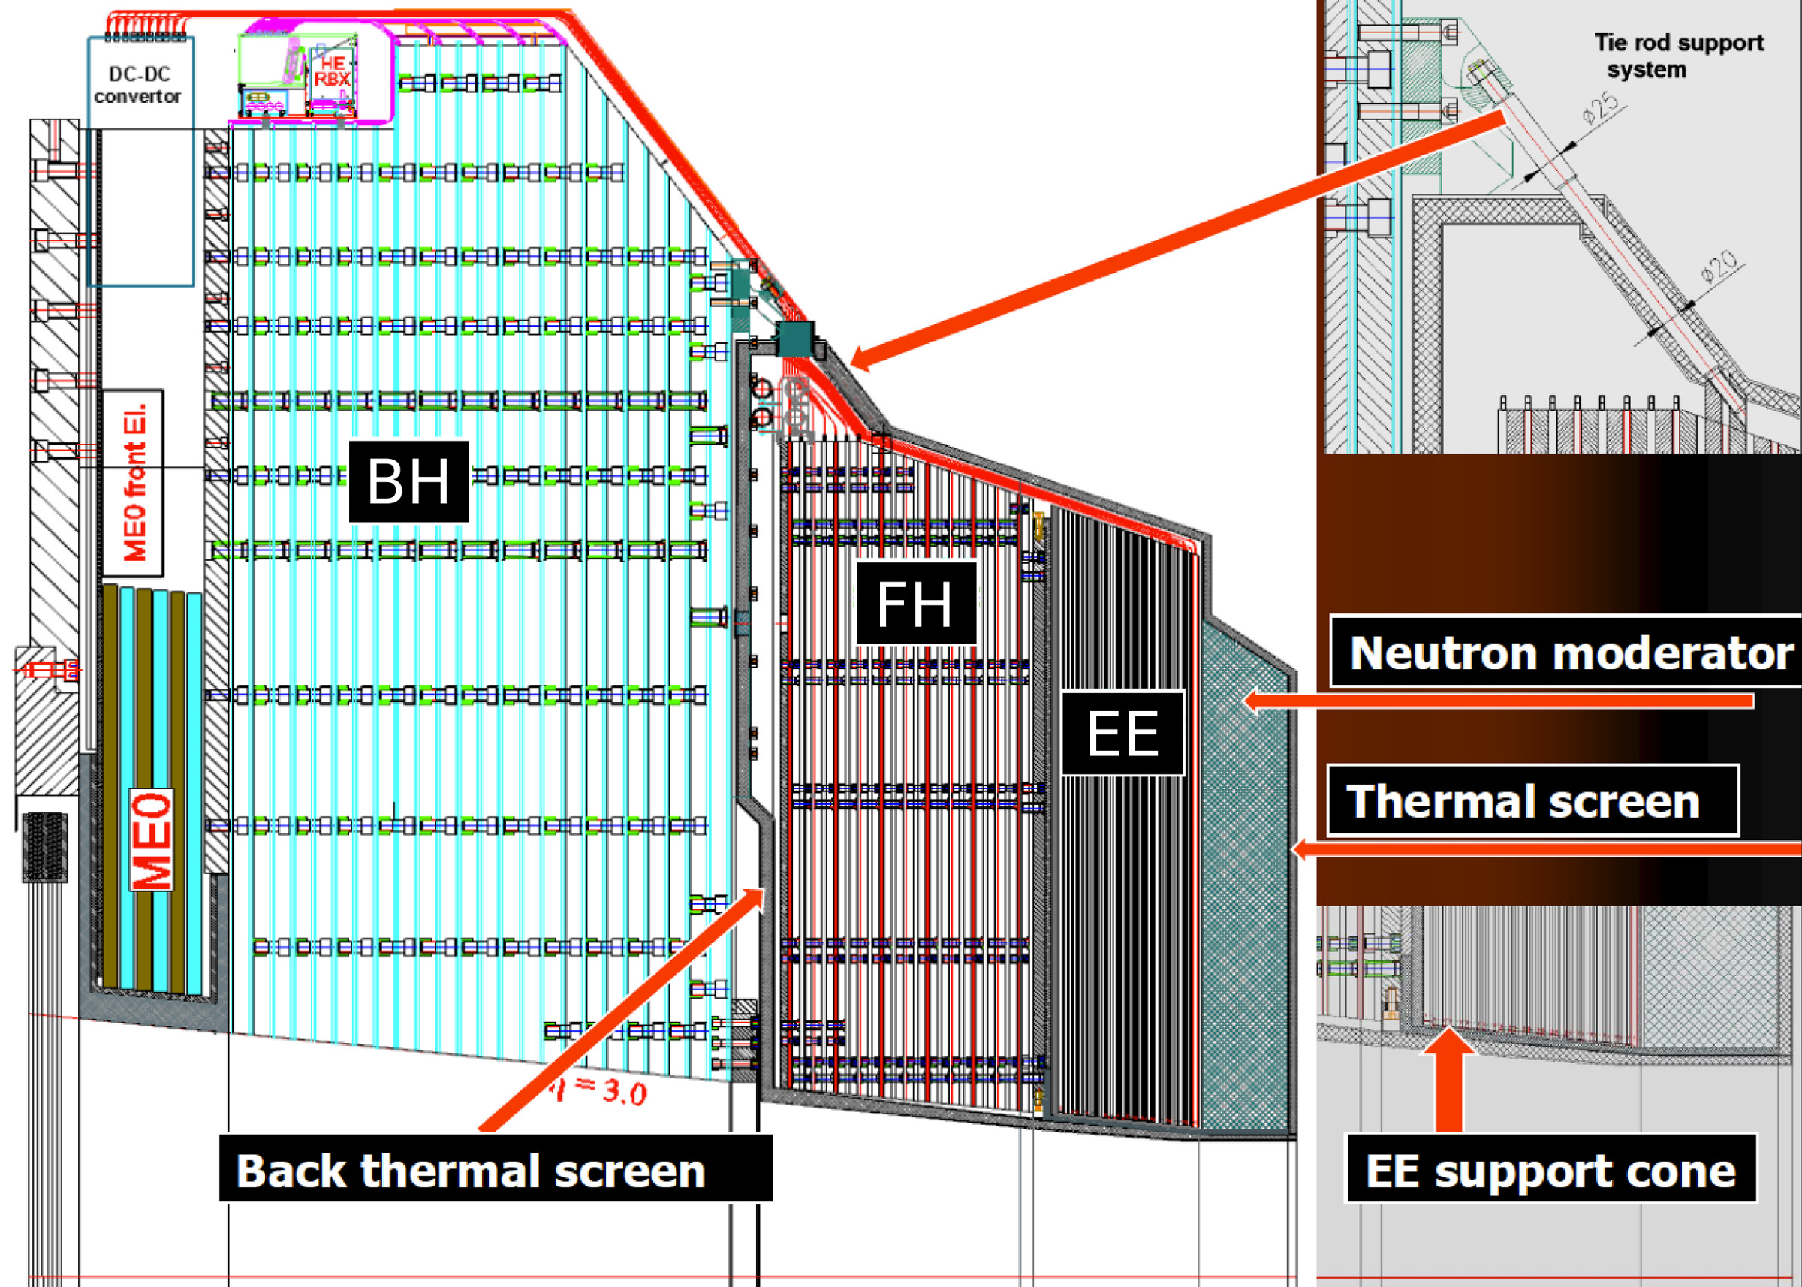
Key Parameters of Endcap Calorimeter
Construction:
Hexagonal Si-sensors built into modules.
Modules with a W/Cu backing plate and PCB readout board.
Modules mounted on copper cooling plates to make wedge-shaped cassettes.
Cassettes inserted into absorber structures at integration site (CERN)
Key parameters:
593 m² of silicon
Pixel size 1 cm and 0.5 cm^{2.}
21,660 modules
92,000 front-end ASICS.
Power at end of life 115 kW.
System Divided into three separate parts:
EE – Silicon with tungsten absorber – 28 sampling layers – 25 X_{o} + ~1.3 λ
FH – Silicon with brass absorber – 12 sampling layers – 3.5 λ
BH – Scintillator with brass absorber – 11 layers – 5.5 λ
EE and FH are maintained at – 30ºC. BH is at room temperature.

Slide 10
Why silicon?
Cheaper than it used to be!
Only sensor material demonstrated to still function at flux levels of 10¹⁶.

Slide 11
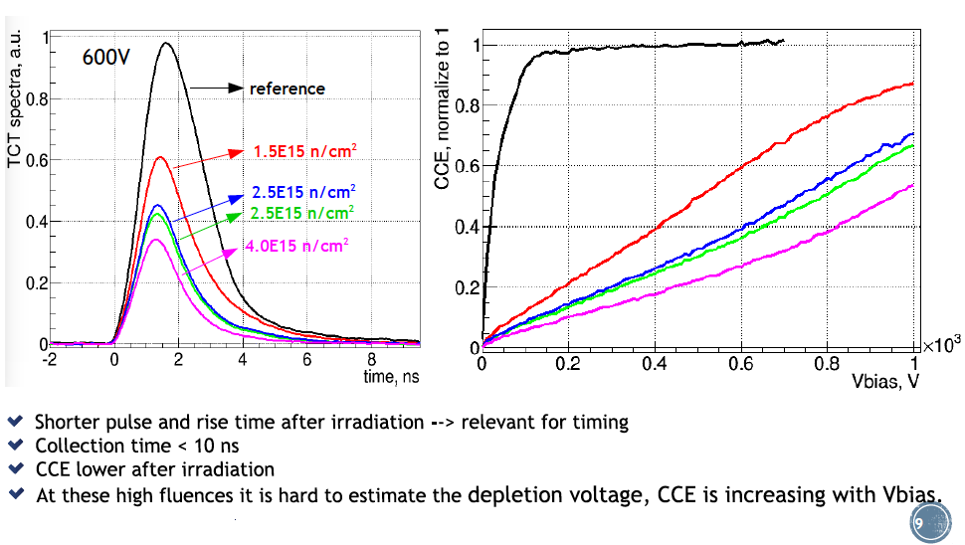
Why silicon?
Lab measurements of irradiated sensors.
Esteban Curras (CERN) Shervin Nourbakhsh (Minnesota)

Slide 12
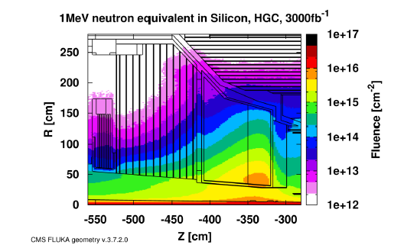
The Detector Challenges
Detector materials.
  Silicon & Scintillator.
Radiation hard electronics.
  Low power large number of channels.
Module Engineering
  Need automated assembly
Low power rad-hard front-end preamp.
  Data flow on and off detector.
Precision timing:
  Registration.
  Clock distribution at the system level.
Data Extraction
  6 million channels at 40 MHz 12-bits/channel.
Power distribution.
  DC-DC converters.
System cooling.
  Operation at -30ºC due to irradiation of the silicon.
Event reconstruction and selection.
  Real time pattern recognition at level 1 and in HLT.

Slide 13
Front-end ASIC
Dynamic range.
  For calibration need to detect MIP signals in sensors and signals from 1 TeV jets
    Dynamic range of 5,000 and noise floor of ~2000 electrons.
Power budget
  Less than 10 mW/channel.
Design proposed by J. Kaplon of CERN
    Low end linear up to 100 fC.
    Top end with time-over-threshold.

Slide 14
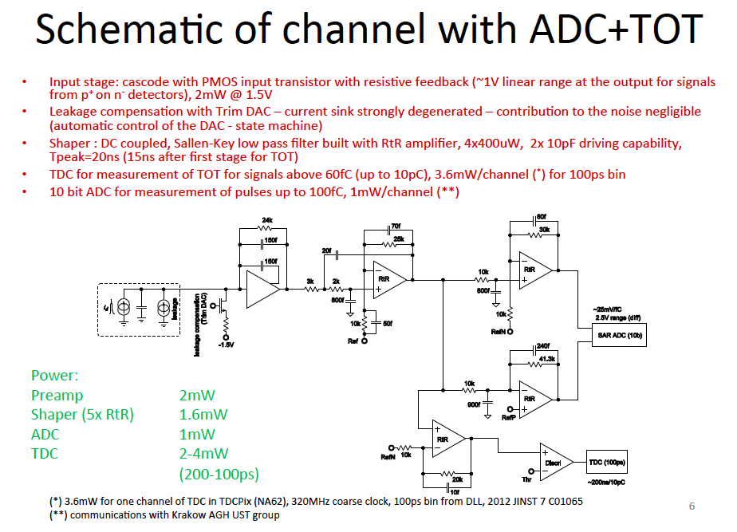
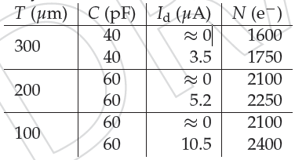
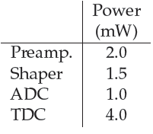
Electronics
Second IBM version
validated at 40MHz
TSCM version
was submitted mid Feb
Jan Kaplon (CERN)
From TDCPix
Presently used in NA62

Slide 15
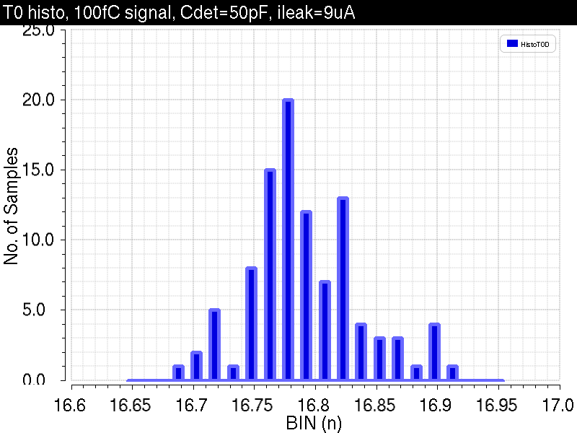
Electronics
Second IBM version
validated at 40MHz
TSCM version
was submitted mid Feb
Jan Kaplon (CERN)
From TDCPix
Presently used in NA62

Slide 16
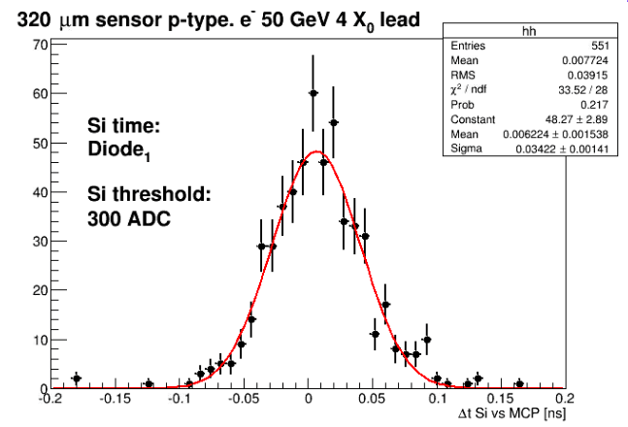
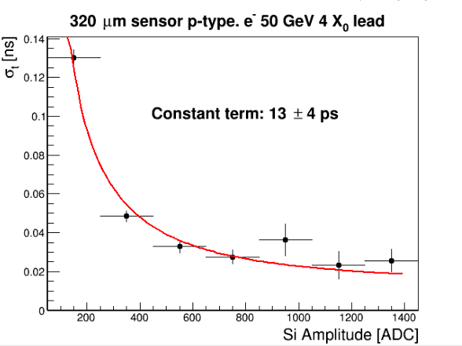
Precision Timing
Consequence of using Time-over-Threshold in the readout is you get a precision timing measurement of signals above ~10 mips.
σ = 39 ps
Measurements by P. Meridiani and T. Tabarelli of precision timing in silicon pixels at 4 X₀ with reference MCP. Constant term limited by the MCPs.
In HGC we are designing for a 50 psec resolution.
Limit is power budget.

Slide 17
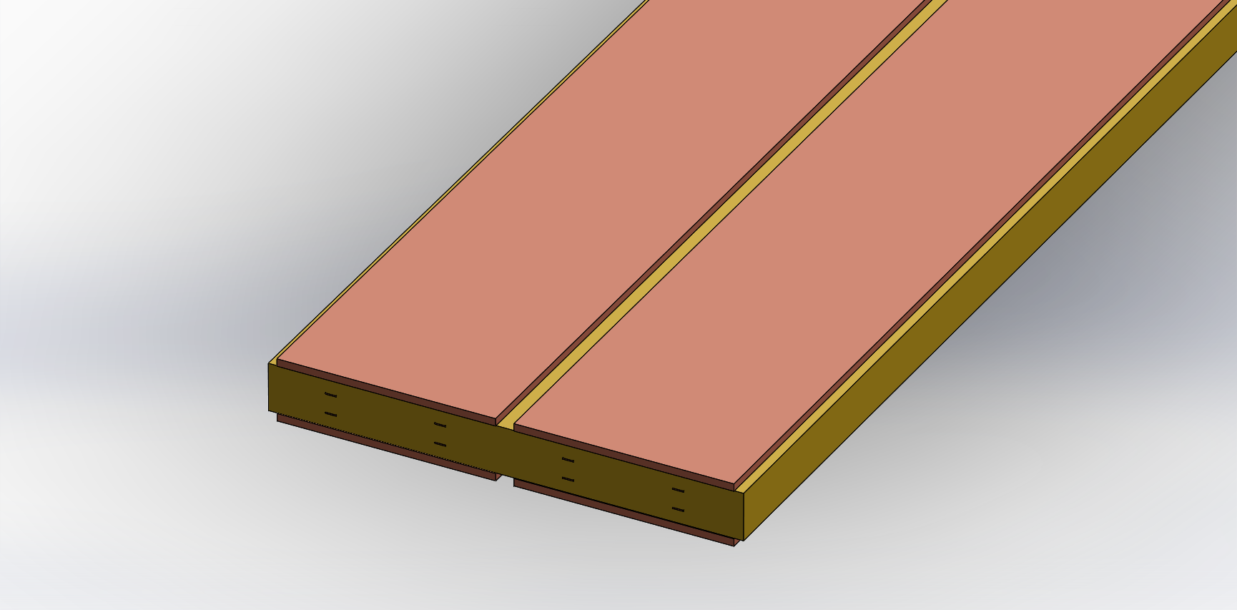
Data Extraction
Problem: How to extract data and supply power to the electronics in the narrow gap.
Default to use Twin-Ax cables for the signals and kapton for the power bus.
Alternative under investigation.
Combine functionality. Use thick copper on PCBs to deliver power.
Embedded transmission lines in PCBs.
Embedded
Differential Pairs
Thick Copper
Power Strips

Slide 18
Data Bus
PCB - 21 mm wide (1.5 mm thick)
Copper Conductors
5 mm wide
0.213 mm thick (6 oz.)
Eight High-Speed
Differential Pairs
0.035 mm thick Cu (1 oz.

Slide 19
Measurements at 6.4 Gbps

Slide 20
Data Extraction
Bring signals to edges and convert at periphery to optical
Copper to optical
Benefit from CDRD program to develop a 120 Gbps data link. UMN, FNAL, OSU, SMU.
12-channel low profile VCSEL to fiber connector
The array based mid-board transmitter ATx will have the first prototype next month. 12-channel VCSEL driver in 0.065 nm technology.

Slide 21
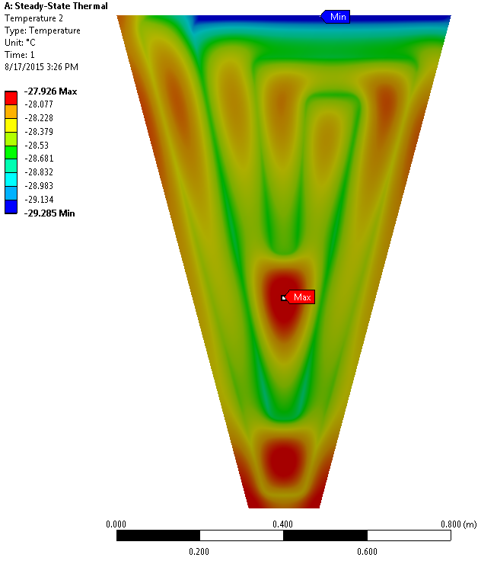
Cooling
Simulation of 6mm copper plate with heat load of 450 W.
CO₂ cooling will by CO2 evaporative cooling.
Viscosity of liquid CO₂ is 100 times less than water.
CO₂ leaves plate colder than when it entered, due to decrease in pressure.
Pressure drop increases inversely to tube radius to the power of 4.7.
Three full-scale test structures all follow predicted temperature behaviour.
Major challenge is the large scale of the cooling plant to deliver CO2. Order of magnitude increase in scale.

Slide 22
Scintillator
We have seen in the current detector a ore rapid degradation of the scintillator than we expected. This is understood as a rate dependent effect. Qualification was done at fluxes much higher than in the detector.
Need to be identify scintillator that will survive the HL LHC era.
At a depth of 5λ radiation levels at HL-LHC become are at ~2 Mrad, which is a tolerable level for scintillator.
* George Santayana

Slide 25
Shopping List -
Where common R&D would help with this project.
  Lower power serializers.
    We have assumed that we would use the LpGBT a ~5 Gpbs serializer ~0.5 mW/channel. Large fraction of th epower budget.
    Power consumption mostly driven by need for precision oscillator. Alternative solution needed.
  System level precision clock distribution.
  Event reconstruction:
    Software – Using Pandora now - topological. 5-dimensional approach needed.
    Image reconstruction --- graphical
  DC-DC converters.
  Graphical Processor Units.
    Image processing after level 1 accept and offline.
  Simulations:
    Advanced tools for event simulation (GEANT5) and activation studies – Fluka++.

Slide 26
Summary
CMS has ambitious plans for calorimeters in the HL-LHC era.
We have benefitted from R&D done for the ILC by the CALICE collaboration.
There are many areas of instrumentation research that can be motivated by the CMS upgrade, that would have a much broader impact.

