Slide 1
DOE Office of High Energy Physics Detector R&D Program
CPAD Instrumentation Frontier Meeting
October 5-7, 2015
Glen Crawford, Helmut Marsiske
Office of Science, U.S. Department of Energy

Slide 2
Transform HEP Through New Instrumentation
More generic high-risk/high-impact Detector R&D
Grand Challenges in strategic areas
More detector science
Also from other fields (e.g., material science)
More university involvement
Large under-utilized intellectual potential; limited infrastructure
More young people
Future instrumentation leaders
More communication/interaction
Workshops and conferences/collaboration
More cost-effective
Sharing of resources and better execution
Non-HEP funding sources (other SC, other agencies, SBIR, etc.)
Notes:
This is where we want to go long-term

Slide 3
How to Maintain a Balanced R&D Portfolio?
Flavor of R&D is changing
Less generic, more project-oriented
Total R&D funding is shrinking
Other higher-priority initiatives
Laboratory-university balance off
Weakened university programs due to waning infrastructure
#27: Focus resources toward directed instrumentation R&D
in the near-term for high-priority projects. As the technical
challenges of current high-priority projects are met, restore
to the extent possible a balanced mix of short-term and
long-term R&D
#28: Strengthen university-national laboratory partnerships in
instrumentation R&D through investment in instrumentation at
universities. Encourage graduate programs with a focus on
instrumentation education at HEP-supported universities and
laboratories, and fully exploit the unique capabilities and facilities
offered at each
Notes:
This is what we are struggling with short-term

Slide 4
Growing the Generic R&D Program
Need to make the best out of the (shrinking) resources we currently have available
Do More with Less
Need to grow the R&D program long-term
Need to make compelling argument to SC management to support transformative R&D with (potentially) far-reaching impact across HEP boundaries
⬅ Particle Physics Science & Technology CONNECTIONS
⬅ Grand Challenges
Notes:
This is what we need to do now and then

Slide 5
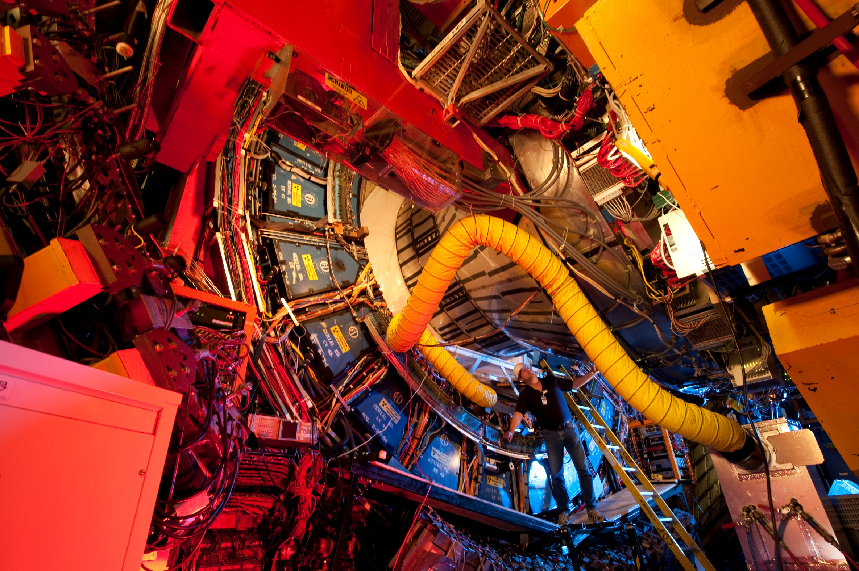
Detector R&D
Notes:
What follows is a description of the current program

Slide 6
The HEP Detector R&D Program
Support research leading to fundamental advances in the science of particle detection, and develop the next generation of instrumentation for HEP initiatives aligned with science priorities
Generic R&D that has the potential for wide applicability and/or high impact
Focus on areas where U.S. can have leadership
Out-innovate the international competition
Enable graduate and post-doctoral research training
Detector R&D research thrusts
Sensors and integrated/front-end electronics
Detector Systems
Trigger and Data Acquisition
Core funding for a few key staff

Slide 7
The HEP Detector R&D Program, cont.
Support infrastructure—technical personnel, equipment, facilities, and test beams—required for technology development and detector fabrication
Detector development and testing facilities (e.g., SiDet)
Test beams for detector testing and evaluation
NOT intended to fund R&D needed for specific HEP projects or facilities
Not for projects that have achieved DOE Critical Decision - 0

Slide 8
Program Funding and Effort
Total funding in FY2015 ~$28M for research as well as detector facilities/test beam operations
85-90% of funding to national labs for research and operations
Largely focused on HL-LHC upgrades and DUNE/SBN
Supports efforts at 5 national labs (~75 FTEs at ANL, BNL, FNAL, LBNL, SLAC) and ~20 universities ( ~25 FTEs)
National labs: annual budget briefings, field work proposals (FWPs), and lab comparative review (last in 2012; next in February 2016)
Universities: annual funding opportunity announcement (FOA) and university comparative review (since 2012)
Special solicitations for Advanced Detector R&D and Collider Detector R&D in the past (last in 2011)
Notes:
Some facts for FY15.

Slide 9
Funding Model for Detector R&D
Type of R&D | Project-specific | Near-term, “incremental” | Mid-term, “demonstration” | Long-term, “generic”
Typical Funding Source(s) | Project funds (post CD-0) OR Program Directed R&D (pre CD-0) | Facility Ops | KA25 Directed R&D | Det R&D Core Special FOAs
Review mechanism | OPA CD review OR Program review | Ops Review | Ad-hoc | Comparative Review
HEP Funding | KA21, 22, 23 Research | KA21, 22, 23 Ops | KA25 | KA25
Examples | LHC Detector upgrades DM G2 R&D | BaBar IFR upgrade | LAPPD | ADR CDRD

Slide 10
We Need Your Ideas…
…How to assess/adjust the existing program
Does it address the technical needs of the P5 science program
Does it address the training/personnel needs
Does it make optimal use of the limited resources we have
…How to formulate a compelling long-term program poised for growth
What are the strategic areas for Grand Challenges that could potentially lead to transformational breakthroughs

Slide 11
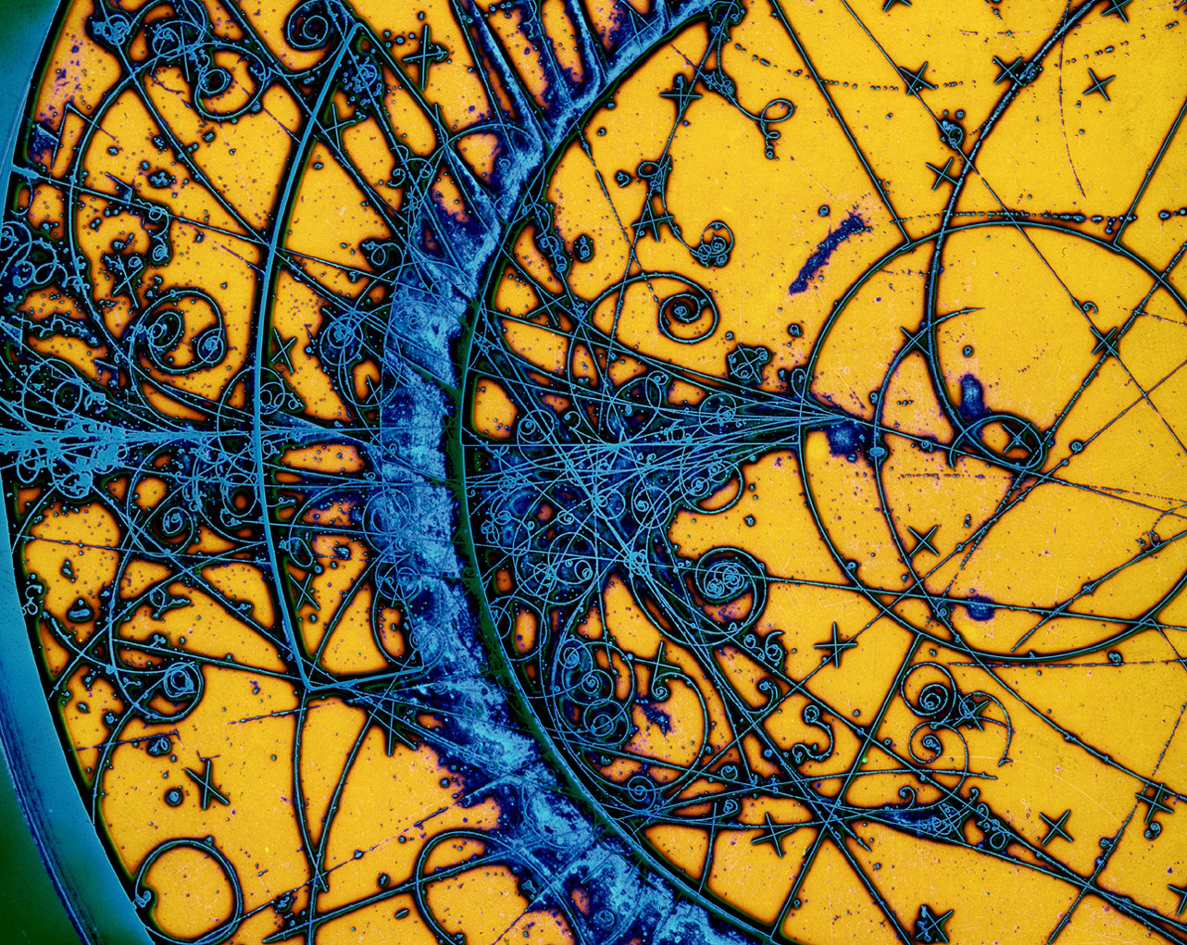
Backup

Slide 12
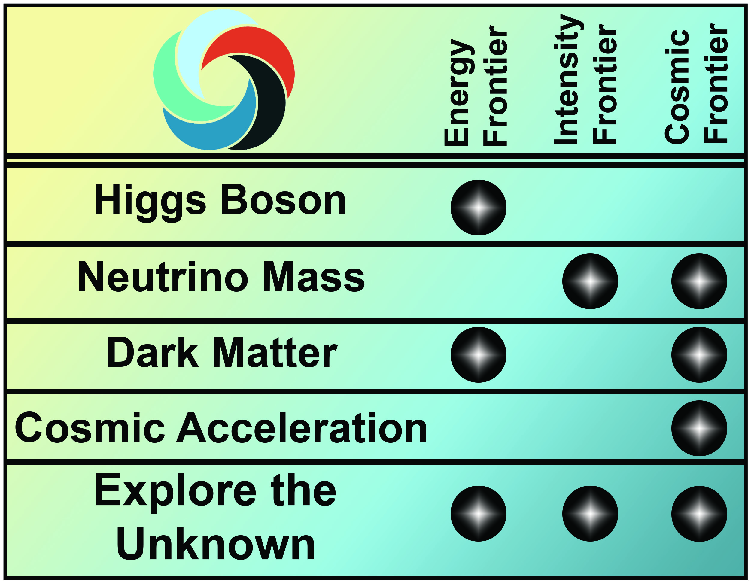
Enabling the Next Discovery
Science drivers identify the scientific motivation while the Research Frontiers provide a useful categorization of experimental techniques

Slide 13
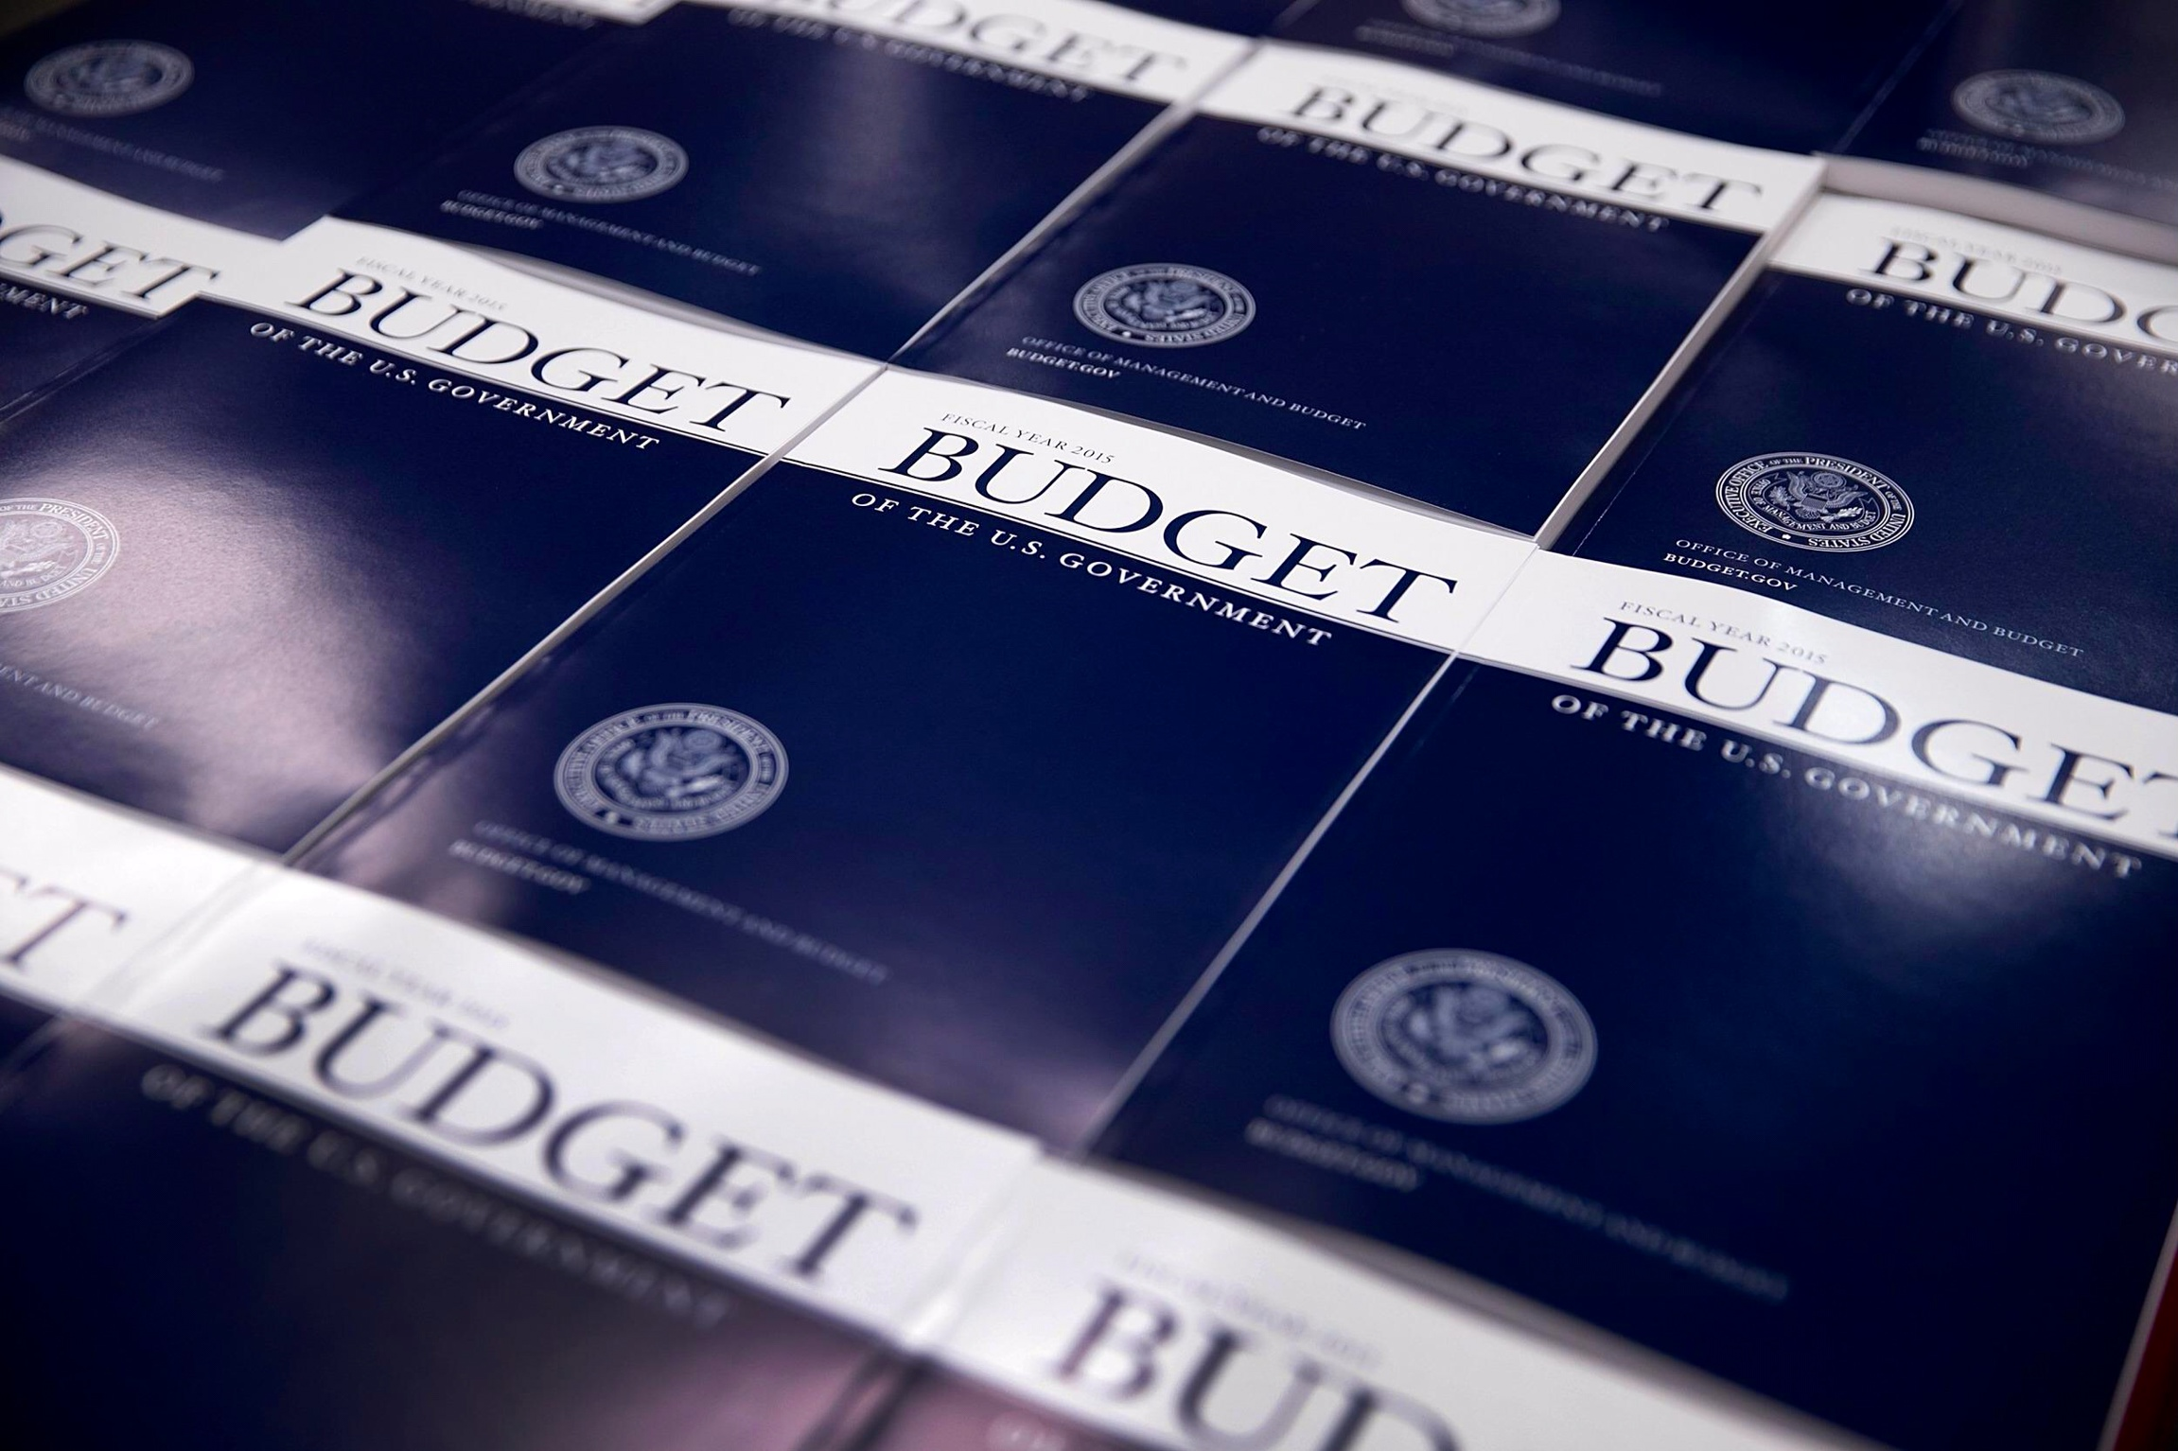
HEP Budget ISSUES

Slide 14
FY 2016 HEP Budget Request Summary
HEP is implementing the strategy detailed in the May 2014 report of the Particle Physics Project Prioritization Panel (P5), formulated in the context of a global vision for the field
HEP addresses the five compelling science drivers with research in three frontiers and related efforts in theory, computing and advanced technology R&D
Increasing emphasis on international partnerships (such as LHC) to achieve critical physics goals
Energy Frontier: Continue LHC program with higher collision energy (13+ TeV)
The U.S. will continue to play a leadership role in LHC discoveries by remaining actively engaged in LHC data analysis and the initial upgrades to the ATLAS and CMS detectors
Intensity Frontier: Develop a world-class U.S.-hosted Long Baseline Neutrino Facility
Continue the design process for an internationalized LBNF and development of a Short-Baseline Neutrino Program that will support the science and R&D required to ensure LBNF success
Fermilab will continue to send world’s highest intensity neutrino beam to NOvA, 500 miles away to Ash River, MN
Cosmic Frontier: Advance our understanding of dark matter and dark energy
Immediate development of new capabilities in dark matter detection by continuing development of 2nd generation experiments; and in dark energy exploration with baselining of DESI and fabrication of LSST camera

Slide 15
FY 2016 HEP Funding by Activity
HEP Funding Category ($ in K) | FY 2014 Current | FY 2015 Enacted | FY 2016 Request | Explanation of Changes (FY16 vs. FY15)
Research | 373,932 | 337,383 | 334,703 | Research reductions support project investments
Facilities | 278,683 | 265,125 | 262,658 | Maintain efficient operations of facilities and ongoing experiments
Projects | 71,305 | 105,698 | 113,401
Energy Frontier Projects | 0 | 15,000 | 19,000 | Ramp up in LHC detector upgrades fabrication
Intensity Frontier Projects | 37,400 | 43,970 | 33,700 | Continue g-2 and FNAL acc. upgrade profiles; some LBNE efforts move to construction
Cosmic Frontier Projects | 30,705 | 45,728 | 58,701 | Increase supports LSSTcam, DESI and second generation dark matter experiments
Other Projects | 3,200 | 1,000 | 2,000 | Planned Lattice QCD hardware acquisition
Construction (Line Item) | 51,000 | 37,000 | 56,100 | Planned profile for Mu2e; engineering and design for LBNE
SBIR/STTR | 21,601* | 20,794 | 21,138
Total | 796,521* | 766,000 | 788,000 | House mark: $776 M; Senate mark: $788.1 M
adf
* SBIR/STTR added to FY 2014 for comparison to FY 2015/2016

Slide 16
Funding Trends by Fiscal Year (FY 2016 shows President’s Request)
Ramp up ILC and SRF R&D programs
Begin
P5
Plan
Trading Projects for more Research
P5 report recommendation suggests increasing the project budget fraction to 20%–25%
“Addressing the [science] Drivers in the coming and subsequent decades requires renewed investment in projects.”
Research fraction consistent with the “>40%” guideline in the P5 report

Slide 17
FY 2016 HEP Budget Request Overview

