Slide 1
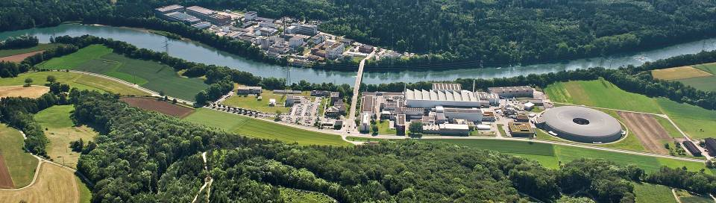
Future of cLFV using muons
Stefan Ritt, Paul Scherrer Institute, Switzerland
- a technological approach

Slide 2
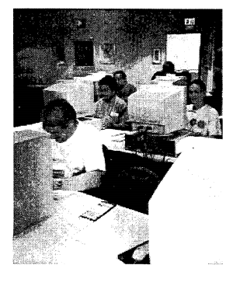
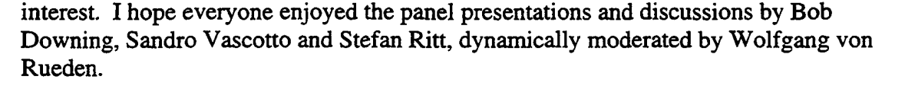
Predicting the Future
11th Real Time Conference, Santa Fe, NM, 1999
What will dominate the future of DAQ?
PCs for Data Acquisition
Linux as Operating System
Java for DAQ programming
→ 66% success rate

Slide 3
Agenda
Introduction to cLFV experiments
Technical requirements
Current and future solutions
  Muon beams
  Calorimetry
  Tracking
  Timing
  (Crate standards)
  Data visualization

Slide 4
Why is cLFV so interesting?
New physics can be explored through virtual loops in low energy high precision experiments, reach O(100 TeV)
While cLFV is forbidden in SM, it is possible on most SM extensions
μ⁺ → e⁺γ
Standard Model
SUSY
γ
γ
W⁻
μ⁻
ν_{μ}
ν_{e}
e⁻
μ⁻
e⁻
Experimental limit: BR(μ⁺ → e⁺γ) < 5.7 x 10⁻¹³
MEG collaboration, PRL 110 (2013) 201801

Slide 5
cLFV with muons
MEG I, MEG II (CH)
Mu3e (CH)
Mu2e (US), COMET (JP), DeeMe (JP)
μ⁺ → e⁺ γ | μ⁺ → e⁺ e⁻ e⁺ | μ⁻ N → e⁻ N
52.8 MeV
γ
e
N
Signal
e
μ
μ
180°
μ
e
e
e
52.8 MeV
< 52.8 MeV
γ
e
ν
Decay in orbit
ν
ν
ν
μ
e
Dominant Background
e
e
μ
ν
μ
μ
ν
e
ν
π
γ
e
e
e
< 52.8 MeV
ν
beam pion

Slide 6
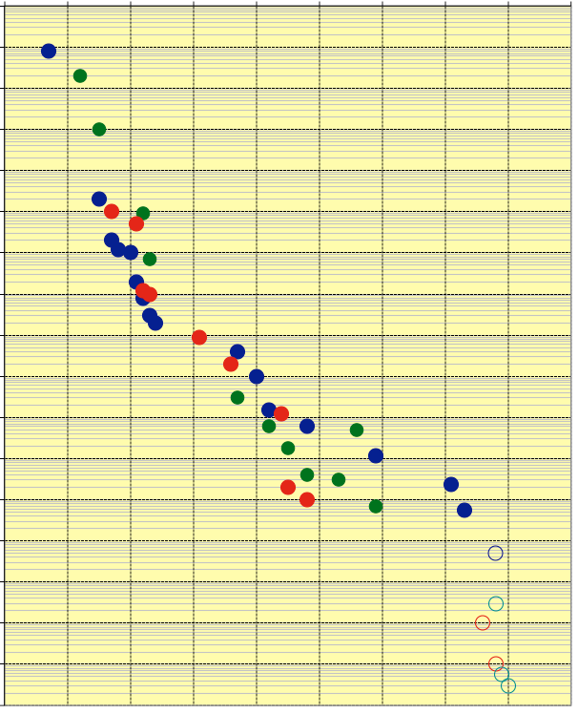
History of cLFV experiments
10⁻⁰
10⁻¹
μ → e γ
10⁻²
μΑ → eA
10⁻³
μ → eee
10⁻⁴
stopped π
10⁻⁵
10⁻⁶
10⁻⁷
μ beams
10⁻⁸
10⁻⁹
stopped μ
10⁻¹⁰
10⁻¹¹
10⁻¹²
MEG I
10⁻¹³
MEG II
10⁻¹⁴
COMET (phase 1)
10⁻¹⁵
Mu3e (phase 1)
10⁻¹⁶
Mu3e (phase 2)
Mu2e
COMET (phase 2)
10⁻¹⁷
1940
1950
1960
1970
1980
1990
2000
2010
2020
2030

Slide 7
Requirements for cLFV experiments
Muon beam
  10⁻¹⁷ sensitivity requires >10¹⁷ muons per year
  stopping target (low mass)
  pulsed vs. DC beam
Gamma detector (μ⁺ → e⁺ γ)
  Good efficiency (solid angle)
  Good resolutions in energy,
  position and time
Positron/Electron detector
  Good position resolution for
  momentum, tracking, vertexing
  Good time resolution
20 – 100 MeV

Slide 8
Muon Beams

Slide 9
Pulsed vs. DC muon beam
Coincidence experiments
μ⁺ → e⁺ γ
μ⁺ → e⁺ e⁻ e⁺
Limited by accidental background
R_{bck} ∝ Rμ²
DC muon beam is best
μ – e conversion
Limited by pions in beam
Contamination <10⁻¹⁷
Only possible with pulsed beam
background
Detector active
sensitivity
signal
events
muons
τ_{μ}=2.2 μs
pions
τ_{π}=26 ns
protons
μ rate
1-2 μs
time

Slide 10
Current and planned muon beams
Laboratory | Beam line | DC rate [Hz] | Pulsed rate [Hz]
PSI (CH) 0.59 GeV / 1.3 MW | LEMS | 4･10⁸ (μ⁺)
 | πE5 | 1.6･10⁸ (μ⁺)
 | HiMB | 1･10¹⁰ (μ⁺) (>2018)
J-PARC (JP) 3 GeV / 210 kW (planned 1 MW) | MUSE D-line |  | 3･10⁷ (μ⁺)
 | MUSE U-line |  | 6.4･10⁷ (μ⁺)
8 GeV / 56 kW | COMET |  | 1･10¹¹ (μ⁻) (2020)
8 GeV / 300 kW | PRISM/PRIME |  | 10¹¹-10¹² (μ⁻) (>2020)
FNAL (USA)
8 GeV / 25 kW | Mu2e |  | 5･10¹⁰ (μ⁻) (2020)
0.8 GeV / 100 kW | PIP-II |  | 2･10¹² (μ⁻) (> 2022)
TRIUMF (CA) 0.5 GeV / 75 kW | M20 | 2･10⁶ (μ⁺)
RAL-ISIS (UK) 0.5 GeV / 75 kW | RIKEN-RAL |  | 1.5･10⁶ (μ⁺)
KEK (JP) 0.5 GeV / 2.5 kW | Dai Omega |  | 4･10⁵ (μ⁺)
RCNP Osaka (JP) 0.4 GeV / 400 W | MUSIC |  | 10⁴ – 10⁵ (μ⁺/μ⁻) (2016)
DUBNA (RU) 0.66 GeV / 1.6 kW | Phasatron |  | 3･10⁴ (μ⁺)
running
planned

Slide 11
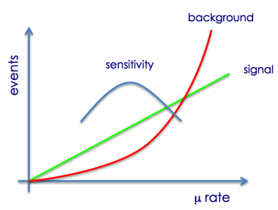
Beam requirements
Experiment | Optimal rate | Possible rate
MEG I | 3･10⁷ | 1･10⁸
MEG II | 7･10⁷ | 1･10⁸
Mu3e Phase I | 1･10⁸ | 1･10⁸
Mu3e Phase II | > 10⁹ | 1･10¹⁰ (>2018)
Mu2e | 5･10¹⁰ | 5･10¹⁰ (2020)
COMET Phase I | 1.3･10⁹ | 1.3･10⁹ (2018/19)
COMET Phase II | 1･10¹² | 1･10¹¹ (>2020)
Long term future:
More muons
More muons
More muons

Slide 12
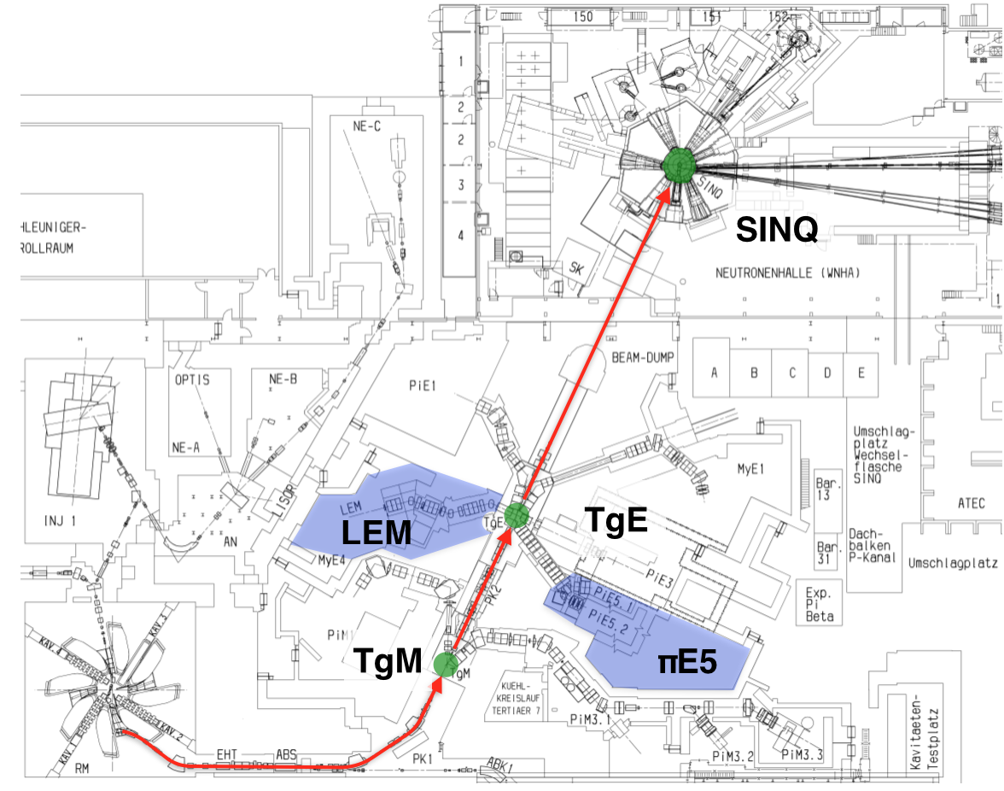
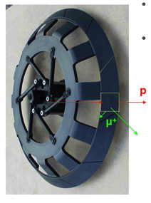
PSI Beam Lines
Target E

Slide 13
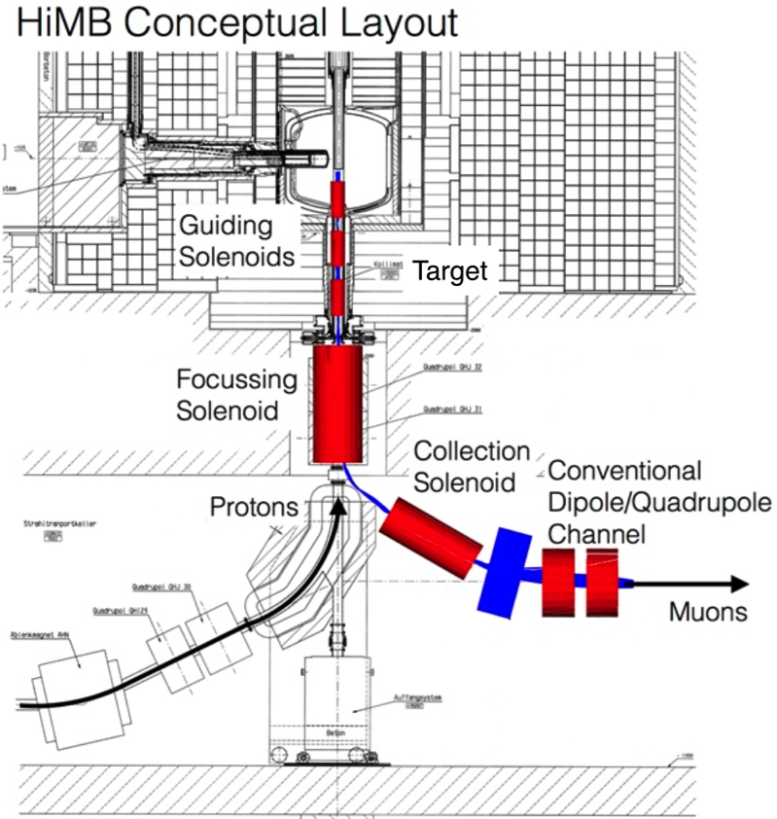
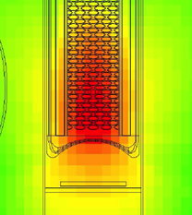
HiMB @ SINQ target
Muons transported opposite of proton beam in a solenoidal channel
Capture large solid angle of full proton beam
First estimates > 10¹⁰ μ / s
Problems:
  SINQ moderator tank imposes severe constraints
  Source collection too low without significant SINQ redesign (impractical)
  → given up
SINQ target

Slide 14

HiMB @ EH
Solenoid Beamline in the Experimental Hall
Just Schematic

Slide 15
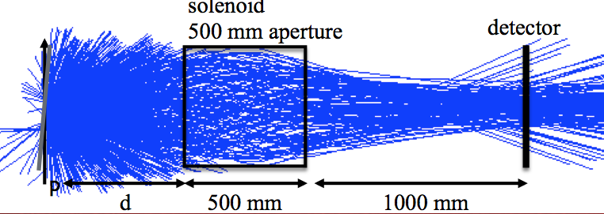
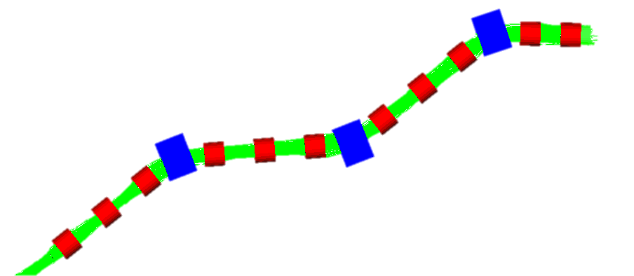
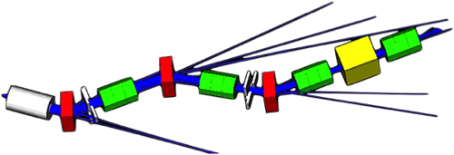
HiMB @ EH details
Feasibility study started 2014
Preliminary conclusions:
  A new 20 mm rotated graphite target seems optimal for muon production
  A capture solenoid (0.5 T) at d = 250 mm can catch 1.5･10¹⁰ μ / s
  A solenoidal beam line can transport ~1･10¹⁰ μ / s
  minor impact on other PSI beam lines
Final conclusion by the end of this year, design will probably follow
p
1.3･10¹¹ μ / s
Conventional beamline (μΕ4)
Proposed solenoidal beamline
5･10⁸ μ / s
1･10¹⁰ μ / s

Slide 16
Calorimetry

Slide 17
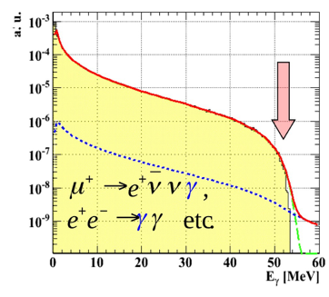
Requirements for photon detector
Radiative Decay
Good efficiency (high Z)
Large solid angle
Good energy resolution
Good position resolution
Good time resolution
< 52.8 MeV
γ
52.8 MeV
γ
ν
μ
μ
180°
ν
e
e
γ Background
52.8 MeV
< 52.8 MeV
Signal Energy
< 52.8 MeV
γ
ν
ν
Total BG
e
μ
Pileup BG
μ
ν
Radiative BG
e
< 52.8 MeV
ν

Slide 18
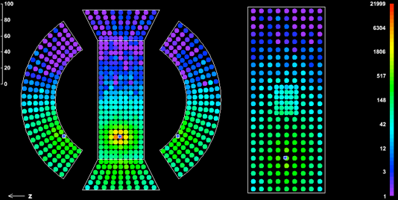
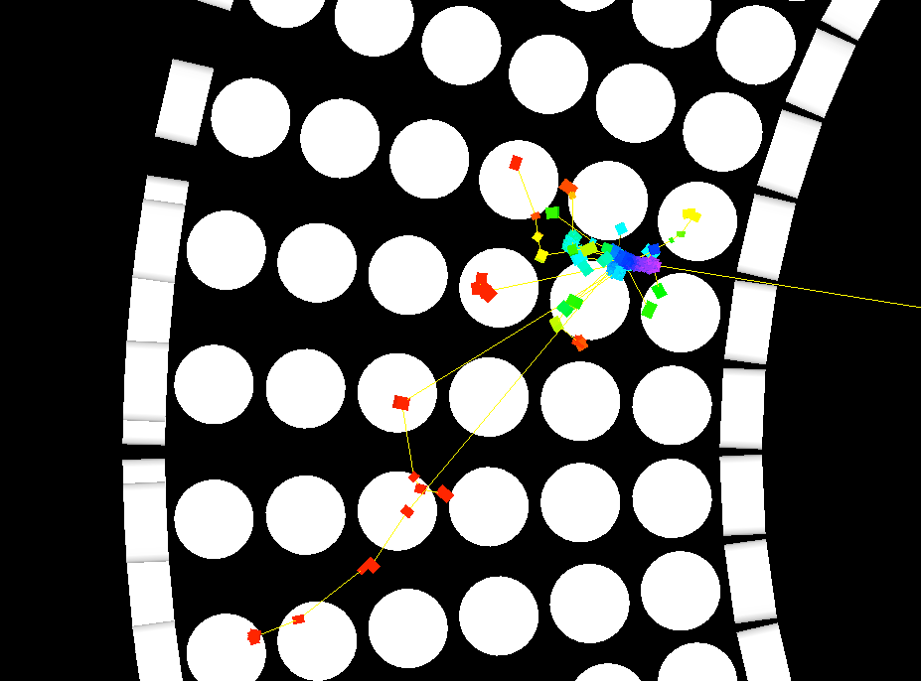
Calorimetry MEG I
Real event
MC
γ

Slide 19
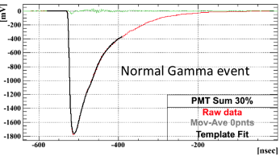
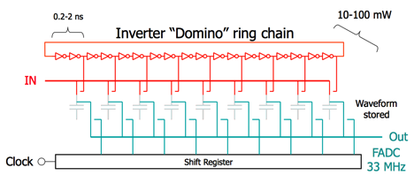
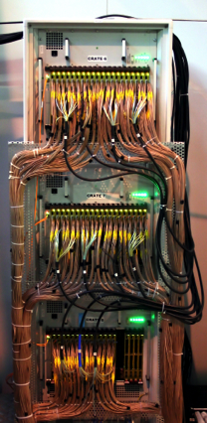
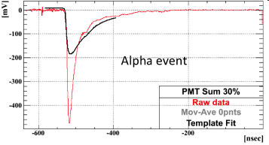
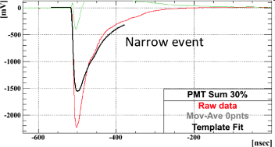
Calorimeter waveforms
DRS4 Chip: 5 GSPS / 11.5 bits
γ
α
μ
γ
900 channels
α
μ

Slide 20
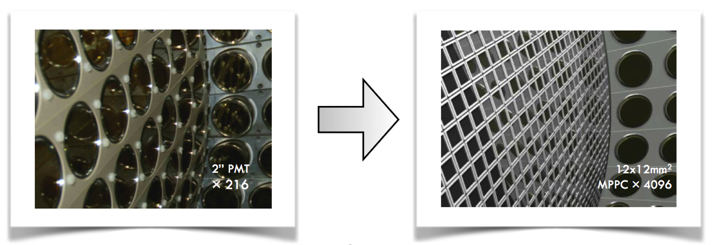
Calorimetry MEG II
Resolution | MEG I | MEG II
x (mm) | 5 | 2.4
y (mm) | 5 | 2.2
z (mm) | 6 | 3.1
E_{γ} (z<2cm) | 2.4% | 1.1%
E_{γ} (z>2cm) | 1.7% | 1.0%
t_{γ} (ps) | 67 | 60
New Hamamatsu VUV SiPM
Tomorrow: Calorimetry
Ryu Sawada: “Noble liquid calorimetry”

Slide 21
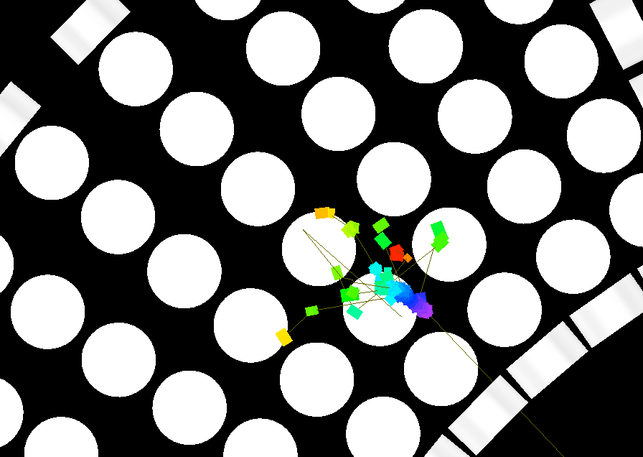
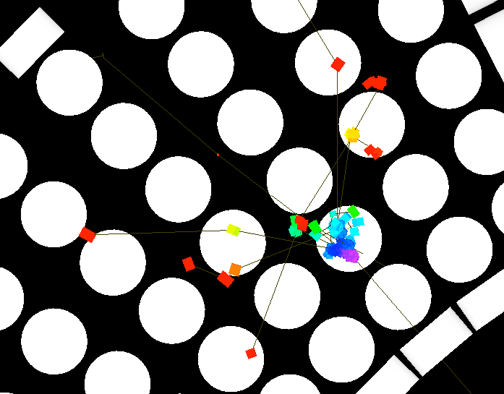
Future calorimetry
Event 1
TPC
use only primary e⁻
use pixel amplifiers with ultra low noise
(< 4e, R. Horisberger, PSI, priv.comm.)
e⁻
e⁻
G. Signorelli (Pisa):
FOXFIRE project
Event 2
Optical TPC
use light and TOF with ~ps resolution to reconstruct full shower
light
Tomorrow: Photodetectors
Eric Oberla: “Optical TPC”

Slide 22
Tracking

Slide 23
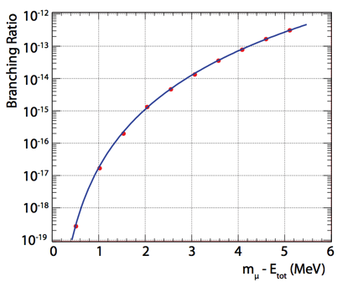
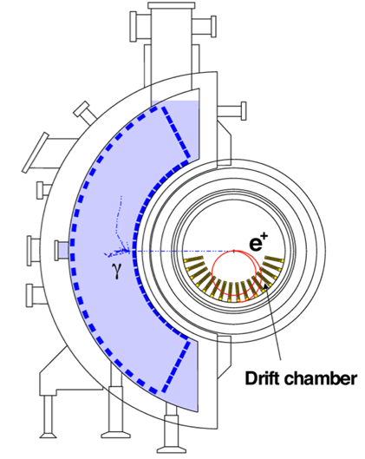
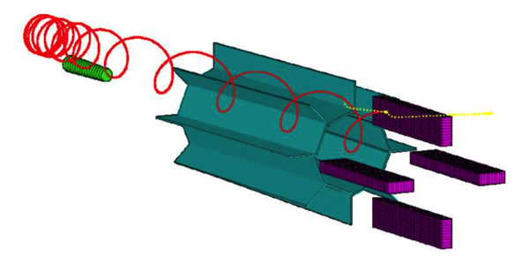
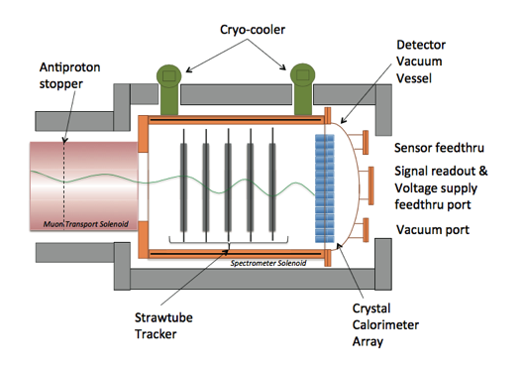
Requirements for charged particle detection
μ⁺ → e⁺ e⁻ e⁺ ν ν
High efficiency and acceptance
High rate capability (10⁸-10¹¹ hits/s)
High energy resolution
  Magnetic spectrometer O(1T)
  → good position resolution O(100 μm)
  → ultra low mass to reduce multiple scattering
  EM calorimeter (time, trigger)
e
ν
e
μ
e
ν
Mu2e
MEG I
COMET

Slide 24
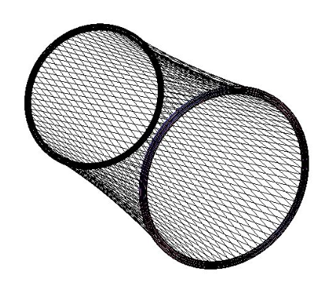
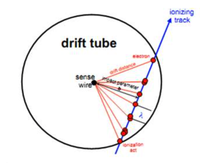
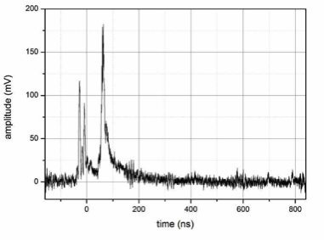
Tracking with DCs and Straws
MEG I
σ_{R} = 210 μm
σ_{Z} = 800 μm
MEG II
σ_{R} = 120 μm
σ_{Z} = 170 μm
Cluster counting
Stereo wires

Slide 25
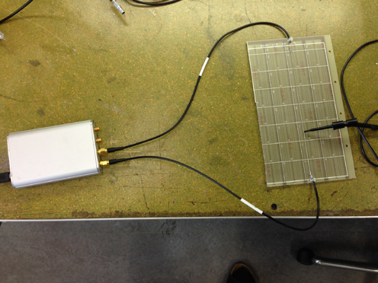
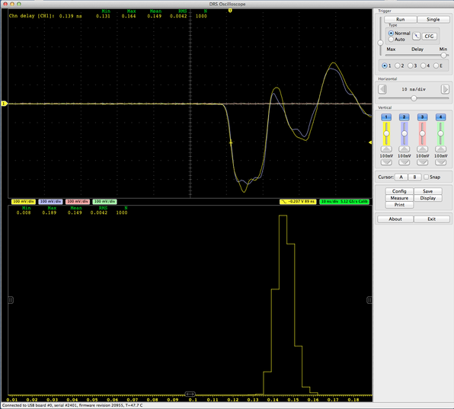
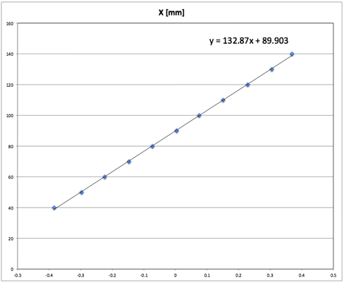
New idea: “Wire-TOF”
Charge division along a wire (DC/Straw) gives ~2 cm resolution
Measuring TOF with new electronics should be much better!
DRS4
Evaluation
Board
4.2 ps
Speed⁻¹: 7.5 ps / mm
Resolution: 560 μm
Tomorrow: Tracking & Vertex
Anatoly Ronzin: “Fast Timing”

Slide 26
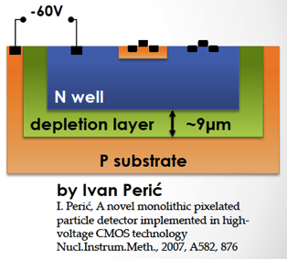
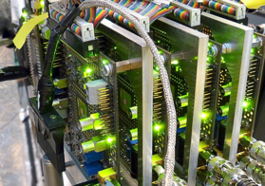
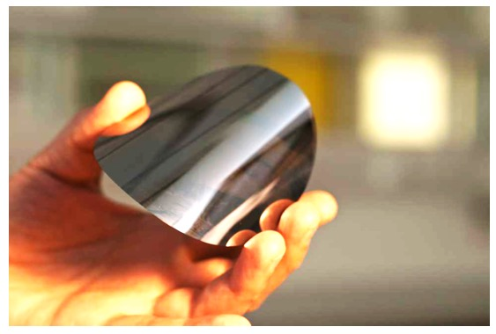
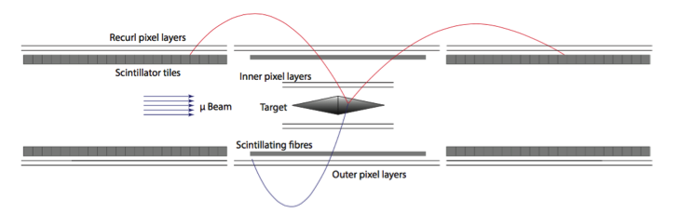
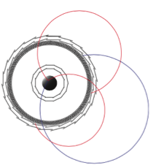
Tracking with HV-MAPS
High Voltage Monolithic Active Pixel Sensors (HV-MAPS)
Reverse biased ~60 V
  fast charge collection < 1ns
  can be thinned to ~50 μm !
  standard HV CMOS technology: ~1000 $ / 8” wafer
  (3.2 $ / cm² vs. 100 $ / cm² for hybrid pixels)
Prototypes successfully tested for Mu3e experiment
  80 μm x 80 μm pixels
  > 99% efficiency
  timing resolution <17 ns
  hit rate capability > 1 MHz / cm²
  X/X₀ = 0.1% including frame, flex print, …
→ attractive replacement for gas detectors!
(minus cooling problem)
Mu3 phase 1B
50 μm thin silicon wafer

Slide 27
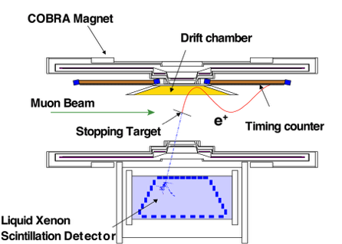
Can’t we make that simpler?
Gas detectors for low mass and good resolution
Scintillation detectors for good timing and triggering
Mu2e
MEG I
COMET
Mu3e

Slide 28
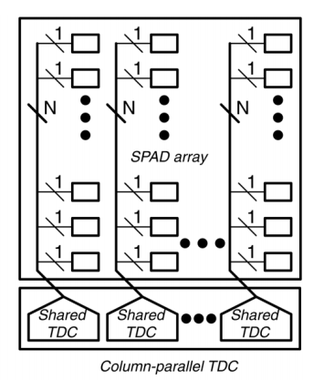
HVMAPS + TDC
Current Mu3e MUPIX
HVMAPS+TDC
50 ps TDC resolution has been demonstrated with SiPMs:
S. Mandai et al.,
IEEE TNS 61 (2014) 44
(Delft University, the Netherlands)

Slide 29
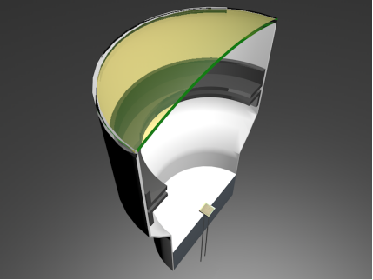
TPC for cLFV experiments
e⁻
Pixel amplifiers/SiPMs
E
Calorimeter
μ
10⁹ tracks / s
R. Horisberger, PSI:
excellent energy resolution
tracking at high rate
problem: ageing
E
Photocathode
No gas gain (ageing!)
VSiPMT can directly detect e⁻ @ 3 keV
(less with reduced SiO₂ layer)
QE = 100% ∙ fill factor, 100 ps timing
SiPM
VSiPMT (Hamamatsu)
G. Barbarino et al, arXiv:1407.2805

Slide 30
Timing

Slide 31
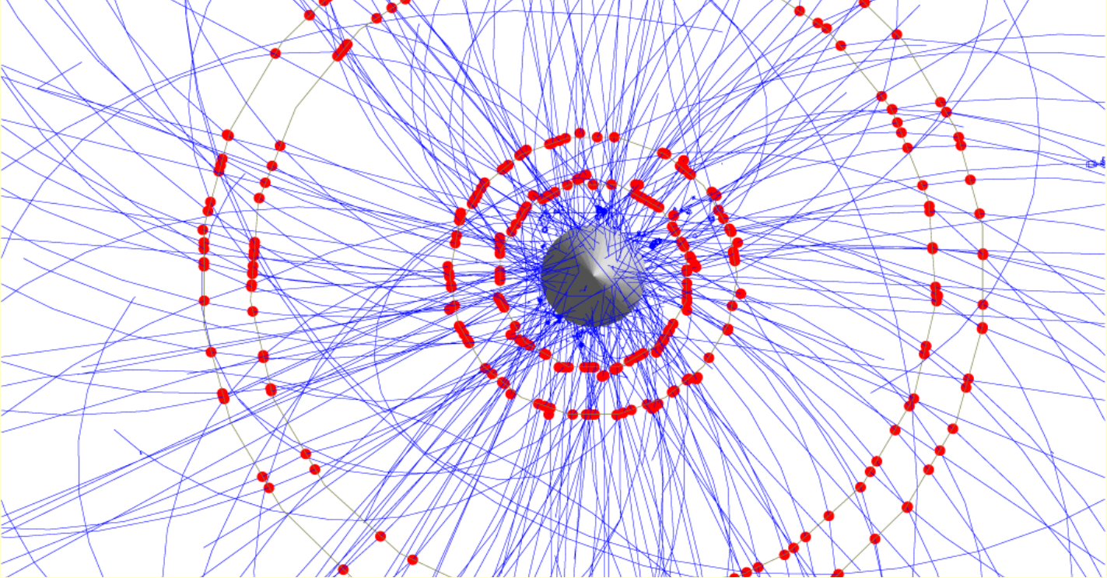
Timing requirements for Mu3e
2 x 10⁹ μ stops/s, 50 ns frame rate
100 μ decays

Slide 32
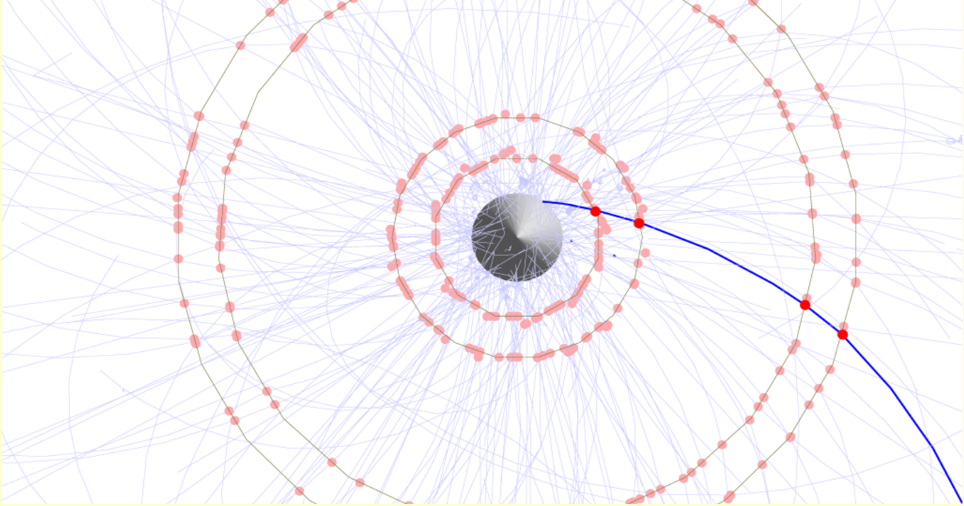
Timing requirements for Mu3e
2 x 10⁹ μ stops/s, 50 ns frame rate
Additional time detector (<1ns): 2 μ decays

Slide 33

Timing requirements for MEG
Limited by accidental background
Timing can help to separate signals from background
γ time from LXe calorimeter
e⁺ time from dedicated timing counter
γ
μ
Resolution (ps) | MEG I | MEG II
Δt_{γ} | 67 | 60
Δt_{e} | 107 | 35
Δt_{e-γ} | 127 | 84
e
All values
in sigma!
γ
ν
ν
e
μ
μ
ν
e
ν

Slide 34
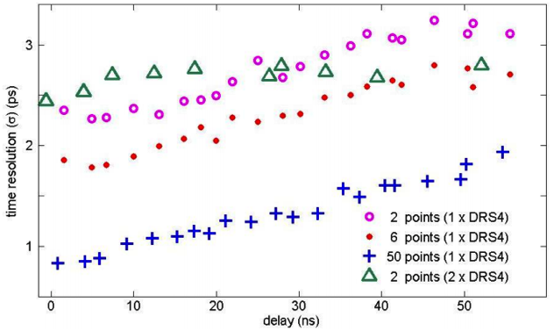
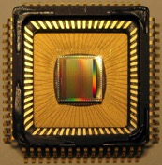
Electronics for timing
Switched capacitor array chips give excellent timing:
  PSEC4 (Chicago): 9 ps, DRS4 (PSI): 1.4 ps
TDC follow up:
  TDC130 (CERN): 2.4 ps, SAMPIC (Saclay): 6.5 ps
Precision clock distribution possible
  MEG I: 20 ps, MEG II: 5 ps
DRS4
arXiv:1405.4975

Slide 35
Timing limitation
voltage noise Δu
signal height U
timing uncertainty Δt
Sampled Waveform
rise time t_{r}
 | Today | NG
U | 100 mV | 100 mV
Δu | 1 mV | 1 mV
f_{S} | 2 GSPS | 10 GSPS
f_{3dB} | 300 MHz | 3 GHz
Δt | ~ 10 ps | 1 ps
Analog
bandwidth
number of samples on slope
only for waveform digitizing
SNR⁻¹
Sampling
speed
Simplified estimation!

Slide 36
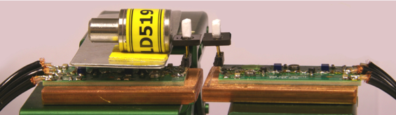
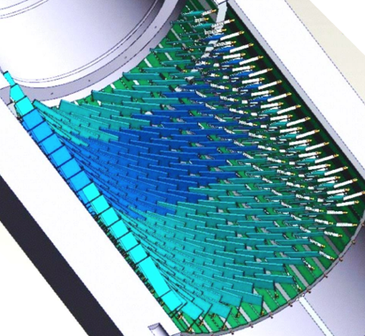
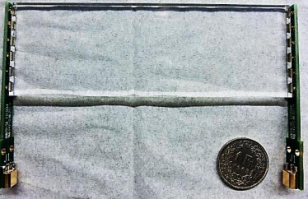
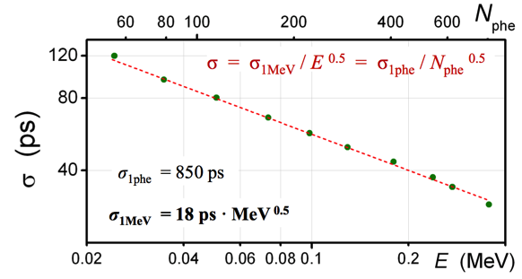

Timing resolution with SiPMs
A. Stoykov et. al. (PSI): NIM A695 (2012) 202
Timing method: CF (20%)
SiPM: MPPC S10362-33-050 (3･3 mm²)
Scintillator: BC422 (3･3･2 mm²)
fill factor area SiPM / area Scint.
MEG II timing counter
120 mm
6 SiPMs in series
Expected (point source) | Δt=(1.14･20ps) / √ (0.135･0.9 MeV)= 65 ps
Measured (uniform illumination) | 75 ps
Hit position error | ~40 ps

Slide 37
Road to better timing
Aim for complete coverage (k=1)
Reduce counter size
(increases channel count 😕)
Integrate readout electronics into detector (avoid long cables)
SiPM
Scintillator
ASIC: Amp.+Disc.+TDC+Serializer
SiPM HV
Planned for Mu3e
timing counters using
MuSTiC chip (KIP HD)
PCB
MEG

Slide 38
Data Visualization

Slide 39
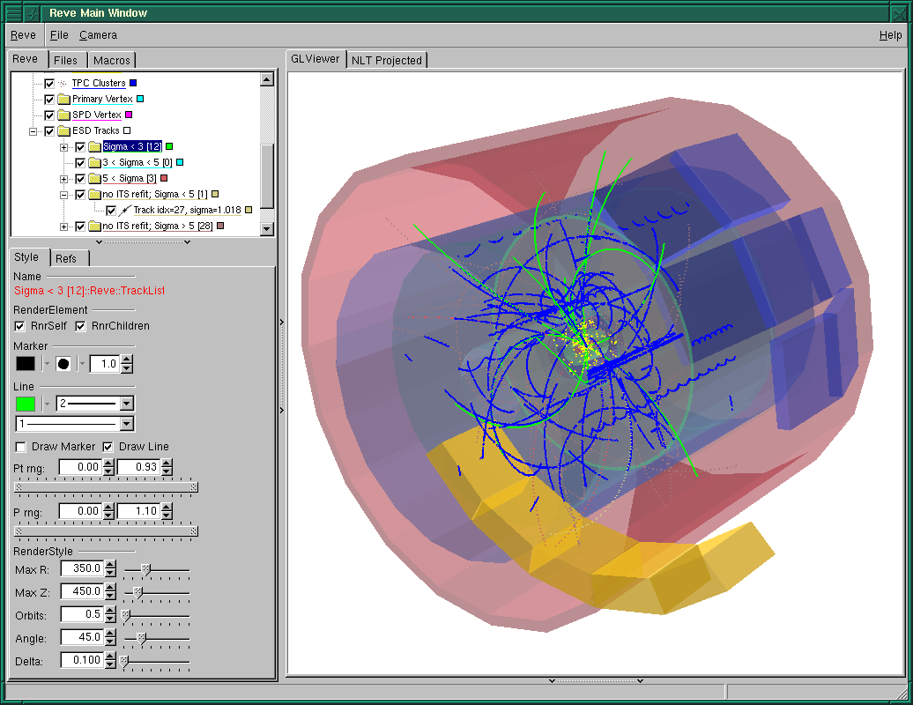


Experimental Data Visualization
The traditional way
  Dedicated programs (ROOT, Qt, TCL/TK, …)
  Must be compiled for different OS
  Require certain libraries to be installed
  No smartphone support

Slide 40

A new opportunity
HTML5 – CSS3 – JavaScript – JSON

Slide 41

Canvas Object
<!DOCTYPE html>
<html>
<body>
<h1>Canvas Demo</h1>
<canvas id=“myCanvas” width=“200”
height=“100” style=“border:1 px solid black”>
</canvas>
<script>
var c = document.getElementById(“myCanvas”);
var ctx = c.getContext(“2d”);
ctx.fillStyle = “red”;
ctx.fillRect(20,20,160,60);
ctx.strokeStyle = “blue”;
ctx.moveTo(0,50);
ctx.lineTo(200,50);
ctx.stroke();
ctx.beginPath();
ctx.arc(100,50,40,0,2*Math.PI);
ctx.stroke();
</script>
</body>
</html>
HTML
JavaScript

Slide 42


DRS4 Web Oscilloscope
http://midas.psi.ch/scope

Slide 43


Smartphone and Tablet

Slide 44

Another Display
grifadc05.triumf.ca
Adam Garnsworthy,
TRIUMF, CA

Slide 45

Data Transport
Hardware
JSON encoding
{ “event” : {
“scale: “100mV”,
“tscale: “100ns”,
“waveform”: [
{“t”: “0ns”, “u”: “ 3.8mV”},
{“t”: “1ns”, “u”: “12.5mV”},
{“t”: “2ns”, “u”: “31.2mV”},
{“t”: “3ns”, “u”: “48.8mV”},
…
]
}}
driver
Canvas
mongoose.h
mongoose.c
For bulk data: “Typed arrays”
(~5 times faster)
x = event.waveform[i].t;
JavaScript
Internet
PC
Controller
FPGA with soft-core
AJAX
Browser

Slide 46

3D Canvas
http://goo.gl/WKkjA6
http://threejs.org

Slide 47
Future of visualization
Experiment data can be displayed on any browser (soon)
  HTML5 is standardized through W3C
  No software to install, no libraries required
  Central updates of software
  Only raw (binary) data needs to be transferred (as opposed to remote desktop applications)
  Perfect for remote monitoring and control
  Easy to learn (Scope took me one week from scratch)
Web server can be incorporated into any web device (“Internet of Things (IoT)”)

Slide 48
Conclusions
Learn HTML5
Try wire-TOF if you use gas detectors
Invest in HV-MAPS technology
Work on electronics-on-detector integration
Have more exchange in technical sectors between cLFV experiments
Thanks to: Satoshi Mihara, Ryu Sawada, Alexey Stoykov, Peter-Raymond Kettle, Zachary Hodge, Felix Berg, Roland Horisberger, André Schöning, Nik Berger, …

Slide 49
Spare Slides

Slide 50
Crate Standards

Slide 51
Bus/Crate Standards
Current standards lack functionality
or are expensive
  ps clock distribution
  trigger distribution
  complicated shelf management
  typical 1 k$ per (empty) slot 6 HE
For MEG II, we developed our own standard
  stackable without dead space
  dual star gigabit link topology
  system-wide clock (ps jitter) and triggering
  program all (!) FPGAs through shelf manager
  crate high voltage for SiPMs
  cost 125 $ per slot 3 HE
A personal view from a crazy physicist
Tomorrow: Markus Joos:
Crate standards at CERN

Slide 52

WaveDAQ System
Fans blow from back to front
Crate Management Board
Power supply 24V / 300W
Fan / Temp. control
Power cycle each slot
FPGA Firmware upload
Ethernet remote control
Data Concentrator Board
Trigger Concentrator Board
16 WaveDREAM boards (256 channels)

Slide 53




MEG II System
Trigger Board
Trigger Board
WaveDREAM Board
DRS4 5 GSPS / 11.5 bits
35 crates
x 256 channels
= 9000 channels
. . .

