Slide 1
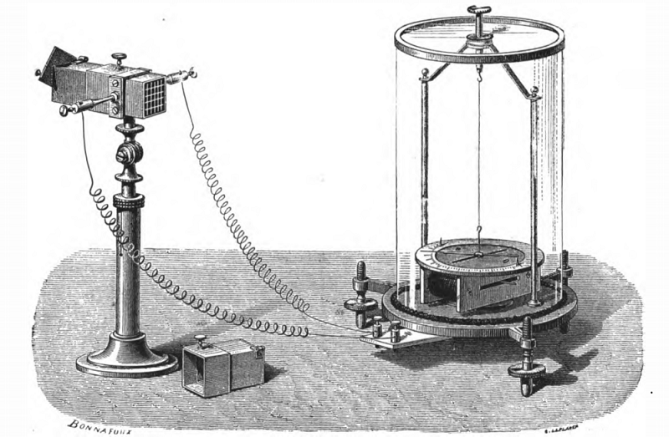
Imaging Calorimeters
Thermomultiplier
Invented by Leopoldo Nobili used by Joule
Joseph Henry P.397 of “Elementary Treatise on Natural Philosophy”, Part II
http://www.princeton.edu/ssp/joseph-henry-project/thermo-electric/thermo-multiplier/

Slide 2
“Calorimetry is fundamentally ugly; a cure here would be to improve resolution, decrease integrating time and find a cheap substitute for steel.”
From "A PRIMER ON DETECTORS IN HIGH LUMINOSITY ENVIRONMENT", by R. Huson, L. M. Lederman, and R. Schwitters (all Fermilab then), 1982 snowmass.
Thanks to Ted Liu for pointing out this quote to me.

Slide 3
Its stops there.
In an imaging calorimeter you measure five dimensions.
More data than we can imagine.
Use all the new tricks coming in from cell phones and video games.

Slide 4
Imagine this

Slide 7
Imaging calorimeters are a technology that is opening up many experimental possibilities. Just as Nobili’s thermomultiplier did many many years ago.
By being smart we can do more for less. Really!

