Slide 1
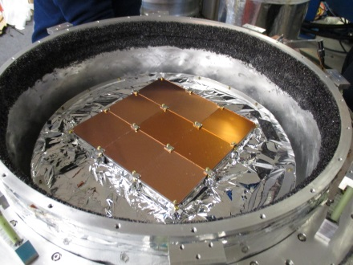
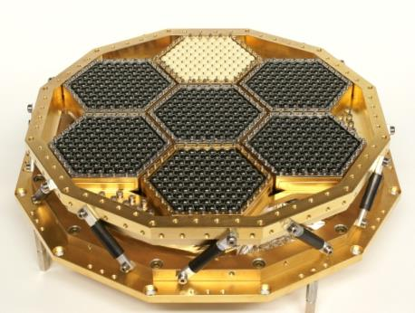
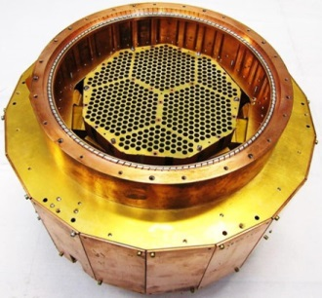
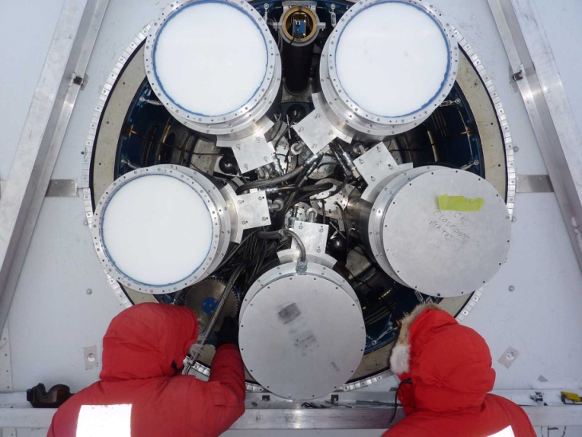
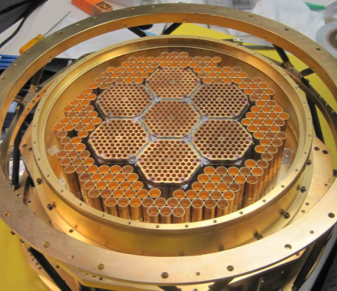
TES Polarimeters for Probing Cosmology
Hsiao-Mei (Sherry) Cho
SLAC National Accelerator Laboratory, Menlo Park, CA
BICEP-3
POLARBEAR
ACTPol
Keck Array
SPTpol
Tuesday Oct 6, 2015
CPAD 2015, Arlington, TX

Slide 2
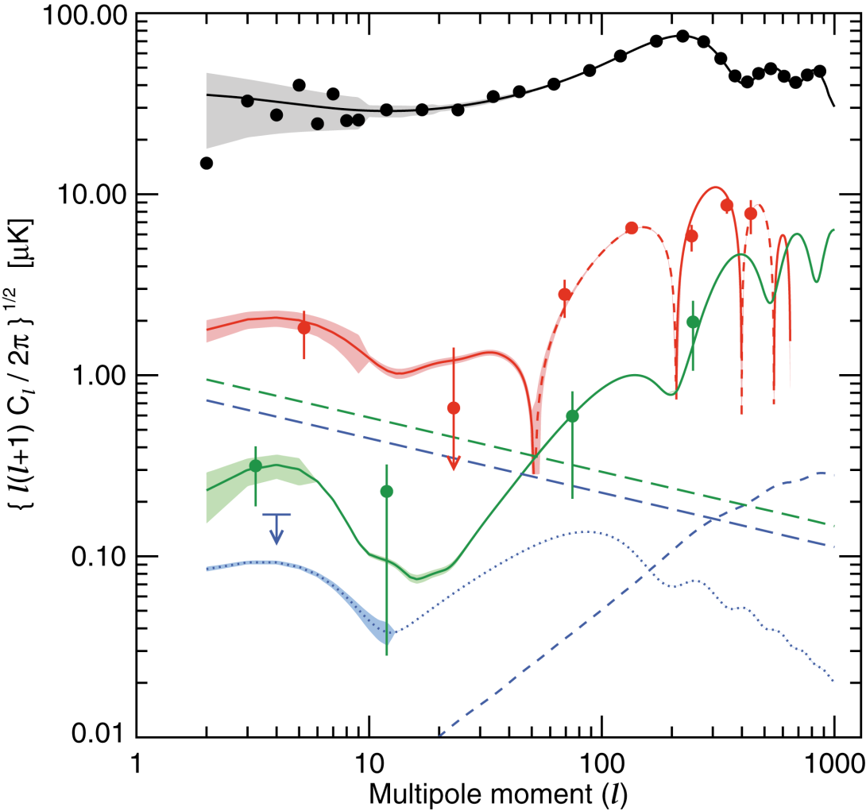
Primordial Gravitational Waves and B-modes
TT
TE
EE
Approx EE/BB foreground
BB r=0.3
G-waves decay once inside the horizon.
Reionization peak (z_{r}=10)
B modes from lensing of E modes (not primordial).
Horizon size at decoupling (z_{dec}=1089)

Slide 3
E-Modes and B-Modes
Polarization maps broken into mathematical basis sets
Density waves: “divergence”, but no “curl”
Unique gravity wave signature: “curl” mode
Similar to the fundamental theorem of vector calculus (Helmholtz theorem), but for a tensor field
Measuring B mode polarization is a very clean way to probe gravity waves in inflation

Slide 4
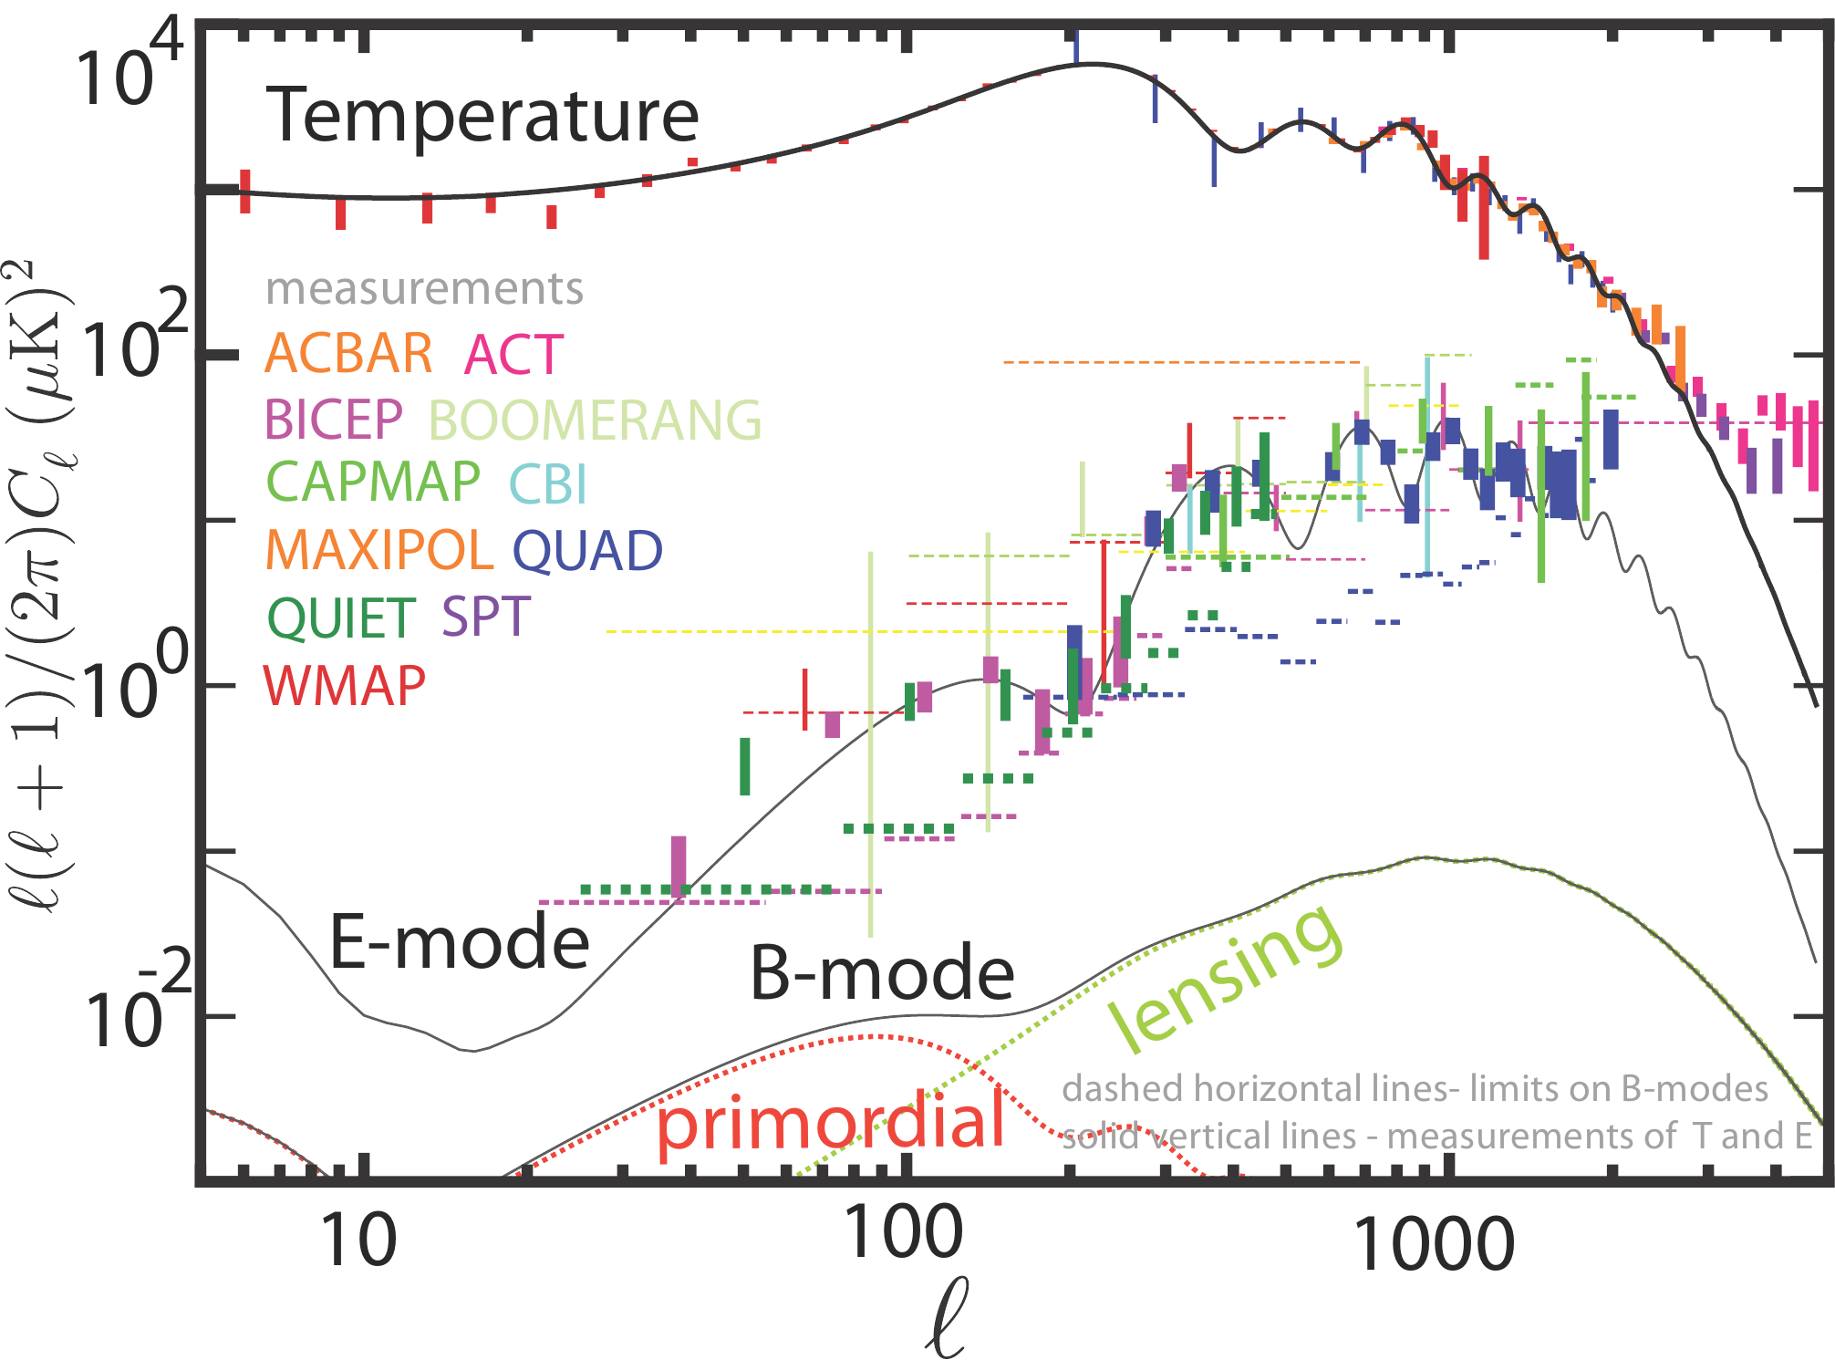
Measurements before TES Polarimeters

Slide 5

CMB Polarimeters in the Field
BICEP-3
POLARBEAR
ACTPol
150GHz
150GHz
95GHz
150GHz
Keck Array
SPTpol
150GHz
150GHz
90/150GHz
150GHz
150GHz
95GHz
95GHz
95GHz
Notes:
5

Slide 6
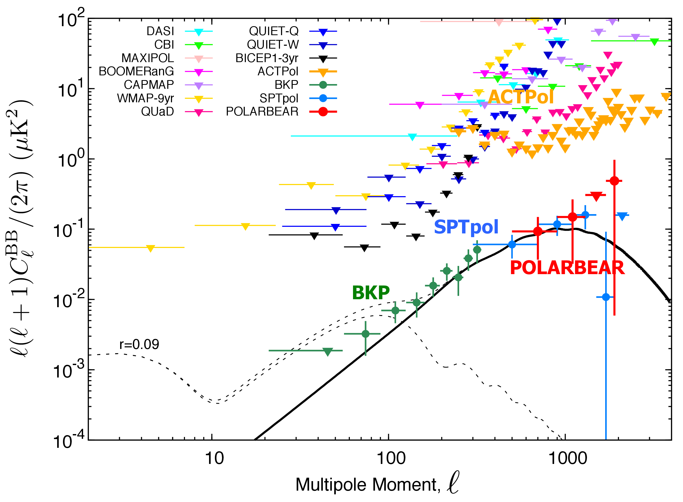
Universe We Know so far

Slide 7
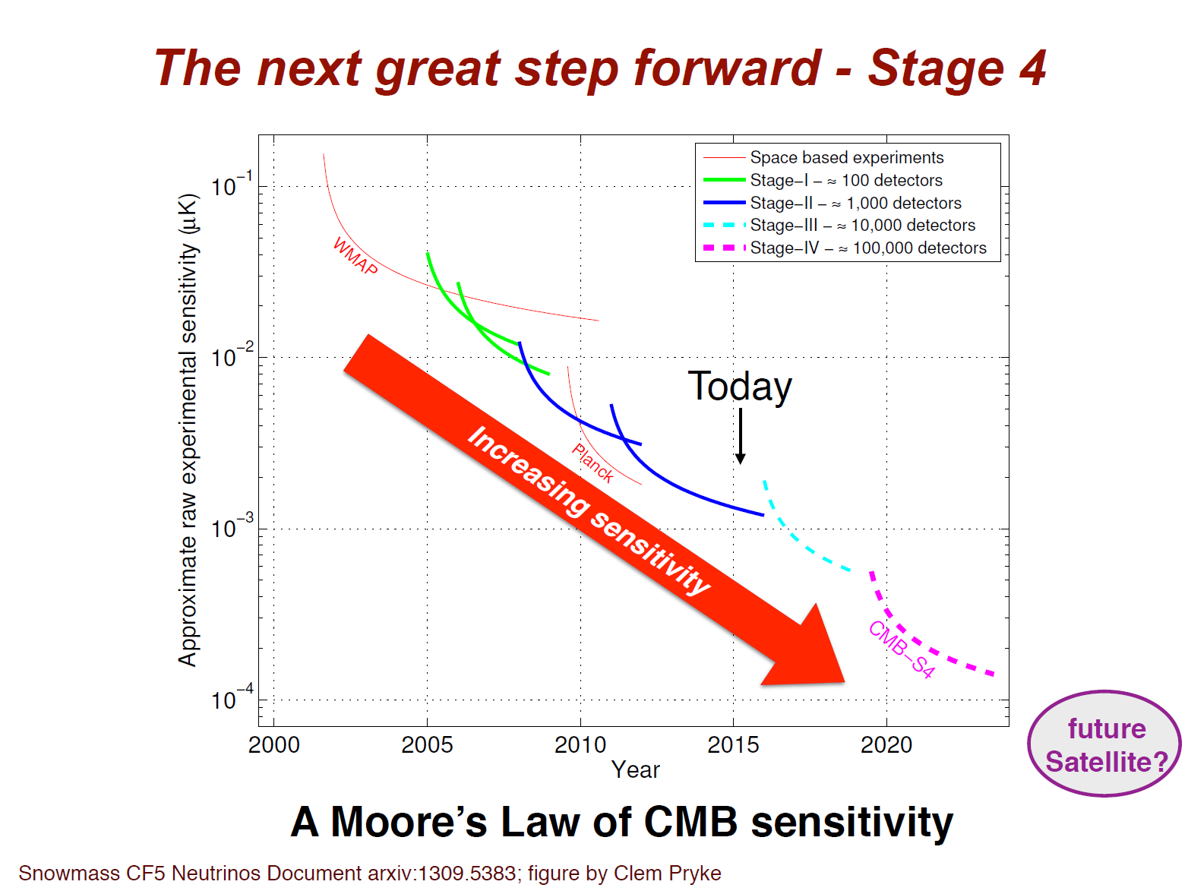
The next great Step forward – Stage 4

Slide 8
Achieving CMB-S4
Target CMB-S4 sensitivity: r = 0.001 at 5-sigma
Multiple observation sites
Multiple telescopes
Multi-chroic detectors
Multi-scale detectors
Multi-
→ Multi-chroic Transition Edge Sensor (TES) Polarimeters

Slide 9
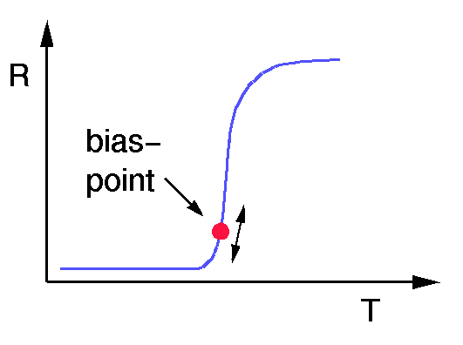
Voltage-Biased TES Bolometer
P_{opt}
R
TES
V
SQUID
Weak
thermal
Link (G)
T
P_{total} = P_{opt} + P_{elc} = constant
T_{bath}
Electrothermal feedback: fast, linear response
Low power dissipation (~1 nW)
Sensitivity limited by fluctuations in the photon arrival rate
K.D. Irwin APL 66 (1995)

Slide 10
Transition Edge Sensor (TES) Polarimeter
40 GHz-300GHz
Antenna coupling
    Otho-Mode-Transducer (OMT) → required corrugated feed-horns or profile feed-horns
    Dual-pol-slot antenna/sinuous antenna → required contact lens
    Phased array (arrays of slot antennas)
Impedance matching
Filter design – bandpass/low pass
Microwave to heat transition
Transition edge sensor (TES)

Slide 11
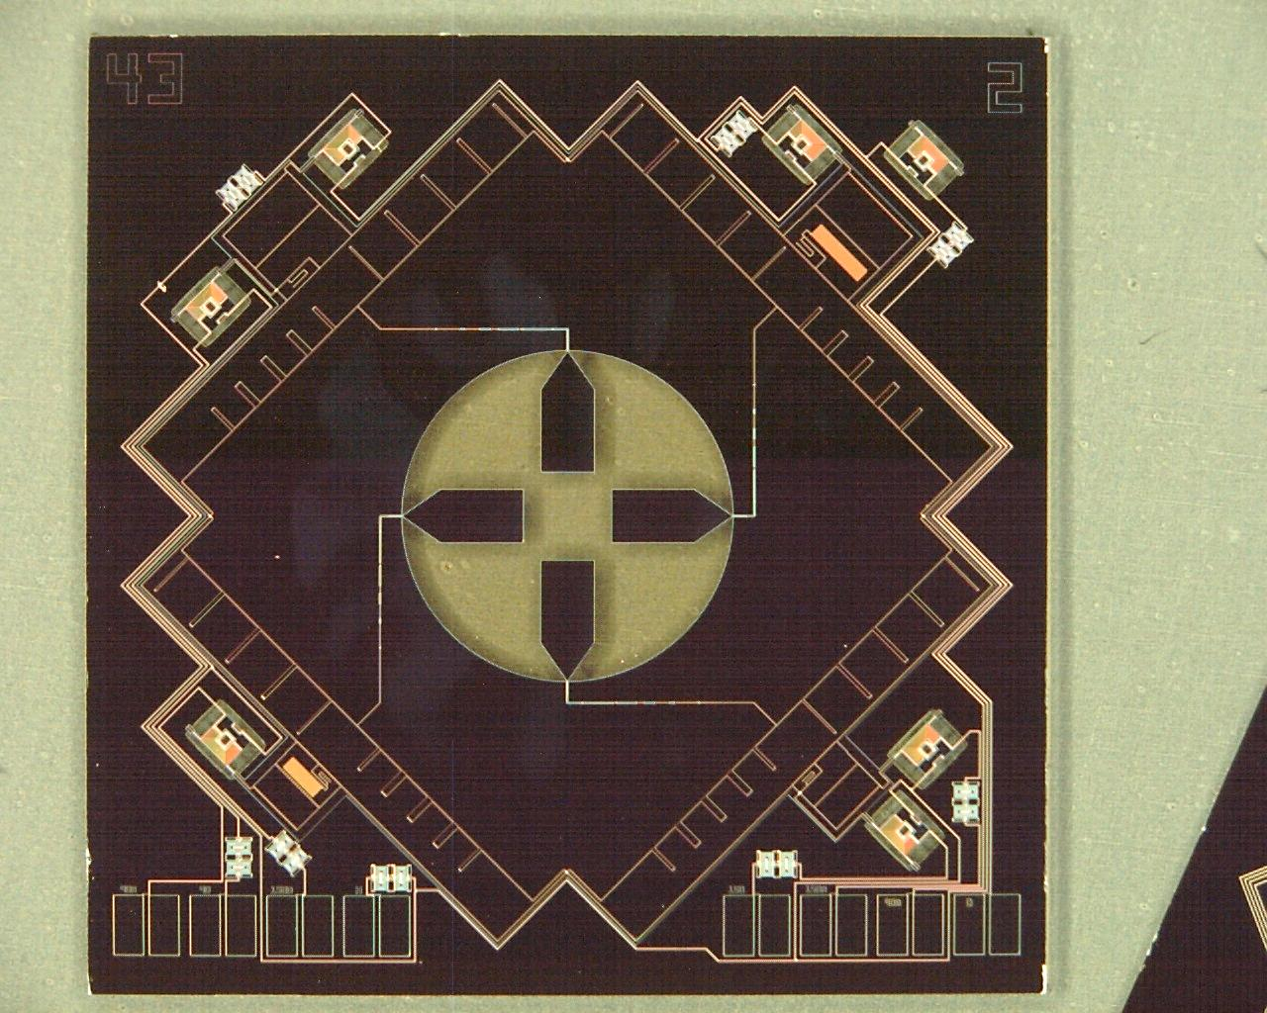
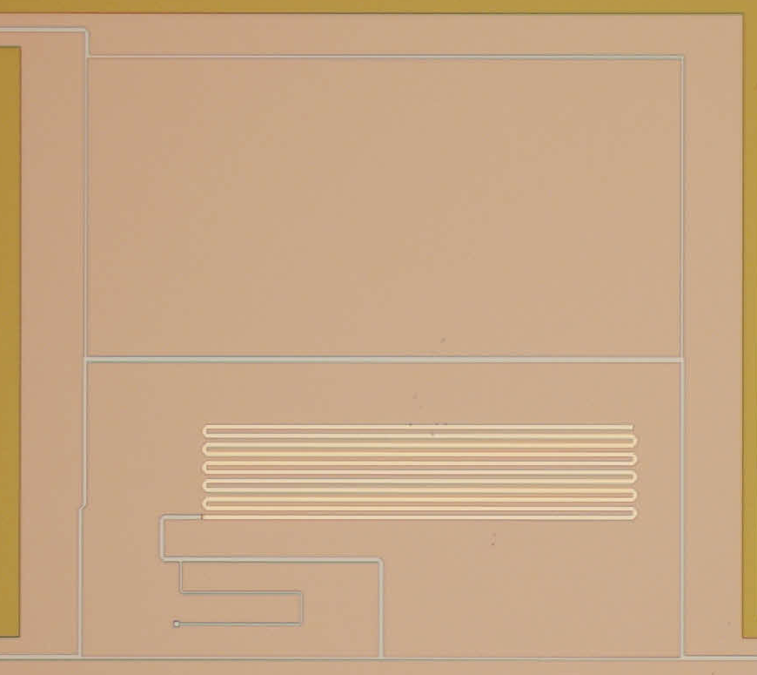
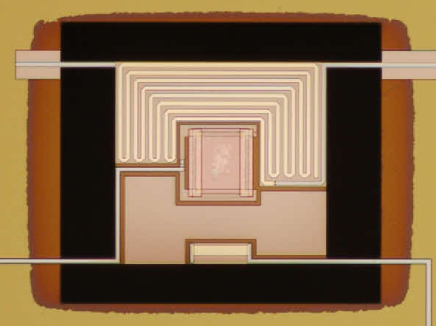
90/150 GHz Polarimeter
Y1-Y2: to TES bolometer
TES
90 GHz filter
hybrid
180° hybrid
150 GHz filter
Y1
Y1
Y2
X1
OMT
X2
Y2
Y1+Y2: dissipated on substrate
Y1-Y2
TES
heater
7 mm

Slide 12
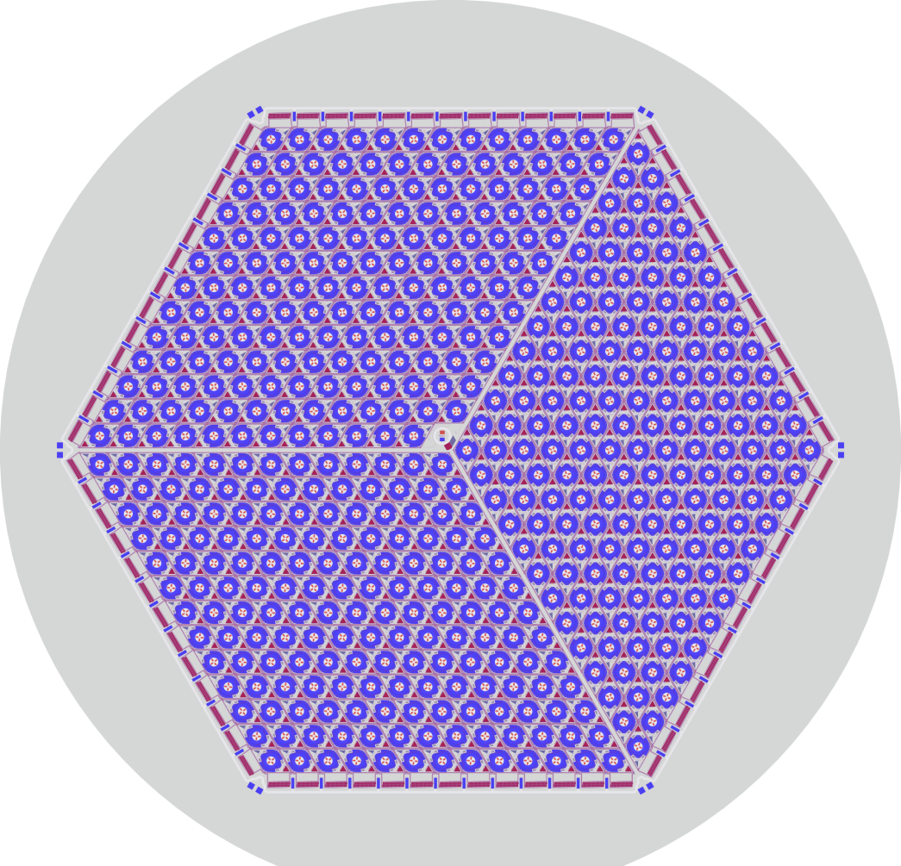
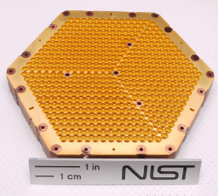
AdvACT 150/230 GHz
Rhombus design
2028 TESs
6 inch wafer
Courtesy of NIST, Boulder

Slide 13
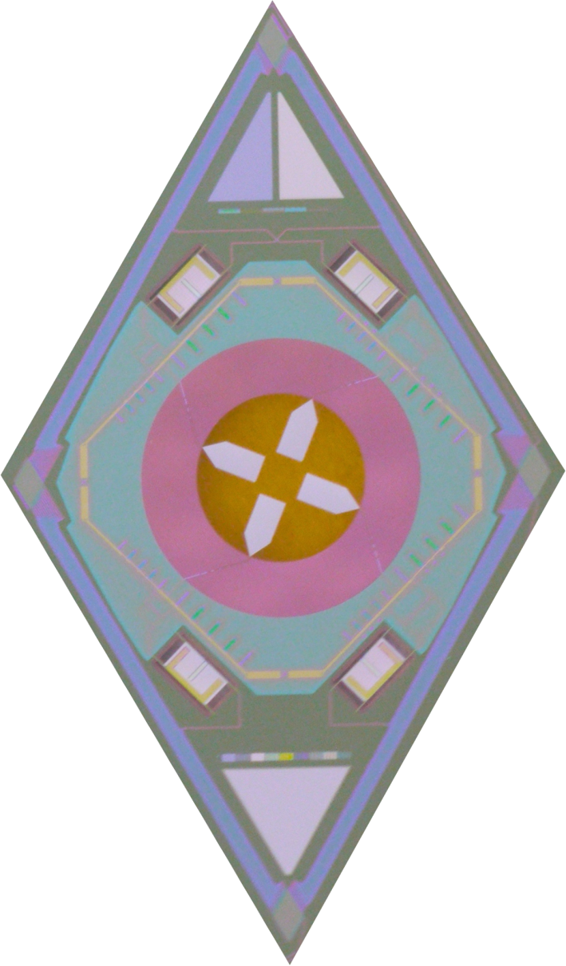
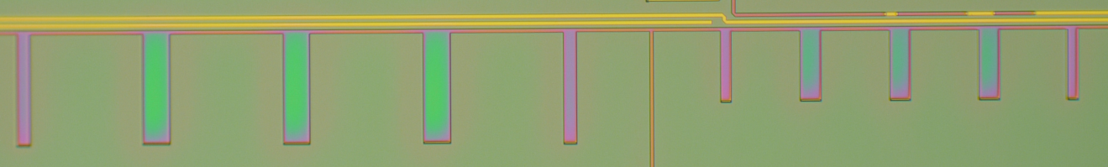
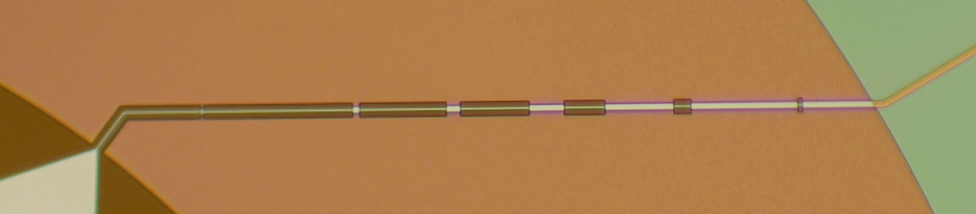
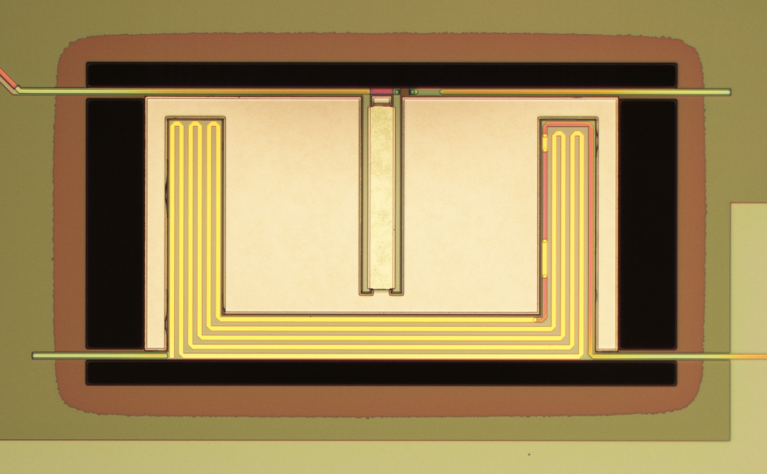
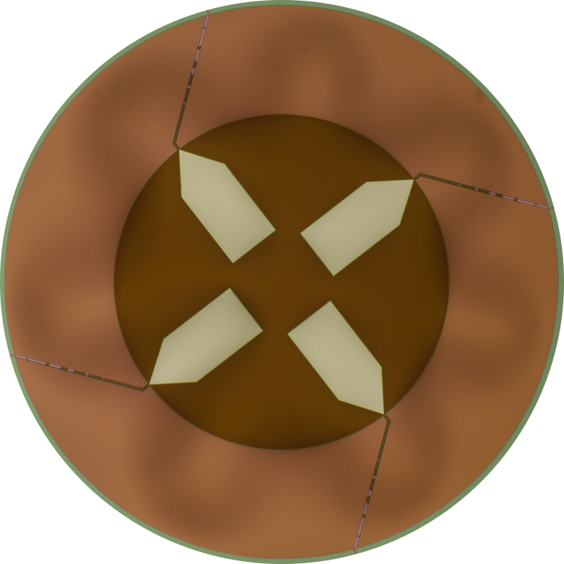
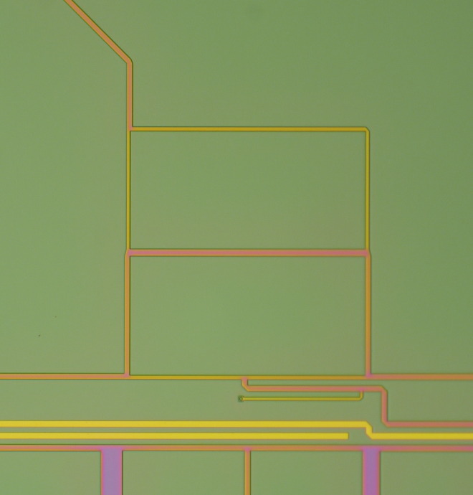
AdvACT 150/230 GHz
Bandpass
CPW to MS
TES
TES
X1
Y2
OMT
Y1
Y1
Y2
X2
rhombus
Courtesy of NIST, Boulder

Slide 14
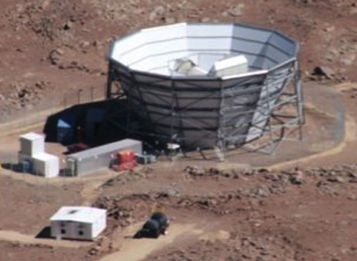

























AdvACT
Atacama Cosmology Telescope
  Four multi-chroic arrays
  30/40 GHz array (LF)
  90/150 GHz arrays (MF)
  150/230 GHz array (HF)
  HF array is scheduled to deploy in 2016

Slide 15
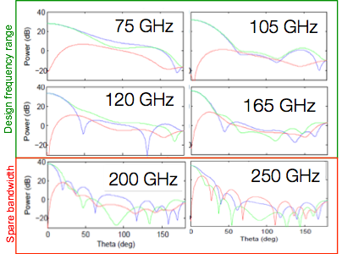
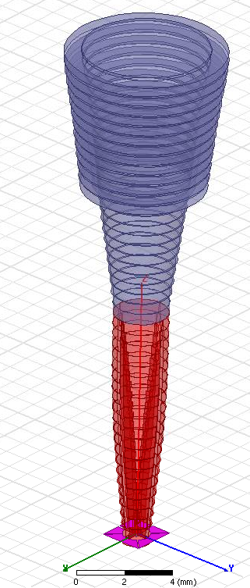
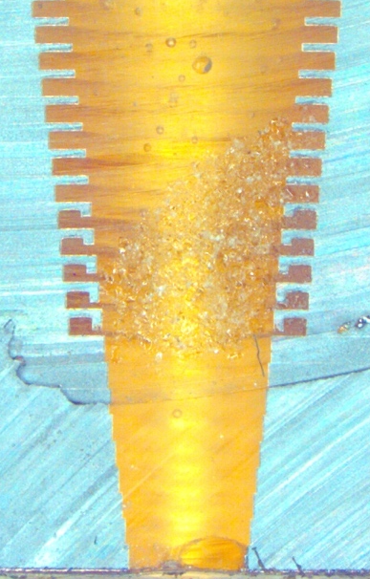
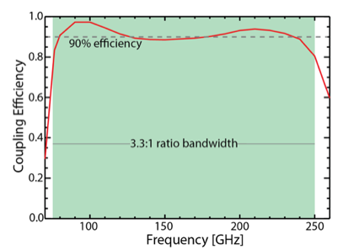
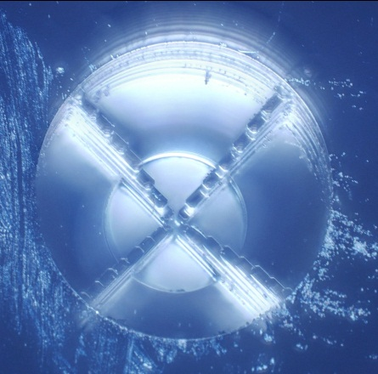
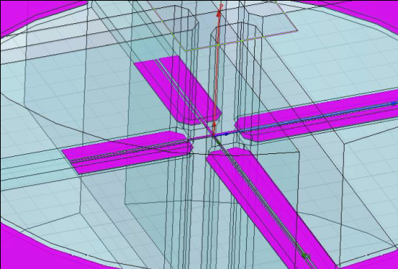
Next Generation Horn Coupled Architecture
Prototype feed
(cross-section)
Ring loaded corrugated feed
Round to quad- ridge transition
cross-section of quad-ridge waveguide
Prototype
quad transition
OMT Design
McMahon et al., fabricated at NIST

Slide 16
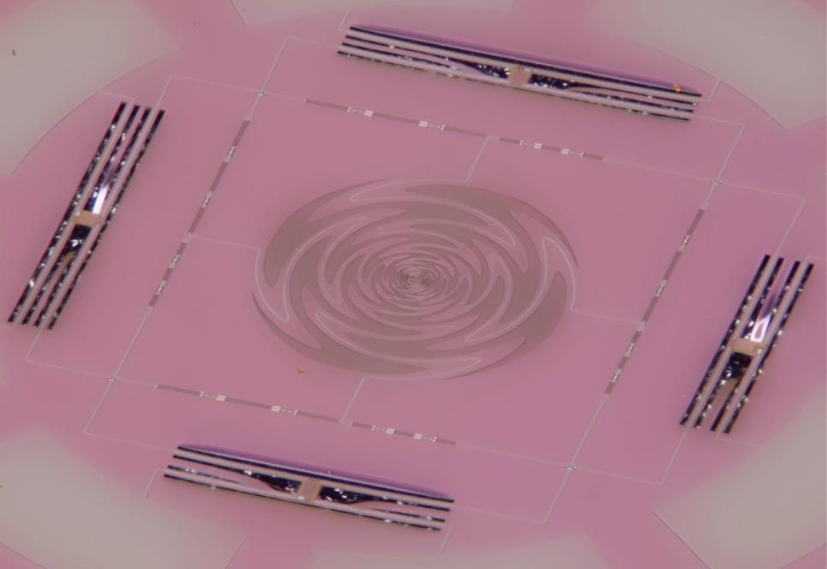
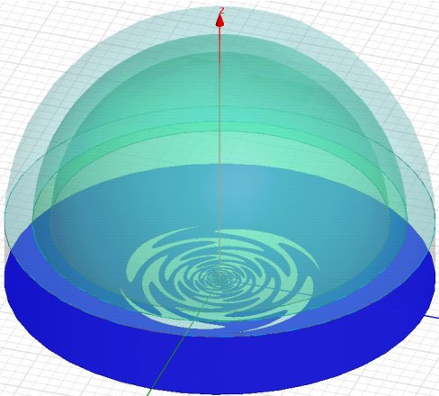
Contacting Lens-Coupling
(2) Broadband Antenna
(3) RF Filters
(4) TES Bolometers
(1) Si Lenslets
Photo taken by Dan Schmidt
Silicon lens focuses beam to antenna
Broadband antenna collects EM radiation
On chip RF filter splits signal into frequency bands
TES bolometers detect signal
Adrian Lee (Berkeley) et al.
Notes:
16

Slide 17
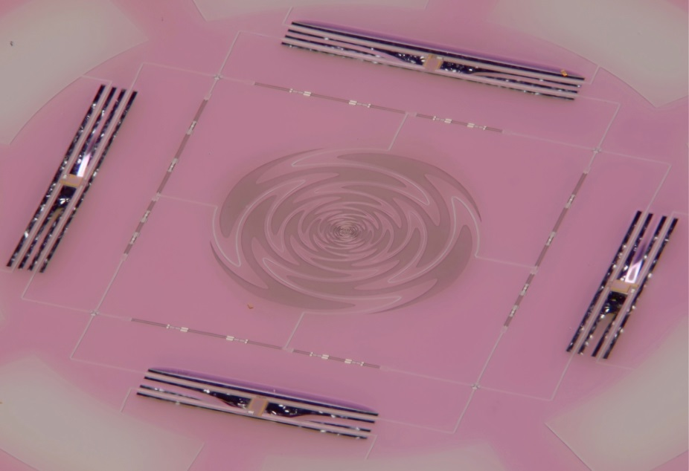
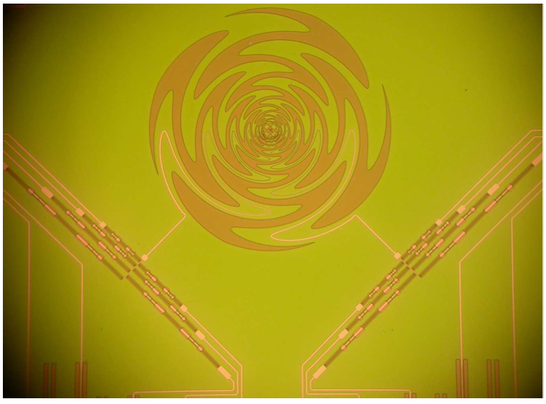
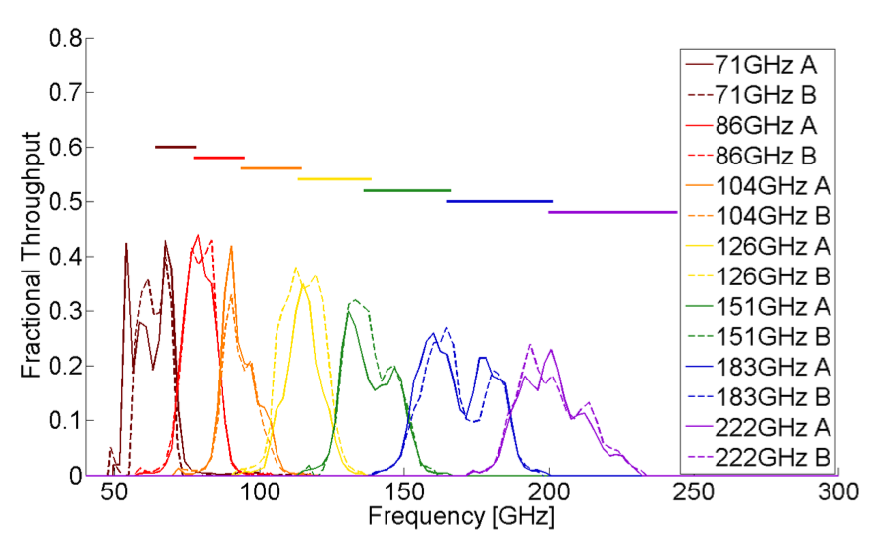
Contacting Lens-Coupling - Multichroic
Adrian Lee (Berkeley) et al.
1 mm

Slide 18
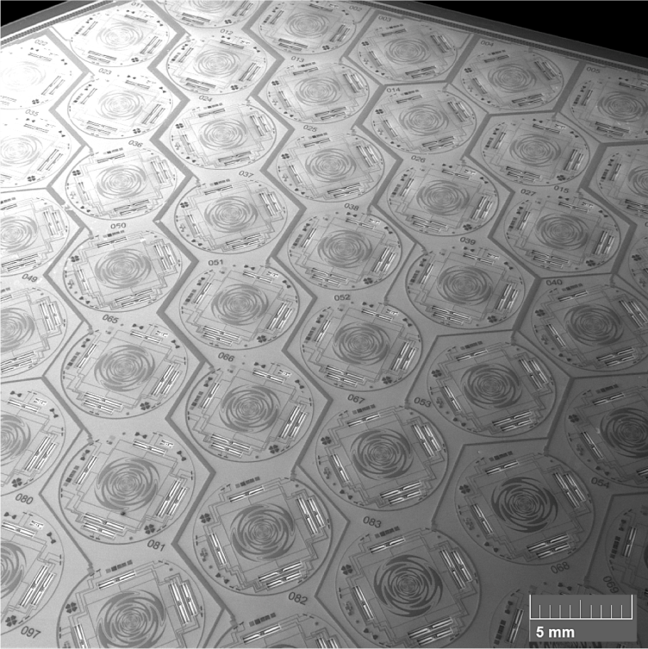
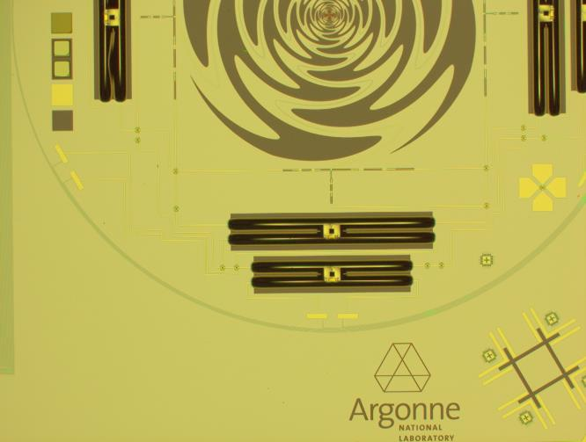
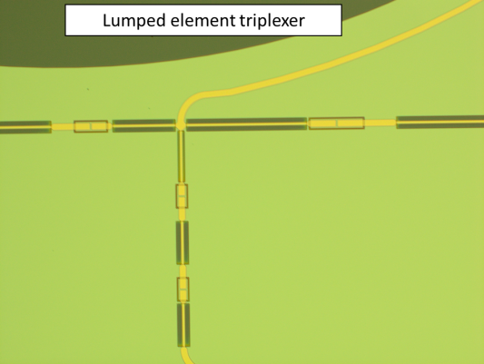
Contacting Lens-Coupling – Multichroic: SPT-3G
Courtesy of SPT-3G collaboration

Slide 19
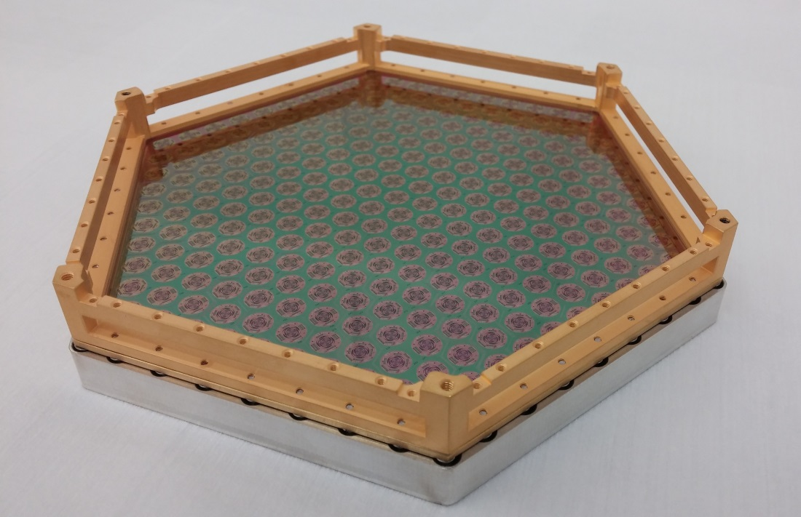
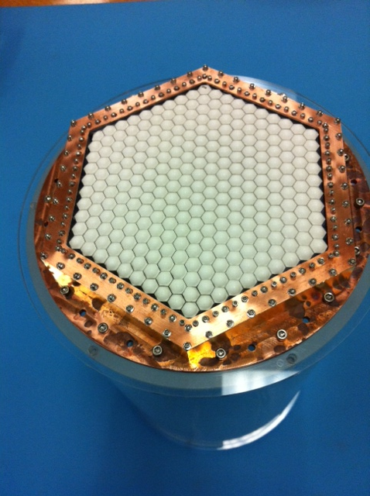
Contacting Lens-Coupling - Multichroic
POLARBEAR-2, Simons Arrays, and SPT-3G
Hexagonal is ~130 mm side to side.
Each pixel is ~6mm diameter.
Courtesy of POLARBEAR and SPT-3G collaborations

Slide 20


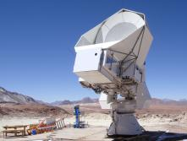
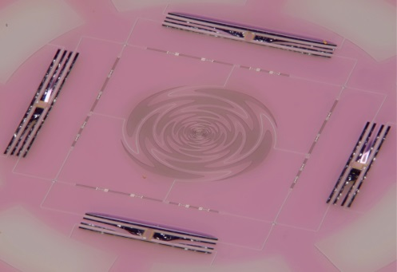
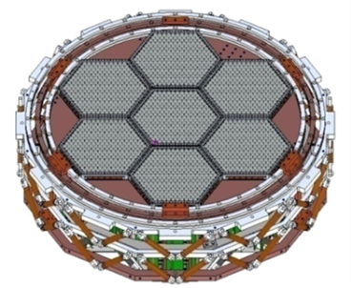
POLARBEAR-2
ANL, APC, Berkeley, Boulder, Cardiff, Dalhousie, IPMU, Imperial, JAXA, LBNL, McGill, Melbourne, Princeton, NIFS, PUC, Sokendai, Trieste, KEK, UCSD
Deploy in 2016
90/150 GHz
Huan Tran Telescope

Slide 21
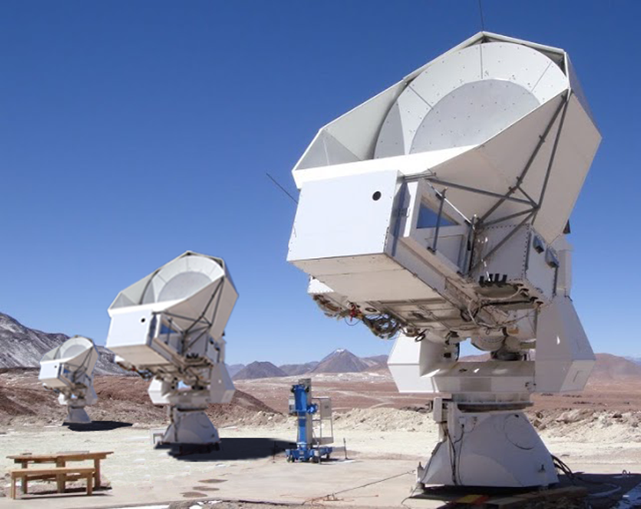
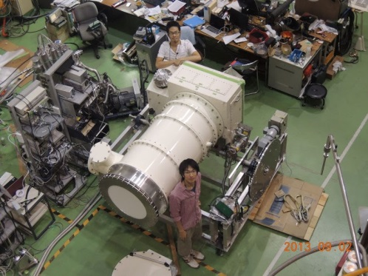
Simons Array (2016)
22,768 detectors
  90/150/220 GHz
Existing
Under Construction

Slide 22


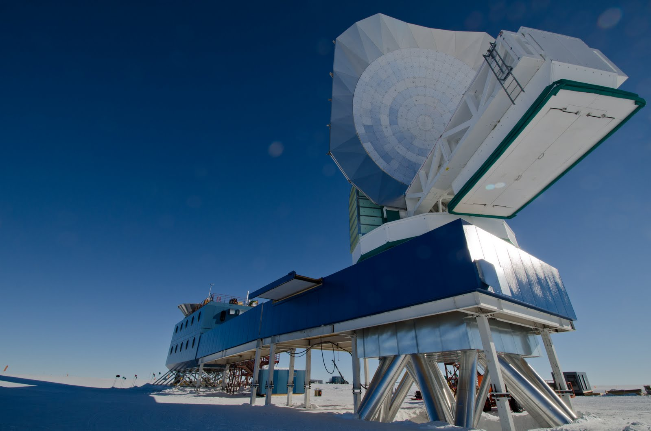
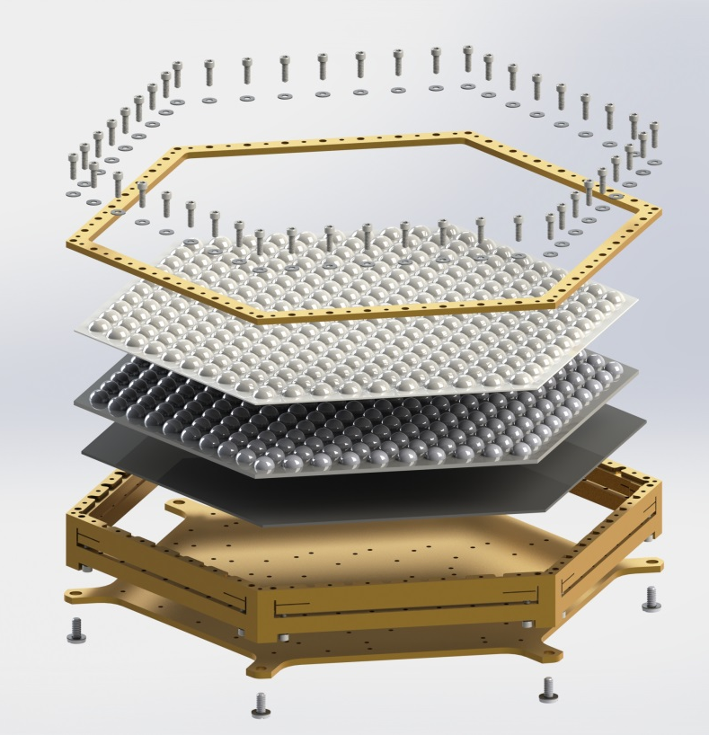
SPT-3G
South Pole Telescope
Scheduled to deploy in 2016
16,234 detectors
100,150,220 GHz

Slide 23
Challenges
Significant progress is being made in stage-3 experiments, but a large jump is required for CMB-S4
Cryocoolers with larger cooling power
Very large multiplexed arrays
High throughput fabrication facilities
High throughput measurement facilities
High throughput assembly facilities
And many more …

