Slide 1
Hybridization & Interconnect
Special thx to Ron Lipton that provided most of the material shown here
Gino Bolla, bolla@fnal.gov, Fermilab

Slide 2
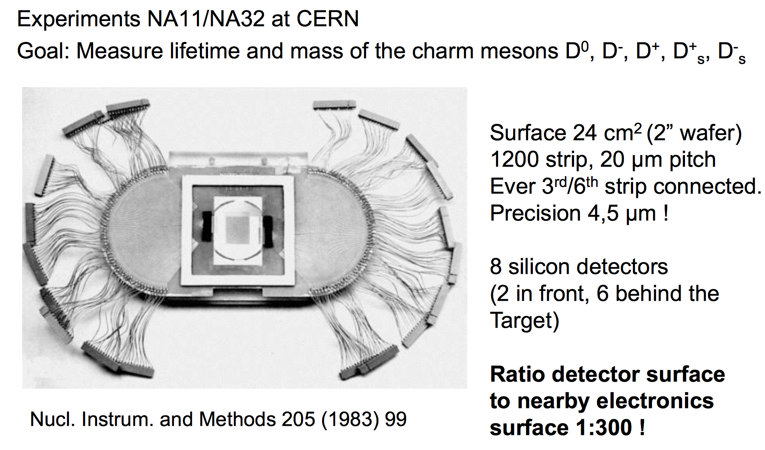
Some 30 years ago

Slide 3
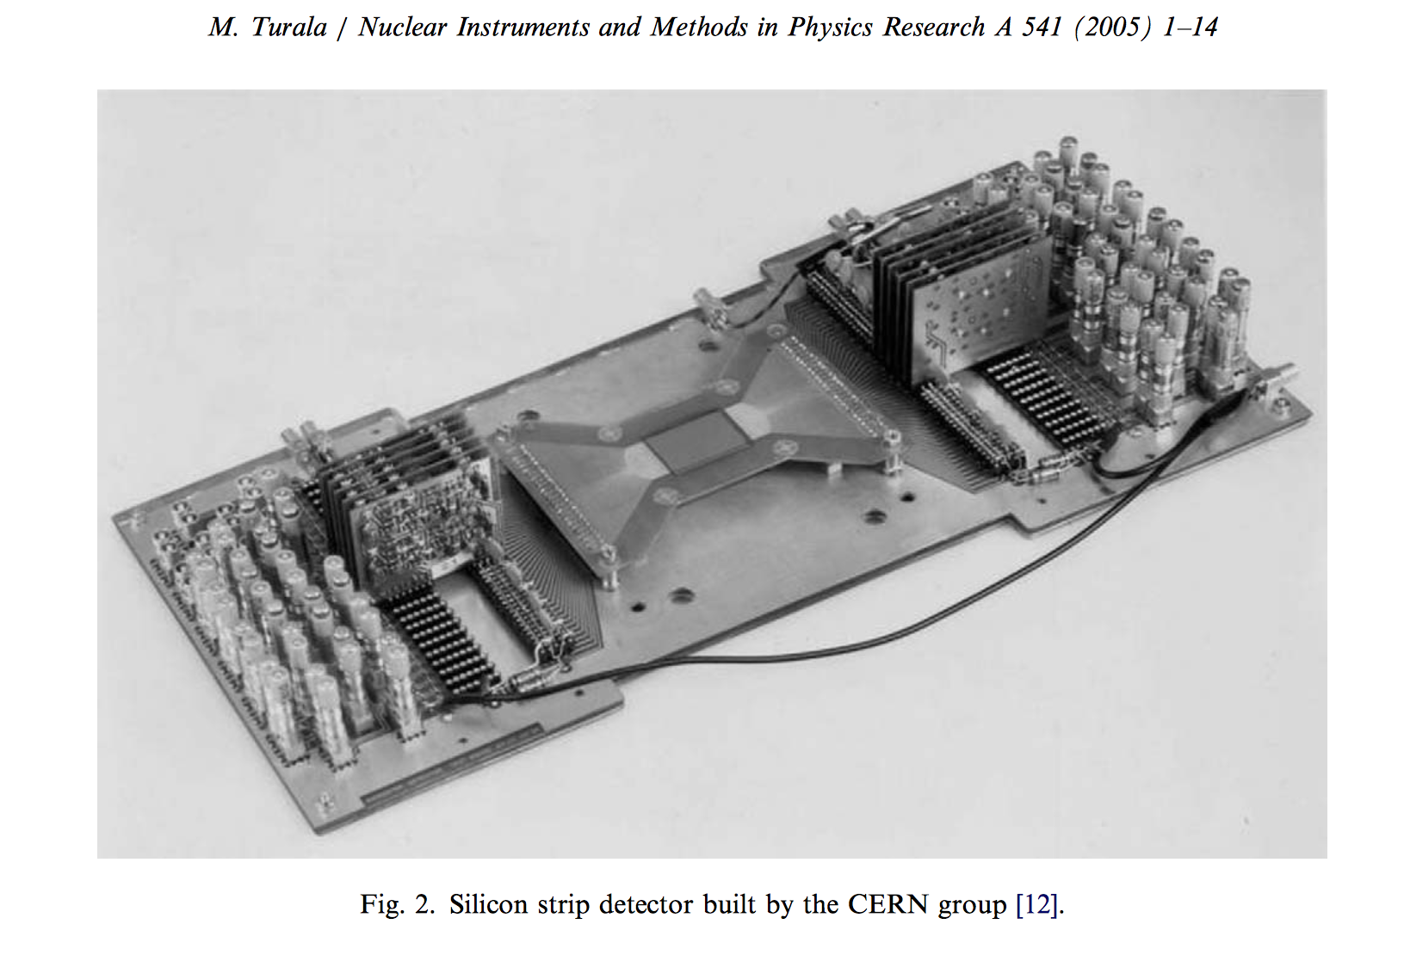
And now you have to read it out

Slide 4
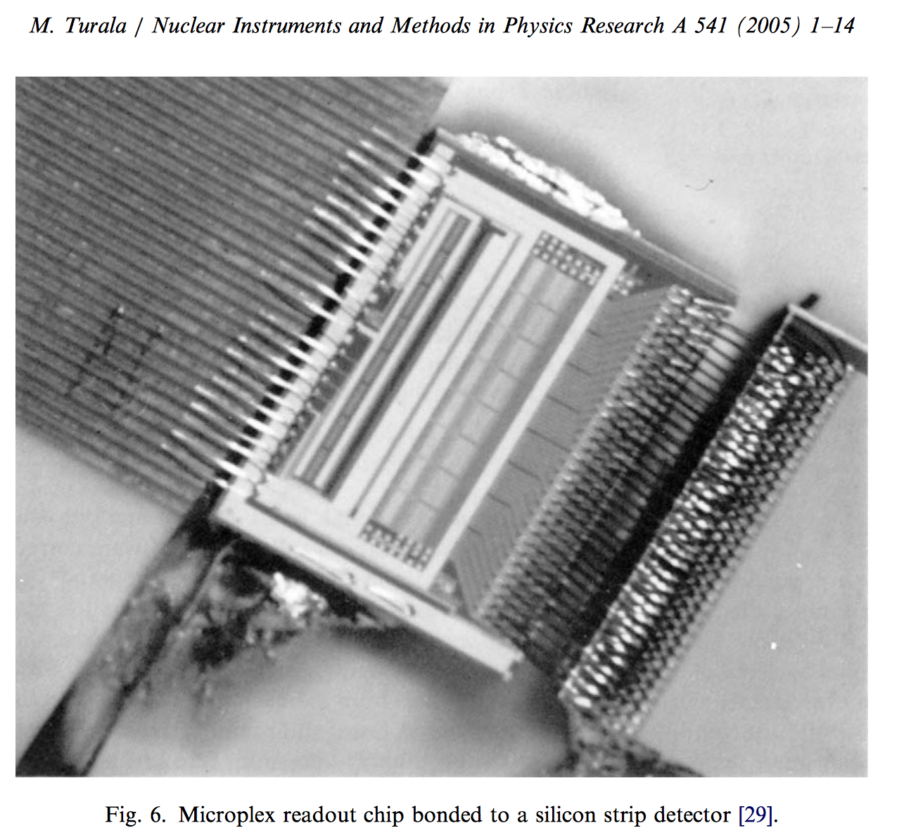
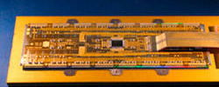
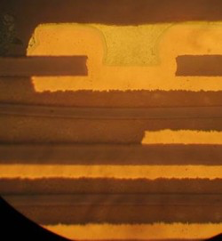
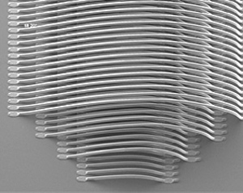
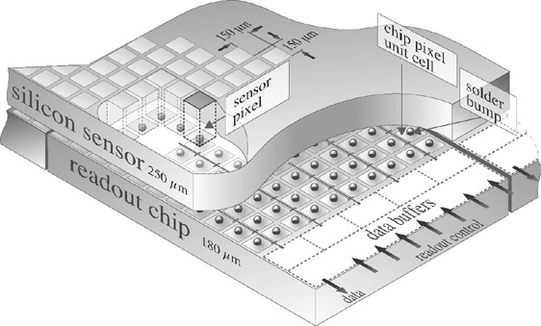
Technology advances (enablers)
VLSI
Fine pitch Flex circuits
And now you can really get creative!
Fine Pitch wirebonding
Bump bonding

Slide 5
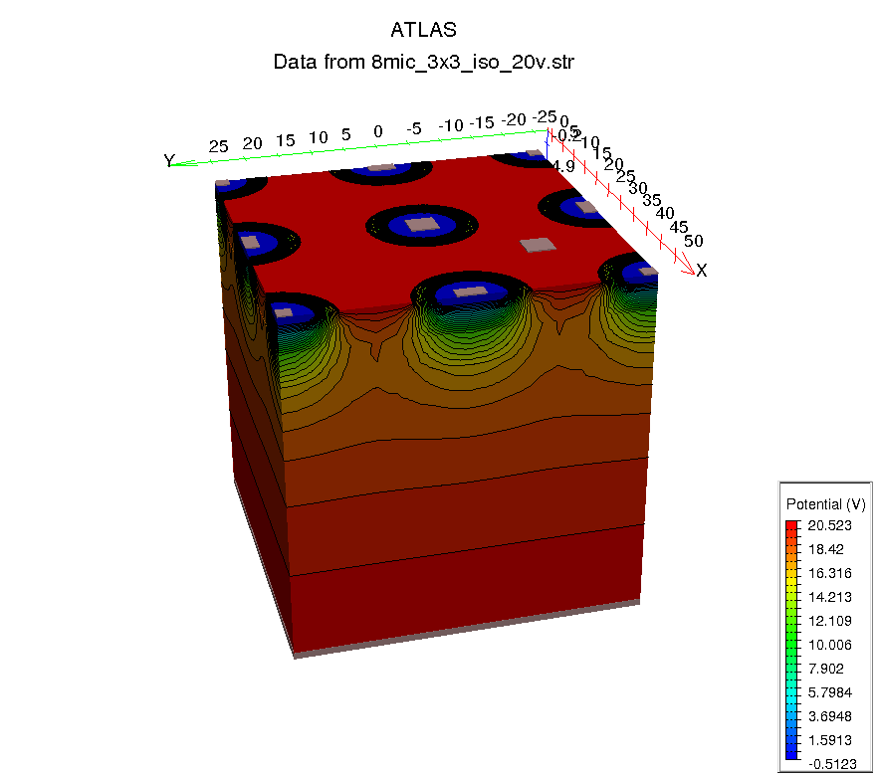
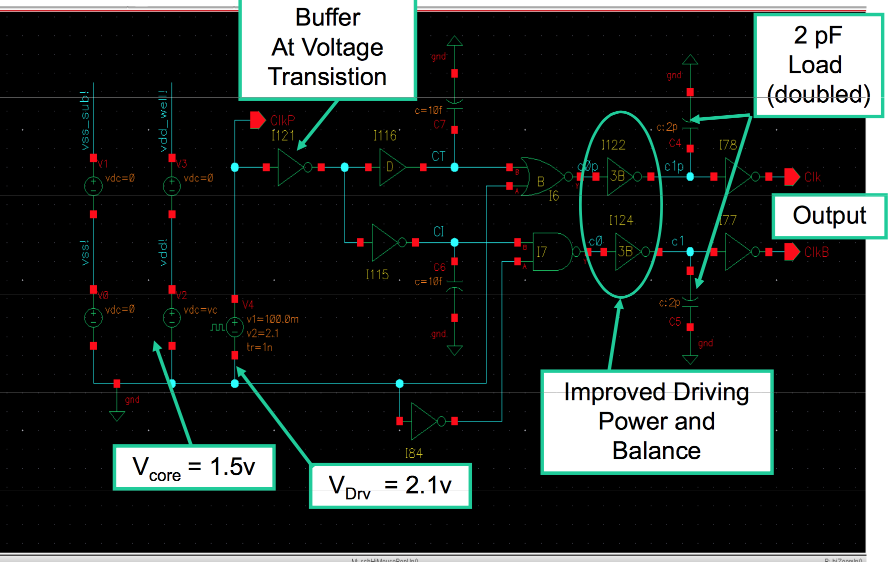
Other enabler
Particle Physics applications of silicon-based
detector systems have benefited enormously
from access to sophisticated TCAD simulation tools to design and simulate semiconductor devices.

Slide 6
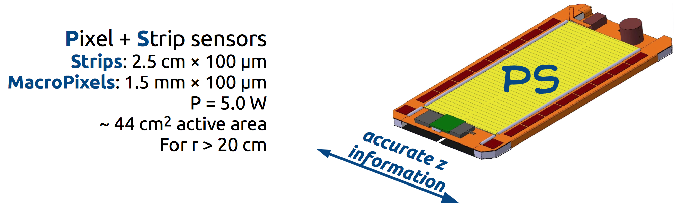
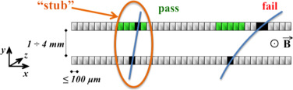
Nowadays (CMS as an example)
On module
  DC-DC converter to minimize cable mass
  Low power Optical Gbit transceiver
    Clock and trigger in
    Data out
All this with low mass composite materials.
And contributes to the trigger every 25 ns

Slide 7
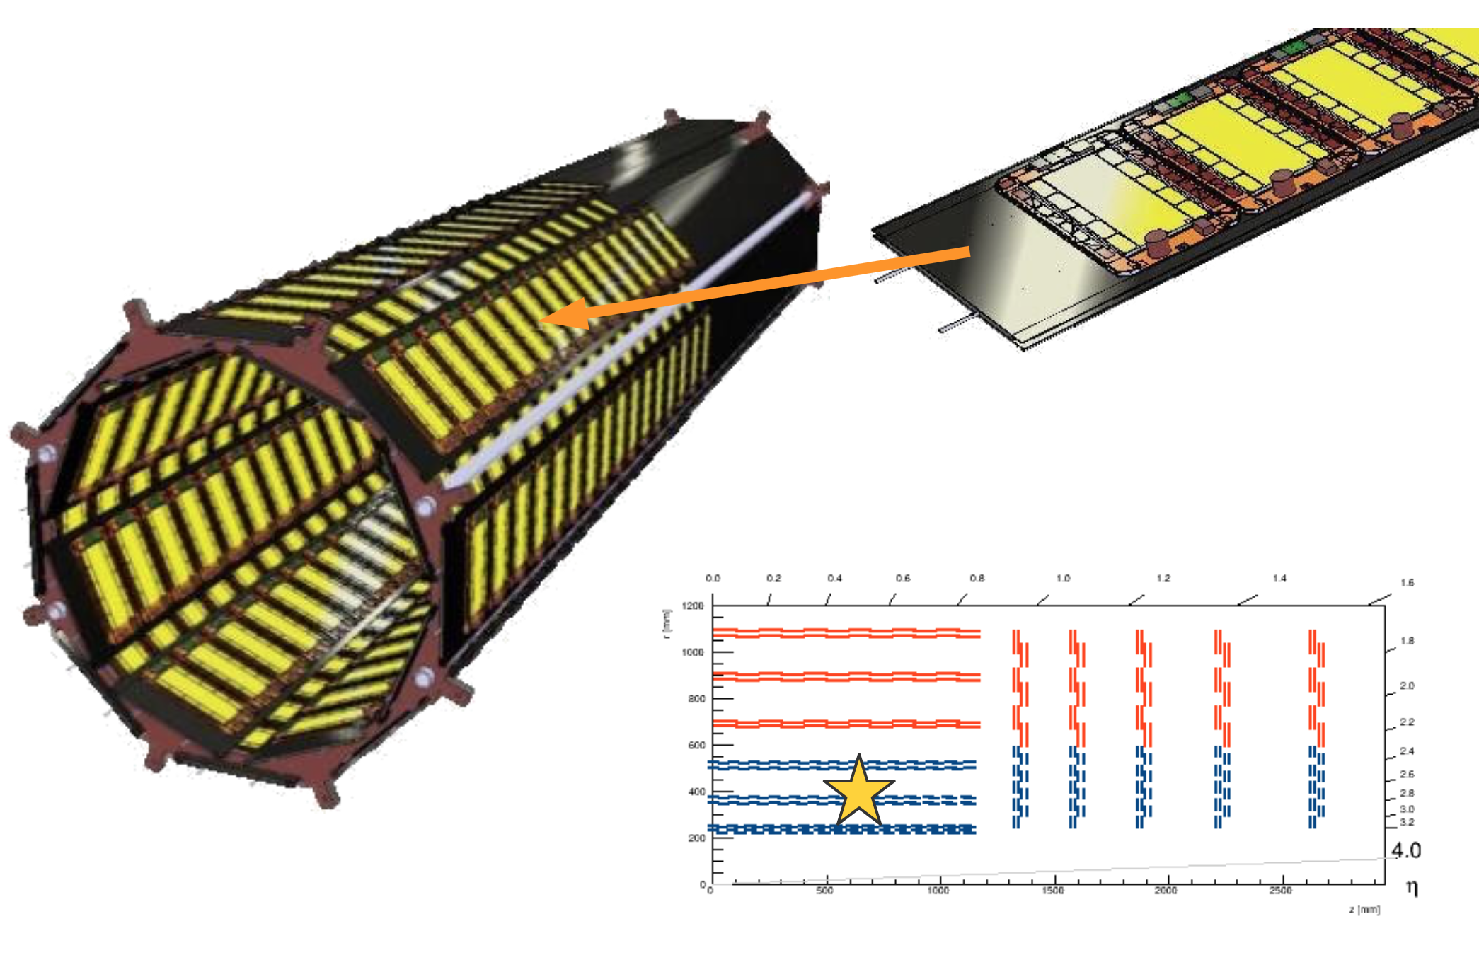
Nowadays (CMS as an example)
You build several of them (~10⁴) and you get ~200 m² of silicon
Precise (~10μm)
Fast (25 ns clock)
Low mass
Radiation hard
  ~100 Mrad
  10¹⁵1 Mev n
I am not going to write low cost
And it is built to take data for ~15 years

Slide 8
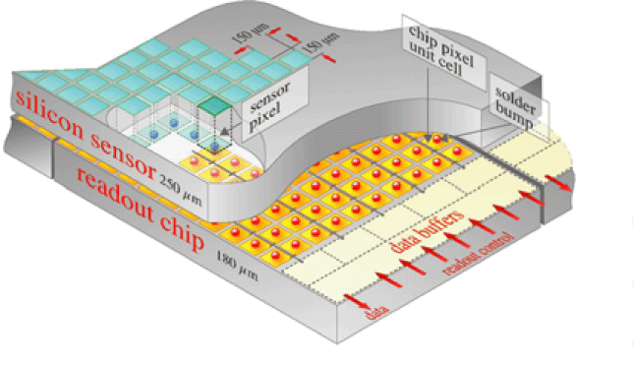
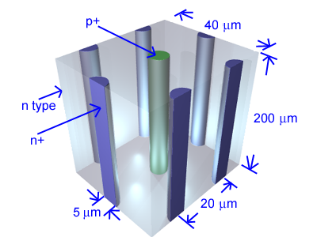
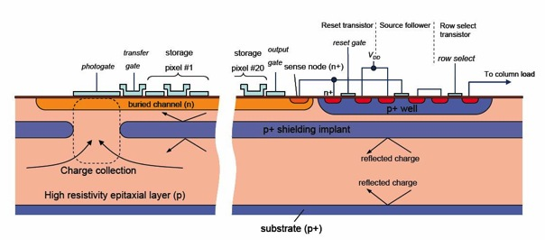
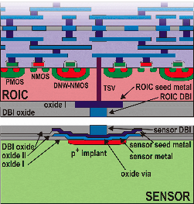
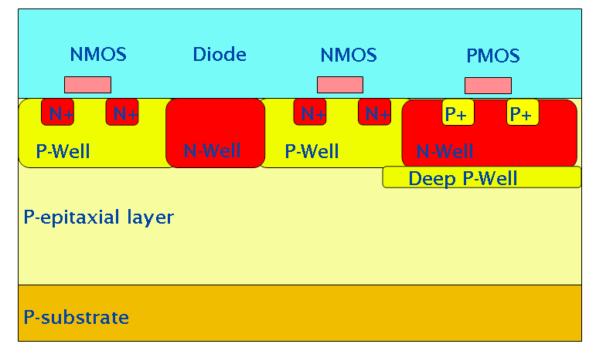
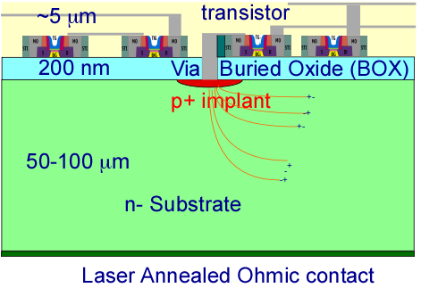
Sensor Technologies
Hybrid
bonding
An embarrassment of riches
3D sensors
CCD
source
top gate
drain
clear
bulk
3D
electronics
~1µm
p+
n+
p+
n+
n+
s
p
n
i
x
internal gate
DEPFET
a
-
y
-
-
+
50 µm
-
r
-
t
-
e
m
m
+
y
-
s
-
n
-
+
+
-
p+
rear contact
MAPS
SOI

Slide 9
The Playing Field – thumb in the air plot (R. Lipton)
Hybrid
pixels
3D sensors
3D
electronics
Radiation
hardness
HV CMOS
SOI
DEPFET
CCDs
Cost/area

Slide 10
The Playing Field – thumb in the air plot II (R. Lipton)
3D
electronics
Integration
density
HV CMOS
Hybrid
pixels
SOI
3D sensors
DEPFET
CCDs
Cost/area

Slide 11
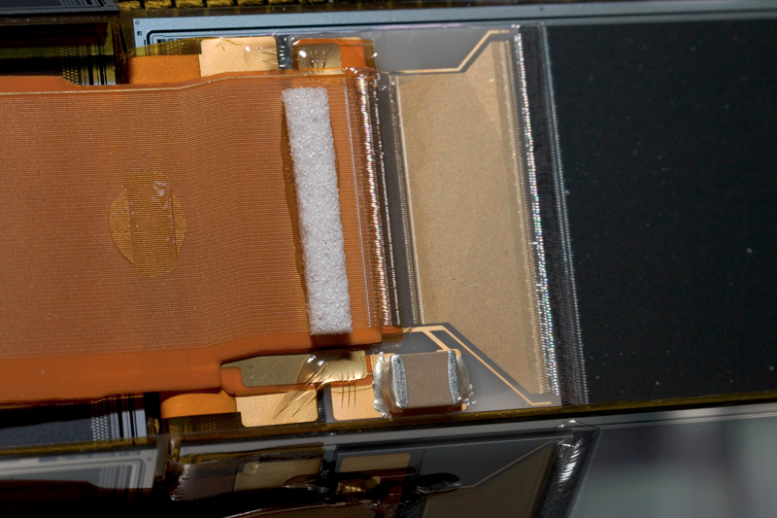
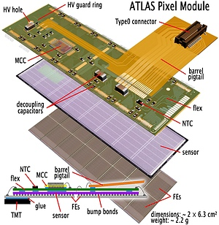
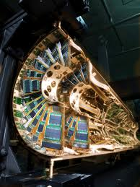
Silicon-based Tracking
D0 Layer 0
Building these devices is essentially an electronics packaging problem, an unusual one…
With billions of channels, 100’s m² surface area
With tbyte/sec bandwidth
Cooled to -20 deg C
With minimal mass
Arranged to give us the information we need to do physics
Given the microscopic scale of the elements, the problems of sensors, readout, and interconnect are inexorably linked.
Hybridization
Analog cable
Flex foldover

Slide 12
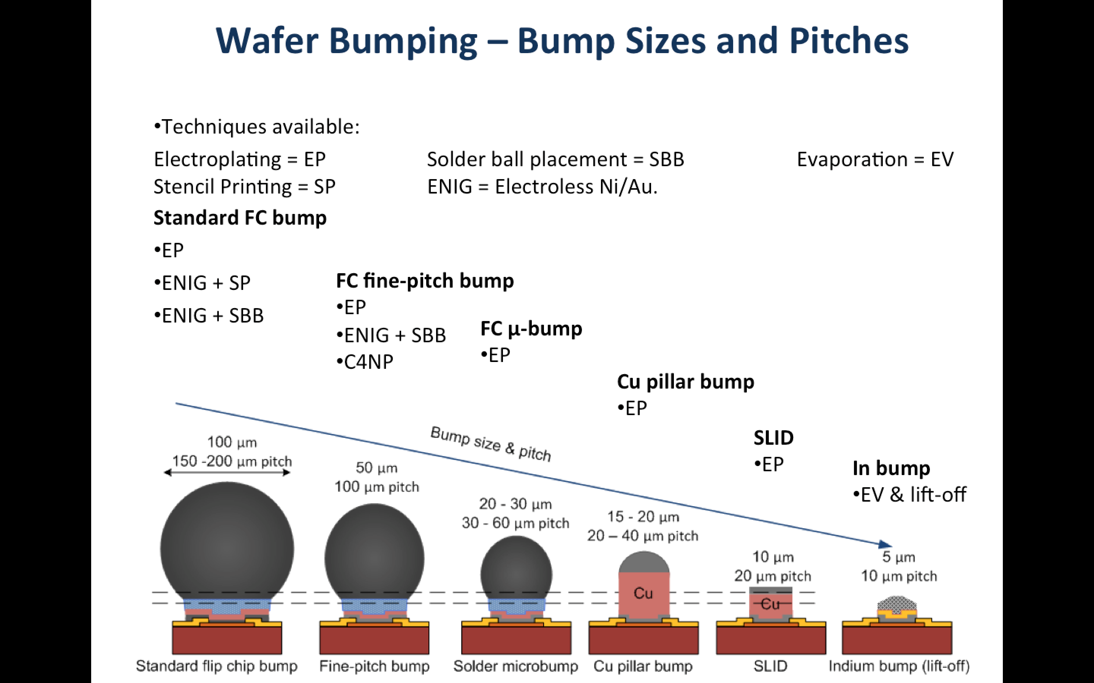
Courtesy of Vaehanen (CERN)

Slide 13
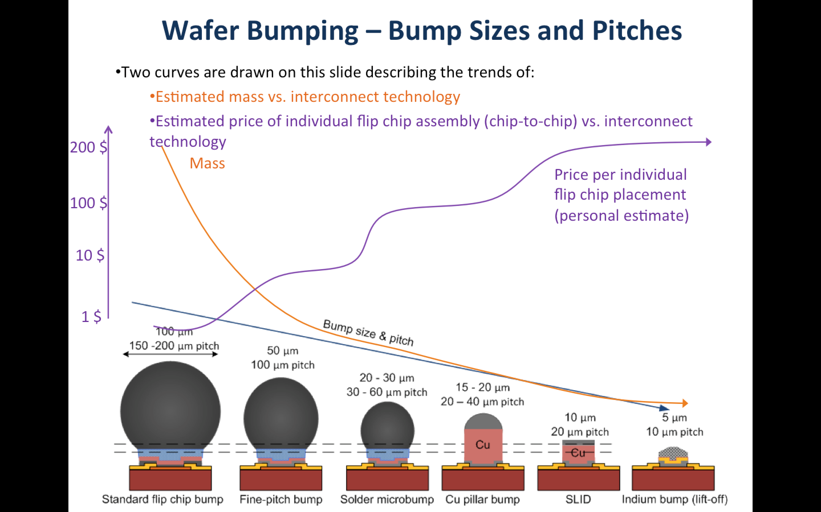
Courtesy of Vaehanen (CERN)

Slide 14
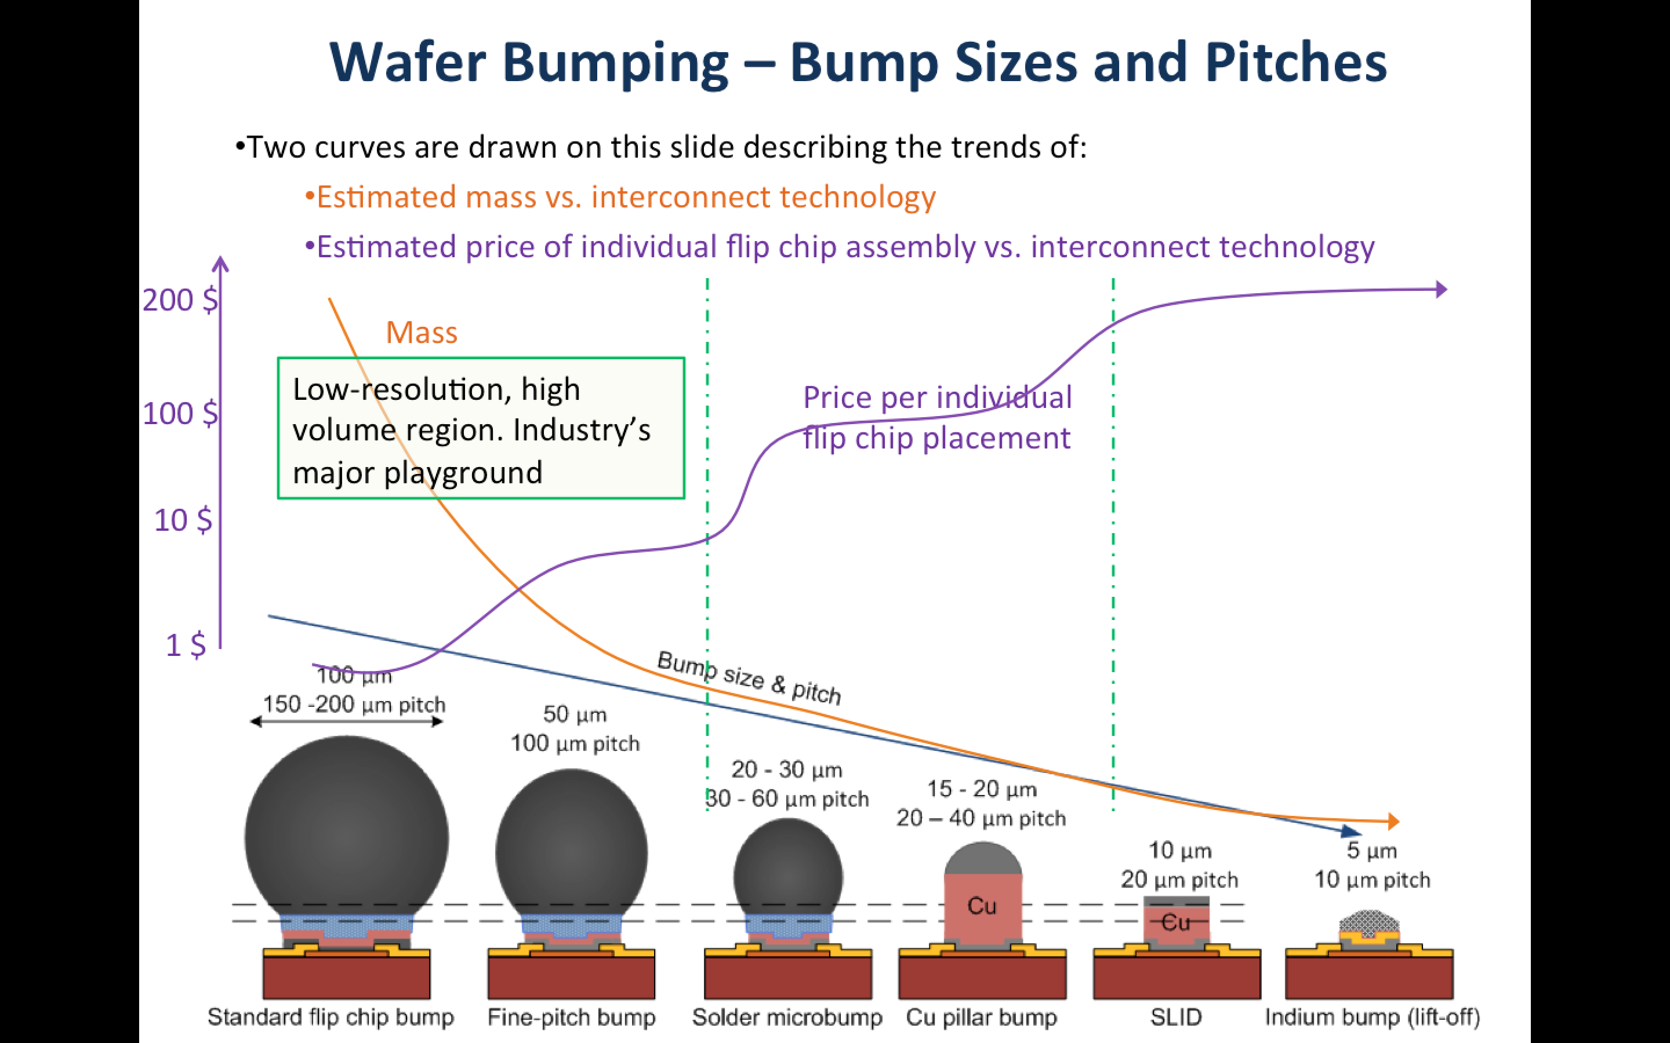
Courtesy of Vaehanen (CERN)

Slide 15
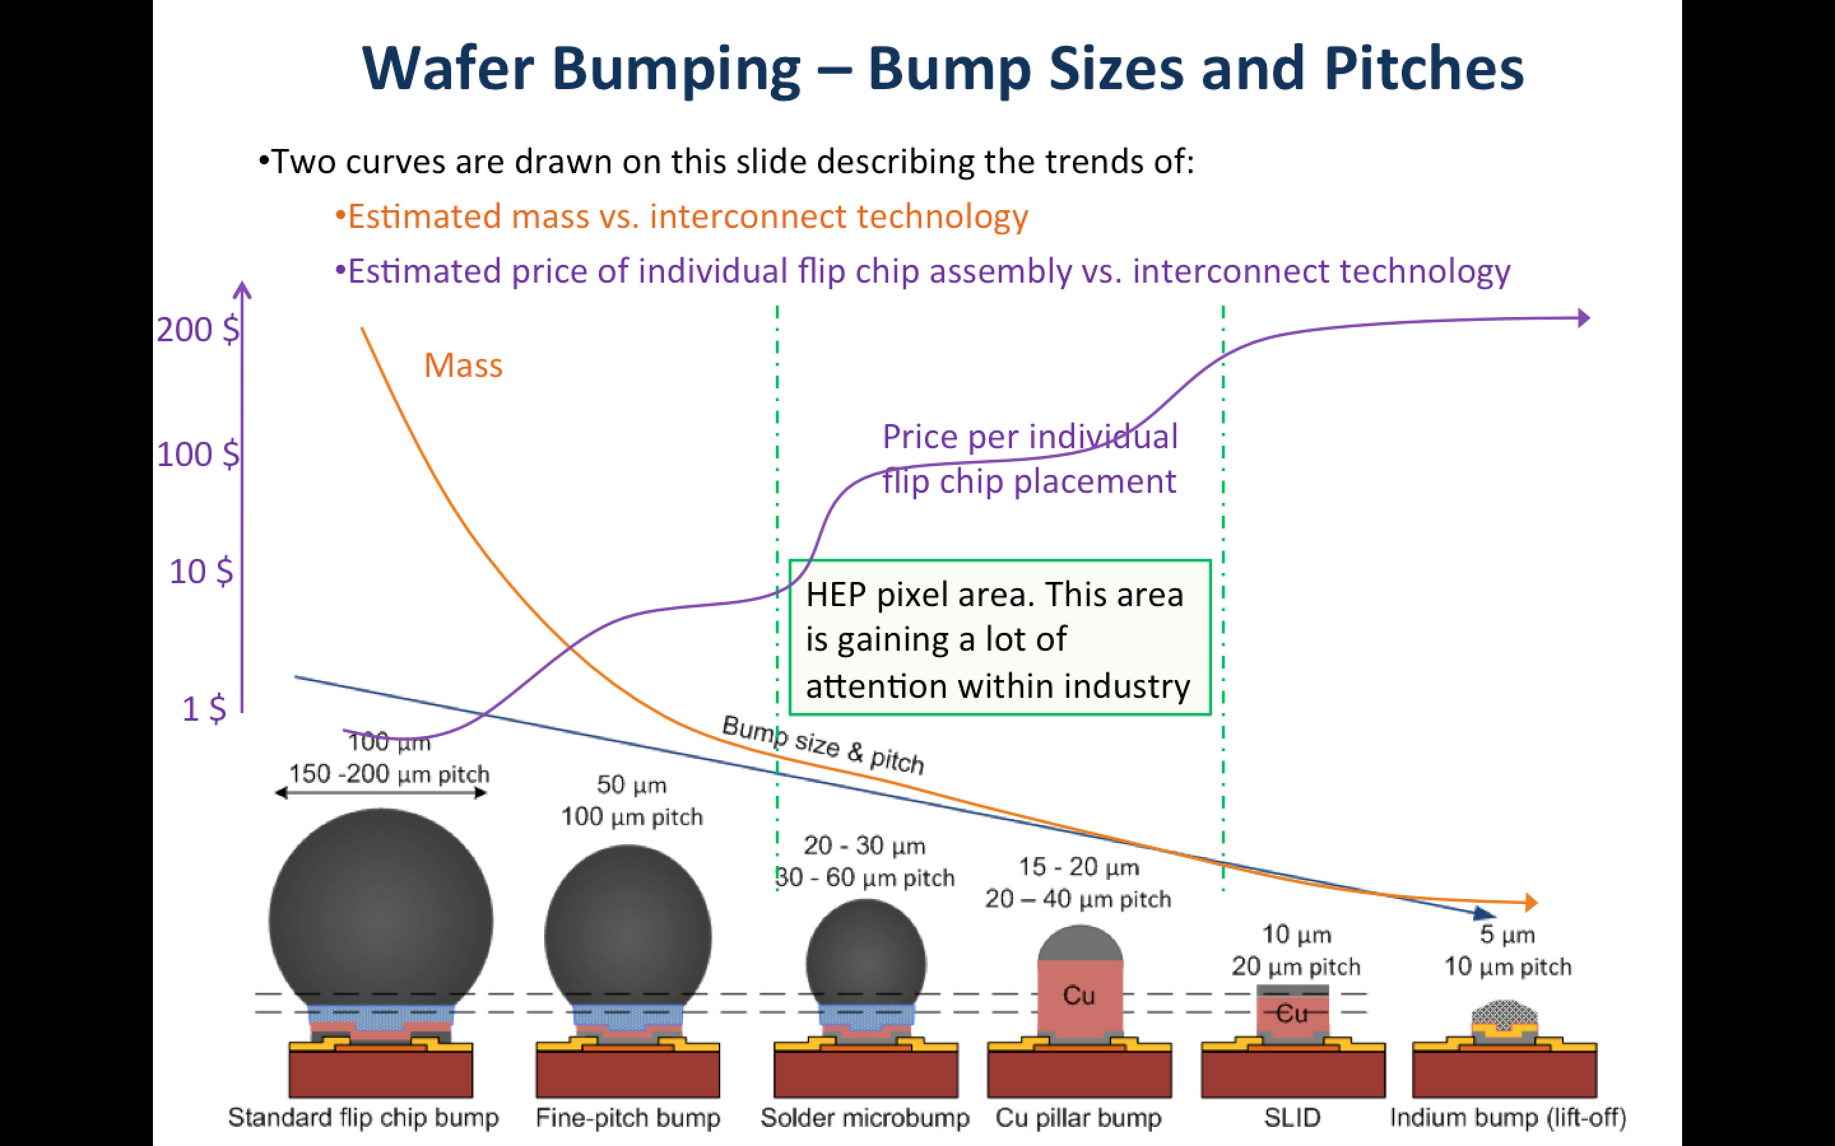
Courtesy of Vaehanen (CERN)

Slide 16
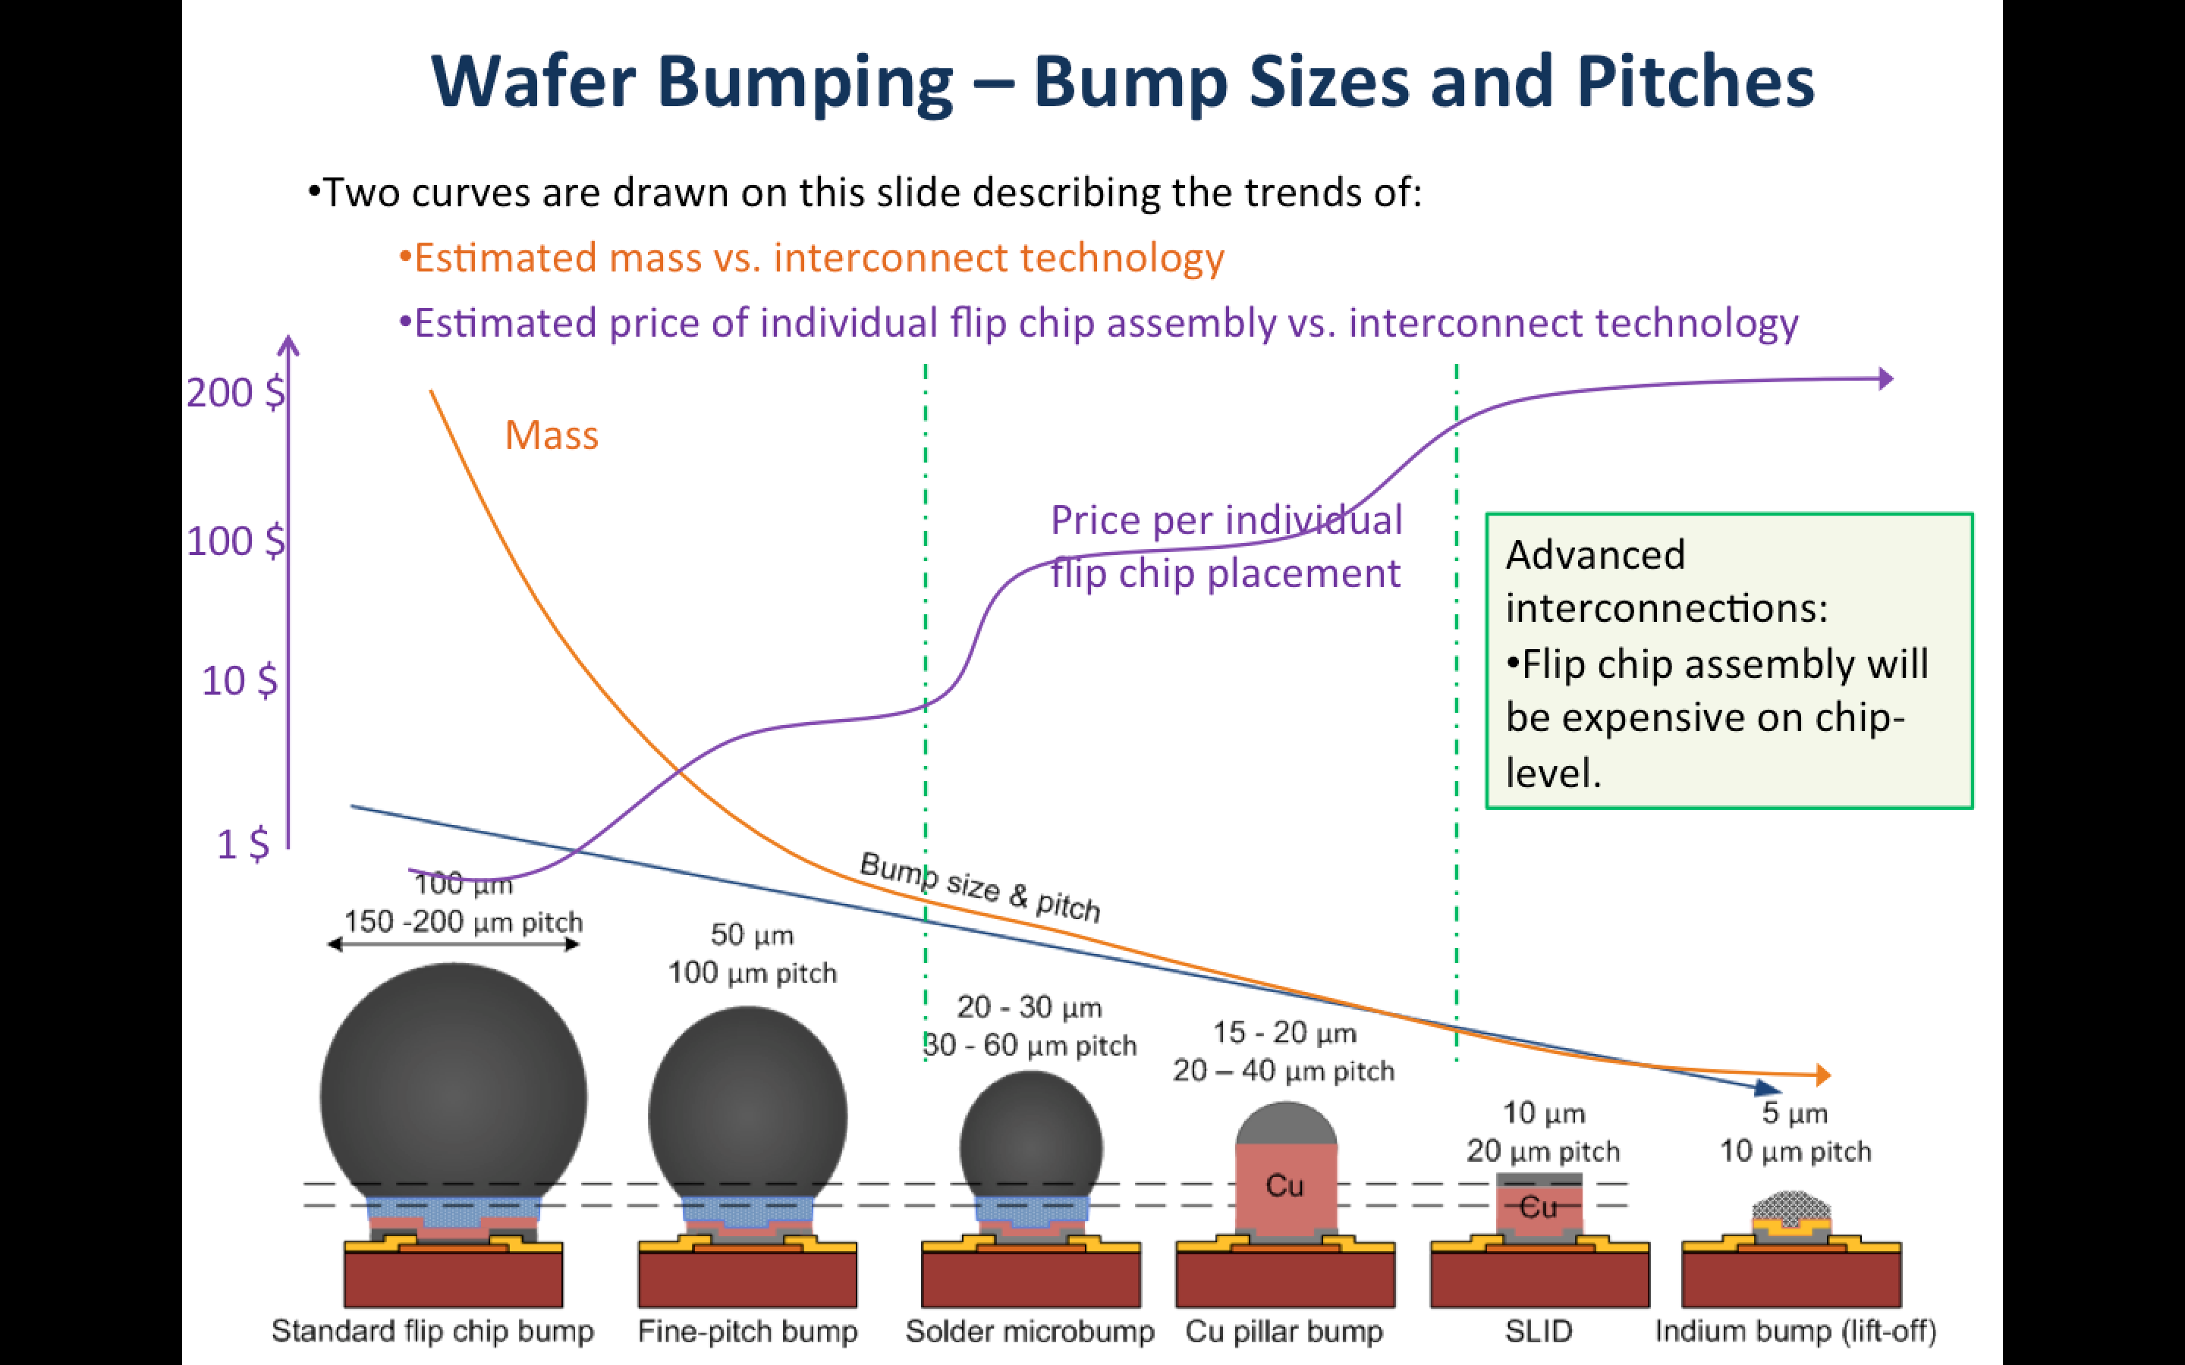
Courtesy of Vaehanen (CERN)

Slide 17
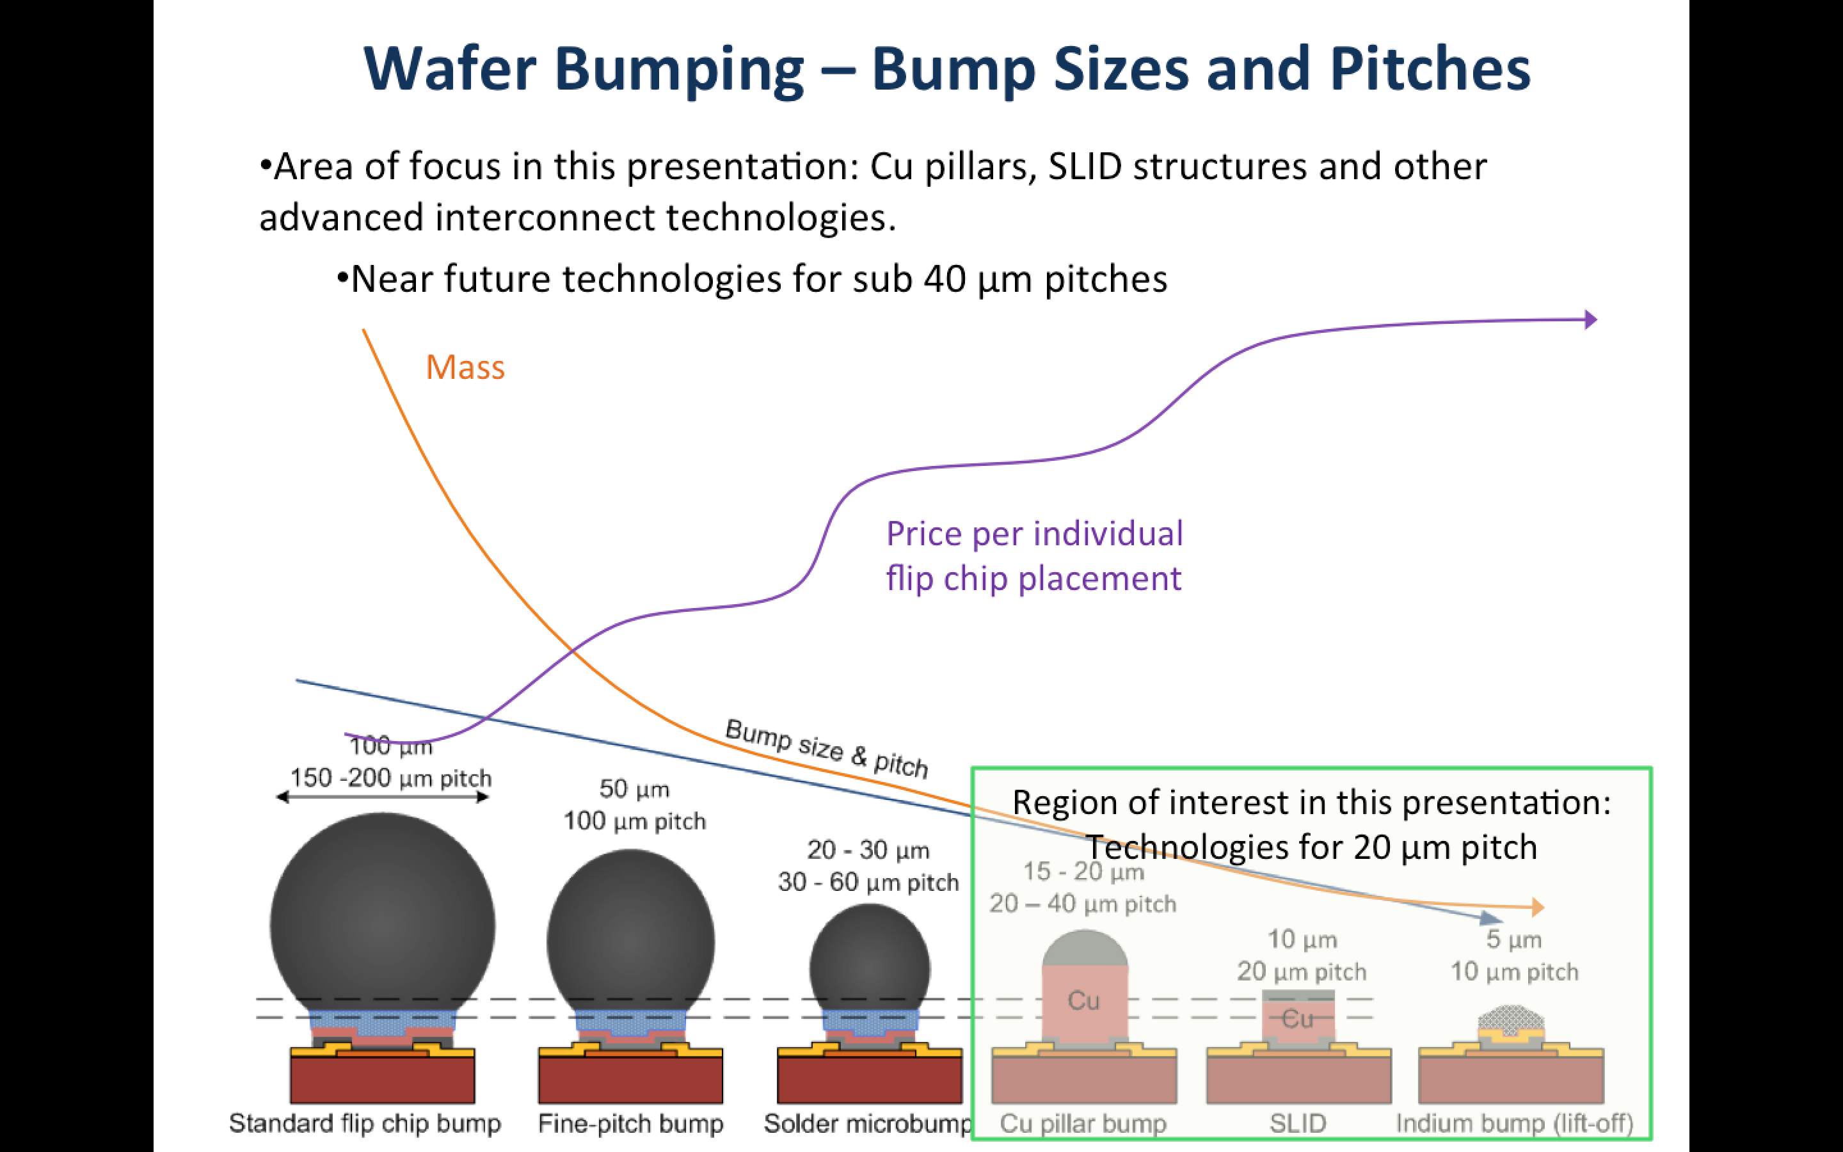
Courtesy of Vaehanen (CERN)

Slide 18
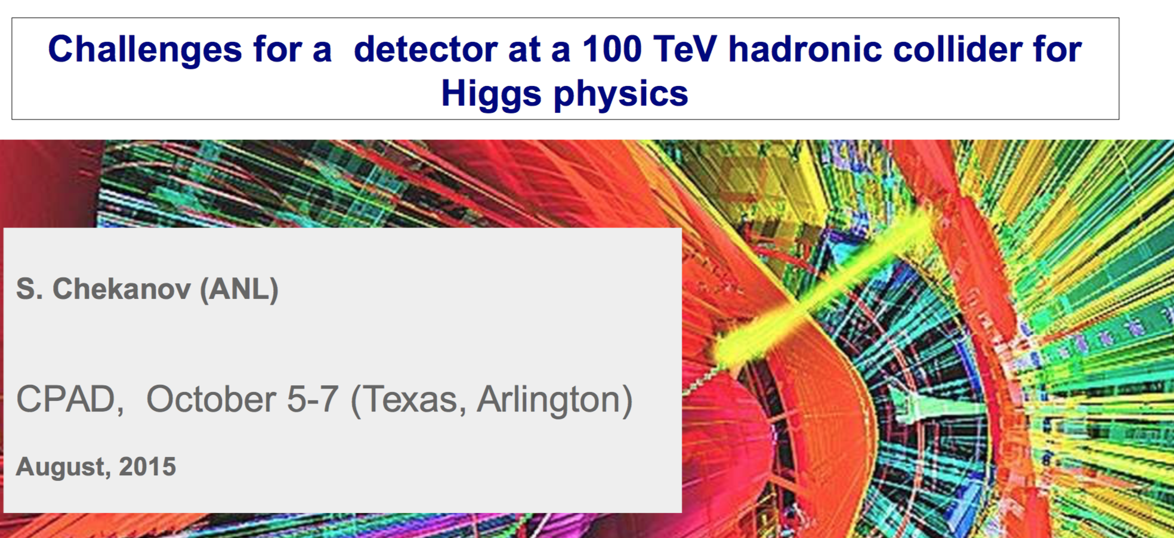
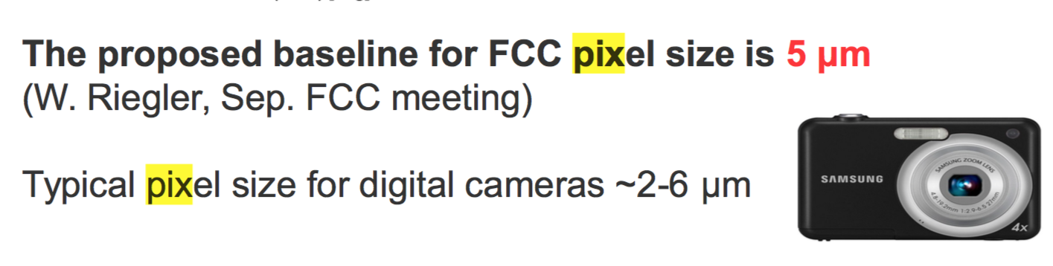
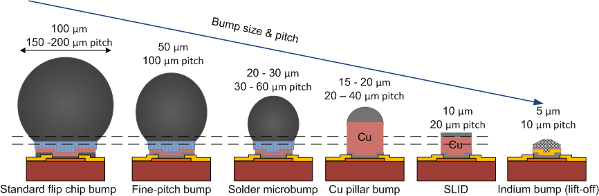
From yesterday

Slide 19
From yesterday
2 μm
4 μm pitch
DBI

Slide 20
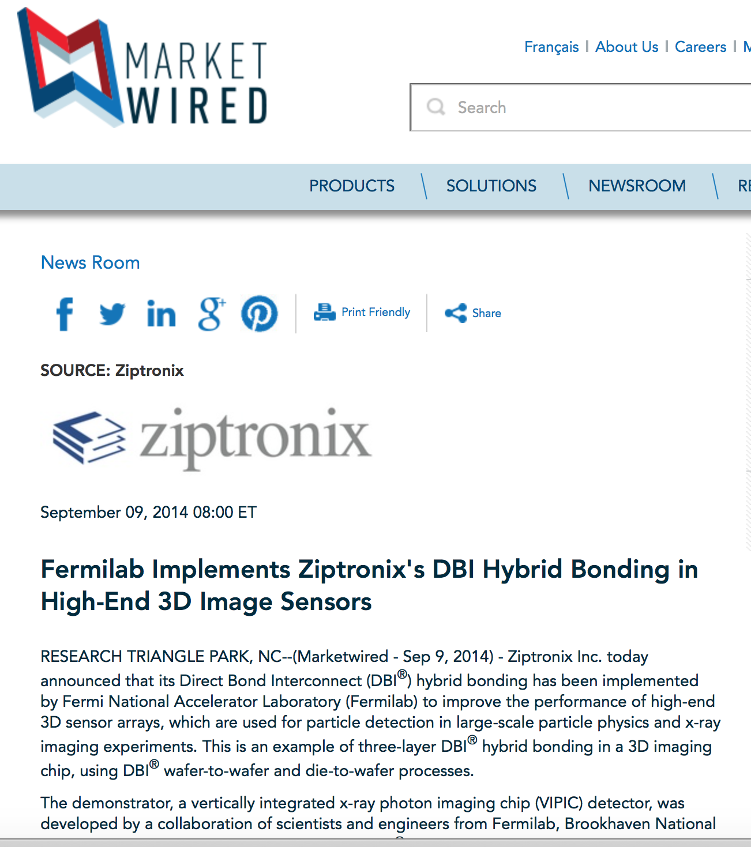
From ziptronix web site
“DBI® can achieve over 100,000,000 electrical connections per square centimeter; a significant increase over the ~100,000 connections per square centimeter density achieved with through-die vias used in other 3D interconnect approaches.”

Slide 21
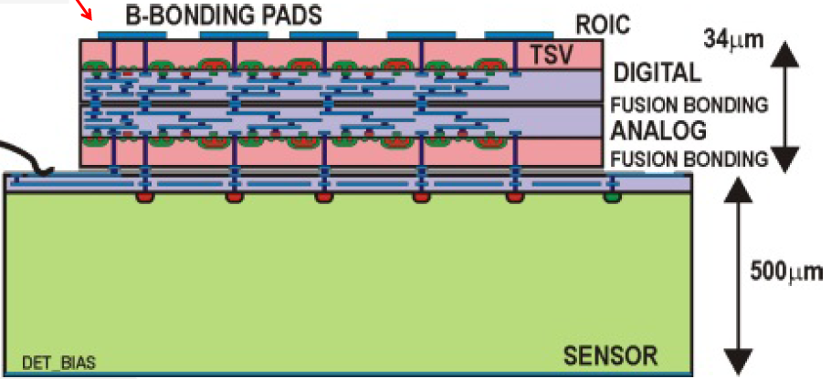
Sensor Integration –Three tier devices
We then chip-to-wafer oxide (DBI) bonded 3D chips to BNL sensors to form three-tier integrated sensor/electronics assemblies
  VIP(ILC), VICTR(CMS), and VIPIC(X-Ray) assemblies
Wafer-wafer bond
Chip-wafer bond
3
2
1

Slide 22
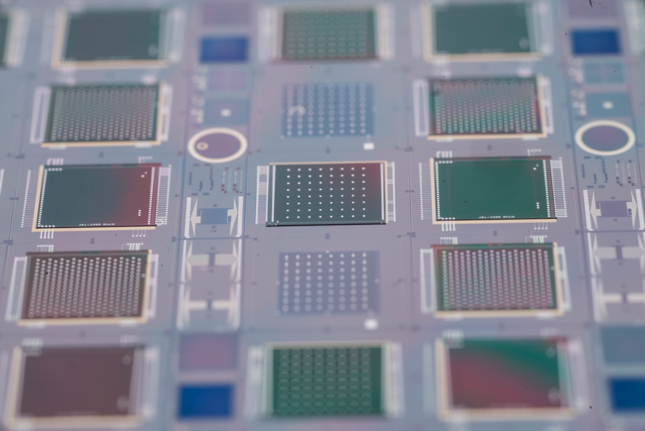
VIP
VICTR
VIP
VIPIC
VIPIC
Next step is tiling these into dense arrays

Slide 23
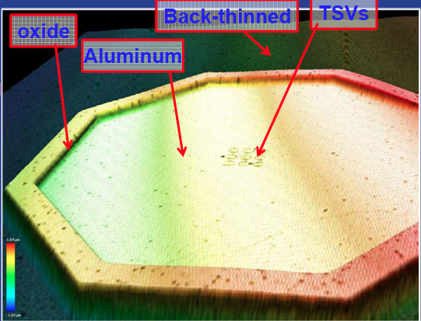
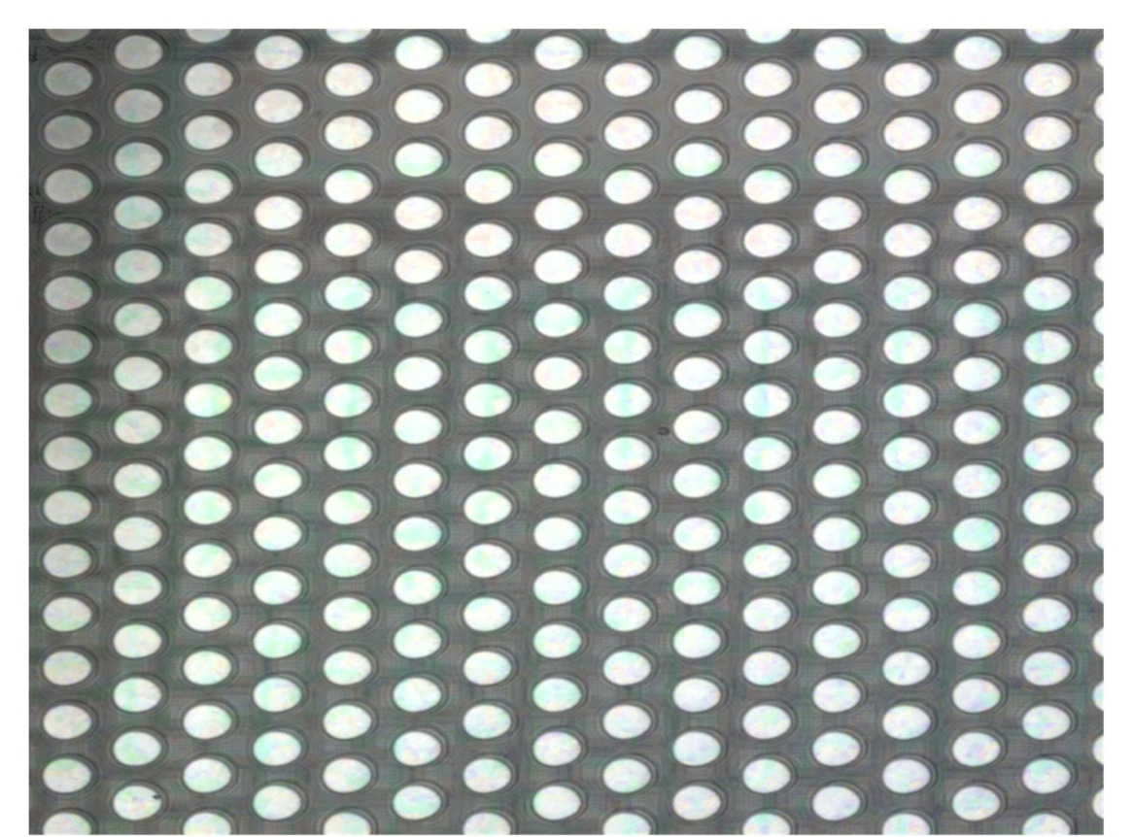
Sensor Oxide Bonding
A promising fine pitch bonding technology
the direct bond interconnect (DBI)
oxide bond process from Ziptronix
  No bump bonds – planar resulting wafer
  Very fine pitch - 4 microns used for
  3D Tezzaron wafers
  Mechanical strength enables
  aggressive post-bond thinning
  Uses standard IC processes - CMP and
  metalization
  Can withstand high temperatures
Wafer-wafer bond can be reworkable
In principal can be low cost
4 micron pitch

Slide 24
Some general remarks
Interconnection and Hybridization technologies have made tremendous progress in the last decades.
They enabled higher channel densities and extremely compact assemblies.
    LHC upgrades for phase-1 and phase-2 seems to be compatible with the present commercial available products
This trend is still ongoing in industry and seems to be compatible with the future needs of our community.
    We need to find the resources and continue to collaborate in close contact with leading industries.

Slide 25
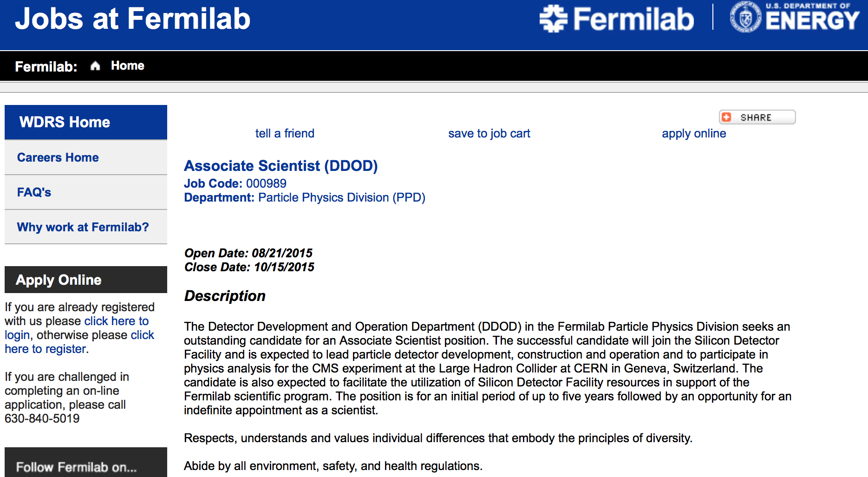
One more slide if you do not mind (just for reading)
http://fermi.hodesiq.com/job_detail.asp?JobID=5103763

