Slide 1
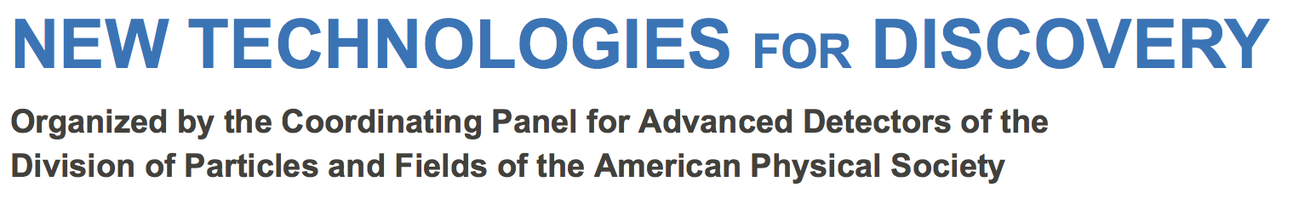
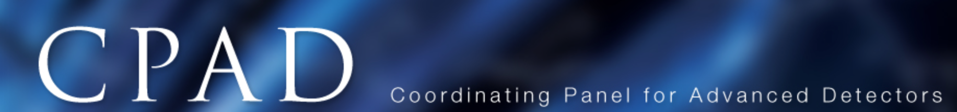

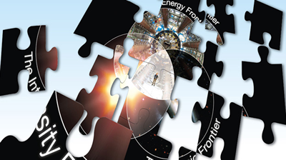
Introduction & Workshop Goals
http://www.hep.anl.gov/cpad
Marcel Demarteau & Ian Shipsey
Co-Chairs CPAD
Notes:
We would like to give you a brief introduxtion to the workshop and its goals.

Slide 2
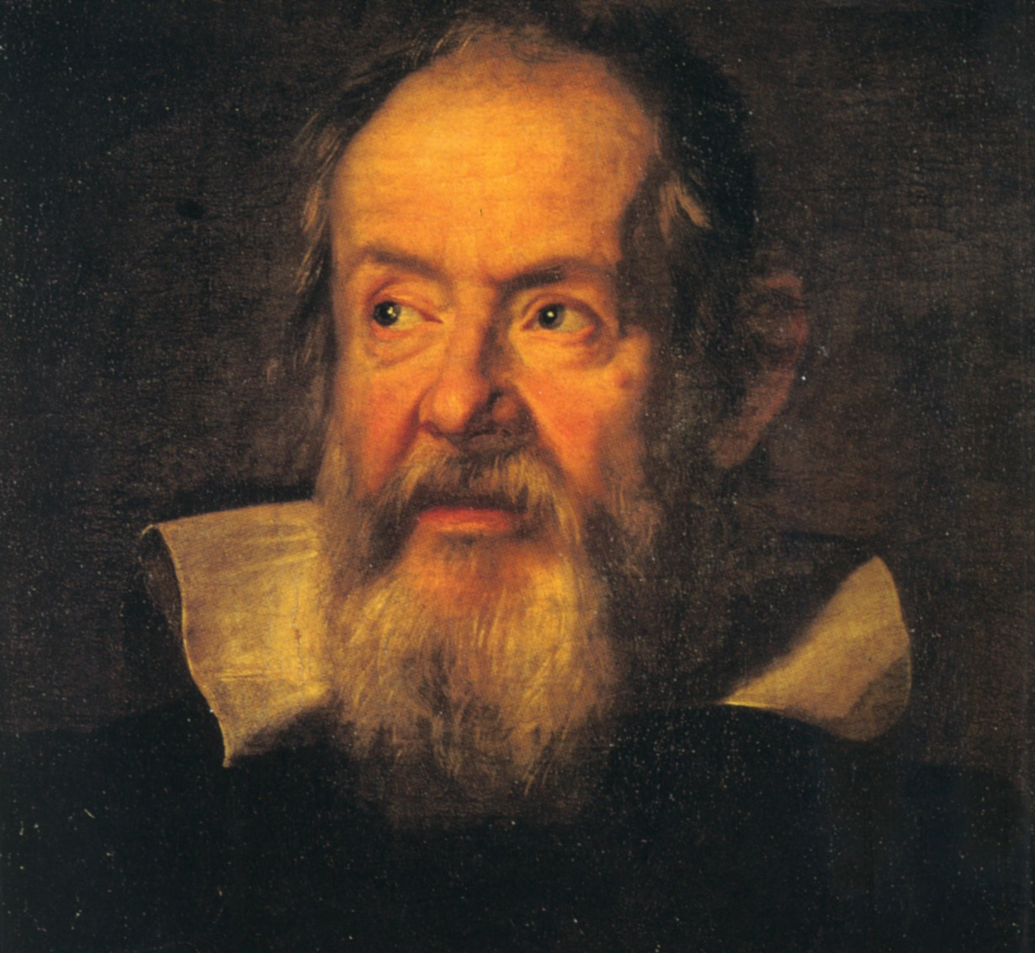
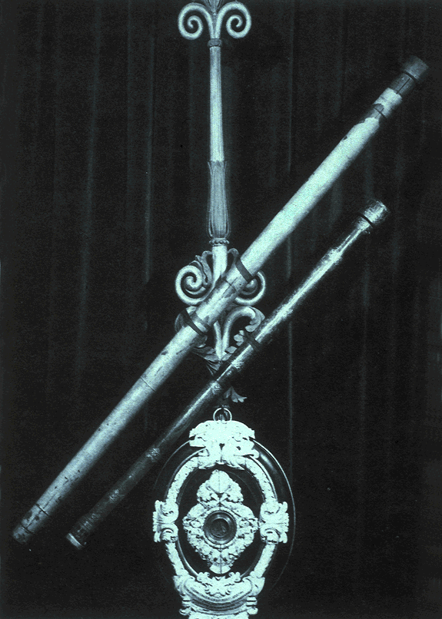
“Measure what is measureable and
make measureable what is not so.”
Galileo Galiliei
1564-1642
Notes:
With his first tlescope In 1608 moons of jupiter
crater on the moon (an imperfcetion in th heavens) and phase of venus only explicable if venus orbits the Sun
displaced earth from it privileged position as the center of everything
Most of our knowledg has come fomr instrimentation and masurement

Slide 3
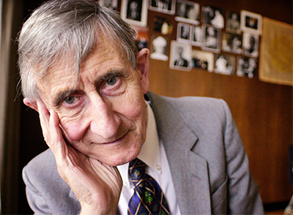
Instrumentation: The Great Enabler
“New directions in science are launched by new tools much more often than by new concepts.
The effect of a concept-driven revolution is to explain old things in new ways. The effect of a tool-driven revolution is to discover new things that have to be explained”
Freeman Dyson
Notes:
Read
Instrumentation is the great enabler for science both pure and applied and our science of particle physics boardly nterprested is grounded in developing novel instrumentation which enables our experiments to look at the world in new ways.

Slide 4
Goal: #1 Evaluation of the Detector R&D program being carried out in support of the High Energy Physics science mission, to determine if the existing program meets the science needs of the P5 science drivers within the twenty year P5 vision.
Notes:
read

Slide 5
Goal #2: proposing new ideas for detection technologies and identifying instrumentation opportunities to enhance the program as an enabler of our science: grand challenges for our field
Notes:
read

Slide 6
Structure of workshop to meet goals:
5 P5 science driver sessions today
highly integrated with 6 technology sessions Tuesday
The 11 sessions are summarized Wednesday a.m.
The outcome of the workshop will be a formulation of the needs of the field to ensure a vibrant future.
The deliverable is a report that will be shared with DOE and NSF that will summarize the workshop findings
The report writing begins at the CPAD committee meeting at 13:00 on Wednesday (directly after the end of the workshop)
A summary of the workshop will also be presented at a future HEPAP meeting.
Notes:
Simply read this slide

Slide 7
The P5 Science Drivers:
The Higgs as a tool for discovery (Rick van Kooten, Ulrich Heinz, Ariel Schwartzman)
Physics associated with neutrino mass (Jae Yu, Kate Scholberg )
The nature(s) of dark matter (Priscilla Cushman , Rupak Mohapatra)
Early and late time cosmic acceleration (Brad Benson, Mike Niemack )
Exploring the unknown (Jim Alexander, Doug Glenzinski )
Technologies:
Noble Liquids (Marty Breidenbach, Cristiano Galbiati, Tom Shutt)
Tracking and vertex detectors & muon detectors (Marina Artuso, Ron Lipton)
Solid State Detectors (bolometers etc.) (Clarence Chang, Yury Kolomensky, Kent Irwin)
Calorimetry (Burak Bilki, Roger Rusack, Erik Ramberg)
Photodetectors (Adam Para, Bob Svoboda, Matt Wetstein)
Trigger and DAQ (Wesley Smith, Mike Huffer)
CPAD & DPF
thank the Working
Group convenors
& local organizers
Andy White and
Dave Nygren
Notes:
Thank the group convers of this workshop for their very hard work preparing the stimulating porgramme of the next 2.5 days.

Slide 8
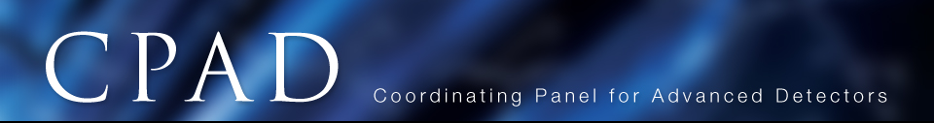
CPAD: to promote, coordinate and assist in the research and development of instrumentation for High Energy Physics nationally, and to develop a detector R&D program to support the mission of High Energy Physics for the next decades.
Membership:
From Universities
  Jim Alexander (Cornell)
  Marina Artuso (Syracuse)
  Rick van Berg (Penn)
  Bonnie Fleming (Yale)
  Ulrich Heintz (Brown)
  Howard Nicholson (Mt. Holyoke)
  Gabriella Sciolla (Brandeis)
  Ian Shipsey* (Oxford)
  Wesley Smith (Wisconsin)
  Matt Wetstein (Chicago)
From Laboratories
  Clarence Chang (Argonne)
  Marcel Demarteau* (Argonne)
  Juan Estrada (Fermilab)
  Maurice Garcia-Sciveres (LBNL)
  David MacFarlane (SLAC)
  Ron Lipton (Fermilab)
  Vinnie Polychronakos (BNL)
  Pete Siddons (BNL)
  Bob Wagner (Argonne)
  Graham Wilson (BNL)
International
  Ariella Cattai (CERN)
  Junji Haba (KEK)
http://www.hep.anl.gov/cpad/
(*) = co-chair
10 CPAD working groups (next slides)
Notes:
The charg fo CPAD is to promote, coordinate and assist in the research and development of instrumentation for High Energy Physics nationally, and to develop a detector R&D program to support the mission of High Energy Physics for the next decades. The member from the unverisity communiity and from the labs is here
We coordinated the Instrumentaion frontier at Snwomass
And the subsequent report and now have 10 groups working on various aspects of the charge. Thse are

Slide 9

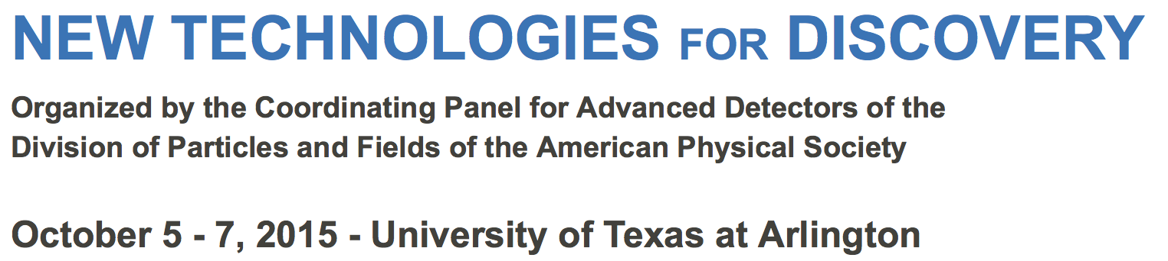
#1 Continuation and organization of an, at least, annual national instrumentation workshop for the HEP community
Notes:
The estalishment of an at last annual national instrumentaion workshop. The product is the meeting this week.

Slide 10
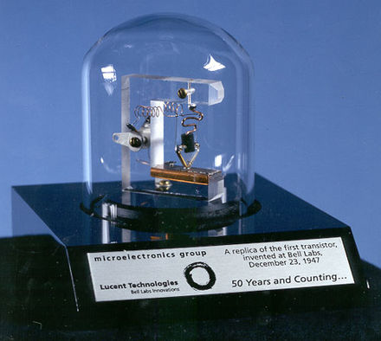
#2 Development of a solicitation for instrumentation grand challenges
This workshop has
a key role to play
Notes:
Read bullet this workshop and future workshops in this series have a key role to play in identifying grand challenges
Note:
Galileo telecope
Instead, what Bardeen, Brattain, and Shockley invented in 1947 was the first point-contact transistor.[8] In acknowledgement of this accomplishment, Shockley, Bardeen, and Brattain were jointly awarded the 1956 Nobel Prize in Physics "for their researches on semiconductors and their discovery of the transistor effect."[14

Slide 11
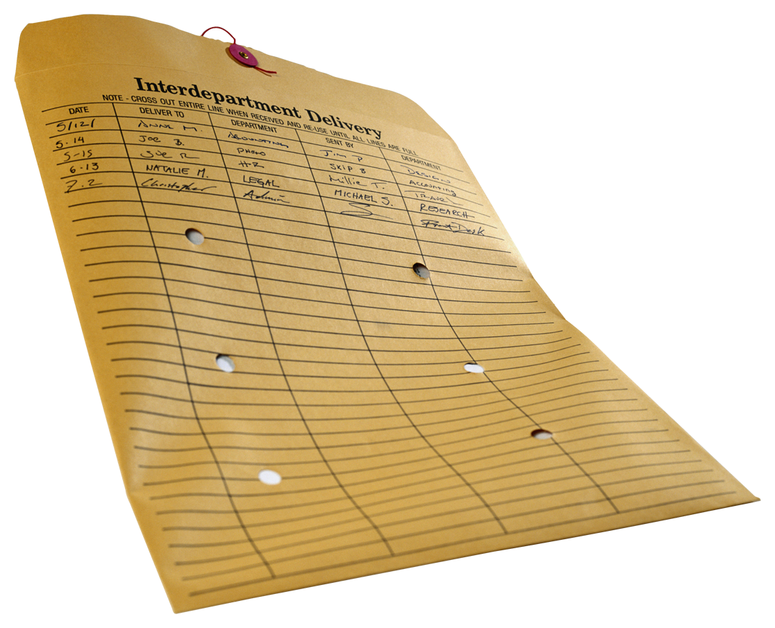
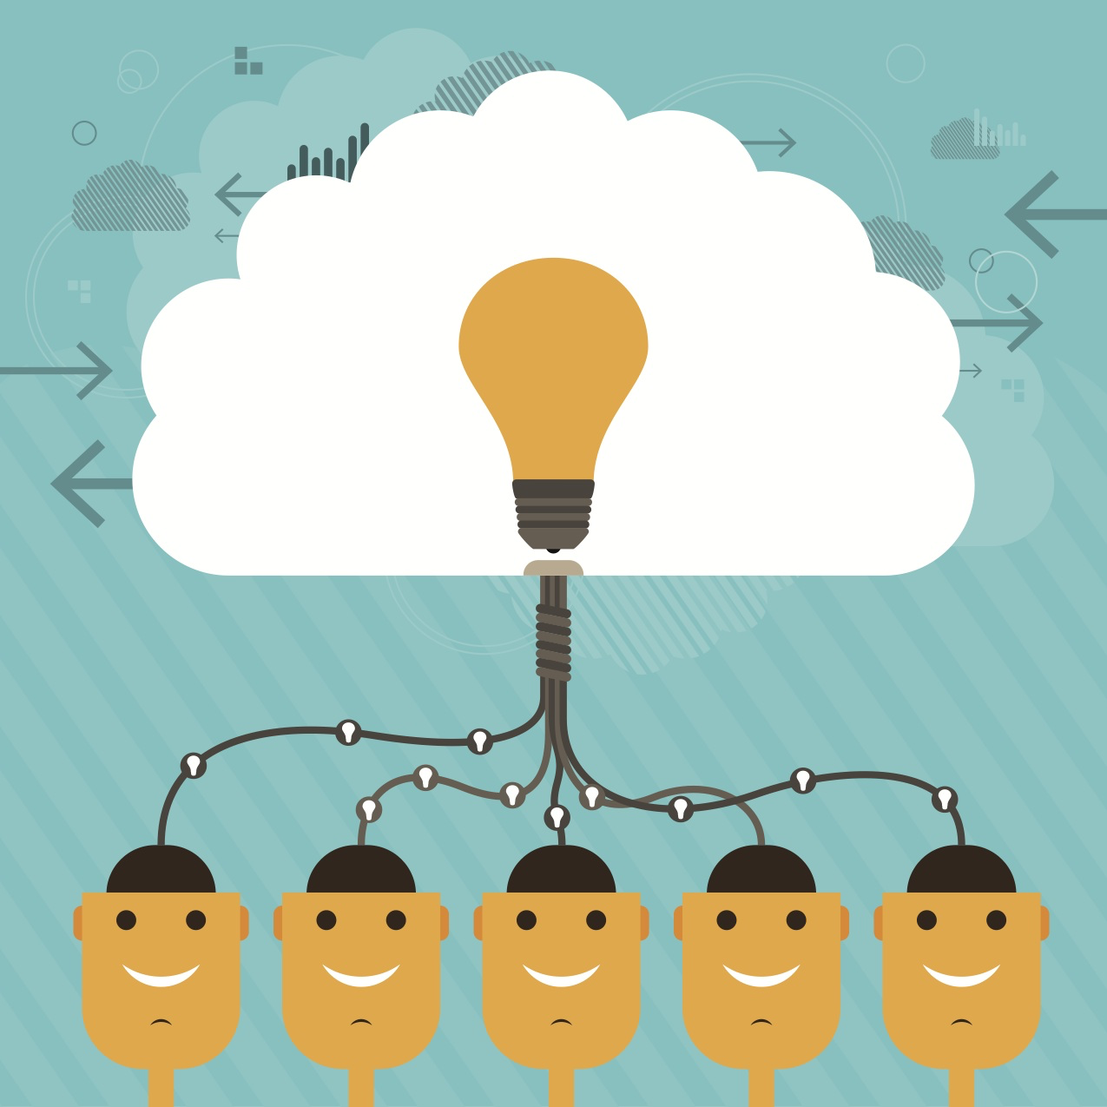
#3 The enhancement of interdisciplinary aspects of instrumentation including a closer relationship with Nuclear Physics, Basic Energy Sciences, the medical community, NASA, and the national security community in part through a series of interdisciplinary workshops
Notes:
The pace of development across the sciences is breathtaking
We can achieve more in instrumentation developemnet together with our colleaguse in other fields of science than we can working apart.
We hav a group exploring ways to devlop a closer relationship with Nuclear Physics, Basic Energy Sciences, the medical community, NASA, and the national security community in part through a series of interdisciplinary workshops
notes:
The field of high-energy physics should reach out to other communities. This should start somewhat locally by establishing a closer relationship with the Office of Nuclear Physics (NP) and the Office of Basic Energy Sciences (BES) of the Office of Science. A workshop, or a series of workshops, intended to bring those communities closer and foster interaction and collaboration with mutual benefit should be held. This should also include the corresponding NSF funded communities. The xtnde to the medical NAS and Nat Sec, communities at a later stage
Closer connections should be established with the medical community, NASA, and national security community. These should take into account existing relationships.

Slide 12
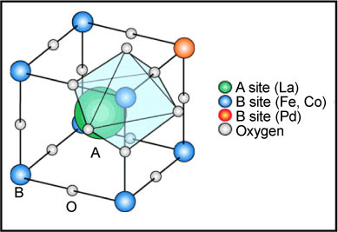
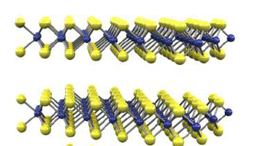
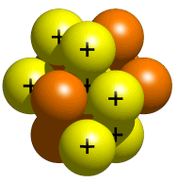
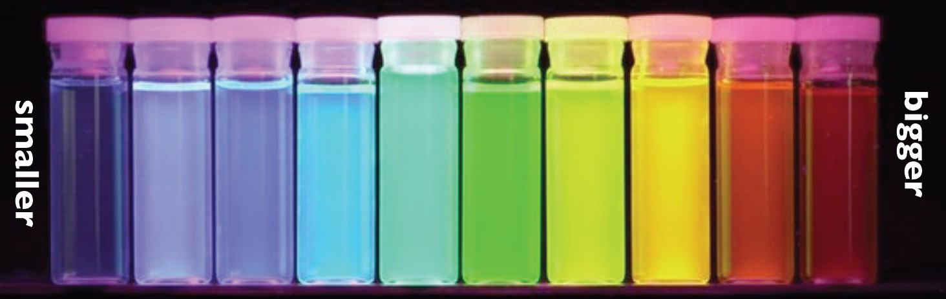
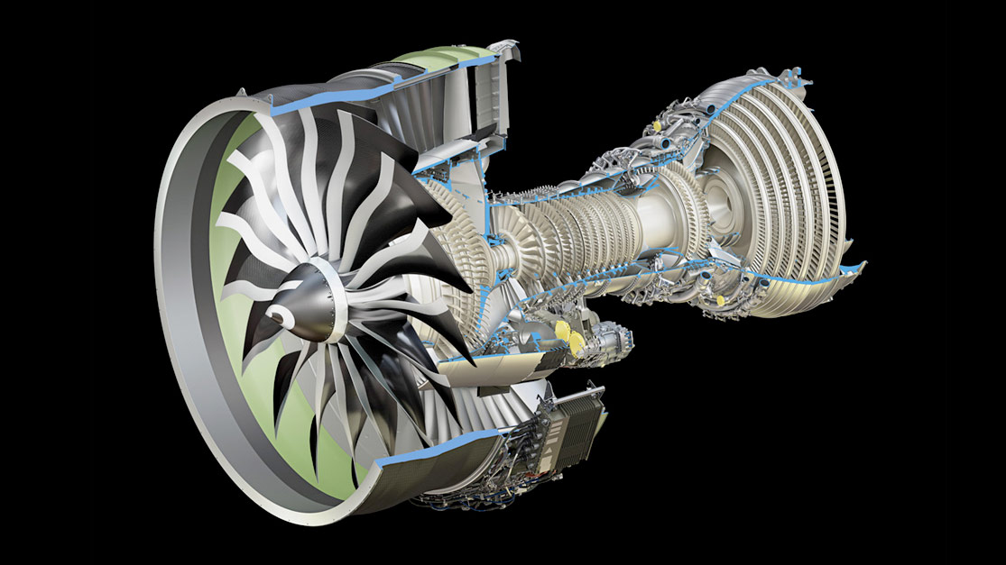
#4 Develop a plan to establish and maintain a repository of new developments in other fields that might benefit the development of new sensors or instrumentation in HEP
Perovskites
Trans Metal Di-chalcogenides
Wavelength shifting through Quantum Dots
Additive manufacturing
…………………
Notes:
Hand in hand with this we have a
A group… Read bullet
some examples are shown here

Slide 13

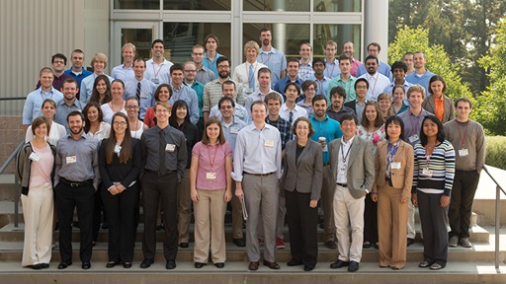
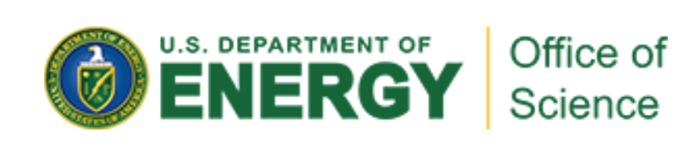
#5 Creation of a National Instrumentation Fellowship program for both post docs and graduate students
+ Private
Sector
Notes:
A group is working on the creation of a prestigious national instrumentation fellowship program for both post docs and graduate students,
The goal is to increase participation of young US scientists in leading-edge instrumentation R&D, and help the compete subsequently for permanent positions and
national labs. The NSF and DOE fellowship programs that already exist may provide one possible route to realizing this working with the private sector is another
Notes:
This is work in porgress.
to maintain and enhance impact of U.S. to detector instrumentation,
and contribution of HEP instrumentation expertise to society (via those that leave HEP to work in industry)
This working group is Read bullet the NSF and DOE fellowship programs that already exist provides one route to realizing this working with the private sector is another

Slide 14
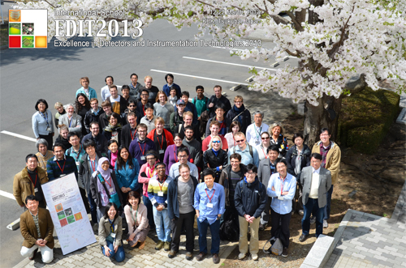
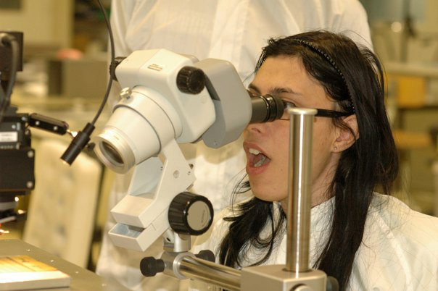
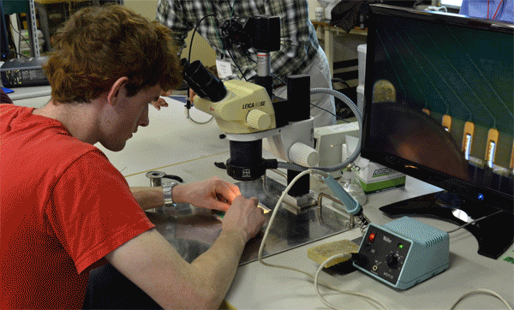
#6 A program to further develop instrumentation schools and education
Notes:
Due to the very long timescales of HEP experiments, opportunities to participate in the design, prototyping and building of detectors are infrequent. In consequence the level of instrumentation experience and expertise among young experimentalists in HEP has declined This is correlated with the overall decline of construction, technical staff, and infrastructure at universities
Many excellent instrumentation schools exist
This working group is looking at ways to enhance and strongly support these schools

Slide 15
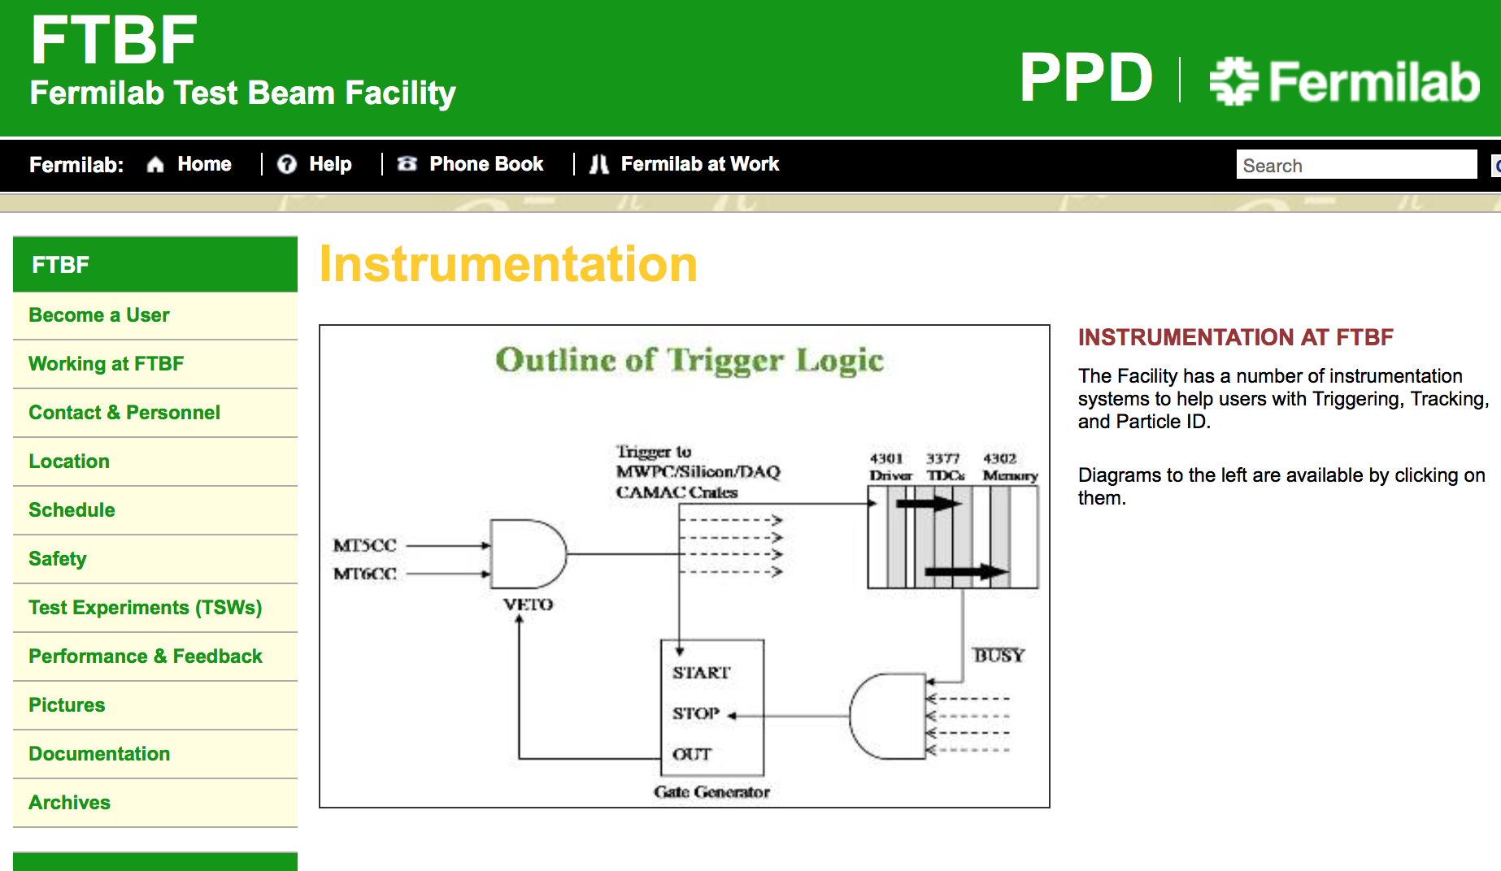
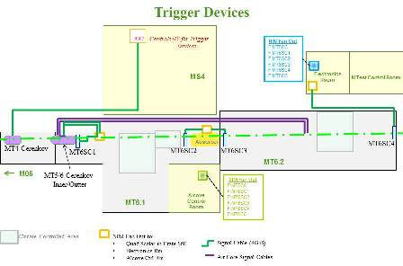
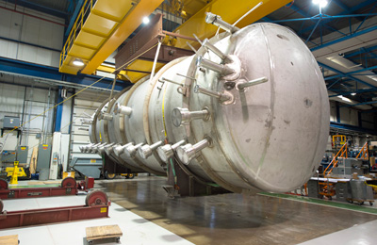
#7 Coordination of instrumentation resources (including engineering) at National Labs for the HEP community at the universities and the National Labs
Notes:
with the overall decline of construction, technical staff, and infrastructure at universitiesit bcoems ever more important
We have agroups studying Coordination of instrumentation resources (including engineering) at National Labs for the HEP community at the universities and the National Labs
& making the nature of these facilities & capabilities more widely known and accessible
Natiional Lab Points of Contact represents natural point of entry for coordinating University-laboratory collaboration on generic R&D
POC are a members of the CPAD, allowing better coordination of Lab resources nationally

Slide 16
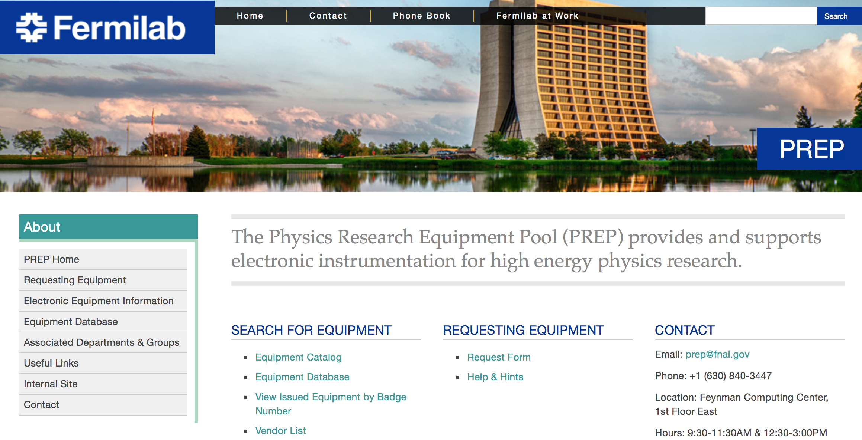
#8 Establish an improved model of an equipment pool that could be used for instrumentation development at U.S. universities and labs.
Notes:
The Physics Research Equipment Pool PREP at FNAL provides support for instrumentation R&D at universities and for particle physics research. This CPAD group is tasked with
exploring ways to increase utilization of the pool

Slide 17

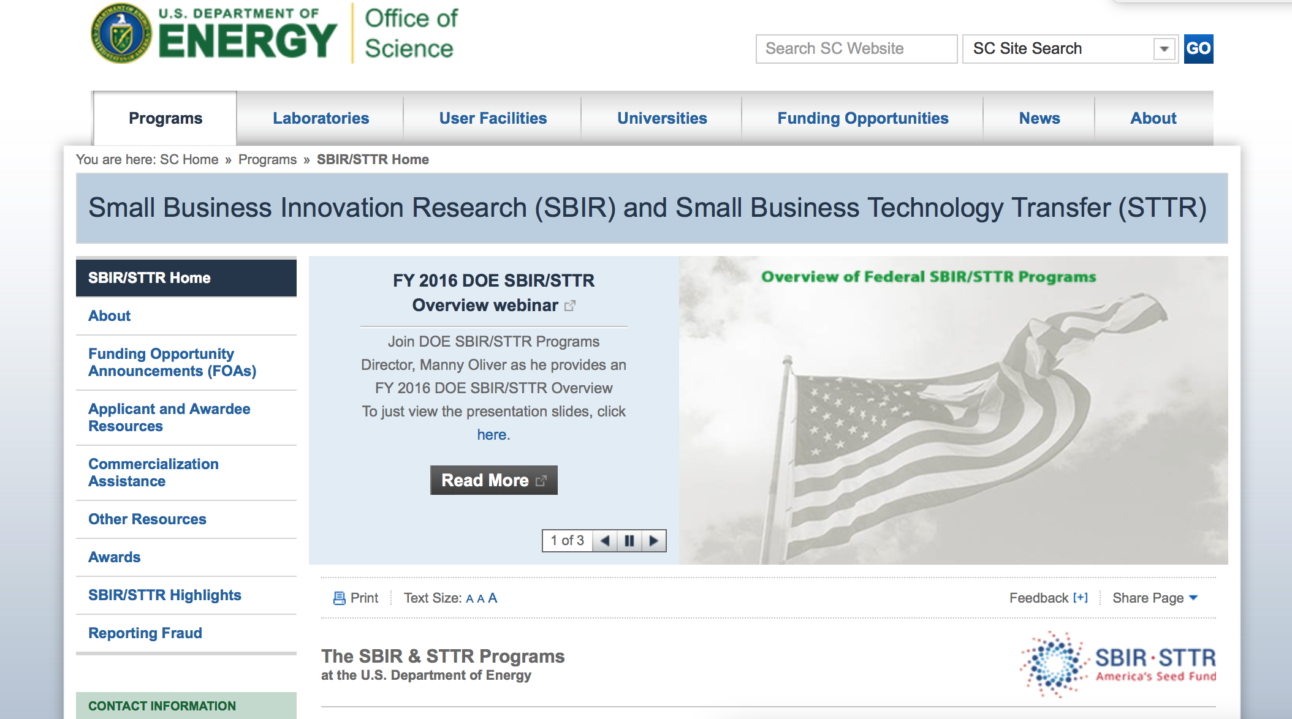
#9 Working with DOE OHEP on which topics in instrumentation should be encouraged in the yearly SBIR/STTR proposal calls. (Started with 2015 call.)
Notes:
The SBIR STTR is one of Amerca’s seed funds CPAD is working with the DOE OHEP to define the scope of of the SBIR call each year

Slide 18
#10 The creation of an APS DPF Award for Excellence in Instrumentation Research and Development
Notes:
To creat an award recognize and reward important contributions to our field by colleagues who excel in instrumentation development – not universally recognized, e.g. in career advancement at Universities. The ward would enhance th prestige of the instrumentationalist
The award was established this year

Slide 19
In this inaugural year the award will be presented at the
"New Technologies for Discovery" Workshop,
CPAD and DPF thank the 2015 Award Committee:
Howard Nicholson (Chair) CPAD
Sally Seidel (vice Chair) DPF
Marina Artuso CPAD
Karsten Heeger DPF
Graham Smith CPAD
Notes:
In this inaugural year the award will be announced and presented at this Workshop,
Before doing so CPAD and PDF wuld like to thank the 2015 Award Committee who had an astonishing difficult job to du du to an outstanding raft of nominations.

Slide 20
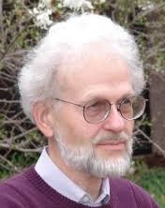
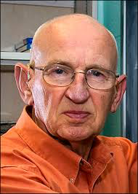
The 2015 DPF Instrumentation Award
is presented to
David Nygren and Veljko Radeka
for widespread contributions and leadership in the development of new detector technologies and low-noise electronics instrumentation in particle physics as well as other fields, and in particular work leading to the development and instrumentation of large volume liquid argon time projection chambers that are now a key element in the global particle physics program.
Notes:
Let Howard read this….

