Slide 1
Neutrino-less double beta decay with gas-phase xenon
David Nygren
University of Texas at Arlington

Slide 2
Perspective
NLDBD search seems to have entered a new era:
“Maybe not big/good enough to succeed,
but too costly to fail”
  Failure: background-limited result: B ~ 1 event/ton/year
Success: B ≤ 0.1 event/ton/year
Energy resolution, extreme radio-purity, and shielding have been insufficient (to date) to achieve sensitivity at ton-scale
Very difficult to produce background estimates based on measurements of materials/environment

Slide 3
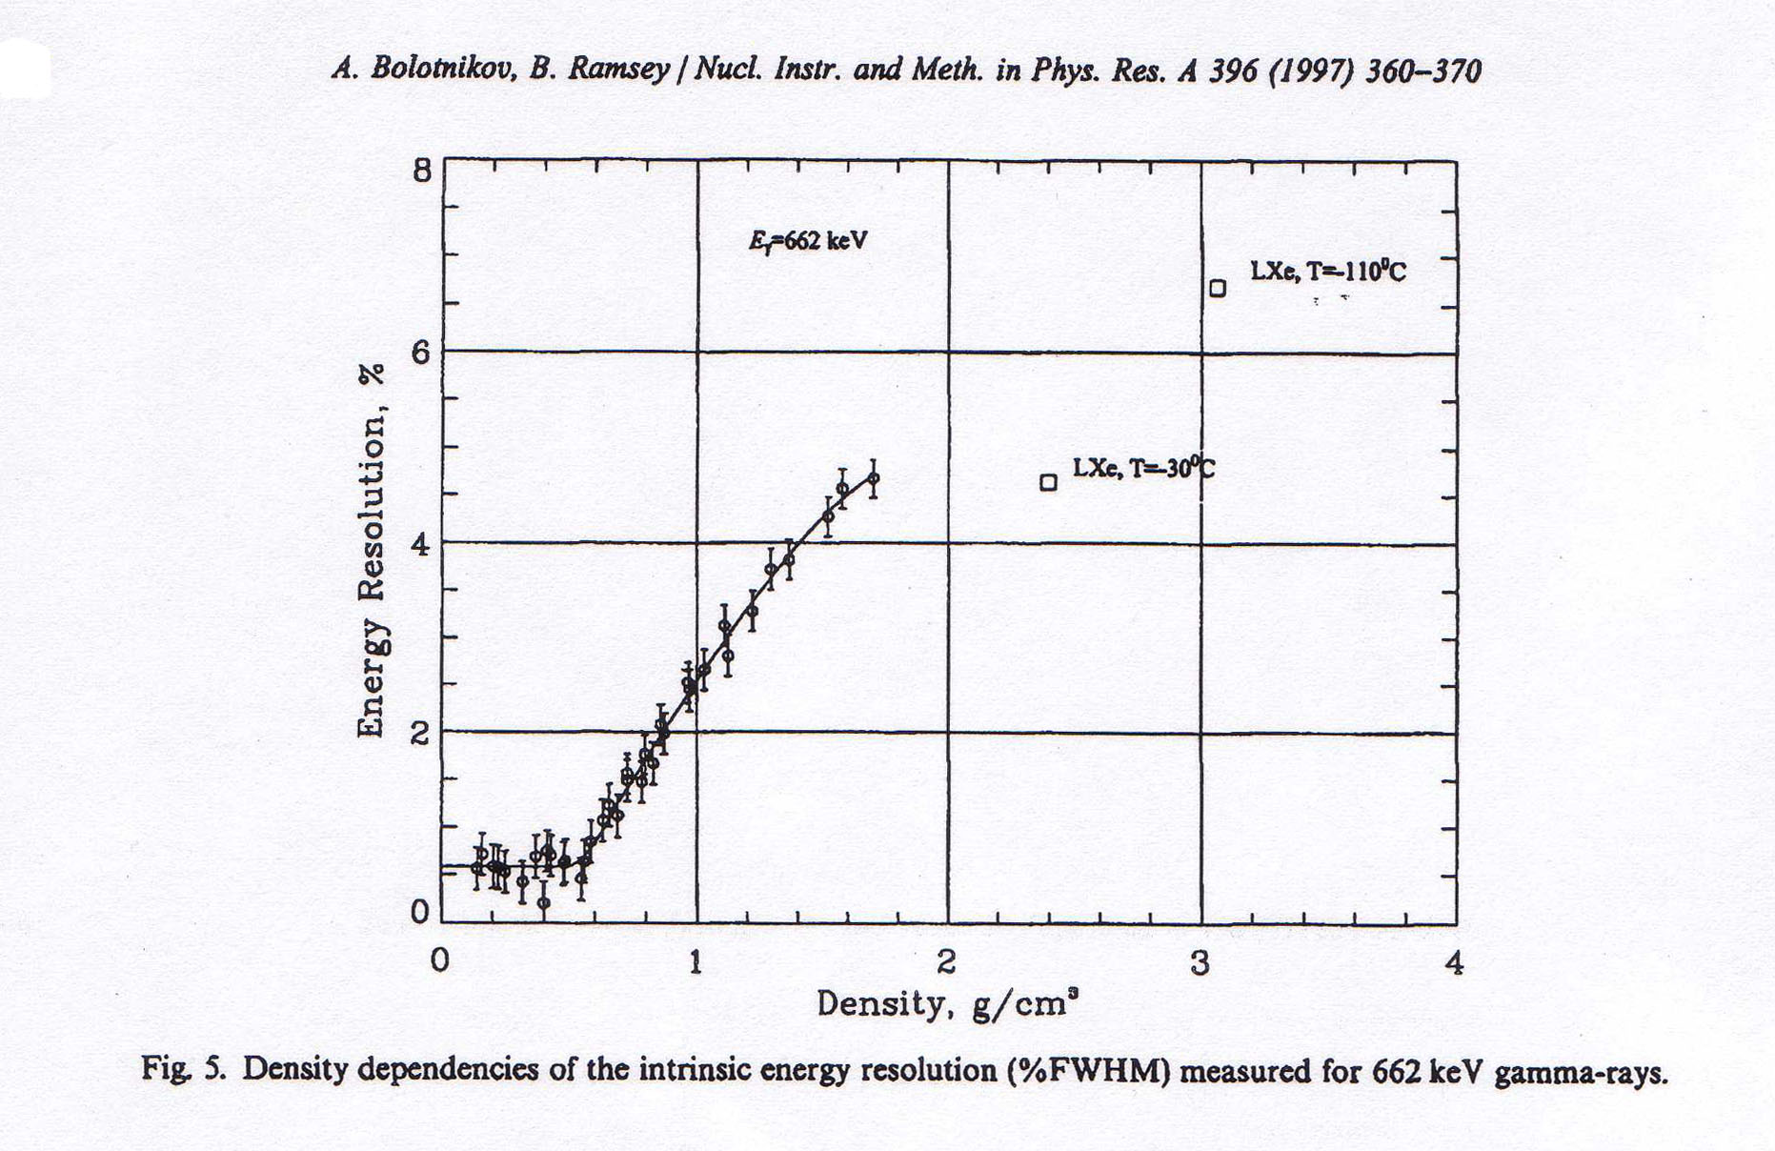
Xenon: Energy resolution depends strongly on density!
Here, the fluctuations are normal
Fano factor
F = 0.15
Unfolded resolution:
δE/E ~0.6% FWHM
ρ = 0.08 g/cm³
F = ~20
Ionization signal only!
For ρ <0.55 g/cm³, ionization energy resolution is “intrinsic”
Notes:
Discuss Recombination in high atomic density and high ionization density.

Slide 4
What is occurring, as ρ increases?
Critical temperature of xenon is room temp
Increasing density → more “liquid phase”
Energetic electrons create δ-rays
  LXe + δ-rays → high ionization density
  High ionization density → recombination
  Recombination → scintillation
  δ-ray spectrum → non-Gaussian behavior
→ Large energy partition fluctuations between Ionization and scintillation in LXe, but not in gas

Slide 5
Impact of fluctuations
Signal fluctuations: σ_{N} = (F⋅N)^{1/2}
F = Fano factor:
  Gas phase: F = 0.15 ± 0.03
  Liquid phase: F ≈ 20
A weighted sum of ionization I and scintillation S signals, E = aI + bS, can, in principle, entirely recover near-intrinsic energy resolution
But: typical overall QDE < 20% → statistically impoverished corrections in LXe
In gas phase, the ionization signal alone is sufficient

Slide 6
Intrinsic Energy resolution at Q_{ββ} = 2457 keV
δE/E = 2.35 ⋅ (F⋅W/Q)^{1/2}
  F ≡ Fano factor (HPXe) : F = 0.15
  w ≡ Average energy per ion pair: w ~ 25 eV
  Q ≡ Energy deposited from ¹³⁶Xe --> ¹³⁶Ba:
N = Q/w ~100,000 primary electrons
σ_{N} = (F⋅N)^{1/2} ~124 electrons rms!
δE/E = 0.3% FWHM intrinsic HPXe
Notes:
Only about x3 worse than Ge diodes!

Slide 7

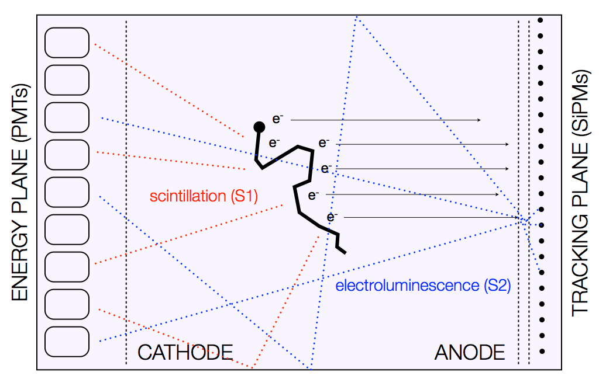
NEXT-XX: A series of photonic TPCs
NEXT: High Pressure Xenon (HPXe) TPC operating in electroluminescent (EL) mode.
NEXT-100: 100 kg of Xenon enriched at 90% in Xe-136 (in stock) at a pressure of 15 bar.
The event energy is integrated by a plane of radiopure PMTs located behind a transparent cathode (energy plane),
PMTs also provide t₀ – essential for the z coordinate and fiducialization.
The event topology is reconstructed by a plane of radiopure silicon pixels (SiPMs) (tracking plane).
TPB coated surfaces
xenon
gas
ionization
EL mode is essential to obtain linear gain; avalanche fluctuations are avoided, and the excellent Fano factor in gas is not lost

Slide 8
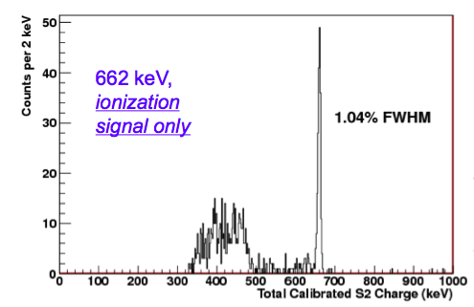
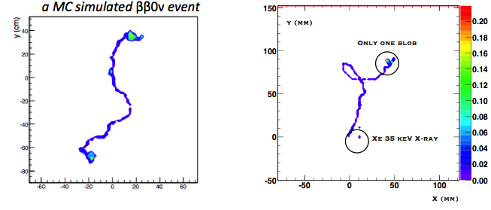
NEXT: Salient features
Excellent resolution (~1% FWHM measured at 662 keV by NEXT prototypes, extrapolates to 0.5 % FWHM at Qbb if all systematics are well controlled
Topological signature (TS) is the ability to distinguish between signal (“double electrons”) and background (“single electrons”); evidence exists that this works well.
Target = detector. Tracking establishes fiducial region, away from surfaces.
TPC: generally scalable. Economies of scale; V/S ratio increases linearly with L.
Xenon: the cheapest isotope to enrich in the market (NEXT owns 100 kg of enriched xenon, ~1 ton exists worldwide).

Slide 9
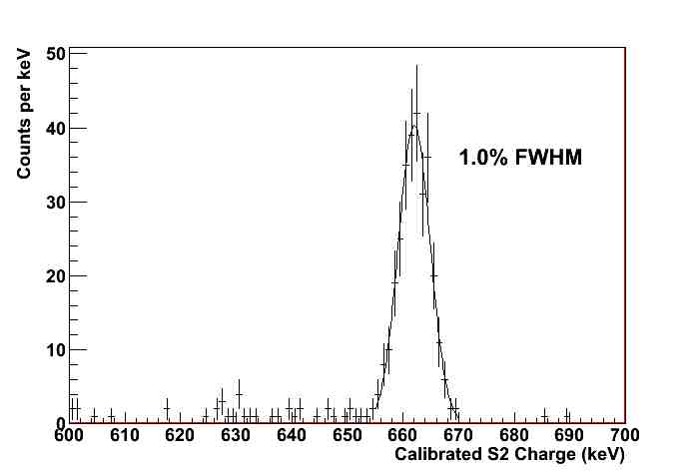
Nearly Gaussian shape
A world record for
xenon-based detectors
Credit: Azriel Goldschmidt
¹³⁷Cs γ-ray: 662 keV

Slide 10
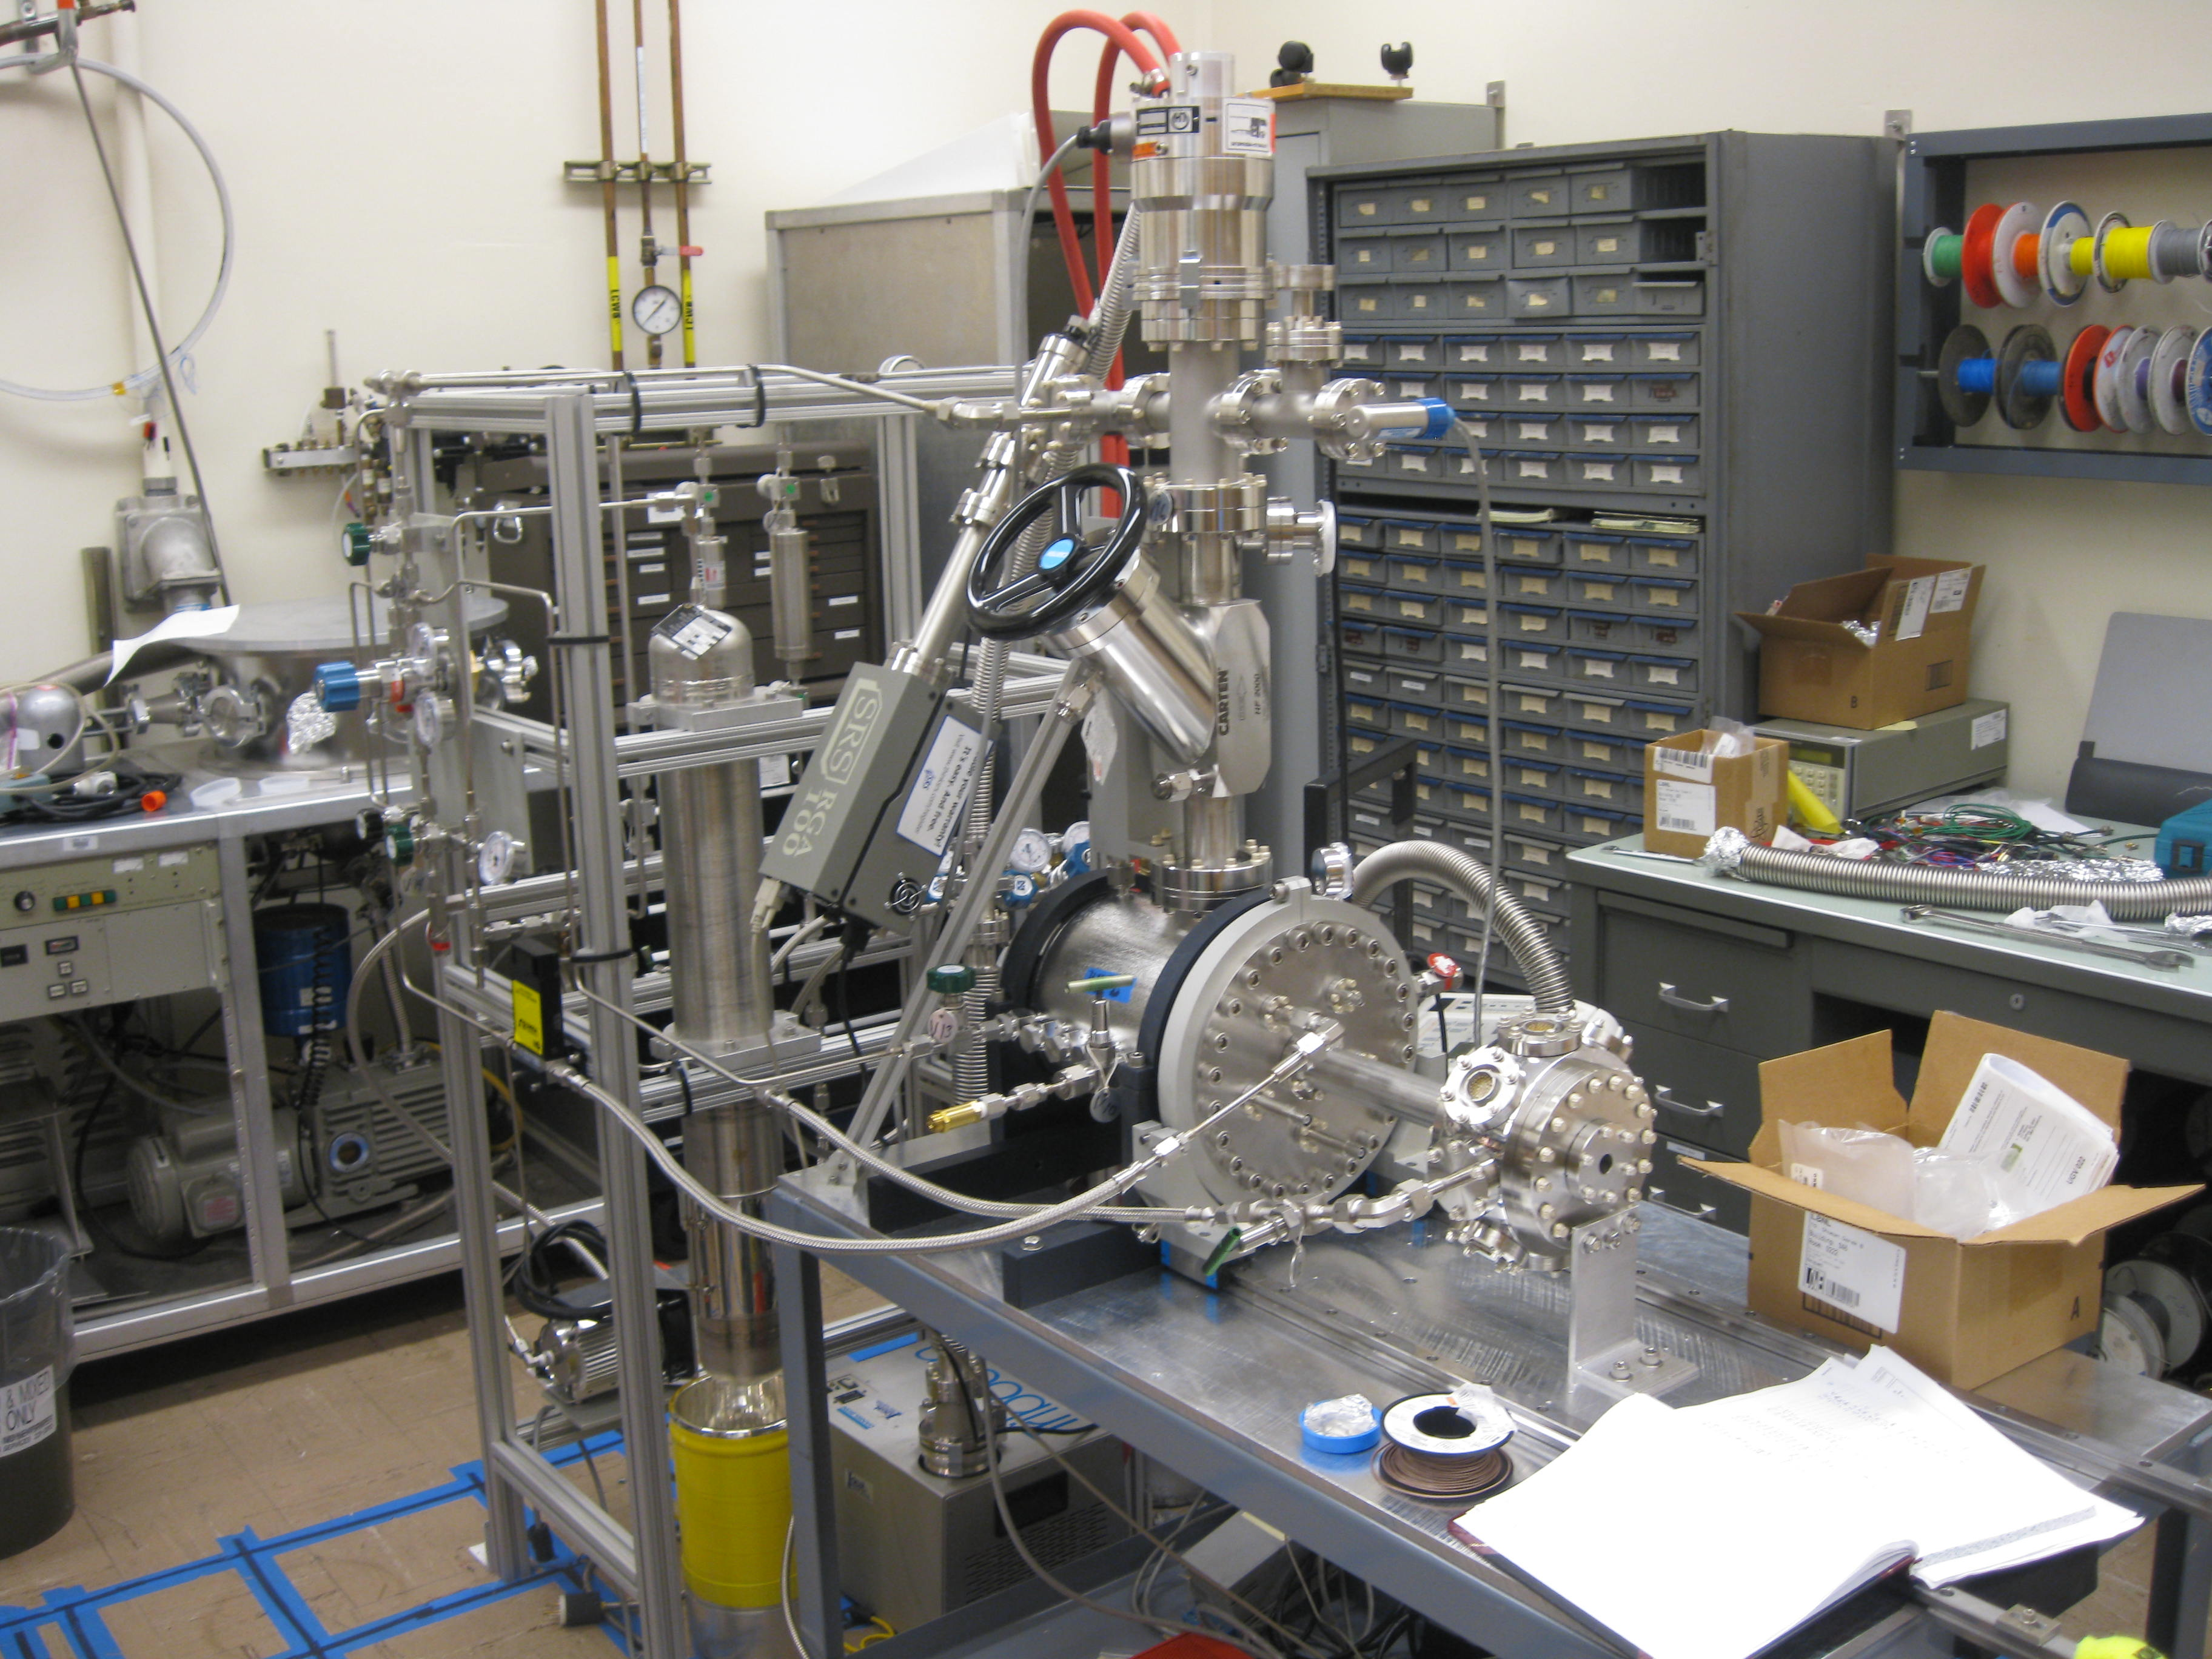
NEXT - DBDM (LBNL)
TIPP 2011
10

Slide 12
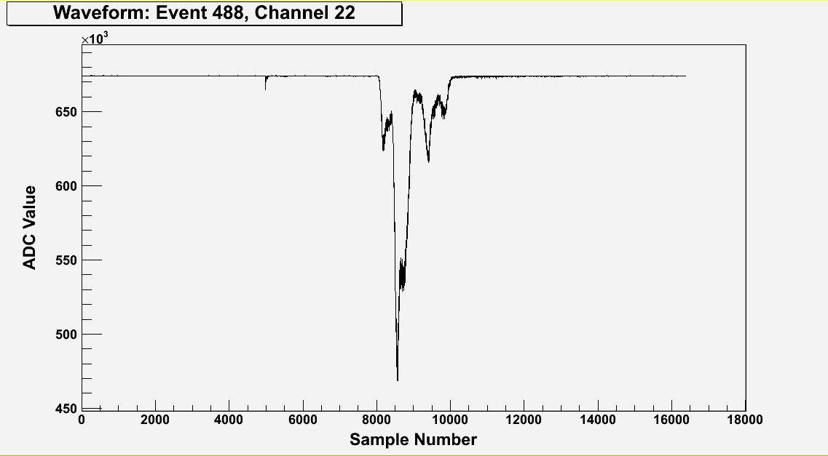
A typical ¹³⁷Cs γ waveform (sum of 19 PMTs)
~300,000 detected photoelectrons
Primary Scintillation (S1)
T0 of event
Electroluminescence (S2)
structure reflects topology
Drift Time:z-position
(~0.01mm/sample)
Drift velocity ~1 mm/ms
TIPP 2011
12
10ns/sample

Slide 13



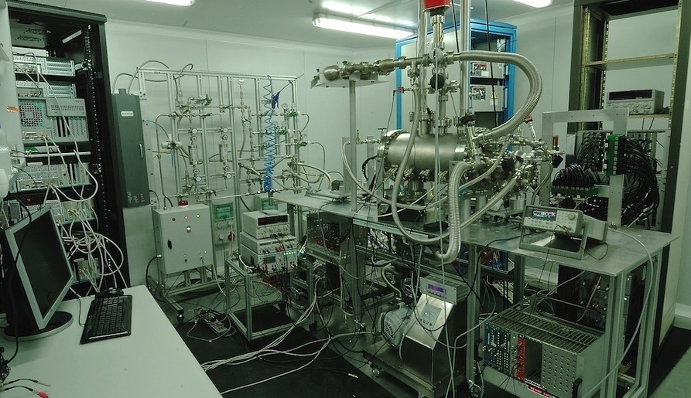

Hot Getter
Gas System
HHV modules
NEXT-DEMO
DAQ
PMTs FEE
SiPMs FEE
(IFIC)

Slide 14
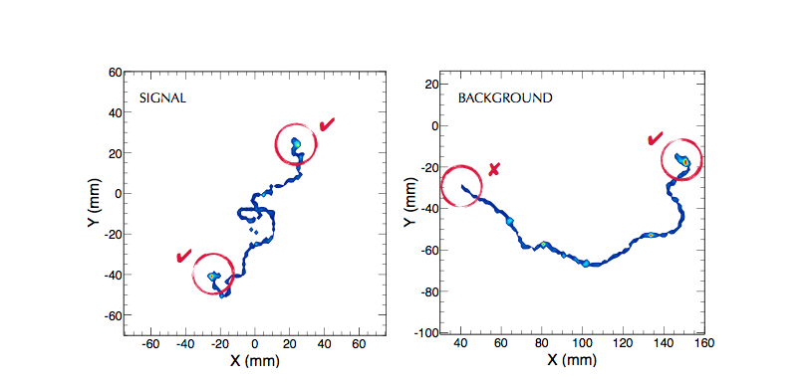
Topological signature - simulation

Slide 15
Valencia
Grid:
1 cm
New low-background SiPM implementation

Slide 16
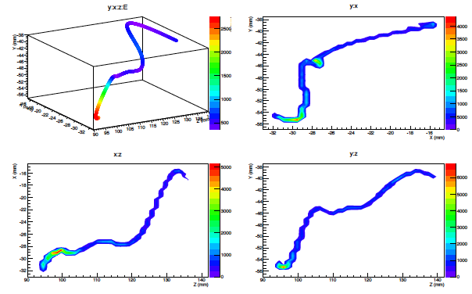
DATA: Real track from ¹³⁷Cs γ-ray – reconstructed with SiPMs
DATA from NEXT-DEMO IFIC, Valencia

Slide 17
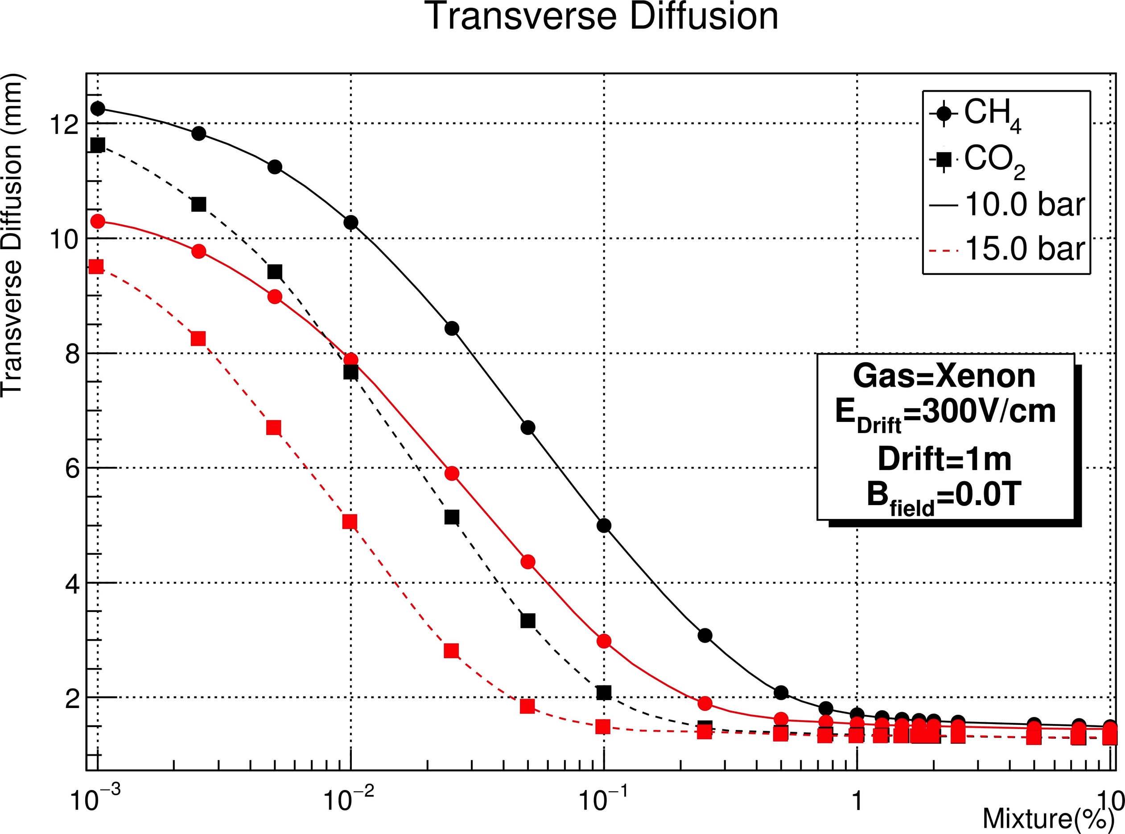
CO2: 0.1 % (CH4: 0.5 %) —> DT < 1.5 mm
CO2: 0.05 % (CH4: 0.25 %) —> DT < 2 mm

Slide 18

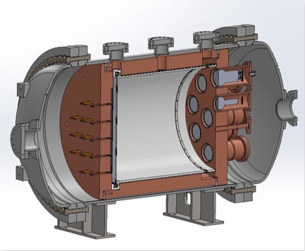



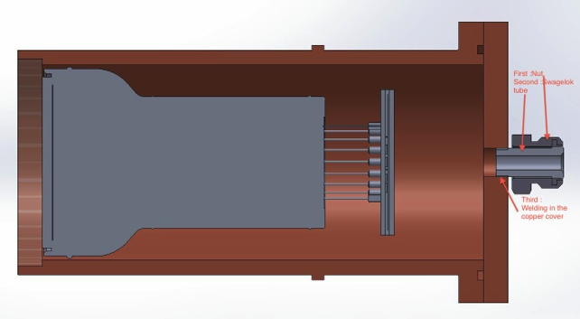
NEXT-10 at a glance
Time Projection Chamber:
10 kg active region, 50 cm drift length
Pressure vessel:
316-Ti steel, 30 bar max pressure
Tracking plane:
1,800 SiPMs,
1 cm pitch
Energy plane:
12 PMTs,
30% coverage
Inner shield:
copper, 6 cm thick

Slide 19
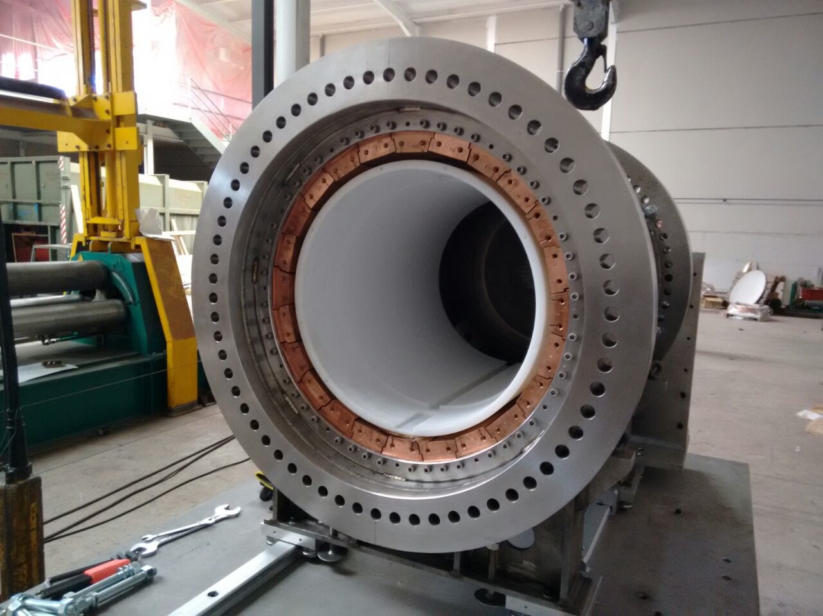
Inner copper shield
Inner Copper Shield made of low-background copper (< 10 muBq/kg)
Barrel ICS thickness is 6 cm (12 cm in NEXT-100). End-cup ICS is 12 cm (12 cm in NEXT-100)

Slide 20
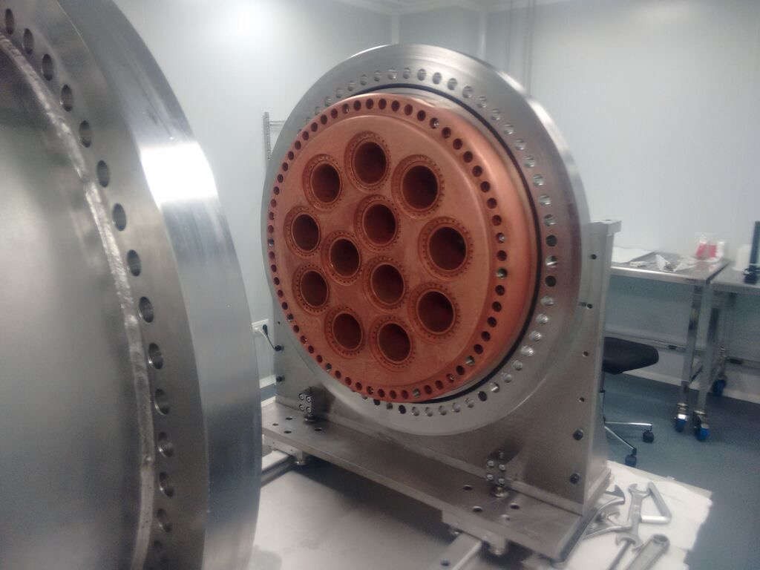
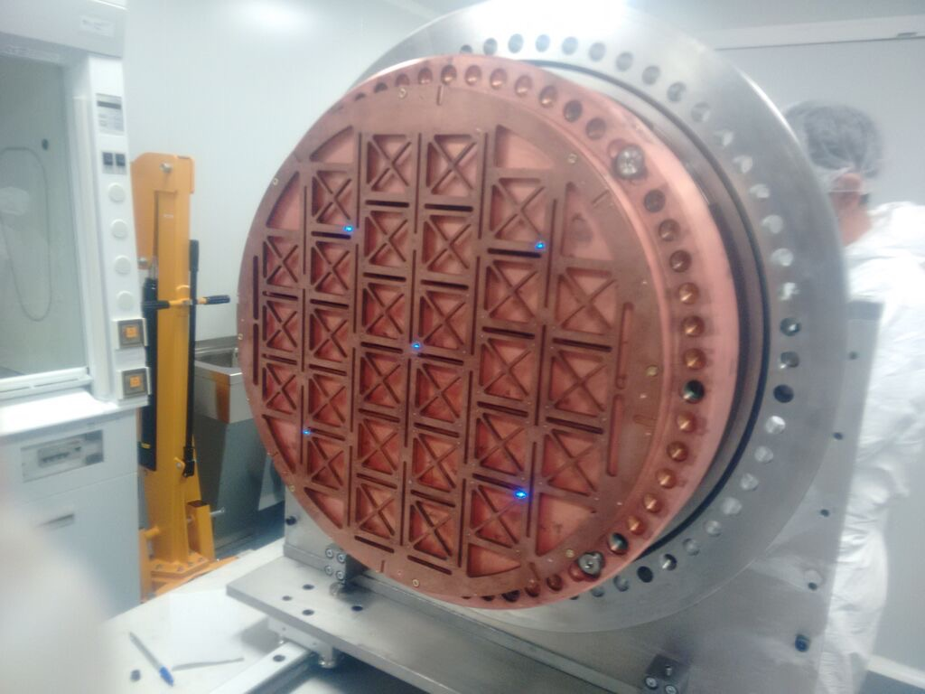
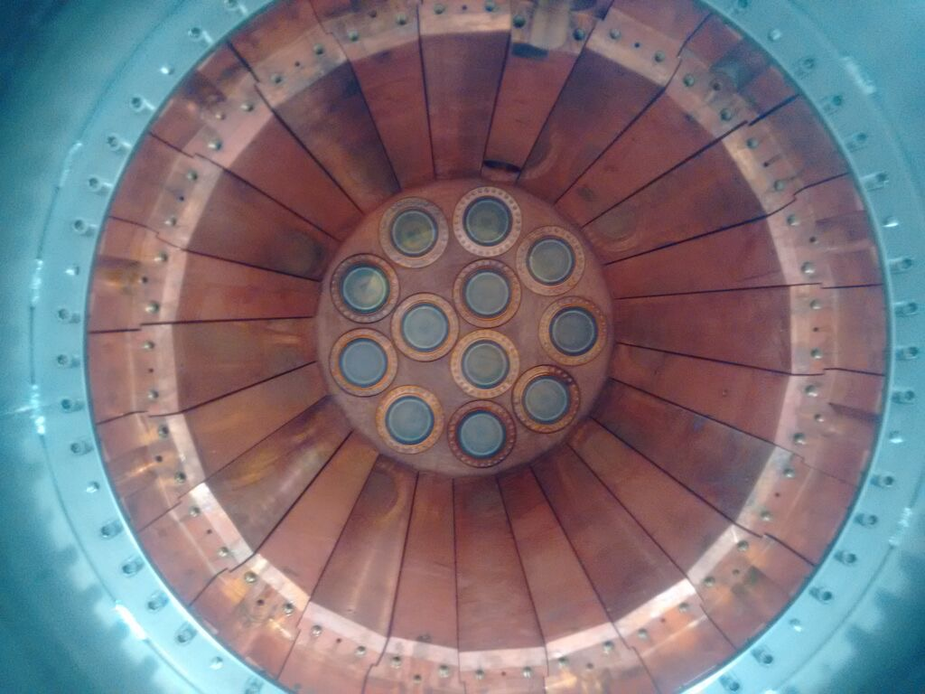
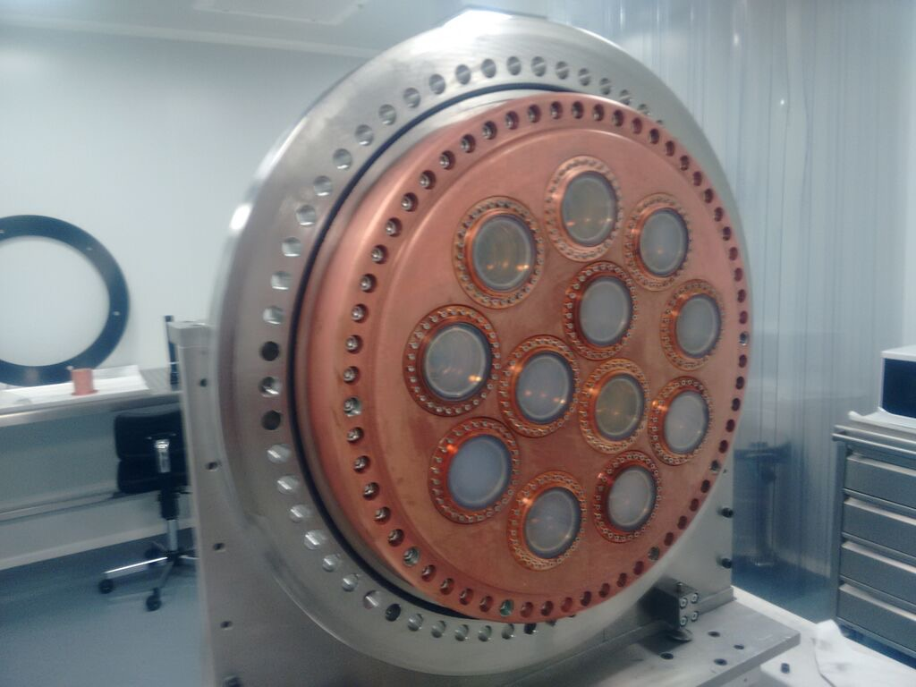
Energy Plane installation (July 2015)

Slide 21
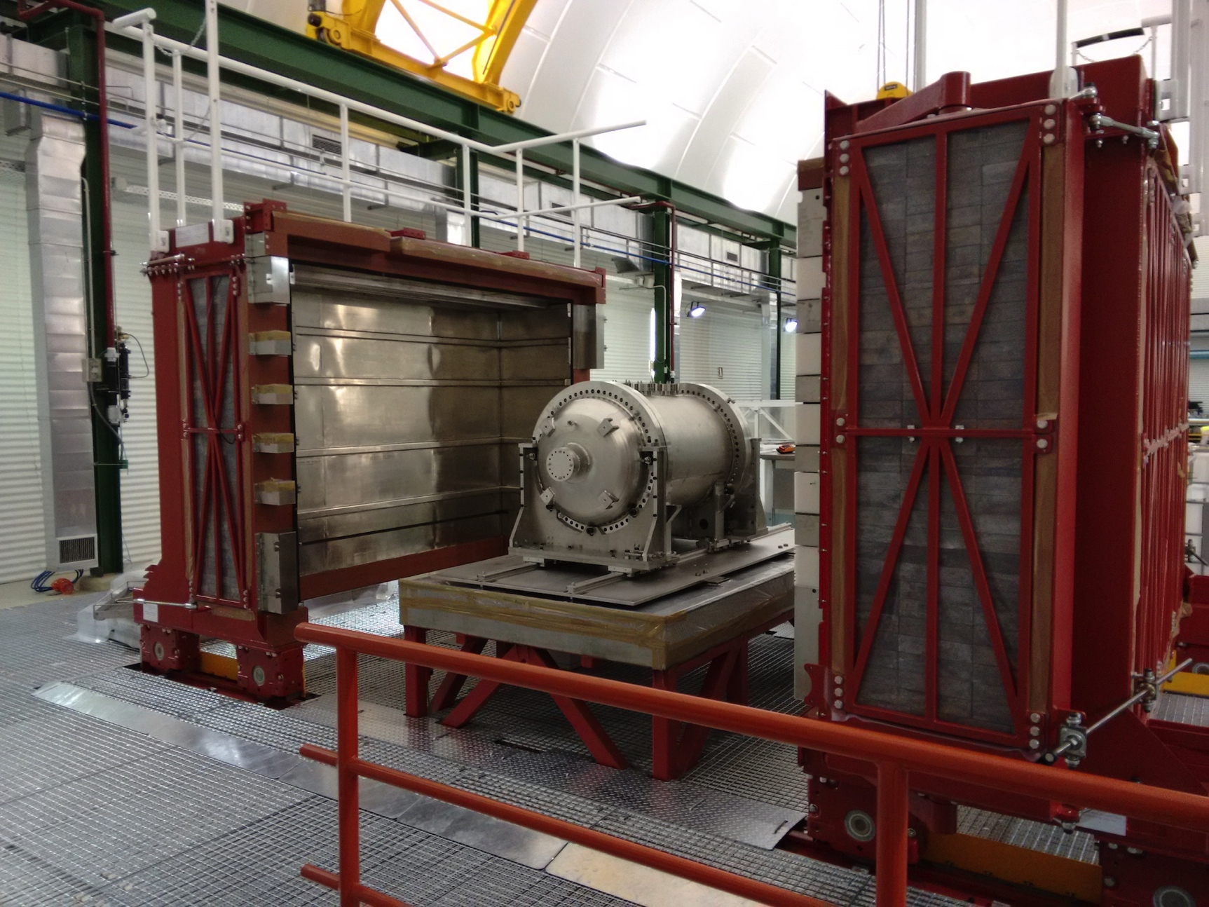
NEXT-10 at the LSC
NEXT-10 on the seismic support table, inside the Lead Castle at the LSC

Slide 22
NEXT-100 Pressure Vessel

Slide 23
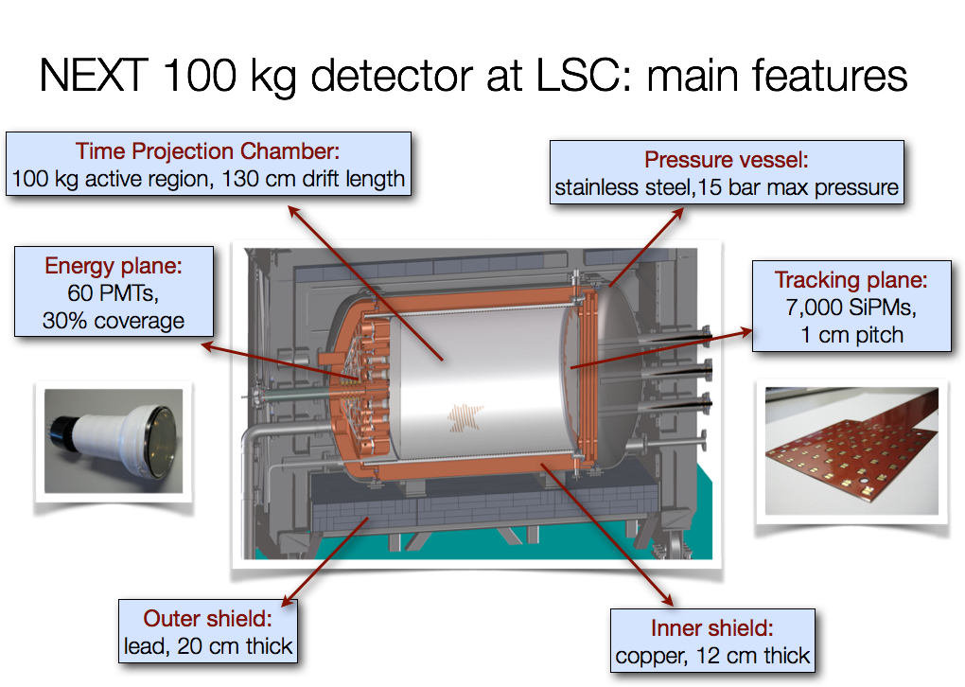

Slide 24
About Xenon in Gas Phase
Excellent intrinsic energy resolution in gas phase:
  δE/E < 3 x10⁻³ FWHM at ¹³⁶Xe Q_{ββ} (2457 KeV)
Hard to realize, but maybe δE/E < 5 x10⁻³ FWHM
Topology available for background rejection
  Single electrons (γ-rays) create one endpoint blob
  Double-beta decay events create two endpoint blobs
electroluminescence → noiseless, linear gain
non-cryogenic → flexibility, new approaches

Slide 25
“Tagging” the barium daughter atom
The Reward:
    normal backgrounds do not make barium
    → a (possibly) background-free experiment!
The Situation:
    Suppose ~10²⁸ atoms in your fiducial volume
    2ν ββ decays are occurring fairly often
The Challenge:
    Ideally, detect the birth of the barium daughter:
      Time window: a few milliseconds
      Spatial window: ~ 1000 mm³ (within locus of decay electrons)

Slide 26
Xenon’s barium daughter
In the decay xenon → barium, the daughter atom is strongly ionized by the nascent electrons emerging from the nucleus and by shell relaxation
  Partial neutralization of barium occurs by electron capture from nearby neutral xenon atoms (ionization potential 12.14 eV)
  Process stops at Ba⁺⁺ because the ionization potential of Ba⁺⁺ is 10.04 eV; it can’t take another electron from a neutral xenon atom
  Ba⁺⁺ is the expected outcome in pure xenon, gas or liquid

Slide 27
Ba⁺ or Ba⁺⁺ ??
Ba⁺ ?
    Barium must be transported out of LXe to a low-pressure trap
    As ++ or + or neutral ??
    For Ba⁺ spectroscopy, must ensure that barium is in Ba⁺ state
    Must show that this ion is really associated with the event
Ba⁺⁺ ?
    Can this natural state be exploited in situ?

Slide 28
There might be a way to use Ba⁺⁺
The technique of Single Molecule Fluorescent Imaging may be adaptable here.
My idea is to exploit a remarkable chemical effect: the transformation of non-fluorescent molecular precursors into a robust fluorescent state by capture (chelation) of doubly ionized alkaline earth elements, such as Ca⁺⁺
Maybe Ba⁺⁺ too!
Calcium and Barium are congeners → similar chemistry…

Slide 29
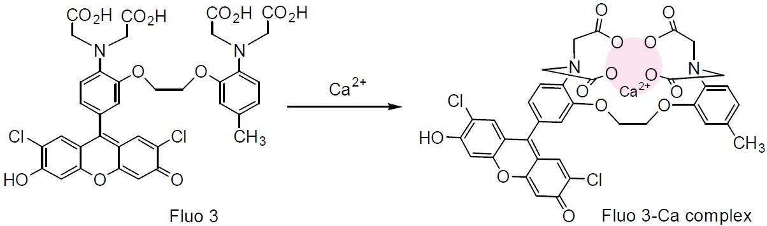
Fluo-3 converts from non-fluorescent to a fluorescent state by chelation!
Once Ca⁺⁺ is captured by Fluo-3, its responsiveness to external excitation
increases by a factor of 60 -80. Two-photon excitation with IR is also possible
This might work for Barium as well since barium and calcium are congeners.
Fluorophores exist for for Pb⁺⁺, Hg⁺⁺, Cu…)
2014 Nobel Prize in Chemistry awarded to three physicists for developing SMFI

Slide 30
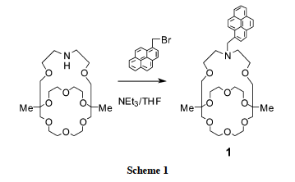
A Fluorescent indicator specific to Ba⁺⁺!
“Monoazacryptand 1”
Y. Nakahara, T. Kida, Y. Nakatasuji, M. Akashi,
Chem. Comm., Roy. Soc. of Chem., 2004, p224-225

Slide 31
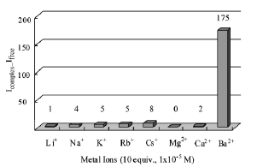

Highly specific to Ba⁺⁺ !

Slide 32
A TPC with a fluorescent cathode?
One can imagine a cathode surface coated with untransformed molecules, waiting to respond strongly after capture of one Ba⁺⁺.
One can imagine that the cathode surface is a dielectric belt that transports at a few mm/s the latent image to a line imager.
Ionization electrons liberated by the decay electrons provide a 3-D image of the event, and also the needed energy resolution, a la NEXT

Slide 33
A TPC with a fluorescent cathode?
One can imagine a cathode surface coated with untransformed molecules, waiting to respond strongly after capture of one Ba⁺⁺.
One can imagine that the cathode surface is a dielectric belt that transports at a few mm/s the latent image to a molecular-ionic imager.
Ionization electrons liberated by the decay electrons provide a 3-D image of the event, and also the needed energy resolution, a la NEXT

Slide 34
A TPC with a fluorescent cathode?
One can imagine a cathode surface coated with untransformed molecules, waiting to respond strongly after capture of one Ba⁺⁺.
One can imagine that the cathode surface is a dielectric belt that transports at a few mm/s the latent image to a molecular-ionic imager.
Ionization electrons liberated by the decay electrons provide a 3-D image of the event, and also the needed energy resolution, a la NEXT

Slide 35
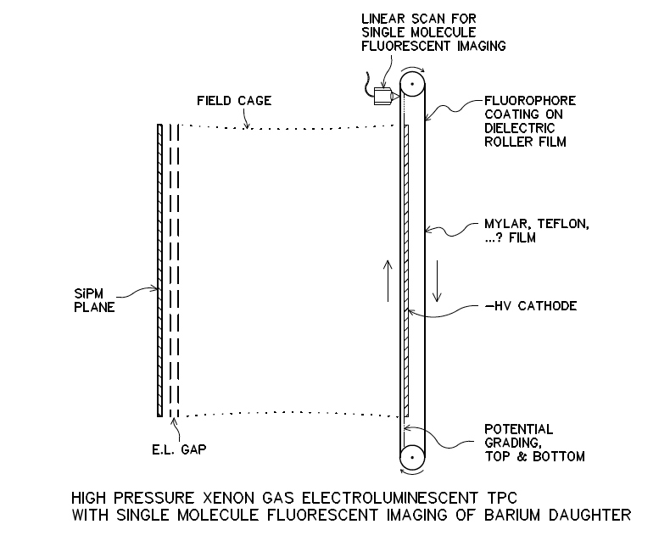

Slide 36
Not quite right…
Molecular coating may not be stable on belt?
  Leave belt uncoated…
  Transfer ion to a coated roller by electrostatics
  Chelation occurs on roller
The non-fluorescent molecular precursors may still contaminate the scan:
  Extract the chelated ion to a second roller
  Only chelated ions exist on second roller
Do SMFI scans on second roller
  Discovery of new ions is automatic
  Repeated verification scans are automatic

Slide 37
Not quite right…
Molecular coating may not be stable on belt?
  Leave belt uncoated…
  Transfer ion to a coated roller by electrostatics
  Chelation occurs on roller
The non-fluorescent molecular precursors may still contaminate the scan:
  Extract the chelated ion to a second roller
  Only chelated ions exist on second roller
Do SMFI scans on second roller
  Discovery of new ions is automatic
  Repeated verification scans are automatic

Slide 38
Not quite right…
Molecular coating may not be stable on belt?
  Leave belt uncoated…
  Transfer ion to a coated roller by electrostatics
  Chelation occurs on roller
The non-fluorescent molecular precursors may still contaminate the scan:
  Extract the chelated ion to a second roller
  Only chelated ions exist on second roller
Do SMFI scans on second roller
  Discovery of new ions is automatic
  Repeated verification scans are automatic

Slide 39
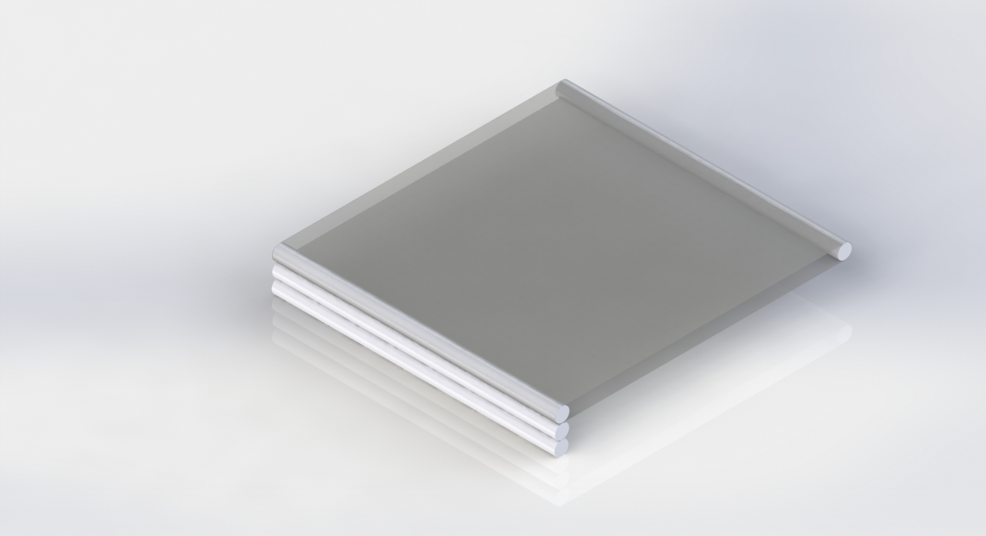
The belt + rollers scenario
Transform appearance of new Ba++ chelate back into TPC volume

Slide 40
Clearly, an out-of-the-box idea!
Not clear if this idea can really work!
  many unfamiliar but plausible steps must be efficient
Current issues include:
  How to make a Ba⁺⁺ source for test setups
  impact of neutral xenon atoms clustering around Ba⁺⁺
  Transfers, molecular coatings, single molecule sensitivity…
The idea serves to stretch our imagination!
If any practical barium-tagging solution exists, it is unlikely to have a conventional nature.

Slide 41
Outlook
NEXT-10:
  Demonstrate power of topological signature using 2-ν decays; explore benefits of diffusion reduction; tracking density; optimize algorithmic approaches
NEXT-100:
  Demonstrate scalability; energy resolution; tracking; calibration; stability; limit on 0-v decay
NEXT-XXX ??
  perhaps: a set of N 300 – 400 kg modules; both enriched and depleted xenon running possible
  Ba⁺⁺ tagging in situ may permit background free result
Notes:
Chinese are starting PandaX-III
AXEL in Japan

Slide 42
Thank you

Slide 43
Backup slides

Slide 44
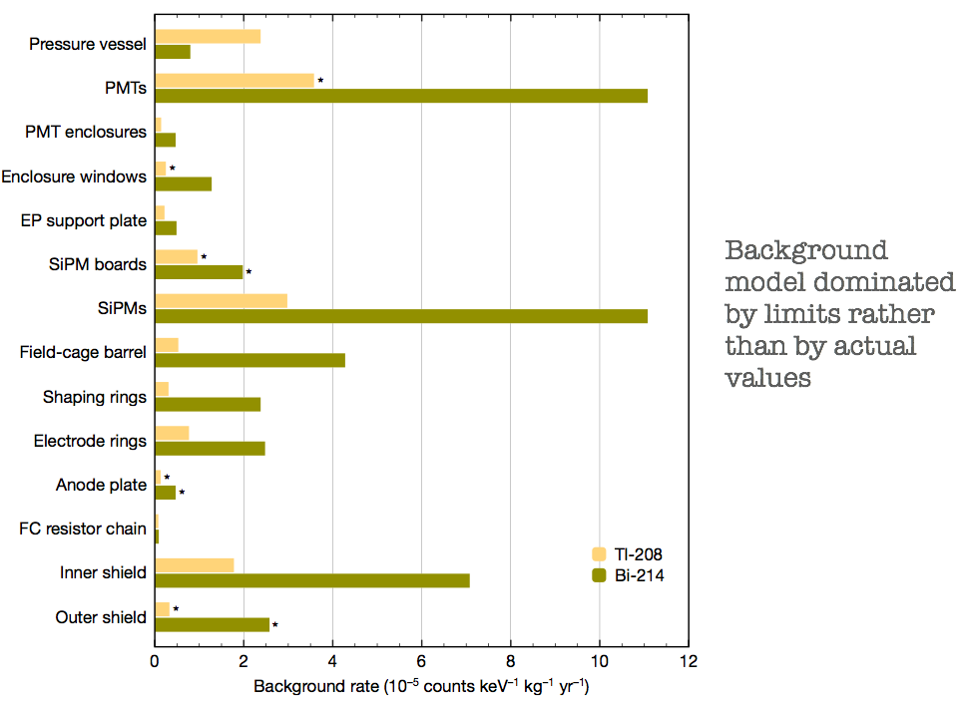
Background Limit:
5.8 x 10^{–4} ckky
measured *
otherwise, a limit

Slide 45
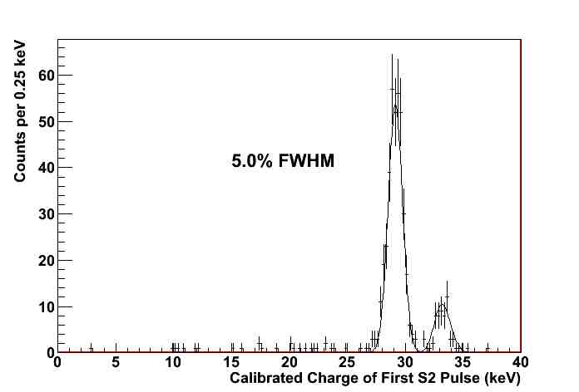
The x-ray peaks at ~30 keV are captured precisely

Slide 46
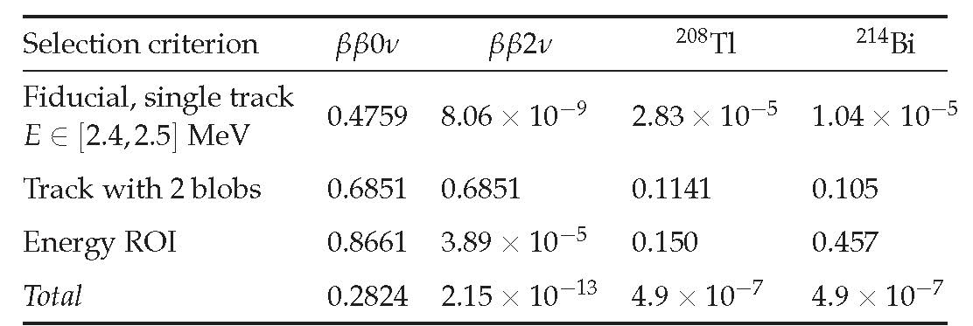
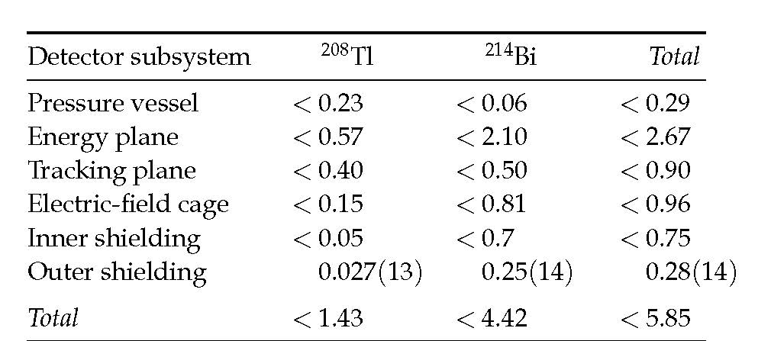
NEXT Expected Performance
Systematic assay of ALL detector components at the LSC HPGe facility
Development of full MonteCarlo simulations
10^{–4} /(keV kg yr)

Slide 47
Topological signature - simulation

Slide 48
Valencia
Grid:
1 cm
New low-background SiPM implementation

Slide 49
CO2: 0.1 % (CH4: 0.5 %) —> DT < 1.5 mm
CO2: 0.05 % (CH4: 0.25 %) —> DT < 2 mm

Slide 50
Original tagging idea:
1980 - 1991
Identify the barium daughter
by optical spectroscopy
(M.Moe PRC44 (1991) 931)
Ba⁺ system best studied
(Neuhauser, Hohenstatt,
Toshek, Dehmelt 1980)
Single ions can be detected
from a photon rate of 10⁷/s
Pursued by EXO…
But:
Triplet state is quenched
in dense gas!
Can excite with blue,
look only for red
²P_{1/2}
650nm
493nm
⁴D_{3/2}
metastable 80s
²S_{1/2}
No scheme for extraction from LXe to
vacuum has been successful, as yet

Slide 51
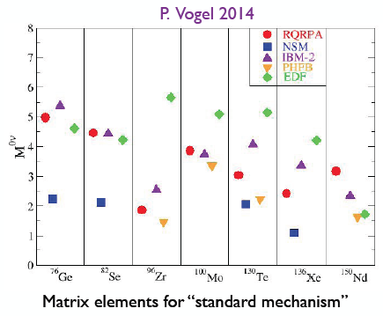
The nuclear matrix element picture
Notes:
EDF= energy density functional method

Slide 52
