Slide 1
LDRD Program Overview and Future Directions
PSE Open Mic
May 7, 2015
Kawtar Hafidi
Office of the Laboratory Director
Becky Rank, LDRD Program Manager
Marianne Lohr-Dietz, Administrative Specialist for LDRD

Slide 2
LDRD is the only source of discretionary R&D funding available to the Laboratory Director
Authorized by congress and regulated through DOE order 413.2B
Maximum allowable LDRD funding level is 6% of the laboratory annual operating/capital equipment budget
The total FY 2014 LDRD Program cost at the national laboratories was $527 million in 1,662 projects
Secretary of Energy annual report to congress has to include LDRD program expenditures and certification of the appropriate use of funds
LDRD Program Overview and Future Directions Kawtar Hafidi
Notes:
Was 8% 2006 and changed to 6% in 2014

Slide 3
LDRD Programs across the DOE Complex
All DOE Labs are eligible for LDRD funding under the FY 2006 Energy and Water Appropriations Act (P.L. 109-103)
Currently 16 Labs will have LDRD programs: AMES, ANL, BNL, FNAL, INL, LANL, LBNL, LLNL, NREL, ORNL, PNNL, PPPL, SLAC, SNL, SRNL, and TJNAF
The labs spent the following on LDRD in FY 2013:
$150.8 M at SC labs
$390.5 M at NNSA labs
$32 M at Energy labs
$5.6 M at SRNL (EM)
LDRD Program Overview and Future Directions Kawtar Hafidi

Slide 4
FY2014 Office of Science approved LDRD Funding
$M
3.8%
0.4%
LDRD Program Overview and Future Directions Kawtar Hafidi
Notes:
Ames began their program in FY 2013, TJNAF began theirs at the start of FY 2014, and FNAL received approval for their program mid-FY 2014. With the approval of FNAL’s program in March 2014. Every GOCO (Government-owned, Contractor-operated) now has an LDRD program.

Slide 5
FY2013 Total LDRD Costs vs. LDRD as a percentage of Lab Costs
Since FY 2014 the new limit is 6%
Total FY 2013 LDRD costs ($M) (Bars)
LDRD % of FY 2013 total lab costs (Black squares)
Science Labs: LDRD % of Total Lab Costs ranged from ~0.6% (AMES), to ~4.5% (PNNL) –
well below the Congressionally-directed 8% limit.
LDRD Program Overview and Future Directions Kawtar Hafidi
Notes:
Bars – total cost
Squares - percentage

Slide 6
Our LDRD investment since 2000
LDRD Program Overview and Future Directions Kawtar Hafidi
Notes:
Max we can invest is 46.8M
Max (2004) is 24.8M – in 2015 is 24.4M (inflation ~ lost around 30%)
100$ in 2004 is worth 124$ in 2015

Slide 7
Purpose of LDRD per DOE order 413.2B
Invest in high-risk, potentially high-value research and development that aims to:
Maintain the scientific and technical vitality of the laboratories
Enhance the laboratories’ ability to address future DOE/NNSA missions
Foster creativity and stimulate exploration of forefront science and technology
Serve as a proving ground for new concepts in research and development
LDRD Program Overview and Future Directions Kawtar Hafidi
Notes:
In principle

Slide 8
In Practice, the LDRD program
Supports the R&D aspects of the laboratories’ strategic plans
Allows labs to assemble multidisciplinary teams not possible with traditional funding boundaries
Serves as a proving ground for advanced R&D concepts that are often subsequently funded by DOE programs
Attracts and retains the best and brightest scientific and engineering staff to the labs
Provides early support for development of new R&D facilities
Provides the flexibility to respond quickly to new R&D opportunities
LDRD Program Overview and Future Directions Kawtar Hafidi
Notes:
Grow the lab, strengthen core competencies and position it for the future

Slide 9
LDRD Program Administration
The LDRD program is managed through the Office of the Laboratory Director (Greg Morin, Director for Strategy and Innovation)
The LDRD Program staff
Kawtar Hafidi, Associate Chief Scientist for LDRD
Becky Rank, LDRD Program Manager
Marianne Lohr-Dietz, Administrative Specialist
Computer Programming Support (CIS)
Jason Boggs
Fred Moszur
Editorial Support (CEP-CR)
Kevin Brown

Slide 10
LDRD Program Components
Strategic Initiatives
R&D explicitly aligned with Laboratory and DOE strategy
Aligned with current core capabilities and those we want to develop/enhance
Director’s Grand Challenge
Supports specific technical topic of substantial strategic value to the Laboratory and DOE
Director Competitive Grants
Highly innovative projects submitted directly to the Laboratory Director
Supports DOE mission/target opportunity for follow-on funding
LDRD Program Overview and Future Directions Kawtar Hafidi

Slide 11
FY2015 LDRD Statistics
FY 2015 Projects Received/Funded
110 LDRD projects funded (to date)
Director’s Grand Challenge
1 project funded
Director’s Competitive Grants
123 New Proposals Submitted
5 New + 23 Renewal
= 28 Total Projects
Strategic Initiatives
20 New + 44 Renewal +
17 Director’s strategic reserve projects
(3 new projects; 14 renewal projects)
= 81 Total Projects
7%
17%
75%
LDRD Program Overview and Future Directions Kawtar Hafidi

Slide 12
LDRD Rules
LDRD funds will not be used to
“Substitute for or increase funding for any tasks . . . that are funded by DOE or other users of the laboratory.” (from DOE Order 413.2B)
Fund projects that will require additional non-LDRD funds to accomplish technical goals of the LDRD project
Fund construction design beyond the preliminary phase
Fund general purpose capital expenditures
LDRD Program Overview and Future Directions Kawtar Hafidi

Slide 13
Examples of Recent Audits and Studies
The IG examined whether LBNL comingled funds between an LDRD project and a National Science Foundation Grant
The IG examined whether LLNL used LDRD funds to supplement programmatic work in fusion energy sciences
LDRD Program Overview and Future Directions Kawtar Hafidi

Slide 14
Future Directions: Management Philosophy
Improve management of the overall program and individual projects
Develop an impactful review process that ensures compliance with DOE regulations and desired program outcomes
Increase the transparency, flexibility and efficiency
Greater support in obtaining desired level of impact for each project
LDRD Program Overview and Future Directions Kawtar Hafidi

Slide 15
Future Directions – work on progress!
This year we have implemented a new DCG mid-year review process
We are analyzing the return on investment of our LDRD program
For FY17, proposal for restructuration of the LDRD program is being discussed among the lab senior management
A new proposal review matrix with a stronger emphasis on evaluating and supporting development of follow-on funding
Change timeline for calls, reviews and award decisions
Upgrade the enterprise management platform: include external reviewers, monitor progress of spending, ….
LDRD Program Overview and Future Directions Kawtar Hafidi

Slide 16
Upcoming events
Argonne and Fermi are hosting the annual Office of Science LDRD program review for all the science labs August 4-6, 2015
Launch a yearly event “LDRD Day” – October 22, 2015
LDRD Program Overview and Future Directions Kawtar Hafidi

Slide 17
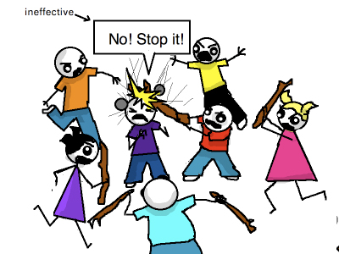
Discussions?
LDRD Program Overview and Future Directions Kawtar Hafidi

Slide 18
Backup slides
LDRD Program Overview and Future Directions Kawtar Hafidi

Slide 19
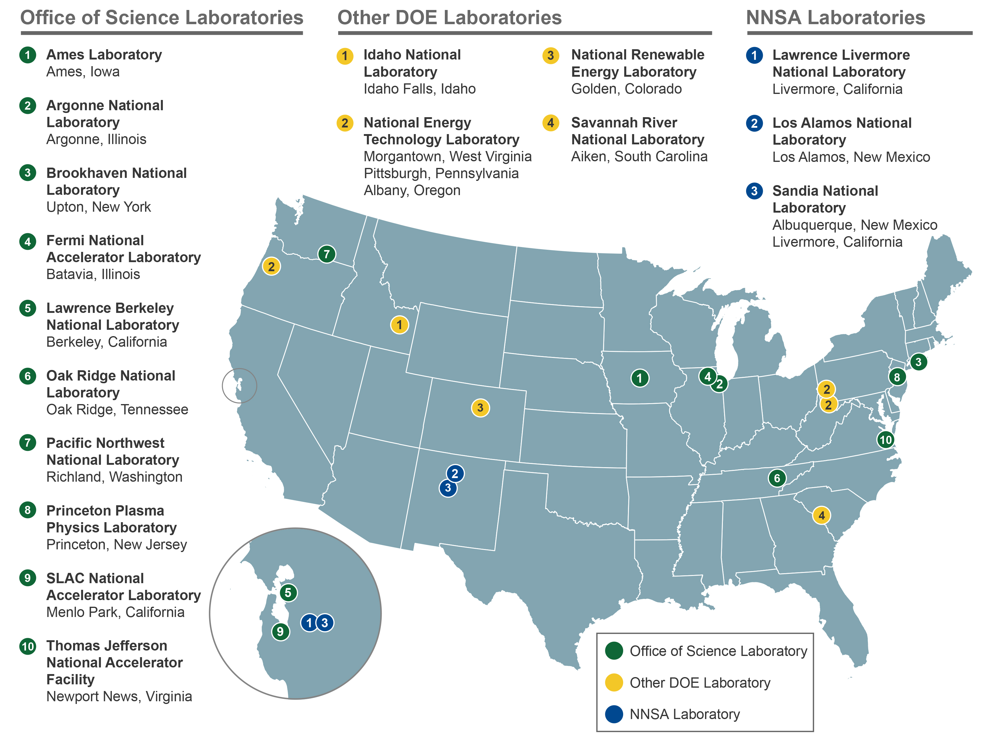

Slide 20
Submitting Proposals
Review all available documents at the LDRD web site
(http://web.anl.gov/ldrd)
All proposals/concept papers must be submitted through the proposals submission website at http://webapps.inside.anl.gov/ldrd/proposals.
Proposal submission consists of two steps:
Online proposal data entry
Project Description Document (PDF file)
Things to consider when submitting:
Is your proposal a DCG or SI?
Is your project mission relevant?
Minimum duration for your project?
Minimum necessary budget for your project?
Is your proposed project research?
Proposal due dates:
DCG : End of April
SI : Mid-May
Notes:
All documents includes:
Calls for both SI and DCG proposals
Guidance for Writing a Proposal
Program Guidance
Project Description Outline
Website has two aspects:
Proposal data – title, PIs, budget, etc.
Document upload
Project Description Outline is
Where you make your case for your proposal.
Keep in mind that not everyone reading your proposal is an expert in your field.
Keep proposal jargon free
Adhere to the page limitations
LDRD projects should not only be “great science” they should have mission relevance, both to Laboratory missions, and more importantly DOE missions.

Slide 21
Investigator Responsibilities – Treat the LDRD office like you treat your sponsor!
If your proposal is funded:
Tell the LDRD Program Office of any changes to your project
Participate in a mid-year project progress review
Provide an annual project report and data updates at fiscal year end
Stop some or all of work if/when you receive funding from a sponsor
Participate in LDRD Program reviews or other events if requested
Provide highlights about project successes
Notes:
Describe mid-year review process

Slide 22
Annual Reporting Requirements
Review all available documents at the LDRD web site
(http://web.anl.gov/ldrd) or Data Collection web system
(https://webapps.inside.anl.gov/ldrd/dc/)
All annual report data metrics and reports must be submitted through the data collection web system (website above)
Annual Report submission consists of two steps:
Online metrics data entry
Annual Project Report (MS Word file and accompanying graphics files)
Things to consider when submitting:
Is your proposal written for non-technical readers?
Do all of your publications and presentations have APT (Argonne Publication Tracking) #s?
Did you adhere to formatting limitations?
Project reports and metrics are due in mid-November
Notes:
All documents includes:
Content and format for the report
guidance for the data collection
metrics requirements
samples of published reports
Annual report –
Metrics
-- collected for all years funded and 3 years post completion
-- includes things like:
# of postdocs
# of new hires
# inventions/patents
review presentations given
awards received
publications
Reports
-- required for all years funded
-- Things to keep in mind
Use project report template
adhere to formatting limitations

Slide 23
LDRD Websites
Important Websites
LDRD Homepage
http://web.anl.gov/ldrd
myLDRD
https://webapps.inside.anl.gov/ldrd/2/
Proposal Submission:
https://webapps.inside.anl.gov/ldrd/proposals
Annual Report and Data Collection
https://webapps.inside.anl.gov/ldrd/dc
R&D Accomplishments (“Highlights”) Reporting Tool
https://webapps.inside.anl.gov/ldrd/highlights/
(Please note: a VPN connection must be used to access all LDRD websites from offsite)

Slide 24
LDRD Contact Information
LDRD Program Office Kawtar Hafidi
Phone Number: x-5373 (x-LDRD) Phone Number: x-4012
E-mail Address: ldrd@anl.gov E-mail Address: kawtar@anl.gov
Lab Mail: Bldg. 201, 1F-29 Lab Mail: Bldg. 201, 158
Becky Rank Marianne Lohr-Dietz
Phone Number: x-6855 Phone Number: x-5373
E-mail Address: rrank@anl.gov E-mail Address: dietzm@anl.gov
Lab Mail: Bldg. 201, 155 Lab Mail: Bldg. 201, 1F-29

