Slide 1
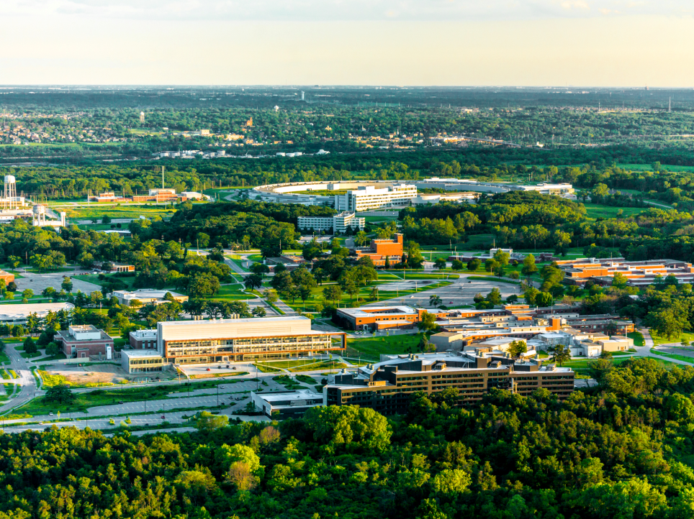
Creating Solutions Together: Welcome

Slide 2
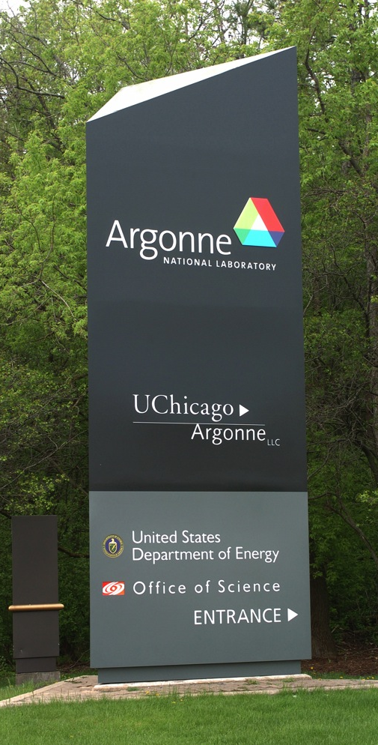
What & How
Solutions to Gaps
Fixing Forward
Idea Generation
Active Involvement
Candid Conversations
Building on Suggestions
Captured Offshoot Ideas

Slide 3
Gathering your BEST experiences in Starting at a new place
Recall one of the times when you started working at a new lab or facility.
It could be Argonne – it could be somewhere else.
What was really helpful in your getting off on the right foot?
A Person who helped you through the first couple of days
An explanation that was really on target
A video of some sort
A walk through of an area

Slide 4
Breakout Session #1 Onboarding & Safety Culture
Group 1 – A323 – Tijana Rajh
Kristine Tanabe, Javier Bareno, Donald Peterson, Bing Shen, Michael Bishof
Group 2 – Break Area - Dan Applegate
Alex Martinson, Aude Hubaud, Charadutta Phatak, Danny Avageakaa, Christine Miller
Group 3 – D286- Jeff Alicz
Jeff Bunquin, Gengbang Jin, Jeffrey Klug, Clayton Dickerson, David Czaplewski
Group 4 – Atrium – Linda Pierce
Bryant Polzin, Sarah Soltau, Pietro Papa Lopes, Ben Kay

Slide 5
Breakout Session #2 Work, Planning and Control
Group 1 – A323 – Tijana Rajh
David Czaplewski, Danny Ayageakaa, Charadutta Phatak, Sarah Soltau
Group 2 – Break Area - Dan Applegate
Jeff Bunquin, Michael Bishof, Bing Shen, Javier Bareno, Pietro Papa Lopes
Group 3 – D286- Jeff Alicz
Auda Hubaud, Kristine Tanabe, Alex Martinson, Bryant Polzin, Clayton Dickerson
Group 4 – Atrium – Linda Pierce
Donald Peterson, Ben Kay, Jeffrey Klug, Gengbang Jin, Christine Miller

Slide 6
Creating Solutions Together: Thank You

