Slide 1
JCESR’s search for transportation batteries beyond lithium-ion
Kevin Gallagher
September 17th, 2015

Slide 2
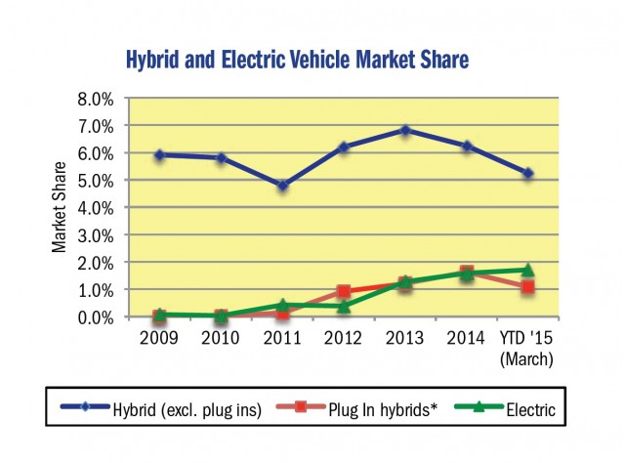
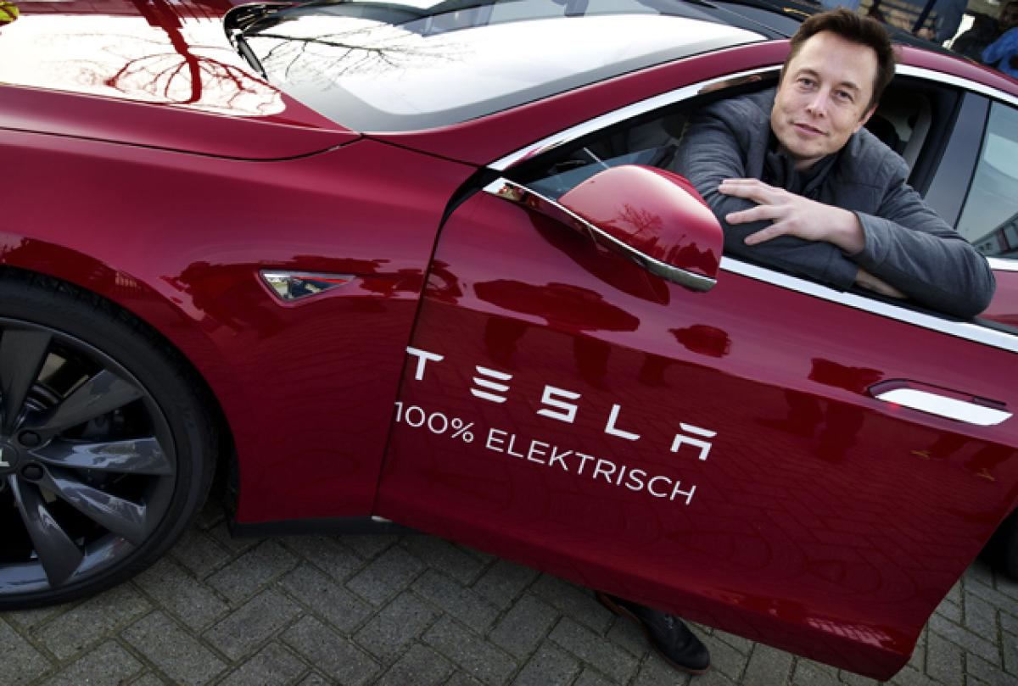
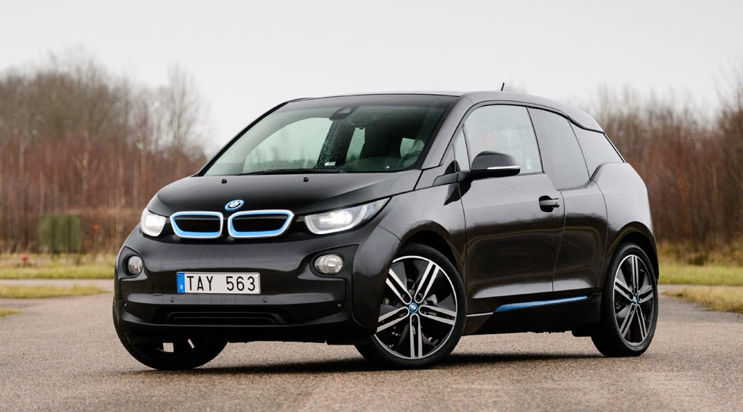
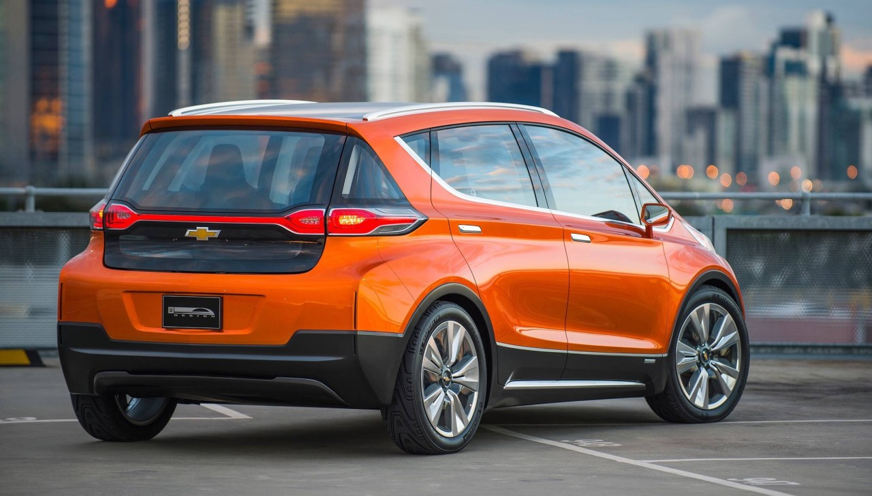
Electric Vehicles – Niche today…
California Market

Slide 3
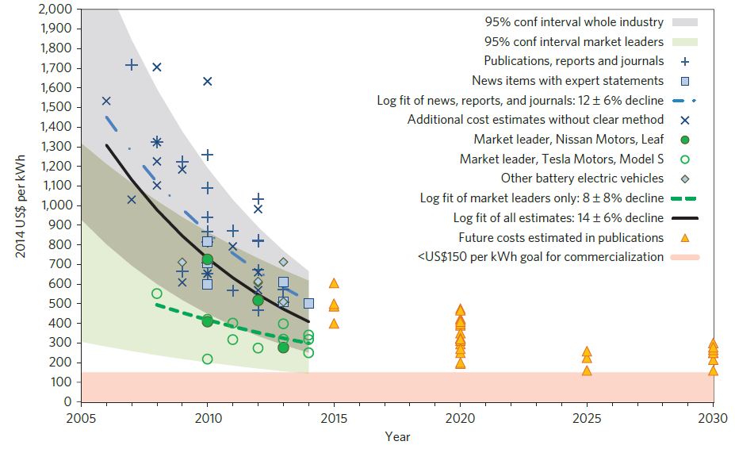
A better battery is one big requirement for larger EV market penetration
Nykvist and Nilsson Nat. Climate Change (2015)
DOI: 10.1038/NCLIMATE2564
Battery $/kWh
Year
Good News:
Lithium-ion is pretty great
and it is getting better

Slide 4
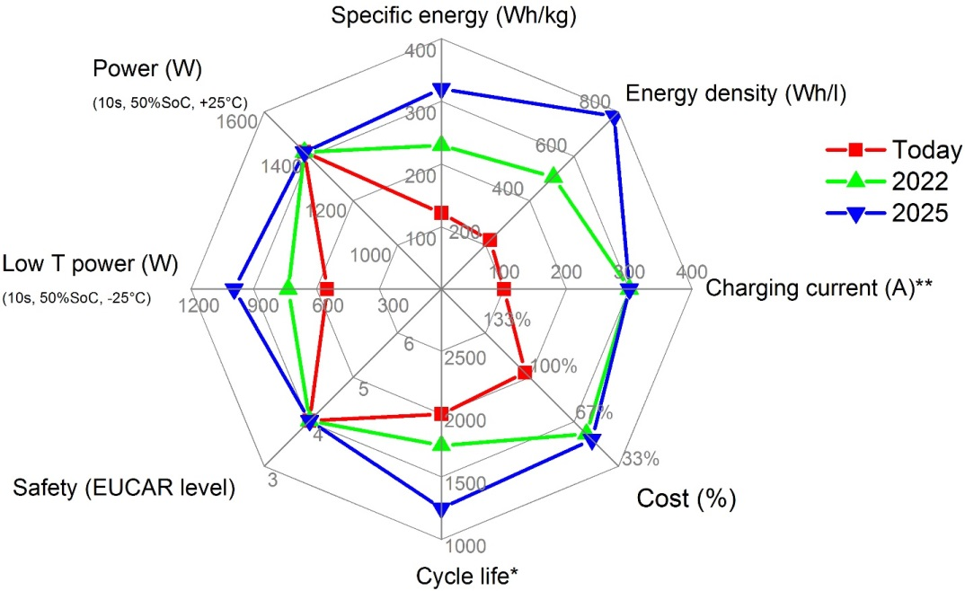
The challenge: traditional Li-ion is unlikely to reach automaker goals for mass market
Cell level criteria from D. Andre et al, J. Mat. Chem. A, 3, 6709 (2015)

Slide 5
How do we discover and develop a new battery with a lower cost curve?
1) Identify what success looks like…materials & system
via Techno-economic modeling
2) Determine guiding design rules for challenge
combining atomic & molecular level understanding to create intuition -> discovery
3) Refine
Remember:
JCESR is an experiment!

Slide 6
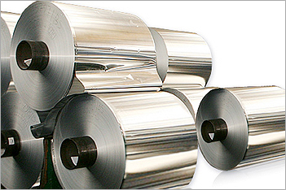
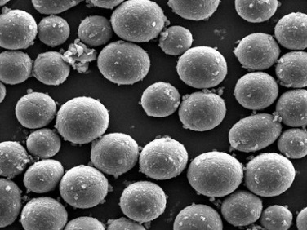
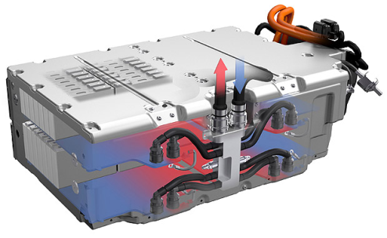
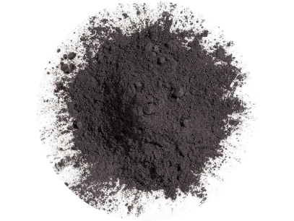
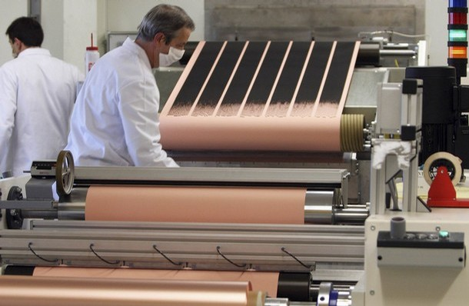
Techno-economic modeling: Building a battery on the computer
Power
Energy
System
Depreciation, Overhead, ROI
Connects system level goals to materials challenges

Slide 7
System Level Volume and Mass Predictions
Li-metal
Si anode
Higher
voltage
7

Slide 8
System Level Volume and Mass Predictions
Magnesium?
8

Slide 9
Battery price scales with mass and volume
Magnesium/Metal-Oxide
e
($/kg)
(kWh/kg)
$/kWh =
Processing costs also scale with size
Increase energy density!
Mg metal anode
Mg⁺⁺
Metal oxide cathode
Lithium/Sulfur
e
Li metal anode
Li⁺
Sulfur
cathode
Lithium/Metal-Oxide
e
Li metal anode
Li⁺
Metal oxide cathode
3 cell couples with potentially <$100/kWh and >400 Wh/l
9

Slide 10
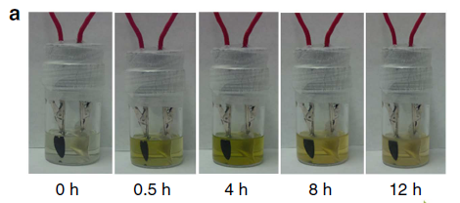
Li-S: discovery of new electrolyte required
Liang et al Nat. Comm.10.1038/ncomms6682 (2015)
Decreasing electrolyte
Low electrolyte volumes in Sulfur electrode result in Li₂S_{x} disproportionation and passivation (poor performance)
Current approach requires 10x excess of electrolyte for long life
10
Eroglu et al, J. Electrochem. Soc. 162 (6), A982 (2015) DOI: 10.1149/2.0611506jes

Slide 11
Learn from the past: sparingly soluble reactant
status quo
Li₂S_{x} fully solubilized
10⁶ mg/l
commercial
Lead acid
1 mg/l
JCESR
S₆²⁻
S_{x}²⁻
Pb²⁺
Li₂S
Pb
PbSO₄
S
Li₂S_{x}
Notes:
understanding mechanisms allows JCESR to unravel the design rules and apply these to the development of performance enhancing electrolytes

Slide 12
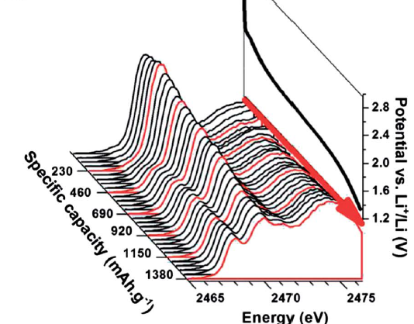
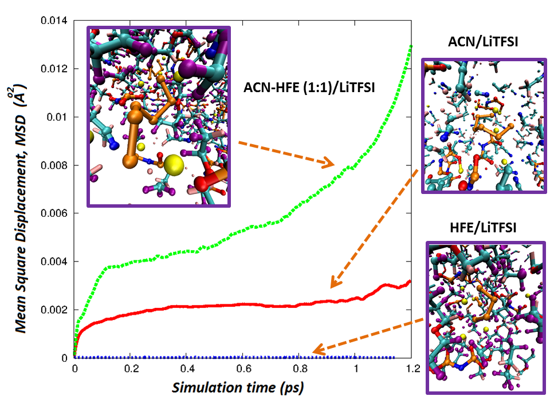
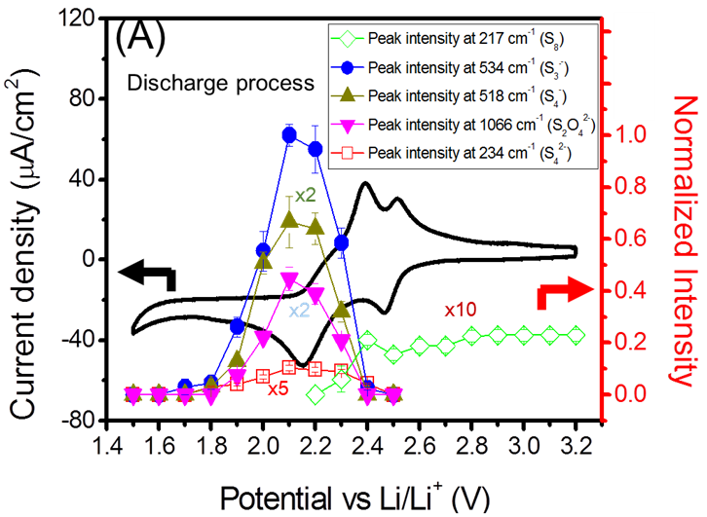
Towards design rules for sparingly soluble
Cuisinier et al Energy Environ. Sci. (2014)
K.C. Lau et al (2015)
H.-L. Wu et al., ACS Appl. Mater. Interfaces 2015, 7, 1709−1719
Developing an electrolyte that conducts Li⁺ without dissolving Li₂S_{x}
12

Slide 13
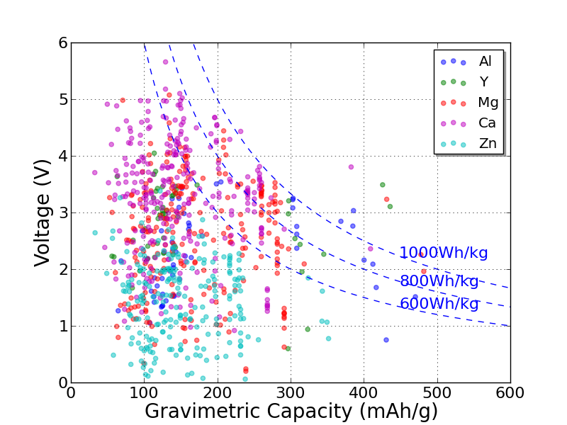
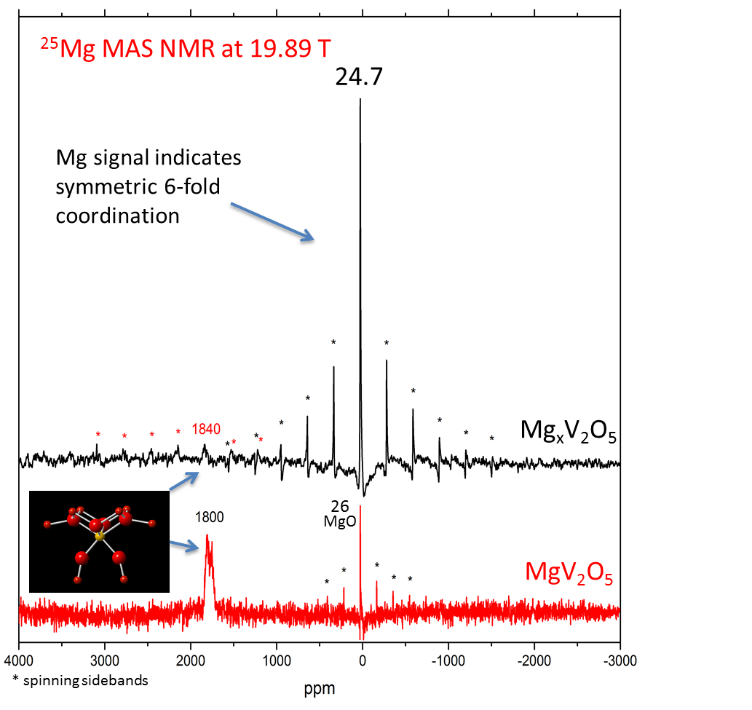
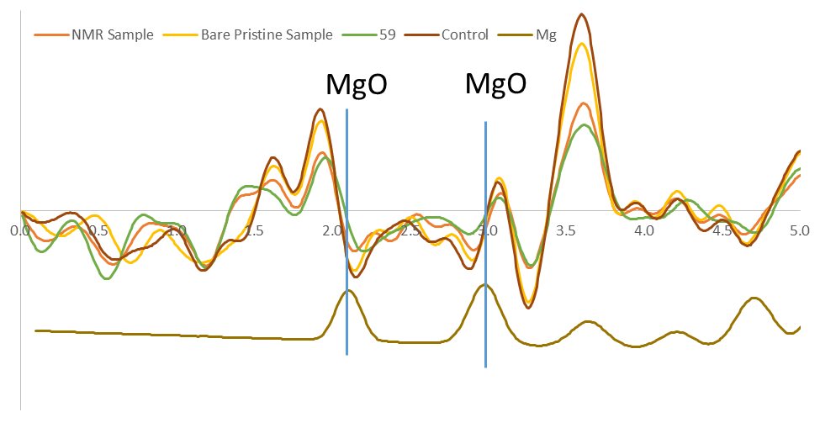
Mg… the indispensable battery of the future?
This is challenging – effort has large computational component to held build intuition through iteration with experiment
Genomic Search
Mg NMR
APS/ALS
Mg Diff.
Mg is critical divergent research because we may never solve Li-metal challenge
13

Slide 14
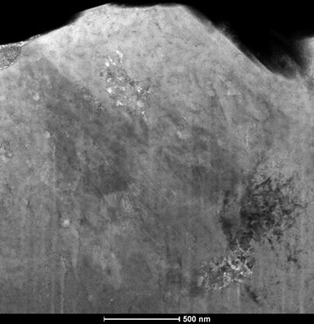
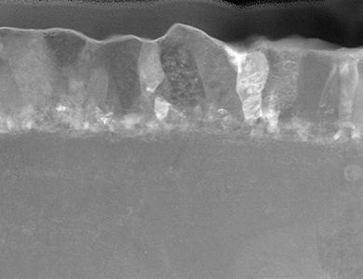
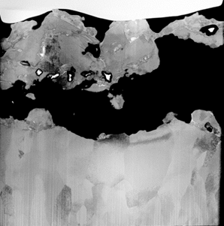
Mg metal plating/stripping shows strong structure activity relationship
cycling in a Mg chloroaluminate
-
-
-
-
-
-
-
-
-
-
-
-
100
pseudoepitaxy
500 nm
99
coulombic efficiency
re-nucleation
500 nm
98
porosity
2 μm
~100% Coulombic efficiency possible! Subtle chemistry requires careful control
N. Hahn et al J. Phys Chem C submitted (2015)
14

Slide 15
To conclude… new materials required for “true” mass market electric vehicles
Metal anodes with high energy cathodes are promising path to <$100/kWh and >400 Wh/l
T-E Modeling used to identify what success looks like at system and materials levels
Integrated characterization, synthesis, & computation efforts to overcome identified challenges

