Slide 1
FCE – Starter Projects
Rob and Salman
Kickoff Meeting
31 August, 2015

Slide 2
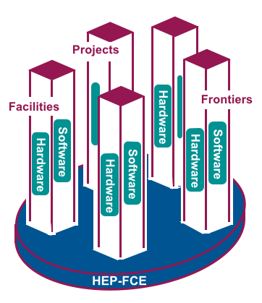
Logic for Starter Projects
What is needed that is not being currently provided?
Of these topics, which ones can be tackled in a small, cross-cutting team environment?
What historical collaborations or activities or layers of expertise can be leveraged to achieve these aims?
Will the projects provide broad benefits to multiple users/communities?
Will the projects help to better connect HEP to itself and to other DOE offices?
Can the projects be done so as to provide useful “success stories” in a short period of time?

Slide 3
Information Input
A lot of studies already exist: HEP Topical Panel on Computing, Snowmass 2013, P5 2015, ASCR/HEP Exascale Requirements Review, most significantly the three HEP-FCE working group reports
FCE reports: Applications Software, Software Libraries and Tools, Systems
Reports are done, will be on the FCE website this week

Slide 4
Major Conclusions and “Hot Spots”
Efficient execution of HEP workloads on next-generation architectures and computational resources, I/O bottlenecks
Data access and storage technologies
Shared libraries and tools — problems for small experiments, too many “local” solutions, lack of set of uniform best practices
Only limited consolidation of applications software components possible
Community generally supportive of HEP software developers (result of survey)
Enhance visibility of HEP computational scientists within the community (major software projects <—> major detector R&D)
Importance of improving the human element, training and other knowledge enhancing opportunities (cross-cutting projects)

Slide 5
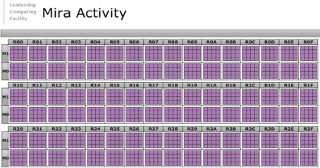
HEP-FCE Initial Priority Areas (2 years)
Next-generation architectures and supercomputer applications (“HPC for HEP”)
Data-intensive/Cloud computing (virtualization/containers)
High-speed networking (as a turnkey production resource)
ASCR-HEP interactions (workshops, JLSE, —)
Cross-cut software development
HEP-FCE infrastructure support and community development
ATLAS event simulation on Mira: While this job was running, Mira was producing the equivalent computing as 5-6 ATLAS Grids. “On our best days, we provide the equivalent computing capacity of the whole ATLAS Grid.” — Tom LeCompte

Slide 6
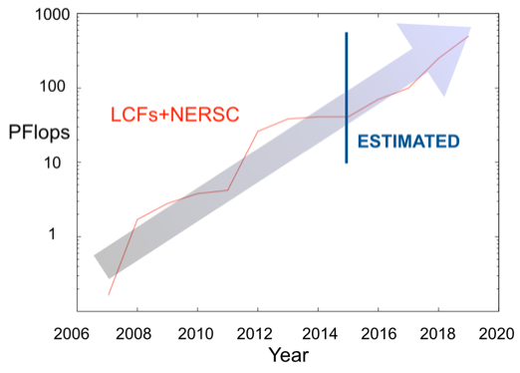
“HPC for HEP”: Resources
LCFs | NERSC | ESnet | HEP Facilities | Local Resources
 | Wide range of users Mission-lifetime allocations Data archives Data simulation and analysis General purpose software available | Network management solutions and optimization LCF/NERSC high-speed data transfers HEP services | HEP users Mission-specific services Data archives Data simulation and analysis Software suite optimized for HEP tasks | Local users and allocations Specific calculations Data analysis (partial datasets) Locally specific software suite
Expert users
Very large HPC calculations
Timely allocations
Data simulation
Software suite optimized for LCF use
ASCR HPC resources overwhelm HEP compute (X 1000)
But need to understand I/O nature of HEP tasks
Also code refactoring is a major problem, does this need to be done anyway?

Slide 7
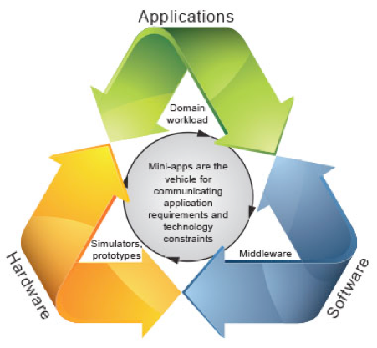
“HPC for HEP”: Next-Generation Architectures
Exposure to architecture “swim-lanes” — CPU/GPU, manycore, nontrivial memory hierarchy, special architectures (e.g., IBM’s TrueNorth)
I/O bound applications — NVRAM exploits
Edge servers/job automation
Portability/Performance issues, useful metrics, overall optimization
“Mini-Apps” for help with code (re-)design and performance modeling
Co-design loop using mini-apps to approximate the workload of the parent application (LLNL STR 2013)

Slide 8
Data-intensive Computing
High Performance Computing
Parallel systems with a fast network
Designed to run tightly coupled jobs
High performance parallel file system
Batch processing
Data-Intensive Computing
Parallel systems with balanced I/O
Designed for data analytics
System level storage model
Interactive processing
High Throughput Computing
Distributed systems with ‘slow’ networks
Designed to run loosely coupled jobs
System level/Distributed data model
Batch processing
Ability to run multiple complex software stacks on the same parallel platform (virtualization and containers)
Resource elasticity to allow “interactive” access to the extent possible
R&D work in understanding I/O patterns and their optimization
Optimization of multiple compute resource use including available storage and networking (learn from new SciDAC project)
Leverage ASCR/HEP Cosmic Frontier project (EASy-HEP)
Potential “instant” customers include DES, DESI, LSST, and SPT

Slide 9
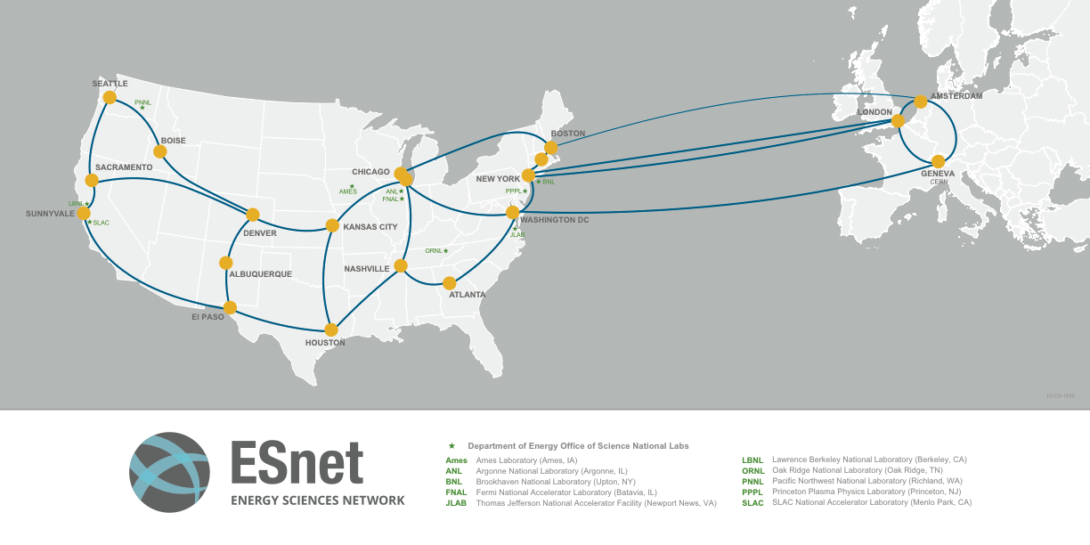
High-Speed Networking
Many HEP data sources exist with high throughput demands on WANs
Cosmic Frontier simulations set desired data transfer rate of 1Pbyte/week (file sizes from KB to ~100GB) as a robust production requirement, possible in principle on ESnet
Many “mundane” bottlenecks are in the way
Joint ESnet/HEP-FCE/DTWG project on solving this problem is underway (desired tools: Globus and HPSS, want FS to FS and HPSS to HPSS, etc.)
Initial characterization and testing between ASCR HPC Centers (ALCF, NERSC, OLCF), add NCSA next, finally BNL and FNAL
Need to deal with software “handshake” problems when crossing ASCR and HEP facility boundaries (NCSA may be less of a problem but not tested yet)
Computational cosmology data transfer “data transfer test package” in the works, other use cases will follow
Characterize pathways, DTNs, firewalls, identity management, chokepoints, failure modes, etc. and document them
Implement dashboard for tracking transfers

Slide 10
More Open Areas —
ASCR/HEP Interactions: Exascale requirements review just completed; report almost ready — many avenues for improved interaction with ASCR — 1) Need to avoid fragmented interactions (but this may be unavoidable given the nature of FOAs), 2) HPC, data-intensive computing, and networks are natural conduits, but already identified, 3) Other areas — software engineering? Uncertainty quantification?
Cross-Cut Software Development: How can HEP-FCE contribute to this? 1) Big experiments can take care of their own problems, but their solutions often don’t scale down, 2) Don’t wish to interfere in ongoing software projects (“if it works —“), 3) Too many entrenched opinions in some areas, 4) Need to find good targets (best situation — they should self-identify)
HEP-FCE Infrastructure/Community Development: How to create an environment for community engagement and support? 1) No reason to reproduce Hepforge, Stack Overfow, GitHub, Google — 2) No desire to be the “police”, enforce standards, best practice notions, or get in the way of people trying to do work, 3) What would be helpful and does not currently exist?

