Slide 1
Spec-z efficiency using DESI Quicksim (An Update)
Anthony Kremin (PhD Candidate, UM)
Christopher Miller (Faculty, UM)

Slide 2
Introduction
Using a redshift estimation code developed at U. Michigan between Dan Gifford and myself
Cross-correlates SDSS template spectra of galaxies with the input spectrum
Used quicksim to generate simulated spectra to both test my code and to the recovery efficiencies for DESI
Did tests on LRG’s and ELG’s so far

Slide 3
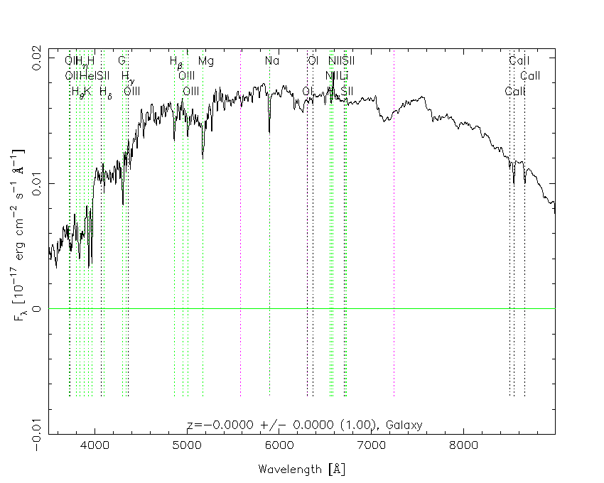
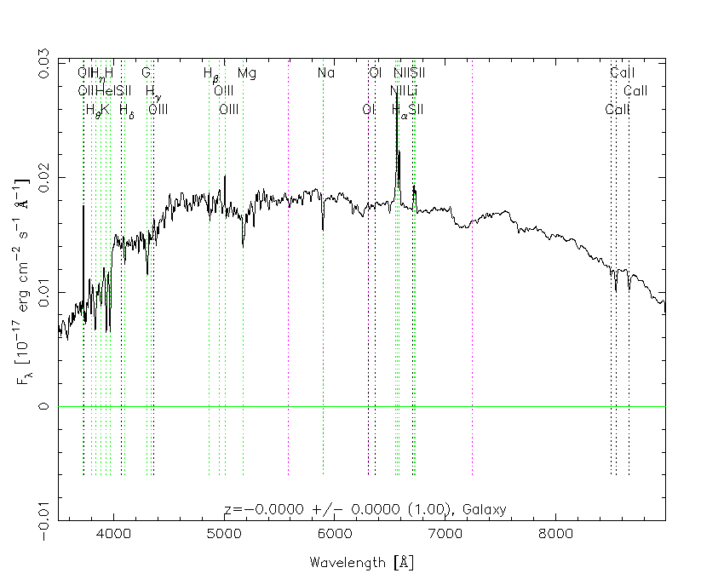
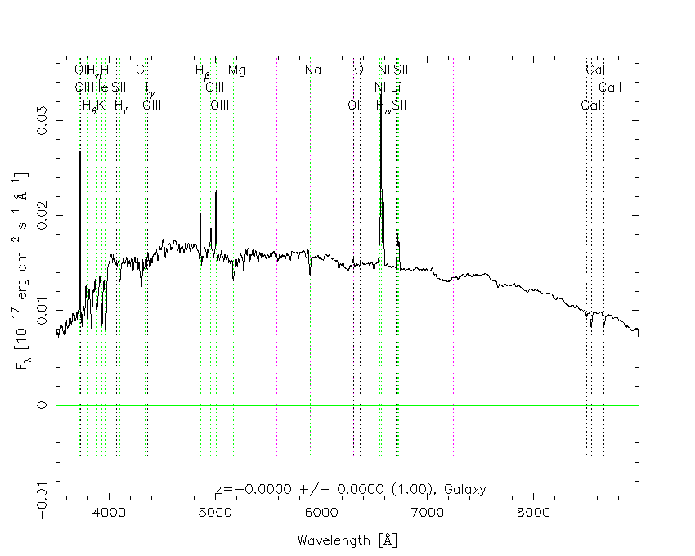
Cross-Correlate SDSS Templates

Slide 4
Shifting through redshifts

Slide 5
Before

Slide 6
LRG Quick-z inputs
Fixed:
z_input: 0.7
Airmass: 1.0
Model: ‘lrg’
Output_mag_band: i
Varied:
Exposure times: 600-4200s in 600s increments
z outputs: 0.1-1.3 in 0.1 increments
Output i Mag: 18-24.1 in 0.1 mag
3767 redshifts with mean signal to noise from 0.1 to 15.

Slide 7
Recovery of Quick-z simulated spectra
0.5 < Mean SN < 1.0
Truth: z = 0.1
Mis-identified

Slide 8
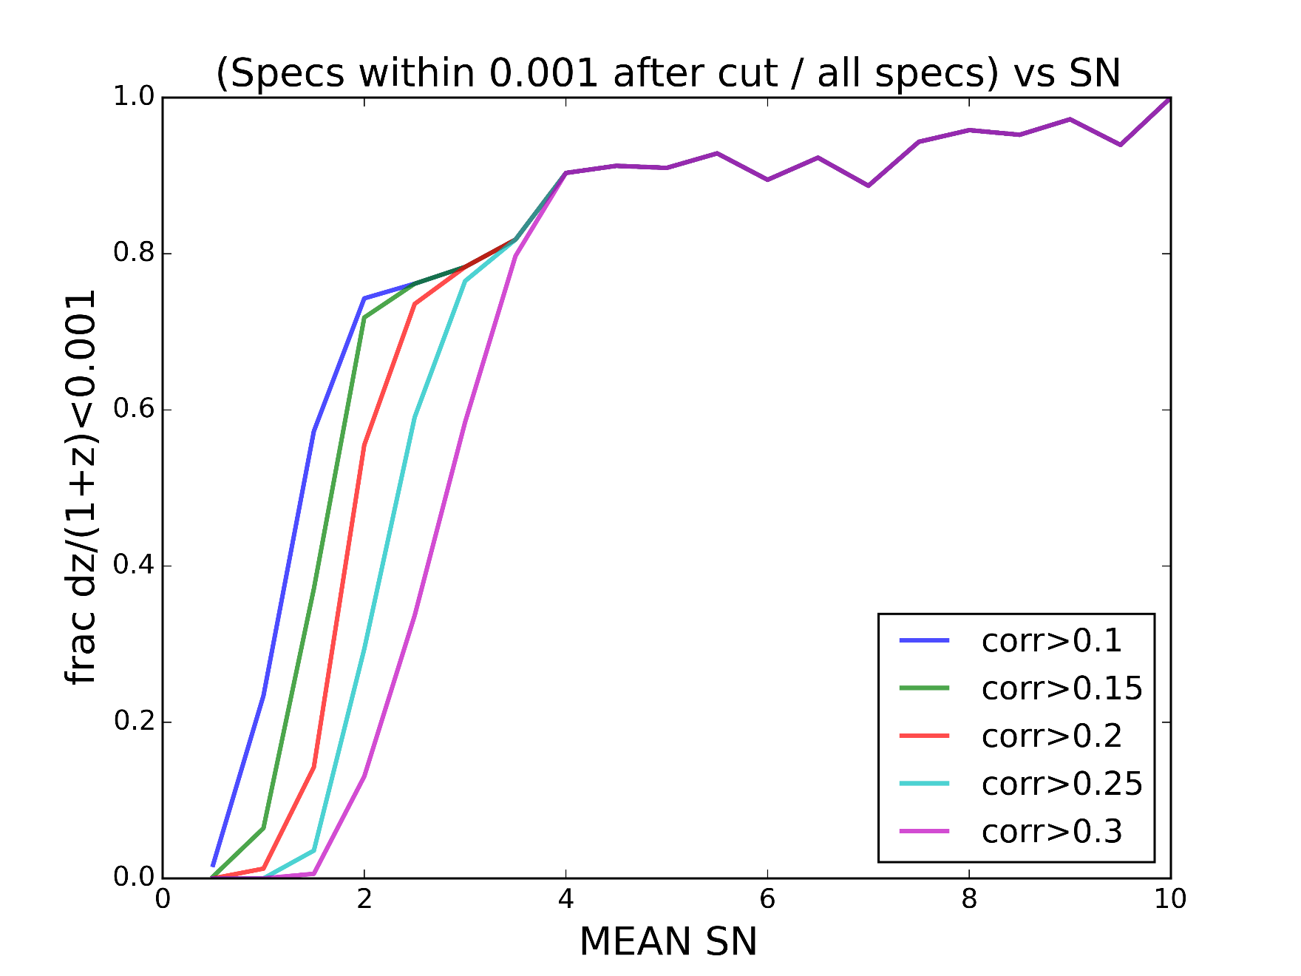
Cutting on correlation: Frac of total

Slide 9
Update

Slide 10
Changes
Realized the 3-sigma deviating “photo-z’s” were causing the recovery inefficiencies at S/N > 4
Removed Gaussian prior
Replaced with flat prior \pm 5 sigma
Greatly improved performance

Slide 11
LRG Quick-z inputs (Same)
Fixed:
z_input: 0.7
Airmass: 1.0
Model: ‘lrg’
Output_mag_band: i
Varied:
Exposure times: 600-3600s in 600s increments
z outputs: 0.1-1.2 in 0.1 increments
Output i Mag: 18-24 in 0.1 mag
3767 redshifts with mean signal to noise from 0.1 to 15.

Slide 12
Use a flat prior instead
0.5 < Mean SN < 1.0
Truth: z = 0.1
‘Correctly’ identified

Slide 13
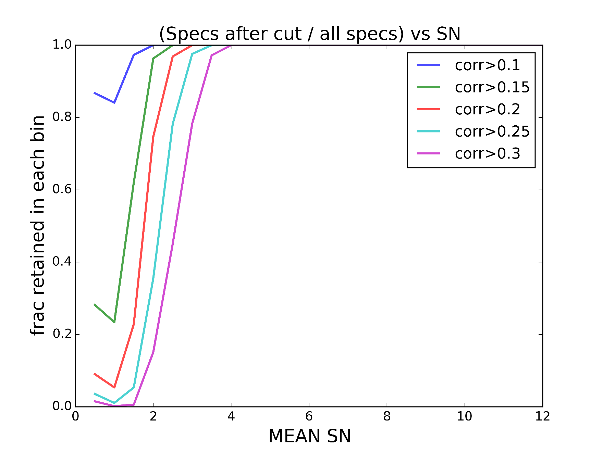
Cutting on correlation: Frac of total

Slide 14
Conclusion
Able to run over large range of Quicksim parameters fairly efficiently using loops (switched from command-line interface to a python function call).
Can generate many simulated spectra based off saved output templates over this large parameter space.
Code generates a “photo-z” by taking:
true_z + 0.02*(1+true_z)*n (n is Gaussian random number)
These ‘photo-zs’ are inserted as priors with the spectra into an automated redshift estimator developed Dan Gifford and Anthony Kremin (UM PhD students).

