Slide 1
Cosmology and the Higgs
Paul Steinhardt
Princeton University
US Atlas Workshop
July 15, 2013

Slide 2
before 2012:
theorists’ worst nightmare
What if all that the LHC finds is
the standard Higgs?
What if all that the Planck satellite finds is
standard ΛCDM?
Game over!

Slide 3
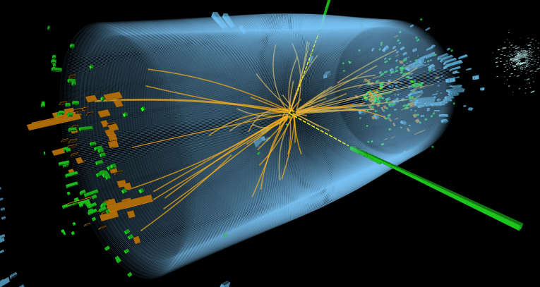
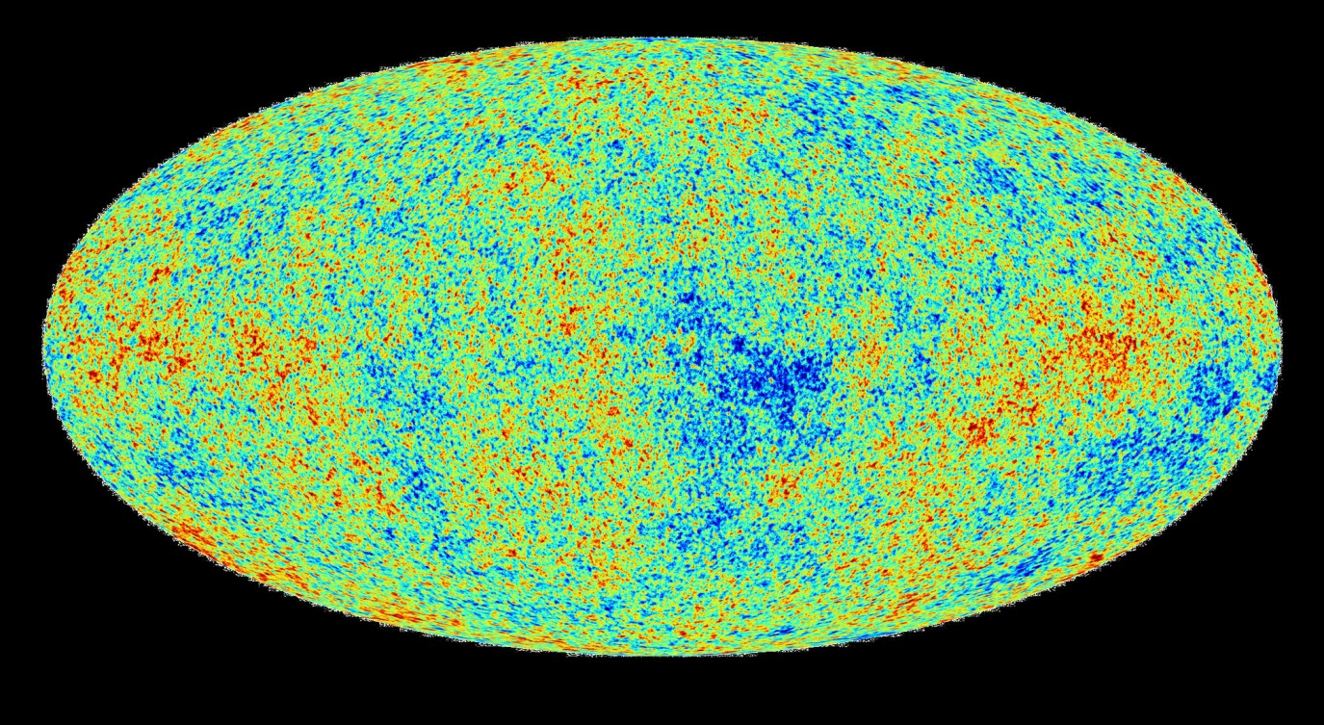
2013: Game over?

Slide 4
2013: No! Not at all!
unexpected mass
simplest inflation
models disfavored

Slide 5
Higgs/top mass estimates change
SUSY or other BSM discovered
Primordial g-waves found

Slide 6
Warning!
This talk is radical.
The views expressed here are not
shared by most theorists.*
*some notable exceptions: colloborators Itzhak Bars (USC) and Neil Turok (Perimeter)

Slide 7
unexpected mass

Slide 8
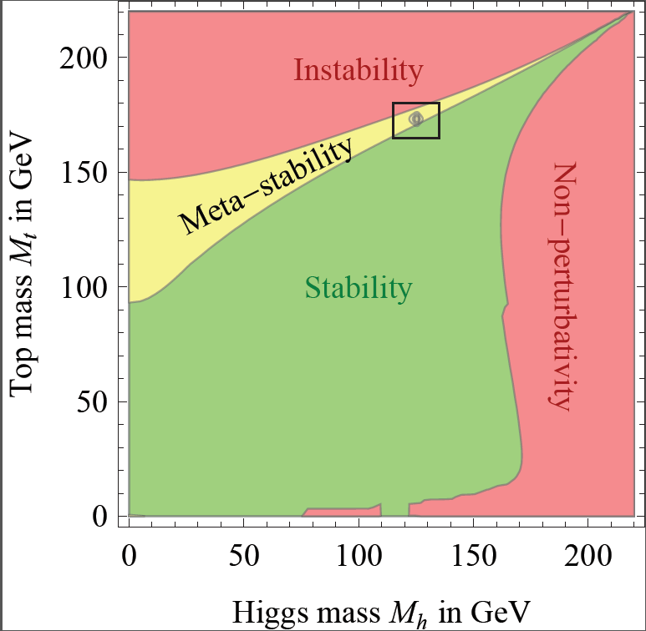
Degrassi, DiVita, Elias-Miro, Espinosa, Giudice, Isidori Strumia (2012)

Slide 9
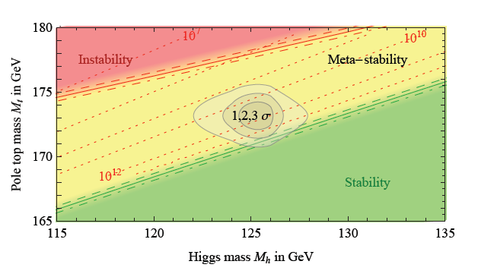
Degrassi, DiVita, Elias-Miro, Espinosa, Giudice, Isidori Strumia (2012)
assuming standard model higgs
➔dark energy
Is temporary

Slide 10
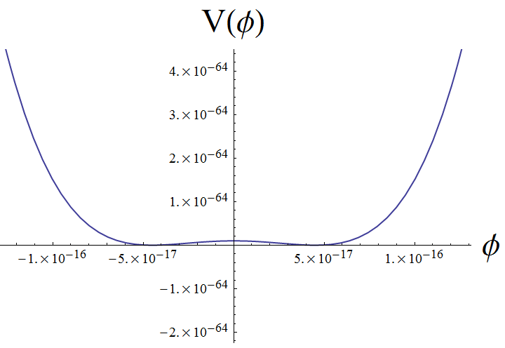
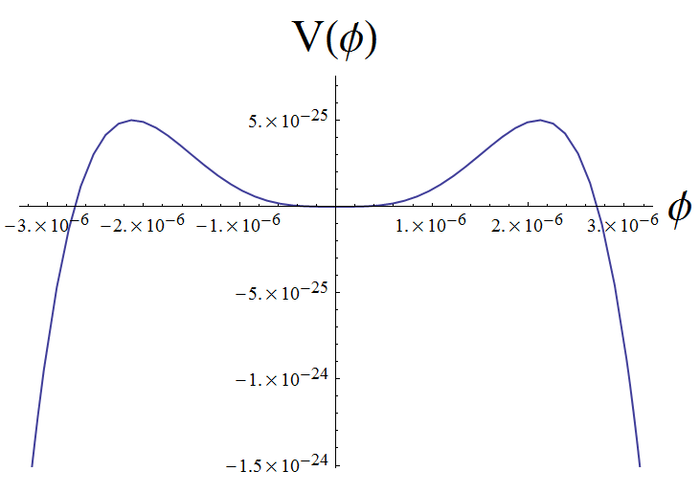
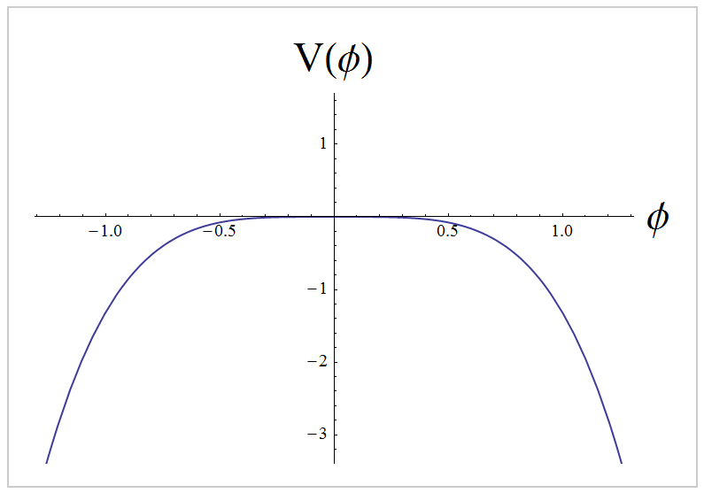

Slide 11
Standard big bang/inflation:
Our observed universe is
unlikely
and its future is precarious

Slide 12
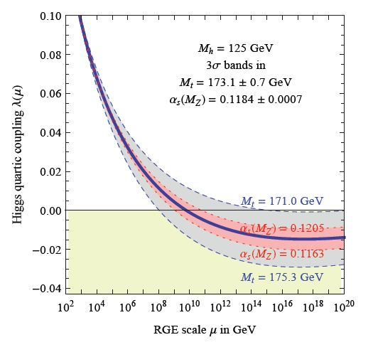
Higgs physics
is nearly scale-free
Degrassi, DiVita, Elias-Miro, Espinosa, Giudice, Isidori Strumia (2012)

Slide 13
Planck2013

Slide 14
A remarkably simple universe!
What does it mean for inflation?
Data selects a special case:
single-field
plateau-like models !
Nearly scale-invariant
Red tilt (to 5σ)
No detectable run
No detectable isocurvature
V
No deviation from gaussianity
No detectable g-waves (r < 0.11)
φ
inflaton field

Slide 15
Planck collaboration, Paper XXII
“The simplest inflationary models have passed an exacting text with the Planck data”
Plateau-models are not the “simplest”…
PLATEAU: FAVORED BY PLANCK
DISFAVORED BY PLANCK
V
V
φ
φ
inflaton field
inflaton field
Anna Ijjas, Abraham Loeb & PJS (2013)

Slide 16
Planck collaboration, Paper XXII
“The simplest inflationary models have passed an exacting text with the Planck data”
Plateau-models are not the “simplest”…
...they have an “unlikeliness problem”…
V
...they have a famous
“initial conditions problem”…
What about Planck disfavors
the truly simplest models?
φ
inflaton field

Slide 17
The road less traveled
must accommodate the following “observations”:
no new physics at low energies
no detectable gravitational waves
metastable universe with modest barrier
nearly scale-invariant microphysics
nearly scale-invariant macrophysics

Slide 18
The road less traveled
suggests two guiding principles
scaling symmetry & cyclic cosmology
no new physics at low energies
no detectable gravitational waves
metastable universe with modest barrier
nearly scale-invariant microphysics
nearly scale-invariant macrophysics

Slide 19
Cyclic universe?
Fits to a tee!

Slide 20
Higgs physics
Is nearly scale-free
Natural way
to generate
scale-invariant
fluctuations
in cyclic picture
Degrassi, DiVita, Elias-Miro, Espinosa, Giudice, Isidori Strumia (2012)

Slide 21
What about scaling symmetry?
to incorporate both micro and macro physics
the logical choice is to include gravity
“local scale symmetry” (aka “Weyl invariance”)
which turns out to give us more than scale-invariance . . .

Slide 22
Simplified case: Higgs + radiation (approaching the big crunch)
+ radiation]
Smooth & Flat; Can ignore potentials and gradients; Ultralocal

Slide 23
Simplified case: Higgs + radiation (approaching the big crunch)
+ radiation]
+ radiation]
Smooth & Flat; Can ignore potentials and gradients; Ultralocal
“Weyl invariant extension” (the same theory written a novel way!):
]
+ radiation
Weyl invariant: $g_{αβ}→e^{2ω(x)}$ $g_{αβ}$ , $φ→e^{−ω(x)}$ $φ$ and s$→e^{−ω(x)}$ $s$
Can choose $ω\left(x\right)$ so that $\frac{1}{12}\left(φ^{2}−s^{2}\right)=1/2κ2 to recover Einstein eqs.$

Slide 24
Every solution of the Einstein equations
+ radiation]
. . . is also a solution of the Weyl invariant extension . . .
]
+ radiation
. . . and also a solution of other gauge-fixed versions (e.g., g = a =1)
but … geodesically incomplete solutions in one gauge
may be geodesically complete solutions in the other !

Slide 25
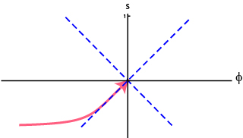
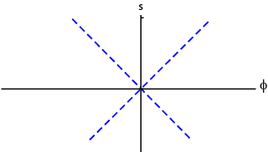
crunch
bang

Slide 26
Weyl invariance can be extended
to all known physics
can also add dark matter and r-handed ν’s

Slide 27
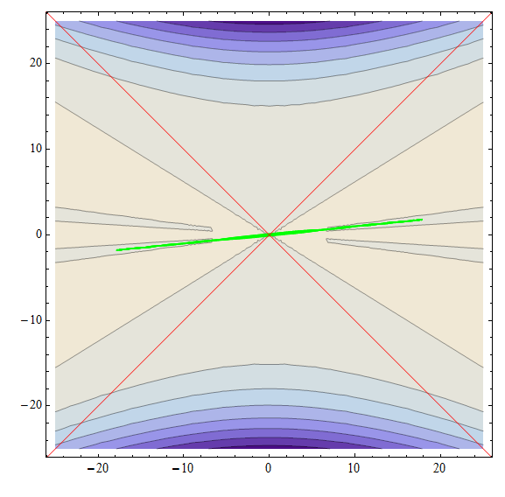
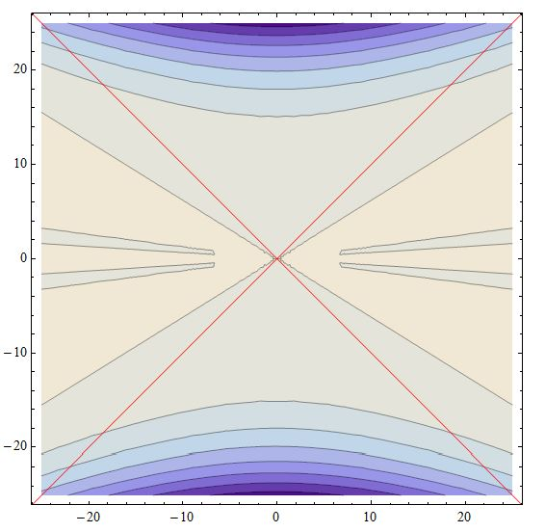
s
φ
troughs = current Higgs vac
higgs = s/φ

Slide 28
s
φ
troughs = current Higgs vac
higgs = s/φ

Slide 29
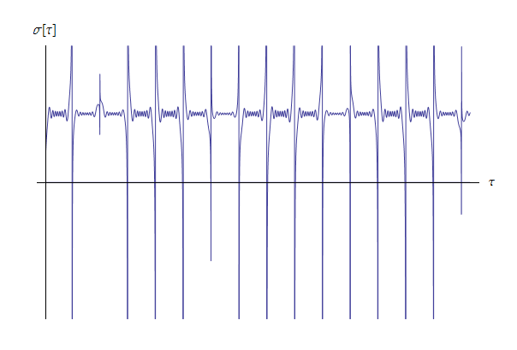
higgs
current
vac

Slide 30
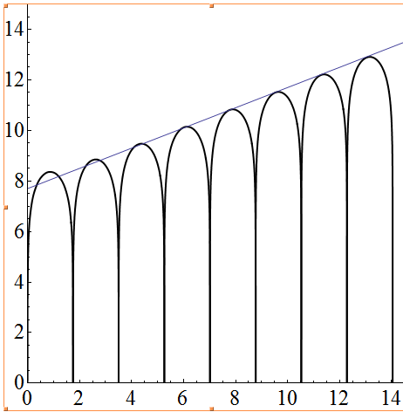
Adding entropy production: volume grows from cycle to cycle
log a(t)
t

Slide 31
Higgs/top mass estimates change
SUSY or other BSM discovered
Primordial g-waves found
“Nothing new”
Everything different
Higgs assumes new importance

Slide 32
For more information, see:
“Local Conformal Symmetry in Physics and Cosmology,”
I. Bars, PJS, and N. Turok, arxiv:1307.1848
and references therein

