Slide 1
Development of RF Deflecting Cavity and Dielectric Power Extraction and Transfer Structure
Qiang Gao
Tsinghua University/AWA

Slide 2
Outline
Design of RF Deflecting Cavity
  Background
  Simulation and RF tuning
  Experiment performance
Design of Dielectric Power Extraction and Transfer Structure (DPETS)
  Background
  Simulation Results
1

Slide 3
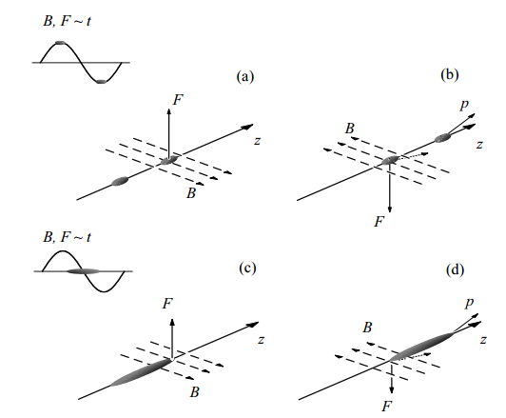
Definition: A high frequency resonant cavity which can deflect the charged particle. It works at TM110 mode (or other dipole mode) which has transverse electromagnetic field near the axis.
Background of Deflecting Cavity
Eg.1
Head-on collision:
Maximum luminosity
Crossing angle
introduced:
Reduced luminosity due to
crossing angle.
Eg.2
Crossing angle
with crab rotation
Effective head-on collision
Collider[2]
Two example of beam interacting with def[1]
[1] Studies of RF deflecting/crab cavities for beam manipulation and diagnostics. Thesis of Jiaru Shi. [2] RF Deflecting Mode Cavities Lecture I – Basics and Applications. Gaeme Burt.
2

Slide 4
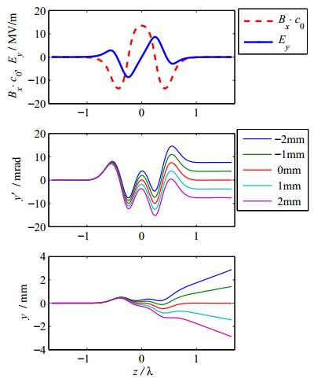
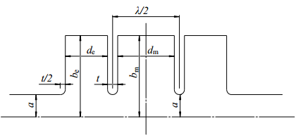
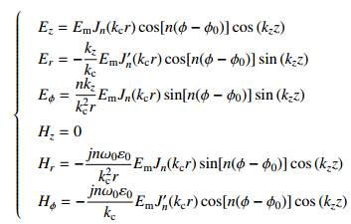
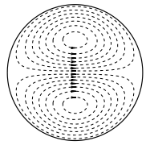
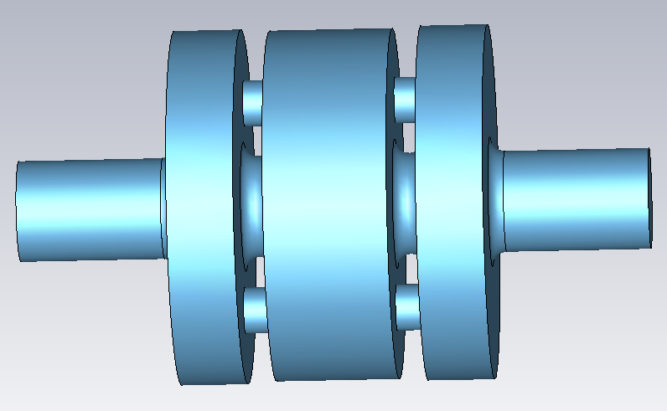
Field map and Simulation
2-dimension schematic
Derived from Maxwell equation, analytic TM mode field expression is
Optimize all the structure parameters to get to the correct frequency , field balance, polarization, and a no off-axis result.
Dynamic simulation
3

Slide 5
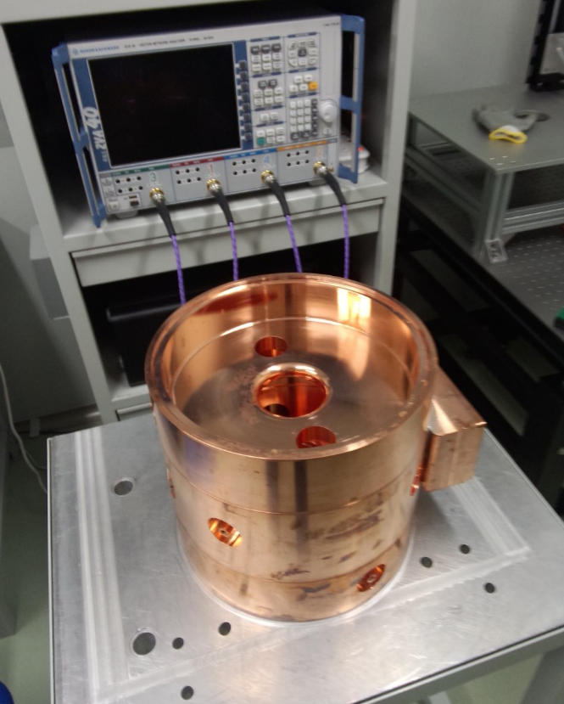
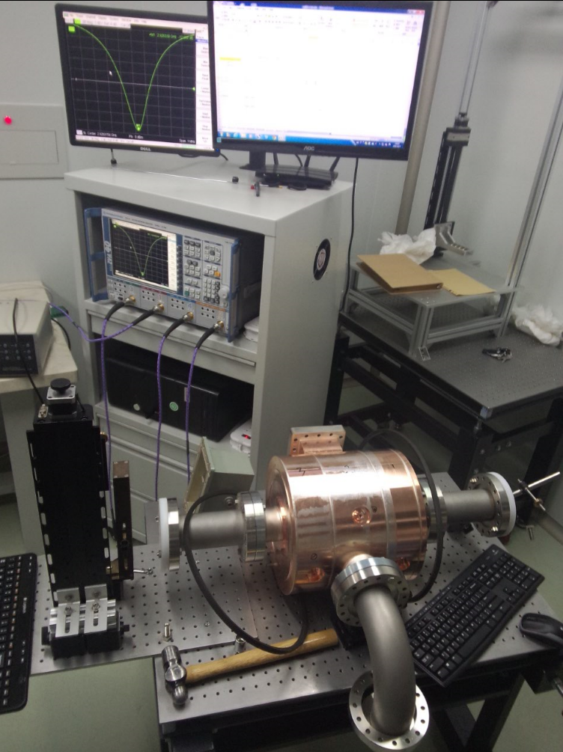
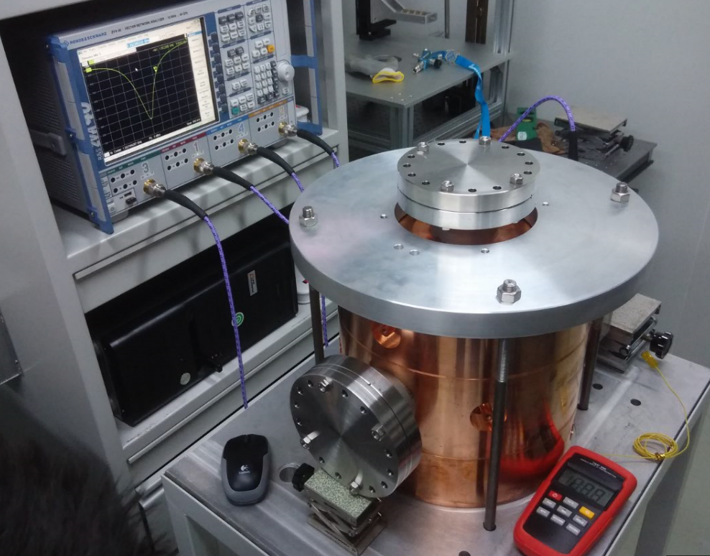
RF tunning
1. Using the network analyzer to measure the frequency.
2. Using bead-pull method (field perturbation theory) to measure the field distribution.
3. Tuning the pin on the cavity to get the correct frequency and field distribution.
 | Pi mode (working mode) | 0 mode
Frequency(MHz) | 1299.873 | 1333.340
Q­L | 8782.93 | 6379.62
Q0 | 19436.61 | 24395.66
Qe | 16023.59 | 8638.69
Beta | 1.213 | 2.824
Field flatness ratio | 0.99,1,0.98 | /
4

Slide 6
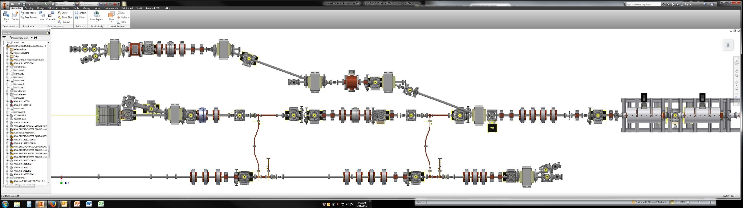
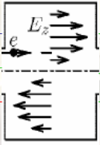
Experiment Performance (Why we need deflecting cavity in AWA)
AWA double dog-leg emittance exchange beam line[1]
Tranvserse
Deflecting cavity
Tranvserse
Deflecting cavity
Tranvserse
Mask
Beam direction
Dipole
magnet
Dipole
magnet
Quadrupole
Two deflecting cavity, one for EEX: to reduce the longitudinal emittance.
one for longitudinal diagnostic: to get the time structure.
Now with some quadrupoles, we can do the longitudinal bunch shaping, make an exchange from the initial transverse profile to final longitudinal profile.
[1] Gwanghui Ha, Lunch Seminar.
5

Slide 7
Design of Dielectric Power Extraction and Transfer Structure (DPETS)
6

Slide 8
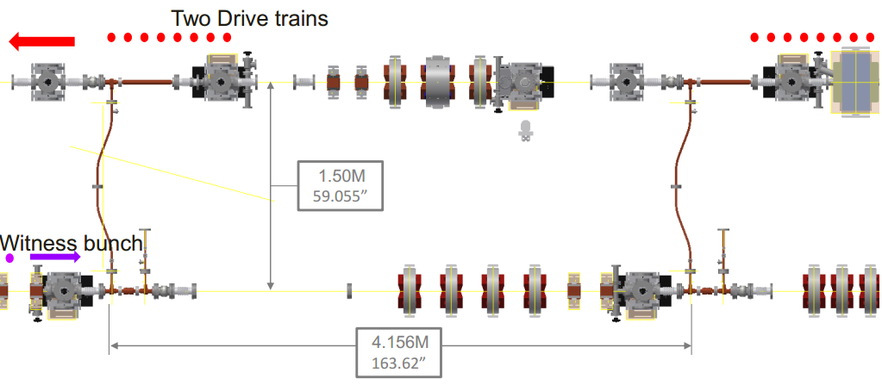
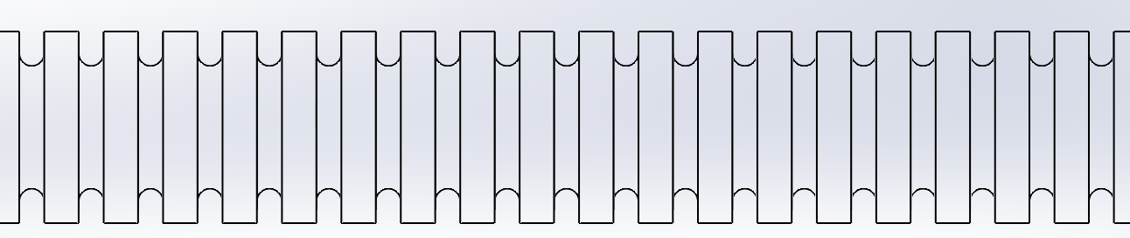
Background of the PETS
PETS characteristics:
High RF Transmission at working frequency.
High R over Q of fundamental mode (TM01).
Damping capability for parasitic dipole mode.
PETS
PETS
Definition: An impedance structure which will generate short RF high power pulse when charged particles pass through it.
Generally using wake potential to describe the wake effect: longitudinal wake potential Wz [V/pC], and transverse wake potential Wt [V/pC/mm].
7

Slide 9
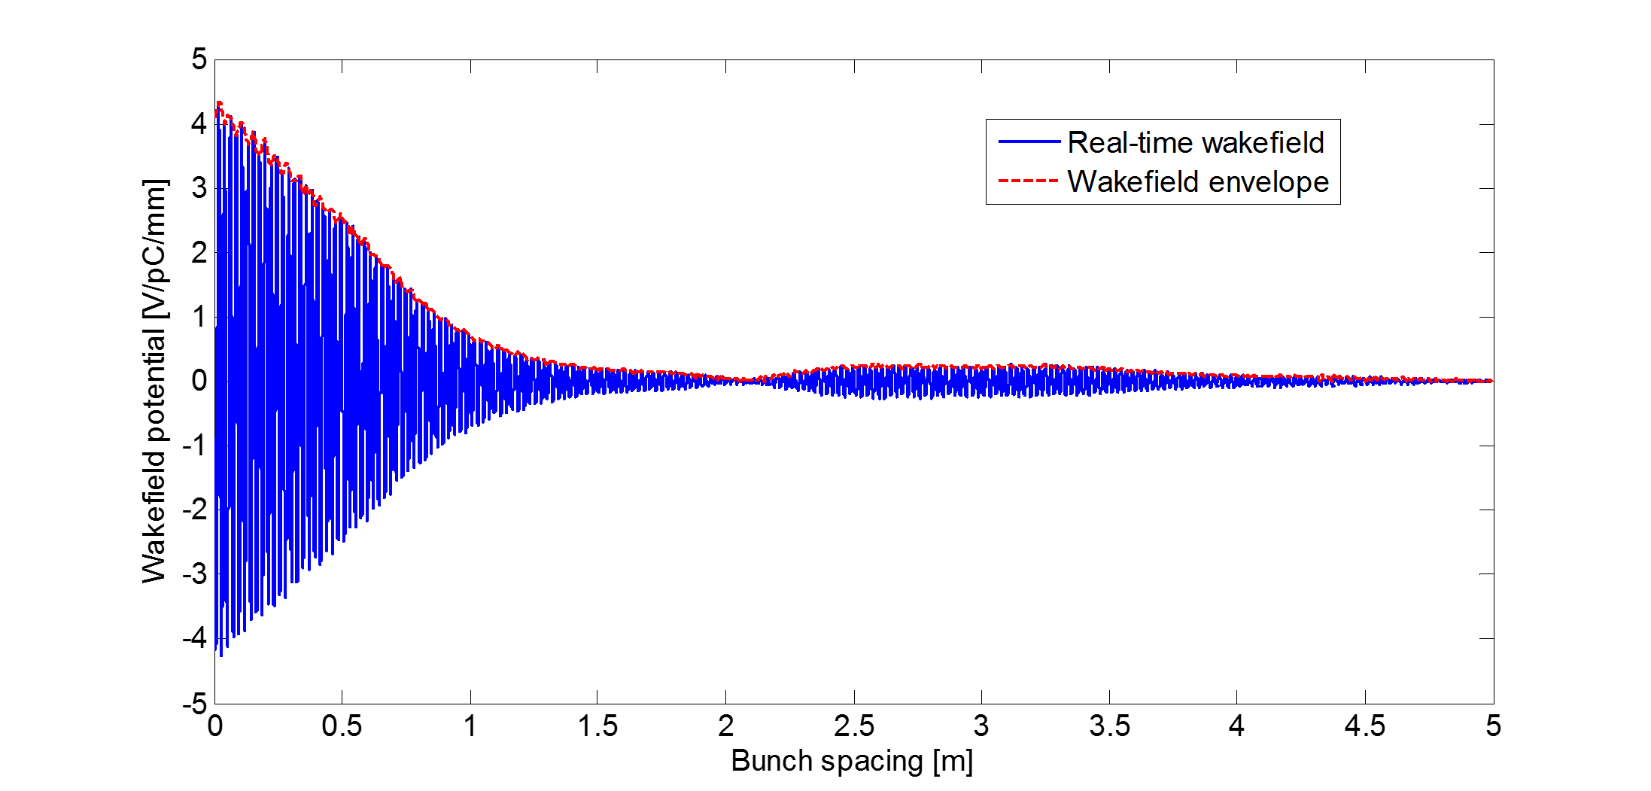
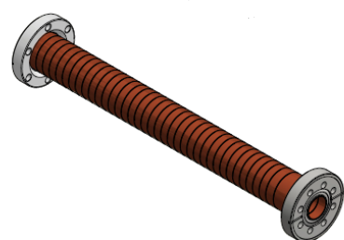
Metallic PETS
position | Wake field [V/pC/mm]
23cm | 3.4868
46cm | 2.6835
69cm | 1.7486
92cm | 0.8784
115cm | 0.4836
138cm | 0.2366
161cm | 0.1937
total | 9.7112
Damping Q~140
In travelling wave theorem,
So the wake potential can be fitted by exponential function.
In our experiment, there are 8 bunches in one train, the 8th bunch will experience the total transverse kick generated by the ahead 7 bunches. If assuming all the bunches have energy 50 MeV, charge 50nC, and initial off-axis 0.2mm, then the 8th bunch experiences a total transverse kick 97KeV, which is 2 mrad. So if the 8th bunch drifts 4m after the PETS, the off-axis will become 8mm. That’s too big for the second structure.
8

Slide 10
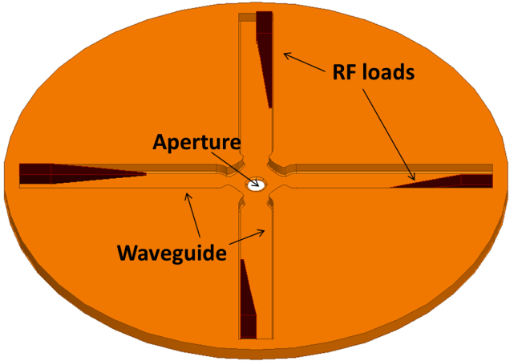
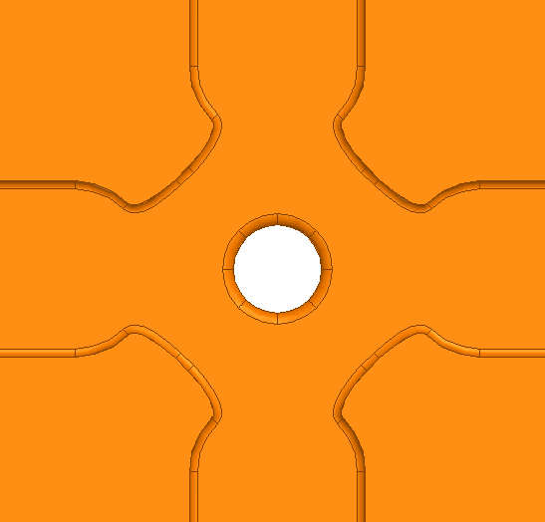
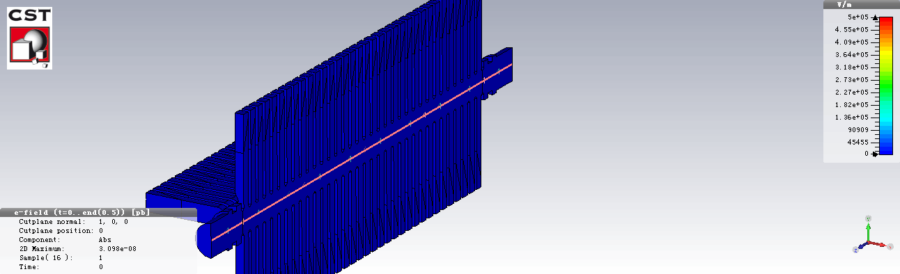
Metalic PETS with Damping Feature
Width
(SiC)
Wall shape
Wall tapering
Opening
CLIC waveguide damping structure[1]
1.Too many parameters to optimize
2.Although the parasitic mode can be damped, but the price of fabrication is very high. We need 35*4 = 140 pieces of RF loads. It will be more than 40,000 dollars only for RF loads!
[1]Hao Zha, CLIC.
9

Slide 11
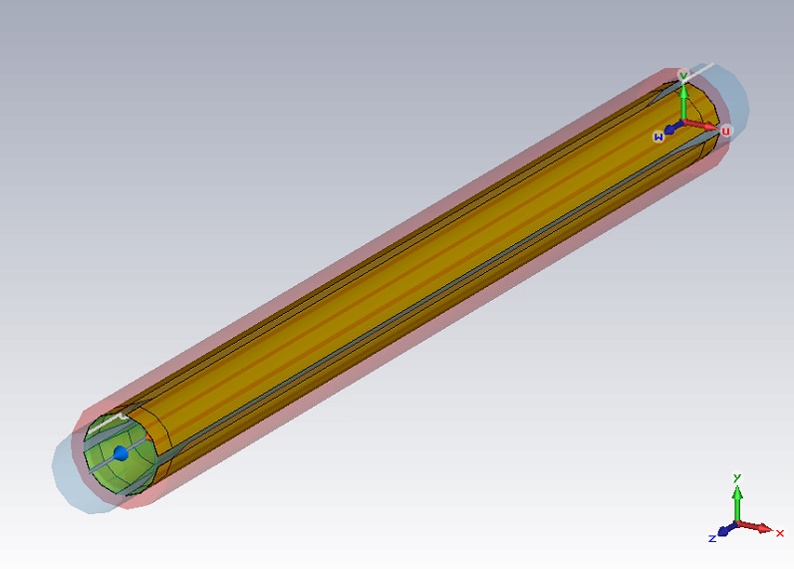
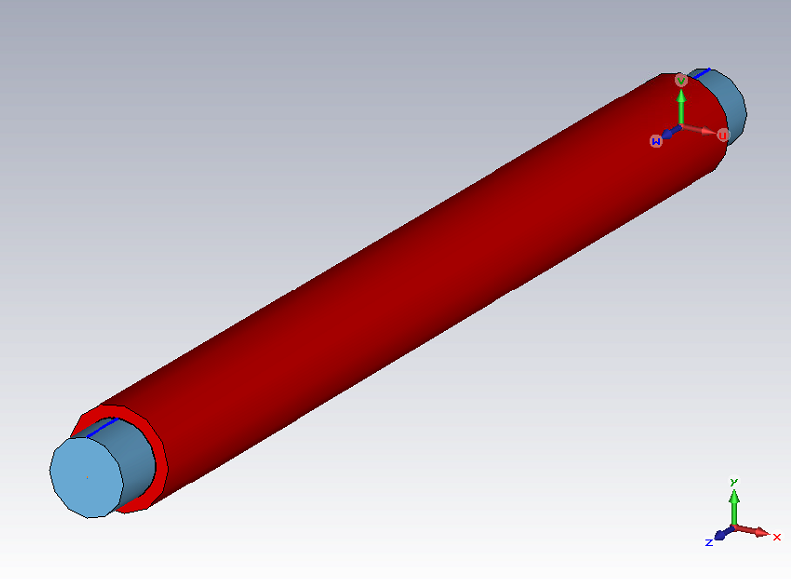
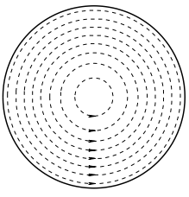
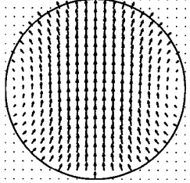
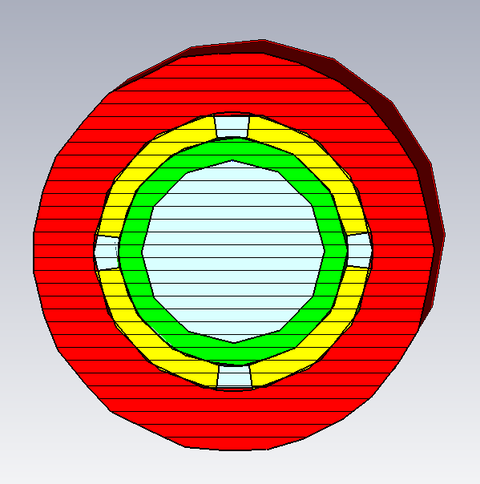
Dielectric PETS with Damping Feature
Current propagating
direction:
axial
Current propagating
direction:
azimuthal
Fundamental mode (TM01)
1ST dipole mode (HEM11)
vacuum
The surface current propagating direction of the fundamental mode is along the axis, and the direction of the 1st dipole mode is along the azimuth. If interrupting the outer conductor with axial cuts and surrounding the sleeve with an absorbing material, the parasitic dipole mode will leak out of the conductor and be absorbed, meanwhile the fundamental mode will maintain good propagation characteristics with only a slight deterioration. The transverse kick effect will be suppressed.
copper
vacuum
Absorber (SiC)
Dielectric material (Al2O3)
10
[1] Chunguang Jing, AN X-BAND DIELECTRIC-BASED WAKEFIELD POWER EXTRACTOR. [2] Wei Gai, Design and simulation of a high frequency high power RF extraction device using a dielectric-loaded waveguide.
Notes:
`

Slide 12
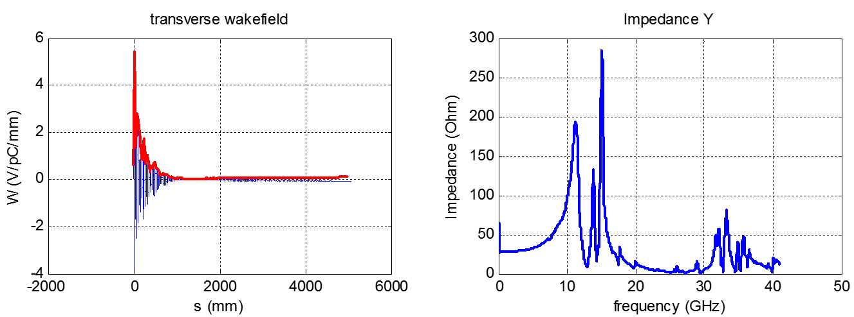
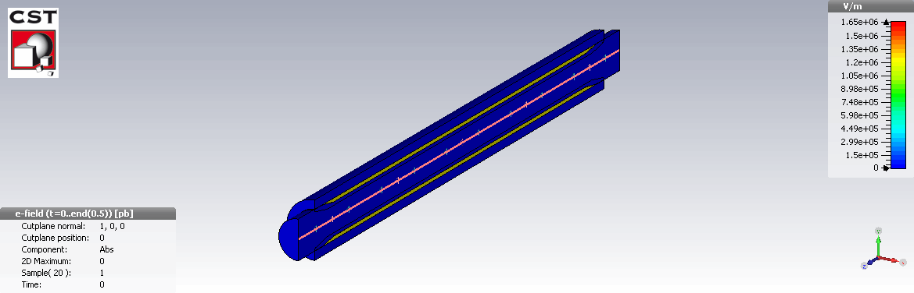
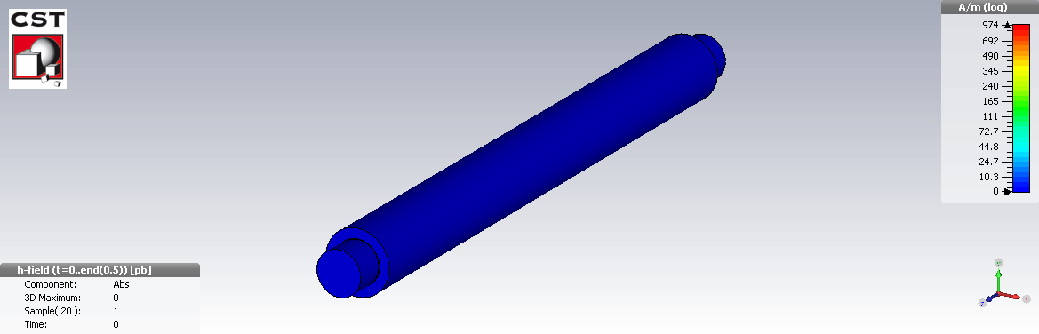
Wakefield simulation result
Position | Potential envelope
23cm | 1.74
46cm | 0.6
69cm | 0.20
92cm | 0.08
115cm | 0.05
138cm | 0.03
161cm | 0.02
total | 2.52V/pc/mm
Damping Q~36
Assuming that the particle is 0.2mm off the axis, charge is 50 nC, energy 50 MeV. Then the transverse kick is about 25.2 KeV, Which means that the divergence is about 0.5mrad. The off-axis is about 2mm if particle drifts 4m.
Now the structure is under fabrication, next step will be the RF test.
11

Slide 13
Thanks for your attention ☺

