Slide 1
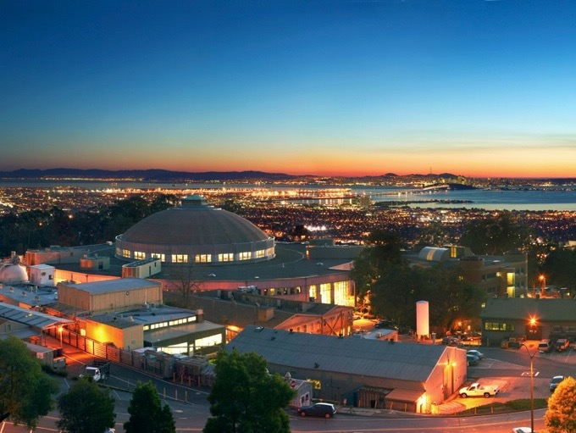
Welcome to Berkeley Lab
Natalie Roe, LBNL Physics Division Director
FCE / CCE Workshop
March 16 - 18 2016, Berkeley CA

Slide 2
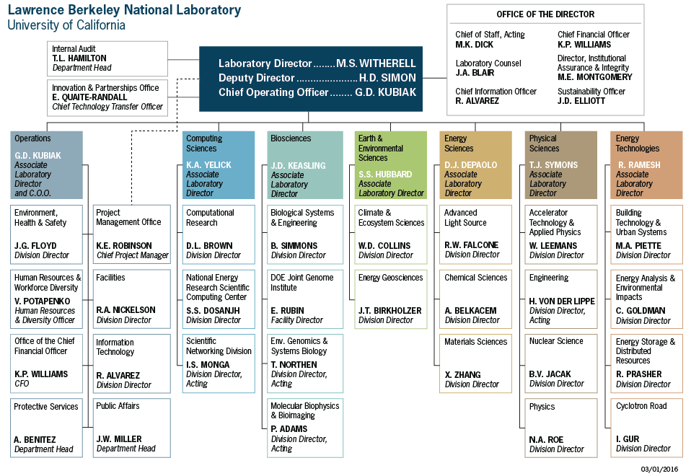
Berkeley Lab Organization
2

Slide 3
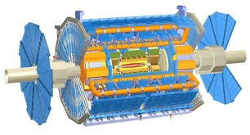
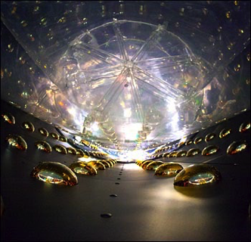
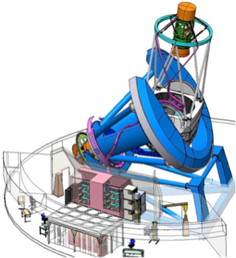
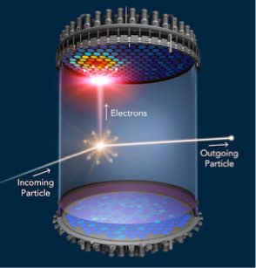
Use the Higgs boson as a new tool for discovery
P5 SCIENCE DRIVERS 2014 and the
Physics Division program
ATLAS, HL-LHC upgrades
Daya Bay => DUNE
Dark Energy - DESI
Dark Matter – LUX, LZ
CMB S4
Theory
Detector R&D
Particle Data Group
Computing
Pursue the physics associated with neutrino mass
Understand cosmic acceleration:
dark energy and inflation
PHYSICS Division
Identify the
new physics of Dark Matter
Explore the unknown: new particles, interactions, and physical principles

Slide 4
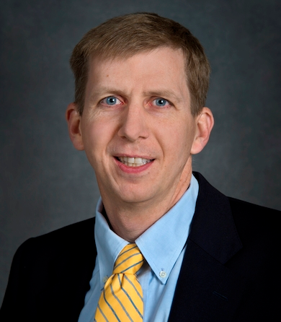
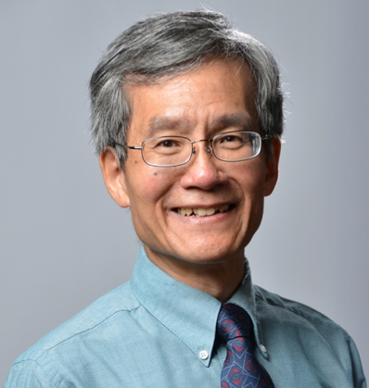
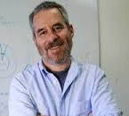
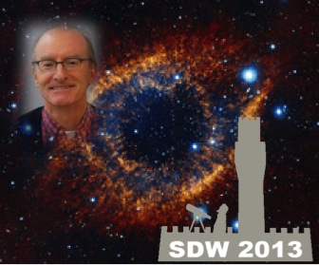
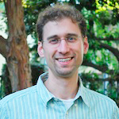
Award-Winning Science
  2015 Lawrence Award for David Schlegel
  2015 & 2016 Breakthrough Prize in Fundamental Physics
    2016 Kam-Biu Luk + DB, Kamland and SNO
    2015 Saul Perlmutter + SCP group
  2014 Panofsky Prize for Kam-Biu Luk
  2014 MacArthur Fellowship for Carl Haber
  2014 Primakoff Award for Dan Dwyer
  2013 Lifetime Achievement Award in CCDs for Physics, Astronomy, Medical and X-Ray Imaging - Stephen Holland
David Schlegel
Carl Haber
  Stephen Holland
Kam Biu Luk
Dan Dwyer

Slide 5



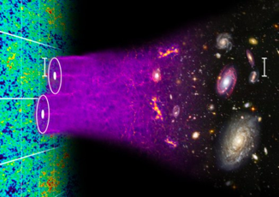

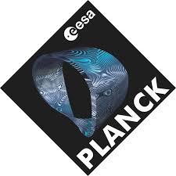




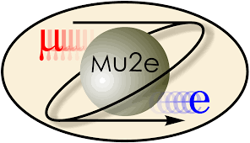

Computational HEP
CompHEP plays an integral role in all LBNL experiments:
creating and running data analysis pipelines
performing simulations to understand and constrain experimental systematics
creating UI’s to monitor and control the experiments.
SNfactory
BOSS

Slide 6
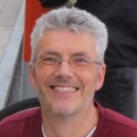
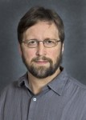
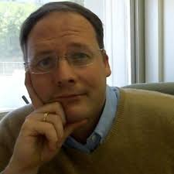

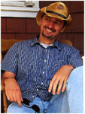
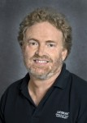
CompHEP Scientific Staff
The staff is highly leveraged among several experimental and simulation-based programs.
6 staff scientists
5 computer system engineers
3 postdocs
6 grad students
working in computational science for the Energy, Intensity and Cosmic Frontiers.
Funding spans HEP experimental programs, the joint HEP-ASCR SciDAC program, CompHEP pilots such as FCE & EASy as well as direct funding from ASCR, NASA, NSF and DOE CSGF.
Julian Borrill
Craig Tull
Peter Nugent
Paolo Calafuira
Zarija Lukić
Simon Patton

Slide 7
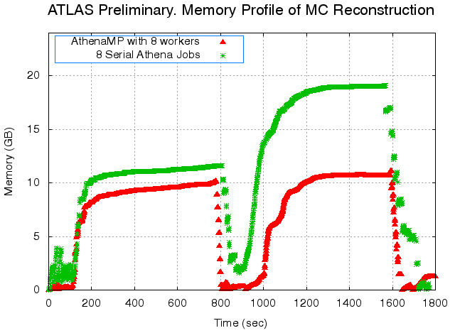
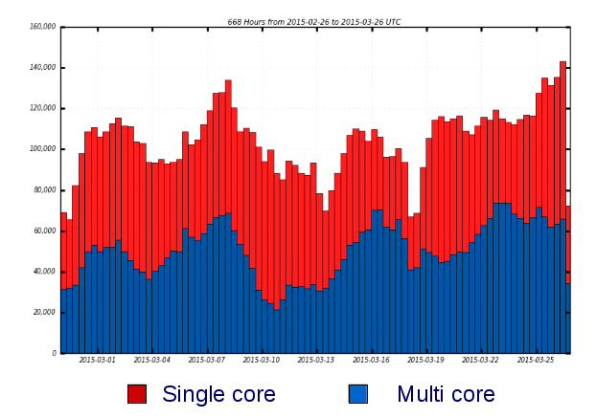
CompHEP Research Highlights
ATLAS – Demonstrated the power of AthenaMP, a multi-process version of the ATLAS reconstruction, simulation and data analysis framework Athena.
It allows the sharing of memory pages between event processors running on the same compute node with little to no change in the application code.
AthenaMP has demonstrated that it can reduce memory usage of certain ATLAS production jobs by a factor of 2.
Notes:
Top: Memory profile of MC digitization (left part of the plot) and reconstruction (right part of the plot). Note that AthenaMP using 8 cores has significantly better memory usage than 8 serial versions of Athena.
Bottom: Number of CPU-cores used by ATLAS production jobs in March 2015. Approximately half are now multi-core.

Slide 8
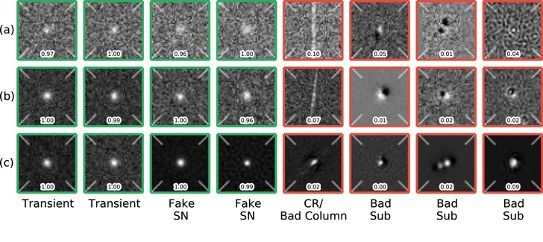
CompHEP Research Highlights
DES– Applied machine learning techniques to the DES SN discovery pipeline to reduce the human scanning load by over an order of magnitude, decrease the number of false positives by an order of magnitude, while still maintaining a high efficiency.
Critically allows the scientists to focus on their science, not deal with the mundane discovery process.
Goldstein et al. (2015)

Slide 9
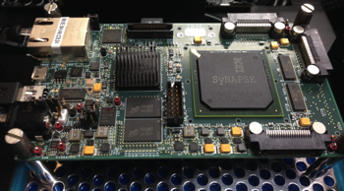
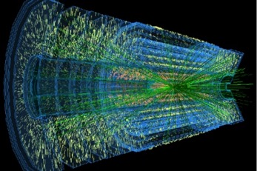
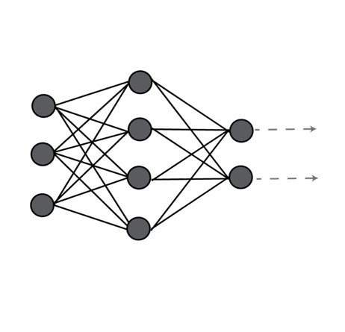
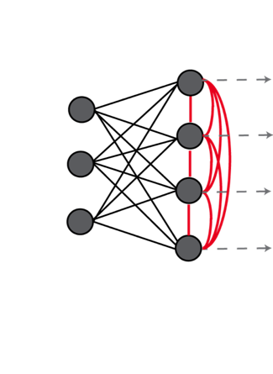
New Directions
LDRD funded – A project set up to explore the boundaries of low-energy, real-time, data-intensive processing with Neuromorphic Computing. Spans HEP, BES, ASCR, Universities and Industry.
One focus is on particle event tracking using the IBM TrueNorth chip. The chip consumes a mere 70 milliwatts, and is capable of 46 billion synaptic operations per second. Per watt–literally a synaptic supercomputer in your palm. Demo’d at SC15.
Track Model
Pattern Recognition
Kalman Filter

Slide 10

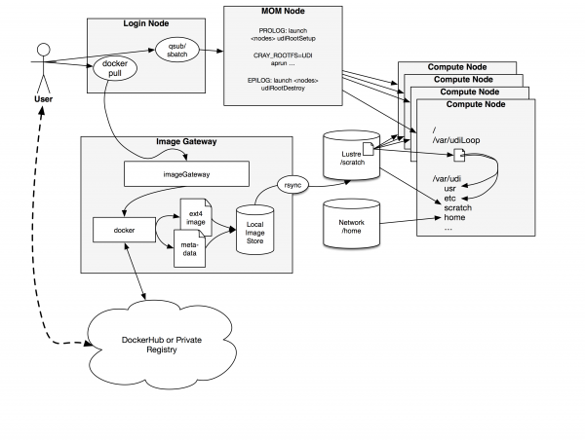
New Directions
FCE & EASy – A key step in future HEP experiments is simplifying the process for scientists to create and modify their own pipelines on HPC resources, through virtualized environments, to tackle the processing and analysis of very large data sets.
Shifter is a prototype implementation that NERSC is developing as a scalable way to deploy containers in an HPC environment for just this purpose.
Through the FCE & EASy we have been testing the use of Shifters for DES & LSST and have recently begun work on running ATLAS software (through CVMFS) on NERSC HPC resources.
Notes:
As shown in figure 1, shifter works by enabling users to pull images from a DockerHub or private docker registry. An image manager at NERSC then automatically converts the image to a common format based on an automated analysis of the image. That image is then copied to the Lustre scratch filesystem (in a system area). The user can then submit jobs specifying which image to use. Private images are only accessible by the user that authenticated and pulled them, not by the larger community. In the job the user has the ability to either run a custom batch script to perform any given command supported by the image, or if a Docker entrypoint is defined, could simply execute the entrypoint.

Slide 11
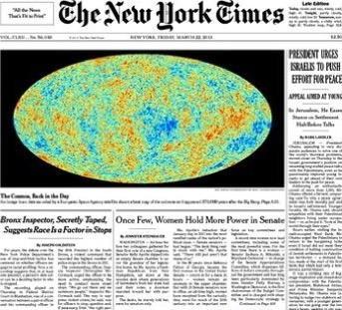
NERSC and HPC for CMB
2007:DOE/NASA MOU on Planck access to NERSC
  Center for Computational Cosmology (C3) founded
2012-2016 NERSC/C3 supports Planck data releases
    Thousands of mission realizations
    100M’s CPU-hours
CMB community allocation on NERSC continues to support analysis of data from almost all sub-orbital experiments
C3 also provides computing/data analysis projections for CMB-S4 proposal to P5
CMB-S4 will gather O(1000x) Planck data.
LBNL’s HPC expertise will be essential for CMB S4 simulations and analysis
CMB-S4

Slide 12
Conclusion
LBNL is supporting the P5 vision for HEP
Computing is an integral part of all our contributions
Best wishes for a productive workshop on the future of computing in HEP!

