Slide 1
Lustre Overview
Nirmal Seenu
Fermilab

Slide 2
Lustre Features
Shared POSIX file system
Key Characteristics
  Aggregates many servers into one file system
  Scales I/O throughput and capacity
  Handles 10,000’s of clients
Built-in storage networking, including routing
No special hardware required
  Any block device is supported as backend storage
Open source

Slide 3
Lustre Components
Management Server(MGS)
  The MGS stores configuration information for all Lustre file systems in a cluster
  Each Lustre target contacts the MGS to provide information, and Lustre clients contact the MGS to retrieve information
  The MGS requires its own disk for storage, but it could be collocated with a MDT
  Multiple Lustre file systems can be managed by a single MGS

Slide 4
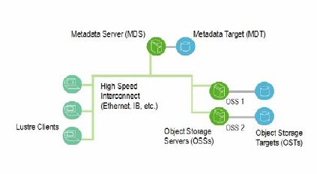
Lustre Components…
Metadata Server(MDS)
  It makes metadata available to Lustre clients via MDT
  Each MDS manages the names and directories in the file system, and provides the network request handling for one or more local MDTs
  It is possible to configure multiple MDTs on the same MDS but it is not recommended
Metadata Target(MDT)
  The MDT stores metadata (such as filenames, directories, permissions and file layout) on an MDS
  There can be only one MDT per file system

Slide 5
Lustre Components…
Object Storage Servers(OSS)
  The OSS provides file I/O service, and network request handling for one or more local OSTs
Object Storage Target(OST)
  The OST stores file data
  A single Lustre file system can have multiple OSTs, each serving a subset of file data
  To optimize performance, a file may be spread over many OSTs. A Logical Object Volume (LOV), manages file striping across many OSTs

Slide 6
Lustre Components…
Lustre Clients
  The Lustre client software consists of an interface between the Linux Virtual File System and the Lustre servers
  Each target has a client counterpart: Metadata Client (MDC), Object Storage Client (OSC), and a Management Client (MGC)
  A group of OSCs are wrapped into a single LOV, and they provide transparent access to the file system
  Clients which mount the Lustre file system see a single, coherent, synchronized namespace at all times
  Different clients can write to different parts of the same file at the same time, while other clients can read from the file

Slide 7
Lustre Components…
Lustre Networking (LNET)
  It is an API that handles metadata and file I/O data for file system servers and clients
  It supports multiple, heterogeneous interfaces on clients and servers
  Lustre Network Drivers (LNDs) are available for a number of commodity and high-end networks, including TCP/IP, Infiniband, Myrinet (MX and GM) and Cray

Slide 8
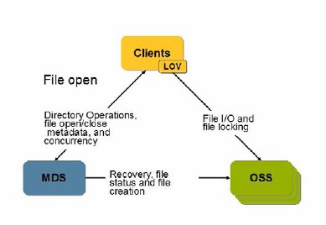
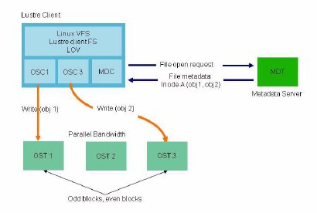
File open and file I/O

Slide 9
Additional Lustre Features
Interoperability
  Lustre runs on many CPU architectures (x86, IA-64, x86-64 (EM64 and AMD64, Power PC architectures [clients only], and mixed-endian clusters; clients and servers are interoperable between these platforms
  Lustre supports various distributions of Linux
  Lustre provides interoperability between adjacent software releases. Versions 1.4.x (x > 7), 1.6.x, and 1.8.x can interoperate with mixed clients and servers
Access control list (ACL)
  The Lustre security model follows a UNIX file system, enhanced with POSIX ACLs
  It supports root squash and restriction of connections to privileged ports
Quotas
  User and group quotas
OSS addition
  The capacity of a Lustre file system and aggregate cluster bandwidth can be increased without interrupting any operations by adding a new OSS with OSTs to the cluster

Slide 10
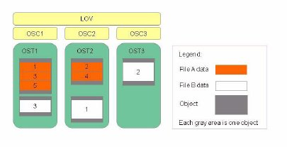
Striping
A RAID 0 pattern, in which data is "striped" across a certain number of objects
  the number of objects is called the stripe_count
Each object contains "chunks” of data
When the "chunk" being written to a particular object exceeds the stripe_size, the next "chunk" of data in the file is stored on the next target

Slide 11
Stripping…
Controlled striping
  The file system has a default setting that is determined at format time
  The default stripe count and stripe size can be tuned
    Directories can be given an attribute so that all files under that directory (and recursively under any sub-directory) have a striping pattern determined by the attribute
    Utilities and application libraries are provided to control the striping of an individual file at creation time
  To change the stripe of a current file
    Create a new directory with required stripe setting
    Copy the file into the new directory
    Move it back to the original location

Slide 12
Installing Lustre Servers
Download the Lustre patched kernel from SUN’s website. Typical installation needs the following rpms
  kernel-lustre-smp-2.6.18-92.1.17.el5_lustre.1.6.7.1.x86_64
  kernel-lustre-source-2.6.18-92.1.17.el5_lustre.1.6.7.1.x86_64
  lustre-modules-1.6.7.1-2.6.18_92.1.17.el5_lustre.1.6.7.1smp.x86_64
  lustre-ldiskfs-3.0.7.1-2.6.18_92.1.17.el5_lustre.1.6.7.1smp.x86_64
  lustre-source-1.6.7.1-2.6.18_92.1.17.el5_lustre.1.6.7.1smp.x86_64
  kernel-ib-1.3.1-2.6.18_92.1.17.el5_lustre.1.6.7.1smp.x86_64
  kernel-ib-devel-1.3.1-2.6.18_92.1.17.el5_lustre.1.6.7.1smp.x86_64
  lustre-1.6.7.1-2.6.18_92.1.17.el5_lustre.1.6.7.1smp.x86_64
Patch the vanilla kernel.org kernel
  Download the supported kernel.org kernel
  Download the Lustre Source
  Install quilt and patch the kernel as described in Lustre Manual

Slide 13
Formatting Lustre Servers
Format the MGS partition
  Its recommended that you create a small(1 GB) MGS partition
    Multiple Lustre file systems can be managed by a single MGS
  mkfs.lustre --mgs --mkfsoptions="-m 0“ /dev/md2
  tune2fs -m 0 -i 0 -c 0 /dev/md2
Format the MDT partition
  mkfs.lustre --fsname=lqcdproj --mdt --mgsnode=iblustre1@tcp1 --param lov.stripecount=1 --mkfsoptions="-m 0" /dev/lustre1_volume/mds_lv
  tune2fs -m 0 -i 0 -c 0 /dev/lustre1_volume/mds_lv
Format all the OSTs
  mkfs.lustre --fsname=lqcdproj --mkfsoptions="-m 0" --ost --mgsnode=iblustre1@tcp1 --param ost.quota_type=ug /dev/sdc1
  tune2fs -m 0 -i 0 -c 0 /dev/sdc1

Slide 14
Lustre Server and Client Options
The default options are specified as a part of mkfs.lustre command
  It can be tuned later with tunefs.lustre if needed
  tune2fs can be used for ext3 tuning
The run time options are specified in /etc/modprobe.conf
  options lnet networks=tcp(eth1)
  options ksocklnd tx_buffer_size=1073741824 rx_buffer_size=1073741824 enable_irq_affinity=1
Lustre Client mount options are specified in /etc/fstab
  lustre3@tcp:/lustre /lustre lustre defaults,flock,_netdev
Live parameter tuning can be done using the lctl command
  lctl conf_param lustre.sys.timeout=600
  These changes get pushed out to all the clients and they are persistent

Slide 15
Installing Lustre Clients
Client RPMs are available for certain kernels
Patchless clients are easy to build from source
  No reboot of worker nodes is required
  Typical lustre client install process
    ./configure --disable-server --enable-adaptive-timeouts --disable-snmp --with-linux=/usr/src/kernels/2.6.18-128.1.10.el5-x86_64
    make
    make install
    depmod –a
    mount –t lustre –o flock lustre3@tcp:/lustre /lustre

Slide 16
Hardware requirements
Stable server hardware
  1 or 2 GB memory / core
    Memory requirement depends on the number of outstanding locks
If using GigE networks, Intel GigE cards are recommended
  Lustre easily triggers most of the Ethernet card/driver bugs
  Interrupt coalescing had to be enabled on Nvidia Ethernet cards

Slide 17
Storage Device Configuration
Software RAID1 for MGS and MDT partition
  MGS and MDT are LVM volumes on Software RAID partitions
OST: Nexsan SATABeast
  42 One-TB Disks
  3 RAID6 volumes (12/14)
  Four 3TB LUNS on each RAID volume
  Battery backup on RAID controllers
    Enable write through(disable write cache) if there is no battery backup on the RAID controller
  SATABeast has two 4Gbps fibre channel ports
    All LUNs are visible on both ports
Two servers(OSS) are connected to each SATABeast
  6 OSTs are served by each OSS under normal operation
  12 OSTs can be served by one of the two OSSs on a server failure

Slide 18
LQCD Lustre Server Configuration
Single socket Intel Xeon Quad Core
  E5420 @ 2.50GHz
  4 GB RAM
  Supermicro X7DBU motherboards
  Intel 80003ES2LAN Gigabit Ethernet Controller
  Mellanox MT25204 [InfiniHost III Lx HCA]
    IPoIB and native IB are used
  QLogic QLE2460 4Gb Fibre Channel

Slide 19
LQCD Lustre Server Configuration

Slide 20
CC Lustre Server Configuration
Dual socket AMD Barcelona Quad Core
  AMD Opteron 2350 @ 2 GHz
  16 GB RAM
  Supermicro H8DMT motherboards
  nVidia MCP55 Ethernet
  QLogic QLE2460 4Gb Fibre Channel

Slide 21
CC Clustre Lustre Architecture

Slide 22
Backup
Metadata backup
  Our Metadata servers are 40GB(unformatted) in size
    The unused portions of the disk was ‘zero’ed out to enable better compression
    dd if=/dev/zero of=/mnt/mdt/tmp/gbfile bs=128k count=8192
  Create the LVM Snapshots
    /usr/sbin/lvcreate -L40G -s -n mdtsnapshot /dev/lustre1_volume/mds_lv
  Create the Backup Image for MDT
    /bin/dd if=/dev/lustre1_volume/mdtsnapshot | gzip -c > /mnt/mdtbackup/mdt-backup.img.gz
  Remove the Snapshot
    /usr/sbin/lvremove -f /dev/lustre1_volume/mdtsnapshot >> $LOGFILE 2>&1
User data Backup
  Its hard to take a valid/consistent snapshot across all OSTs
  Done from a lustre client using regular backup tools

Slide 23
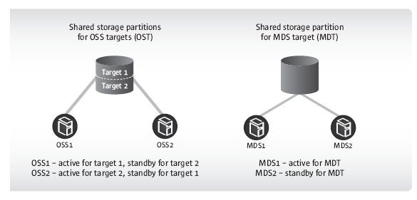
High Availability and Rolling Upgrades
This failover mechanism, in conjunction with software that offers interoperability between versions, is used to support rolling upgrades of file system software on active clusters
Lustre MDSs are configured as an active/passive pair
OSSs are typically deployed in an active/active configuration that provides redundancy without extra overhead

Slide 24
Scalability and Performance
LQCD - Lustre file system has ~2000 clients running with IPoIB without any problem
  Mounting ~2000 clients takes a few seconds
  Un-mounting clients takes a little longer depending on the usage pattern on the clients
  Performance is limited by the amount of data that can be transferred in and out of SATABeast
CC – Lustre file system
  Performance is limited by the GigE network

Slide 25
Data Safety and Replication
The client-OST connection guarantees data integrity
Clients caches transactions and replays failed transactions if needed
Client cache is released on write acknowledgement from the MDS
No support for data replication. It might be available in the future versions

Slide 26
Monitoring and Admin tools
Statistics and health information is available in the /proc file system on Lustre Server and Clients:
  /proc/sys/lustre
  /proc/fs/lustre
“lfs check servers” list the status of all servers
Checking for the presence of a file on the lustre client seems to be sufficient in most cases.
Periodic checking for “Call Trace” in the dmesg output.

Slide 27
Bestman Installation
Lqcsrm is the Bestman/GridFTP server
  This hardware is the same as the LQCD Lustre servers
  lustre client is mounted on this node at /lqcdproj
Use pacman to install Bestman
  pacman -get http://vdt.cs.wisc.edu/vdt_11098_cache:Bestman
Configure the certificate update script
Configure PRIMA
Configure Bestman
  ./vdt/setup/configure_bestman --server y --user daemon --cert /etc/grid-security/osg-se/hostcert.pem --key /etc/grid-security/osg-se/hostkey.pem --gums-host gums.fnal.gov --gums-port 8443 --gums-dn /DC=org/DC=doegrids/OU=Services/CN=lqcdsrm.fnal.gov --enable-gateway --with-transfer-servers gsiftp://lqcdsrm.fnal.gov --with-allowed-paths=/lqcdproj;/scratch --globus-tcp-port-range 40000,41000 --http-port 8080 --https-port 8443 -cksm_type=null

Slide 28
Backup Slides

Slide 29
e2fsck and lfsck
e2fsck is used to recover journals and to verify the integrity of the LDISKFS file system on MGS, MDT and OST partitions
  It takes about 15 minutes to check a 3TB partition
lfsck is used to verify that the data on MDT matches the data on the OSTs and vice versa
  Run “e2fsck –f” on MDT and all OSTs
  Run “e2fsck” again to create a MDS Database
  Push mdtdb file to all the OSSs and create a OST database file using the mdtdb file
  Push all the mdtdb file and ostdb files to client and run lfsck on the client using all the db files as input
  Its highly recommended to do a dry run (“lfsck –n”) before making permanent changes

Slide 30
/proc/sys/lustre
[root@lustre3 lustre]# ls -l
-rw-r--r-- 1 root root 0 Jun 12 10:29 alloc_fail_rate
-rw-r--r-- 1 root root 0 Jun 12 10:29 debug_peer_on_timeout
-rw-r--r-- 1 root root 0 Jun 12 10:29 dump_on_eviction
-rw-r--r-- 1 root root 0 Jun 12 10:29 dump_on_timeout
-rw-r--r-- 1 root root 0 Jun 12 10:29 fail_loc
-rw-r--r-- 1 root root 0 Jun 12 10:29 fail_val
-rw-r--r-- 1 root root 0 Jun 12 10:29 ldlm_timeout
-rw-r--r-- 1 root root 0 Jun 12 10:29 max_dirty_mb
-r--r--r-- 1 root root 0 Jun 12 10:29 memused
-r--r--r-- 1 root root 0 Jun 12 10:29 memused_max
-r--r--r-- 1 root root 0 Jun 12 10:29 pagesused
-r--r--r-- 1 root root 0 Jun 12 10:29 pagesused_max
-rw-r--r-- 1 root root 0 Jun 12 10:29 timeout

Slide 31
/proc/fs/lustre
[root@lustre3 lustre]# ls -l
-r--r--r-- 1 root root 0 Jun 12 10:28 devices
-r--r--r-- 1 root root 0 Jun 12 10:28 health_check
dr-xr-xr-x 4 root root 0 Jun 12 10:28 ldlm
dr-xr-xr-x 2 root root 0 Jun 12 10:28 llite
dr-xr-xr-x 3 root root 0 Jun 12 10:28 lov
dr-xr-xr-x 9 root root 0 Jun 12 10:28 lquota
dr-xr-xr-x 2 root root 0 Jun 12 10:28 mdc
dr-xr-xr-x 3 root root 0 Jun 12 10:28 mds
dr-xr-xr-x 3 root root 0 Jun 12 10:28 mdt
dr-xr-xr-x 3 root root 0 Jun 12 10:28 mgc
dr-xr-xr-x 3 root root 0 Jun 12 10:28 mgs
dr-xr-xr-x 8 root root 0 Jun 12 10:28 obdfilter
dr-xr-xr-x 26 root root 0 Jun 12 10:28 osc
dr-xr-xr-x 3 root root 0 Jun 12 10:28 ost
-r--r--r-- 1 root root 0 Jun 12 10:28 pinger
-r--r--r-- 1 root root 0 Jun 12 10:28 version

Slide 32
/proc/fs/lustre/obdfilter/lustre-OST0012
[root@lustre3 lustre-OST0012]# ls –l
-r--r--r-- 1 root root 0 Jun 12 10:38 blocksize
-r--r--r-- 1 root root 0 Jun 12 10:38 brw_stats
-rw-r--r-- 1 root root 0 Jun 12 10:38 client_cache_count
-rw-r--r-- 1 root root 0 Jun 12 10:38 client_cache_seconds
--w------- 1 root root 0 Jun 12 10:38 evict_client
dr-xr-xr-x 129 root root 0 Jun 12 10:38 exports
-r--r--r-- 1 root root 0 Jun 12 10:38 filegroups
-r--r--r-- 1 root root 0 Jun 12 10:38 filesfree
-r--r--r-- 1 root root 0 Jun 12 10:38 filestotal
-r--r--r-- 1 root root 0 Jun 12 10:38 fstype
-r--r--r-- 1 root root 0 Jun 12 10:38 hash_stats
-r--r--r-- 1 root root 0 Jun 12 10:38 kbytesavail
-r--r--r-- 1 root root 0 Jun 12 10:38 kbytesfree
-r--r--r-- 1 root root 0 Jun 12 10:38 kbytestotal
-r--r--r-- 1 root root 0 Jun 12 10:38 last_id
-r--r--r-- 1 root root 0 Jun 12 10:38 mntdev
-r--r--r-- 1 root root 0 Jun 12 10:38 num_exports
-rw-r--r-- 1 root root 0 Jun 12 10:38 quota_btune_sz
-rw-r--r-- 1 root root 0 Jun 12 10:38 quota_bunit_sz
-rw-r--r-- 1 root root 0 Jun 12 10:38 quota_itune_sz
-rw-r--r-- 1 root root 0 Jun 12 10:38 quota_iunit_sz
-rw-r--r-- 1 root root 0 Jun 12 10:38 quota_switch_seconds
-rw-r--r-- 1 root root 0 Jun 12 10:38 quota_type
-rw-r--r-- 1 root root 0 Jun 12 10:38 readcache_max_filesize
-r--r--r-- 1 root root 0 Jun 12 10:38 recovery_status
-rw-r--r-- 1 root root 0 Jun 12 10:38 stats
-r--r--r-- 1 root root 0 Jun 12 10:38 tot_dirty
-r--r--r-- 1 root root 0 Jun 12 10:38 tot_granted
-r--r--r-- 1 root root 0 Jun 12 10:38 tot_pending
-r--r--r-- 1 root root 0 Jun 12 10:38 uuid

Slide 33
/proc/fs/lustre/obdfilter/lustre-OST0012/brw-stats
snapshot_time: 1244821207.889622 (secs.usecs)
read | write
pages per bulk r/w rpcs % cum % | rpcs % cum %
1: 187354 32 32 | 40670 6 6
2: 1386 0 32 | 6336 1 7
4: 1889 0 32 | 2122 0 8
8: 3739 0 33 | 2141 0 8
16: 5429 0 34 | 5452 0 9
32: 5688 0 35 | 10761 1 11
64: 7537 1 36 | 23962 3 14
128: 9117 1 38 | 41612 6 21
256: 359654 61 100 | 476572 78 100
read | write
disk I/O size ios % cum % | ios % cum %
4K: 53222 11 11 | 44097 5 5
8K: 1962 0 12 | 11202 1 7
16K: 2080 0 12 | 12409 1 8
32K: 3842 0 13 | 6593 0 9
64K: 5571 1 14 | 16624 2 11
128K: 5943 1 16 | 29349 3 15
256K: 7897 1 17 | 132621 16 32
512K: 9562 2 20 | 113189 14 46
1M: 359423 79 100 | 423307 53 100
read | write
I/O time (1/1000s) ios % cum % | ios % cum %
1: 143005 24 24 | 74850 12 12
2: 1301 0 24 | 51740 8 20
4: 40928 7 31 | 265027 43 64
8: 176144 30 62 | 130869 21 85
16: 71121 12 74 | 56747 9 95
32: 82984 14 88 | 21602 3 98
64: 52322 8 97 | 4906 0 99
128: 12021 2 99 | 2180 0 99
256: 1628 0 99 | 1008 0 99
512: 285 0 99 | 587 0 99
1K: 47 0 99 | 85 0 99
2K: 7 0 100 | 20 0 99
4K: 0 0 100 | 7 0 100

Slide 34
Upgrade Experiences…
A clean shutdown of all Lustre servers and clients is preferred on upgrades
  Automatic recovery process take a long time if clients weren’t shutdown cleanly
  Recovery process can be cancelled
    All the cached transactions on the client side are cancelled

Slide 35
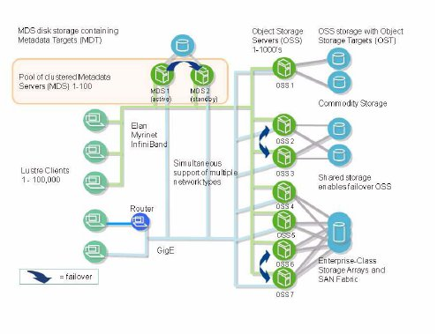
Lustre Architecture

Slide 36
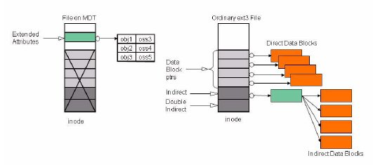
File on MDT
MDS inodes point to objects, ext3 inodes point to data

Slide 37
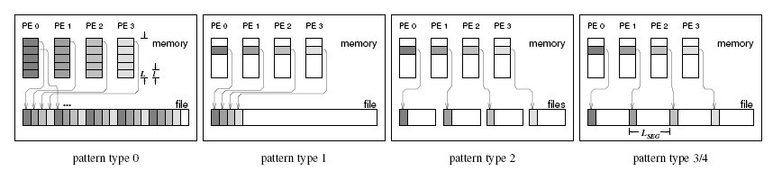
B_eff_io Pattern Details
Access methods:
  initial write
  Rewrite
  Read
Transfer Patterns
  (0) striped collective access, scattering large chunks in memory with size “L “each with one MPI-I/O call to/from disk chunks with size “l”
  (1) striped collective access, but one read or write call per disk chunk
  (2) noncollective access to one file per MPI process, i.e., on separated files
  (3) same as (2), but the individual files are assembled to one segmented file
  (4) same as (3), but the access to the segmented file is done with collective routines

Slide 38
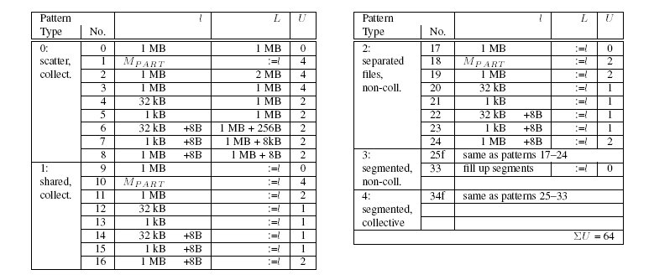
Pattern Sizes

Slide 39
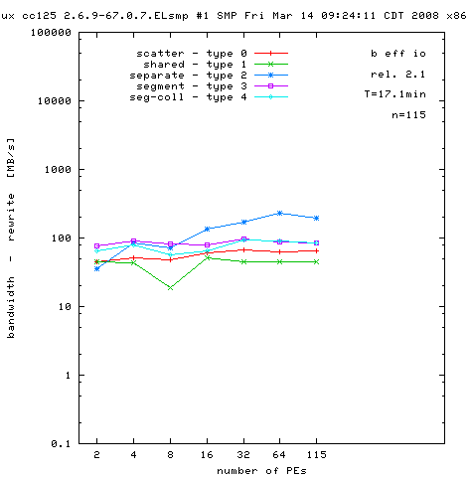
CC Lustre Effective I/O Bandwidth benchmark

Slide 40
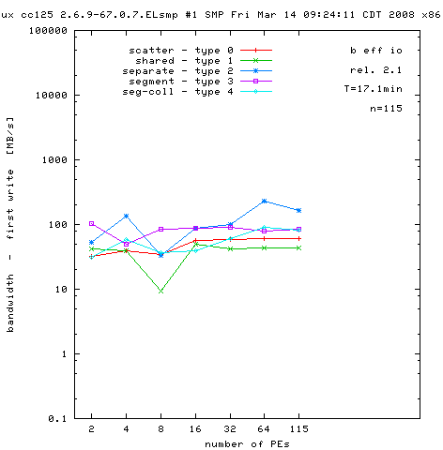
CC Lustre b_eff_io …

Slide 41
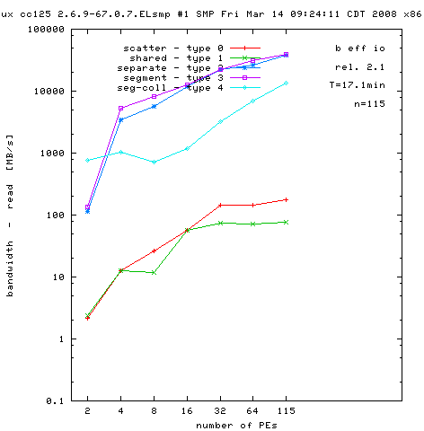
CC Lustre b_eff_io…

