Slide 1

U.S. Particle Physics
(focus on activities supported by DOE Office of High Energy Physics) and its connection to the Japan – U.S. Program ………
January 17 (U.S.) / January 18 (Japan), 2013
Young-Kee Kim
on behalf of the U.S. working group team

Slide 2
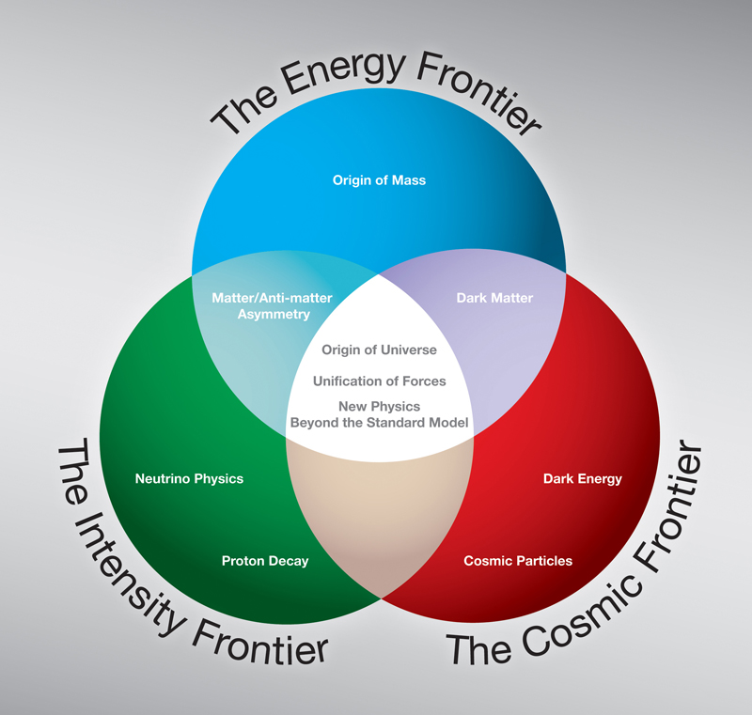
U.S. Particle Physics
Theory
Computing
Detector R&D
Accelerator R&D

Slide 3
Energy Frontier
Tevatron was shut down on September 30, 2011; the analysis will continue for several years.
Expect to continue exploiting the LHC this decade. The LHC (accelerator and detectors) has been one of the largest investments by the US-HEP ever.
Evaluating the case for contributions to the High Luminosity LHC, including both accelerator and detector upgrades.
Snowmass process will examine long-term priorities and strategies for Higgs Factories or higher energy machines
  U.S. has made R&D investments for several of possible options, most notably the ILC, but also the muon collider and CLIC

Slide 4
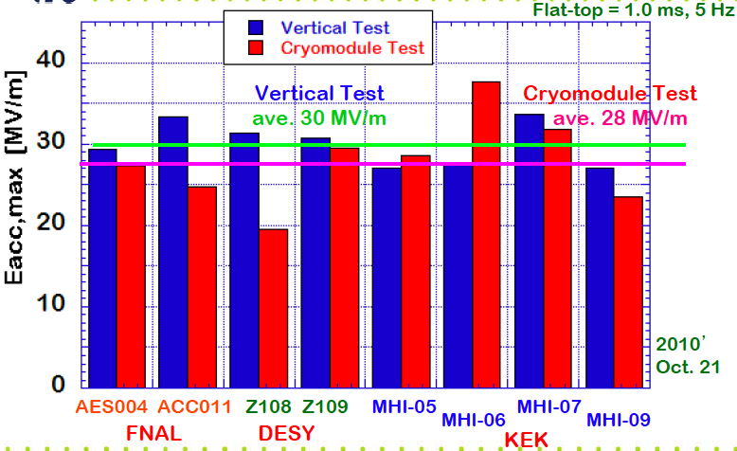
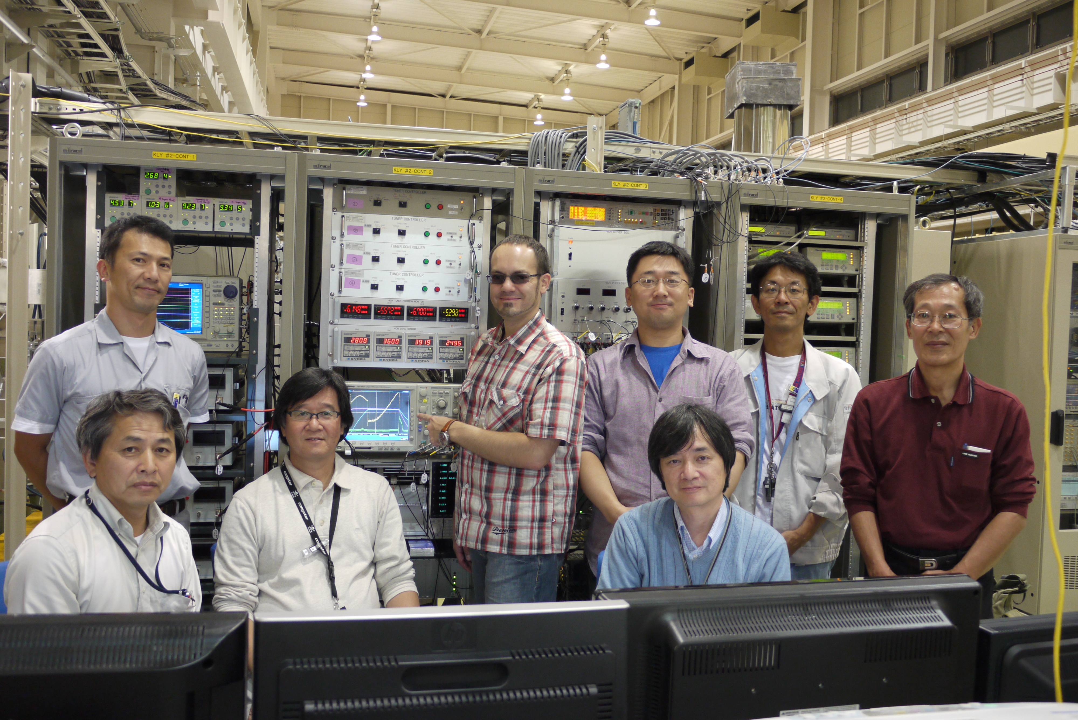
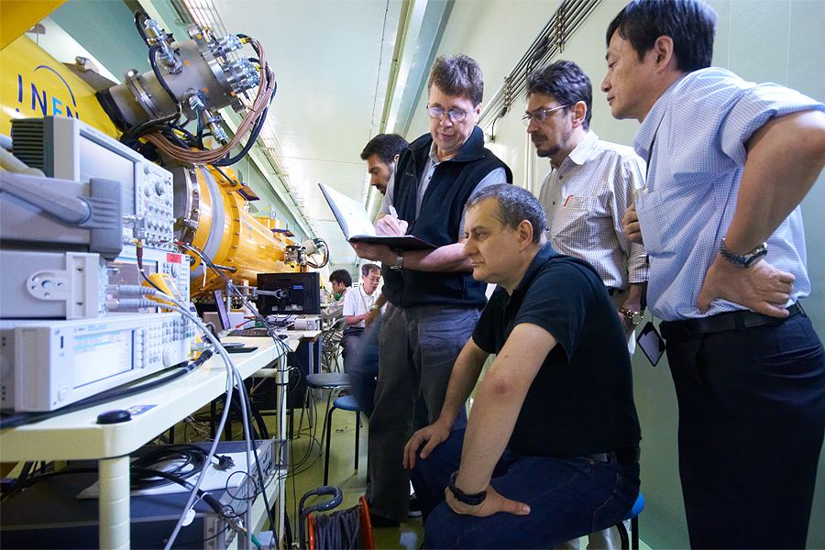
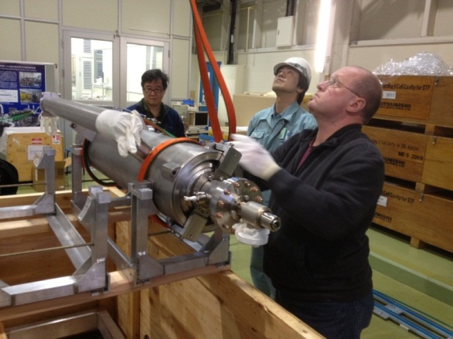
Energy Frontier: ILC
Vertical cavity test
• CW low power test
reached: < 30 MV/m >
S1-Global cryomodule
• 1ms, 5 Hz pulse
Individual test reaching:
< 28 MV/m＞
ATF / ATF2
• BPM, instrumentation, R&D

Slide 5
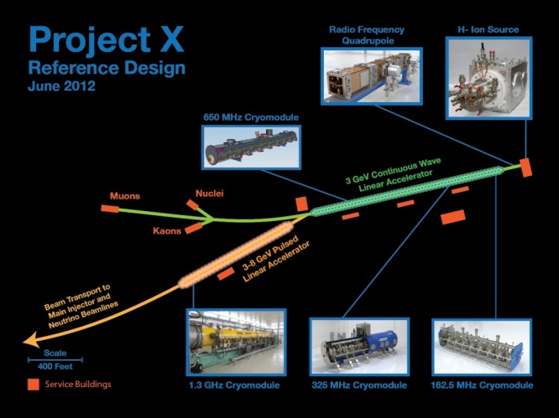

Energy Frontier
ILC technology is aligned with Project X → continue relevant SRF R&D program.
If we ultimately need several TeV, we will need either CLIC or a Muon Collider. Most US effort is on studying the feasibility of the muon collider (MAP). Both are formidable enterprises
Energy upgrade of LHC (energy doubler): The U.S. program is carrying out the R&D program on Nb₃Sb in collaboration with CERN
1.3 GHz ILC Cryomodule

Slide 6
Energy Frontier and Intensity Frontier
Experimental reach (model dependent)
Proton Decays
Intensity
Frontier
Neutrinos
Charged Leptons
Indirectly
Directly
Quarks
Connection
Energy
Frontier
LHC
Tevatron
1 3 5 Log (Energy [GeV]) 13 15 17

Slide 7
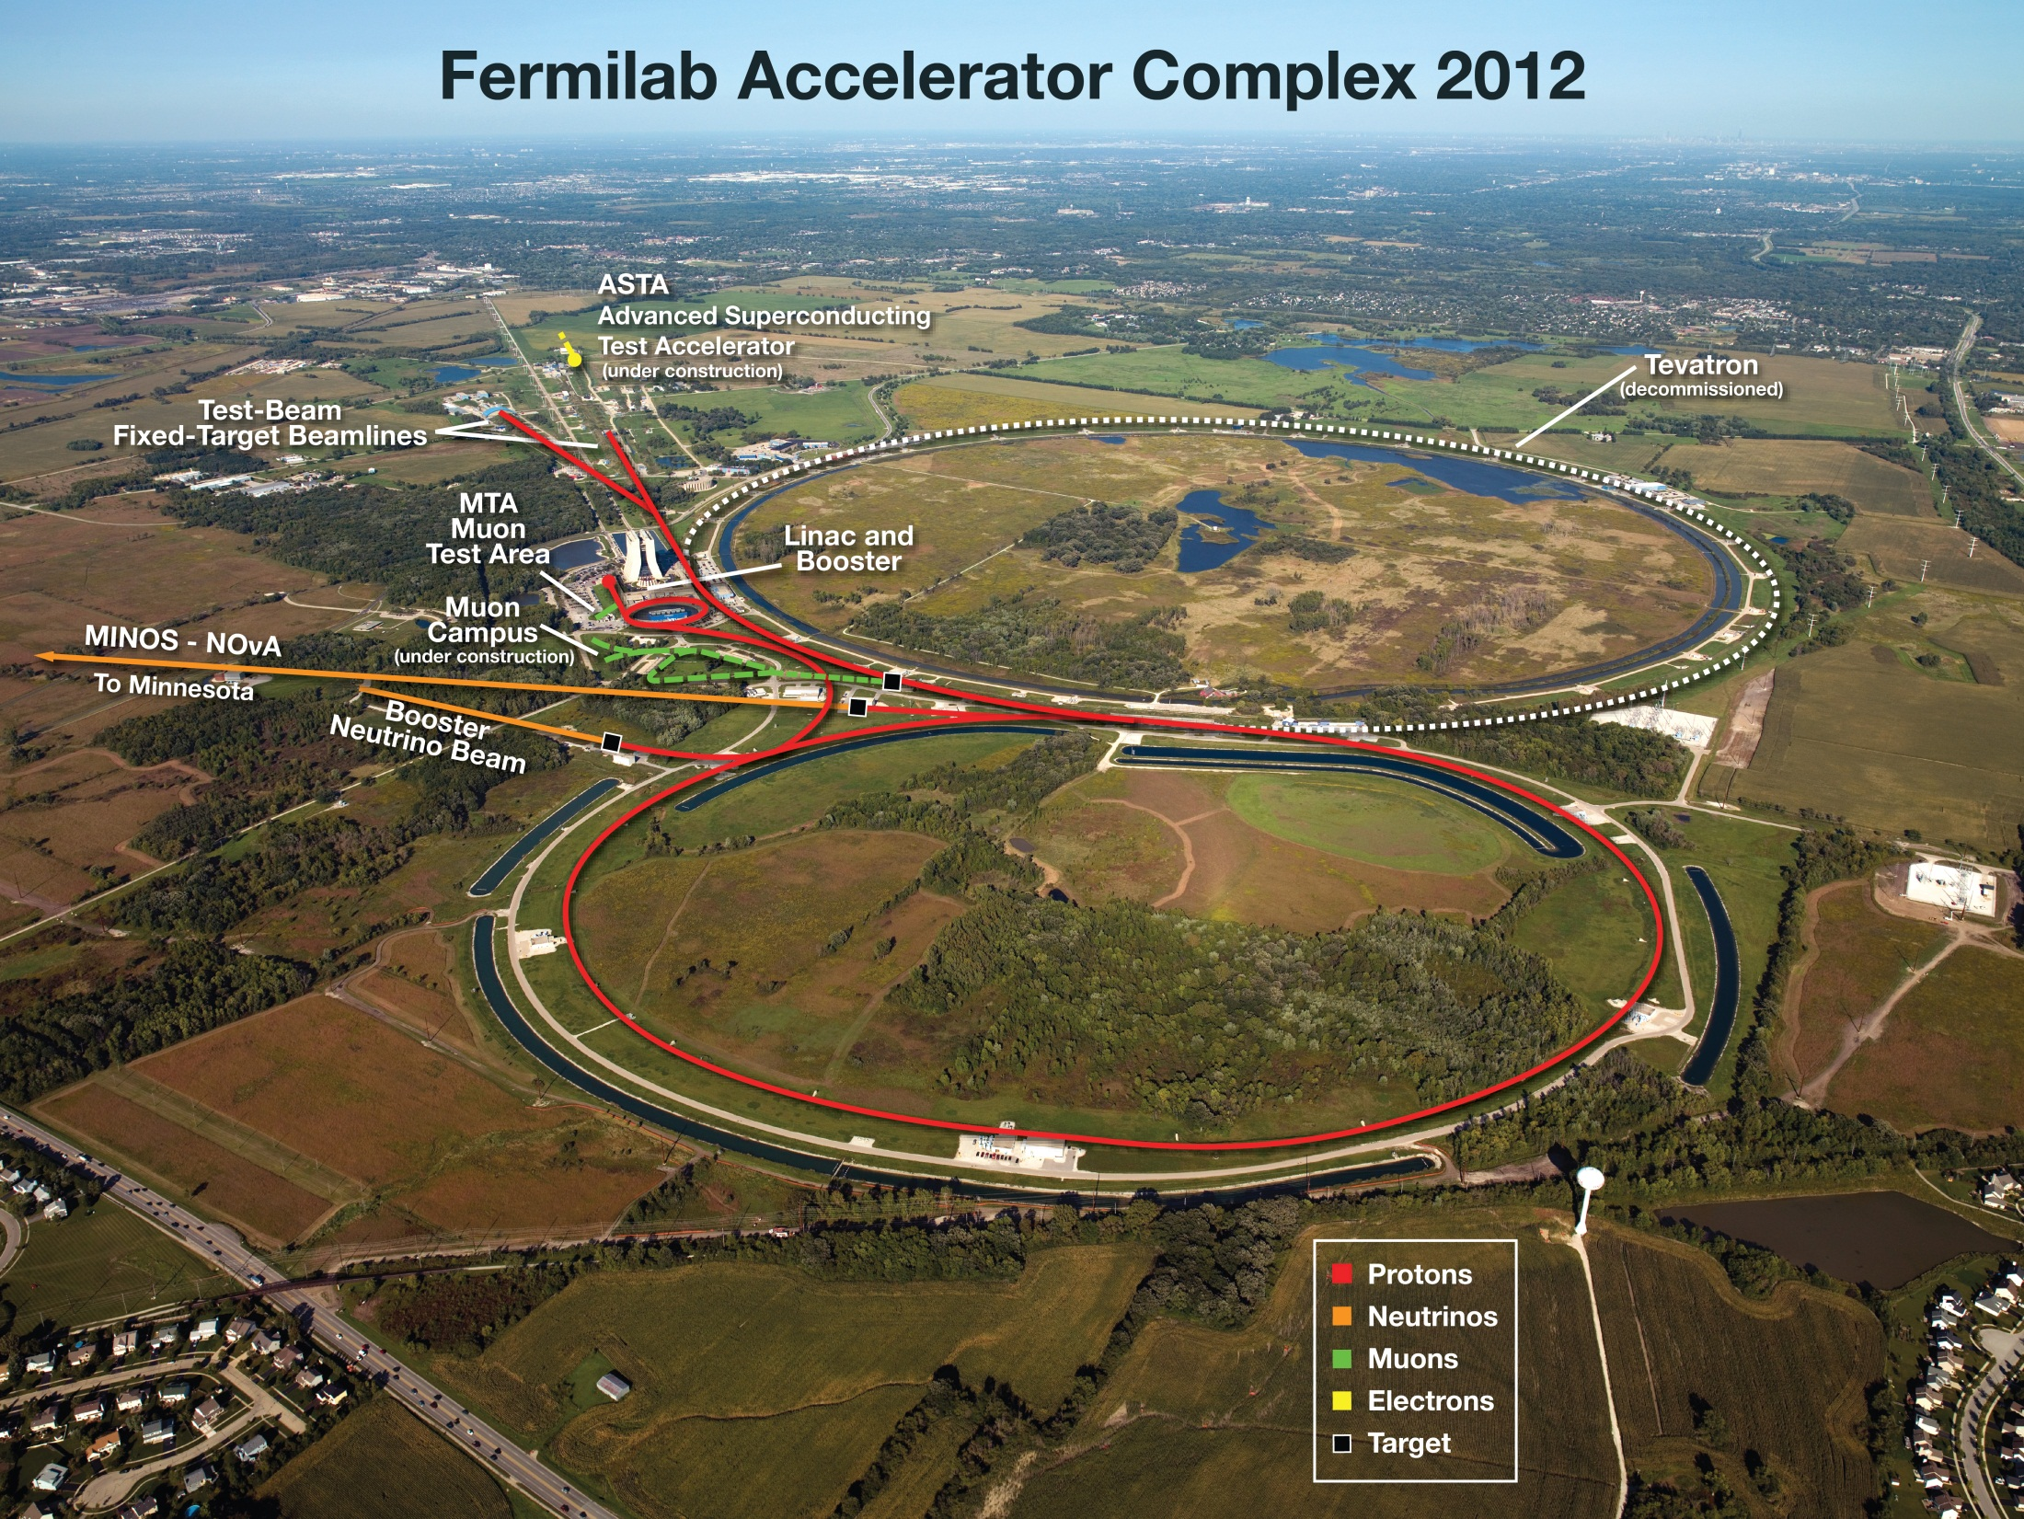
Intensity Frontier (current accelerator complex)

Slide 8
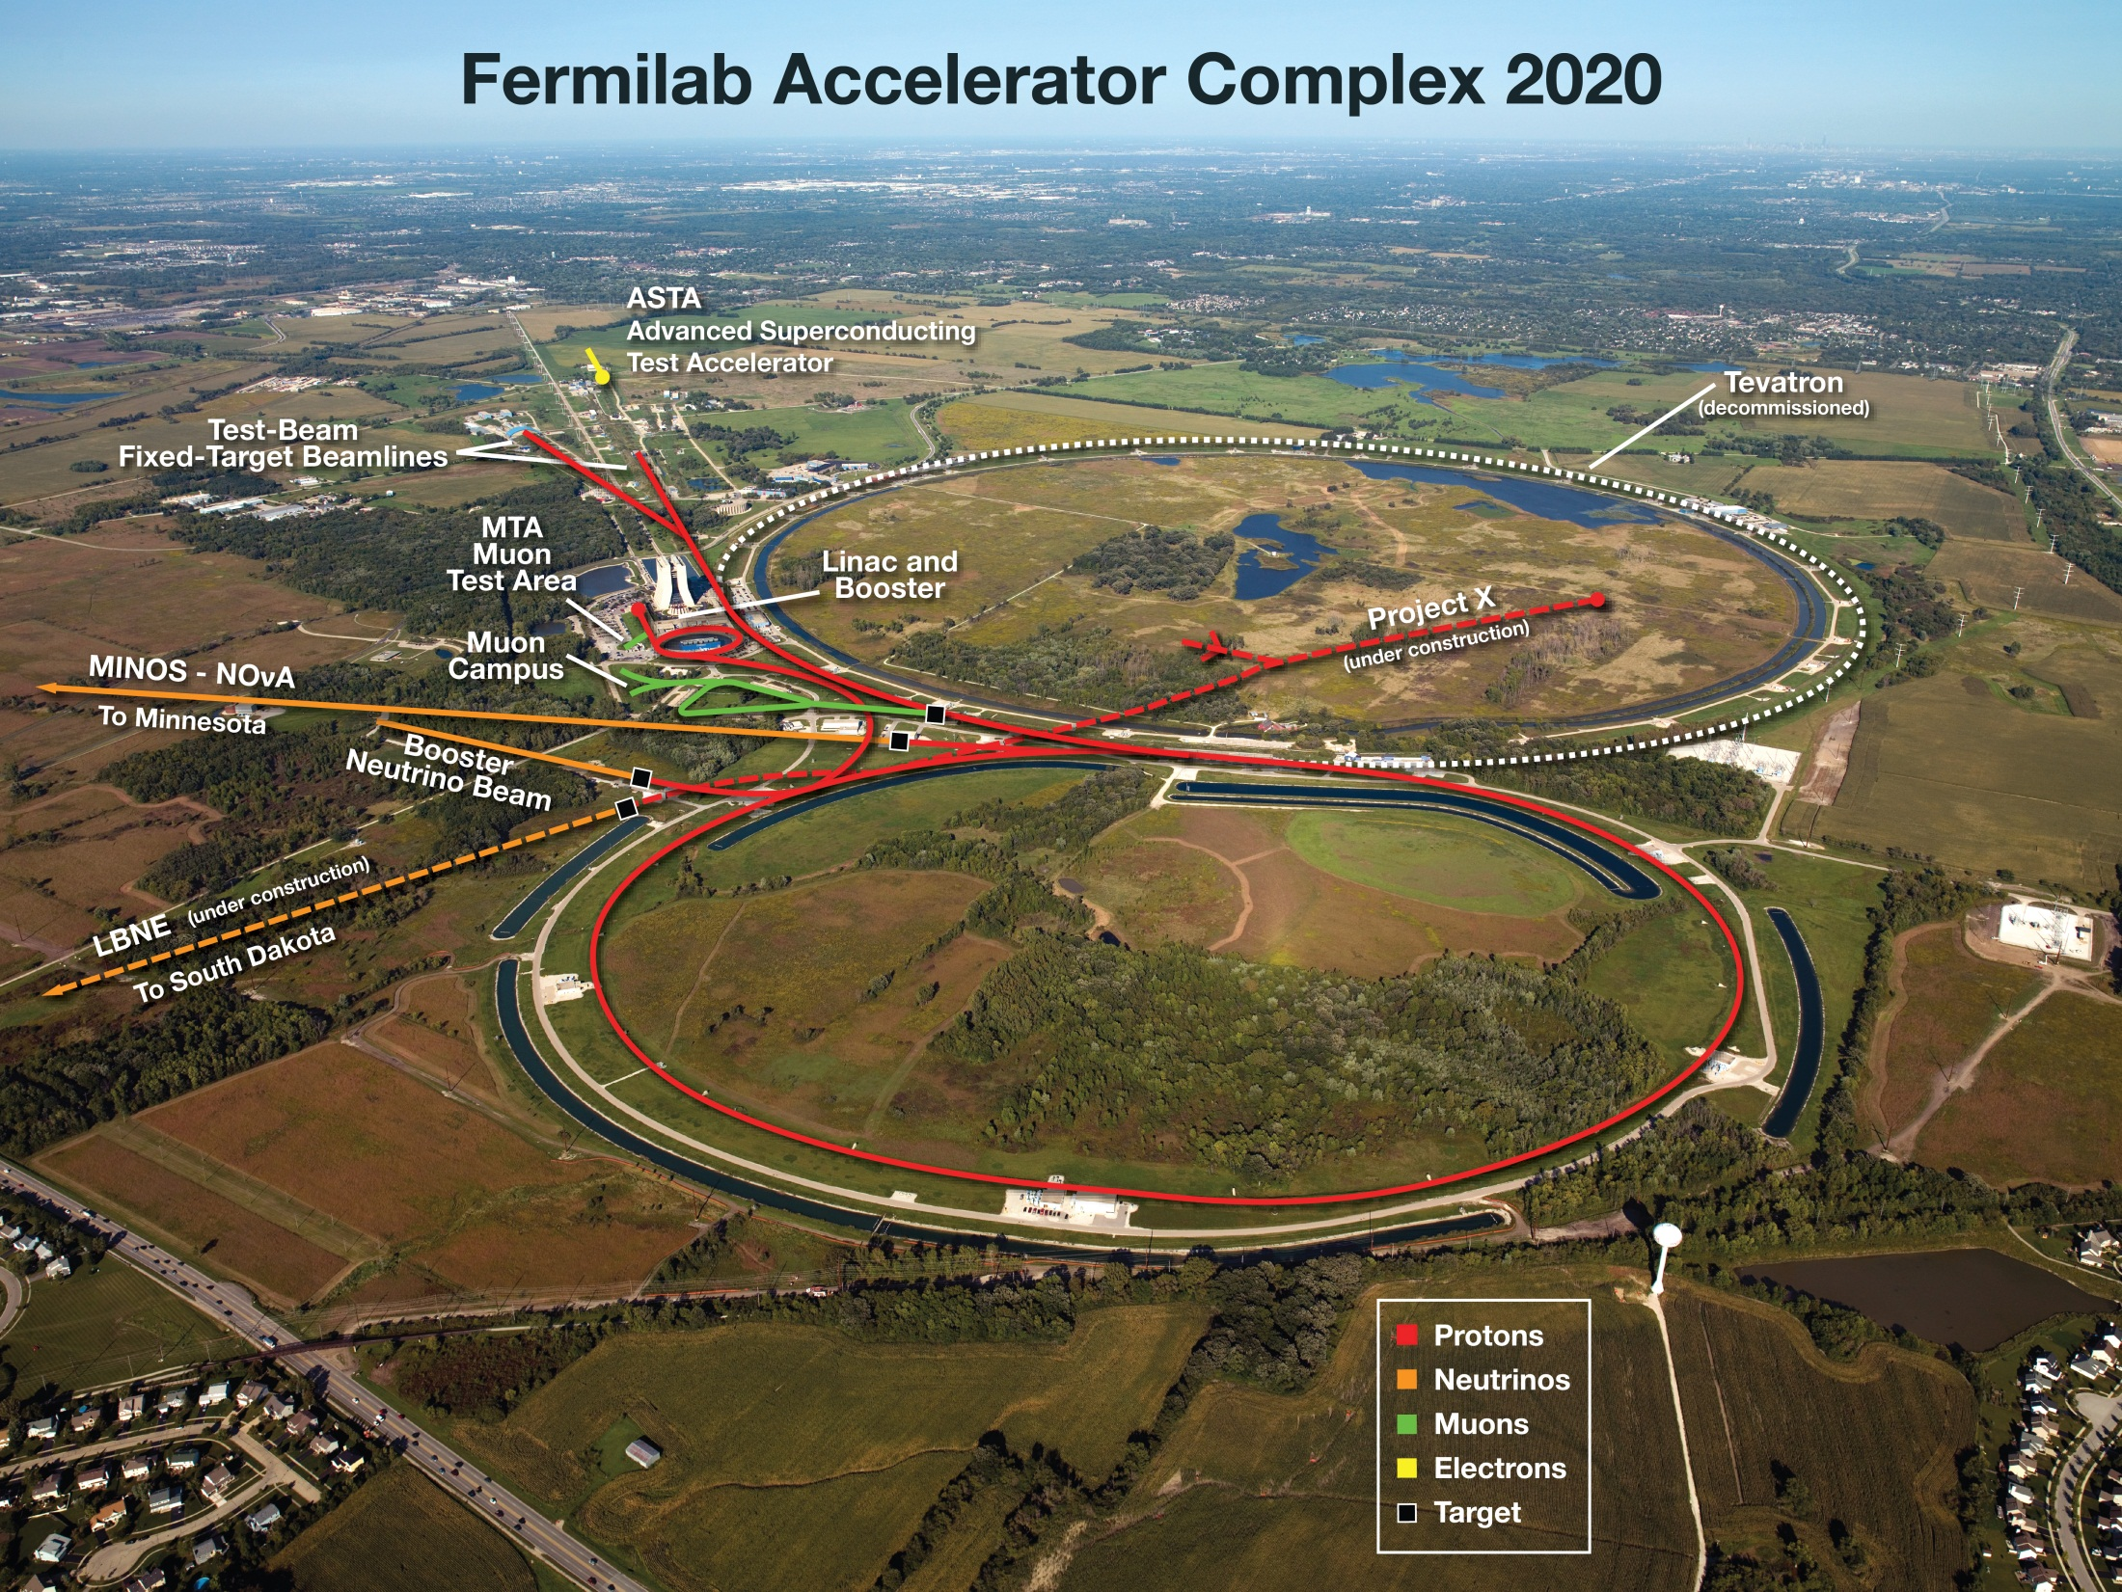
Intensity Frontier (future accelerator complex)
+

Slide 9
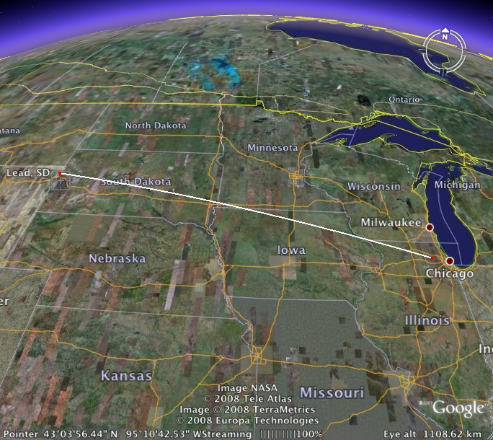
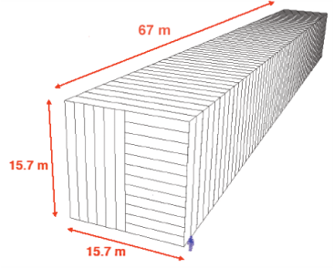
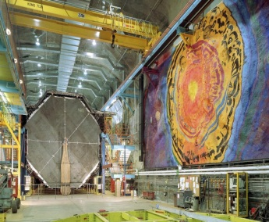
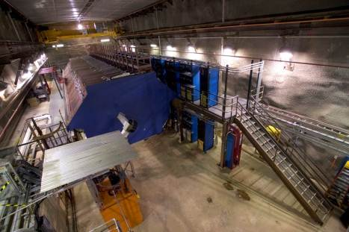
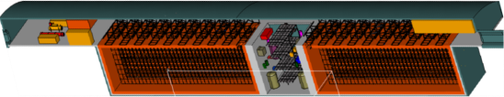
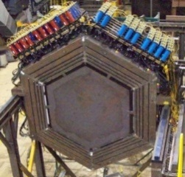
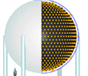
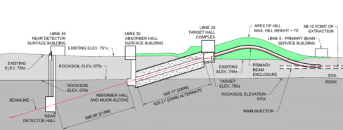
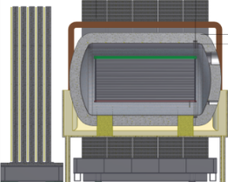
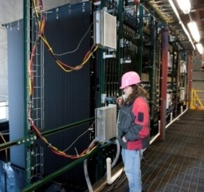
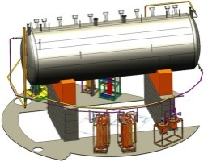
Intensity Frontier: Evolution of long-baseline ν experiments
MINOS (2005 – ~2015) → NOvA (2013 – ~2022) → LBNE (~2022 – )
under construction
online 2013
(700 kW)
NOvA (far)
Surface
14 kton
MINOS (far)
at 2340 ft level
5 kton
operating
since 2005
(350 kW)
MINOS (near)
735 km
810 km
MINERvA
1300 km
LBNE Far detector
at 4850 ft level
34 kton LAr TPC
700 kW → 2.3 MW(Project X)
MiniBooNE
New beamline
Near detector
NOvA
(near)
MicroBooNE
under construction
(LAr TPC)

Slide 10
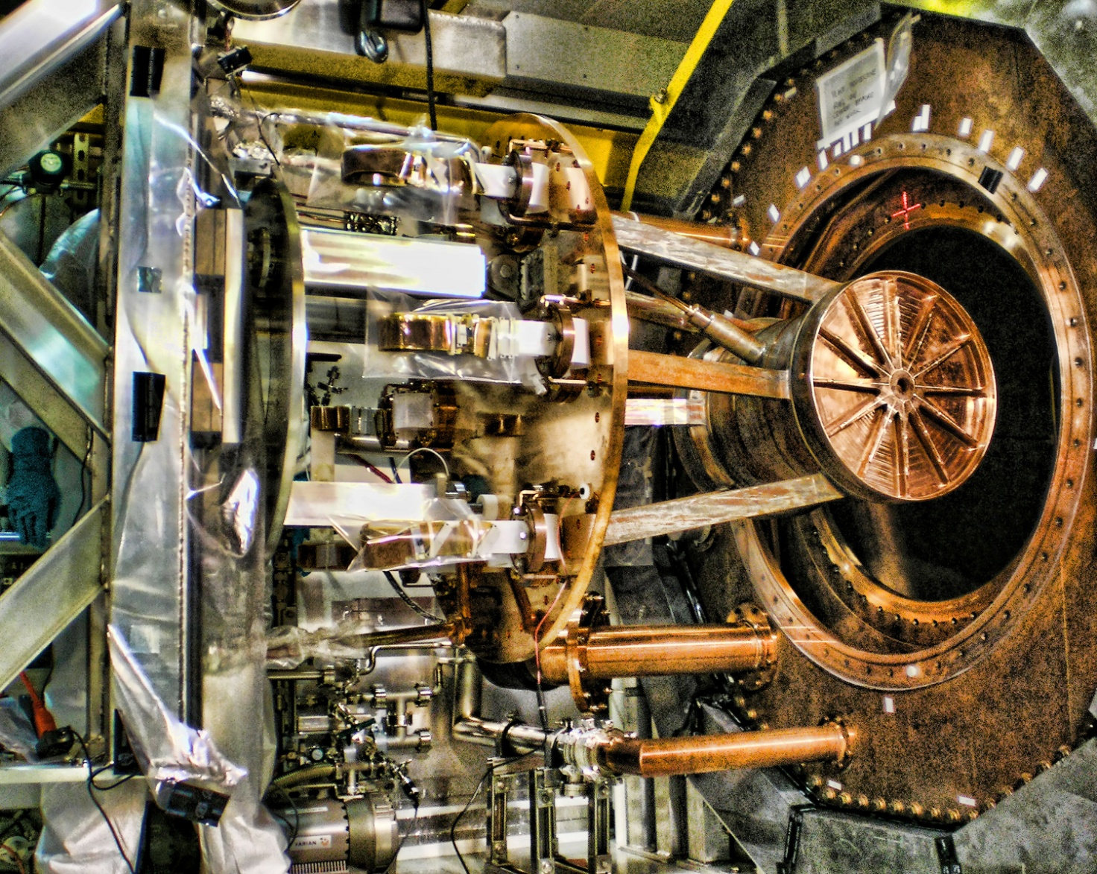
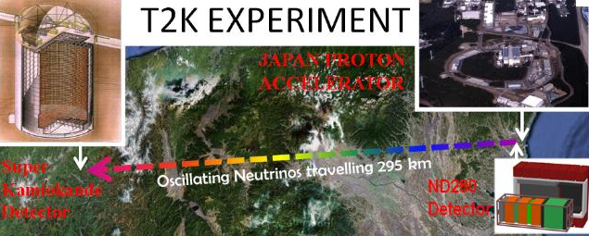
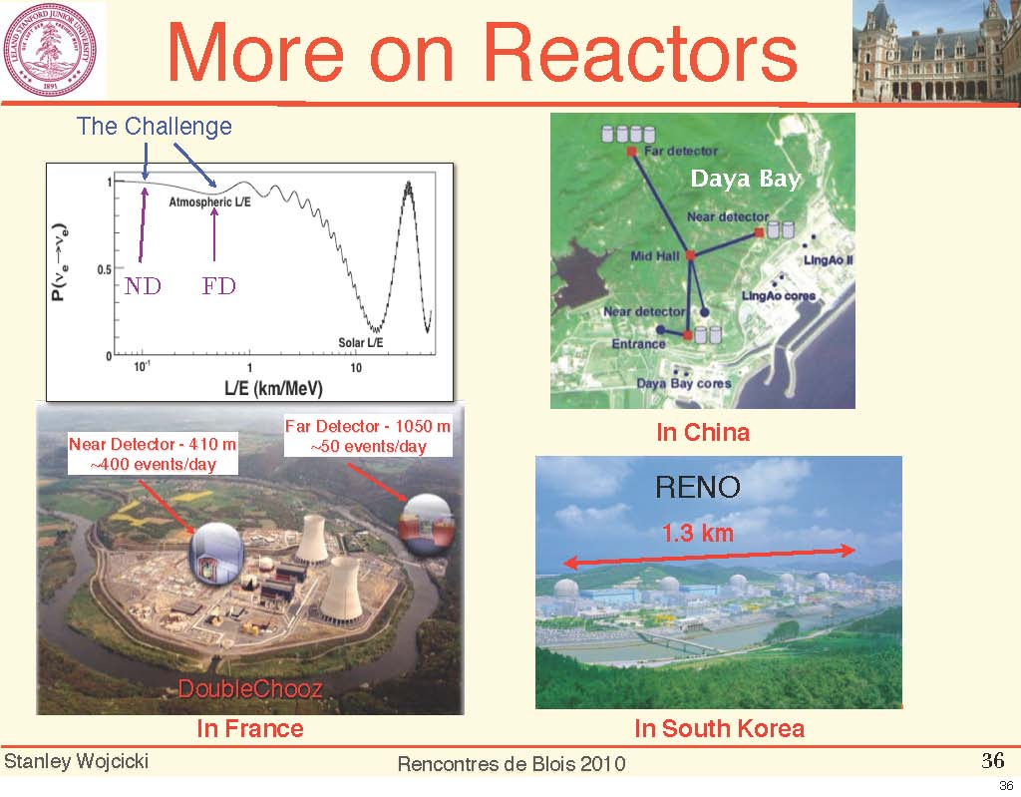
Intensity Frontier: Neutrinos
Accelerator based:
  T2K
Reactor based:
  Daya Bay
  Double Chooz
Neutrinoless double β decay:
  EXO (liquid Xenon) at WIPP (U.S.)
Japan
China
Double CHOOZ France
Notes:
0166734314

Slide 11
Intensity Frontier: Rare Processes
New Terascale LHC discovery will raise flavor and unification questions
  most likely not accessible or only crudely accessible at LHC.
  Flavor programs could
    Measure systematically new FV and CPV couplings
    i.e. flavor structure of New Physics.
    Distinguish SUSY Breaking mechanisms
  Flavor physics is unification physics.
Extends New Physics searches beyond LHC
  New Physics at scales beyond LHC
    could give measurable flavor effects
    Flavor programs – unique opportunity to explore up to ~1000 TeV.

Slide 12
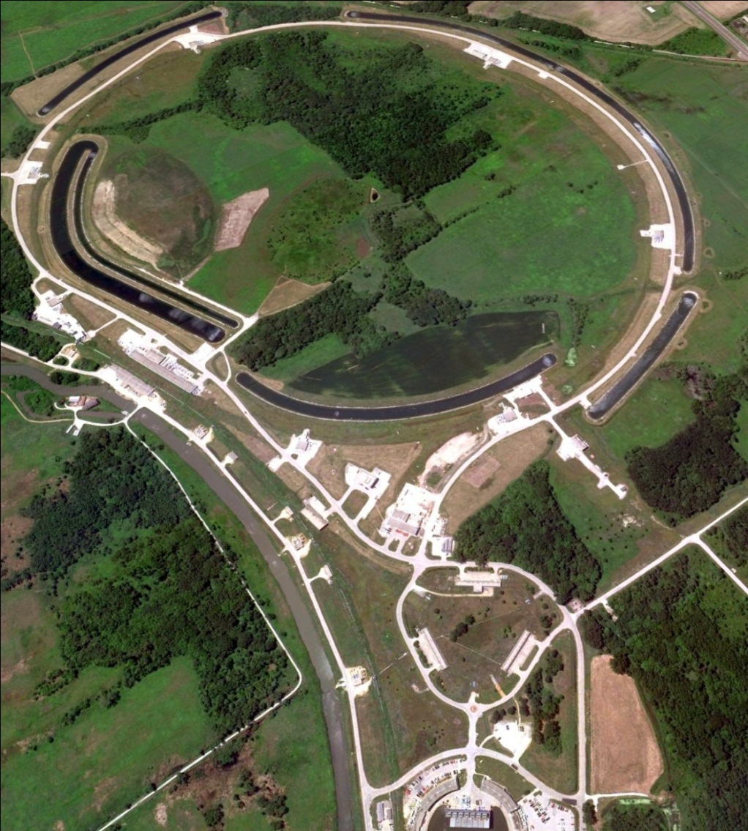
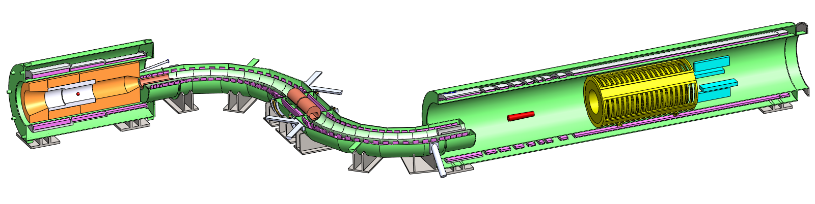
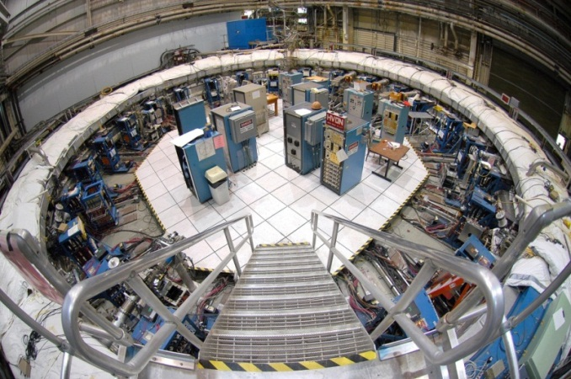


Rare Processes: Muon Programs
At Fermilab
Proton delivery
Mu2e
Beam Transfer
Muon g-2
Muon Campus

Slide 13
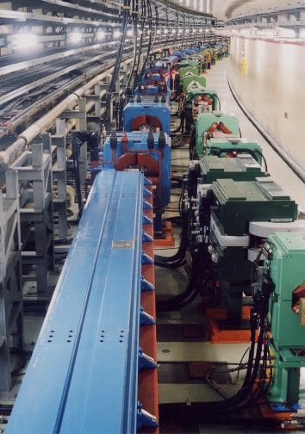
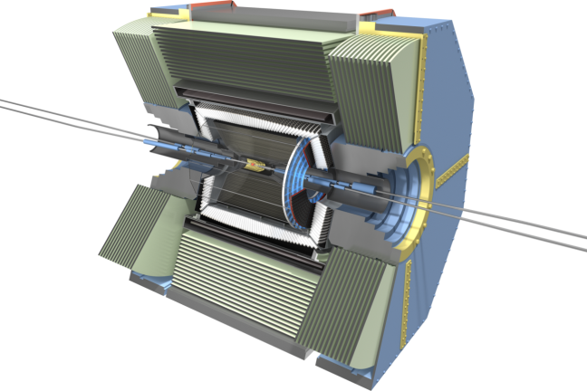
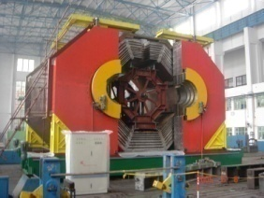
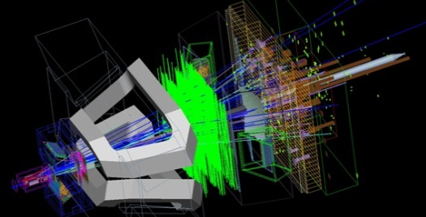
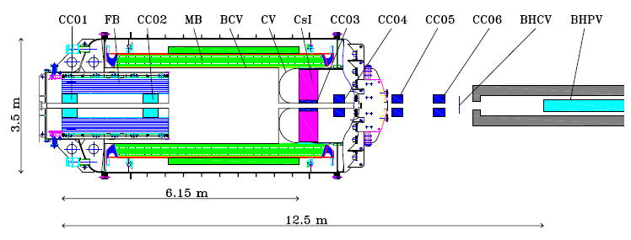
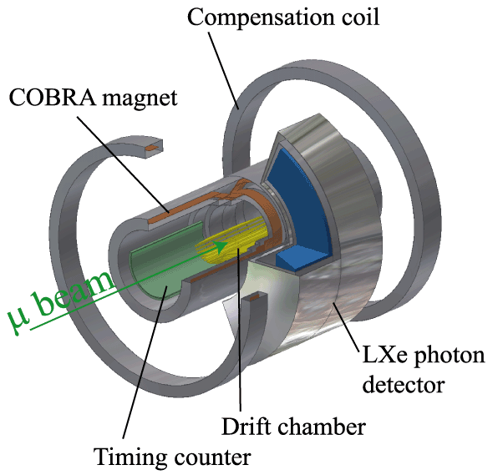
Rare Processes
Bottom-Charm-Tau
  KEKB / Belle, SuperKEKB / Belle II
  BEPC/BES III
  LHCb
Kaon
  KOTO
Muon:
  MEG
BES III LHCb
MEG
KOTO

Slide 14
Cosmic Frontier
Principal thrusts are the study of dark energy and dark matter
Dark matter
Direct Dark Matter Search Sensitivities
Current generation
Generation II
Generation III
currently developing

Slide 15
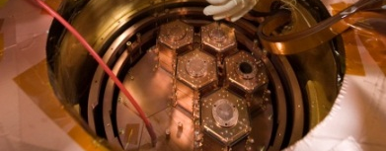
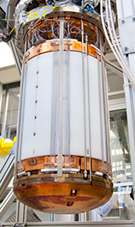
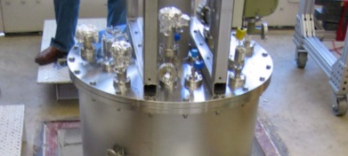
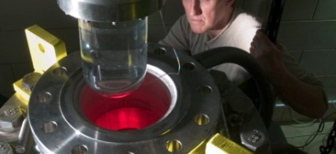
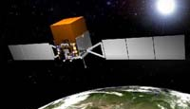
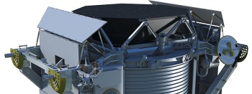
Cosmic Frontier: Dark Matter
Direct detection: efforts towards “zero background”
  CDMS (Ge bolometers) – Soudan / SNOLab
  LUX (liquid-gas Xenon) – Homestake
  DarkSide (depleted liquid Argon) – Gran Sasso
  COUPP (bubble chamber) – SNOLab
  .....
Indirect detection: look for annihilation products
  Fermi-GLAST
  AMS
  IceCube

Slide 16
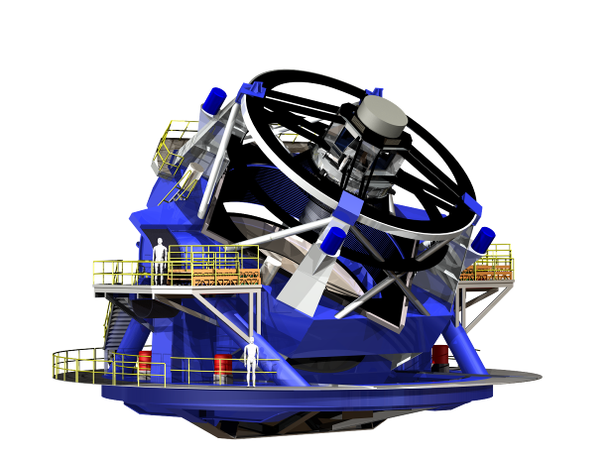
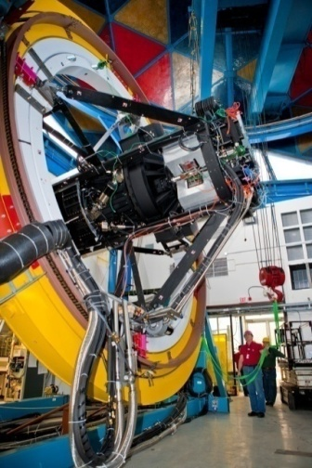
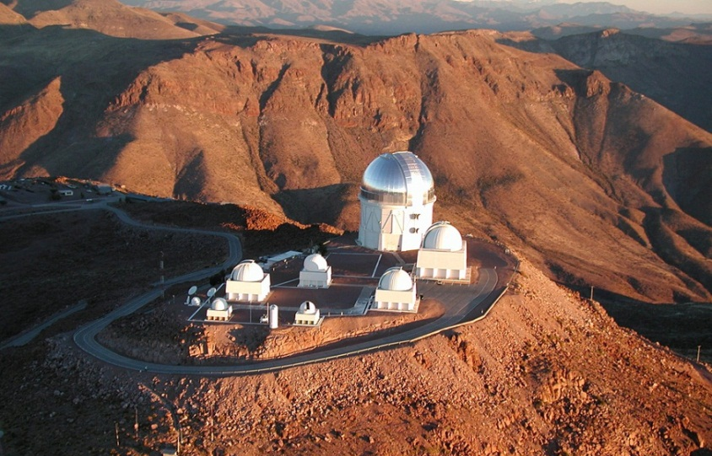
Cosmic Frontier: Dark Energy
DES LSST
Being commissioned
MS DESI
spectrographic survey
570-Megapixel
digital camera
Dark Energy Camera

Slide 17
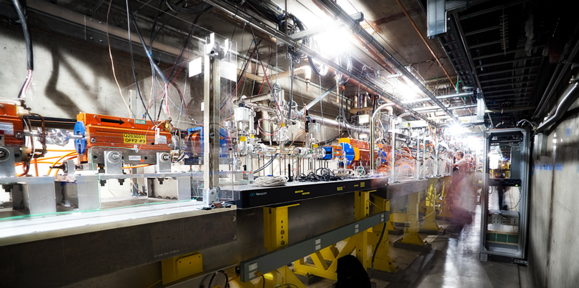
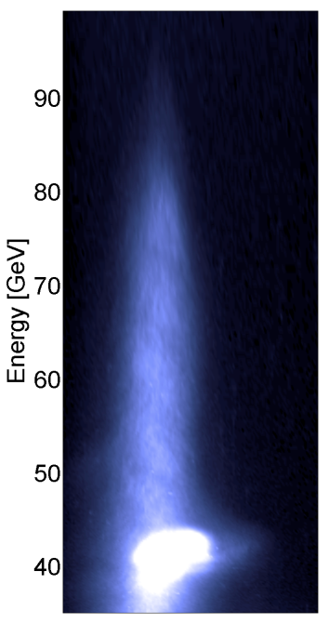
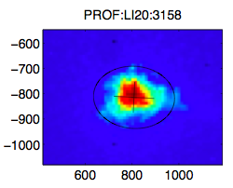
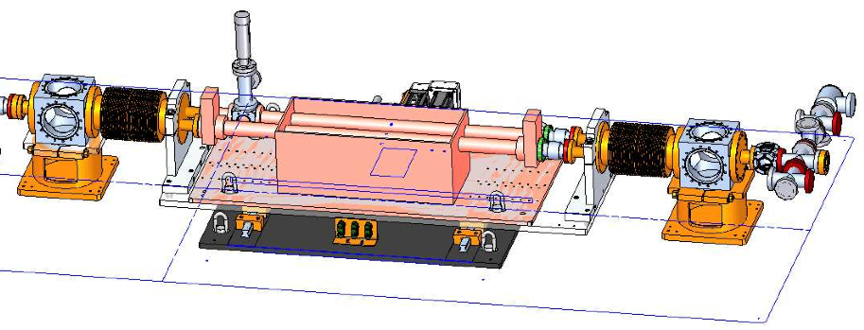
Accelerator R&D: User Facility
Plasma Wakefield Acceleration research at SLAC
Beam Direction
Beam at IP!

Slide 18
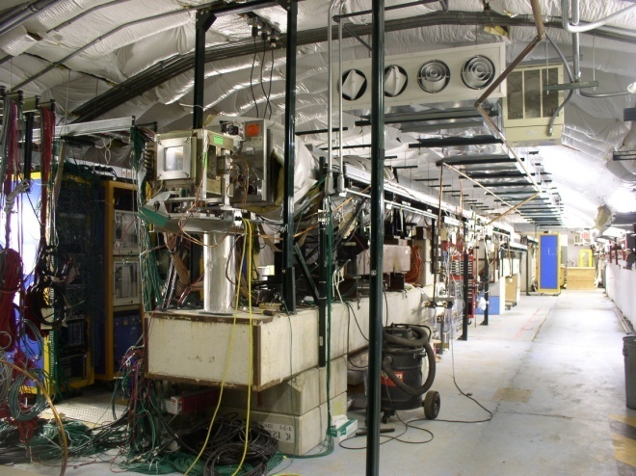
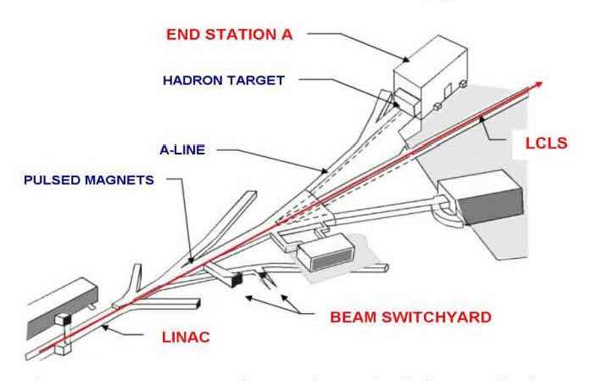
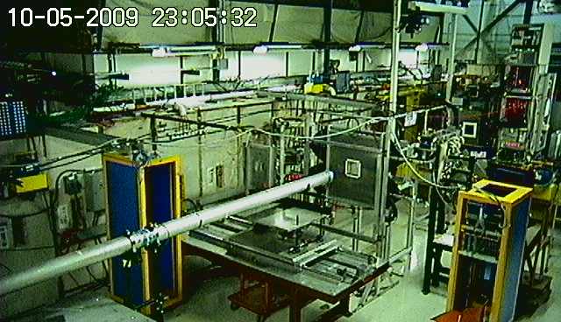
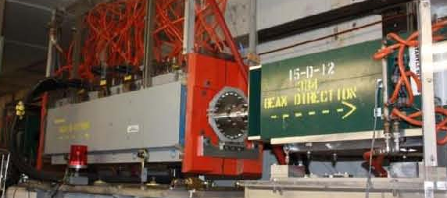
Detector R&D: Testbeam User Facilities
Fermilab (hadrons) SLAC (electrons)

Slide 19
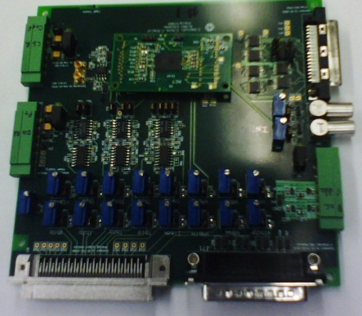
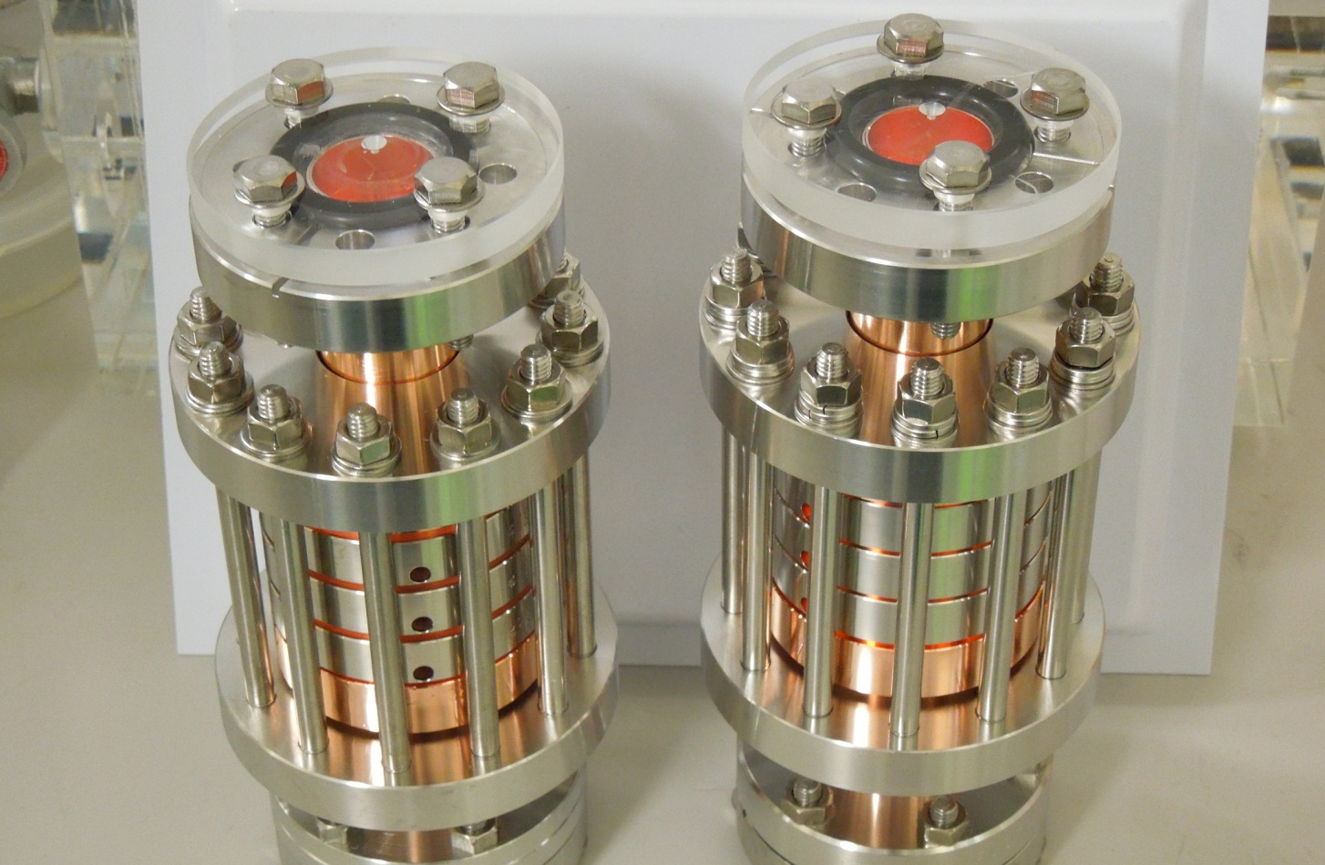


Other Activities
Detector R&D
  Advanced Pixel Sensors using SOI technology
  GEANT4 development
  Particle ID
  4 degree K electronics
Accelerator R&D
  High gradient
Polar Bear II (CMB)
Particle Data Group
  26 Years of Japanese-US
  Collaboration

Slide 20

The PHENIX Experiment at RHIC
(U.S.: supported by DOE Office of Nuclear Physics)
Designed to: Characterize properties of the QCD transition from hadronic to partonic matter (sQuark Gluon Plasma)
Measure gluon and quark contributions to the spin of the proton
Study Nuclear structure and Gluon saturation effects
US-Japan subsystems comprise 15-20%
Detector subsystems built and supported by Japan-US
  Ring Imaging Cherenkov Counters (RICH)
  Time of Flight (TOF)
  Aerogel Cherenkov Counter (ACC)
  Beam Beam Counters (BBC)
Subsystems built and supported by RIKEN
  Muon Spectrometer Arm (South)
  Muon LVL1 Trigger
Contributions from both RIKEN and US-Japan
  Reaction Plane Detector (RXNP)
  Muon Piston Calorimeter (MPC)
5 out of 11 Japanese Universities & Research supported by Japan-US program funds

Slide 21
Activities supported by 2012 Japan – U.S. program
Red = Japan based programs
Blue = US based programs
Green = both sides
Detector R&D
  Muon experiments
  SOI
  GEANT4
  Particle ID
Accelerator R&D
  ILC related R&D
  High luminosity (SuperKEPB)
  High gradient
Others
  Particle Data Group
Experiments
  CDF
  PHENIX
  GLAST
  Rare Kaons
  Belle II
  Polar Bear II

Slide 22
Summary
Long and strong collaboration between Japan and U.S.
  thanks to the “Japan – U.S. program”.
We look forward to continued collaboration, planting the seeds of future scientific discovery.

