Slide 1
Fermilab Briefing
Young-Kee Kim
URA Board of Trustees Meeting
April 17, 2012

Slide 2
Outline
Organization / International Collaborations
Fermilab’s plan
  2011 – 2030
  Status of New Projects
Budget

Slide 3
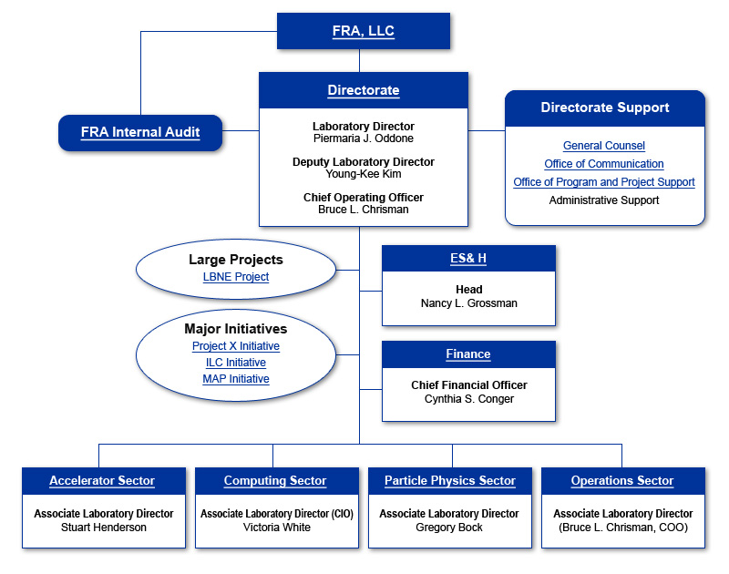
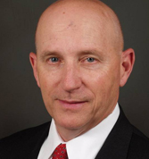
Fermilab Organization
Interim head
Carl Strawbridge

Slide 4
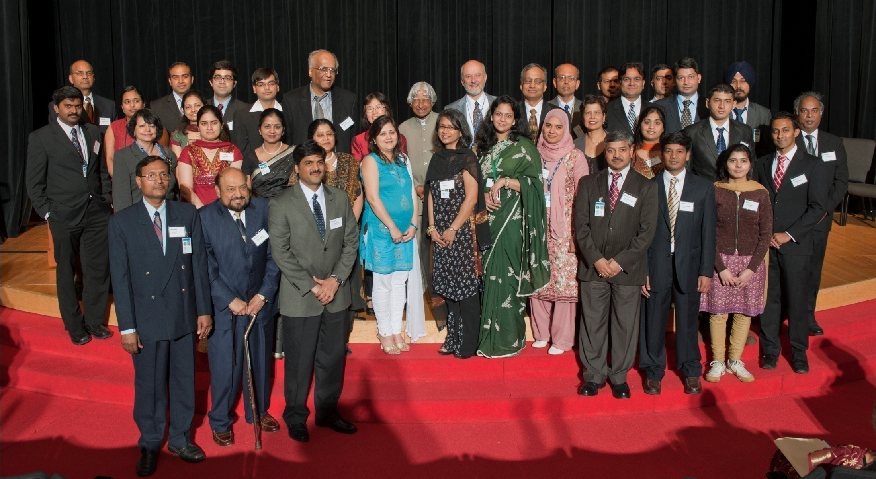
Fermilab – India Collaboration

Slide 5
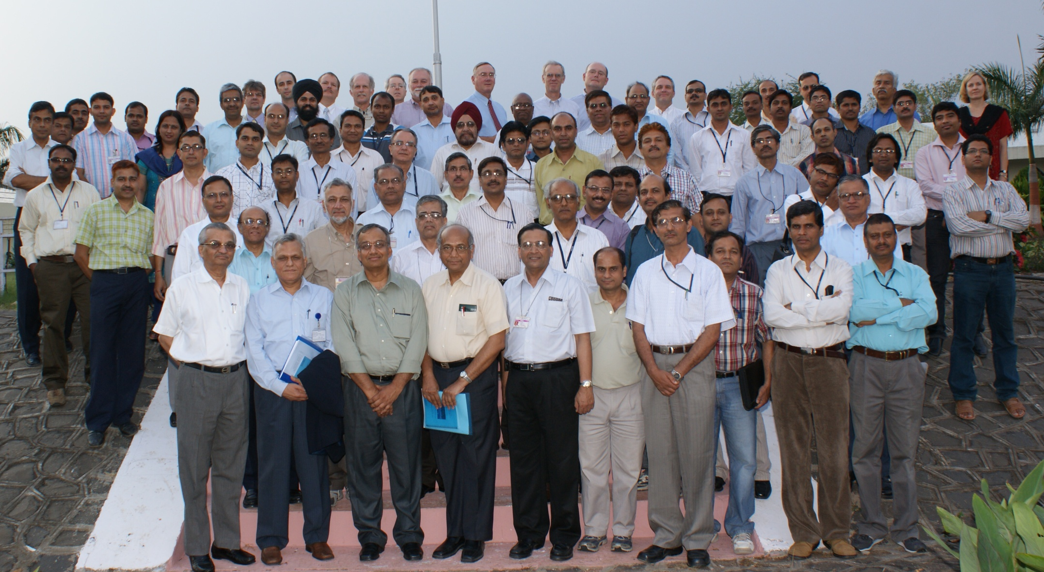
Fermilab – India Collaboration

Slide 6
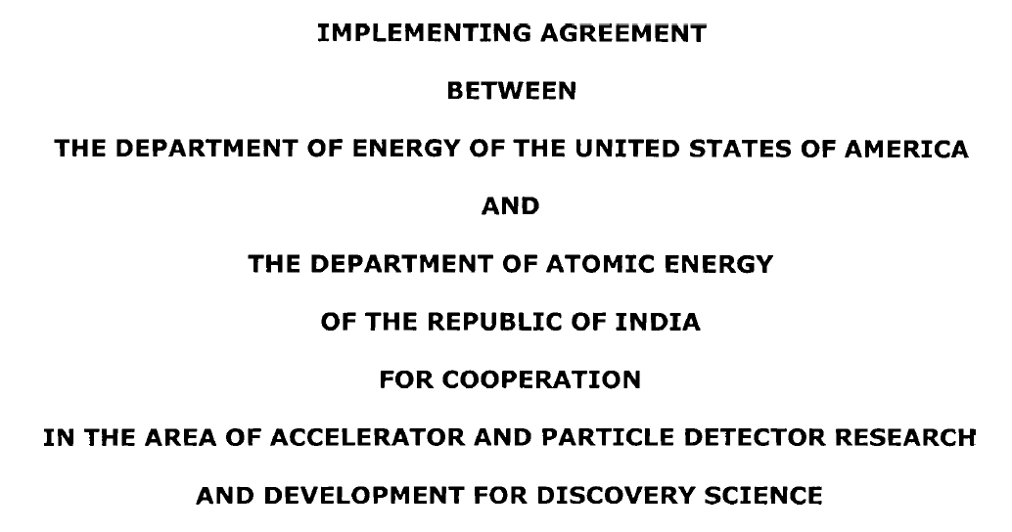


DOE-DAE: Implementing Agreement
The U.S.’ DOE and India’s Department of Atomic Energy signed an Implementing Agreement on Discovery Science that provides the framework for India’s participation in the next generation particle accelerator facility at Fermilab. http://www.state.gov/r/pa/prs/ps/2011/07/168740.htm

Slide 7
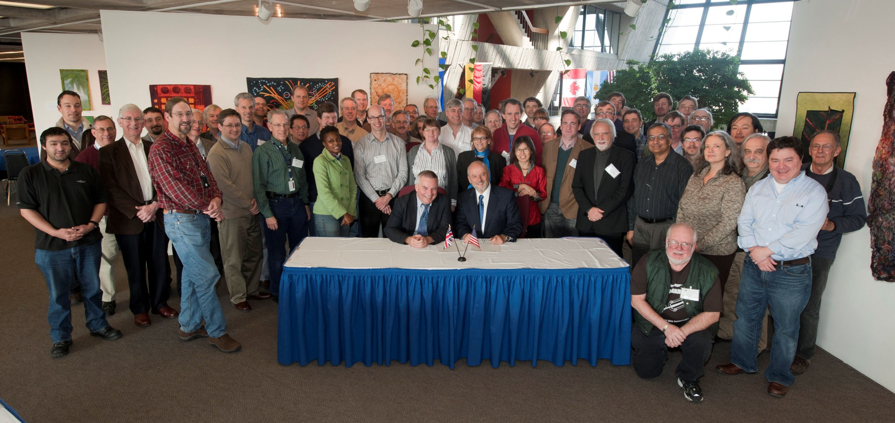
Fermilab – UK Collaboration
Workshop on January 12-14, 2012
Letter of Intent signed

Slide 8
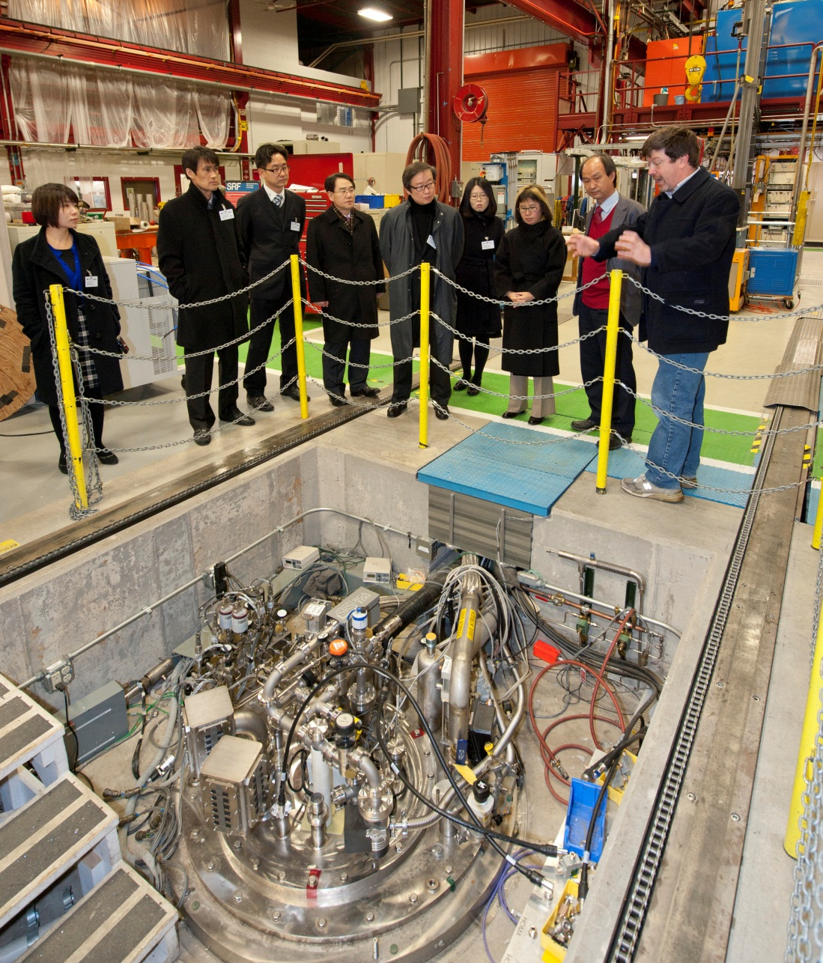
Fermilab – Korea Collaboration
Feb. 7, 2012

Slide 9
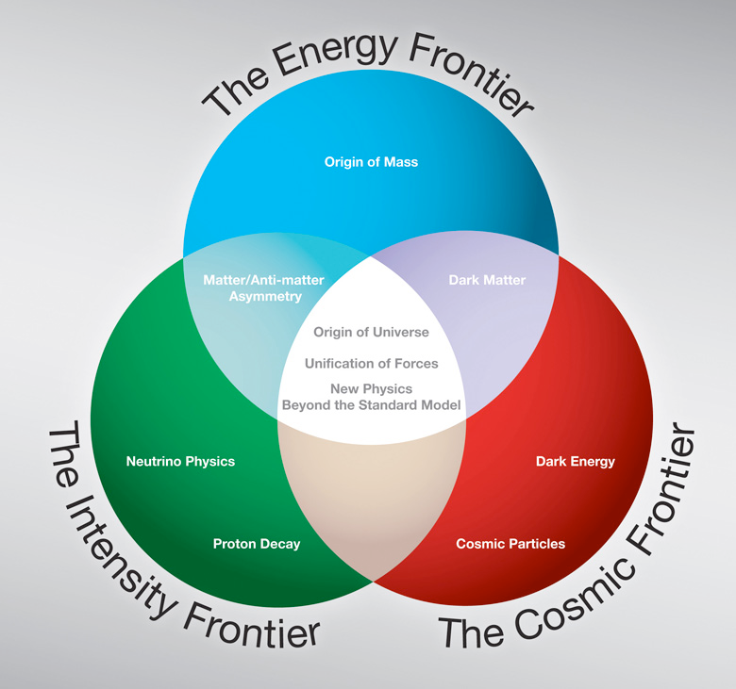
Program planned along three frontiers

Slide 10
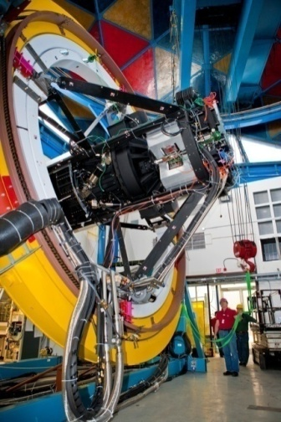
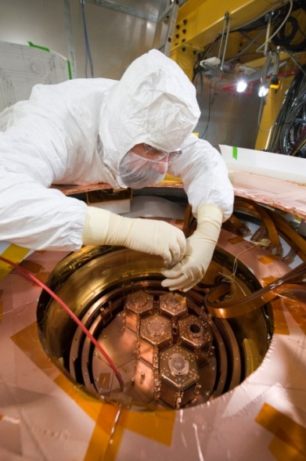
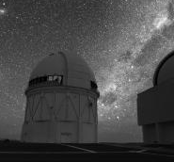
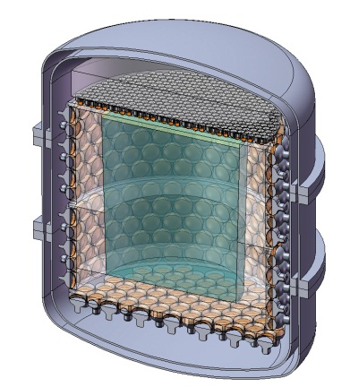
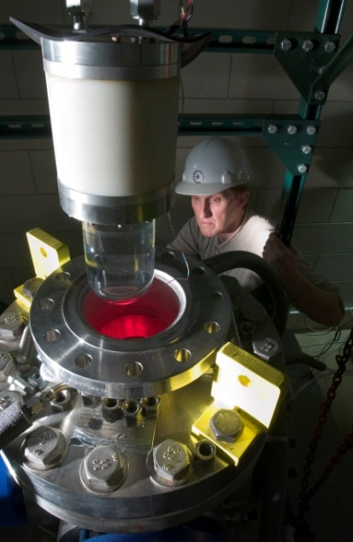
Cosmic Frontier at Fermilab
Dark Matter Detector
Dark Energy Camera
DES
Dark Matter Particle
Detector
CDMS
DarkSide
COUPP
nuclear recoil
570-Megapixel
digital camera
Fermilab
Detectors in underground facilities
Chile

Slide 11

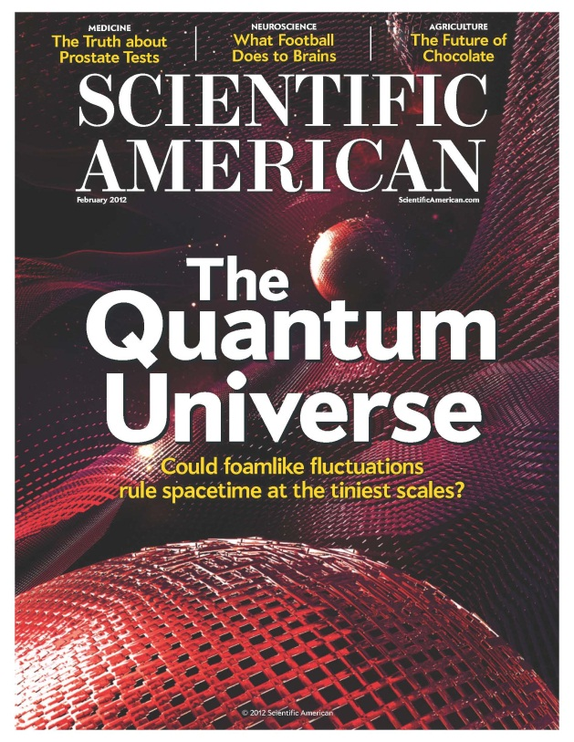
Cosmic Frontier at Fermilab
Exploring
Highest Cosmic Ray Particles
(Auger)
Exploring
Quantum Space-time
(Fermilab Holometer)

Slide 12
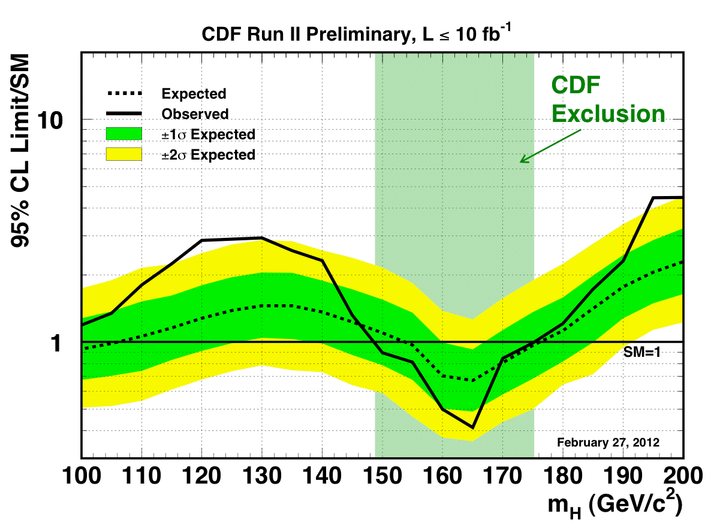
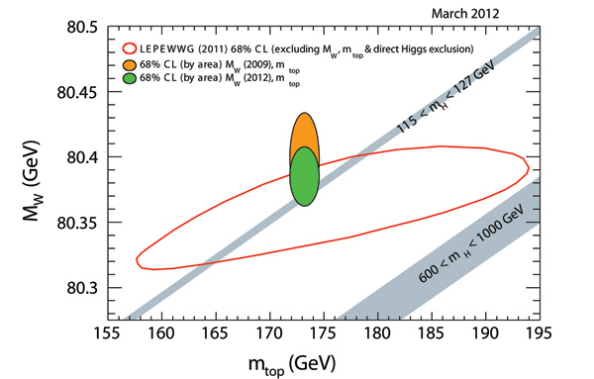
The Energy Frontier
Continued analysis of Tevatron data with important results
The principal activity for the foreseeable future is exploitation of the LHC

Slide 13
Next steps at the energy frontier
The next steps will be to contribute to the High Luminosity LHC with both detector and accelerator upgrades. Very active and vital program on CMS
The biggest unknown is what follows the LHC?: ILC ? CLIC ? Muon Collider ? Energy doubler ?

Slide 14
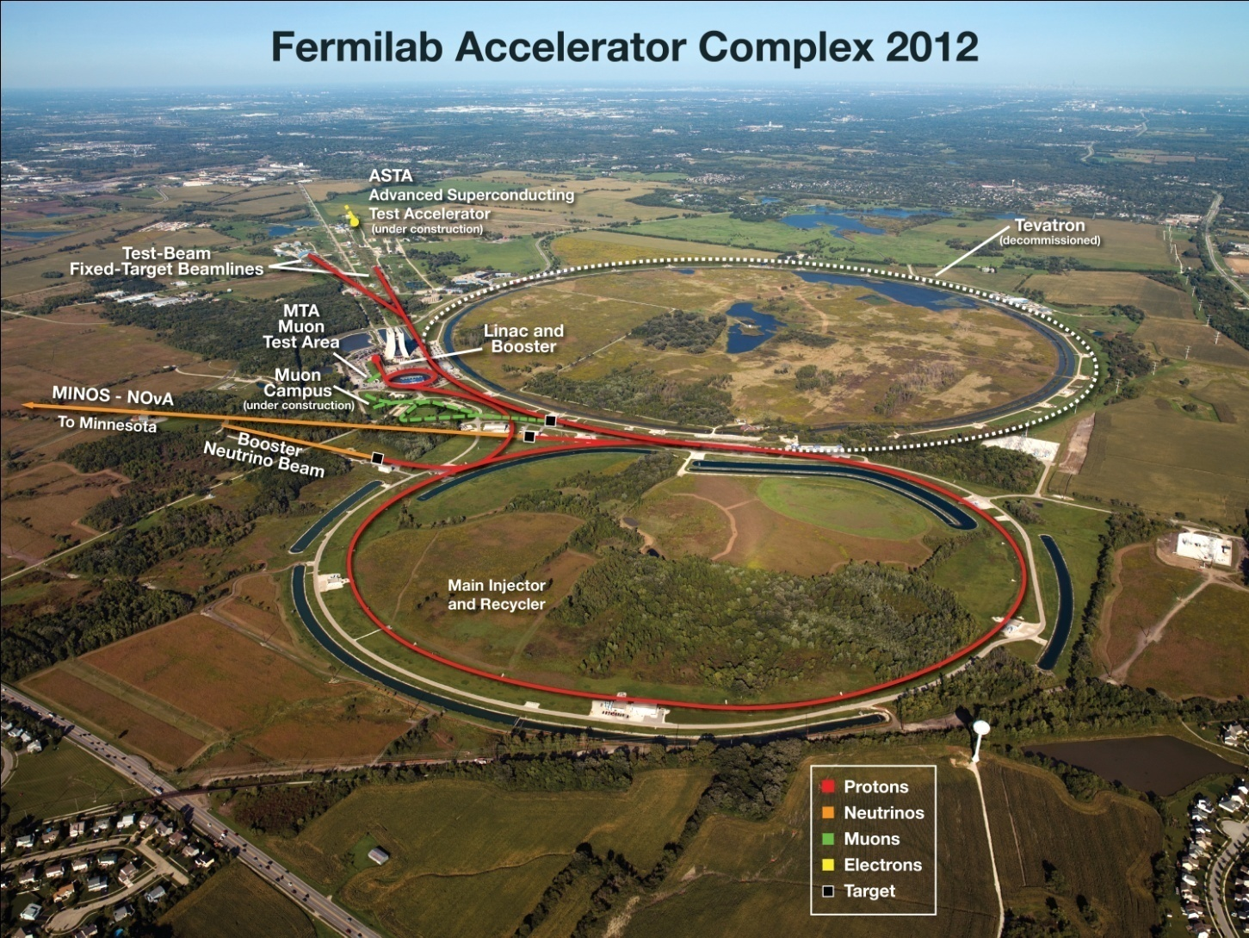
The Intensity Frontier
Illinois Accelerator Research Center
(IARC)

Slide 15

Intensity Frontier Workshop
(Nov. 30 – Dec. 2, 2011)
500+ Attendees
Six very active working groups:
  Charged leptons
  Heavy Quarks
  Hidden Sector
  Neutrinos
  Nucleons/Nuclei/Atoms
  Proton Decay
(http://www.intensityfrontier.org/)

Slide 16
Scientists Activities (2010 – 2016)
Doesn’t include anticipated new hires for FY 2012-2016

Slide 17
Scientists Activities (2010 – 2016)
Doesn’t include anticipated new hires for FY 2012-2016
Experiments
Experiments

Slide 18
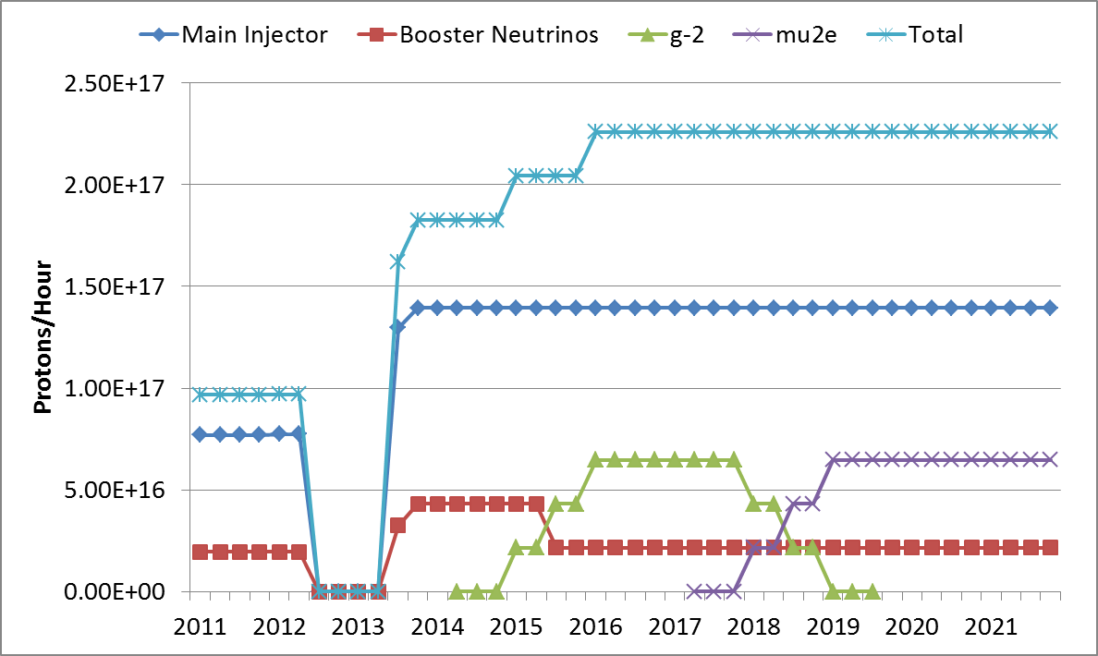
Proton Improvement Plan for Intensity Frontier Program
120 GeV ν
NOvA Shutdown
NOvA LBNE
MINERvA
MINOS+
120 GeV ν
8 GeV μ
MINOS MINERvA
8 GeV ν
g-2
Mu2e
8 GeV ν
MicroBooNE
MiniBooNE
Project X: R&D
Phase-1 Construction

Slide 19
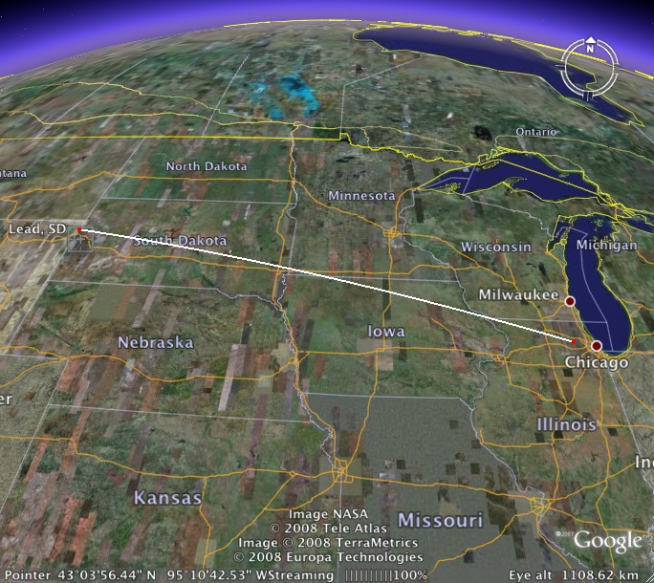
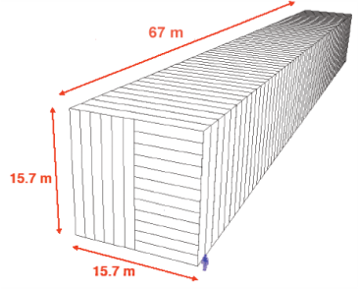
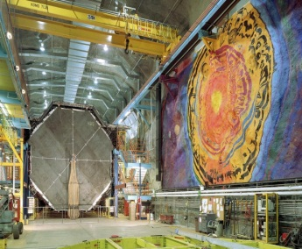
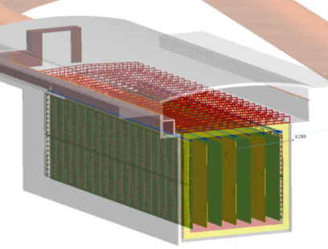
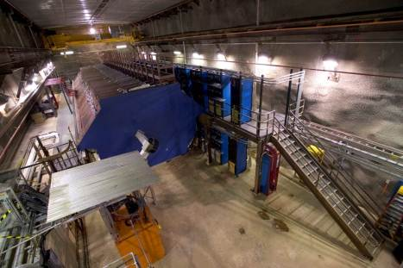
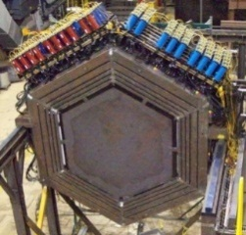

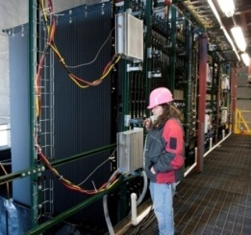
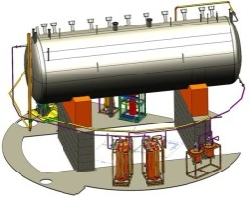
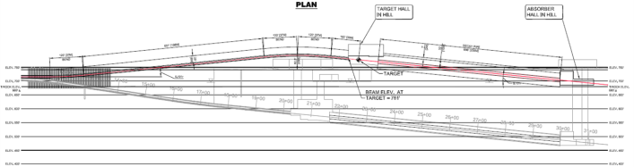
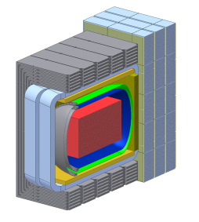
Intensity Frontier at Fermilab: Neutrinos
NOvA (far)
MINOS (far)
Operating
since 2005
(350 kW)
under construction
Online 2013
(700 kW)
Far detector
MINOS (near)
735 km
MINERvA
LBNE under development
1300 km
Proton decay
Supernovae neutrinos
MiniBooNE
NOvA
(near)
Goal: operating in 2020s
MicroBooNE
Beamline
Near detector

Slide 20
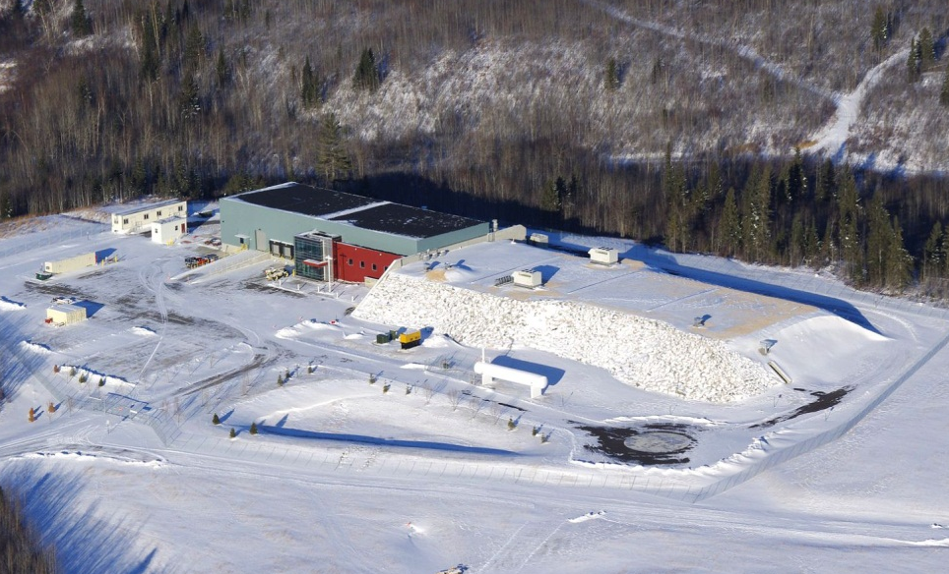
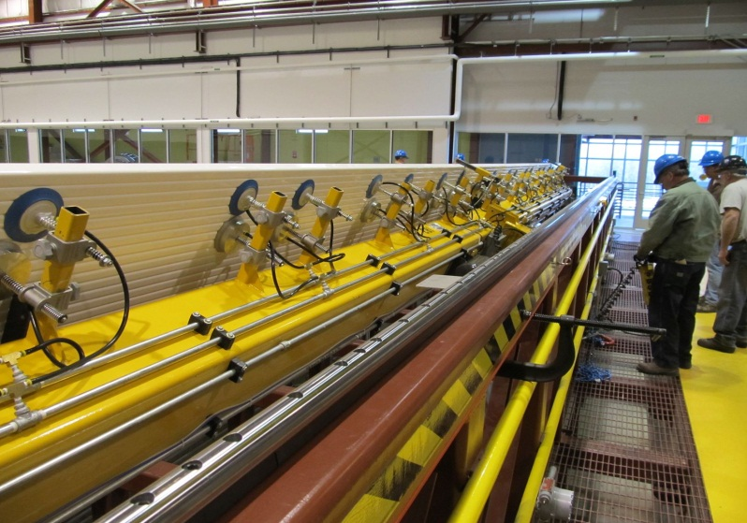
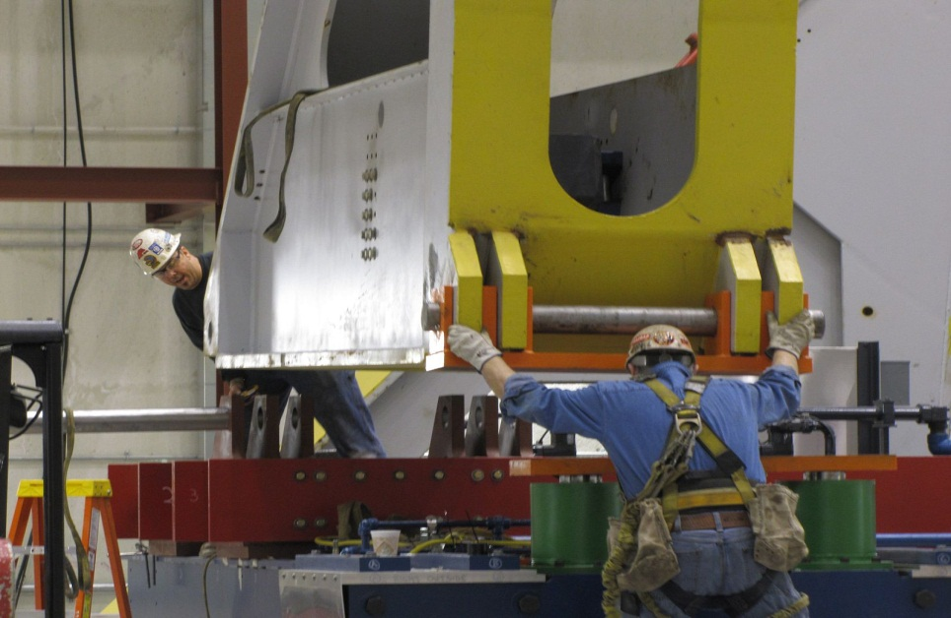

NOvA

Slide 21

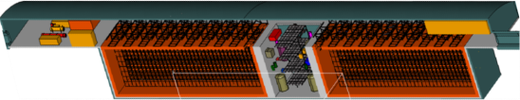
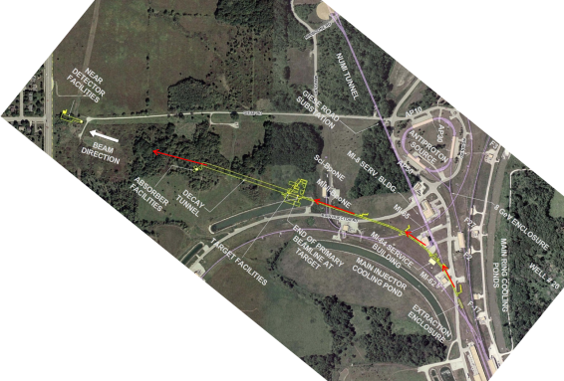
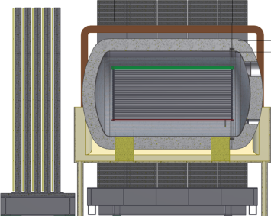
Sample with bullet points
Long Baseline Neutrino Experiment
First Bullet
Second Bullet
  More
  Yet more
  Still more
      Less important
        Trivial
New Neutrino Beam at Fermilab…
Precision Near Detector
Directed towards a distant detector
33 kton Liquid Argon Far Detector
Collaboration: 331 members
61 institutions (6 US labs) and 5 countries (India, Italy, Japan, UK, US)
Continue to grow!

Slide 22
The physics is extraordinary
Sheds light on fundamental aspects of the laws of nature
Neutrinos: crucial mixing angles, the mass-ordering and most importantly CP violation
Proton decay: its discovery would have a profound significance for unification ideas. The unification of forces implies the proton will decay
Supernova neutrinos: allows the only direct experimental view of the complex dynamics of supernova core collapse; sensitivity to the mass hierarchy

Slide 23
Phased approach and alternatives
Brinkman’s letter of March 19th: give us a phased approach/alternatives with physics at every stage
We established Steering Committee and under the Steering Committee a Physics Group and a Engineering/Cost group
Approaches based on two directions:
  Homestake which preserves ultimate physics over time
  NuMI beam: not ideal but does have reach in both mass hierarchy and CP violation
http://www.fnal.gov/directorate/lbne_reconfiguration/index.shtml

Slide 24
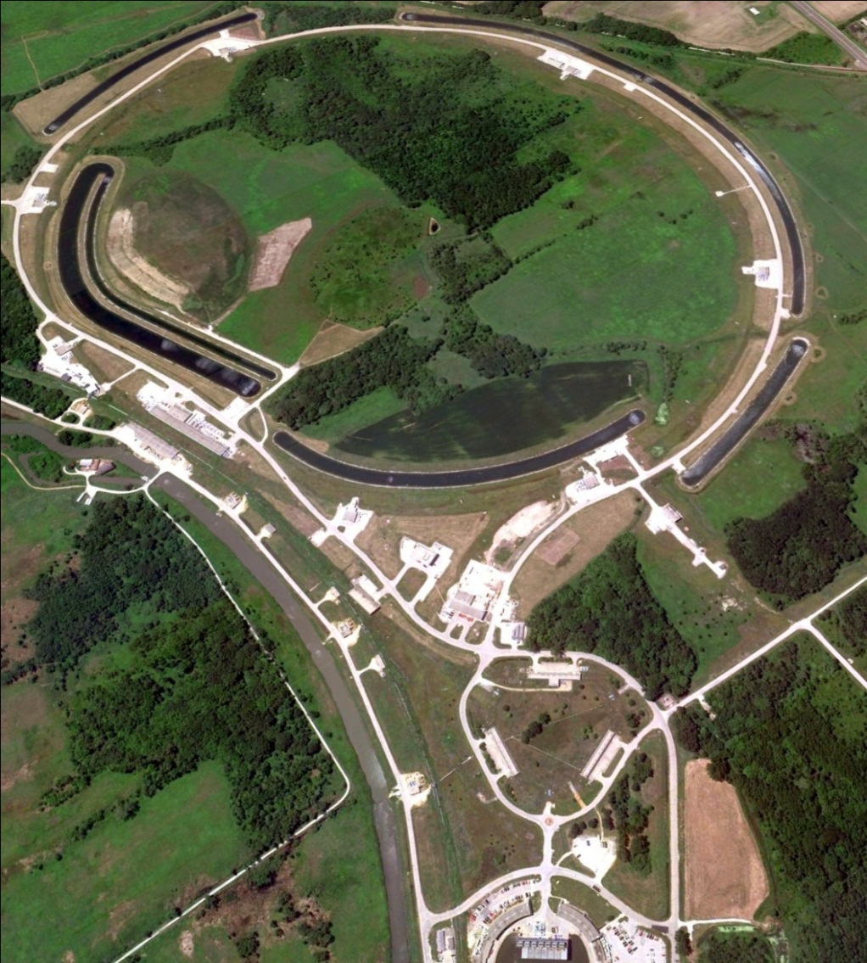
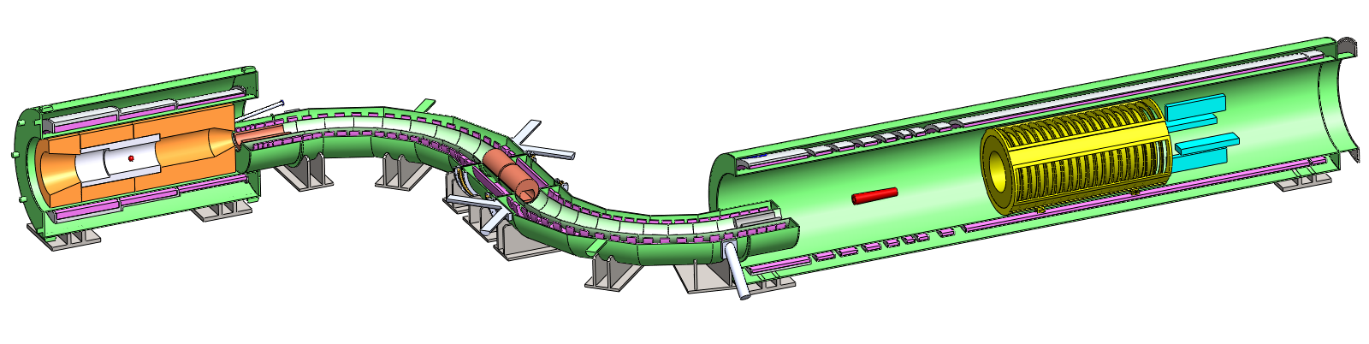
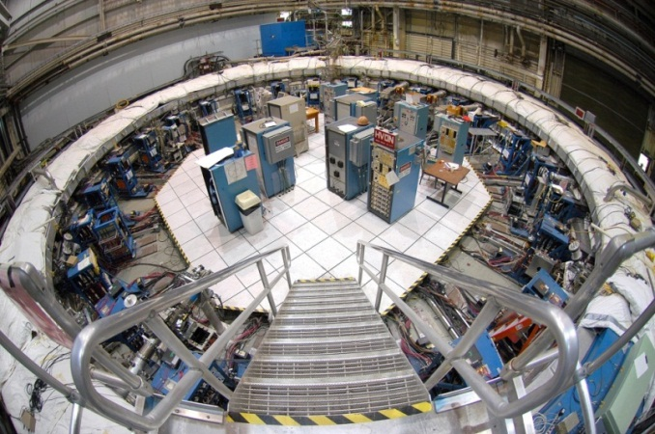


Muon Campus and Muon Experiments
Proton delivery
Beam Transfer
Muon Campus

Slide 25
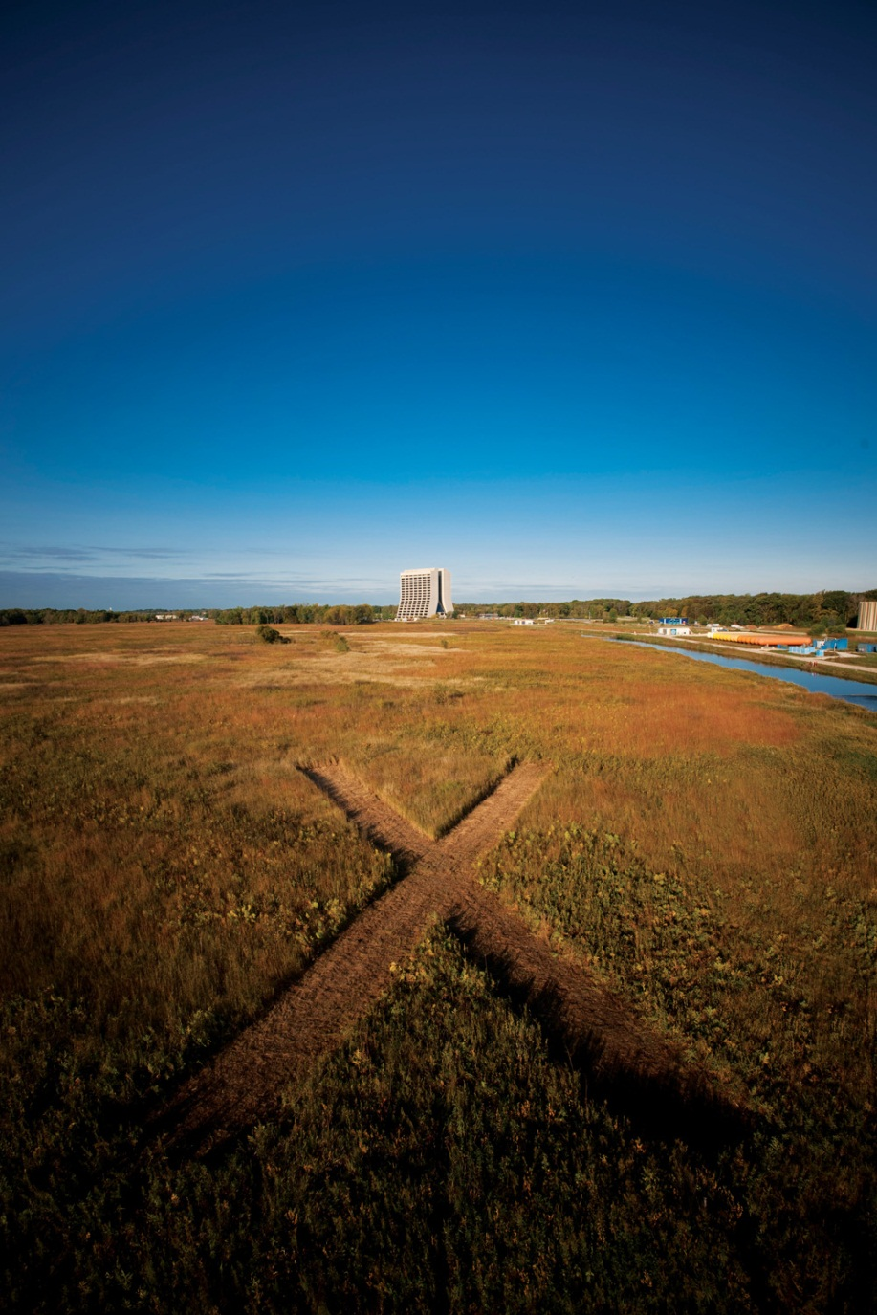
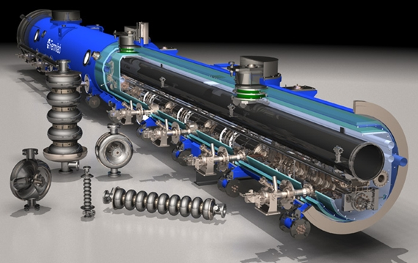
Project X
will be the world’s most powerful proton source
will make the world’s most powerful beams of neutrinos, muons, kaons and nuclei to explore new physics in unprecedented breadth and depth
will establish a versatile technical foundation for future accelerators

Slide 26
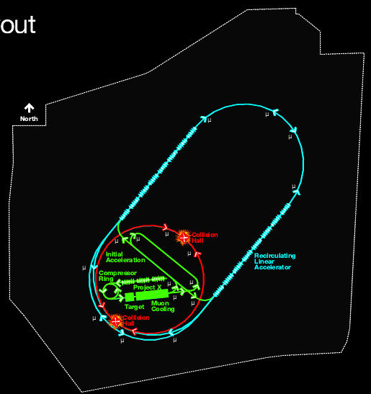
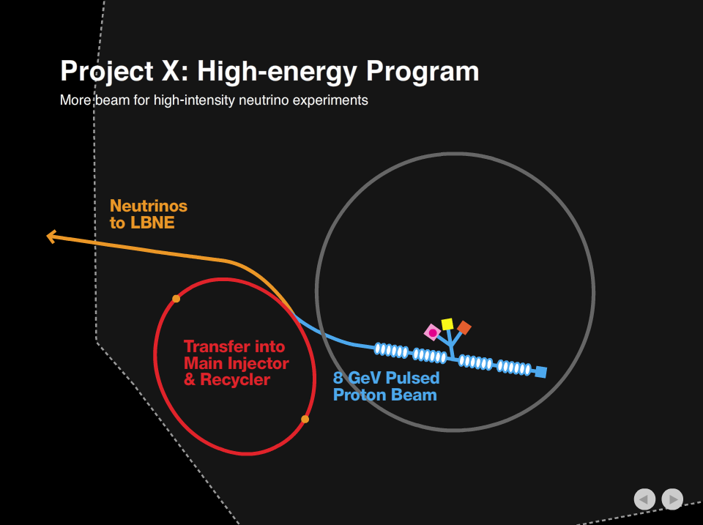

Slide 27
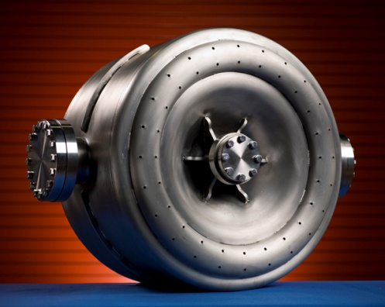
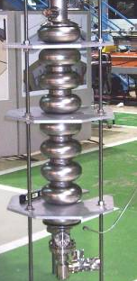
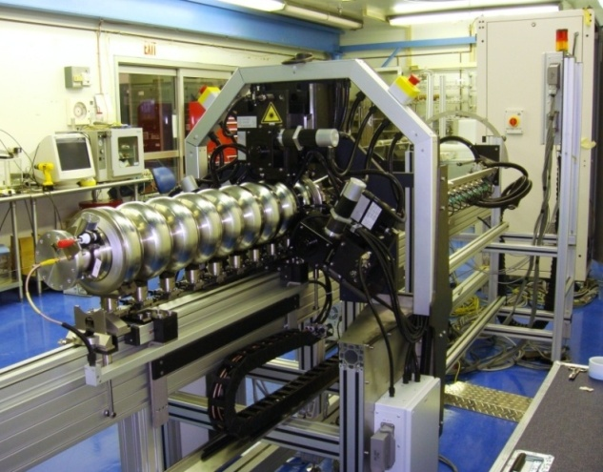
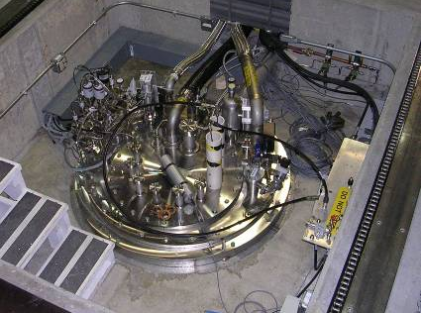
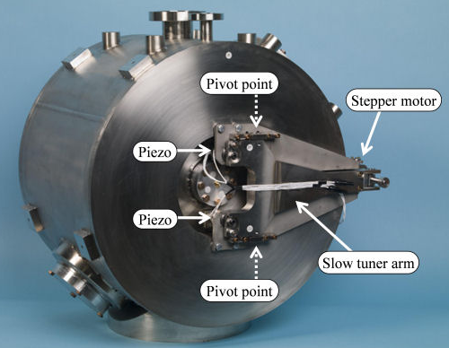
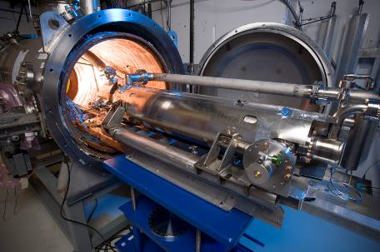
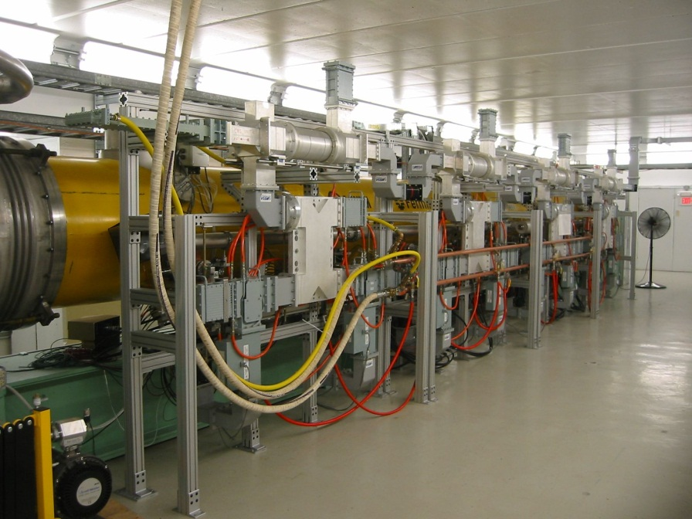
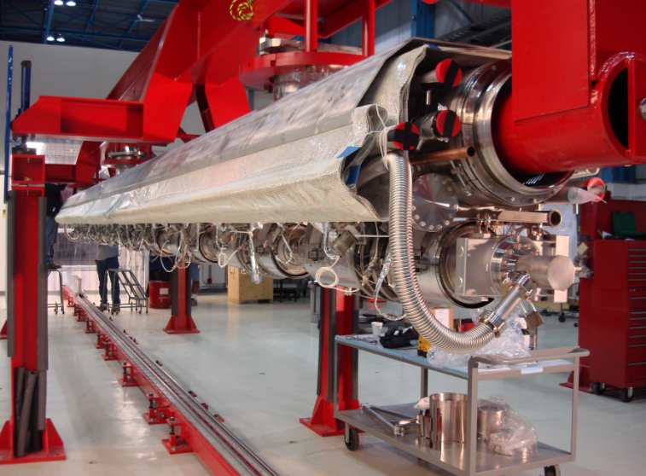
Project X and Lepton Collider Development Facilities at Fermilab

Slide 28
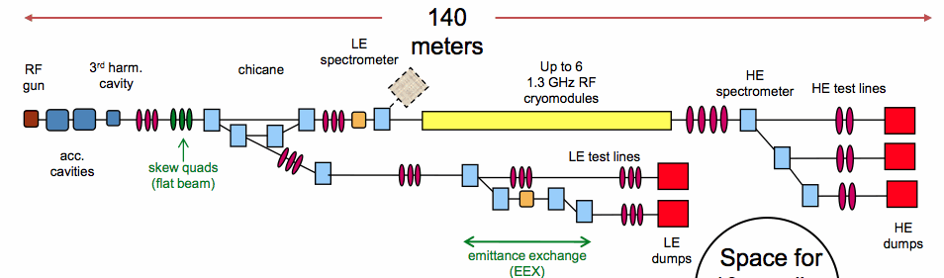



Accelerator System Test / Research Facility

Slide 29
Project Timeline
R&D
Construction
Operations
Uncertainties in LBNE and Project X

Slide 30
Running Experiments
Shutdown: May. 2012 – Mar. 2013
Shut-down
Running with a partial detector

Slide 31
Fermilab’s Scientific Plan
NuMI (120 GeV):
350 kW
Booster (8GeV): 35 kW
NuMI (120GeV):
700 kW
Booster (8GeV): 80 kW
Project-X:
>2MW @ 120 GeV
3MW @ 3 GeV
150 kW @ 8 GeV
Neutrino Factory
2010s +
DM (~100kg)
DE (DES)
Cosmic Particles Holometer, …
2020s +
DM (~ton scale)
DE (LSST)
New initiatives
Beyond
To be determined
LHC
Tevatron
LHC Upgrades in
luminosity and energy
Lepton Colliders
Data Analysis + Technology Research and Development

Slide 32
Fermilab’s Scientific Plan
MINOS
MiniBooNE
SciBooNE
LBNE + other ν’s
Muon program
Kaon program
New physics with nuclei
Energy Applications
Neutrino Factory
2010s +
DM (~100kg)
DE (DES)
Cosmic Particles Holometer, …
2020s +
DM (~ton scale)
DE (LSST)
New initiatives
Beyond
To be determined
MINOS+
NOvA
MINERvA
MicroBooNE
Mu2e
Muon g-2
SeaQuest
LHC
Tevatron
LHC Upgrades in
luminosity and energy
Lepton Colliders
Data Analysis + Technology Research and Development

Slide 33

Illinois Accelerator Research Center (IARC)
Ground Breaking on December 16, 2011
Construction ends by the end of 2013
CDF Assembly / Collision Hall
New building
Accelerator science, technology, education, partnerships with industry

Slide 34
IARC: The Opportunity for Fermilab
Opportunity to put substance behind the claim that HEP is the developer/steward of accelerator technology within the Office of Science
Opportunity to function as a center for accelerator based projects ( e.g. Project X, or other non-HEP Projects in the Office of Science, e.g. NGLS,FRIB) and to partner with other labs (e.g. ANL)
Opportunity for Fermilab (and ANL) to become a National center for accelerator education
Opportunity to establish additional funding sources outside HEP or with industry develop IP
Opportunity to develop technologies that benefit society bringing recognition to the DOE SC lab.s and to Fermilab

Slide 35
IARC: The Opportunity for Industry
Fermilab has:
  a world-leading accelerator engineering and scientific staff that have the potential to make an impact beyond the field of high-energy physics.
  core capabilities and infrastructure that are unique, and that could potentially be used in application beyond the field of high-energy physics.
  And will have the IARC physical plant in 2013-2014
Industry can leverage these assets to create new accelerator based products and capabilities

Slide 36
The budget
Extremely tight this year at $393M
Very bad budget in the President’s FY13 budget request. Essentially a $30M cut from this year’s budget and from expected profiles (LBNE -$25M; Mu2e -$5M; ILC -$6M; +$5M help in R&D)
OHEP went to OMB initially with a significant ramp up for FY12 that was killed. So was the request to continue ILC R&D. To get the ramp-up OHEP squeezed many budget categories. We need to adjust, at least partially, during FY12.

Slide 37
Some concluding remarks
A very strong, world leading program in neutrinos and rare processes
That will come under tremendous stress with the proposed budget for FY2013
Reduction of the base and of staff → large fixed costs implies indirect costs are likely to go up
Very difficult planning: getting new large projects via squeeze like we did with LBNE in the early part of the projects can be a prescription for disaster
We need to propose a phased approach/alternative that that is sufficiently attractive for Office of Science to invest in these tough

Slide 38
END

Slide 39

The Intensity Frontier
The present theory is a remarkable intellectual construction
But is not complete; can not answer many deep questions
2020s
2010s
now

Slide 40

Fermilab Accelerator Complex (until Sept 30, 2011)
Energy Frontier
Intensity Frontier
SCRF Test Facility
neutrino beams
testbeam
proton beam
Muon Test Facility
anti-proton accelerators
Neutron cancer center
Tevatron
Main Injector
Recycler

Slide 41
Intensity Frontier (this decade)
More powerful neutrino beams
New muon beams
SCRF Test Facility
neutrino beams
testbeam
proton beam
Muon Test Facility
muon beams
Neutron cancer center
Tevatron
Main Injector
Recycler

Slide 42
Intensity Frontier:
Developing programs for 2020s and beyond
LBNE
(Long Baseline Neutrino Experiment)
Project X

Slide 43
Other items

Slide 44
DOE Underground Science Committee
Charge by Bill Brinkman
Help define cost-effective options for planned underground experiments, and strategies for implementing a world-class program of underground science, consistent with SC’s mission in High Energy and Nuclear Physics
  Experiments – long baseline neutrino experiment (LBNE), 3rd generation dark matter (DM), 1-ton scale neutrinoless double-beta decay (DBD)
  Assess cost and schedule estimates for deploying these experiments
  Review will provide the “baseline” needed for budget planning and discussion of strategies going forward.

Slide 45
Summary of the DOE Committee
May 2011
The committee believes there are compelling scientific motivations for all three experiments and an important opportunity for the U.S. to take a leadership position for the foreseeable future.
There are important advantages and opportunities in developing a common site for these experiments if the needed infrastructure can be shared in a cost effective manner.
A common site only works in the scenario where LBNE has one or more detectors at 4850ft at Homestake.
If no LBNE at Homestake 4850ft level, DBD and DM are not cost effective at Homestake

Slide 46
NRC Committee on DUSEL: Summary
July 2011
The proposed DUSEL offers:
  Excellent science program
  Strong programmatic impact
The value of the whole is greater than the sum of the parts.
  Merits of: stewardship, addressing need in the international context, education/outreach
The cost of the whole is less than the sum of the parts.
  Merits of co-location.
If the proposed DUSEL cannot be achieved, strive to:
  Develop the 3 major physics experiments
  Benefit from co-location and stewardship
Prepublication version of report: http://www.nap.edu/catalog.php?record_id=13204

Slide 47
New Project: LBNE Status
Determine the far detector technology
  By December 2011
Establish a governance model for the underground facility
  By early 2012
CD-1 (preliminary baseline range)
  late 2012

Slide 48

New Project: MicroBooNE and Mu2e
MicroBooNE: received CD-2 (performance baseline) / 3a (start of construction) in Sept. 2011
Mu2e
  CD-1 Lehman review was scheduled mid December, but it is postponed by ~6 months (cost issue): good progress made with alternative solutions

Slide 49
Congressional Language: Accelerator R&D
The Committee understands that powerful new accelerator technologies created for basic science and developed by industry will produce particle accelerators with the potential to address key economic and societal issues confronting our Nation. However, the Committee is concerned with the divide that exists in translating breakthroughs in accelerator science and technology into applications that benefit the marketplace and American competitiveness. The Committee directs the Department to submit a 10-year strategic plan by June 1, 2012 for accelerator technology research and development to advance accelerator applications in energy and the environment, medicine, industry, national security, and discovery science. The strategic plan should be based on the results of the Department’s 2010 workshop study, Accelerators for America’s Future , that identified the opportunities and research challenges for next-generation accelerators and how to improve coordination between basic and applied accelerator research. The strategic plan should also identify the potential need for demonstration and development facilities to help bridge the gap between development and deployment.

Slide 50
Congressional Language: Intensity Frontier
…the Committee understands that the United States has an opportunity to lead in the intensity frontier. Specifically, the United States has unique capabilities that should be exploited to develop a world-leading program of neutrino science to understand the role neutrinos play in the evolution of the universe and design new particle beams and highly sensitive detectors to advance this area of science. The Committee directs the Office of Science to submit a report not later than 180 days of enactment that lays out
  the expected benefits of intensity frontier science,
  a strategy for maintaining the U.S. lead, and
  the funding needs over the next 10 years, including construction activities, of implementing the proposed strategy.

Slide 51
DOE OHEP Response
Task forces, workshops to help formulate OHEP response
Intensity Frontier workshop
  Nov 30 – Dec 2, Rockville Hilton, www.intensityfrontier.org
Accelerator taskforce being formed

