Slide 1
Accelerators at Fermilab
Young-Kee Kim the 7th IDS-NF Plenary Meeting
October 17, 2011

Slide 2
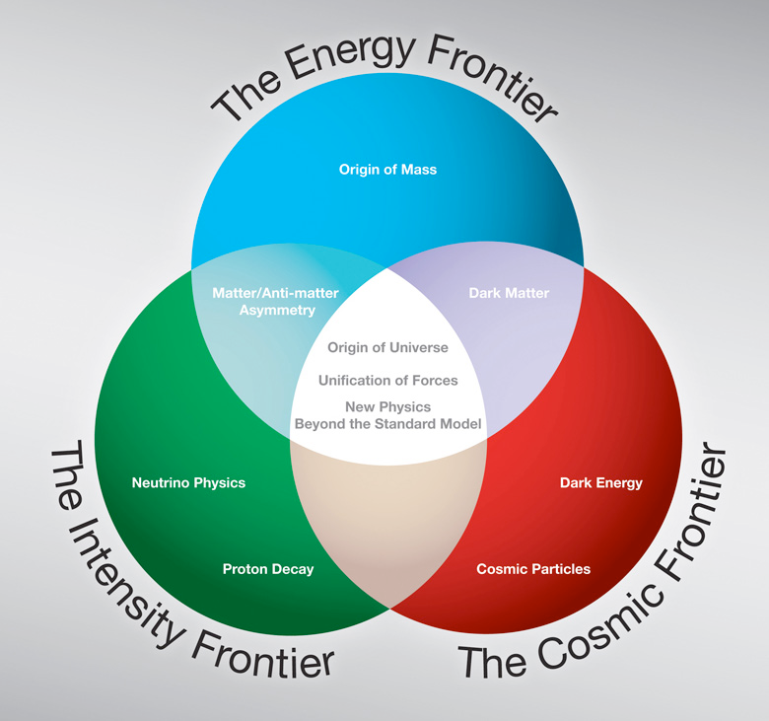
Fermilab program expressed in three frontiers

Slide 3
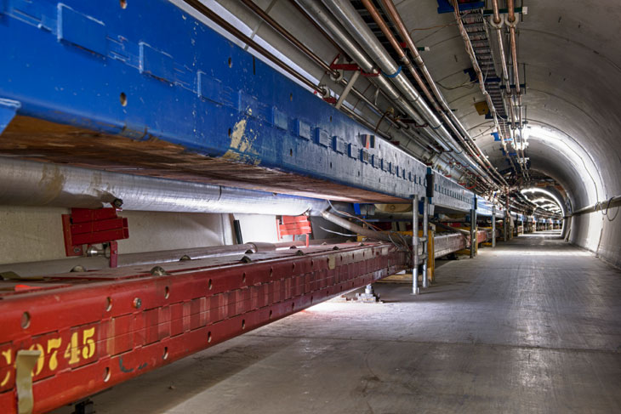
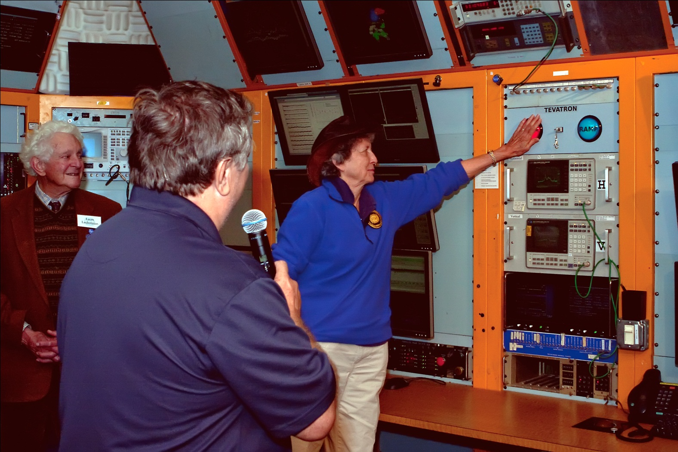
The Energy Frontier: The Tevatron
We just shut down the Tevatron down at ~2:30 pm, Friday, September 30, 2011; the analysis will continue for several years
shut down at ~2:30 pm, Sept. 30th after 28 years of operations
Tevatron Symposium
Monday, June 11, 2012

Slide 4
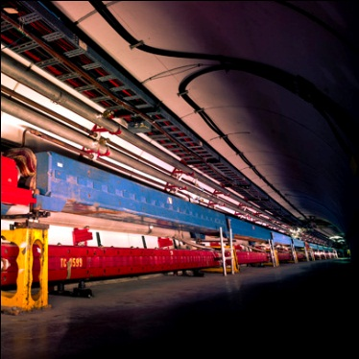
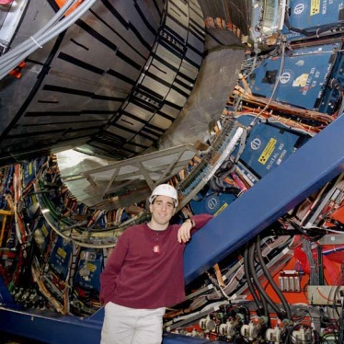
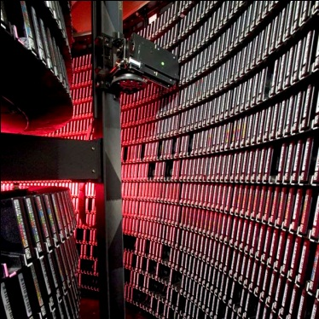
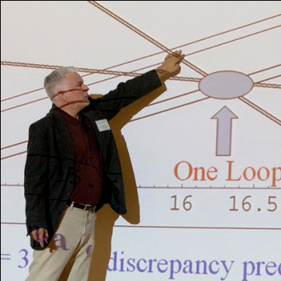
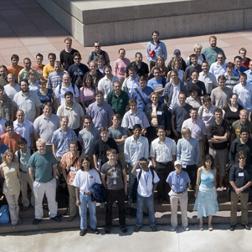
Completion of an era: Tevatron
Accelerator Innovations
  First major SC synchrotron
  Industrial production of SC cable (MRI)
  Electron cooling
  New RF manipulation techniques
Detector innovations
  Silicon vertex detectors in hadron environment
  LAr-U238 hadron calorimetry
  Advanced triggering
Analysis Innovations
  Data mining from Petabytes of data
  Use of neural networks, boosted decision trees
  Major impact on LHC planning and developing
  GRID pioneers
Major discoveries
  Top quark
  B_{s} mixing
  Precision W and Top mass → Higgs mass prediction
  Direct Higgs searches
  Ruled out many exotica
The next generation
  Fantastic training ground for next generation
  More than 500 Ph.D.s
  Produced critical personnel for the next steps, especially LHC

Slide 5
Data Analysis at the Tevatron
Low mass Higgs
  Direct searches: LEP, Tevatron, LHC
    114 GeV/c² – ~140 GeV/c² not excluded (95% CL)
  This is the mass range favored by the top quark and W boson mass measurements
  Search strategy (now)
    Tevatron: dominated by H → bb
    LHC: dominated by H → γγ
    Data analysis by this winter will be able to exclude this region if Higgs is not there!
_

Slide 6
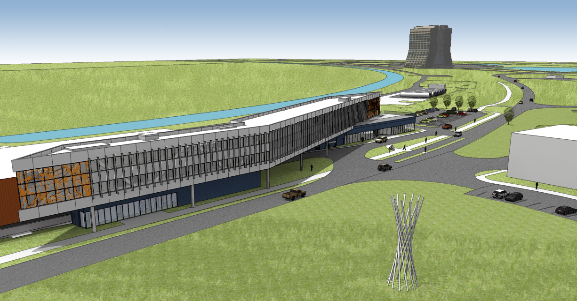
Illinois Accelerator Research Center
Construction of IARC (2011 – 2012)
CDF Assembly / Collision Hall
New building
Elements: Office, Education and Technical building, High Bay Space (existing CDF building), Additional parking lots
Close proximity to the industrial area of the lab.
Accelerator: Research (S&T), education, partnerships with industry

Slide 7

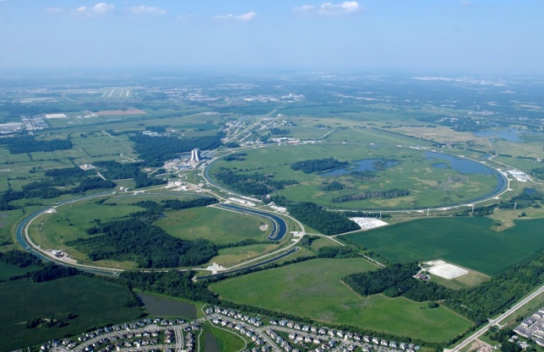
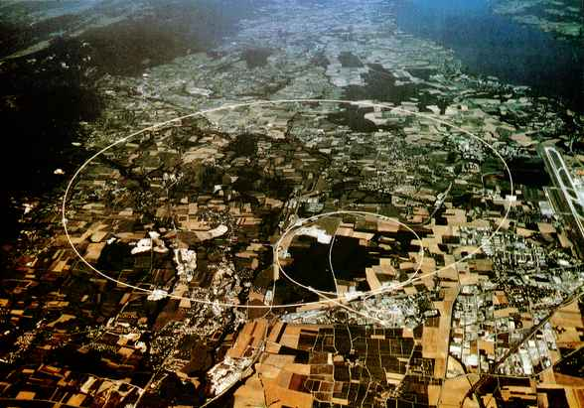
Fermilab and LHC: Accelerators and Experiments
CMS Tier-1 Computing Center, LHC Physics Center, Remote Operation Center
Supporting the US Community
Fermilab
CERN
Tevatron
LHC
Lepton Collider
(energy to be determined)
(technology, site to be determined)
Notes:
0166734314

Slide 8
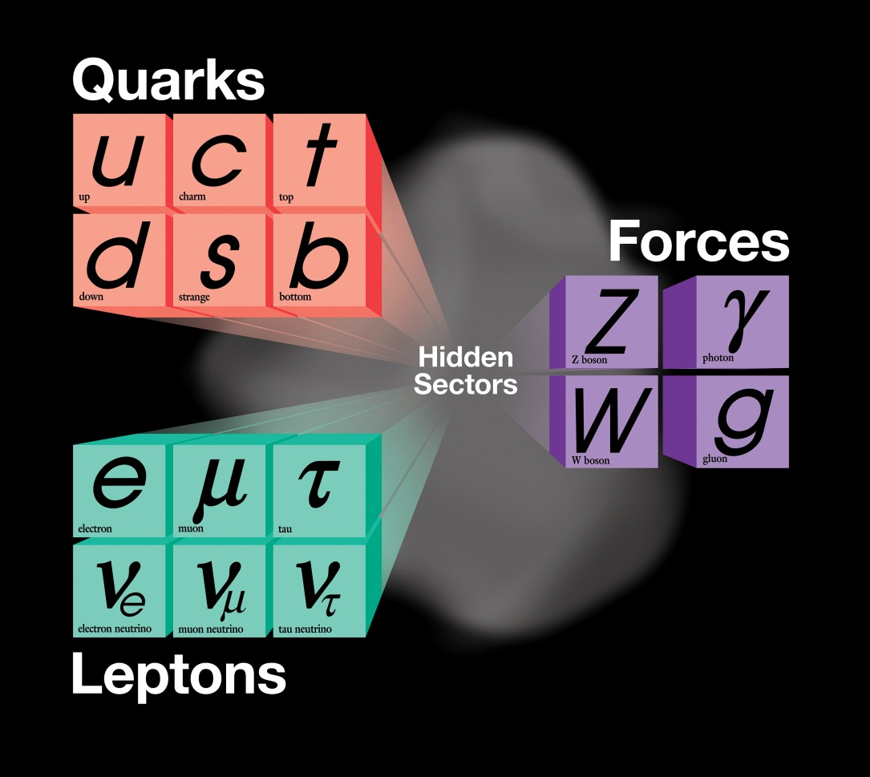
The Intensity Frontier
The present theory is a remarkable intellectual construction
But is not complete; can not answer many deep questions
2020s
2010s
now

Slide 9
Intensity Frontier: Neutrinos(this decade)
“Known
unknowns”
ν SM: Pattern of neutrino masses and mixings
  Long baseline experiments:
  MINOS (735 km) → NOvA (810 km)
Beyond ν SM: Explore cracks in our understanding: sterile neutrinos? Anomalous interactions?
  Short baseline experiments: MiniBooNE → MicroBooNE
  Long baseline experiments: MINOS → MINOS+
Neutrino physics measurements as a probe of nuclear structure and support of oscillation experiments
  Dedicated experiment: MINERvA
MINOS+ (735km)
“Unknown
unknowns”

Slide 10
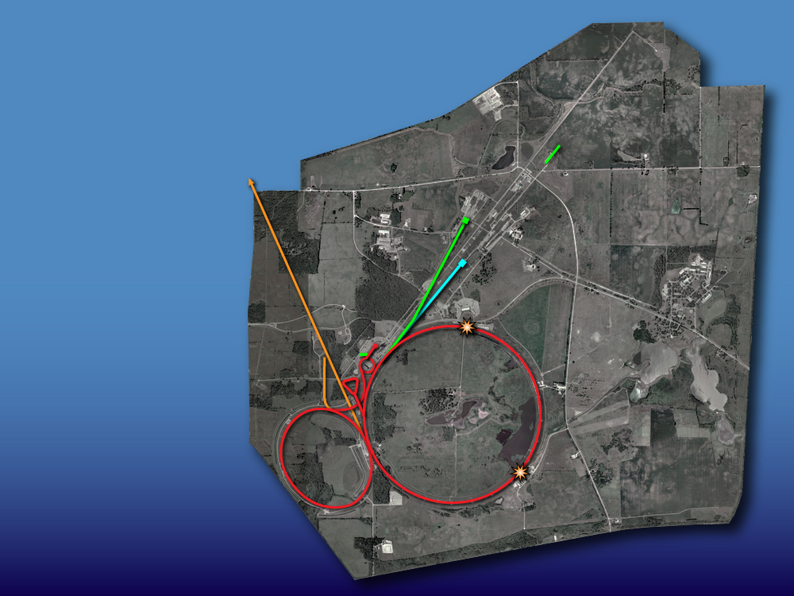
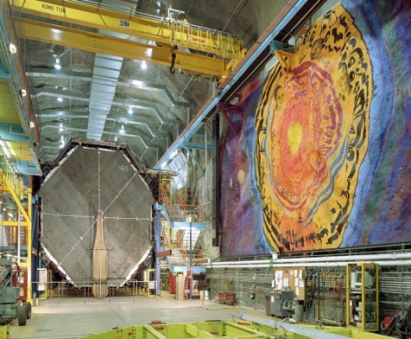
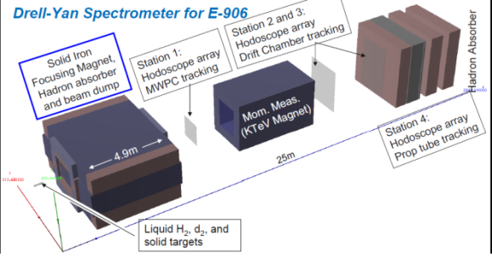
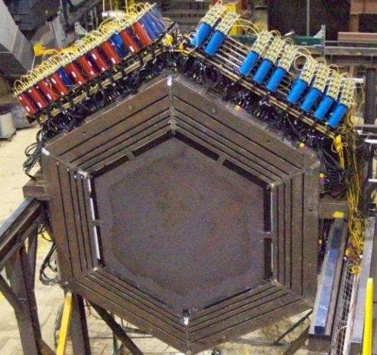

The Intensity Frontier: Now
SCRF Test Facility
(Integrated program for Project X and ILC)
Neutrino beams
MINOS
Testbeam
Proton beam
SeaQuest
Muon Test Facility
MINERvA
Accumulator,
Debuncher
Neutron cancer center
Tevatron
Main Injector,
Recycler
Mini
BooNE

Slide 11
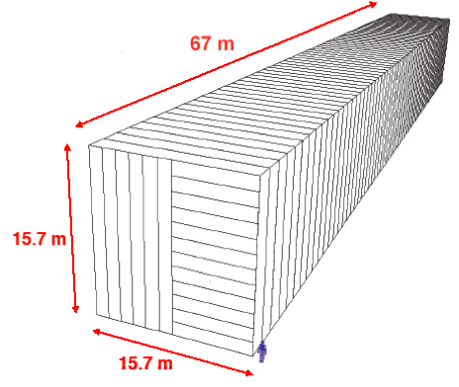
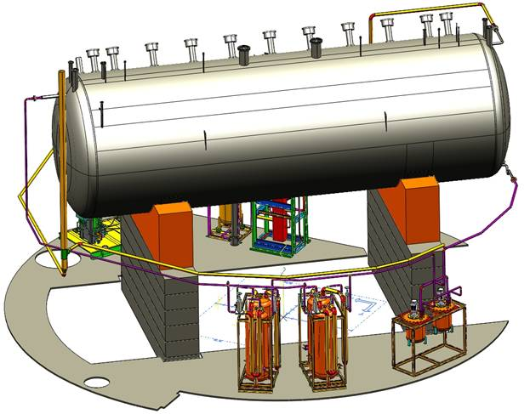
The Intensity Frontier: NOvA era (2013 ~ )
SCRF Test Facility
(Integrated program for Project X and ILC)
NOvA
Neutrino beams
MINOS+
Testbeam
Proton beam
SeaQuest
Muon Test Facility
MINERvA
Accumulator,
Debuncher
Neutron cancer center
Tevatron
Main Injector,
Recycler
MicroBooNE
Mini
BooNE
(TBD)

Slide 12
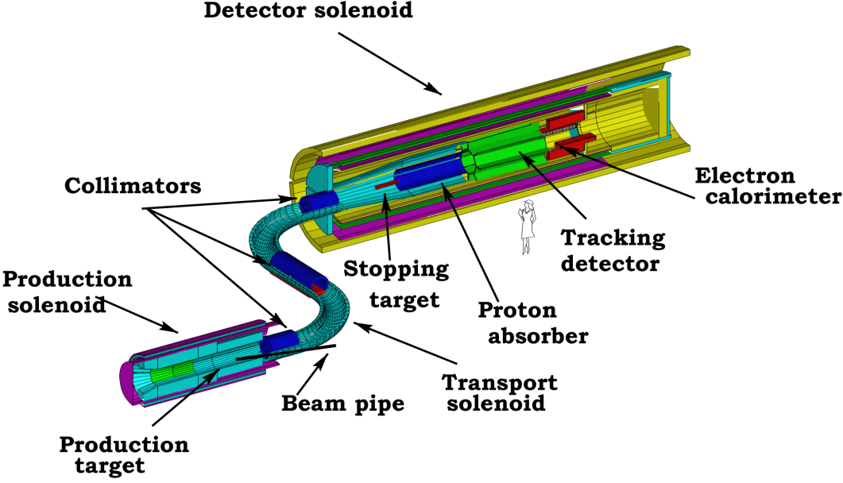
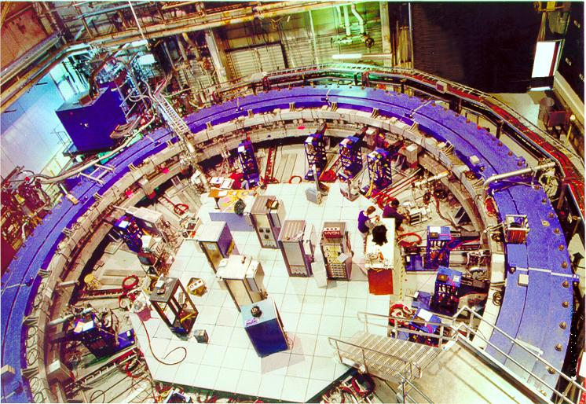
The Intensity Frontier: adding muon programs (2010s +)
SCRF Test Facility
(Integrated program for Project X and ILC)
LHC and Rare Processes:
New Terascale LHC discovery will raise flavor and unification questions; Determine/verify structure
  New Physics at scales beyond LHC
Neutrino beams
Testbeam
Proton beam
Muon Test Facility
Muon g-2
Accumulator,
Debuncher
Neutron cancer center
Tevatron
Main Injector,
Recycler
Mu2e

Slide 13
2020s +
proton-accelerator program:
LBNE
Project X: accelerators and experiments
R&D
construction
in this decade

Slide 14
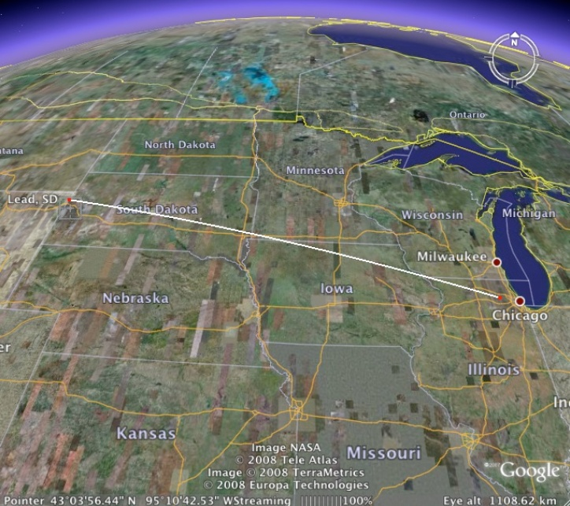
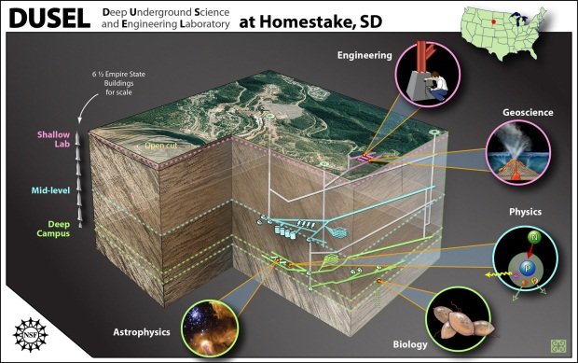
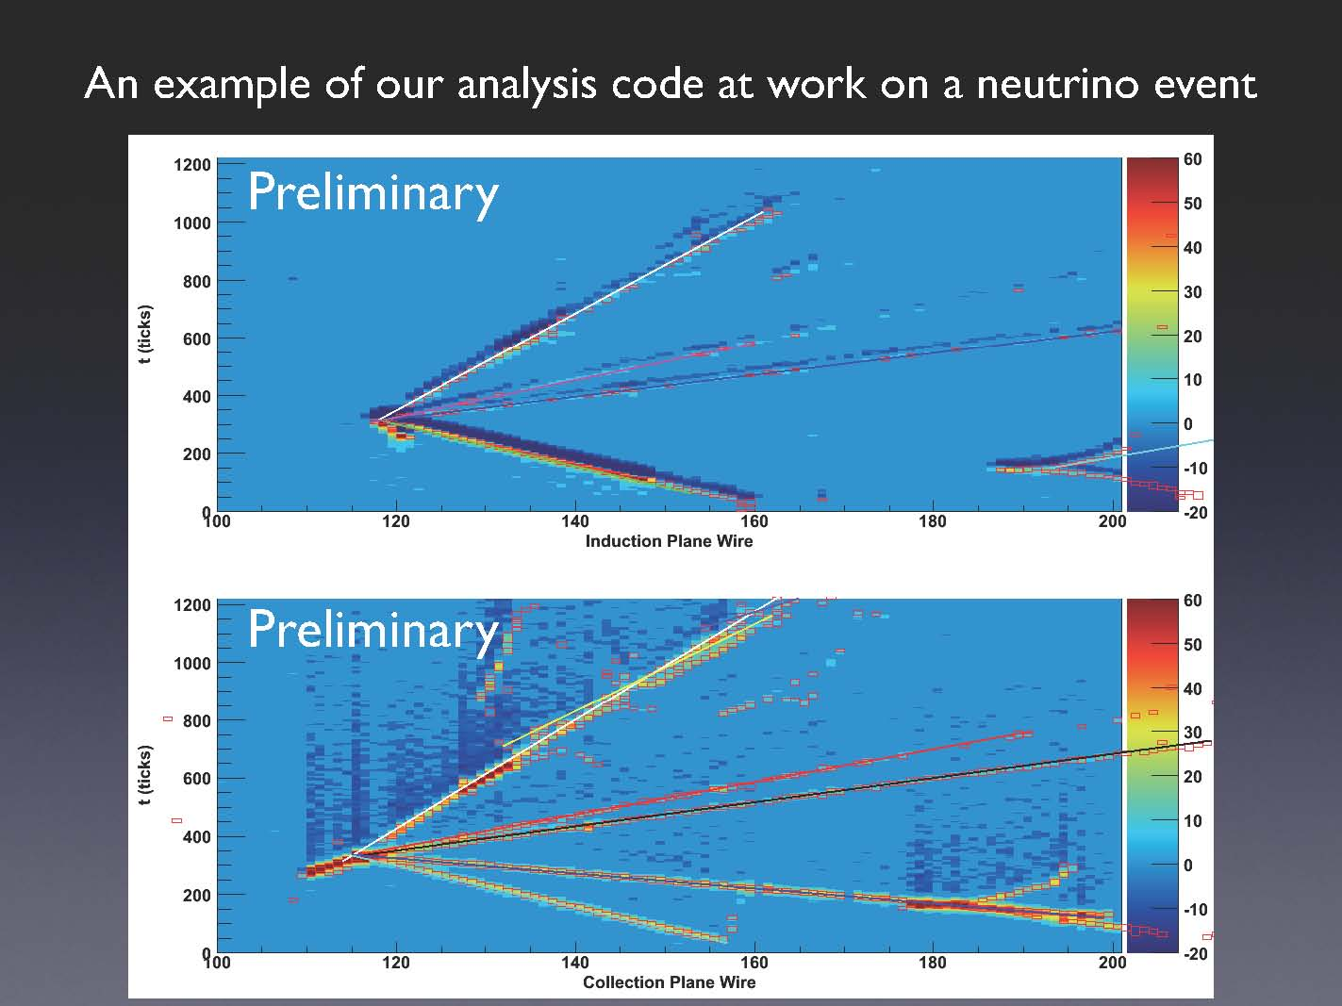
LBNE (Long Baseline Neutrino Experiment):
318 members from 58 institutions from India, Italy, Japan, UK, US
Continue to grow!
1300 km
~200 kton
Water Cerenkov
(Super K)
~34 kton Liquid Ar TPC
ICARUS
ArgoNeuT
MicroBooNE
Matter – Antimatter Asymmetry with Neutrinos
Proton Decay
Supernovae Neutrinos
Notes:
14

Slide 15
Other physics with LBNE detectors
Proton decay
Atmospheric neutrino oscillations
Supernovae neutrinos
Short baseline neutrino physics
WC
LAr

Slide 16
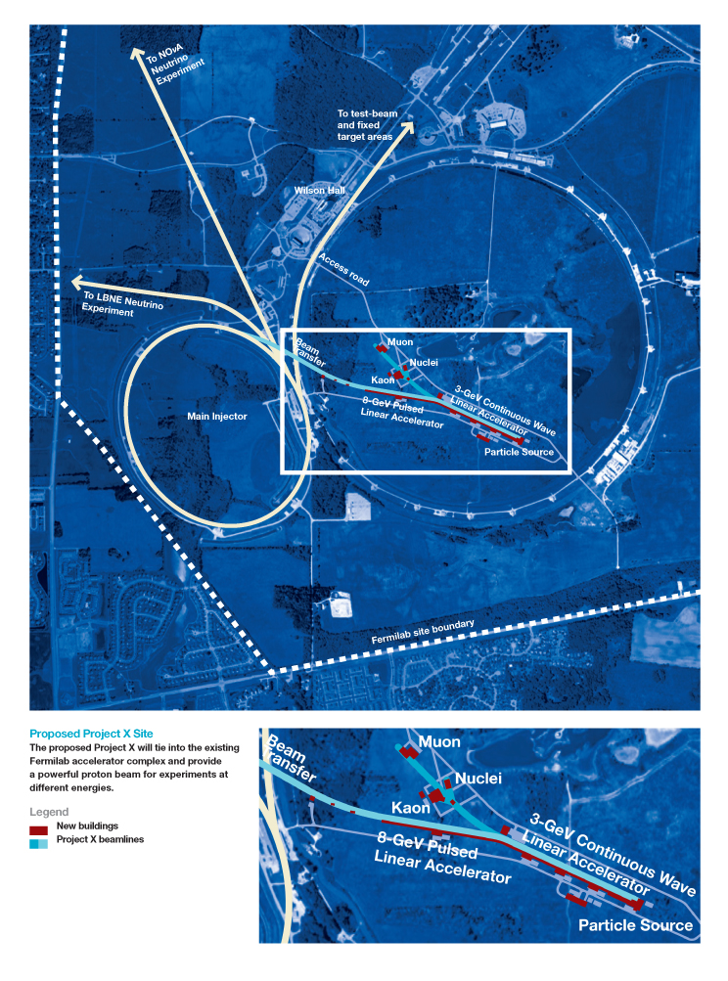
Project X: 5 MW Proton Accelerator
LBNE
Neutrino program
Muon program
Kaon program
New physics with nuclei
Energy applications

Slide 17
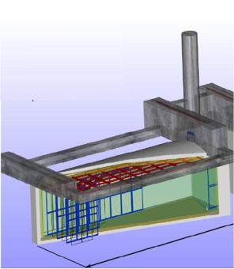
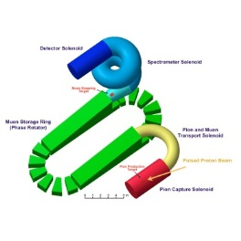
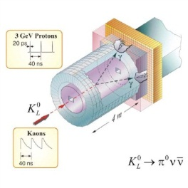
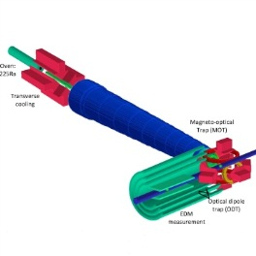
Project X and the big questions
Where does mass come from?
Why is matter dominant?
What are the neutrino masses and what do they say?
  Where are the heavy neutrino partners?
  Why are there three families of quarks and leptons?
  Do the forces unify?
  Does nature use supersymmetry or other new symmetries?
  Are there extra dimensions of space?
  What is dark matter?
  What is dark energy?
neutrinos
muons
kaons
Nuclei
(EDMs..)

Slide 18
Fermilab Accelerator-based Program
NuMI (120 GeV):
350 kW
Booster (8GeV): 35 kW
NuMI (120GeV):
700 kW
Booster (8GeV): 80 kW
Project-X:
>2MW @ 120 GeV
3MW @ 3 GeV
150 kW @ 8 GeV
Neutrino Factory
2010s +
2020s +
Beyond
LHC
Tevatron
LHC Upgrades in
luminosity and energy
Lepton Colliders
Technology Research and Development

Slide 19
Fermilab Accelerator-based Program
MINOS
MiniBooNE
SciBooNE
LBNE + other ν’s
Muon program
Kaon program
New physics with nuclei
Energy Applications
Neutrino Factory
2010s +
2020s +
Beyond
Project X:
MINOS+
NOvA
MINERvA
MicroBooNE
Mu2e
Muon g-2
SeaQuest
LHC
Tevatron
LHC Upgrades in
luminosity and energy
ILC
Muon Collider
Technology Research and Development
MAP (Muon Accelerator Program)

Slide 20
The Muon Accelerator Program (MAP)
Mission
  “…to develop and demonstrate the concepts and critical technologies .. for Muon Colliders and Neutrino Factories.”
Goal
  “… to deliver results that will permit the high energy physics community to make an informed choice of the optimal path to a high-energy lepton collider and/or a next-generation neutrino beam facility…”
Organization
  Requested by DOE Office of HEP (in 2009) for a U.S. Muon Collider & Neutrino Factory R&D program hosted at Fermilab.
  Organization is in place & functioning: >200 participants from 15 institutions: http://map.fnal.gov/

Slide 21
The Muon Accelerator Program (MAP)
R&D Plan and Deliverables
  Deliver on commitments to making MICE and the IDS-NF studies a success.
  Focus on key technology development and testing
    RF cavities in magnetic fields
    High-field solenoids for final cooling
    Collider ring magnets configurations that can handle heat-loads

Slide 22
The Muon Accelerator Program (MAP)
R&D Plan and Deliverables (cont.)
  Deliver a Design Feasibility Study to enable the community to judge the feasibility of a multi-TeV Muon Collider (~FY16):
  Coordinate with the physics community on Muon Collider physics capabilities, detector and MDI

Slide 23
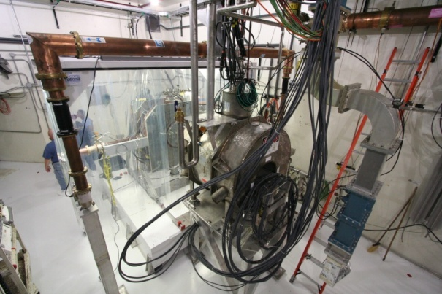
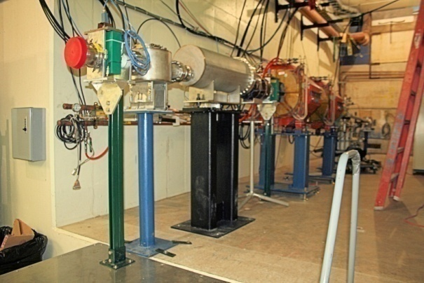
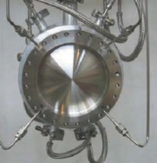
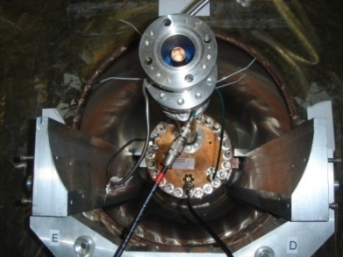
The Muon Accelerator Program (MAP)
MuCool Test Area (MTA) at Fermilab
  One of the most important challenges is demonstrating feasibility of high-gradient RF cavity operation in the presence of strong magnetic fields
  MTA: the end of Linac to provide a platform for ionization cooling component testing with a particle beam (recently commissioned)
  Brings together high power RF systems, cavities, 5T solenoid, LH₂ handling and 400 MeV proton beam
Liq. H₂ absorber
(KEK)
High Pressure RF Cavity (FNAL & Muons Inc.)

Slide 24
Conclusion: Fermilab Accelerator-based Program
MINOS
MiniBooNE
SciBooNE
LBNE + other ν’s
Muon program
Kaon program
New physics with nuclei
Energy Applications
Neutrino Factory
2010s +
2020s +
Beyond
Project X:
MINOS+
NOvA
MINERvA
MicroBooNE
Mu2e
Muon g-2
SeaQuest
LHC
Tevatron
LHC Upgrades in
luminosity and energy
ILC
Muon Collider
Technology Research and Development
MAP (Muon Accelerator Program)

