Slide 1
Hard and Important
The Challenges of Teaching (Physics) and What We Should Do
To Improve It
Sam Dyson
Senior Instructional Specialist, Science
Chicago Public Schools
Notes:
When I arrived on the scene it was like entering a room in which the conversation about public secondary education had just begun. This talk is about why it is that so many of the problems we face in education are 100 years old.
If your interested in learning about how you might improve you physics teaching, I’m afraid I may disappoint you. If, however, you are interested in why the challenges of physics teaching seem at times intractable, I may say something of interest to you. In any case, I’m leaving time at the end for conversation about some of the points I will raise and I hope you will challenge my assertions.

Slide 2
My Path to This Conversation
BA → SA → CfA (MF) → MEd → WPCP → IMSA (CQ) → GA → CPS → PhD?

Slide 3
Questions to Ponder
Why are we still so clueless?
Our ignorance can be divided into problems and mysteries. When we face a problem, we may not know its solution, but we have insight, increasing knowledge, and an inkling of what we are looking for. When we face a mystery, however, we can only stare in wonder and bewilderment, not knowing what an explanation would even look like. -Chomsky

Slide 4
Questions to Ponder
How does a profession evolve?
American Medical Education 100 Years after the Flexner Report:
All forms of professional education share the goal of readying students for accomplished and responsible practice in service to others. Thus, professionals in training must master both abundant theory and large bodies of knowledge; the final test of their efforts, however, will be not what they know but what they do.
Cognitive psychology has demonstrated that facts and concepts are best recalled and put into service when they are taught, practiced, and assessed in the context in which they will be used.

Slide 5
Questions to Ponder
Why are we still so clueless?
From Mysteries to Problems
How does a profession evolve?
From Problem-Constrained to Problem-Driven
How do we reconcile the successes of physics research with the failures of (physics) education?

Slide 6
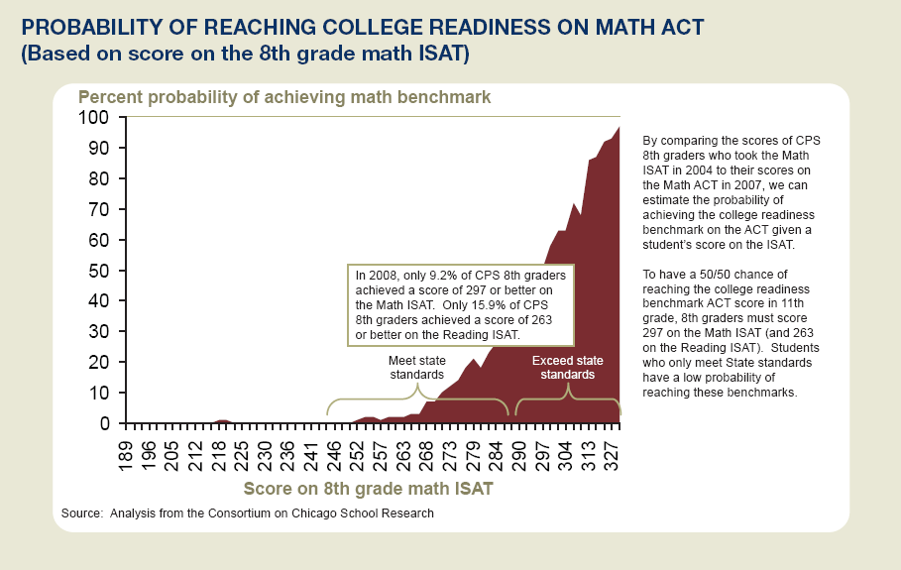

Slide 7
2009 CPS AP Participation
 | Number of AP Test Takers (and As Percentages of Entire CPS HS Subgroup Enrollments, incl. Charter)
Subgroup (w/ CPS HS Enrollment) | Stats | Calc AB | Calc BC | Bio | Chem | Env Sci | Phys B | Phys C Mech | Phys C E&M
White (9,817) | 137 (1.40) | 160 (1.63) | 55 (0.56) | 179 (1.82) | 120 (1.22) | 101 (1.03) | 90 (0.92) | 18 (0.18) | 18 (0.18)
Asian (4,338) | 126 (2.90) | 211 (4.86) | 56 (1.29) | 165 (3.80) | 153 (3.53) | 101 (2.33) | 103 (2.37) | 21 (0.48) | 19 (0.44)
Black (59,089) | 293 (0.50) | 223 (0.38) | 7 (0.01) | 270 (0.46) | 122 (0.21) | 183 (0.31) | 82 (0.14) | 17 (0.03) | 4 (0.01)
Chicano (23,228*) | 184 (0.79) | 239 (1.03) | 16 (0.07) | 242 (1.04) | 111 (0.48) | 95 (0.41) | 72 (0.31) | 5 (0.02) | 5 (0.02)
Puerto Rican (4142*) | 39 (0.94) | 34 (0.82) | 3 (0.07) | 58 (1.40) | 17 (0.41) | 18 (0.43) | 15 (0.36) | 1 (0.02) | 1 (0.02)
Native American (197) | 2 (1.02) | 1 (0.51) | 0 (0.00) | 4 (2.03) | 1 (0.51) | 2 (1.02) | 1 (0.51) | 0 (0.00) | 0 (0.00)
* Initial enrollment estimates based on 2008 Racial Ethnic Survey data; %s likely larger than actual

Slide 8
2009 CPS AP Participation Summary
AP participation varies by subgroup by > 10 x
In AP Calculus and Physical Sciences
more than 6% of Asian CPS students took them
compared to less than 0.4% of Black CPS students

Slide 9
2009 CPS AP Performance
 | Mean Score (on a scale from 1 to 5)
 | Stats | Calc AB | Calc BC | Bio | Chem | Env Sci | Phys B | Phys C Mech | Phys C E&M
White | 3.2 | 2.6 | 3.9 | 2.8 | 2.5 | 2.7 | 2.4 | 3.2 | 3.1
Asian | 2.8 | 2.4 | 3.6 | 2.6 | 2.3 | 2.3 | 2.3 | 3.5 | 3.1
Black | 1.2 | 1.3 | 2.4 | 1.2 | 1.3 | 1.3 | 1.3 | 1.7 | 3.3
Chicano | 1.4 | 1.4 | 2.6 | 1.3 | 1.6 | 1.6 | 1.4 | 3 | 3.2
Puerto Rican | 1.5 | 1.5 | 2.3 | 1.4 | 1.4 | 1.4 | 1.3 | 4.0 | 2.0
Native American | 3.0 | 3.0 | -- | 1.5 | 1.0 | 1.0 | 1.0 | -- | --

Slide 10
Clarifying What We Mean By…
“Hard”
Multi-dimensional
Several inputs
Cognitively Complex
Not obvious
Process-Dependent
Hidden

Slide 11
Some of the best teaching is indirect…. This process is inaccessible to direct observation by an outside person in the same way as our internal bodily processes are to a medical practitioner. In both these cases, a person who intervenes without an adequate mental image of what is going on inside is as likely to do harm as good.
-Richard R. Skemp
The Psychology of Learning Mathematics

Slide 12
Clarifying What We Mean By…
“Hard”
“Important”
Multi-dimensional
Several inputs
Cognitively Complex
Not obvious
Process-Dependent
Hidden
Important/High-Stakes
Lives Depend on It
Combats Financial Poverty
Combats Intellectual Poverty

Slide 13
The Astronaut and the Teacher: Training Appropriate for the Task

Slide 14
In Problem-Driven Professions…
Agreement About What the Problems Are
Clearly Defined Terms
Communication Between Researchers and Practitioners

Slide 15
How Do We Get There From Here?

Slide 16
The Strategy
“We have the opportunity to become the premier urban district.”
Dr. Barbara Eason-Watkins
CPS Chief Education Officer
Achievement Strategy—Building the Foundation
Advancement Strategy—Nurturing Excellence

Slide 17
Project Goals and Audiences
To design and execute a program that demonstrates:
(1) Training teachers as collaborative problem solvers will transform teaching into a problem-driven rather than problem-limited profession.
Middle and High School Teachers
Committed core
(2) Excellent scholarship by underrepresented students in math and science is a necessary component and catalyst of our success.
Entering 6th to entering 12th graders
Students of high need and potential

Slide 18
Summer Component
Summers Before Each Grade Level | Seven-Year Student Growth Plan | Four- to Five-Year (min) Teacher Growth Plan | Teacher Proficiency Level
6th 7th | • Pre-Algebra • Intro to scientific inquiry | • Obtain endorsements from partner universities • Attend summer teacher session for graduate credit • Assist and co-teach summer student session • Receive academic year coaching | Fellow (1 yr as needed)
8th 9th | • Algebra and proportional reasoning • Intro to experimental design • College visits | • Attend summer teacher sessions for grad credit • Co-teach summer student session • Participate in academic year teaming • Continue optional graduate level courses • Participate in one optional “sabbatical summer” of lab research | Resident (3 yr min)
10th 11th 12th | • Math and science leading to AP-level calculus and science course • Grade 11 summer living on university campus • Grade 12 summer research fellowship | • Co-plan and teach teacher summer sessions • Direct student summer research internships • Provide academic year mentorship | (1 yr min)

Slide 19
Summer Component
Summers Before Each Grade Level | Seven-Year Student Growth Plan | Four- to Five-Year (min) Teacher Growth Plan | Teacher Proficiency Level
6th 7th | • Pre-Algebra • Intro to scientific inquiry | • Obtain endorsements from partner universities • Attend summer teacher session for graduate credit • Assist and co-teach summer student session • Receive academic year coaching | Fellow (1 yr as needed)
8th 9th | • Algebra and proportional reasoning • Intro to experimental design • College visits | • Attend summer teacher sessions for grad credit • Co-teach summer student session • Participate in academic year teaming • Continue optional graduate level courses • Participate in one optional “sabbatical summer” of lab research | Resident (3 yr min)
10th 11th 12th | • Math and science leading to AP-level calculus and science course • Grade 11 summer living on university campus • Grade 12 summer research fellowship | • Co-plan and teach teacher summer sessions • Direct student summer research internships • Provide academic year mentorship | (1 yr min)

Slide 20
Summer Component
Summers Before Each Grade Level | Seven-Year Student Growth Plan | Four- to Five-Year (min) Teacher Growth Plan | Teacher Proficiency Level
6th 7th | • Pre-Algebra • Intro to scientific inquiry | • Obtain endorsements from partner universities • Attend summer teacher session for graduate credit • Assist and co-teach summer student session • Receive academic year coaching | Fellow (1 yr as needed)
8th 9th | • Algebra and proportional reasoning • Intro to experimental design • College visits | • Attend summer teacher sessions for grad credit • Co-teach summer student session • Participate in academic year teaming • Continue optional graduate level courses • Participate in one optional “sabbatical summer” of lab research | Resident (3 yr min)
10th 11th 12th | • Math and science leading to AP-level calculus and science course • Grade 11 summer living on university campus • Grade 12 summer research fellowship | • Co-plan and teach teacher summer sessions • Direct student summer research internships • Provide academic year mentorship | (1 yr min)

Slide 21
Summer Component
Summers Before Each Grade Level | Seven-Year Student Growth Plan | Four- to Five-Year (min) Teacher Growth Plan | Teacher Proficiency Level
6th 7th | • Pre-Algebra • Intro to scientific inquiry | • Obtain endorsements from partner universities • Attend summer teacher session for graduate credit • Assist and co-teach summer student session • Receive academic year coaching | Fellow (1 yr as needed)
8th 9th | • Algebra and proportional reasoning • Intro to experimental design • College visits | • Attend summer teacher sessions for grad credit • Co-teach summer student session • Participate in academic year teaming • Continue optional graduate level courses • Participate in one optional “sabbatical summer” of lab research | Resident (3 yr min)
10th 11th 12th | • Math and science leading to AP-level calculus and science course • Grade 11 summer living on university campus • Grade 12 summer research fellowship | • Co-plan and teach teacher summer sessions • Direct student summer research internships • Provide academic year mentorship | (1 yr min)

Slide 22
Enrollment
Enrollment Targets | Students • Two 30-student classrooms at each grade level • 60 students per grade level | Teachers • 4 teachers and 1 mentor per classroom • 8 teachers + 2 mentors per grade level

Slide 23
Enrollment
Enrollment Targets | Students • Two 30-student classrooms at each grade level • 60 students per grade level | Teachers • 4 teachers and 1 mentor per classroom • 8 teachers + 2 mentors per grade level
 | Operation Year 1—2011 Grades 6 & 9
 | • 120 students | • 16 teachers + 4 mentors

Slide 24
Enrollment
Enrollment Targets | Students • Two 30-student classrooms at each grade level • 60 students per grade level | Teachers • 4 teachers and 1 mentor per classroom • 8 teachers + 2 mentors per grade level
 | Operation Year 1—2011 Grades 6 & 9
 | • 120 students | • 16 teachers + 4 mentors
 | Operation Year 2—2012 Grades 6, 7, 9, 10
 | • 240 students | • 32 teachers + 8 mentors

Slide 25
Enrollment
Enrollment Targets | Students • Two 30-student classrooms at each grade level • 60 students per grade level | Teachers • 4 teachers and 1 mentor per classroom • 8 teachers + 2 mentors per grade level
 | Operation Year 1—2011 Grades 6 & 9
 | • 120 students | • 16 teachers + 4 mentors
 | Operation Year 2—2012 Grades 6, 7, 9, 10
 | • 240 students | • 32 teachers + 8 mentors
 | Operation Year 3—2013 Grades 6 – 11
 | • 360 students | • 48 teachers + 12 mentors

Slide 26
Enrollment
Enrollment Targets | Students • Two 30-student classrooms at each grade level • 60 students per grade level | Teachers • 4 teachers and 1 mentor per classroom • 8 teachers + 2 mentors per grade level
 | Operation Year 1—2011 Grades 6 & 9
 | • 120 students | • 16 teachers + 4 mentors
 | Operation Year 2—2012 Grades 6, 7, 9, 10
 | • 240 students | • 32 teachers + 8 mentors
 | Operation Year 3—2013 Grades 6 – 11
 | • 360 students | • 48 teachers + 12 mentors
 | Operation Years 4+—2014 onward Grades 6 – 12
 | • 420 students | • 56 teachers + 14 mentors

Slide 27
Summer Institute Principles and Outcomes, 1
Guiding Principles |  | Desired Outcomes
• Successful math and science instruction in CPS requires a committed core of outstanding teachers and students throughout the district whose efforts produce exceptional scholarly achievement. | → | • Student scholarship and teacher practice will provide a model of excellence within the district by advancing math, science, and urban education nationally. • Teachers will demonstrate the ability to teach honors and college-level subjects for understanding. • Participating students will demonstrate college readiness by earning a 3 or better in AP Calculus and in one or more AP science courses during or before their senior year.
• Improving math and science instruction requires nurturing that “committed core.” | → | Summer residencies will give teachers ongoing, collaborative, in-the-field professional growth. • CPS and its partners will create a network of science and math teachers supported by regular meetings and online resources serving new and experienced teachers. • CPS students will receive academic-year supports through individual and group study sessions supporting a growing peer group.

Slide 28
Summer Institute Principles and Outcomes, 2
Guiding Principles |  | Desired Outcomes
• Learning for understanding is significantly different from learning to acquire information, differing both in method and outcome. | → | • The lessons prepared by teachers and the problems solved by students will reflect their ability to make new connections, an essential indicator of understanding.
• A teacher’s ability to implement and design experiences that lead students to construct their own understanding is an essential skill of rigorous instruction. | → | • Teachers and their mentors will collaboratively modify and create a curriculum supporting students’ efforts to construct novel intellectual connections.
• Although intellectual poverty is a greater obstacle to students’ future development than financial poverty, students’ intellectual potential will be more fully realized as their basic financial needs are met. | → | • Student and teacher pay and aggressive promotion of learning for understanding will result in greater than 90% student retention from the summer before 6th grade to the summer before 12th grade, excluding transfers out of CPS. • A significant positive shift in math and science attitudes and achievement will be observed relative to non-participant peers.
Notes:
need to add metric about summer learning loss

Slide 29
Another Model—Lesson Study
A strategy for collaborative problem-solving:
1. Team develops the research lesson
2. Live research lesson w/ one teacher, many observers
3. Post-lesson discussion w/ teacher-researchers and observers
Notes:
2:25 start of planning, 3:40 stop (1:15 tot)
5:38 start of lesson, 7:20 stop (1:42 tot)
11:50 start of reflection, 13:10 stop (1:20)

Slide 30
So What’s the Big Idea?
Even the best teachers in the best classrooms will encounter problems they can’t solve alone.
i.e. Teaching is hard.
Problems should be a source of progress, not the barrier thereto.
The training should suit the difficulty and importance of the task.

Slide 31
Thank you, Chris!

