Slide 1

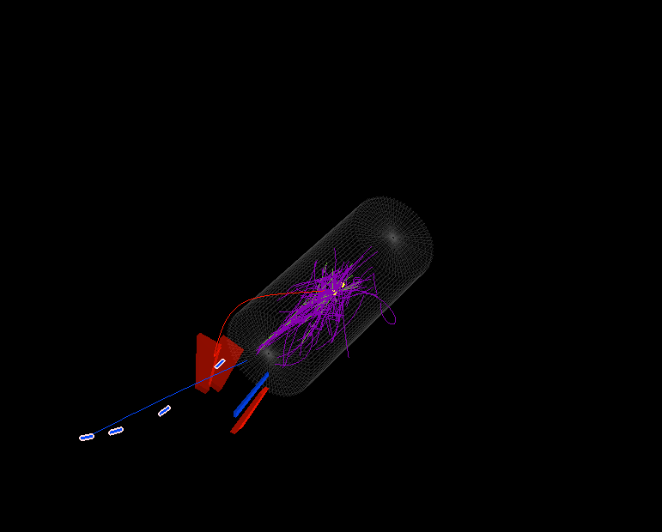
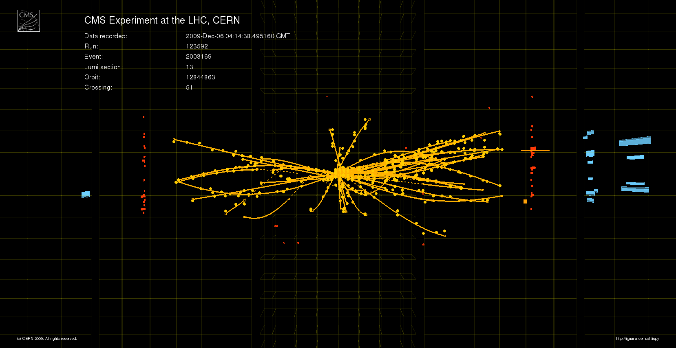

CMS Growing UP
CMS Experiment at the LHC, CERN
Run/Event: 123592/526063
Candidate Muon Event
Slawek Tkaczyk
FNAL
Chris Quigg Symposium
14-15 December 2009

Slide 2
OUTLINE
Introduction
Construction
Commissioning and Operation
  Cosmic Muons
  First LHC beams
Conclusions

Slide 3
Physics Cruxes of Today
  How do particles acquire mass?
  What is the origin of the spontaneous symmetry breaking?
  Is the Universe super-symmetric?
  What explains dark matter?
  Are there extra dimensions?
BIG unsolved questions need POWERFUL apparatus to look for answers!

Slide 4
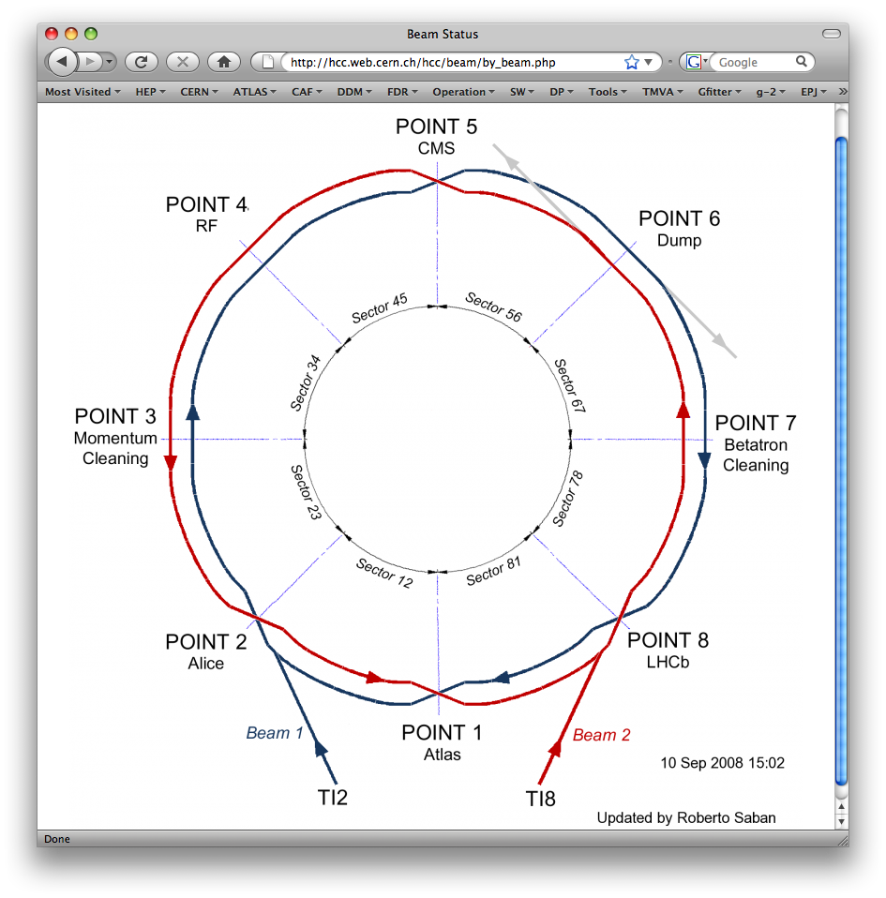
CERN LARGE HADRON COLLIDER
27 km circumference
1200 dipole magnets
14m long
8.4 T field
Dual aperture
Proton-Proton collisions at 14 TeV
25ns between beam crossings
Peak Luminosity 10³⁴s⁻¹cm⁻²
20 collisions per beam crossing
CMS
LHCb
ALICE
ATLAS

Slide 5
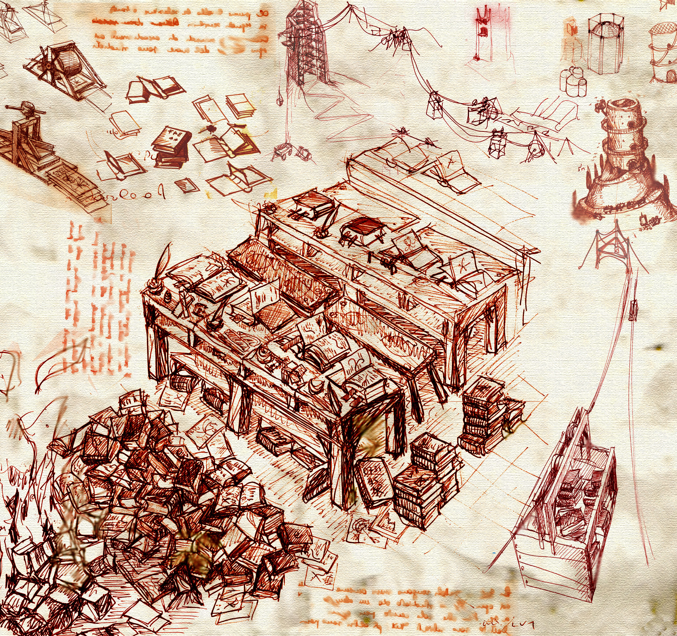
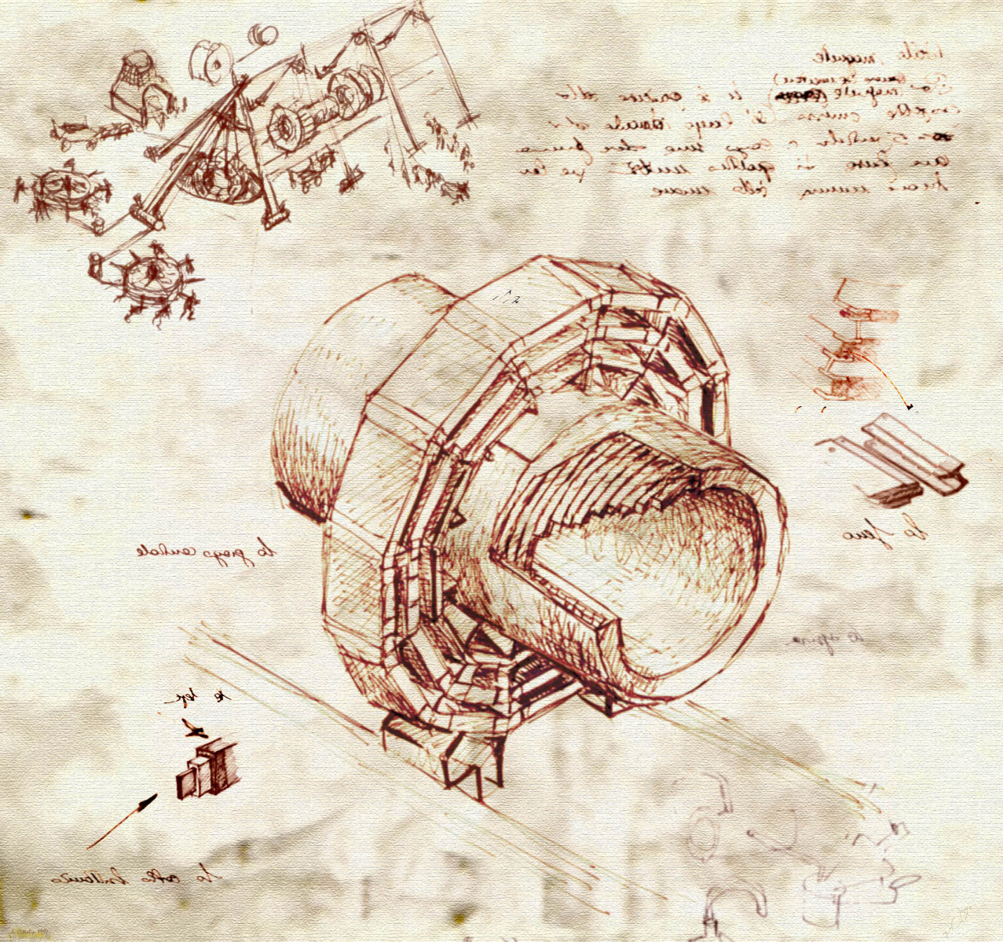
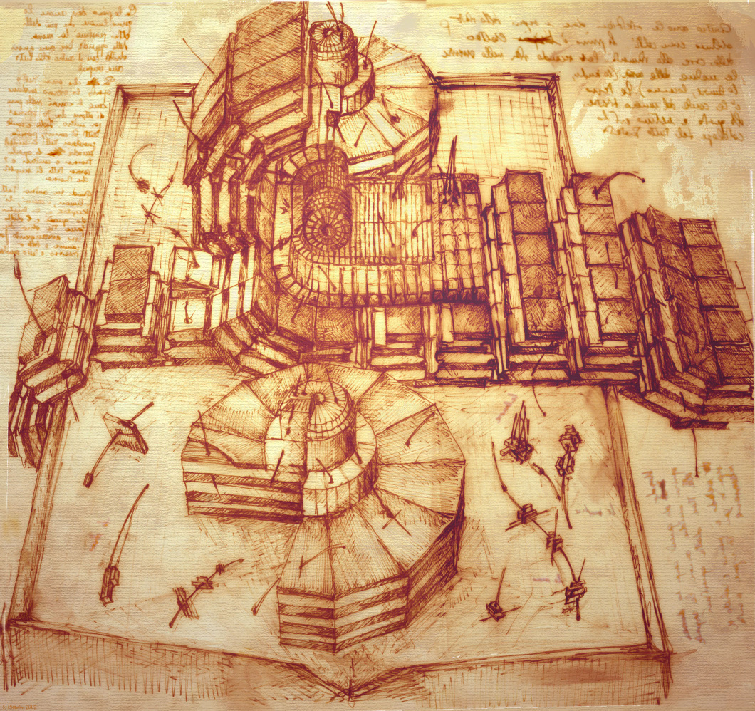
CMS Detector Concept

Slide 6
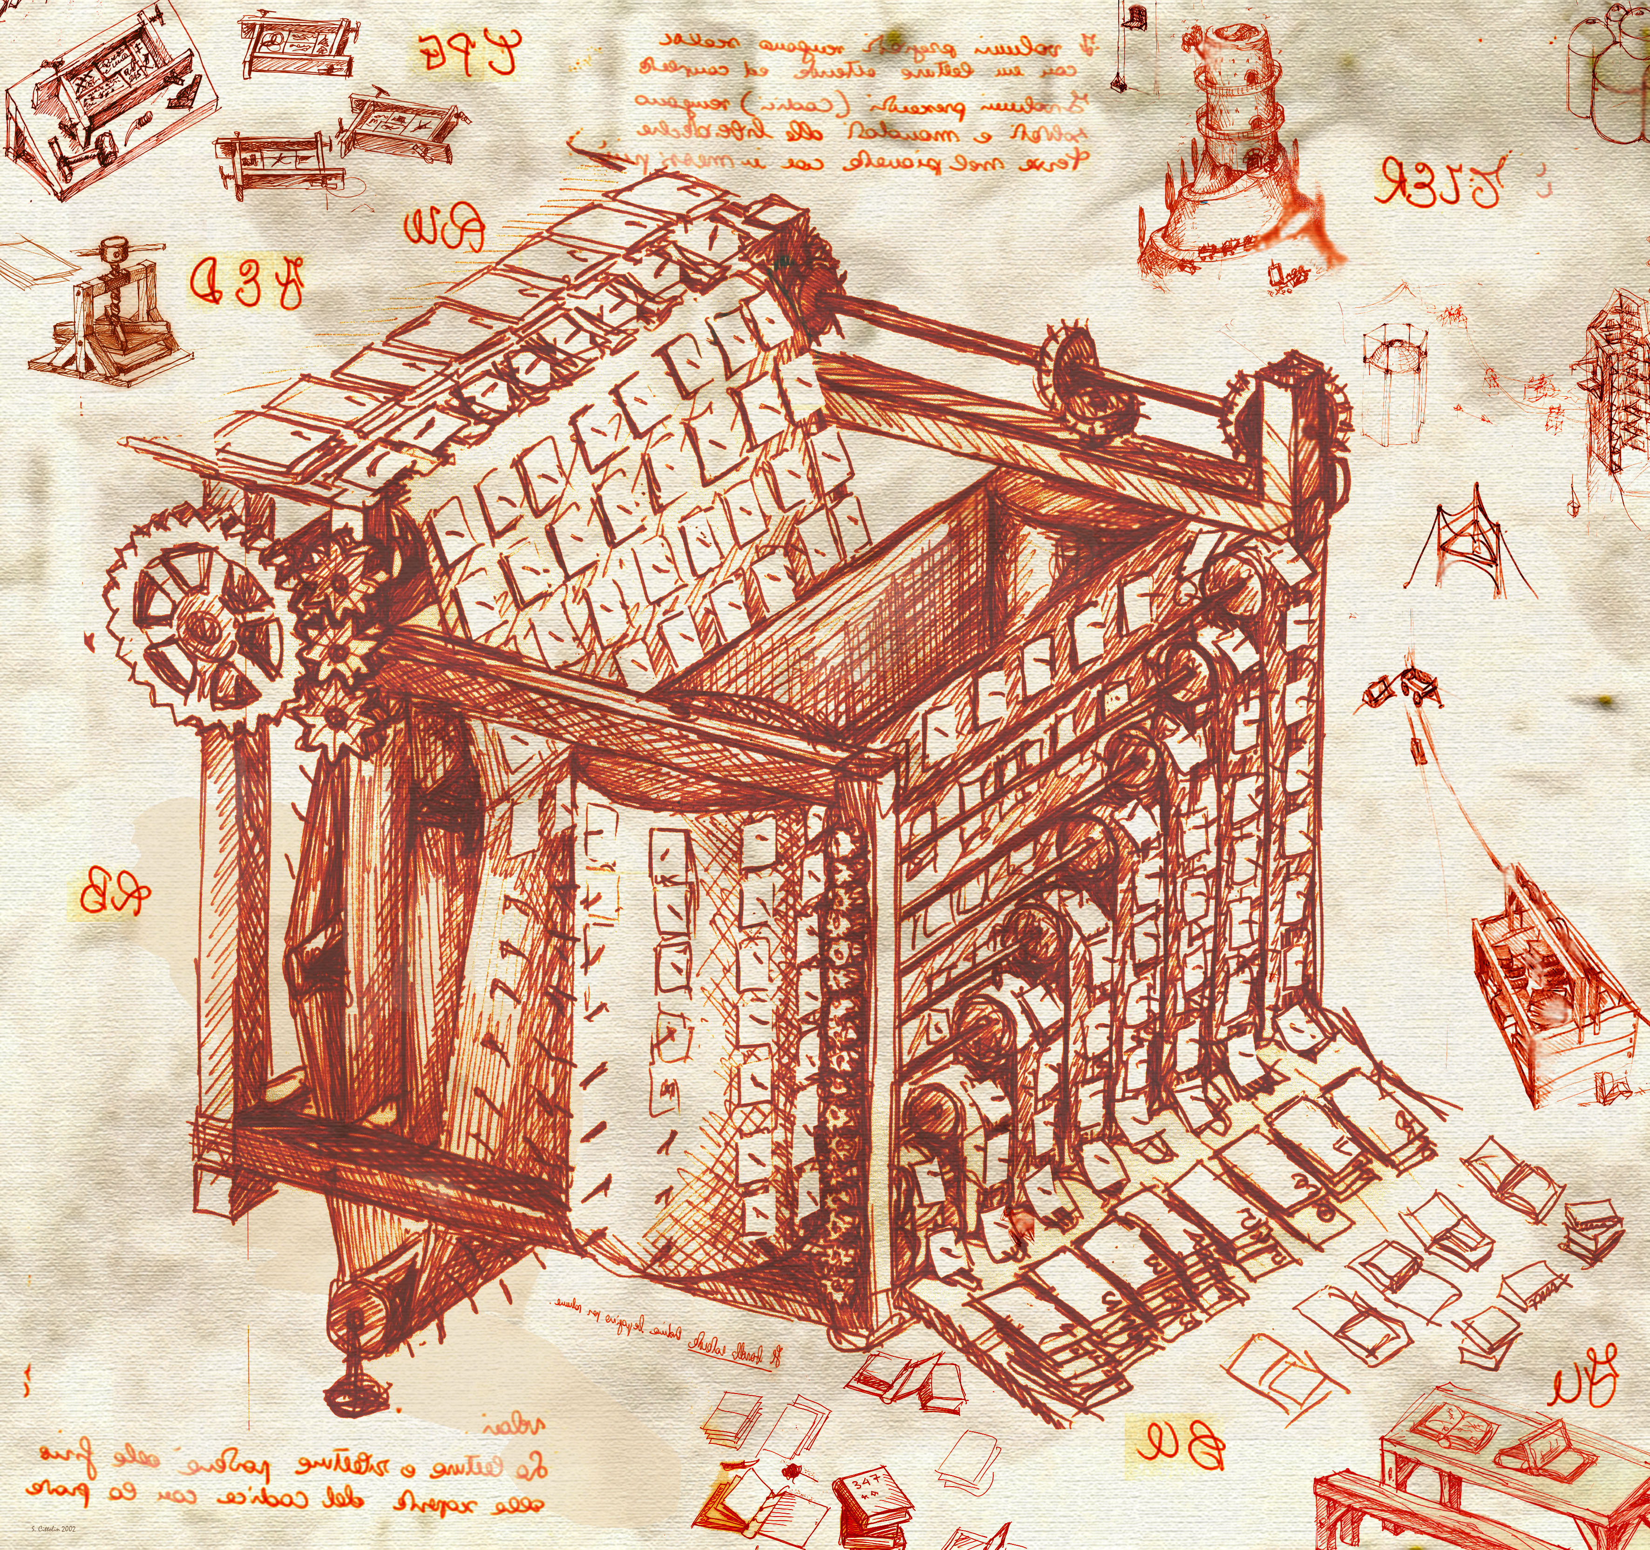
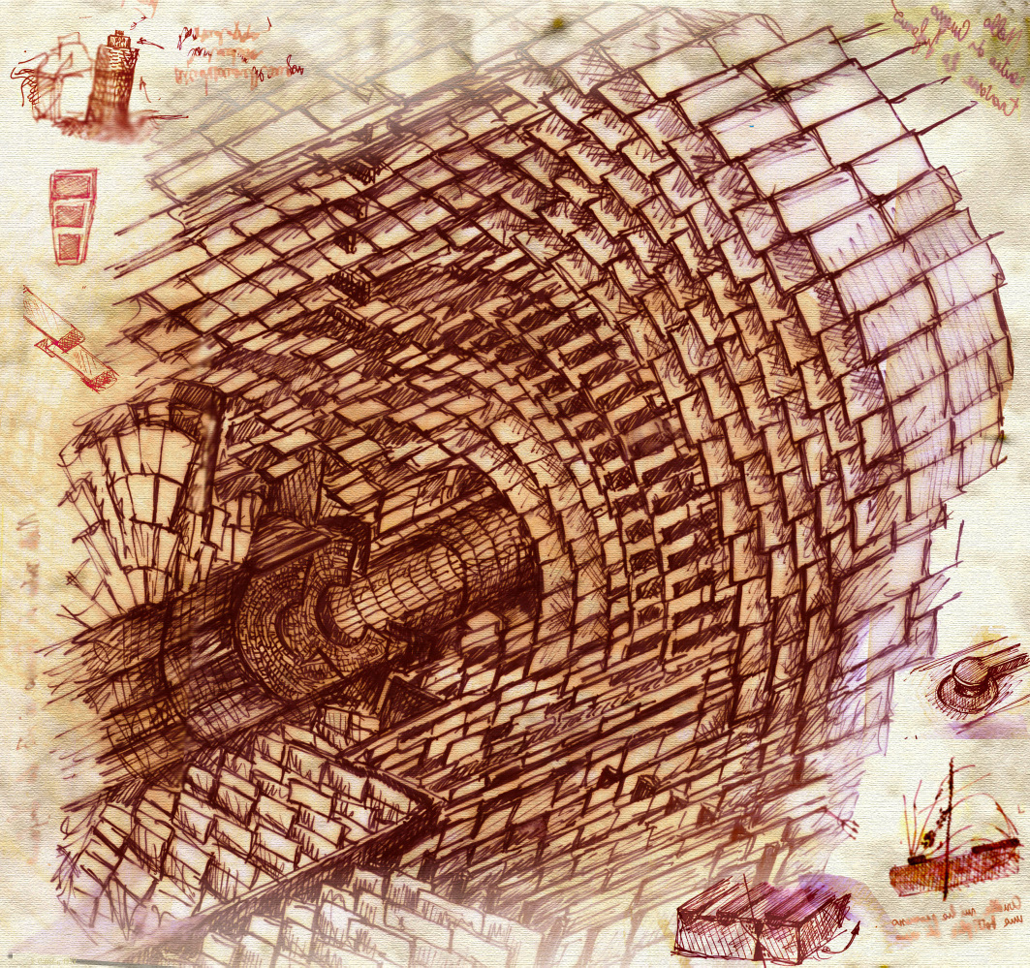
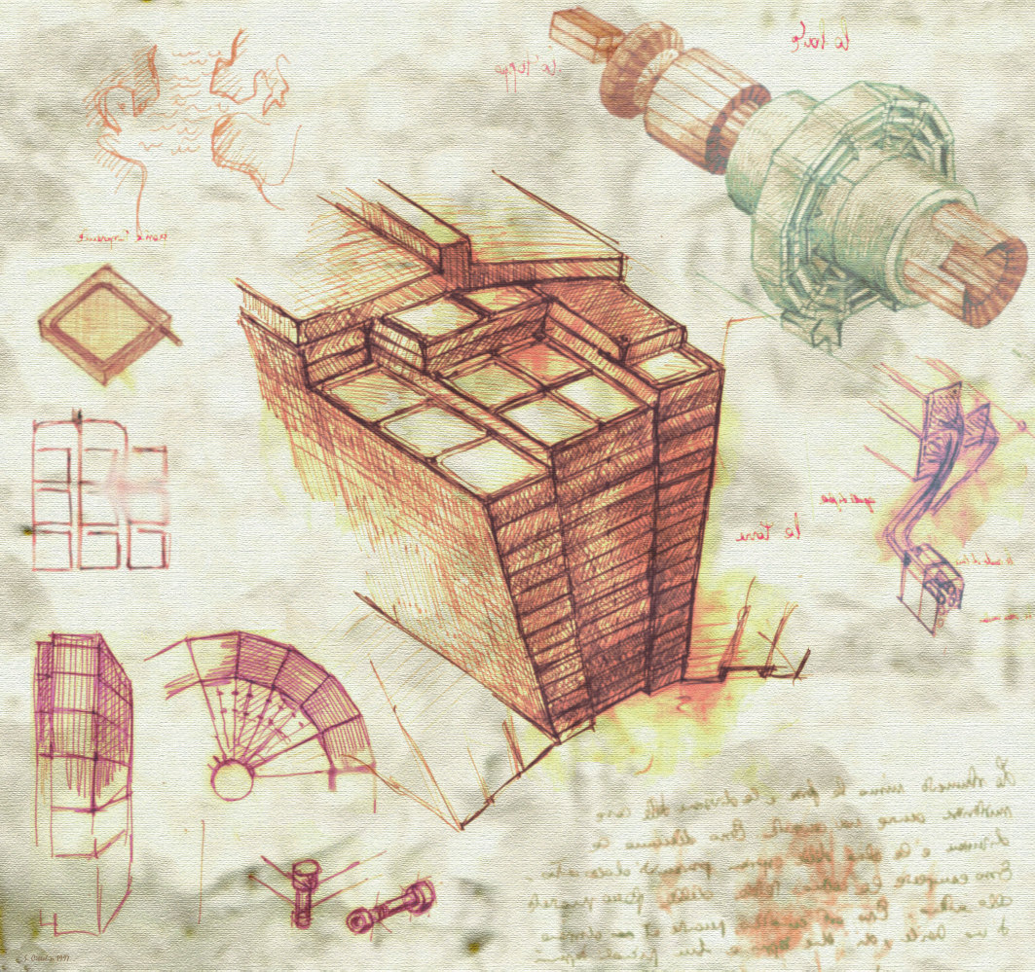
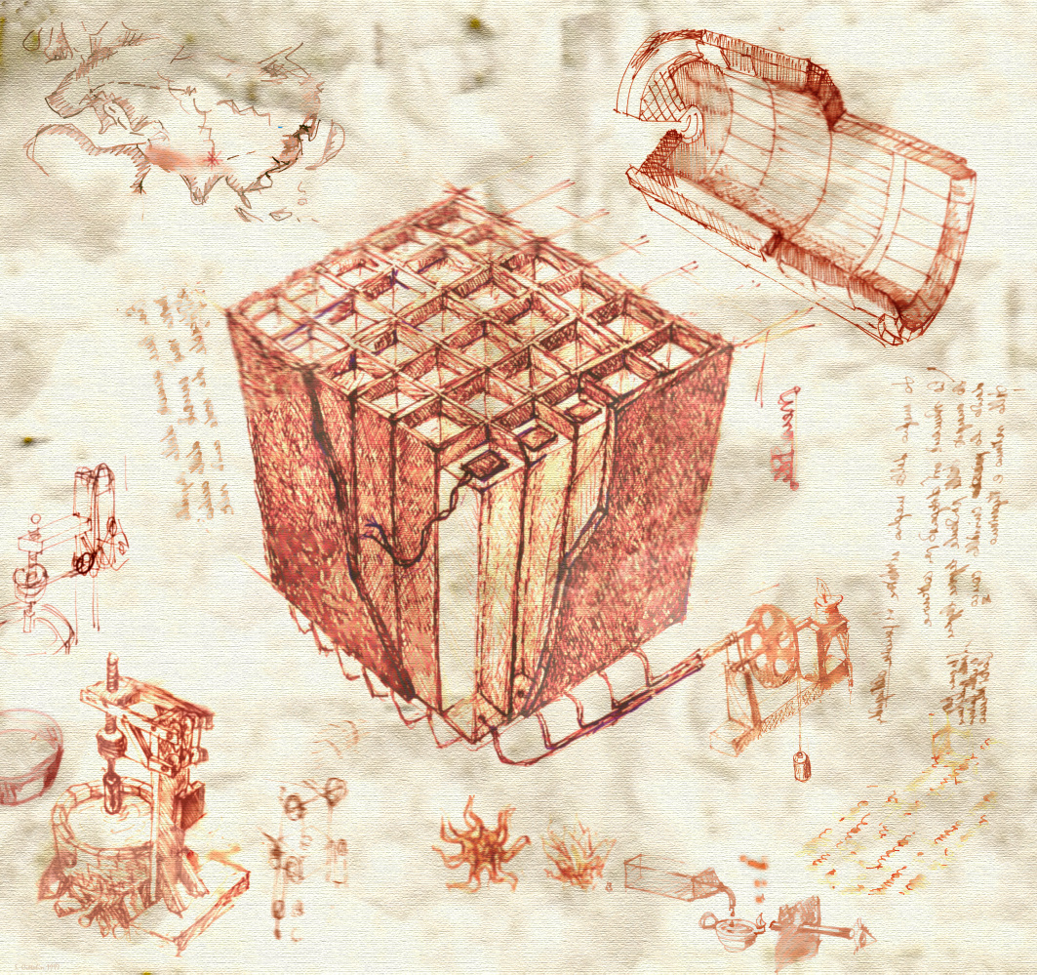
CMS Concept

Slide 7
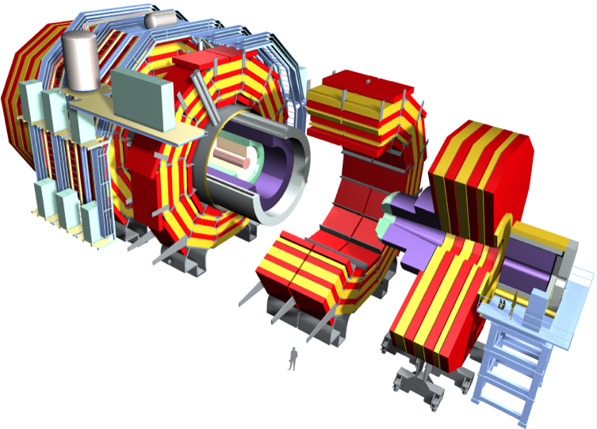
CMS Design
Superconducting Coil, 4 Tesla
CALORIMETERS
ECAL
HCAL
76k scintillating
PbWO4 crystals
Plastic scintillator/brass
sandwich
Steel YOKE
Level-1 Trigger Output
Up to 100 kHz
Directly feeds Higher Level Trigger CPU farm
TRACKER
Pixels
Silicon Microstrips
220 m² of silicon sensors
9.6M (Str) & 66M (Pix) channels
MUON
ENDCAPS
MUON BARREL
Weight: 1250T
Diameter: 15m
Length: 22m
Drift Tube
Resistive Plate
Cathode Strip Chambers (CSC)
Chambers (DT)
Chambers (RPC)
Resistive Plate Chambers (RPC)

Slide 8
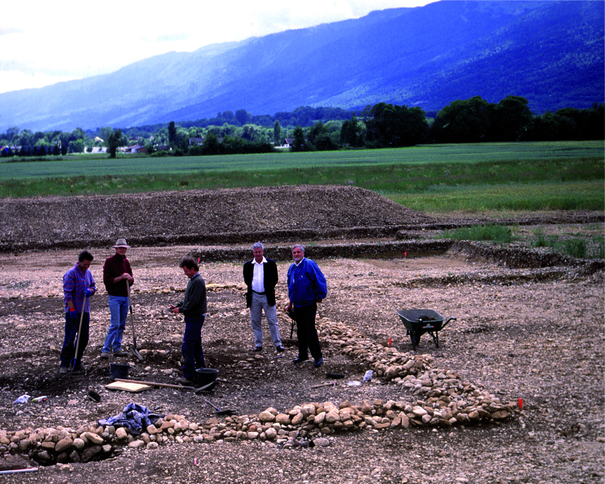
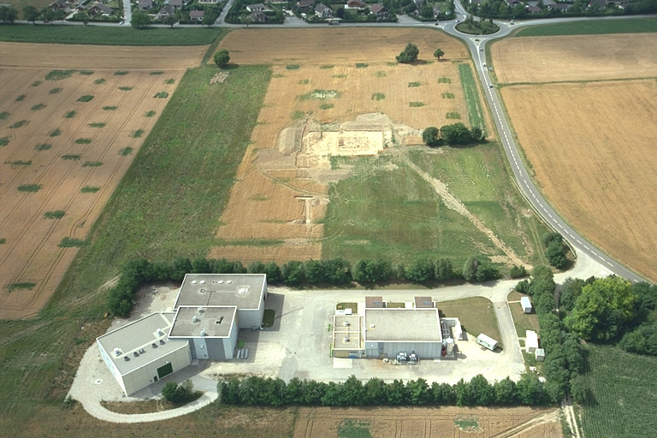
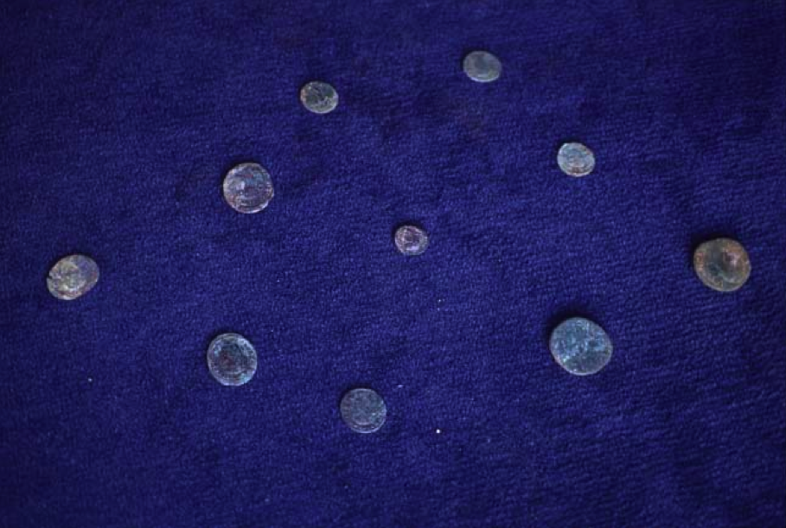
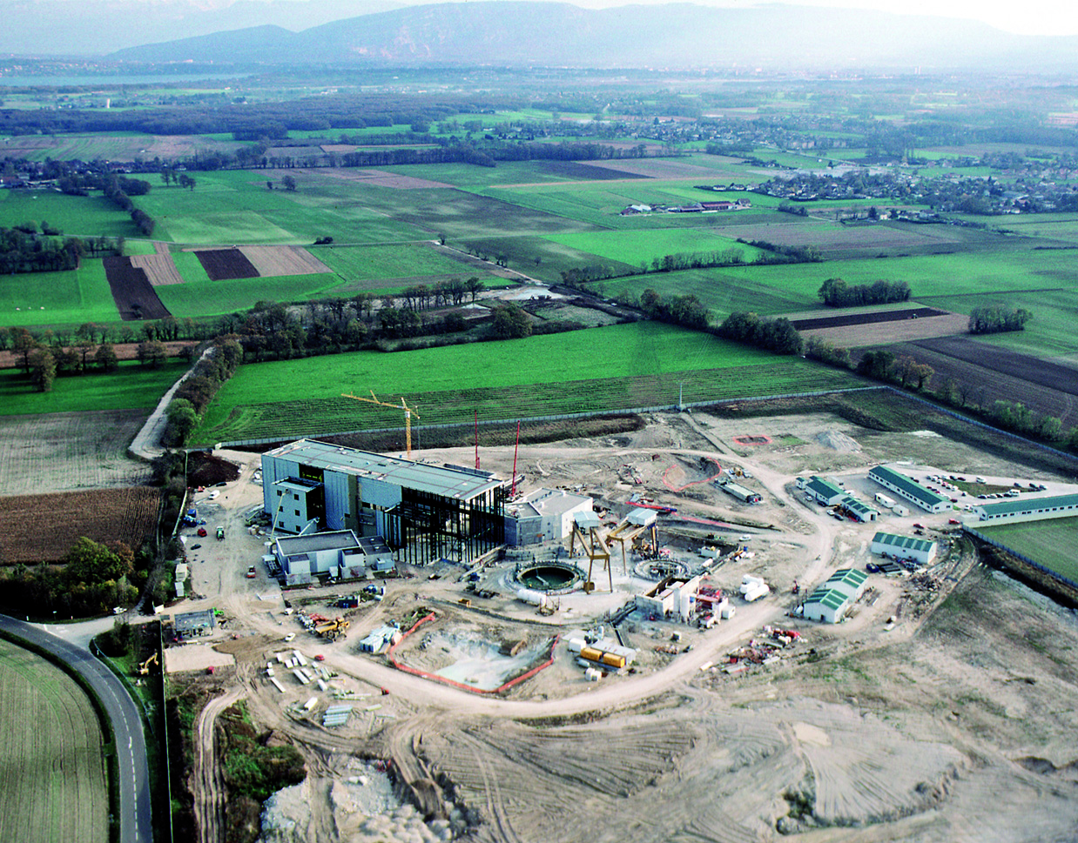
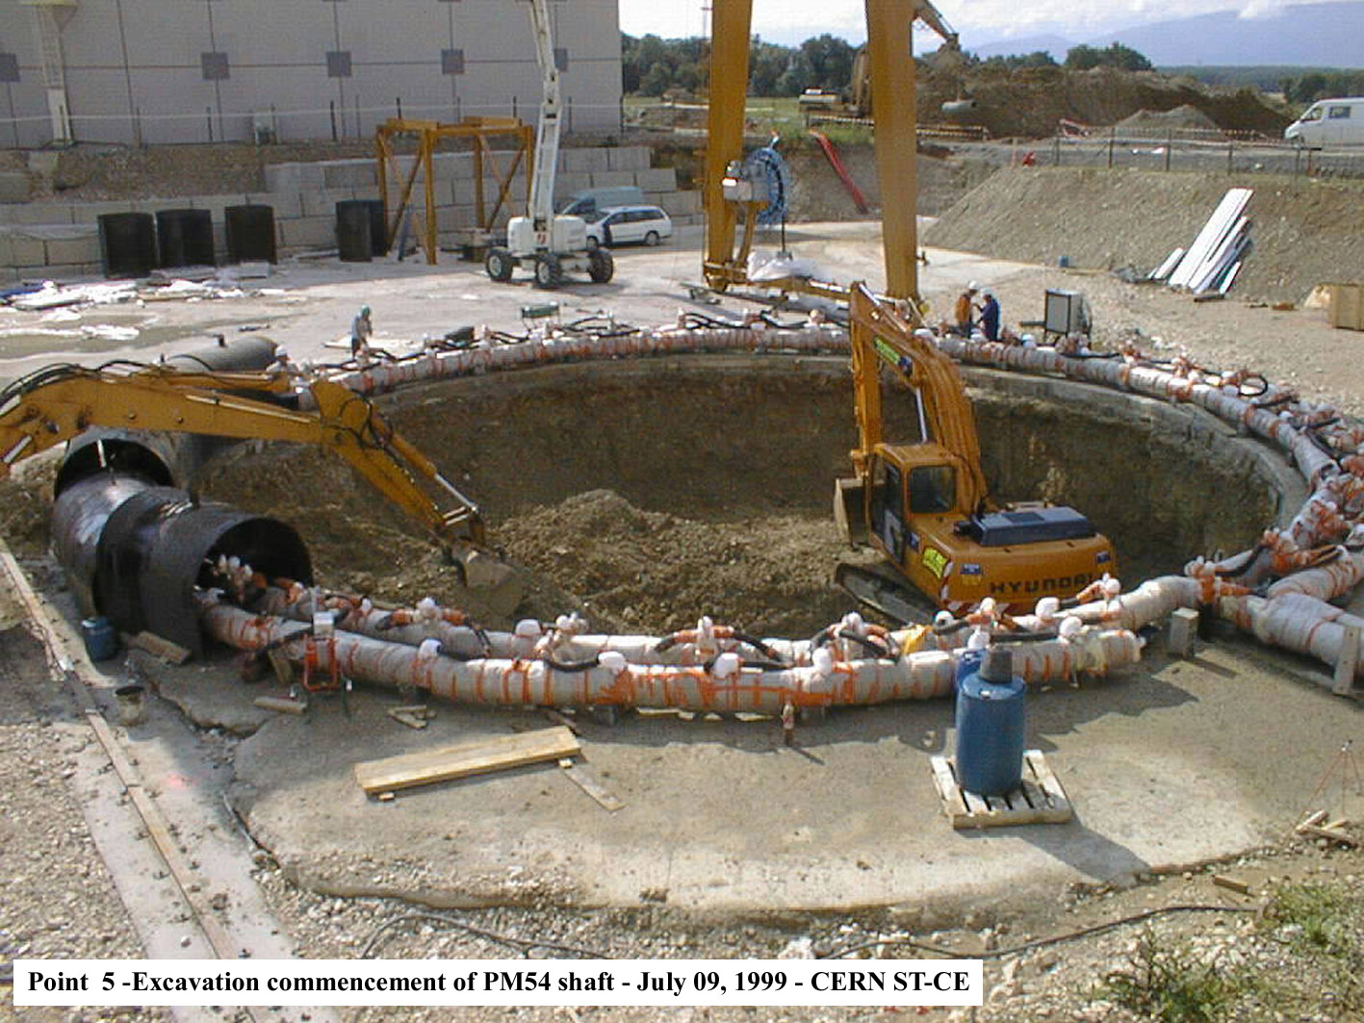
Aerial view of P5 - 1998
Gallo Roman vestiges

Slide 9
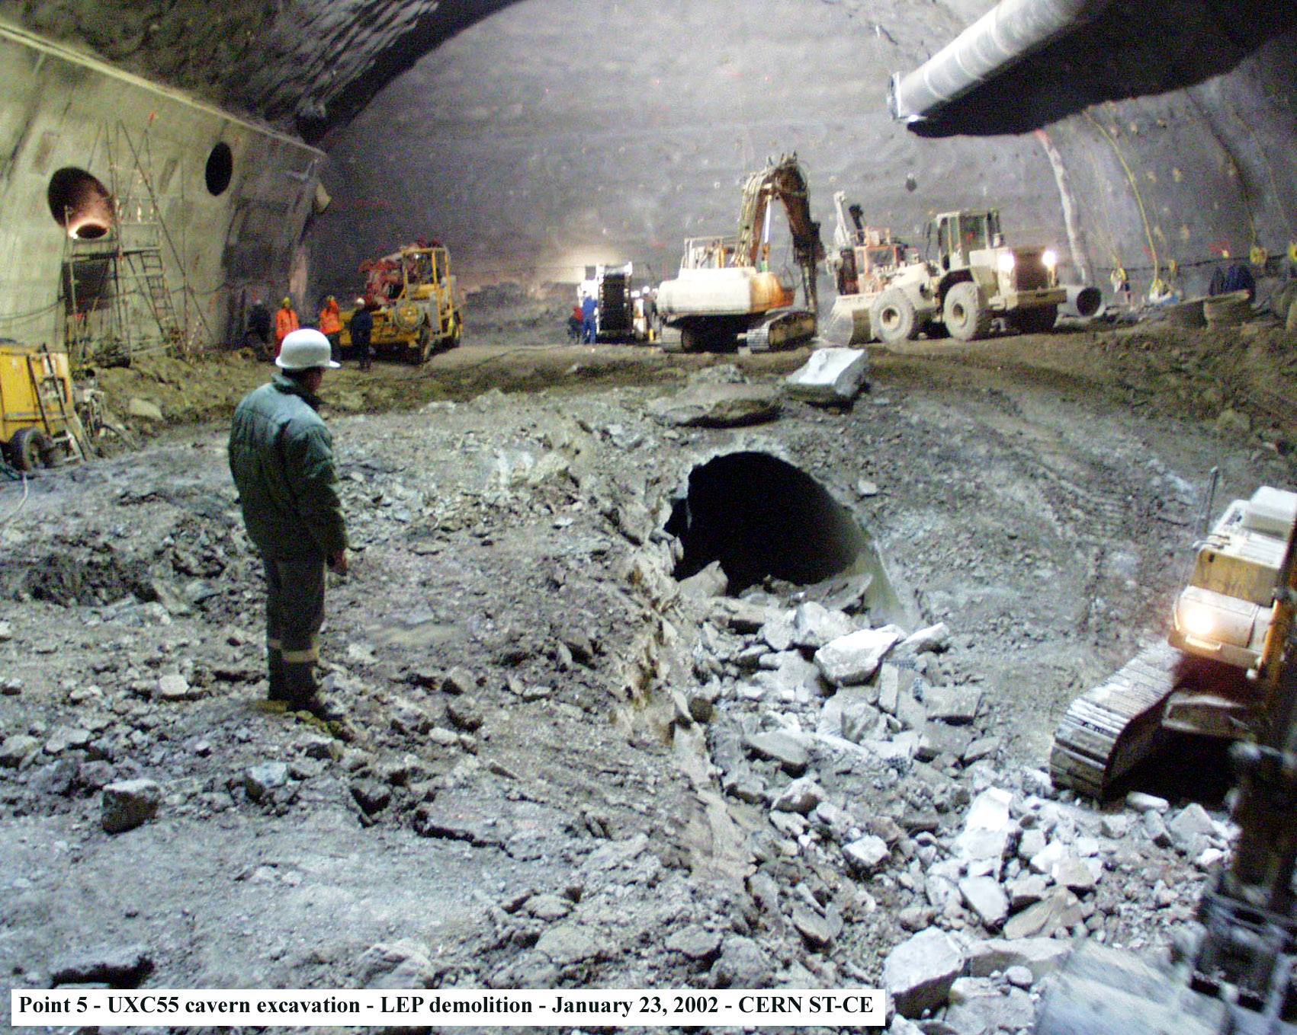
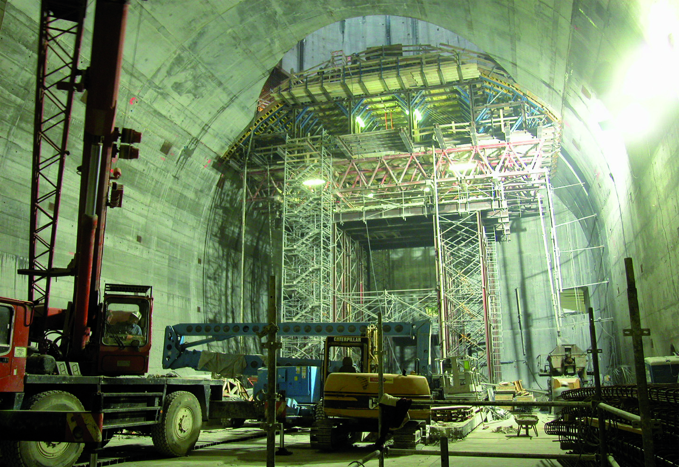
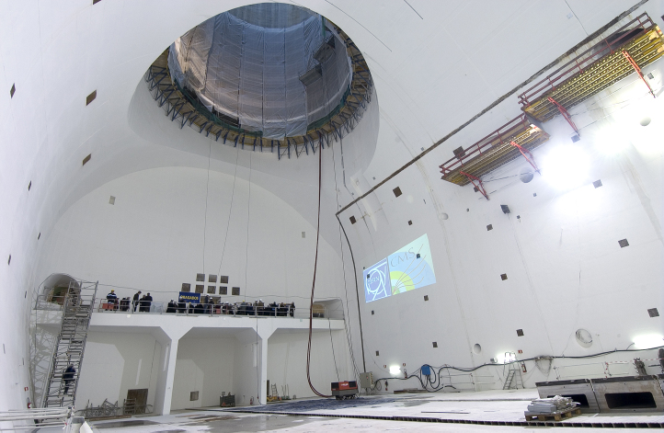
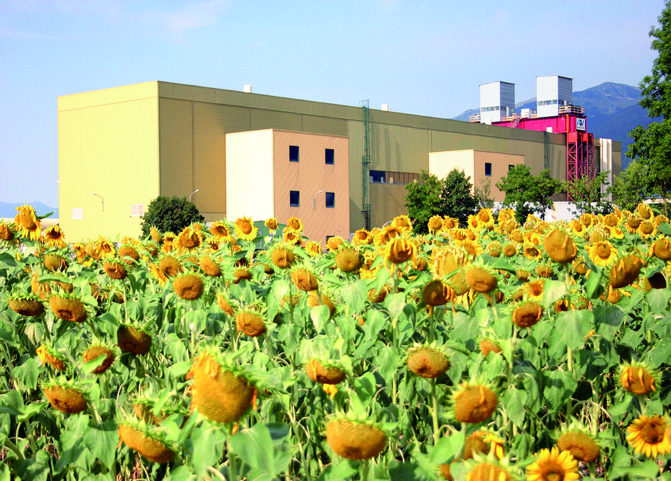
Finishing Point 5
1 February 2005

Slide 10
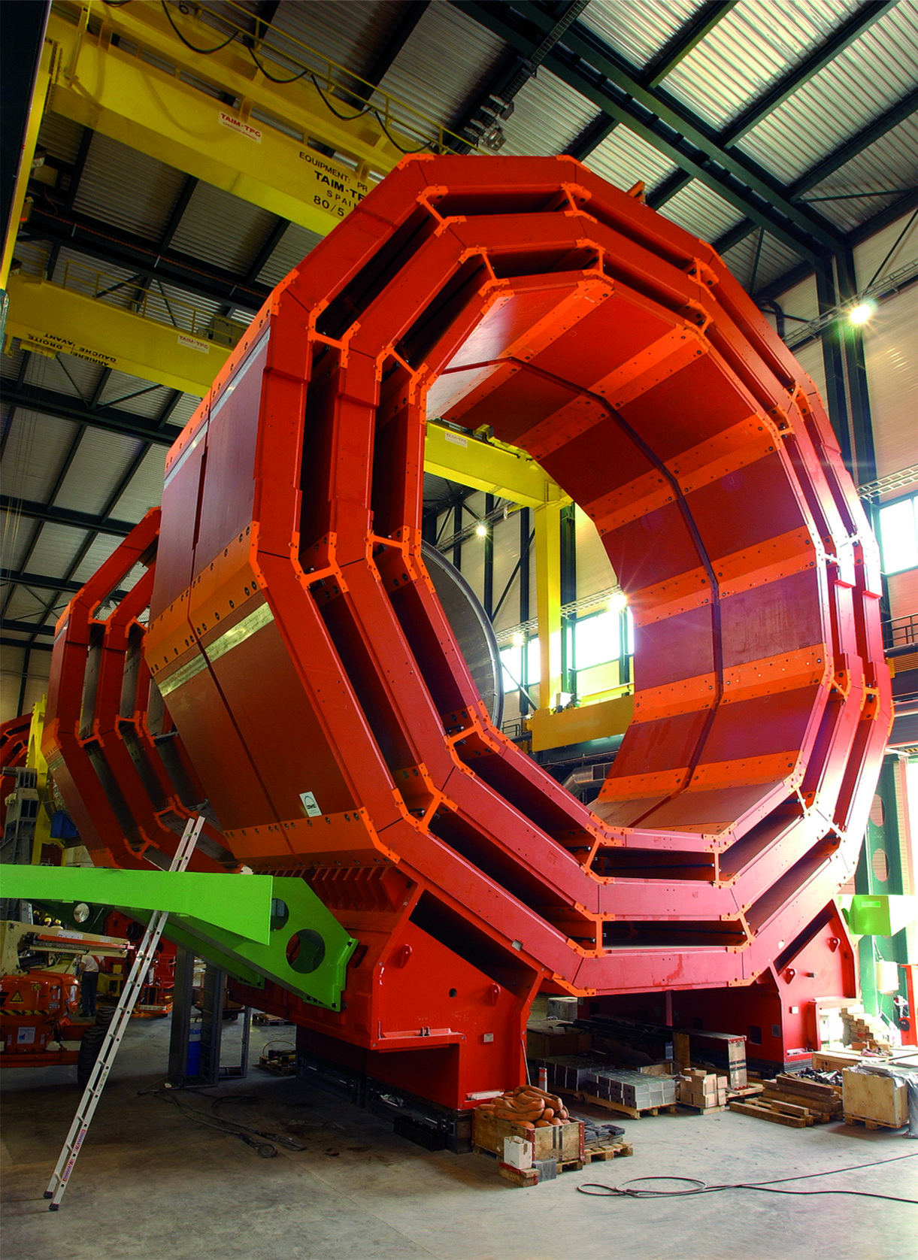
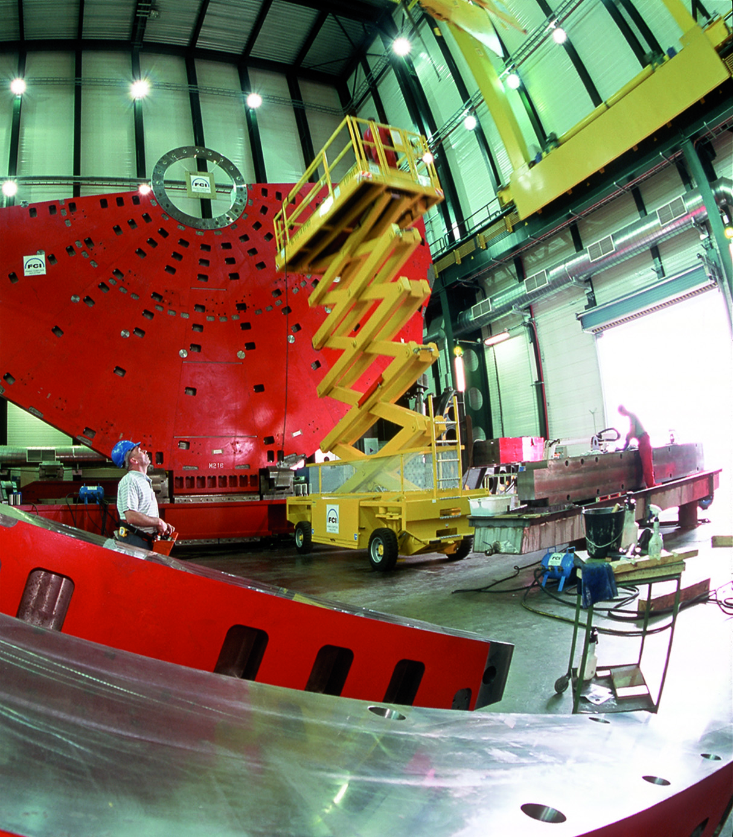
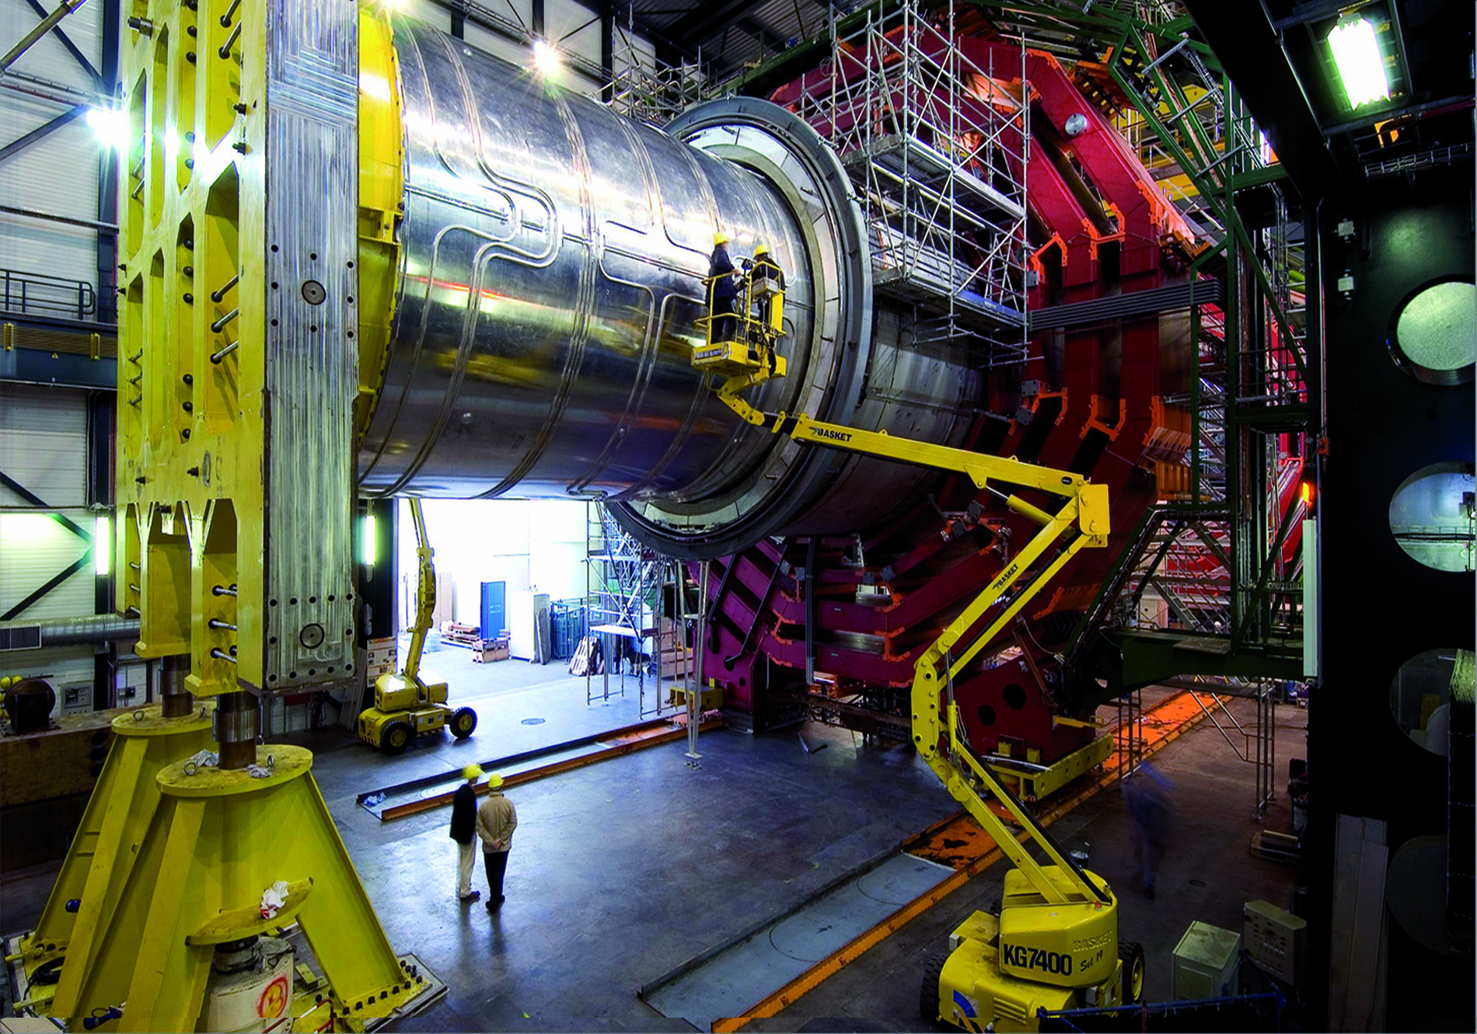
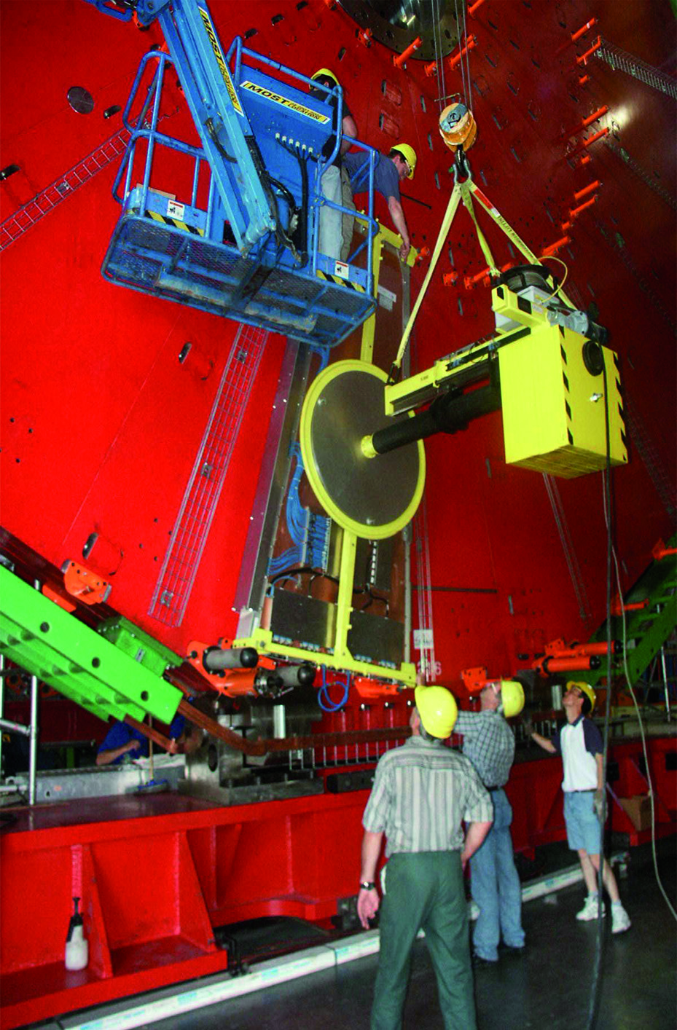
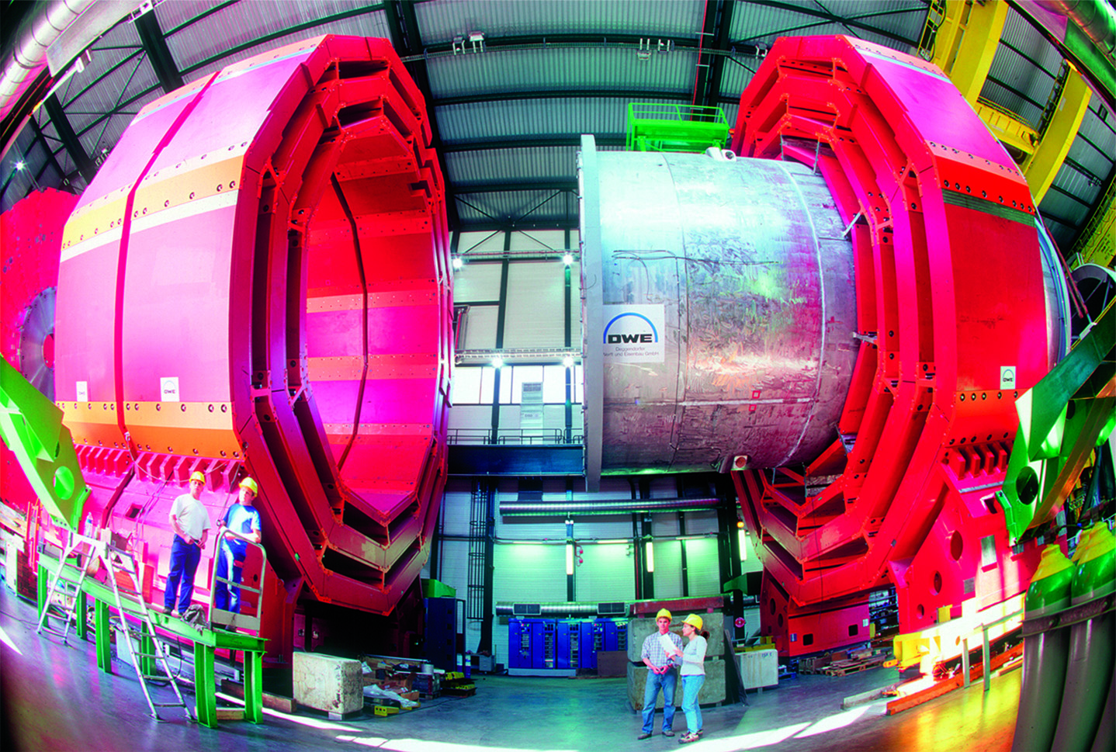
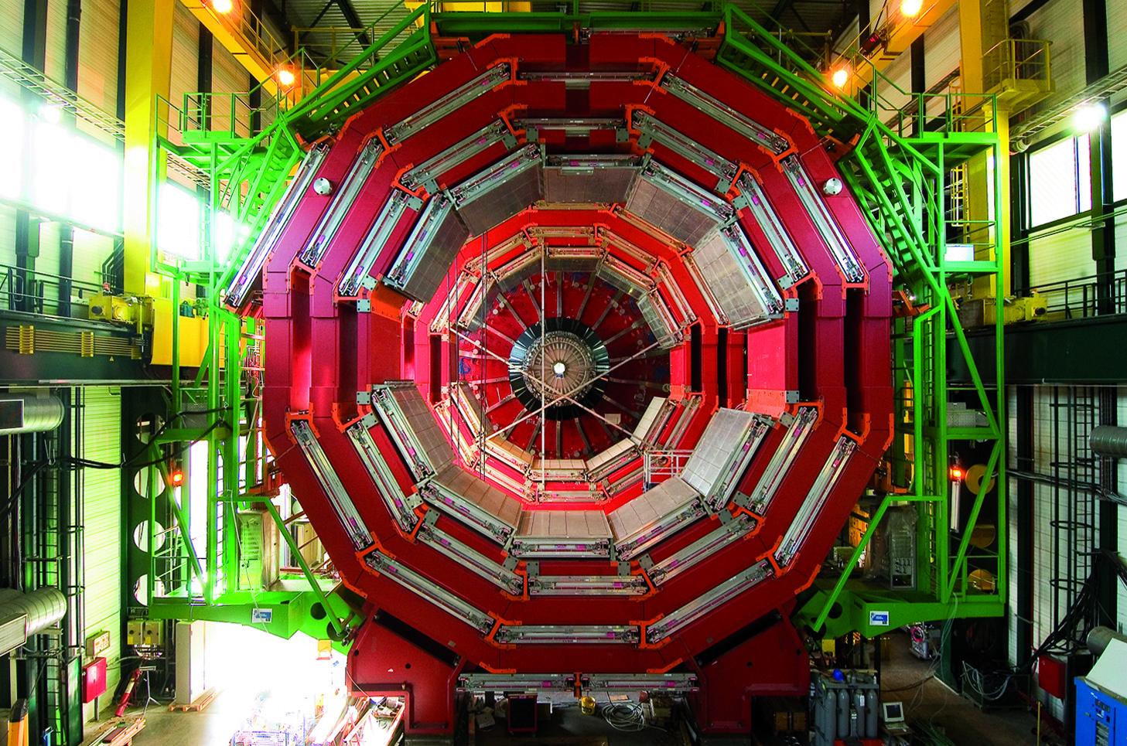
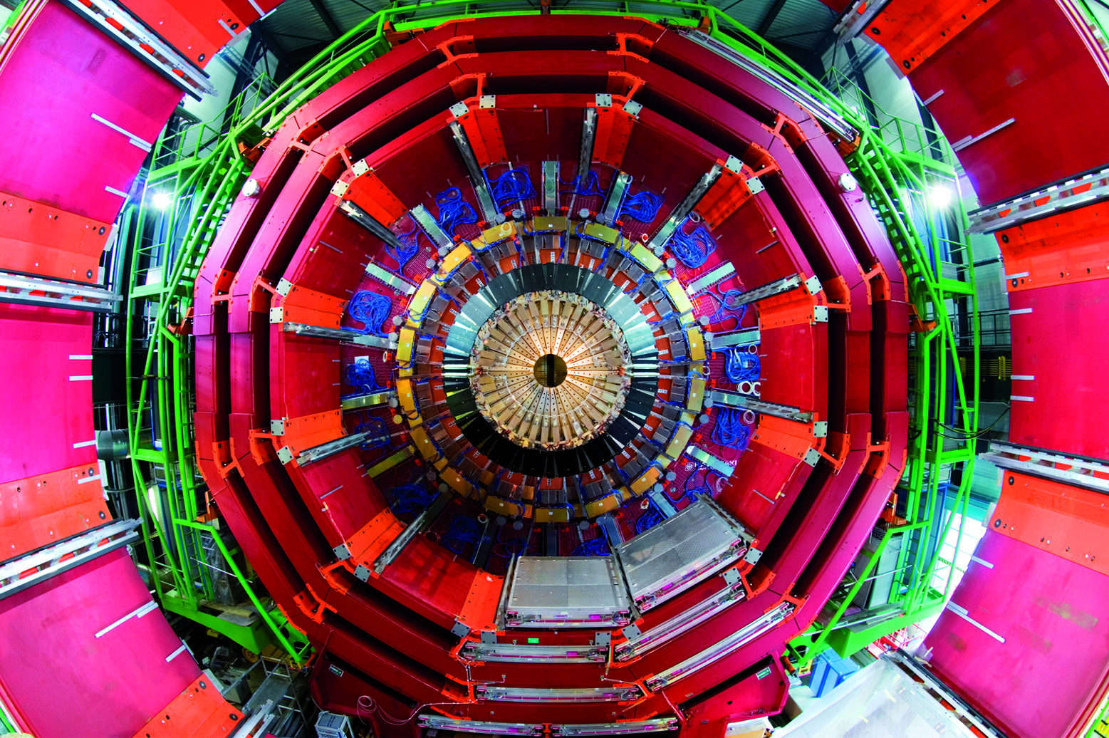
CMS Assembly on Surface

Slide 11
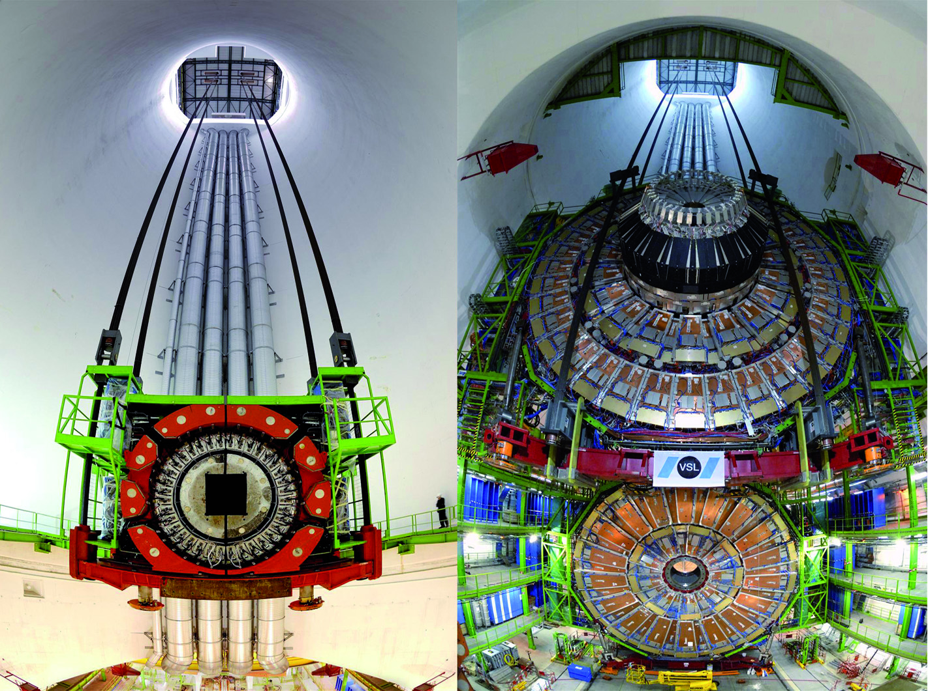
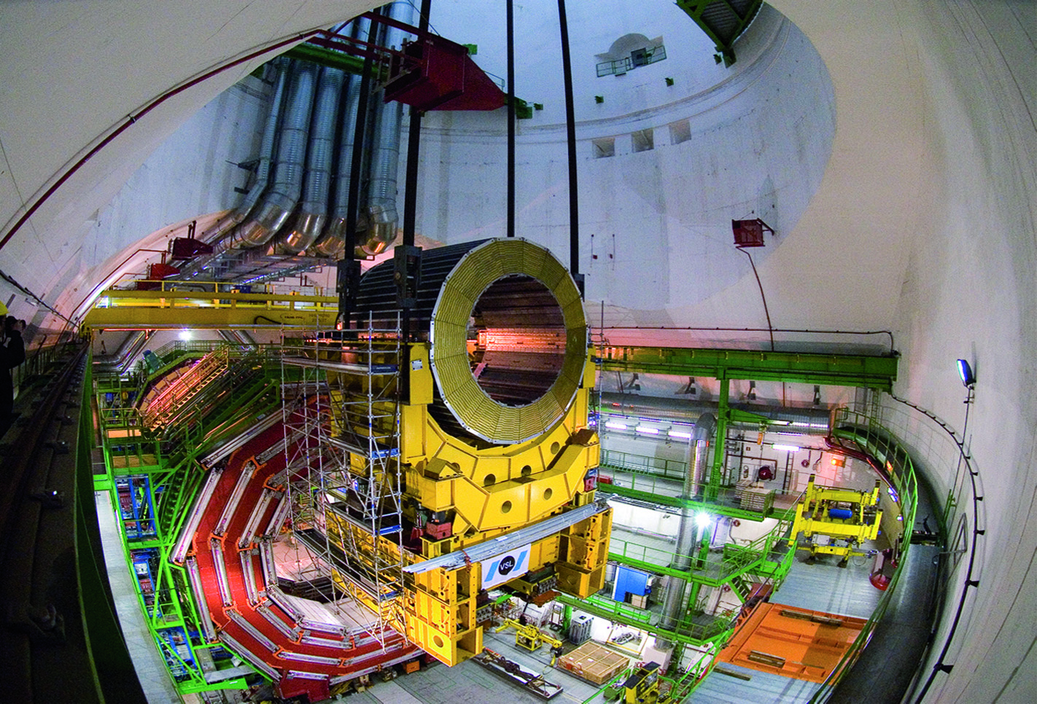
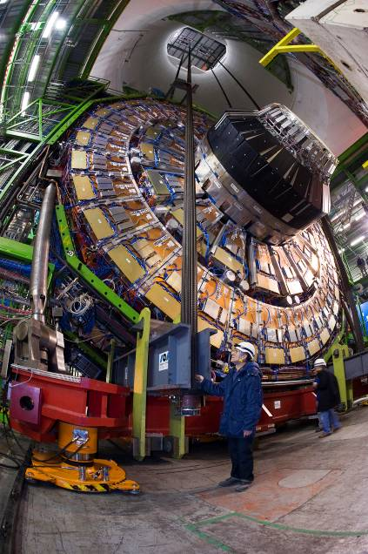
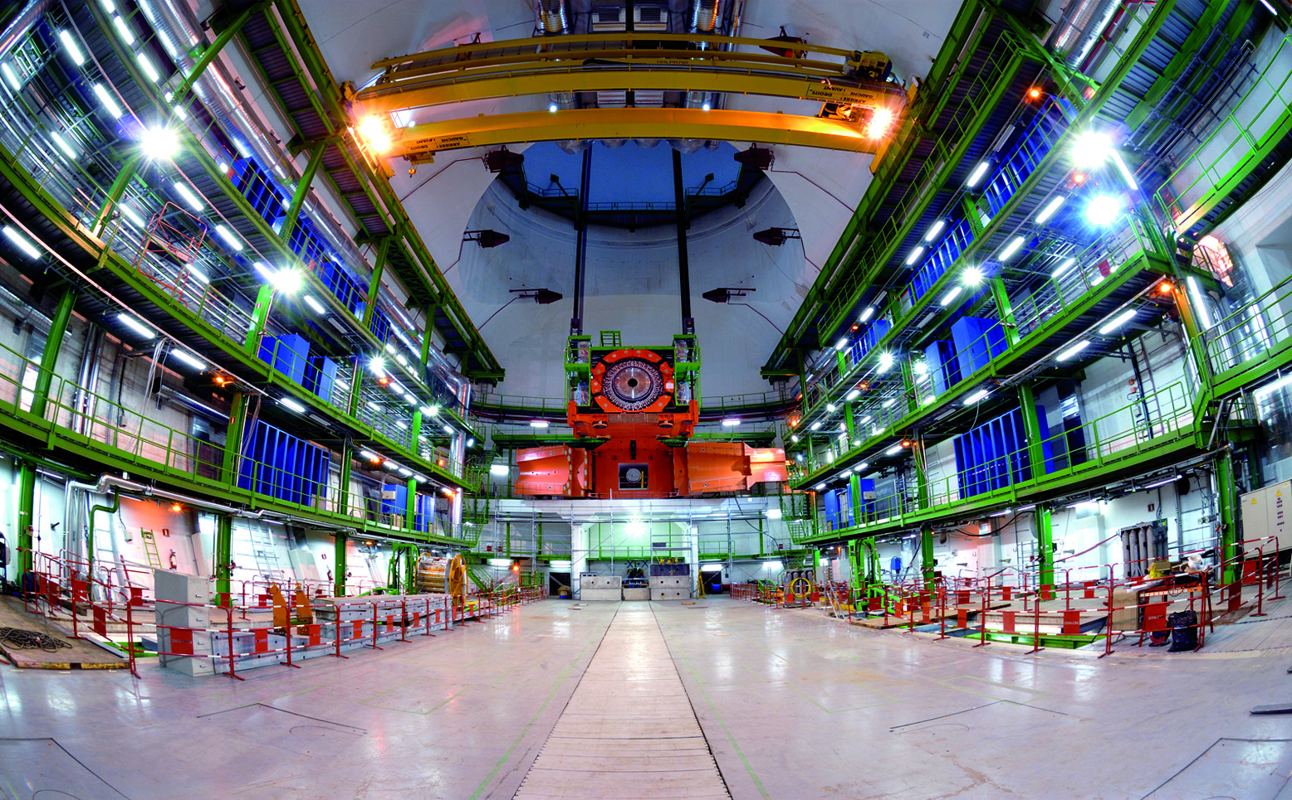
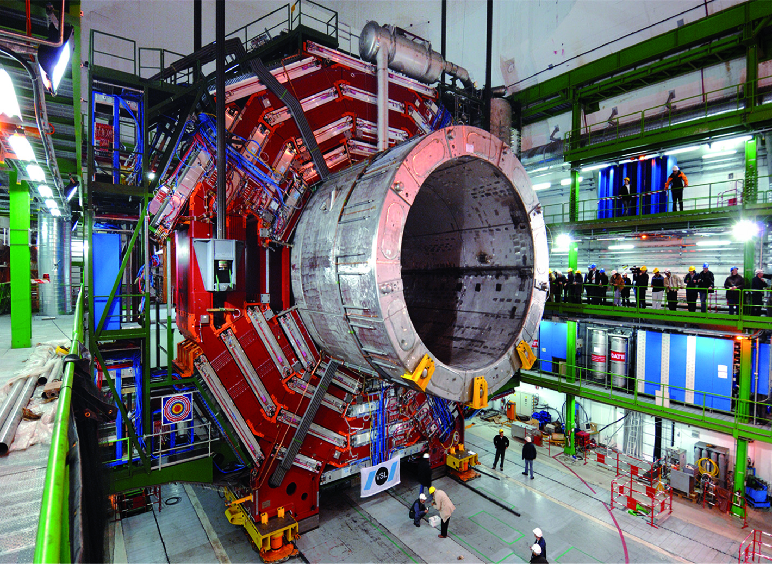
15 Modules Lowered
YE-1 Last : 22 Jan 2008
Feb 2007
Masses: 400 – 2000 t
YE0 critical clearances
YE1 most difficult:
COG out of the plane
1430 t & nose of 465 t out of plane

Slide 12
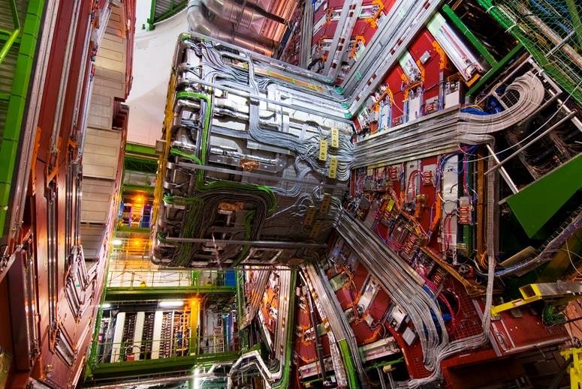
Cabling of CMS
All services for Tracker, ECAL, HCAL
250 km cables, pipes, fibres
6100 cables, 4000 fibre ribbons, 1000 pipes
50000 person hours
8 months

Slide 13
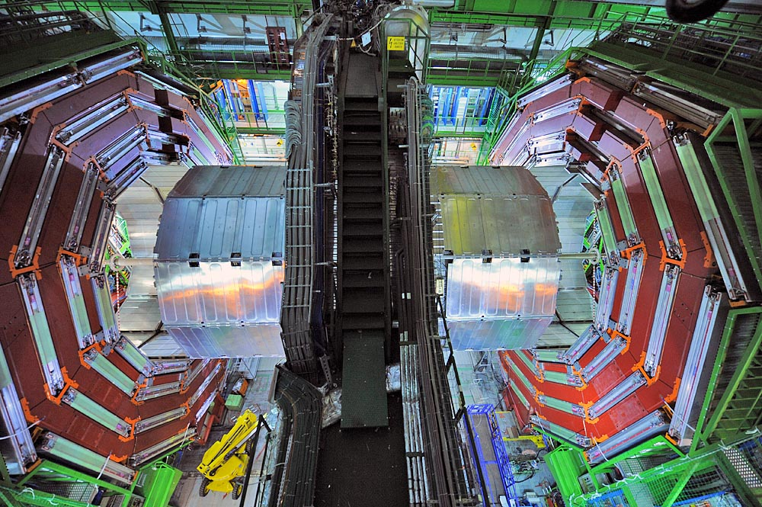
CMS Ready for Closure

Slide 14
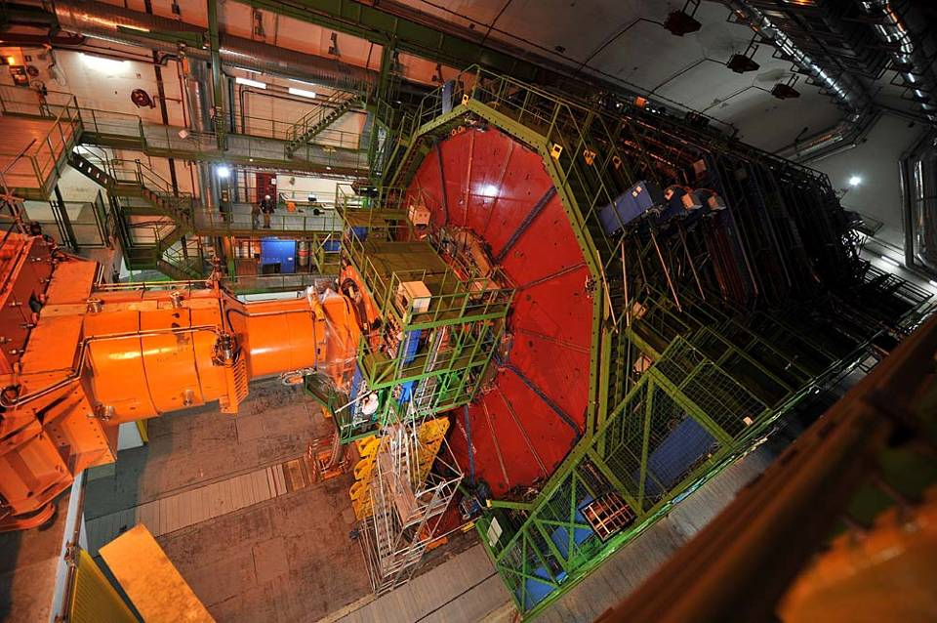
CMS Final Closure and
Ready for Collisions
3rd September 2008

Slide 15

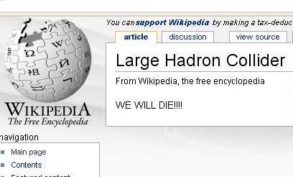
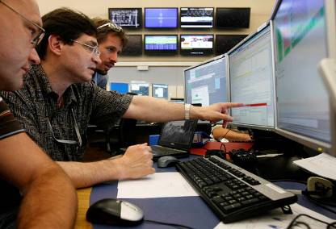
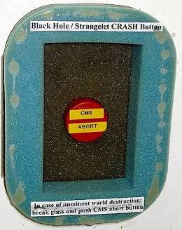
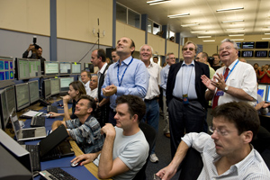
10 Sep 08 – Media Splash Event

Slide 16
CMS Commissioning with Cosmic Muons
Regular Global Run exercises since 2008
  Varying frequency
  Specific goals set
Cosmic RUn at ZEro Tesla –CRUZET
  Global exercise to accumulate cosmic muon data from entire detector
Cosmic Run At Four Tesla-CRAFT
  Gain experience in operation of CMS with magnetic field
  Stability of subsystems and infrastructure
  Oct 2008 – 23 days ; Aug 2009 – 40 days – leading to beams
1 billion cosmic muon events recorded and analyzed!
  Data distributed widely
  Analyses done with advanced versions of the sw releases and using LHC Grid infrastructure
  Submitted >23 publication from CRAFT

Slide 17
CMS Commissioning
Conflicting Interests: assembly and integration concurrent with operation
Commissioning work on single components
  Check & Repair of hardware components
  Tuning of firmware and software
  Local runs for better understanding of noise
  Calibration and alignment
Global commissioning: bring whole detector to work
  Verify integrity of services: trigger, timing, DAQ, DCS
  Exercise data flow from detector to Tier-2 centers
  Optimize performance
  Improve procedures for good running efficiency

Slide 18
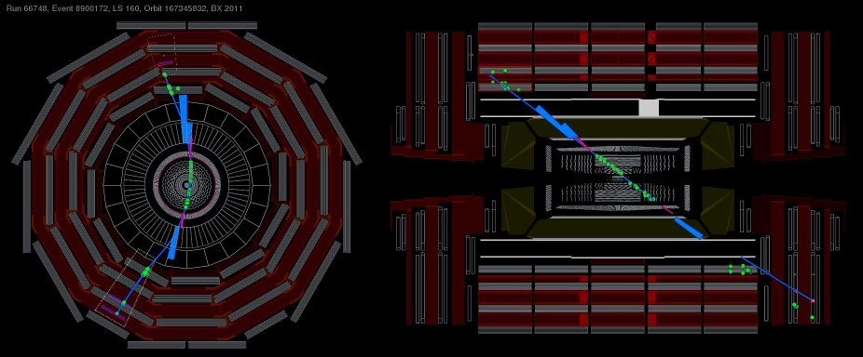
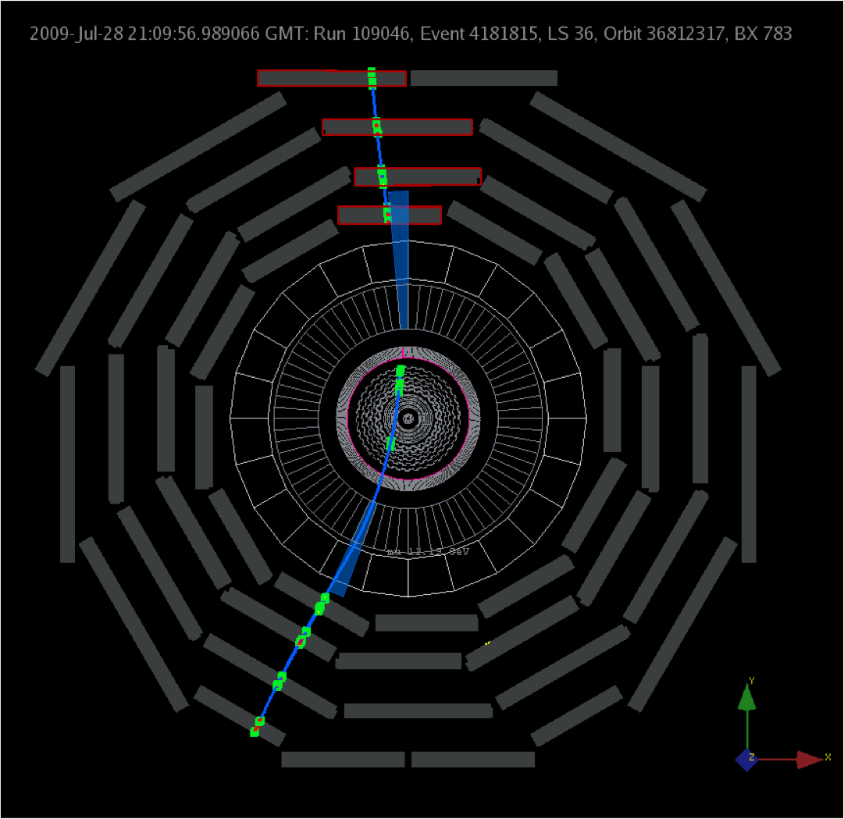
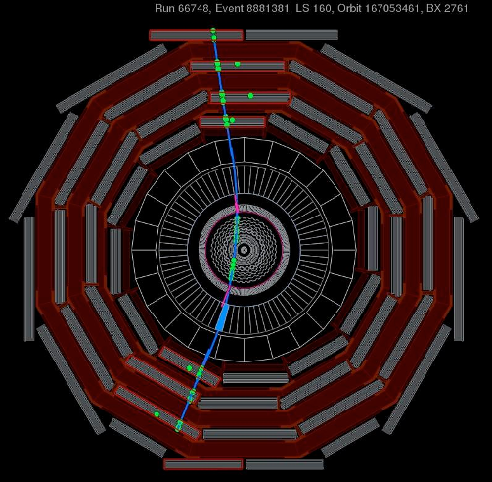
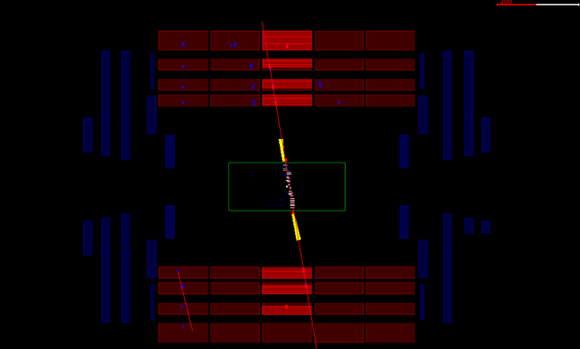
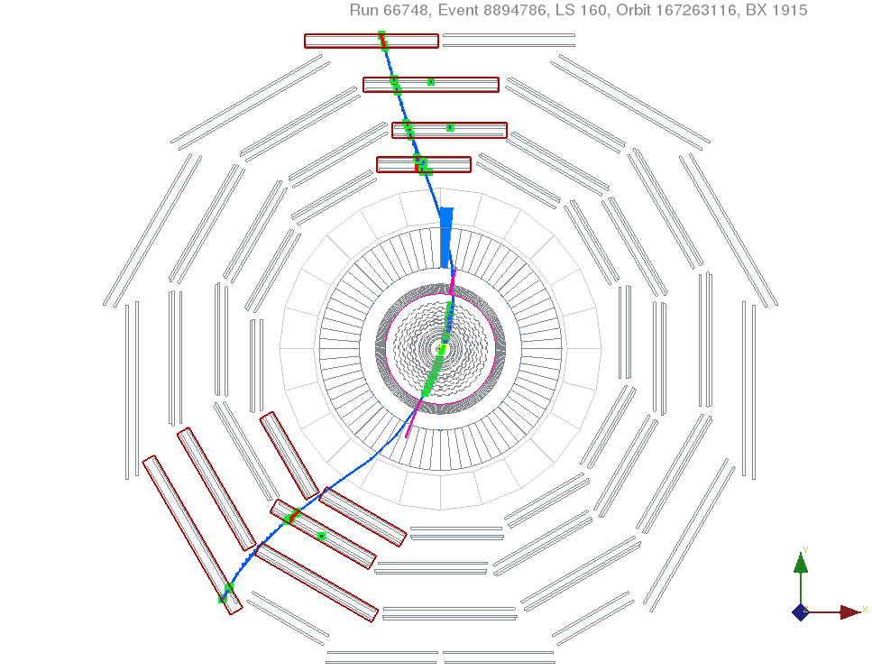
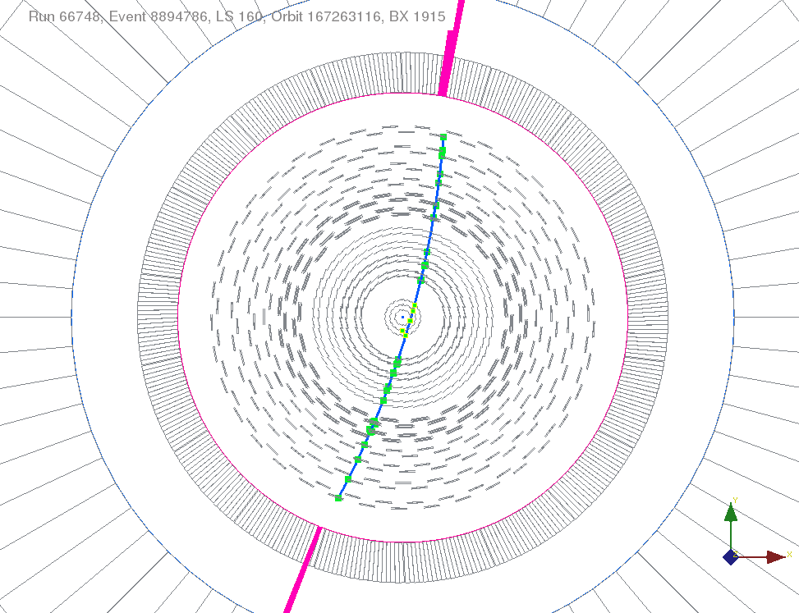
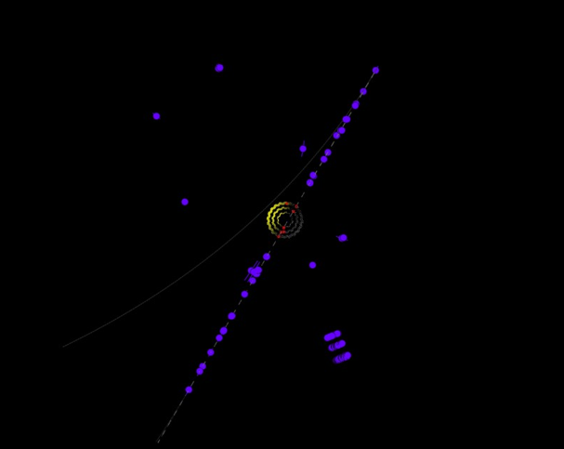
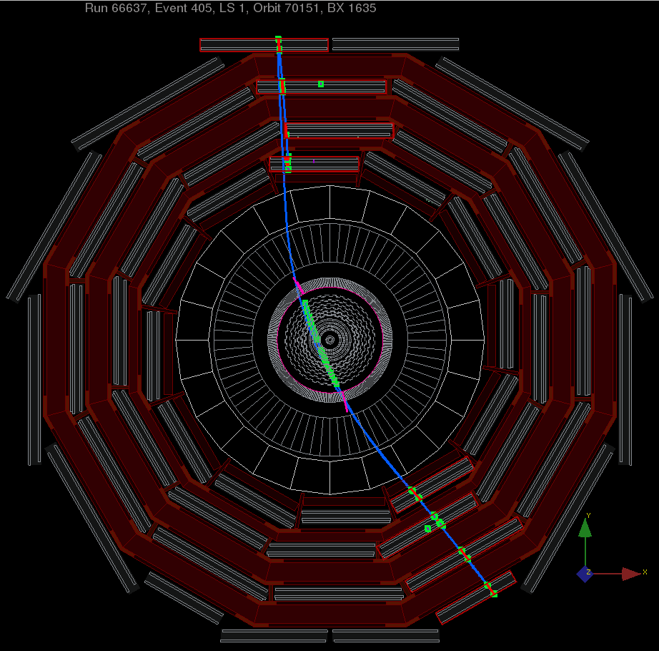
From Straight to Bent Tracks

Slide 19
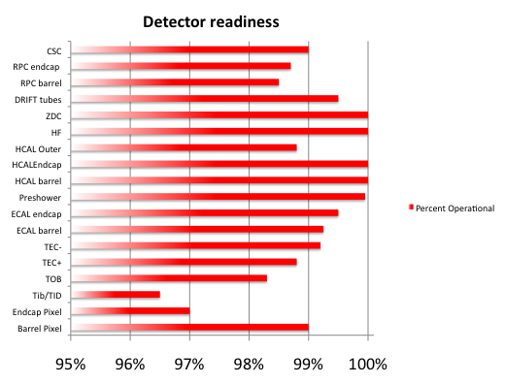
CMS Performance
Subdetectors
Will investigate possibility of repairs during longer shutdowns

Slide 20
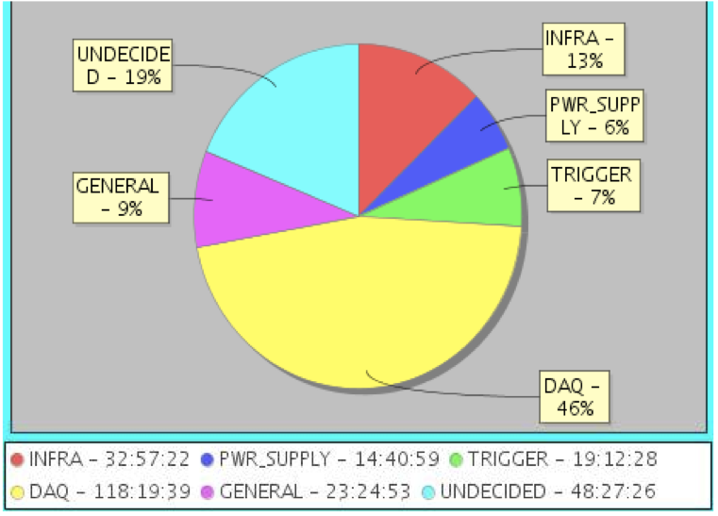
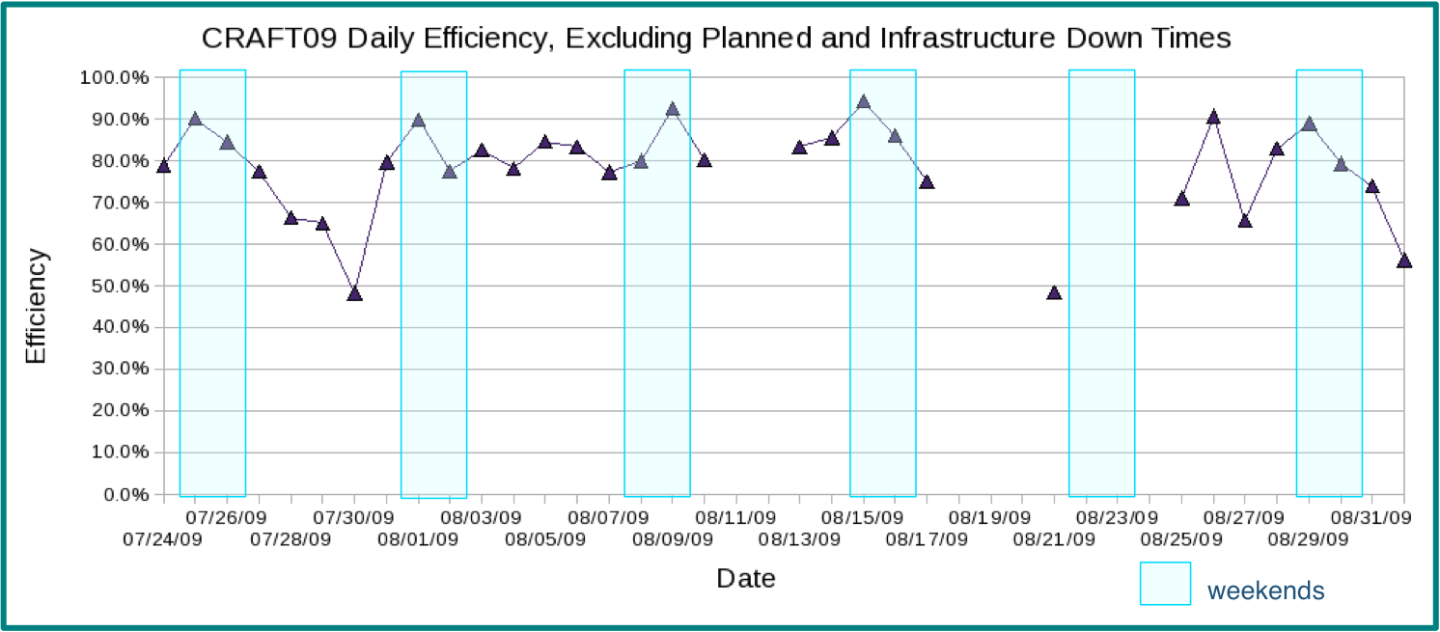
Operational Efficiency in CRAFT2009
Automated Run Time Logger in CRAFT’09
Average efficiency: 71% between 24 July – 1 Sep ’09
Weekend effect visible
Human action required to assign cathegory
maintenance
high rate
CMS preliminary

Slide 21




Tracker Performance - CRAFT
Hit Efficiency
CMS Preliminary
99.9% - after excluding faulty modules
98.2% - with all modules
CMS preliminary
Tag muons with tracks reconstructed in the muon chambers
Two algorithms: Combinatorial Track Finding & Cosmic Track Finder

Slide 22



CMS Performance
Momentum comparison between Standalone and Tracker Muons
Test of B field map

Slide 23





CRAFT 2008 Performance over 23 papers submitted to JINST
Muon Chambers
Point Resolution
Alignment in Inner Tracker
Energy deposited by muons
ECAL
Si Trkr
Modules
total
Points- data
TOB_{x}
2.6 um
ionisation
radiative
HCAL
Bpix
Modules
PXB_{x}
2.6 um

Slide 24




CMS Splash Events
~2x10⁹ protons @ 450 GeV on collimator 150m upstream of CMS
Many secondary particles traverse the detectors

Slide 25


LHC Injects and Circulates Beams
Friday 20Nov to Monday 23Nov2009
Splashes on both sides on CMS during threading
Adjust timing of critical trigger parameters
  Beam Pickup and Beam Scintillators
  Feedback to LHC on RF cogging
CMS in special configuration:
  Calorimeters ON
  Muon at standby voltages
  Inner Trk, magnet OFF
Circulating beams with lifetimes exceeding 5hr
Accumulation of Beam Halo events
Fri 20 Nov 21:29
Run 121964 Evt 62138

Slide 26









Beam Halo Muons in Endcaps - CSC
ME-1
ME-2
ME-3
ME-4
ME+1
ME+2
ME+3
ME+4

Slide 27
2 LHC Circulating Beams
Monday 23Nov2009 - 13:30
Amazing progress in commissioning single beams
  RF capture, Orbit corrections, aperture scans
  Optical dispersion remarkably good
  Beam lifetimes increasing ~10hr
Sunday PM - information of possible simultaneous two beam circulation within 24hr:
  Machine experts advise prudence for sensitive systems close to the beam.
  Machine protection systems, collimators and solenoid compensation not yet fully commissioned.
  Very special CMS configuration: Calorimeters and Muon Systems ON, Tracker Outer Barrel (TOB) ON. Magnet OFF.
Preparations for circulating beams with bunches in the same bucket …and a possibility of crossings in CMS and ATLAS
Fri 20 Nov 21:29

Slide 28


Monday 23 Nov 2009
Afternoon Fill
Beams were injected at ~13:30 and ‘quiet conditions’ declared.
  lack of evidence of collisions, LHC ops try steering beams, first at P1 then P5, to bring them ‘closer’ to each other
  Steering difficulties at P5 provoked large losses in Beam 2.
  Fill dumped soon afterwards due to deteriorating beam conditions.
Adjust beam for CMS
Fri 20 Nov 21:29
TOB ON
1 min.
TOB ON
CMS Beam Monitoring sees the losses during the several trims attempted by an operator

Slide 29

A candidate Event-Afternoon Fill
Mon 23 Nov 14:46
Run 122294 Evt 36157242
Apparent vertex at -60 cm
Difficult to conclude that we see collisions

Slide 30


Monday 23 Nov 2009
Evening Fill
Steering
TOB ON
Fri 20 Nov 21:29
After successful steering at P5: crossing beams.
Collisions seen shortly after!

Slide 31




A First Event – Evening Fill
Mon 23 Nov 19:26
Run 122314 Evt 8605569
Mon 23 Nov 19:26
Run 122314 Evt 8605569
First candidate collision

Slide 32

Thank you LHC Team!

Slide 33

30 Nov 2009
Two beams at 1.18 TeV

Slide 34


CMS Trigger configuration
Beam Pickups timed in with splash events
Beam Scintillators timed in with single beams
L1: trigger on Beam Pickups, record decisions of min. bias triggers
High Level Trigger: Select events with L1 min. bias decisions in a +- 2bx window around BPTX or with activity in calorimeters
Afternoon fill
Evening fill
Partial beam loss
0.5 Hz !
Beam steering
0.06 Hz

Slide 35




Prompt Track Information
Evening Fill
CMS 2009 Preliminary
Uncorrected Distribution
Collisions close to the center
All tracks with > 6 hits
and χ² < 10
Events triggering BSC and having at least 3 tracks
Mean z = -1.1 ± 0.9 cm
Clean vertices (≥ 3 tracks)
Beam gas or wall interactions or collisions far away from center?

Slide 36

Track Energy Loss
3 MeV/cm compatible with MIP
Loose quality track selection
Upper tail from low momentum tracks (no B-field)

Slide 37


Calorimeters timing in collision data
ECAL
η>0: 6.9 ± 0.3 ns
η<0: 6.7 ± 0.4 ns
Signal timing on “plus” and “minus” sides of ECAL and HCAL consistent with collisions
(phase wrt bunch clock is arbitrary)
HCAL

Slide 38


First diphoton resonance in CMS
CMS 2009 Preliminary
Uncorrected Distribution
MC (MinBias 900 GeV no B)
M(π⁰) is lower in both data and MC
Mostly due to the readout threshold (100 MeV/Crystal).
Conversions: part of the energy is deposited upstream of ECAL.
Event timing is consistent

Slide 39

First Event with Magnet ON
Nov 30 2009

Slide 40




Dijet Candidate Event

Slide 41


Dijet Candidate Event
Anti-K_{T} algorithm with cone size R=0.7
 | Jet 1 | Jet 2
Corrected p_{T} (GeV) | 24 | 26
η | 0.3 | 2.0
φ | 2.5 | -0.7
EM Energy Fraction | 0.5 | 0.6
Jet 1 (13/24 GeV)
Jet 2 (12/23 GeV)

Slide 42
Barrel Muon Candidate

Slide 43

Ks Candidate Events

Slide 44


Ks and Lambda Events

Slide 45
CMS Near Term Plans
Exploit the collisions at 0.9, 2.36, 7 TeV and any lumi
Commission detector with first beams
Understand its performance, calibrations, alignment, efficiencies and resolutions
Optimize trigger selection and rates
Target First Physics: Measure particle spectra, jets, PDF, Standard Model processes, W/Z, top’s, and VV,…
Tune underlying event and pile-up effects
Start exploring huge physics potential of LHC

Slide 46
Conclusions
CMS Construction is over
Commissioning with beams progresses rapidly
LHC’s leaps in energy and luminosity present enormous exploration opportunities
Excitement of Discoveries is arriving!

