Slide 1


Implementing a Time-to-Digital Converter (TDC) in an FPGA
Fermi National Laboratories &
Tuskegee University
College of Electrical Engineering
Summer 2009 SIST Internship
Aaron Ragsdale: SIST Intern
Mentor: Jin-Yuan Wu

Slide 2
Overview
Objective
Introduction
Hardware
Firmware
Testing
Conclusion
Acknowledgements
References

Slide 3
Objectives
Build an electronic board that utilizes two Field Programmable Gate Arrays(FPGA):
  Time to Digital Converters(TDC) FPGA- Contains the TDC itself as well at Data Acquisition (DAQ) circuits.
  Data Acquisition (DAQ) FPGA- interfaces the TDC FPGA, serial port, Ethernet connection, as well as other important components
Implement firmware that can be used in many practical applications

Slide 4
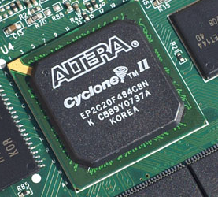
Introduction
What are Field- Programmable Gate Arrays?(FPGAs)
FPGAs are semiconductor devices
composed of programmable logic
components called “logic blocks” that
can be configured and re-configured
to perform complex combinational functions.

Slide 5
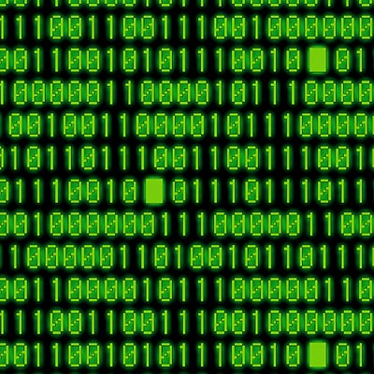
Introduction
A Time to digital converter (TDC) is a device that converts signals of pulses into a digital representation of time.

Slide 6
Introduction
The TDC FPGA has a wide range of applications:
High energy Physics Experiments
Time-of-Flight (TOF)
Fermilab: Main Injector Particle Production Experiment

Slide 7
Introduction
MIPP is an experiment studying hadronic flavor particle production at Fermilab. The experiments will cover 1 to 120 GeV/c on multiple targets (liquid Hydrogen, Minos targets and various nuclear targets including Uranium) for six beam species (pion, kaon, protons and their antiparticles).
Open geometry spectrometer used to study hadron production.
Hadronic fragmentation – test scaling law of particle fragmentation

Slide 8
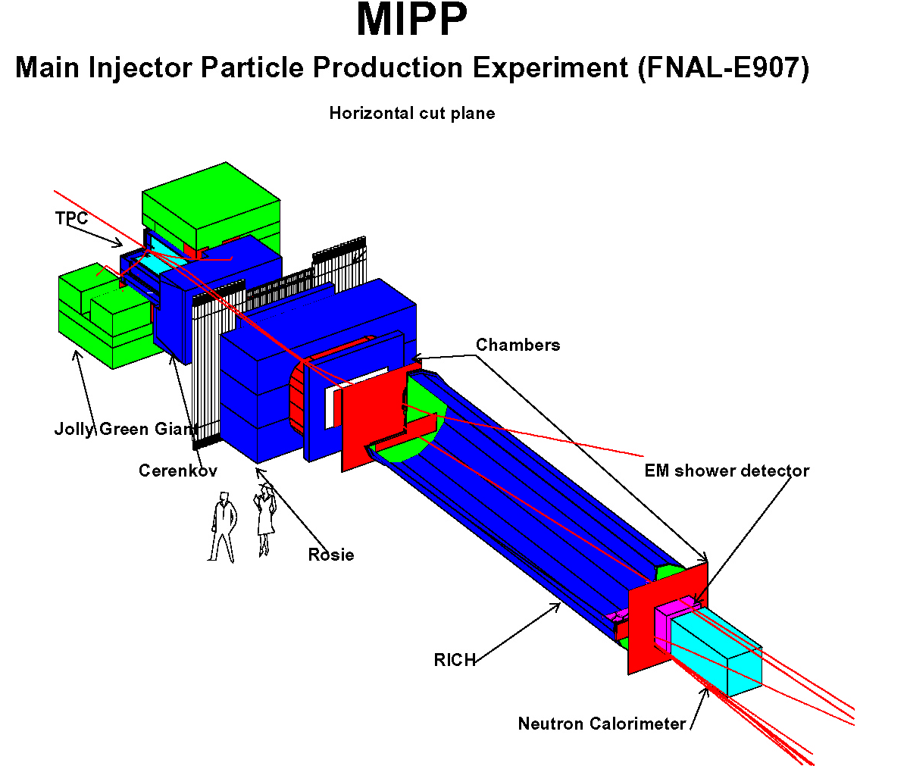
Time of Flight
Time-of- Flight

Slide 9
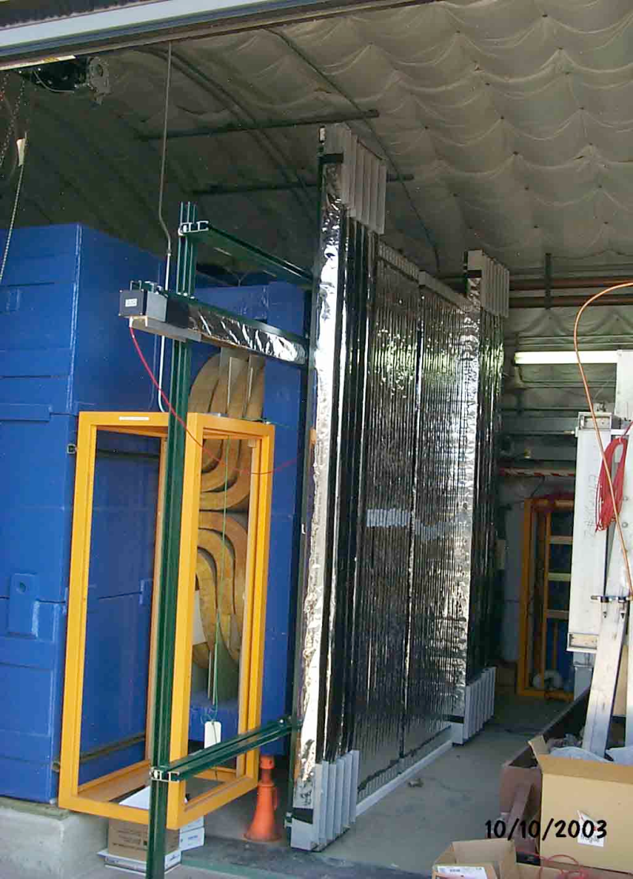
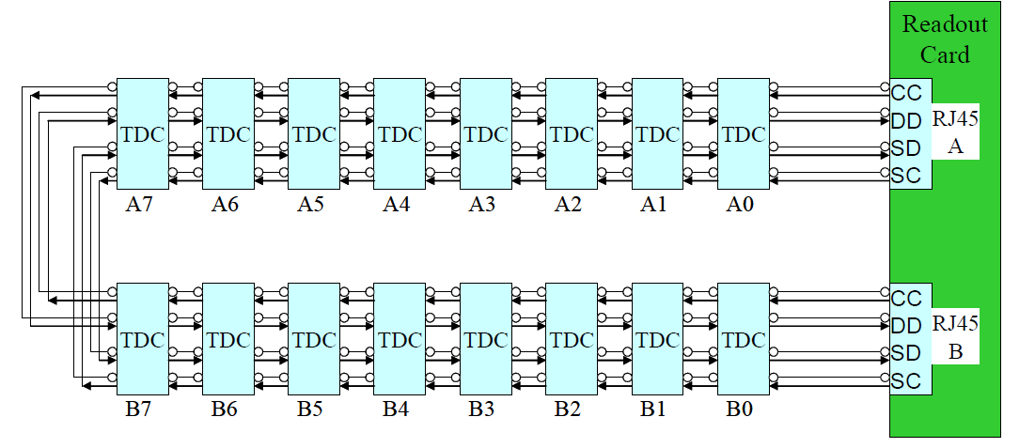
Time of Flight
TDC CARDS
AMP
CARDS

Slide 10
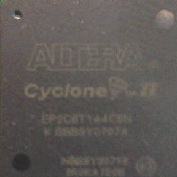
Hardware
Altera Cyclone II FPGA EP25Q208
Altera Cyclone II FPGA EP2C8T144
Ethernet Port: DB9 Converter
Serial Port: RJ-45 connector
On-Board Signal: Crystal Oscillator (25 MHz)
External Signal: BNC Connectors
Clock: Crystal Oscillators (50 and 25 MHz)
Configuration Chip
Serial Connector to USB Blaster

Slide 11
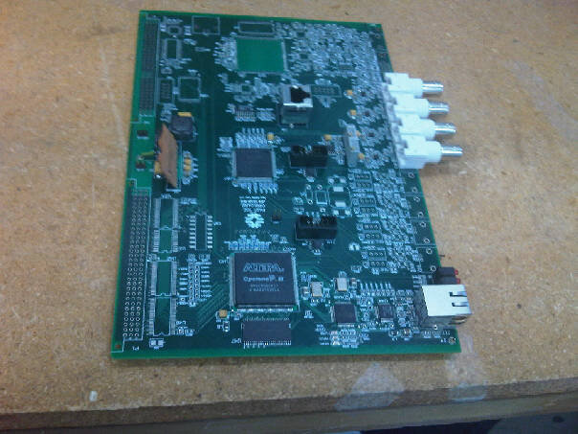
Serial Port
Power Supply
TDC FPGA
BNC Connectors
Configuration Chip
USB Blaster Connection
Ethernet Port
Ethernet Chip
DAQ FPGA
Crystal Oscillator

Slide 12
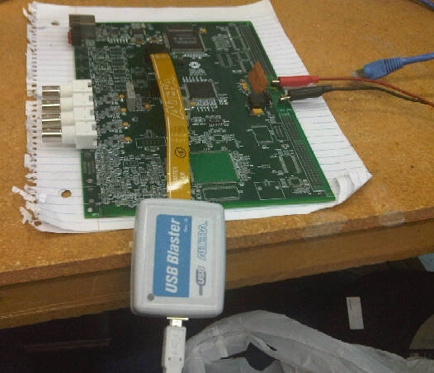
Firmware
Firmware:
Schematic-based entry
Altera Quartus II Software

Slide 13
TDC FPGA Firmware
There were two major problems:
The temperature and the voltage power supply were causing uneven bin widths.
The wide bins would then limited the time resolution and precision of the TDC.

Slide 14
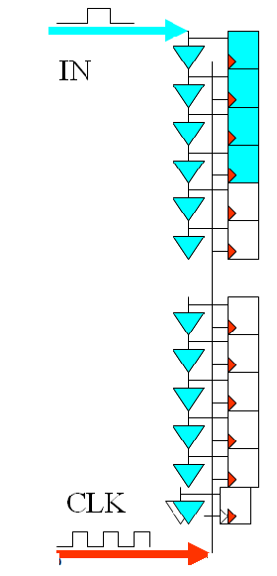
Carry Chain
The Cyclone II utilizes a carry chain adder as it delay chain.
The registers recodes each bit of the adder result, and a priority encoder follows the array.
Questions!?
Calibrate:
Temperature/Voltage
Clock too fast?/ too slow?
Synchronizing Input
Timing Reference

Slide 15
TDC FPGA Firmware
Widths of bins are different and varies with supply voltage and temperature.
Some bins are ultra-wide due to LAB structure

Slide 16
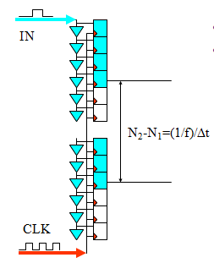
Auto- Calibration
Longer delay line
Some signals may be registered twice at two consecutive clock edges.
The two measurements can be used:
  to calibrate the delay.
  to reduce digitization errors.

Slide 17
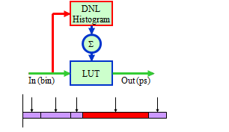
Auto-Calibration
It provides a bin-by-bin calibration at certain temperature.
It is a “turn-key” solution.
A DNL histogram is booked in the FPGA internal memory. Once all hits are booked into the histogram, the lookup table (LUT) is integrated from the DNL histogram so that it outputs the actual time of the center of the addressed bin.

Slide 18
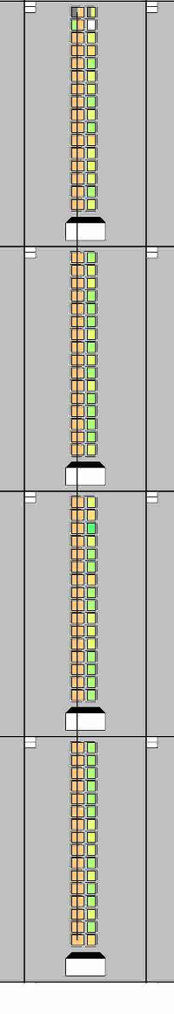
Wave Union Launcher
.
Wave Union
Launcher
The wave union launcher creates multiple logic transitions after receiving a input logic step
In
CLK

Slide 19
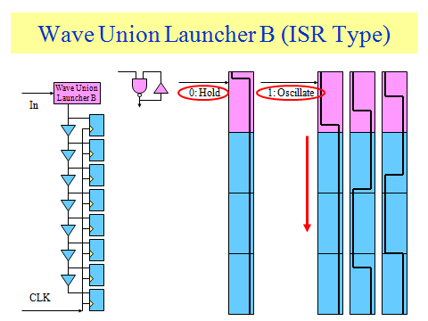
Wave Union Launcher
After arrival of the input, the wave union launcher B starts to oscillate launching a wave union into the carry chain. The carry chain/register array structure takes 16 snap shots of the oscillation bit patterns in 16 clock cycles at 400MHz. The phase of the oscillation is determined by the arrival time of the input signal. Then in the 16 snap shots, the locations of the logic transitions can be utilized to compute the arrival time of the input signal to a higher resolution through the processing block “SumHitD”.

Slide 20
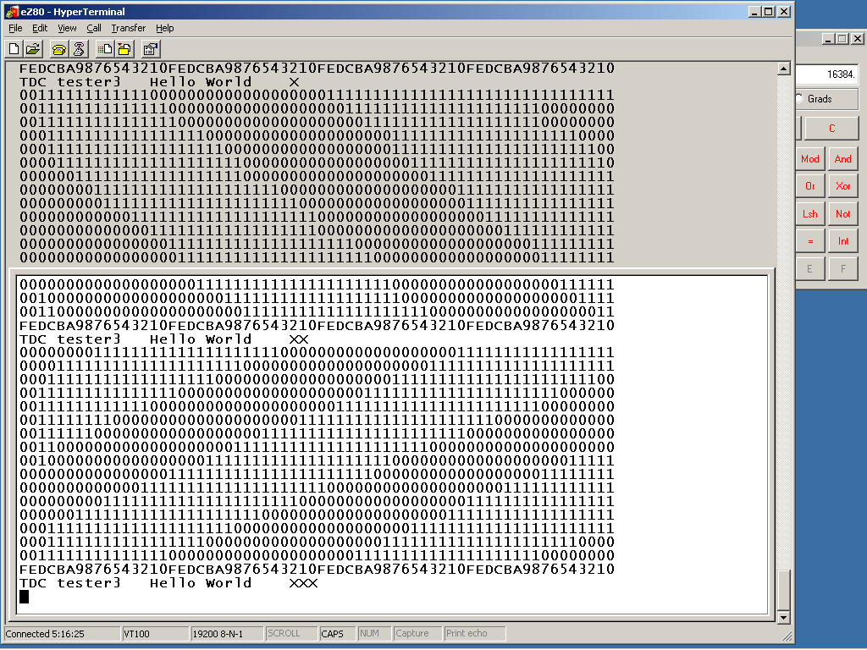
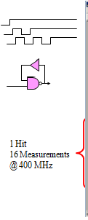
Wave Union Launcher

Slide 21
TDC FPGA Firmware
Ultra-Wide bins were eliminated

Slide 22
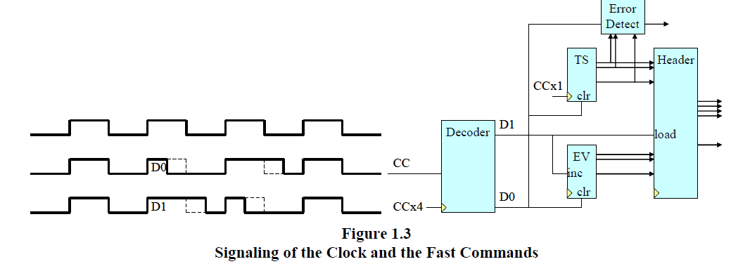
TDC FPGA Firmware
Distributing a Timing Reference
Once D0 is detected by the decoder the time stamp counter (TS) and event counter (EV) are reset.
Each time the D0 marker arrives the least bits of the TS should be 0.
Time Stamp

Slide 23
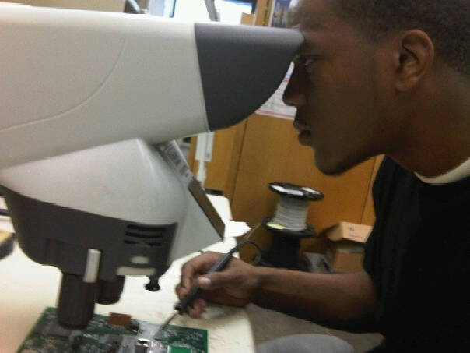
DAQ FPGA Firmware
Interfaces the TDC FPGA, a Synchronous Dynamic Random Access Memory, the Serial Port, the Ethernet circuit and the VME bus, a flash memory and the USB connection.
Element Configuration is essential

Slide 24
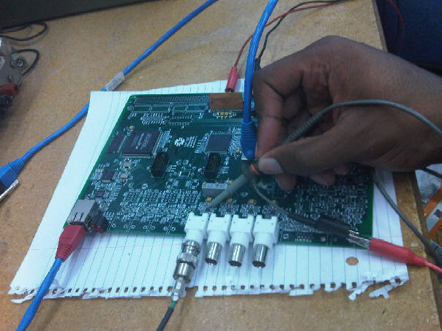
Testing
The firmware was downloaded successfully.
The next step was to test it.

Slide 25
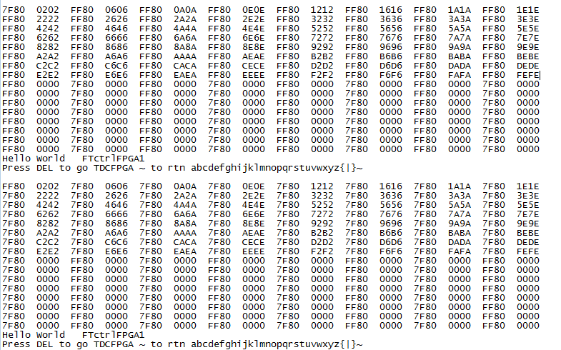
Testing
DAQ Counter as it collects data

Slide 26
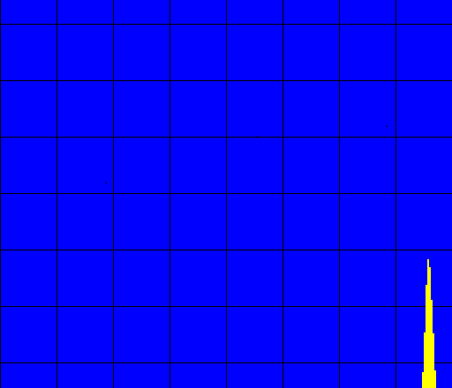
Testing
The TDC FPGA was able to simulate and transmit raw data.
A histogram was displayed.

Slide 27
Conclusion
The Board functioned well.
This TDC FPGA is innovative in that it solved many problems prevalent in the previously developed firmware. Its new flexible firmware enables it to be utilized in many practical applications.

Slide 28
Acknowledgements
Jin-Yuan Wu, my Supervisor
Sten Henson
SIST Program Committee
Dianne Engram
Jamieson Olsen
Dr. Davenport
Kenie Moses

Slide 29
References
[1] A. Amiri, A. Khouas & M. Boukadoum, “On the Timing Uncertainty in
Delay-Line-based Time Measurement Applications Targeting FPGAs,”
in Circuits and Systems, 2007, IEEE International Symposium on, 7-10
27-30 May 2007 Page(s): 3772 - 3775.
[2] J. Song, Q. An & S. Liu, “A high-resolution time-to-digital converter
implemented in field-programmable-gate-arrays,” in IEEE Transactions
on Nuclear Science, 2005, Pages 236 - 241, vol. 53.
[3] M. Lin, G. Tsai, C. Liu, S. Chu, “FPGA-Based High Area Efficient
Time-To-Digital IP Design,” in TENCON 2006. 2006 IEEE Region 10
Conference, Nov. 2006 Page(s):1 – 4.
[4] J. Wu, Z. Shi & I. Y. Wang, “Firmware-only implementation of time-todigital
converter (TDC) in field programmable gate array (FPGA),” in
Nuclear Science Symposium Conference Record, 2003 IEEE, 19-25 Oct.
2003 Page(s):177 - 181 Vol. 1.

