Slide 1


Hadron Therapy FFAG designs: proton, carbon, isochronous
Fermilab
Dr. Carol Johnstone
FFAG09
Sept 23, 2009
Fermilab

Slide 2
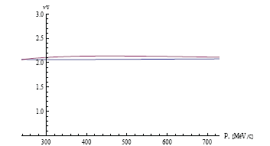
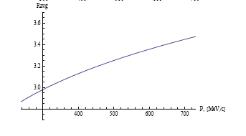
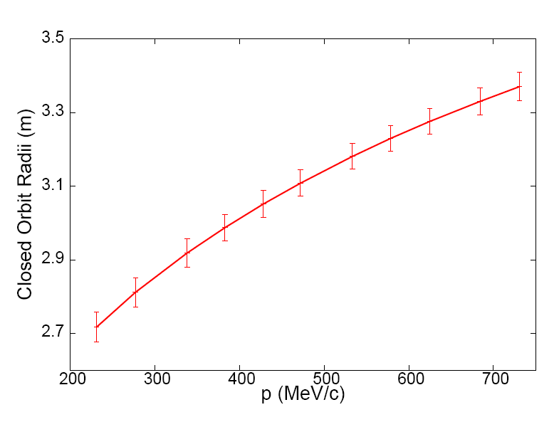
A 30-250 MeV Proton FFAG for Hadron Therapy
Mathematica® initial parameters compared with COSY INFINITY and full field description
3.4 m
Again strong tune splitting horz/vert, but radial dependence is well reproduced

Slide 3
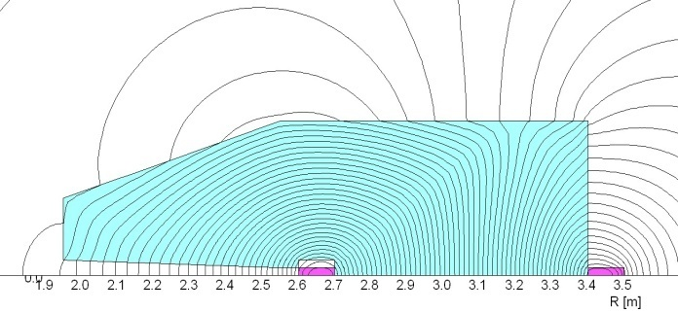
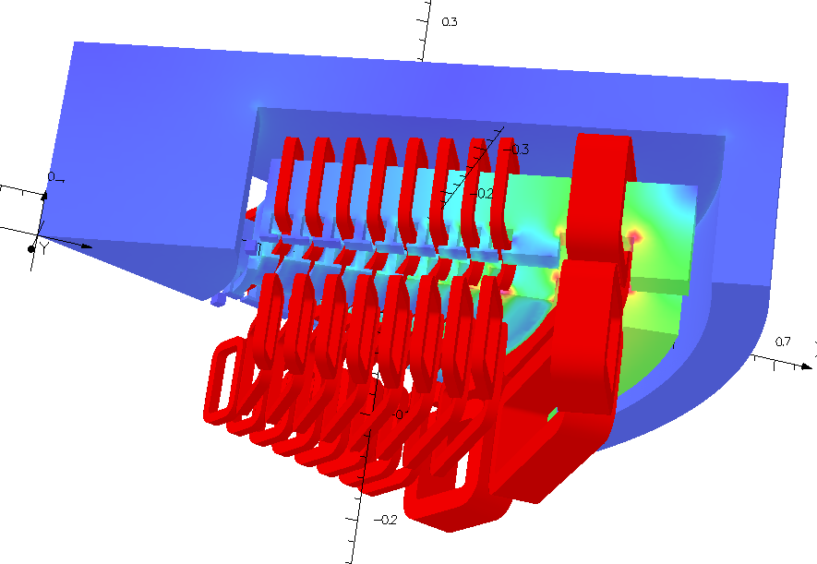
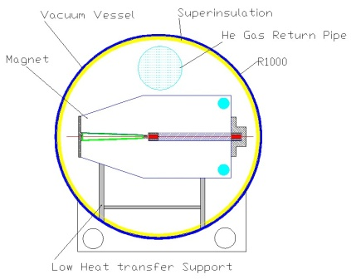
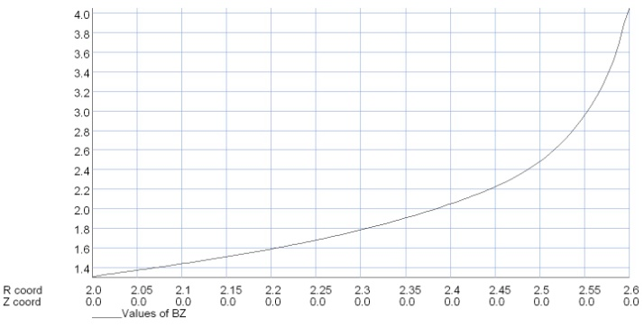
Hardware Concepts for a Nonlinear Nonscaling FFAG
An innovative new approach to a combined-function 4T magnet is under design based conventional NbTi superconducting magnet technologyand construction techniques.
For normal conducting/permanent magnets, inset trim coils are being designed for radial field adjustment and fringe field control –very important for vertical tune. You can essentially “buck” fringe field effects.

Slide 4
COSY INFINITY results and DA
General Parameters of the triplet 30-250 MeV nonscaling FFAG design.
General Parameters of the triplet 30-250 MeV nonscaling FFAG design after tune optimization in COSY – only tune variations are affected.
Parameter | Unit | Injection | Extraction
Energy Range | MeV | 30 | 250
Tune/cell (ν _{x} / ν_{y}) Ring tune (ν _{x} / ν_{y}) | 2π-rad | 0.31 / 0.16 2.51/1.28 | 0.31 / 0.21 2.51/1.66
Average Radius | m | 2.75 | 3.39
No. cells |  | 8
Long Straight | m | 1.17 | 1.17
Peak Field F D | T | 1.21 -1.37 | 3.13 -3.41
Magnet Lengths F D | m | 0.646 0.129 | 0.803 0.176
Apertures F D | m | 0.63 0.55
Parameter | Unit | Injection | Extraction
Energy Range | MeV | 30 | 250
Tune/cell (ν _{x} / ν_{y}) Ring tune (ν _{x} / ν_{y}) | 2π-rad | 0.31 / 0.22 2.48/1.75 | 0.31 / 0.19 2.48/1.55
Average Radius | m | 2.75 | 3.39
No. cells |  | 8
Long Straight | m | 1.17 | 1.17
Peak Field F D | T | 1.21 -1.37 | 3.13 -3.41
Magnet Lengths F D | m | 0.646 0.129 | 0.803 0.176
Apertures F D | m | 0.63 0.55
Dynamic aperture a midpoint, 112 MeV., horizontal (left), vertical (right) DA at all energies for both planes is extremely large.

Slide 5
Nonscaling Carbon lattice
Design was extended to carbon with longer (2m) straights
Embedded rings for multi-ion cancer therapy make a compact accelerator chain competitive with cyclotrons
¹²C ⁶⁺
^{p}
5.5 – 6.9 m
3.5 m

Slide 6
Additional constraint: Isochronous Condition
In addition to stable tune, the condition of “isochronism” was imposed on the orbits:
This equation is useful in determining initial “feasible” apertures and field strengths

Slide 7
Isochronous Lattices: nonscaling nonlinear FFAGs
First ring: 18 MeV – 150 MeV isochronous H- FFAG – this energy range was chosen to make a “standalone” therapy
machine to drive “low-energy” fixed rooms
and SC high-energy ring
3 m outer machine radius, 1m straights, 1.07-1.87 m injection to extraction orbits
Tune per cell with just quad + sext field profile (top) and then adding octupole (middle) and ring tune (bottom)
Physical layout of 18-150 MeV 4 sector isochronous NC ring

Slide 8
Machine Parameters for a 18-150 MeV H- isochronous FFAG: Normal conducting
General Parameters of the triplet 18-150 MeV isochronous nonscaling FFAG
Parameter | Unit | Injection | Extraction
Energy Range | MeV | 18 | 150
Tune/cell (ν _{x} / ν_{y}) Ring tune (ν _{x} / ν_{y}) | 2π-rad | 0.30 / 0.31 2.51/1.28 | 0.29 / 0.31 2.51/1.66
Average Radius | m | 1.07 | 2.88
No. cells |  | 4
Long Straight | m | 1.0 | 1.0
Peak Field F D | T | 1.21 0 | 1.09 -0.24
Magnet Lengths F D | m | 1.068 0.108 | 1.892 1.120
Apertures F D | m | 2.00 1.25
Isochronous vs. calculated orbits

Slide 9
150-250 MeV Superconducting Isochronous Proton FFAG
1.75 m outer machine radius, 2m straights, 1.24-1.52 m injection to extraction orbits (0.28 m orbit separation)
Tune per cell with up to duo-decapole (top) and ring tune (bottom)

Slide 10
Machine Parameters for a 150-250 MeV isochronous proton FFAG: Superconducting
General Parameters of the triplet 150-250 MeV isochronous nonscaling FFAG
Parameter | Unit | Injection | Extraction
Energy Range | MeV | 150 | 250
Tune/cell (ν _{x} / ν_{y}) Ring tune (ν _{x} / ν_{y}) | 2π-rad | 0.29/ 0.29 1.46/1.45 | 0.29 / 0.29 1.46/1.47
Average Radius | m | 1.24 | 1.52
No. cells |  | 5
Long Straight | m | 2.0 | 2.0
Peak Field F D | T | 3.21 0 | 3.52 -1.81
Magnet Lengths F D | m | 0.722 0.108 | 0.892 0.344
Apertures F D | m | 0.294 0.218
Higher orders reduced deviation from isochronicity by a factor of 2
Isochronous vs. calculated orbits

Slide 11
Motivation for two rings
Inner ring drives “low-energy” treatment rooms – H- extraction
CW – simultaneously inject into the outer small-aperture SC ring
Outer ring drives the gantry treatment rooms
Two treatment rooms operating simultaneously – potentially doubling patient throughput

Slide 12
Shielding Considerations: applying MARS to optimize shielding
Dose distribution around the graphite degrader and copper collimators for 240, 200,160,120, and 70 MeV
Dose peaks at 160 -120 MeV plus <5% transmission translates into ~factor of 10 increase in dose, so radiation shielding grows rapidly with energy degrading. Degrading the lower energy ring is much less of a shielding issue.

Slide 13
Arguments for FFAG hadrontherapy
FFAG designs are advancing rapidly internationally, particularly for medical and HEP applications
Embedded rings for multi-ion cancer therapy make a compact accelerator chain competitive with cyclotrons.
A CW (isochronous) nonscaling FFAG has been developed -very important for accurate dose delivery, lower intensity beams, reduced shielding
A two-stage FFAG system could improve facility efficiency and reduce shielding requirements.

