Slide 1
Clinical Specifications for Accelerators
Fermilab
Prof. George Coutrakon
Northern Illinois University
As interpreted by Dr. Carol Johnstone
FFAG09
Sept 23, 2009
Fermilab

Slide 2
Clinical Specifications for Accelerators
This talk is based on a document describing the baseline specifications developed for the Northern Illinois Proton Treatment and research Center.
The baseline facility will have four treatment rooms consisting of two proton gantries and two fixed horizontal beam room (HBR).
At least one gantry room will have pencil beam scanning capability
A fifth room will be used for dosimetry, radiobiology and materials irradiation

Slide 3
Accelerator and Beam Transport Systems
Accelerator needs to achieve a dose rate of 2 Gy/min/liter to a cubic target (10 x 10 x 10 cm³) regardless of the depth of the target in the patient for passively scattered beams.
For intensity modulated proton therapy (IMPT), the minimum dose rate is 1 Gy/liter/min.
Clinical beams any treatment room require a proton range between 4.0 g/cm² ( ~70 MeV) and 32 g/cm² (~230 MeV) in the patient with field sizes up to 25 x 25 cm² and reproducible to +/-0.02 g/cm²

Slide 4
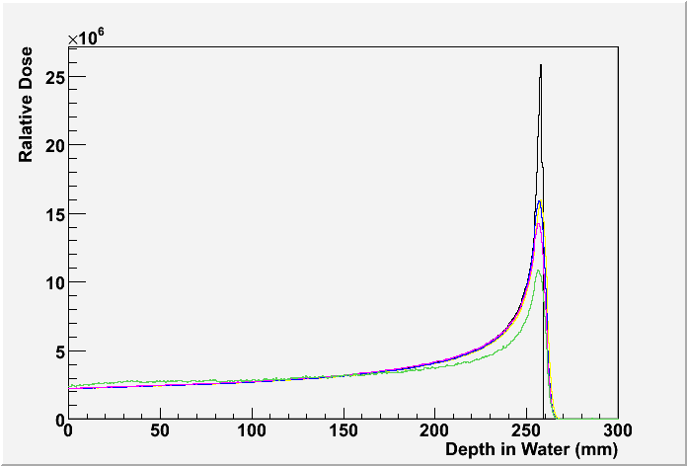
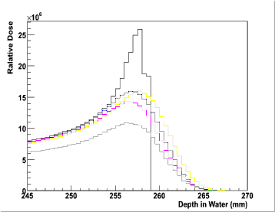
Converting to Accelerator Conventions
So what the heck is +/-0.02 g/cm^{2 –}
Conversion to range in water:
0.02 g/cm² = 0.02 cm, or 100 μm
This number is the allowed variation in range of the Bragg peak – generally measured with respect to the distal edge
Still not there – need conversion to energy
For 225 MeV protons this is
E_{loss} (dE/dx) = 0.0417 MeV / 100um
(1) Ionisation energy loss
(2) (1)+Energy fluctuation
(3) (2)+Multiple Coulomb Scattering
(4) (3)+Hadron elastic scattering
(5) (4)+Hadron inelastic scattering

Slide 5
Alternatively – you can derive this number approximately from standard tables
Energy/ Range in H₂O from Janni Tables
70 MeV / 4cm
100 MeV / 7.7 cm
130 MeV / 12.3 cm
160 MeV / 17.7 cm
190 MeV / 23.8 cm
230 MeV / 33.0 cm

Slide 6
Energy constraints on delivered Beam
“Energy stability (second to second) and reproducibility (day to day) of accelerated beam must yield a range constancy of +/- 0.02 cm in water equivalent material. For synchrotrons, the energy stability is the constancy from one beam pulse to the next. For cyclotrons, it is the energy constancy from one second to the next.” (this is consistent with range requirement)
Implies energy stability of delivered beam must be
+/- 0.08 MeV (rms)
Compare with momentum spread in the 400-MeV Fermilab Linac
95%, full Δp/p = 0.5% +/- 0.1% (rms)
This translates into ΔE_{kin} of +/- 0.68 MeV (rms)
Can be at the limits of accelerator energy stability

Slide 7
Transmission
However, in a cyclotron this really represents the momentum acceptance of the beamline – the ESS or Energy Selection System used after a degrader
Severe requirements on momentum aperture result in severe secondary losses after a “production” target (in addition to the rapid decline in the cross section for production of lower energy beams + increasing severe emittance blowup – geometric emittance is fixed by collimators )
Below is a transmission table
Energy | PSI | Munich
250 MeV | 100% | 100%
240 MeV |  | 6.6%
230 MeV | 10%
100 MeV | 3% | 0.06%
70 MeV | 1% | 0.03%

Slide 8
Energy Steps for treatment
The range adjustment resolution will be 0.05 g/cm² or 0.05 cm in water.
energy step of 0.2 MeV
Synchrotrons can handle this, especially with a matched well-tuned transport line. Large Synchrotrons naturally are very sensitive to the central reference trajectory (large dispersion, small aperture, TOF accuracy …)
In the cyclotron, the burden is again on the transport line

Slide 9
Additional specifications on accelerator and transport
The time to switch beam delivery between any two rooms and any two energies
<1 minute for clinical operations – present claim is 30 sec
Challenge with solid core magnets and hysteresis unless energies and therapy is carefully coordinated
Research applications, in any room,
the dose rate must be lowered to ~10⁻⁵ from the 1 Gy/liter/min. This “may “ include lowering beam current injected into the accelerator, lowering extraction efficiency and lowering beam transport efficiency (slamming beam into a component – just as a foot note we can activate a component to 40 mr/hour @1’ in an hour of Fermilab Linac beam)
Beam energy from the accelerator / energy degrader must be able to be lowered to 30 MeV – this gets exciting for a 230-250 MeV cyclotron
a fast beam abort system must be used to terminate beam in less than 200 μsec. This requirement is driven by beam scanning safety considerations and low dose and low dose rate radiation biology experiments.

Slide 10
Beam Delivery Systems and Gantry
Clinical field sizes of 1-25 cm² square area available in every treatment room except in one of the gantries having an IMPT beam delivery system where the maximum field size for the IMPT nozzle will be 30 x 40 cm (preferred spec) or 25 x 25 cm (minimum spec).
A user selectable spread out Bragg peak (SOBP) shall be generated with dose uniformity +/- 2 % across the depth of the target for all beam energies. The user must be able to select from a library of SOBP sizes which will range from 1 cm to 25 cm in 0.5 cm steps – this implies 2 MeV steps rather than the previous 0.2 MeV.
The useful SOBP range will be defined from the 98% of D(max) at the distal side to 98% of D(max) at the proximal side of the treatment volume.
the measured dose ( in phantom) must be better than +/-5% for more than 95% of the clinical target volume.

Slide 11
Distal Edge and Penumbra
Dose fall off (from 90% to 10% of the central target dose) on the distal edge of the Bragg peak will be less than 1 mm plus 3% of the range in water (reiterate: repeat range to 0.2 mm, 3% is due to “straggling”, then the momentum uncertainty or spread is allowed to add another 1 mm ! In quadrature! – but spread and repeatability are linked)
Lateral dose fall off or penumbra (from 90% to 10% of the central target dose) will be less than 2 mm plus 3% of the proton penetration depth (i.e. the natural penumbra due to multiple Coulomb scattering in water or tissue equivalent material). This 2mm is essentially beam divergence: emittance/halo related. How far does the beam size expand through the patient independent of Coulomb
AGAIN the quadrature addition translates 1 mm to 5 mm in energy @high energy
as illustrated in the following specification table

Slide 12
Penumbra and distal edge fall off limits
Energy/ Range in H₂O from Janni Tables | Maximum allowed Penumbra (90% to 10%) | Max. allowed distal edge falloff (90%-10%)
70 MeV / 4cm | 3.2 mm | 2.2 mm
100 MeV / 7.7 cm | 4.3 mm | 3.3 mm
130 MeV / 12.3 cm | 5.7 mm | 4.7 mm
160 MeV / 17.7 cm | 7.3 mm | 6.3 mm
190 MeV / 23.8 cm | 9.1 mm | 8.1 mm
230 MeV / 33.0 cm | 12 mm | 11 mm

Slide 13
The field flatness and symmetry in any plane normal to the central axis and passing through the clinical tumor volume (CTV), shall be within +/- 3% of the central axis dose value at the geometrical center of the target. This flatness and symmetry criteria shall apply to the volume enclosed by the 80%isodose surface. – This is almost an advertisement for spot scanning.
Under normal treatment conditions (no interrupt faults), dose conformity requirements shall apply to pencil beams having diameter no greater than 8 mm (FWHM) at the entrance to the patient
Safety from accidental overdoses. At least two independent dose monitors shall prevent an overdose of no more than 30% of the prescribed dose to no more than 5% of the clinical target volume ( CTV).

Slide 14
Conclusions
It’s clear that there are inconsistencies with accelerator/beam transport specifications – some are difficult and others “lax”
The cyclotron and synchrotron behave very differently – the burden in the cyclotron is on the energy selection section and beam transport.

