Slide 1
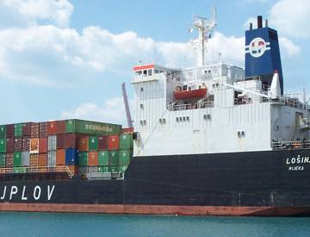
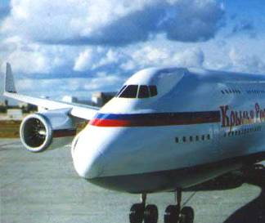
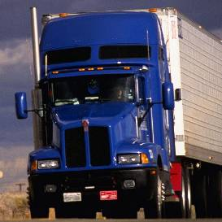
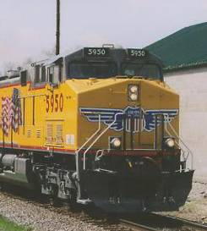
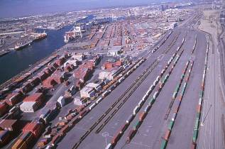
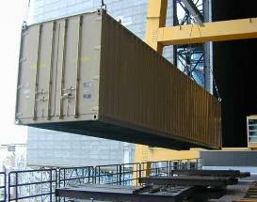

Accelerators in Homeland Security
William Bertozzi
Wilbur Franklin, Alexei Klimenko, Steve Korbly
Robert Ledoux, Rustam Niyazov, Dave Swenson
Consultants: Fred Mills, Martin Berz, Kyoko Makino

Slide 2
Introduction - Outline
What are the events that Homeland Security is trying to prevent?
What are the Dangers we want to discover?
What processes are used to discover these dangers?
  Radiography (photon and neutron)
  Neutron induced reactions
  Photon induced reactions
The role that accelerators play
  Neutron generation
    Reactions used
    Intensities required
  Photon generation
    Hadron induced reactions
    Bremsstrahlung
    Monochromatic photon sources
Important characteristics of electron accelerators
Novel approaches to accelerators

Slide 3
Some Important Dangers
Explosives
  Examples of extensive damage
    Oklahoma, Lebanon, Lockerbie, Halifax (1917)
  Important elements: N, O, Cl, Na, S, K, P (and fulminates)
Toxic Substances
  Mustard gas (C₄H₈Cl₂S), Sarin (C₄H₁₀FO₂P), Phosgene (CCl₂O), etc.
Dirty Bombs
  ¹³⁷Cs, ⁶⁰Co, etc.
  Shielding materials: Pb, W, Fe, etc.
Special Nuclear materials
  ²³⁵U, ²³⁹Pu, ²³⁷Np
Weapons of Mass Destruction
  ²³⁵U, ²³⁹Pu, ²³⁷Np, Explosives, Tamper materials, etc.

Slide 4
Detection: Possible Nuclear Pathways
Beam
Measured Particle
Neutrons Neutrons: Scattering, Fission (Neutrons)
Photons: Capture, Scattering
Photons Photons: Nuclear Resonance Fluorescence
Effective Z (EZ-3DTM)
Neutrons: Fission (Prompt Neutrons)

Slide 5
The Roles that Neutrons Play
Transmission radiography
Capture reactions leading to specific decays
  Example: Many, but not ubiquitous if speed is needed, (even-even small cross sections)
Inelastic scattering leading to specific decays
  Example: Many, but energetic neutrons produce backgrounds.
Induced fission
  Thermal capture and fast capture
Others

Slide 6
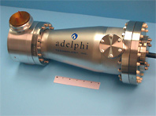
Neutron Generators
Accelerator-based fusion:
  D-D: ~2.5 MeV ²H + ²H → ³He + n
  D-T: ~14.1 MeV ³H + ²H → ⁴He + n
Adelphi Technology
  DD 10⁹ n/s
  DD 10¹⁰ n/s
  DT 10¹⁴ n/s
    DU amplifier
    60 kW
Stripping reactions – example: 9Be(D,n)10B; Controllable energy, Van de Graaff, RFQ, Cyclotrons

Slide 7
Detection Processes that Use Photons
Transmission Radiography
  Density dependence of penetration
Nuclear Resonance Fluorescence
  Scattering from nuclear states
  Transmission absorption
Effective –Z determination
  Multiple processes yielding strong Z-dependence
Photon Induced Fission
  Distinctive properties of Prompt neutron energy spectra

Slide 8
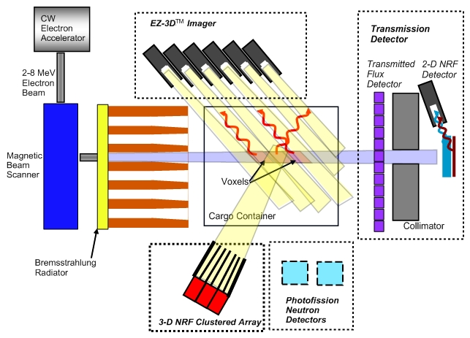
NRF and EZ-3D with 3D Voxels, 2-D NRF Transmission Detection and Prompt Photofission Neutrons

Slide 9
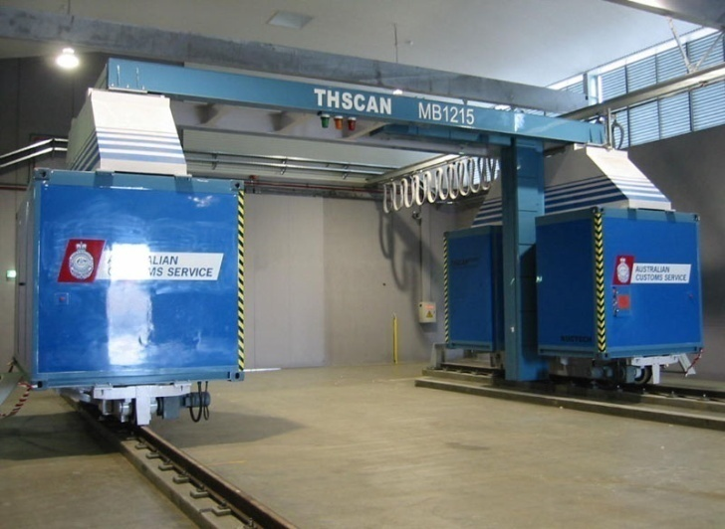
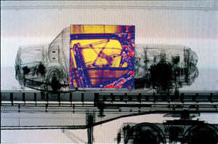
Radiography with Photons
Pictures courtesy Australian Customs and Border Protection Service

Slide 10
Nuclear Resonance Fluorescence

Slide 11
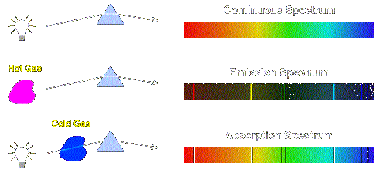
Analogy: NRF to Optical Spectrometry
Optical Spectroscopy
NRFI Spectroscopy
“Bremsstrahlung” Spectrum
3-D Imaging of Back-angle High-Energy Photons
2-D Isotope Specific Transmission Imaging

Slide 12
Nuclear Resonance Fluorescence Physics
Natural width:
~ 100 meV
Incident Photons
Doppler
broadened width:
~ 12 eV (N),
~ 3 eV (U)
~
~
Resonant Photon
Nitrogen
(¹⁴N)
Oxygen (¹⁶O)
Carbon (¹²C)
Carbon (¹³C)
E
7.029 MeV
7.117 MeV
6.917 MeV
Recoil Shift
NRF Emitted Photons
  Energy Range 1-8 MeV
  Nearly Isotropic
  Downshifted (Doppler recoil) ~ 1keV
    No self absorption
5.691 MeV
4.915 MeV
4.439 MeV
3.685 MeV
3.089 MeV
2.313 MeV

Slide 13
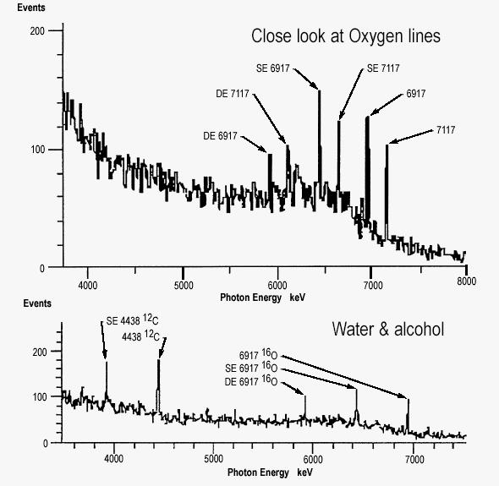
Alcohol NRF Spectrum
Notes:
Spectral example…

Slide 14
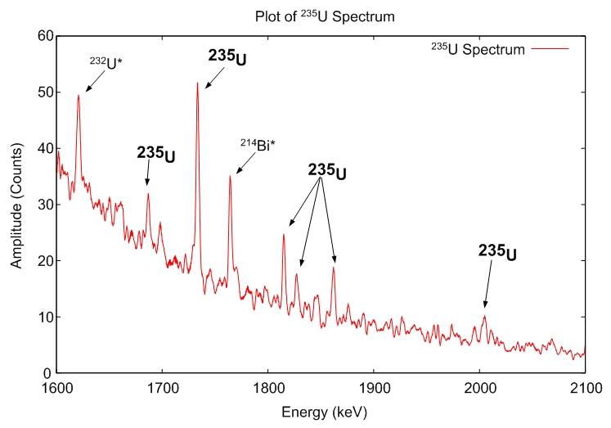
NRF Spectrum from ²³⁵U
E_{beam} = 2.1 MeV
Measurements performed with PNNL
Notes:
Necessary, a good spectra of one of the materials to be discussed in the presentation.

Slide 15
Effective – Z Determination

Slide 16
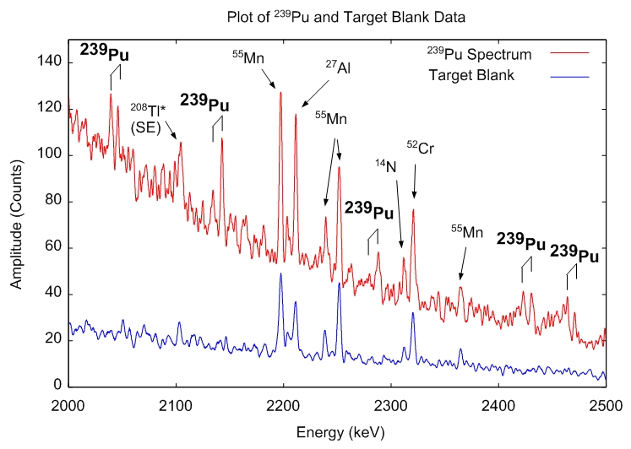
NRF Spectrum from ²³⁹Pu
E_{beam} = 2.8 MeV
Measurements performed with LLNL
Notes:
Necessary, a good spectra of one of the materials to be discussed in the presentation.

Slide 17
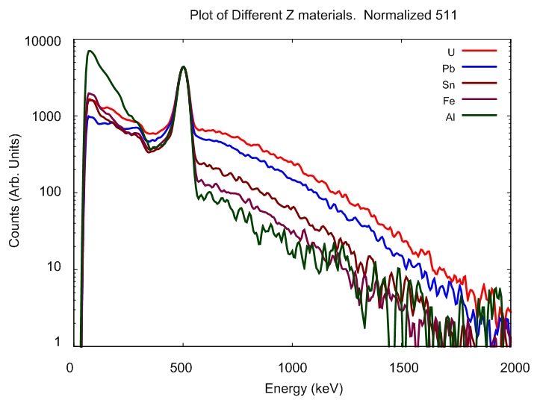
EZ-3D™ Technology Summary
Compton Pair Production
Coulomb Scattering
Beam Photon
e⁻
Back-Angle Photon
Single Compton Scatter with Ebeam = 5 MeV
  E_{photon} (120º) = 320 keV
  E_{photon} (180º) = 240 keV
Pair Production → e+e- annihilation (~Z²)
  E_{photon} = 511 keV
EZ-3D™ effect ~ Z^{α}
Detection is automated
Rapidly identifies high-Z anomalies

Slide 18
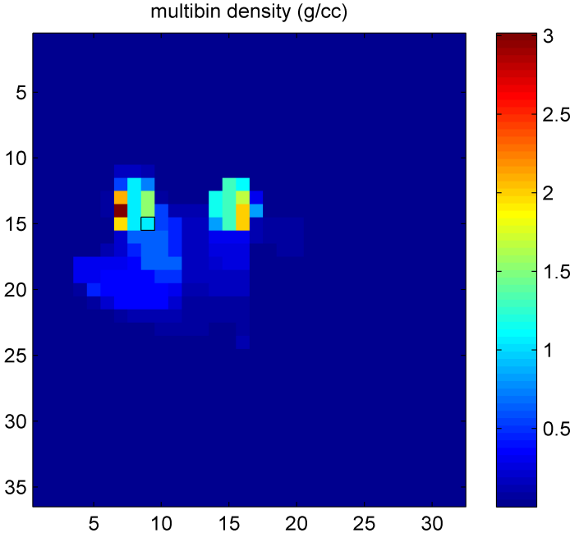
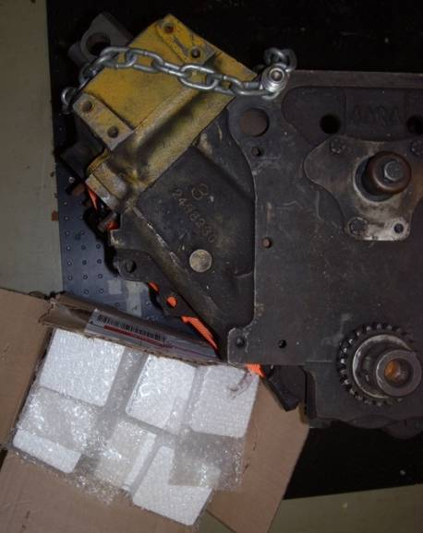
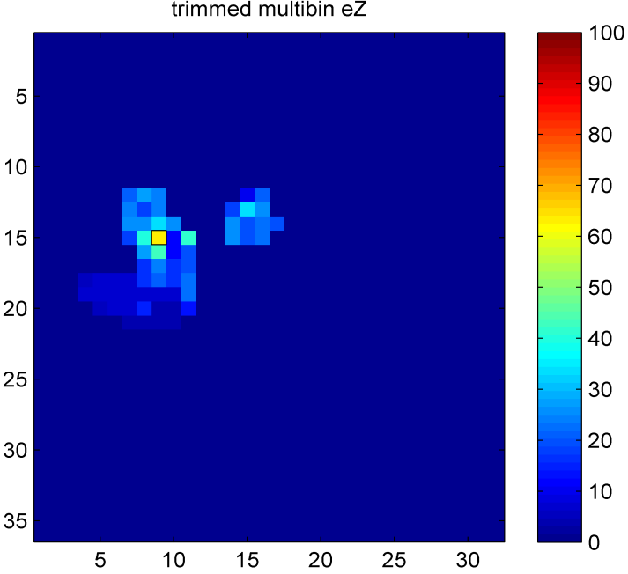
Tests @ UCSB Low Z Materials
Beam
Truck engine with various materials embedded.
  Pb
  Sn
  C4
Pb
Sn
Engine
C4
Density reconstruction
  Two points of high density material: Pb, Sn
  One point with low Z_{eff}
Effective Z identification
  Two points with high Z_{eff}: Pb, Sn
  One point with low Z_{eff}
18
Notes:
18

Slide 19
Prompt Neutrons from Photon Induced Fission

Slide 20
Prompt Neutrons from Photon Induced Fission
C. P. Sargent, W. Bertozzi, P. T. Demos, J. L. Matthews, and W. Turchinetz, Prompt Neutrons from Thorium Photofission, Phys. Rev. 137, B89 - B101 (1965)
Time-of- Flight Measurement of Neutron Energy Spectra and Angular Distribution
Less than 7% of prompt neutrons come from scission at separation
Prompt neutrons from photon induced fission result from fully accelerated fragments (velocity boost)
Energy distribution of prompt neutrons extends past 8 MeV
Energy distribution independent of photon energy below 10 MeV

Slide 21
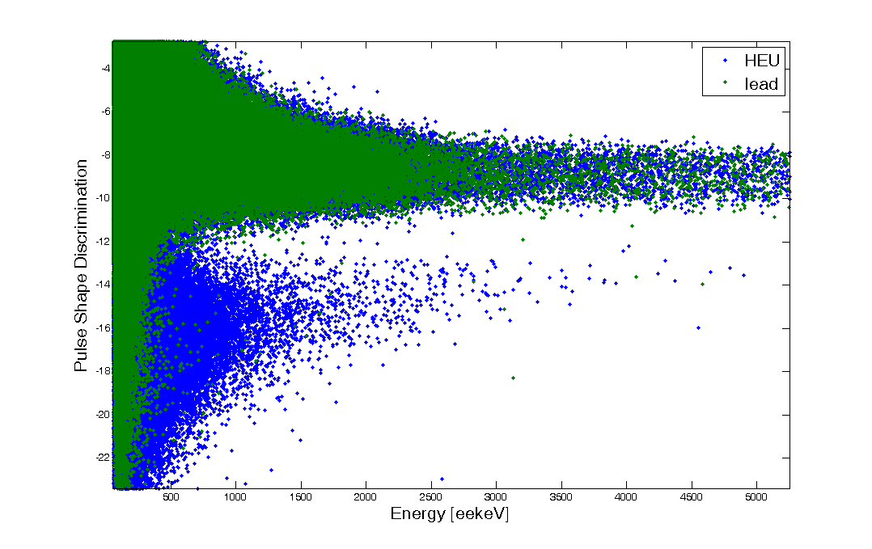
Prompt Photofission Neutrons
Prompt, high energy neutrons provide unique signal for fissile material
Neutron energy distribution independent of incident photon energy
Minimal background contamination above threshold
Significant neutron yield for E > 3 MeV → highly transmissive
Relative to Prompt
  Delayed Photons ~1/10
  Delayed Neutrons ~1/200
E_{beam} = 9 MeV
Lead
HEU
Photon events
Neutron events
3 Mev
6 Mev
Notes:
21

Slide 22
Important Properties of Photon Beams
Energy
  Radiography: ≤ 9 MeV
  NRF: 1.5 – 7.1 MeV; energy of states
  Effective – Z : E ~ 9 MeV (but lower energy is effective)
  Photon induced fission: 5.3 MeV < E < ~9 MeV
Intensity: Depends on cargo attenuation, speed of detection, and counting system
  Radiography: presently use linear accelerators at < 100 μA
  NRF: ~ 10⁸ γ/s/eV
  Effective – Z: Intensities similar to NRF
  Photon Induced fission: As much as possible for dense cargoes, but very effective at intensities similar to NRF
Duty Cycle
  Radiography: Linacs at 10⁻³ duty; ion integration; (photon counting)
  All other techniques count individual events with spectral information
  High duty cycle is a premium for event counting at high intensities

Slide 23
Electron Accelerators For Inspection
Electron accelerators are important tools for inspection applications
Important criteria for accelerators
  Energy: ~ 3, 6, 9 MeV
  Intensity: several mA
  Duty cycle: As large as possible
Continuous time distribution (high duty cycle) desirable
  Discrete event counting enhanced
  Improves detector performance
  Improves Signal to Noise, S/N
Existing technology for these applications is limited
  Duty cycle limited in prevailing technology (RF linacs)
  Large spatial profile for electrostatic machines
  High initial and operating costs for commercial high duty cycle machines (e.g. IBA Rhodotron)
Need for new technology providing high duty cycle beams at low cost, small spatial profile and portable design for widespread adoption

Slide 24
Passport Compact Accelerator Objectives
Passport Systems has received SBIR funding to demonstrate a new type of compact, cost efficient electron accelerator
Phase II - Design, build and demonstrate an operational prototype
  High duty cycle, variable intensity
  Accelerate electrons to energies for scanning applications
  Significantly lower cost, spatial requirements vs. existing technology
  Prototype product for demonstration to customers
Notes:
24

Slide 25
The FFAG Induction Accelerator
Simple concept of induction with static guide magnetic fields
Simple power supply consideration
  Simple pulsed mode
  No radiofrequency power
Induction Core requirements
  High permeability
  High saturation field
  Low losses
High duty ratio possible: to 50% (Kerst)
Dynamic beam current modalities easily achieved

Slide 26
Types of FFAG Electron Accelerators
Scaling Accelerators
  Radial sector
    Inventors: Kieth Symon, Andre Kolominsky, Andre Lebedev, Tihiro Ohkaiwa
  Spiral sector
    Inventor: Donald W. Kerst
Non Scaling
  Linear field with edge modifications
    Inventor: C. Johnstone
  Others to be invented

Slide 27
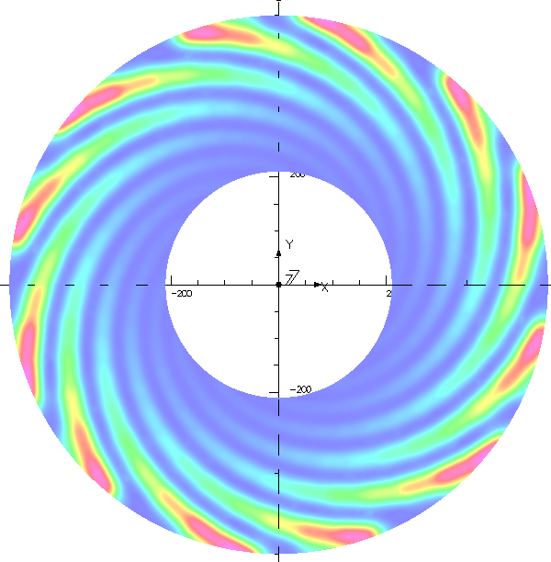

Theoretical Model
Spiral ridge model
“Flutter”

Slide 28
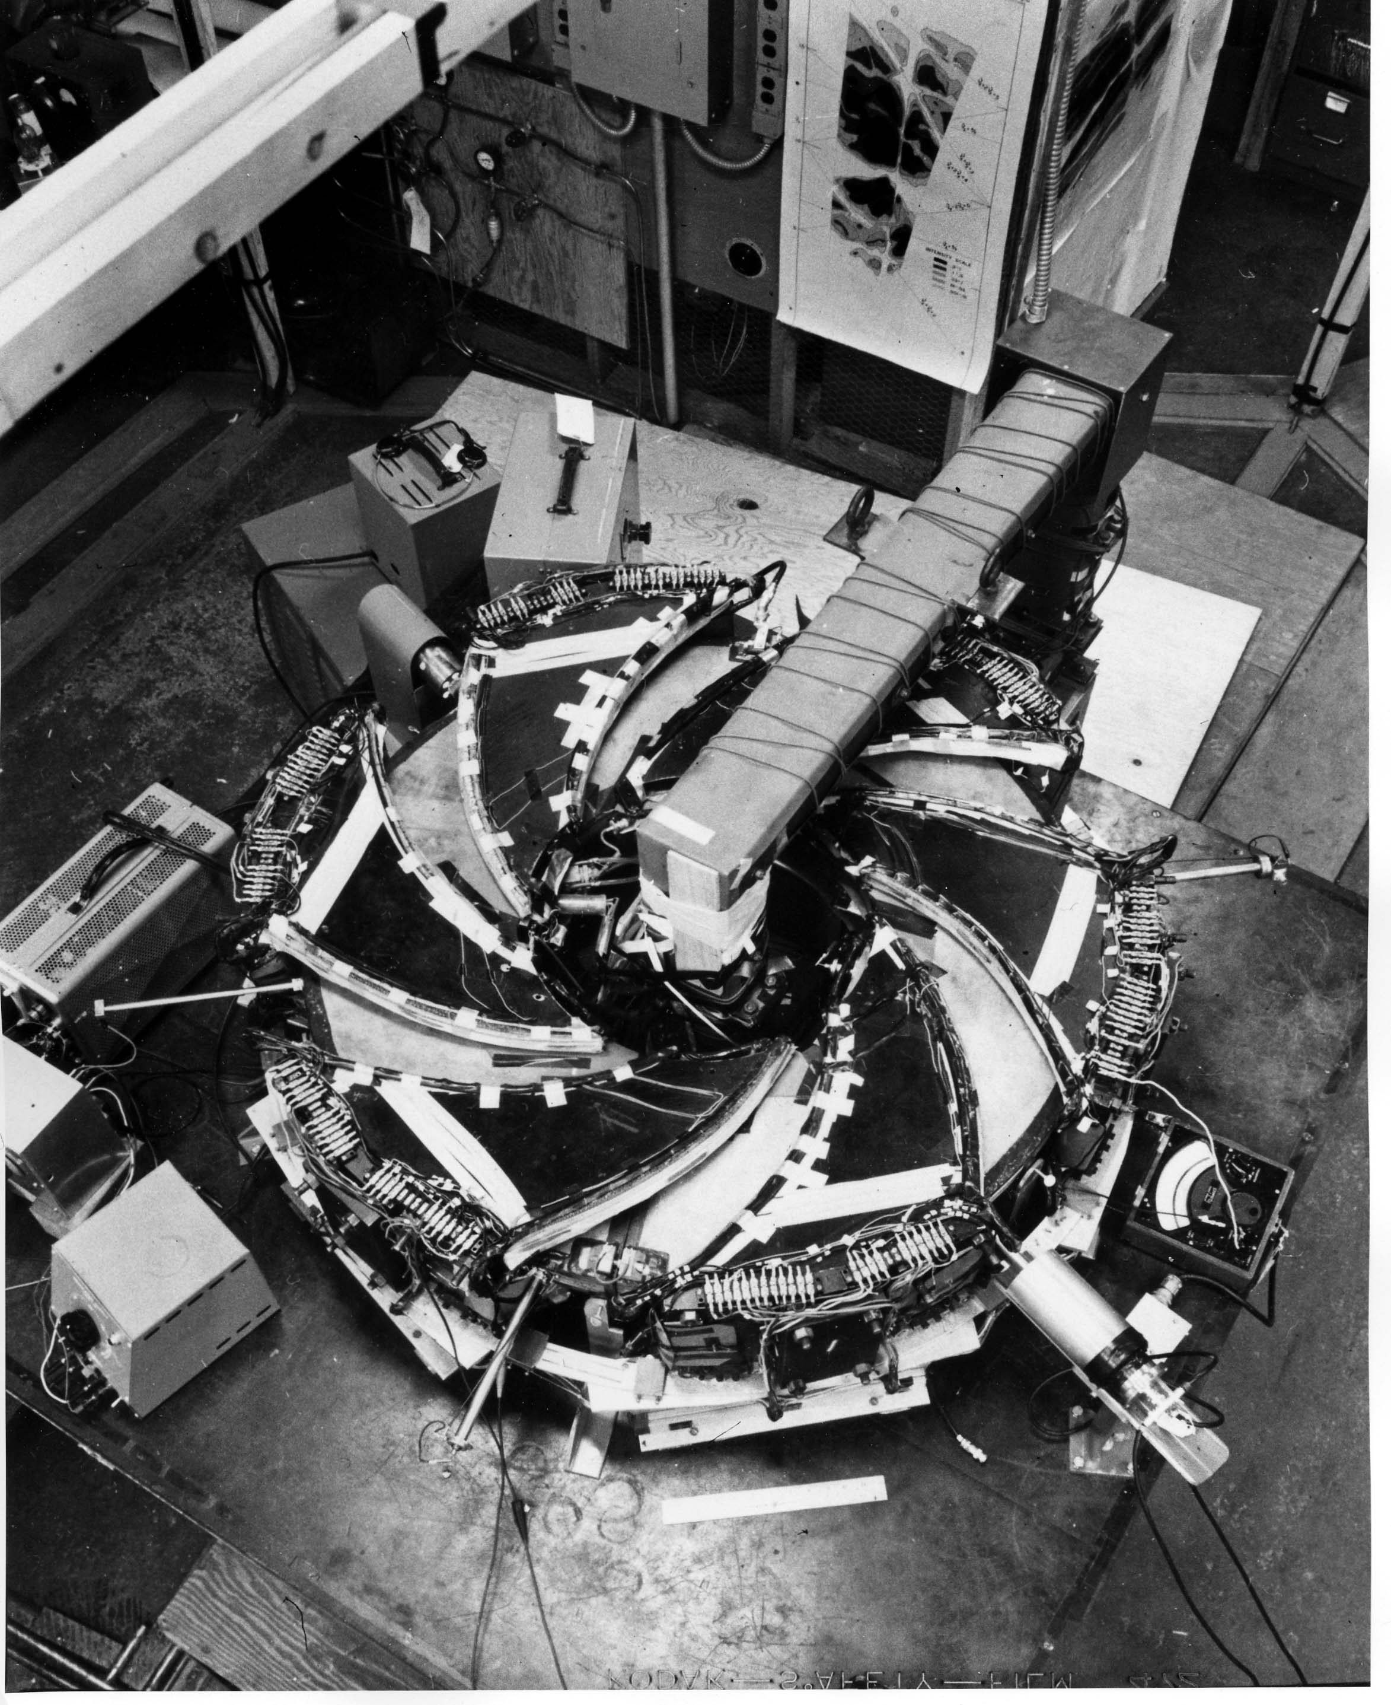
A Spiral Sector FFAG (~ 125 keV)
Inventor: Donald W. Kerst
“Innovation Was Not Enough”: Jones, Mills, Sessler, Symon and Young; World Scientific, Singapore, To be published

Slide 29

Theoretical Model
Radial sector model
“Flutter”

Slide 30
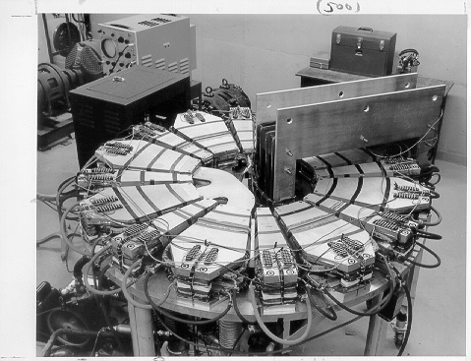
A Radial Sector FFAG (~ 425 keV)
Inventors: Kieth Symon, Andre Kolominsky, Andre Lebedev, Tihiro Ohkaiwa
“Innovation Was Not Enough”: Jones, Mills, Sessler, Symon and Young; World Scientific, Singapore, To be published

Slide 31
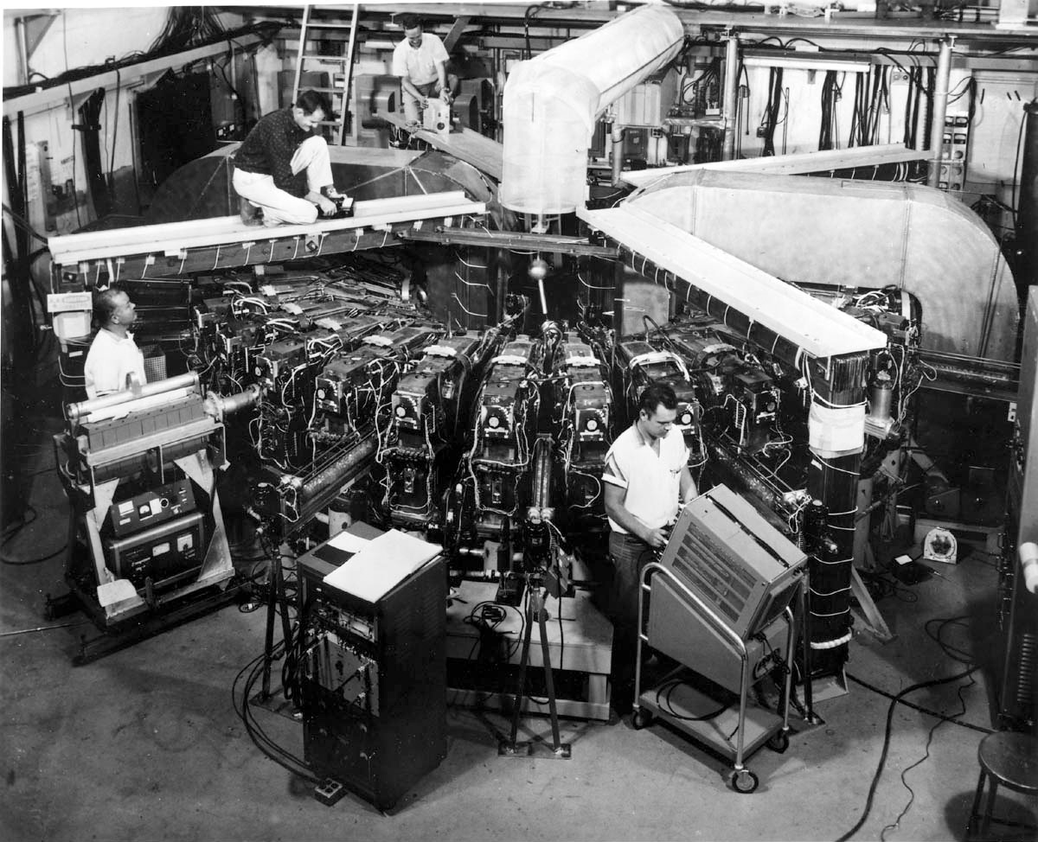
50 MeV Radial Sector Electron Accelerator
Two-Way Model at the Stoughton site, 1961
MURA
“Innovation Was Not Enough”: Jones, Mills, Sessler, Symon and Young; World Scientific, Singapore, To be published

Slide 32
CAP Acceleration Mechanism - Simplified
Top View
V
time
Induction
Core
~10⁻⁴ s
I
T
time
Accelerating Gap
Imparts V = ΔE
On Each Turn
Side View
t
Time for full acceleration
DC = [(T - t)/T] x 0.5
For symmetric square pulse
di/dt = V / L
V = E·dl
Notes:
Acceleration mechanism 1 slide overview
High permeability core excited by current flowing in high cond outer surface of vac cham
Acts as inductive circuit during for interval up to saturation field giving E field with curl
Chamber shields time-dep fields from penetrating except in 1 localized gap region
Electrons inside chamber fed continuously from DC gun during pulse receive modest boost in energy traversing gap
Orbits successively grow in scaling field

Slide 33
Tools Used in Design
Opera from Vector fields
  FFAG Guide fields and relation to magnetic geometry
  Electron gun and injection optics integrated to FFAG guide orbits
Omnitrak
  Electron gun and injector optics
    Cathode parameters
    Thermal effects
    Electrode parameters
    Emittance
Cosy
  Tracking orbits through fields
  Establishing dynamic apertures
  Extension for tracking each orbit with energy gain during each orbit
  Establishing injection parameters to miss gun on first few turns
  Establishing likely resonances
  Establishing tunes

Slide 34
Tracking Examples
Mechanical Models
Opera derived Magnetic Fields
COSY tracking
  Dynamic apertures
  Tunes
  Orbit by orbit tracking
  Transmission through mechanical model
  Establish resonance examples
Two emittance examples at injection
Injection example
Tunes and resonances

Slide 35
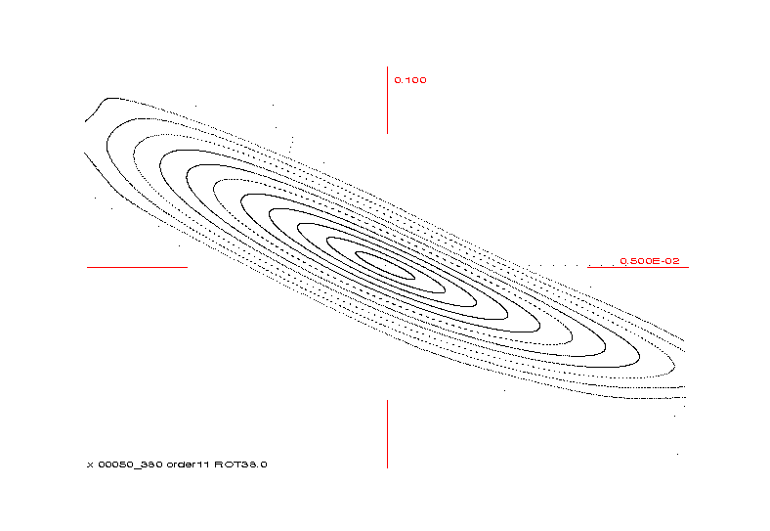
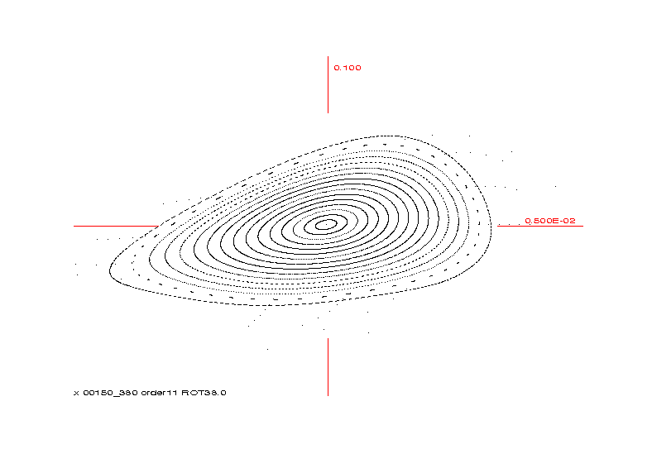
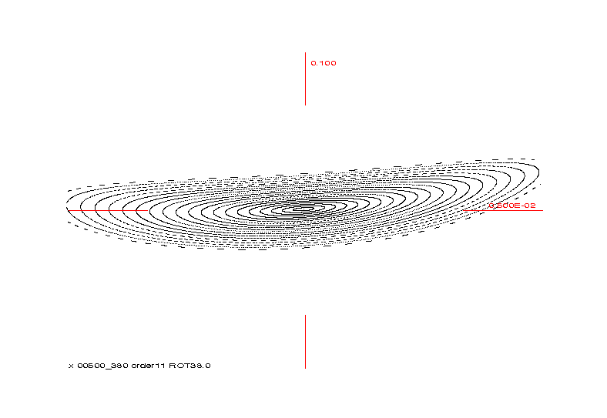
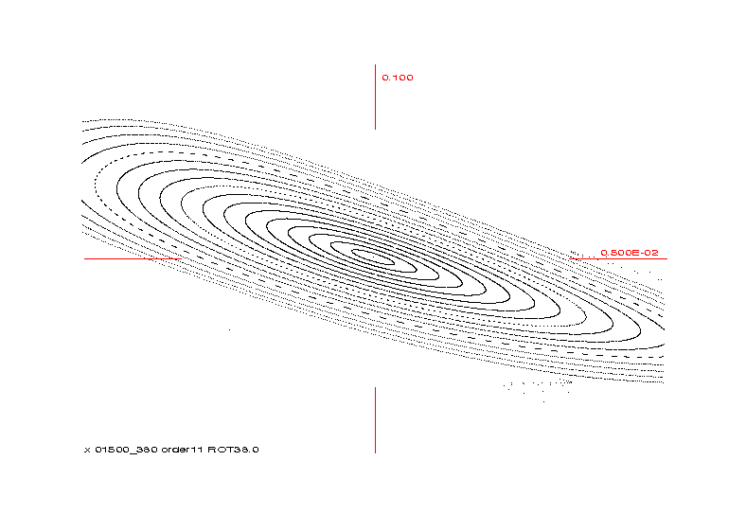
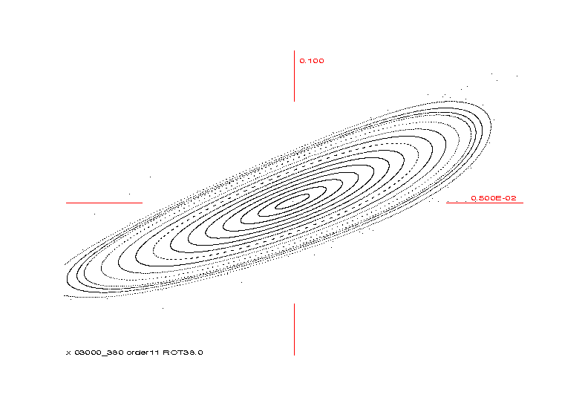
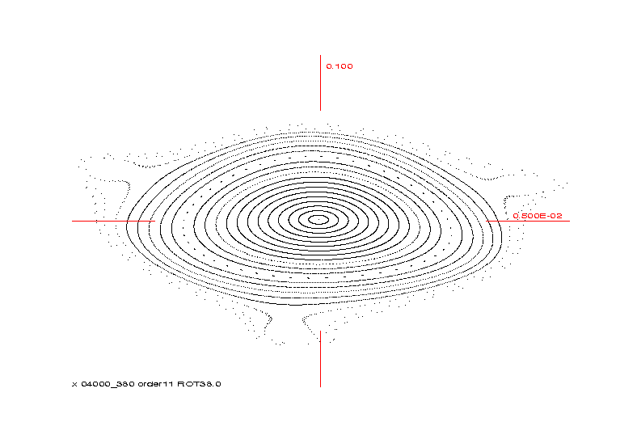
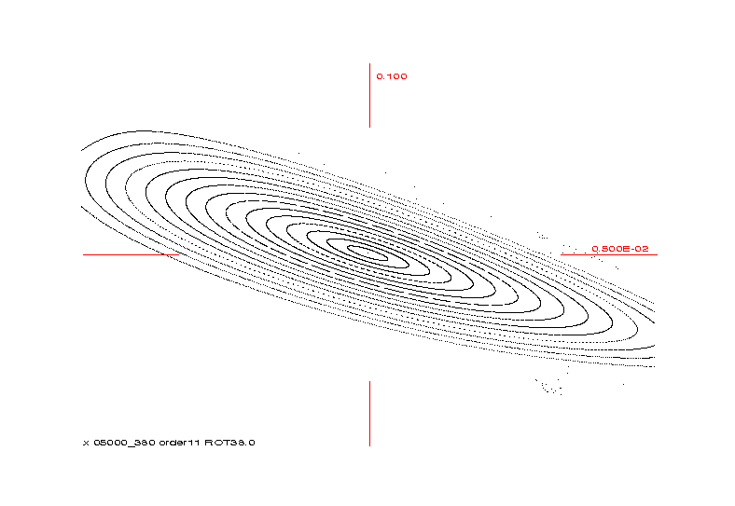
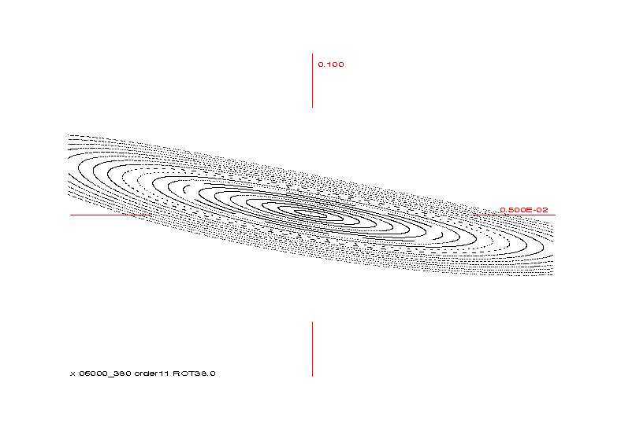
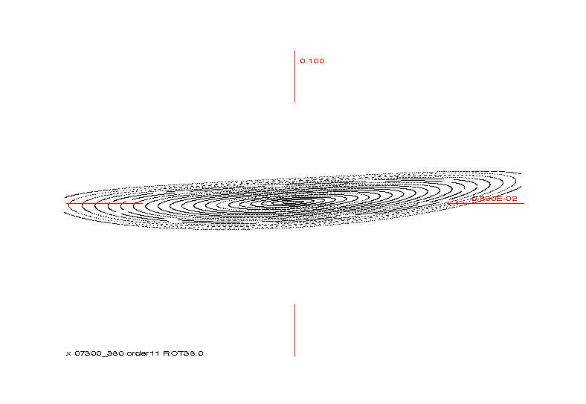
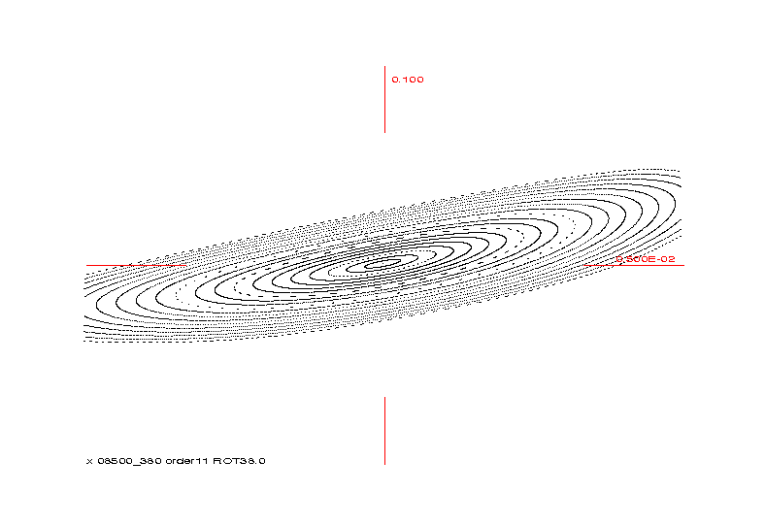
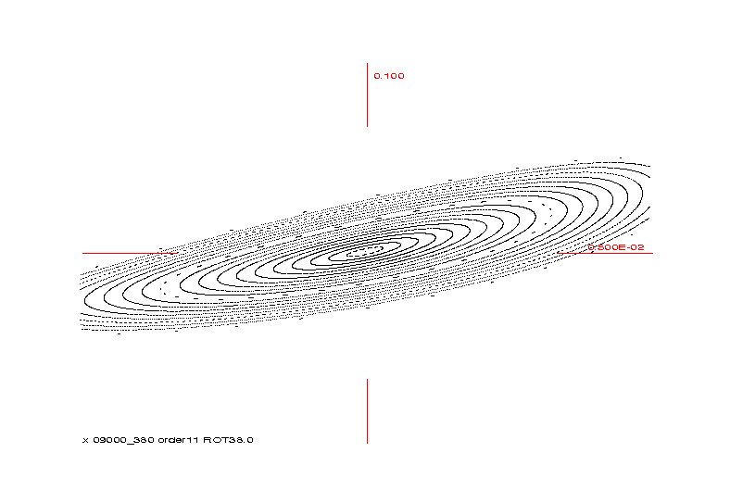
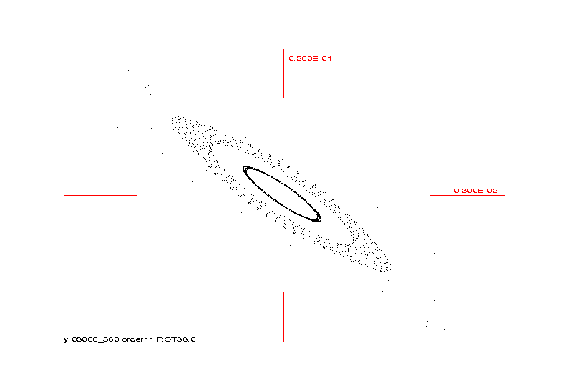
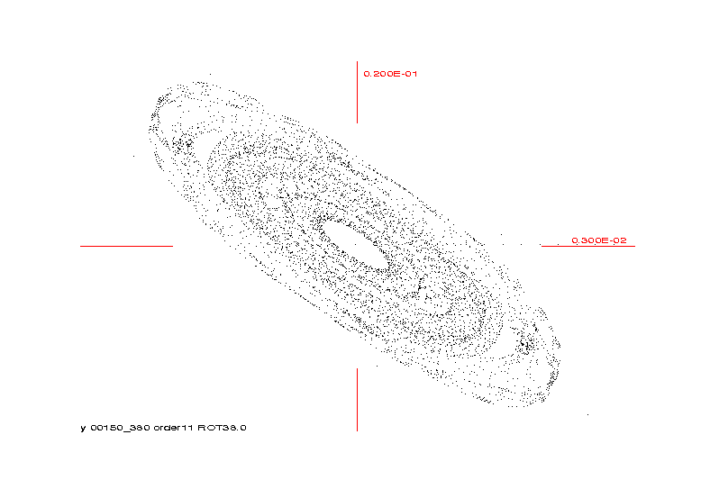
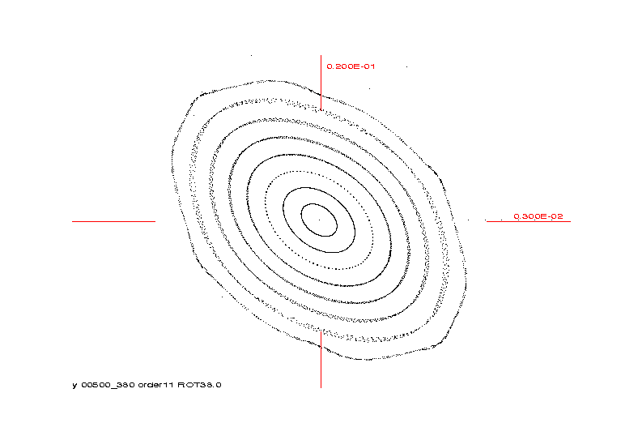
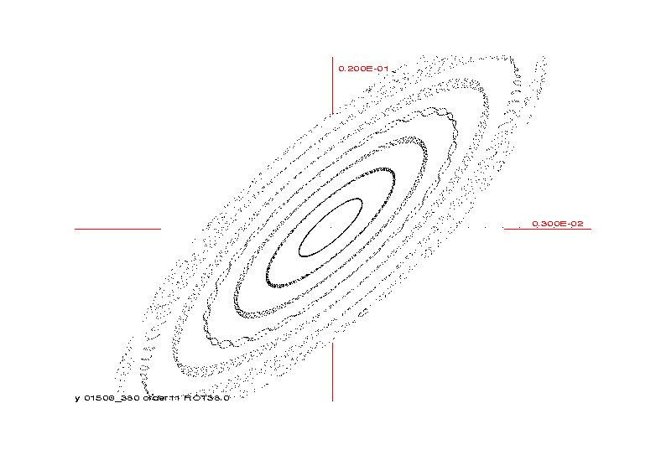
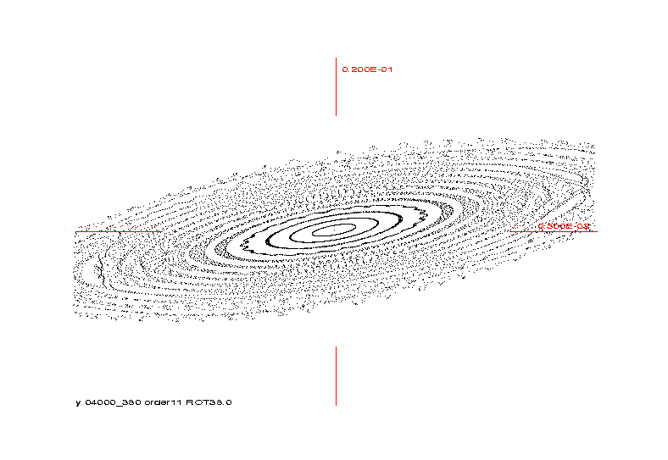
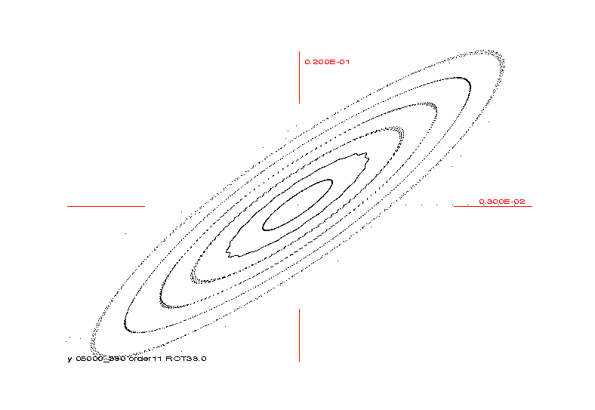
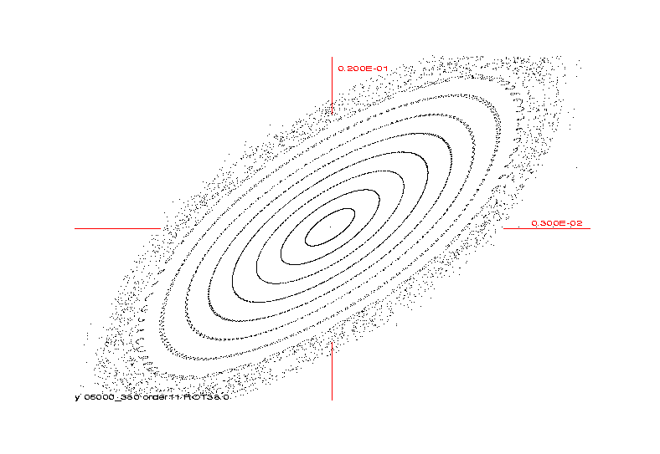
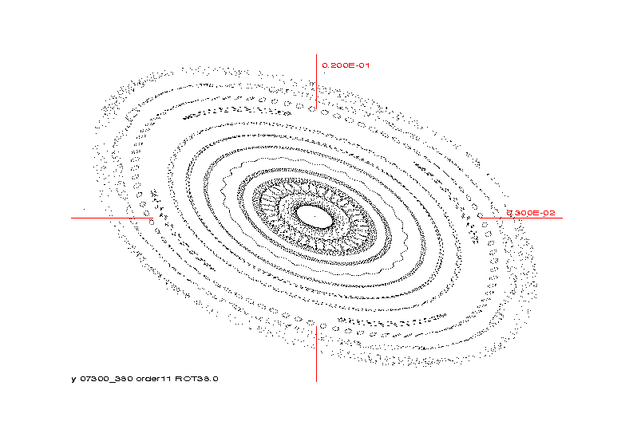
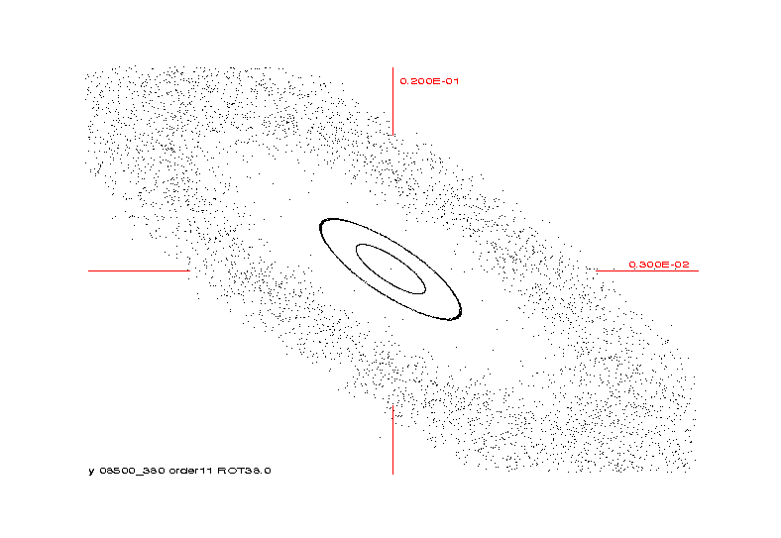

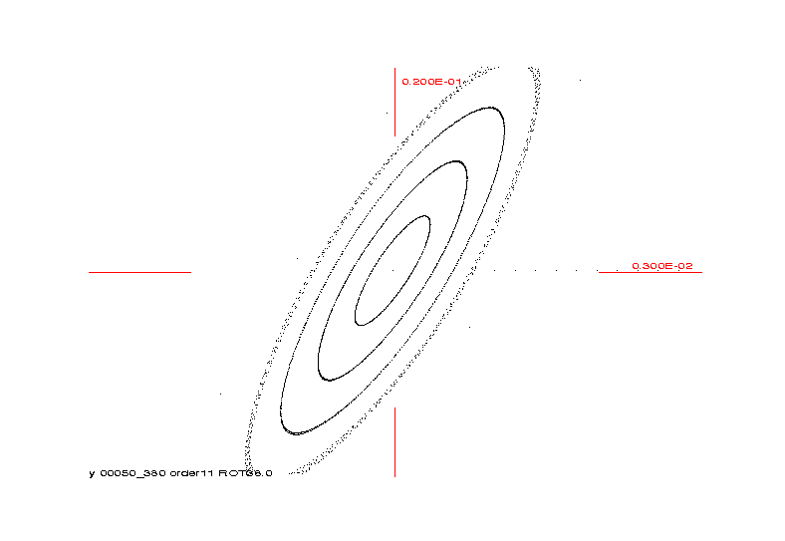
Acceptances
Horizontal acceptance
Vertical acceptance
50 keV
150 keV
500 keV
6000 keV
1500 keV
3000 keV
4000 keV
5000 keV
7300 keV
8500 keV
9000 keV

Slide 36
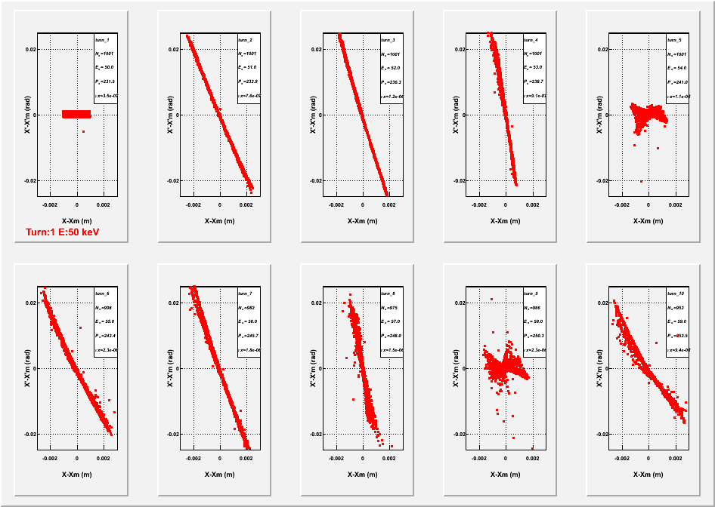
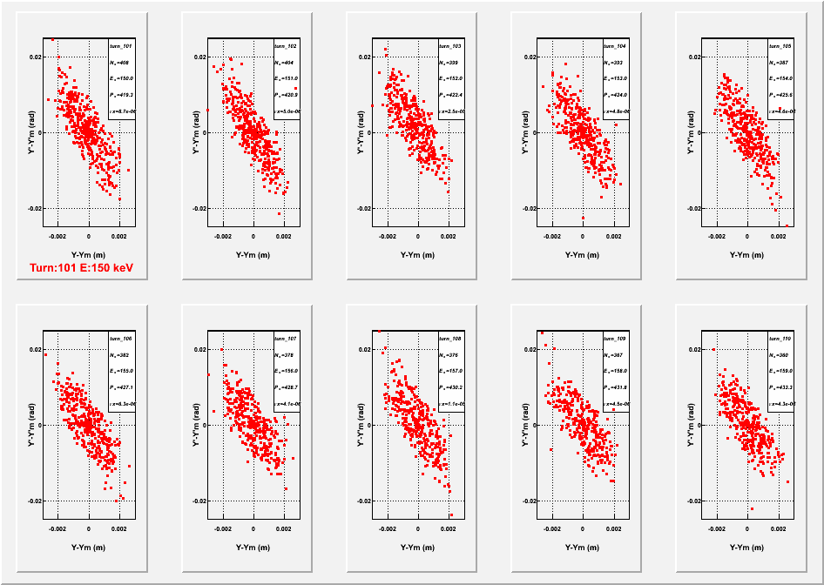
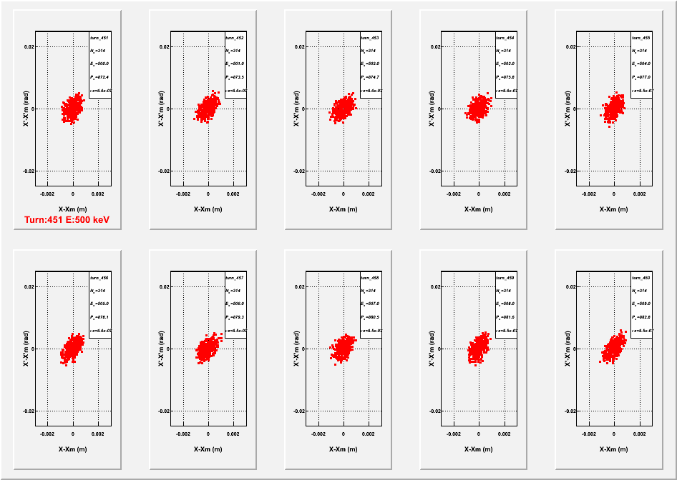
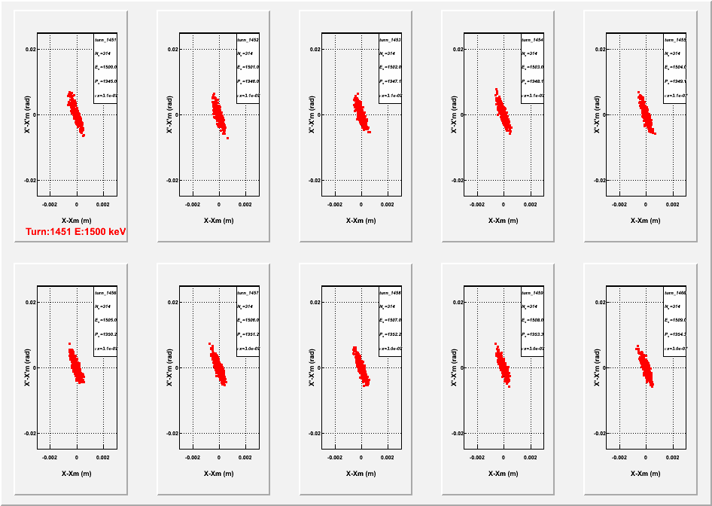
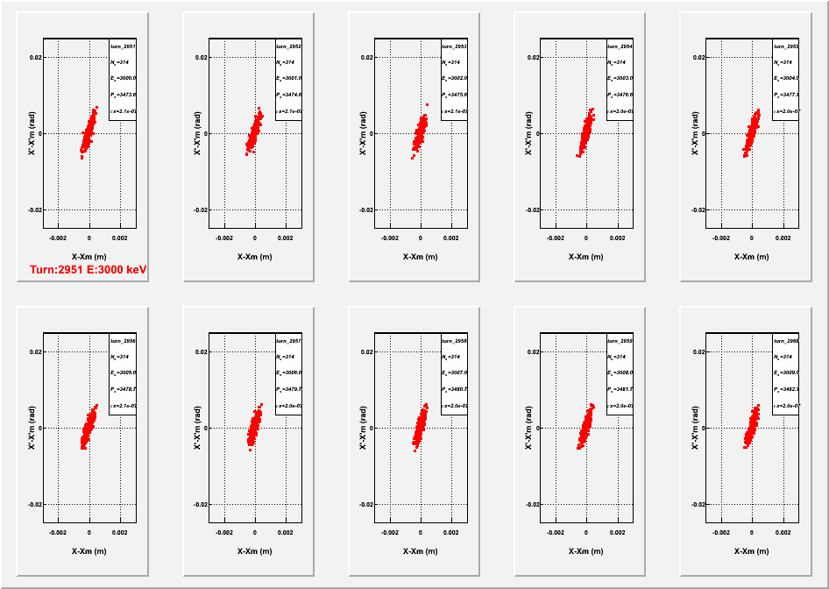
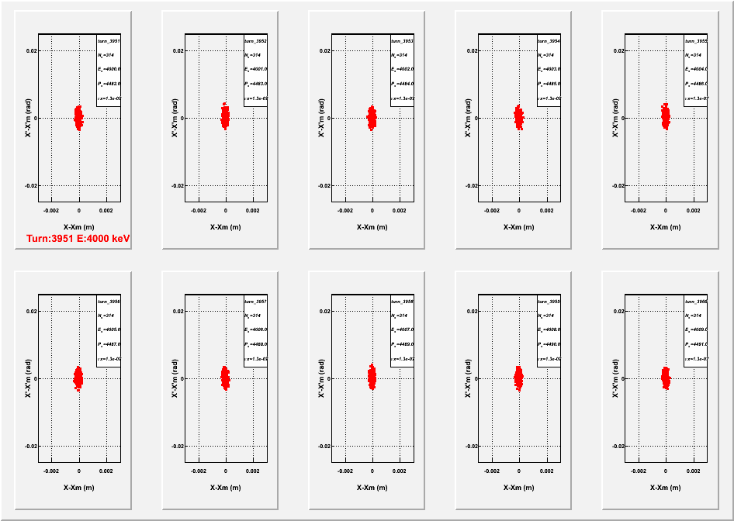





















Particle Tracking
1.0x1.0 mm-mrad
Horizontal
Vertical
50 keV
150 keV
500 keV
6000 keV
1500 keV
3000 keV
4000 keV
5000 keV
7300 keV
8500 keV
9000 keV
8000 keV
7000 keV
7500 keV

Slide 37

Emittance in X and Y
1.0x1.0 mm-mrad

Slide 38

Transmittance
1.0x1.0 mm-mrad

Slide 39
















Particle Tracking
0.5x2 mm-mrad
Horizontal
Vertical
50 keV
150 keV
500 keV
7300 keV
7500 keV
8000 keV
8500 keV
9000 keV

Slide 40

Emittance in X and Y
0.5x2.0 mm-mrad

Slide 41

Transmittance
0.5x2.0 mm-mrad

Slide 42
Tune Calculations

Slide 43

Horizontal Tunes and Amplitude Dependant Tune Shift

Slide 44

Vertical Tunes and Amplitude Dependant Tune Shift

Slide 45


Slide 46




COSY Particle Tracking in Phase Space
Orbit 1
0
injection
Orbit 2
Orbit 3
inflector

Slide 47


Understanding One
50 keV Acceptance
Vertical acceptance
Amplitude dependant tune shift
_{y}=8 π mm mr
4X fold symmetry
1.80=9/5
1.75=7/4
_{y}=17 π mm mr
5X fold symmetry

Slide 48
Conclusions
Importance of High Duty Cycle
Feasibility of Induction Accelerator Modality
  Large momentum range acceptance
  Good transmission
  Small footprint
  High intensities
  Duty cycle approaching 50%

Slide 49
Thank You

