Slide 1
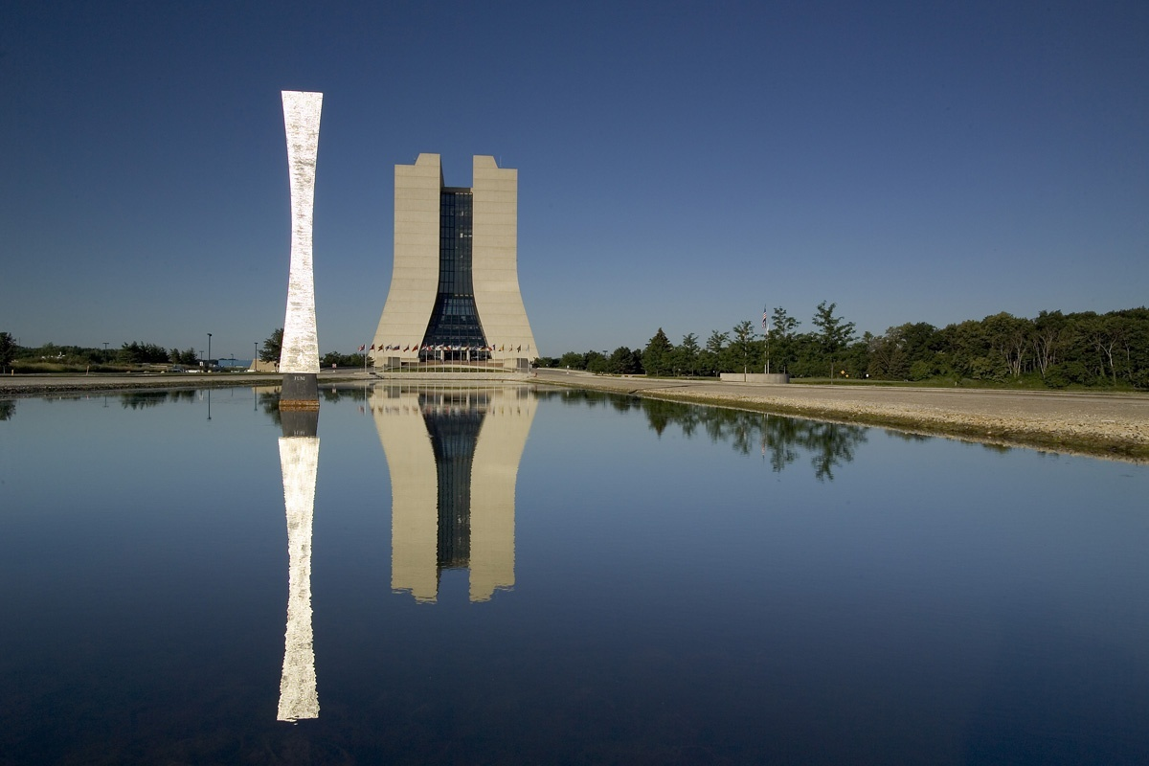
All Hands Meeting
Status of Fermilab
Pier Oddone
September 9, 2009

Slide 2
Outline
Operational Highlights
  IQA: Integrated Quality Assurance
  Engineering Standards: Manual and Teamcenter
  Health and Safety: H1N1, needed improvement
The future program
  The big picture
  A strategy for the US and Fermilab

Slide 3
Quality
We all have an intuitive understanding of a quality product: it does what it is supposed to do without trouble
In scientific research quality means achieving correct, reproducible results, maximizing the information we get from data
There are many processes to get there: administrative, operational, scientific. They all must be done with quality

Slide 4
Quality Assurance
All the processes that we put in place to make sure that we deliver quality in all our diverse activities
We analyze what we do and make sure that we have the processes necessary to deliver expected results consistently and efficiently
We already do a lot of it – but not in a consistent and systematic way and not in all our activities

Slide 5
Integrated Quality Assurance
Our program is called Integrated Quality Assurance or IQA – because it really must be a state of mind
Do we need it?
  The consequences of faulty assurance processes can be severe: many examples
  It is one of the foundations of continuous improvement
  It is also a requirement of our contract to have a quality assurance program that meets expectations: we must be smart on how we accomplish this

Slide 6
IQA: Foundational Principle
QA is integrated into our everyday work and is both a personal responsibility as well as a collective one. It is modeled after the successful Integrated Safety Management or ISM. What it is NOT: a layer of processes imposed externally.
    Implementation of IQA is a line management responsibility: line organizations have the authority, responsibility, and are accountable for integrating QA into all work

Slide 7
IQA: Line Management Responsibility
Office of Quality and Best Practices (OQBP) -
  Developed framework, provides oversight for implementation, performs/coordinates independent assessments
  Assist D/S/Cs in implementing IQA – training, assistance to QARs, data archival and trending
AD’s, Heads of Programs, D/S/C
  Implement IQA in accord with principles & requirements of IQA including continuous improvement
  Perform self assessments to make sure performance objectives and requirements are met

Slide 8

IQA: Standards
The requirement is the implementation of the Quality Assurance Order DOE 414.1C
The order allows a great lead of latitude in choosing a consensus standard: we chose ANSI/ASQ Z1.13, Quality Guidelines for Research
X
X
ANSI/ASQ
Z1.13
NQA-1

Slide 9
How do we do this?
We need a recognizable approach. We are audited on this requirement so auditors have to recognize how we assure quality
Many of our existing processes were not cast in a standard framework and some processes are missing
We help ourselves with: a) a standard framework that makes explicit our processes as part of IQA and b) we fill the gaps

Slide 10
IQA: not free
It is a considerable effort by the laboratory and an investment for the future
We have four new QA Engineers (QAEs) under the guidance of the Office of Quality and Best Practices (OQBP)
  Provide support and guidance to D/S/Cs
  Train and support QARs
  Assist in development and review of Corrective Action Plans
  Perform Independent Assessments

Slide 11
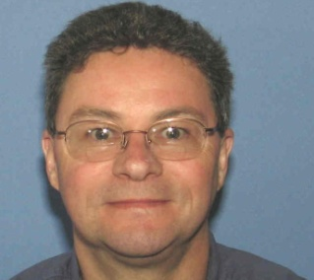
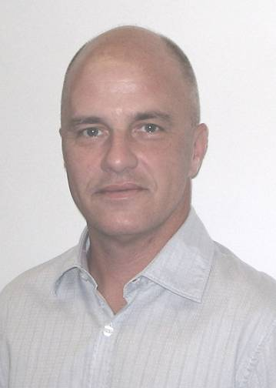
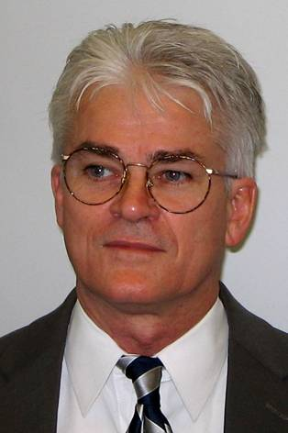
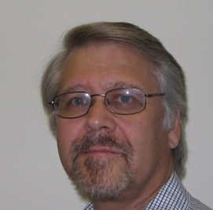
QAEs
Jed Heyes
QA Manager
Kurt Mohr, QAE
Tom King, QAE
Tom Gehrke, QAE

Slide 12
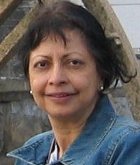
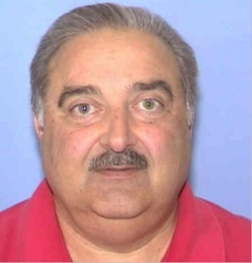
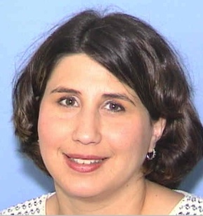
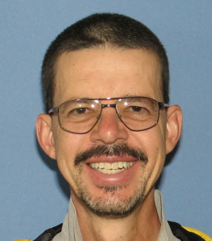
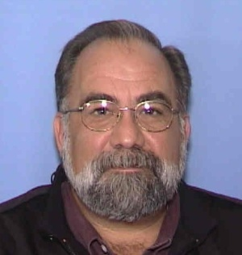
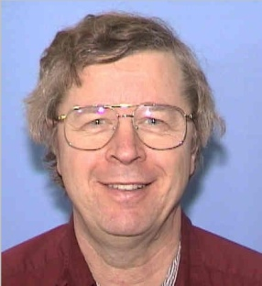
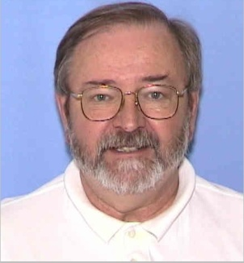
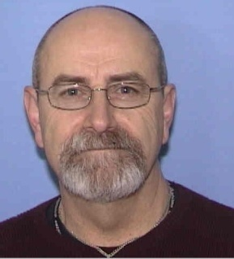
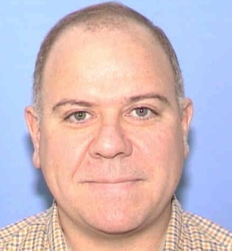
Quality Assurance Representatives
Bakul Banerjee
CD
Frank Cesarano
BSS
Nicole Gee
WDRS
Tim Miller
ES&H
Jim Rife
TD
Don Rhode
AD
Kieth Schuh
PPD
Rod Walton
FESS
Jim Wollwert
FI

Slide 13
Where are we?
Completed to Date:
  Establish team of QA professionals; QAEs and D/S/C QARs
  QAR orientation & training, including Audit Training
  As-Is baseline – WELL DONE!
  Development of Corrective Action Plans to close gaps discovered during As-Is baseline
  Reconciliation of all points from the DOE 2006 QA audit (21 findings completed, 5 nearing completion)

Slide 14
Where are we going?
Next
  DOE audit starting September 14th, 2009
  Build Assessment Plans, identifying gaps and inadequacies
  Determine response using a graded approach to ensure application of controls are “right-sized” for risks posed by Fermilab processes
  Implement response and corrective actions
  Embed in the culture of the laboratory
  http://www.fnal.gov/pub/quality/

Slide 15
Engineering Manual
Root-cause analysis of the LHC triplet failure led to task force on engineering practices
Events at LHC have further highlighted the need for systematic approach: standard practices, risk based reviews and documentation
With engineering in different Fermilab organizations, we must make special efforts to have common practices

Slide 16
Engineering Manual
Nine Major Elements are covered in the manual:
  Requirements and Specifications
  Engineering Risk Assessment
  Requirements and Specifications Review
  System Design
  Engineering Design Review
  Procurement and Implementation
  Testing and Validation
  Release to Operations
  Final Documentation

Slide 17
Key feature of the manual
Created by engineers from different parts of the laboratory under guidance of Paul Czarapata
The main body is short – 33 pages – to allow easy reading
Useful examples are shown in the Appendix
It is a LIVING document: controlled copy on the web

Slide 18
Key feature of the manual
Defines roles and responsibilities through the engineering process
Defines requirements for risk analysis and level of formality based on risk
Puts requirements on documentation on all phases of engineering process

Slide 19
Teamcenter
We are investing on Teamcenter license to use a modern EDMS system for engineering documentation
Teamcenter will be used to
  Capture all elements of the approved Fermilab engineering process and documents
  Connect and control engineering specifications, design analysis, CAD drawings, safety documentation, and QC reports in a central repository
  Allow more efficient data sharing across organizations

Slide 20
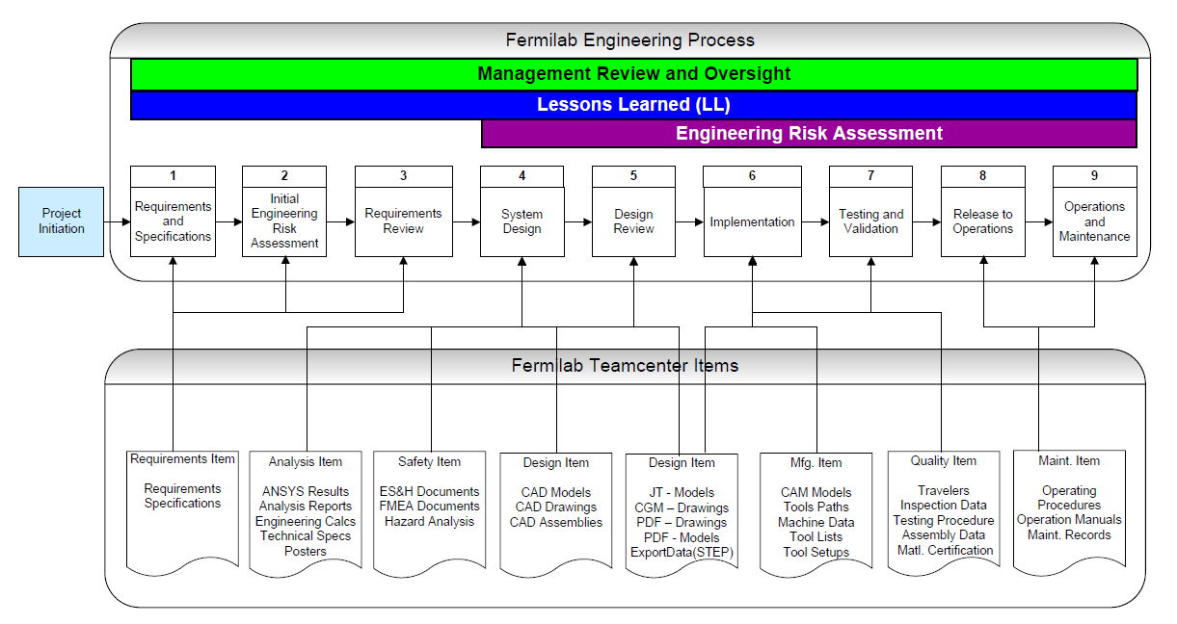
Teamcenter and engineering

Slide 21
EH&S
H1N1 Pandemic
  Get a seasonal flu shot (available early October)
  Practice good hand hygiene and cough etiquette
  Stay home if you are sick - call medical (x3232) if you suspect you have the flu and stay home for 24 hours after you are fever free with no medication
  Use our website for current information: http://www.fnal.gov/pub/fluquestions/

Slide 22
EH&S
Fermilab Director’s Triennial Self-Assessment of ES&H – recommendations:
  Educate supervisors in Human Performance Improvement
  Standardize a Reward & Recognition program for ES&H
  Document ES&H performance on performance reviews
  Communicate the importance of SMART (Specific, Measurable,Attainable, Relevant, and Time-bound) goals for Fermilab personnel ES&H goals.

Slide 23
Injuries are a matter of concern

Slide 24
Injuries are a matter of concern

Slide 25
The big picture
The laboratory is doing very well: many results from the Tevatron, leading programs in neutrinos and particle astrophysics. Fermilab provided most results at Lepton-Photon 2009
The shutdown has gone well and we are ready for a two year run with great discovery potential pending DOE support in FY11
Base budget is in reasonably good shape and we have received nearly $150M ARRA funds

Slide 26
The big picture
The strategy for the future has broad support: it is a challenging and exciting program
Several briefings to the Director of the Office of Science, Bill Brinkman: laboratory planning, neutrinos, Project X. Also visit to the laboratory by Bill Brinkman and Pat Dehmer
The program places strong demands on us to manage well and efficiently and work closely with our partner institutions

Slide 27
Facilities and experiments
Energy
Tevatron
LHC
LHC
LHC upgrades
LHC
ILC??
LHC
ILC or
Muon Collider
Minos
MiniBooNE
NOvA
MicroBooNE
MINERvA
LBNE
Mu2e
Project X+LBNE
Mu2e
ν Factory
Intensity
P Auger
DM: scalable?
DES
JDEM
DM searches
P Auger
DM Searches
JDEM
Cosmic
Now
2012
2015
2018

Slide 28
Energy Frontier: Tevatron

Slide 29
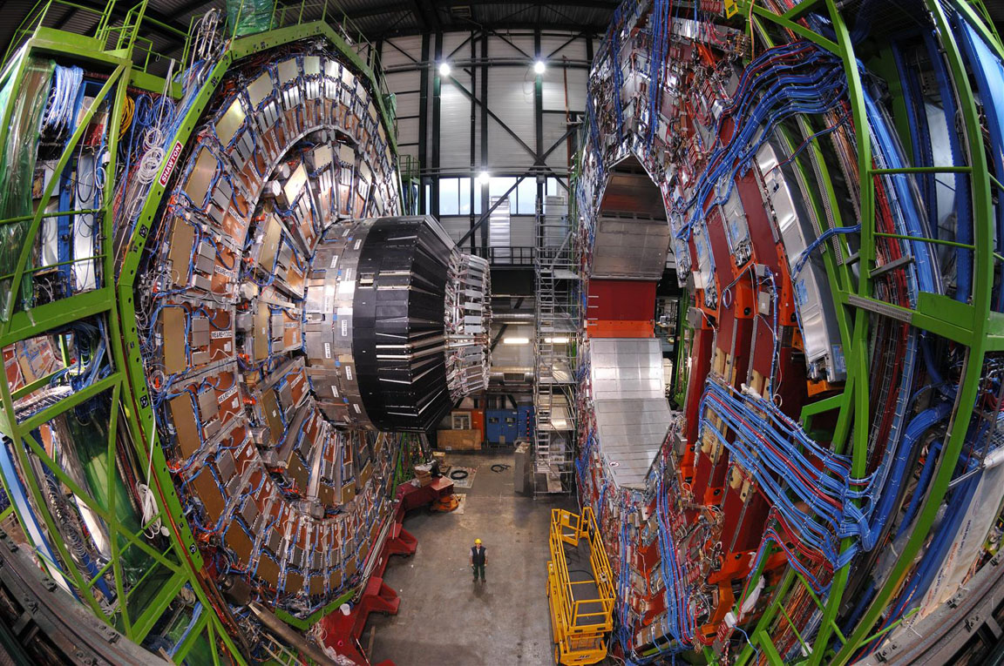
CMS

Slide 30
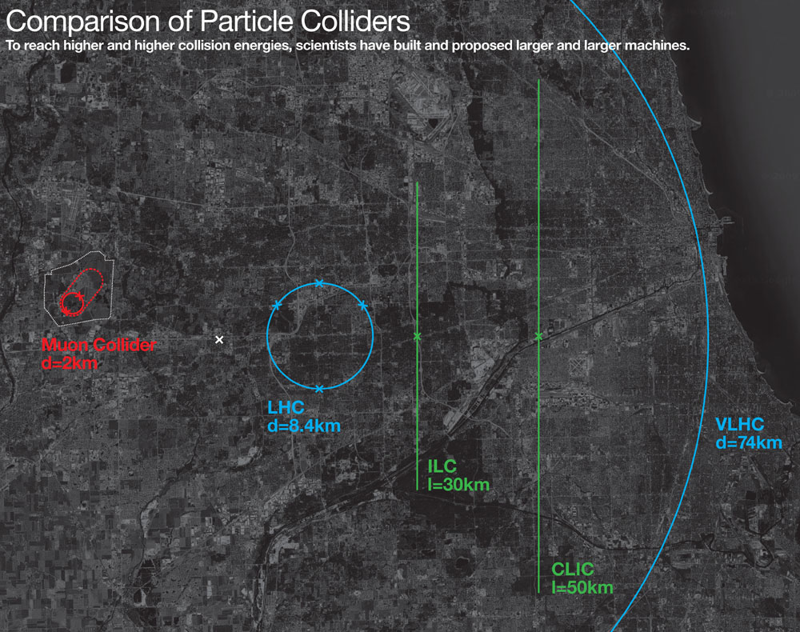

Slide 31
Lepton colliders beyond LHC
ILC Enough
By far the easiest!
LHC Results
or
CLIC
ILC not enough
or
Muon collider
31
Notes:
31
31

Slide 32
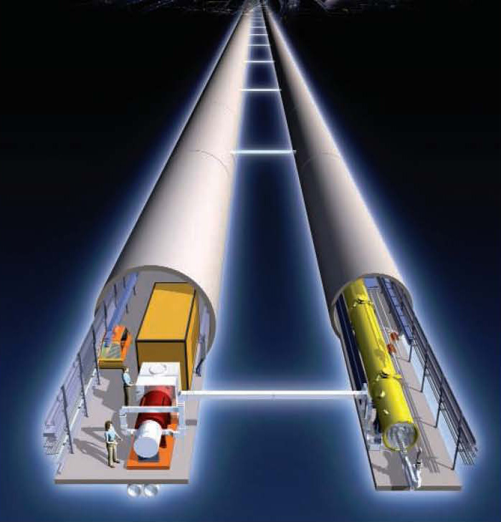
HEP world: need TeV lepton collider
International
Linear
Collider (ILC)
ILC
e⁻ e⁺
LHC
p p

Slide 33
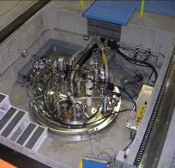
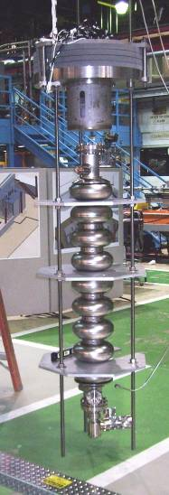
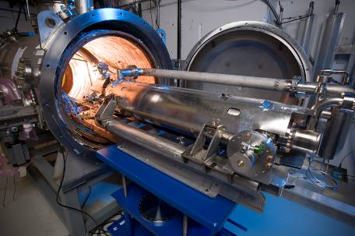
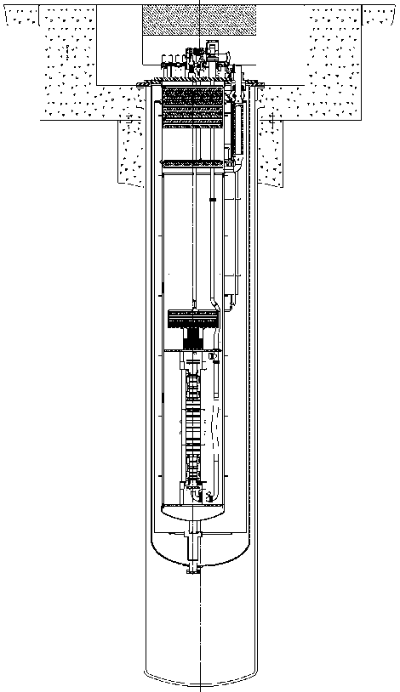
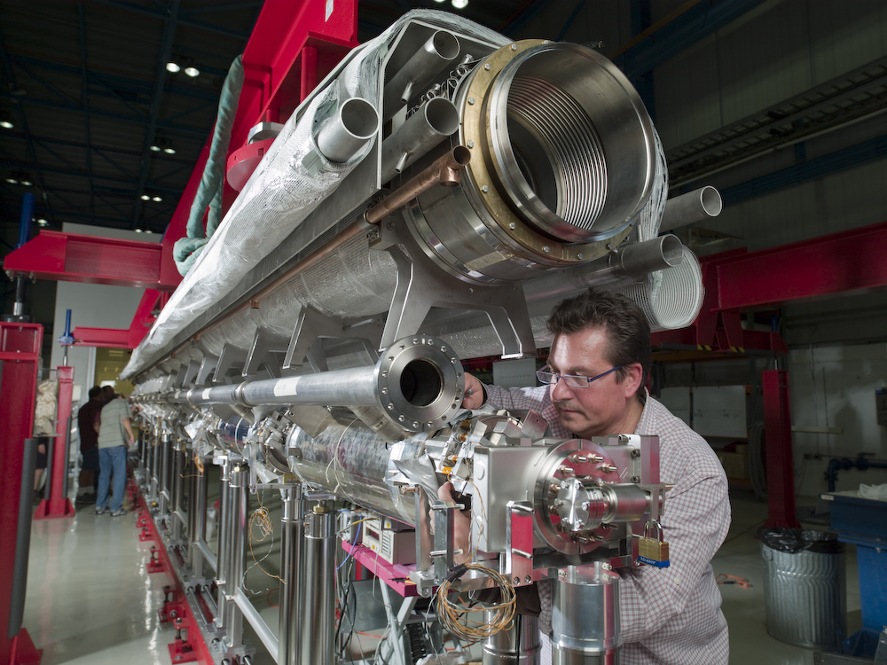
ILC/Project X technology at Fermilab
Horizontal Test Stand
1st cryomodule
Vertical Test Stand

Slide 34
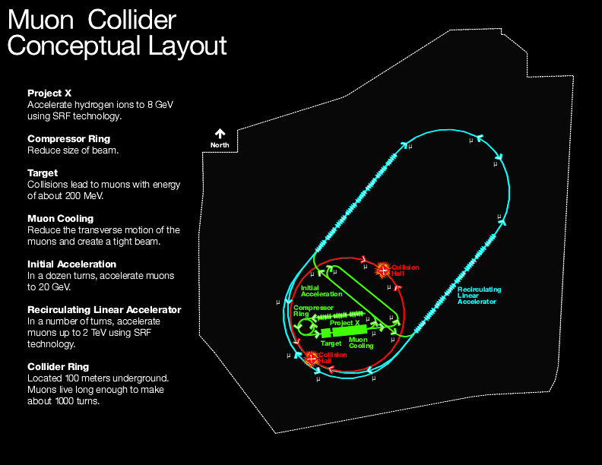
Muon collider layout
4 TeV

Slide 35
Muon collider functional layout
Target Capture Cool Format Accel Collide
Color indicates degree of needed
R&D (difficulty) and demonstration

Slide 36
Muon collider/ILC/Project X
ILC and Project X developing very efficient accelerating structures that can be run economically
Muon collider requires substantial acceleration (few km) that ideally would use ILC/ Project X technology

Slide 37
Facilities and experiments
Energy
Tevatron
LHC
LHC
LHC upgrades
LHC
ILC??
LHC
ILC or
Muon Collider
Minos
MiniBooNE
NOvA
MicroBooNE
MINERvA
LBNE
Mu2e
Project X+LBNE
Mu2e
ν Factory
Intensity
P Auger
DM: scalable?
DES
JDEM
DM searches
P Auger
DM Searches
JDEM
Cosmic
Now
2012
2015
2018

Slide 38
Two avenues to real understanding !
Intensity frontier:
the most particles
Allows the study of neutrinos and rare process
Sensitive to physics far beyond the LHC, but only indirectly
Need to measure multiple processes
LHC: direct production
of heavy particles
Wonderful direct discoveries of physics beyond the Standard Model
Very difficult and often impossible to study how new particles couple to each other and to ordinary particles
Need both for a complete understanding

Slide 39
Interplay: LHC Intensity Frontier
nothing
Only handle on the
next energy scale
Intensity
Frontier
LHC
Determine/verify
structure of new
physics. Anything
beyond?
Lots

Slide 40
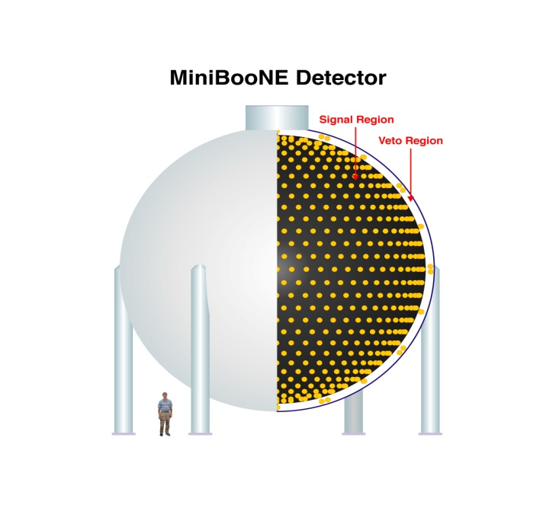
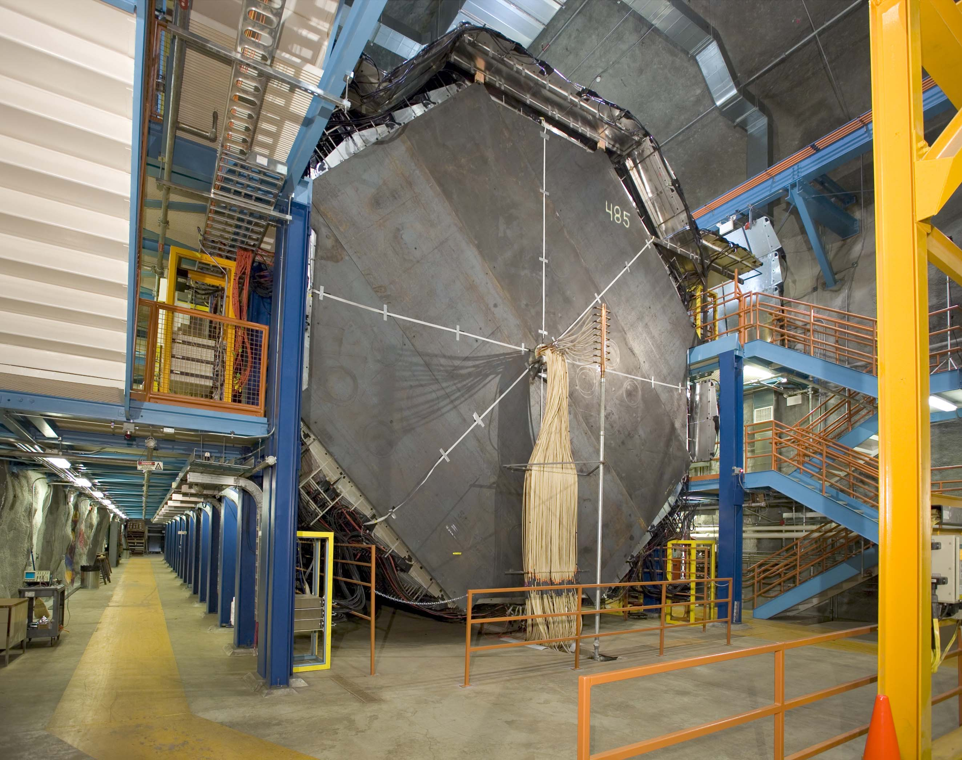
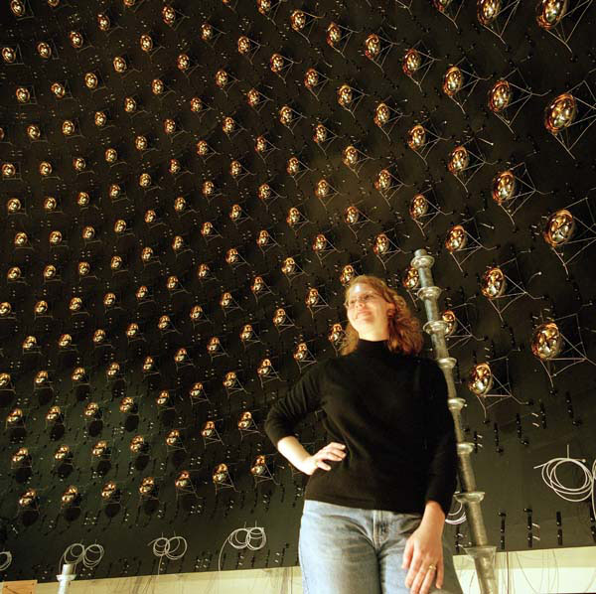
Progress: neutrinos
Minos Far Detector

Slide 41
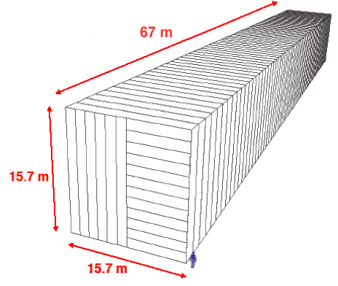
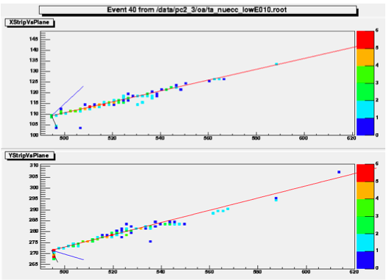
NOvA
NOvA is optimized for the detection of νμ→νe and νμ→νe oscillations
NOvA is:
  An upgrade of the NuMI beam intensity from 400 kW to 700 kW
  A 14 kt “totally active” tracking liquid scintillator calorimeter sited 14 mrad off the NuMI beam axis at a distance of 810 km
  A 215 ton near detector identical to the far detector sited 14 mrad off the NuMI beam axis at a distance of 1 km
MIPs
2.5 GeV νe + p →1.9 GeV e⁻ + 1.1 GeV p + 0.2 GeV π⁺
20 cm
20 cm
MIPs

Slide 42
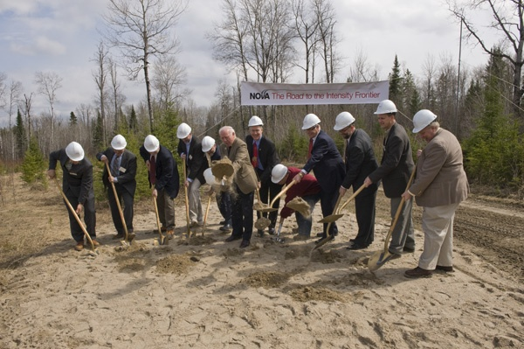

Progress: NOvA groundbreaking

Slide 43
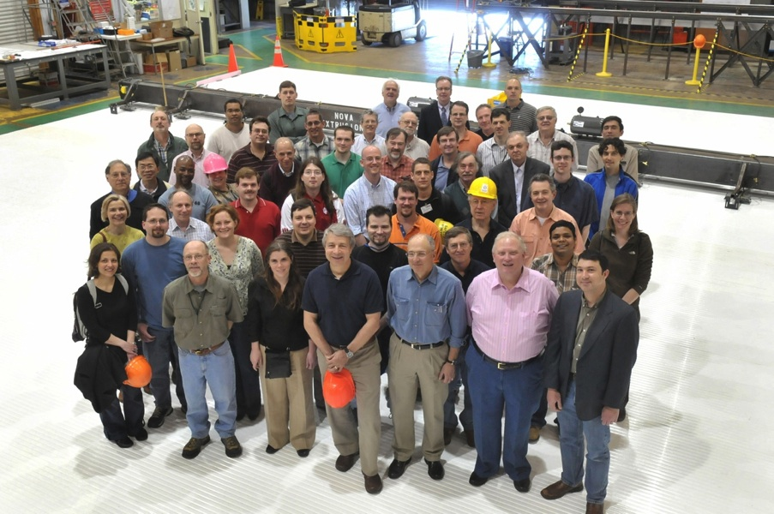
The NOvA Collaboration
at Argonne National Lab, 25 April 2009
180 Scientists and Engineers from 26 Institutions
Argonne National Laboratory - University of Athens - California Institute of Technology - University of California, Los Angeles - Fermi National Accelerator Laboratory - Harvard University - Indiana University - Lebedev Physical Institute - Michigan State University - University of Minnesota, Duluth - University of Minnesota, Minneapolis - The Institute for Nuclear Research, Moscow - Technische Universität München, Munich - State University of New York, Stony Brook - Northwestern University - University of South Carolina, Columbia - Southern Methodist University - Stanford University - University of Tennessee - Texas A&M University - University of Texas, Austin - University of Texas, Dallas - Tufts University - University of Virginia, Charlottesville - The College of William and Mary - Wichita State University
Notes:
This project requires a large team, some of whom are pictured above at a recent meeting at Argonne National Laboratory standing on a prototype of the first plane of the detector. We’re all looking forward to first data from the completed experiment in 2014.

Slide 44
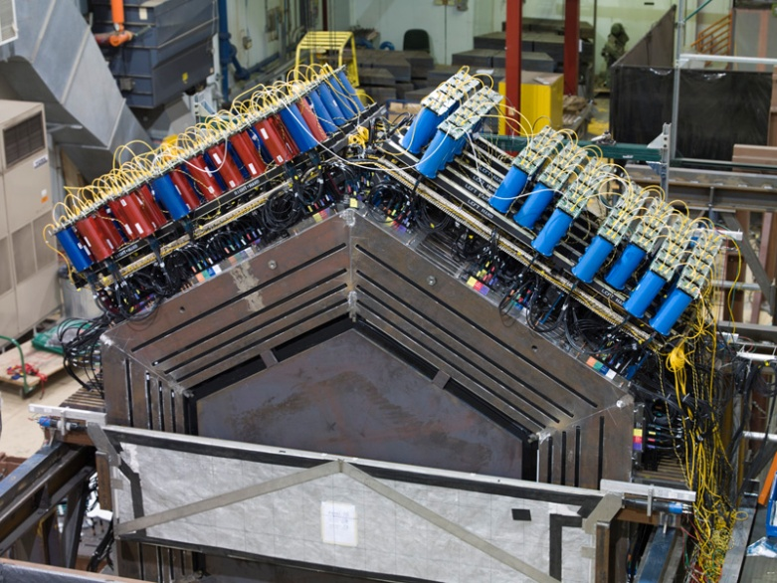
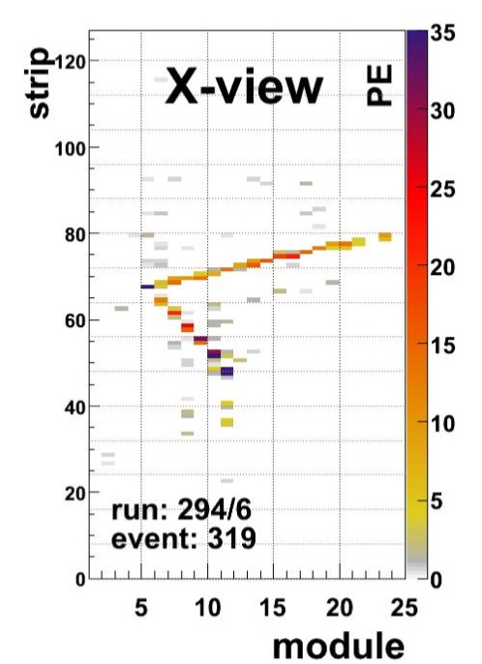
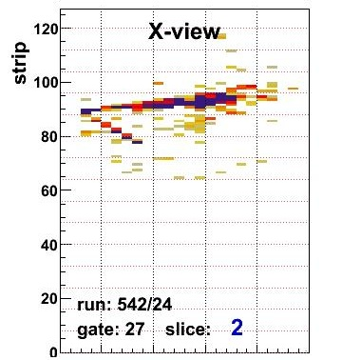
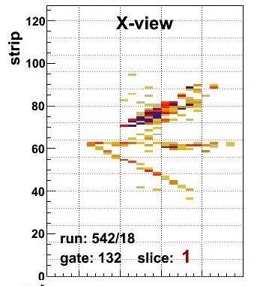
MINERvA Sees!
Prototype took data Apr.15 ~Jun.15
15k events, publishable physics
Data taking with 50% det: Oct.2009
Full det.: Summer.2010
ν_{μ}n→μ⁻p
ν_{e}n→e⁻p
ν_{μ}n→μ⁻π⁰X
e
π⁰
μ
μ
p
p
π?

Slide 45
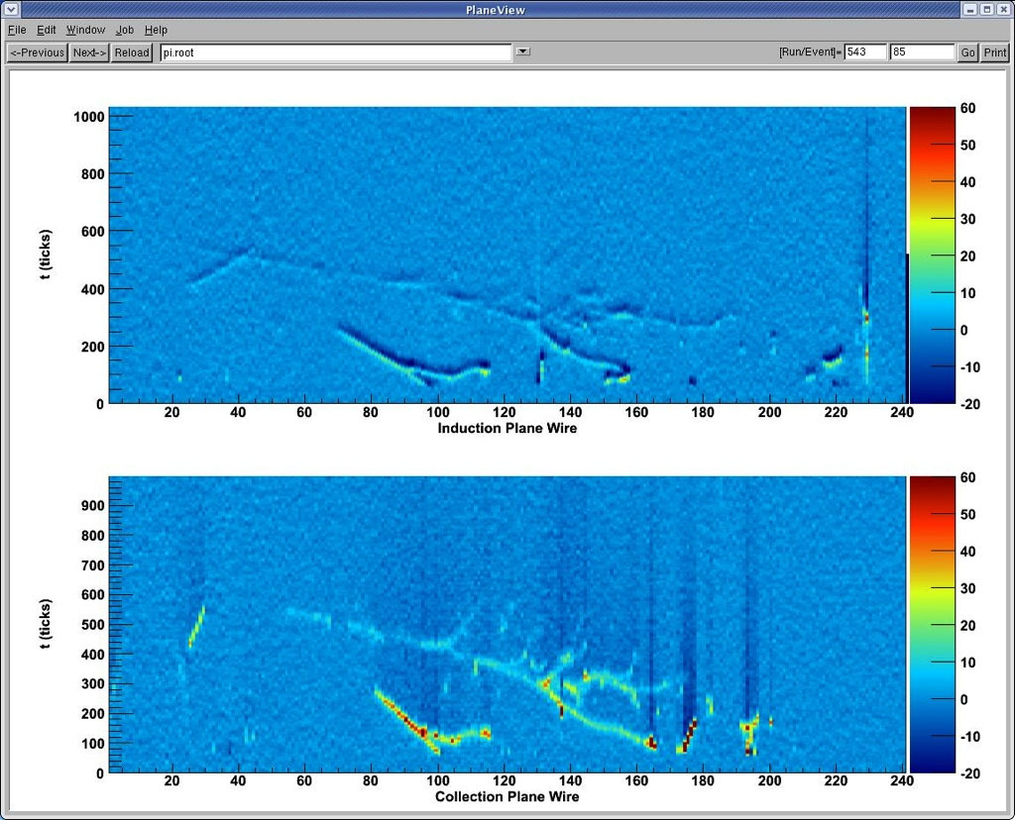
First ArgoNeut LAr TPC events

Slide 46

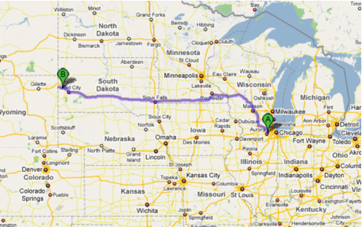
L = 1290 km

Slide 47
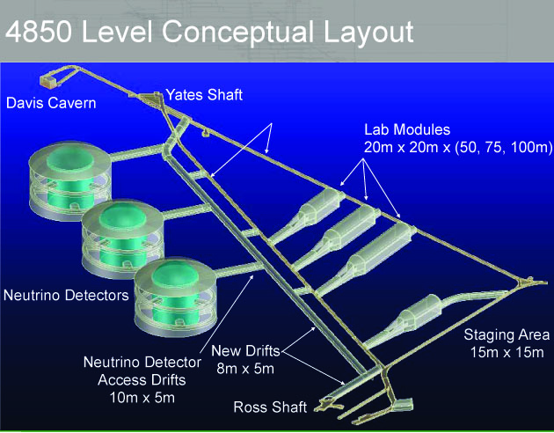
Intensity frontier: DUSEL

Slide 48
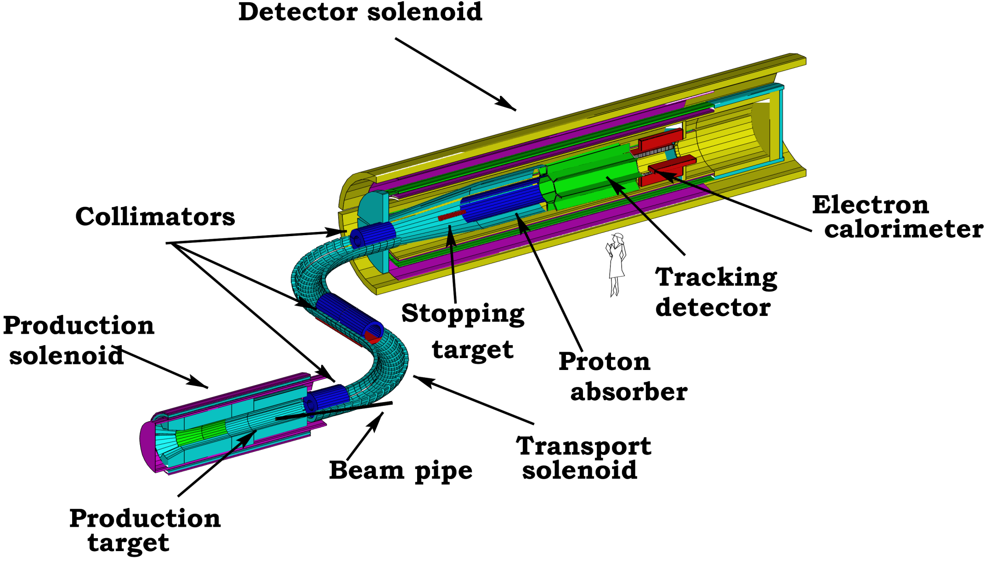
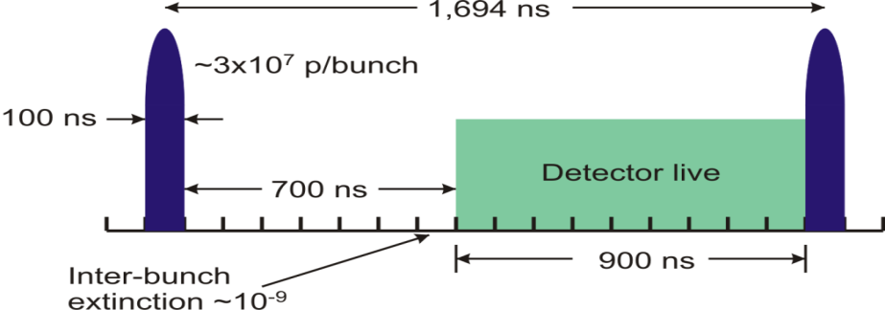
μ to e Conversion (μN → eN)
for every incident proton 0.0025 μ⁻’s are stopped in the 17 0.2 mm Al target foils
MECO spectrometer design

Slide 49
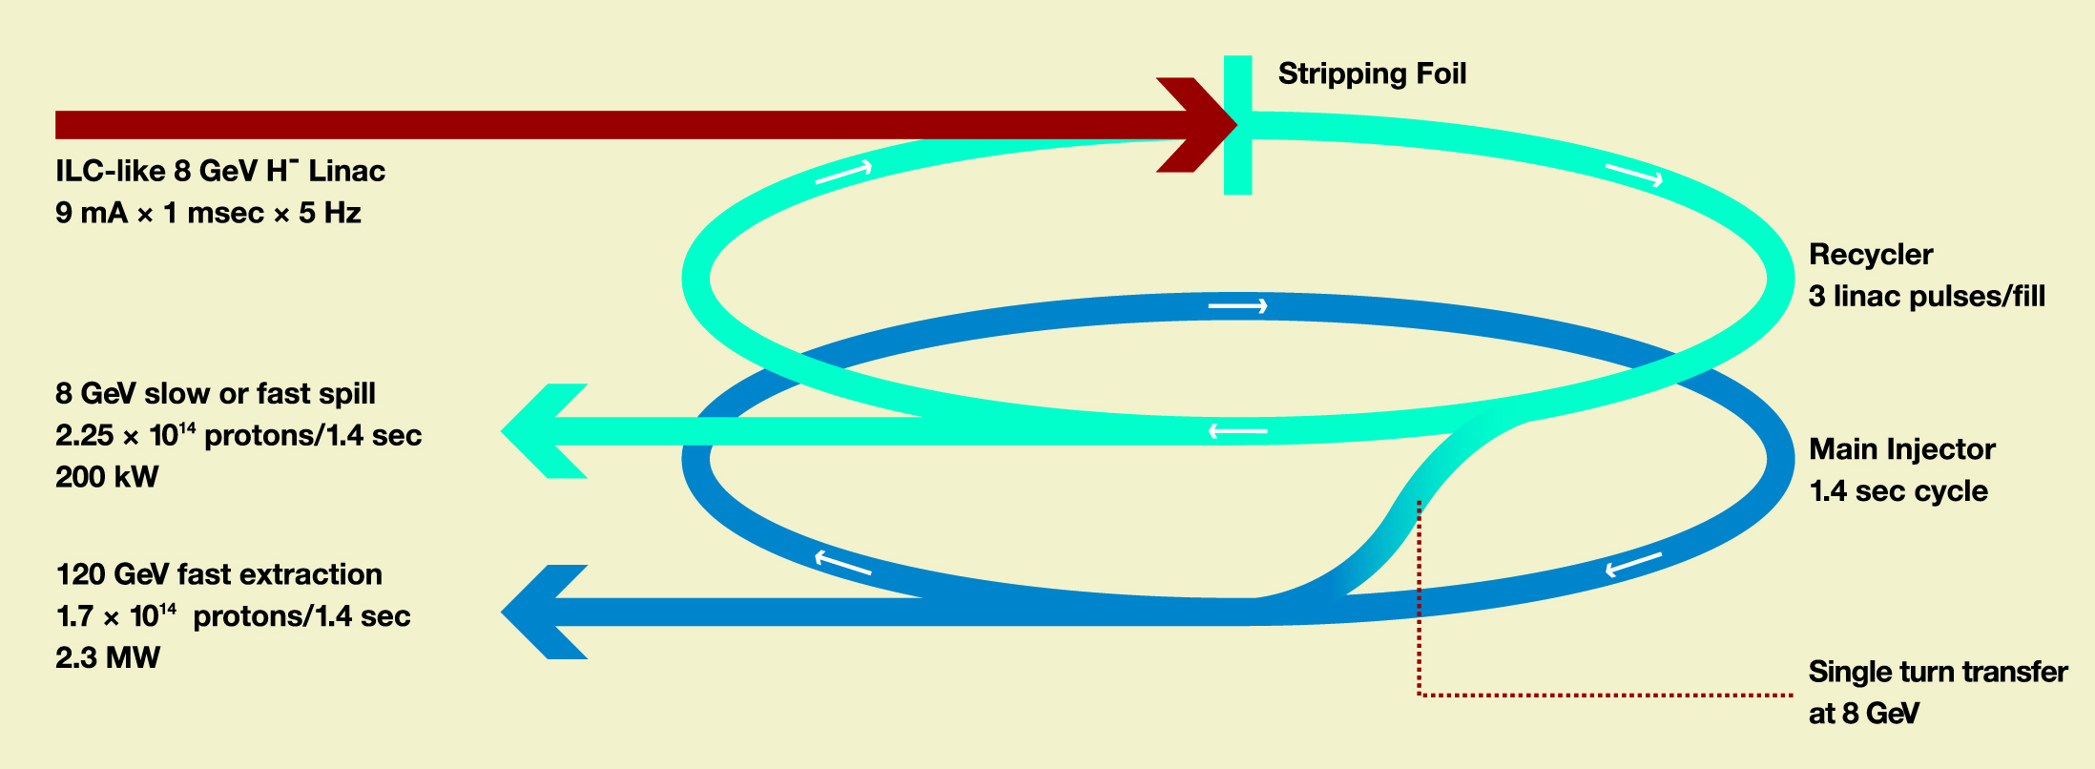
Evolution of the Project X concept
Originally an 8 GeV pulsed linac (5Hz, 1 msec pulses) with accumulation in the Recycler storage ring and acceleration to high energy in the Main Injector
Original
Idea

Slide 50
Evolution of Project X
Work on Project X has led to a much better idea for a unique and flexible facility
Instead of an 8 GeV pulsed linac (1 msec pulses at 5 Hz) use a CW linac (continuous pulses at 325 MHz) delivering 2 MW at 2 GeV of either protons or H⁻ ions
These pulses can be directed flexibly to different experiments with different time patterns and pulse intensities

Slide 51

Project X and LBNE to Homestake
5% of the time line, the 2 GeV linac feeds a simple Rapid Cycling Synchrotron (RCS), 500m circumference, to strip, accumulate and boost the energy to 8 GeV
Six pulses of the SAB are transferred to the recycler, filling the existing recycler, and every 1.4 sec transferred to the Main Injector for acceleration to high energies (60 GeV to 120 GeV)

Slide 52

Project X and 8 GeV beams
8/14 RCS cycles are available for an 8 GeV program driven by a fast spill (single turn). An example is a much upgraded muon g-2
Slow extraction as needed for rare processes is very limited from circular machines: only method is resonance extraction which is “rad dirty” and limits extraction to 10s of kW.

Slide 53
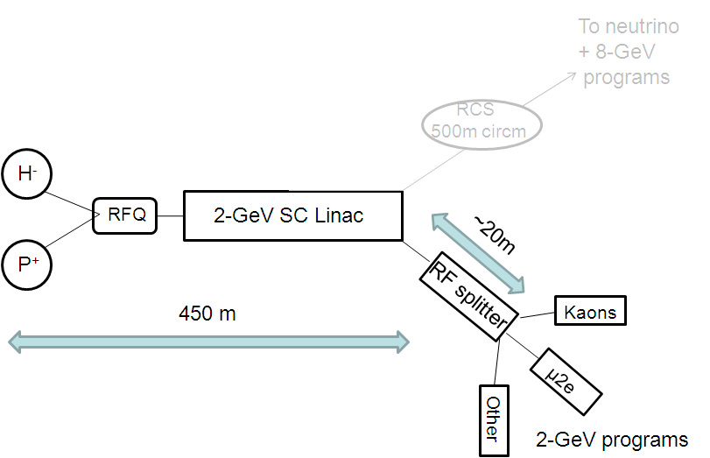
Project X and 2 GeV beams
The greatest potential for rare processes comes from 2 MW continuous beam. Intensity experiments need continuous beam: pile up is the main limitation in pulsed beams

Slide 54
Facilities and experiments
Energy
Tevatron
LHC
LHC
LHC upgrades
LHC
ILC??
LHC
ILC or
Muon Collider
Minos
MiniBooNE
NOvA
MicroBooNE
MINERvA
LBNE
Mu2e
Project X+LBNE
Mu2e
ν Factory
Intensity
P Auger
DM: scalable?
DES
JDEM
DM searches
P Auger
DM Searches
JDEM
Cosmic
Now
2012
2015
2018

Slide 55
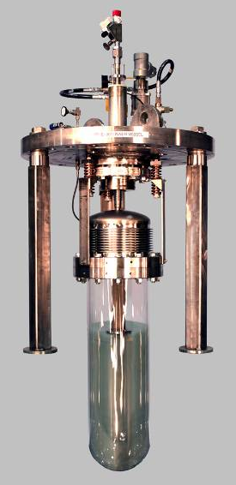
Underground dark matter detectors
COUPP
60 kg / 30 liter
CDMS
Low temp. Ge / Si crystals
4 kg
→ 15 kg
2 kg / 1 liter
COUPP
Room temp. CF₃I Bubble Chamber
55
Notes:
55
55

Slide 56
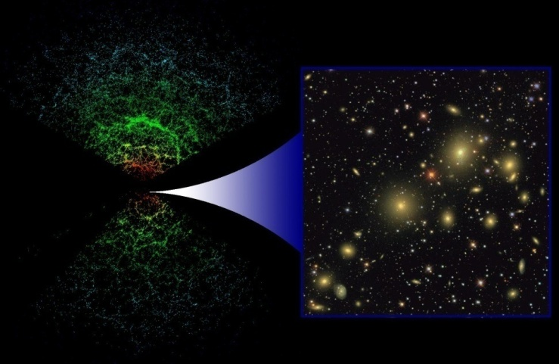
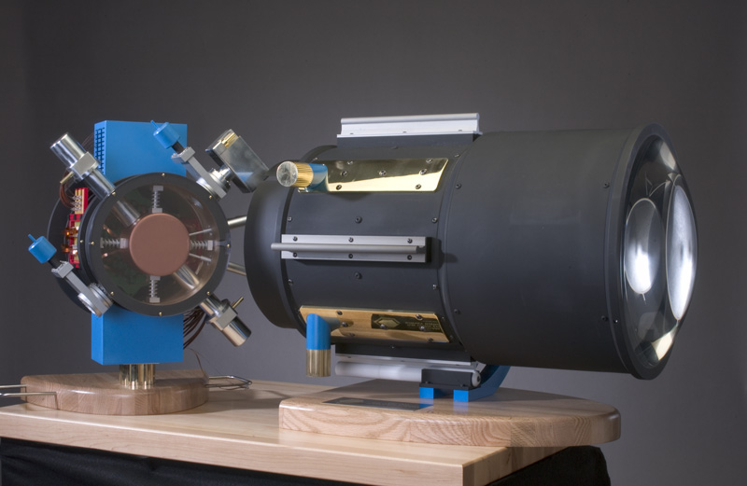
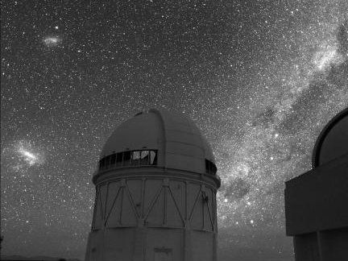
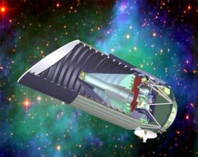
Probing Dark Energy
SDSS
DES
JDEM
¼ scale model DECAM
56
Notes:
56
Spectra of thousands of Supernovae
Map the Universe out to even higher redshift
Weak Lensing from space

Slide 57
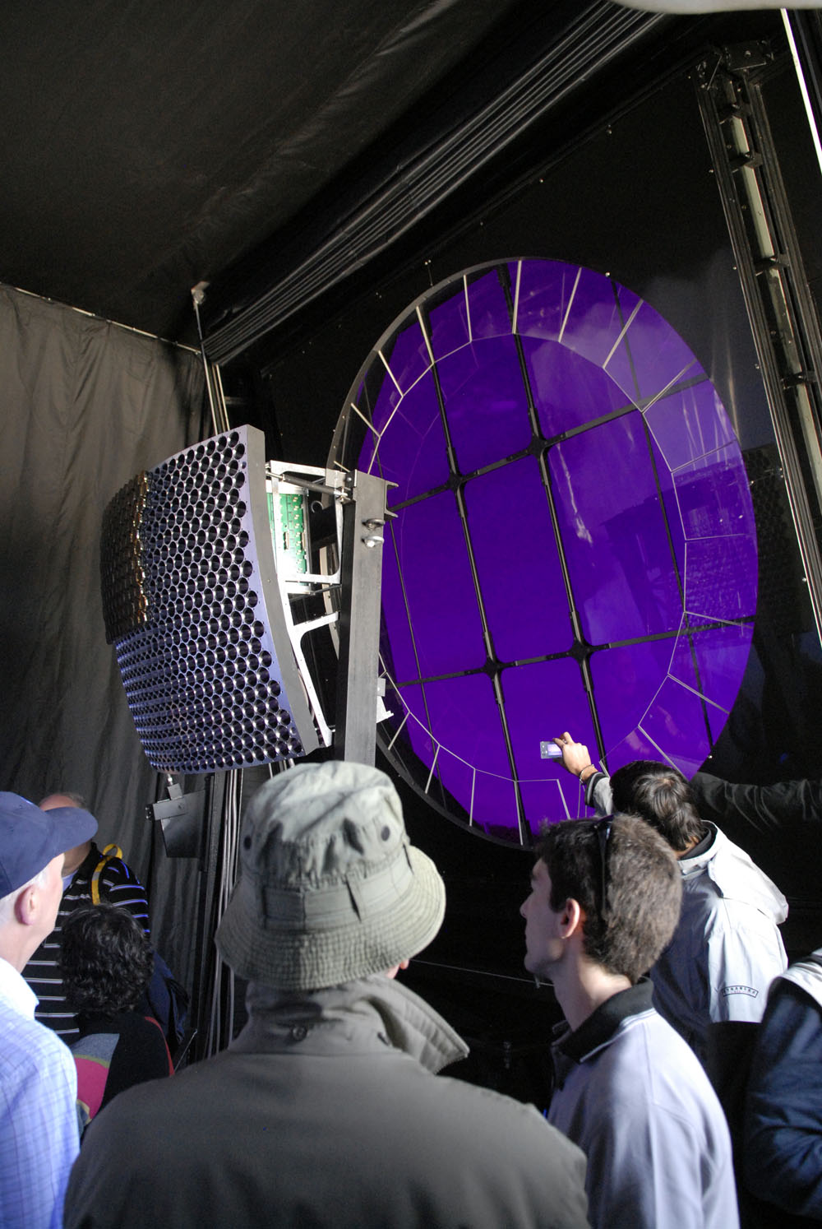
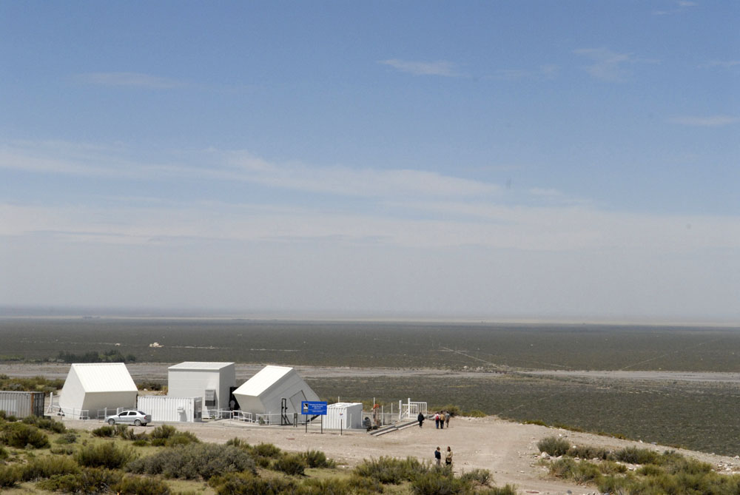
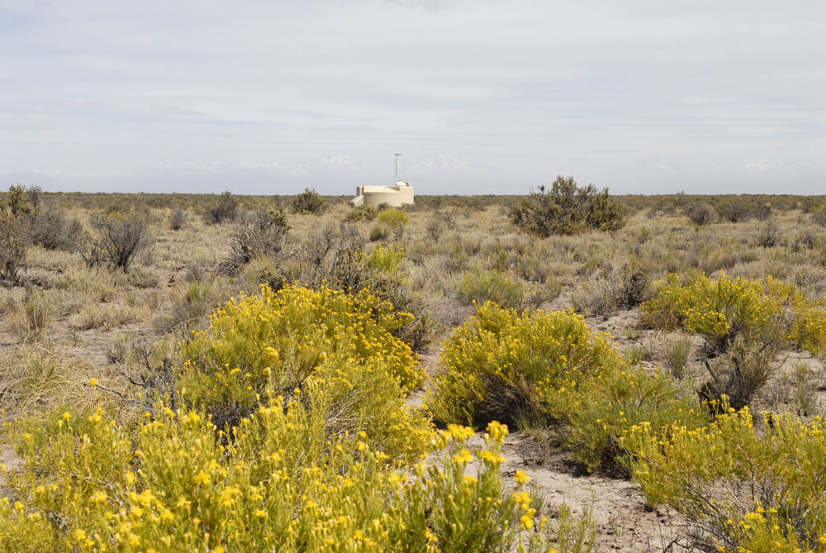
UHE Cosmic Frontier: Pierre Auger

Slide 58
Cosmic frontier: new ideas
One ton detector scale dark matter searches
Pierre Auger North
21 cm radio band survey (dark matter distribution)
Holographic noise
Axion searches

Slide 59
A formidable program ahead
Very demanding of ourselves at all levels
Must leverage our efforts by involving the national and international community in developing the program
Must have the underlying management and information systems that make us effective at delivering such a program

