Slide 1
ILC/SRF Strategic Planning OHAP
Rich Stanek
September 17, 2009

Slide 2
Introduction
ILC and SRF efforts are Programs NOT Projects
No DOE Critical Decisions (related to ILC or SRF)
No start date for ILC construction exists
Project X is still being evaluated (ICD-1 vs. ICD-2)
No Resource Loaded Schedule (individual schedules exist)
Many technical milestones exist incl. use of ARRA funds (DOE)
Try to be “project-like” in our management scheme
Set goals, budgets & schedules and track progress
Very nature of this R&D work means
Technical objectives are changing and the plan must adjust
Nevertheless this technology (SRF) could hold the key to the Lab’s future
ILC ➔ Specific goals set by the GDE (can change during year)
SRF ➔ Build SRF infrastructure (1 CM/month) and qualify U.S. vendors for cavities, CM parts, RF equip.

Slide 3
Funding
Landscape (funding) has been extremely dynamic
Lows of FY08 Omnibus to Highs of FY09 ARRA
ILC and SRF are separate B&R categories
Each brings its own source of funds to the Lab
In FY09,
ILC (KA 1502021) = $11.2M
SRF (KA 1502012) = $22.5M
ARRA SRF = $52.7M
IARC Building = $20M
There is a set workforce that is engaged in SRF activities ➔ Mech, Cryo, Elect, RF, SC Magnet…
ILC ~ 25 FTE (CFS, ML A/P, Global Sys. plus Cav. & CM)
SRF ~ 62 FTE (Facilities ➔ Const & Ops plus Cavity Fab.)
Recently the Lab has opened 10 new positions for SRF
Think of these Programs as a Level of Effort

Slide 4
FTE Analysis for FY09 vs. FY10
FY09 numbers do not include the 10 new positions or the contract personnel
By early FY10, will have ~ 15 contractors on ILC/SRF

Slide 5
ILC Overview
The goal of the ILC work is to
Advance the ILC design consistent with the objectives of the ILC GDE
Promote the readiness of U.S. to participate in an ILC
ILC GDE has set the following specific goals
Prepare a submission of a Technical Design Report on the 2012 timescale
Reduce the estimated cost of the ILC
Meet the S1, S2 & S3 Goals (gradient/yield, CM , RF Unit)
FNAL ILC scope of work and budget determined on a yearly basis ➔ in consultation with ILC ART Director (Mike Harrison)
General guidance is equal to FY09 (flat-flat)
Fairly well known work force (by name)
Facility operation shared with SRF ➔ build 1 CM/yr

Slide 6
ILC FY10 Scope of Work
As discussed with ILC ART Director:
Still under development but includes
Slightly more emphasis on CFS and ML A/P
Participation in DESY 9 mA Test
Continued pursuit of fabricating 1 CM/year
Slightly more involvement in SC magnet R&D
FY11 is more of the same

Slide 7
ILC/ARRA CM Plan

Slide 8
ILC FY09 Actual Achievements and FY10 Plan
In FY09, ILC Program produced following results
CFS helped develop the Minimum Design Concept
Continued Ring to Main Linac design (A/P)
Began participation in 9 mA test (LLRF)
Processed cavities at Joint FNAL/ANL EP facility
Dressed first 1.3 GHz 9 cell cavity (still needs HTS test)
Ordered parts for CM3
Worked on safety analysis for cavity/CM
In FY10, ILC Program plans to
Continue CFS, ML A/P and LLRF involvements
Test CM1
Assemble CM2
Continue to EP process, VTS, dress & HTS 9 cell cavities

Slide 9
SRF Mission Statement
Mission:
Develop SRF infrastructure at FNAL and perform R&D to master the technology for future accelerator projects (e.g. ILC or Project X)
Goals:
Master fabrication & processing of cavities & cryomodules
Build SRF infrastructure (difficult for industry to provide)
Large cryogenic & RF systems, cavity & cryomodule testing
Operate facilities to acquire required expertise
Transfer SRF technology to U.S. industry
Participate in national & international collaborative R&D

Slide 10
Feb 07 Review: SRF B&R Scope of Work
Construct SRF infrastructure
Cavity Fabrication Infrastructure
Including EB Welder
Cavity Processing Facilities
Vertical Test Systems (VTS 2/3)
Horizontal Test Systems (HTS-2)
Cavity & Cryomodule Assembly Facility (CAF)
RF unit Test Facility (ILCTA_NML)
Including new cryoplant and beam
Cryomodule Test Stand (CTS)
Infrastructure SRF Material R&D
IARC infrastructure

Slide 11
SRF Infrastructure Plan
ARRA has a big influence on SRF infrastructure
New NML Cryoplant would not be possible otherwise
Helps recover from FY08 Omnibus Bill
This coupled with contributions from India has relieved major funding limitations

Slide 12
SRF FY09 Actual Achievements and FY10 Plan
In FY09, SRF Program produced following results
Operated existing facilities VTS, HTS, CAF
Finished construction of Joint FNAL_ANL EP facility
Continued construction of ILCTA_NML
Began work on IB1 Cryo Upgrades
In FY10, SRF Program plans to
Operate existing facilities ANL EP, VTS, HTS, CAF
Test CM1
Continue construction of ILCTA_NML
Finish IB1 Cryo Upgrades
Procure VTS-2
Work on ARRA Projects

Slide 13
Labor Resources
Labor resources are limited
In FY10, have SWF budget for ~89 FTE (combined ILC + SRF)
Currently have ~70 FTE working on these tasks
Current FY09 SRF labor ~ half of FY08 Q1 FTE
Finishing 3.9 GHz will help
Need to add more people to the effort to stay on schedule
Supplement internal staff with contract employees
Works well for general purpose needs
In some cases, using contract employees is difficult especially when experience is essential
Cryogenic engineers
RF engineers
High vacuum technicians
Also adding consultant help
H Padamsee, P Kelley…

Slide 14
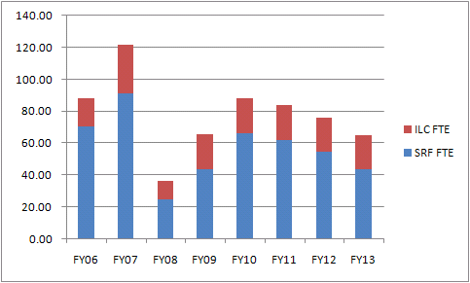
SRF + ILC Labor Profile
Apparent roll off in SRF FTE
absorbed by ARRA Projects
➔ Assumed flat in OHAP
FTE
Fiscal Year

Slide 15
Labor Needs
Current Labor Force working on the just SRF part of the Program ~ 48 FTE (slightly increasing each month)
SRF Plan calls for ~ 57 FTE/yr (on average/based on 4 yrs) with a peak of ~ 67 FTE needed in FY10 / ~ 63 FTE in FY11
With 3.9 GHz winding down ~10 FTE free up
Must increase the work force (in certain disciplines) as well as redirect people to work on specific tasks
Cryogenic and mechanical engineering
RF engineering
Need to train additional techs for clean room environment and to work with chemical processing equipment
Utilize contract personnel
Continue to integrate new people into the Program as they become available

Slide 16
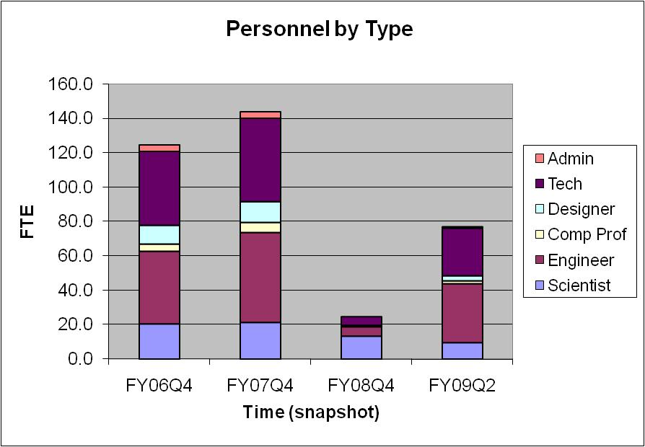
Track FTE by Type

Slide 17
ARRA SRF Influence
ARRA SRF funds are mostly M&S
SWF for Lab staff working on ARRA paid for by SRF B&R
Exception FES engineering staff on GPP projects
Don’t expect more Lab Staff to be added to SRF effort
Over and above 10 new SRF positions created in FY09
Use contract personnel to fill the gaps
Realize that there will be conflicts with this approach
Have to set priorities
New NML Cryoplant vs. Test CM1 (Cryo Eng resources) ➔ Cryoplant
ARRA SRF funds do the following
Advance parts of the current Plan
Allow parts of the original Plan that were dropped (due to lack of funds) to be reinstated
Allow new initiatives to spur U.S. industry involvement

Slide 18
ARRA SRF Plan

Slide 19
ARRA SRF Milestones

Slide 20
Summary
For ILC and SRF Programs:
Know exactly what resources we had in FY09 and what was accomplished
Technical Plan for FY10
Continue to operate facilities
Continue construction of NML
Work on ARRA projects
Have FY10 resource plan which includes agreed upon level of staff plus 10 new openings + contractors
Technical Plan for FY11 is
More of the same for ILC ➔ push towards TDR in 2012
For SRF, operate facilities
Bring VTS-2 on line, continue construction of NML
Continue work on ARRA projects

Slide 21
Backup Slides

Slide 22
Project X : SRF Deliverables
FY09
Test of β=1.0 Cryomodule #1 at Fermilab
Completion of Type-4 CM design
Dress cavities for CM # 2
FY10
Fabricate β=1 CM # 2 (1st CM with U.S. processed cavities)
Order parts and dress cavities for CM #3 the first Type IV Cryomodule
FY11
Test CM #2
Fabricate, & install Px quadrupole package for CM #3
Complete CM #3 and test
FY12
Complete CM #4 (Project X β=1.0 Prototype) and test
Complete and test Project X RF unit test
Complete 1st β=0.8 cryomodule
Viable U.S. vendors for Project X cavities and CM parts
Good cavity processing yields at Project X gradients (25 MV/M)
infrastructure capable of 1 Cryomodule per month output
Using ANL, JLAB, SLAC, and FNAL infrastructure

Slide 23
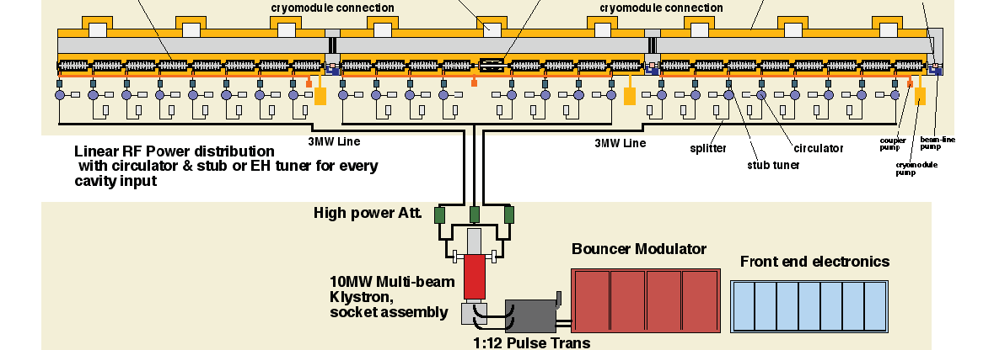
ART R&D Program Deliverables (2012)
The highest priority activity in the ART program is SRF development which represents 50% of the total effort. Deliverables are:
High gradient cavity fabrication (35 MV/m, yield 80%) tech transfer to at least 2 North American vendors completed
Cryomodule type 4 design, fabrication and horizontal testing completed for 3 cryomodules
Solid state modulator, tunable power distribution system
LLRF control
String test of a complete, high gradient, RF unit; installed & operation started
SLAC
NML facility
ILC RF Unit: 3 CM, klystron, modulator, LLRF
Slide 23
Notes:
23

Slide 24
Px and ILC Deliverables Set the Scope
S0 Goal: Master cavity processing & handling to achieve 35 MV/M gradient with 80% yield on 1st try, 90% yield after 2nd
Project X: 1 CM/month = 96 good cavities a year ( > 25 MV/M)
Requires U.S. vendors capable of fabricating 100 cavities/yr
Laboratory/industrial processing and test capability able to handle >200 process/test cycles per year (ANL, FNAL, JLAB)
Drives scope of planned ANL/JLAB EP and FNAL VTS upgrades
Drives the need for SRF materials and surface studies
Project X goals & ILC S1 and S2 ILC goals:
Require infrastructure to dress and HTS test cavities
Require infrastructure to build ILC Cryomodules at 1/month
Require infrastructure to test individual cryomodules
Require infrastructure to test Px or ILC RF units (NML)
Large overlap in Project X and ILC 1.3 GHz needs

Slide 25
Schedules and Milestones
SRF Program Office manages individual elements of the Plan by setting scope of work, budget and high level milestones
Individual parts of the program have project schedules and more detailed lower level milestones
Technical progress on critical systems is monitored and reported weekly
via standing management & coordination meetings
All of this information is fed into our planning process ➔ results in our SRF Budget Plan

Slide 26
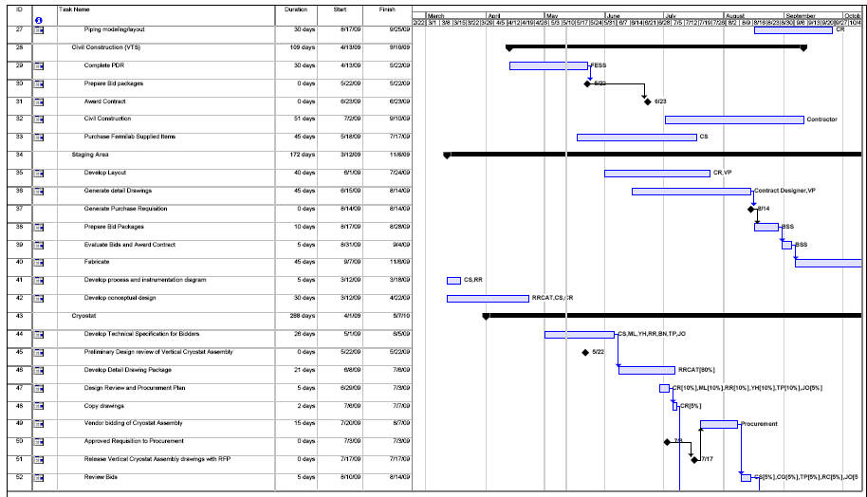
Example VTS System Upgrade
This particular schedule has labor resources identified

Slide 27
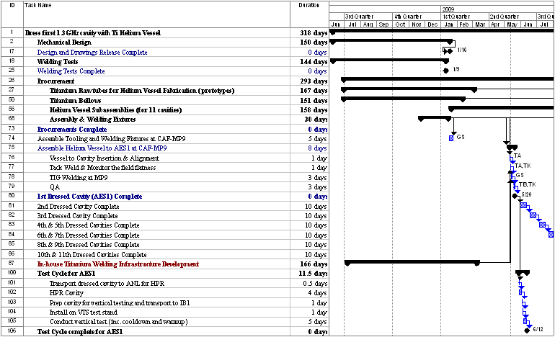
Example Dressed Cavity Schedule

Slide 28
Example NML Detailed Milestones
Completed NML Milestones
Refrigerator #1 Operational (8/07)
Begin Civil Design of Build. Extension (8/07)
Commission Refrig. #1 (Liquify Helium) (9/07)
Move RF Systems to NML (5MW & CC2) (10/07)
Install CM Support Girders (4/08)
1st Cryomodule Delivery to NML (8/08)
Delivery of 1st Waveguide from SLAC(9/08)
Commission Vacuum Pump & Frick(12/08)
Cryo System Feedbox/Endcap Delivery(2/09)
Delivery of Remaining WG from SLAC(2/09)
Move CC2 to NML (3/09)
Install Cryo Feedbox/Endcaps (4/09)
Commission 300kW RF into Load (5/09)
Future NML Milestones
Warm RF Tests of CC2 (5/09)
Commission Cryo Distribution Sys. (CC2) (6/09)
CM1 Safety Documentation Complete (6/09)
Prelim. GPP Design Complete (6/09)
CC2 Operational (6/09)
3 MW RF System Operational (7/09)
Begin 1st Cryomodule RF Tests (Warm) (7/09)
CM1 Ready for Cooldown (8/09)
Cathode Equipment from INFN (8/09)
INFN to Assemble Cathode at NML (8/09)
Order Cryoplant (8/09)
Begin Construction of Build. Extension (8/09)
Cold RF Testing of CM1 (9/09)
Refrigerator #2 Operational (9/09)
2nd Cryomodule Delivery to NML (2/10)

Slide 29
End of FY09: SRF Milestones
1) Vertical Test Stand: VTS-1 operational and capable of testing single and nine cell 1.3 GHz elliptical cavities or HINS 325 MHz SSR1 spoke resonators at about two tests per scheduled month ➔ Done
2) Horizontal Test Stand: HTS-1 capable of testing 1.3 GHz dressed cavities at 1.8 K at a rate of one per month
➔ In Progress
Awaiting arrival of first dressed 1.3 GHz cavity

Slide 30
End of FY09: SRF Milestones
3) ANL/FNAL EP facility: capable of Electro-polish, ultrasonic rinse, High Pressure Rinse of single or nine-cell cavities at a rate of 1 process per two weeks. Ultra clean water, cavity handling fixtures and clean room performance validated
In Progress System validated for single-cells, continue to work on nine-cell commissioning 4) CAF: fixtures & clean rooms validated for assembly of CM and dressing of 1.3 GHz cavities
In Progress TIG welding of Ti validated for cavity dressing. CM 1 and 3.9 GHz assembled 5) Tumbling machine: operational for single cells In Progress

Slide 31
End of FY09: SRF Milestones
6) Optical inspection device: operational for single and nine cell cavities ➔ Done
Control system improvements in progress 7) Automated Cavity tuner: DESY-KEK-FNAL collaboration 1st of 4 machines near completion ➔ In Progress 8) NML Refrigeration: Single TeV satellite based NML refrigerator operational with large vacuum pump able to achieve 60 W at 1.8 K
➔ In Progress
9) 3 MW 1.3 GHz RF power source operational in NML
➔ In Progress

