Slide 1
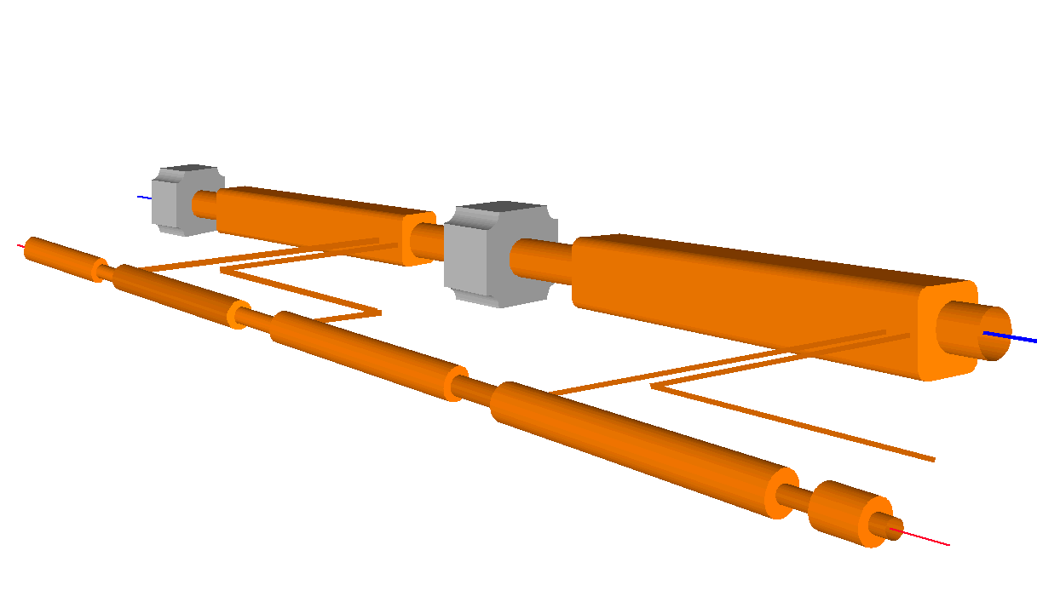

CLIC Overview and Status
D. Schulte for the CLIC team
Very short introduction to CLIC scheme
Feasibility issues
Conclusion
http://clic-study.web.cern.ch/CLIC-Study/

Slide 2
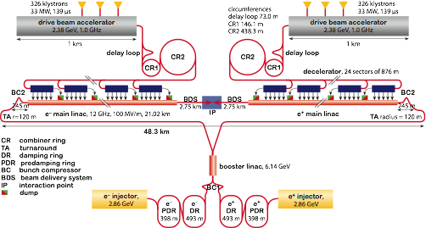
The CLIC Layout

Slide 3
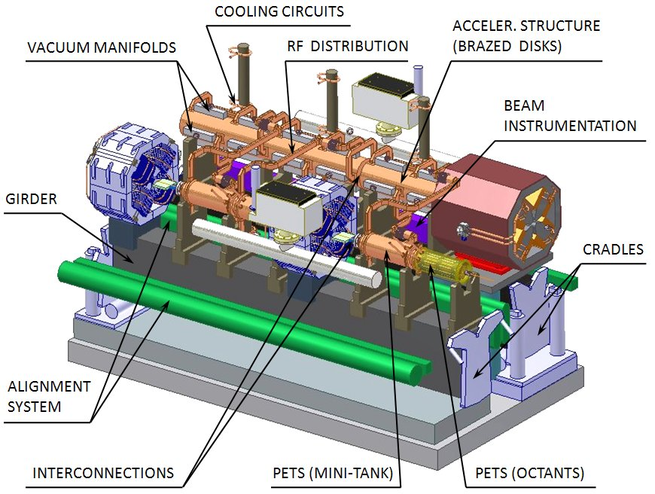
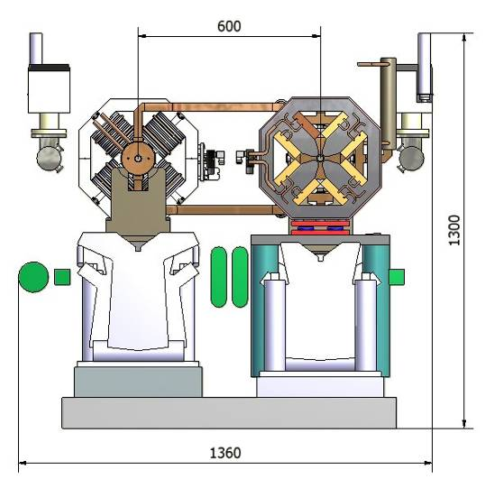
CLIC Two Beam Acceleration Module
Main Beam
Drive Beam
G. Riddone et al.
20760 modules (2 meters long)
71460 power production structures PETS (drive beam)
143010 accelerating structures
(main beam)
3

Slide 4
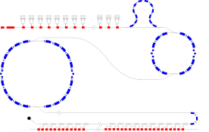
CLIC Power Source Concept
Drive Beam Accelerator
efficient acceleration in fully loaded linac
Delay Loop × 2
gap creation, pulse compression & frequency multiplication
RF Transverse Deflectors
Combiner Ring × 3
pulse compression &
frequency multiplication
Combiner Ring × 4
pulse compression &
frequency multiplication
CLIC RF POWER SOURCE LAYOUT
Drive Beam Decelerator Section (2 × 24 in total)
Power Extraction
Drive beam time structure - initial
Drive beam time structure - final
240 ns
240 ns
5.8 μs
140 μs train length - 24 × 24 sub-pulses
4.2 A - 2.4 GeV – 60 cm between bunches
24 pulses – 101 A – 2.5 cm between bunches

Slide 5
The CLIC Rational
Aim at high centre-of-mass energy at reasonable cost
  Reduce machine size
    high accelerating gradients -> structure design
  Minimise cost per unit length
    focus is on the main linac module and tunnel
  Power source
Aim at high luminosity
  Push beam current -> push efficiency
  Push specific luminosity -> high beam quality
  Push effective run time -> operation and machine protection
Aim at good experimental conditions
  Detector design
  Quality of luminosity spectrum
  Background conditions
D. Schulte
FNAL November 2009
5

Slide 6
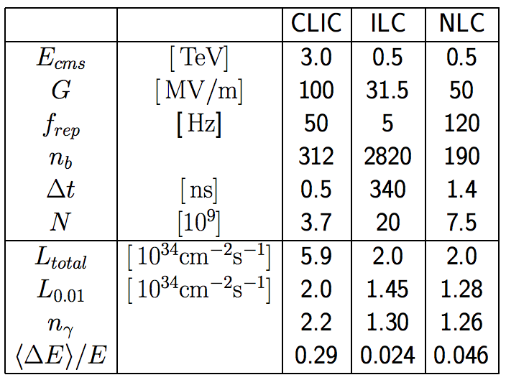
Basic Parameter Comparison
ILC is based on superconducting cavities
NLC had been based on klystrons
500GeV and initial parameter sets for CLIC exist

Slide 7
Gradient Limitations
Structure gradients are limited by breakdowns, depending on
  Surface electric field
  Pulsed surface heating
    Surface magnetic field and pulse length
  RF power flow
    RF power flow through iris aperture, depends on pulse length
  Have empiric model for limit values but no full theory
    Experiments are vital
Structures can generally achieve higher gradients if the aperture is reduced
  But higher wakefields ⇒ beam stability
  Can focus the beam more ⇒ tight tolerances on misalignments and jitters
  Need to find a compromise ⇒ performed full parameter optimisation

Slide 8
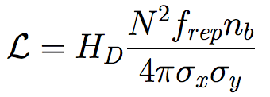
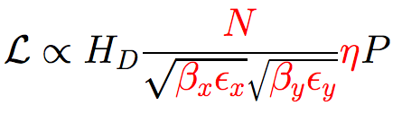
Luminosity
The luminosity is given by
Which can be written as
Note σ_{x}>> σ_{y}
Hence try to optimise
efficiency (main linac)
vertical beam size
horizontal beam size
Use realistic assumptions about obtainable beam parameters

Slide 9
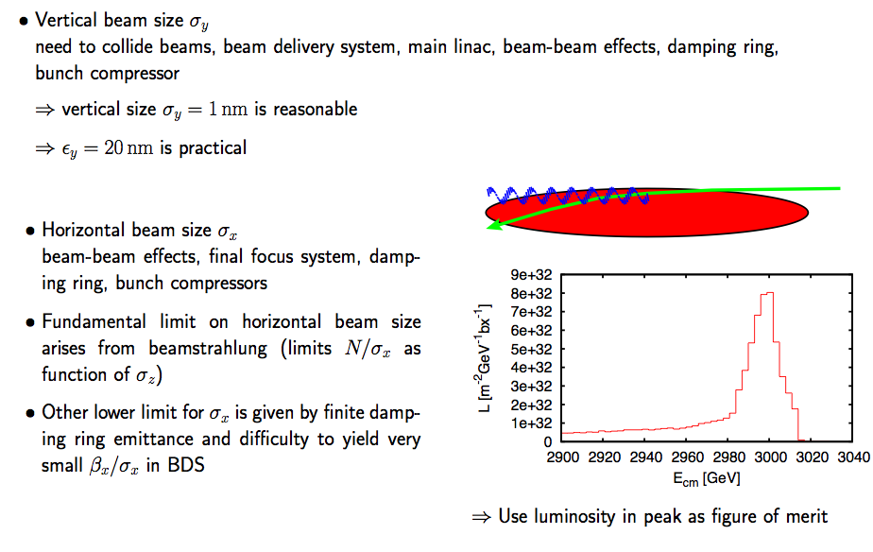
IP Beam Size Limitations at the IP
For our parameters 40nm x 1nm

Slide 10
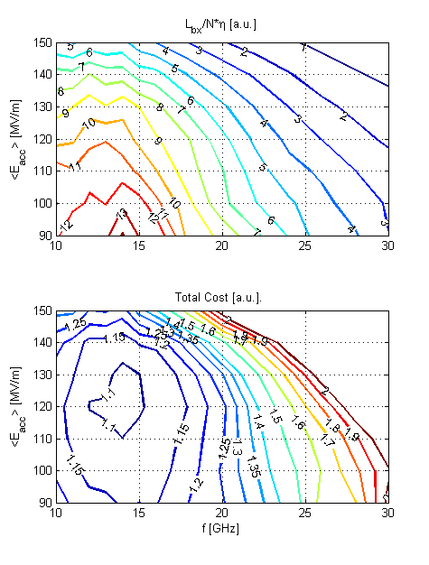
Optimisation Results
Optimisation - figure of merit:
  Luminosity per input power
  Luminosity per cost
Using
  Structure limits:
  Beam dynamics:
Take into account cost model
Once assumptions are defined, parameters drop out automatically
Chose 100MV/m and 12GHz
A.Grudiev et al.

Slide 11
Tentative long-term CLIC scenario
Shortest, Success Oriented, Technically Limited Schedule
Technology evaluation and Physics assessment based on LHC results
for a possible decision on Linear Collider with staged construction starting with the lowest energy required by Physics
Conceptual
Design Report
(CDR)
Council
approval
Technical
Design?
Technical
Design Report
(TDR) ?
Project
approval ?
First
Beam?
CDR:
Address CLIC feasibility issues
  And a part of performance and cost issues
Conceptual design of a linear collider based on CLIC technology
Estimation of its cost (capital investment & operation)
CLIC Physics Study and detector development (L. Linssen et al.:

Slide 12
CLIC Feasibility Issues

Slide 13
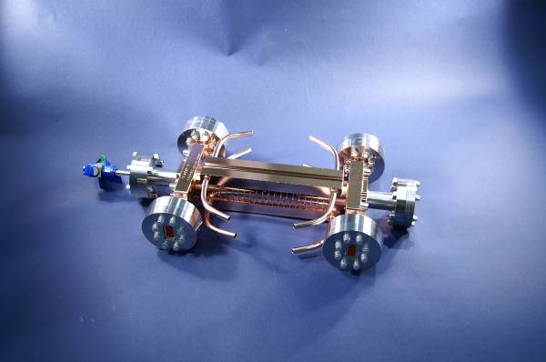
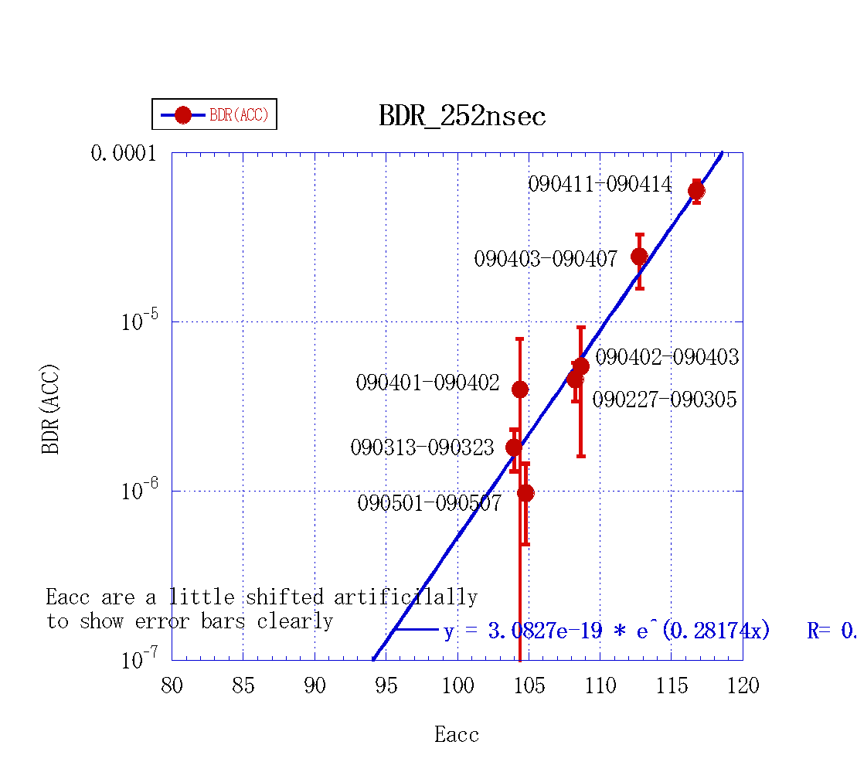
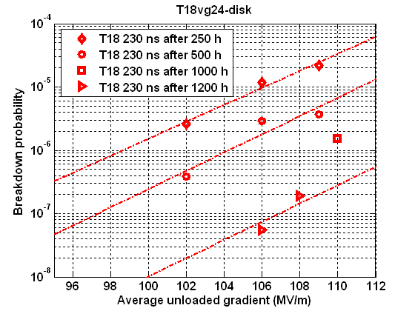
Accelerating Structure Performance
Excellent Collaboration: CERN-KEK-SLAC
3 structures T18_VG2.4_disk
(no damping)
RF design @ CERN Fabricated @ tested at SLAC and KEK
Exceeded 100 MV/m at
nominal breakdown rate
Frequency: | 11.424 GHz
Cells: | 18+2 matching cells
Filling Time: | 36 ns
Length:active acceleration | 18 cm
Iris Dia. a/λ | 0.155~0.10
Group Velocity: vg/c | 2.6-1.0 %
Phase Advace Per Cell | 2π/3
Power for <Ea>=100MV/m | 55.5 MW
Unloaded Ea(out)/Ea(in) | 1.55
Es/Ea | 2
Improvement by
conditioning
CLIC
nominal

Slide 14
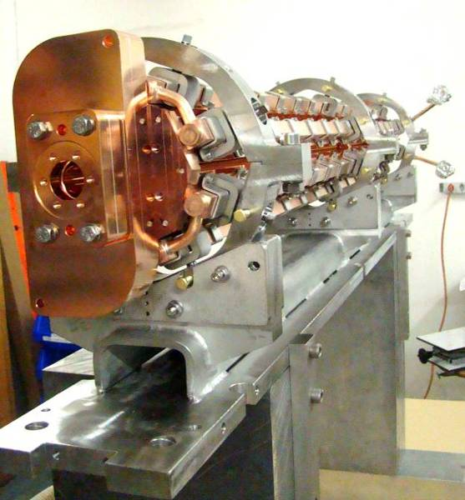
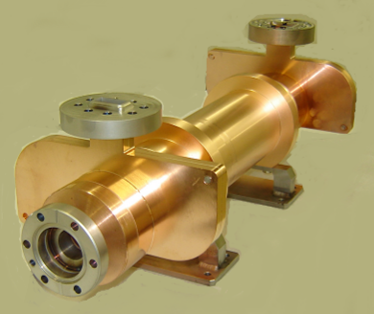
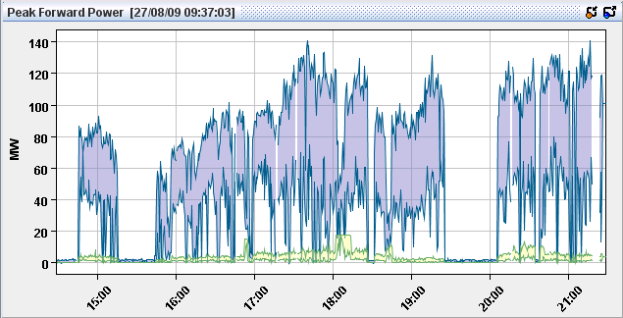
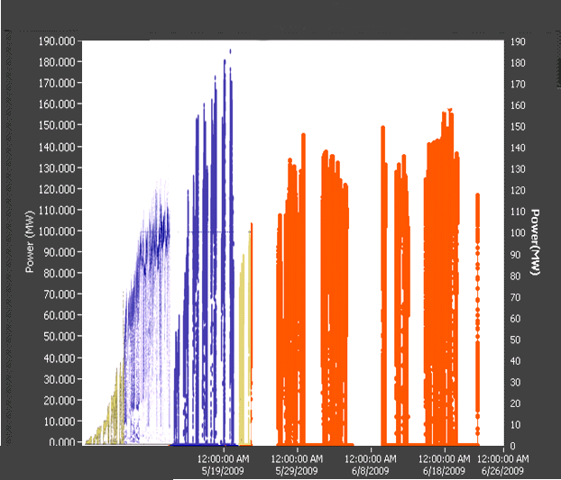
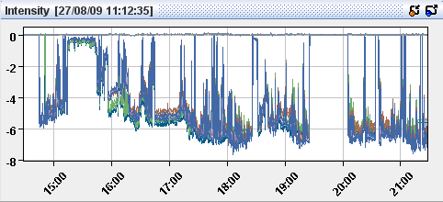
PETS Experimental Results
Klystron driven @ SLAC
Drive beam driven @ CTF3
266 ns
(240 ns CLIC target)
CLIC target
CLIC target

Slide 15
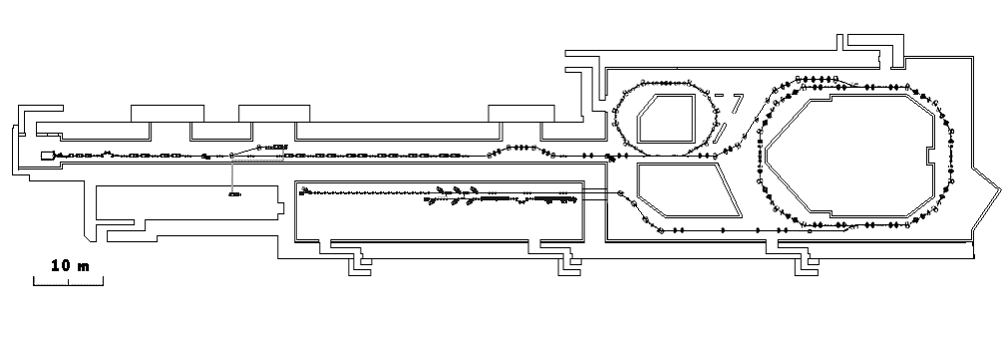
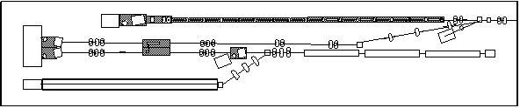
Two-Beam Acceleration:
CLIC Test Facility (CTF3)
Demonstrate Drive Beam generation
(fully loaded acceleration, beam intensity and bunch frequency multiplication x8)
Demonstrate RF Power Production and test Power Structures
Demonstrate Two Beam Acceleration and test Accelerating Structures
PULSE COMPRESSION
FREQUENCY MULTIPLICATION
magnetic chicane
150 MeV e-linac
30 GHz test stand
3.5 A - 1.4 μs
Delay Loop
Combiner Ring
CLEX (CLIC Experimental Area)
TWO BEAM TEST STAND
PROBE BEAM
Test Beam Line
Photo injector tests,
laser
28 A - 140 ns
Infrastructure from LEP
total length about 140 m

Slide 16
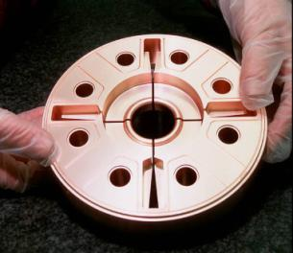
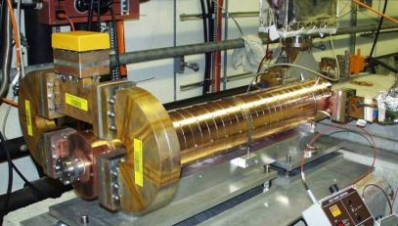
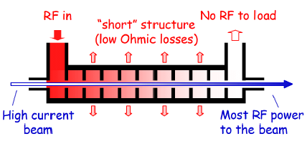
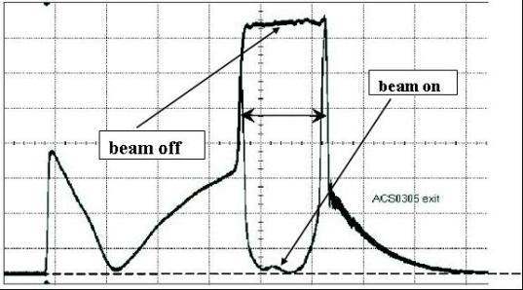
Drive Beam Generation:
Full Beam Loading Acceleration in Drive Linac
Drive Beam accelerating structure:
Proof of one of the major CLIC features:
Full Beam Loading
RF to beam transfer:
95.3 % measured
RF power at output of accelerating structure
Linac routinely operated with full beam loading

Slide 17
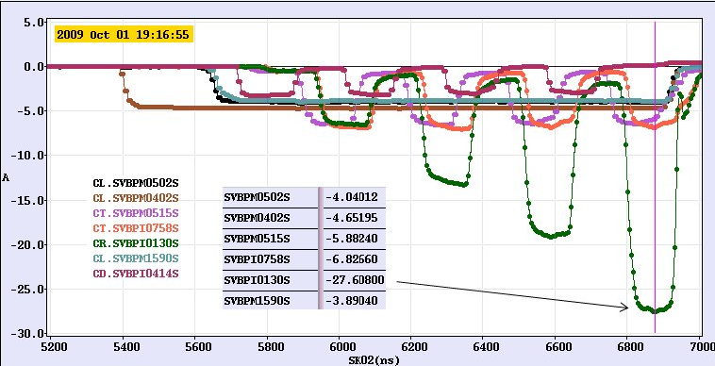
Drive Beam Generation:
Beam Pulse Compression in CTF3
Remaining: some increase in intensity (10%), phase stability

Slide 18
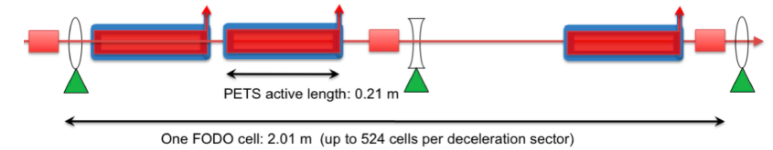
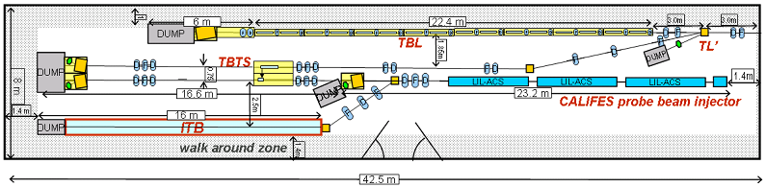
Drive Beam Deceleration and Module: CLEX
Decelerator sector: ~ 1 km, 90% of energy extracted
Two-beam Test Stand:
test the characteristics of a single PETS
Test Beam Line:
test of beam transport where a large fraction of the energy is extracted, under betatron motion (16 PETS)

Slide 19
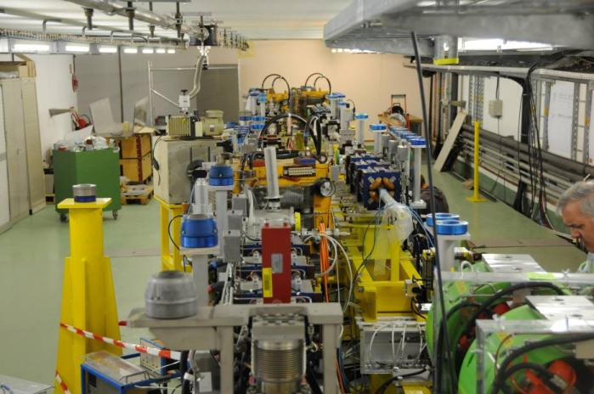
Two Beam Module:
Principle of two-beam acceleration had been established in CTF and CTF2
Test of new PETS and accelerating structure end 2009-2010
Some tests after 2010 (wake monitors)

Slide 20
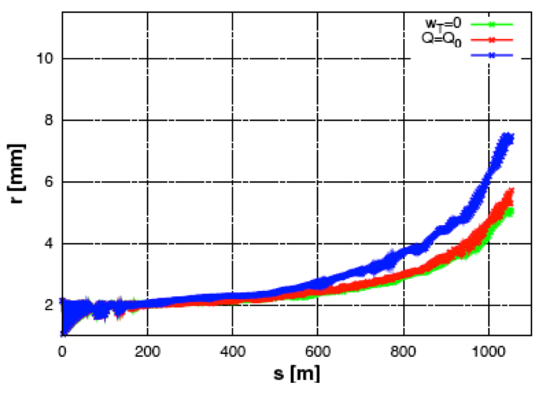
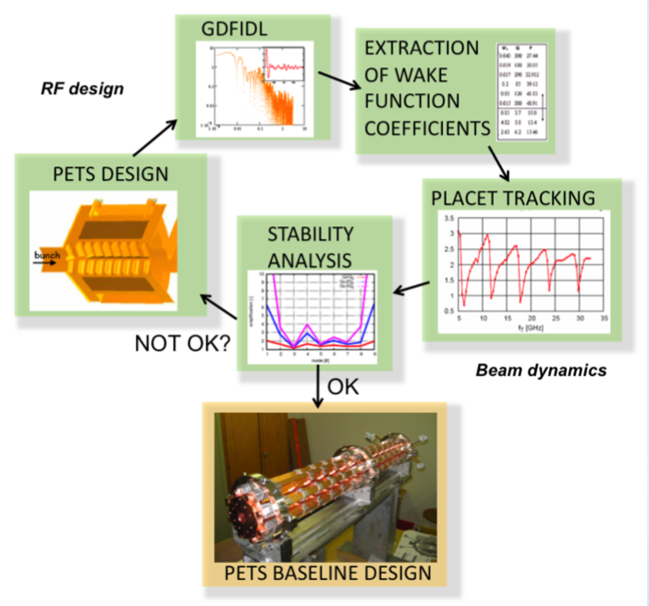
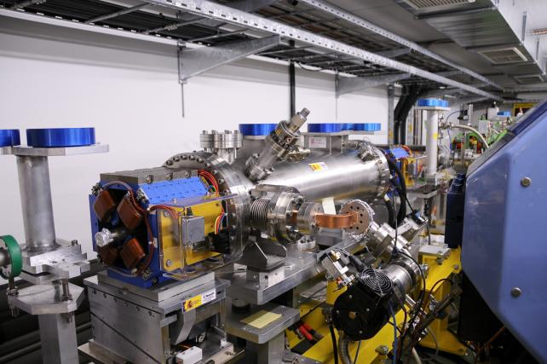
Drive Beam Deceleration
Drive beam has high current (100A) and large energy spread (factor 10)
  Simulations show that the beam is stable
  Several iteration of PETS design
Test Beam Line (TBL) under construction will increase confidence
  first PETS installed
  beam to the end
D. Schulte
FNAL November 2009
20

Slide 21
Drive Beam Generation Feasibility
Drive beam generation feasibility demonstrated
  Intensity stability still to be improved
  Timing stability to be addressed (XFEL collab)
    a number of components exist or are being developed
J.-P. Delahaye et al.

Slide 22
Beam Driven RF Power Generation Feasibility
RF power generation by single PETS feasibility demonstrated except for breakdown rate.
ON/OFF mechanism being built, still to be tested
Efficient RF power extraction in multiple stages still to be addressed in TBL (being built for tests in 2010)

Slide 23
Two Beam Acceleration Feasibility
Acceleration Structure with nominal parameters
demonstrated without damping:
  RF to beam efficiency still to be improved.
  Structures with damping being built still to be tested.
Two beam acceleration principle demonstrated in CTF2
  Two Beam Test Stand being built integrating (final) prototypes with power and beam tests in CTF3

Slide 24
Ultra Low Beam Emittances/Sizes
Achievement of small emittances is based on
  Advanced lattice designs
    Damping ring, most important RTML lines, beam delivery system
  Advanced component design
    Instrumentation, e.g. wake monitors
    Damping ring wigglers
    Final focus magnets
  Low level of imperfections
    Alignment and stabilisation of beam line elements (ground motion etc)
    Control of timing and drive beam phase and amplitude stability
    Stray fields
  Advanced strategies to deal with imperfections
    Beam-based alignment, tuning and feedback
On all items R&D is ongoing

Slide 25
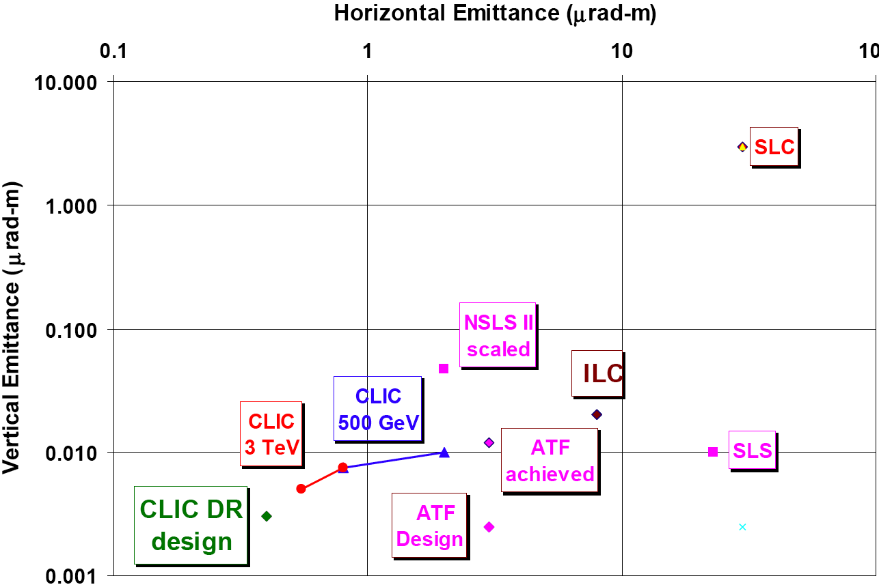
Damping Ring Design
PARAMETER | NLC | CLIC (3TeV)
bunch population (10⁹) | 7.5 | 4.1
bunch spacing [ns] | 1.4 | 0.5
number of bunches/train | 192 | 312
number of trains | 3 | 1
Repetition rate [Hz] | 120 | 50
Extracted hor. normalized emittance [nm] | 2370 | <500
Extracted ver. normalized emittance [nm] | <30 | <5
Extracted long. normalized emittance [keV.m] | 10.9 | <5
Injected hor. normalized emittance [μm] | 150 | 63
Injected ver. normalized emittance [μm] | 150 | 1.5
Injected long. normalized emittance [keV.m] | 13.18 | 1240
Design achieves goals with 10-20% margin
intra-beam scattering is important (new detailed code available)
electron cloud and FBII are relevant (global effort on mitigation)
advanced wigglers are instrumental (first prototypes available)
other issues
500GeV conservative parameters scaled from existing or approved rings
D. Schulte
FNAL November 2009
25

Slide 26
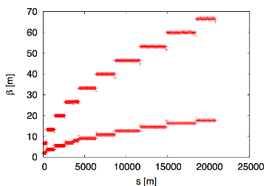
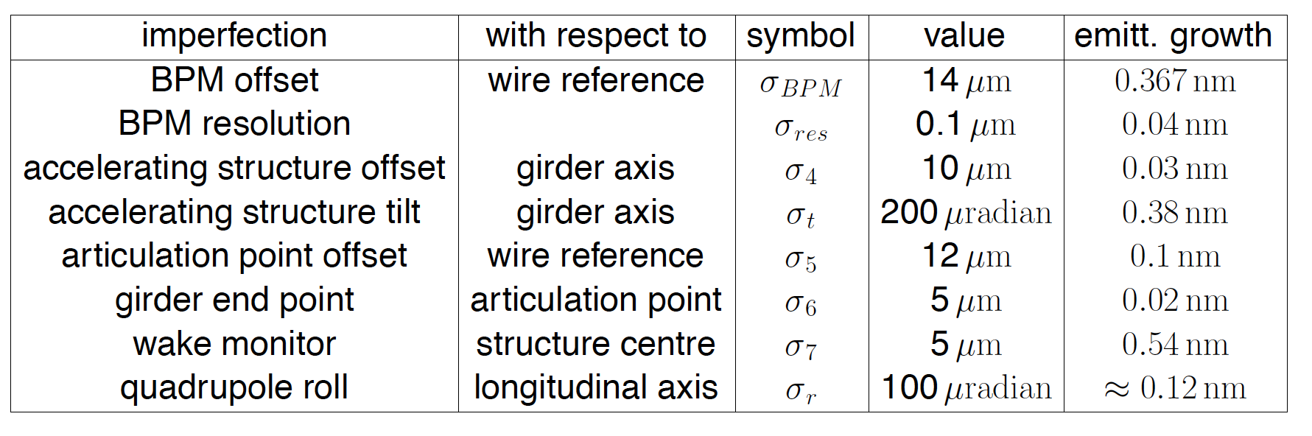
Main Linac Design
Main linac uses strong focusing to maximise bunch charge that can be transported in stable fashion
About 10% of the linac are magnets
Leads to tight alignment tolerances (O(10μm))
Leads to tight stability tolerances (O(1nm) for quadrupoles)
D. Schulte
FNAL November 2009
26

Slide 27
Beam Delivery System Design
The beam delivery system cleans the beams and squeezes them at the collision point
Challenge to squeeze the beam down to 40 nm x 1 nm and to maintain collision
Optics design
Stabilisation of beam line components against ground motion and technical noise
Instrumentation
Beam-based tuning, correction and feedback
Global effort at ATF2 is addressing the relevant issues
Intra-pulse feedback, BPMs, wire monitors, stabilisation, tuning algorithms, ...
Challenge to ensure collimator survival
Profit from ILC work and LHC developments
Final quadrupole (QD0) is inside the detector (L*=3.5m)
Alternative option with longer L* but has some luminosity reduction
Additional effort is ongoing to develop stabilisation equipment
D. Schulte
FNAL November 2009
27

Slide 28

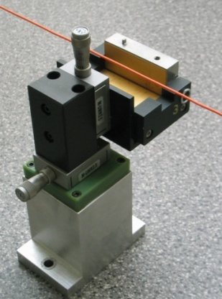
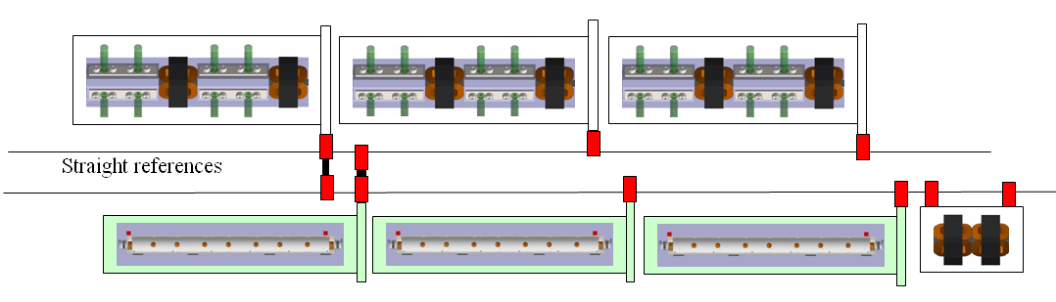
Pre-Alignment Concept
Principle has been demonstrated in CTF2
Straight reference = stretched wire
Vertical & transverse position measured with Wire Positioning Sensors (WPS)
Accelerating structures
PETS + DB quad
pre-aligned on independent girders
  DB and MB girders pre-aligned with 3+1 DOF (« snake system » / “articulation point”)
Simulations with predicted errors show good beam quality
MB quad pre-aligned independently with 5+1 DOF

Slide 29
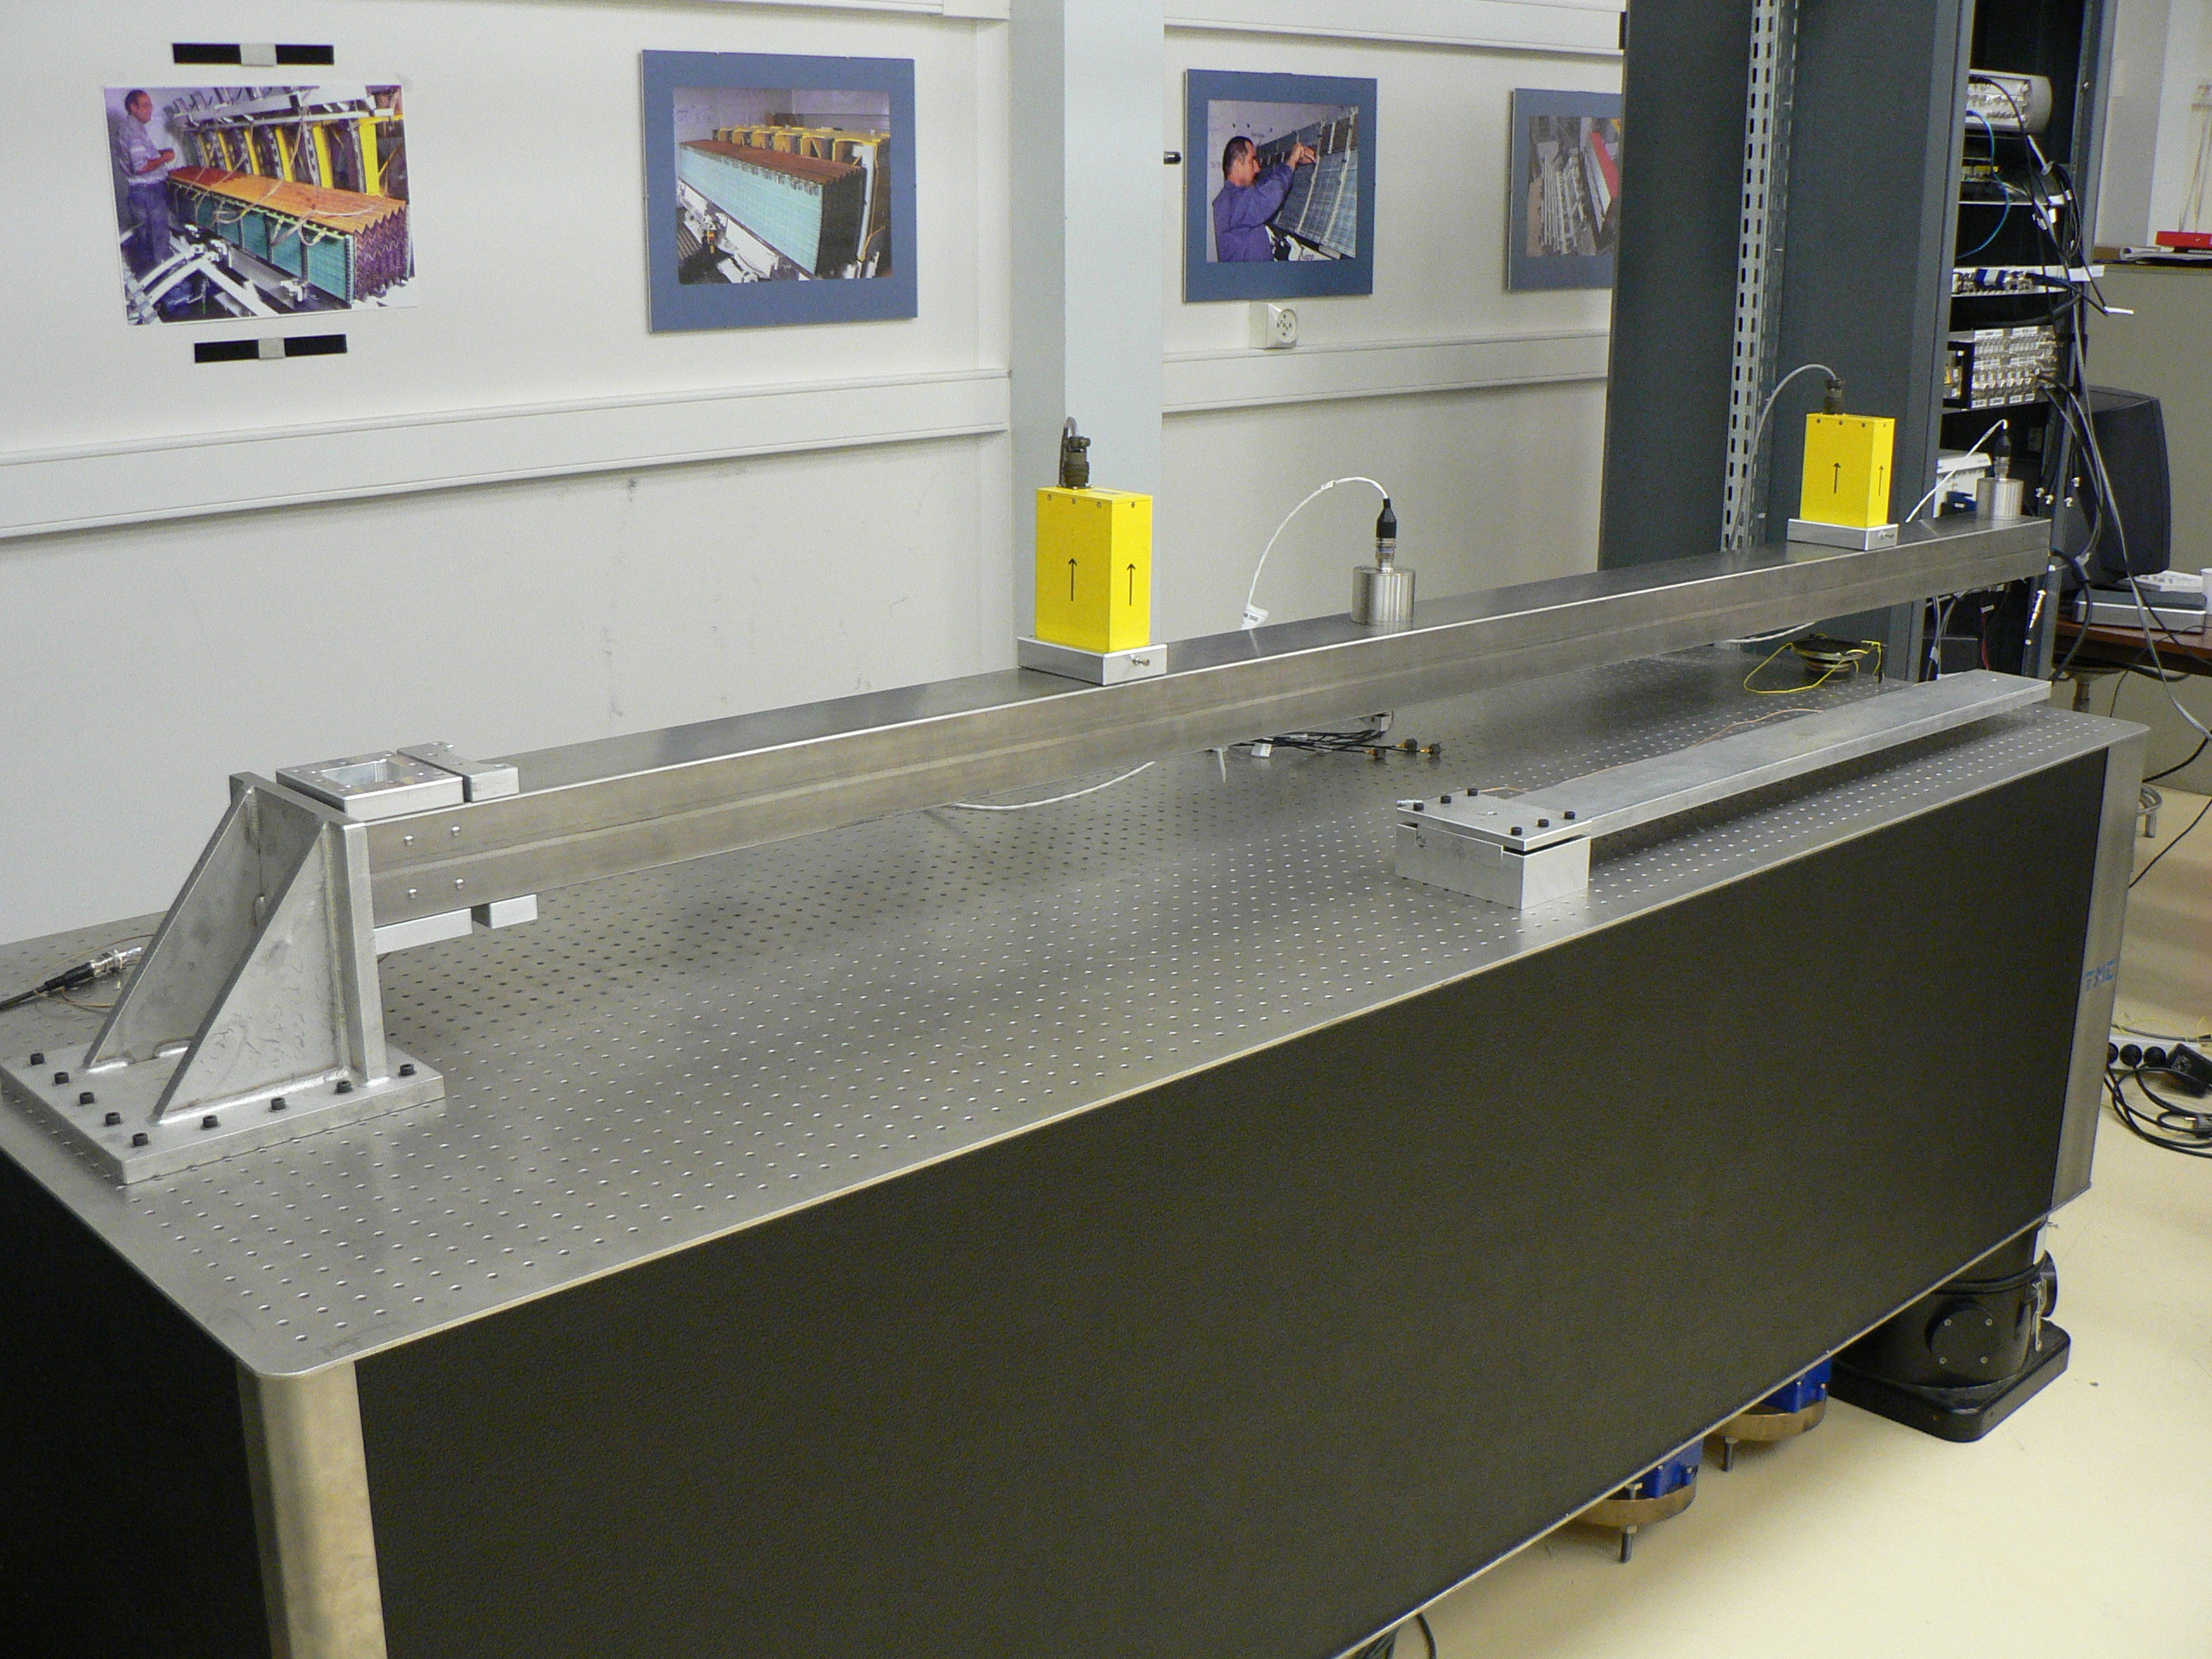
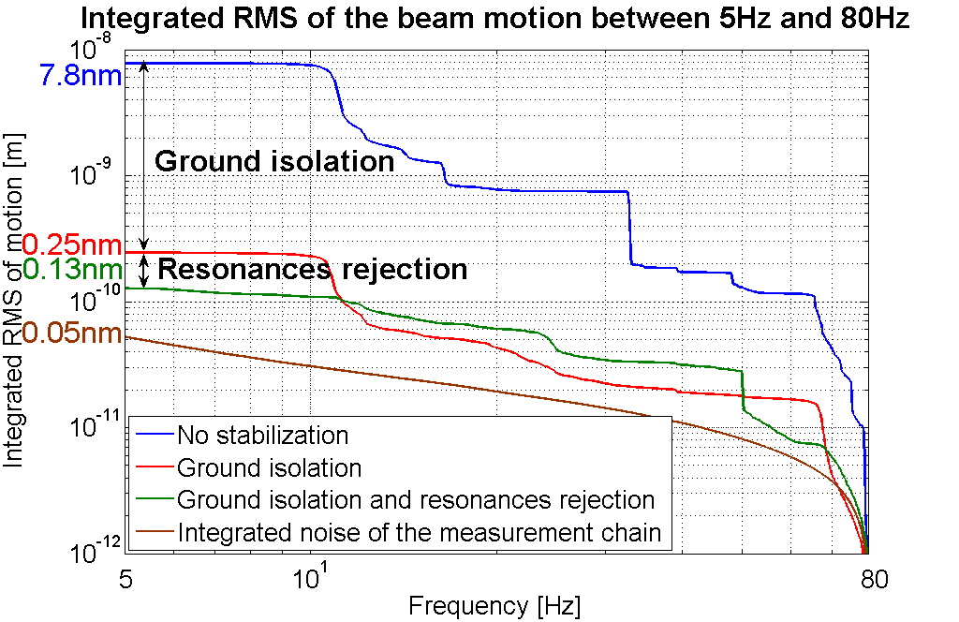
Stabilisation
Protoype of ML quadrupole stabilisation in development, expected for 2010 (1nm at 1Hz)
Final doublet stabilisation is in study
support concept in detector (sub-nm stability required)
sensors
integration with beam-based feedback (0.3nm beam-beam jitter)
All stabilisation depends on environnement
have to continue of study technical noise sources
(L.Brunetti et al, 2007)
29

Slide 30
Beam Emittances Preservation Feasibility
Ultra low beam emittances addressed in ATF2, SLS & NSLS2
Emittance preservation by simulation bench-marked in CTF3 and with other codes
Principle of 10 micron Pre-Alignment demonstrated in CTF2 and wire test
  Feasibility by upgraded method integrated Module Test Bench
Principle of sub-nanometer active stabilisation demonstrated
  nm stabilisation of main linac quad prototype (400 kGs) in lab and integration in Two Beam Module
  Application to realistic detector environment (adequate support)

Slide 31
CLIC Detector Issues
Detector requirements are close to those for ILC detector
  First studies indicate that ILC performances are sufficient and necessary
  Adapt ILD and SID concepts for CLIC
Differences to ILC
  Larger beam energy loss
  Time structure (0.5ns vs. ~300ns)
  Higher background
    High energy
    Small bunch spacing
  Other parameters are slightly modified
    Crossing angle of 20 mradian (ILC: 14 mradian)
  Larger beam pipe radius (30mm)
  Slightly denser and deeper calorimetry
Linear collider detector study has been established at CERN beginning of 2009 (see http://www.cern.ch/lcd)

Slide 32
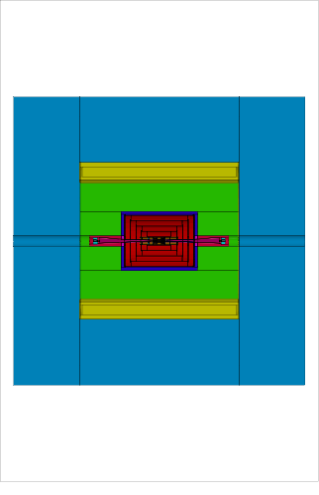
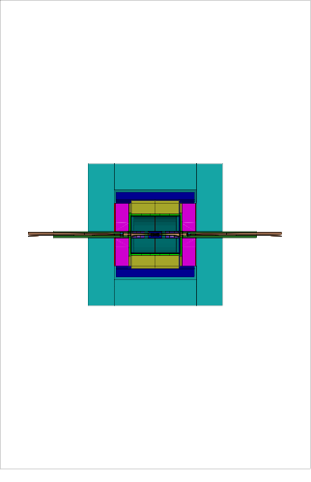
CLIC Detector Concepts
Created CLIC 3 TeV detector models using SiD and ILD geometries and software tools
Andre Sailer
CLIC_SiD
CLIC_ILD
Height:
7.0 m
Height:
6.9 m
Length: 6.9m
Length: 7.1m (not to Scale)

Slide 33
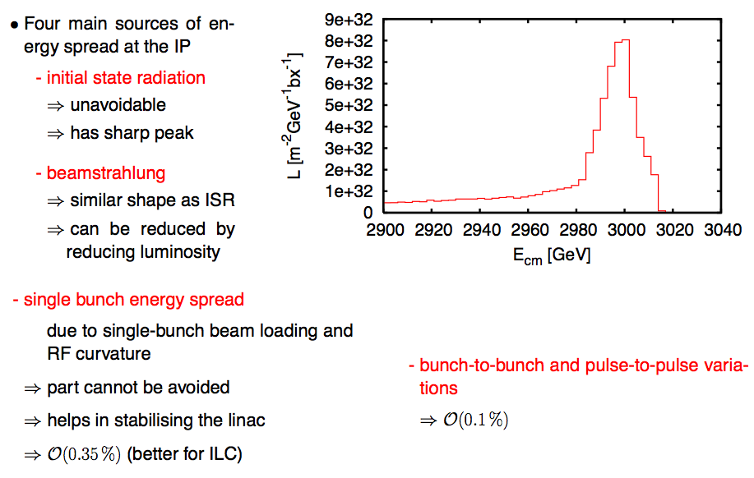
Luminosity Spectrum
Can be reduced for some luminosity loss
33

Slide 34
Background
A number of background sources exist
  From the machine
    Beam tail and halo (collimation)
    Synchrotron radiation (partly by collimation)
    Muons (magnetised iron spoilers, if needed)
  From the beam collision
    Beamstrahlung (exit hole)
    Coherent pair production (exit hole)
    Incoherent pair production (mask, vertex detector radius)
    Hadronic events (time stamping)
  From the spent beams
    Backscattered pairs (shielding, soft material layers)
    Neutrons (shielding, distance)
    …
Will only quickly touch the beam-beam background
  Most fundamental background
34

Slide 35
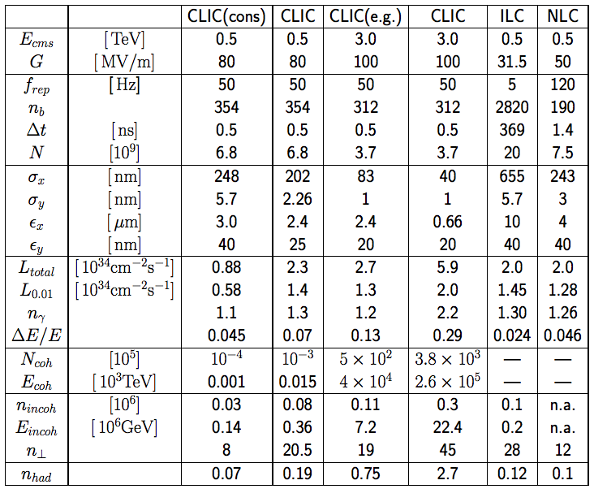
CLIC Main Parameters
D. Schulte
FNAL November 2009
35

Slide 36
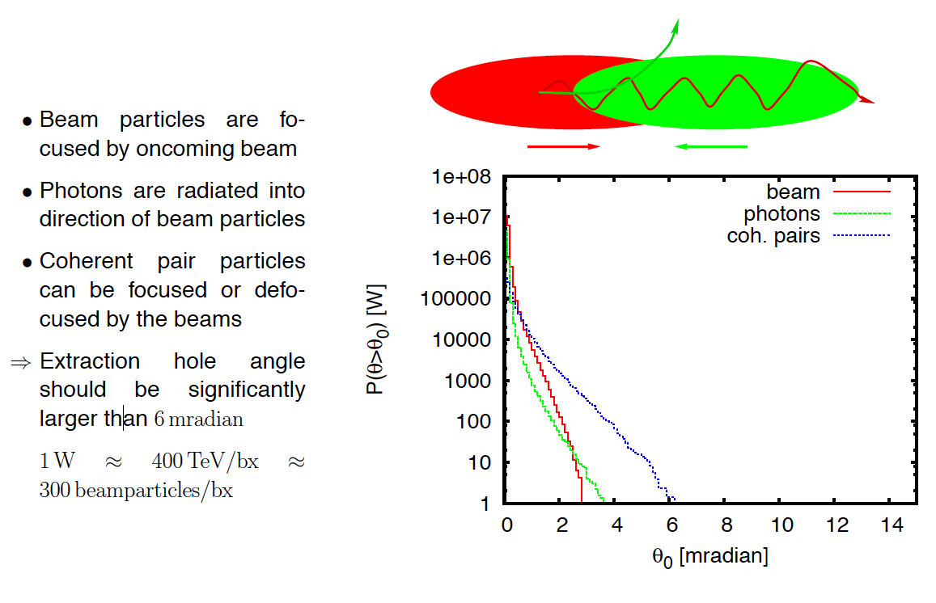
Extraction Hole Size
Based on this 10mradian opening hole has been defined
and 20mradian crossing angle
36

Slide 37
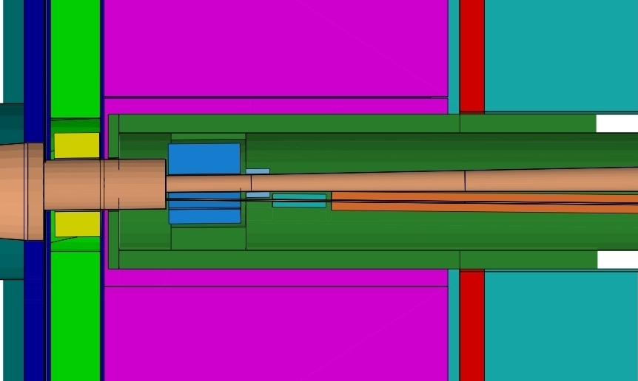
CLIC_ILD Detector Concept
Forward Region Version 3 Nov. 2009
ECal end-cap
HCal end-cap
Yoke end-cap (partial)
LumiCal
BeamCal
QD0 (partial)
Andre Sailer

Slide 38
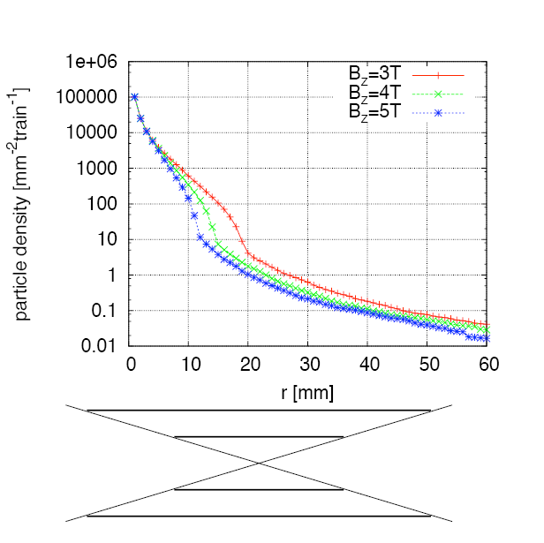
Vertex Detector Radius
Simplified study using simple cylinder without mass
  Coverage is down to 200 mrad
Simulating number of particles that hit at least once
  Experience indicates that number of hits is three per particle
⇒ At r₁ ≈ 30 mm expected 1 hit per train and mm²
z=αr
38

Slide 39
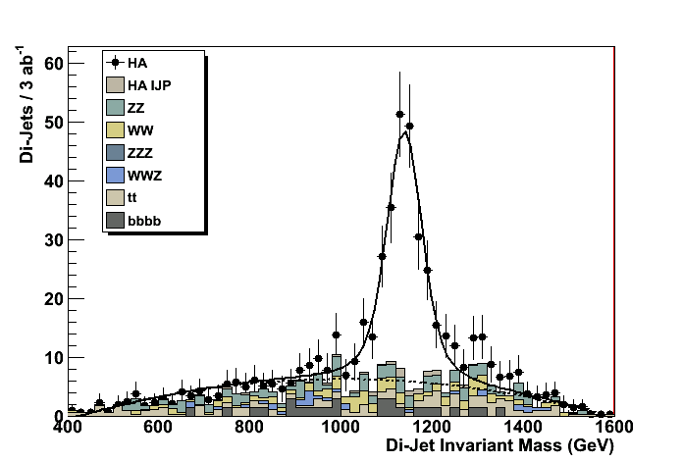
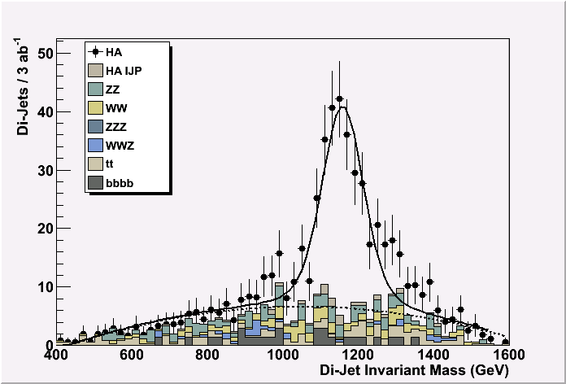
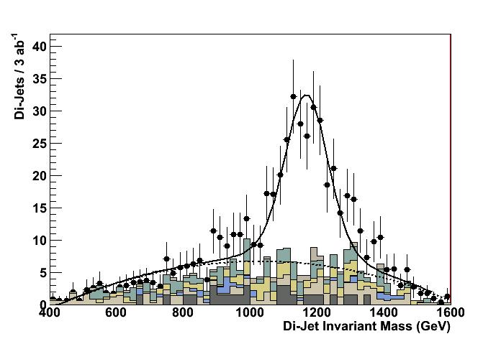
Time stamping requirements
Simulation example of heavy Higgs doublet H⁰A⁰ at ~1.1 TeV mass (supersymmetry K’ point)
e+e- ➔ H⁰A⁰ ➔ bbbb
Signal + full standard model background + γγ=>hadron background
CLIC-ILD detector: Mokka+Marlin simulation, reconstruction + kinematic fit.
Marco Battaglia
Zero bunch crossings
M_{A} mass resol. 3.8 GeV
20 bunch crossings
M_{A} mass resol. 5.6 GeV
40 bunch crossings
M_{A} mass resol. 8.2 GeV

Slide 40
Hardware/Engineering R&D
Hardware/engineering R&D needed beyond present ILC developments:
Time stamping
  Needed for all sub-detectors; challenging in inner tracker/vertex region; trade-off between pixel size, amount of material and timing resolution
Power pulsing and DAQ developments
  In view of the CLIC time structure
Hadron calorimetry
  Dense HCAL absorbers to limit radial size (PFA calo based on tungsten)
Solenoid coil
  Reinforced conductor (building on CMS/ATLAS experience)
  Large high-field solenoid concept
Overall engineering design and integration studies
  For heavier calorimeter, larger overall CLIC detector size etc.
  In view of sub-nm precision required for FF quadrupoles
In addition: Core software development

Slide 41
Operation & Machine Protection System
Beam power is high
  damage potential as well
Machine protection has been integrated into design
  e.g. collimation in beam delivery system
Some studies have been already performed for most critical system, e.g.
  impact of failures on collimation system
  failures in drive beam decelerator
But more work is needed
Full concept is being developed based on LHC experience
  Build system failsafe where possible
  Get a confirmation that all system are working shortly before the beam pulse arrives
  For drive beam at generation pulse is long so can react within pulse

Slide 42
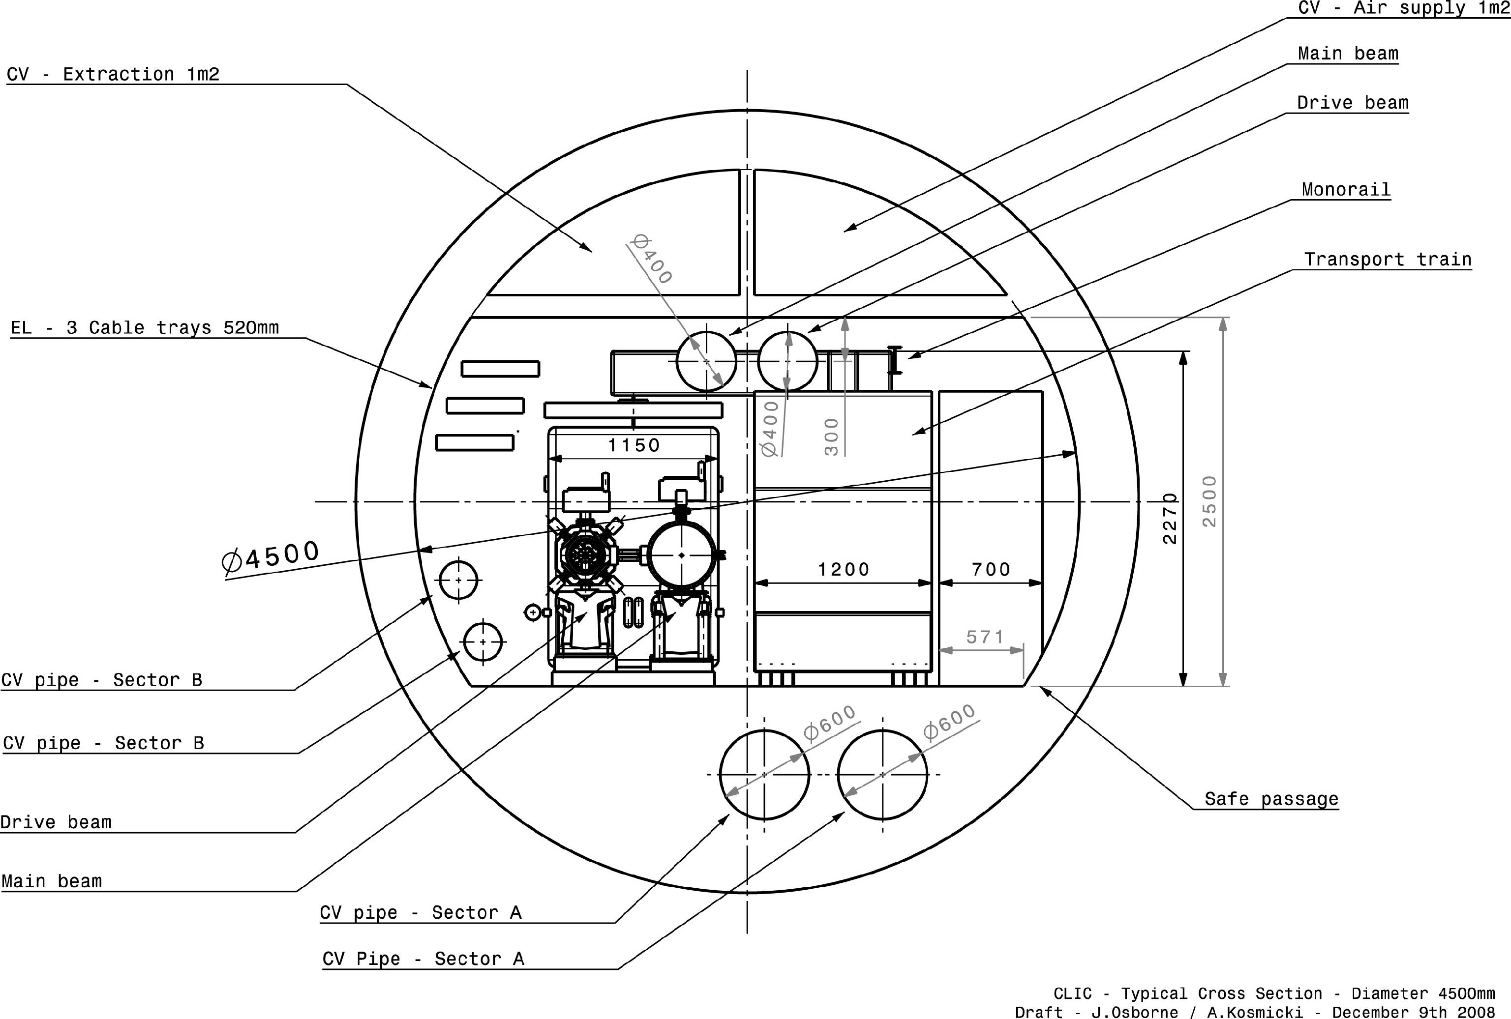
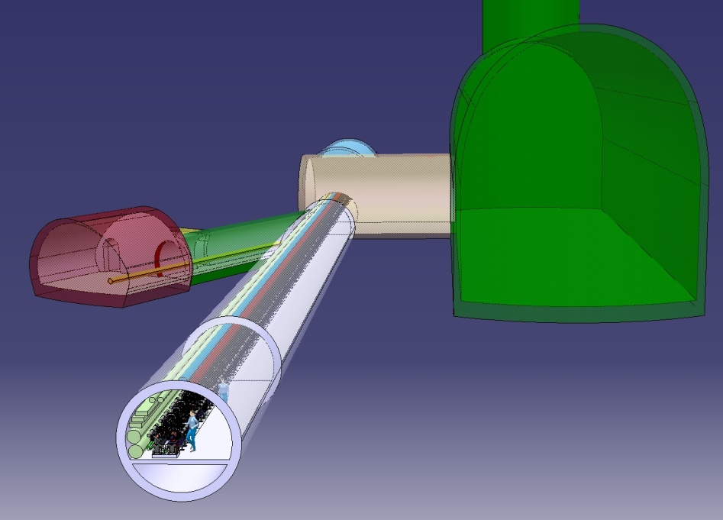

Tunnel Integration
DB turn-around
DB dump
UTRA
cavern
Standard tunnel
with modules
42

Slide 43

Example Site at CERN
IP under CERN Prevessin site
Phase 1: 0.5 TeV extension 13 km
Phase 2: 3 TeV extension 48.5 km
CERN site
Prevessin
Detectors and
Interaction Point
0.5TeV = 13 Km
3 TeV = 48.5 Km

Slide 44
CLIC Machine Installation (Based on LHC Experience)
3 TeV
3 additional years
500 GeV
7 years ready for HW commisioning
Civil engineering
Transport
Interconnections
Tunnel installation

Slide 45
Conclusion
CLIC is moving foward to the CDR
  many promising results
  but more work is essential
  feedback detector study is important
The TDR phase is in preparation
CLIC is supported by a strong collaboration
  collaboration with ILC very useful
Notes:
45

Slide 46
























World-wide CLIC&CTF3 Collaboration
http://clic-meeting.web.cern.ch/clic-meeting/CTF3_Coordination_Mtg/Table_MoU.htm
33 Institutes involving 22 funding agencies from 18 countries
Aarhus University (Denmark)
Ankara University (Turkey)
Argonne National Laboratory (USA)
Athens University (Greece)
BINP (Russia)
CERN
CIEMAT (Spain)
Cockcroft Institute (UK)
Gazi Universities (Turkey)
Helsinki Institute of Physics (Finland)
IAP (Russia)
IAP NASU (Ukraine)
INFN / LNF (Italy)
Instituto de Fisica Corpuscular (Spain)
IRFU / Saclay (France)
Jefferson Lab (USA)
John Adams Institute (UK)
JINR (Russia)
Karlsruhre University (Germany)
KEK (Japan)
LAL / Orsay (France)
LAPP / ESIA (France)
NCP (Pakistan)
North-West. Univ. Illinois (USA)
Patras University (Greece)
Polytech. University of Catalonia (Spain)
PSI (Switzerland)
RAL (UK)
RRCAT / Indore (India)
SLAC (USA)
Thrace University (Greece)
University of Oslo (Norway)
Uppsala University (Sweden)
D. Schulte
FNAL November 2009
46
Notes:
46
46

Slide 47
Thanks
To all the people from whom I stole slides, plots etc.
  Jean-Pierre Delahaye, L.Linssen, K. Elsener, Alexej Grudiev, Frank Tecker, Walter Wuensch …

Slide 48
Reserve
D. Schulte
FNAL November 2009
48

Slide 49

ILC Detector Resolution
M. Thomson
D. Schulte
FNAL November 2009
49

Slide 50
CLIC Main Parameters
http://cdsweb.cern.ch/record/1132079?ln=fr http://clic-meeting.web.cern.ch/clic-meeting/clictable2007.html
Center-of-mass energy | CLIC 500 G |  | CLIC 3 TeV
Beam parameters | Conservative | Nominal | Conservative | Nominal
Accelerating structure | 502 |  | G
Total (Peak 1%) luminosity | 0.9(0.6)·10³⁴ | 2.3(1.4)·10³⁴ | 1.5(0.73)·10³⁴ | 5.9(2.0)·10³⁴
Repetition rate (Hz) | 50
Loaded accel. gradient MV/m | 80 |  | 100
Main linac RF frequency GHz | 12
Bunch charge10⁹ | 6.8 |  | 3.72
Bunch separation (ns) | 0.5
Beam pulse duration (ns) | 177 |  | 156
Beam power/beam (MWatts) | 4.9 |  | 14
Hor./vert. norm. emitt (10⁻⁶/10⁻⁹) | 3/40 | 2.4/25 | 2.4/20 | 0.66/20
Hor/Vert FF focusing (mm) | 10/0.4 | 8 / 0.1 8 / 0.3 |  | 4 / 0.07
Hor./vert. IP beam size (nm) | 248 / 5.7 | 202 / 2.3 | 83 / 2.0 | 40 / 1.0
Hadronic events/crossing at IP | 0.07 | 0.19 | 0.57 | 2.7
Coherent pairs at IP | 10 | 100 | 5 10⁷ | 3.8 10⁸
BDS length (km) | 1.87 |  | 2.75
Total site length km | 13.0 |  | 48.3
Wall plug to beam transfer eff | 7.5% |  | 6.8%
Total power consumption MW | 129.4 |  | 415
D. Schulte
FNAL November 2009
50

Slide 51

CLIC Test Facility (CTF 3)
Demonstrate Drive Beam generation
(fully loaded acceleration, bunch frequency multiplication 8x)
Test CLIC accelerating structures
Test power production structures (PETS)
30 GHz “PETS Line”
Bunch length
chicane
Delay Loop – 42m
Combiner Ring – 84m
RF deflector
TL1
Injector
Linac
4A – 1.2µs
150 MeV
Laser
30 GHz test area
28A – 140ns
150 MeV
CLEX
TL2

Slide 52

Parameter Optimisation
A. Grudiev et al.

Slide 53

Luminosity Limitations

Slide 54

Beam-Beam Effect

Slide 55

Horizontal Beam Size Optimisation

Slide 56
Beam Size Limitations
At the IP the horizontal beam size is much larger than the vertical
  also the horizontal emittance is much larger than the vertical
The minimum horizontal beam size is mainly given by
  damping ring
  ring to main linac transport
  beam delivery system
The minimum vertical beam size is mainly given by
  damping ring
  ring to main linac transport
  main linac
  beam delivery system
  need to collide
With advanced damping ring and beam delivery system designs we find a 40nm horizontal beam size limitation
D. Schulte
FNAL November 2009
56

Slide 57
Tentative Long-Term CLIC Scenario
Shortest, Success Oriented, Technically Limited Schedule
Technology evaluation and Physics assessment based on LHC results
for a possible decision on Linear Collider with staged construction starting with the lowest energy required by Physics
Conceptual
Design Report
(CDR)
Council
approval
Technical
Design?
Technical
Design Report
(TDR) ?
Project
approval ?
First
Beam?
EC supported
programmes
FP6 IA:CARE
FP7 IA:EUCARD
FP7 CNI:TIARA
FP7 CNI:CLIC?

Slide 58
Power flow @ 3 TeV
Wall Plug
415 MW
Modulator auxiliaries
260.4 MW AC power
252.6 MW
η_{REL} = .93
η_{M} = .90
aux = 0.97
Main beam injection, magnets, services, infrastructure
and detector
Power supplies
klystrons
η_{K} = .70
148.0 MW 1 GHz RF power
154.6 MW
Drive beam
acceleration
η_{S} = .95
η_{A} = .977
η_{plug/RF} = 38.8 %
137.4 MW Drive Beam Power
13.7 MW
F(σ) = .97 × .96
η_{D} = .84
Drive beam
power extr.
η_{RF/main} = 27.7 %
Dumps
107.4 MW
η_{TRS} = .98
PETS
η_{T} = .96
η_{tot} = 6.8 %
101.1 MW 12 GHz RF power
(2 x 101 kJ x 50 Hz)
Main
linac
η_{RF} = .277
28 MW
Main beam

Slide 59
Power flow @ 500 GeV
Wall Plug
129.4 MW
Modulator auxiliaries
63.4 MW
61.5 MW
η_{REL} = .93
η_{M} = .90
Power supplies
klystrons
aux = 0.97
Main beam injection, magnets, services, infrastructure
and detector
η_{K} = .70
1 GHz RF power: 36.1 MW
66 MW
Drive beam
acceleration
η_{S} = .95
η_{A} = .977
η_{plug/RF} = 38.8 %
Drive Beam power: 33.5 MW
13.7 MW
F(σ) = .97 × .96
η_{D} = .84
Drive beam
power extr.
η_{RF/main} = 39.6 %
Dumps
26.2 MW
η_{TRS} = .98
PETS
η_{T} = .96
η_{tot} = 7.5 %
12 GHz RF power: 24.6 MW
(2 x 25 kJ x 50 Hz)
Main
linac
η_{RF} = .396
9.75 MW
Main beam

Slide 60
LC 500 GeV Main parameters
Center-of-mass energy | NLC 500 GeV | ILC 500 GeV | CLIC 500 G Relaxed |  | CLIC 500 G Nominal
Total (Peak 1%) luminosity | 2.0(1.3)·10³⁴ | 2.0(1.5)·10³⁴ | 0.9(0.6)·10³⁴ |  | 2.3(1.4)·10³⁴
Repetition rate (Hz) | 120 | 5 | 50
Loaded accel. gradient MV/m | 50 | 33.5 | 80
Main linac RF frequency GHz | 11.4 | 1.3 (SC) | 12
Bunch charge10⁹ | 7.5 | 20 | 6.8
Bunch separation ns | 1.4 | 176 | 0.5
Beam pulse duration (ns) | 400 | 1000 | 177
Beam power/linac (MWatts) | 6.9 | 10.2 | 4.9
Hor./vert. norm. emitt (10⁻⁶/10⁻⁹) | 3.6/40 | 10/40 | 7.5 / 40 | 4.8 / 25
Hor/Vert FF focusing (mm) | 8/0.11 | 20/0.4 | 4/0.4 | 4/0.1
Bunch length (microns) | 100 | 300 | 100 | 72
Hor./vert. IP beam size (nm) | 243/3 | 640/5.7 | 248 / 5.7 | 202/ 2.3
Soft Hadronic event at IP | 0.10 | 0.12 | 0.07 | 0.19
Coherent pairs/crossing at IP | 10? | 10? | 10 | 100
BDS length (km) | 3.5 (1 TeV) | 2.23 (1 TeV) | 1.87
Total site length (km) | 18 | 31 | 13.0
Wall plug to beam transfer eff. | 7.1% | 9.4% | 7.5%
Total power consumption MW | 195 | 216 | 129.4

