Slide 1
ILC and CLIC Detector R&Ds
Hitoshi Yamamoto
Tohoku University
12-Nov-09, Muon Collider Workshop, Fermilab
(Much of the contents: from ALCPG09 and CLIC09)

Slide 2
ILC

Slide 3
ILC Features
Well defined initial state
  e+e- system : 4-momentum known
  Its polarization(s) also ‘known’
Energy scan
  e.g.
Relatively low noise rate (clean!)
Small beam size, small beampipe (even with pair bkg)
  → Hermeticity, vertex resolution
Long inter-train gap (200ms) for readout
Detector can/should take advantage of the above
  → good resolutions

Slide 4
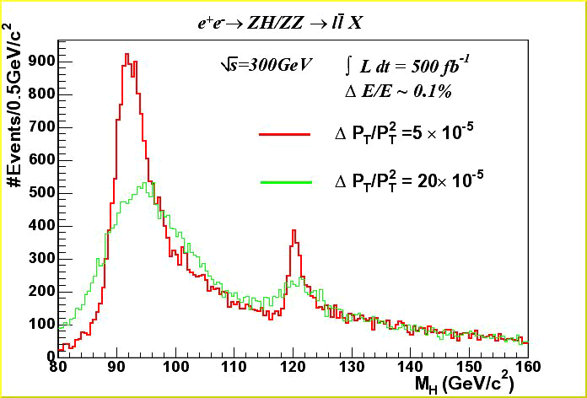
Higgs recoil mass resolution
Goal
Current
120 GeV Higgs signal
Good momentum resolution of tracking is required (not a luxury!)

Slide 5
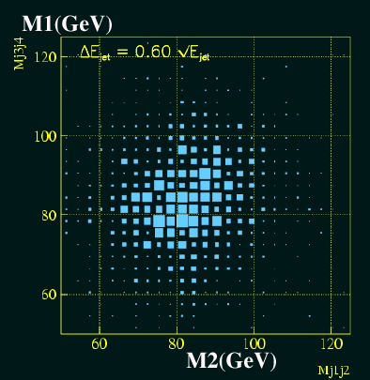
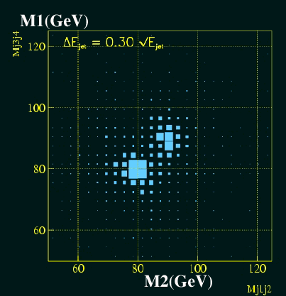
Jet(quark) reconstruction
Current
(Important mode if no Higgs is found)
Goal
is required for Z/W→jj to be separated (not a luxury!)
A promising technique : PFA (particle flow algorithm)
  Use trackers for charged energy, calorimeters for the rest
  Remove double countings by pattern rec. (granularity!)

Slide 6
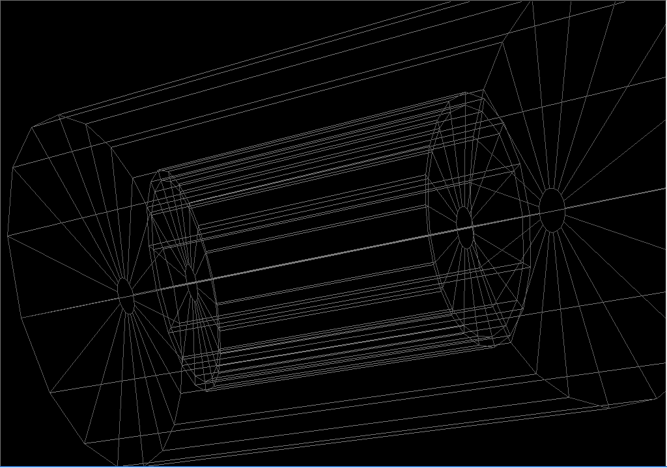
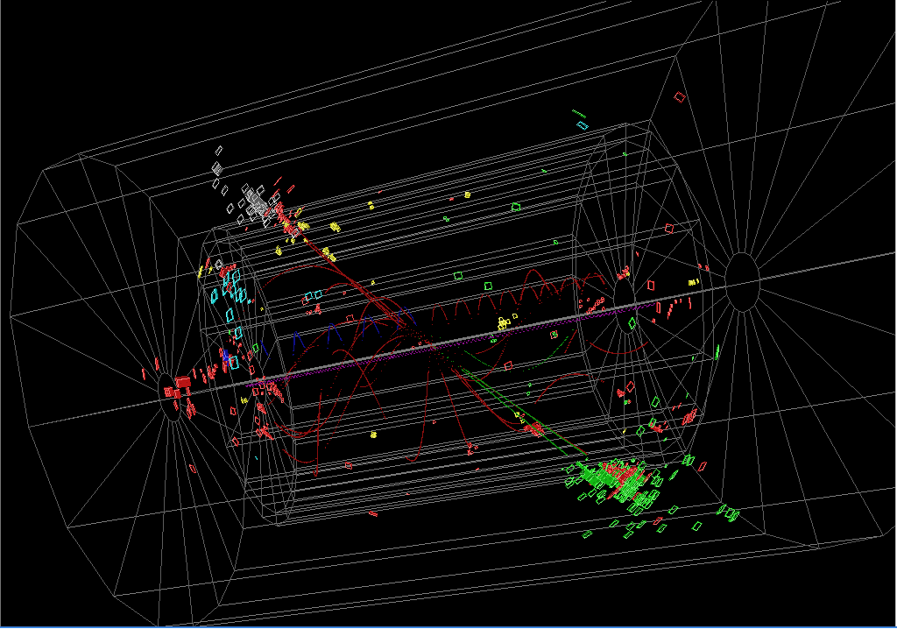
Event Display
PFA
T. Yoshioka
e+
e-
Yellow : Photon
Red, Green : Charged Hadron
Black, Blue : Neutral Hadron
Z → qqbar @ 91.2GeV
Next: 電子、陽電子衝突

Slide 7
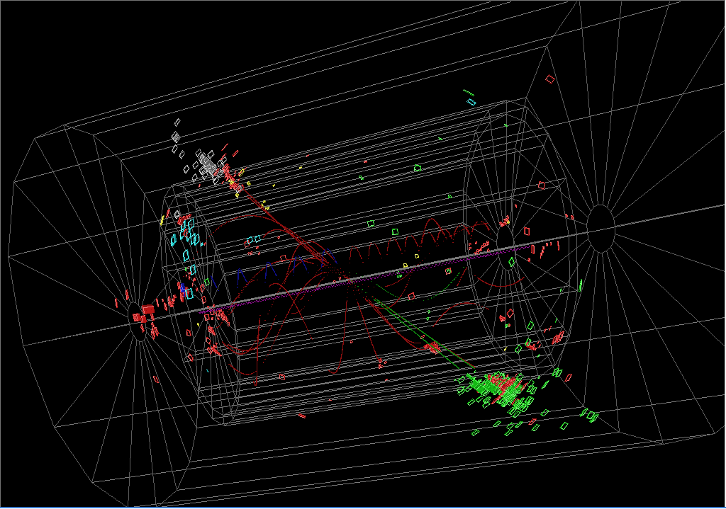
Event Display
PFA
T. Yoshioka
Yellow : Photon
Red, Green : Charged Hadron
Black, Blue : Neutral Hadron
Gamma Finding

Slide 8
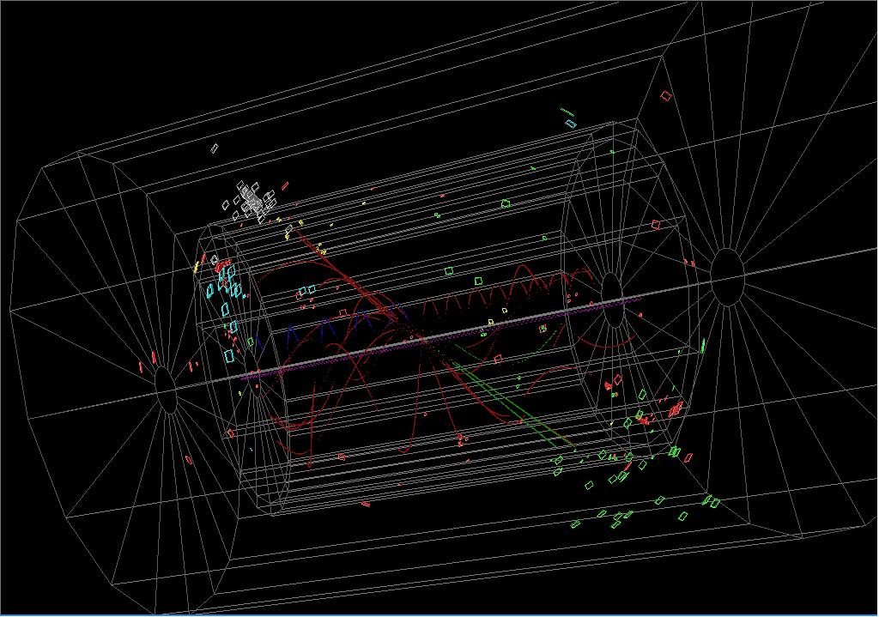
Event Display
PFA
T. Yoshioka
Yellow : Photon
Red, Green : Charged Hadron
Black, Blue : Neutral Hadron
Charged Hadron Finding

Slide 9
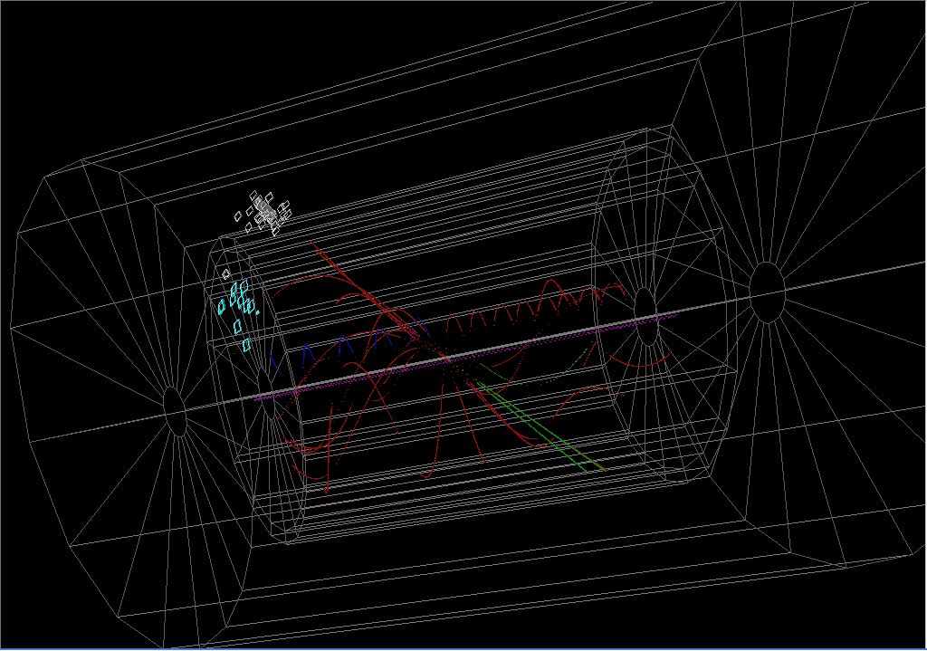
Event Display
PFA
T. Yoshioka
Yellow : Photon
Red, Green : Charged Hadron
Black, Blue : Neutral Hadron
Satellite Hits Finding

Slide 10
Event Display
PFA
T. Yoshioka
Yellow : Photon
Red, Green : Charged Hadron
Black, Blue : Neutral Hadron
Remaining : Neutral Hadron

Slide 11
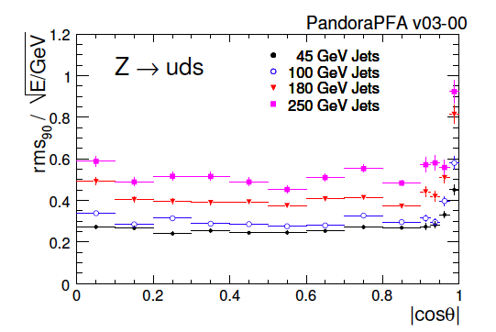
PFA Performance - state of the art -
Realistic full simulation (ILD)
Achieved at Ejet up to ~100 GeV

Slide 12
ILC Detectors
 | ILD | SiD | 4th
Tracker | TPC+Si-strip | Si-strip | TPC/Si-strip/DC
Calorimeter | PFA | PFA | Compensating
B | 3.5 T | 5T | 3.5T
ECAL Rin | 1.83m | 1.25m | 1.5m
Rout | 6.99m | 6.20m | 5.80m
Zout | 6.62m | 5.60m | 6.08m
(dimensions are approximate)
3 groups submitted LOI:
http://www.linearcollider.org/cms/?pid=1000472
All: ECAL/HCAL inside solenoid
Uses pixel detectors for vertexing

Slide 13
IDAG Validation
IDAG (International Detector Advisory Group)
  Advises the research director of ILC
  Evaluated the LOIs that are submitted March 31, 2009, and reported its recommendation to the research director
ILCSC approved the recommendation, Aug 19, 2009.
The validation result officially announced at ALCPG09 (Albuquerque, Sep 29. 2009)
  ILD and SiD are ‘validated’ (i.e. endorsed to work toward the 2012 detailed baseline report.)
  Dual-readout calorimetry R&Ds are encouraged to continue
  Ref: http://www.linearcollider.org/cms/?pid=1000471

Slide 14
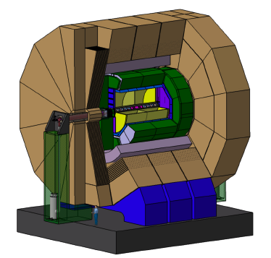
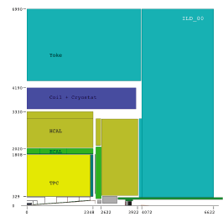
ILD
Vertex
  6 (3 pairs) or 5 layers (no disks)
  Technology open
Si-strip trackers
  2 barrel + 7 forward disks (3 of the disks are pixel)
  Outer and end of TPC
TPC
  GEM or MicroMEGAS
  Pad (or si-pixel) readout
ECAL
  Si-W or Scint-strip-W
HCAL
  Scint-tile or Digital HCAL

Slide 15
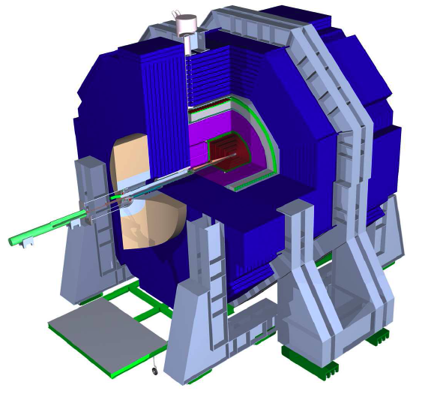
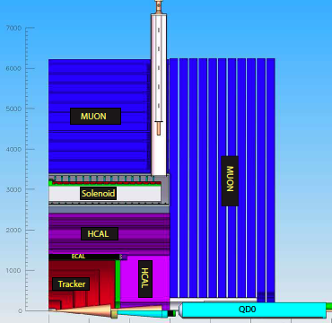
SiD
Vertex
  5 barrel lyrs + 4 disks
  Technology open
Si-strip-trackers
  5 barrel lyrs + 4 forward disks/side
EMCAL
  Si-W 30 lyrs, pixel (4mm)²
HCAL
  Digital HCAL with RPC readout with (1cm)² cell
  40 lyrs

Slide 16
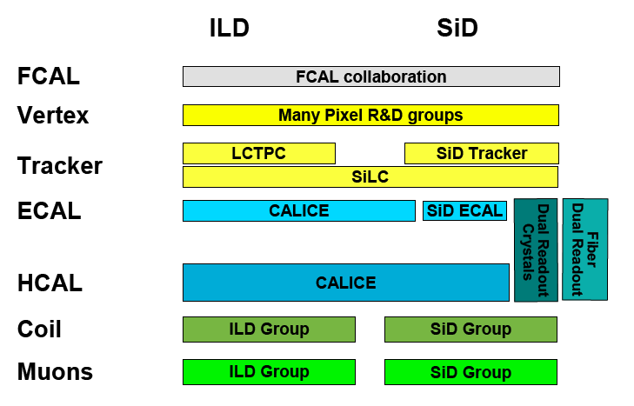
ILC Detector R&D Groups
Marcel Stanitzki
Driven by ‘horizontal’ collaborations

Slide 17
WWS Reviews on ILC Detector R&Ds
Goal
  Improved communications → enhanced R&Ds
Reviewers
  WWS R&D panel members, external experts, funding agency reps. Chair: C. Damerell
Had 3 reviews:
  Feb 07, Beijing : Tracking
  Jun 07 DESY : Calorimetry
  Oct 07 Fermilab : Vertexing
Reports
  http://physics.uoregon.edu/~lc/wwstudy/detrdrev.html
  Valuable information on ILC-related detector R&Ds
The WWS R&D panel is superseded by the R&D common task group
chaired by M. Demarteau (under the ILC research director)

Slide 18
Vertexing
If one integrates hits over 1 train for (25 μm)² pixel,
  Occupancy too high (by the pair background)
  Strategies: time slice a train (~20), small pixel, bunch id (ideal)
Many technological options pursued:
  Time slicing: CPCCD, ISIS, MAPS, deep N-well, CAP, DEPFET
  Small pixel: FPCCD
  Bunch id: Chronopixels, SOI, 3D
Vertexing Review Report
  ‘Unable to eliminate any of them (at present)’
  ‘2-4 technologies to start up, others for upgrades’
  ‘Some have applications in other fields’
Promising technologies: vertical integration (3D, SOI)

Slide 19
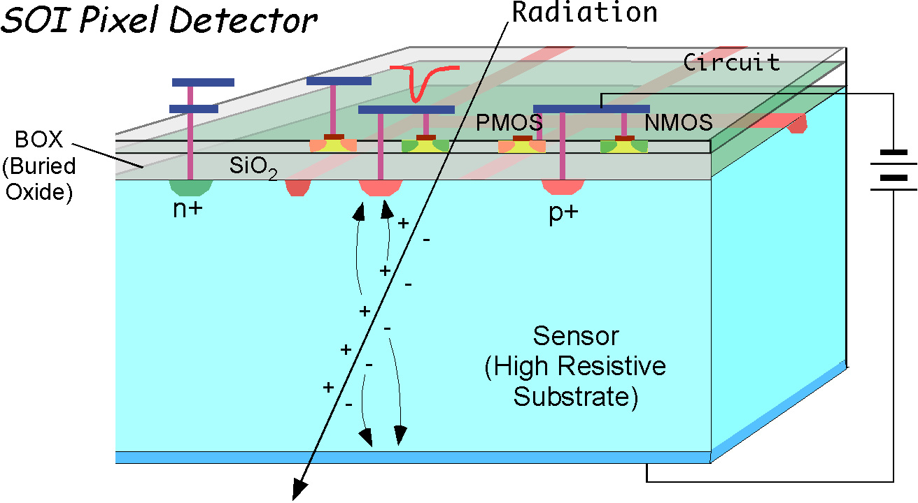
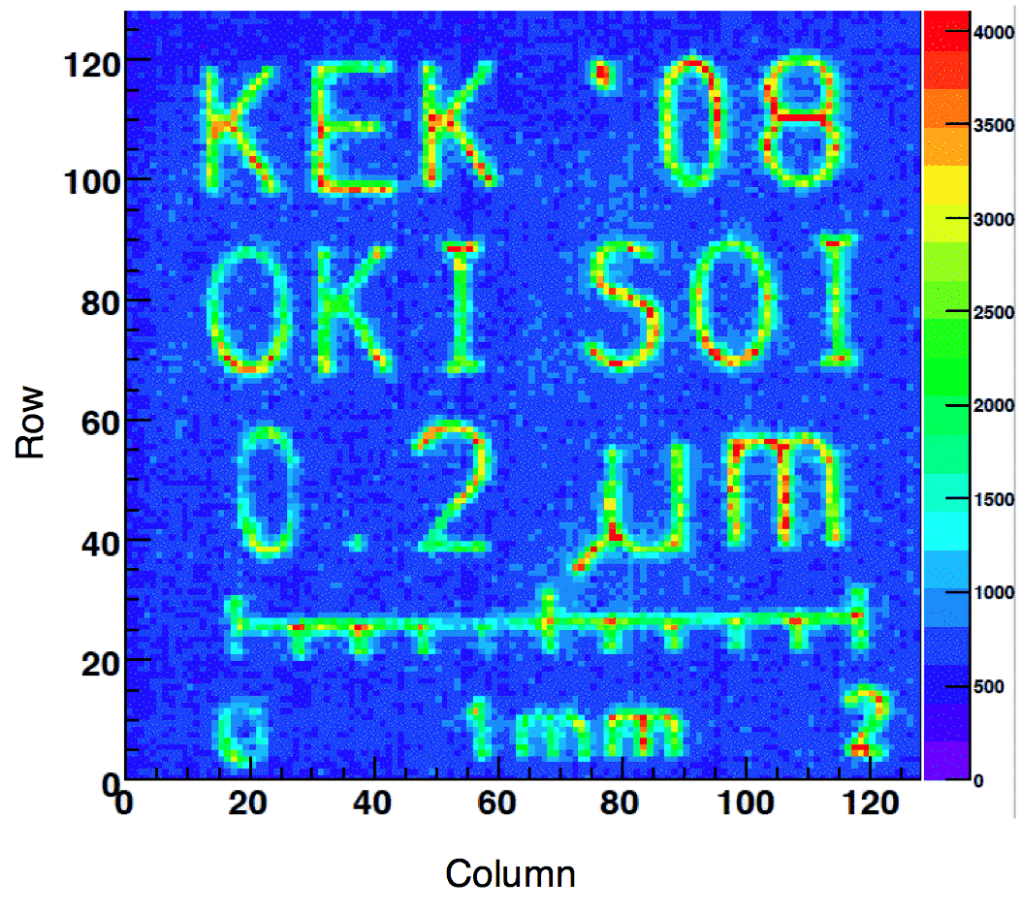
SOI (Silicon on Insulator)
Semi vertical integration
Active area very close to the readout circuit (~200nm)
  Sensor interferes with the readout circuit (e.g. back gate effect)
Buried p-well technology:
  Fixed the back-gate effect
  A major advance for SOI

Slide 20
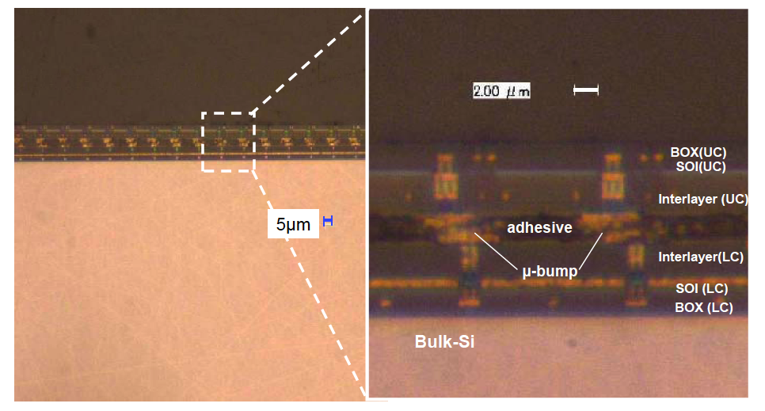
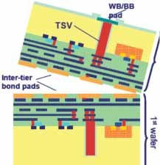
3D Integration
Via and bonding technologies
- industry-driven
Liberation from the process constraints
Higher integration density
Radiation tolerance
Lower power consumption
● Zycube (bonding)
Test chip designed by
LBNL/KEK made by OKI
Being tested now
● Terrazon run.
FNAL-based.
Broad range of MAPS and readout
Electronics, being fabricated now
● More to come
Zycube

Slide 21
Main Tracker
3 basic technologies
  Si strip (SiLC collaboration, SiD tracker)
  TPC (LC-TPC collaboration)
  CluCou (cluster-counting DC for 4th)
WWS review panel report
  ‘Extremely impressed’
  ‘Currently far from goals for all options’
  ‘Forward tracking’ : ‘achieved in practice?’
  ‘A large prototype (R=1m) in B=3~5 T recommended’
  Not yet: LC-TPC has tested a ‘large-prototype’ with r=38cm in 1T

Slide 22
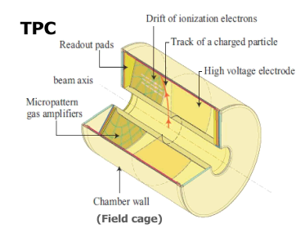
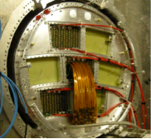
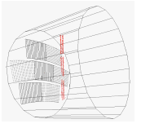
LC-TPC collaboration
Goal: develop ILD TPC
    ~200 points per track
    R = 1.8m, L=4.3m
    MPGD
      GEM or MicroMEGAS
    Read out
      1x5 mm² pads
      CMOS pixel option under R&D
‘Large’ prototype made
  D = 0.7m, L=0.6m
  Beam test under 1T (DESY)
  Both GEM and MicroMEGAS
  So far so good. Data is being analyzed.
Prototype endplate
Beam with GEM

Slide 23
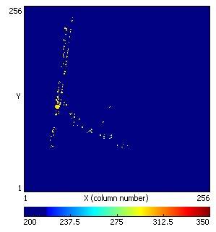
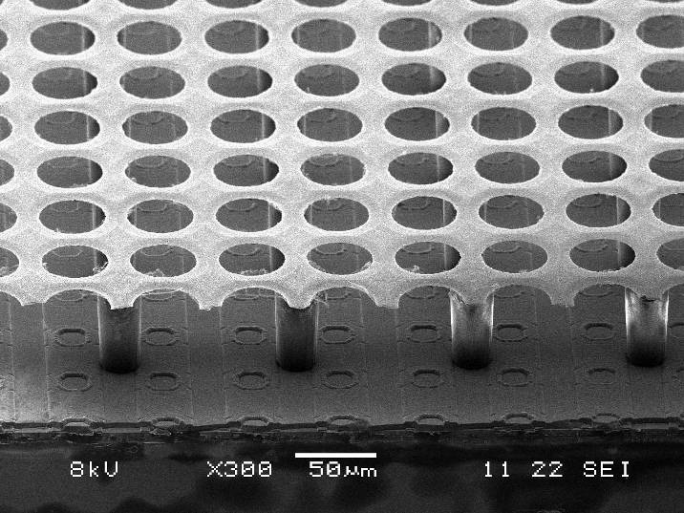
Pixel Readout of TPC
Use pixel sensors instead of pads
Cell size : 1x5 mm² → 55x55 μm²
Good spacial resolution
Good 2-track separation (<1mm)
Possibly cluster counting (dE/dx)
275 μm

Slide 24
Calorimetry
PFA-based
  CALICE collaboration (41 groups)
    Si-W and Scint-W ECAL, Analog and DigitalHCAL
  SiD-CAL (17 groups, some in CALICE)
    Si-W ECAL, DHCAL, AnalogHCAL
Compensating (dual-readout)
  DREAM collaboration (8 groups)
  Fermilab group
WWS review panel report
  ‘PFA and compensating both may be needed – esp. in forward region’
  Compensating:
    ‘Needs more people’, ‘The approach could be the outright winner particularly in the … forward region’
  PFA:
    ‘Extremely promising, but simulation alone cannot be trusted.’
    ‘Use a large-scale physics prototypes’
    – cal part nearly done (CALICE) (tracking not included)

Slide 25
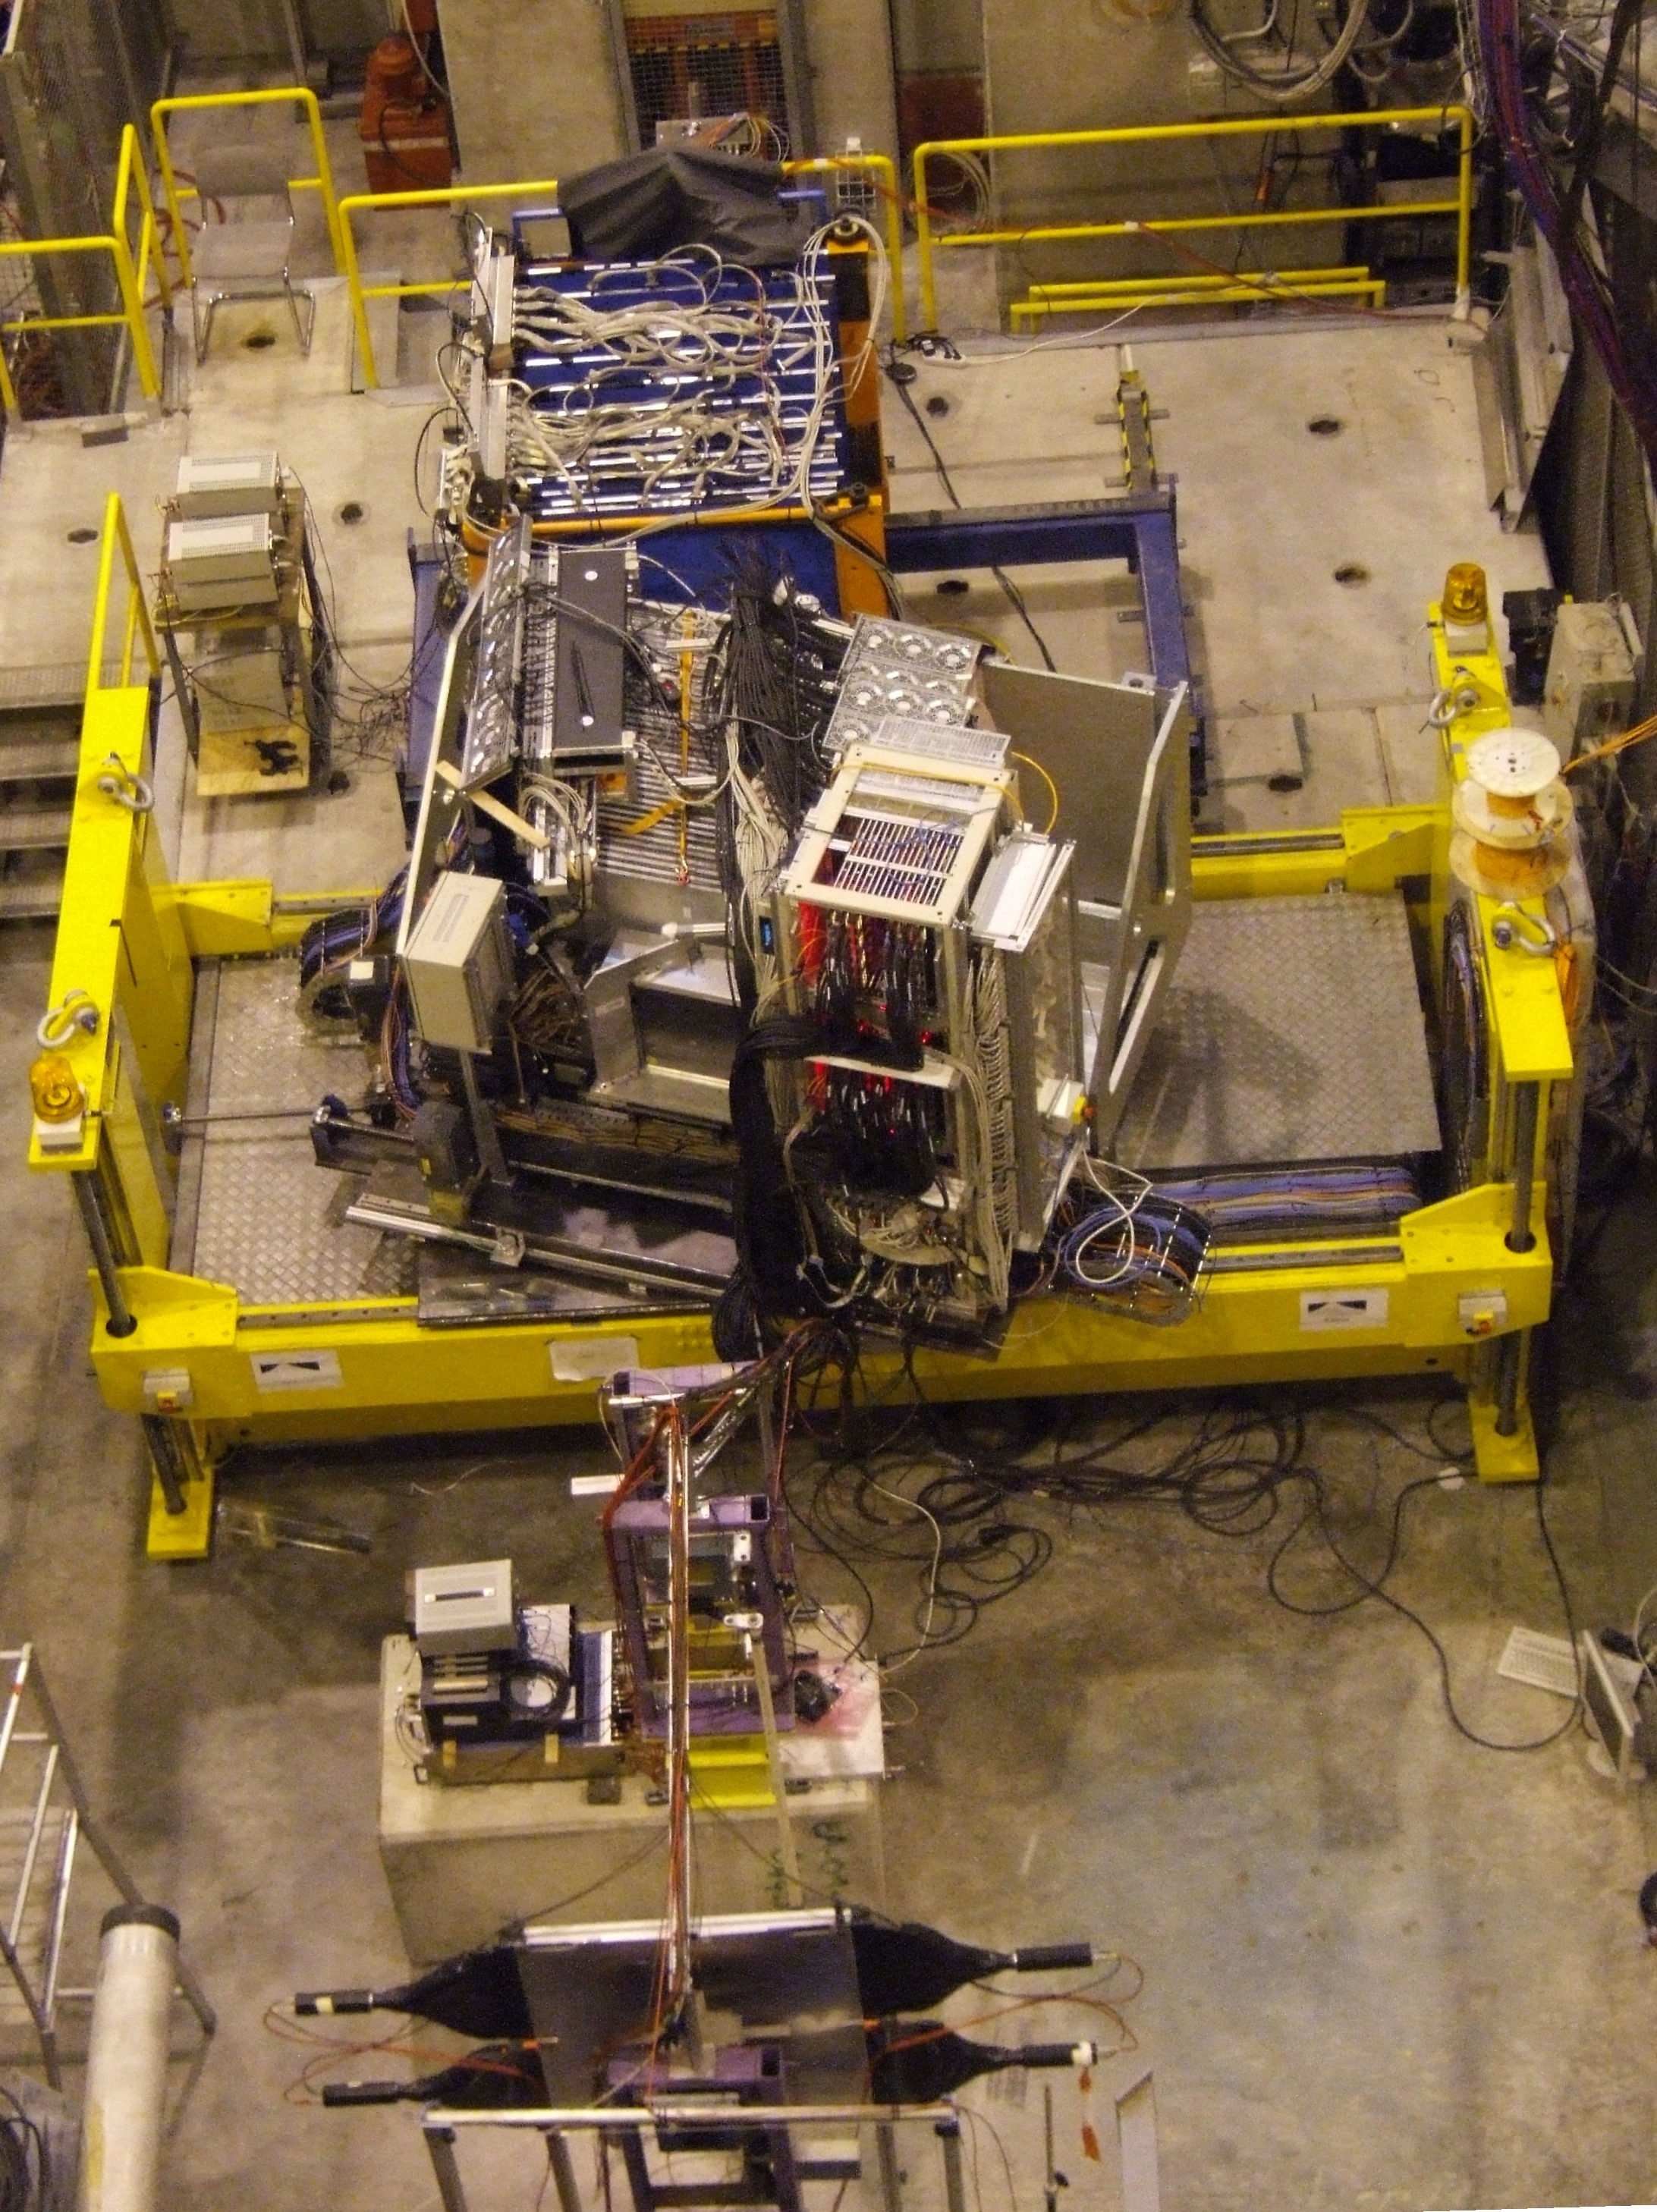
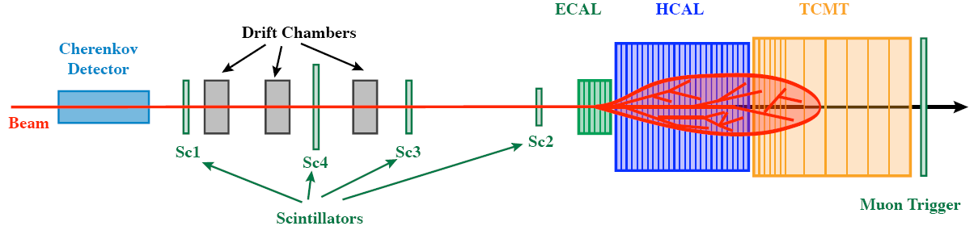
CALICE Beam Tests
Main beam tests, using π, μ, e beams:
2006-7
  SiW ECAL + AHCAL + TCMT @ CERN
2007
  Small DHCAL test @ Fermilab
2008
  SiW ECAL + AHCAL + TCMT @ Fermilab
2009
  Scint-W ECAL + AHCAL + TCMT @ Fermilab
  Standalone RPC and Micromegas tests @ CERN
2010 planned
  SiW ECAL + DHCAL + TCMT @ Fermilab
There is no perfect Hadron shower MC, but
results are more or less consistent with MC.

Slide 26
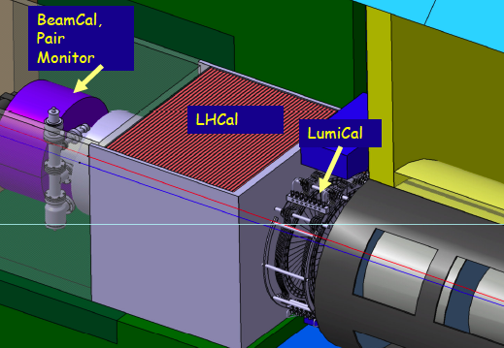
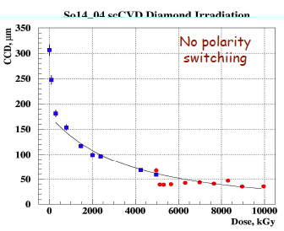
Forward Instrumentation
ILD
FCAL collaboration
BeamCAL
  GaAs
  Diamond (sCVD)
  Sapphire
LumiCAL
  Short Si-strip
Pair monitor
  Si pixel
Applications
  FLASH, CMS - tested
Diamond, up to 10MGy

Slide 27
CLIC

Slide 28
From ILC to CLIC Detectors
Andre Sailer
Created CLIC 3 TeV detector models using SiD and ILD geometries and software tools
Changes:
  20 mrad crossing angle (instead of 14 mrad)
  Vertex Detector to ~30 mm inner radius, due to Beam-Beam Background
  Hadron Calorimeter, more dense and deeper (7.5 λ_{i}) due to higher energetic Jets
  For CLIC_SiD: Moved Coil to 2.9m (CMS Like)
CLIC_SiD
CLIC_ILD
Height:
6.9 m
Height:
7.0 m
Length: 6.9m
28
Length: 7.1m (not to Scale)

Slide 29
Pair Backgrounds
  CLIC 3 TeV :
  Coherent pairs (3.8×10⁸ per bunch crossing)
  High energy (~ TeV) → disappear in beam pipe : ignore for now
  Incoherent pairs (3.0×10⁵ per bunch crossing)
  Lower energy → inner vertex layers
Incoherent pairs:
ILC 0.5 TeV: n_{incoh} 0.1x10⁶ bx
CLIC 3 TeV: n_{incoh} 0.3x10⁶ bx
B. Dalena, D. Schulte
Large energy diffrence between
0.5 TeV and 3 TeV.
Pt of pairs: x3 for CLIC 3 TeV wrt ILC

Slide 30
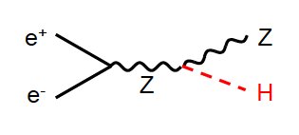
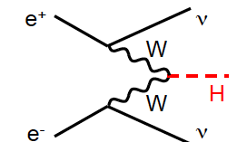
S vs T channel
S-channel
T-channel
e.g.
e.g.
Cross section ∝ 1/S
decreases with S
Particles → barrel region
Cross section ∝ log S
increases with S
Particles → forward region
At high energy (3 TeV), T-channel processes tend to
dominate.
Lots of backgrounds in forward region
- esp. 2γ → hadrons.

Slide 31
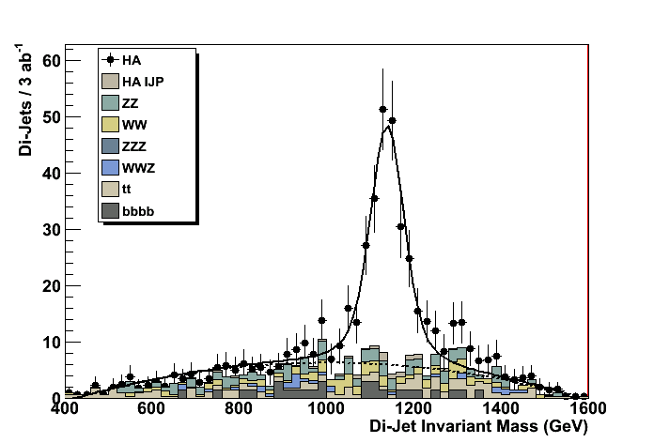
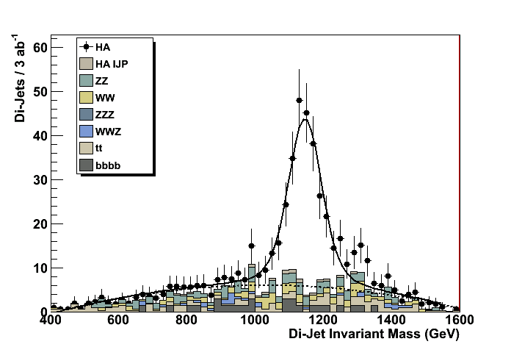
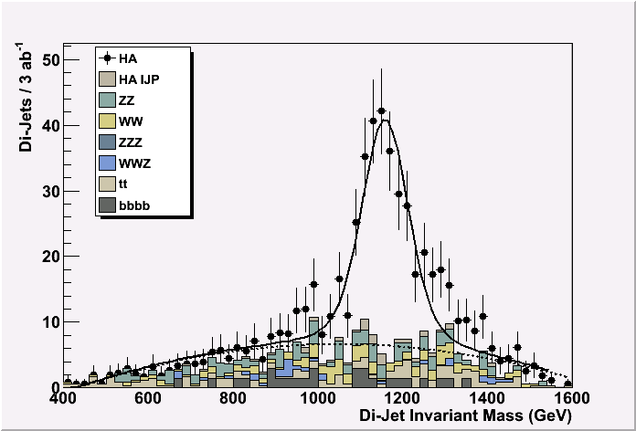
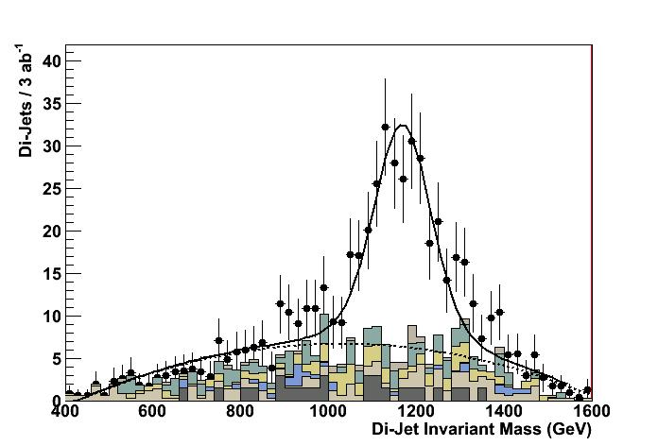
Time Stamping
Energy in e⁺e⁻ event from γγ g hadrons background
Degradation of physics signal as function of background integrated in the detector
(MOKKA G4 Simulation + Marlin Reconstruction)
0.5 ns
5 ns
10 ns
20 ns
Preliminary results of full G4+reco analyses indicate
physics performance impacted for Δt > 10-15 ns
M. Battaglia

Slide 32
Time Stamping in Vertexing
At preset: no proven/usable technology to achieve 10ns time stamping with
small enough pixel (<25 μm sq.)
H.G. Moser: (CLIC09)
Hybrid Pixels (LHC-like): too much material, large pixels
CMOS Sensors: too slow
DEPFET: too slow (frame readout)
Advanced CMOS: very interesting. Key: PMOS & high resistivity epi
3D integration: solves many problems:
evolution/combination of hybrid pixels, MAPS or DEPFETs
Most promising way to go!

Slide 33
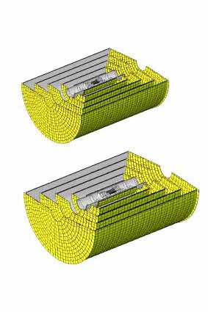
Tracker : Silicon vs TPC
Silicon Tracker
Possibly good for time stamping.
Maybe also better suited for forward
region Tracking. (no thick end-plate)
Can pattern recognition work in the
high background environment?
TPC
50 μs full drift,
Salt-and pepper backgrounds are mostly
removed by rejecting micro-curlers. No
significant efficiency loss at ILC.
Can it still work at CLIC? (short bunch sp., more
bkg)

Slide 34
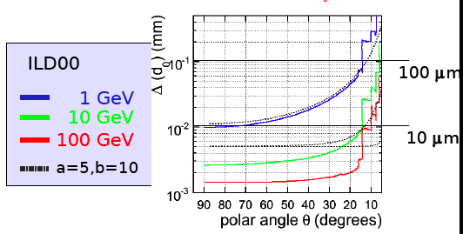
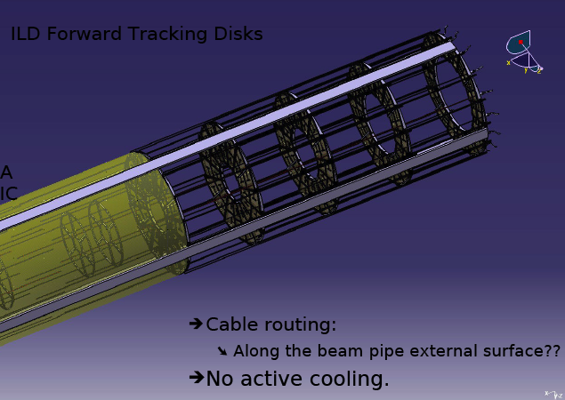
Forward Tracking
Impact parameter
Marcel Vos
Conslusion:
If the central tracking and vertexing is semewhat of a challenge (for CLIC), maintaining good performance at small polar angle is close to impossibility.
Backgrounds
Momentum resolution (B field)
Vertexing (Barrel servicing)
Pattern recognition
Clearly, needs intensive work.

Slide 35
Jet reconstruction - PFA (Pandra)
B = 4 T (3.5 T for ILD)
HCAL : 8 λ (6 λ for ILD)
Meets the jet energy resolution goal
(3~4%) up to 500 GeV jet.
M. Thomson
E_{JET} | σ_{E}/E = α/√E_{jj} |cosθ|<0.7 | σ_{E}/E_{j}
45 GeV | 25.2 % | 3.7 %
100 GeV | 28.7 % | 2.9 %
180 GeV | 37.5 % | 2.8 %
250 GeV | 44.7 % | 2.8 %
375 GeV | 71.7 % | 3.2 %
500 GeV | 78.0 % | 3.5 %
SiD PFA and Compensating
Calorimetry give similar
jet resolution

Slide 36
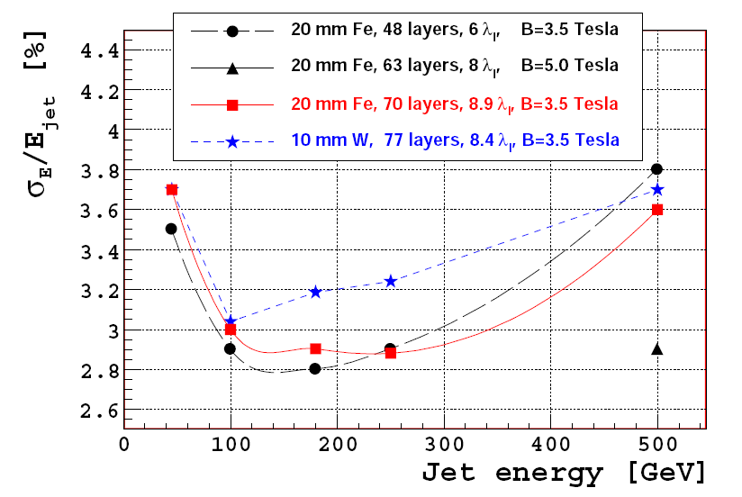
W-HCAL
Simulation :
(P. Speckmayer)
PFA resolution is comparable to Fe
- No tuning done for W
Prototype idea:
(W. Klempt)
Start 2010 with a “small” prototype:
  *Start with ~20 W plates size 80x80 cm², 1 cm thick
  *Use as much as possible existing equipment from CALICE (detector planes, readout electronics, DAQ, mechanical infrastructure…..)
  *First test beam at PS/SPS in autumn 2010
  *Later increase depth to 40 or more layers
Angela Lucaci-Timoce

Slide 37
Summary
Much of the HEP detector R&Ds have been driven by ILC
  Horizontal detector R&D collborations have been effective in carrying out the efforts. (CALICE, LC-TPC, SiLC, FCAL, etc…)
The large amount of works done for ILC detectors are concisely summarized in the 3 LOIs:
  http://www.linearcollider.org/cms/?pid=1000472
Critical assessments of the ILC detector R&Ds are reported in the WWS detector R&D reviews:
  http://physics.uoregon.edu/~lc/wwstudy/detrdrev.html
CLIC detector R&Ds have greatly benefitted from the ILC detector studies.
There are important ‘CLIC-specific’ issues, but solutions to them will benefit ILC.
  Time stamping, forward region, etc.

Slide 38
