Slide 1
Software Frameworks
Muon Collider Physics Workshop
10-12 November 2009, Fermilab
P. Mato /CERN

Slide 2
Outline
About myself
Introduction
  Software components
  Programming languages
  Software frameworks
Software interoperability levels
  Level-1 to Level-3
Leveraging from the LHC common software
Conclusions

Slide 3
About myself
Former LHCb core software coordination
  Architect of the GAUDI framework
Applications Area manager of the Worldwide LHC Computing Grid (WLCG)
  Develops and maintains that part of the physics applications software and associated infrastructure that is common among the LHC experiments
Leader of the Software Development for Experiments (SFT) group in the Physics (PH) Department at CERN
  Projects: Geant4, ROOT, GENSER, SPI, CernVM, etc.
  Giving support to LHC experiments (+LC Detector studies)

Slide 4
Basic Requirements
The emphasis on the requirements for the software system of a [almost] running experiment is different than for a conceptual detector design studies
  Flexibility vs. performance, ideal detector descriptions vs. realistic ones, etc.
  Naturally the attention changes with the evolution of the project and the software system should evolve with it
Emphasis on interoperability, reuse and enabling independent developments is common
  Level 1 - Application Interfaces/Formats
  Level 2 - Software Integrating Elements
  Level 3 – Common frameworks

Slide 5
Simplified Software Structure
Applications
Applications are built on top of frameworks and implementing the required algorithms
(e.g. simulation, reconstruction, analysis, trigger)
Event
Det
Desc.
Calib.
Every experiment has a framework for basic services and various specialized frameworks: event model, detector description, visualization, persistency, interactivity, simulation, calibrarion
Experiment Framework
Simulation
Data
Mngmt.
Distrib.
Analysis
Specialized domains that are common among the experiments
(e.g. Geant4, COOL, Generators, etc.)
Core Libraries
Core libraries and services that are widely used and provide basic functionality
(e.g. ROOT, HepMC,…)
non-HEP specific
software packages
Many non-HEP libraries widely used
(e.g. Xerces, GSL, Boost, etc.)

Slide 6
Software Components
One or more implementations of each component exists for LHC
Foundation Libraries
  Basic types
  Utility libraries
  System isolation libraries
Mathematical Libraries
  Special functions
  Minimization, Random Numbers
Data Organization
  Event Data
  Event Metadata (Event collections)
  Detector Description
  Detector Conditions Data
Data Management Tools
  Object Persistency
  Data Distribution and Replication
Simulation Toolkits
  Event generators
  Detector simulation
Statistical Analysis Tools
  Histograms, N-tuples
  Fitting
Interactivity and User Interfaces
  GUI
  Scripting
  Interactive analysis
Data Visualization and Graphics
  Event and Geometry displays
Distributed Applications
  Parallel processing
  Grid computing

Slide 7
Programming Languages
C++ used almost exclusively by all LHC Experiments
  LHC experiments with an initial FORTRAN code base have completed the migration to C++ long time ago
Large common software projects in C++ are in production for many years
  ROOT, Geant4, …
FORTRAN still in use mainly by the MC generators
  Large developments efforts are being put for the migration to C++ (Pythia8, Herwig++, Sherpa,…)
Java is almost inexistent for LHC
  Exception is the ATLAS event display ATLANTIS

Slide 8
Scripting Languages
Scripting has been an essential component in the HEP analysis software for the last decades
  PAW macros (kumac) in the FORTRAN era
  C++ interpreter (CINT) in the C++ era
  Python is widely used by 3 out of 4 LHC experiments
Most of the statistical data analysis and final presentation is done with scripts
  Interactive analysis
  Rapid prototyping to test new ideas
Scripts are also used to “configure” complex C++ programs developed and used by the experiments
  “Simulation” and “Reconstruction” programs with hundreds or thousands of options to configure

Slide 9
Role of Python
Python language is really interesting for two main reasons:
  High level programming language
    Simple, elegant, easy to learn language
    Ideal for rapid prototyping
    Used for scientific programming (www.scipy.org)
  Framework to “glue” different functionalities
    Any two pieces of software can be glued
    at runtime if they offer a “Python interface”
    In principle with PyROOT any C++ class can be easy used from Python

Slide 10
Definition: Software Framework
A software framework is an abstraction in which common code providing generic functionality can be selectively overridden or specialized by user code providing specific functionality.
A software framework is similar to software libraries in that they are reusable abstractions of code wrapped in a well-defined API
  Typically the framework “calls” the user provided adaptations for specific functionality
Is the realization of a software architecture and facilitates software re-use

Slide 11
Data Processing Frameworks
Experiments have developed Software Frameworks
  General architecture of any event processing applications (simulation, trigger, reconstruction, analysis, etc.)
  To achieve coherency and to facilitate software re-use
  Hide technical details to the end-user Physicists
  Help the Physicists to focus on their physics algorithms
Applications are developed by customizing
the Framework
  By the “composition” of elemental Algorithms to form complete applications
  Using third-party components wherever possible and configuring them
ALICE: AliROOT; ATLAS+LHCb: Athena/Gaudi; CMS: CMSSW

Slide 12
Features of an ideal Framework
Predefined component ‘vocabulary’
  E.g. ‘Algorithm’, ‘Tool’, ‘Service’, ‘Auditor’, ‘DataObject’, ‘Property’, ‘DetectorCondition’, etc
Separation from interfaces & implementation
  Allowing for evolution of implementations
Plug-in based (dynamic loading)
Homogenous configuration, logging and error reporting
Built-in profiler, monitoring, utilities, etc.
Interoperable with other languages (e.g. Java, Python, etc.)

Slide 13
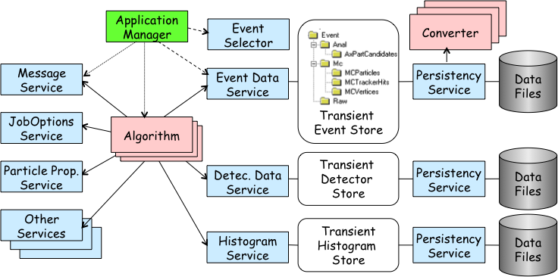
Example: GAUDI Framework
GAUDI is a mature software framework for event data processing used by several HEP experiments
  ATLAS, LHCb, HARP, GLAST, Daya Bay, Minerva, BES III,…
The same framework is used for all applications
  All applications behave the same way (configuration, logging, control, etc.)
  Re-use of ‘Services’
  (e.g. Det. description)
  Re-use of ‘Algorithms’
  (e.g. Recons -> HTL)
Equivalent to MARLIN
for LDC

Slide 14
Gaudi: Principal Design Choices
Separation between “data” and “algorithms”
Three basic categories of “data”
  event data, detector data, statistical data
Separation between “transient” and “persistent” representations of data
Data store-centered (“black-board”) architectural style
“User code” encapsulated in few specific places
Well defined component “interfaces” with plug-in capabilities

Slide 15
Gaudi: Algorithms & Transient Store
Data T1
Data T1
Transient
Event
Data Store
Data T1
Algorithm
A
Data T2, T3
Data T2
Algorithm
B
Data T4
Data T3, T4
Algorithm
C
Data T5
Apparent dataflow
Real dataflow
Data T5
Notes:
Algorithm & Transient Store
In order to minimize the coupling between algorithms, the transient data store acts a “black-board” between algorithms. An Algorithm does not need to know from where the data has been produced, it only knows what data it requires and what data will be producing.
As in shown in the viewgraph, we can create “data-flows” using a number of Algorithms known only, their inputs and outputs, by scheduling them in the adequate order.

Slide 16
Gaudi: Control Sequences
Concept of sequences of Algorithms to allow processing based on physics signature
  Avoid re-calling same algorithm on same event
  Different instances of the same algorithm possible
Event filtering
  Avoid passing all the events through all the processing chain
Event
Input/Output
Algorithm
Filter
Decision
Single
Instances

Slide 17
Interoperability Level-1

Slide 18
Application Interfaces
Agreement on ‘standard formats’ for input and output data is essential for independent development of different detector concepts
  Detector description, configuration data, MC generator data, raw data, reconstructed data, statistical data, etc.
This has been the direction for the ILC software so far (e.g. lcdd, lcio, stdhep, gear,…)
  Very successful
  Interoperability with different languages (C++, Java)
Unfortunately LHC has been standardizing on other formats/interfaces (e.g. HepMC, GDML, ROOT files, etc.)
  Effort has started to increase convergence in this area

Slide 19
Standard Data Formats
It is not sufficient to say that is ‘ROOT’ format or ‘ASCII’ format
  You need to agreed on what is the actual data contents
  It implies common or standard ‘Event Data Models’
Common Event Data models
  Obviously within an experiment the Event model is common
    Algorithms can be easily re-used between reconstruction, high-level trigger, etc.
  Sharing of Event Data models in LHC has not happen
  On the contrary, LCIO is a very successful Event Model (and I/O system) for the ILC community
    It allows to interoperate between detector concepts

Slide 20
HepMC Event Record
Event record written in C++ for HEP MC Generators.
  Many extensions from HEPEVT (the Fortran HEP standard common block)
Agreed interface between MC authors and clients (LHC experiments, Geant4, …)
I/O support
  Read and Write ASCII files. Handy but not very efficient.
  HepMC events can also be stored with ROOT I/O

Slide 21
GDML Exchange Format
Geometry Description Markup Language (XML)
Low level (materials, shapes, volumes and placements)
  Quite verbose to edit directly
Directly understood by Geant4 and ROOT
  Long term commitment
Has been extended by lcdd with sensitive volumes, regions, visualization attributes, etc.

Slide 22
Simulation Interfaces
text
editor
HL Desc.
(xml)
GDML
(xml)
ROOT
TGeom
geometry
(root)
MC generators
Geant4
HepMC
Pythia
Pythia
HepMC
Flugg
MCTruth
(root)
MCDB
Fluka

Slide 23
Interoperability Level-2

Slide 24
Software Integrating Elements
To facilitate the integration of independently developed components to build a coherent [single] program
Dictionaries
  Dictionaries provide meta data information (reflection) to allow introspection and interaction of objects in a generic manner
  The LHC strategy has been a single reflection system (Reflex)
Scripting languages
  Interpreted languages are ideal for rapid prototyping
  They allow integration of independently developed software modules (software bus)
  Standardized on CINT and Python scripting languages
Component model and plug-in management
  Modeling the application as a set of components with well defined interfaces
  Loading the required functionality at runtime

Slide 25
Strategic Role of C++ Reflexion
Python
(PyROOT)
CINT
Object I/O
Scripting (CINT, Python)
Plug-in management
etc.
ROOT meta C++
ROOT
Reflex
Reflex
data
rootcint
XDict.so
X.h
genreflex
dictionaries

Slide 26
ROOT I/O
Highly optimized (speed & size) platform independent I/O system developed for more than 10 years
  Able to write/read any C++ object (event model independent)
  Almost no restrictions (default constructor needed)
Make use of ‘dictionaries’
Self-describing files
  Support for automatic and complex ‘schema evolution’
  Usable without ‘user libraries’
All the LHC experiments rely on ROOT I/O for the next many years

Slide 27
Interoperability Level-3

Slide 28
Common C++ Framework?
Common interfaces/formats between detector concepts is good but adopting a “common framework” is even better
  It would enable one level up in re-use (at the algorithm/tool level)
What are the alternatives?
  Evolve MARLIN and be universally adopted?
  Use an existing LHC framework (e.g. GAUDI, AliROOT)?
  Do something else?

Slide 29
Python as a Software-Bus
Python could also be seen as a framework where you can plug easily “extension modules” in binary form implemented using other languages.
  Very easy and natural to interface to C++ classes
  Python should only be the “glue” between modules developed in C++ or other languages
  The interface (API) for Python extension modules is quite simple and at the same time very flexible (generic functions)

Slide 30
Python Software Bus
Very rich set specialized generic modules
LHC modules
Several GUI toolkits
Ganga
PVSS
XML
Database
GUI
GUI
Python
shell
Gateways to other frameworks
JPype
PyROOT
GaudiPython
math
math
Java
Classes
Root
(C++)
Classes
Gaudi
Framework
Very rich set of Python standard modules

Slide 31
Python as the ‘Framework’
The high-level steering of applications could be done in Python
  Configuration, plugin (module) loading, event loop, algorithm scheduling, etc.
  The low Python execution performance shouldn’t be a problem at this level
    The real number-crunching could be done in a proper compiled language (e.g. C or C++)
Essential to define ‘interfaces’ for the framework components
  As it is the case for a C++ framework

Slide 32
Re-using LHC common software

Slide 33
A New HEP Library
Based on what exists of common software for LHC, we plan to provide a coherent and fairly complete set of software packages ready to be used by any existing and new HEP experiment
  Utility libraries, analysis tools, MC generators, full and fast simulation, reconstruction algorithms, etc.
  Reference place to look for some needed functionality
  Made from internally and externally developed products
[fairly] independent packages including some integrating elements such as ‘dictionaries’, ‘standard interfaces’, etc.
  Support for I/O, interactivity, scripting, etc.
Easy to configure, deploy and use by end-users
  Good packaging and deployment tools will be essential

Slide 34
Reconstruction Algorithms
Unfortunately very little has been done in common between the LHC experiments
  Different Event Models
  Different Data Processing Frameworks
The equivalent of the LCIO event data model did not exists
Within a given experiment, alternative set of algorithms has been developed and could be evaluated thanks to the common event model and framework
Work in this direction will be part of an EU-FP7 proposal (AIDA)

Slide 35
Math, Statistical, Analysis,…
ROOT is the facto standard and repository for all these common functionality
  Histogramming, random numbers, liner algebra, numerical algorithms, fitting, multivariate analysis, statistical classes, etc.
The aim is to continue to provide and support a coherent set of mathematical and statistical functions which are needed for the analysis, reconstruction and simulation

Slide 36
Software Configuration and Distribution
Re-using existing software packages saves on development effort but complicates “software configuration”
  Need to hide this complexity
A configuration is a combination of packages and versions that are coherent and compatible
E.g. LHC experiments build their application software based on a given “LCG/AA configuration”
  Interfaced to the experiments configuration systems (SCRAM, CMT)

Slide 37
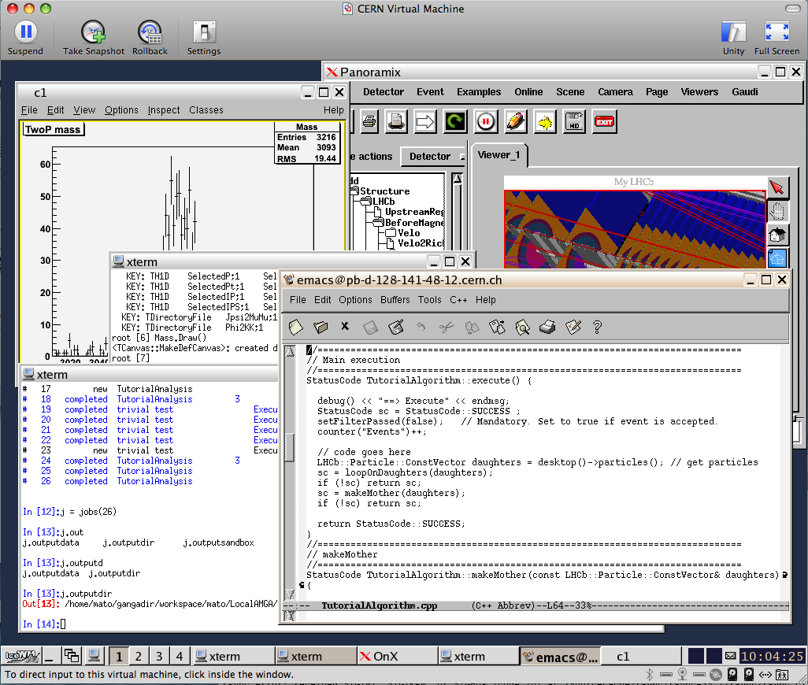
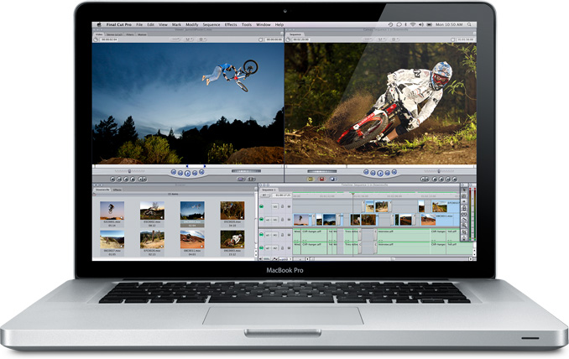
Virtualization helps software deployment
CernVM is a virtual appliance that is being developed to provide a portable and complete software environment for all LHC experiments
  Decouples experiment software from system software and hardware
It comes with a read-only file system optimized for software distribution
  Operational in offline mode
  for as long as you stay within
  the cache
  Reduces the effort to install,
  maintain and keep up to date
  the experiment software

Slide 38
Conclusions
I have been focusing on the reasons why a Framework is needed rather than recommending a concrete one
When deciding on the framework (and languages) not only the technical advantages should be considered
  Interoperate with existing codes from the community (e.g. ROOT, Geant4, etc.)
  People training is
Common interfaces/formats is good but adopting a common framework is even better
  It would enable one level up in re-use
  Single framework to cover all applications is desirable
MC detector studies could profit from existing structures and support for the common LHC software

