Slide 1
New Ideas for Collider IR design: Flat Beams
C. Johnstone and N. Mokhov, Fermilab
MCD meeting
November 11, 2009

Slide 2
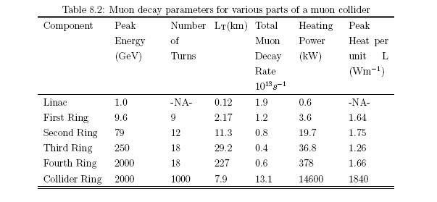
Introduction
One of the most serious technical issues in the design of a muon collider arises from muon decay. In the 2x2 TeV muon collider, with 2 x 10¹² circulating muons, 2 x 10⁵ μ→eν-ν+ decays occur per meter. Immersed in strong magnetic fields, electromagnetic showers deposit ~2 kW/meter in the storage ring, several orders of magnitude more than in upstream systems. Below is a summary of the heat deposited in the different systems of a high-energy muon collider.

Slide 3
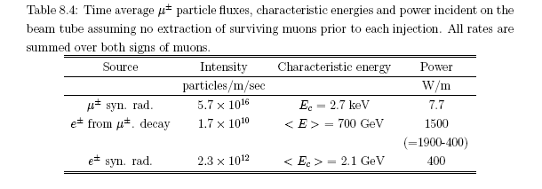
Heat Generation in Muon machines
Heat Sources:
Muon synchrotron radiation
Muon decay: electrons, positrons and associated synchrotron radiation, and neutrinos
Muons from the primary beam that hit the vacuum chamber
The breakdown of heat deposition shows that the SC magnet design is almost completely influenced by muon decay and synchrotron radiation from decay products

Slide 4
Heat Generation in Muon machines
LESS THAN 0.1% of the energy from muon decay products can be deposited on the SC coils or its surrounding support structure. Prior solutions for the heating problem include:
Thick tungsten radiation shield to reduce the deposited energy by three orders of magnitude
Separate the coils across the midplane – open midplane
Active (background sweep dipoles) and passive (tungsten collimators) inserted between the final focus quadrupoles to shadow/shield the SC.

Slide 5
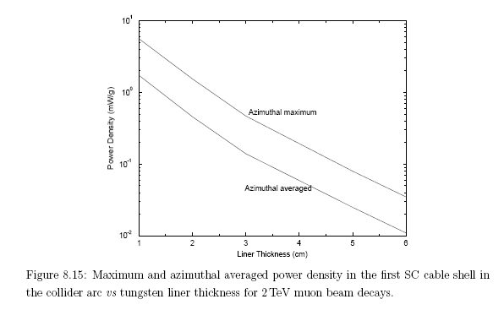
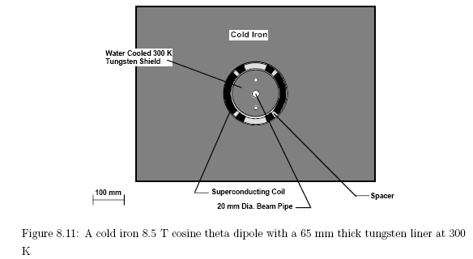
Tungsten liner
By itself the thickness of a tungsten liner would be 65 mm to reduce the heat load from muon decay by three orders of magnitude. This implies
The warm bore required for 5σ beam is 20 mm.
The tungsten liner increases the bore to 160 mm with severe impact on the final focus magnets, optics, and ring impedence.

Slide 6
Consequences of enlarged apertures in final focus
Adding the 6 cm liner increases the difficulty of an already problematic design
The nonlinear dynamics dominated by the IR are strongly correlated to the strength of and beam size at the final focus quadrupoles*
The beam size at the quadrupole nearest the IP is 2 cm (2.5 σ) and adding 6 cm to the aperture represents a factor of 4 decrease in quadrupole strength, a factor of 4 increase in length, with an approximate corresponding increase in the β function, (square root of the beam size)
First-order chromaticity has a linear dependence the peak β function and therefore increases almost linearly with the strength reduction
Nonlinear behavior associated with chromatic correction sextupoles can show orders of magnitude increase with severe impact on dynamic aperture
*”Zeroth-Order Design Report for the Next Linear Collider”, SLAC-474, Proceeding os the Snowmass Workshop, June-July, 1996.

Slide 7
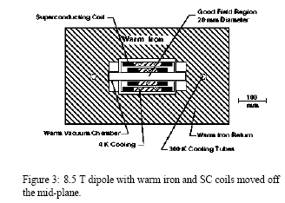
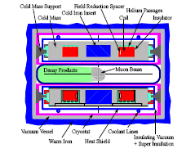
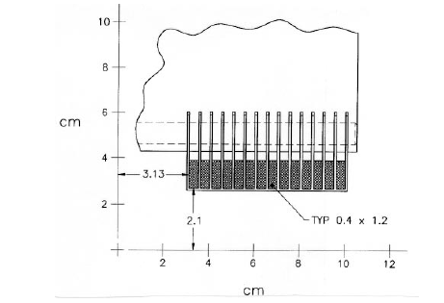
Open midplane magnet design
Another approach is to clear the midplane of SC coils
The coils are separated in the dipoles such that <0.1% of the energy from muon decay is deposited in the coils or its 4K surrounding support structure
The iron return yoke would likely be cold with the heavy supports needed to counteract the attractive forces between coils. The remaining muon decay energy would be deposited in a separate, cooled radiation shield.
A corresponding separated coil quadrupole can be designed with 100-200 T/m gradients.
The separated coil design clearly impacts detector design due to the larger-radius shielding required on the midplane

Slide 8
Open midplane design drawbacks
There are difficulties associated with achieving the desired optics using nonconventional magnets
Open mid-plane magnets as noted in this workshop have very poor field quality and cannot necessarily be modeled using conventional components exhibit high-order multipole content.
The muon collider lattice is extremely sensitive to end or fringe field and error effects.
Such effects would change and dominate completely the dynamics of the collider ring.
Accurate simulations would require the actual field map from TOSCA. Once a field map is required, optimization of parameters entirely within existing optical codes is not currently implemented nor is there a straightforward approach to implement a field map design and then reverse-engineer the magnet design.
As also noted in this workshop, open midplane magnets with large apertures introduce extreme support stressed, with the supports aggravated by large vertical apertures.

Slide 9
Combined Approach
By far the most effective approach is a combined passive and shielding design consisting of:
Tapered liners in final focus quads
Background sweep dipoles
Positioned on either side of the final focus quadrupoles, a pair of 15-m long, 8.5T background dipoles had to be placed 1 m upstream of the final focus to remove background from the arcs and the long preceding drift. (This is a bucked pair of dipoles to keep the dispersion function under control in the long drift.)
Tungsten collimators sandwiched between quadrupoles
15-cm long with a 4σ aperture to shadow completely the SC final focus quads with a 5σ aperture.
Tungsten collimators within the detector with the aspect of the two nozzles on either side of the IP

Slide 10
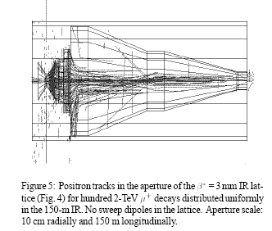
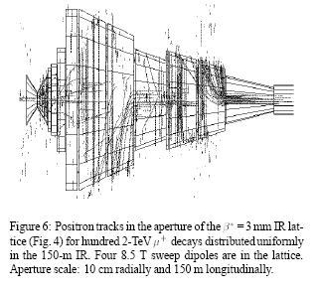
Results: Combined Approach
The combined effect allowed the tungsten liner to be reduced to 2 cm
Promoting a factor of 2 decrease in linear chromaticity and sextupole strength
Higher order chromaticities which require higher-multipole correction dropped by two orders of magnitude.

Slide 11
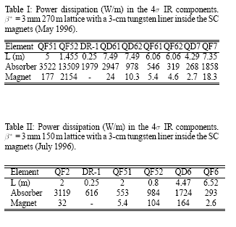
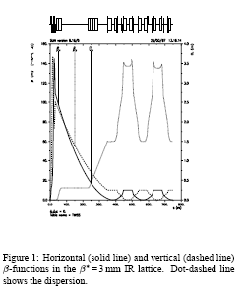
Results: Combined Approach continued…
Top performing IR design and comparisons of dependence of heat dissipation in IR and shielding design approaches-

Slide 12
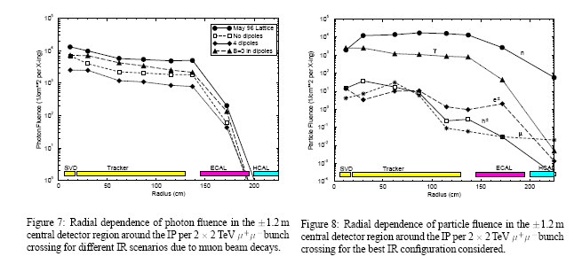
Detectors…
Central detector backgrounds…

Slide 13
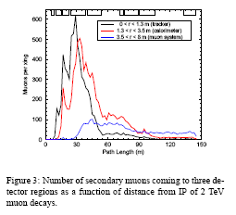
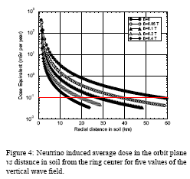
Neutrinos
Serious problem with Bethe-Heitler pairs: 15 to 90 m from the IP is responsible for high muon fluxes in the calorimeter
Approaches include magnetized shielding across the entire tunnel cross section, timing cuts
Neutrino fluxes outside are also a problem – every meter may require a dipole or an oscillation of the guide field in time to move the beam within the accelerator

Slide 14
Impact on the Current Collider Work
We have backgrounds for 50x50 GeV, 250x250 GeV, and 2 x 2 TeV Colliders
The most serious problem was the 250x250 GeV collider. Backgrounds were never solved
This implies the 750x750 GeV collider under design is likely to have more severe background issues than the 2x2 TeV collider extensively studied.

Slide 15
New Ideas: Flat Beams; Asymmetric Transverse emittances
Conventional Magnetic components focus only in one plane and defocus in the other
Flat beams are naturally suited to quadrupole telescopes
Reduce both aperture requirements and nonlinearities
Assume a factor of 4 difference in the low beta value for vertical and horizontal with 1 cm as the average.
To preserve a round beam @IP would require:
for similar high-betas, this result in a larger vertical than horizontal aperture
A flat beam, however, reduces vertical apertures AND nonlinearities due to beam divergence. Equalizing beam divergence requires:
which translates into a much smaller vertical than
horizontal aperture

Slide 16
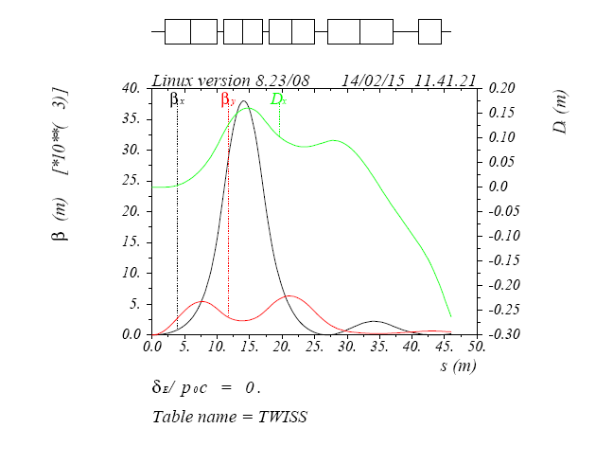
Example: Asymmetric IR
Initial IR design has begun on an asymmetric low beta IR
A combined-function magnet was introduced as the first element to provide not only additional vertical focusing and aperture reduction, but also to provide background sweeping and dispersion for the IR quadrupoles
The vertical aperture in this design is reduced from 20 mm to a 4 mm maximum in the IR quadrupoles mitigating the support issues

Slide 17
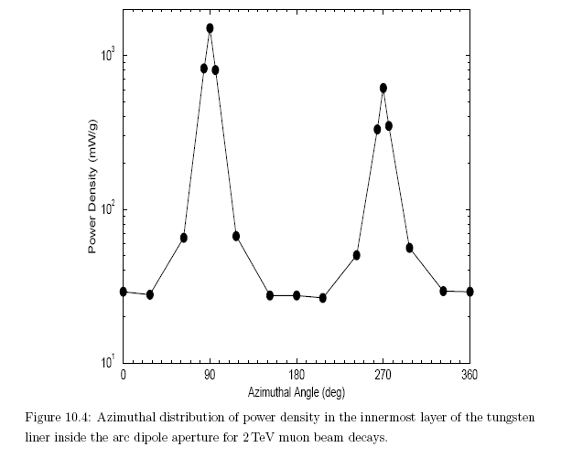
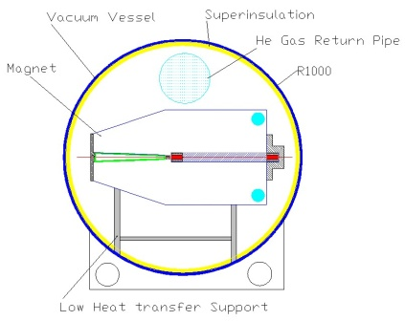
Superconducting C magnet
Originally conceived for FFAG rings but would work certainly for Neutrino Factory magnets
Unclear how to accommodate the cryostat in a MC IR
“Open” on one side – inside of ring
Exploits the asymmetric background and heat deposition from muon decays (factor of 4 inside/outside)

Slide 18
Conclusions
Magnet liners continue to be a problem
Open midplane magnets have serious drawbacks particularly with large vertical apertures and support
An open midplane magnet design is more feasible with small vertical apertures
Small vertical apertures imply asymetric emittance and IR low beta design
Advantage includes reduced nonlinear dynamics and error and fringe field impact
Disadvantage is a factor of 2 decrease in luminosity relative to the round-beam IR

