Slide 1
CLIC Machine Detector Interface
D. Schulte

Slide 2
Introduction
Machine detector interface issues have been studied for the 2003 CLIC Physics Report
  parameters have changed since but are relatively close today
  Conclusion are basically still valid
  But need refinement of studies
A new linear collider detector working group has been formed
  In collaboration with the beam physics has made and will verify a number of design choices
    Luminosity spectrum
    Crossing angle
    Solenoid field and configuration
    Beam pipe size
    Forward region design
Also a machine detector working group has been created to deal with technical issues
  QD0 magnet design, stabilisation and integration
  Push-pull scheme, detector infrastructure and many other items

Slide 3
Background
A number of background sources exist
  From the machine
    Synchrotron radiation
    Muons
  From the beam collision
    Beamstrahlung
    Coherent pair production
    Incoherent pair production
    Hadronic events
  From the spent beams
    Backscattered pairs
    Neutrons
    …

Slide 4
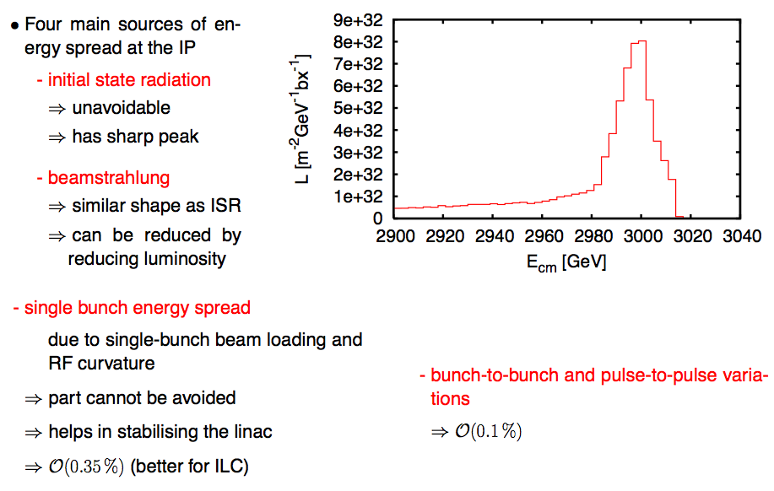
Luminosity Spectrum
Can be reduced for some luminosity loss

Slide 5
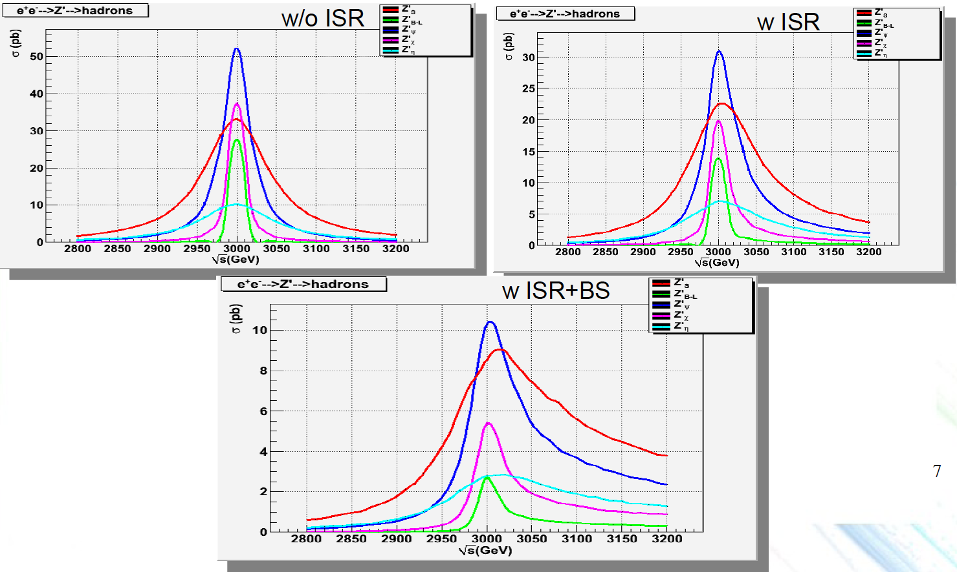
Z’ and Luminosity Spectrum
O. Cakir
For cross section rise use of peak luminosity is reasonable approximation

Slide 6
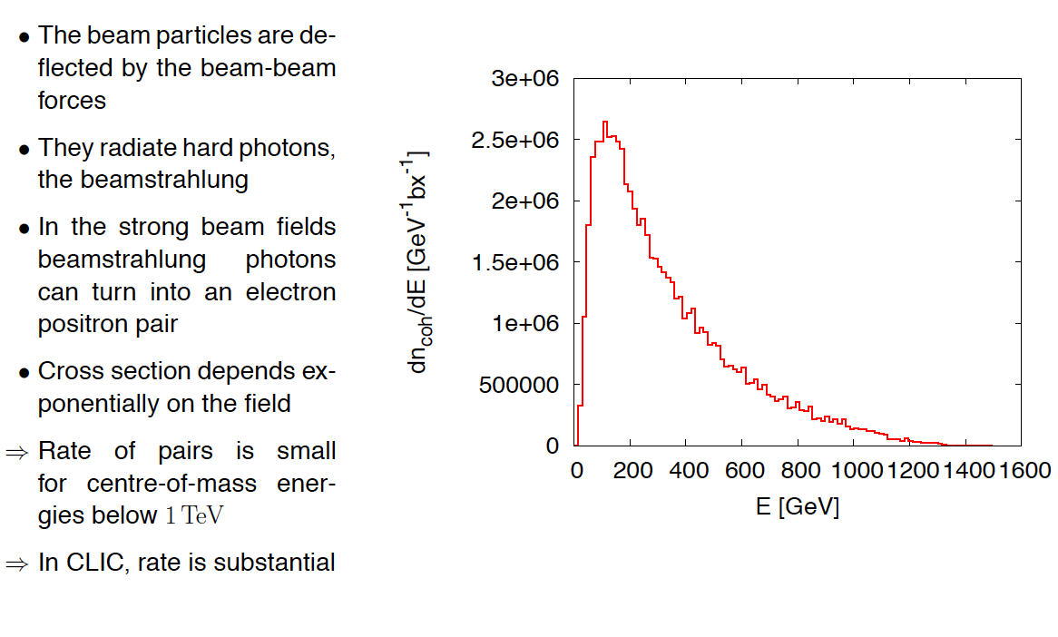
Spent Beam Content

Slide 7
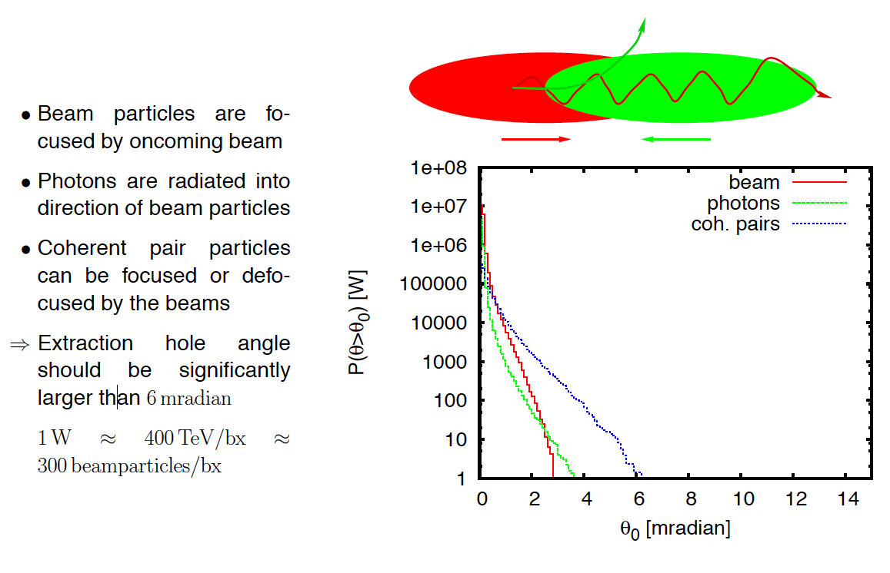
Spent Beam Angles
Conclude that crossing angle should be more than 20mradian

Slide 8
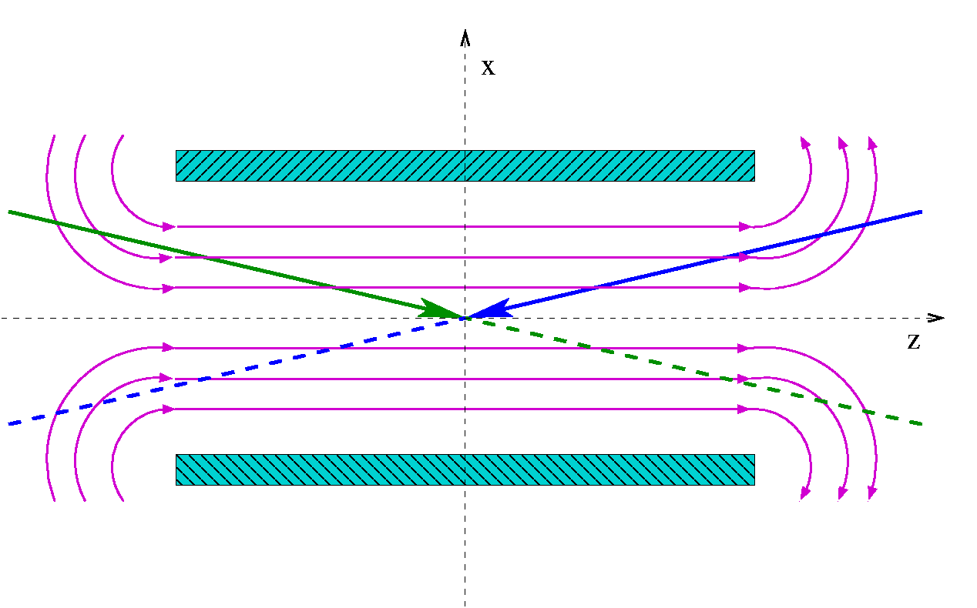
Solenoid Effects
Weak focusing: in the two transverse planes
Orbit deviation: the beam is bent as it traverses the magnetic field
Coupling between x-y plane: the particle position in one plane depends on the position in the other plane
Dispersion: particles at lower energies experience a larger deflection than those at higher energies
The beam emits Incoherent Synchrotron Radiation (ISR) as it is deflected
θ_{c}/2
Schematic view of the two beam colliding with a crossing angle in the detector solenoid.
B. Dalena

Slide 9
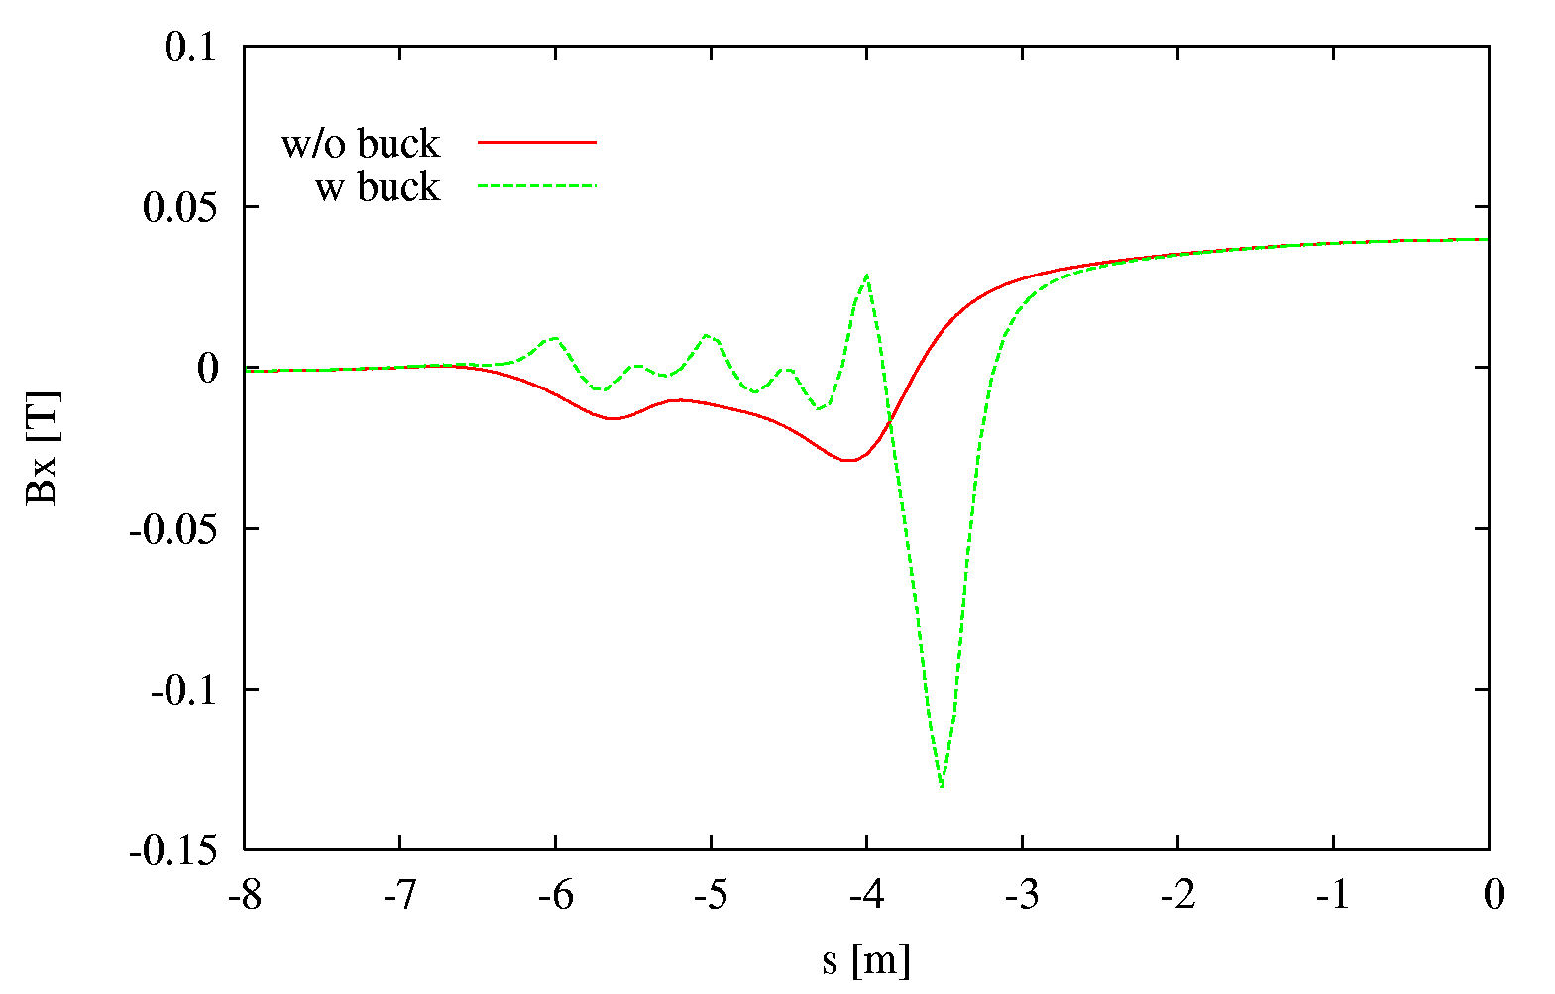
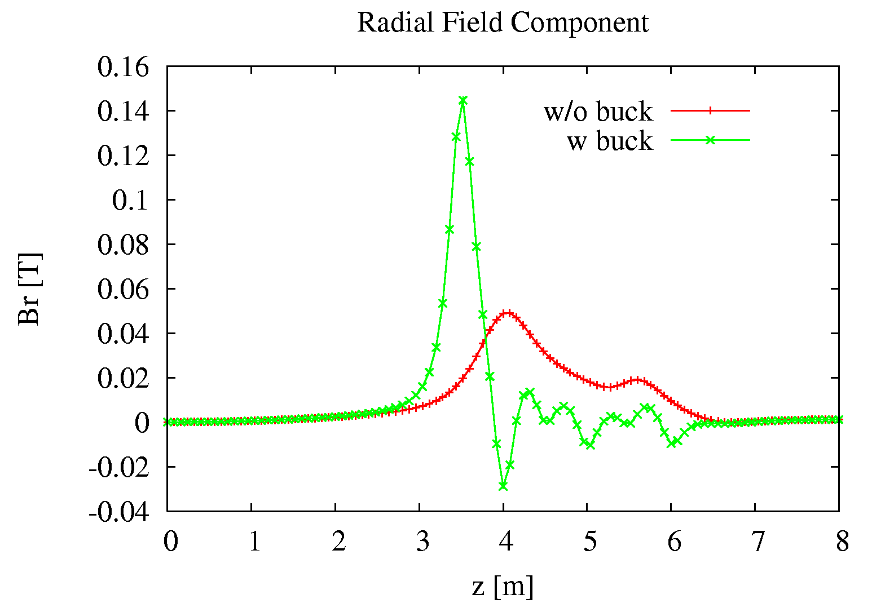
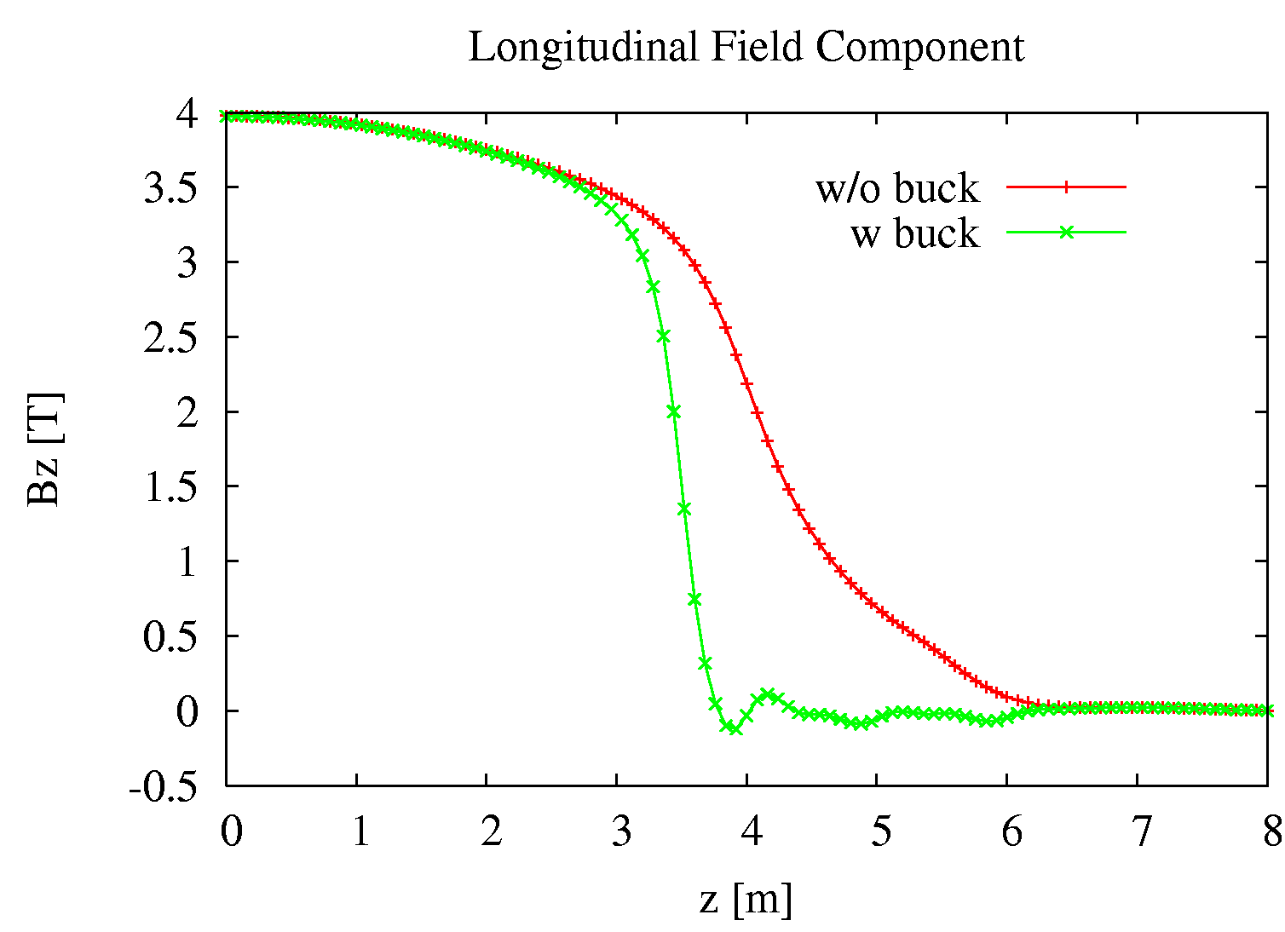
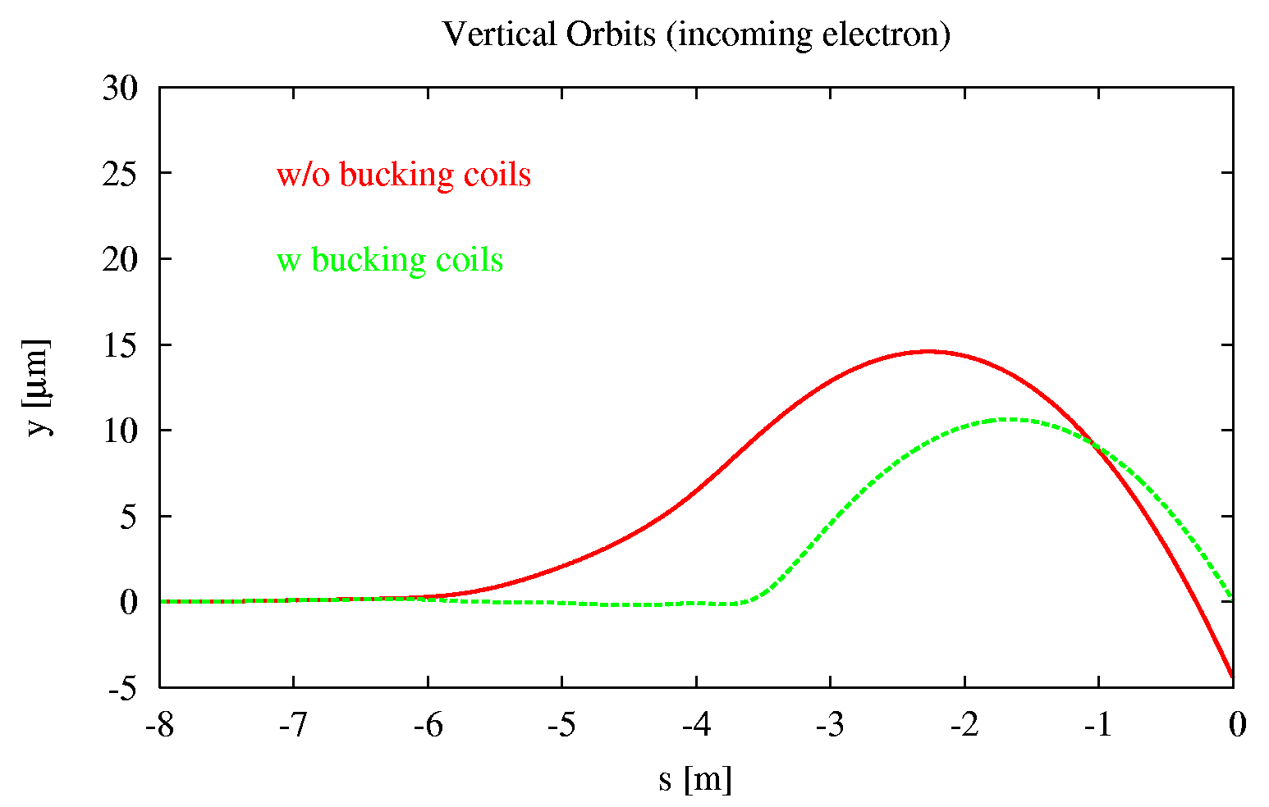
Compensating Solenoid
“Anti-solenoids” (bucking coils covering QD0), cancelling the main solenoid magnetic field component in QD0, and reduces offset at IP (z=s=0).
solenoid
reference system
beamline reference system
QD0
QD0
B. Dalena et al.

Slide 10
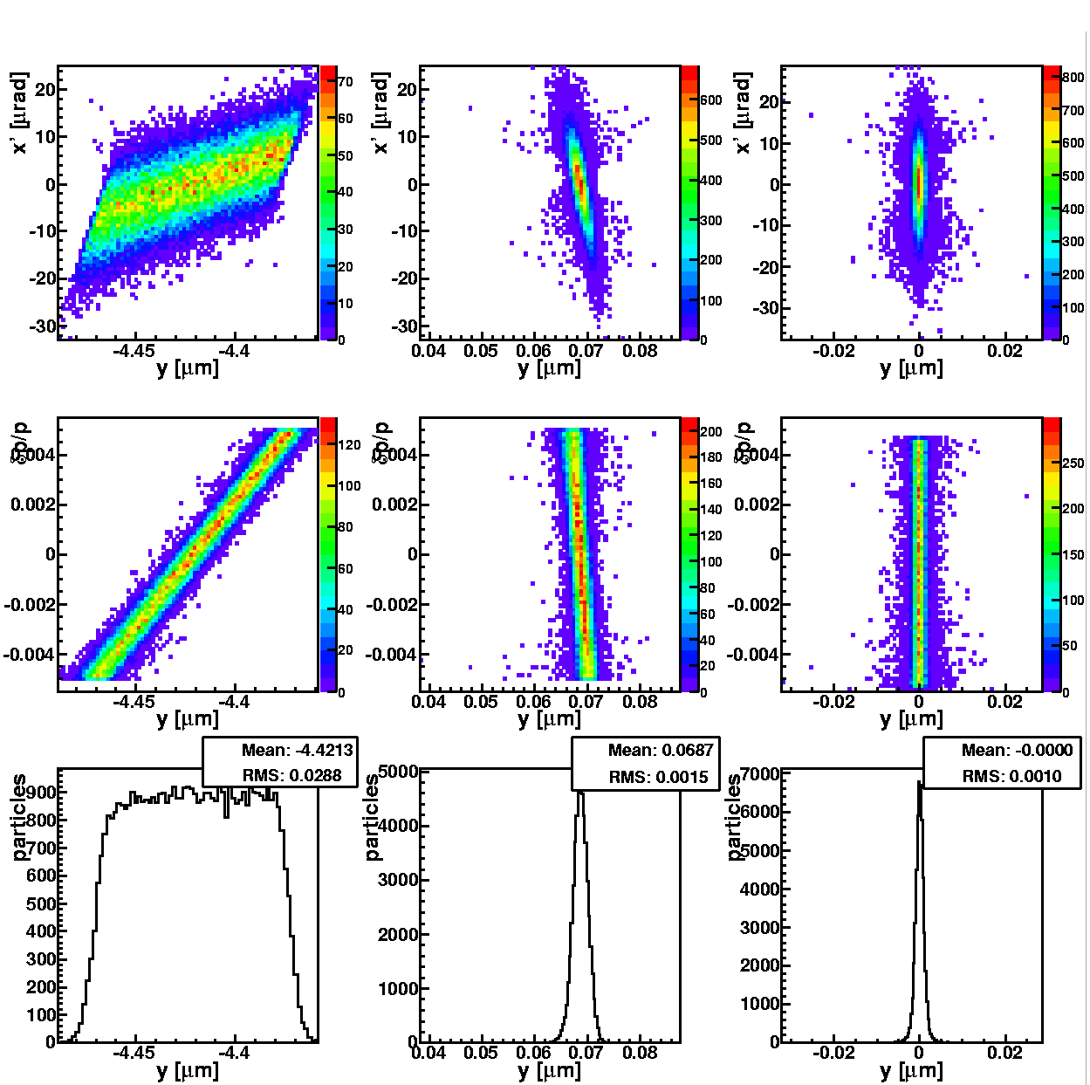
Vertical Dispersion and <x’,y> Coupling
a
b
c
< x’,y > coupling and
vertical dispersion at IP
Tracking trough FFs and IP Solenoid
Tracking trough FFs and IP Solenoid + anti-solenoids covering QD0
Tracking trough FFs only
Residual <x’,y> coupling and dispersion can be compensated using the other FFs magnets

Slide 11
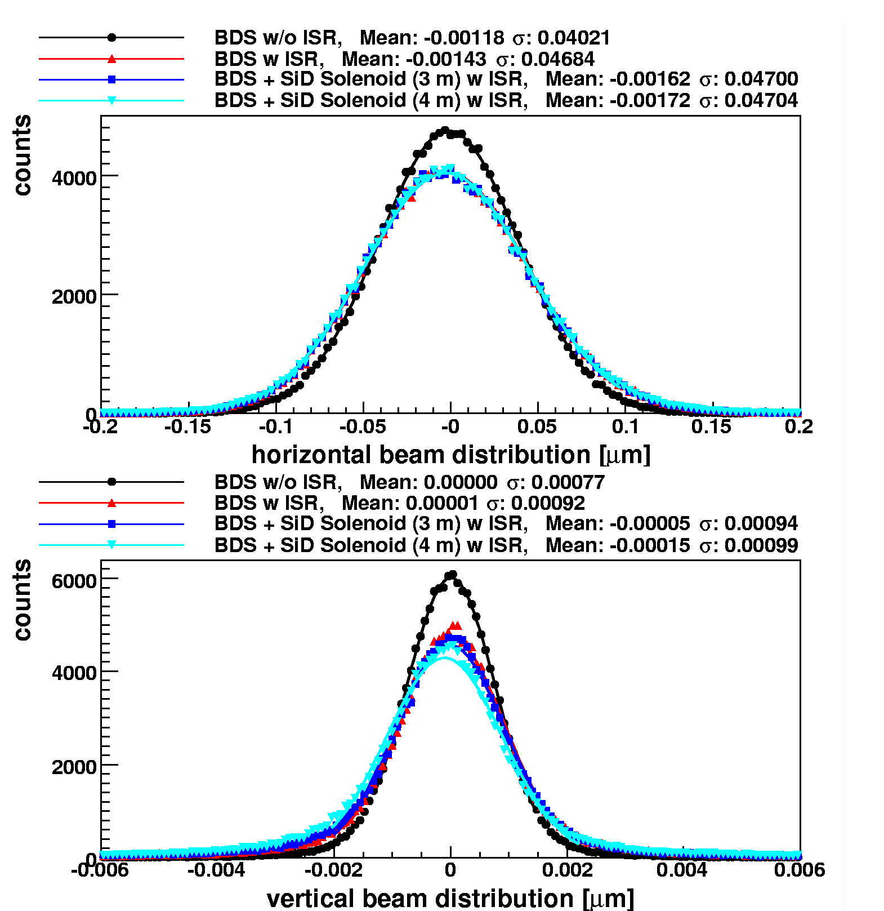
Incoherent Synchrotron Radiation
Full beam tracking from linac entrance to IP (PLACET)
Beam-beam simulations (GUINEA-PIG)
Map | Bz [T] | L[m] | Lumi loss [%]
Old SiD | 5 | 2.8 | ~4.0
New SiD | 5 | 2.8 | ~3.0
ILD | 4 | 3.7 | ~4.0
ILD + AntiDiD | 4 | 3.7 | ~25.0
Conclude that crossing angle should be no more than 20mradian
No antiDiD
B. Dalena et al.

Slide 12
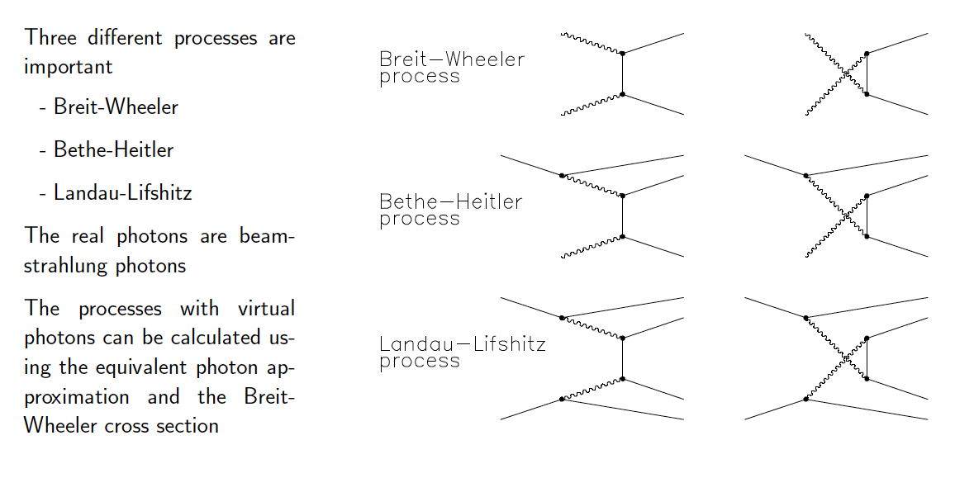
Incoherent Pair Creation

Slide 13
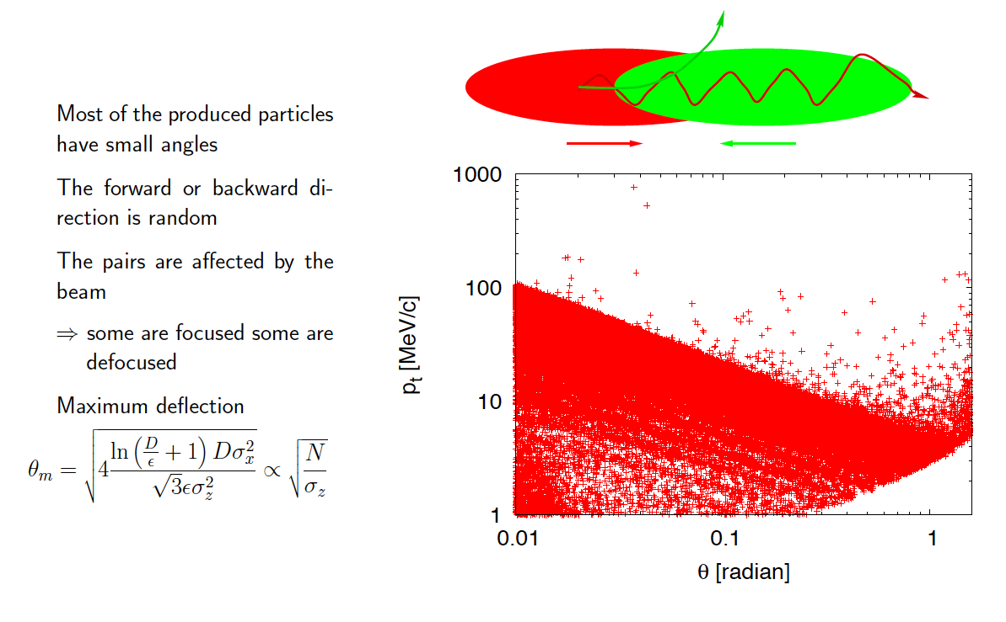
Deflection by the Beams

Slide 14
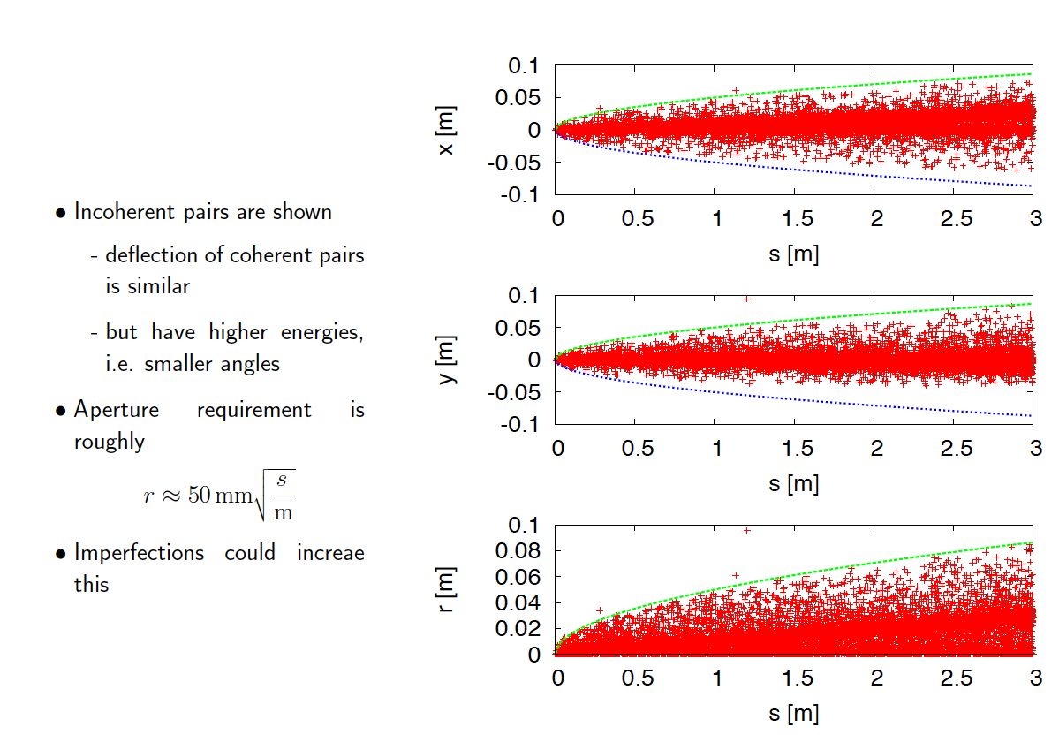
Aperture Requirements

Slide 15
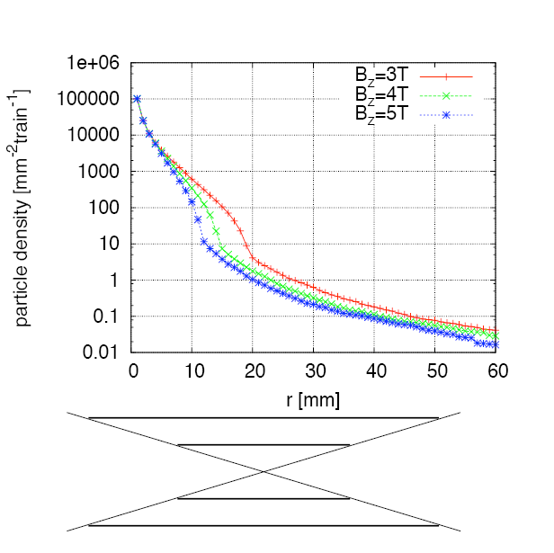
Impact on Vertex Detector
Simplified study using simple cylinder without mass
  Coverage is down to 200 mrad
Simulating number of particles that hit at least once
  Experience indicates that number of hits is three per particle
At r₁ ≈ 30 mm expect 1 hit per train and mm²
z=αr

Slide 16
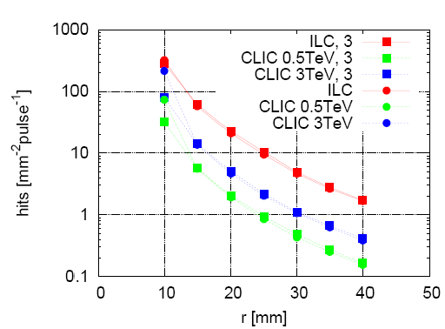
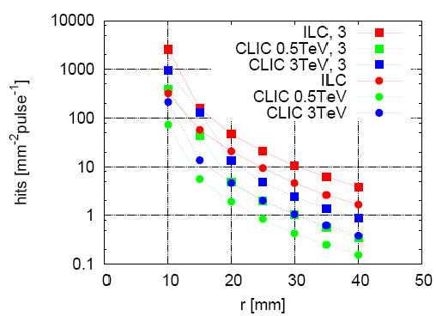
Hit Distribution and Vertex Detector Radius
GEANT 3 based simulation
Angular coverage Δz/r = 3, 5 and Bz = 5 T
⇒ hit density does not depend on coverage angle if the radius is large enough to avoid deflected particles
Angular coverage Δz/r = 5 and Bz = 3, 5 T
⇒ vertex radius for constant hit density scale as:
∝

Slide 17
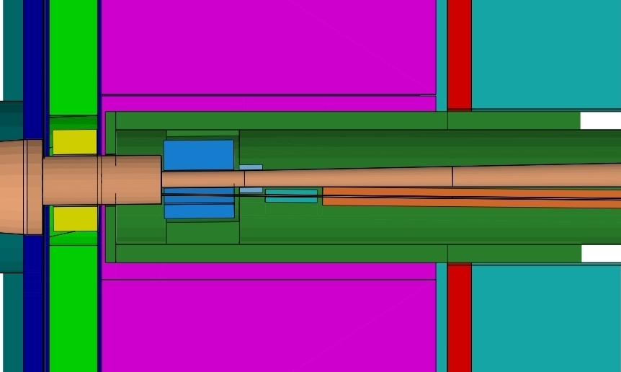
CLIC_ILD Detector Concept: Forward Region
Version 3 Nov. 2009
ECal end-cap
HCal end-cap
Yoke end-cap (partial)
Andre Sailer
LumiCal
BeamCal
QD0 (partial)

Slide 18
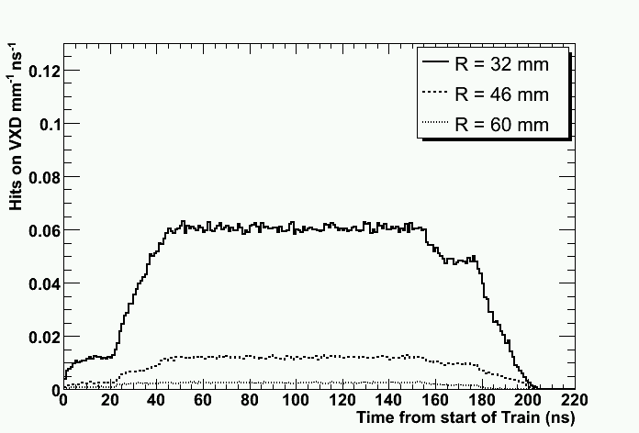
Courtesy M.Battaglia and A.Sailer
Backscattered + direct pairs
Direct
pairs
Backscattered
pairs (not read)

Slide 19
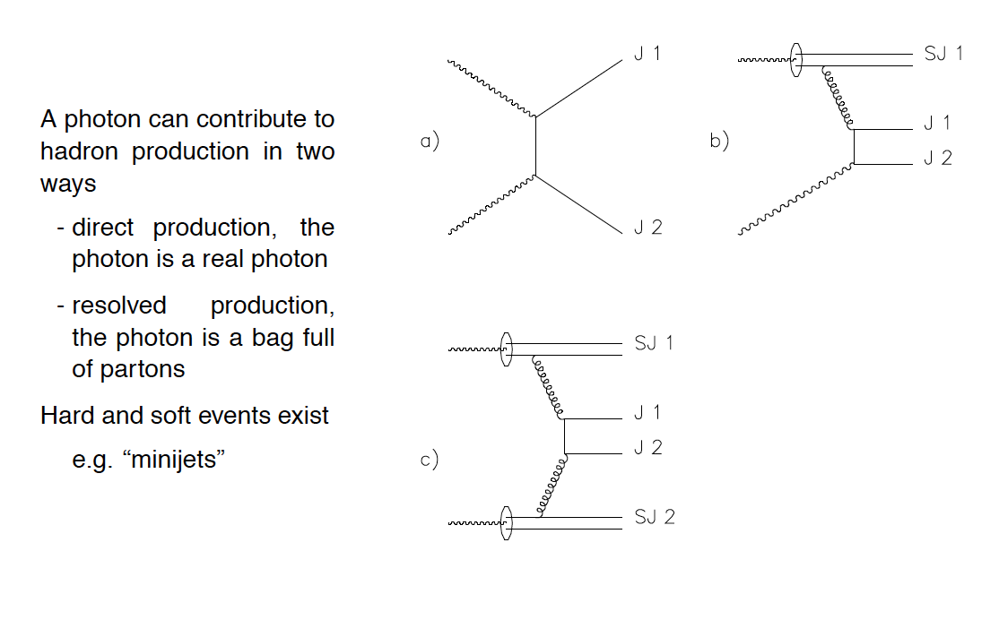
Hadronic Background

Slide 20
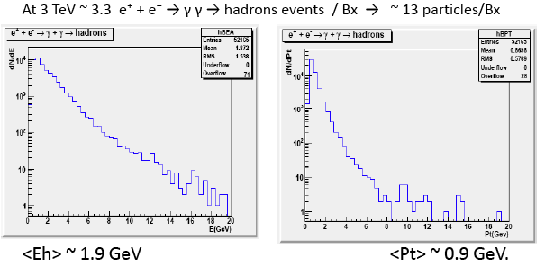
Hadronic Background (cont.)
Data base with hadronic events available
Hadronic background is very much peaked in the forward and backward direction
collision of one soft and one hard photon
Adds to background
adds 25% of hits in vertex detector
tracks overlayed with events
D. S. et al.
Jean-Jacques Blaising

Slide 21
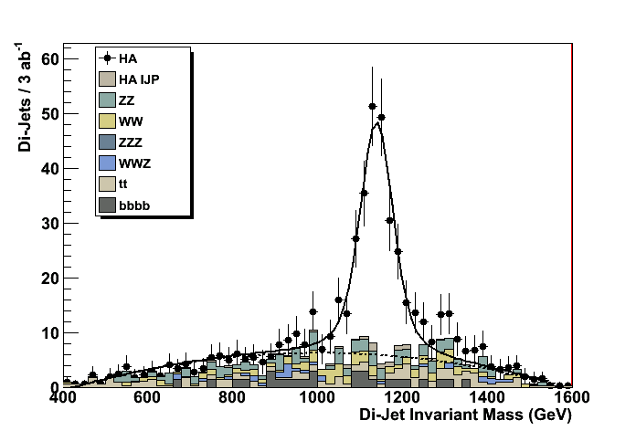
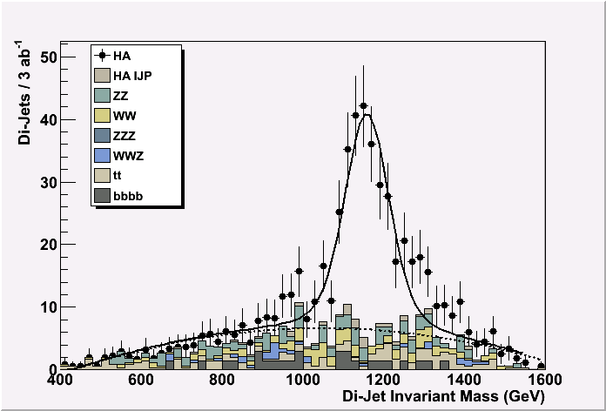
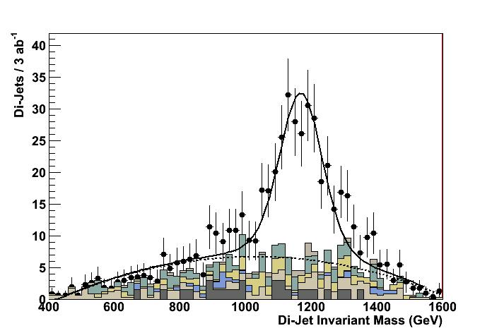
Hadronic Background and Time Stamping
Simulation example of heavy Higgs doublet H⁰A⁰ at ~1.1 TeV mass (supersymmetry K’ point)
e+e- ➔ H⁰A⁰ ➔ bbbb
Signal + full standard model background + γγ=>hadron background
CLIC-ILD detector: Mokka+Marlin simulation, reconstruction + kinematic fit.
Marco Battaglia
Zero bunch crossings
M_{A} mass resol. 3.8 GeV
20 bunch crossings
M_{A} mass resol. 5.6 GeV
40 bunch crossings
M_{A} mass resol. 8.2 GeV

Slide 22
MDI Working Group Priorities
Highest priority for the work until end 2010 are those subjects linked to the “CLIC critical feasibility items”, nota bene:
  Choice of the magnet technology for the FF magnets
  Integration of these magnets into the detectors, and their alignment
  Feasibility study of sub-nm active stabilization of these magnets
  Luminosity instrumentation
  Spent beam disposal
  Beam background backsplash from the post-collision collimators and dumps into the detector
  Intrapulse-Beam feedback systems in the interface region
L. Gatignon et al.
22

Slide 23
Other Items to be Addressed in MDI:
Issues where the beam delivery system (BDS) influences the beam/background conditions for the detector
Issues where the BDS physically impacts on the detector
Beam background and its impact on the forward (det.+accel.) elements, including backsplash of background particles from one hardware element to the surrounding elements
Beam pipe, beam vacuum and vacuum infrastructure in the interface region
Radiation environment and radiation shielding in the interface region
Cryogenic operational safety issues in the interface region
Magnetic environment in the interface region (shielding of FF quadrupole, correction coils, anti(-DID), stray fields from the detector, etc.)
Overall mechanical integration (including the routing of services) in the interface region
Pull-push elements and scenarios (detector-to-detector interface)
Cavern layout and services (handled principally under CES WG)
From the CLIC MDI working group mandate
23

Slide 24
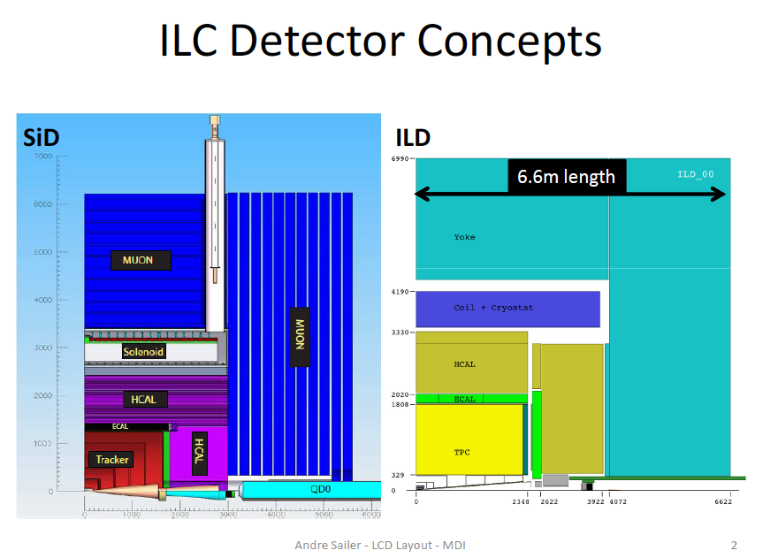

Slide 25
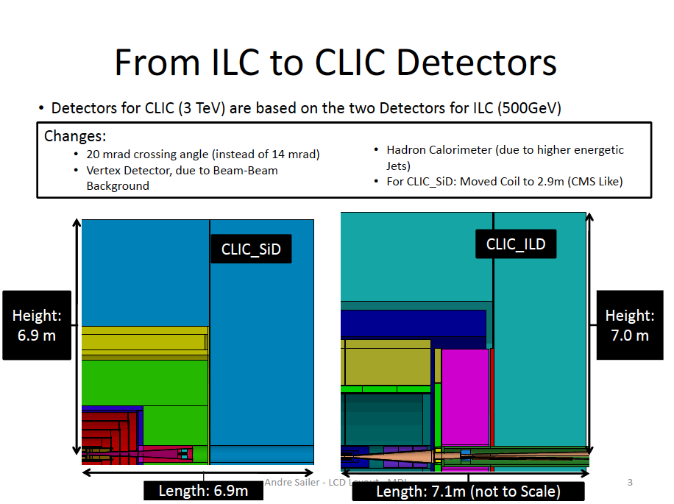

Slide 26
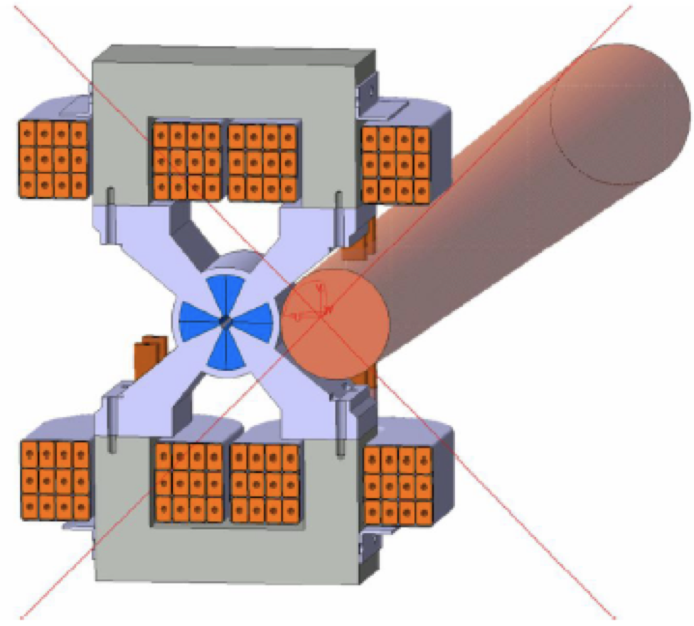
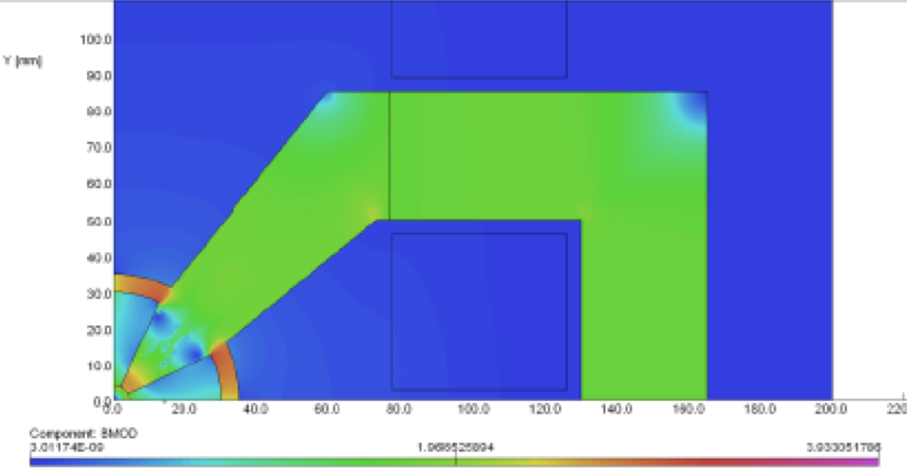
QD0 Design
Magnet design needs to allow for spent beam extraction
Hybrid design is tunable by 10-20%
Can achieve the required field strength
M. Modena et al.

Slide 27
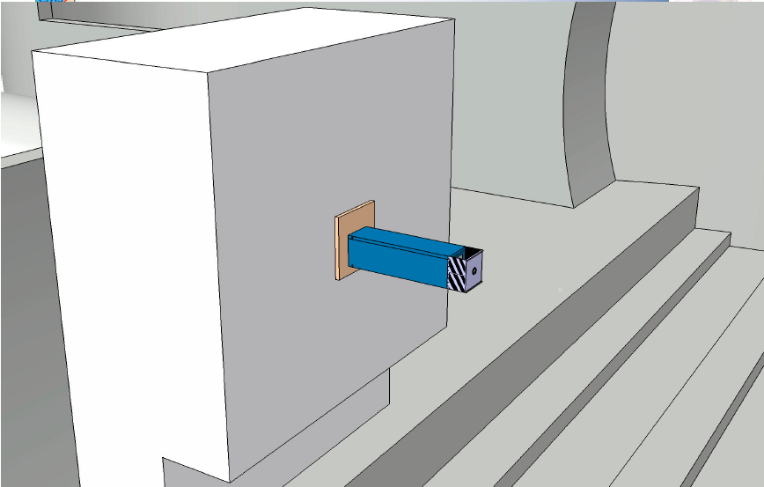
QD0 Integration Concept: First Ideas
Courtesy A.Hervé

Slide 28
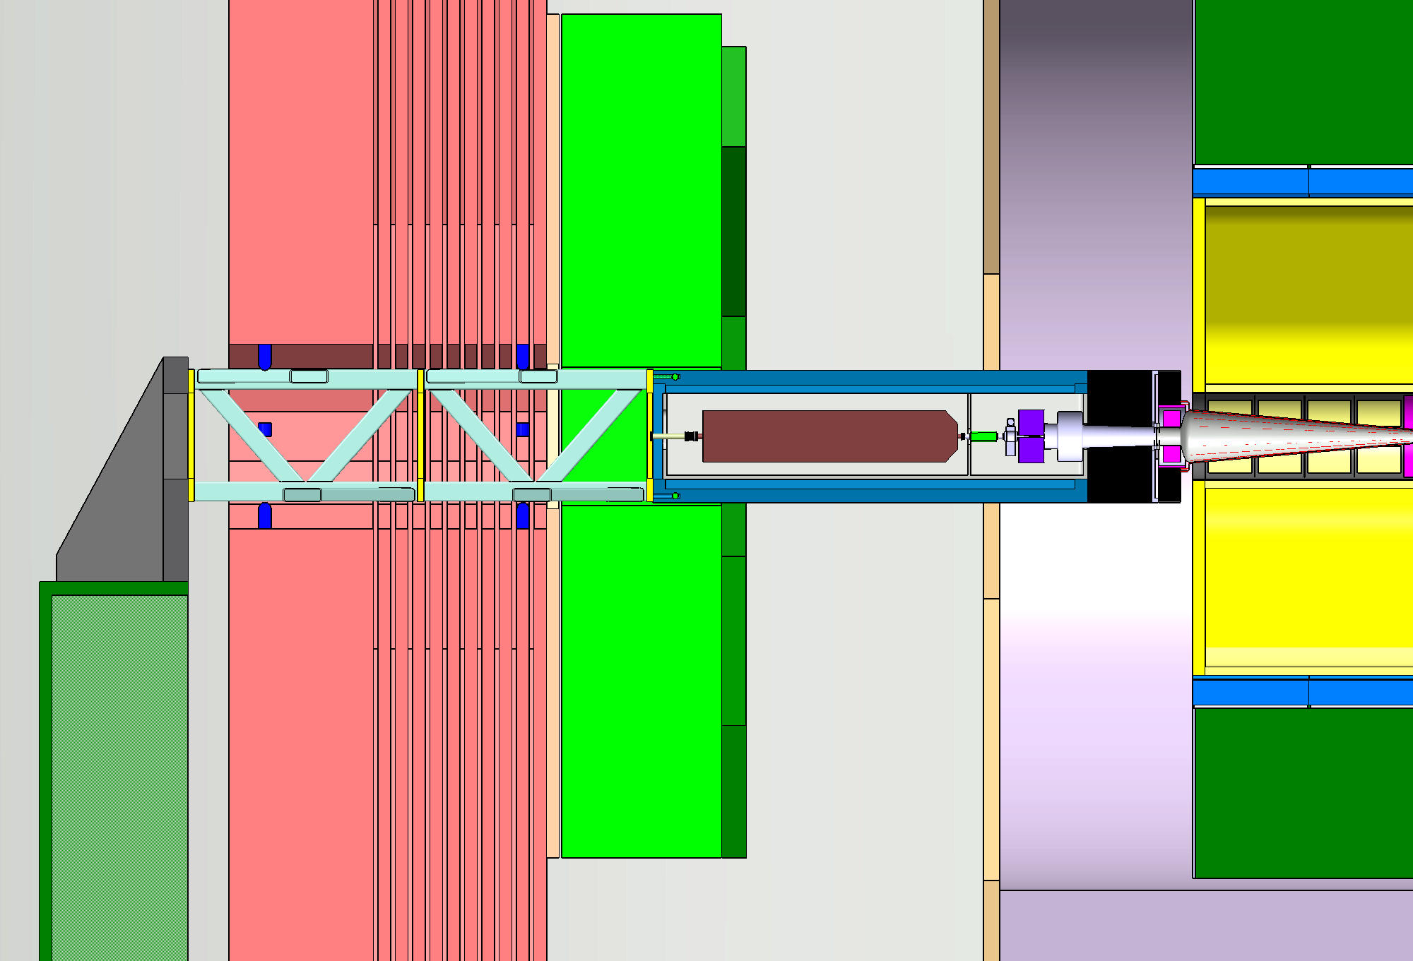
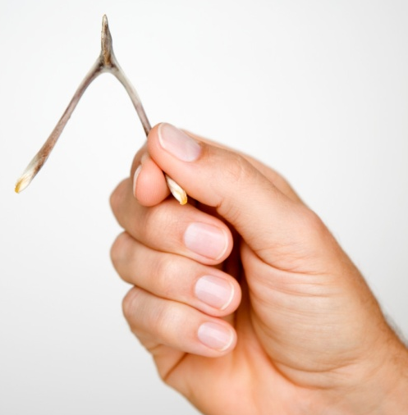
Quadrupole Support Garage Position
“plugs”
QD0
Yoke +
muon det.
HCAL + ECAL
end-cap
K. Elsener

Slide 29
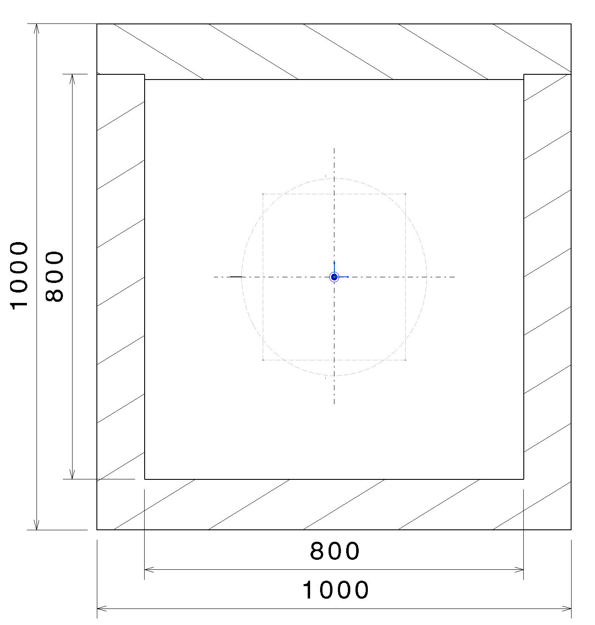
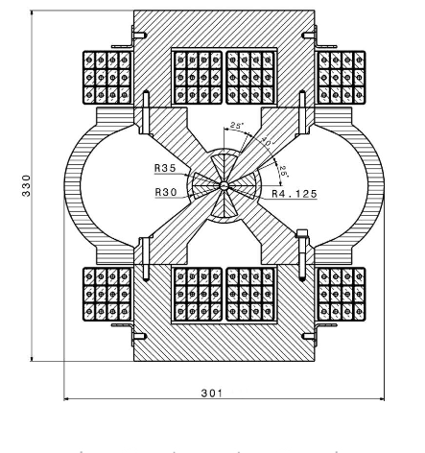
Cooling pipes with laminar flow
Support
QD0 Coils
(independent
of yoke)
Support Table
Support Tube
A. Herve
A. Herve

Slide 30
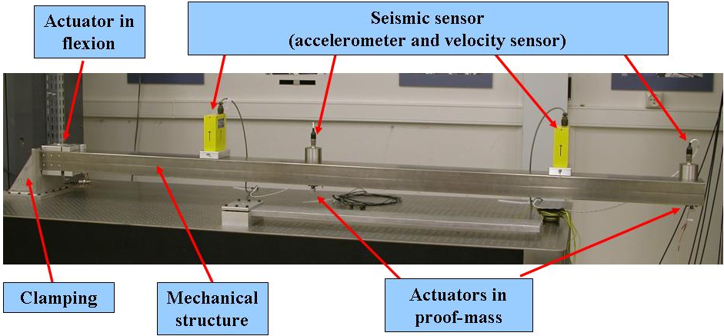
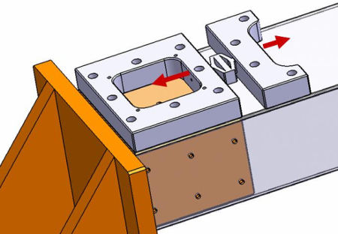
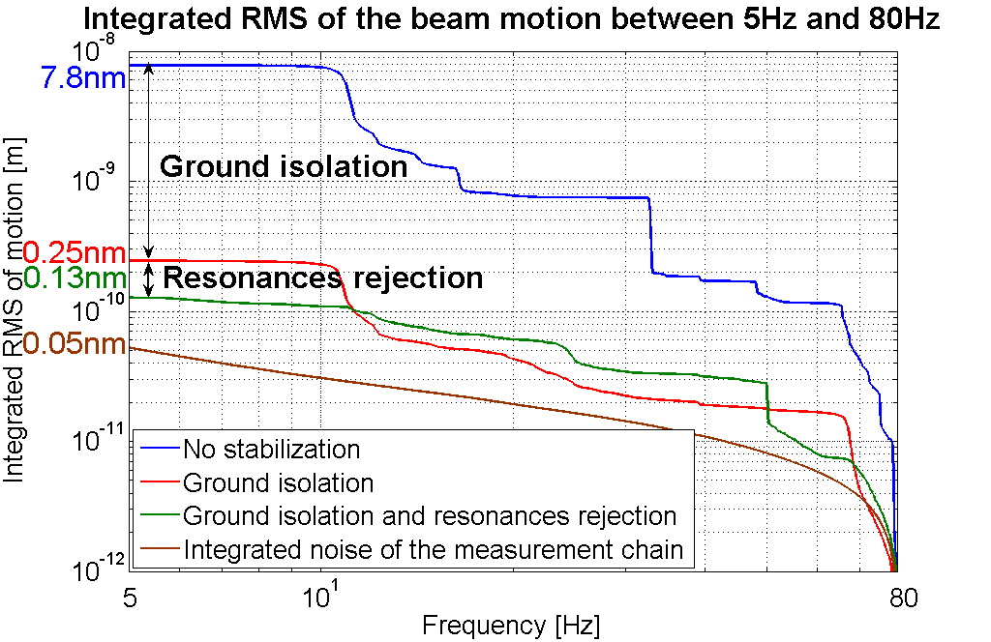
Achieved Performance
L.Brunetti et al (EPAC/Genova 2008)
LAPP active system for resonance rejection
CERN TMC active table for isolation
The two first resonances entirely rejected
Achieved integrated rms of 0.13nm at 5Hz

Slide 31
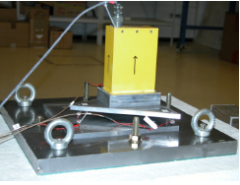
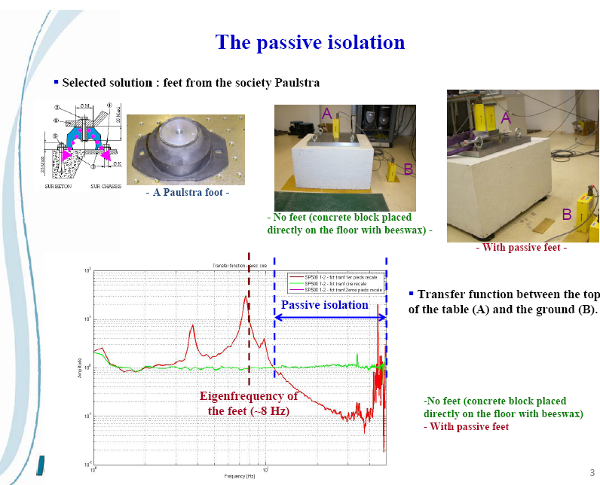
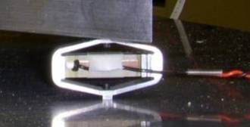
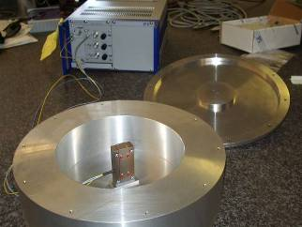
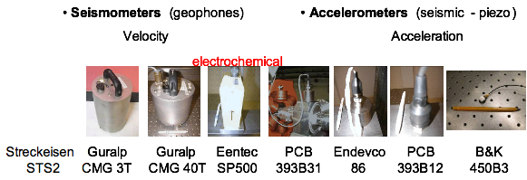
Current Work
Courtesy A.Jeremie
Replace big stabilisation table by a compact passive+active stabilisation system
Active system
Passive system
Instrumentation study (sensors and actuators)

Slide 32
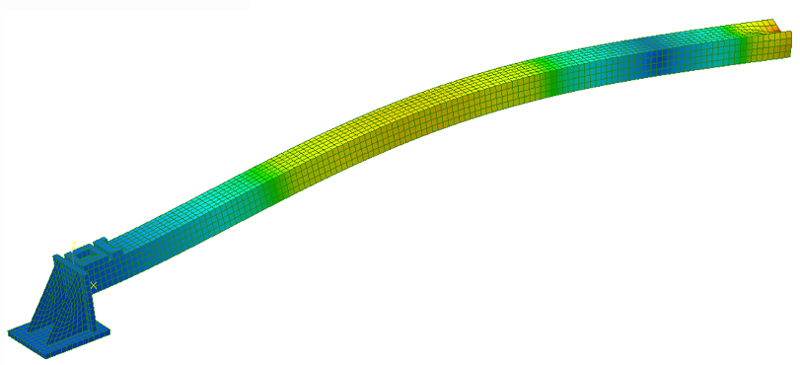
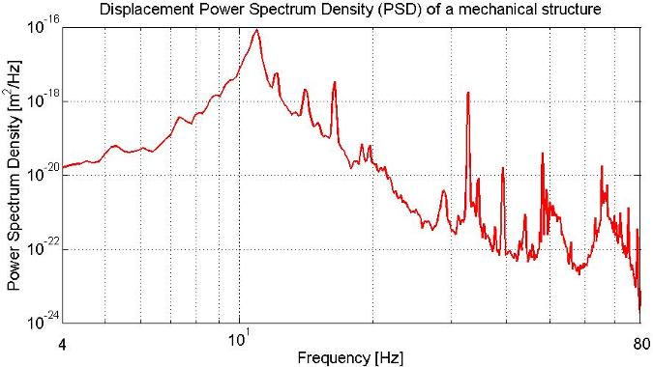
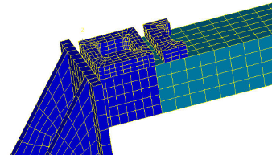
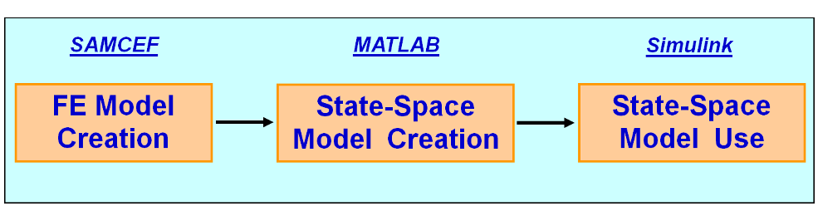
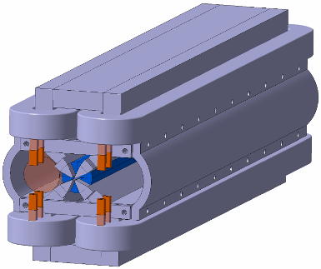
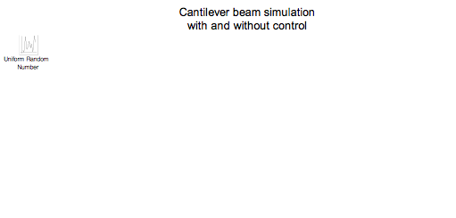
Current Work
Courtesy A.Jeremie
Simulations
Feedback development
Ex : force (actuator) applied to a point
Different strategies studied:
A knowledge only at strategic points
A local model for the disturbances amplified by eigenfrequencies.
A complete model
FF magnet design
Evgeny Solodko

Slide 33
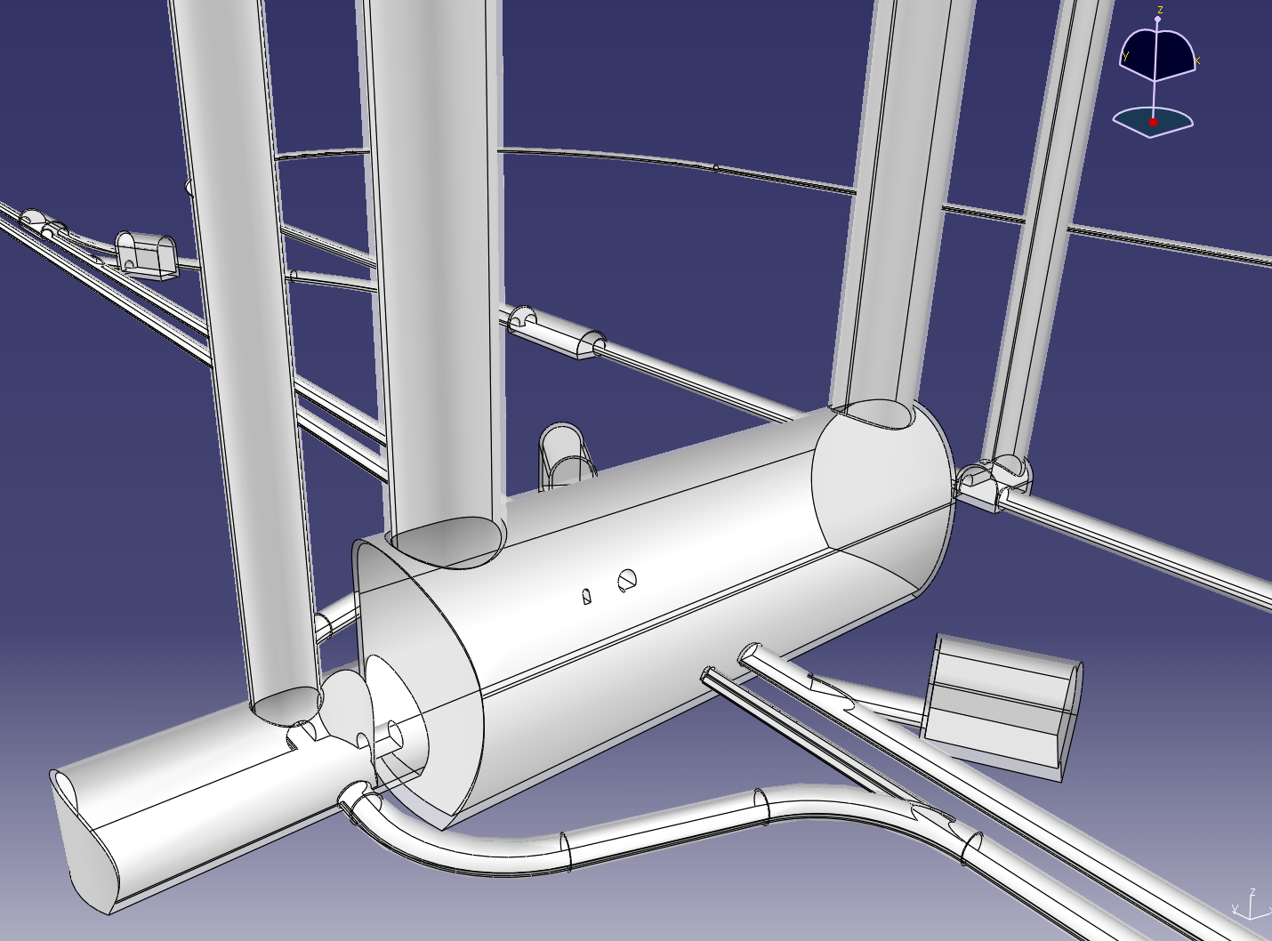
Cavern Layout
Courtesy J.Osborne
Based on ILC design

Slide 34
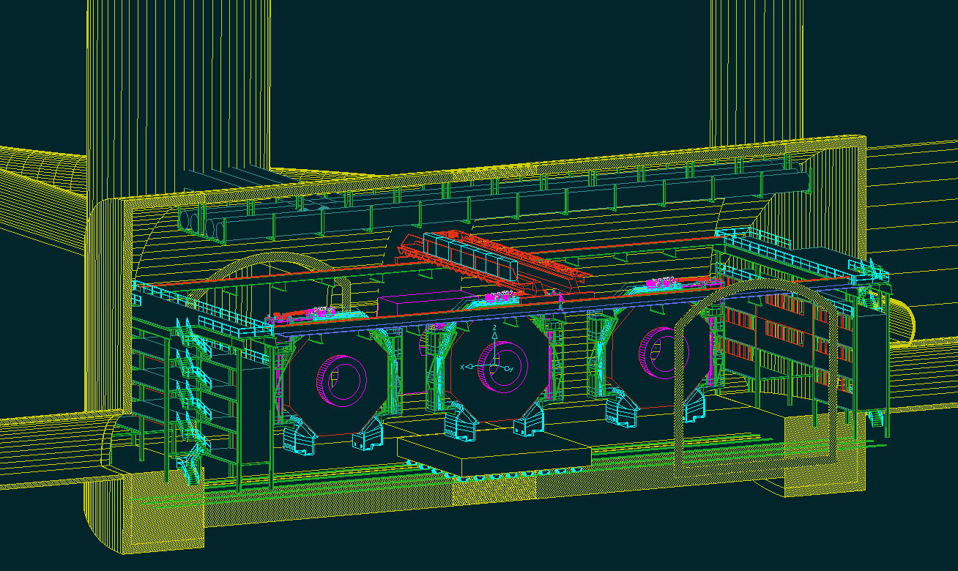
Cavern Layout
A. Hervé – H. Gerwig – A. Gaddi / CERN

Slide 35
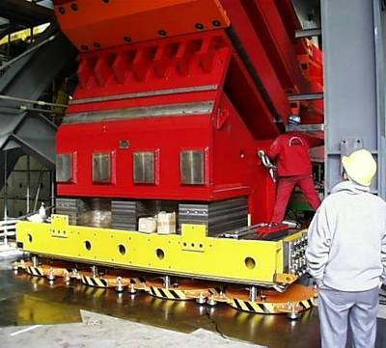




Detector moving
Air-pads at CMS – move 2000T
Concept of the platform, A.Herve, H.Gerwig
J.Amann

Slide 36
Summary and Conclusions
Basic choices have been made for the MDI
  crossing angle
  forward region openings
  vertex detector radius
  position of first quadrupole
  time stamping
They will be critically reviewed based on detailed technical work
Items that will be addressed include
  QD0
  QD0 integration and stabilisation
  Solenoid and anti-solenoids
  Intra-pulse feedback
  Backgrounds
  Vacuum
  Civil engeneering and infrastructure

Slide 37

CLIC Forward Region Detectors
    Maintain very forward calorimetry functionalities, adapt to accelerator requirements (stability!), minimise back-scattering of background

